Slide 1
Implementation of the ePIC Results Release Policy
J. Lajoie, S. Dalla Torre
August 18, 2025

Slide 2
Results Release and Publication Policies
The Results Release Policy was endorsed by the Collaboration Council May 2025.
https://zenodo.org/records/15390156
The Publication Policy was endorsed by the Collaboration Council in July 2025.
https://zenodo.org/records/15874182
These two policies were designed to work together
A lot of the policy is forward-looking to physics data

Slide 3
Question about Procedures:
There is confusion around the terms “preliminary result” and “performance result”. Where does a projection from simulations fit in?
A “preliminary result” is “based on real collision data and contain new physics messages” – this is something we will not have for some time.
A “performance result” is defined as:
ePIC Test Beam: results based on test beam data.
ePIC Computing: results related to software and computing infrastructure, algorithm, flow chart, plans, DAQ, etc.
ePIC Performance: results based on simulation, cosmic ray data, real data, etc.
ePIC Simulation: results based on simulation, machine learning, etc.
ePIC Technical: technical/engineering drawings.
So – a projection from simulations is a “performance result”. This means that approval is at the PWG level, and there is no requirement under the policy for a collaboration-wide presentation.
But you can’t tell me that EIC science projection plots are not critically important to the collaboration! This bothers a bit, depending on the details…

Slide 4
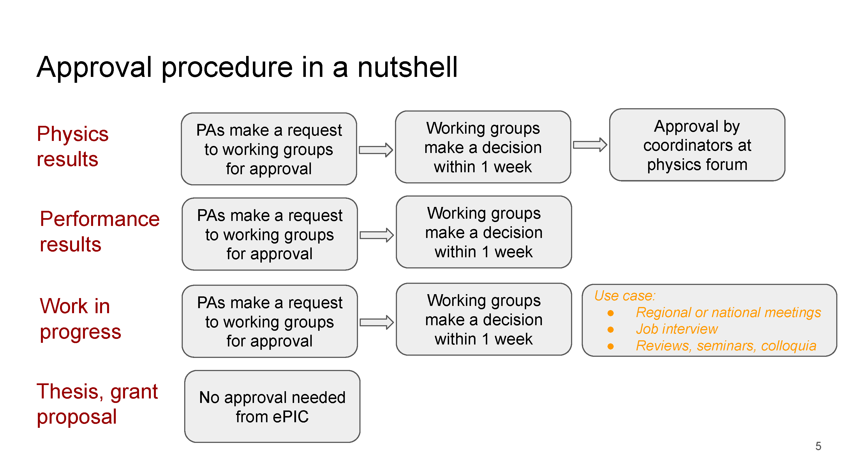
CUSTOM: Presentation at an ePIC meeting (PA, GM or special purpose)
From Ronrong’s CC presentation 17 July 2025:
https://indico.bnl.gov/event/28733/

Slide 5
ePIC Customs and Norms
Establish as a custom/norm that performance results approved for release are shown at an ePIC meeting that is (a) announced for that purpose and (b) accessible to all members of the collaboration
Could be a PAC, GM or a special meeting for that purpose
This should happen shortly after the PWG approval are preferably before it is shown publicly.
Let’s see how this works. If people are happy with it then it can be incorporated in a future update of the Results Release policy, or the collaboration could continue with it as a custom.
REMINDER: Approved results should be uploaded to the ePIC document database (Zenodo for now)

