Slide 1
PreTDR – Editorial Board
Kickoff Meeting
August 6th, 2025

Slide 2
Editorial Board – composition
The preTDR Editorial Board has been formed by the SP-Office
  Editorial Board composition (12 members in total)
    Board co-chairs: Silvia Dalla Torre and John Haggerty
    Ex-officio members: Spokesperson, CC Chair and Deputy, PM Representative in the TIC
    Members:
      Olga Evdokimov
      Yulia Fullertova
      Peter Jones
      Yongsun Kim
      Rosario Turrisi
      Zhenyu Ye
Thanks to you all for serving ePIC within this demanding task!

Slide 3
Editorial Board – Goal
Deliver a finalized preTDR by December 15, 2025
The motivations of this goal will become self-evident in the following, when external timelines will be recalled

Slide 4
preTDR recent news
The development of preTDR Chapters 2 and 8 as well as the new EIC project structure with subprojects suggests to have a separate stand-alone document for the ePIC Detector; appropriate additions will guarantee the link and consistency with the EIC preTDR
In a simplified view:
In practice:
At the moment, the preTDR still includes chapter 2 (Physics Goals and Requirements) and chapter 8 (Experimental Systems)
We need planning for the additions:
  General Introduction, including an Accelerator introduction
  The Detector-Accelerator Interfaces
  An Executive Summary
Detector preTDR
(chapters 2 and chapter 8 matters)
Including also:
Accelerator introduction
Detector-accelerator interfaces
EIC preTDR
Including also:
A Detector Executive Summary

Slide 5
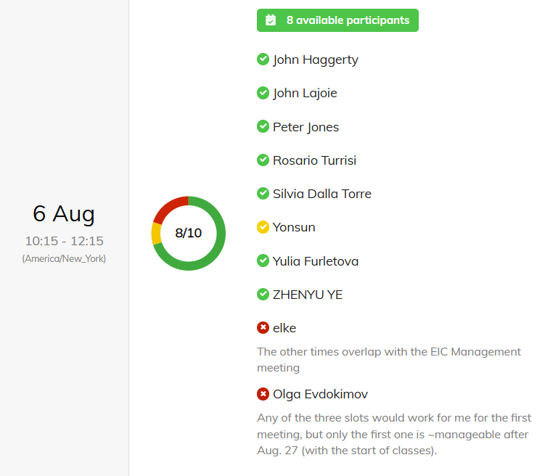
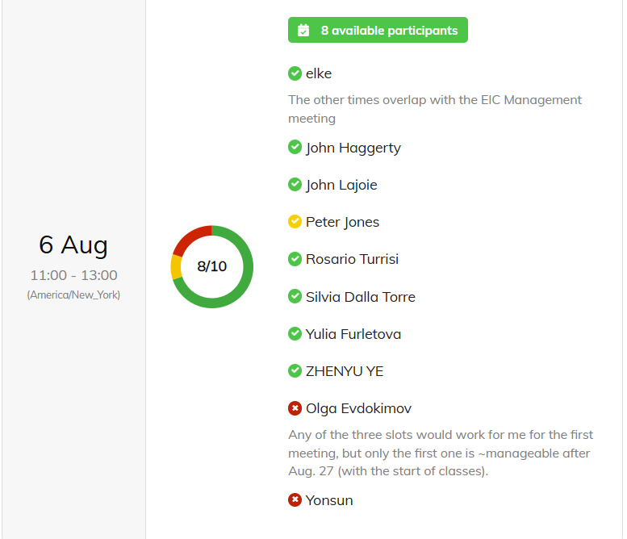
Editorial Board – LOGISTIC
Inspecting the overall ePIC agenda, the less heavily busy day of the week is Wednesday
Our meetings will be working ones: reserve 2 h seems adequate
Doodle pool to optimize the time: 10 (over 12) answers received
  2 time windows preferred:
although Olga and Elke will be able to attend only partially (Olga the first hour, Elke the second hour) this time slot has been selected: we will meet on Wednesday from 10.00am to 12.00pm ET

Slide 6
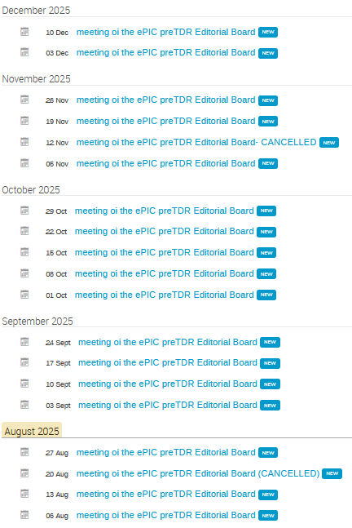
Editorial Board – LOGISTIC
Created an INDICO category for our meetings
  preTDR Editorial Board (under category Spokesperson’s Office)
  Access restricted to the Board Members

Slide 7
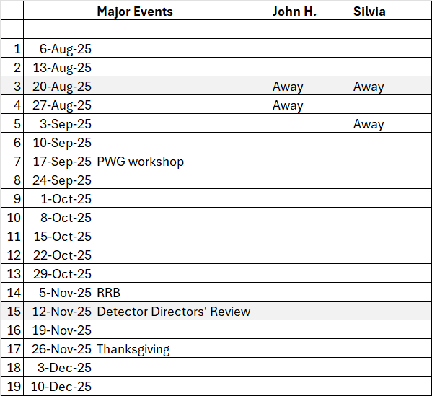
Editorial Board – calendar
Editorial Board Calendar:
19 Wednesdays, 17 meetings
Elements guiding the organization of our activity:
Detector Directors’ review
  November 12-14, 2025
  A (non-final) preTDR version to be made available ~ 2 weeks in advance → end of October
CD2 DOE OPA Review
  Expected in June 2026
  The final preTDR has to be made available 2 weeks in advance
Our deadline of December 15 is derived from these project-related timelines
Thanks to you all for serving ePIC within this demanding task!

Slide 8
Editorial Board – calendar
Editorial Board Calendar:
19 Wednesdays, 17 meetings
A request about the activity planning coming from inside the ePIC Collaboration:
Physics Readiness Workshop
  September 17-18, 2025, London
  PACs would like a first feedback on “chapter 2”
Thanks to you all for serving ePIC within this demanding task!

Slide 9
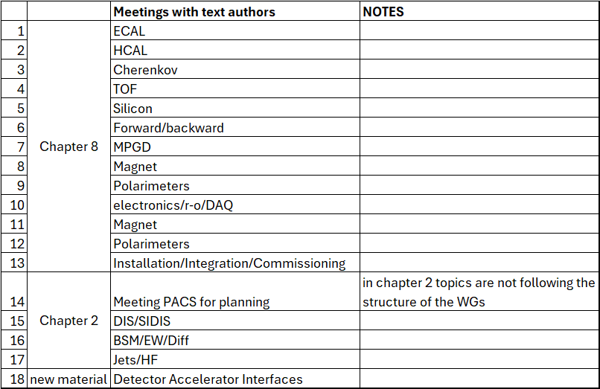
Editorial Board – planning our activity
  This table does not include the needs of meetings of the Editor Board alone for finalization
  Tentative planning
  At each meeting:
    initial 0.5 h of Ed. Borad internal discussion
    1.5 h with the invited author guests
    Question/comments for the authors prepared in advance (Ed. Board homework!)

Slide 10
Editorial Board – internal organization
  It has been decided during the Aug 6th meeting that subgroups will be formed
  The different subsystems will have a subgroup as reference in order to speedup the progress
  The subgroups will meet subgroups in parallel; they will present their own comments/questions as well as those from the other members of the Ed. Board; they will report to the whole Board in the collegial meetings
  The subgroups are formed by the non ex-officio members: 4 groups of 2 people can be formed

Slide 11
Editorial Board – strategy: (1) more editing by the authors
We have now a reference version (Version2.2, August 4th)
We know that several authors would like to go on editing their text
  Their dedication is appreciated
  At the same time, should/can we work consistently on a text which is continuously modified ?
Decided during the Aug 6th meeting :
  In order to facilitate the Editorial Board activity, the authors are asked to group their further editing and implement them during week September 8-12. After September 12 any further editing has to be agreed upon with the Editorial Board.

Slide 12
Editorial Board – strategy: (2) common prescriptions
Which are the common prescriptions we would like to preserve, namely not giving up?
In the following slides we analyze the prescriptions one by one and make decisions about

Slide 13
FIGURES - metadata
This is a prescription already fixed for Version0 and Version1 and often disattended
Please follow the “Guidelines for Reproducing TDR Plots”
In Zenodo: https://zenodo.org/records/14170704
  Accessible ONLY to those registered in the Zenodo ePIC Community
  Should we recall people how to register ?

Slide 14
General Aspects
Generic statements to be removed
Example from section REQUIREMENT: “The subsystem meets the stringent physics requirements set by the EIC program.” If such a statement is included it must refer to specific requirements supported by quantitative figures.
Additional Material
  The Additional Material has to be removed and become ePIC TNs and/or future NIMA papers
  Please, note that: all the essential information should be included in the preTDR text, which must be self-contained; TN notes enrich and offer more details.

Slide 15
About REQUIREMENTS
The official table of Project Requirements has been made available to the Collaboration:
https://indico.bnl.gov/event/27584/attachments/61023/104859/20241205-Requirements.xlsx
Please use the “Performance requirements” as a checklist: them all should be addressed in the preTDR;
At the same time, please, notice that not all need to be address in the DSC-dedicated subsection (for examples, aspects of mechanics and integration can be addressed in the Integration subsection).
The sharing of this material between DSC-subsection and detector-global subsection is not obvious. Is this prescription problematic ?

Slide 16
MODIFICATION in the STRUCTURE of the DSC subsections
Each DSC is requested to implement these scheme (second version, modified after Version1.1) in producing the text for Version2
NEW
Requirements
Requirements from physics:
Requirements from Radiation Hardness:
Requirements from Particle Fluence:
Justification
Device concept and technological choice:
Subsystem description:
Performance:
Implementation
Services:
Subsystem mechanics and integration:
Calibration, alignment and monitoring:
Status and remaining design effort:
Environmental, Safety and Health (ES&H) aspects
Quality Assessment (QA), Construction and assembly planning:
Collaborators and their role, resources and workforce:
Technological Challenges and Path Forward:

Slide 17
NEED OF REFERENCE TO COMMON SCENARIOS
Radiation hardness requirements
  Refer to the same estimation of the doses integrating over the same amount of time → details will be communicated
  Needed: consistency with the subsection 8.2.3 “Radiation Level”
Requirements from Data Rates:
Data rates should refer to a single global table in Subsection 8.3.10 Readout Electronics and Data Acquisition.
Do not forget data rates with reference to the Electronics/r-o/DAQ subsection.
Reference scenario: e-p max luminosity (10 x 275)
PERFORMANCE
They should be obtained by simulation including background.
The same background scenario(s) should be used by all DSCs → use the most updated background files
Always using the reference solenoid magnetic field: 1.7 T

Slide 18
QUALITY ASSESMENT (QA) PLANNING
Overall project approach to Quality Assurance
The overall structure to organize and store the information is being put together, while the specific aspects related to the different subsystems are going to be collected by the CAMs. The source of the information are the DSCs. When the material is organized in the overall scheme, the DSCs will be invited to crosscheck it. The information is needed for CD2. These documents are not part of the preTDR.
In the preTDR the following has to be shortly mentioned:
short description of the QA process indicating which components and which fraction of samples will be tested;
short description of the setups for QC and justification of multiple setups, when they are more than one (different function/amount of work/...)

Slide 19
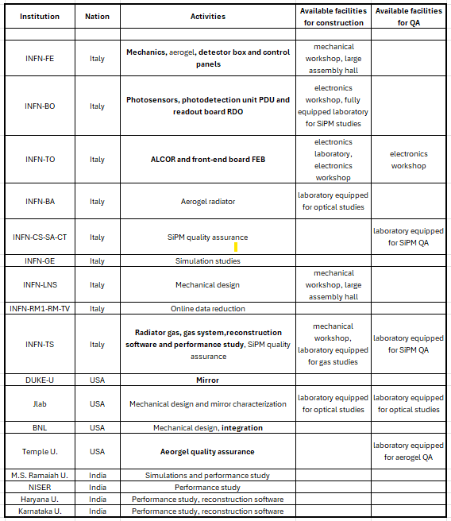
Collaborators and their role, resources and workforce
Need of more homogeneous material !
Please, include only the following:
A Table as in the example to be used as a template (task leading groups in bold).
Add a few lines about in-kind, when appropriate.
REQUESTED on Aug. 6th:
Check this table with the PM.
Disclaimer:
This is not the final dRICH table, please consider it as a template

Slide 20
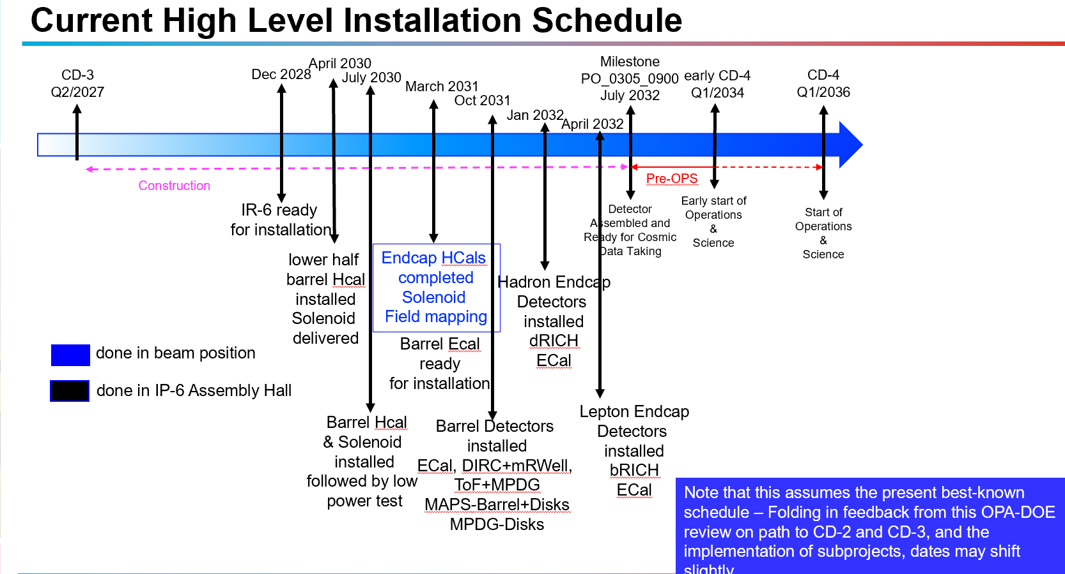
General Consistency
IMPLEMENTATION
  Need to refer to the same implementation model, with reference to the details in “8.4 Detector Integration” (subsection not yet available)
  Guidance in writing: a common reference calendar
    This is from a recent PM talk; a more formal calendar needed
STATUS AND REMAINING DESIGN EFFORT
  This is a preTDR: R&D should no longer be mentioned in the text.

Slide 21
Feedback from the Collaboration
An e-mail to the whole collaboration pointing to:
Version2.2 (August 4th) available in Zenodo (with direct link)
Google form for the feedback
  The form allows for multiple entries without the need of reopening it;
  Inputs are collected in a spread sheet that will be made available to all the authors so that each comment received can be answered;
  Feedback requested by the end of September; it can be difficult to follow and integrated later comments.
The e-mail is ready and, with your green light it will be sent out today

Slide 22
Major outcome of the discussion August 6th
Following a lively and constructive discussion about the structure of the Detector preTDR, the following structure of the document is proposed:
Executive Summary
Introduction
  Including the requirements as resulting from the YR and captured by the project requirement document (high level page)
“chapter 8”
  Presenting the detector subsystems matching the requirements (mainly individual performance)
“chapter 2”
  Presenting the holistic detector performance by the performance for key physics measurements
  Also a subsection about Early Science needed
Detector-Accelerator interfaces

Slide 23
Starting the Editorial Board activity
PROPOSAL of first actions:
Ask the PACs to meet already next week to define with them the details of the
chapter 2 strategy – August 13
  Also an opportunity to provide them our first thoughts about chapter 2 match their request of a preliminary feedback before the September meeting
  IF CONFERMED, read chapter 2 and have a first list of comments/questions about for next week
  Later, deeper analysis of chapter 2 after the September meeting
Contact DSCs whose text looks advanced to make a calendar for the meetings on 8/27, 9/3, 9/10

