Slide 1
PreTDR – Editorial Board
3rd Meeting
August 27th, 2025

Slide 2
Attendance today
Excused members:
John H. is out-of-office (vacation)
Peter is out-of-office (vacation)
Yongsun is sick

Slide 3
AGENDA
Editorial Board alone (10.00-10.30)
Communications about the preTDR process
Reminder: new detector preTDR outline (as defined at the previous meetings)
Invitation of authors at the coming meetings
Meeting PACs (10.30-11.00)
Progressing with the outline of the chapter
“Detector Performance for the EIC physics program”
Reference: their most recent e-mail (sent by Rachel) on Aug. 25th
Meeting ECal authors (11.00-12.00)
Accepted invitations: Oleg Tsai (forward endcap); Alexander Bazilevski (CAM)
Tanja out-of-office message; BIC busy preparing their mid September review
Need to iterate with the other ECals

Slide 4
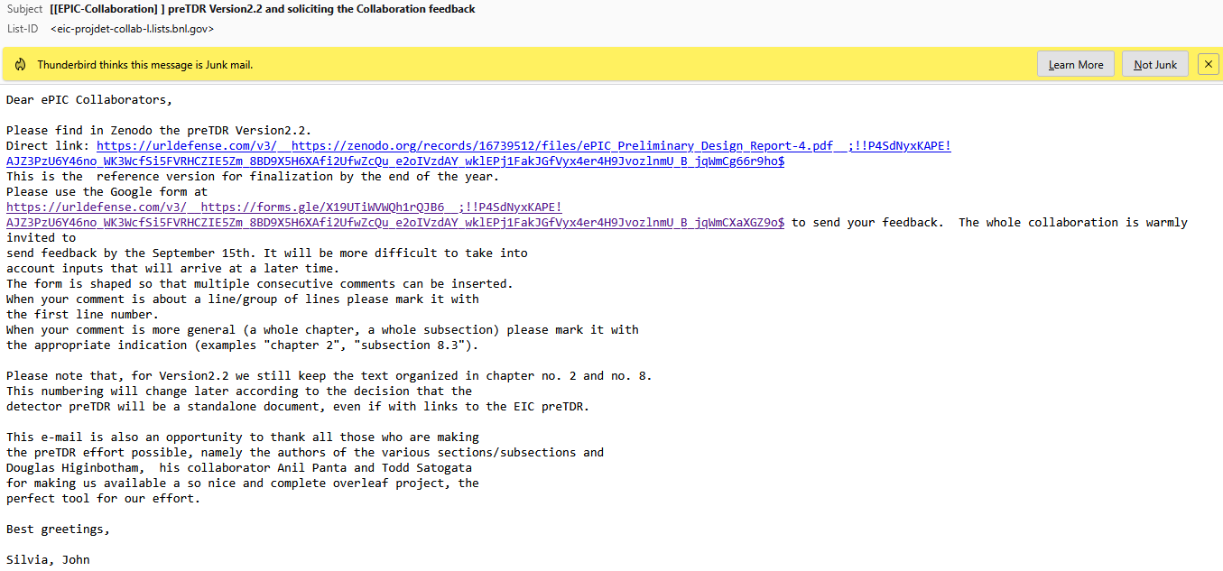
Communications
E-mail sent on August 4th Version2.2 published on Zenodo
69 comments received (as on Aug 27th)
A reminder needed to solicit more inputs from the Collaboration
How to use this comments?
Several are just typos, style suggestions, …
The one with comments on the content should reach the authors

Slide 5
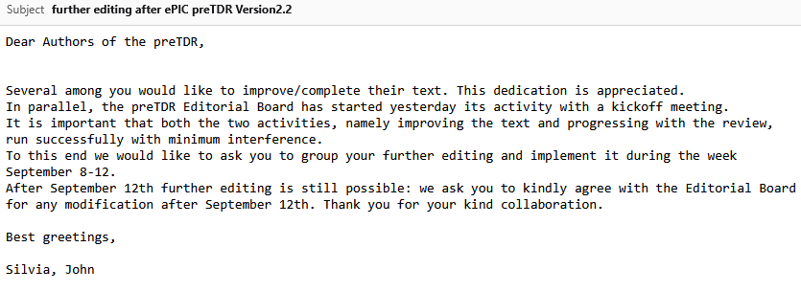
Communications
E-mail sent on August 7th

Slide 6
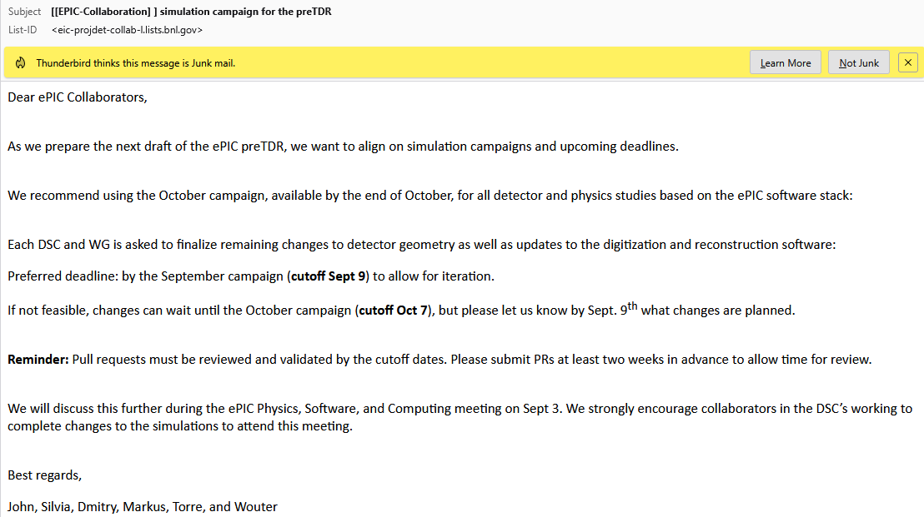
Communications
E-mail sent on August 15th

Slide 7
New detector preTDR outline
The new structure proposed for the Detector preTDR
Executive Summary
Introduction – CHAPTER 1
About the EIC project and the accelerator complex (high level approach)
Requirements – CHAPTER 2
Requirements resulting as an evolution of the YR ones, also cross-checked with those in the project requirement document (high level page)
“chapter 8” – CHAPTER 3
Presenting the detector subsystems matching the requirements (mainly individual performance)
“chapter 2” – CHAPTER 4
Presenting the holistic detector performance by the performance for key physics measurements
Detector-Accelerator interfaces (INTEGRATION INTO THE FACILITY) – CHAPTER 5

Slide 8
First groups of authors that we would like to contact
Selection criteria
Text looks already reasonable advanced
A selection of subdetector that refer to different Board subgroup
Possible dates for the invitation are also indicated (we have to keep some flexibility on dates)
Authors’ groups
ECals ^{(*)} August 27th
far forward/backward September 3rd
electronics/read-out/DAQ September 10th
HCal September 17th
Tracking September 24th
PID October 1st
^{(*)} only partially effective: we need to send out invitations well in advance
Already
discussed
new

