Slide 1
TDR Status
John Haggerty
Silvia Dalla Torre

Slide 2
New TDR order
Thanks to Doug for implementing our new document organization!
Chapter 0 ("Style Guide") [ will be removed in final version ]
Executive Summary
CHAPTER 1 – Introduction
CHAPTER 2 – Detector Requirements
CHAPTER 3 – Experimental Systems (this is the past Chapter 8)
CHAPTER 4 – Detector Performance for the EIC physics program (this is the past Chapter 2)
CHAPTER 5 – Detector-Accelerator interfaces

Slide 3
Editorial board Meetings
Meeting status
9/10/2025 Jeff Landgraf and Fernando Barbosa
8.3.10 Readout Electronics and Data Acquisition
Good discussion, good list of updates by Jeff; promised early October
9/17/2025 Alex Jentsch Far Forward Detectors
8.3.7 Far Forward Detectors
Good discussion, needs additional material and reorganization

Slide 4
Status of project provided sections (from Silvia)
8.1 General Detector Considerations and Operations Challenges
Background rates need to be updated
Otherwise ready for review (unless there is some reason to think the background rates will be very different)
8.3.2 Magnet
Ready to review
8.3.2 Polarimeters
Still a placeholder; PM will contact authors to complete
8.4 Detector Integration
Ready to review
8.5 Detector Commissioning and pre-Operations
Empty; Elke will provide a brief version based on existing material

Slide 5
Record keeping
I’d like to be better about keeping our records on the Indico agenda page for each meeting
We may not have slides from the presenters, but we have our organizational slides and notes and/or minutes, links to useful references, etc.
Today’s agenda: https://indico.bnl.gov/event/29209/

Slide 6
Today
8.3.6 Hadronic Calorimetry

Slide 7
Please join in the discussion!
To get the most benefit from these meetings, please participate actively in the discussion!
Particularly if you don’t understand something—it’s useful to bring that up and we absolutely do not want to dismiss your concerns—if something is unclear to insiders, it is almost certainly going to be unclear to the many reviewers to come.
And if you want to take notes and send email comments, please send them to Silvia and me—they won’t be anonymized but we’ll collect them.

Slide 8
Tomorrow
We start the second meeting of the week tomorrow:
Thursday Sep 25 11:30am ET
8.3.4.1 AC LGAD

Slide 9
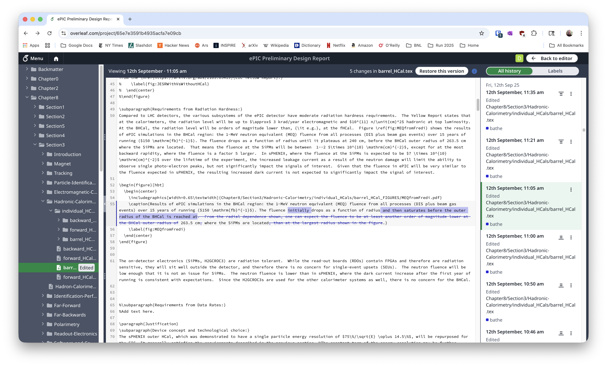
Looking for changes in the Overleaf
The simplest thing is to just scroll through the project history on the right side
Clicking on the entries takes you to the changes in the source file
OK for a small number of fairly simple changes

Slide 10
Compare to a labeled version
You can compare to any version, but comparing to a labeled version is usually what you want
I mean to label versions frequently, but haven’t done that
But we can go back through the history and do it ex post facto if we want
Just be careful not to “Restore this version”
It’s not fatal, but leaves a mess behind

Slide 11
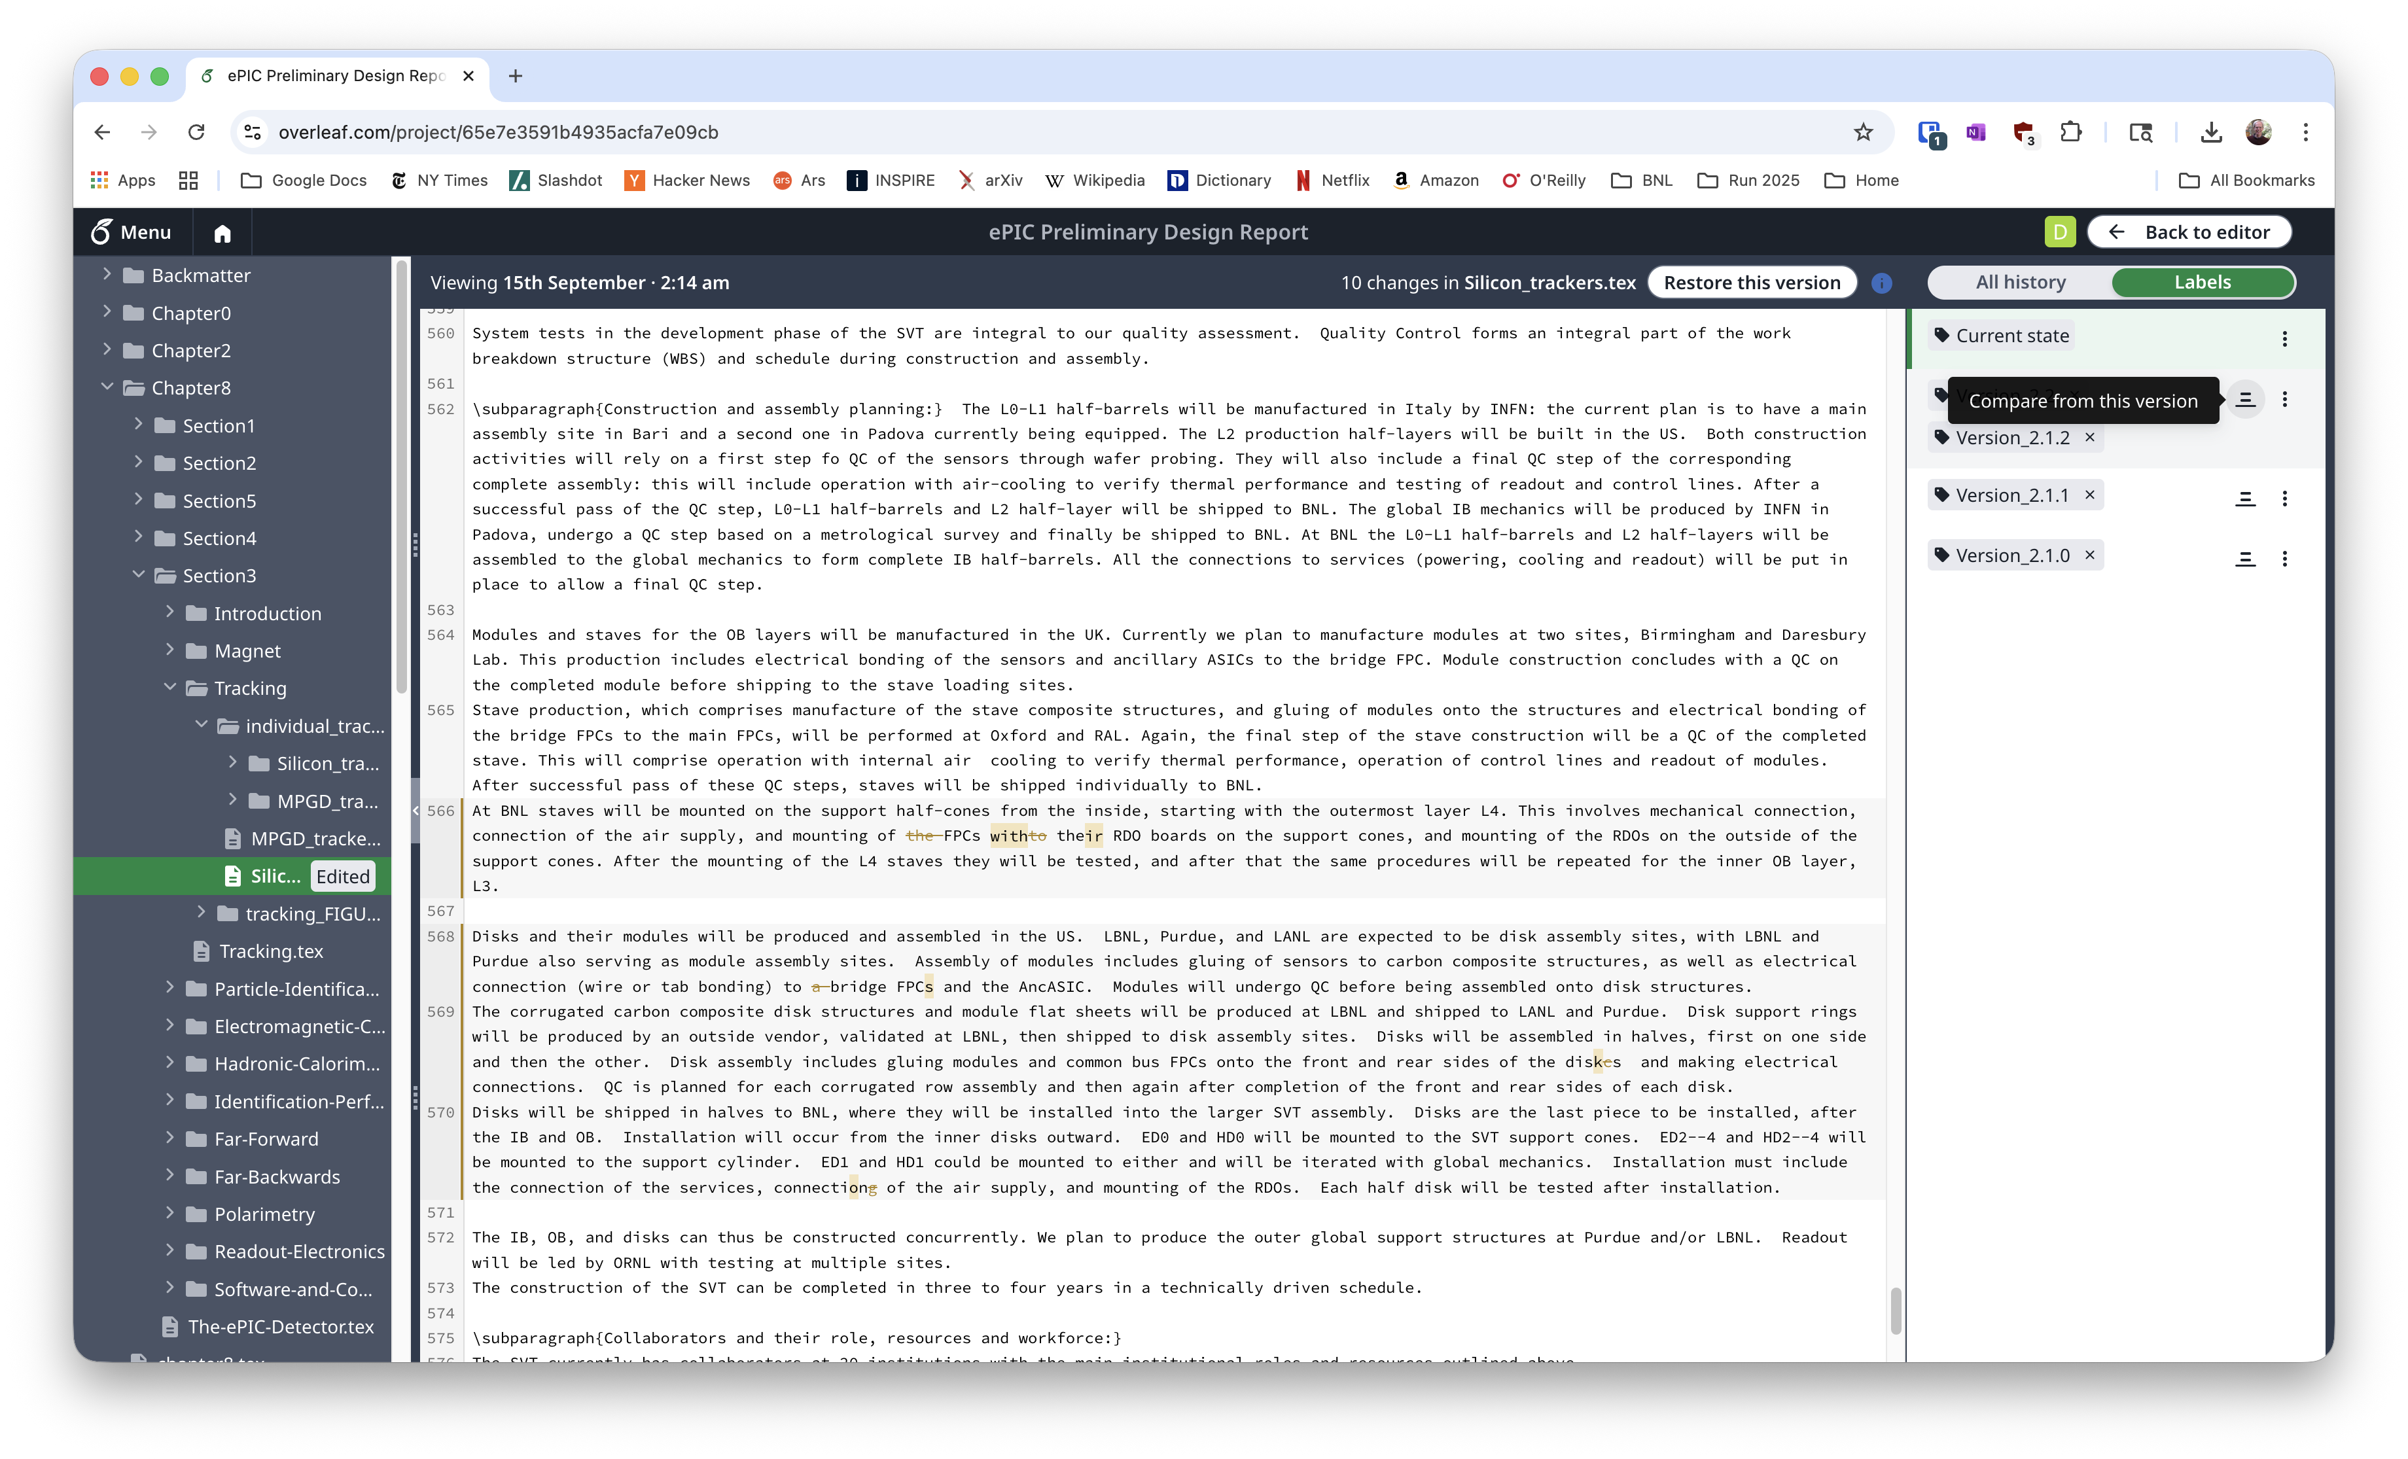

Slide 12
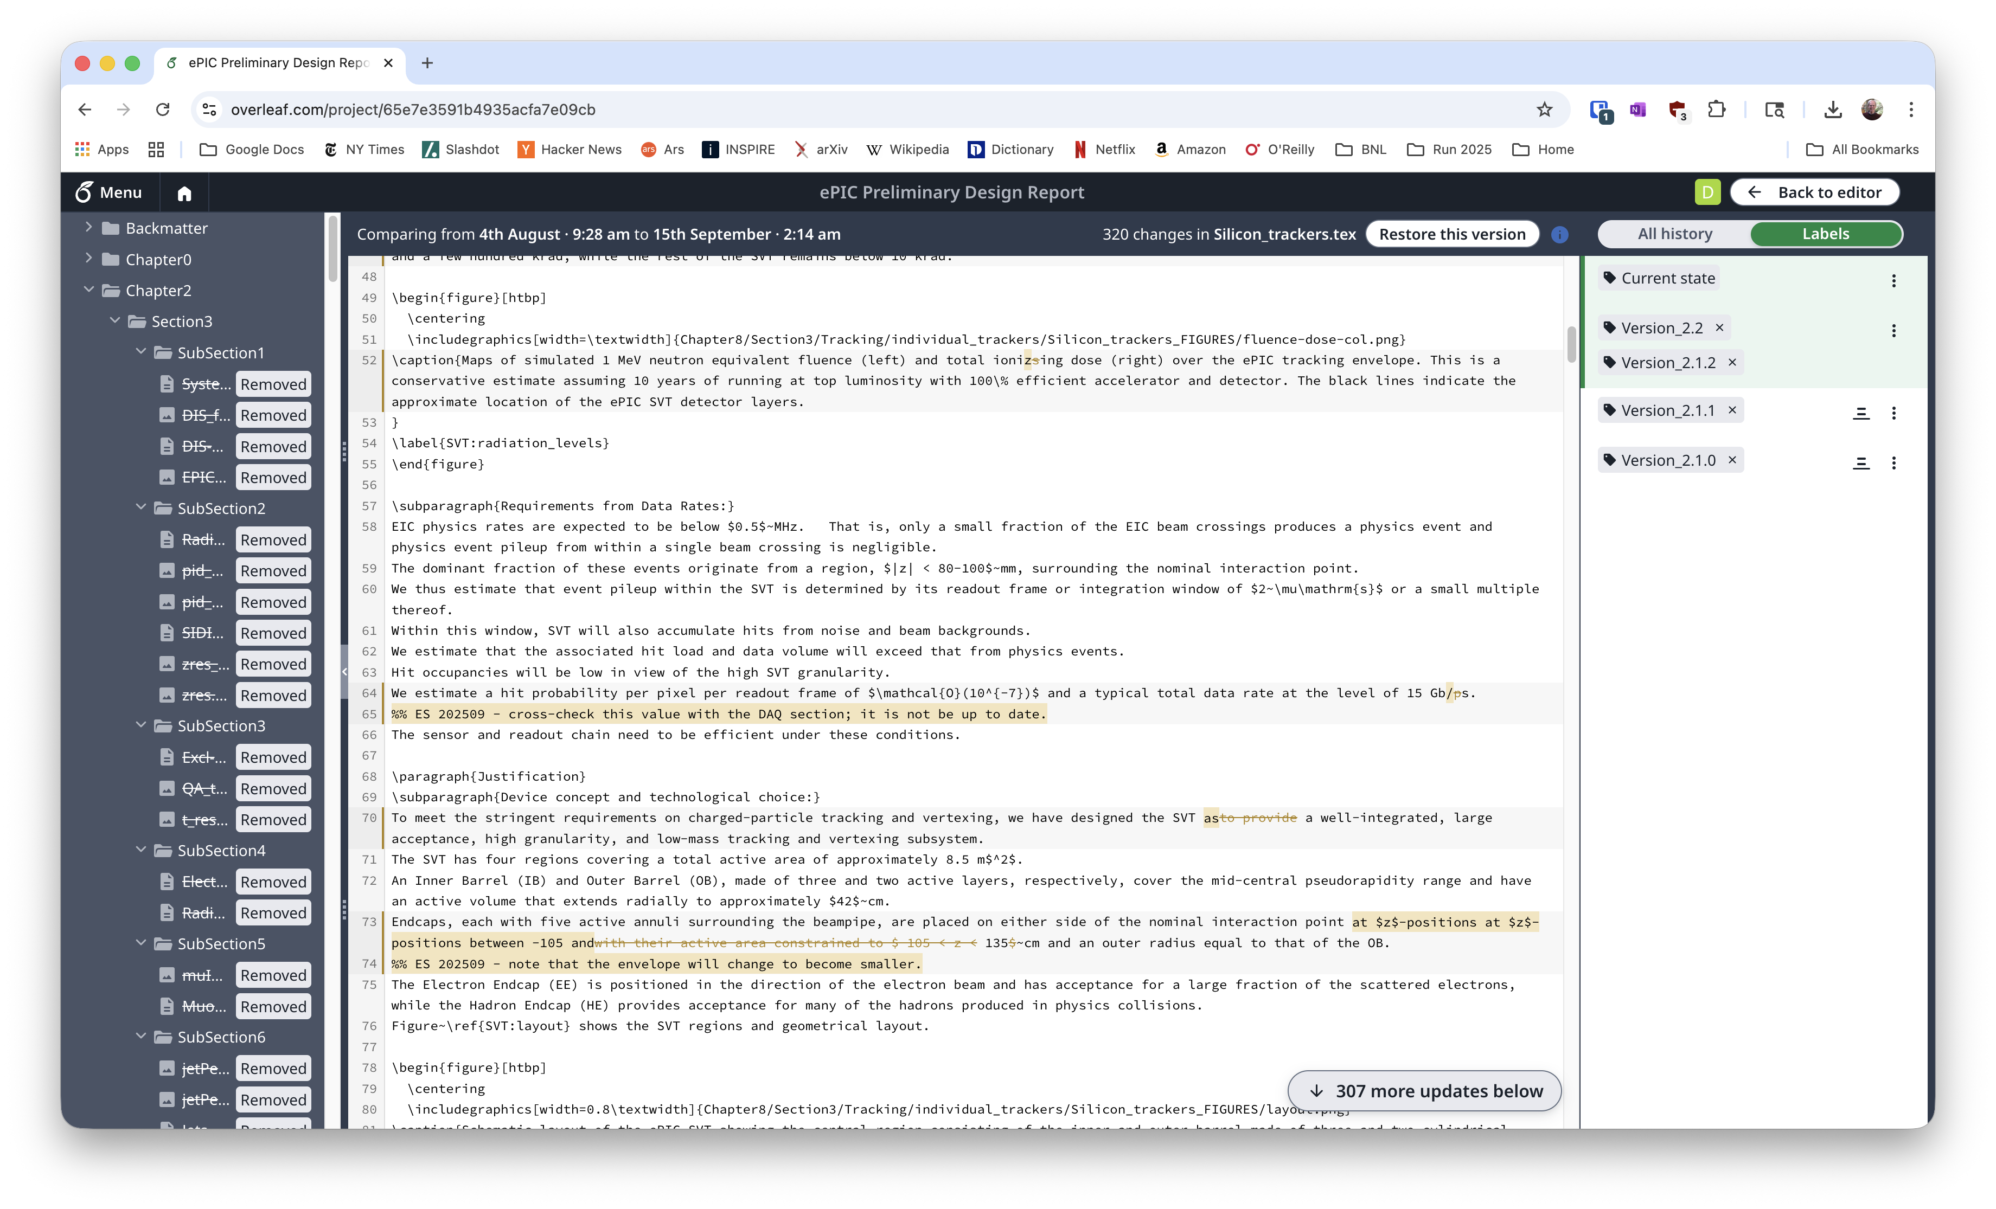

Slide 13
Other ways to compare versions
There are other ways to compare versions
I sometimes download the source and work with the text locally
You can download source for any version
If you’re just looking at differences in one file, command line tools are good enough
diff --side-by-side
You’ll probably need a wide terminal window
Not well suited to large numbers of changes, either
Some people use the source in github directly which has its own capabilities for comparing versions
You can look at the github history for a file and see nicely highlighted differences
Generally, I discourage people from accessing the repository directly… even people who know what they are doing sometimes leave puzzles behind, and there might be some peculiarities in commits direct from github compared to commits from Overleaf, but if you are confident you’re a power user, you might like the familiarity of github (and you probably don’t need my instructions)

