Slide 1
Far-Forward / Far-Backward
Detector Integration
Jonathan Smith (JLAB), Ron Lassiter (JLAB),
India Krehbiel (JLab), David Powell (JLAB)
August 11, 2025

Slide 2
Primary Updates Outline
ZDC Support Frame
B0
Cable Routing
Sourcing Hardware
Bringing on Avishay Mizrahi

Slide 3
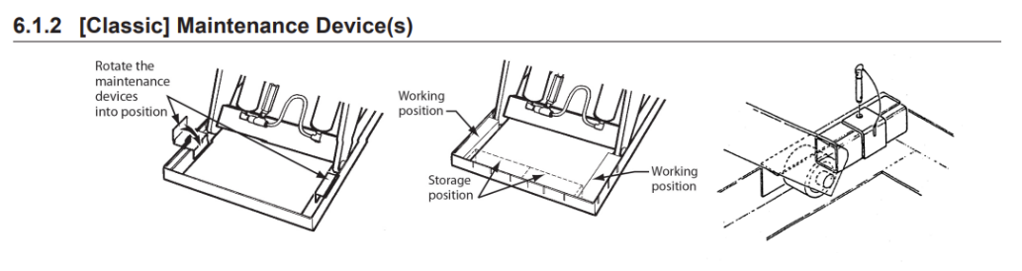
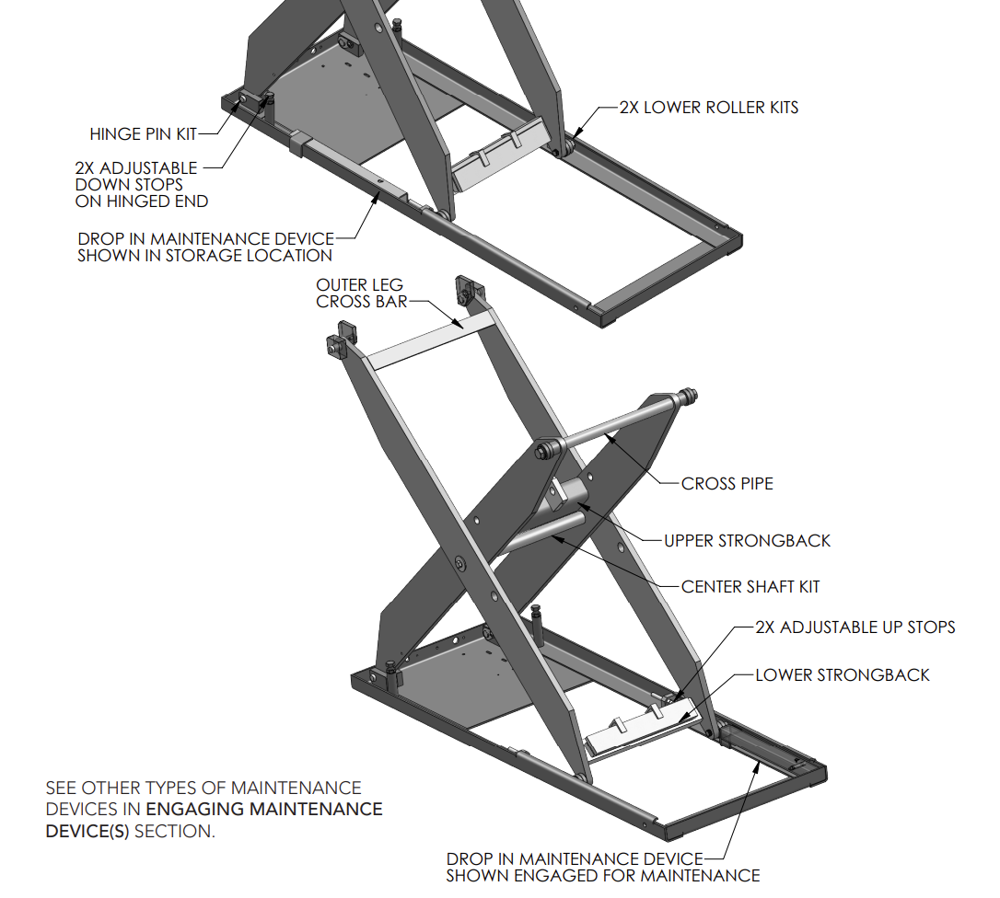
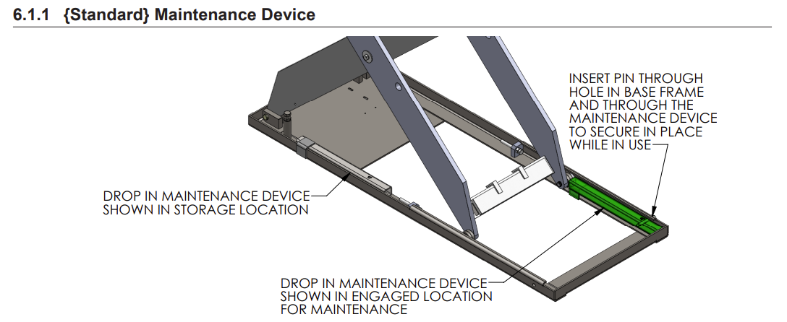
ZDC Support Frame
The Southworth Table comes with maintenance chocks. A similar replacement could be made to support more weight, in addition to removable legs attached to the underside of the tabletop.

Slide 4
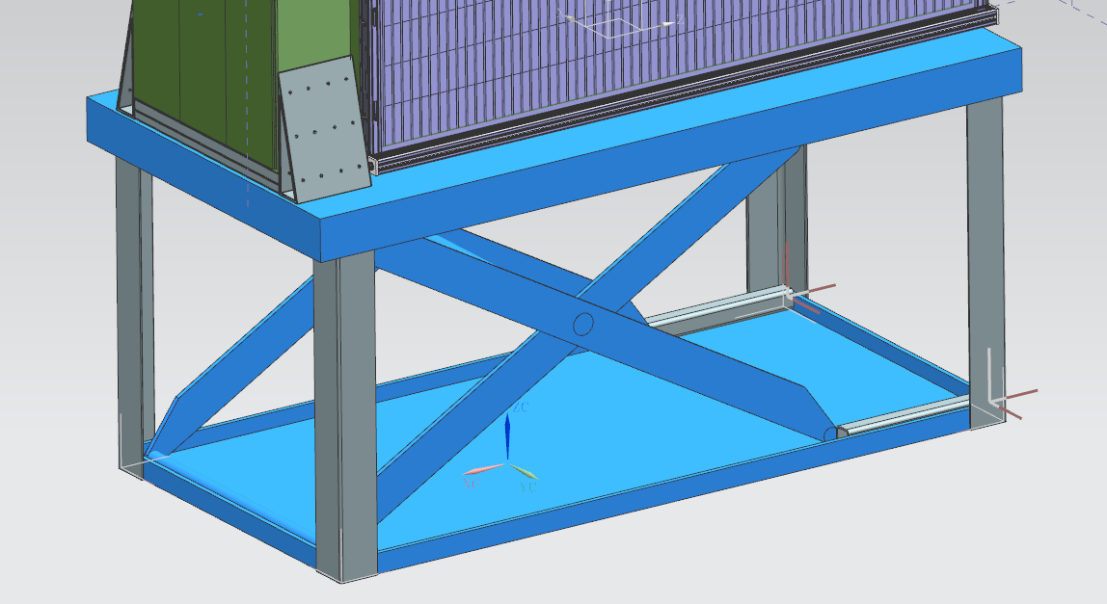
ZDC Support Frame Concept
Note: Jlab does not have the STEP file from Southworth. Southworth stated they will send a 3D model upon purchase.

Slide 5
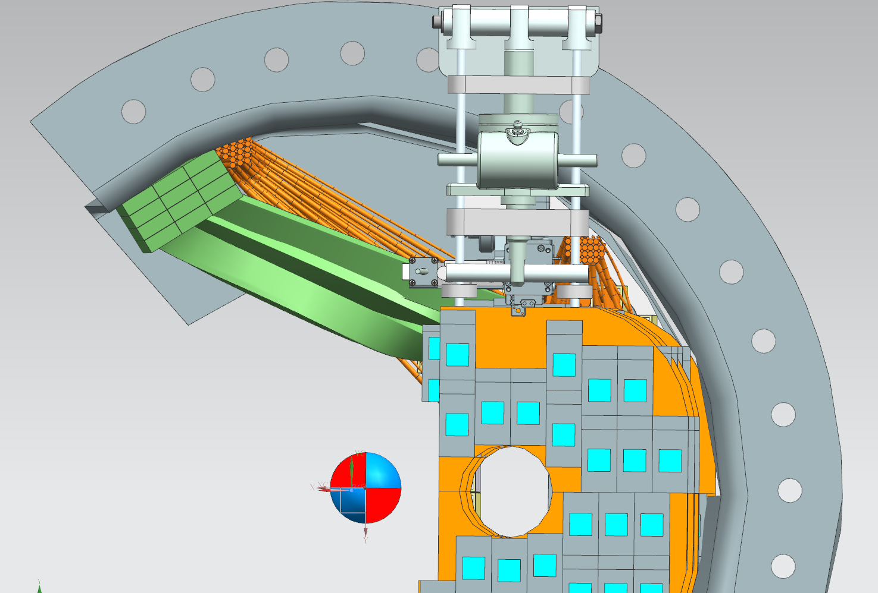
B0 Cable Routing
Current cabling shown is for (1) detector layer and calorimeter
Running cables on top and bottom of B0 Barrel at the 11 o’clock and 7 o’clock position.

Slide 6
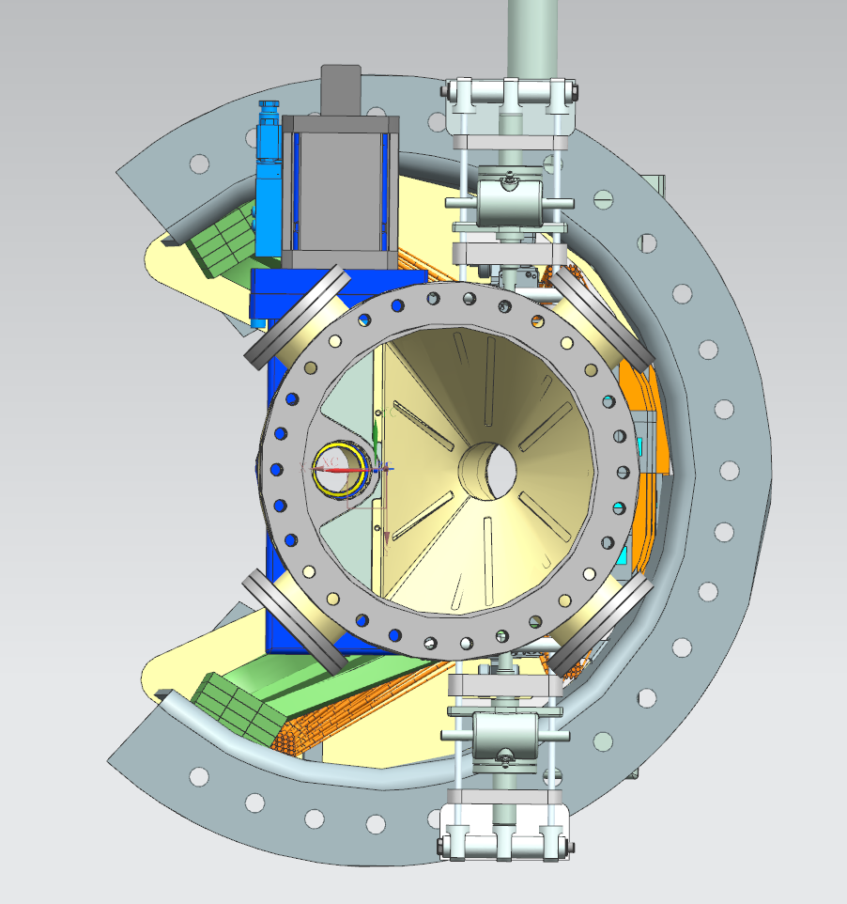
B0 Cable Routing
There’s concern about space allotted for cabling at the front of the B0 Magnet. The electron vacuum valve obstructs cable routing at the 11 o’clock position.
Note: Current cable representation represents (1) detector layer and the Calorimeter. Not shown are (3) additional detector layers and cooling.

Slide 7
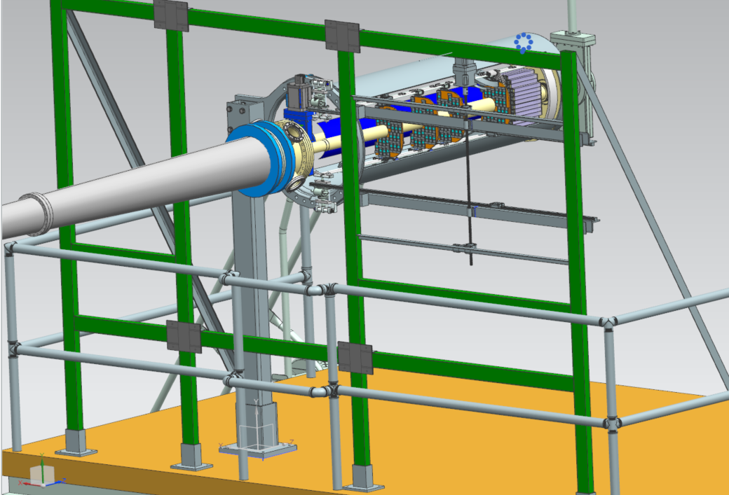
Sourcing Hardware for B0 Tooling
Limitations:
Electronic motors inside barrel preferred to be controlled outside due to High-Radiation zone
No pneumatic nor hydraulic systems due to high risk of maintenance required in inaccessible areas
Non-magnetic material
We’re in communication with vendor CrossCo, Larry Sedley, about sourcing potential hardware options for this system.

Slide 8
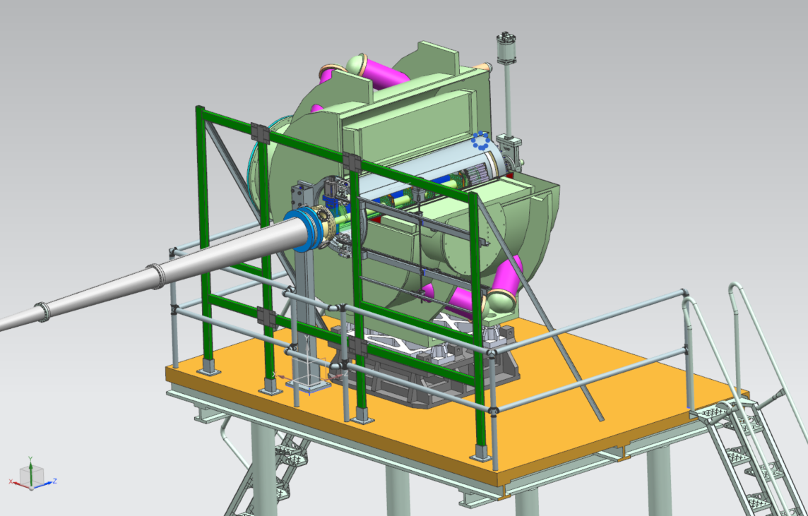
B0 Going Forward
Requested an Engineer – Bringing on Avishay Mizrahi for future development of the B0 Tooling. Avishay’s has experience in developing the B0 magnet, and his expertise will be more than helpful for the detector tooling design.

