Slide 1
Barrel Outer Tracker / MPGD (μRWELL)
Triple I Engineering Meeting Update (08182025)
Seungjoon Lee (Jlab)

Slide 2
Update
Jlab MPGD Facility is moving foreword.
HEPA filters are ready to be installed in clean room.
When Clean room is ready, all devices will be assembled and installed
uRWELL PCB and GEM foils are ready to be tested at CERN – Still waiting for shipping
Preparing Thermal simulation for cooling (Girish, BNL)

Slide 3
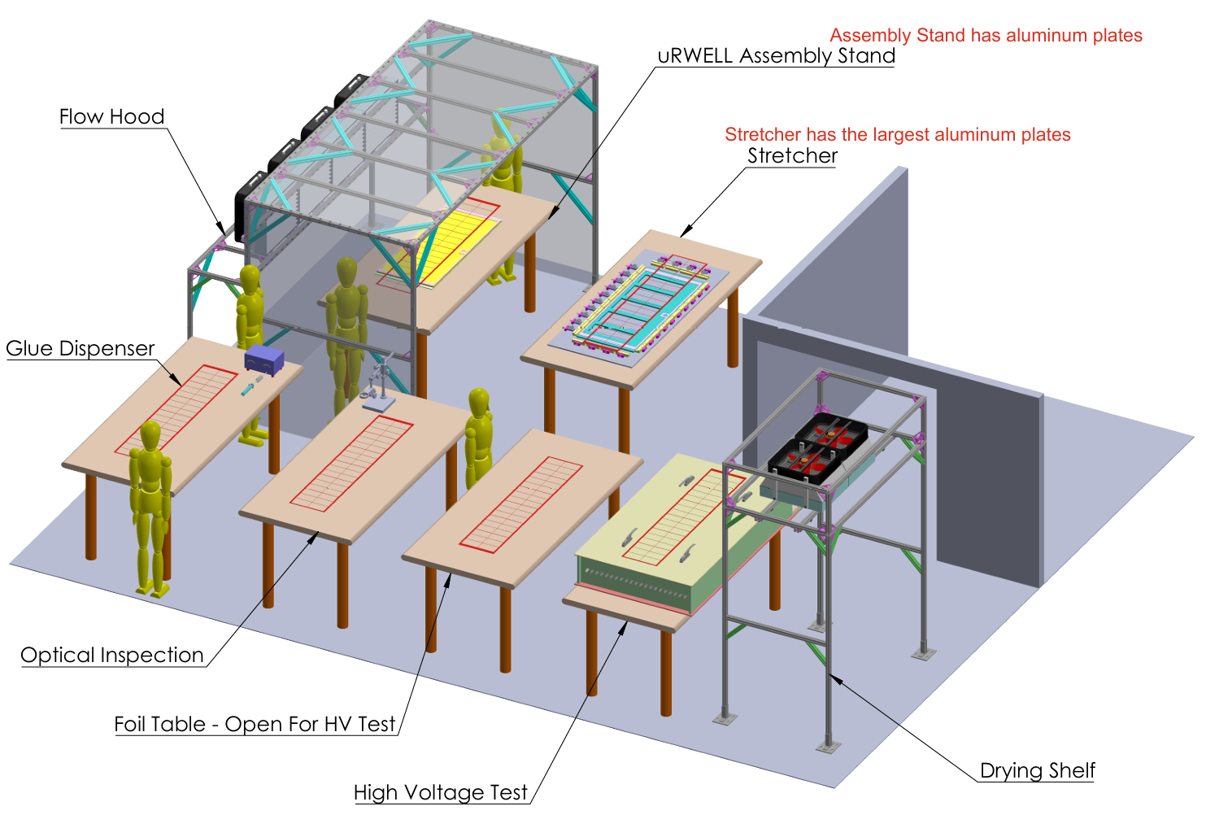
Latest design of MPGD clean room

Slide 4
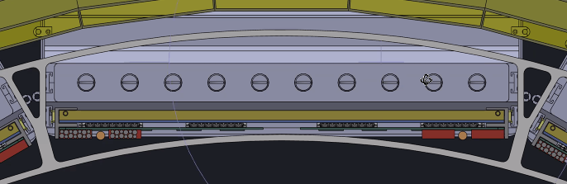
New design of DIRC & MPGD frame (from Dan, BNL)
The new design of DIRC & MPGD frame is overlapped with MPGD envelop.
This area is not empty, MPGD will have services on the area as well

Slide 5
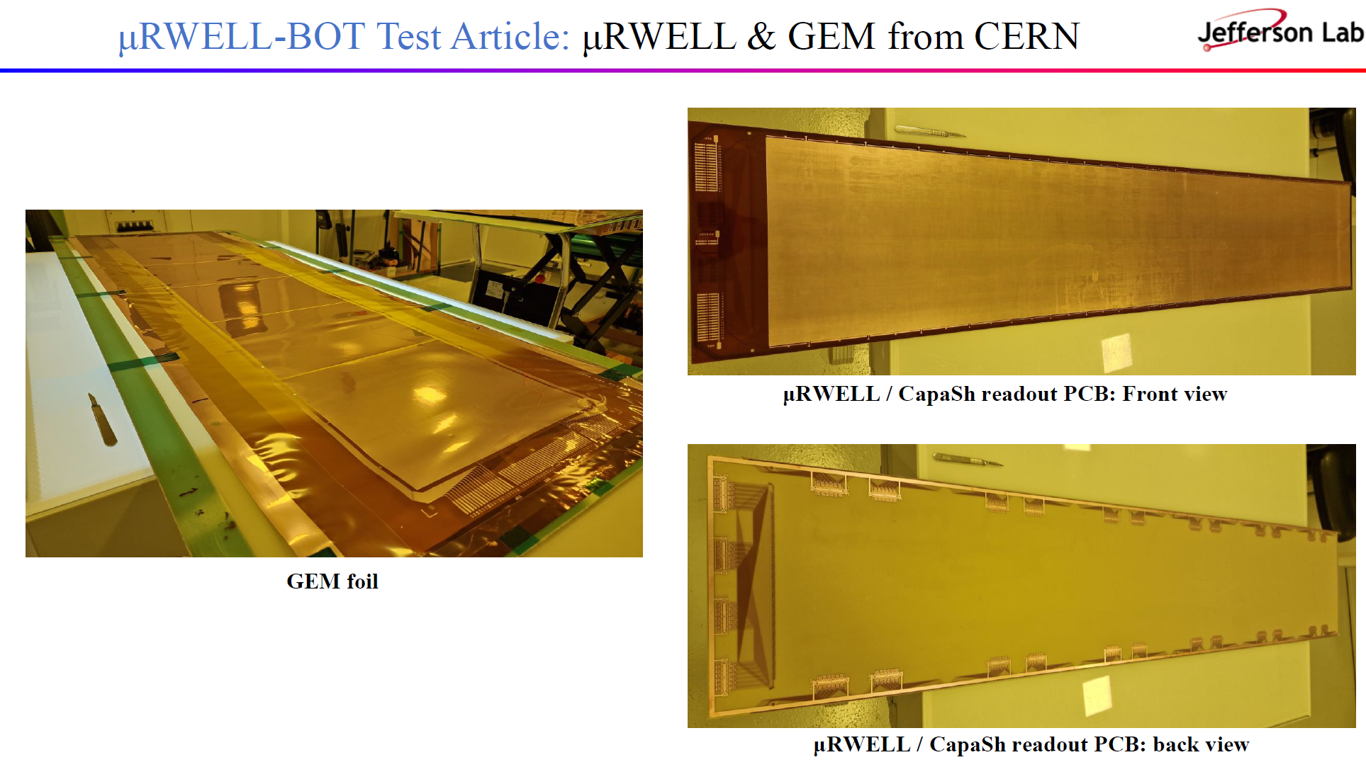
Update from CERN
CERN is working on basic test and PCB connector assembly.
ETA to Jlab is July 2025.

Slide 6
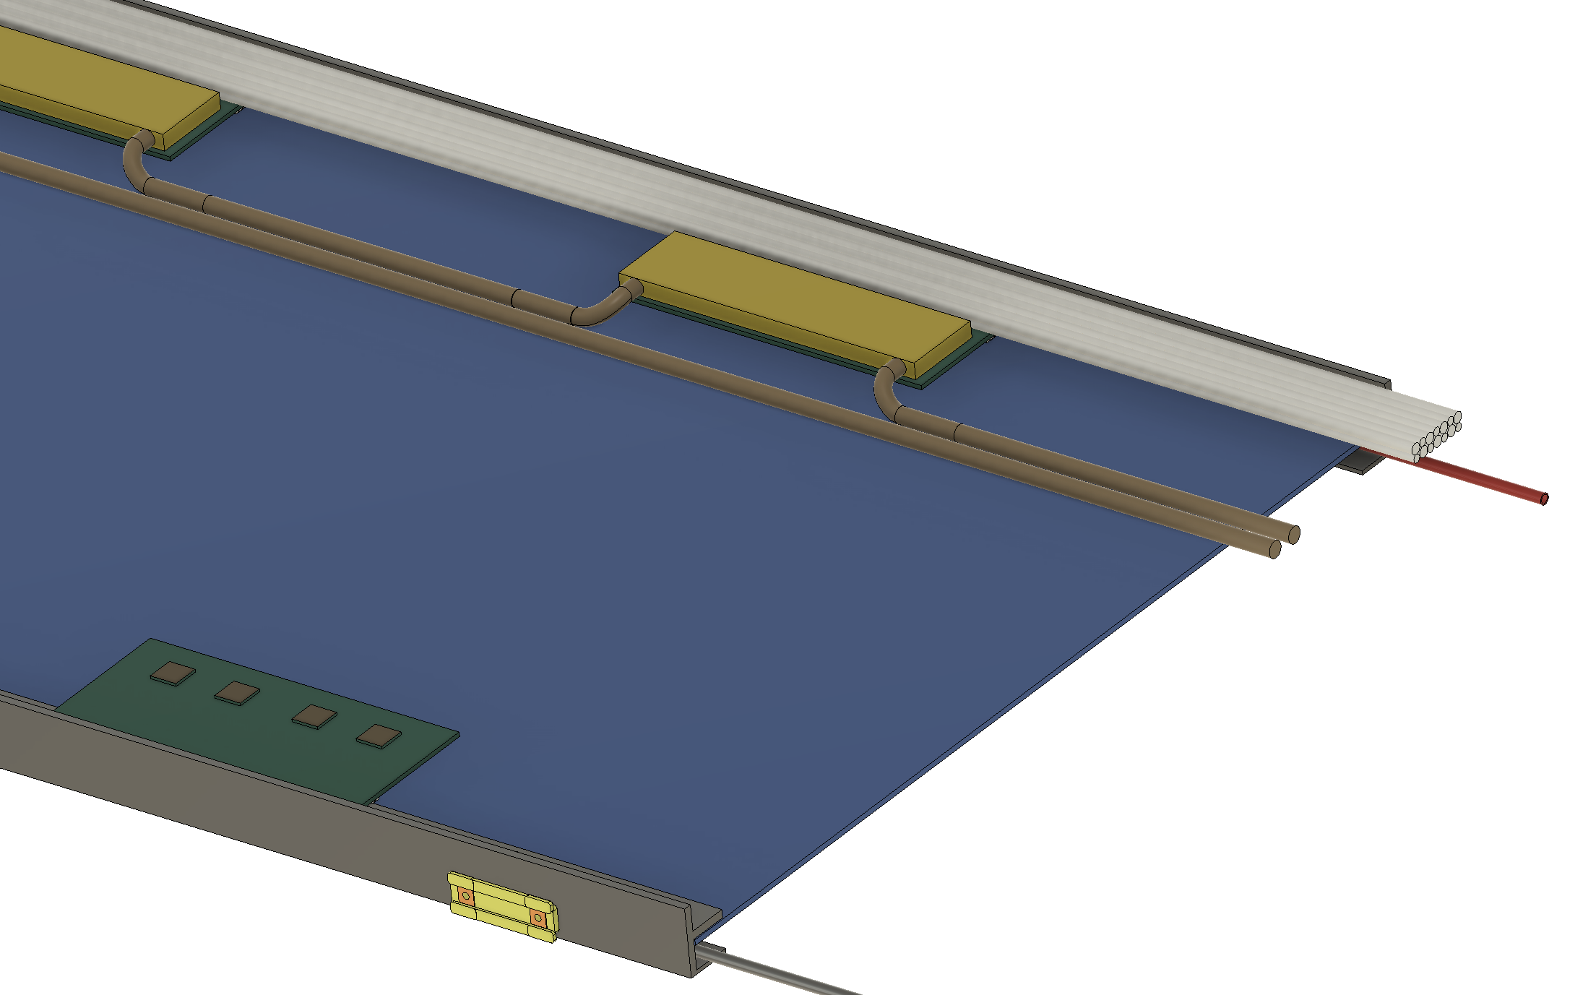
µRWELL-BOT: Front End Readout (FEB) & Services Requirements
Readout electronics:
ASIC: SALSA (under development @ Saclay): 64 chs / ASIC
FEB: 4 ASICs optical fiber communication via lpGPT + VTRx
14 FEBs / modules; 256 chs / FEB ➔ Total: 3,584 chs / module
FEB: 4 ASICs / board, optical fiber communication via lpGPT + VTRx
Service/Parts | Per Module | Total | Parameter
Frontend Board | 14 | 336 | 256 Channel / FEB
High Voltage | 1 (resistive divider) | 24 | 3.2 mm OD
Low Voltage | 14 | 336 | 6 mm OD
Gas | 2 | 48 | 3 mm ID, 4 mm OD
Cooling | 4 | 96 | 6 mm ID, 8 mm OD
Data Cable | 14 | 336 | Optical Fiber
Sensor | 2 | 24 | Temp. & Humidity
Ground |  |  | Depends on grounding plan
Services
FEB with cooling
Services & cabling:
The volume & diameter of the service line are subject to change as the FEB design progresses.
The cooling requirement has not yet been finalized ➔ The current cooling approach utilizes water cooling with a heatsink.
All three subsystems BOT, ECT, and CyMBaL will collaborate on the cooling system design.
Gas in
Cooling in/out
FEB w/o cooling
Gas out

Slide 7
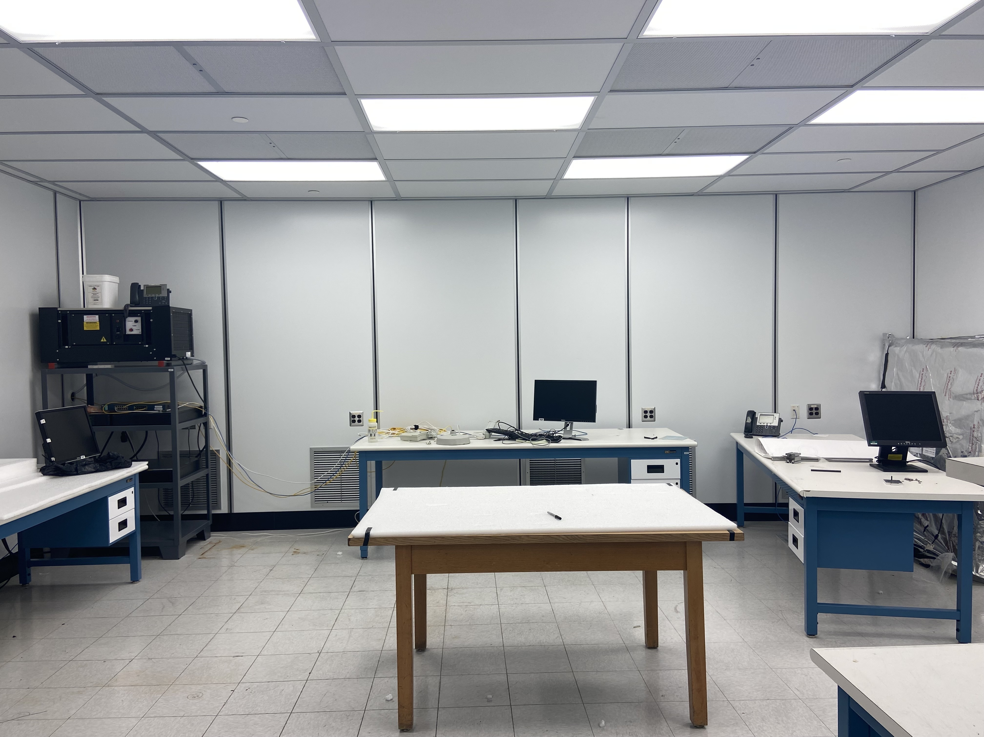
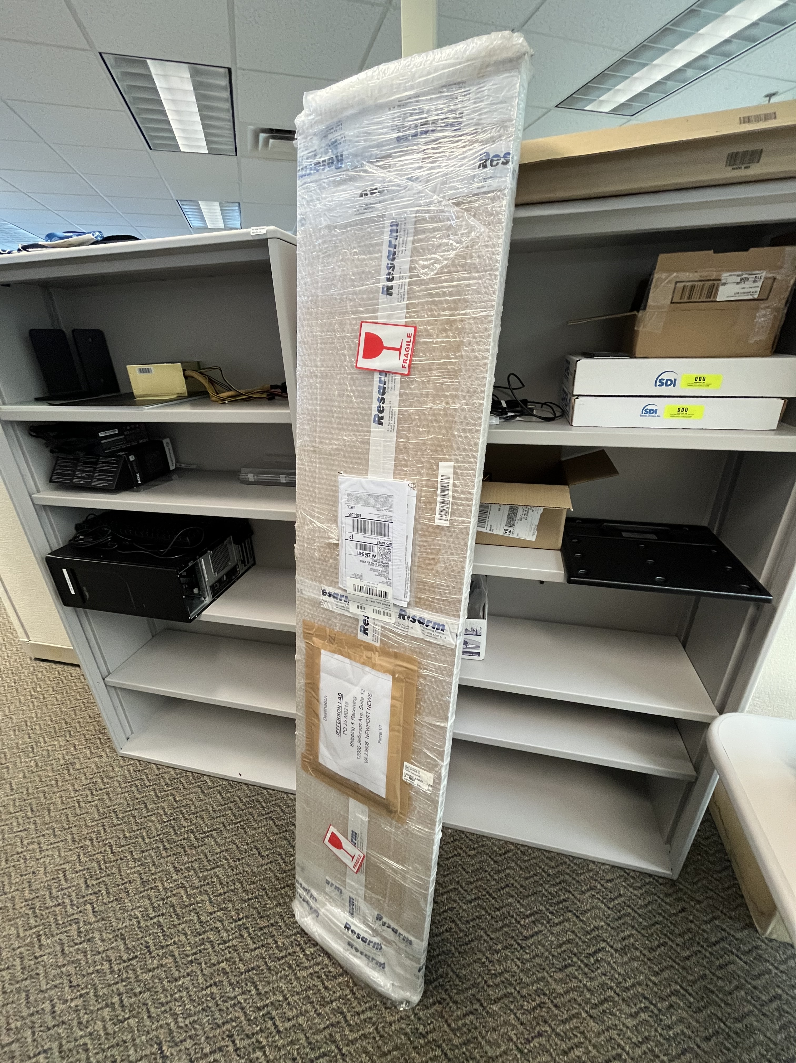
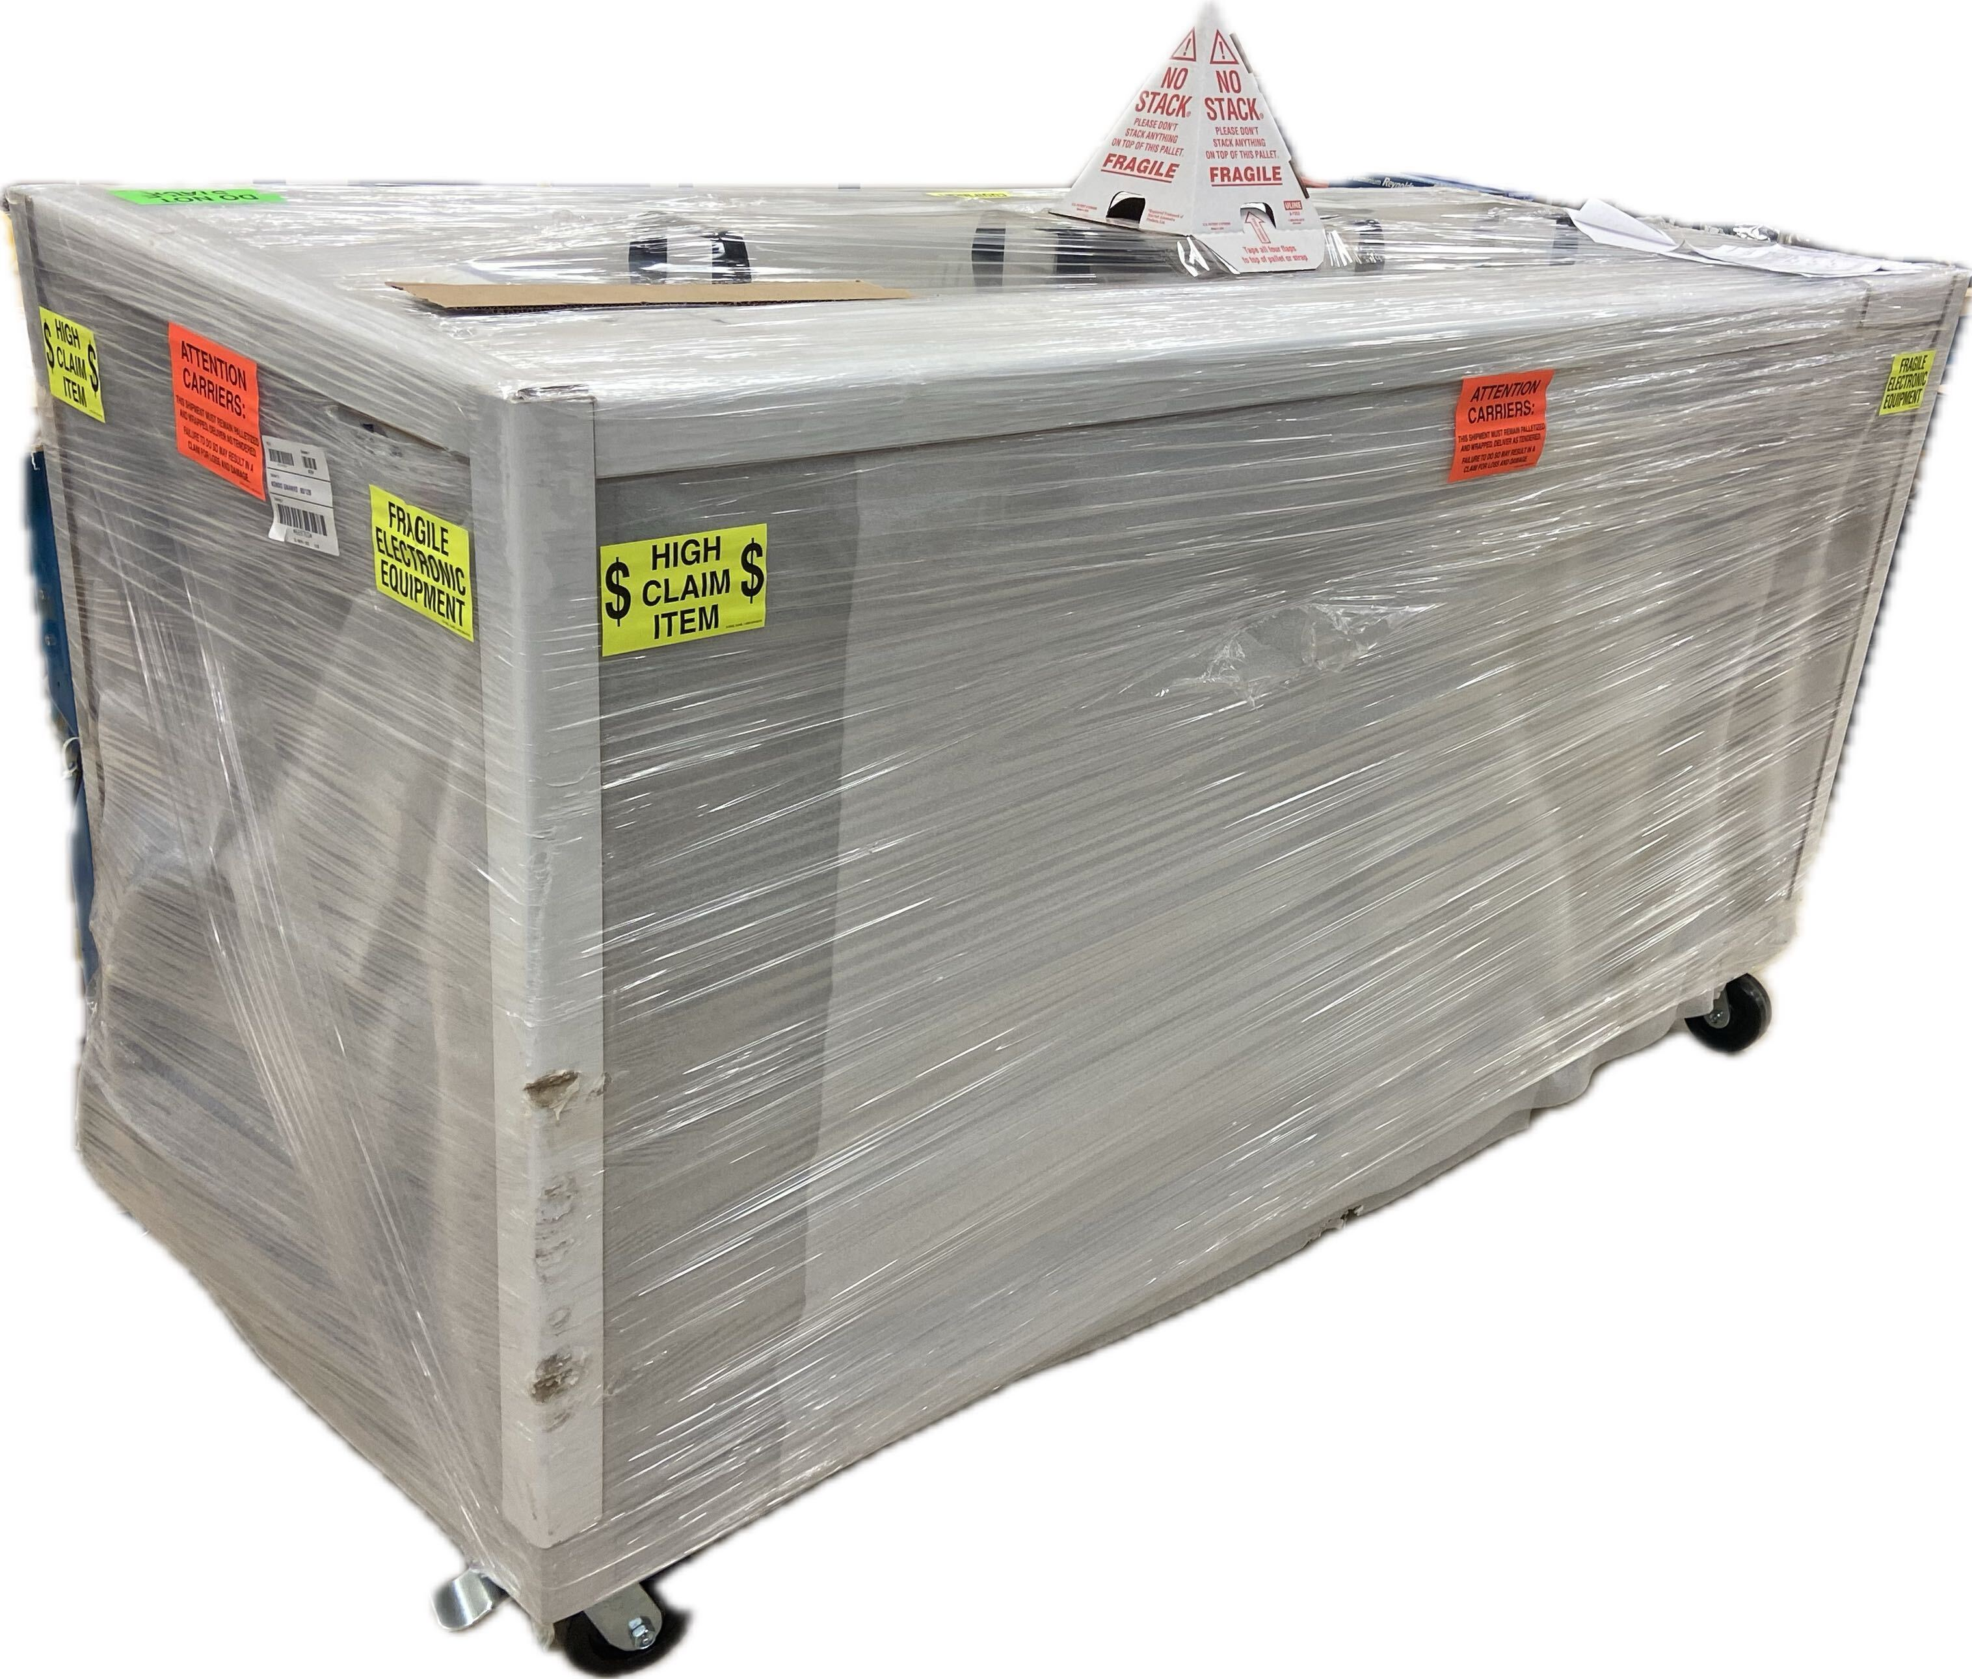
µRWELL-BOT: PED Test Article Activities - Where Are We As Of Now?
Test article module:
Support frame delivered
GEM, μRWELL / readout PCB, cathode foil – 07/2025
Assembly of the test article module: 08/2025 – 10/2025
Clean room refurbishment ongoing
Procurement of major instruments & machine shop job
Some instruments in hand (Ultrasonic Bath, oscilloscope ..)
Test beam with test article
Ongoing JLab Test beam for gas choice with small prototype
Planned CERN Test beam for full scale test article – 11/2025
MPGD Clean Room in EEL-121 @ Lab
Support frames set for μRWELL-BOT test article modul
Large Ultrasonic Cleaning Bath

Slide 8
Backup

Slide 9
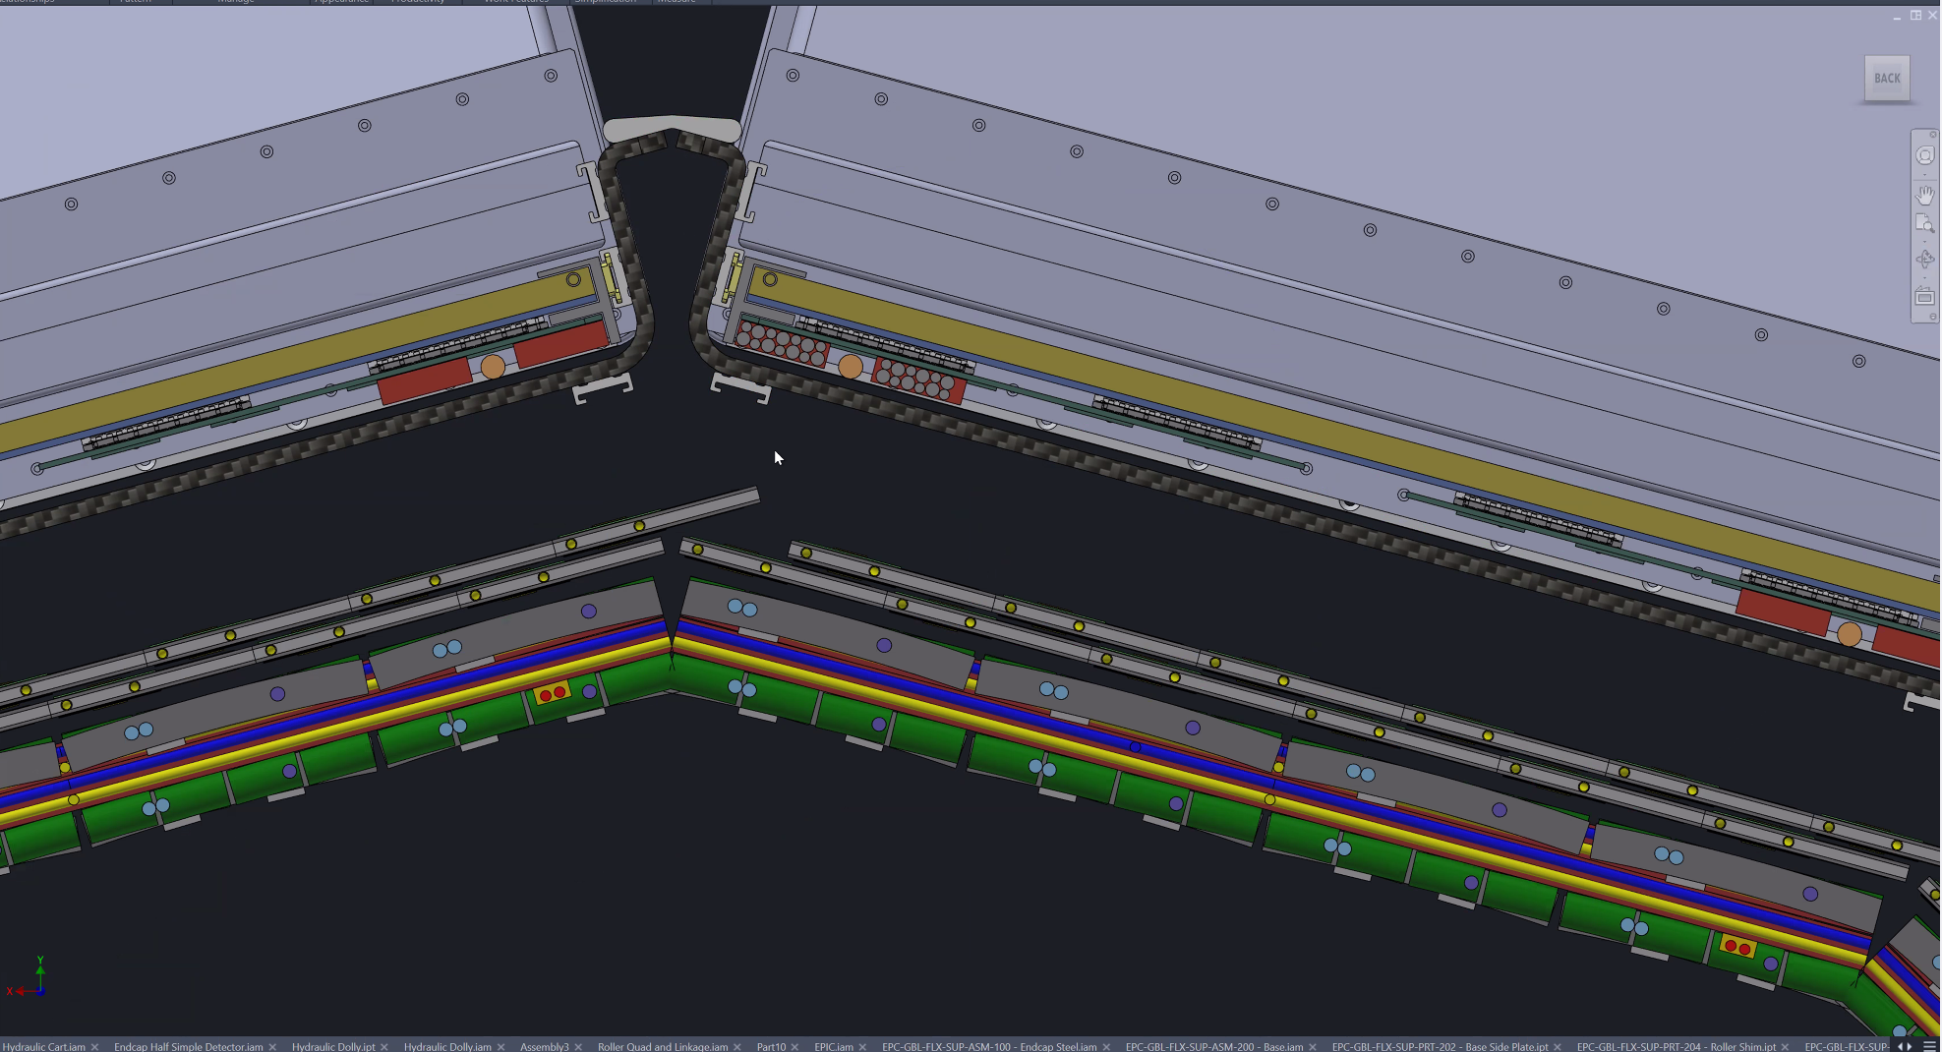
New Design Draft (from Dan)
CF housing encapsulates MPGD, removing extra space for service
It would be a good chance to review MPGD envelope

Slide 10
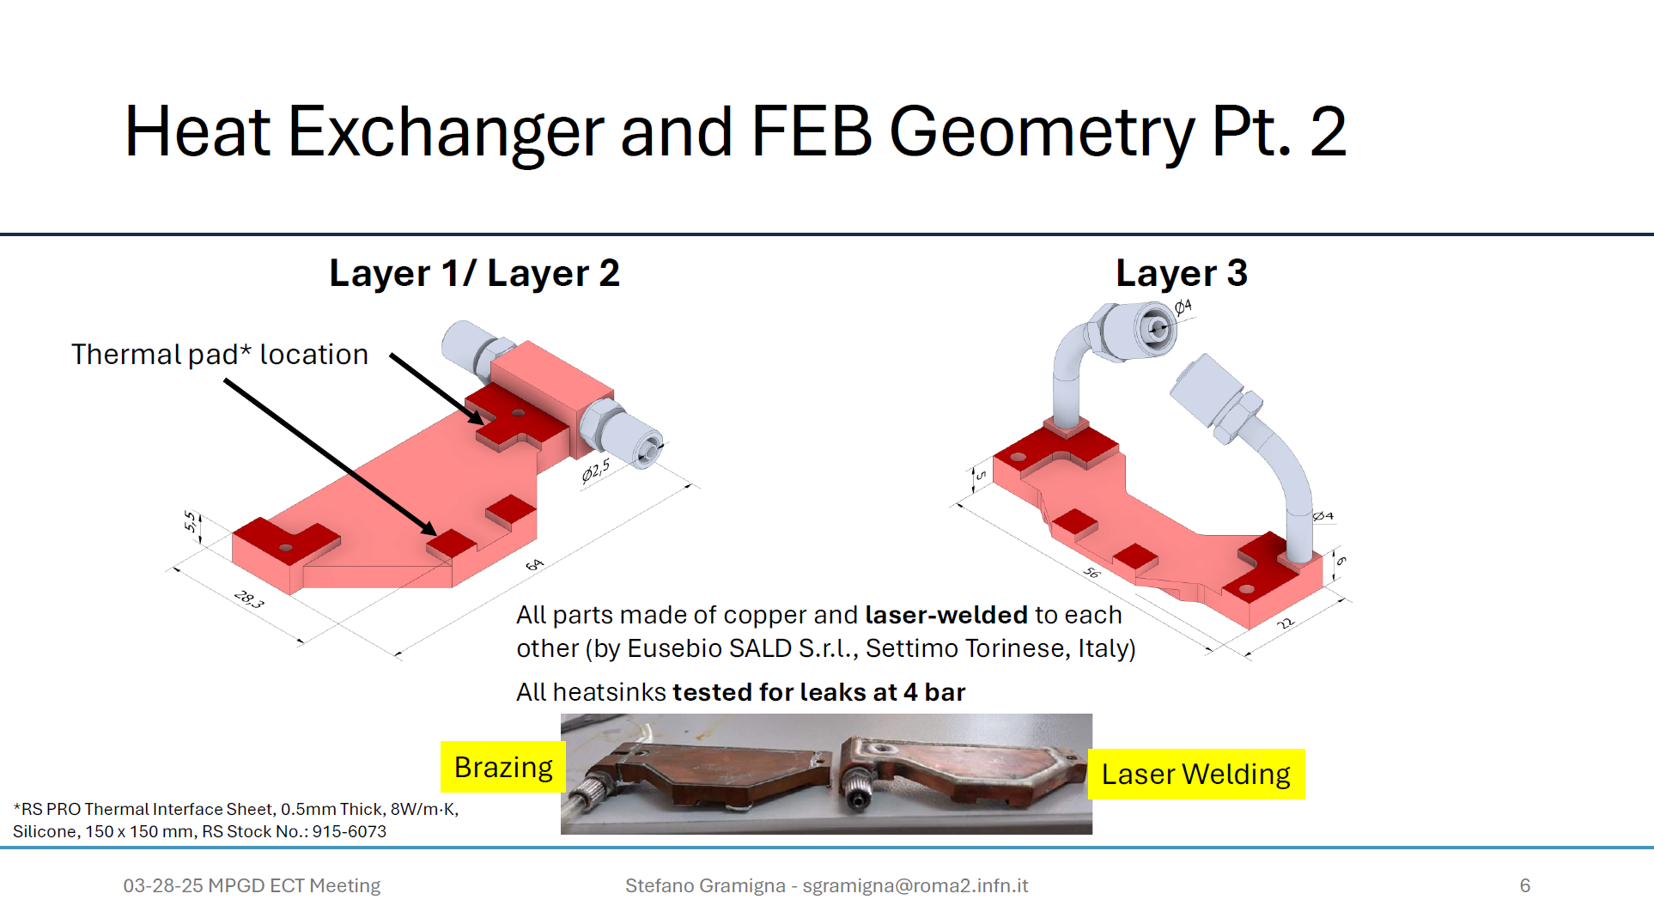
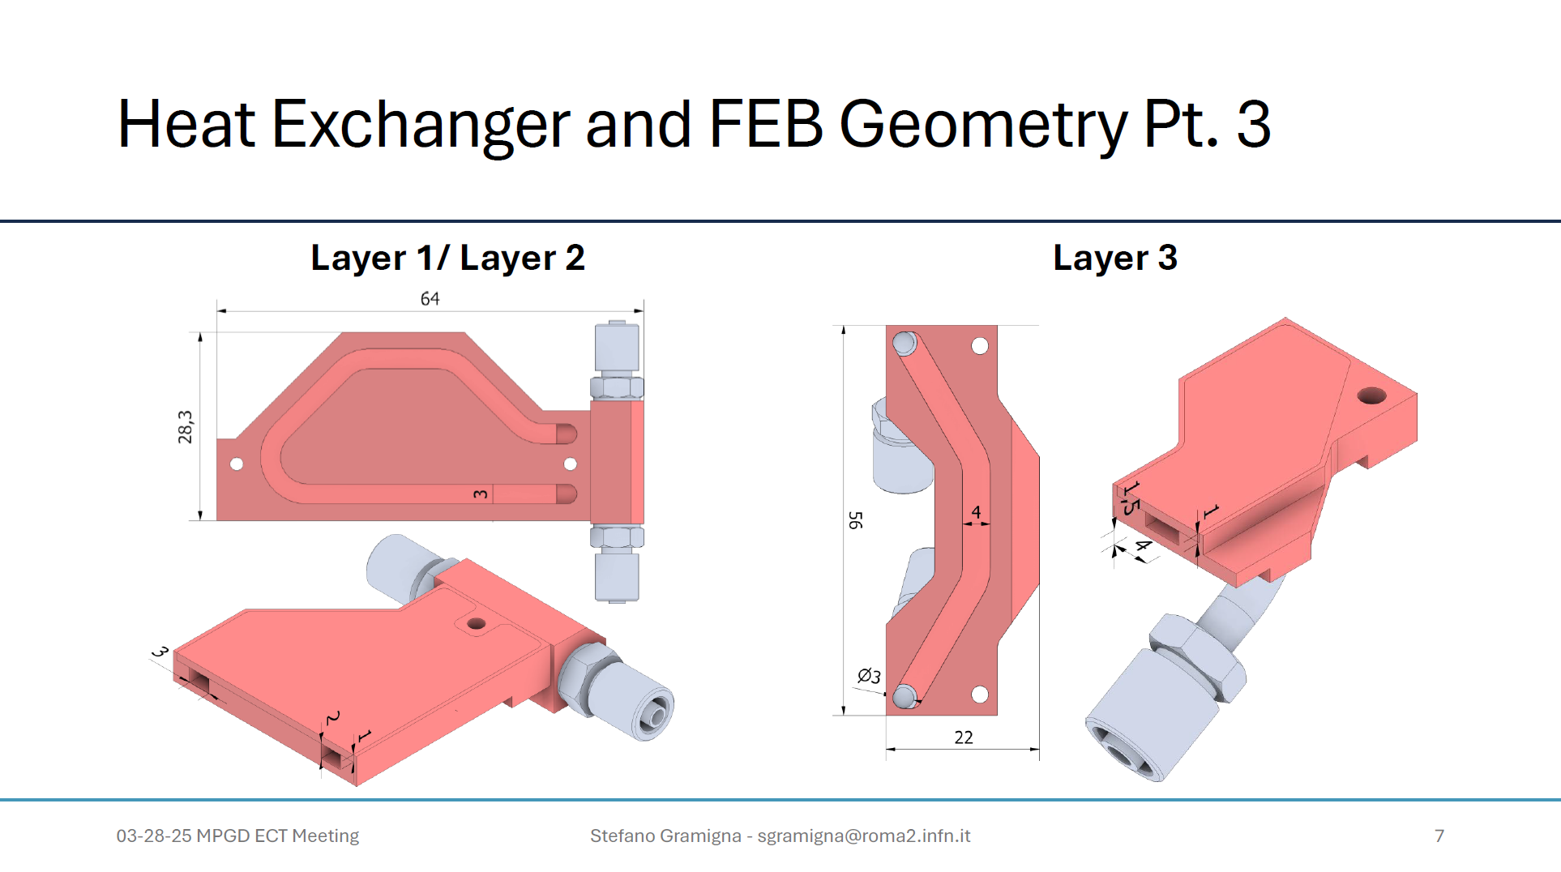
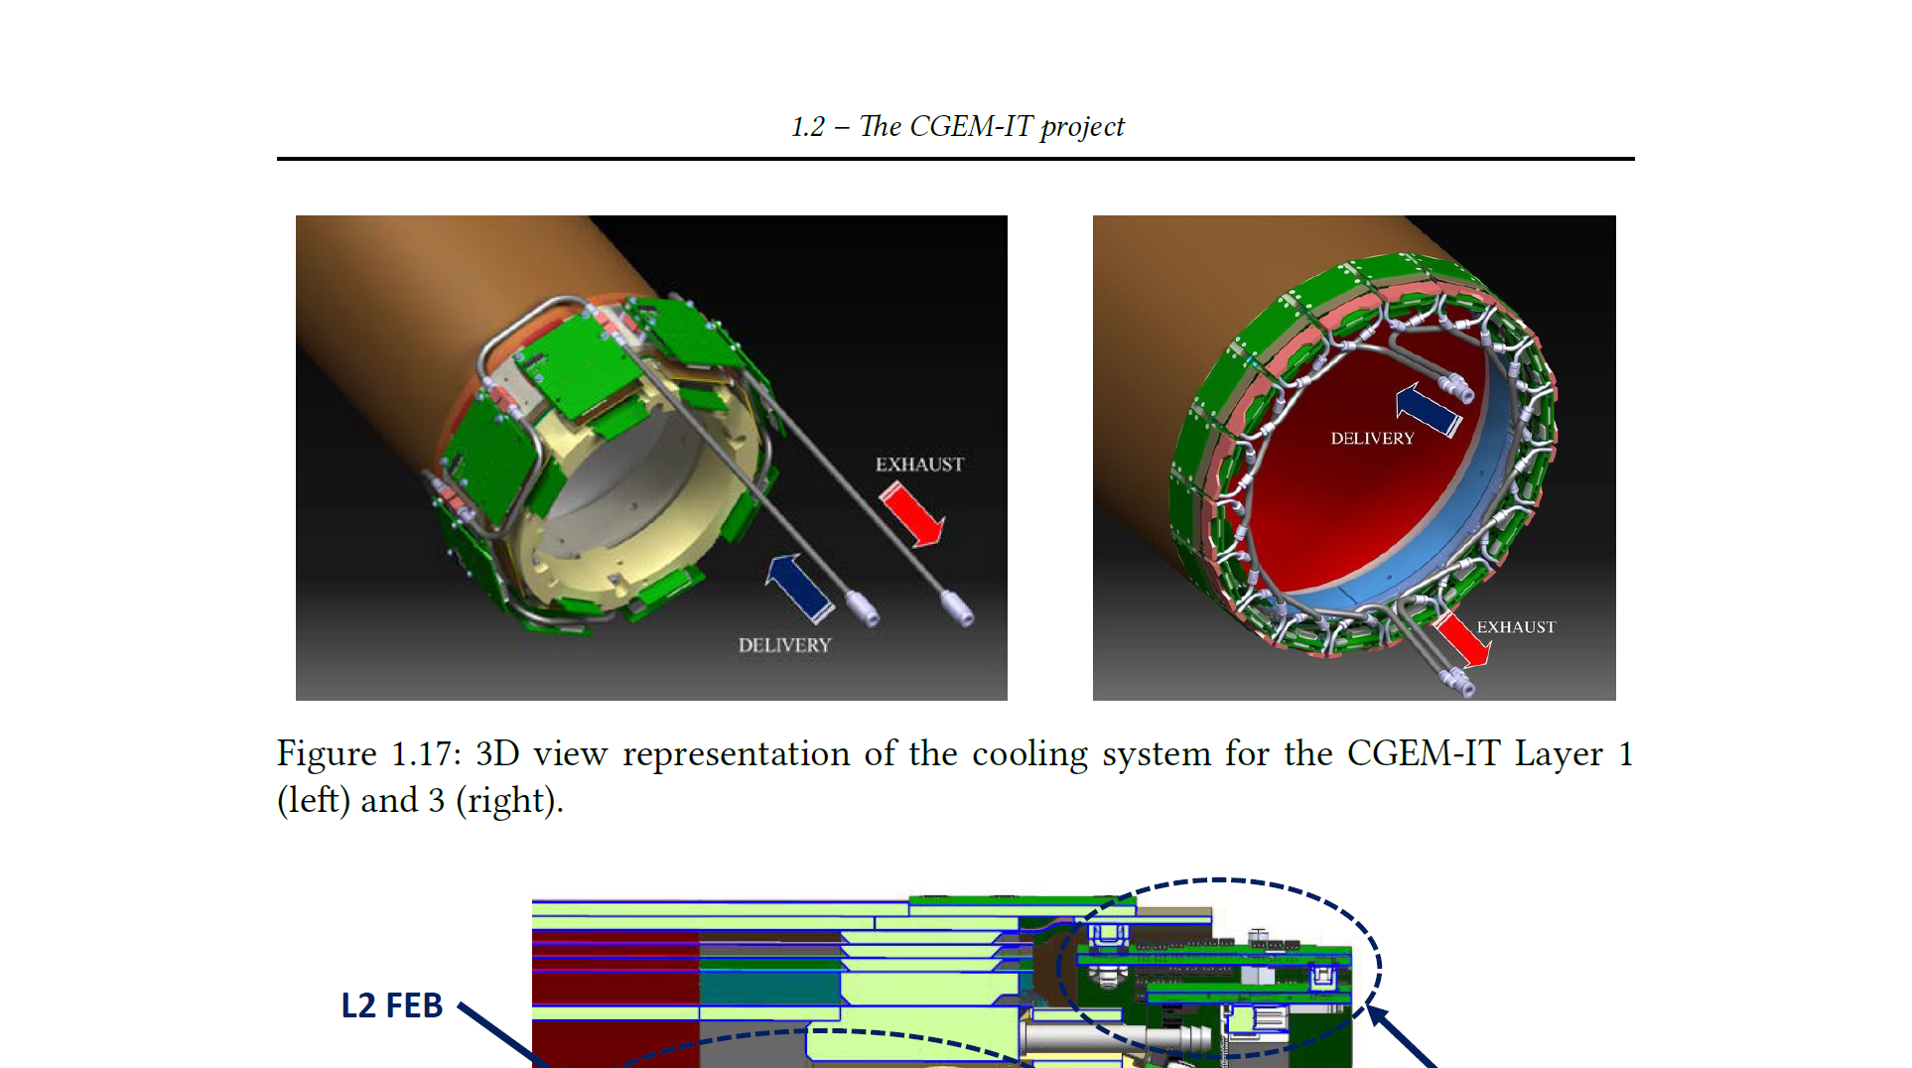

Slide 11
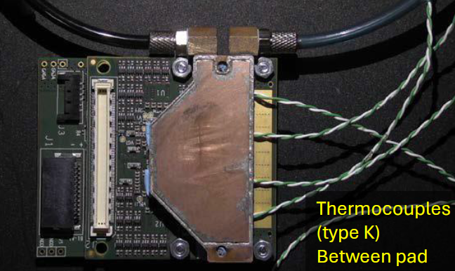
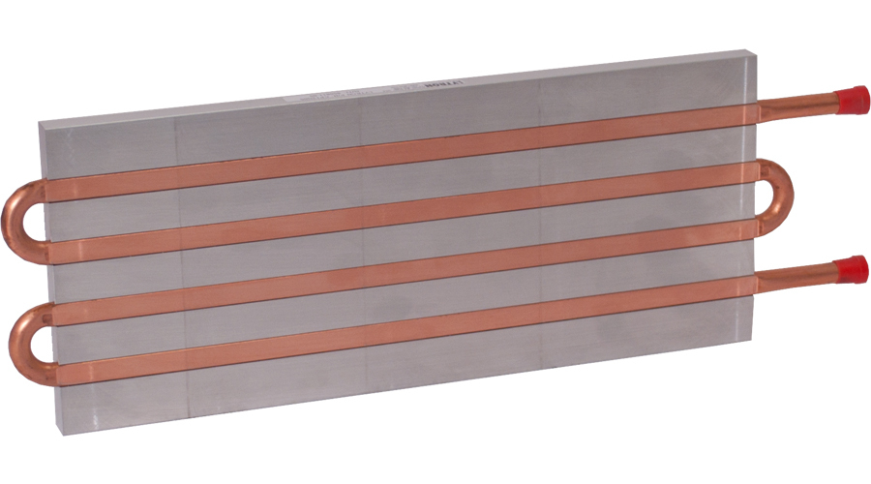
Comparison of cold plate

Slide 12
Options for heatsink
Direct heatsink with stainless steel tubing
- simple, smaller tubing
- less bending (lower pressure drop)
- requires insulation
Custom made heatsink with soft tubing
- complicate heatsink required, larger tubing
more bending (high pressure drop)
insulation not required

