Slide 1
BIC Update
Triple I Engineering Meeting Update
Kevin Bailey & Tom O’Connor
August 18, 2025

Slide 2
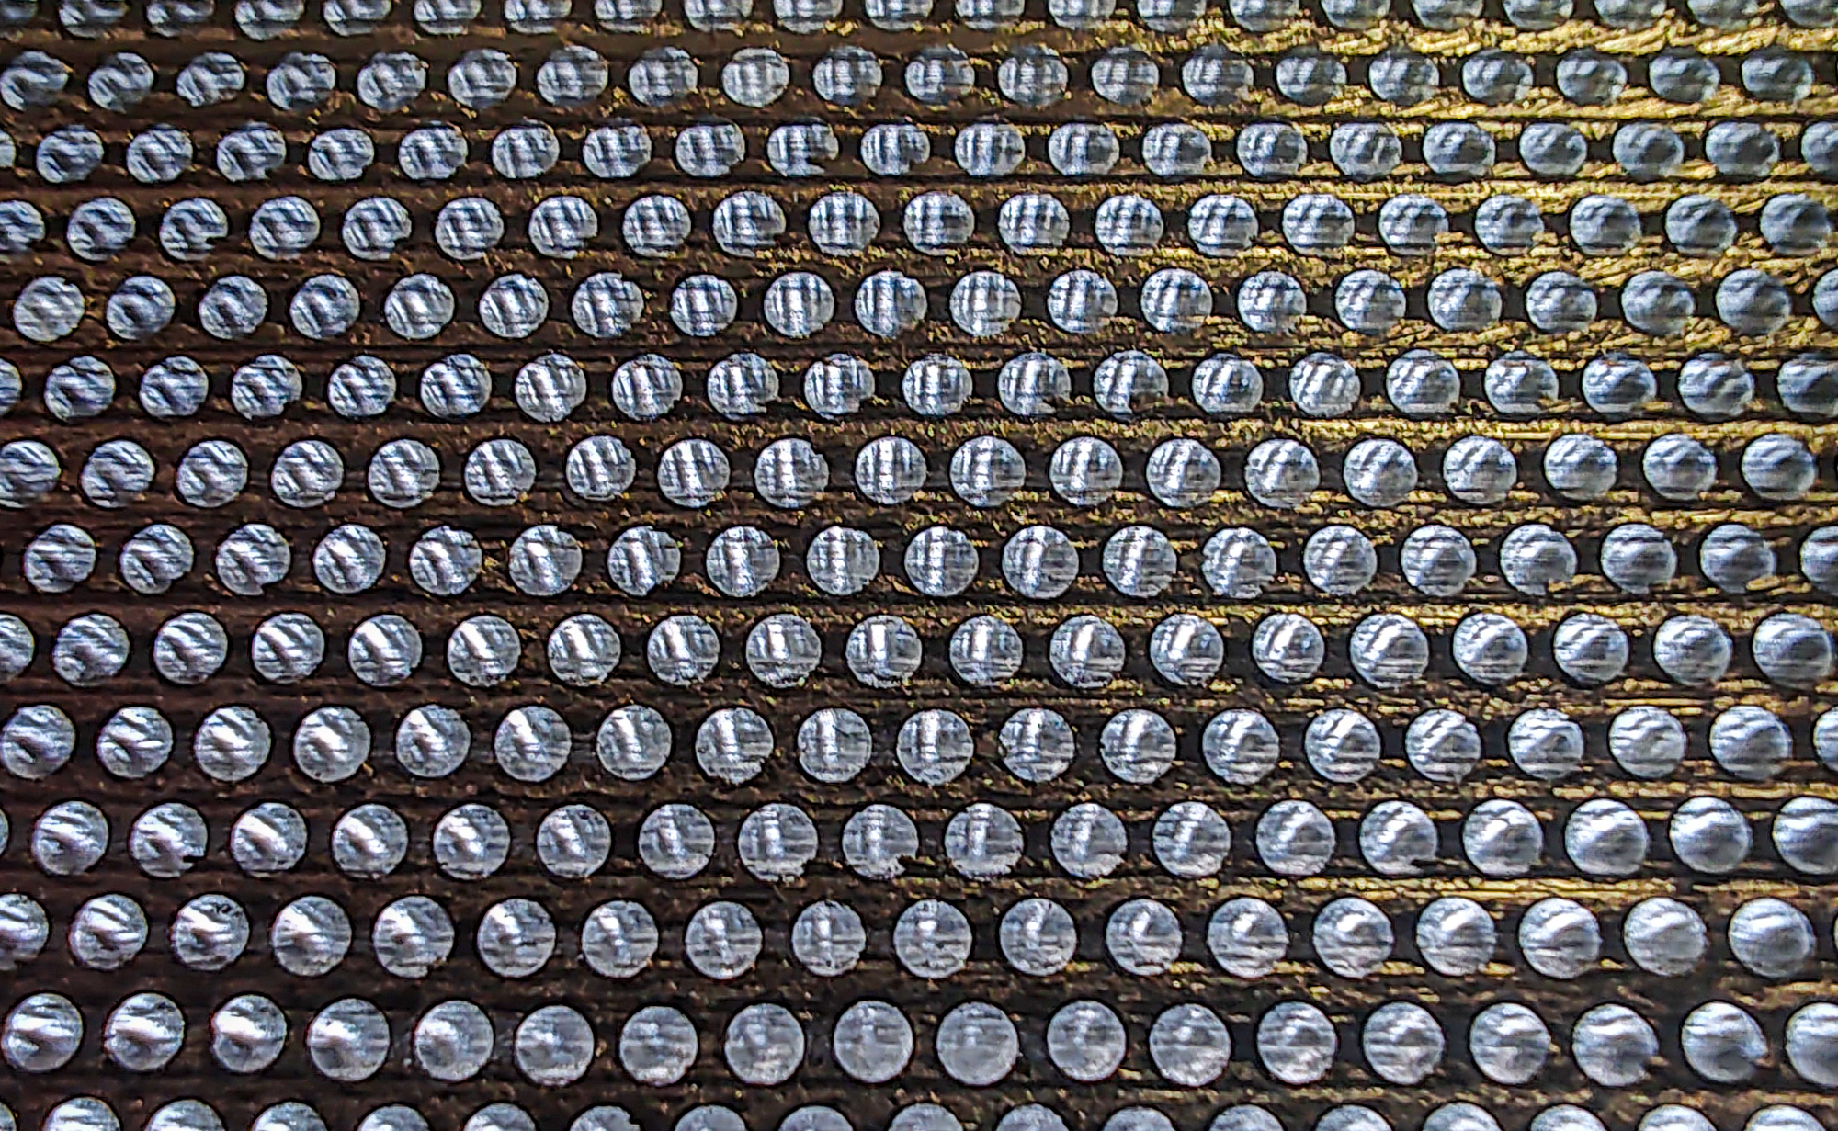
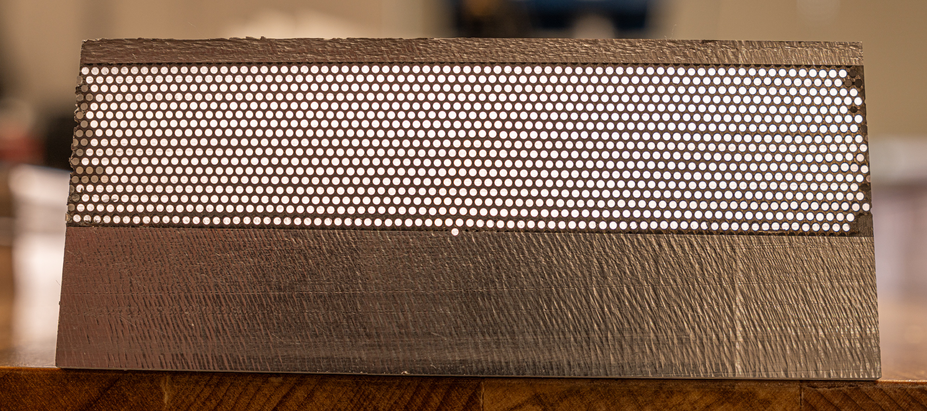
Second Test Article
Using GlueX lead 11cm wide
Using dummy fiber
Measurements
  Density 5.0g/sqcm
Quality of construction improves

Slide 3
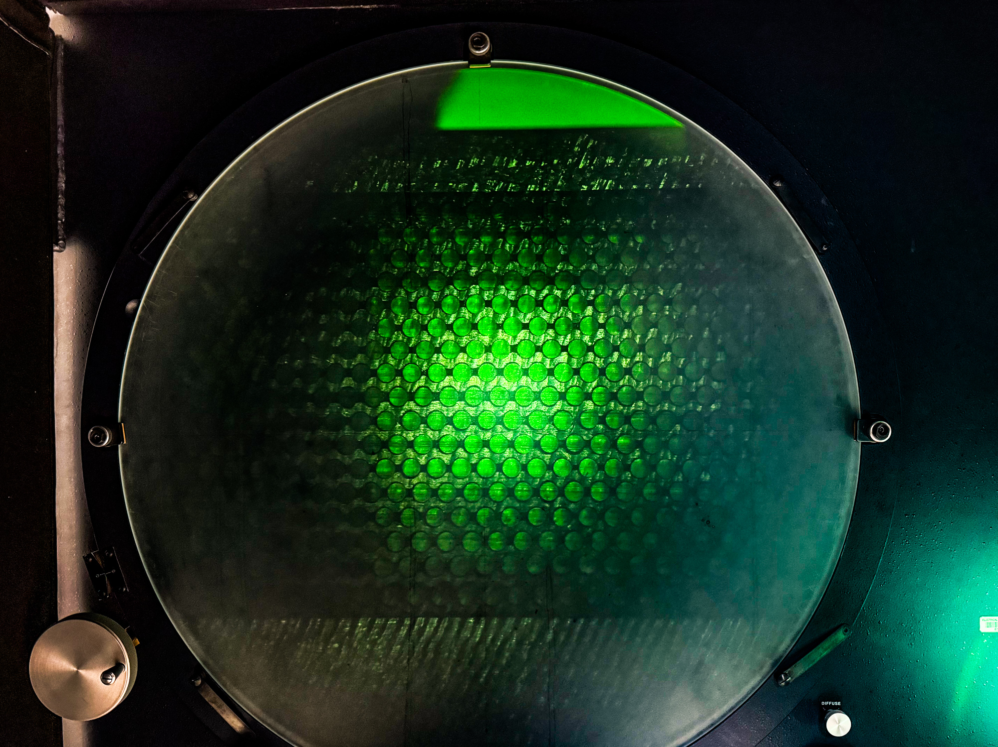
Test 2 w/ Optical Comparator
Measurements of spacing
Overall Matrix Thickness = 22.57mm (reference value = 21.73mm)
Horizontal Fiber Spacing = 1.37mm (reference value = 1.35mm)
Groove Depth = 0.36mm (reference value = 0.44mm)
Lead Layer Thickness = 0.91mm (reference value = 1.00mm)
Vertical Spacing – calculated = 1.26mm (reference value = 1.22mm)
Vertical spacing over 4 layers – side = 1.27mm
Vertical spacing over 4 layers – middle = 1.20mm

Slide 4
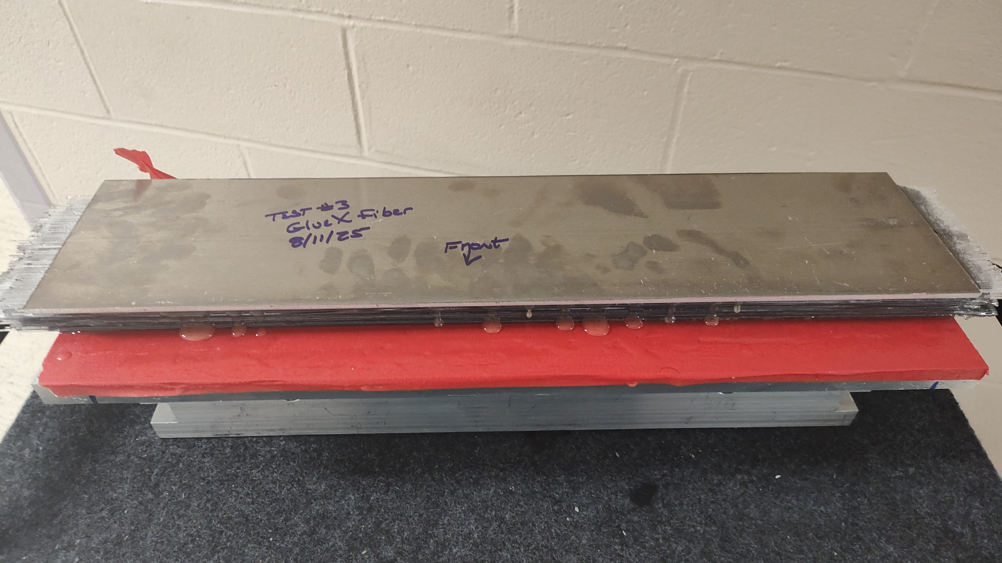
Third Test article
Using GlueX lead & GlueX fiber
Construction completed and awaiting machining
Measurements tbd

Slide 5
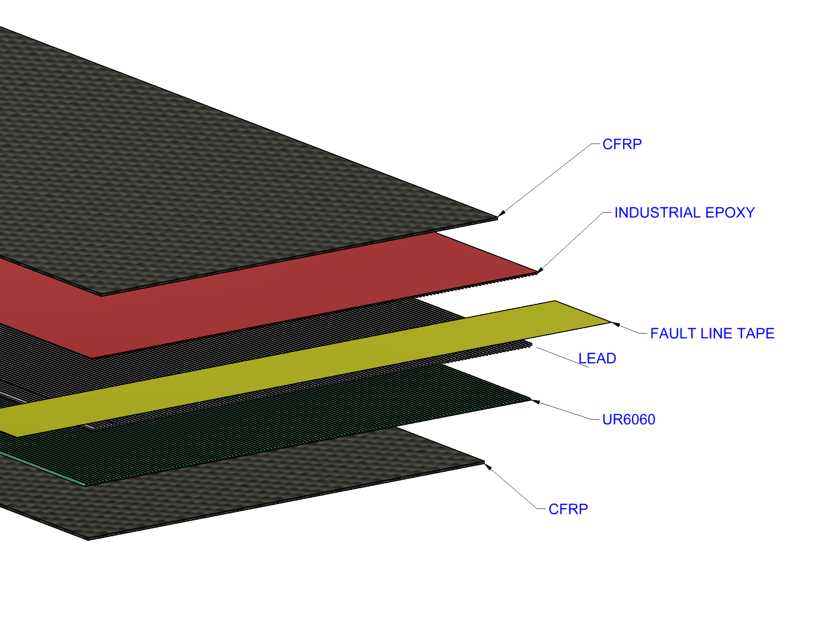
Destructive Test @ CMSC
Two cases
Two modes
Mode 1
Interlaminar Fracture Toughness DCB
(Double Cantilevered Beam)
- normal to plane of crack
Mode 2
Interlaminar Fracture Toughness ENF
(End Notched Flexure)
- Parallel to crack plane – shear
…a total of 15 samples for Three point bending (Mode II), and 16 for DCB (Mode I)

Slide 6
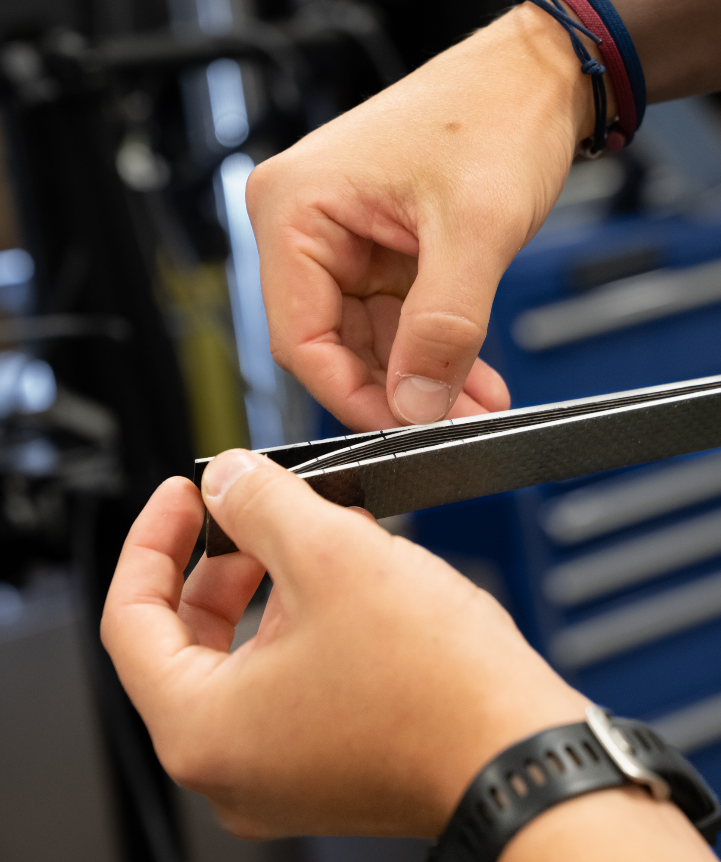
Wednesday August 13 2025
Unexpected Failure
Samples tested fail at UR6060
Glue joint…what was supposed to be the stronger bond.
The UR6060 was the incorrect adhesive
New samples under construction (50% complete) and to be tested next week

Slide 7
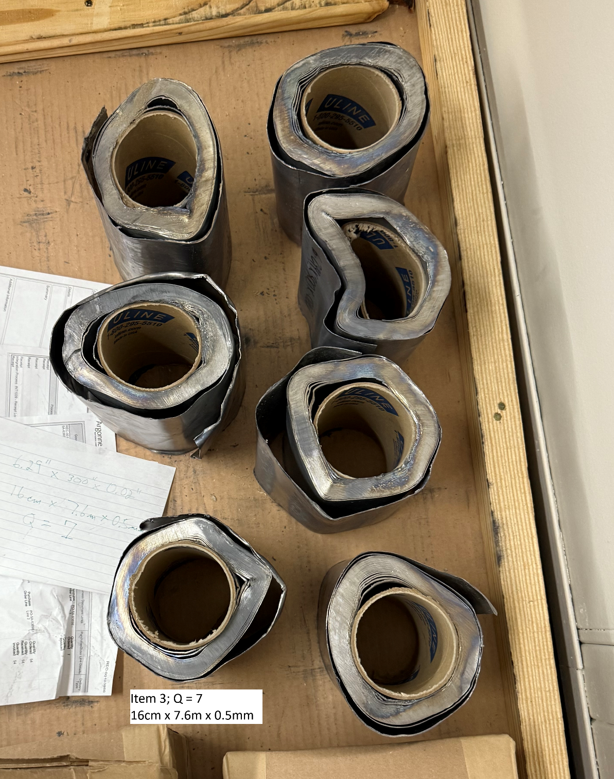
Lead update
New Lead order in process for on hand stock
  Enough for .05m test articles
Finding a source agreeable to +/- 50microns difficult

