Slide 1
Cradle, Barrel HCAL & Moving Mechanism
EIC Experimental Equipment Mechanical Engineering Round Table 9/8/25
Nathaniel Speece-Moyer (BNL)

Slide 2
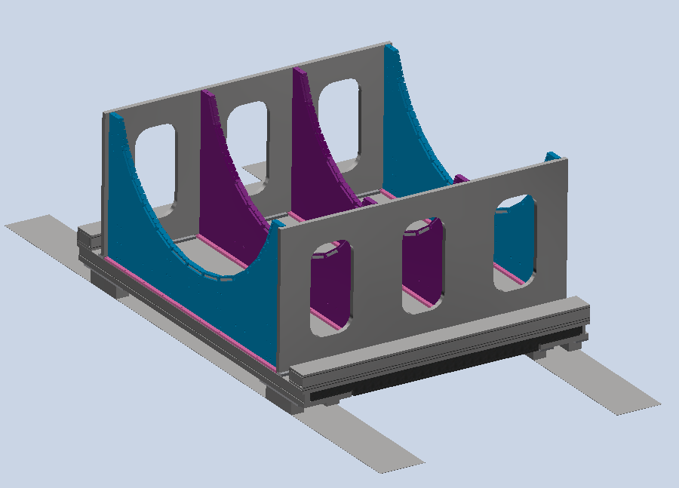
Cradle and Moving Mechanism Updates
Updates
Ranked design options for moving the cradle. Reached consensus with the mechanical engineers at BNL that the best path forward is with air bearings.
Air bearings will cover most of the surface under the cradle.
Will have rollers as a backup in case of air bearing failure.
Will include pistons to raise/lower the detector.
Adjustable fixed stops will be used to control the final position in the x, y, and z directions.
A challenge will be finding space for fixed stops.
Investigated high-capacity air bearings used on CMS detector at CERN. Company/distributor has changed several times in the last 15 years. Appears these high-pressure air bearings are no longer manufactured. There is a company that still has these, but they won’t sell them to us and will instead ship equipment and travel from Germany to the US each time we want to move the detector. Unless we get new information, we are not going to pursue this option.
Platform over the detector will be re-used or similar to the platform from sPHENIX.
Have updated the cradle model and started preliminary FEA simulations.
Need to update expected forces from the magnet in later simulations.
Current cradle design, based off sPHENIX cradle.

Slide 3
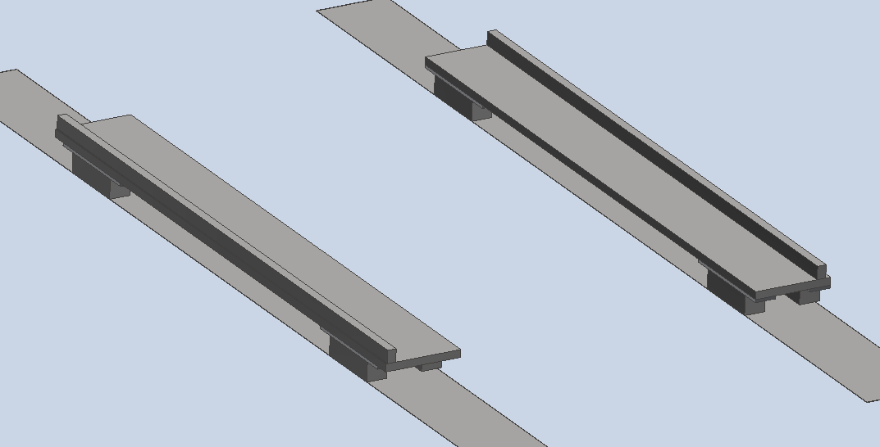
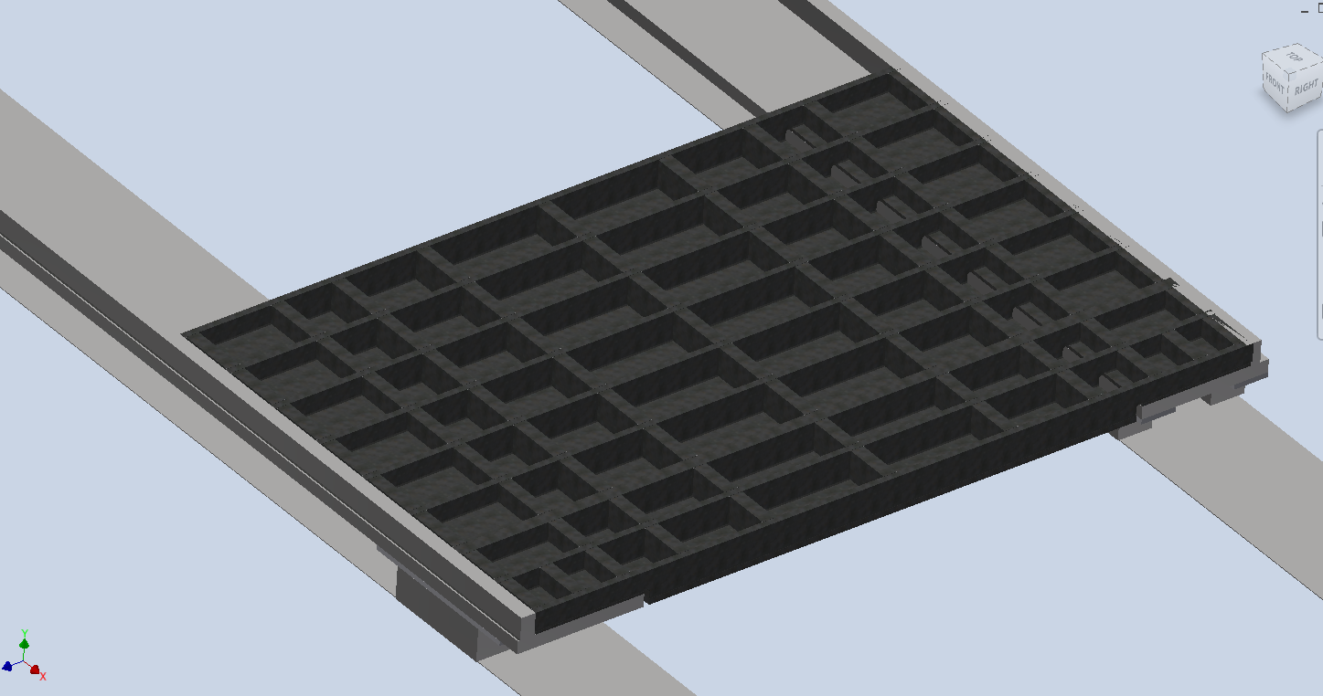
Cradle and Moving Mechanism Updates
Roller support beams set down first on rails.
Welded lower platform section (2x) placed on roller support beams.
Only one of the lower platform sections modeled at this stage.

Slide 4
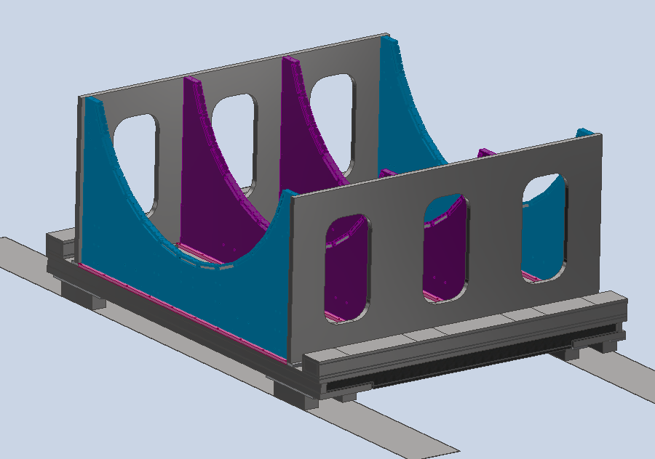
Cradle and Moving Mechanism Updates
Top plates, pedestal sections, vertical reinforcement, and platform reinforcement beams can be added and bolted to the bottom assembly.

Slide 5
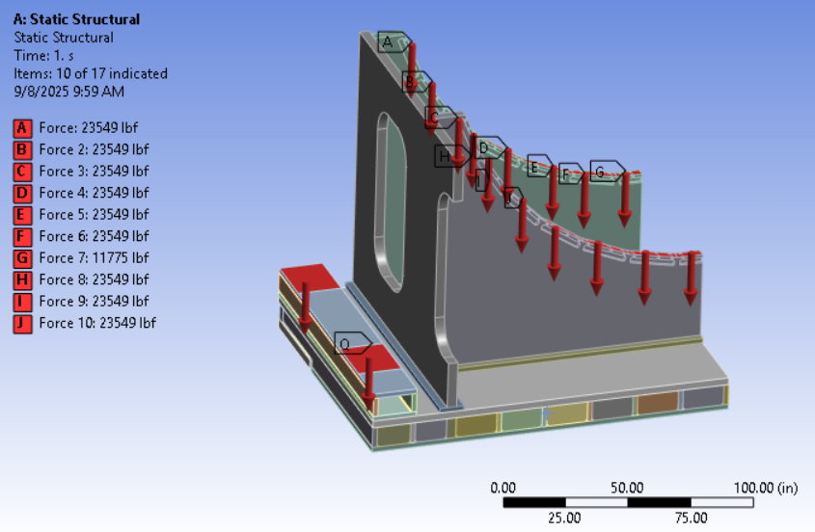
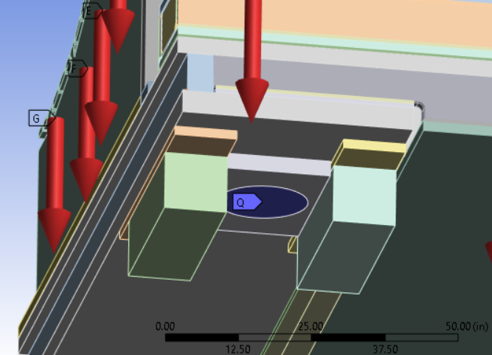
FEA Model
Quarter symmetry model
HCAL and inner detector weights evenly distributed over HCAL contact areas.
Weight of the platform, assuming a 2 in thick steel plate, was distributed on the contact areas for the platform columns. Included an estimate for magnet forces on the platform.
Largest size single-pass continuous welds used as a starting point (5/16 in). May need to adjust later.
Welds were simulated as solid members with bonded contacts to parts that are welded. Contacts set to frictionless between welded parts on areas that were not welded.
Bonded contacts everywhere else.
Fasteners to be modeled in the next iteration instead of bonded contacts.
Fixed constraint at the location of the hydraulic cylinder.

Slide 6
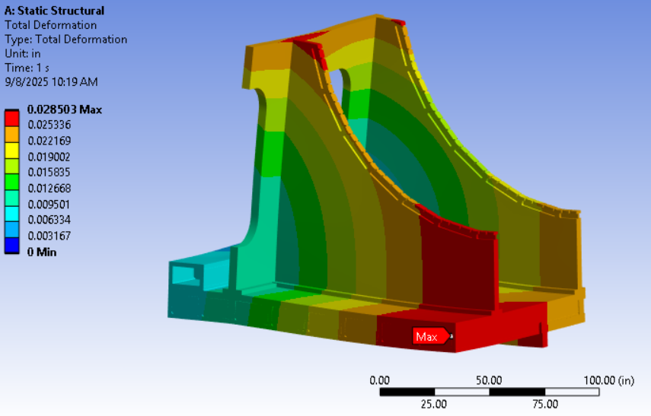
Results - Deformation

Slide 7
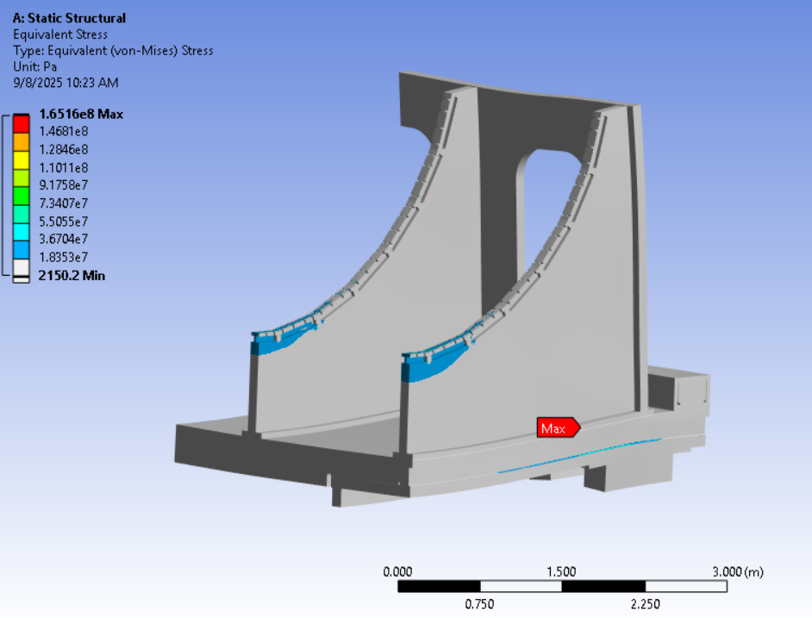
Results – Equivalent Stress
Most parts of the structure have low stress. Likely opportunities for material reduction. To be determined after adding fasteners.
Mesh refined in highest stress areas.
Contact meshing used for welds.

Slide 8
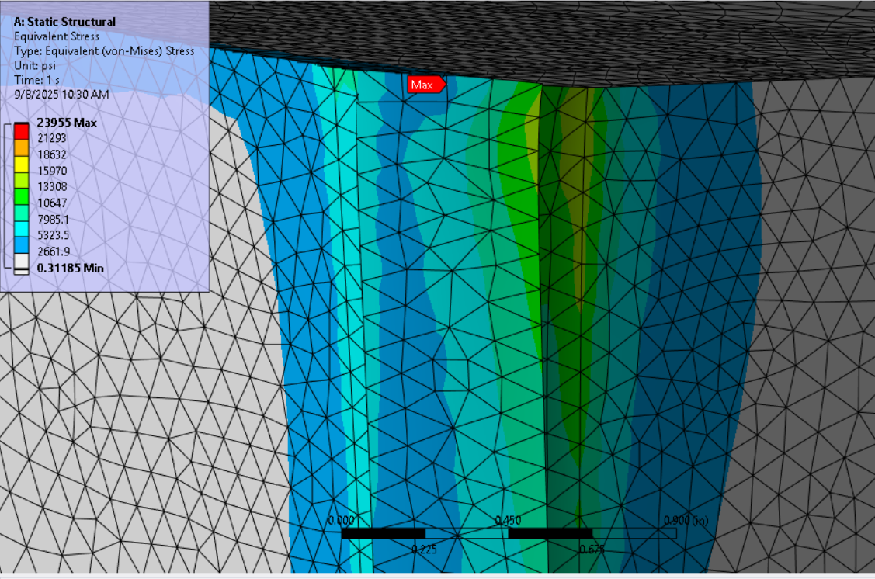
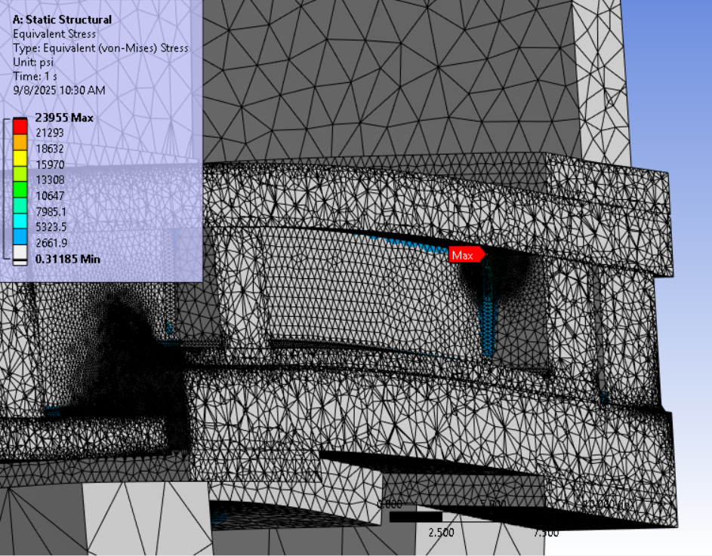
Results – Equivalent Stress

Slide 9
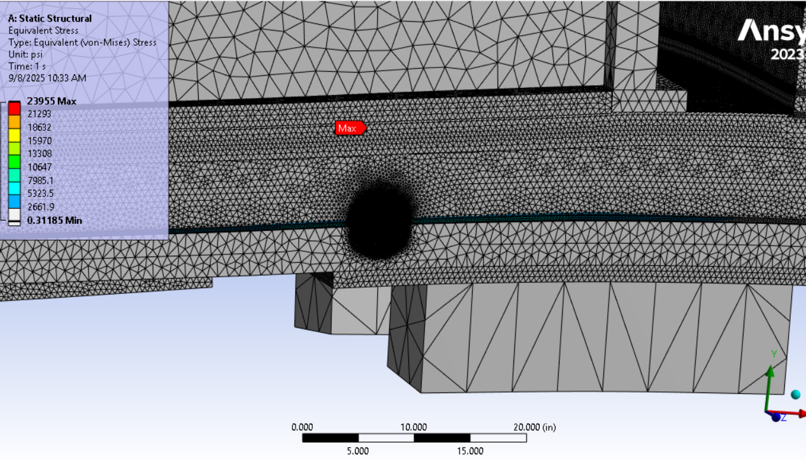
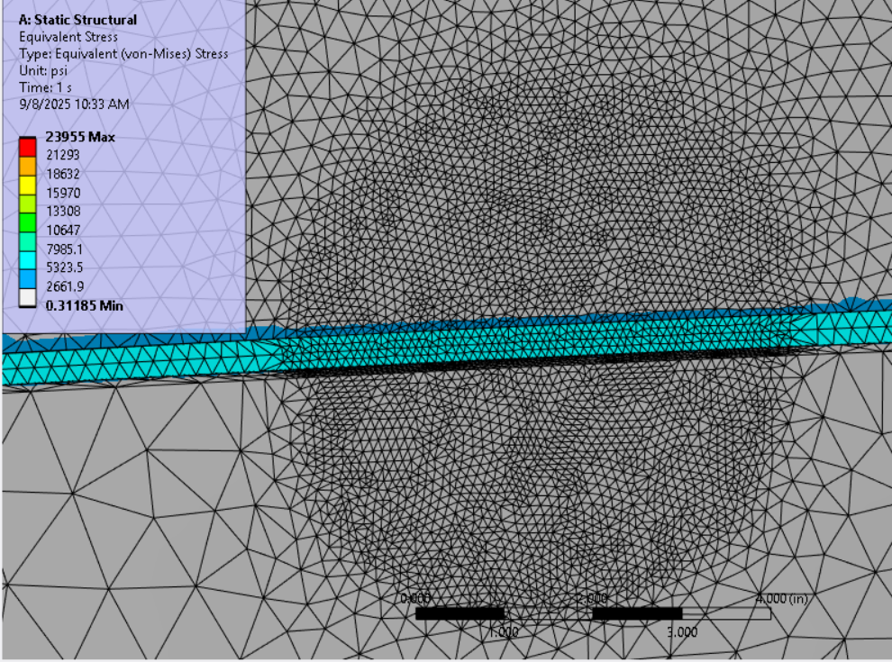
Results – Equivalent Stress

Slide 10
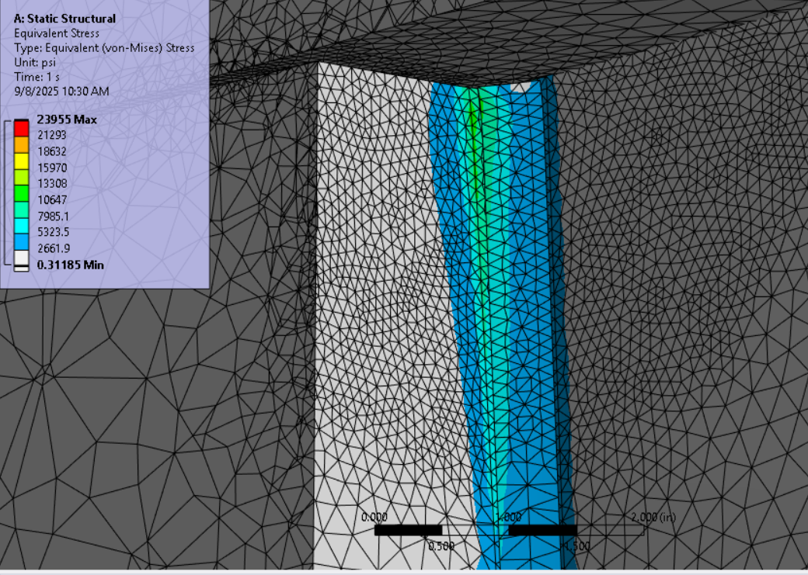
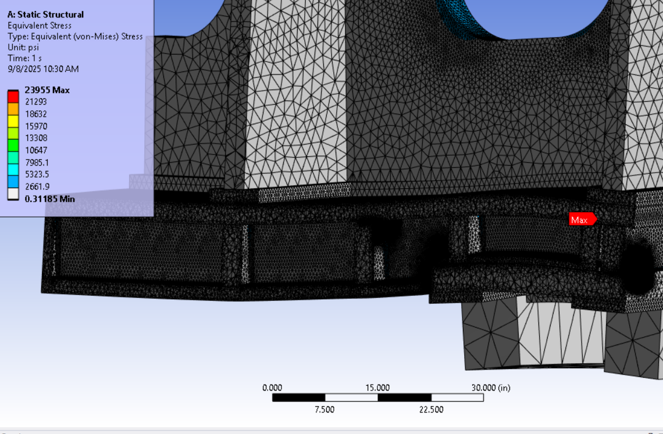
Results – Equivalent Stress

Slide 11
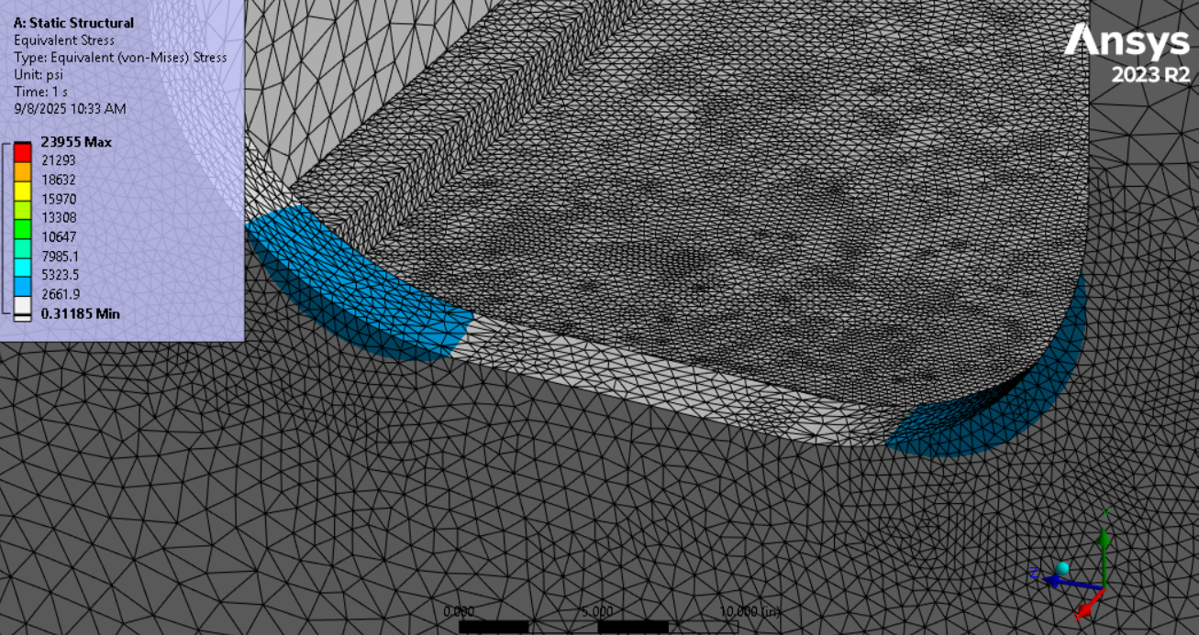
Results – Equivalent Stress

Slide 12
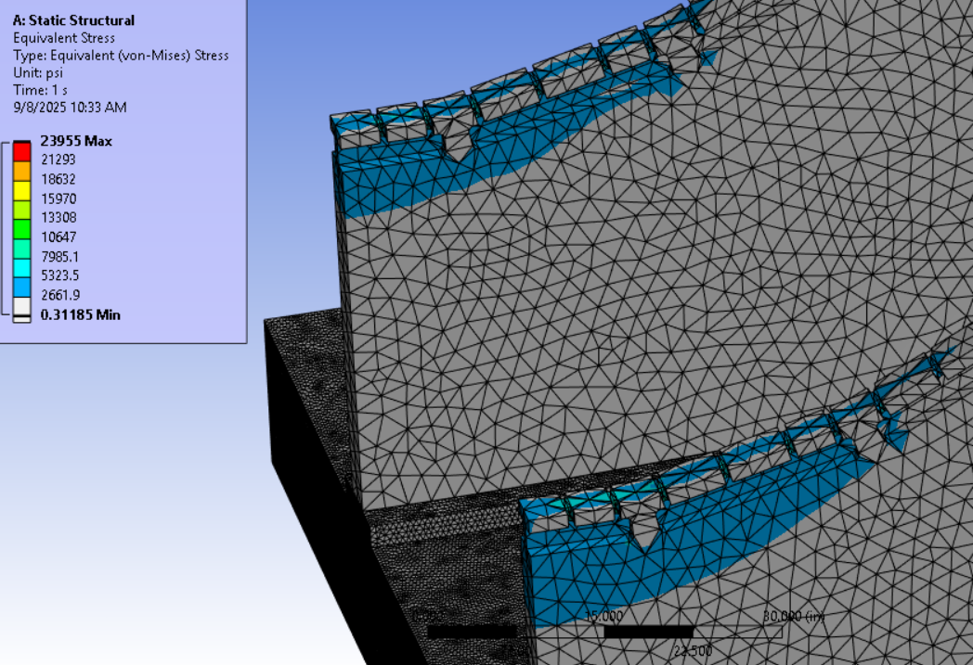
Results – Equivalent Stress
Not the area of interest for this simulation - used a coarse mesh.

Slide 13
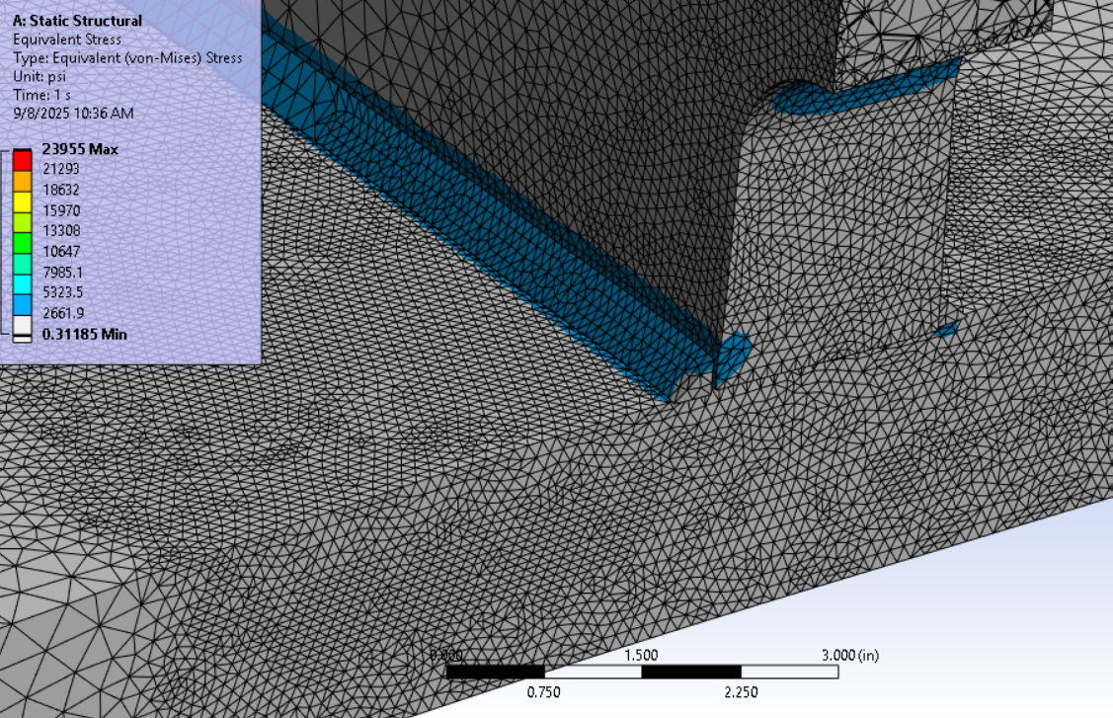
Results – Equivalent Stress

Slide 14
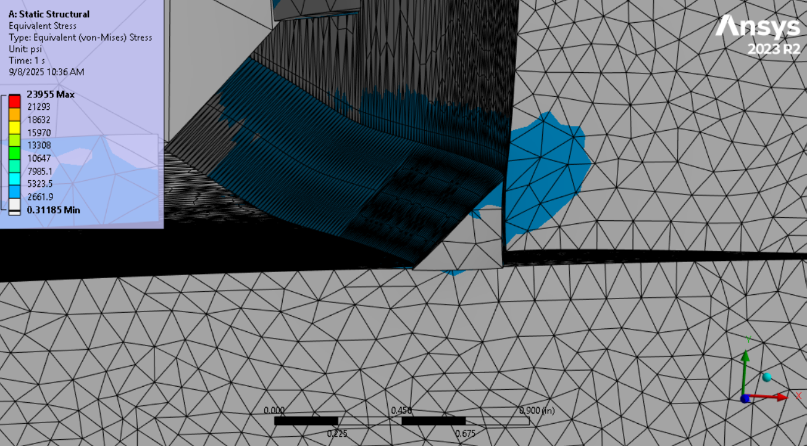
Results – Equivalent Stress
???
Need to take a closer look at this area.

Slide 15
Summary and Next Steps
Need to include fasteners in the model and re-run the simulation.
Need to investigate high stress weld areas. Refine mesh in model, may need to add more weld material or supports.
May be able to reduce material in other areas which can be determined as the simulation is refined.
Magnet group will need to run simulations with the latest cradle and platform models, and forces will need to be incorporated in the latest mechanical model.

Slide 16
Question & Comments

