Slide 1
BHCal Mechanical Modifications
Dan Cacace

Slide 2
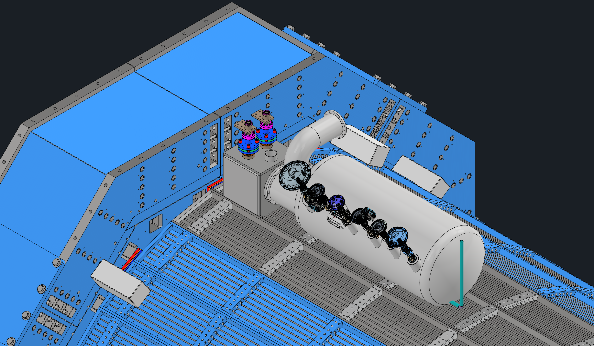
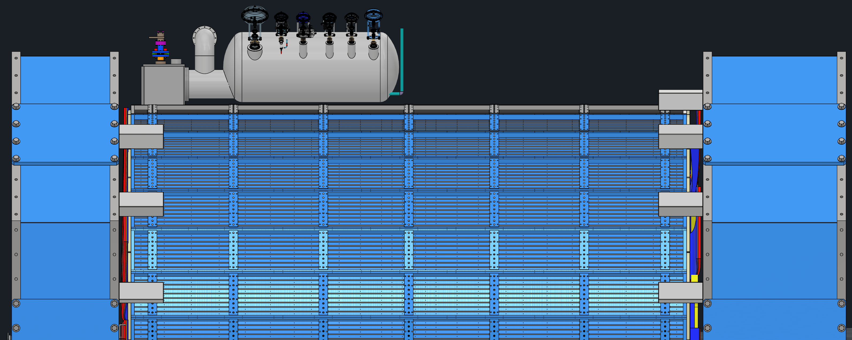
Current Interference
The magnet chimney needs a cutout in the HCal for the phase separator to be mounted on the OD.
The three top sectors of the HCal are already unique from sPHENIX due to a similar issue.
The modifications would be made to these three sectors.
Magnet Chimney
Endcap
Magnet Phase
Separator
Normal Sectors
3 Chimney Sectors

Slide 3
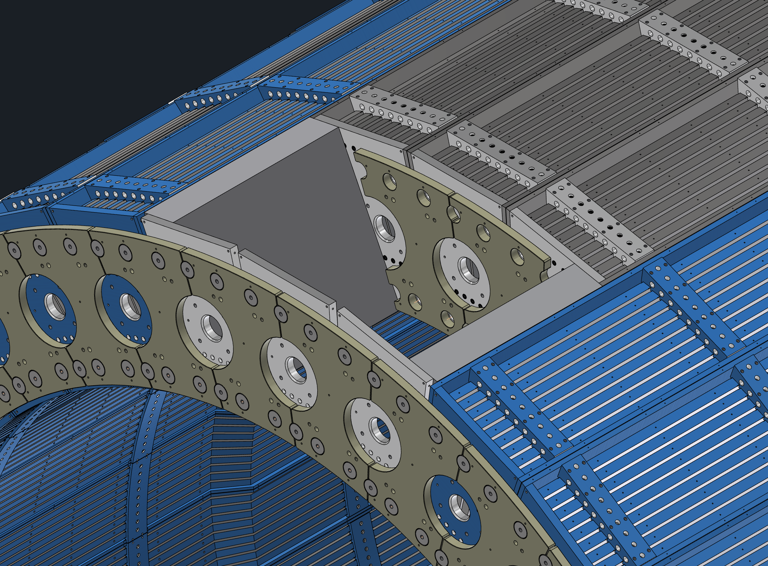
Proposed Modifications
We need to cut short the three chimney sectors, such that the interference is eliminated, and we maintain the full HCal structure
All chimney tiles would be eliminated, but all full tiles would remain intact.
This attempts to minimize the modifications needed and impact on the structure.
Possibly can regain some tiles in extensions, but will be more complicated/work/expensive.
Cutout For Chimney
Extend Sector
for structure
Maintain HCal
Splice-Plate Structure
Adapt splice plates to
support top sector

Slide 4
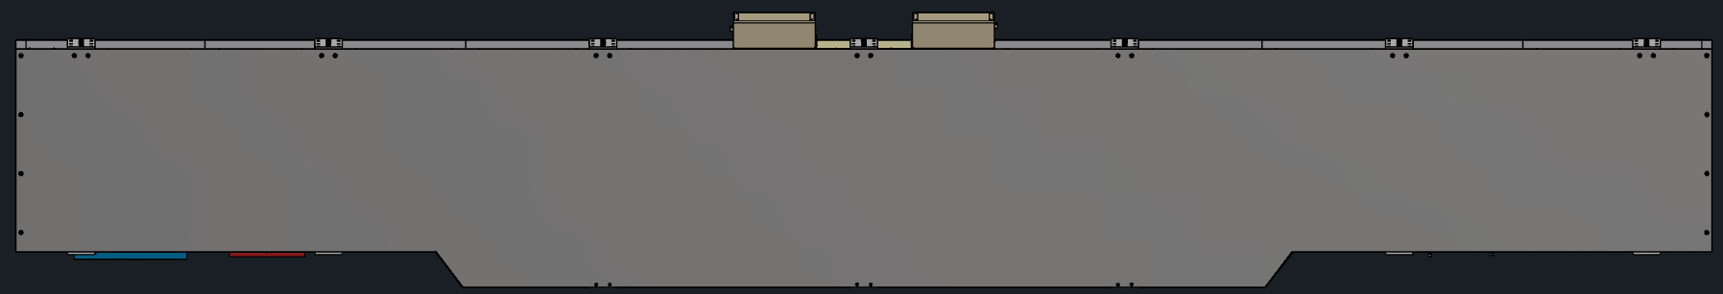
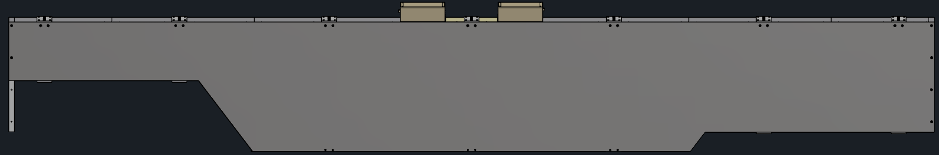
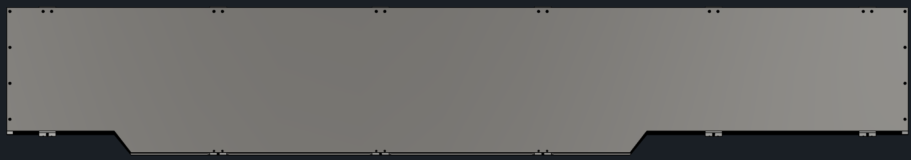
HCal Sectors
Normal HCal Sector
Chimney HCal Sector
Modified Chimney HCal Sector

