Slide 1
Radiation Impact on SiPMs, overview
Stefan Bathe
Baruch/CUNY

Slide 2
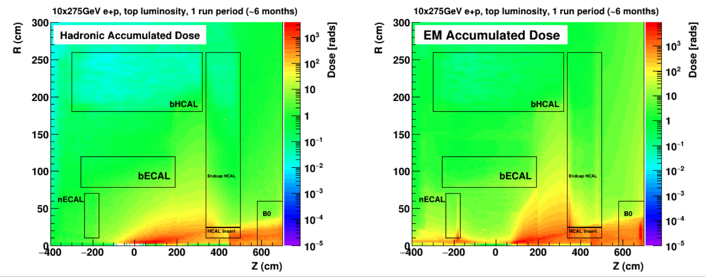
Barrel HCal Radiation exposure
Orders of magnitude lower dosage than fHCal
Anticipate testing for other subsystems will be sufficient

Slide 3
Quoting from current pre-TDR draft
Yellow Report: at the calorimeters, the radiation level will be <= 3 krad/year EM and 10¹¹ n/cm² hadronic at top luminosity
At BHCal, the radiation level will be only 10 rad EM and 0.1 rad hadronic, orders of magnitude lower than, e.g., at the fHCal.
The on-detector electronics (SiPMs, H2GCROC3) are radiation tolerant.
The neutron fluence will be low enough that it is not an issue for SiPMs.
The neutron fluence is lower than in sPHENIX, where the dark current increase is consistent with expectations.

