Slide 1
Experience from Buiding and Operating the HERA Lepton-Proton Collider
EIC Seminar, August 26, 2025
Ferdinand Willeke
BNL-EIC
August 26, 2025

Slide 2
Outline
HERA Model
Timeline
ep collision parameters
Luminosity Upgrade (HERA-II)
Operations
Background Issues
Reliability
HERA Relevance for EIC

Slide 3
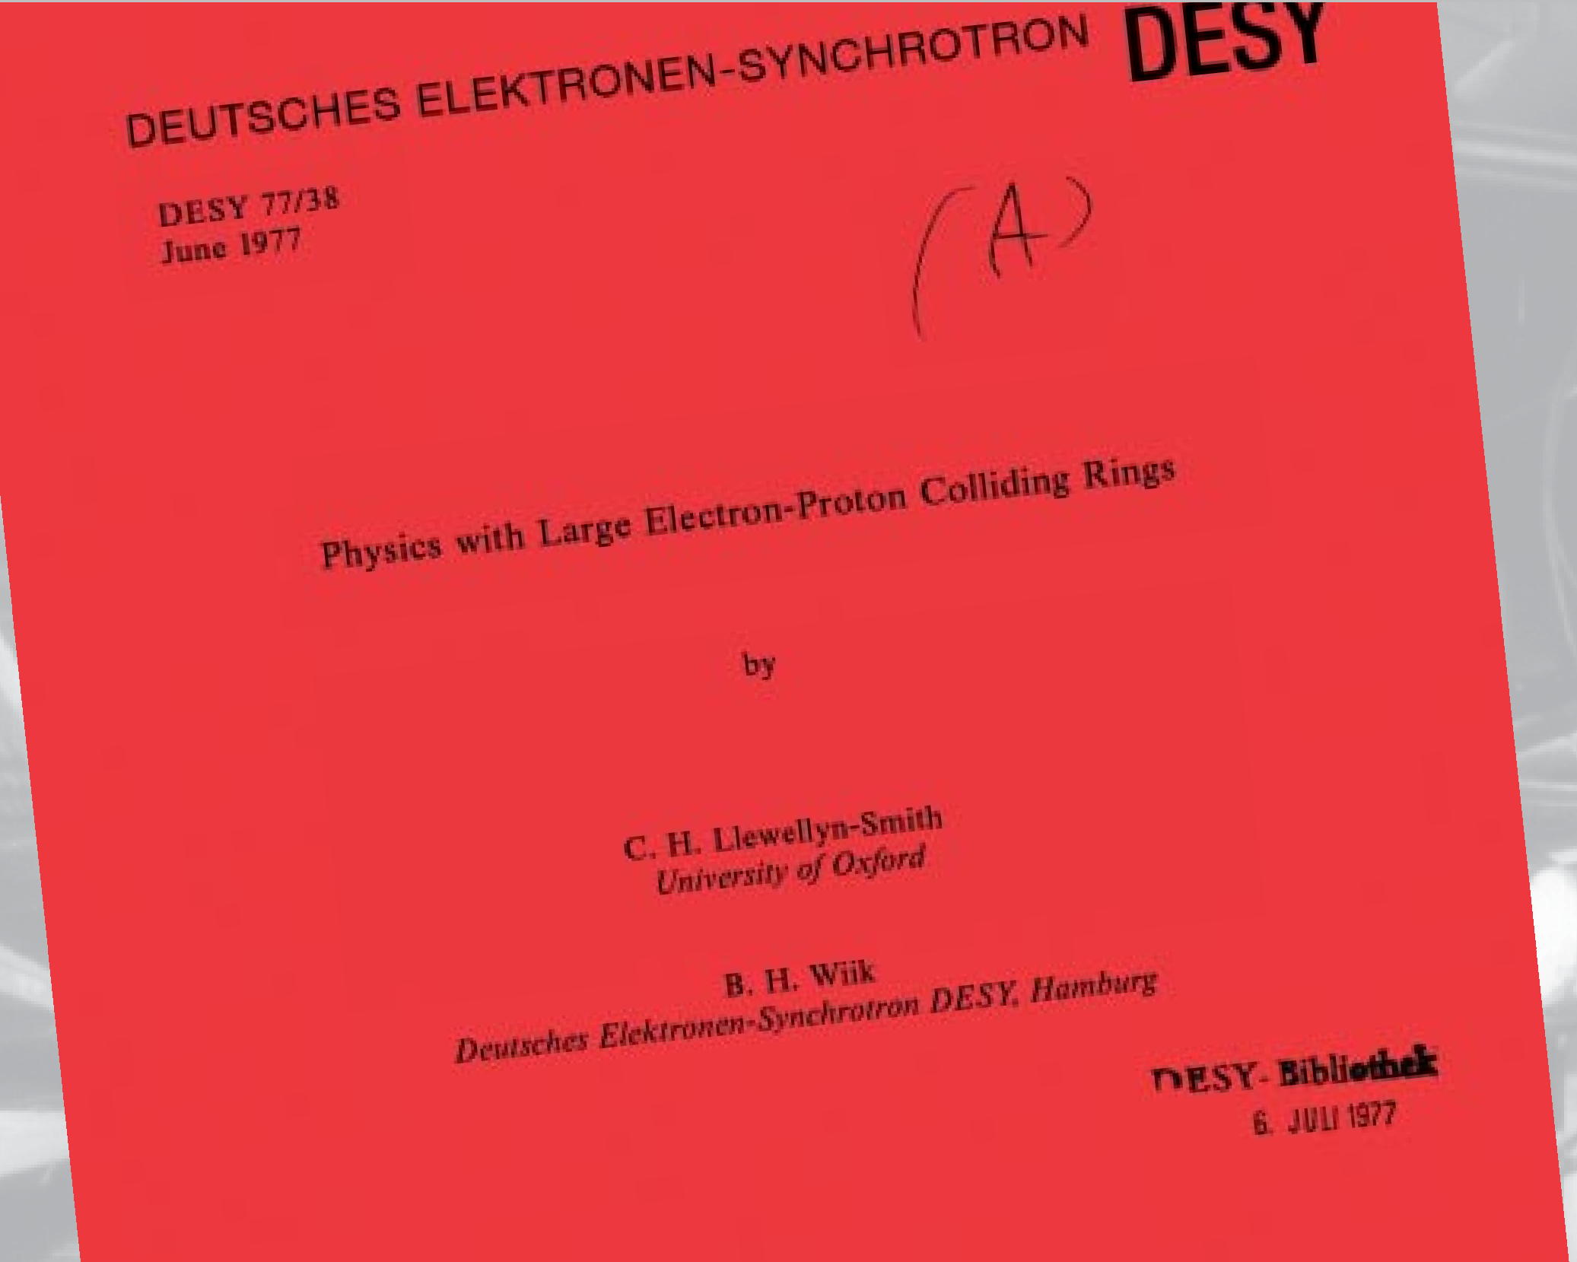
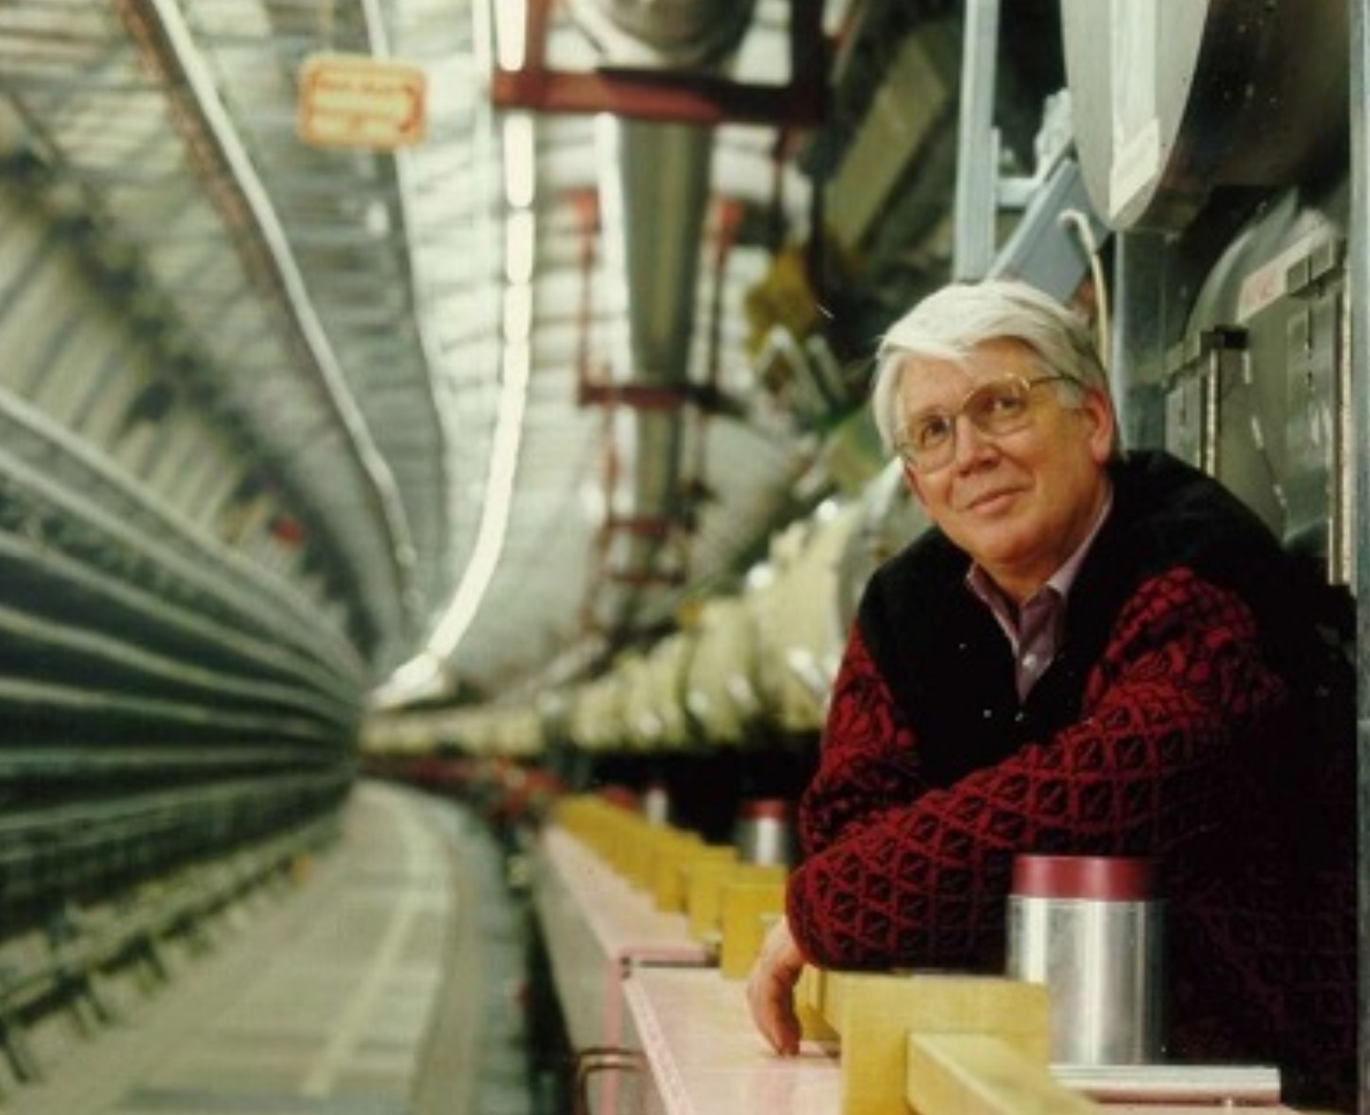
Ideas on Lepton-Hadron Colliders as early as 1972

Slide 4
HERA-Model
1984: Start Construction of the 6.3 km long Collider facility in a 20 m Underground Tunnel
HERA was only possible with strong in kind contributions to the accelerator:
The total project cost was about 700 M€ (~ 2 Billion^{*)} $ escalated to 2025).
The civil construction of the 6.2 km long tunnel 20 m underground, including four 7-story underground halls for equipment and experiments plus some above-the-ground service building was about 150 M€ which was paid for by the German Government.
About 1/3 was contributed in-kind accelerator equipment by international partners:
10 partners contributed half of the 400 superconducting 6T 10 m long dipole magnets,
half of the 400 1.8 m long quadrupole magnets 76 T/m,
all superconducting quadrupole-, sextupole-, and decapole-, and do-decapole correction coils,
three 52 MHz RF systems
superconducting current feeds,
design of the DESY-II Proton Synchrotron
contributions to labor for vacuum systems,
contributions to labor for magnet measurements,
contributions to beam instrumentation and
short sample measurements of the superconducting Rutherford cable
2/3 of the equipment and labor cost was provided by the German Government
This Partnership is referred to as the “HERA Model”
*) these are no official numbers but rough estimates

Slide 5
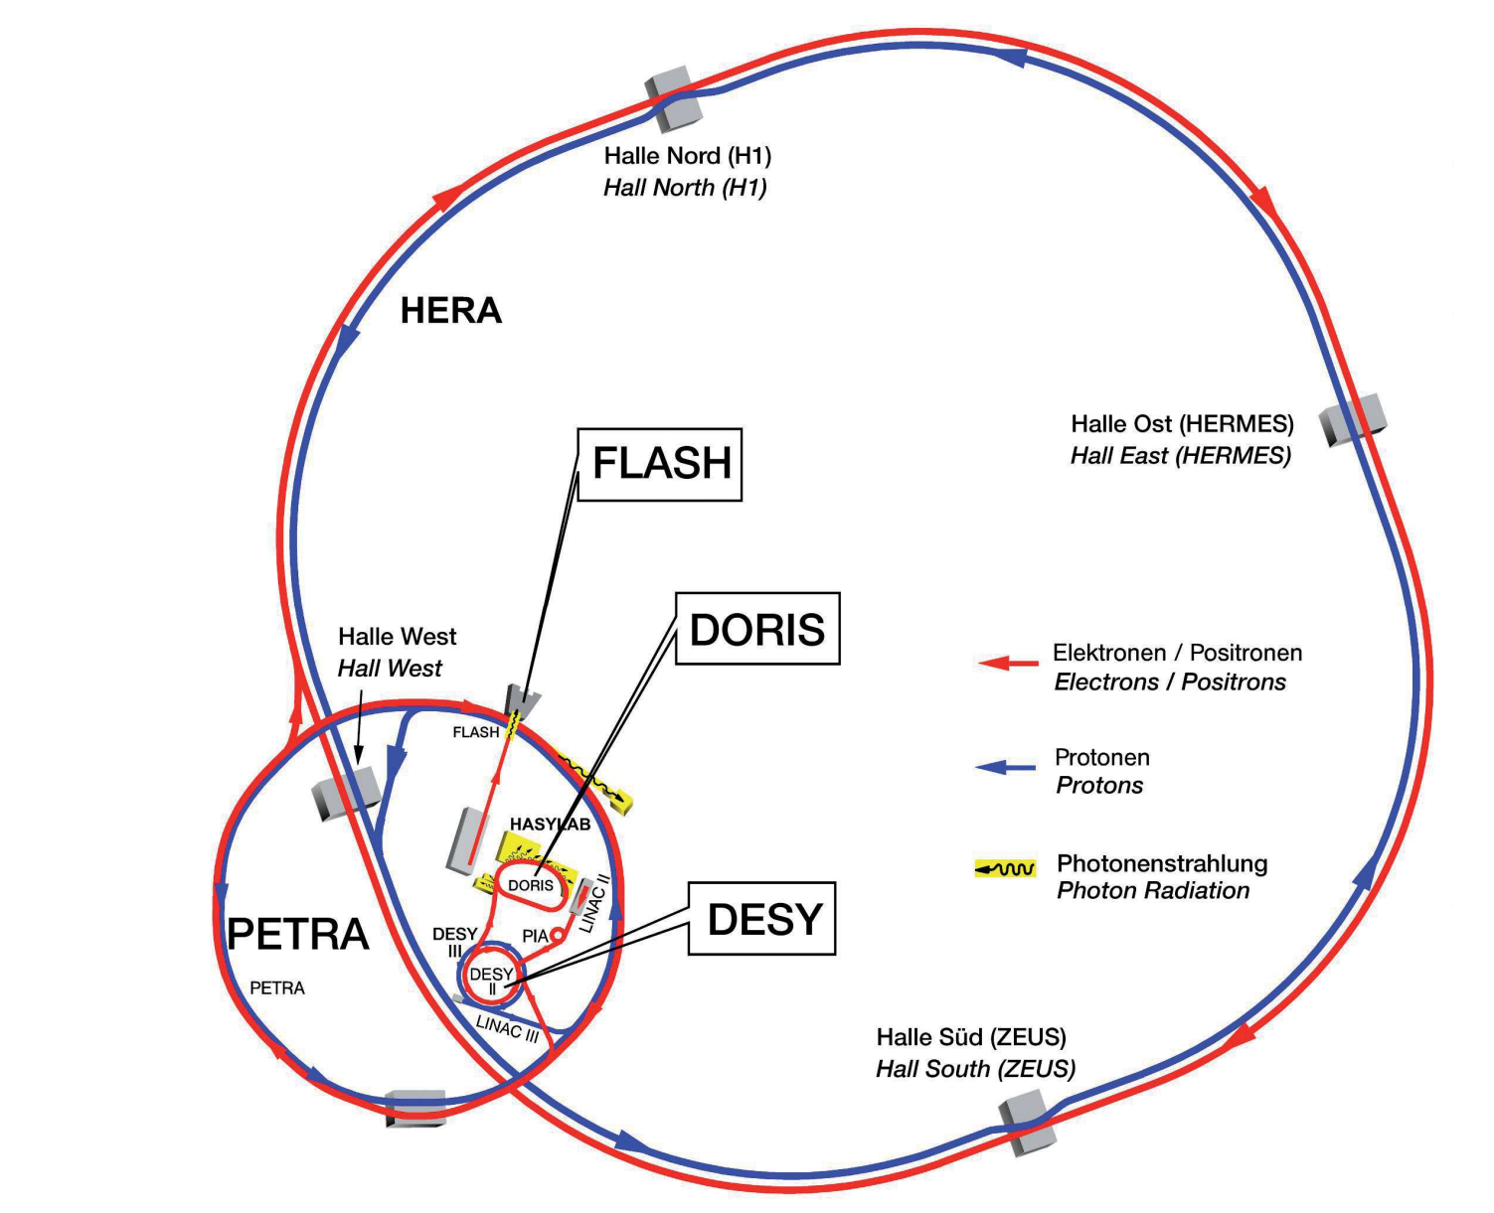
HERA
Provided collisions with 920GeV p beams and 27.5 GeV longitudinally spin-polarized lepton (e+/e-) beams for colliding beam experiments H1 and ZEUS.
Two 6 km circumference rings in underground tunnel (20m). Proton ring with superconducting magnets, lepton ring with superconducting RF.
Luminosity: 5.4 10³¹ cm⁻²s⁻¹ simultaneously at two experiments respectively
Longitudinally Polarized Electrons provided to fixed target experiment HERMES
Protons also provided to fixed (wire) target detector HERA-B

Slide 6
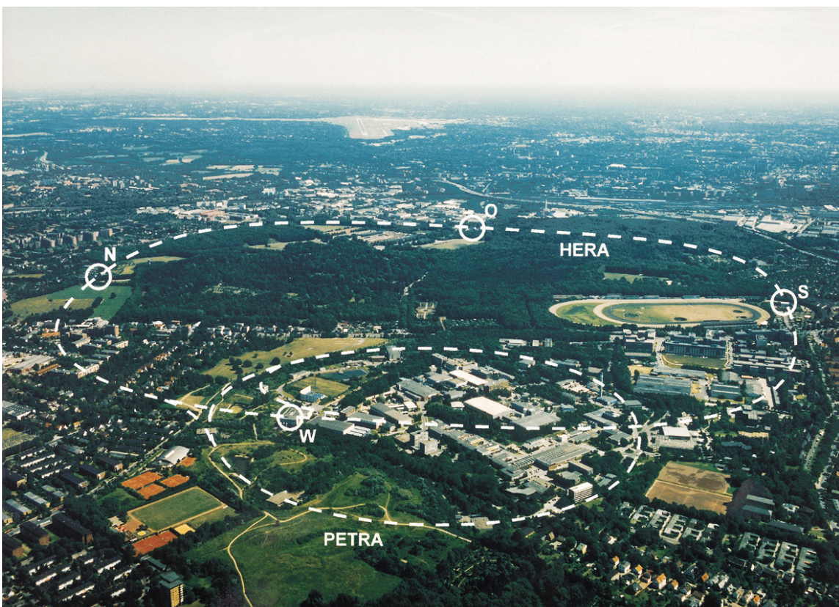
HERA Overview
HERMES
H1
ZEUS
HERA-B

Slide 7
HERA Physics Case and Motivation
Original (highlights):
Experimental proof of electro-weak unification
Systematic measurements of structure functions (PDF)
Is there a combined leptonic-hadronic state (Lepto-quark)?
What happens at very low-Bjorken–X?
Are there right handed W-bosons?
After HERMES experiment was added in 1995:
Resolving the proton spin puzzle
Generalized PDF …

Slide 8
HERA Chronology
HERA-I
1984 Construction Project authorized in 1984
1988 civil construction & electron ring complete
e-ring commissioning
1991 ep Commissioning Complete, first luminosity
1992 Start Operation for physics 820GeV p+ & 27.5GeV e-
discovery of the “dust problem” (no particle free
installation!)
1993-4 820GeV p & 27.5 GeV e+
1995 add HERMES IR and spin rotators
improvement of sc RF (bias voltage coupler)
1996 add HERA-B IR, 920GeV p – 27.5GeV e+
1997 exceed design luminosity 2∙10³¹cm⁻²s⁻¹
1997-8 e-vacuum upgrade, IP➔ NEG, add more RF power (2MW) & 8 RF Cavities
1998-2000 920GeV p & 27.5GeV e-/e+
productive runs > 50 pb⁻¹y⁻¹
HERA II
2000-2001 Luminosity Upgrade, Factor 2.5 H1 & ZEUS Spin rotator installed
s.c. IR magnets inside detector, focusing magnets much closer to IP
Synchrotron radiation from beam separation magnets passes through entire IR and is absorbed far (30m) from IP
2001 Fall Re-commissioning
2002-2003 Resolving Detector Background Issues
2004-2007 Productive luminosity runs >100 pb⁻¹y^{-1,} p-e+/e- ,long. Polarized leptons
Runs with varying proton energy: 450GeV-620GeV (F_{L})

Slide 9
HERA Collider Parameters^{*)}
Parameter Symbol/unit Design Value Achieved
Protons per bunch N_{p} / 10¹¹ ¹
Beam Energy E_{p} / GeV
Normal. proton emittance ε_{N} / μm
Proton b functions β∗_{y,x} / m
Leptons Current I_{e} / mA
Lepton emittance ε_{e} / nm
Number of coll. Bunches n_{b}
e vert. bb tune shift/ip Δν_{ye}
hor./vert. beam size at IP σ_{x,y,p,e} /μm
specific Luminosity L_{s} /10³⁰cm⁻²s⁻¹mA⁻²
Luminosity / IP L /10³¹cm⁻²s⁻¹
Number of IPs
*) these are the parameters of HERA II after luminosity upgrade
0.85
920 920
20 (15-20)
0.18, 2.45 0.18, 2.45
58 50
20 20
174 174
0.045 0.050
114 x 30 112 x 25
1.8 2.
7 5.4
2 2
Center of mass energy:318 GeV
Total vertical Beam-Beam Tune shift e: 0.1
Note: Total vertical bb tuneshift Δν_{y}= 0.1
like ESR!

Slide 10
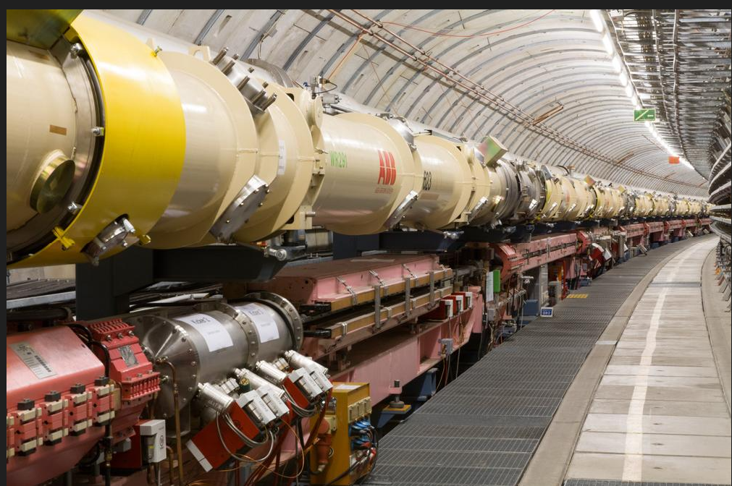
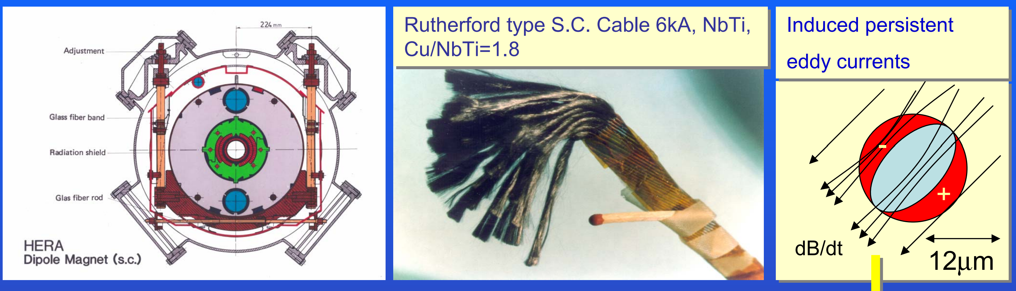
HERA Accelerator Lattice
Circumference 6.3 km
Number of 10 m long dipoles 400 in each ring
Four straight sections ~300 m
Protons 920 GeV
SC Magnet operating bend field: 5.04 T (p),
FODO lattice, 90 degree, cell length = ~50m
Electrons 27.5 GeV
FODO lattice, 72 degree, cell length = ~25m
120 MV RF voltage10 MW RF power
HERA s.c. magnet
B=~6T, ap = 55 mm

Slide 11
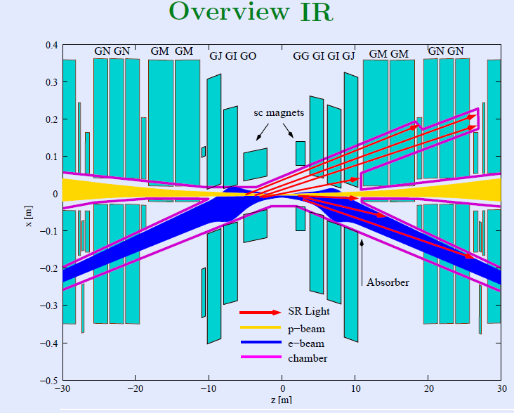
Detector
Magnetic Separation exploiting different e and p rigidity
Symmetric
“c-bend” scheme
s.c. Separation magnets inside detector
80k beam
pipe
TOP VIEW

Slide 12
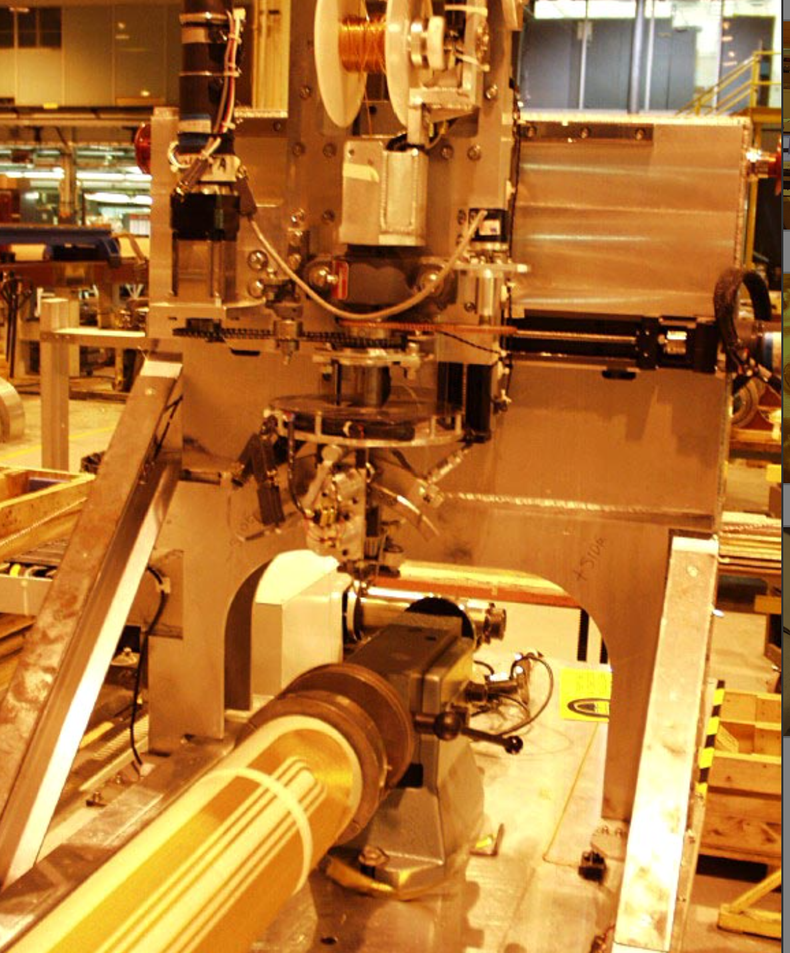
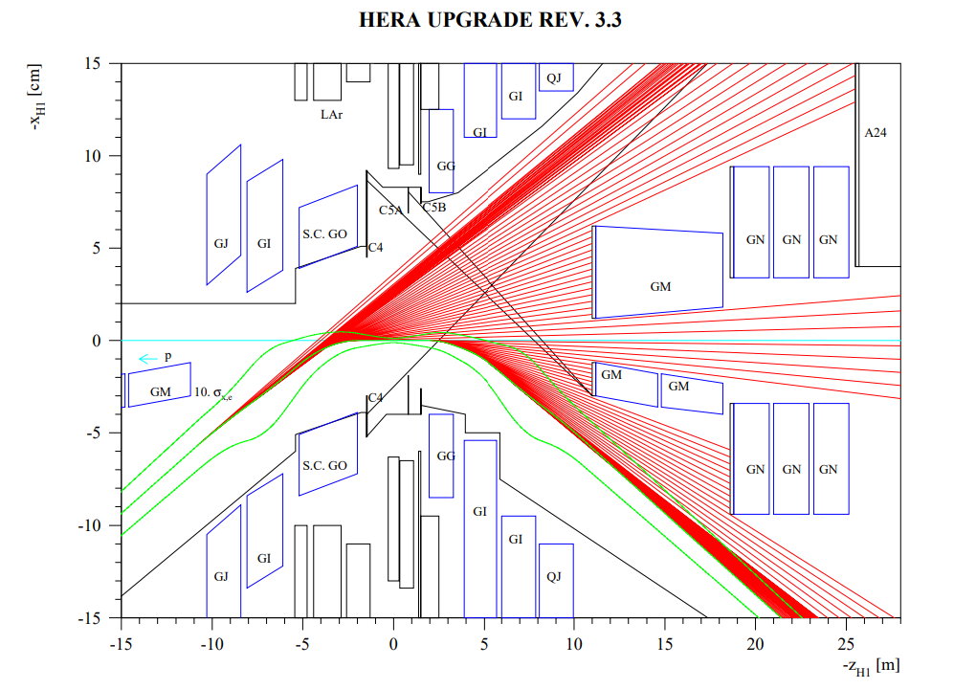
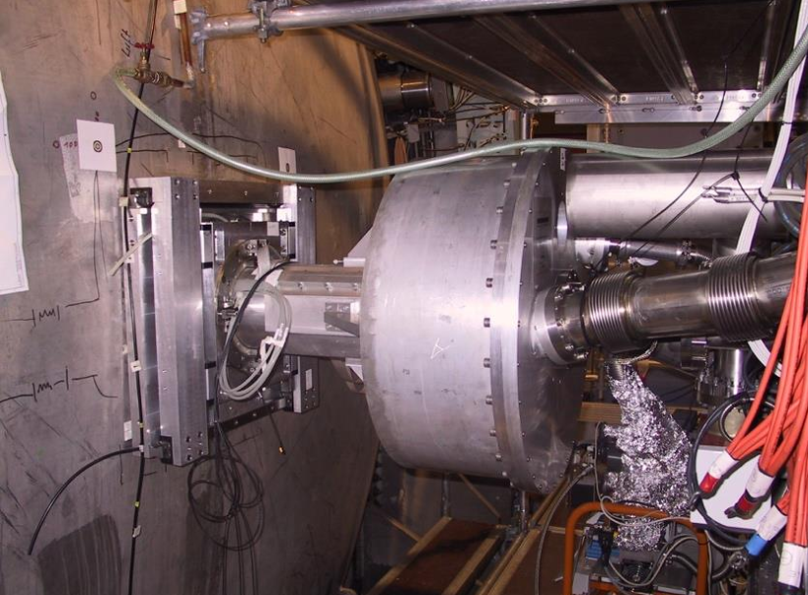
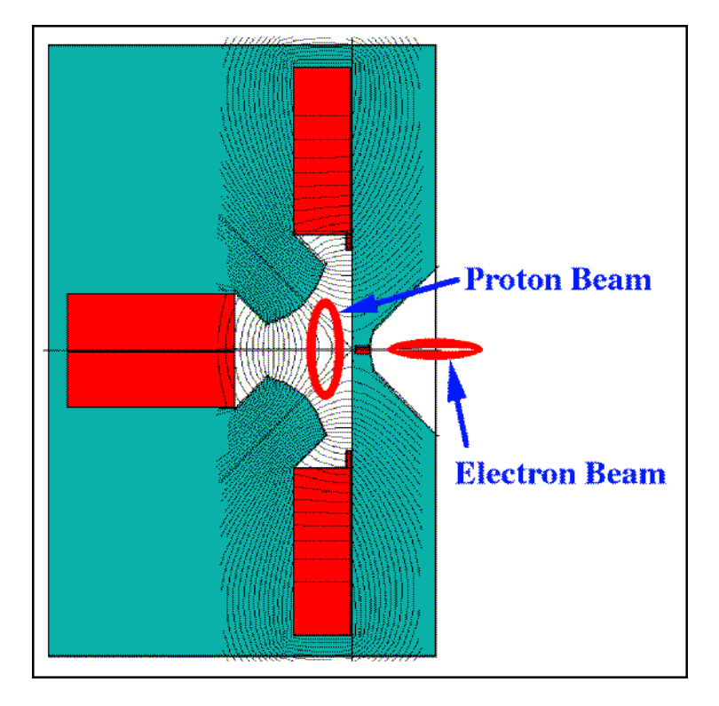
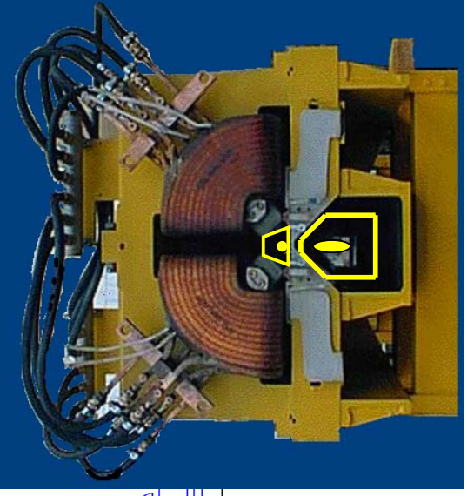
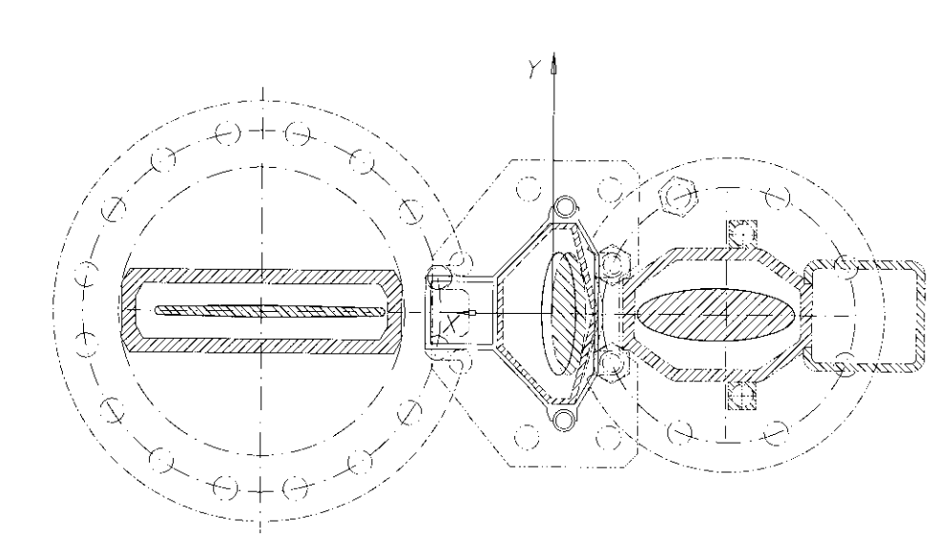
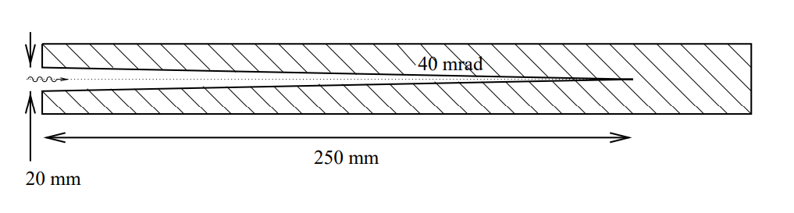
IR Design
Superconducting magnets for e focusing & beam separation integrated into detector vacuum
Synchrotron radiation generated in upstream beam separation passed through detector and forward magnet system to be absorbed far from IP
All proton final focus elements normal conducting, 1st quadrupole half quadrupole
Half quadrupole + cut-out mirror plate
Superconducting direct wind magnets (built at SMD BNL)
Installed inside detectors
Synchrotron radiation from magnetic beam separation passed through detector beam pipe
“Crotch” absorber

Slide 13
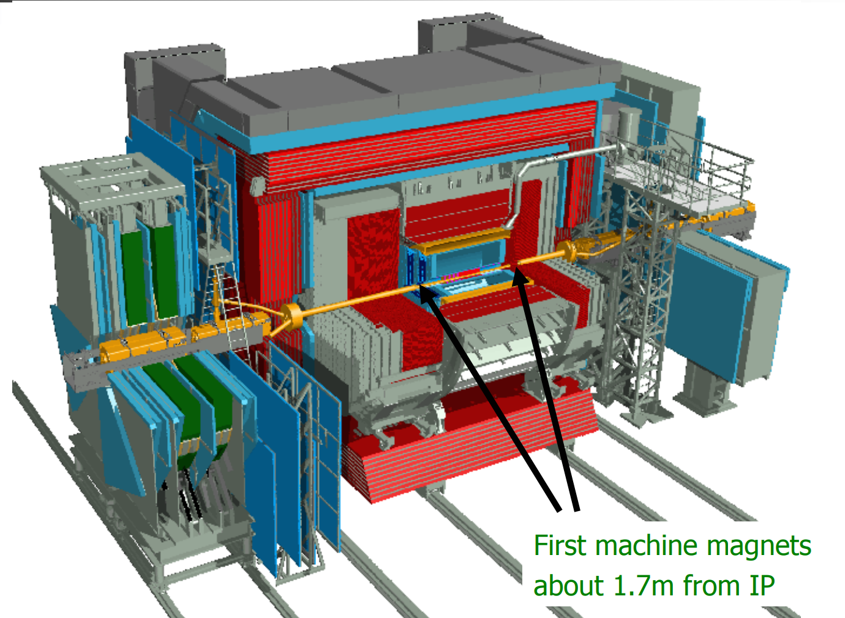
Detectors with Accelerator Magnets Inside

Slide 14
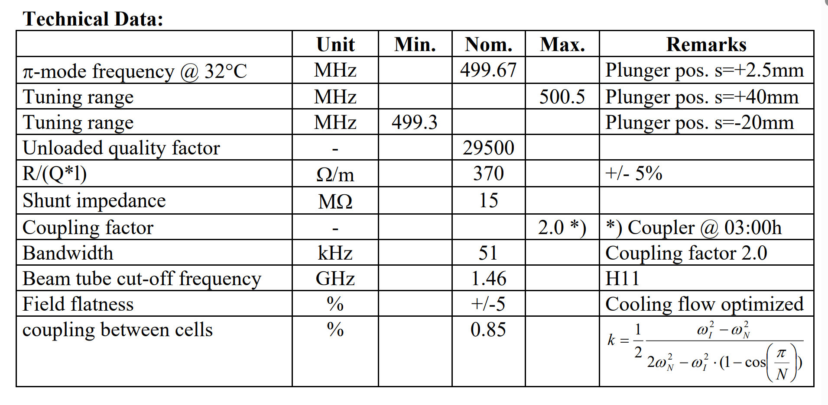
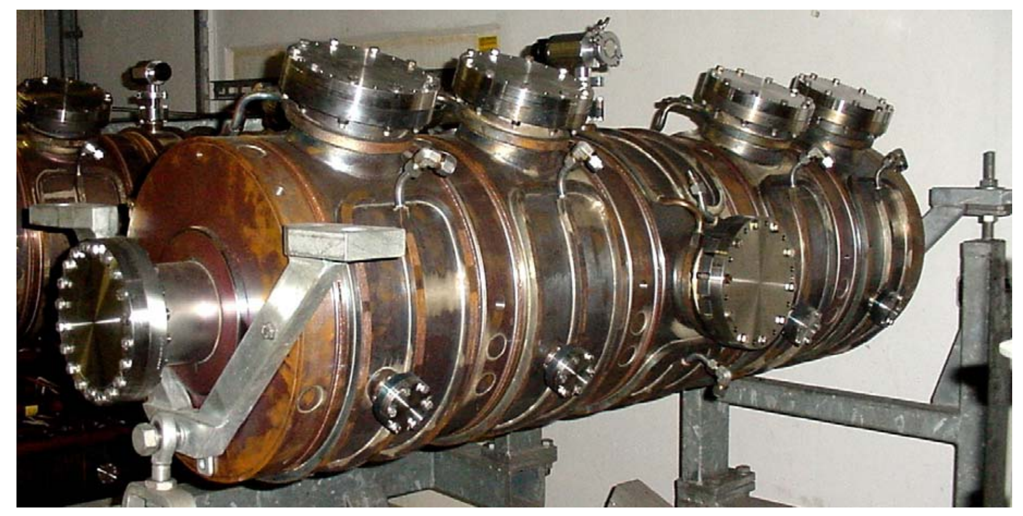
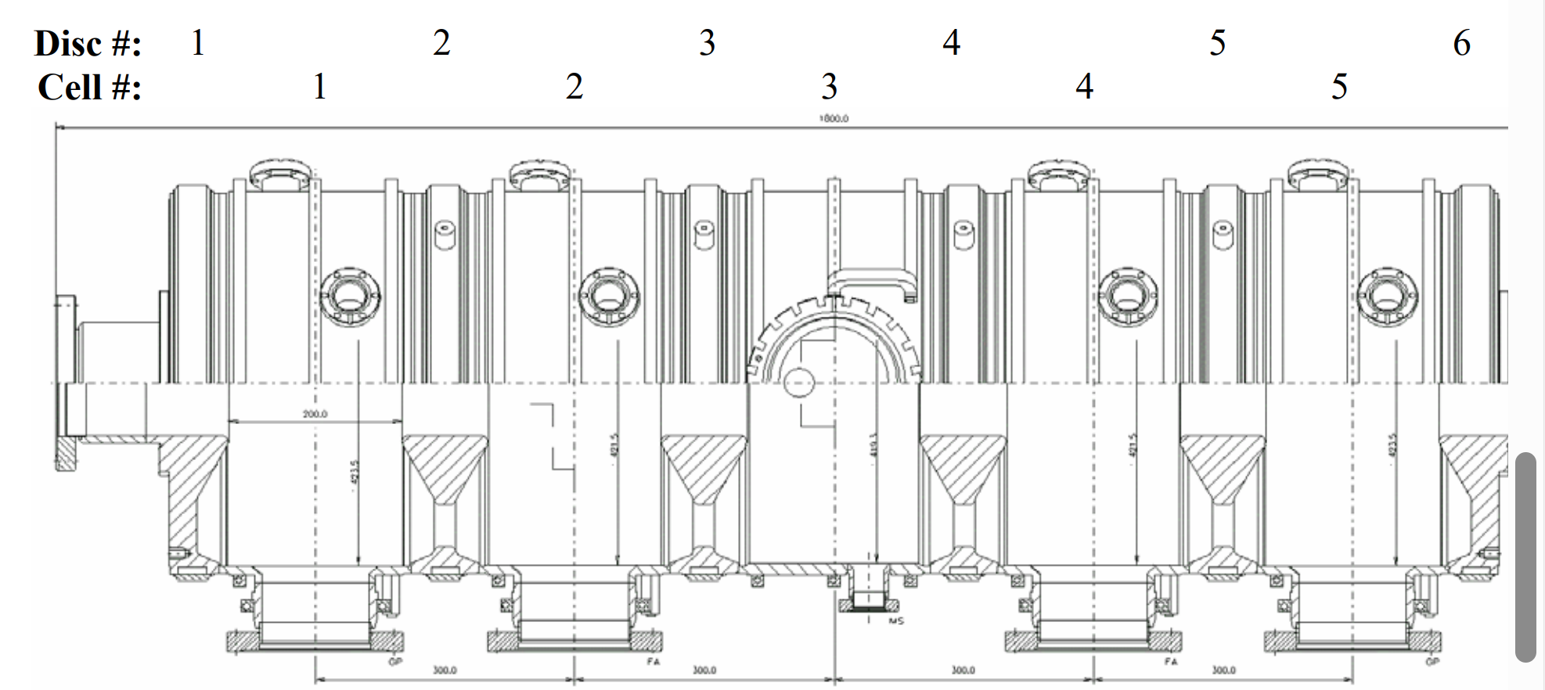
HERA RF System
For 27.5 GeV, needed ~120 MV of RF voltage and ~10 MW RF Power
To save cost, the 500 MHz 5-cell and 7-cell cavities were carried over from PETRA to HERA. These cavities were optimized for maximum voltage in an attempt to find the Top Quark with PETRA. 86 such nc cavities were installed in HERA. The had a rich HOM spectrum due to their re-entrant cell geometry and were not an optimum choice for a high intensity electron storage ring
RF Power:
7 (8) 2 MW 50 MHz klystron transmitters
In all 8 straight sections

Slide 15
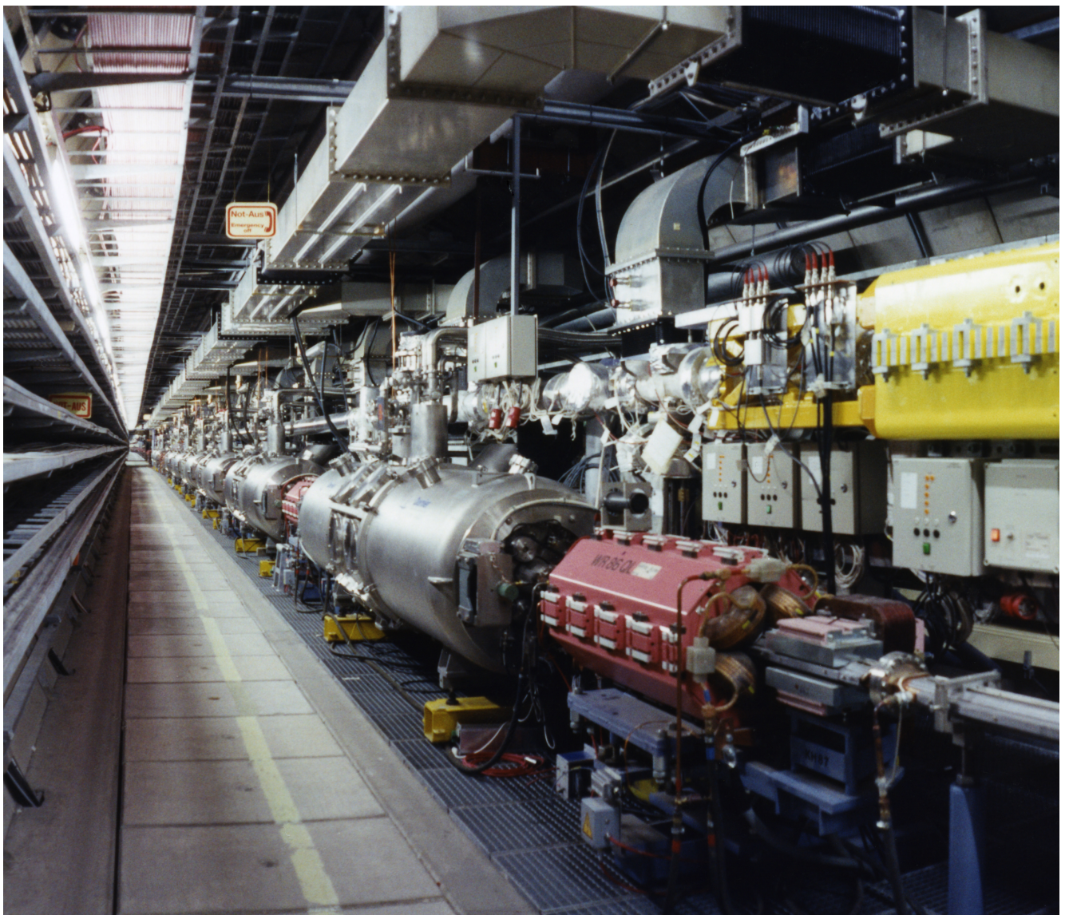
HERA Superconducting 500 MHz RF System
HERA had 16 4-cell 500MHz superconducting (4.5 K) cavities installed. Unfortunately, they all suffered from Q-disease so the accelerating gradient was very modest. Thus they acted as energy savers

Slide 16
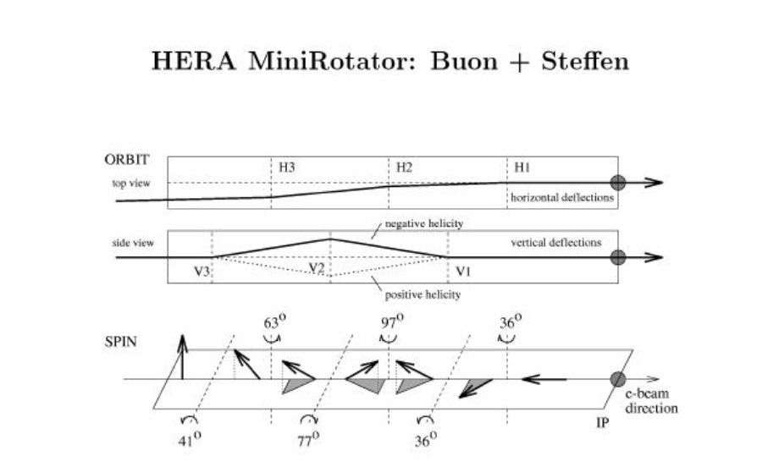
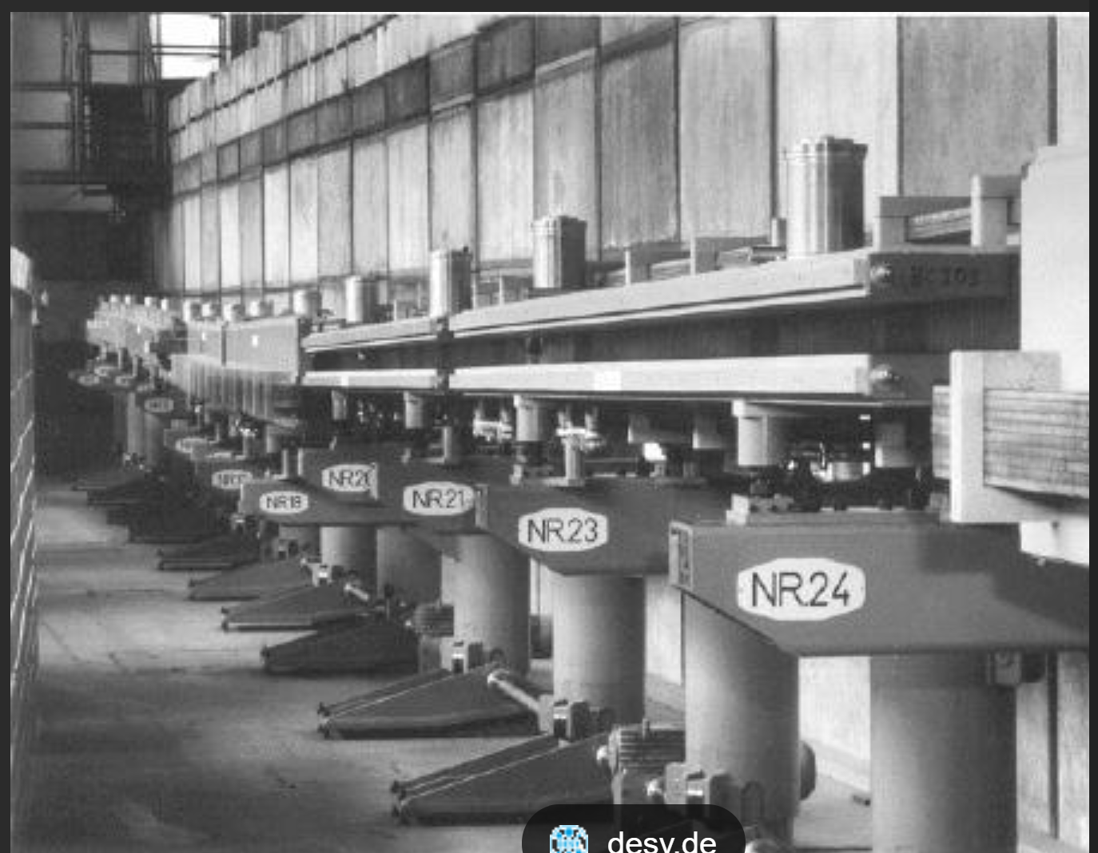
HERA Spin Rotators Around 3 Experiments
Mechanically moveable horizontal and vertical magnets rotated the spin from the vertical direction into the forward or backward longitudinal direction
The spin rotator had only horizontal and vertical bending magnets. The lowest possible was 27.5 GeV (limited by horizonatal beam excursion in the tunnel. This limited HERA achieveable lumunosity

Slide 17
Operations 1992-2007
No major problems to turn-on machine
HERA commissioning went quickly (less than 5 months)
No surprise with e-p collisions, The HERA concept each beam experiences what it would experience with an equal collision partner
Specific luminosity according to design values
Spin rotators installed for HERMES in 1995, e-polarization up to 70% (60% in operations)
However, after 1992, the start up of operations, the first years of HERA were hard:
The proton accelerator chained was optimized during HERA operations
The HERA tunnel and electron ring were completed in only 4 years after project start in 1984, but the quick progress had its price: There was dust in the vacuum chamber, that ionized by SR was pushed by the Integrated pumps into the beam➔ τ_{beam} ok until I_{beam} ~3 mA, then τ_{beam} only seconds ➔ operated with e+
The RF cavities were pushed too hard and frequent discharge limited progress with e beam intensity
Reliability upgrade in 1997/8: an 8th klystron transmitter, bias voltage on sc cavity coupler, replacing all integrated getter pumps with NEG pumps: very productive runs in 1998/9, design performance reached
Luminosity upgrade in 2000
by rebuilding the two interaction regions with s.c. magnets in detector to boost luminosity to 5.4 x 10³¹cm⁻²s⁻¹

Slide 18
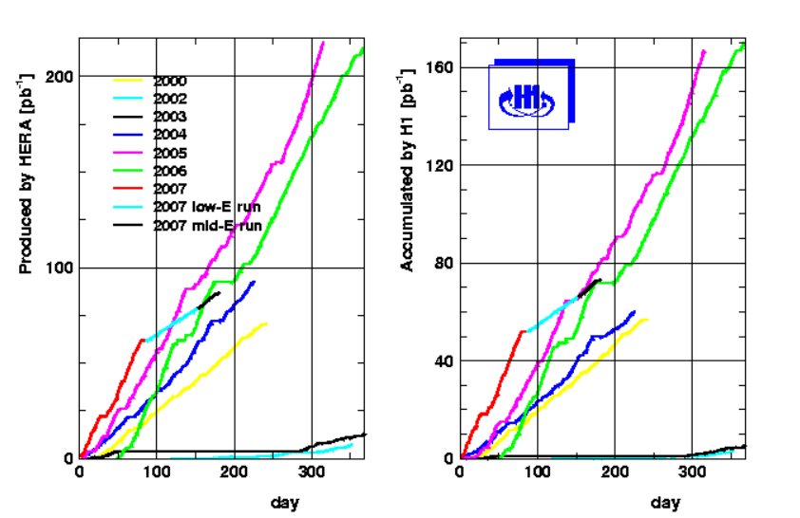
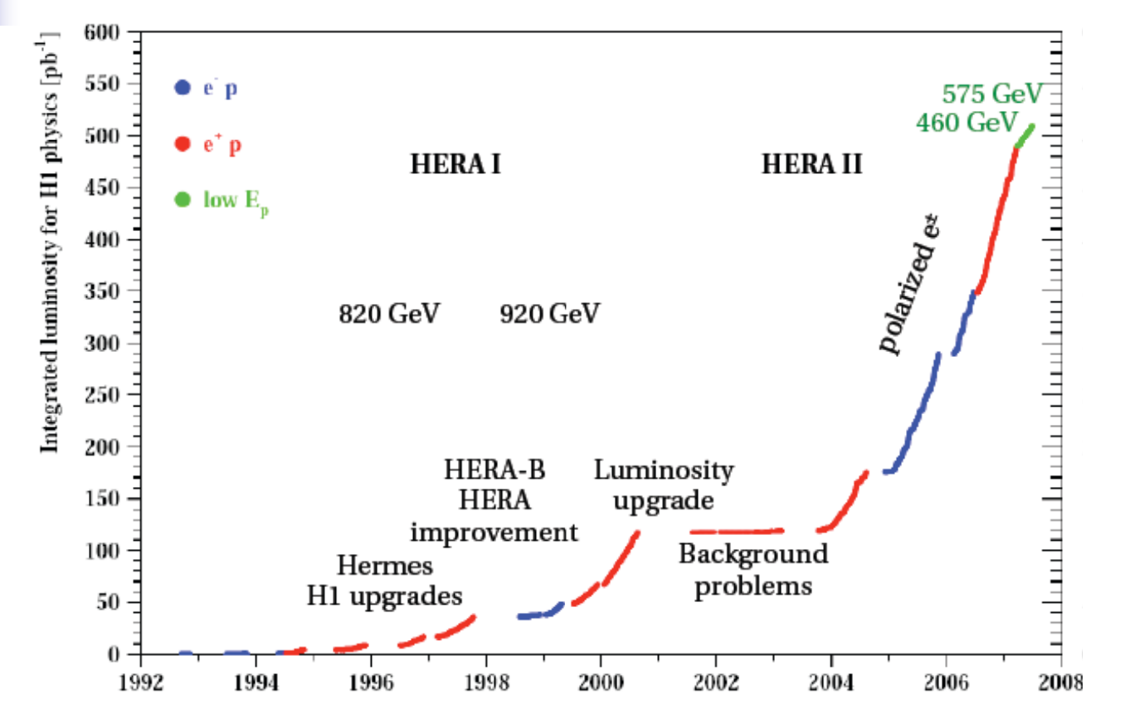
HERA Luminosity Production
Low p-energy
runs

Slide 19
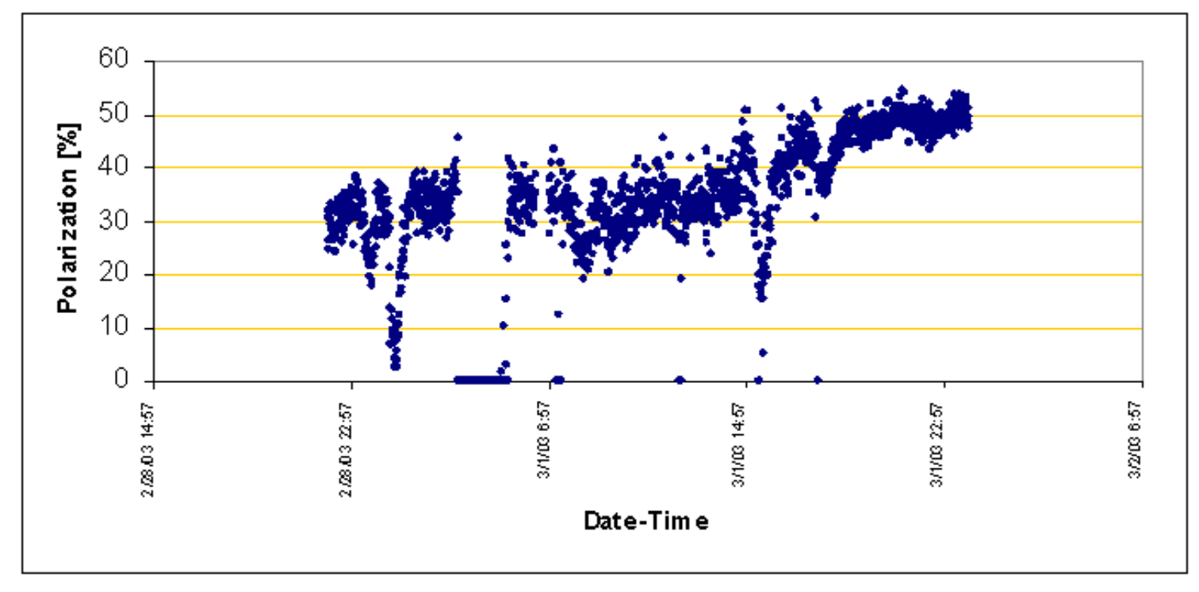
Beam Polarization with 3 Rotator Pairs
Polarization Tune up

Slide 20
Experimental Backgrounds
After luminosity upgrade in 2000, the brand new vacuum system in the IR’s
was exposed to full beam currents
background levels and detector occupancy huge which improved slowly over time
The concept of SR radiation passing through IR and down stream low-beta quads
Worked well but …. Only if the collimation of backscattered protons from the crotch
Is properly designed and built
Pumping in the detector was not sufficient and required upgrading pumping
The s.c. machine magnets in the detector with 80K beam pipe helped a lot but
Initially this cryopump saturated quickly ➔ IR magnet was frequently warmed up with subsequent drastic improvement of near IP vacuum
Vacuum in the downstream nc low-beta quads was 1 nTorr with full current

Slide 21
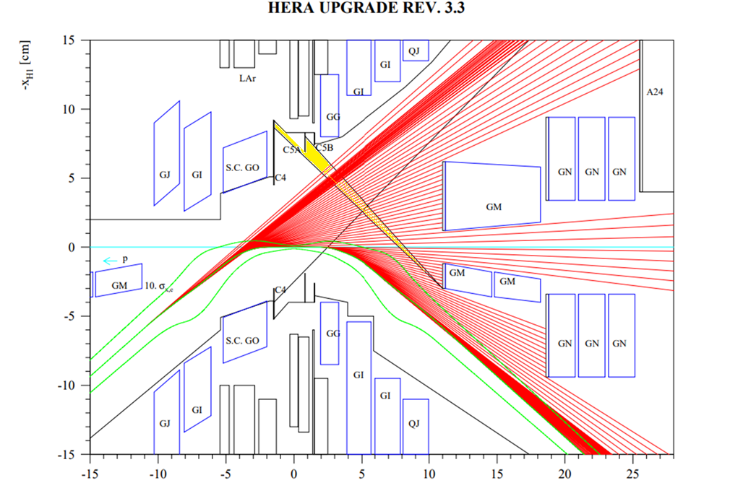
Faulty SR mask

Slide 22
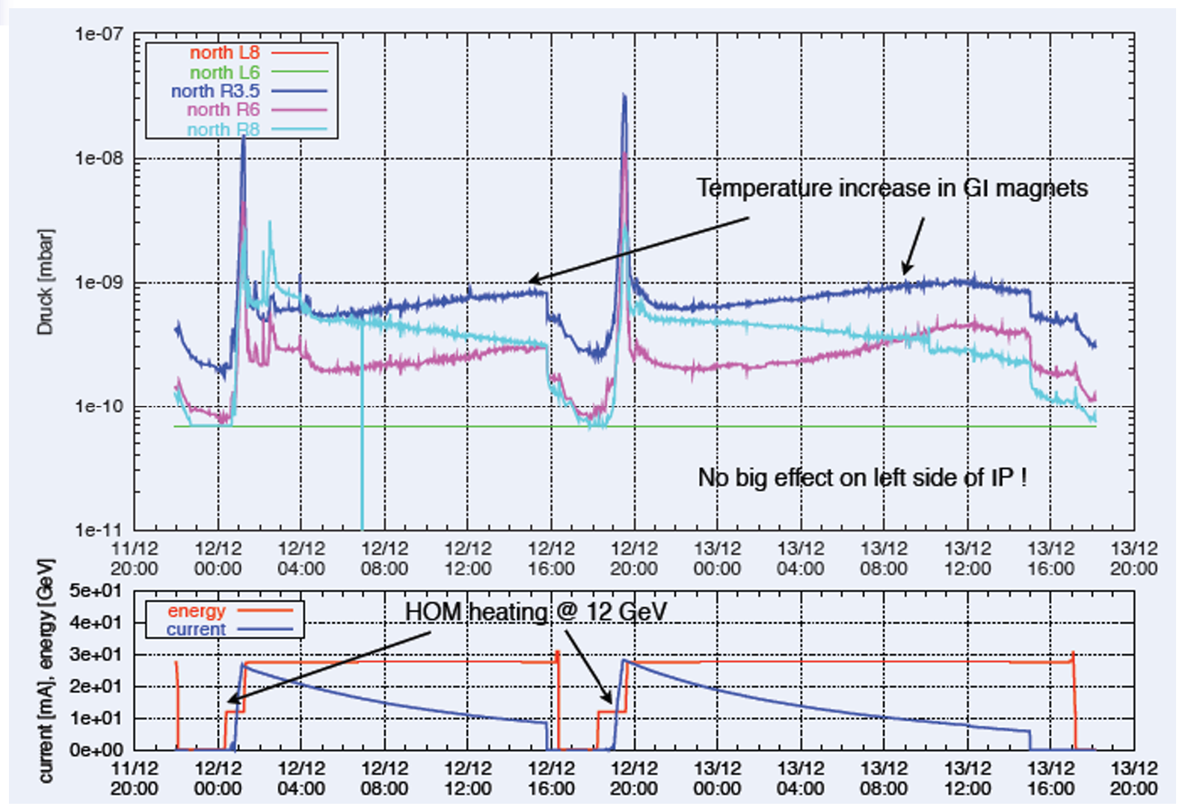
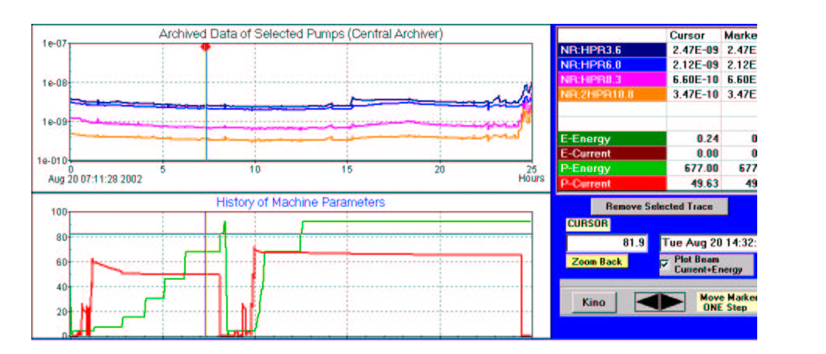
Vacuum Pressure in the Interaction Region
Vacuum pressure with full beam current 1 nTorr
Pumping: NEG, Ion pumps TSP, and Cryopumps (80K beampipe in SC IR magnets)
Vacuum IR magnets
Inside H1 detector
IR nc magnets

Slide 23
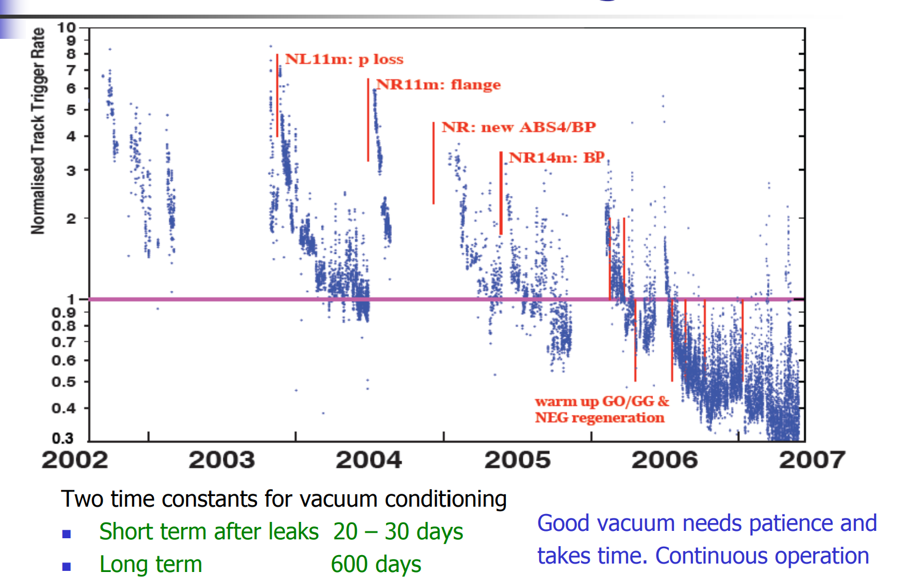
Slow improvement of IR vacuum

Slide 24
Conclusions for EIC Backgrounds
Good pumping of the detector beam pipe is essential
Detector Beam pipe need to be degassed (hot N₂ gas?)
Start beam operation with small and modest currents as early as possible
Cold beam pipes around the IP are helpful but might have to be warmed up frequently duing early operations
Design of masks against backscattered SR photons and Bremsstrahlung from the luminosity monitor exit window and from the conversion target is crucial (maybe e tagger as well)
Radiation hard design of μ-vertex detector
Collimation of proton beam is very important: 2-stage collimation with collimation in both planes
Be prepared for tedious empirical p-beam tuning (tunes, chromaticity, linear coupling) using Selected detector backgrounds as Figure of Merit
Accelerator reproducibility after injection cycle remarkably good (easy luminosity tuning)
Luminosity optimization with horizontal and vertical angle bumps
Beam oscillations were not particularly harmful (maybe different in EIC)

Slide 25
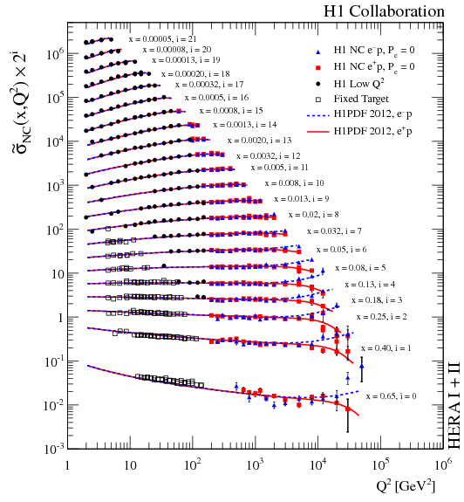
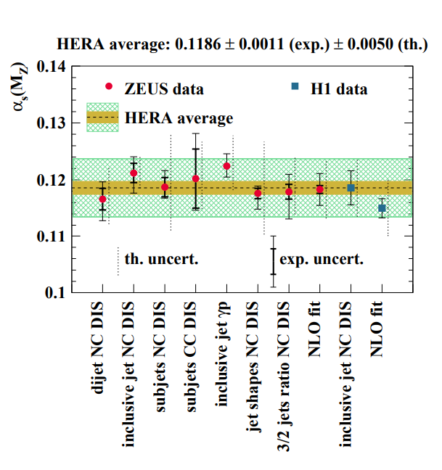
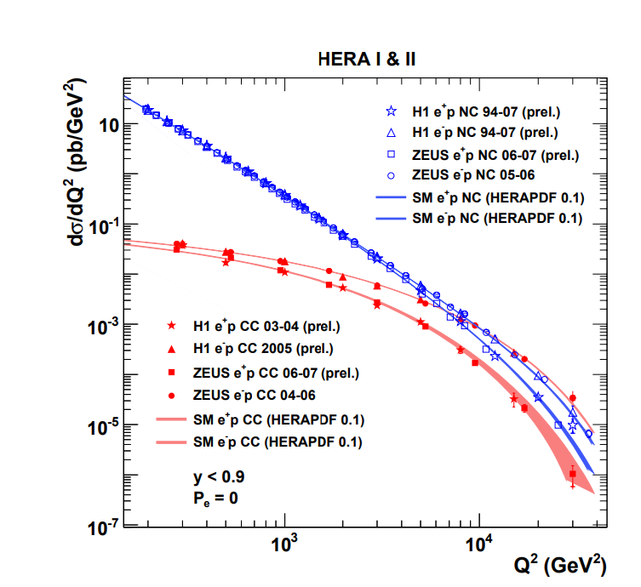
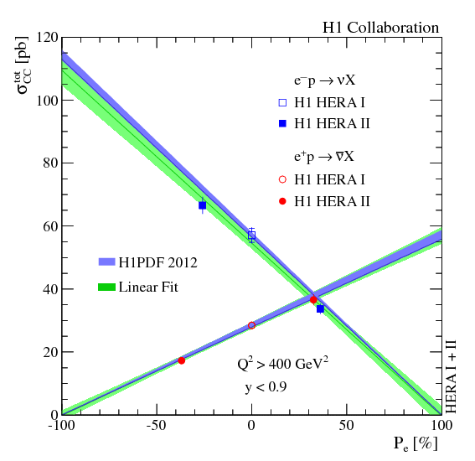
Some HERA Physics Highlights
Most precise measurement of α_{s}
(m_{W}c²)²
Bjorken Scaling invariance and strongly growing gluon density for low values of Bjorken X
No right handed W vector bosons!
Manifestation of electro-weak interactions: at scale of Q² ~m_{W}² electro-weak unification visible

Slide 26
Summary
HERA, was the first and so far only ep-collider
There were no new fundamental problem with collisions of completely different types of particles
Specific luminosity of HERA was as predicted. There were no major beam dynamics issues.
High luminosity was limited by electron current and RF power and the minimum electron energy of 27.5 GeV due to space limitations for the spin rotator
Detector backgrounds were critical and required extremely low vacuum prossure in the IR and careful hadron collimation
High availability had to be balanced against affordability and was difficult to achieve. Several investments (more installed RF power and more RF cavities etc) were crucial to improve availability
HERA’s physics results are a monument in experimental electro-weak physics and quantum chromodynamics and were important in evaluating LHC results.

Slide 27
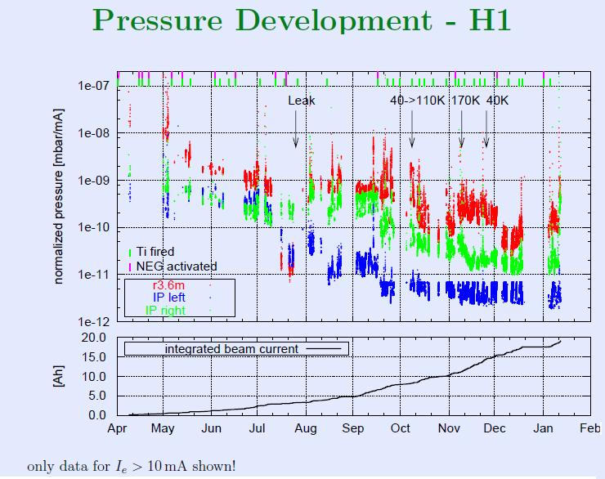
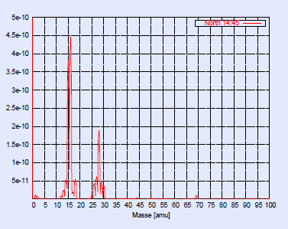
IR vacuum improving rapidly and in steps after warm up of sc. Magnets with 80K beam pipe
IR Pumping:
Distributed NEG
Lumped Ion pump
Ti-Subl.Pumps
IR Vacuum clean, minor traces of
Methane, HCN, Ethane after warmup
2002-2003

