Slide 1
Electronics and DAQ WG 8/14/2025
News / Announcements
DAQ PDR3 scheduled for Sept 3-4. Speakers should have been contacted already. “Full Slide Page Turn” August 25th.
Next week meeting?
Other Business?

Slide 2
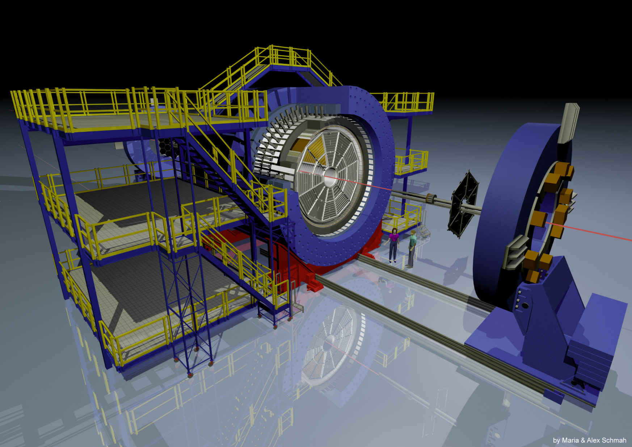
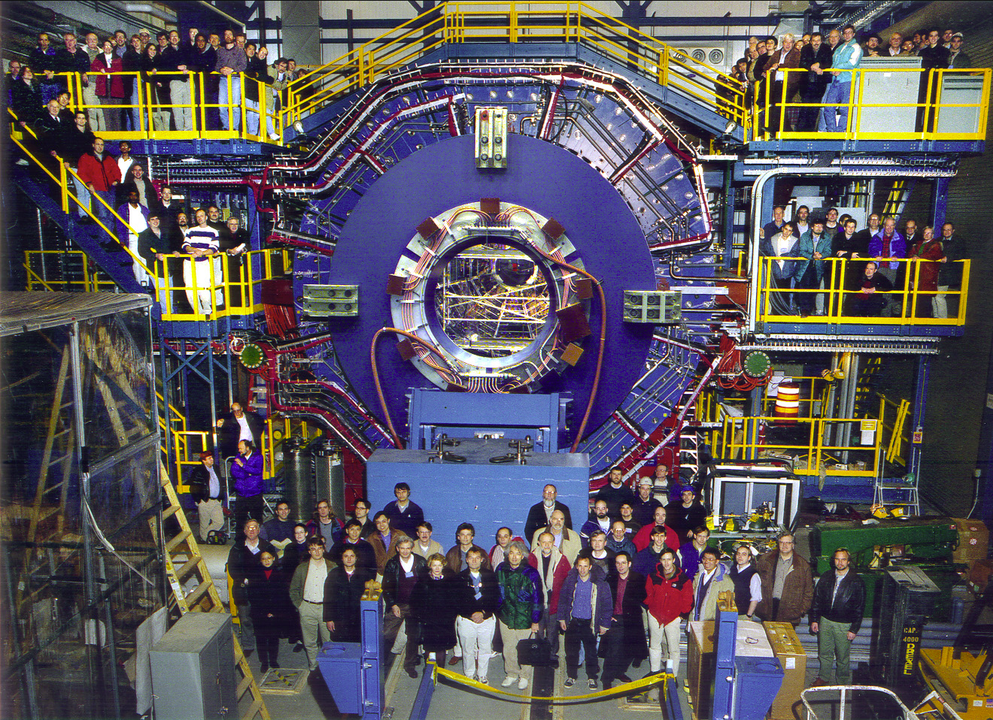
How much rack space do we need for RDOs, Networks, Fibers?
What are the details of the fiber Routing for the central detector?
What are the services we need for the platform electronics?

Slide 3
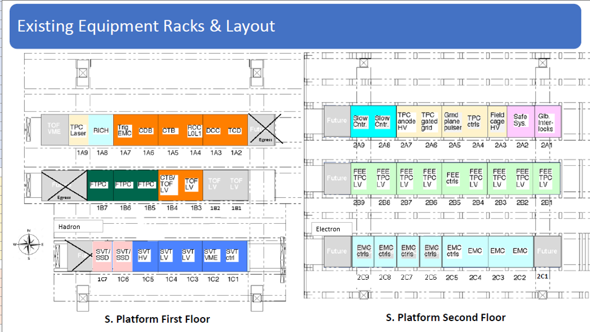
Tims Space Estimates for south platform Racks:
Tim’s Estimates:
STAR: 48 Racks Available
EPIC: 45 Racks Available
: 6/Row level level
: 7/row upper level
Fiber:
2 network racks, one on each level
RDO
SVT – 75u
EcalEndcapP – 2 x crates TBD
Potential Extra Space TBD
23 Racks used for itemized non-RDO electronics by Tim Camarda

Slide 4
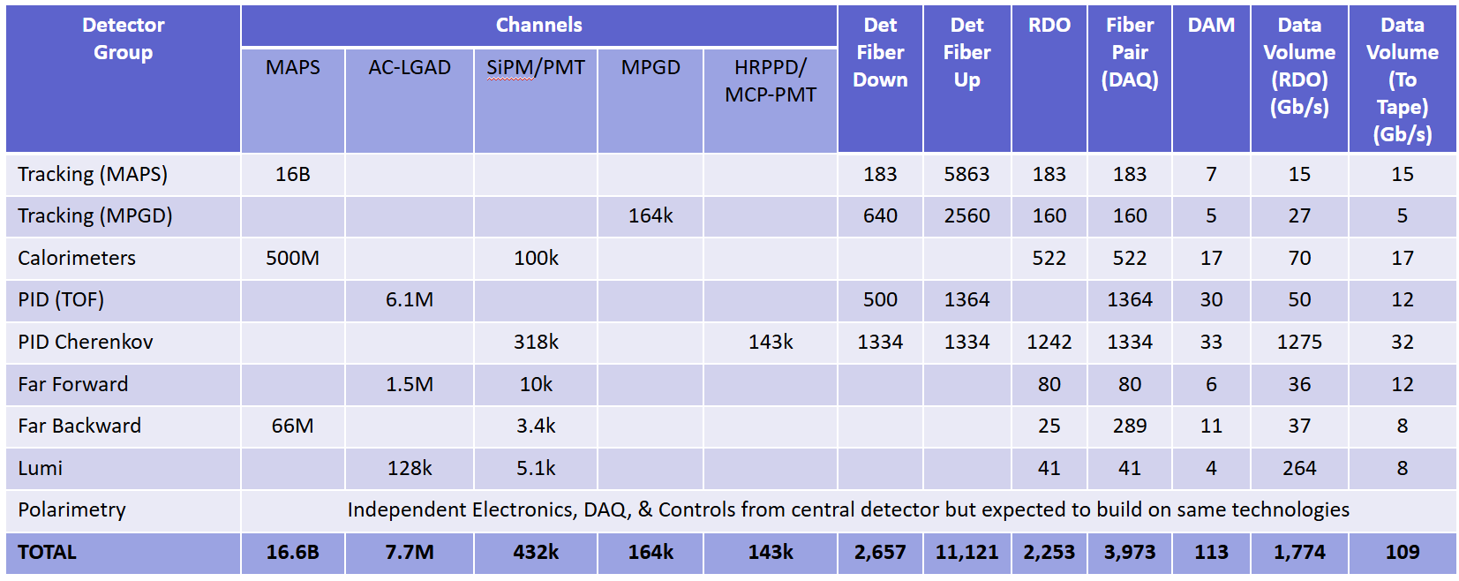
Number of RDOs On South Platform:

Slide 5





Number of RDOs On South Platform:
2088
Si Tracking → RDO 488 if 12:1 reduction
270 if 16:1 reduction
135 if 32:1 reduction
South Platform RDO: 865 – 1218
South Platform - DAQ Fibers: 3515 – 9243

Slide 6
Order of magnitude space required
South Platform RDO: 865 – 1218
South Platform - DAQ Fibers: 3515 – 9243
Assume 6u, 20 slot Crates, with 6 crates / rack
→ 44 – 61 Crates
→ 8 – 11 Racks
For Fiber: Assuming bundles run to South Platform
All fibers placed on single port 1u 48 port patch panels/w 40 panels/rack
→ 2 – 5 racks of patch panels
How much space needed for services?

Slide 7
Discussion:
What should the Packaging of the RDOs be?
What Services do we need? Is air cooling enough? Does it affect AC needs?
Our initial plan for fiber routing is:
Fiber Bundles from DAQ room terminated in patch panels at the South Platform
Individual fibers to be run from DAQ patch to RDOs
Individual fibers to be run from DAQ patch to detector patch panels for on-detector FEBs/RDOs
Is this reasonable? Should multi-fiber bundles be patched rather than single fibers? Some combination?

