Slide 1
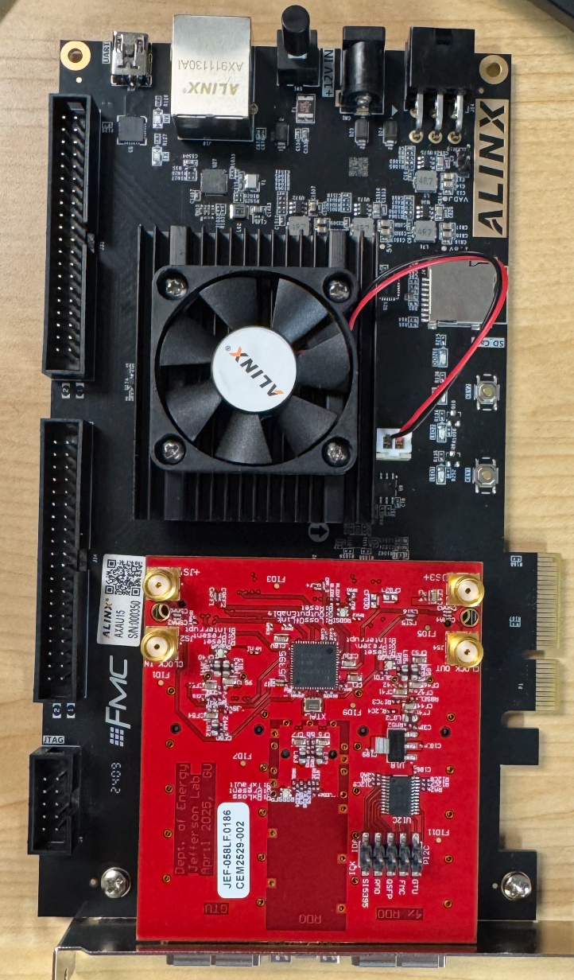
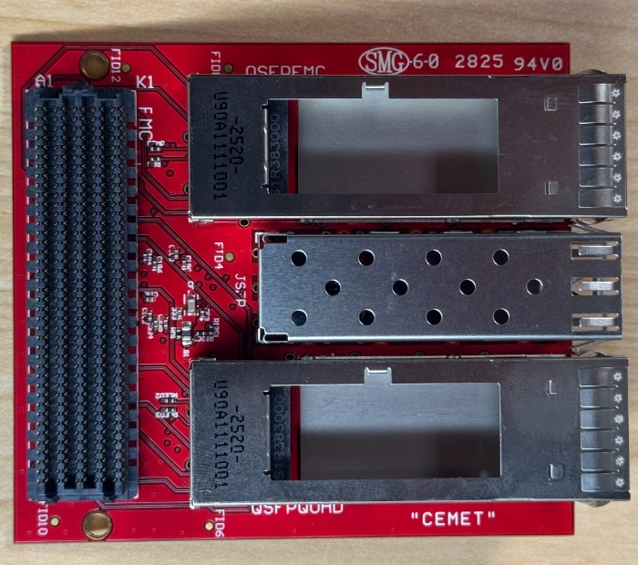
1. The FMC adaptor
20 pieces were received
Five pieces were tested;
Most of them do not have the SMA connectors and the I2C connector, so that the board can fit into single-width slots;

Slide 2
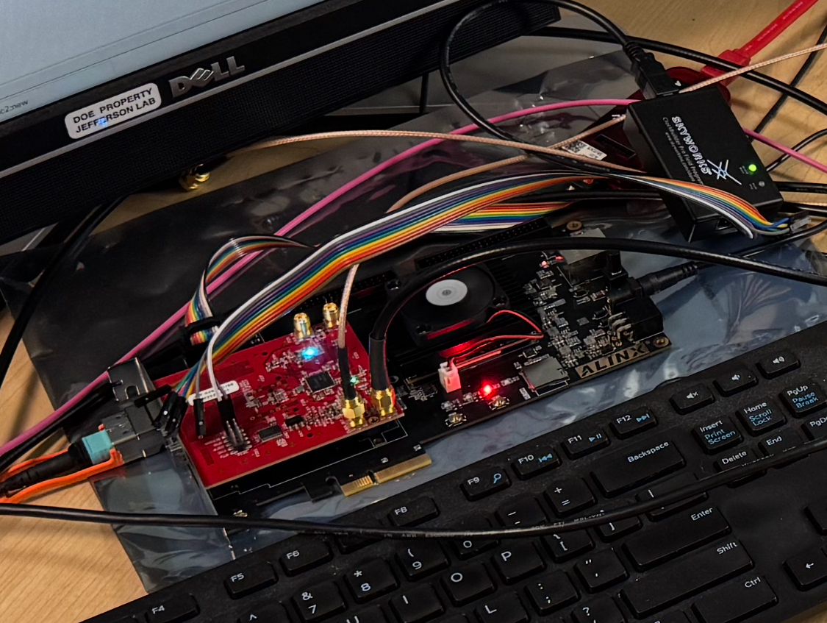
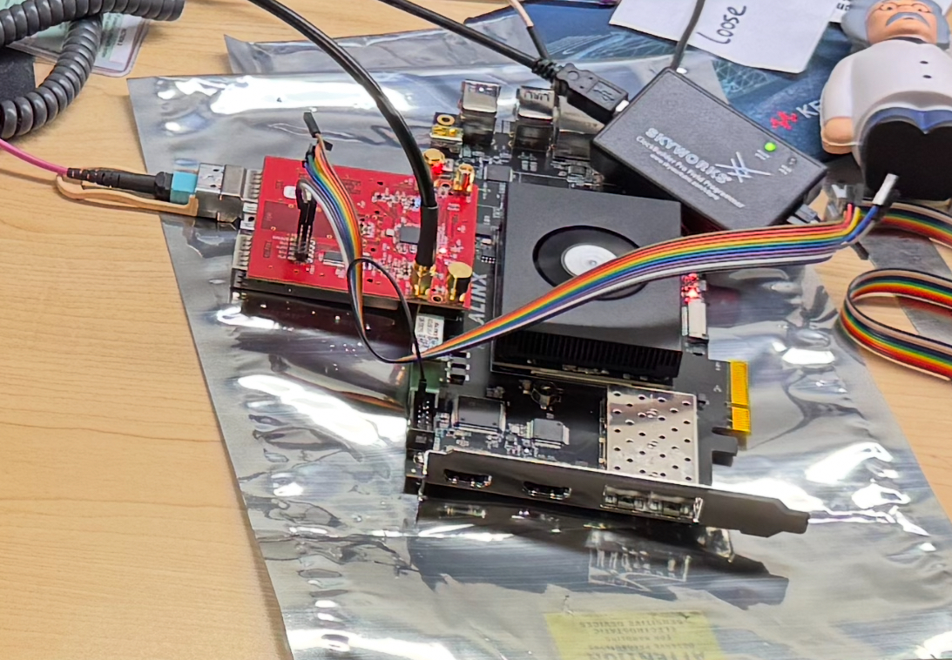
2. The clock test setup
This Si5395 is in “DAM” mode, with fiber input (19.7 MHz)
This Si5395 is in LOL_holdover mode, (system clock source)

Slide 3
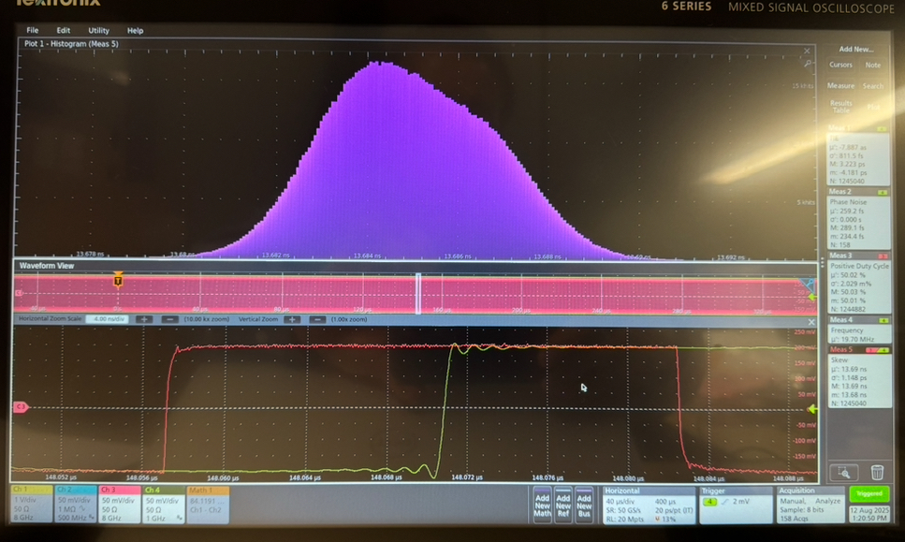
2. The clock test
The phase of the two Si5395 outputs:
13.6842 ns ± 1 ps
FWHM: ~5 ps
2 ps

Slide 4
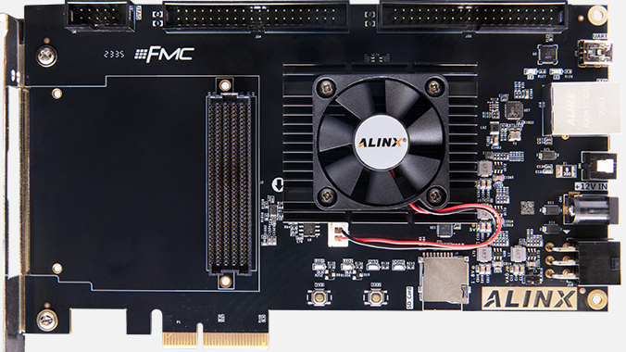
3. Some pico/micro/miniDAQ related information
The price of ALINX’s boards:
AXAU15: $556
The ACAU15 SOM ($334) is included.

Slide 5
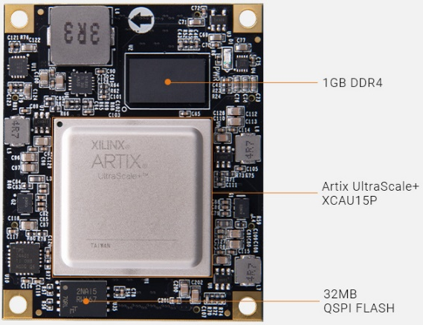
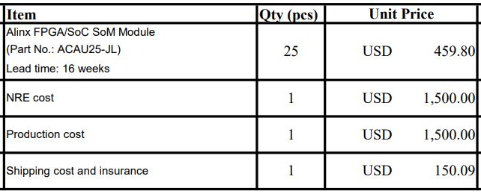
3. ACAU25-JL SOM
ACAU15: $334
AMD UltraScale+ Artix XCAU15P-2FFVB676I
XCAU15P
ACAU25-JL co-design
AMD UltraScale+ Artix XCAU25P-2FFVB676I
XCAU25P

Slide 6
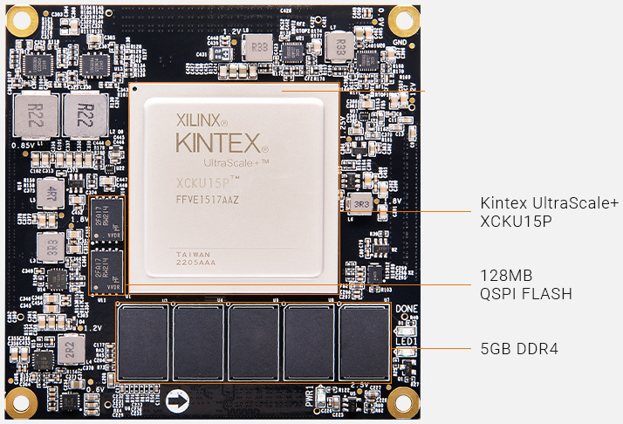
4. Fiber RDO thought
ALINK.COM price:
ACKU15$2781
AMD Ultrascale+ Kintex:
Xcku15p-2FFVE1517i
 | ACKU15 SOM | XCKU15P FPGA | ACKU11 SOM
GTH/GTP | 32/24 | 44/32 | 32/20
price | $2781 | $9K (A1760) (~$4K special) | ?
Aggregation capability | 52 : (1-4) | 72 : (1-4) | 48 : (1-4)

Slide 7
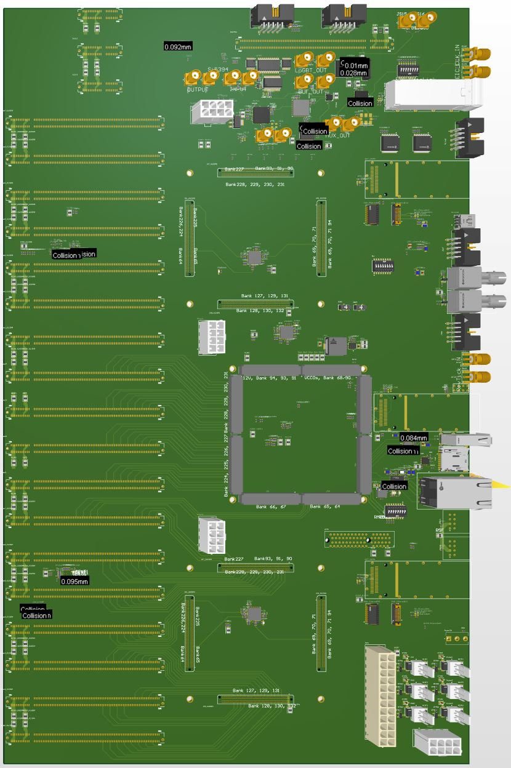
4. The FIBER RDO ideas
The GTU base board
EIC common platform inputs
GTU user interface (1000BaseT)
40 GBE
/ 4*RDO
2* DAM
Generic IO
Cooling fan (12V)
Clock (phase)
Monitor plugin
ATX power
+3.3V, +5V, +12V
AMD
ZU19EG
MPSOC
AMD
KU15P
SOM#1
AMD
KU15P
SOM#2
4* PCIe +12V power
18* optic transceiver adaptor boards (to DAM)
3* dedicated Clock fanout
Optic transceivers

Slide 8
4. Fiber RDO thought
Rough estimates:
Cost: $4K per board ($5K including the optic transceivers), ➔ $500K for 5k streams (plus fibers)
Rackspace: < 40 U
limited by the MTP fiber connectors
And NO fiber patch panel
The rack can be very short (12”)

