Slide 1
pfRICH Laser System PED Update Engineered Diffuser Studies
August 14,2025
Bob Azmoun (BNL), Dan Cacace (BNL), Bill Li (MSU)

Slide 2
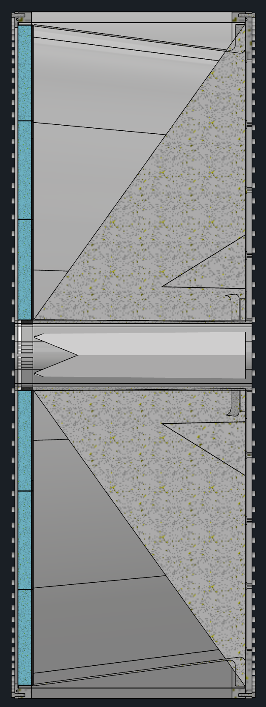
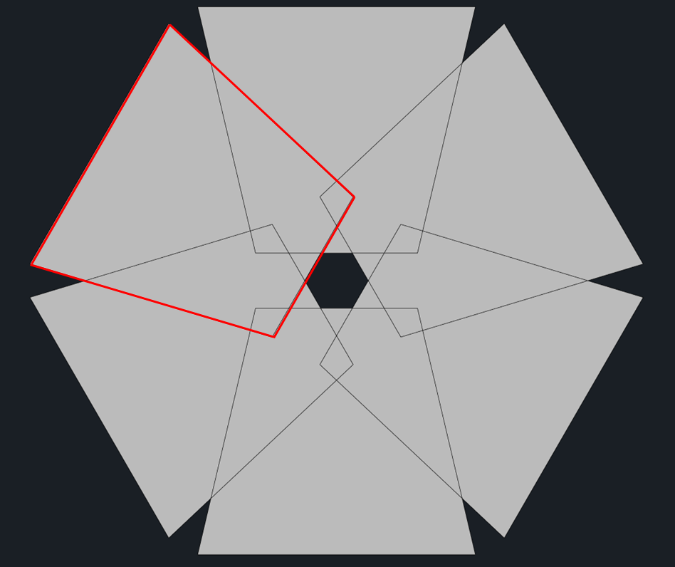
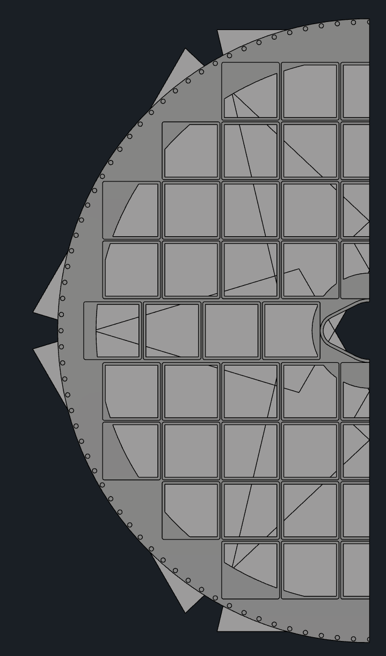
RECAP: Method of Light Delivery
Outer mirror
The purpose of the pfRICH laser calibration system is to act as a standard candle, to gauge and monitor the single photon response of the HRPPD pixels in terms of timing and signal amplitude.
An array of 6 fibers is used for direct illumination of HRPPDs + array 6 fibers is used to reflect light off of the mirrors
Light profiles from 6 fibers for direct illumination
HRPPD coverage
Here 1 of 6 fibers directly illuminates a HRPPD from gap between inner mirror and aerogel
*Tilt angle of fiber is critical to minimize reflections from mirror; can also use baffle to better shape light profile
Inner mirror
The light path from a given fiber to a HRPPD pixel defines the photon flight length
A radially divergent profile is a good match for the annular shape of the HRPPD sense plane
Aerogel
HRPPD
Light profile from a single fiber on the HRPPD sense plane
*Overlapping profiles can be separated in time using different length fibers
pfRICH Vessel
6 fibers for direct HRPPD illumination + 6 fibers for the mirror illumination should suffice to illuminate all HRPPD pixels

Slide 3

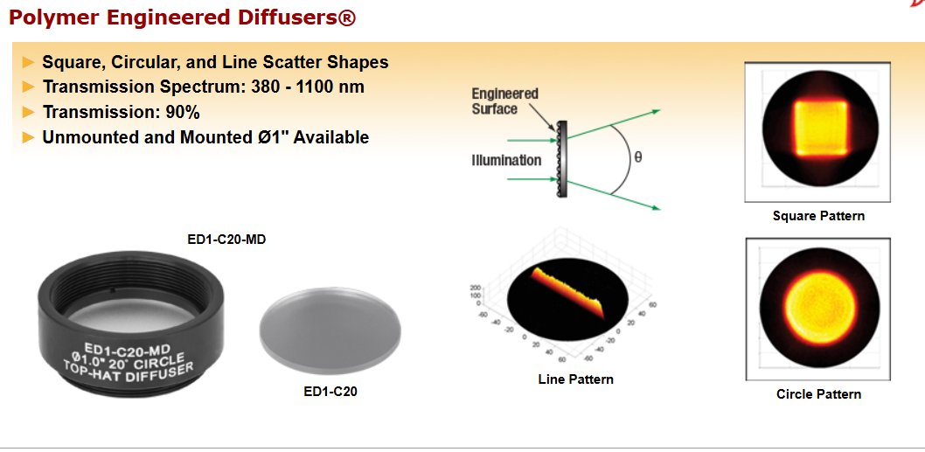
Engineered Diffuser Employed to Shape Intensity Profile on pfRICH Sense Plane

Slide 4
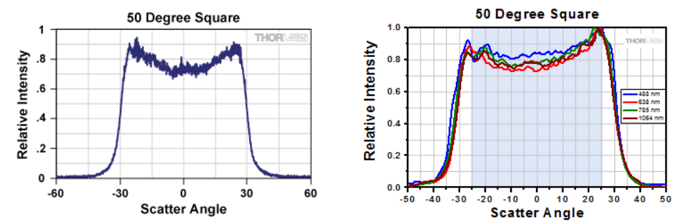

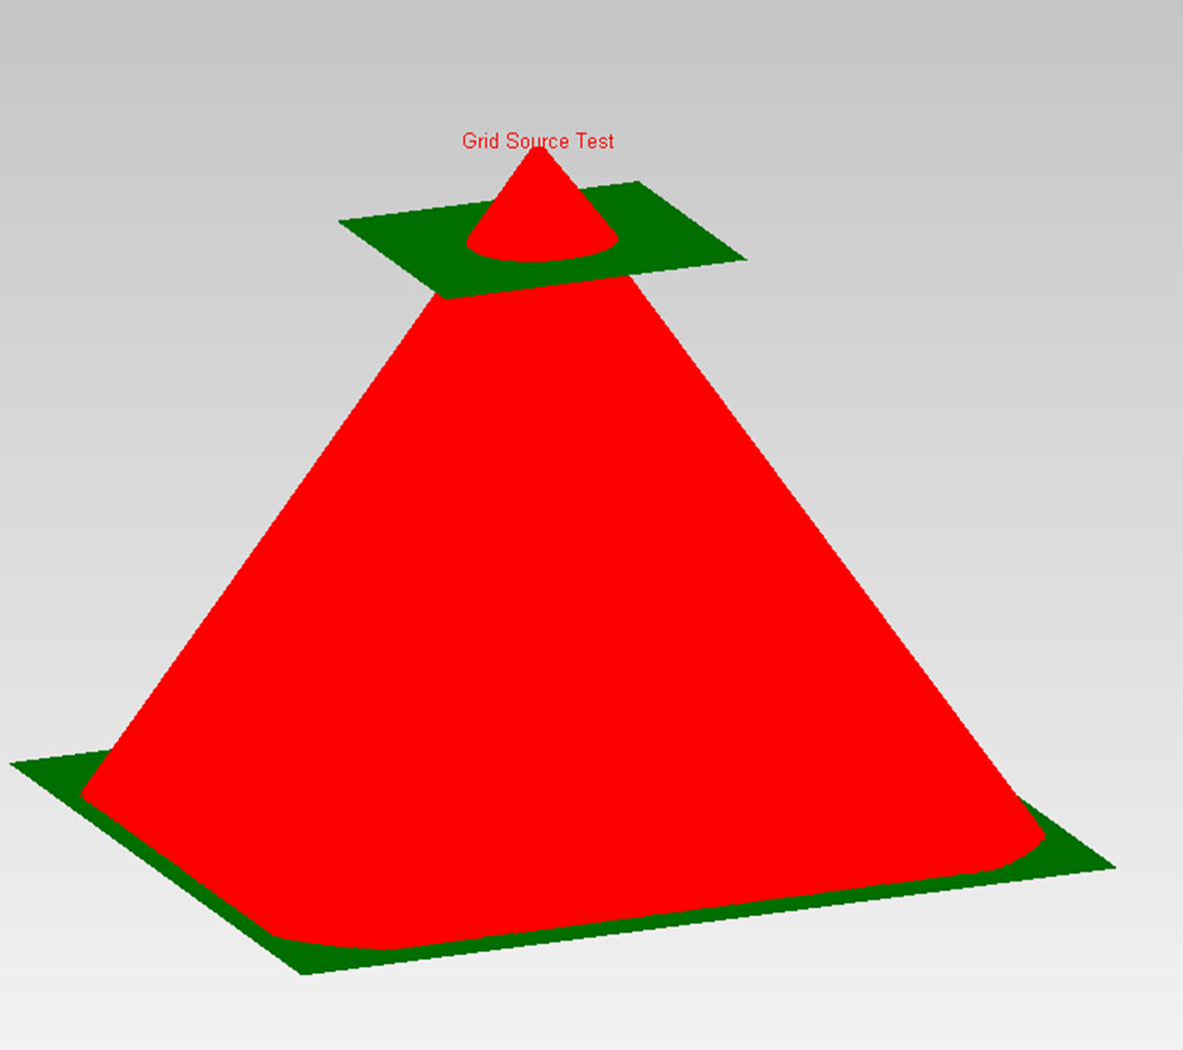
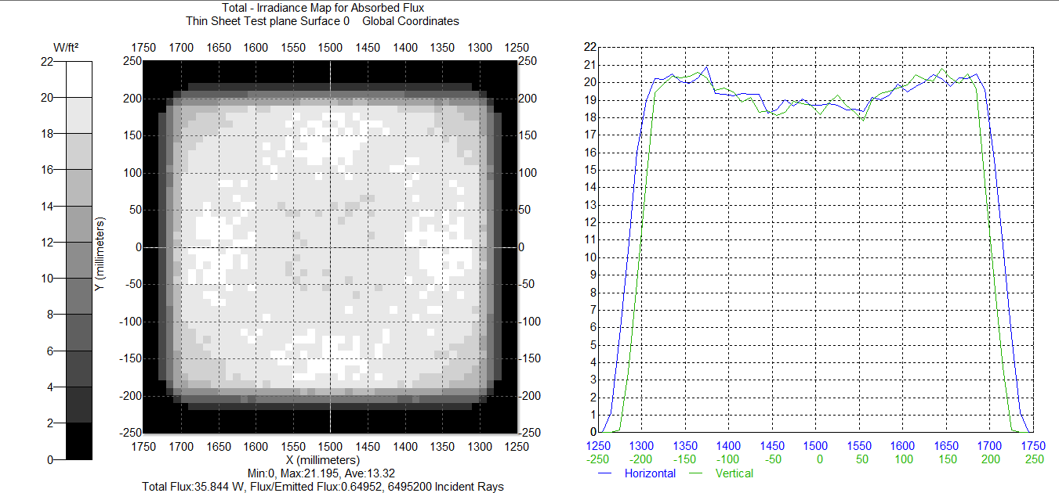
Recreate Thorlabs Square Intensity profile in Simulation

Slide 5
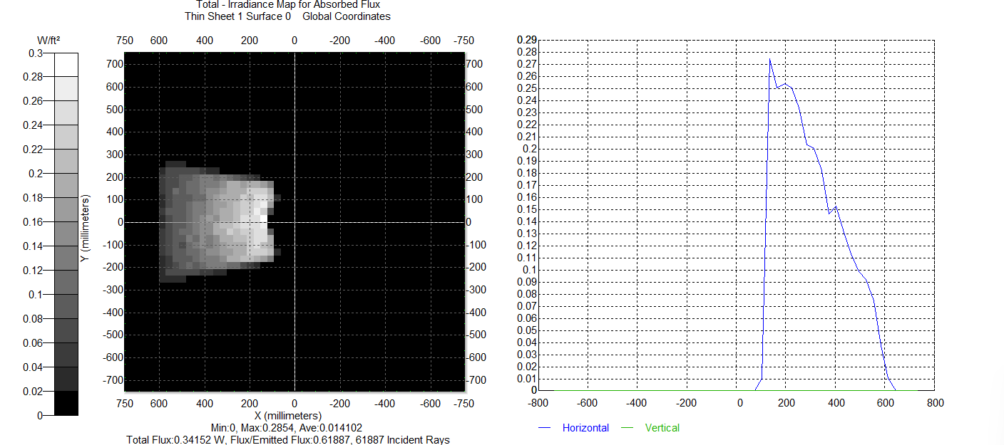
Projected Intensity profile on pfRICH sense plane
Single Fiber Source

Slide 6
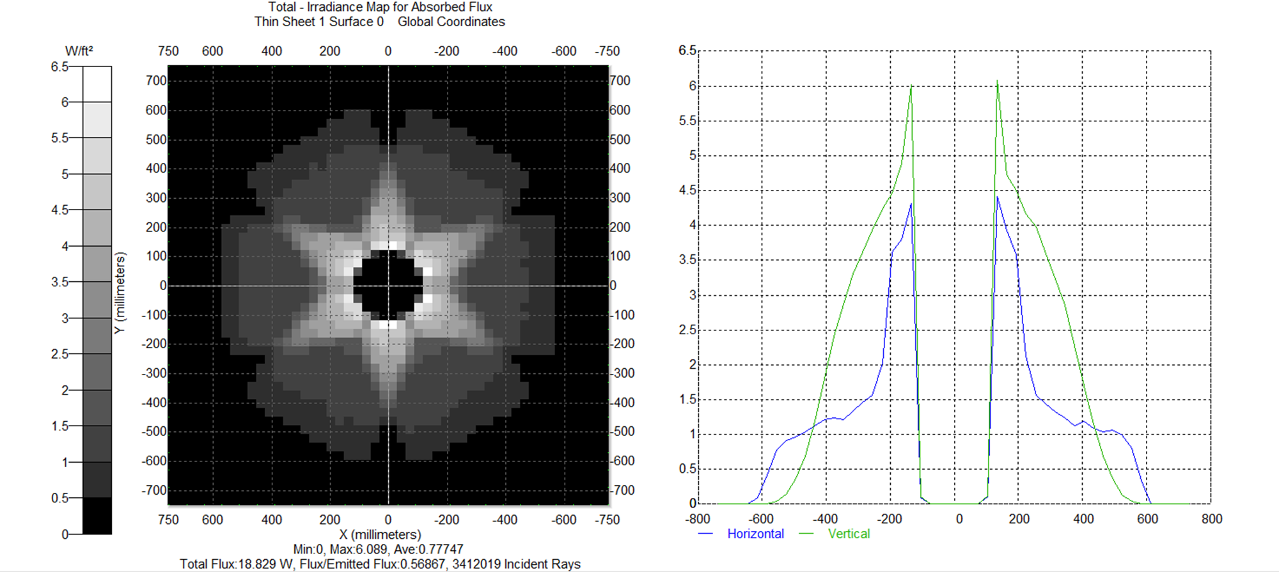
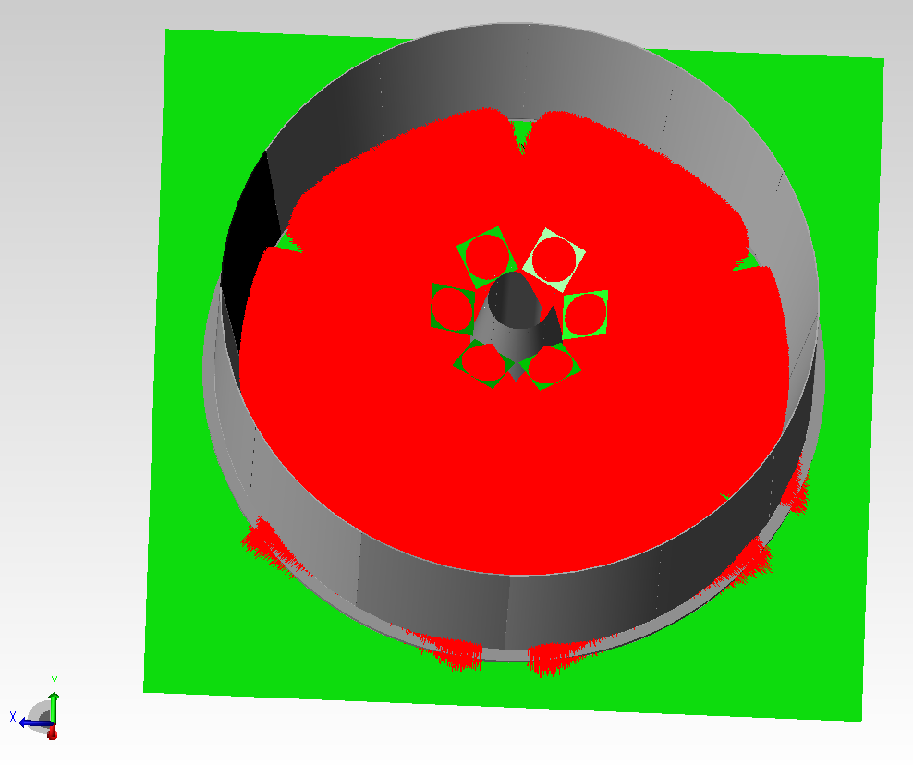
Full Intensity Profile Simulation on Sense Plane
Array of 6 Fiber Sources
NB: Each of the 6 sectors will be flashed one at a time, so this would be an integrated intensity pattern.
It is critical for the performance of the laser calibration system that this intensity profile is reasonably accurate
For this reason, we need to verify the intensity pattern in the lab

Slide 7
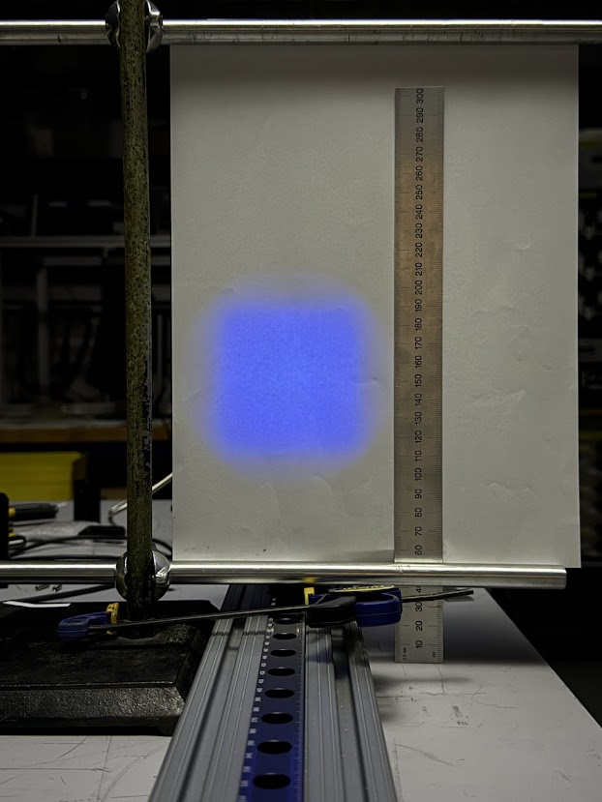
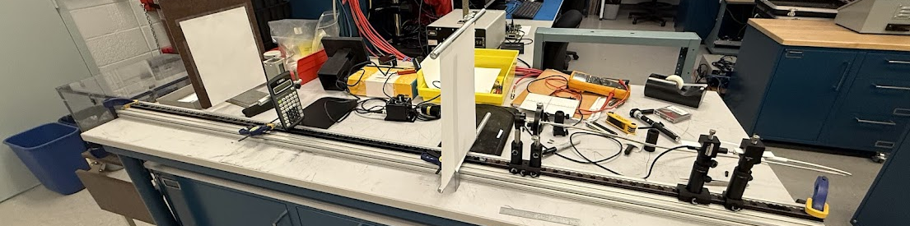
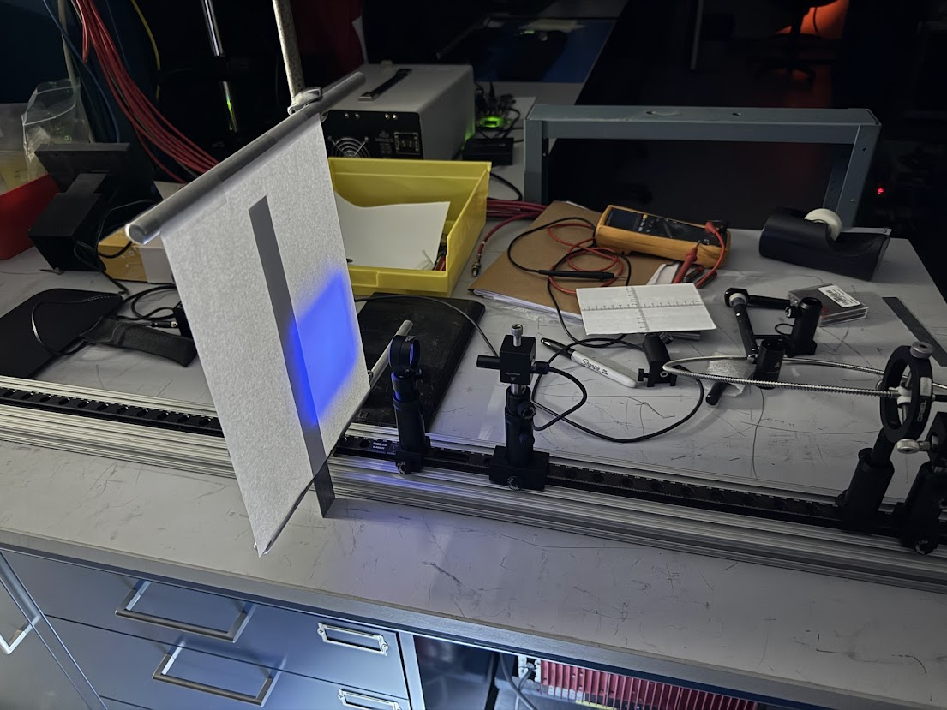
Use Benchtop Setup to Measure Profile used in Simulation
Used x7 core fiber bundle to maximize light output for optimal image quality
Focal Screen
(semi-transparent)
Optical
Camera
50º Sq.
Diffuser
Fiber Bundle
Output
Projected
Image
Fiber Bundle
Input
405nm
CW Laser
50cm
d
f
Graduated Optical Rail
d = distance between focal screen and diffuser
f = distance between fiber tip and diffuser surface

Slide 8
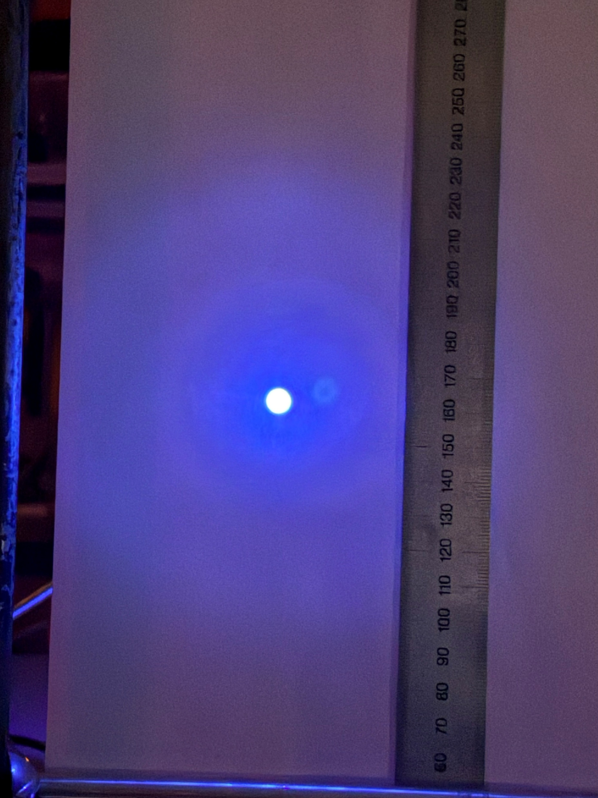
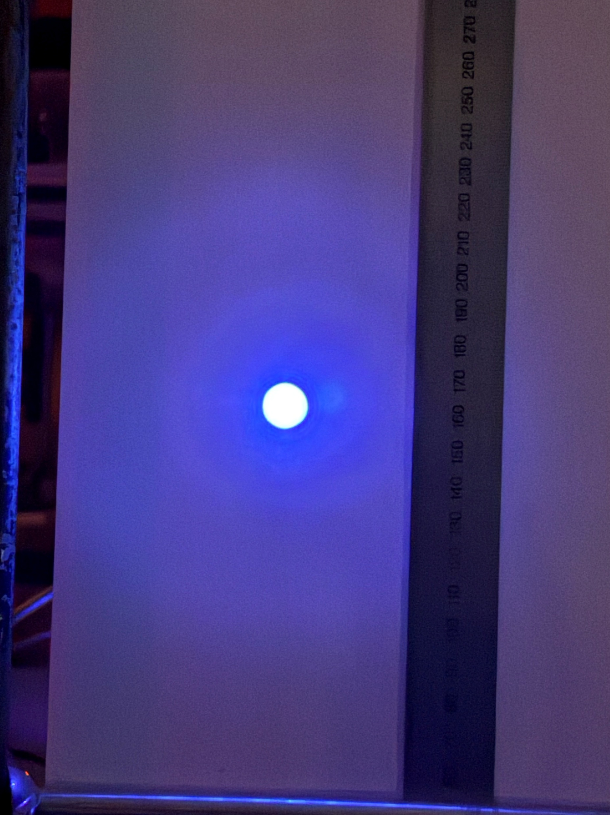
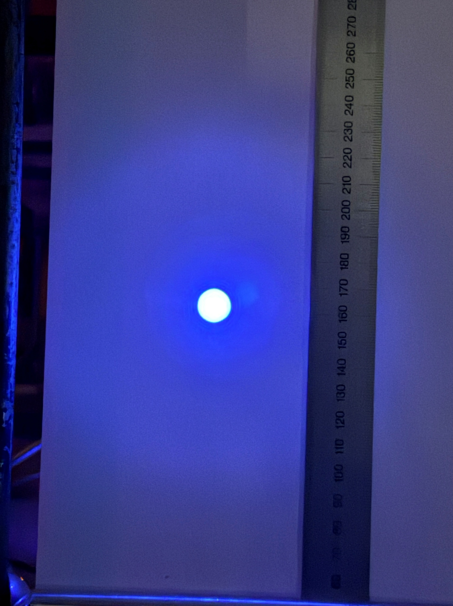
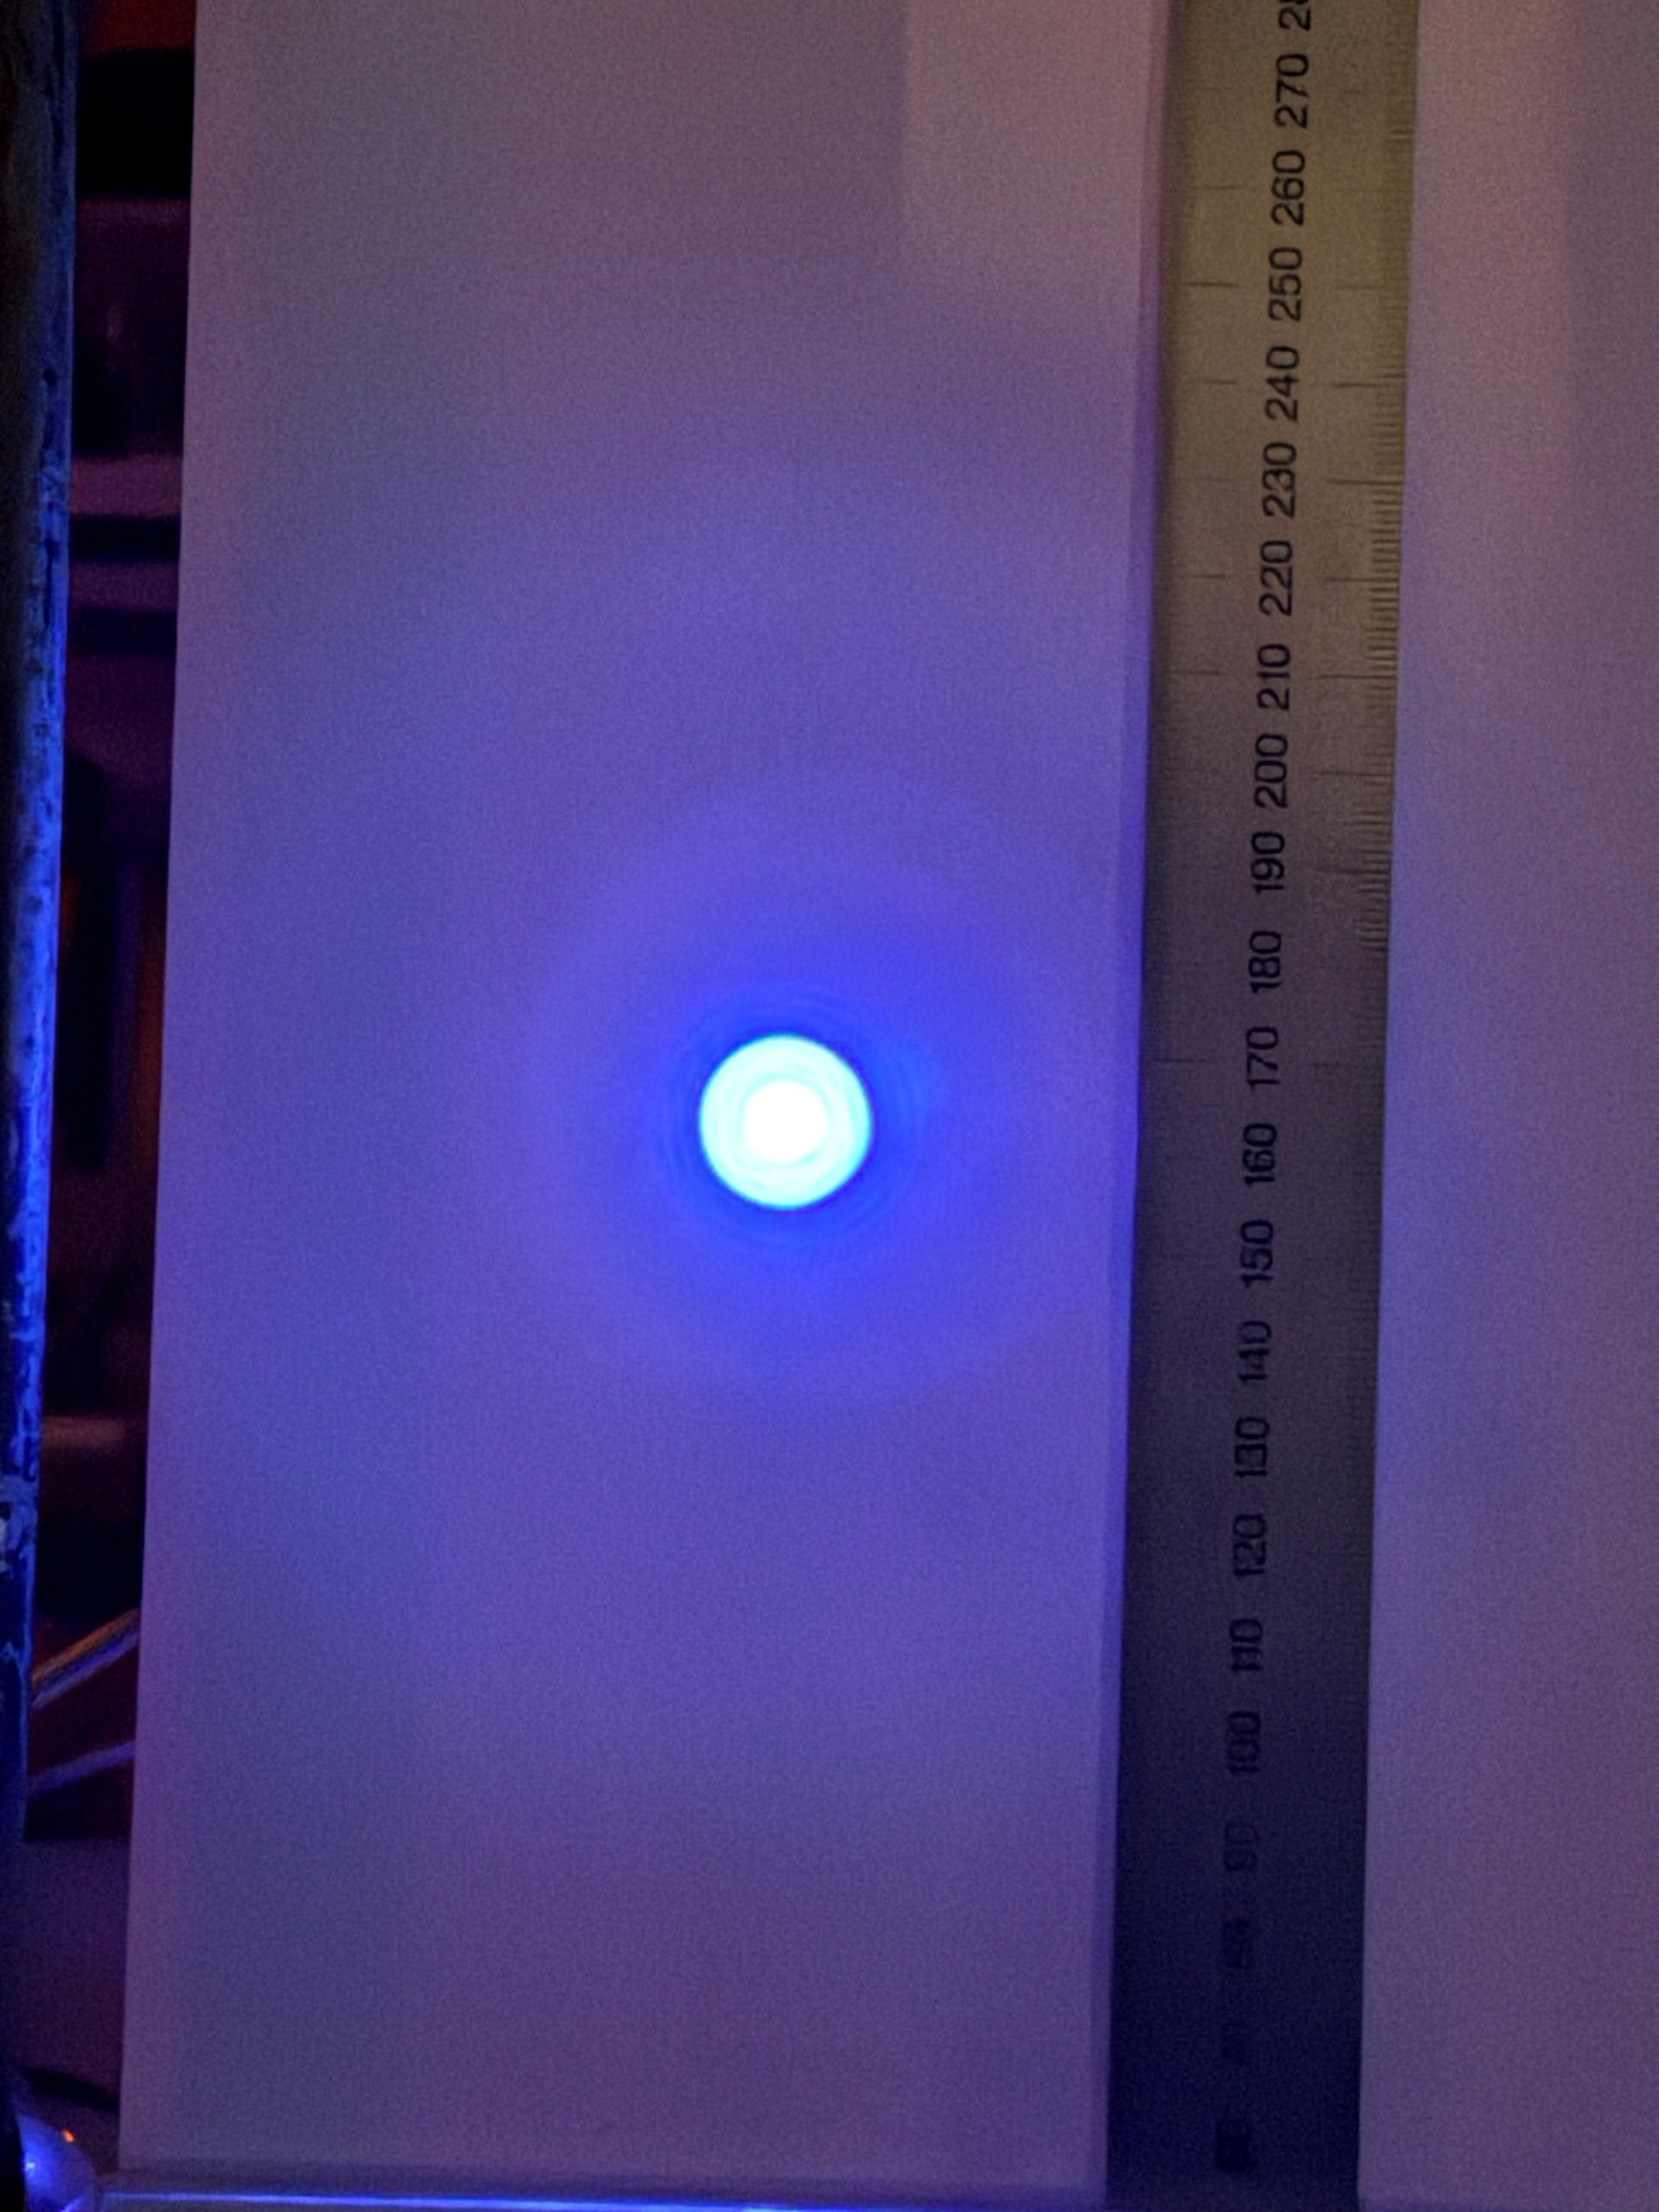
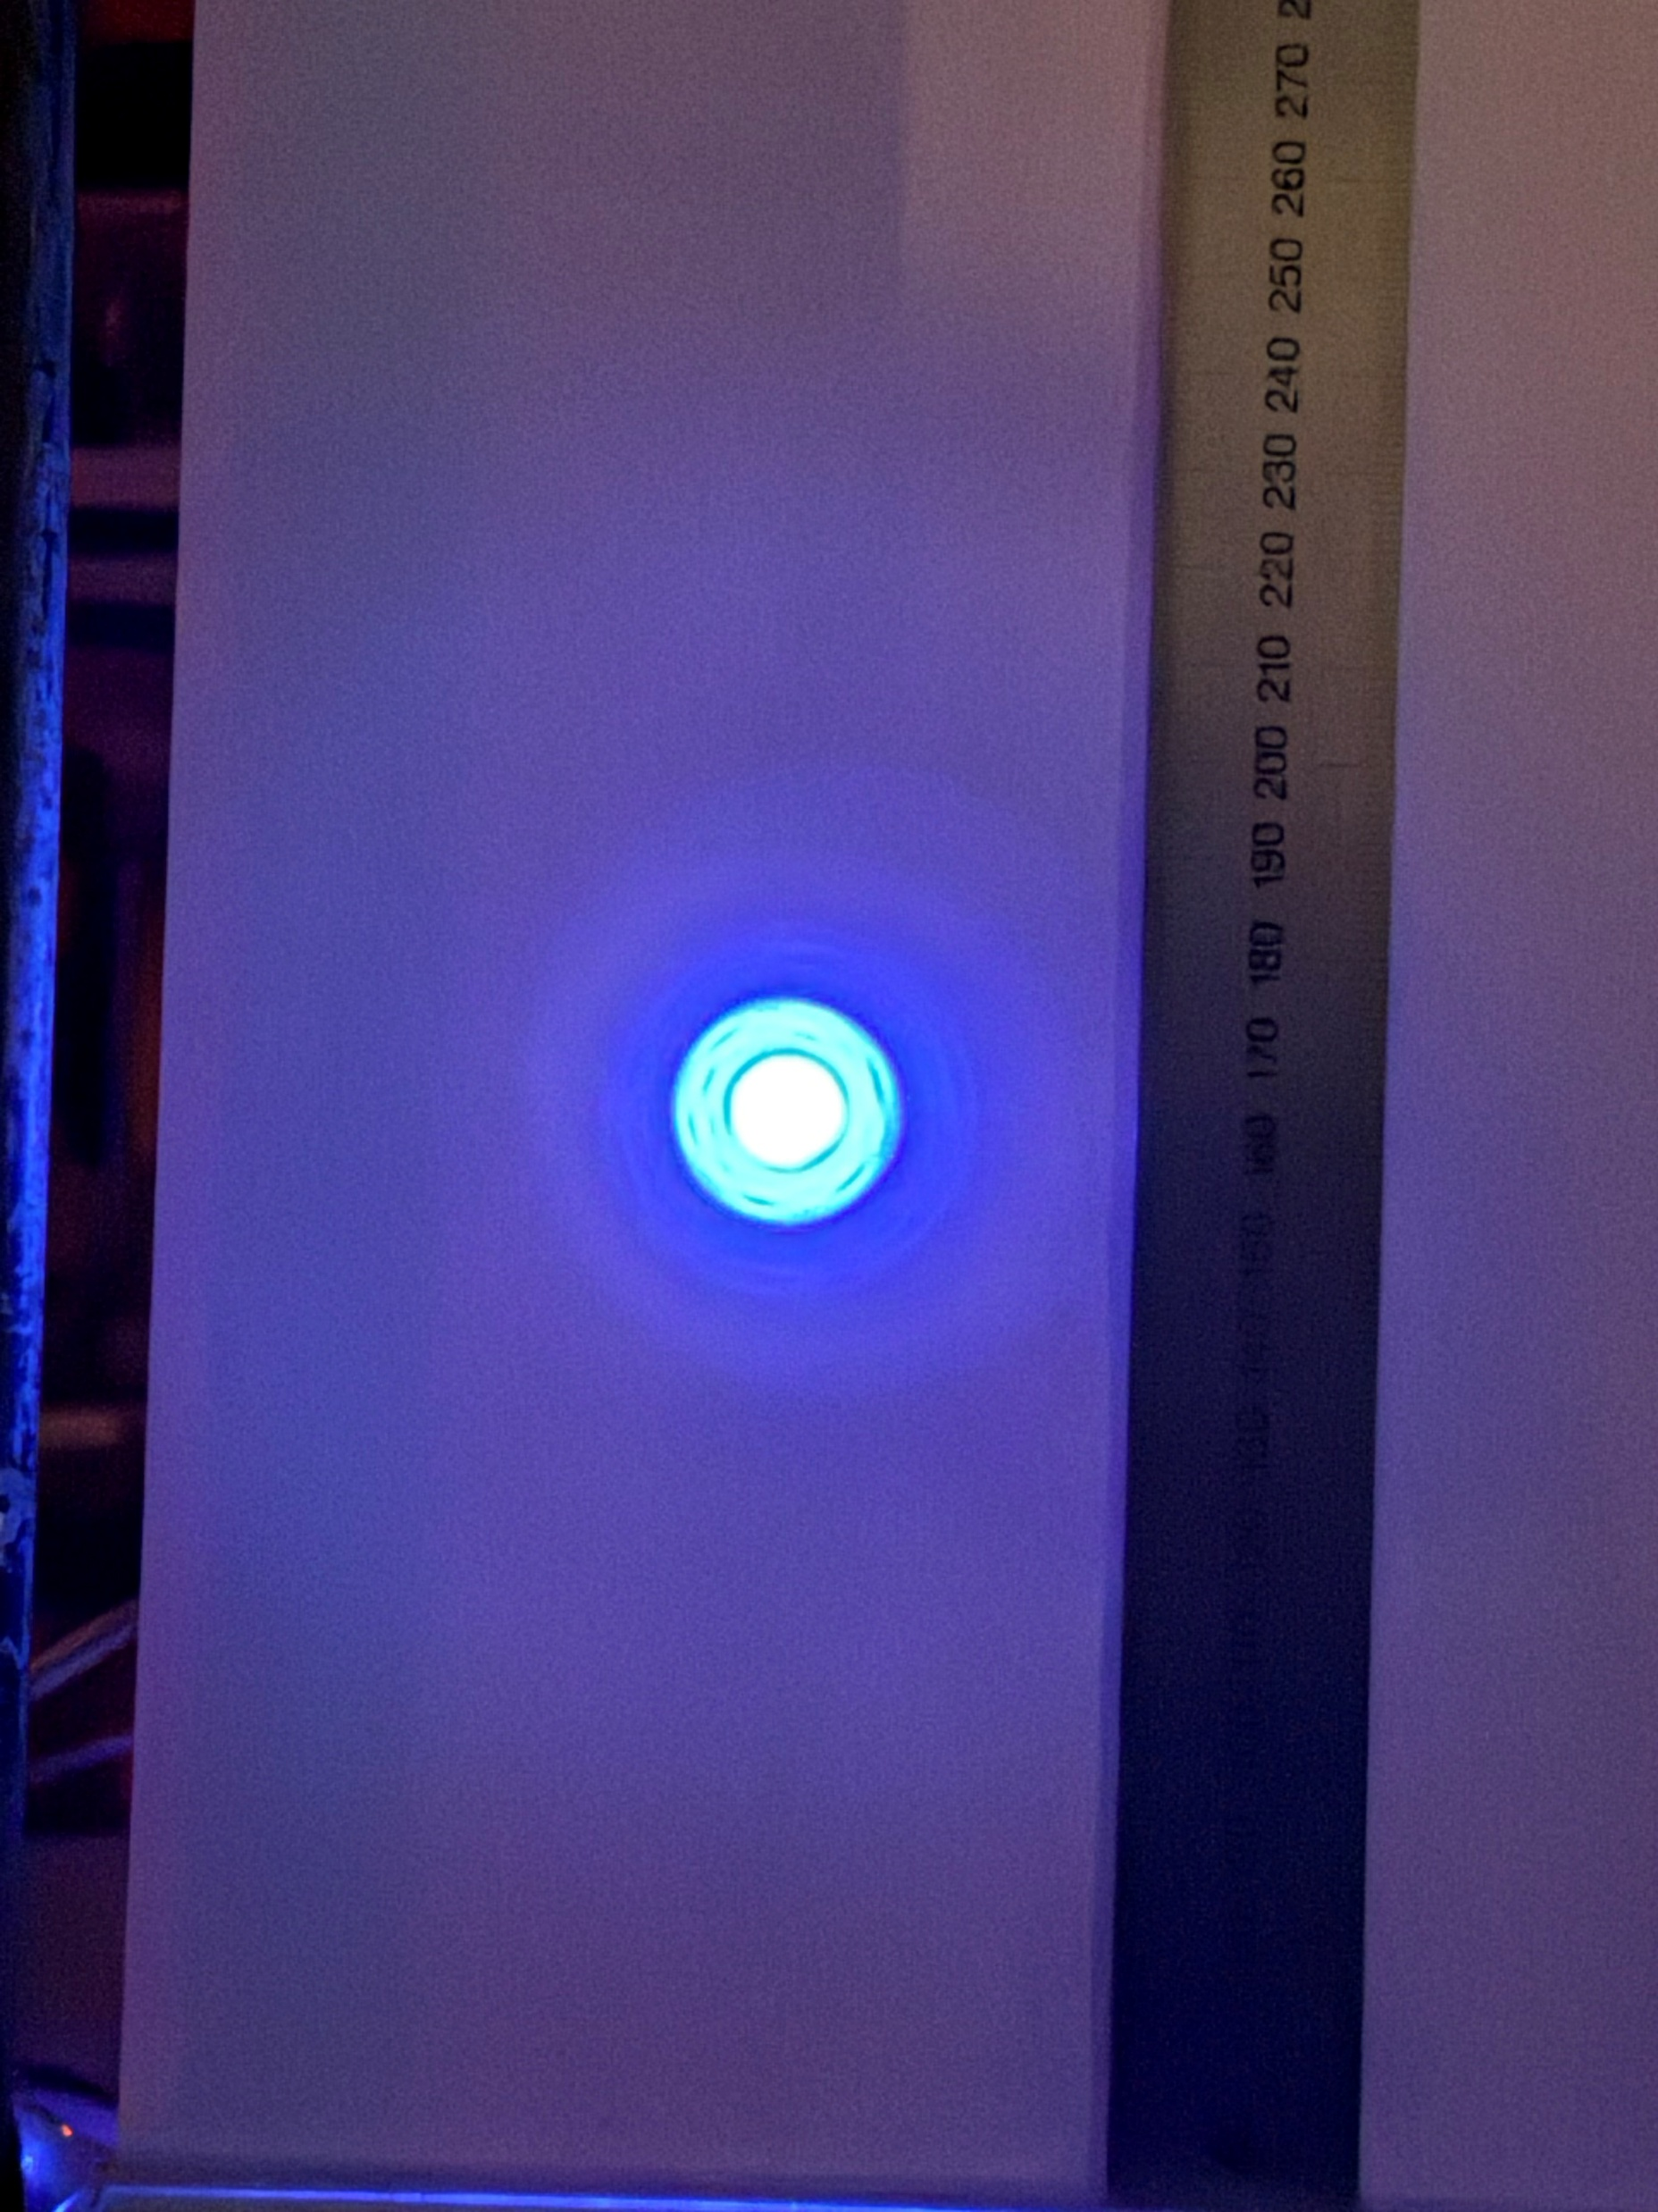
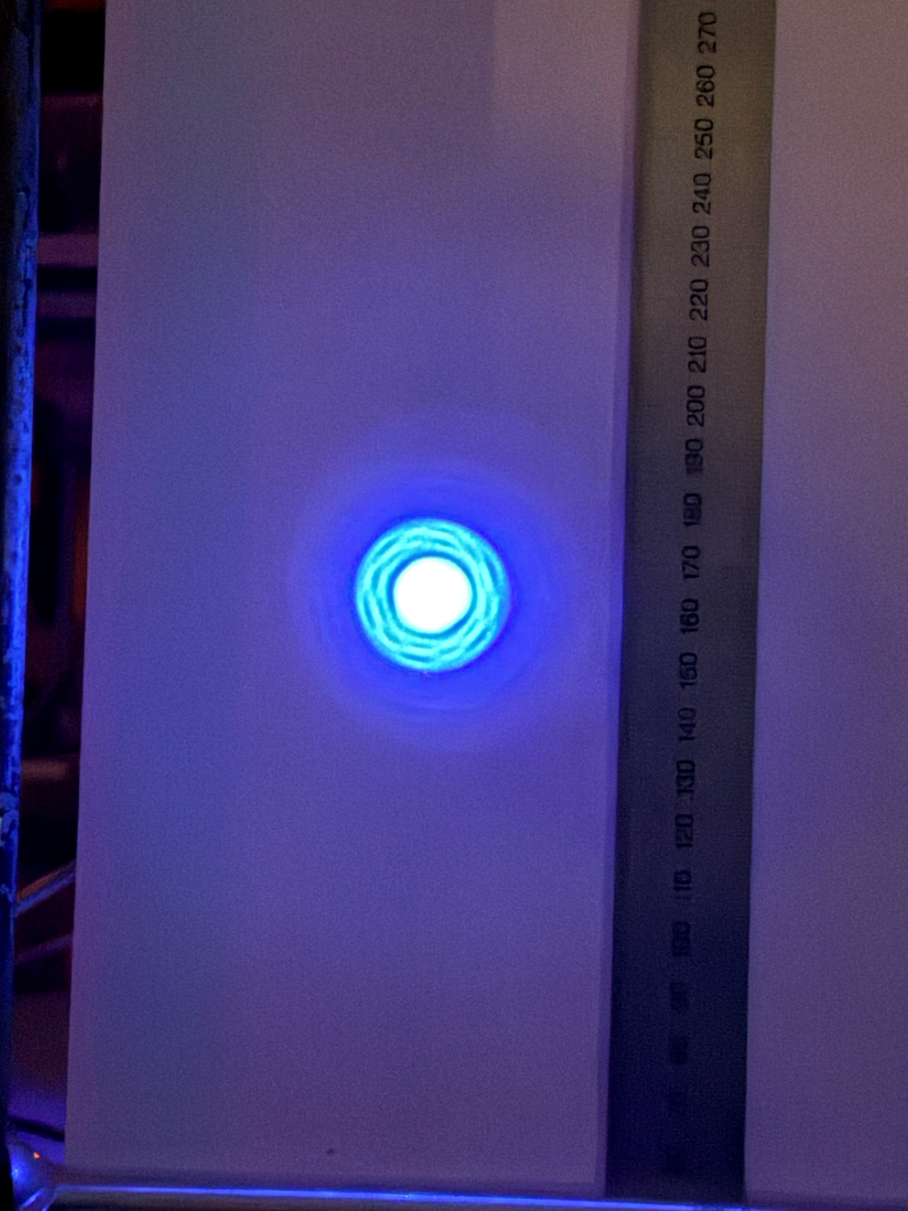
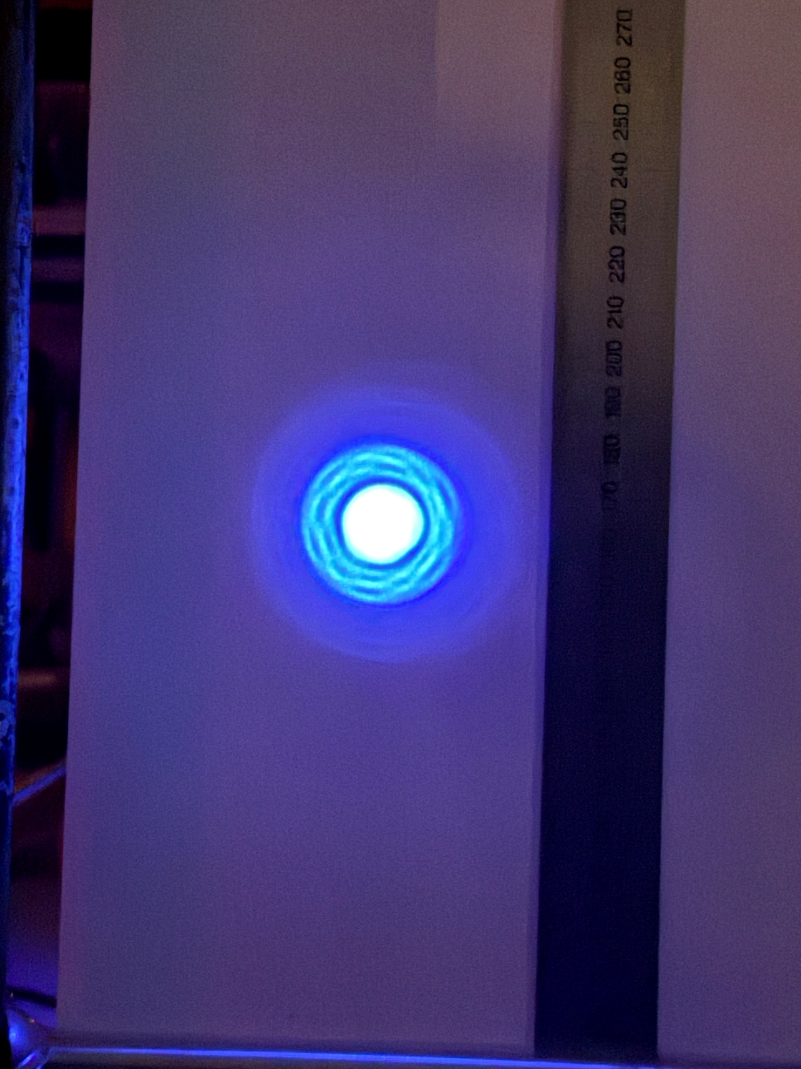
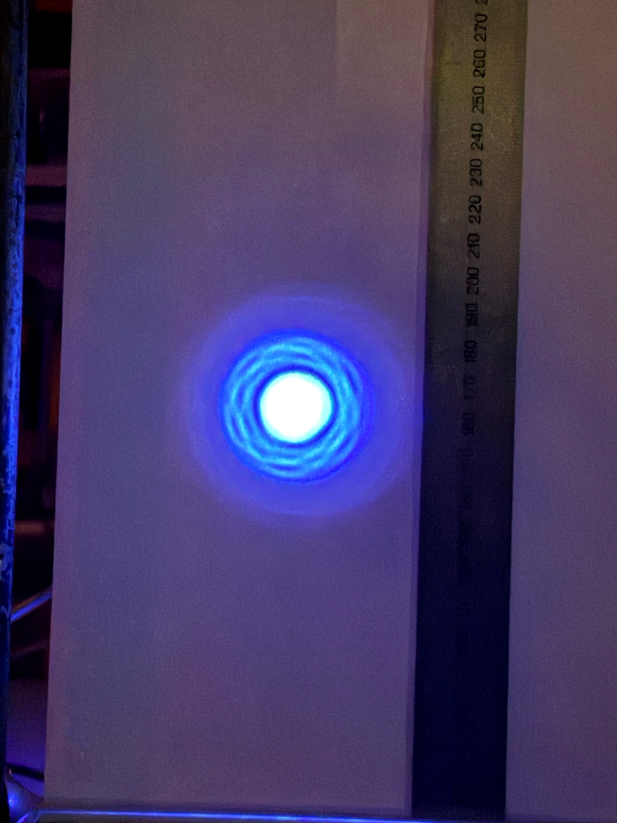
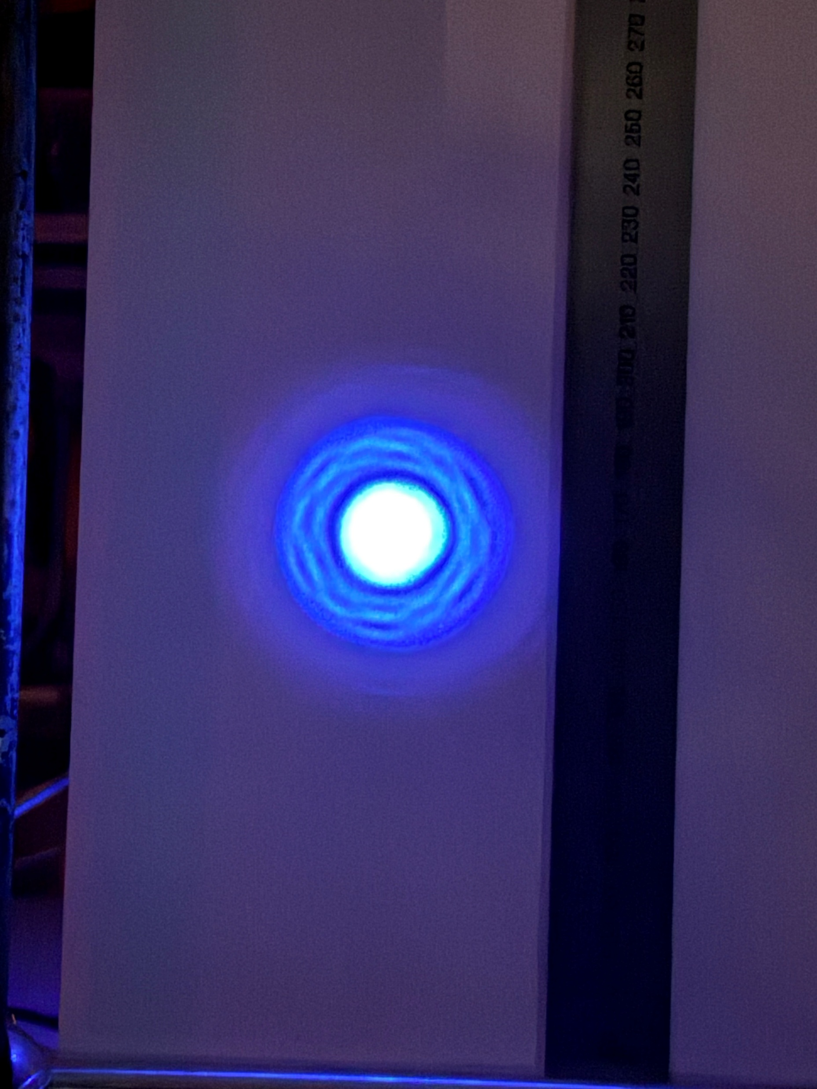
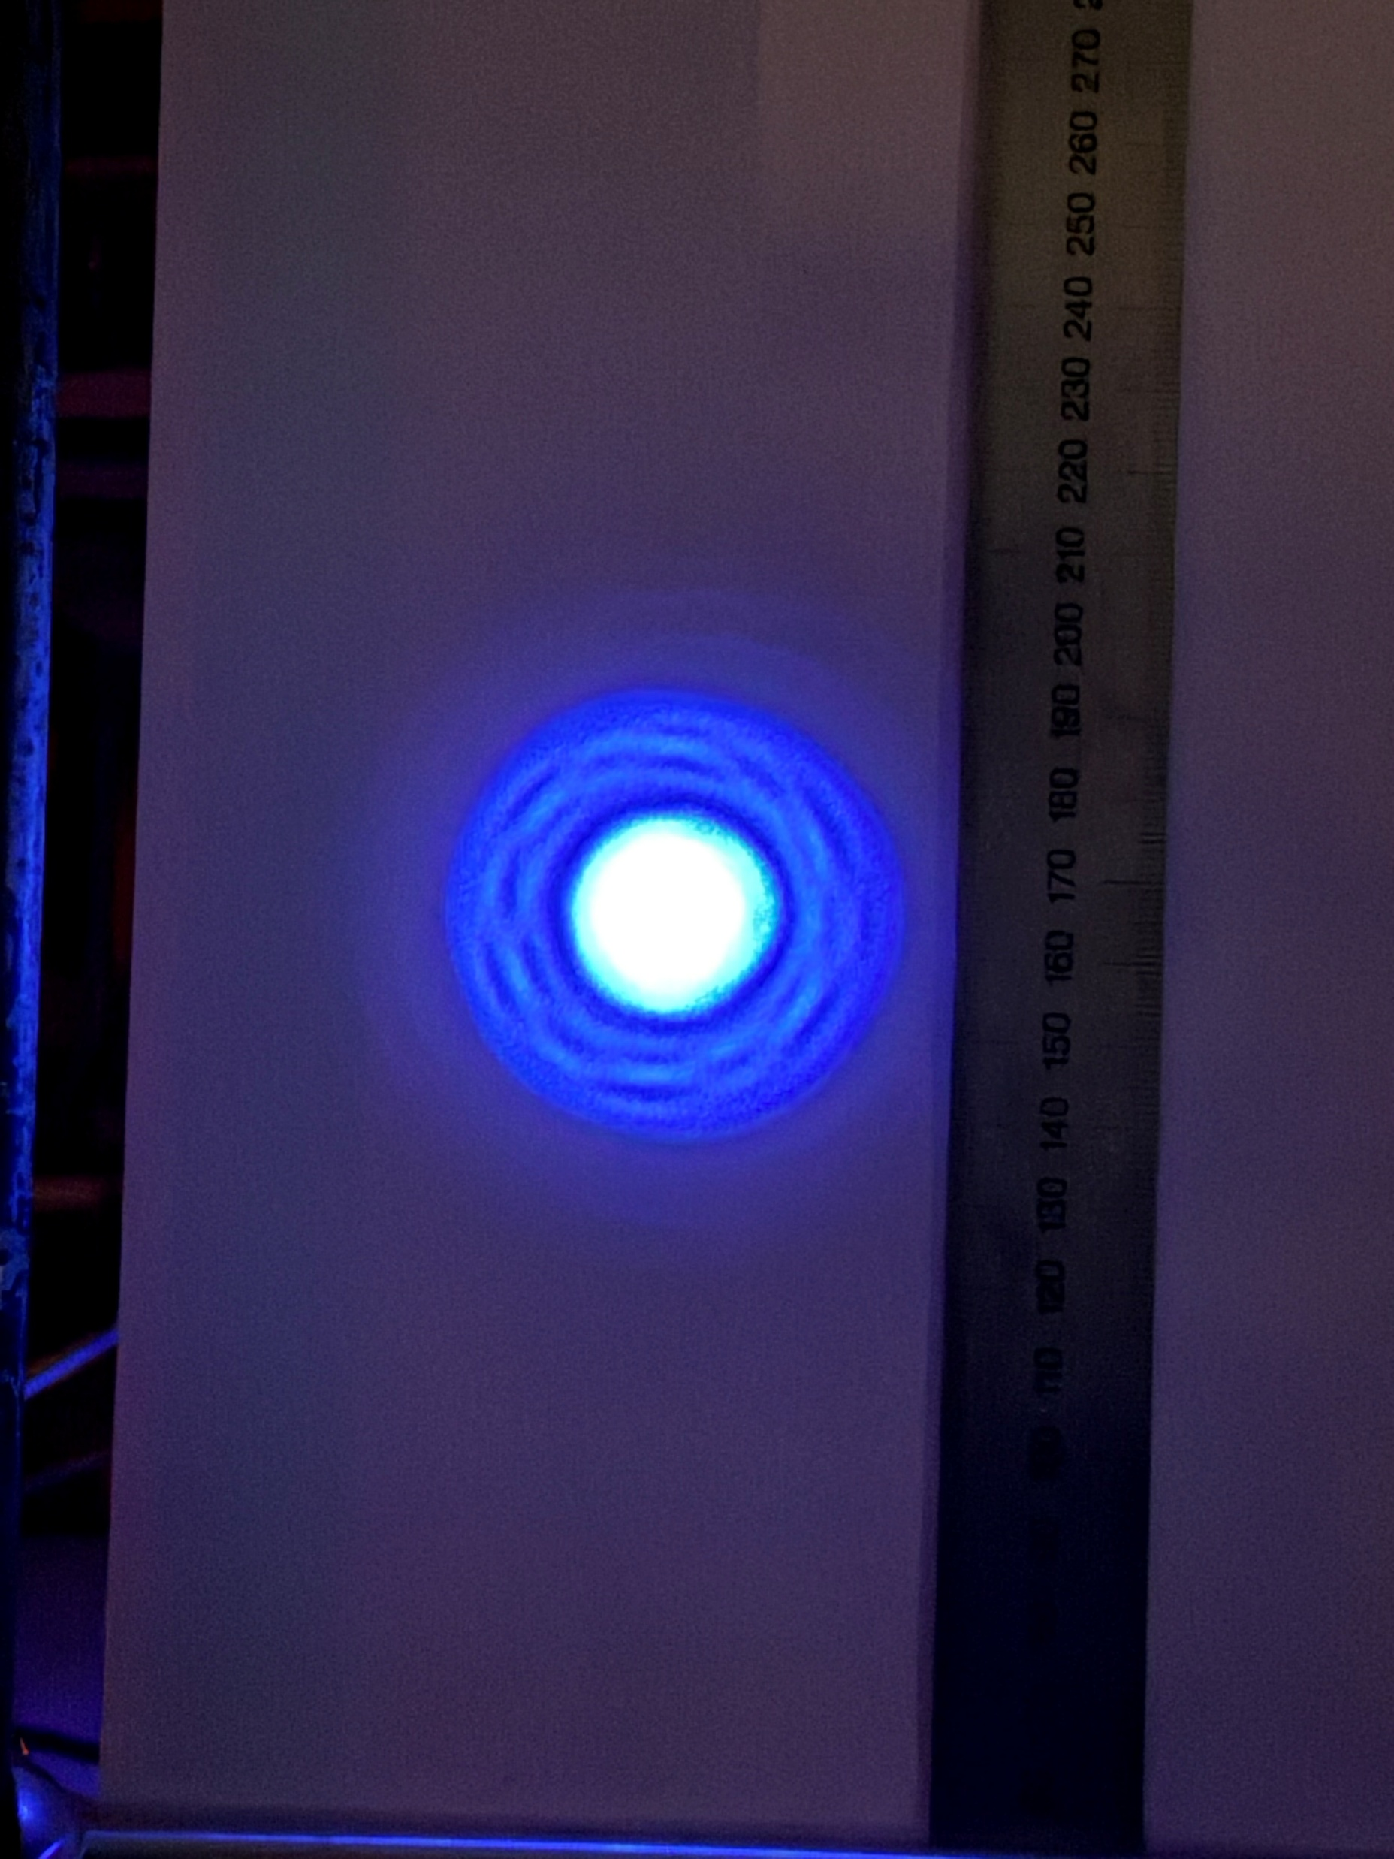
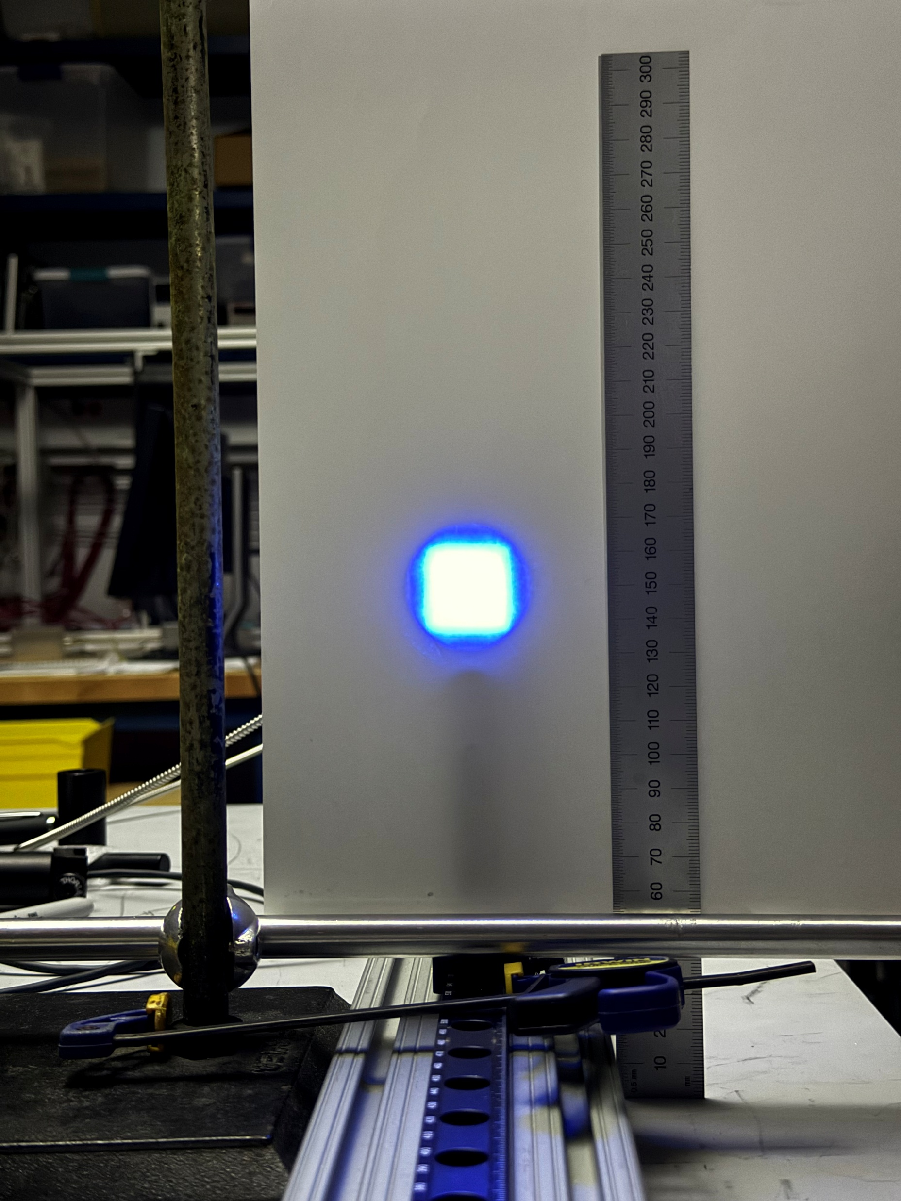
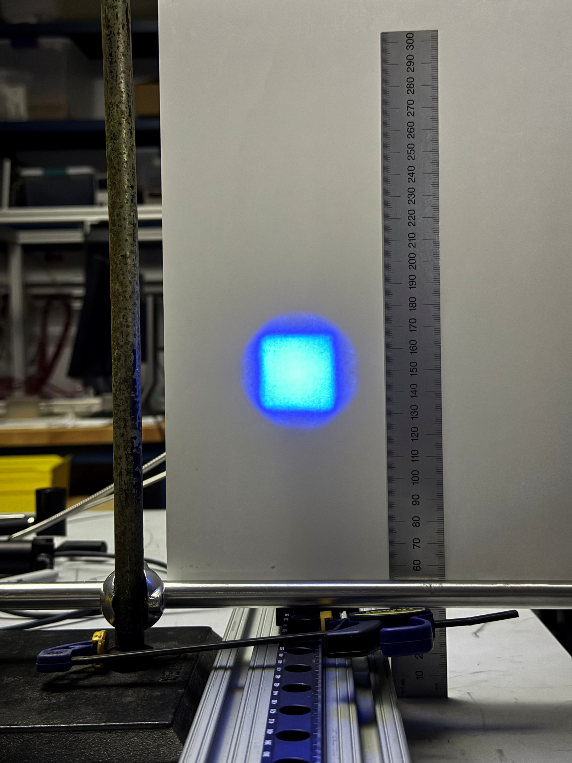
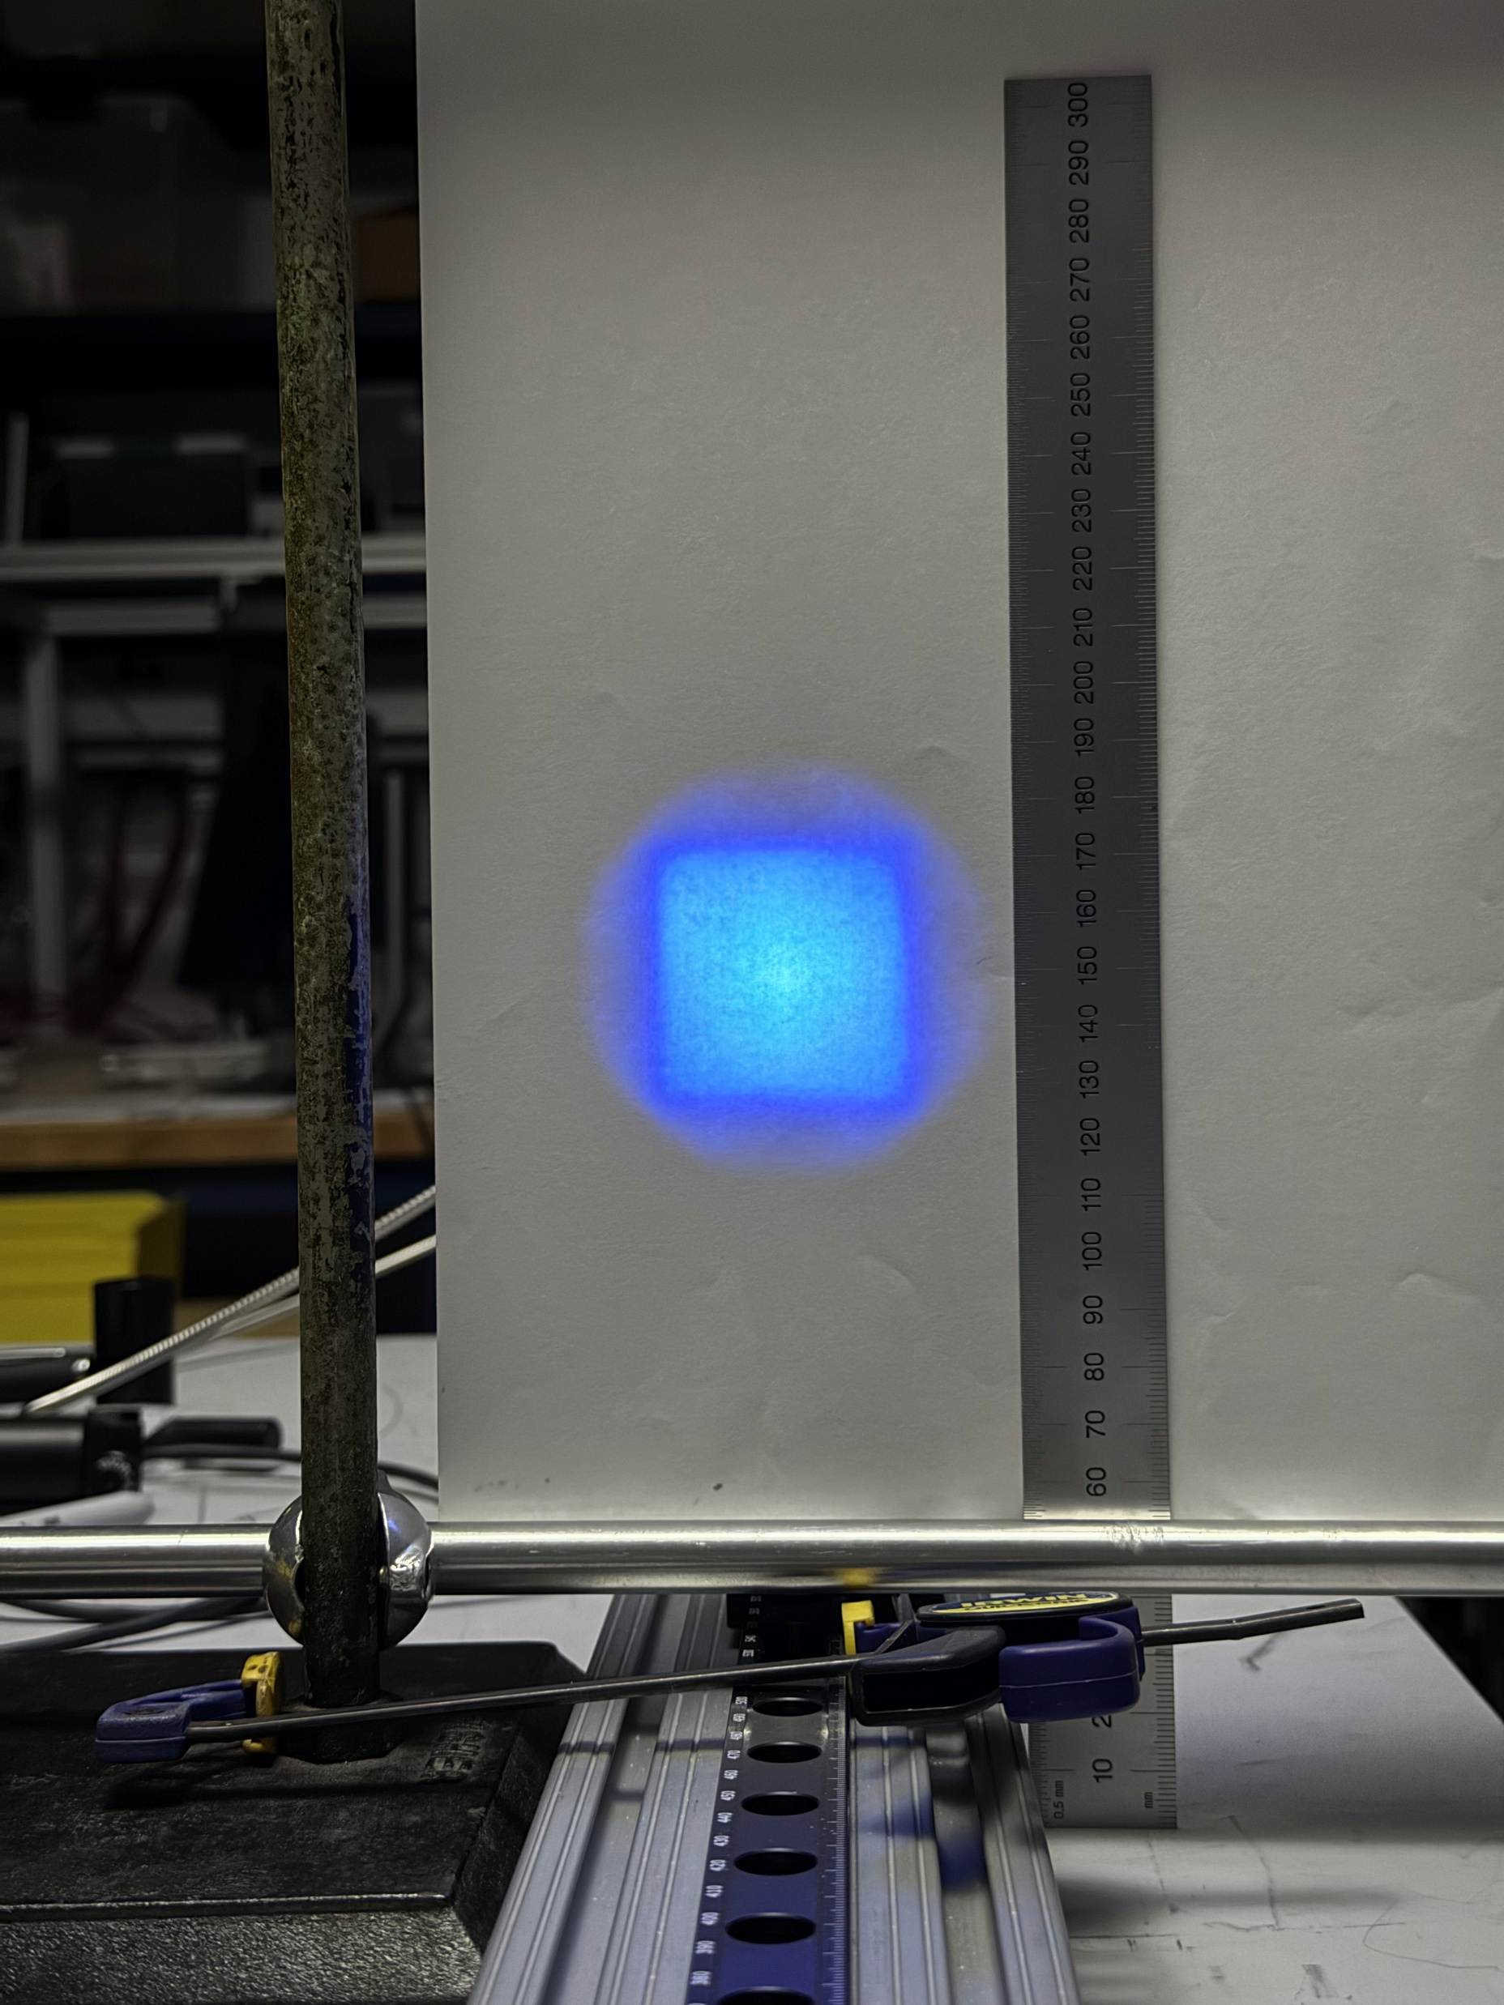
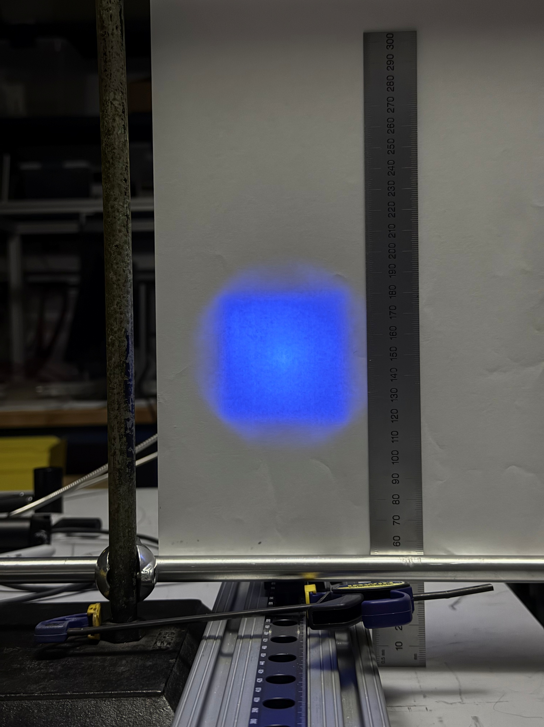
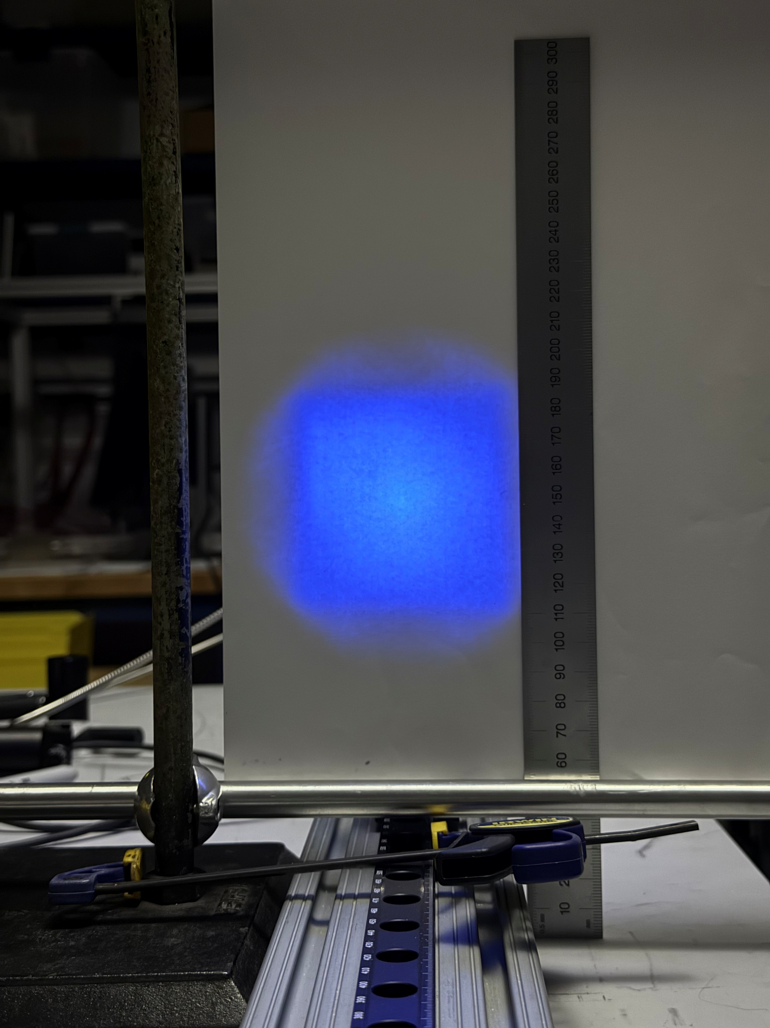
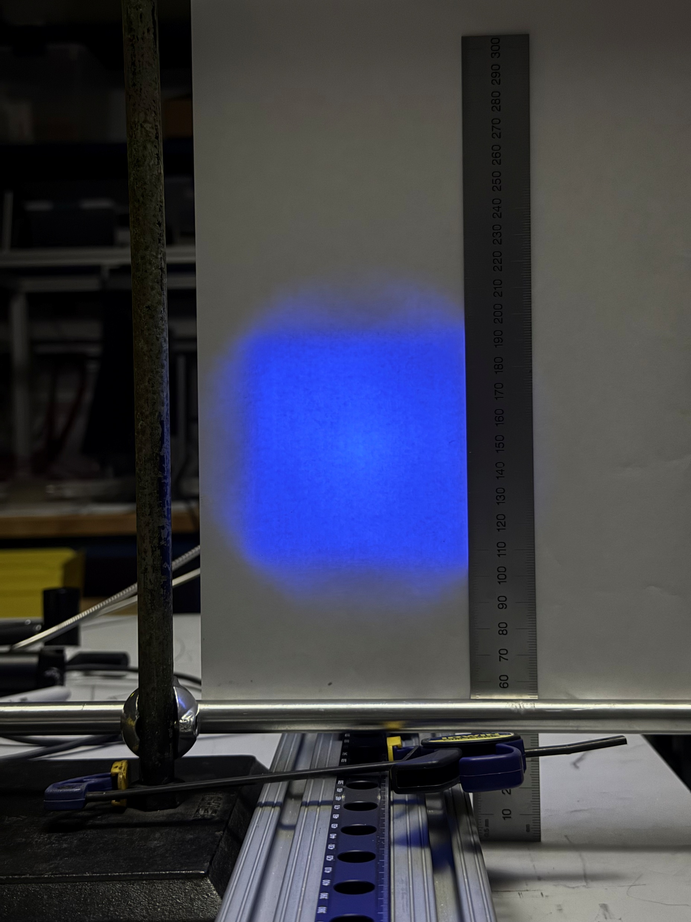
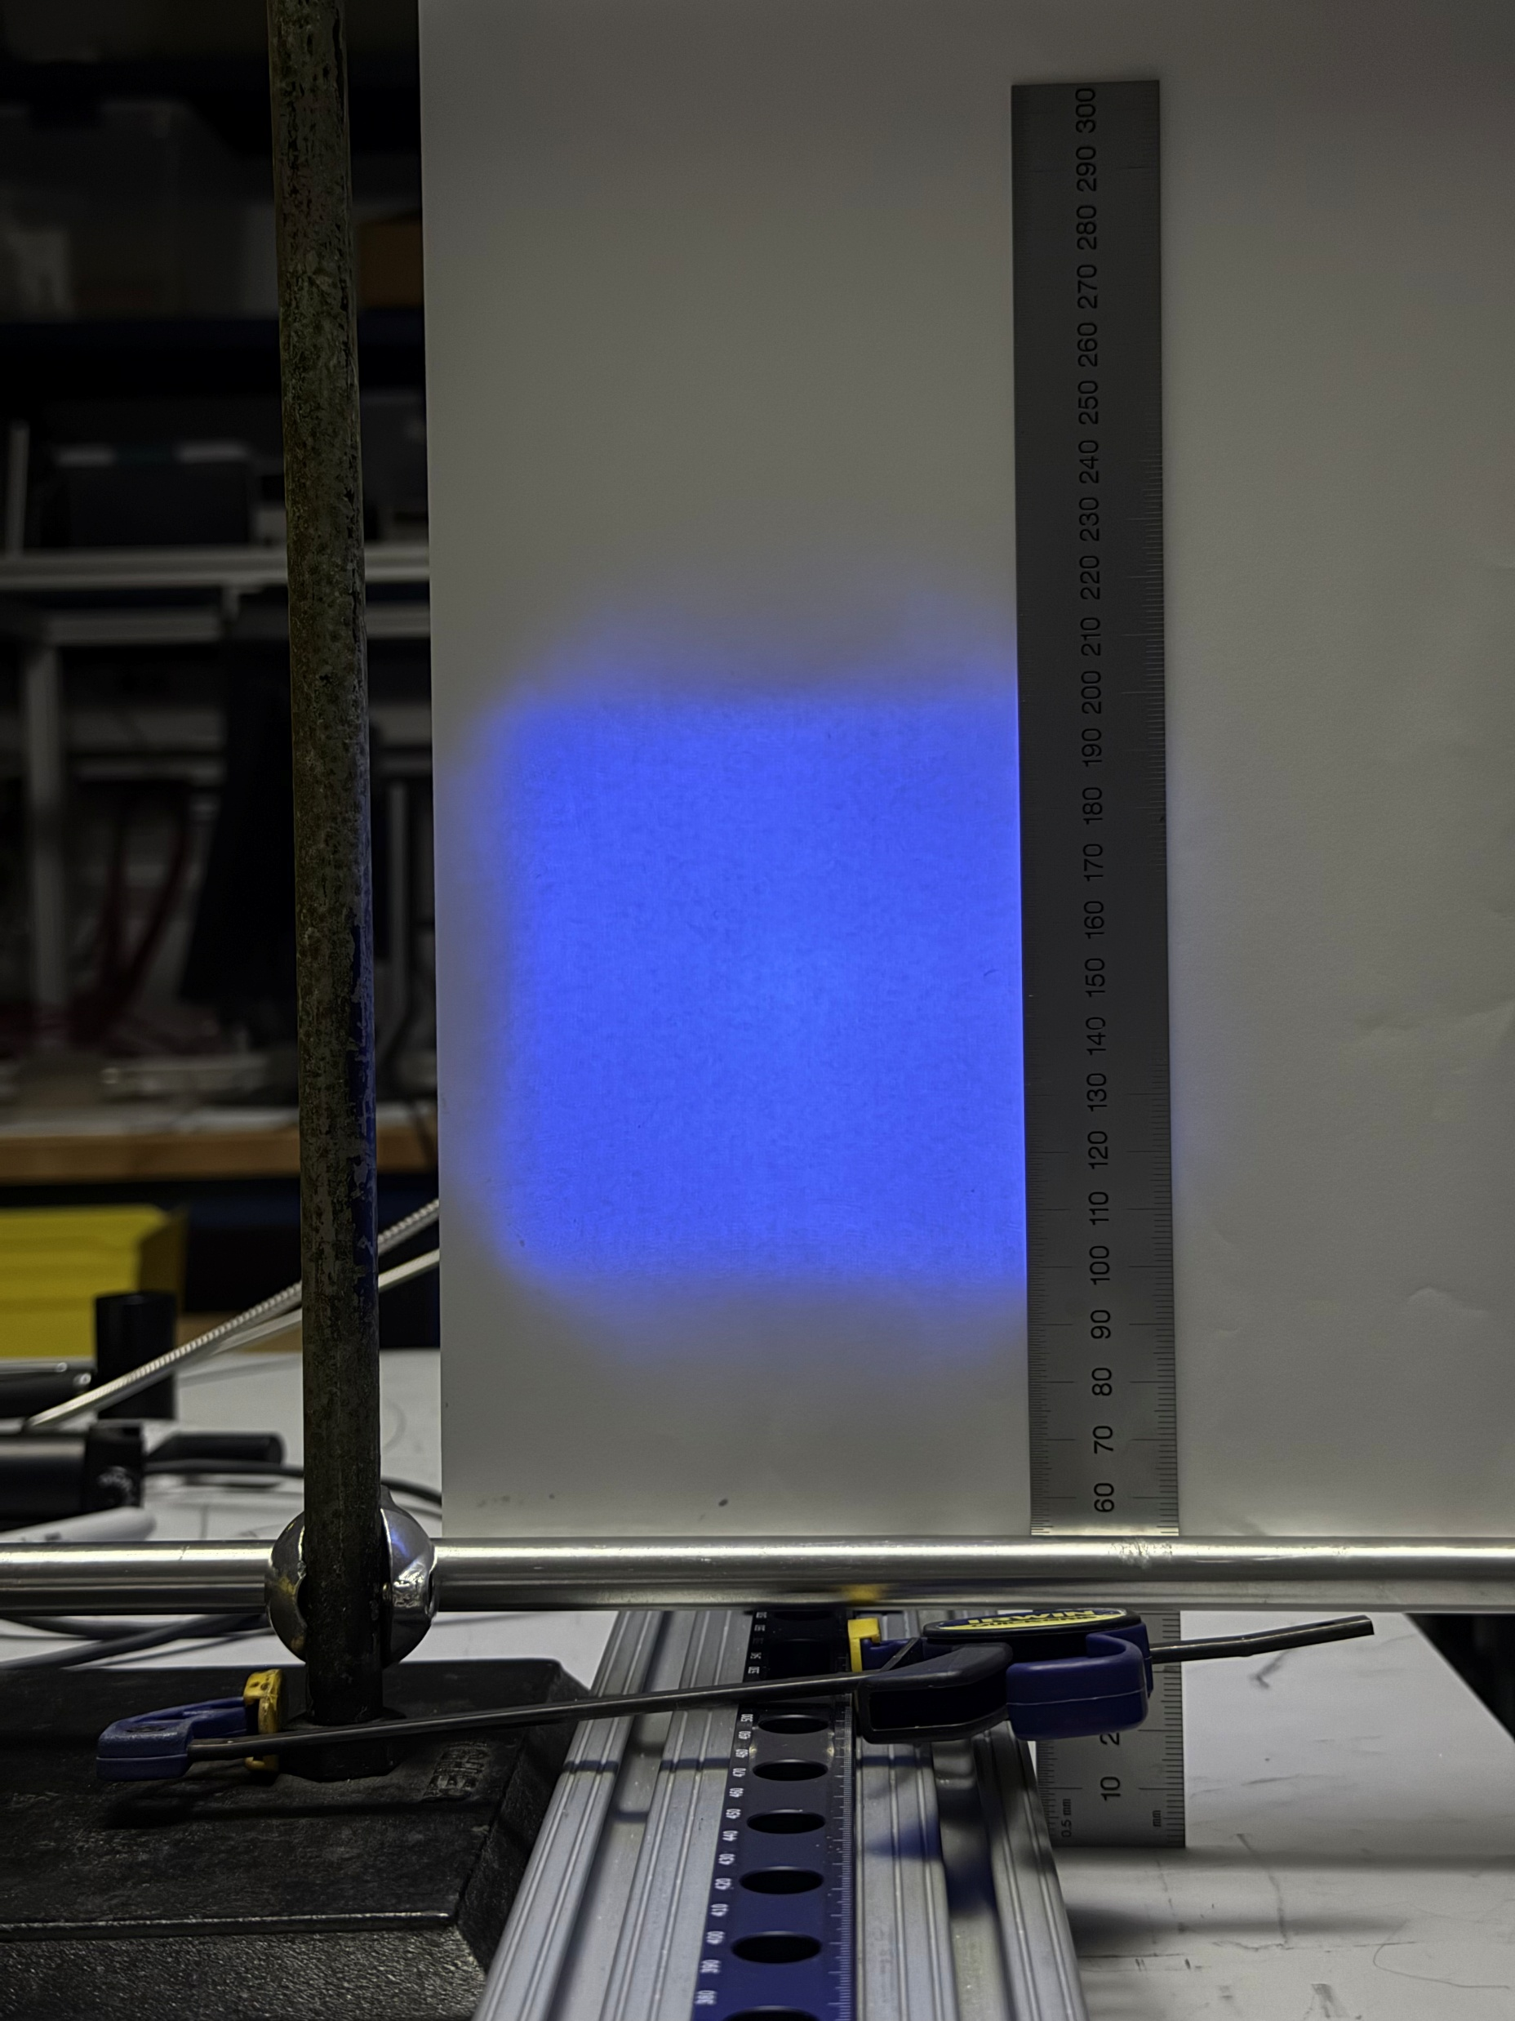
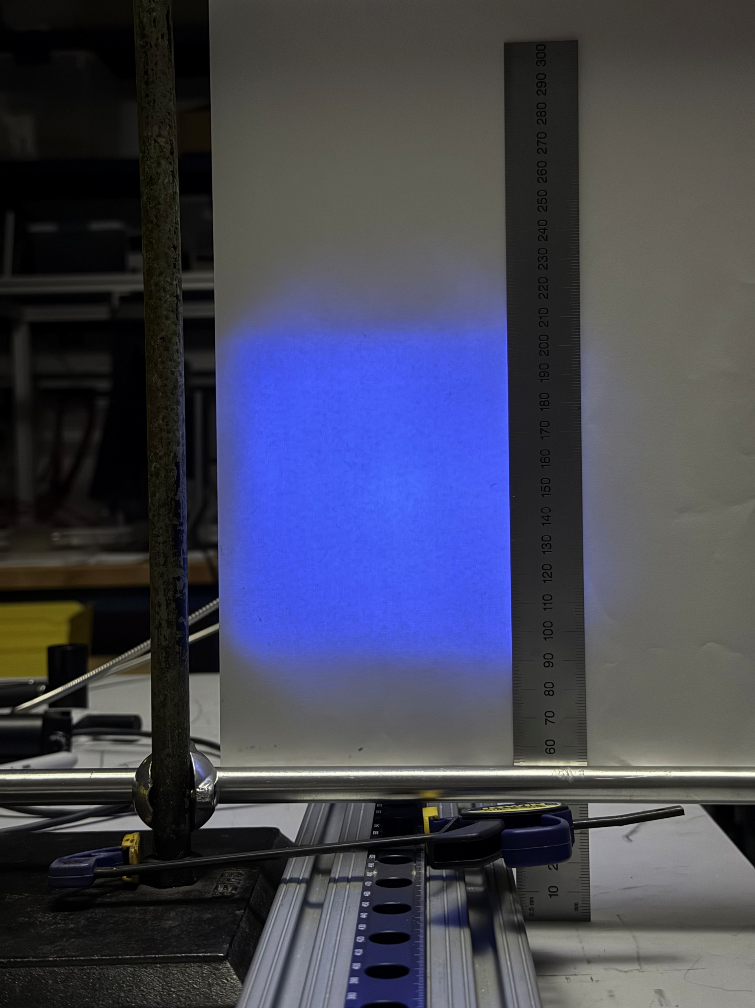
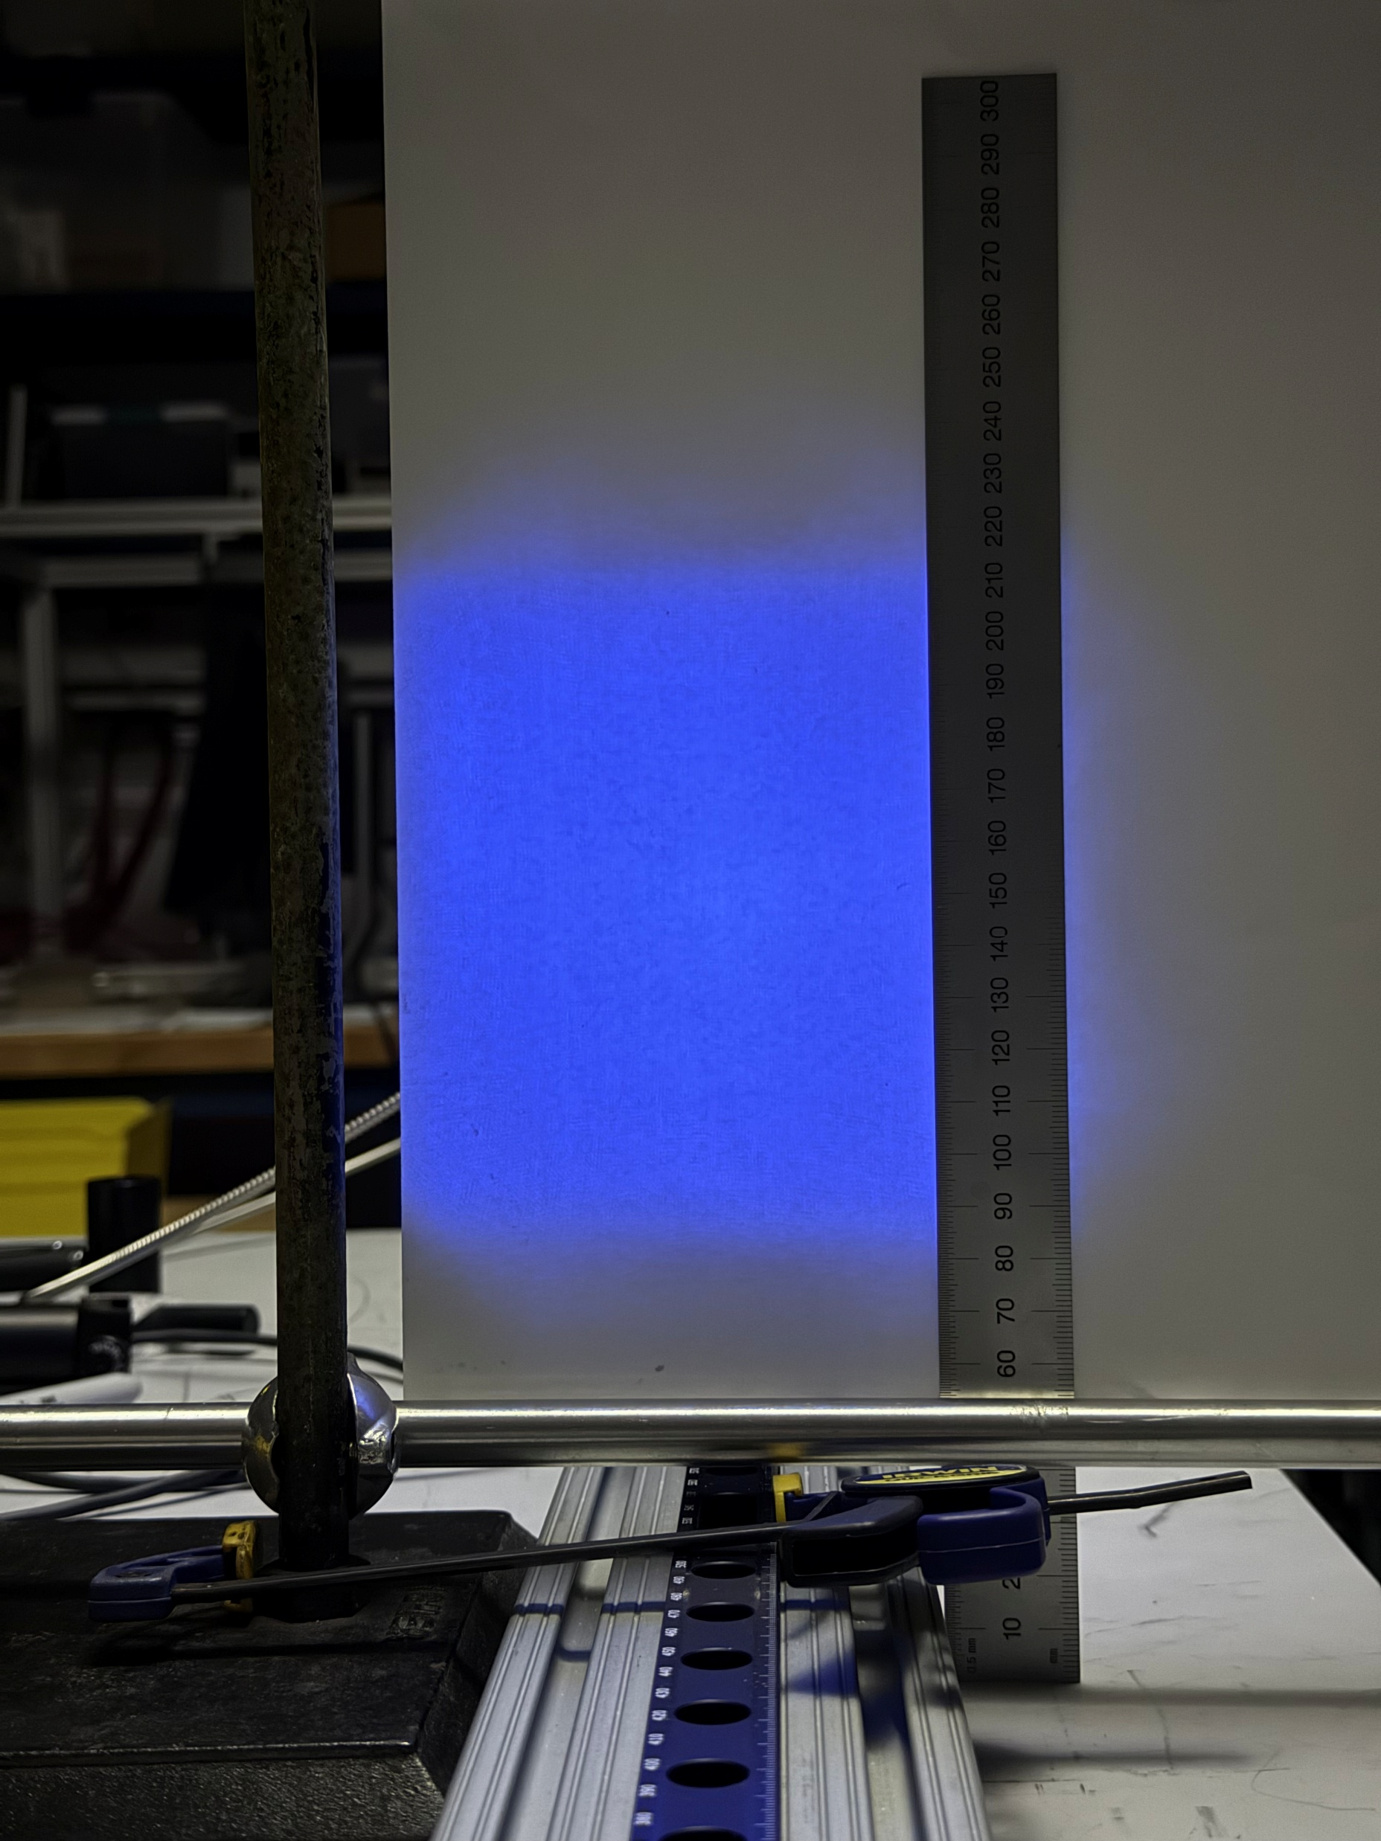
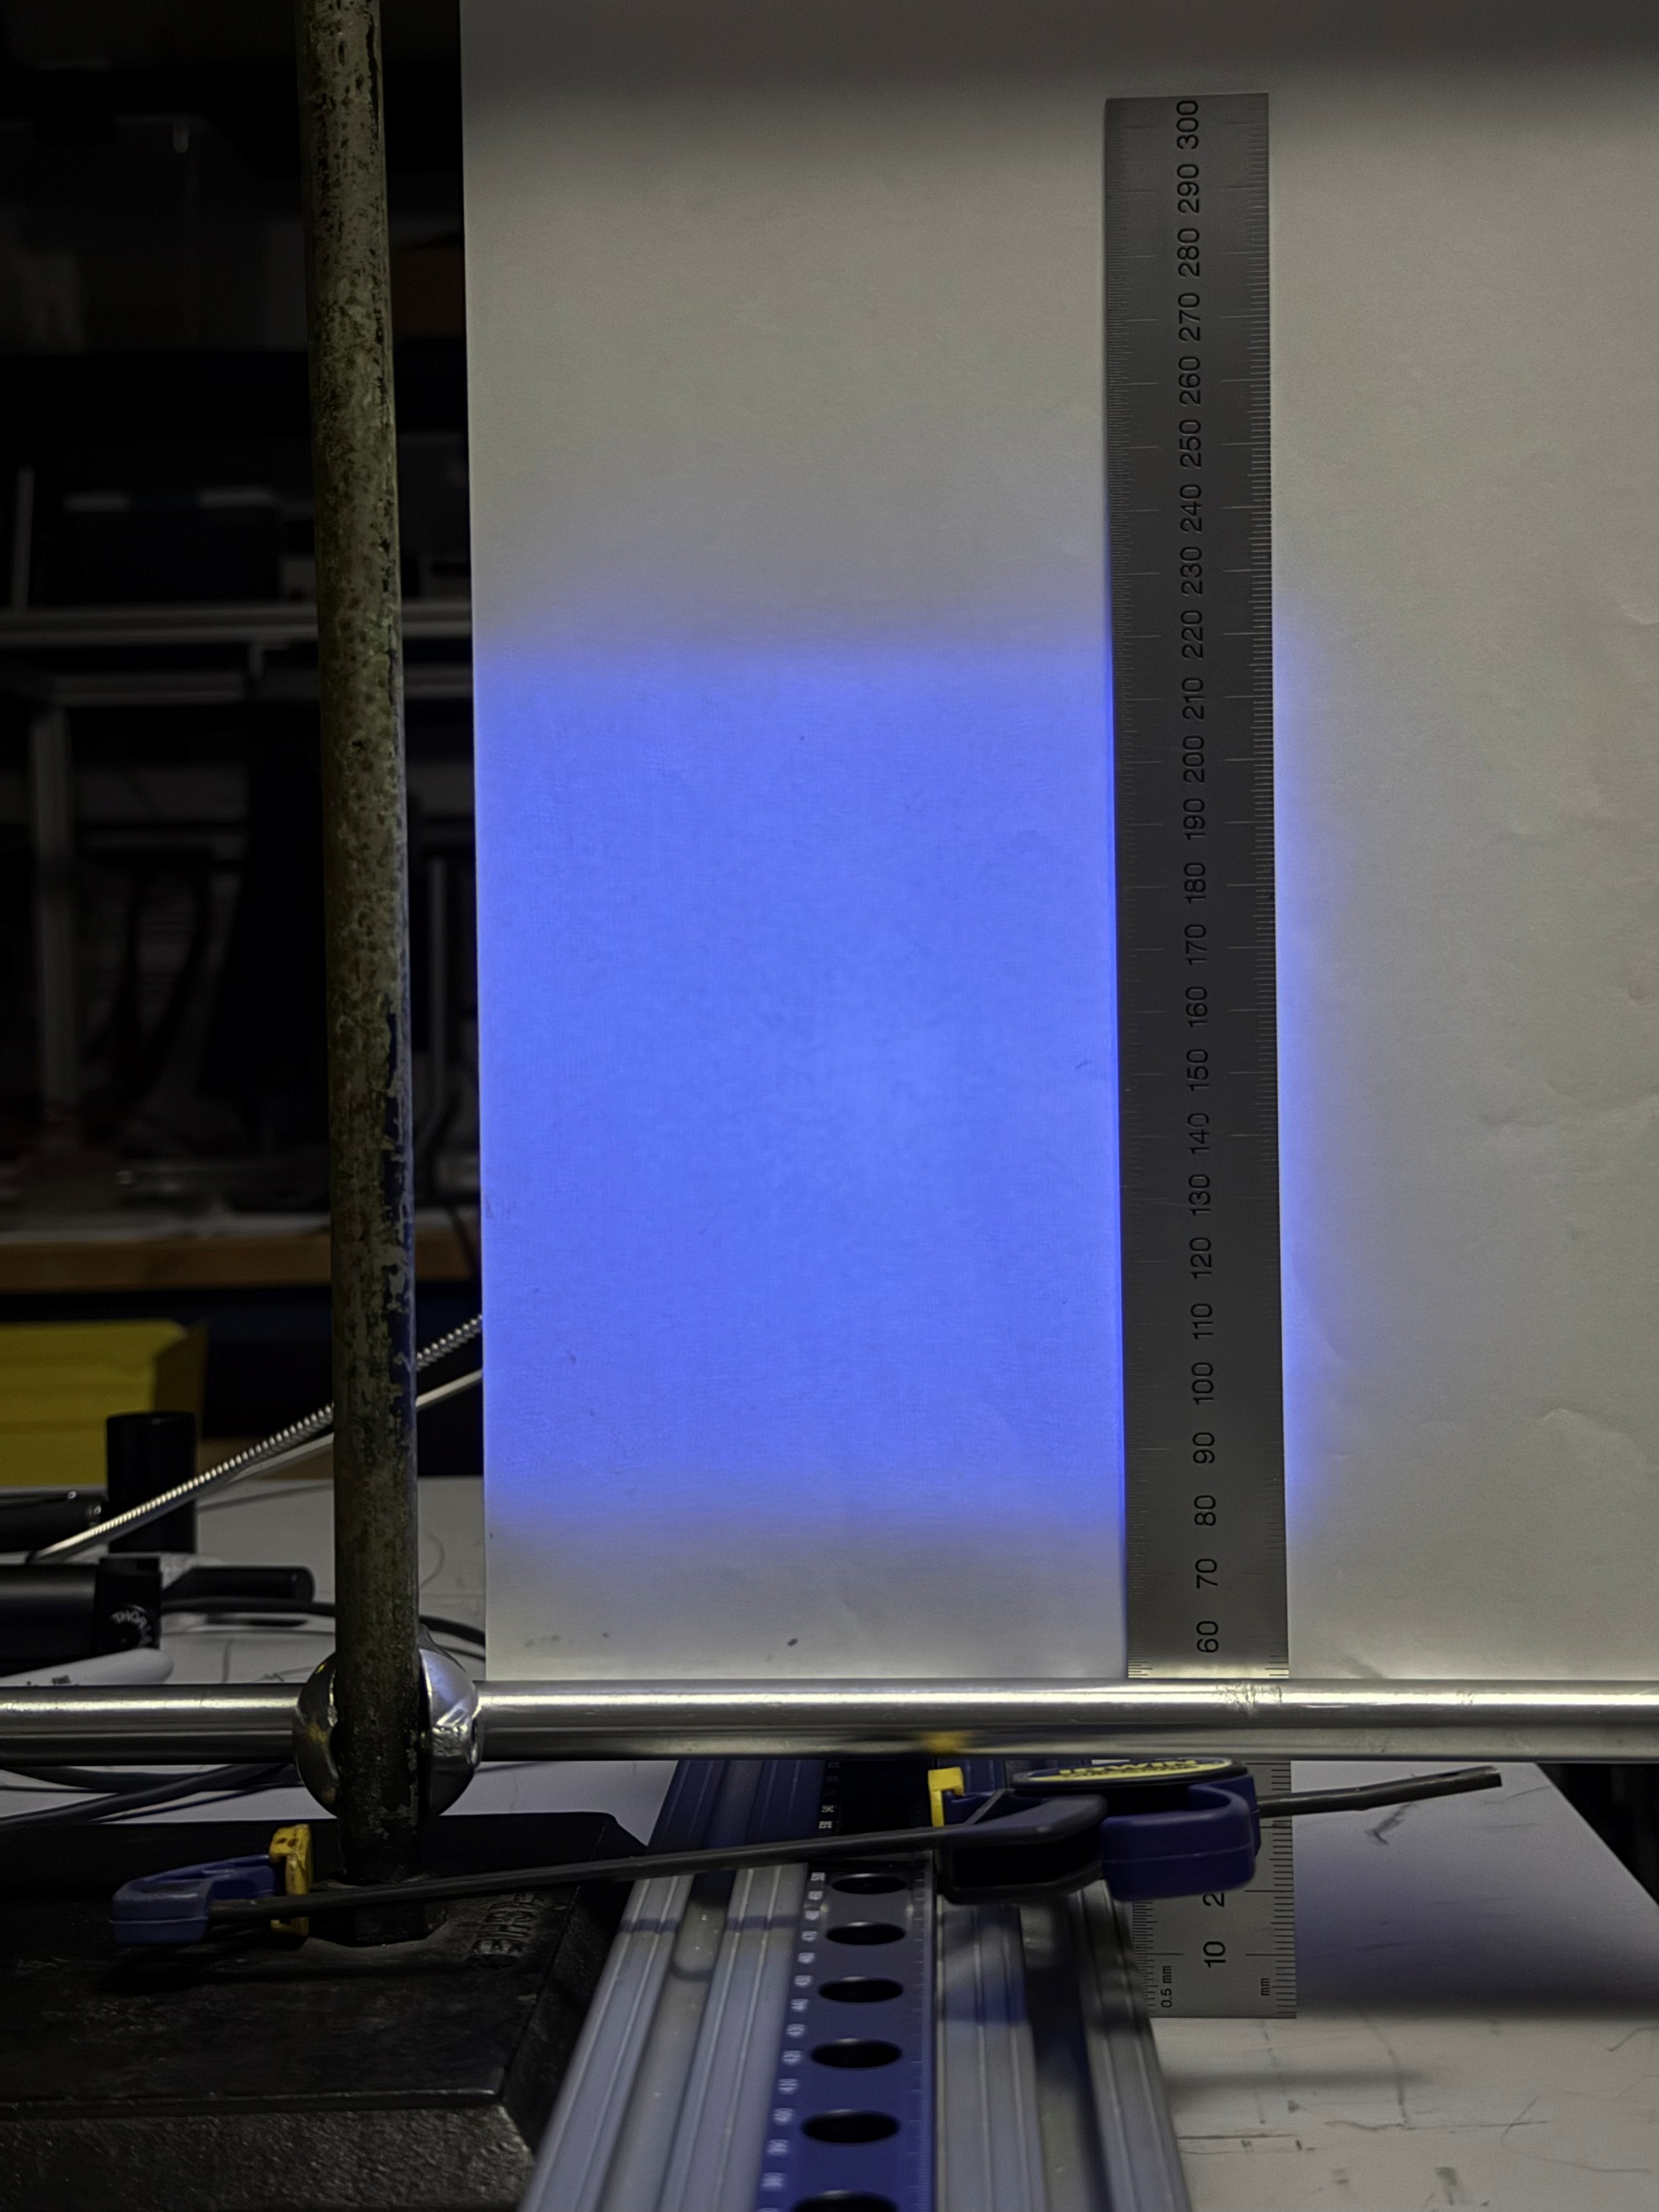
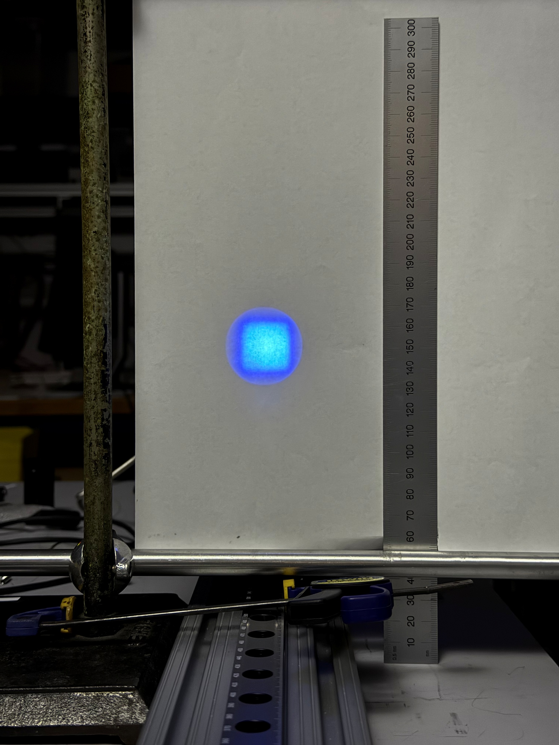
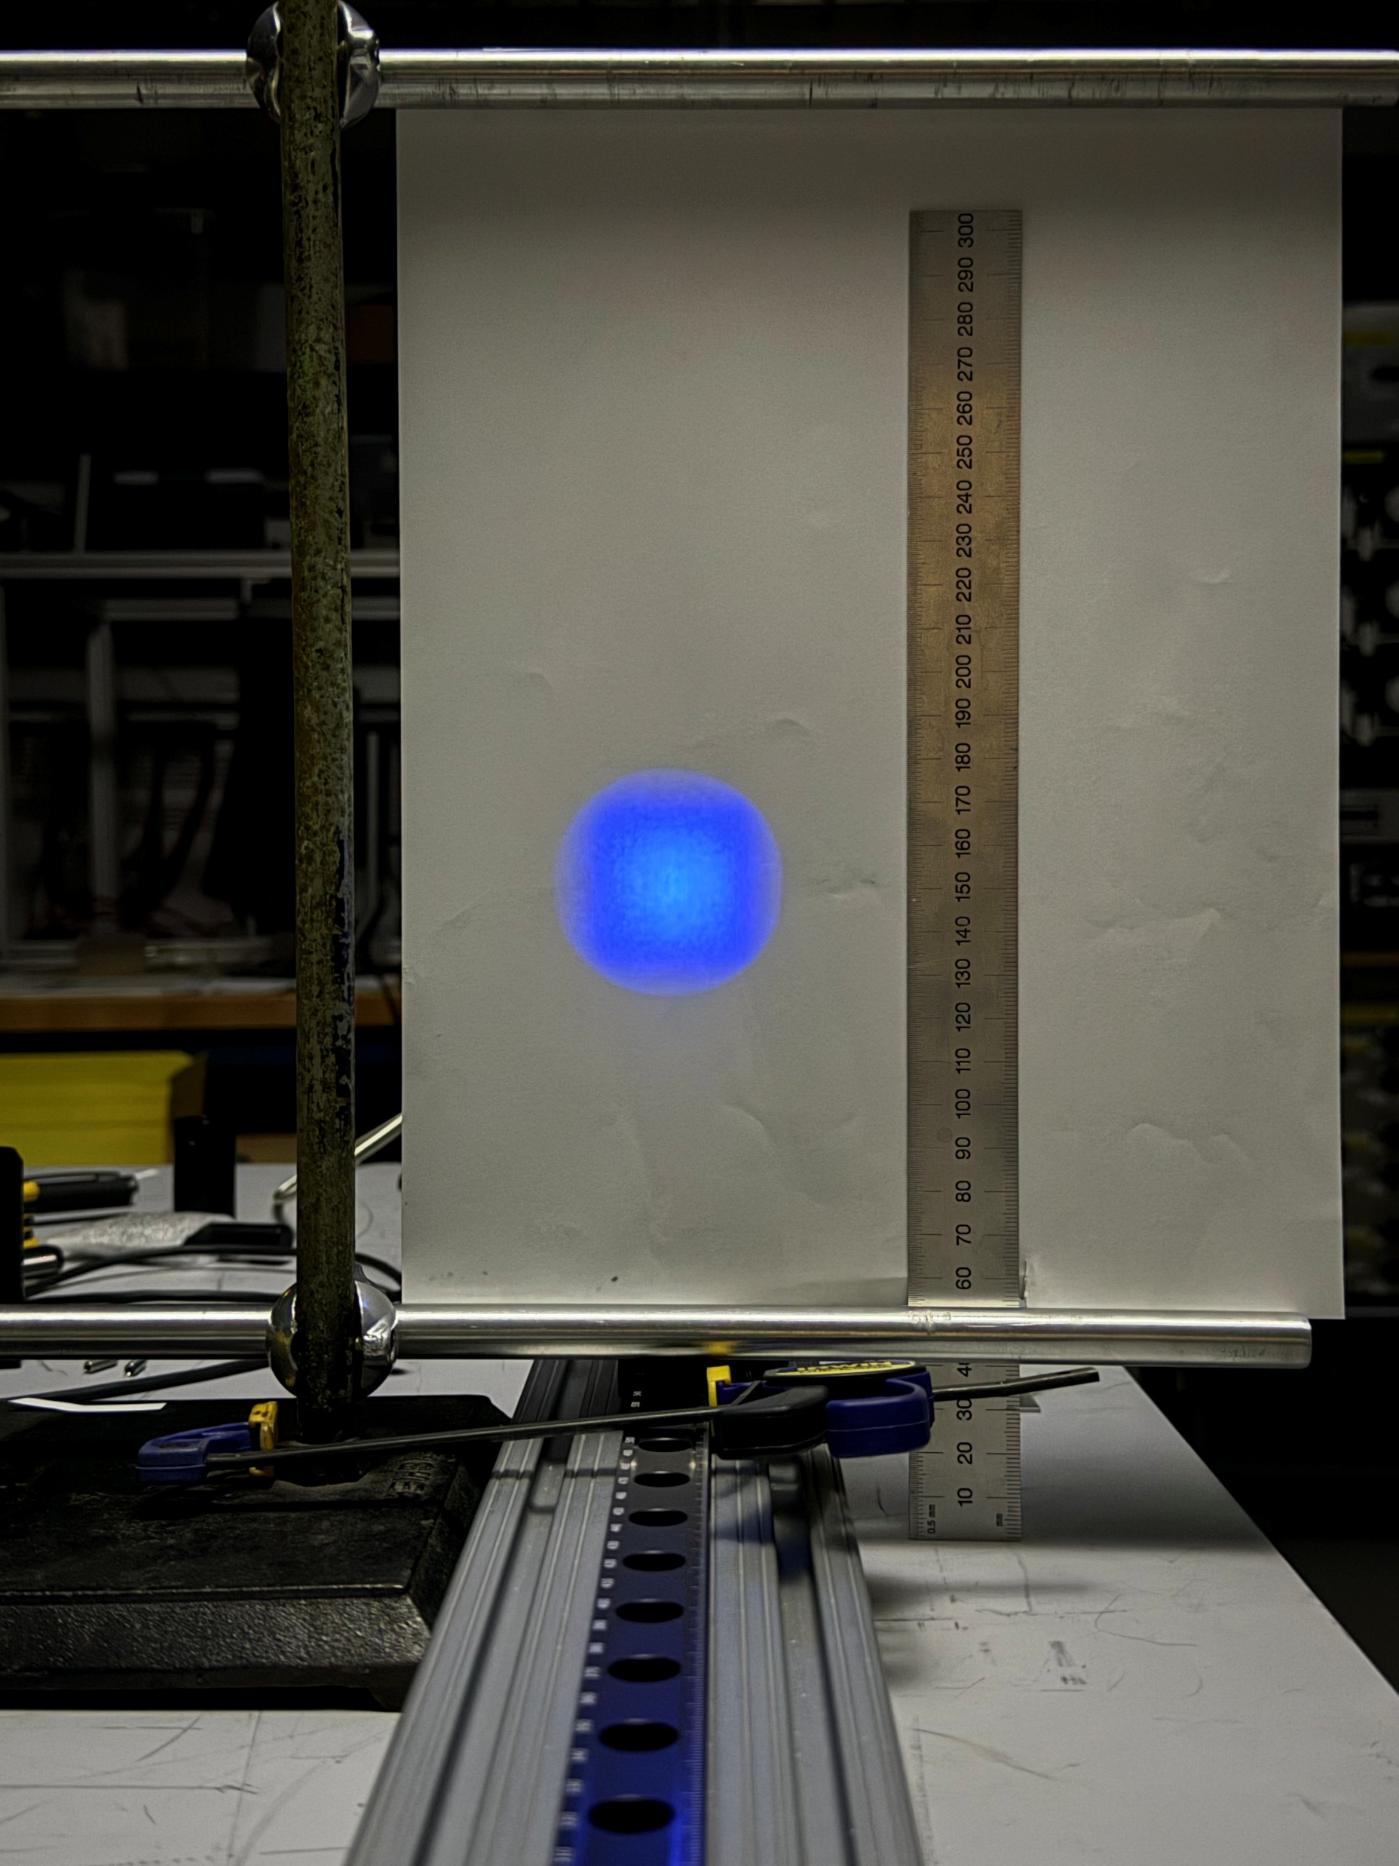
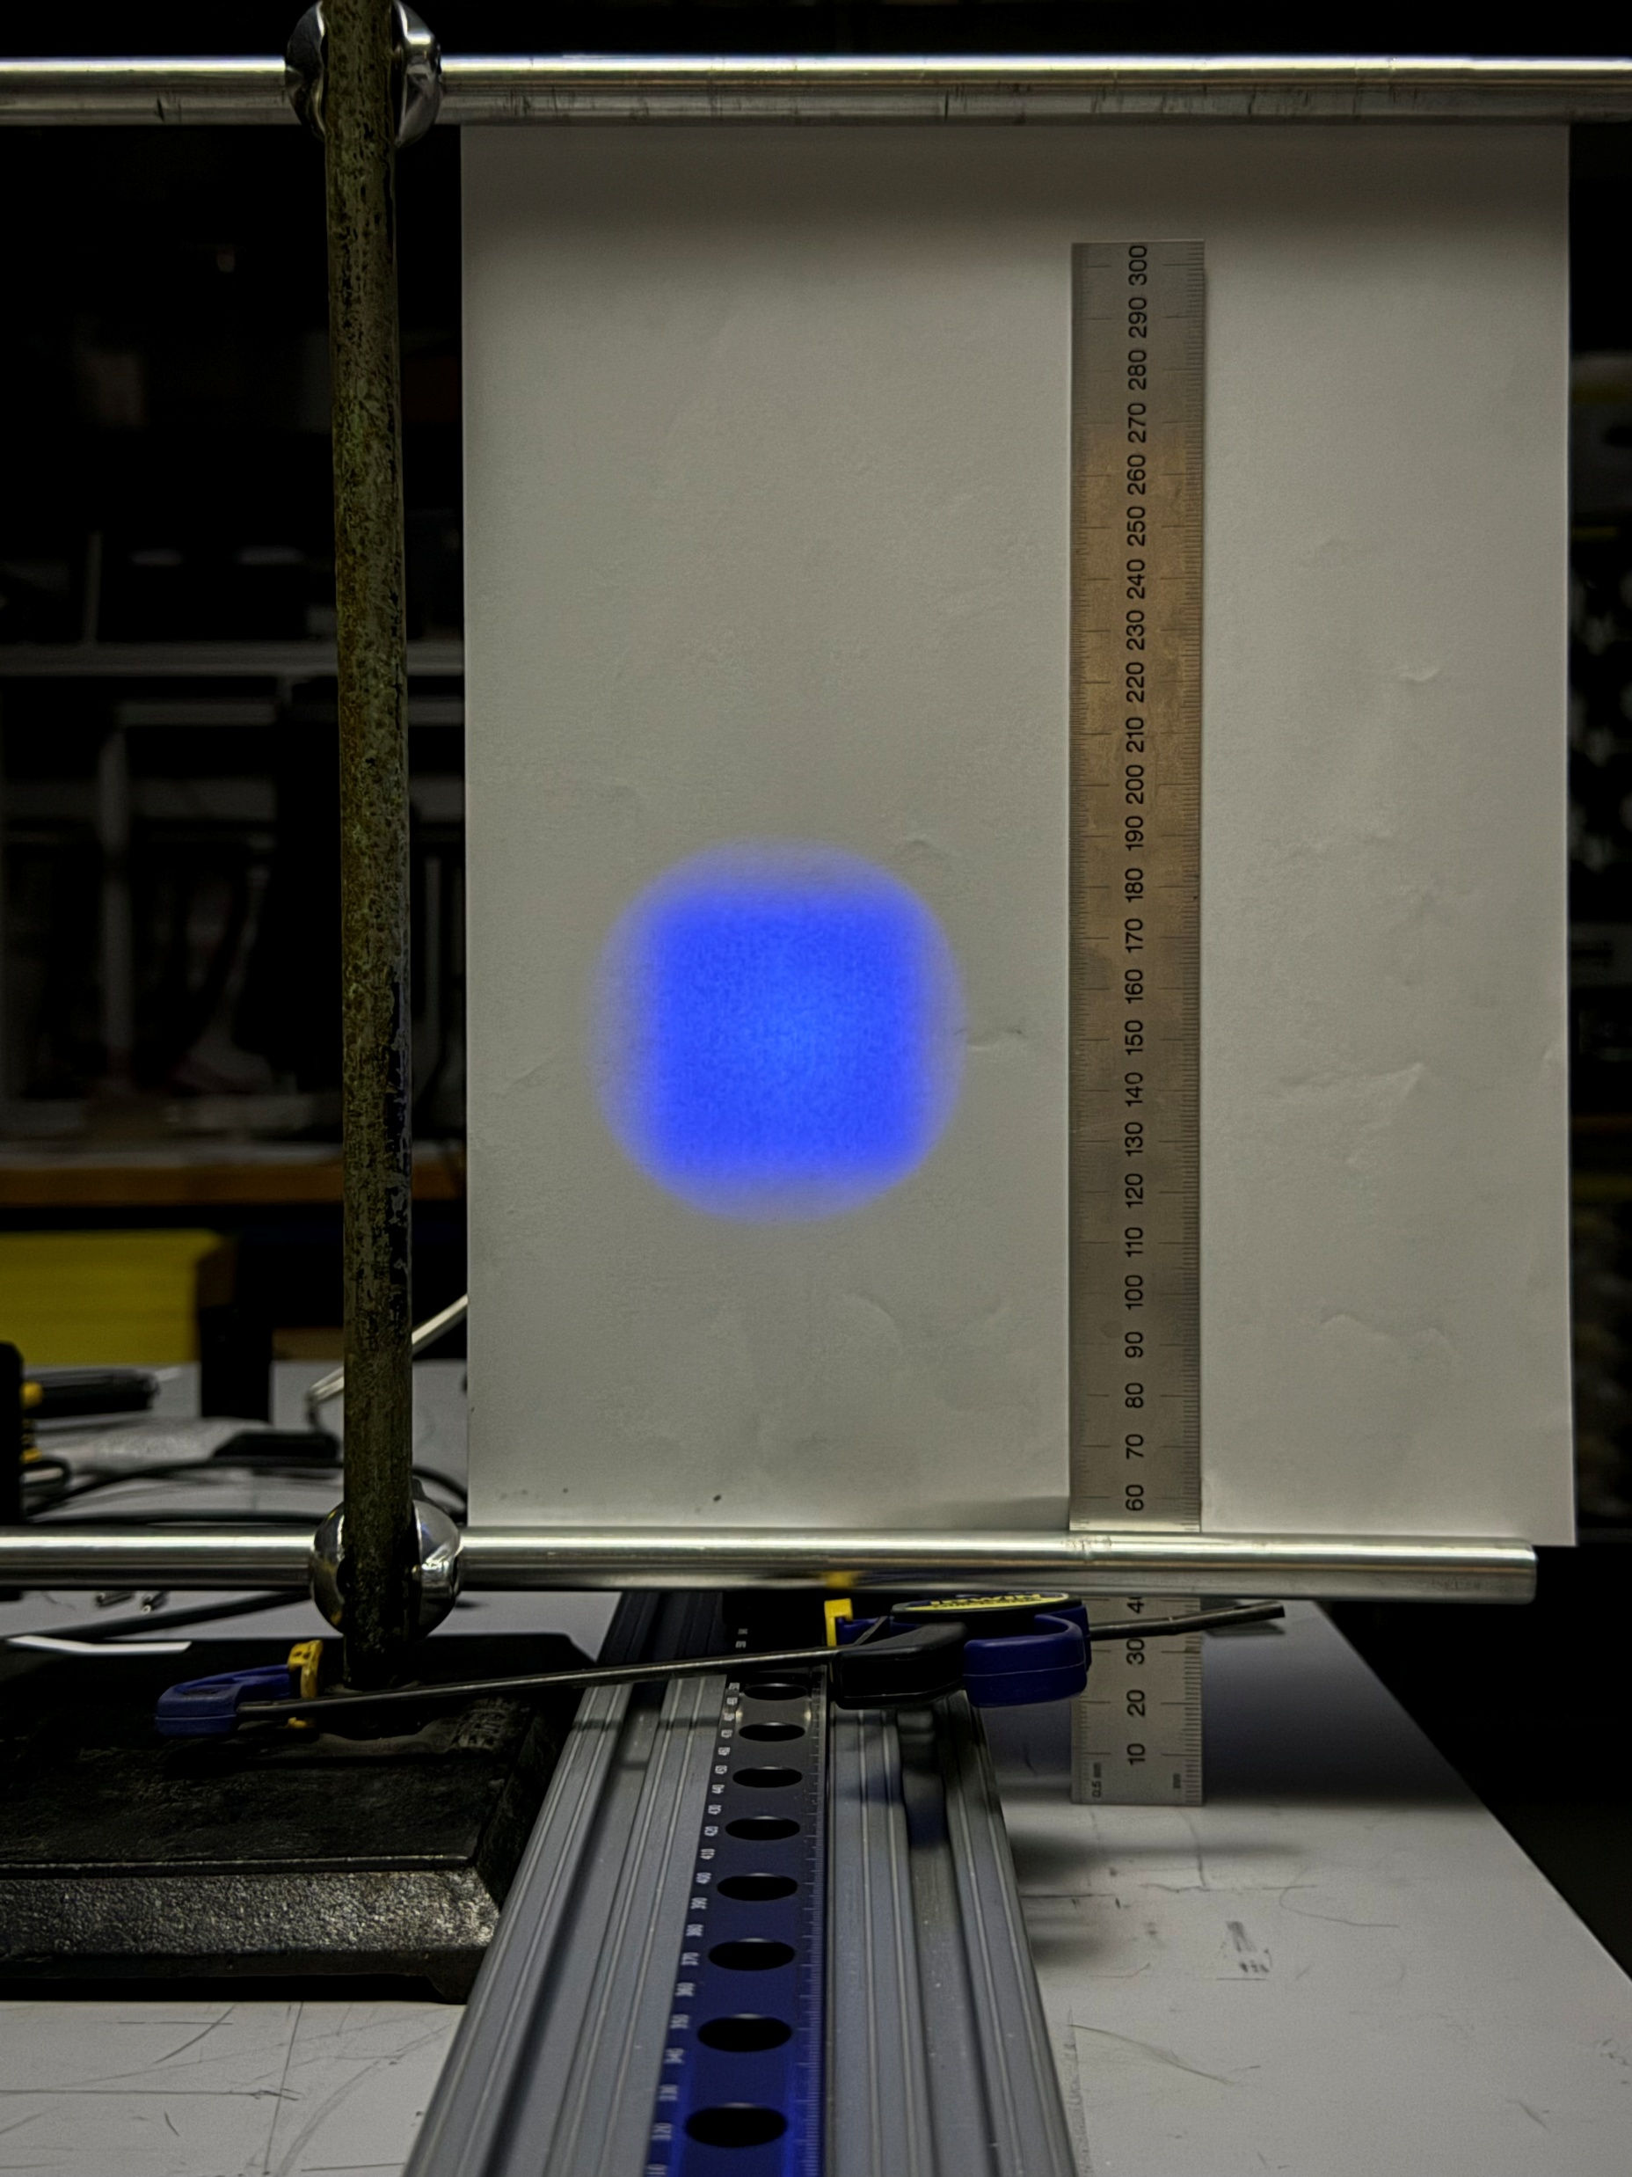
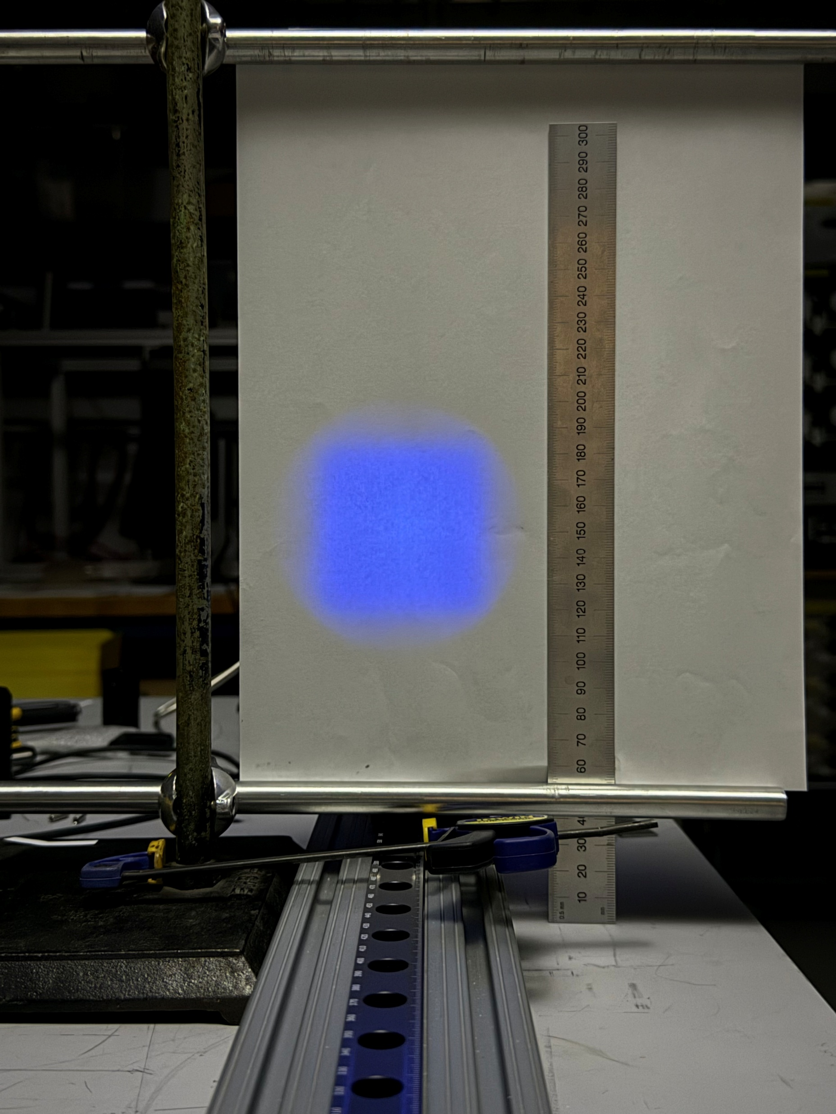
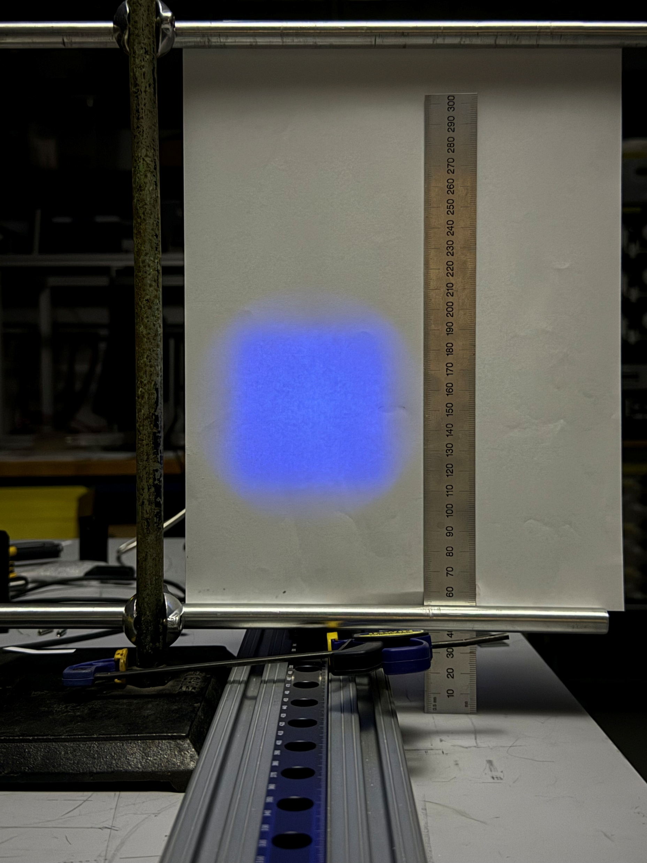
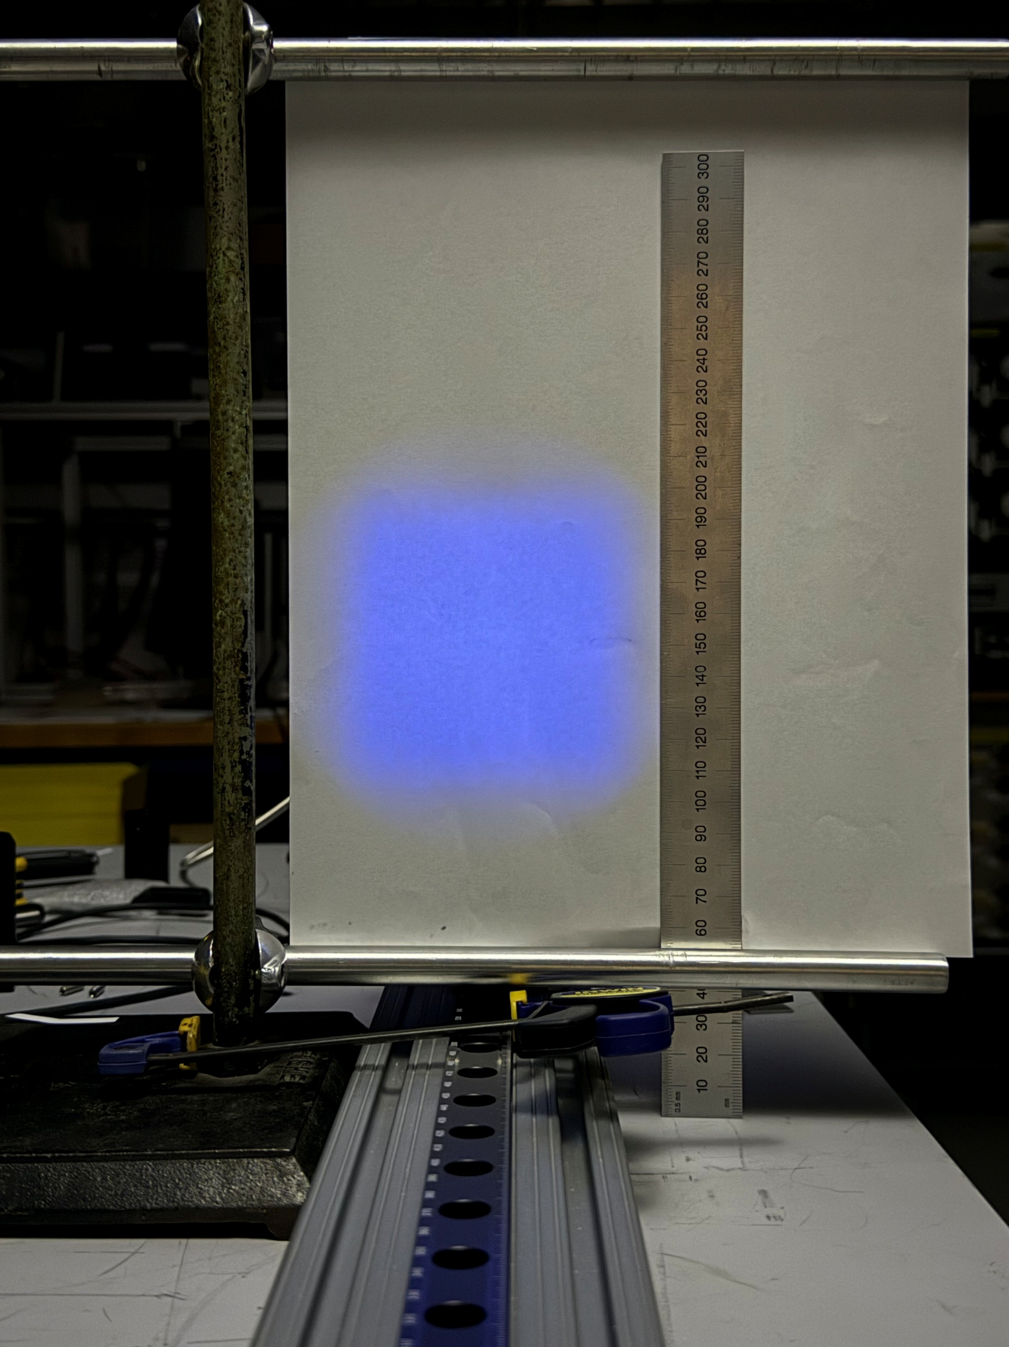
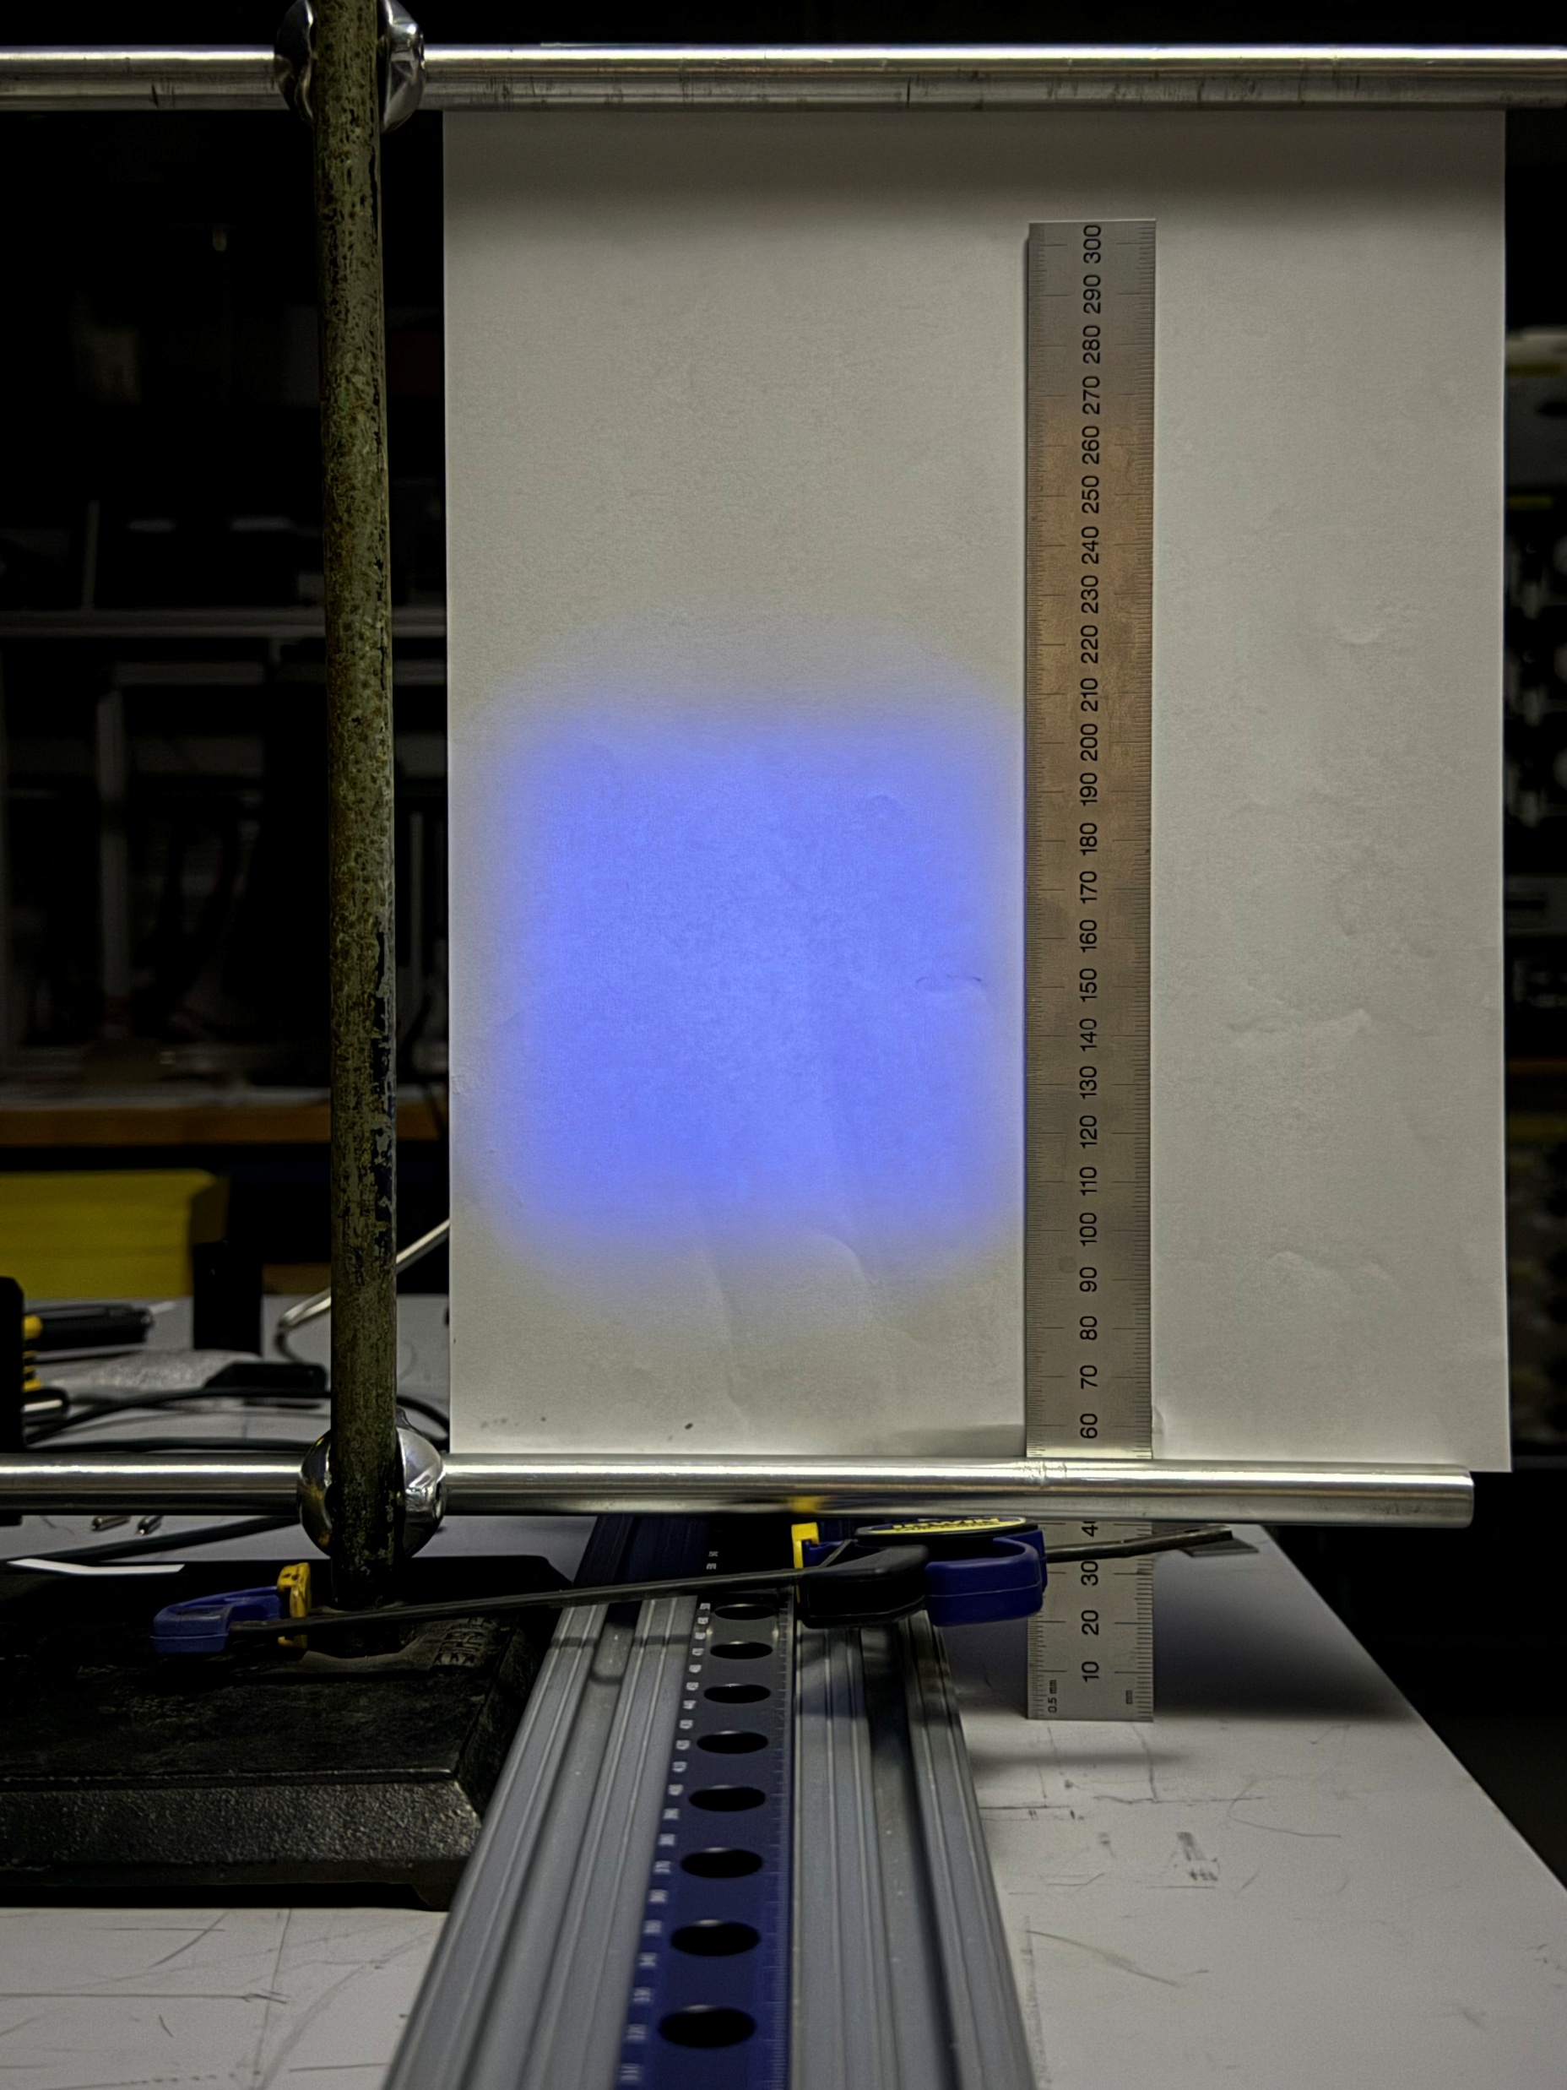
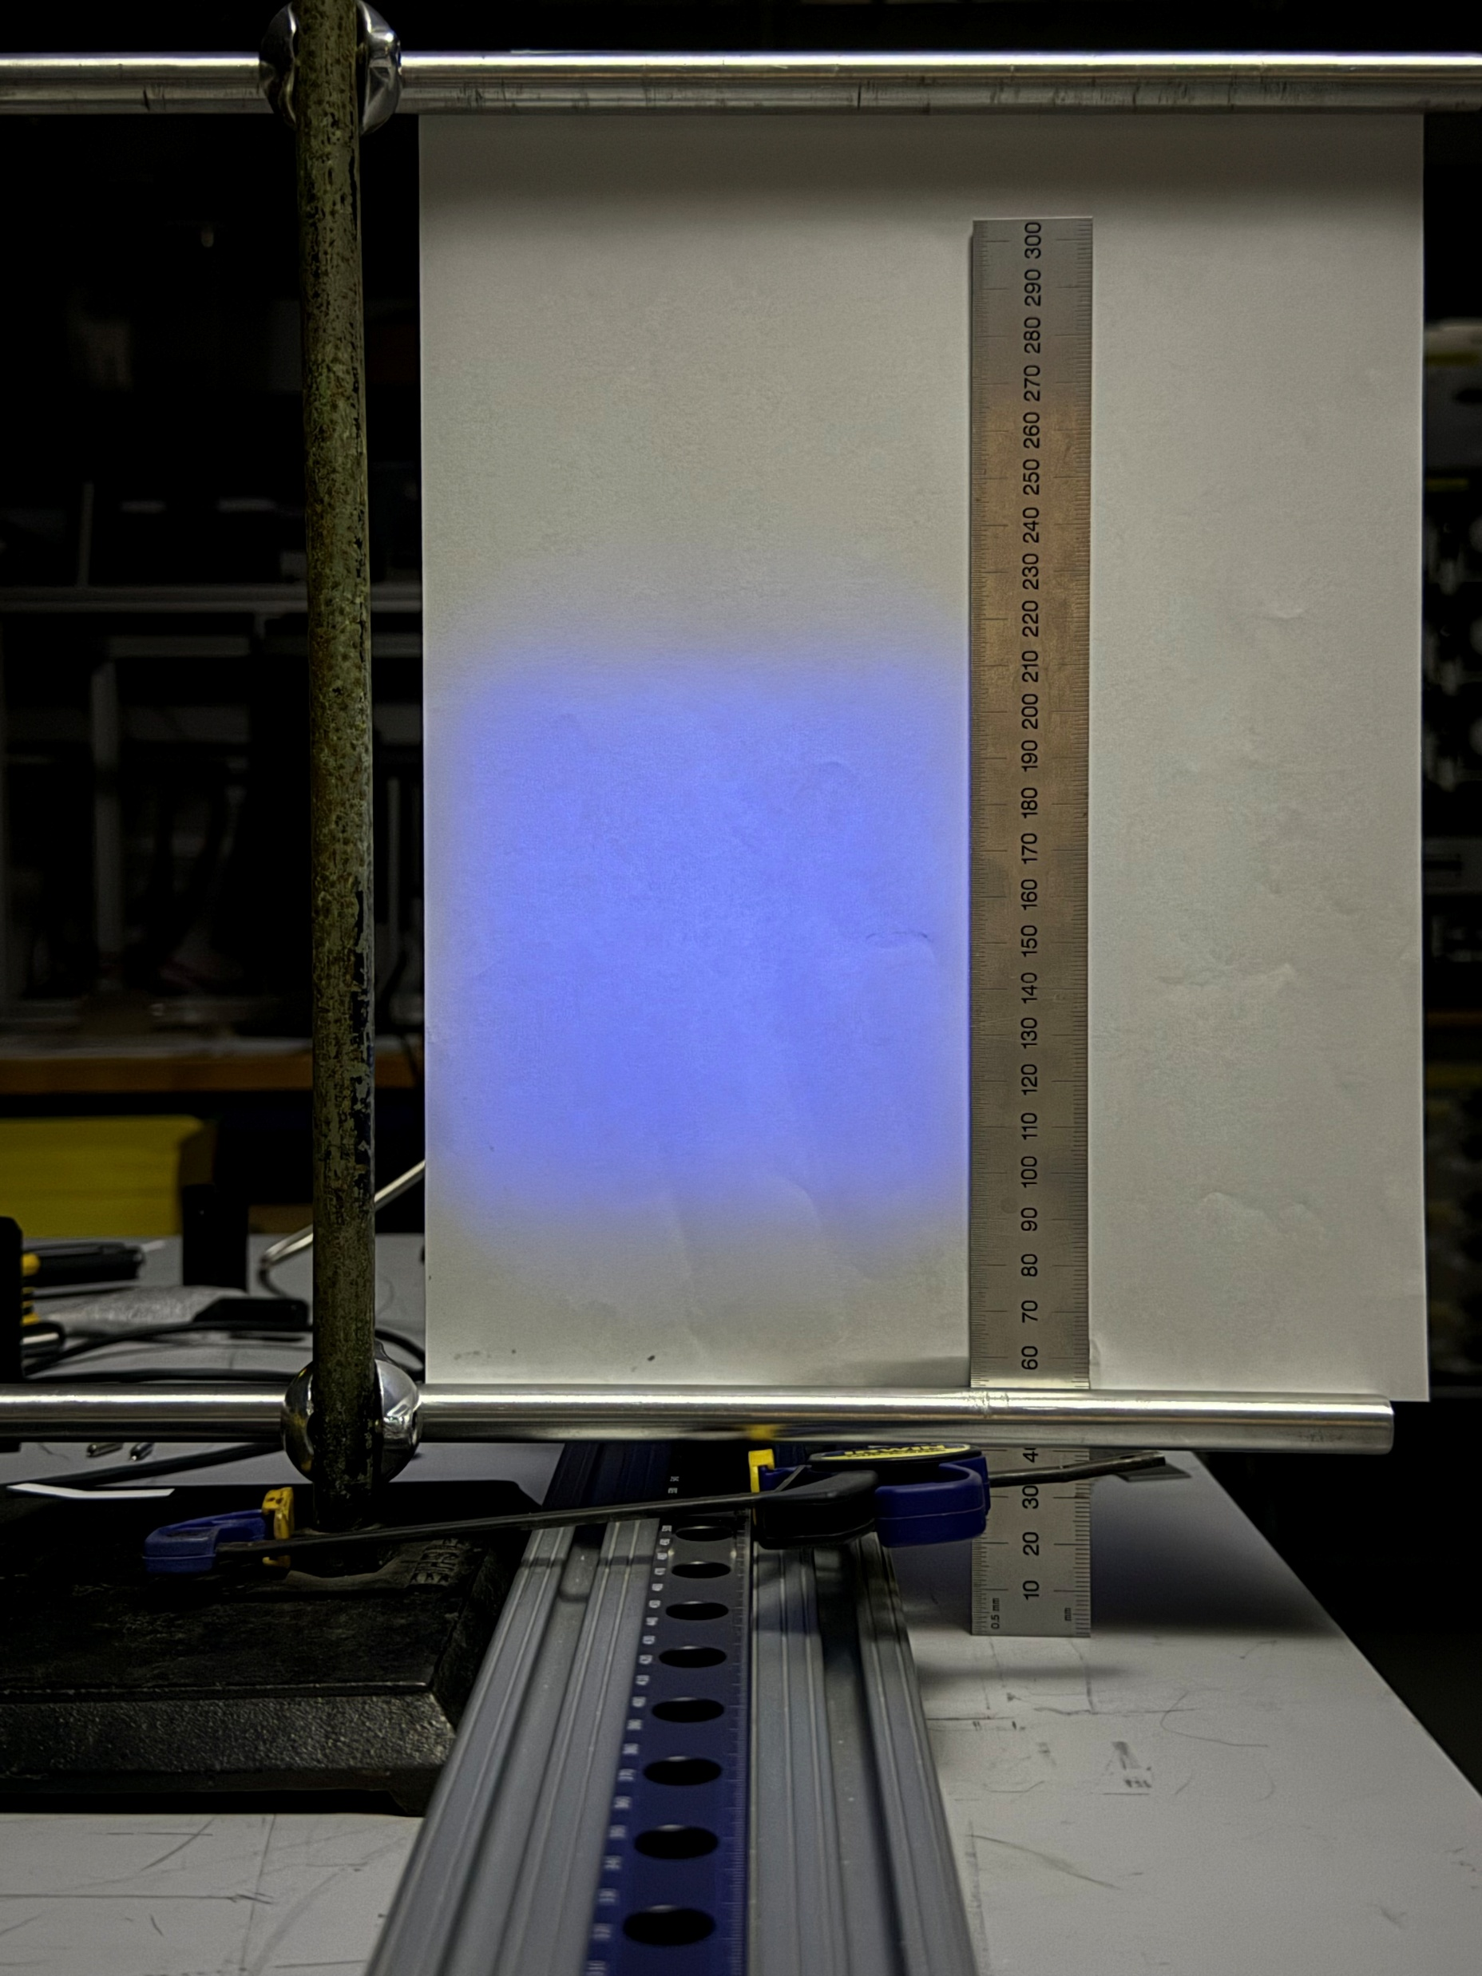
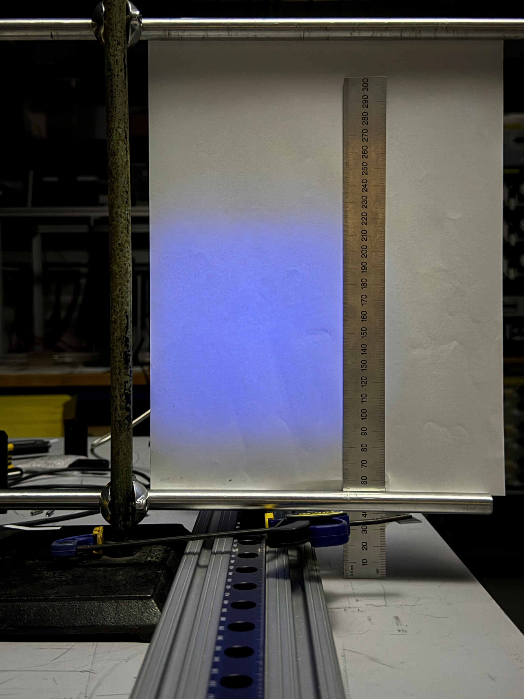
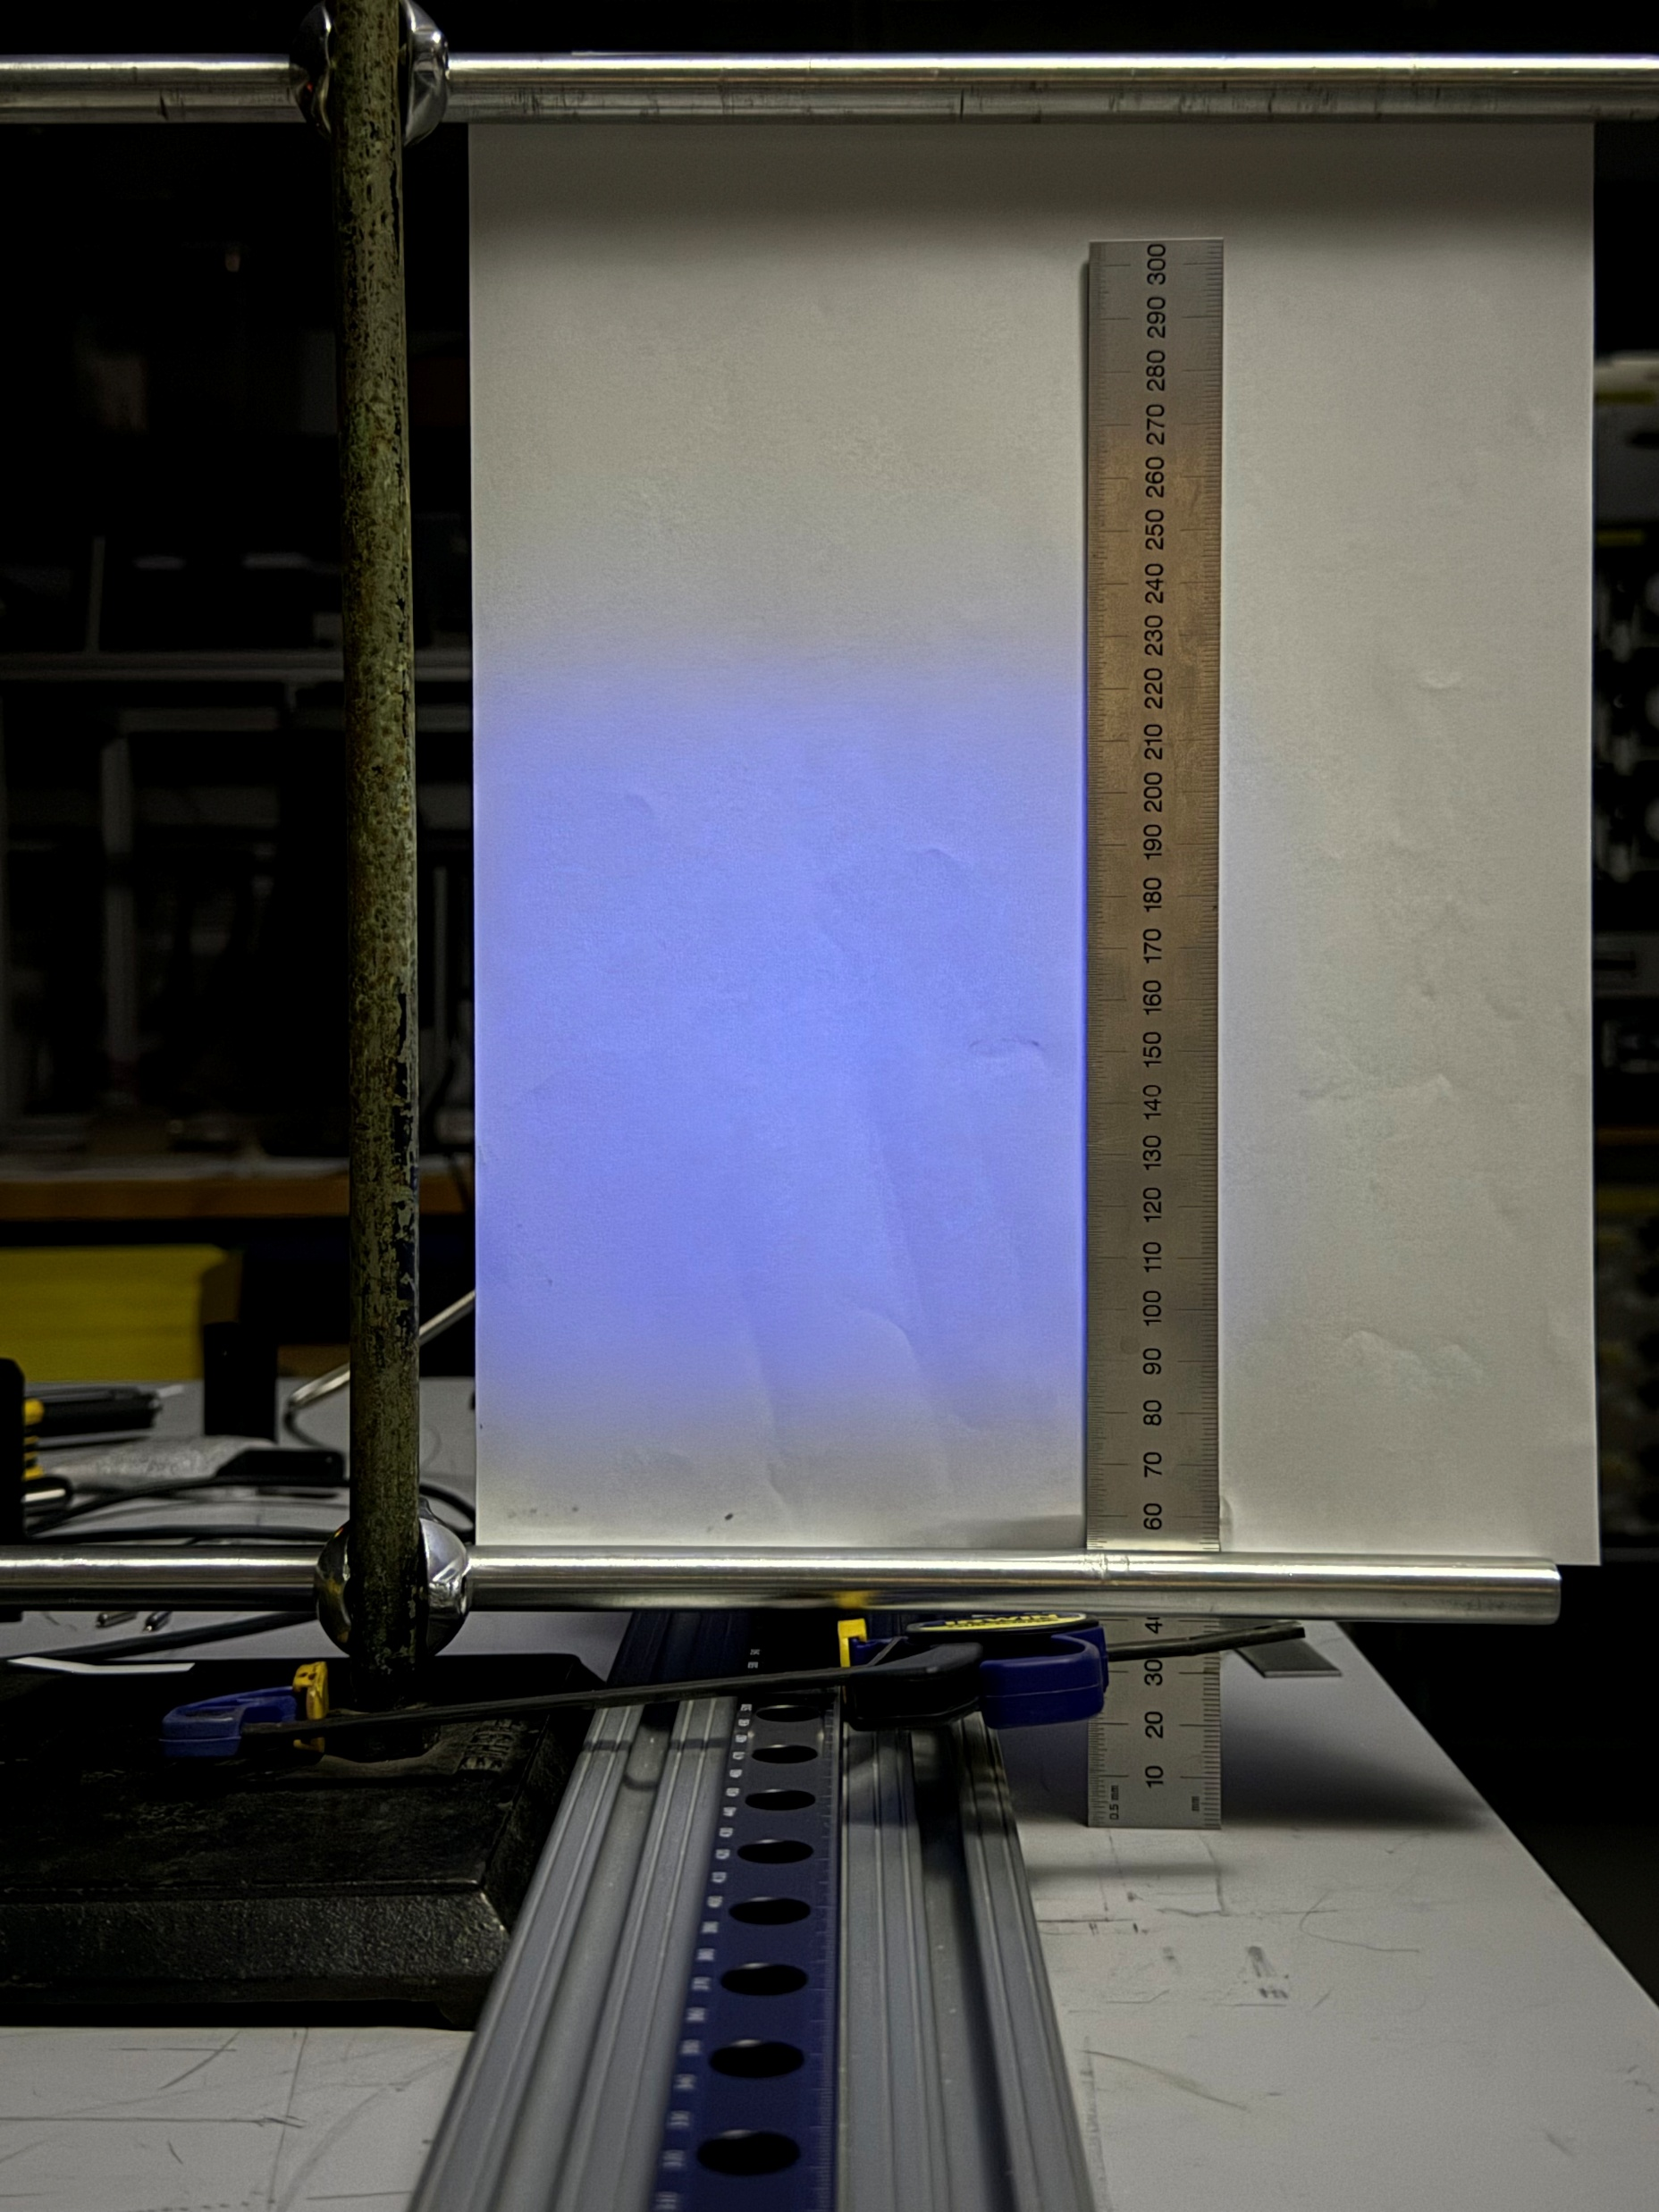
Series of images taken at different distances “d”
Laser + Fiber Bundle:
Laser + Diffuser:
Laser + Fiber Bundle + Diffuser:

Slide 9
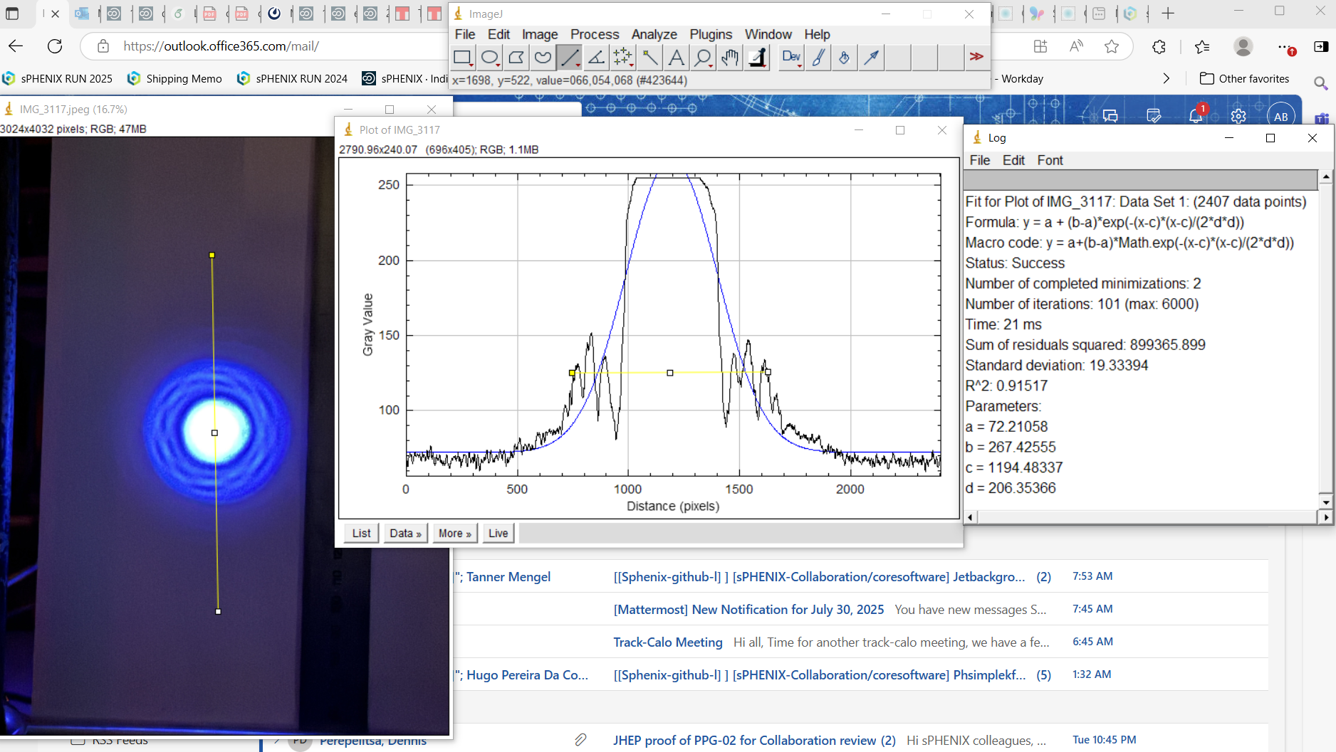
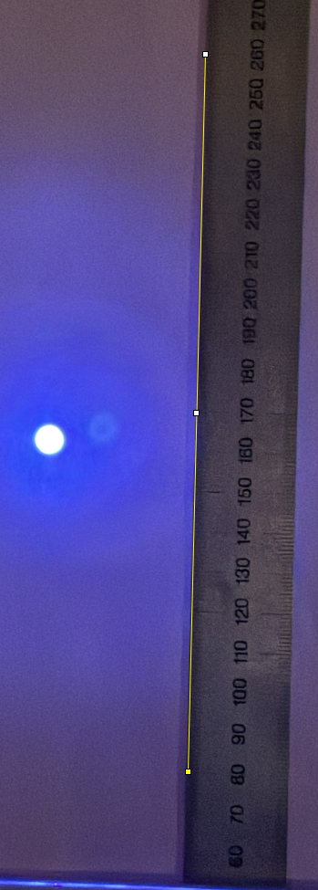
Pixel-Grey-scale Analysis: Fiber Bundle Output
Use image processing program (Image J) to analyze images
convert pixels to mm using image of ruler
determine dimensions of intensity profile in mm at different d
Grey-scale distribution is a flat-top with secondary peaks in the tails (possibly due to partially filled spatial modes resulting from the particular launch conditions used, ie illuminating bundle cores with laser beam (parallel rays))
Gaussian fit results in relatively large fluctuations in fit parameters
Estimating the Edges of intensity patten using the edges of the outer-most secondary peaks results in the most consistent measurement

Slide 10
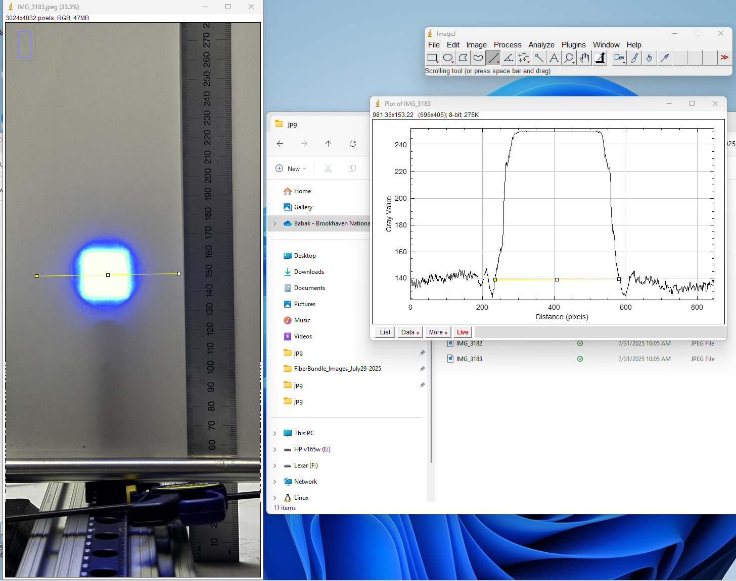
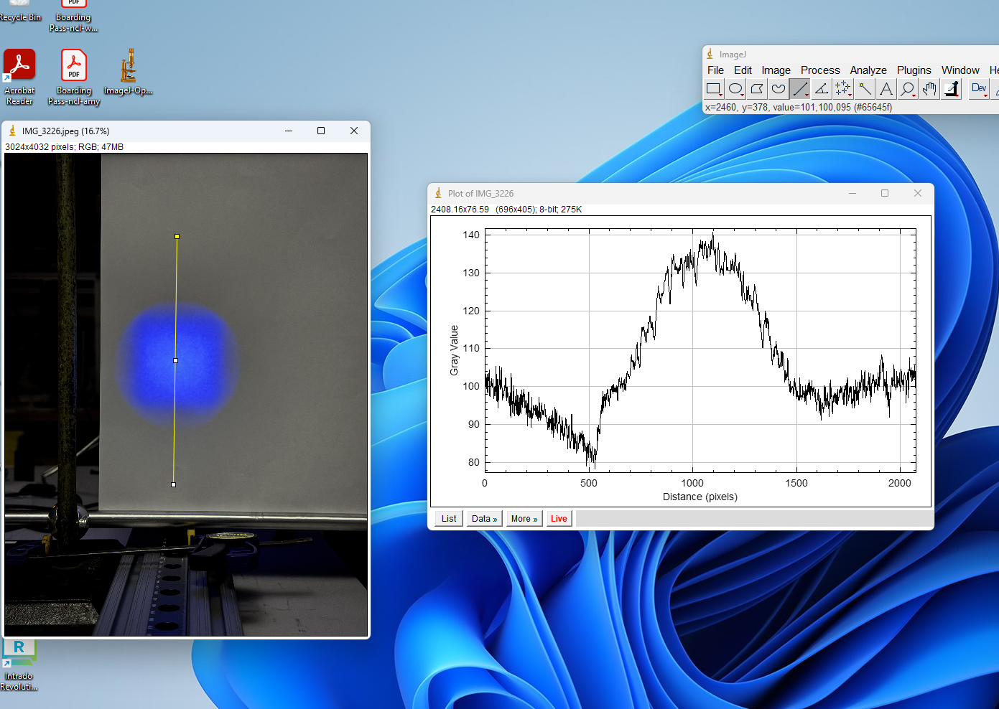
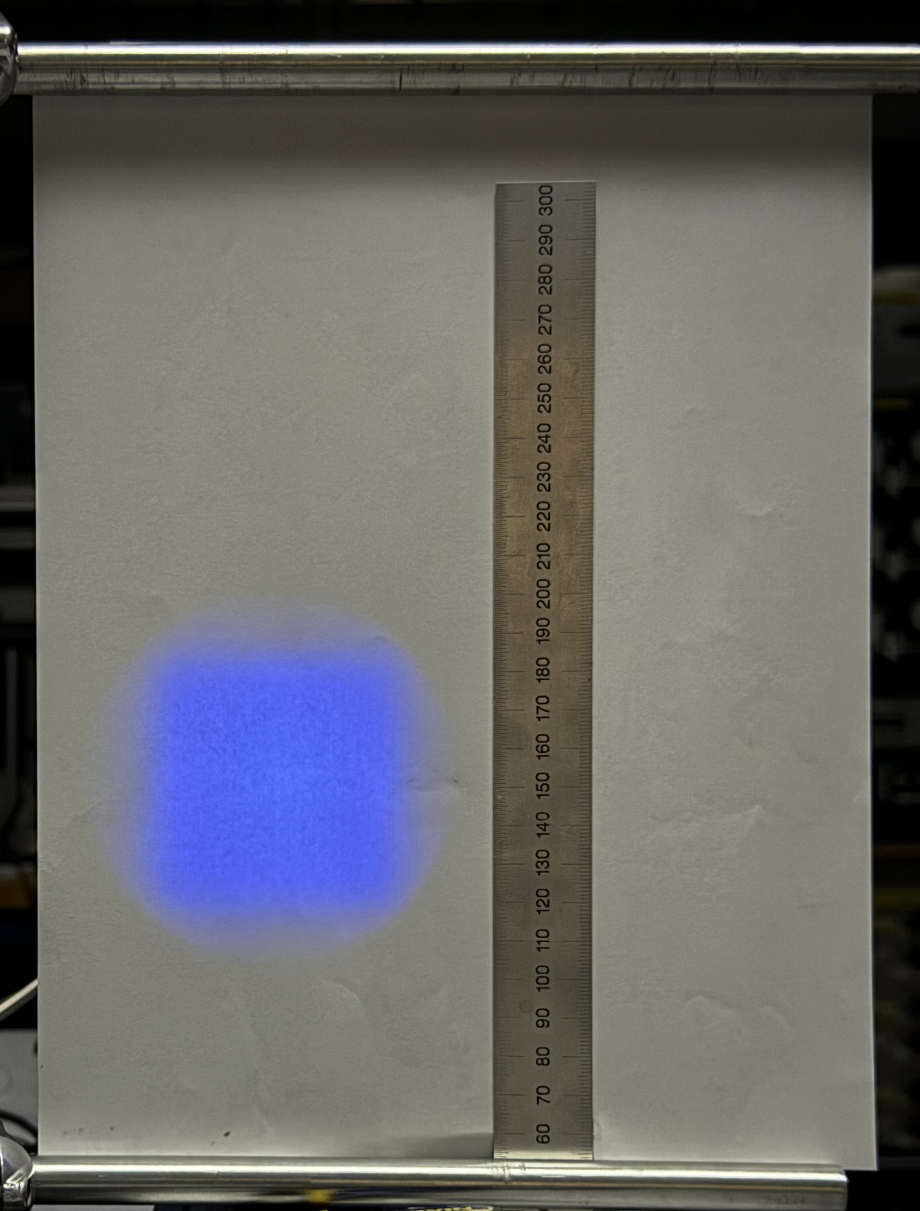
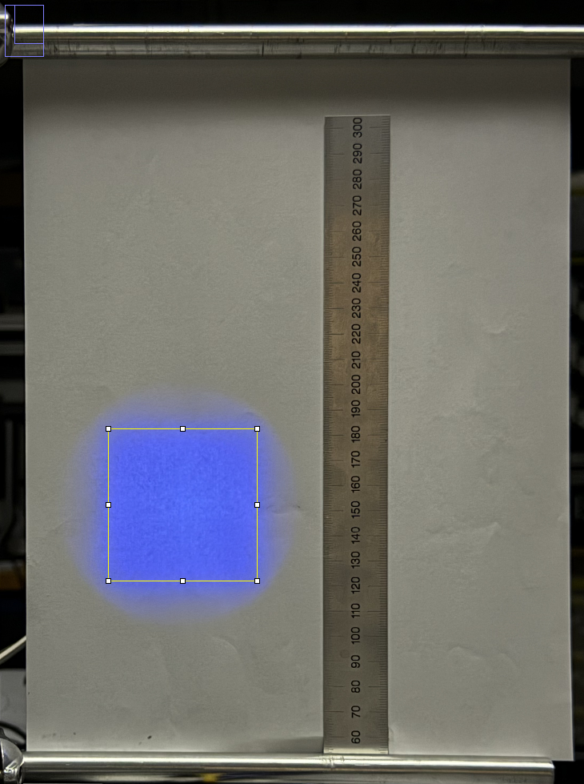
Pixel-Grey-scale Analysis: Diffuser Output
Perimeter is well defined when contrast is high (sufficient only at high flux density)
Non-uniform white background causes large fluctuations in baseline
Fits to the grey scale distributions are precise, but inaccurate
Eyeballing a square fit to the image and assigning a relatively large error gives the most consistent results (accurate, but imprecise)

Slide 11

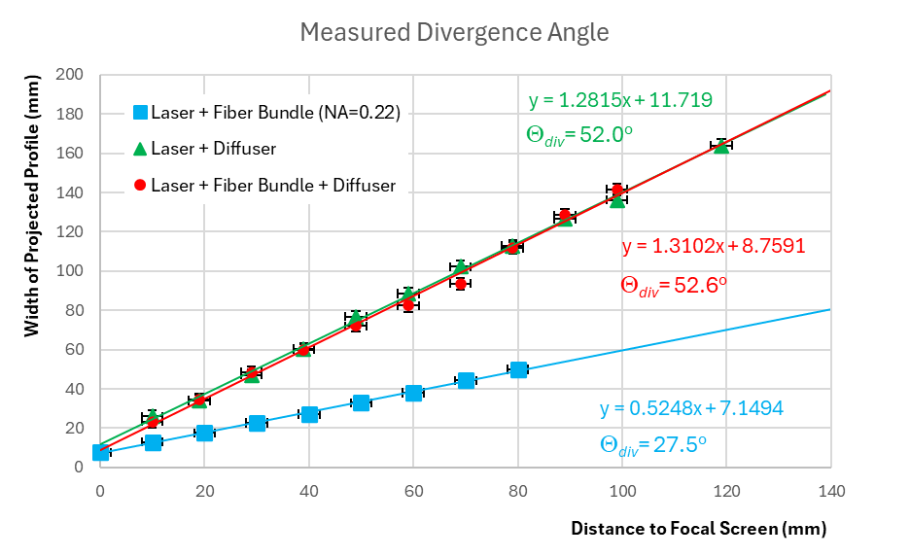
Divergence Angle
Thorlabs measure of the div. angle for the 50º polymer engineered diffuser
The goal is to measure the divergence angle for the fiber alone, then the fiber and the diffuser together
First, we verify that the measured fiber divergence is equal to the expected divergence
Fiber bundle NA = 0.22 → Θ_{div} = 25.4º (full angle)
NB: The SM fiber we intend to use for the pfRICH has a NA = 0.12 (Θ_{div} = 13.8º)
Measured Θ_{div} = 27.5º ± 3º is consistent with quoted NA
Next, we measure the divergence of the diffuser by itself using a laser source
The measured divergence angle of 52.0º is also consistent with the manufacturer specs
The agreement of these results with expectations demonstrates the reliability of the measurement scheme
Finally, we measure the div. angle of the fiber bundle diffuser combination to see whether the light source profile influences the output profile of the diffuser
The increase in div. angle from 52.0º to 52.6º is well within the error, indicating that the effect of using either a laser (parallel rays) or a fiber (light cone) to illuminate the diffuser is not detectable here and will likely have a negligible impact on our application for the pfRICH.

Slide 12









Distance between diffuser and fiber “f ”
d is fixed
f is varied to see the effect on the output profile
Though we can see the intensity of the output change, the camera changed its settings automatically for each exposure. The image intensity was not corrected for these changes and so it would be incorrect to compare these intensities, even on a relative scale.
The goal here is to see whether the profile width changes as a function of f

Slide 13




Shape of Diffuser Intensity Profile
The pixel-to-pixel intensity within a given exposure has good fidelity
The relative intensity between exposures is not corrected and cannot be taken at face value
Conclusion: the intensity profile of the diffuser in the near and (relatively) far field show a flat top, as expected
d = 10mm
f = 3mm
W = 23mm
d = 10mm
f = 3mm
H = 23mm
d = 80mm
f = 3mm
W = 90mm
d = 80mm
f = 3mm
H = 93mm

Slide 14
Summary
The following assumptions about the diffuser profile we incorporated into our simulations were verified by the following bench-top measurements:
The diffuser profile does indeed have a ~50º full divergence angle, even when using a (divergent) fiber source
A highly divergent source like a fiber produces almost the same output profile from the diffuser as a laser beam does
The distance between the fiber tip and the diffuser is not a critical parameter
The intensity profile from the diffuser is indeed a flat top with gradually falling edges, similar to the specifications of the manufacturer
The diffuser does have a preferred orientation that defines the orientation of the square profile, so care must be taken when installing these optics
The incident angle of the light source on the surface of the diffuser linearly affects the tilt angle of the output intensity profile, so care must be taken when aligning these optics in order to avoid steering the intensity pattern away from the intended target

Slide 15
Backup

Slide 16



Numerical Aperture of Fiber Optical Cable
Source: https://en.wikipedia.org/wiki/Numerical_aperture

