Slide 1
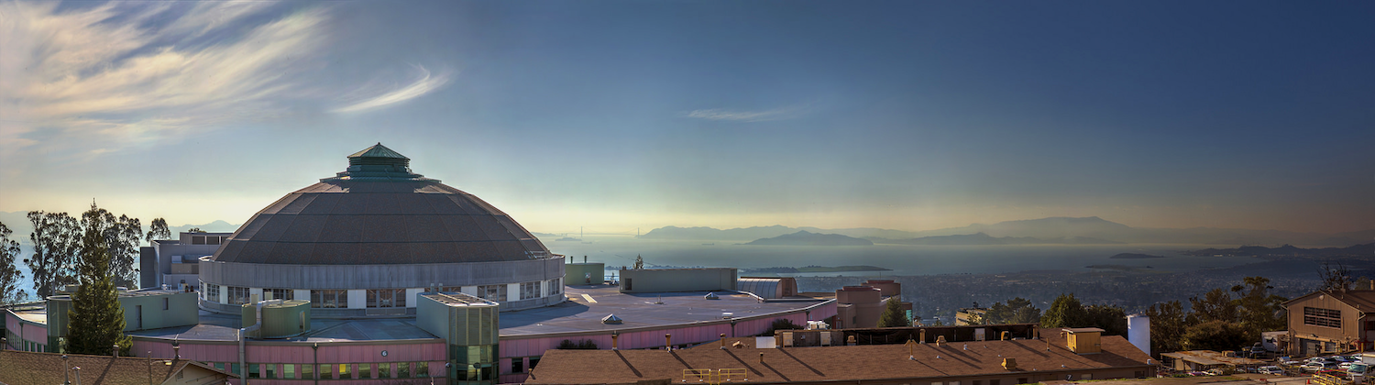



Beam Stability - How to meet users’ requirements
Christoph Steier
ALS/ALS-U/ATAP, LBNL
April 26, 2017

Slide 2
Topics
Introduction - Importance of Stability
Stability – from design to operations
  Facility design / Disturbance Source Suppression
  Damping of vibrations
  Active Correction
    Feed Forward
    Feedback – Slow/Fast
    Multibunch feedbacks
Areas of Concern
  Orbit
  Beamsize – Lattice function / Coupling / nat. emit
  Beam Energy / energy spread
  Lifetime, injection efficiency -> Top-off

Slide 3
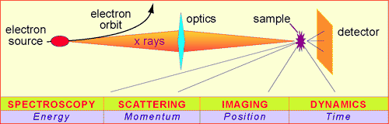
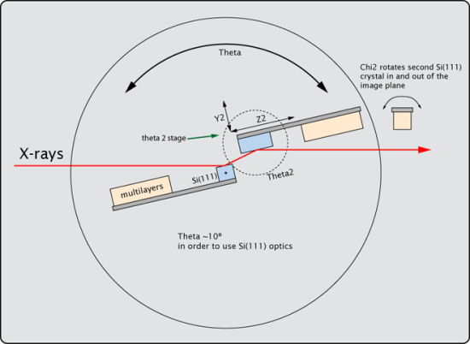
Beam Stability Requirements
Typical requirements of modern SR user experiments:
All of those requirements relate back into stability requirements for beam position + angle, beamsize + emittance, beam energy, beam energy spread, …
Often stability can be more important to SR users than brightness+flux
For current SR sources, this means for example submicron orbit stability (for DLSR in both planes)
Measurement parameter | Stability Requirement
Intensity variation ΔI/I | <<1% of normalized I
Position and angle | <2-5% of beam σ and σ’
Energy resolution ΔE/E | <10⁻⁴
Timing jitter | <10% of critical time scale
Data acquisition rate | 10⁻³ – 10⁵ Hz
3
Notes:
3

Slide 4
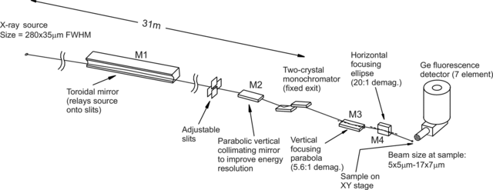
Beamline Example
Beamline 10.3.2 at the ALS
Hard x-ray, microfocus, micro X-ray absorption or fluorescence, …
Environmental samples (‘dirt’)
Very heterogenous

Slide 5
Causes for Orbit Distortions (no F/B)
Thermal
Vibration
Insertion Device Errors
Power Supply Ripple
.1
1
10
100
1000
Hertz
5

Slide 6
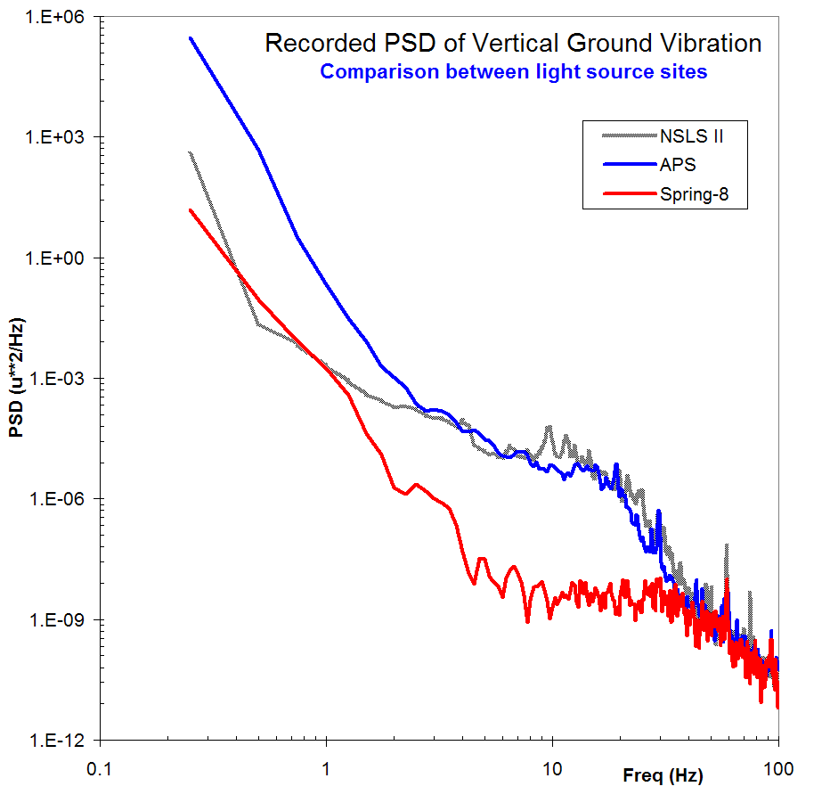
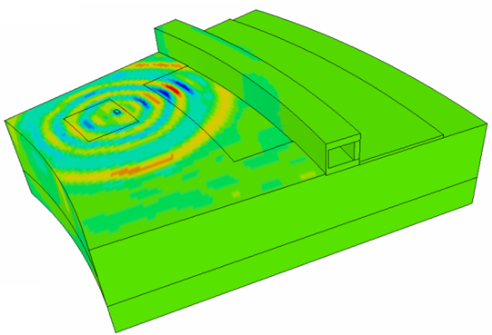
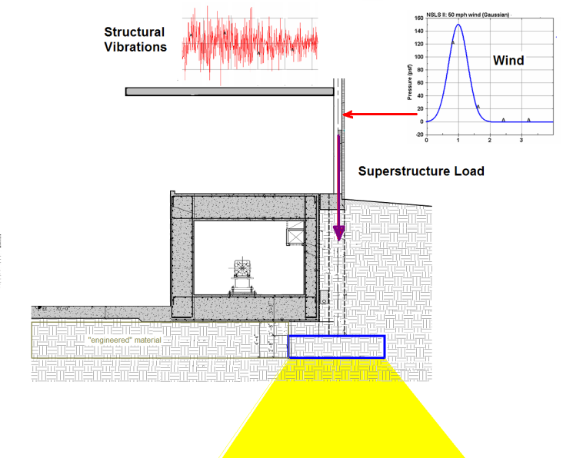
Stability / Design
Courtesy: N. Simos, NSLS-II
One hopefully starts by selecting a good / quiet site (not always possible) - at least need to know all caveats
Nowadays FEA allows optimization of slab design
Important: Minimize vibration coupling from pumps, …
Also keep external disturbances in mind (wind, sun, …)

Slide 7
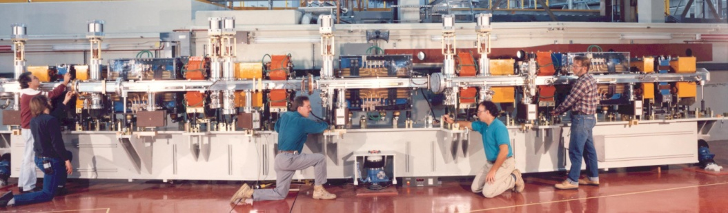
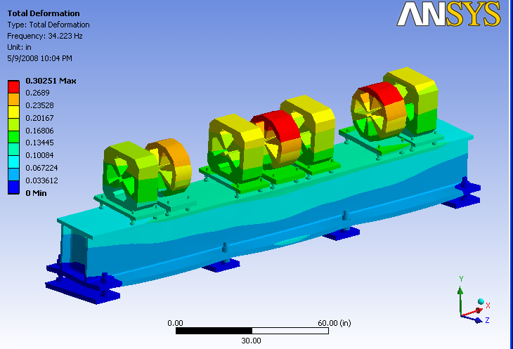
Girder Design
ALS
Soleil
NSLS-II: courtesy S. Sharma
Some early 3rd generation sources had massive girders (low resonance frequencies – sampling larger ground oscillation amplitudes)
Later ones had girders with higher resonance frequencies but movers, that significantly lowered them
Newer designs (Soleil, NSLS-II, …) avoid this caveat – smaller vibration transmission to beam

Slide 8
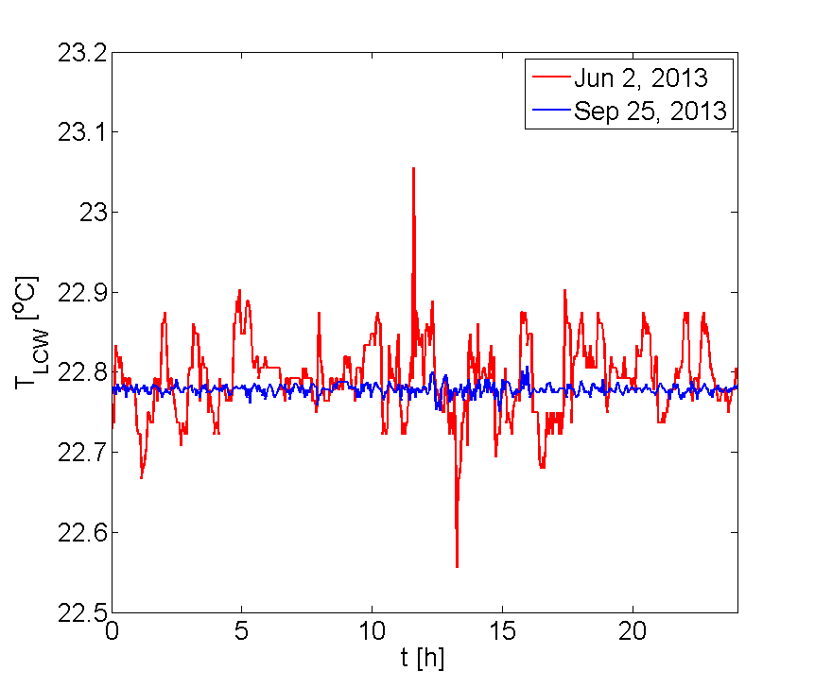
Air/water temperature stability
Left: ALS water temperature, Right: Tunnel air temperature
Stable environmental conditions are extremely important
State of the art is water and tunnel air temperature stability on the order of 0.1 degree C
Stable power supply controllers, invar rods for BPM mounts, … also help, but it is always best to also keep the conditions constant

Slide 9
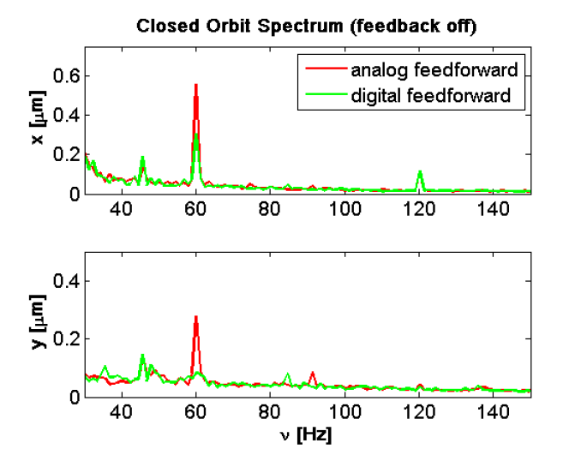
Good power supplies are essential
Strong corrector magnets with high vacuum chamber cut off frequencies can be significant sources of orbit noise
Observed at several light sources
Achievable power supply performance increased over the years
9

Slide 10
Identify and Fix Problems
ALS – fixed power supply
Spring-8: water vibration
Often vibration sources / coupling into sensitive equipment is found during after commissioning
Fixing the worst offenders often gives big benefit
Examples above: Power supply at ALS, water induced vacuum chamber vibration at Spring-8; Another example are viscoelastic damping elements at ESRF

Slide 11
(old) ALS Example: Orbit Power Spectral Density
11

Slide 12
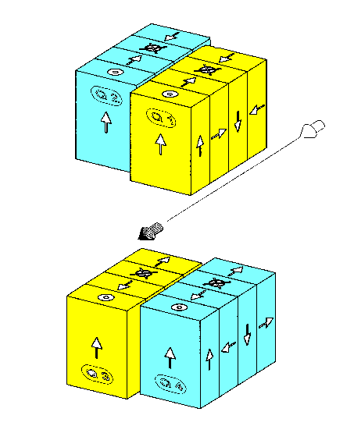
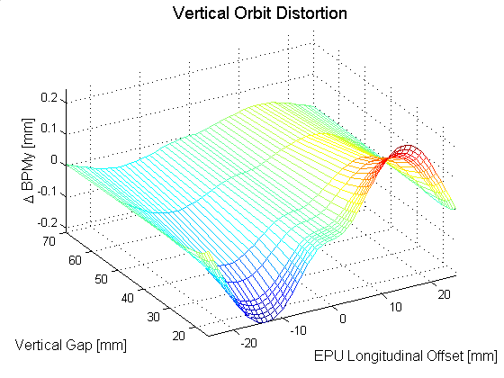
Insertion Device Compensation: Example - EPU
EPU
Electron Beam
Corrector Magnets
Mechanically, an ALS EPU can move from left to right circular polarization mode in ~1.6 sec.
Without compensation early EPUs would distort the electron beam orbit by ±200 μm vertically and ±100 μm horizontally. Using corrector magnets on either side of an EPU, 2-dimensional feed forward correction tables are used to reduce the orbit distortion to the 2-3 μm level. Update rate of ALS feed-forward is 200 Hz.
12

Slide 13
EPU Feed Forward Orbit Correction
Orbit Error without Feed Forward Correction
200 Hertz Feed Forward Correction
13

Slide 14
Orbit Feedback
Even in extremely stable light sources, orbit feedback can always improve stability
This is particularly true for the effects of insertion device motion (feed-forwards are never perfect)
Nowadays, all light sources tend to use global orbit feedbacks with some variation of SVD (or direct matrix inversion) – local feedbacks are used less seldom
Fundamentally, one only needs one (fast) orbit feedback, however, practical aspects often require two (lack of enough fast corrector magnets, lack of strong enough corrector magnets, lack of enough suitable BPMs, …)

Slide 15
Software used for slow orbit feedback
All ALS high level controls accelerator physics routines are implememted in Matlab
Orbit feedback is controlled using a GUI which allows to ramp for injection, do single orbit corrections, standardize the lattice, etc.
Matlab includes all Matrix manipulation tools necessary and has proven to be very reliable
Code is very flexible (algorithm development is simple and can if urgent need arises even be done during user operation)
Based on Matlab Middle Layer – now widely used at many (most) light sources

Slide 16
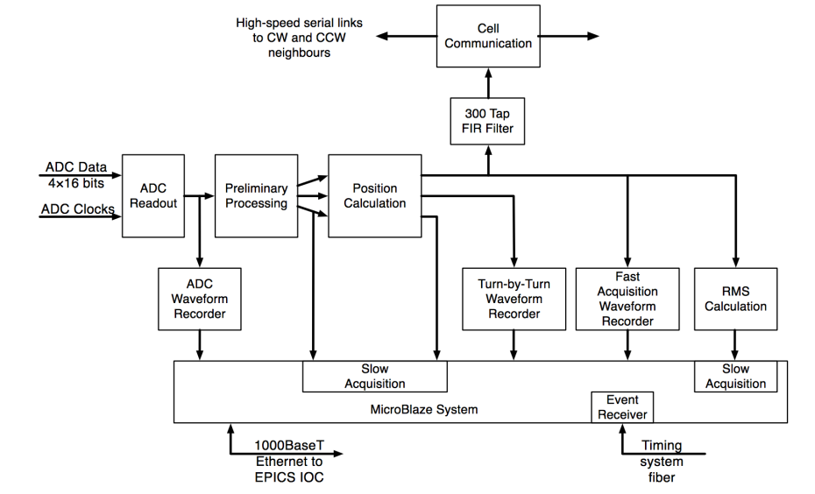
Fast orbit feedback topologies
Many different types of fast orbit feedbacks are in use
State of the art are systems with update rates of several kHz and closed loop bandwidths between 80 and almost 200 Hz
In some systems, PID algorithms are supplemented by notch filters, …

Slide 17
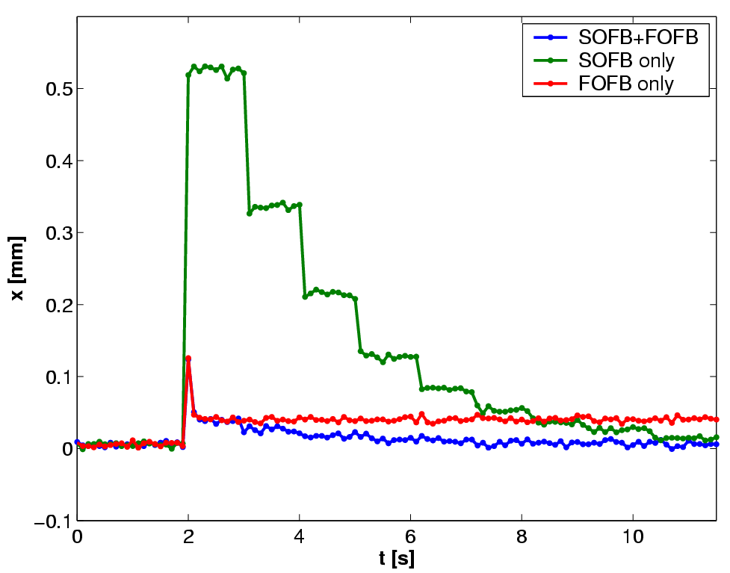
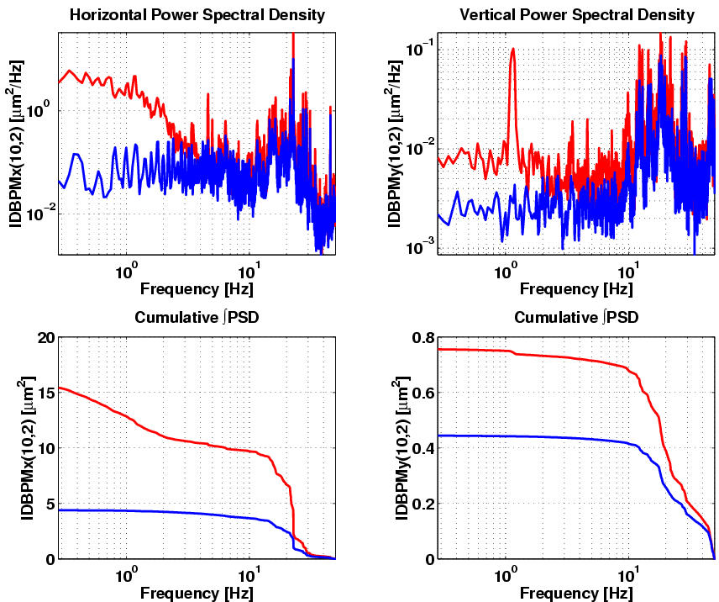
Frequency Overlap – Master/Slave
ALS needs slow and fast feedback (do not have enough fast correctors)
Avoided frequency dead band – fast system not DC blocked
Synchronization by SOFB updating FOFB golden orbit
Combination of both systems provides best of both and no interference!

Slide 18
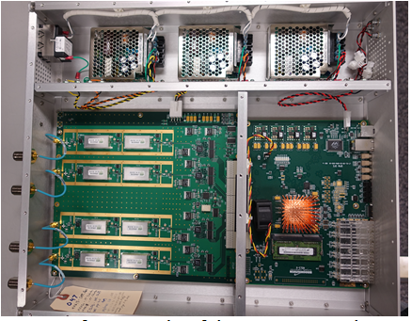
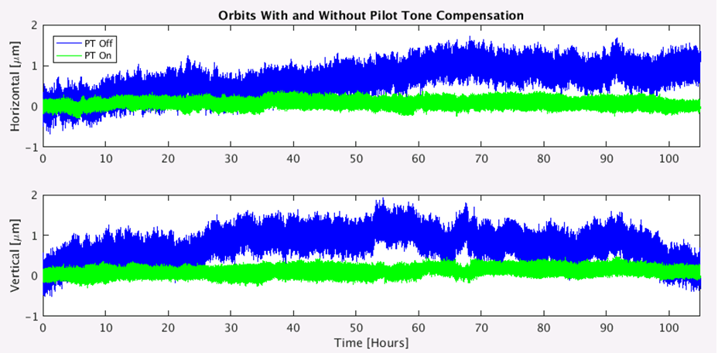
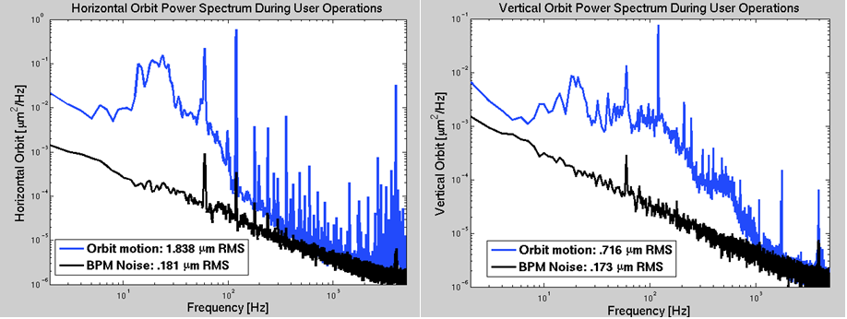
Trends: Low Noise, High Update Rate, low latency
70 nm daily rms noise (10 Hz bandwidth)
Strong and effective collaboration with NSLS-II
Also need: fast power supplies, magnets, special vacuum chambers, … - development is ongoing
Digital front-end is same as NSLS-II
Firmware, software, EPICS device support, analog front-end and pilot tone developed at the ALS.

Slide 19
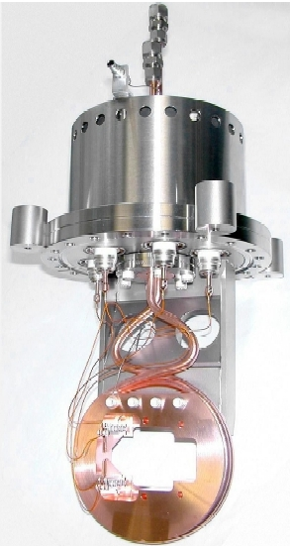
Photon BPMs
Synchrotron radiation is abundant in many accelerators – very useful for low noise, non desctructive position measurement
Shown below is a simple x-ray BPM for dipole beamline, which is broadly used.
FMB
BESSY II,
ALS,
SLS,
LNLS
Work very well for dipoles in the vertical plane
For undulators OK for hard x-rays
  with Decker distortions if undulators scan a lot
difficult for VUV, no good solution for EPUs, still
e-
SR
Δy
Beam
e-
“Blades”

Slide 20
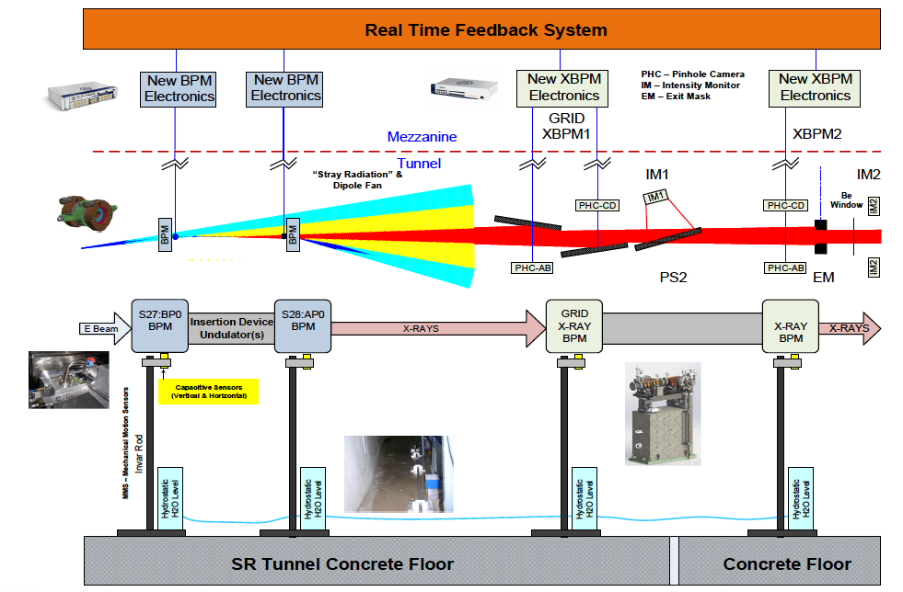
Example of Feedback Integration R+D - APS
Courtesy: Bob Lill (APS/APS-U)

Slide 21
RF phase noise
Mode 0 motion nowadays is very small – 0.03 degrees rms
Dominated by noise from master oscillator, rf distribution system, rf frequency correction … not HVPS
  Fast RF amplitude feedback reduces effect of HVPS to this level
Use improved master oscillator + filtering at several points in low level RF frequency distribution system

Slide 22
Instabilities / Feedback / HOMs
A. Blednykh
C. Stelmach
ALS TFB: W. Barry
Very fast stability / single+multibunch instabilities
Routinely addressed by multibunch feedback system (longitudinal/transverse) – most recent ones all digital
HOM free cavities (SC or N/C) help, particularly long.
Transversely feedbacks allow operation with small chrom. -> good lifetime
  Also can be used to increase TMCI threshold (ALS factor >4)
  And finally to reduce duration of injection transients in top-off

Slide 23
Beamsize Stability
Because orbit stability is excellent, at ALS we actually receive more complaints about beamsize stability
Problem is tougher at low energy light sources (beam less stiff)
Main culprit at ALS are EPUs (elliptically polarizing undulators)
Some examples of affected experiments:
  STXM (scanning transmission X-ray microscopes) – I0 normalization difficult, not included in state-of-the-art beamlines
  Microfocus beamlines investigating dirt samples
What needs to be corrected:
  Optics distortion (beta functions)
  Skew gradients
  Potentially horizontal/vertical natural emittance

Slide 24
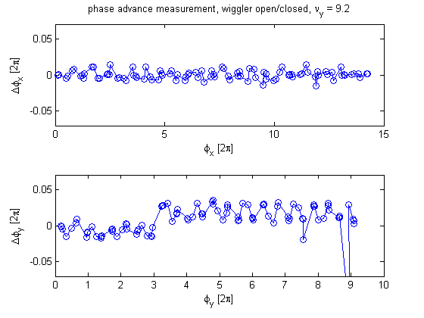
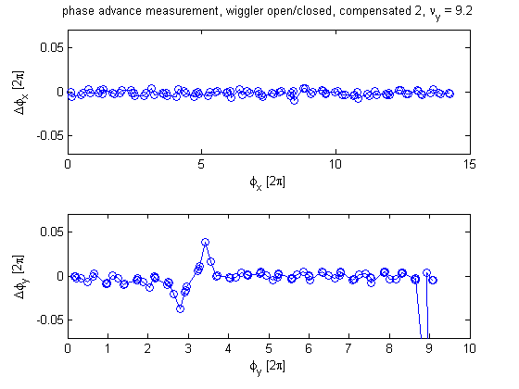
Insertion Device Optics Correction
Example shown above is the systematic focusing change due to a wiggler and how the local optics feed-forward restores it. One uncompensated wiggler in the ALS produces several 10s of percent beta beating and completely ruins the injection efficiency.
To find the best lattice correction is not trivial, since keeping beamsizes constant is not the only consideration.
Maintaining dynamic and momentum aperture is very important as well and optimum solutions are not always obvious (and sometimes require change of the base lattice).
In newer light sources this can also involve sextupole FF (beyond the scope of this talk).

Slide 25
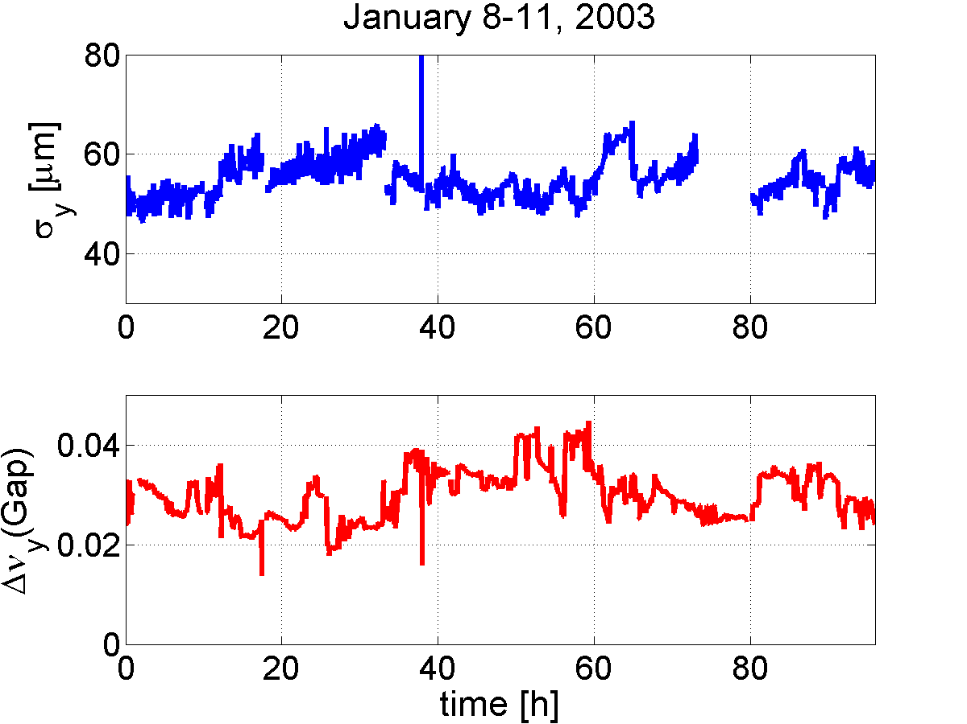
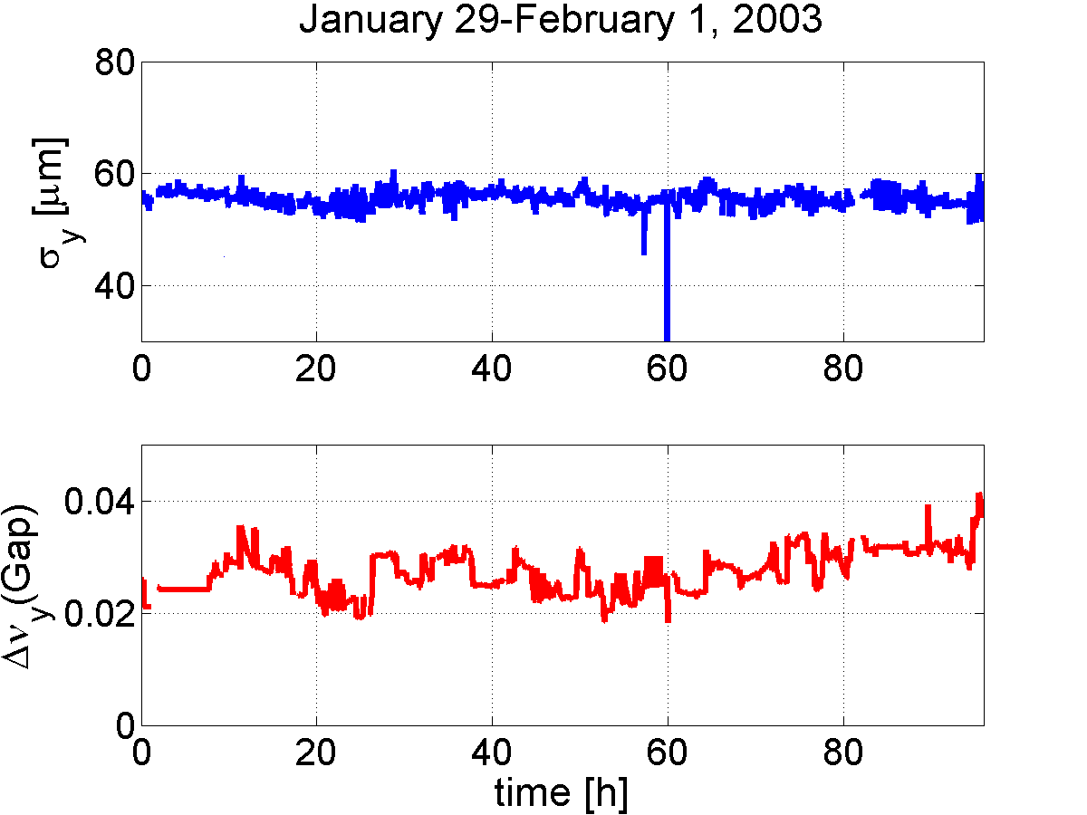
Vertical Beamsize Stability
One issue affecting the beamsize are residual tuneshifts (after feedforward compensation) when scanning undulators or skew errors inside those undulators (especially EPUs)
Using dispersion wave instead of coupling resonance to increase vertical emittance improves beamsize stability

Slide 26
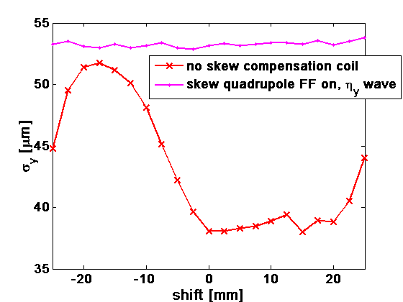
Undulator effects on vertical beamsize
Vertical beamsize variations due to EPU motion were big problem.
Is caused by skew quadrupole (both gap and row phase dependent)
Root cause reduced in newer devices
Installed skew coils for feedforward correction
Stability now <1%, relative stability will at first be worse for smaller beamsizes
For reference: Whenever an undulator moves, about 120-150 magnets are changed to compensate for the effect (slow+fast feed-forward, slow+fast feedback)

Slide 27
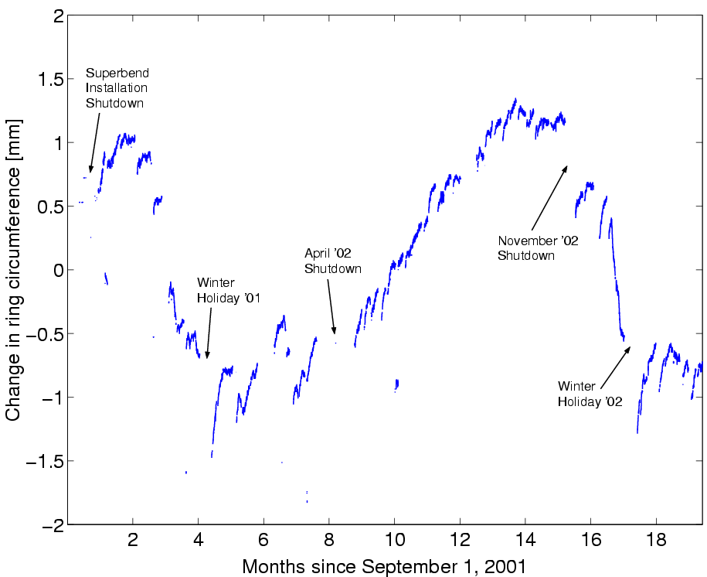
RF Frequency Feedback / Energy Stability
Circumference of ring changes (temperature inside/outside, tides, water levels, seasons, differential magnet saturation, …)
RF keeps frequency fixed – beam energy will change
Instead measure dispersion trajectory and correct frequency (at ALS once a second)
Can see characteristic frequencies of all the effects in FFT (8h, 12h, 24h, 1 year)
Verified energy stability (a few 10⁻⁵) with resonant depolarization

Slide 28
Energy calibration (resonant depolarization)
High precision measurement of beam energy is relatively simple at low energy light sources like ALS
Allows some conclusions about long term orbit/magnet/ground plate stability
Implemented rf-frequency feedback at ALS and verified it with energy measurements
Some radiation standards applications require extreme stability (example: BESSY)

Slide 29
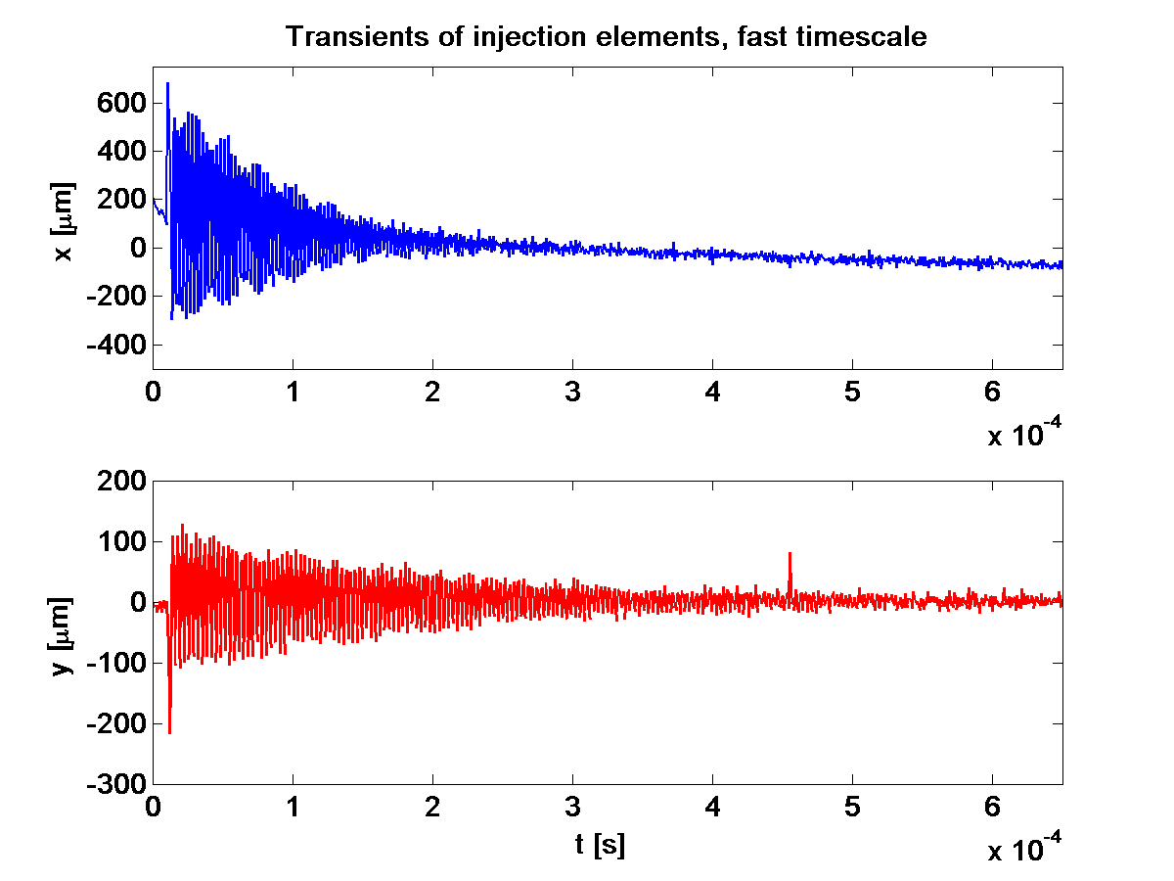
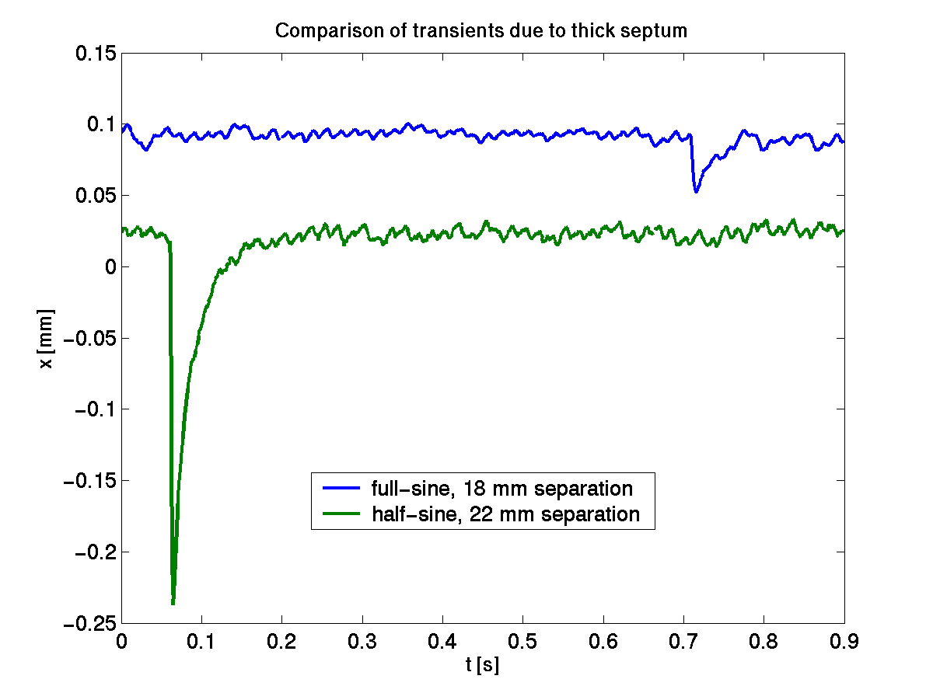
Long Term Stability (with Feedback)
ALS: mid term orbit stability (with+w/o Top-off)
ALS: injection transients (fast+slow)
Top-off greatly improves the mid- and long-term stability (also for user beamline optics)
  It does present some additional challenges in form of injection transients, however, currently the benefits greatly outweigh those.
  Injection transients can be improved with better injection element design (magnets and pulsers), use of transverse multibunch feedbacks, or use of multipoles as injection kickers

Slide 30
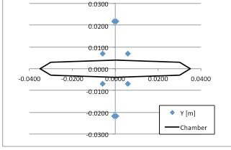
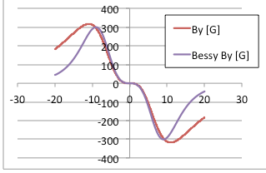
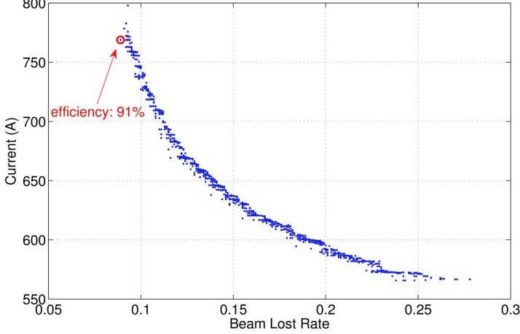
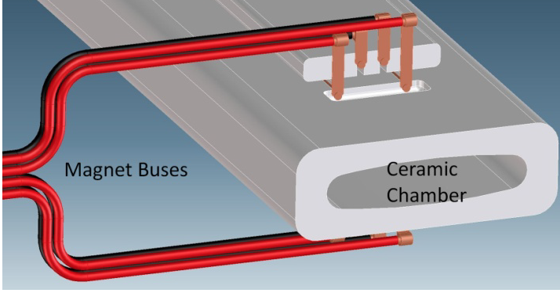
Nonlinear Injection Kicker
ALS is developing a nonlinear injection kicker
  Planned to be installed in August next to 6 mm stripline kicker
  Started design from earlier BESSY effort
  Application is both ALS and ALS-U accumulator
Kicker / conductor geometry optimized by MOGA integrated with full injection efficiency calculation

Slide 31
Outlook / Challenges
Light source development continues to ever smaller emittances -> tighter stability requirements (mostly horiz.)
Photon BPMs work well for hard x-ray undulators (potentially with Decker distortions), not so well for VUV, still no good solution for EPUs
Large number of fast switching insertion devices (EPUs, …) at low/intermedium energy light sources -> more perturbations
Truly transparent top-off is very difficult.
And of course: How do achieve similar relative stability when moving to high rep-rate FELs, or DLSRs (with new injection methods)
  Swap out presents some new challenges compared to top-off

Slide 32
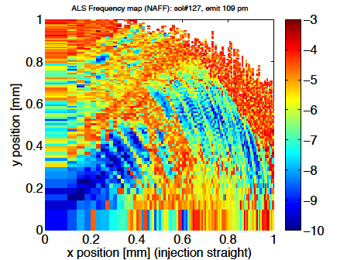
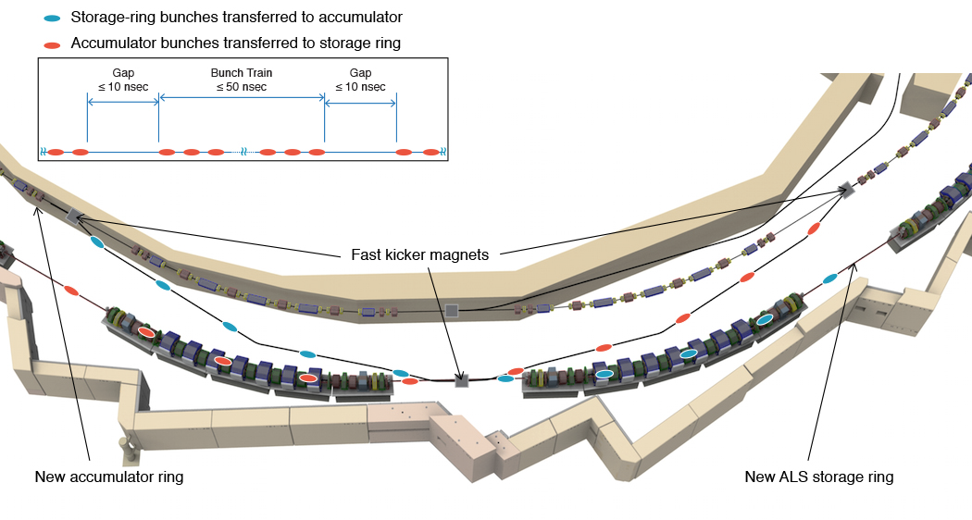
Bunch Train Swap-out with Accumulator
storage ring bunches transferred to accumulator
Swap-out injection was first proposed by M. Borland for possible APS upgrades

Slide 33
Summary
Stability is one of the most important deliverables of light sources
Very integrated problem:
  includes all phases of facility design, commissioning, operations
  Includes orbit, beamsize, energy, at various time scales
Orbit:
  Short and medium term (hours – 200 Hz) sub-micron orbit stability is achieved in 3rd generation light sources.
    Important: Fast orbit feedback (fast end) systems and “top-off” operation (slow end)
    Major culprit causing distortions: Insertion devices
Beamsize:
  Relative beamsize stability of better than 1% can be achieved
    excellent compensation of Insertion devices is needed (FF system)
In reality, the accelerator and the user beamlines are one integrated system and should be optimized as such. This has been started, but is not very advanced, yet. Usually both are optimized independently
The author gratefully acknowledges contributions from many colleagues !

Slide 34
Backup Slides

Slide 35

Why does the orbit/position need to be constant
Without slits it is obvious that beam motion will translate to motion of photon beam on sample, i.e. different sample areas are measured
Similarly in a monochromator without slits a vertical beam motion translates into a photon energy shift
With slits, the effects get smaller and smaller with smaller slit size (there still are 2nd order effects because of the beam profile and the nonzero slit size). However, the smaller the slit the smaller the transmission and the larger the intensity fluctuations (and effects of slit alignment and motion).

Slide 36
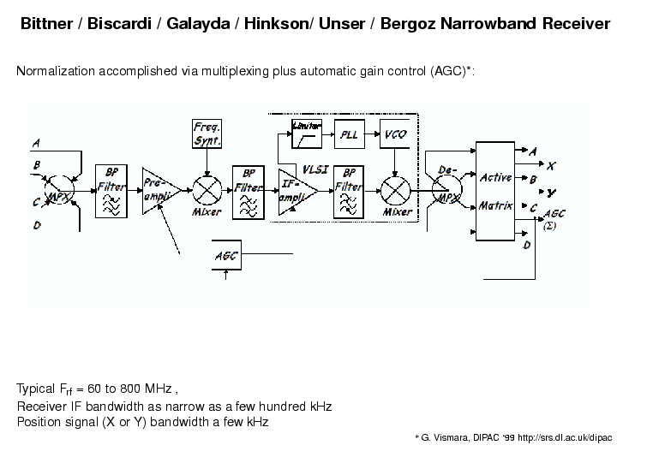
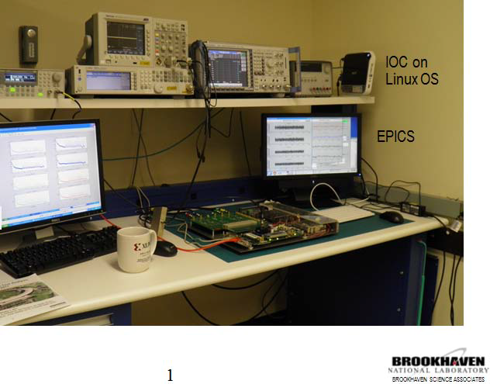
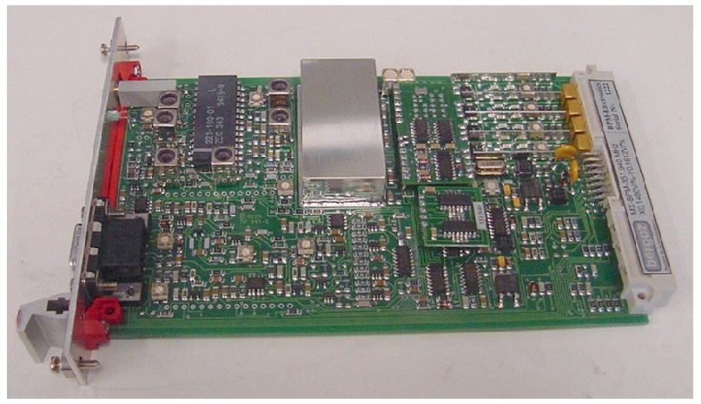
Signal Processing Electronics
More recently: Digital BPMs only frontend is analog, followed by ADCs, FPGAs (sometimes DSP) and digital signal processing
Courtesy Kurt Vetter

Slide 37
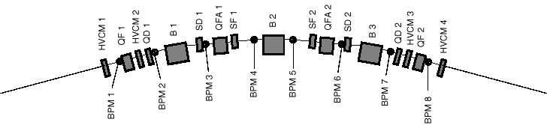
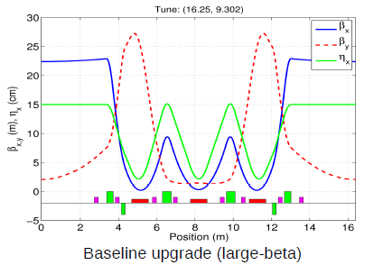
ALS – orbit measurement + correction
Half
Straight
Half
Straight
Arc
12 nearly identical arcs – TBA; aluminum vacuum chamber
122 beam position monitors in each plane (about 4 of stable type per arc)
8-12 horizontal, 6-8 vertical corrector magnets per arc (~100 total per plane)
48 individual skew quadrupoles
beam based alignment capability in all quadrupoles (either individual power
supplies or shunts)
22 corrector magnets in each plane on especially thin vacuum chamber pieces

Slide 38
Magnet Vibration PSD
38

Slide 39
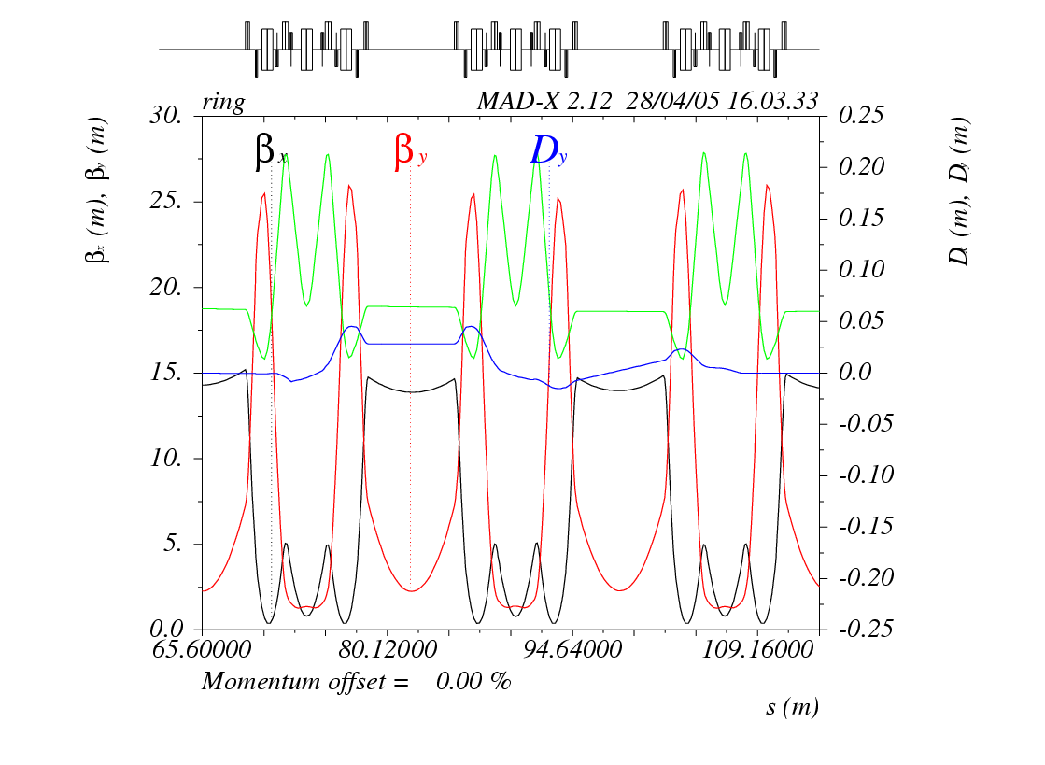
Another Beamsize Stability Challenge Example
Fs-slicing facility at ALS uses vertical separation -> high field undulator in the middle of a sizeable local vertical dispersion bump
To keep vertical (natural) emittance constant, whenever this undulator scans, 20 skew quadrupoles around the ring are used to change a global vertical dispersion wave
femtosecond
laser pulse
femtosecond electron bunch
femtosecond x-rays
λ_{W}
70 ps electron
bunch
spatial separation
Dispersion due to bending magnets coupled into vertical plane with skew quadrupoles (closed disersion bump).
wiggler
Vertical apertures in focus plane in undulator beamlines
electron-photon interaction in wiggler

