Slide 1
Review of Beam Instrumentation and Feedbacks
Guenther Rehm
Diamond Light Source
HBSLS workshop, 26-27 April 2017

Slide 2
Outline
Impact of HB-SLS on Instrumentation
Beam Position Monitors and Orbit Feedback
Bunch-by-Bunch Monitors and Feedbacks
Tune Monitors and Feedbacks
Photon Beam Position Monitors and Feedback
Beam Profile Measurement and Feedback
Summary

Slide 3
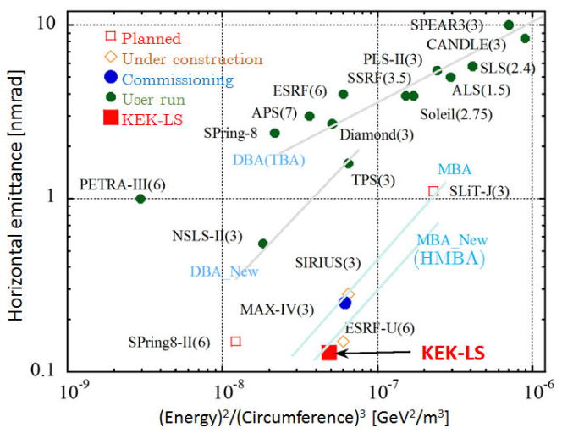
Evolution of SLS once more
APS-U(6)
WEPOW020, IPAC2016

Slide 4
HB-SLS relative to established SLS
Horizontally lower emittance ~60-300pm
  Beam sizes shrinks to ~7-17um (1m beta)
Vertically mostly stays at ~8pm
  Beam size stays at ~3 um (1m beta)
Smaller beam pipes
  Smaller BPM buttons (less signal), but closer to the beam (more signal) TUPF14, IBIC2014
  Higher impedance, potential NEC coating, more driving terms for instabilities? WEPHA002, IPAC2015
More advanced optical lattice
  Higher requirements on tune stability TUPWA013, IPAC2015
  Smaller dynamic aperture TUPJE063, IPAC2015
General advances on beamlines
  Faster data collection demands stable beam to higher frequencies
  DOI: 10.1107/S2059798316012304
  Break down the ‘wall’ between source and sample with integrated approach to stability DOI: 10.1107/S2053273315097168

Slide 5
Beam Position Monitors
Worldwide population dominated by single commercial supplier
Multiplex switching is the ruling favourite DIPAC03,IT02
  Evident short and long term stability, and low dynamic compression (aka ‘fill pattern dependence’) MOD1A01, DIPAC07
  Turn-by-turn data possible, with some complications
  THPE087, IPAC2010
Several recent independent ‘in-house’ developed approaches:
  NSLS-II design WECYB2, IBIC2014 and ALS follow up (with pilot tone, no yet published)
  LNLS approach Open Hardware (different kind of switching) WECYB3, IBIC2014
  Elettra trialling a ‘pilot tone’ BPM TUPG02, IBIC2016

Slide 6
Orbit Feedback
Until recently typically done ‘in-house’ to cope with complexity and variety of interfaces. Implemented in DSP, CPU and FPGA MOOC01,DIPAC09
Recently also commercially supplied in FGPA:
  TPS WEPG07,IPAC2016, MAX-IV, Solaris TUPRI078,IPAC2014
Controller is typically PI, or better IMC MOPGF175, ICALEPCS2015, sometimes used with inverse matrix regularisation MOC3O04, ICALEPCS2015
  For BPM noise evaluation the bandwidth of the ‘complementary sensitivity’ (DC to 100-300Hz) is most relevant
Good comparison of FB performance remains difficult due to lack/disagreement of required tools on all installations

Slide 7
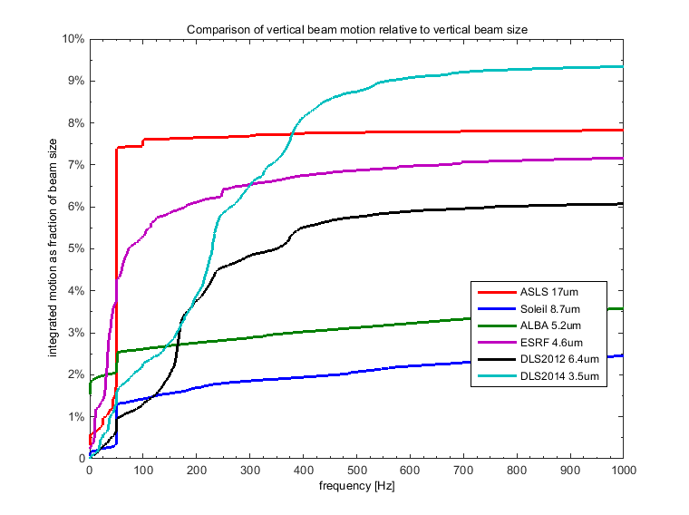
Comparison of Orbit Stability
DOI:10.1088/1742-6596/425/4/042001

Slide 8
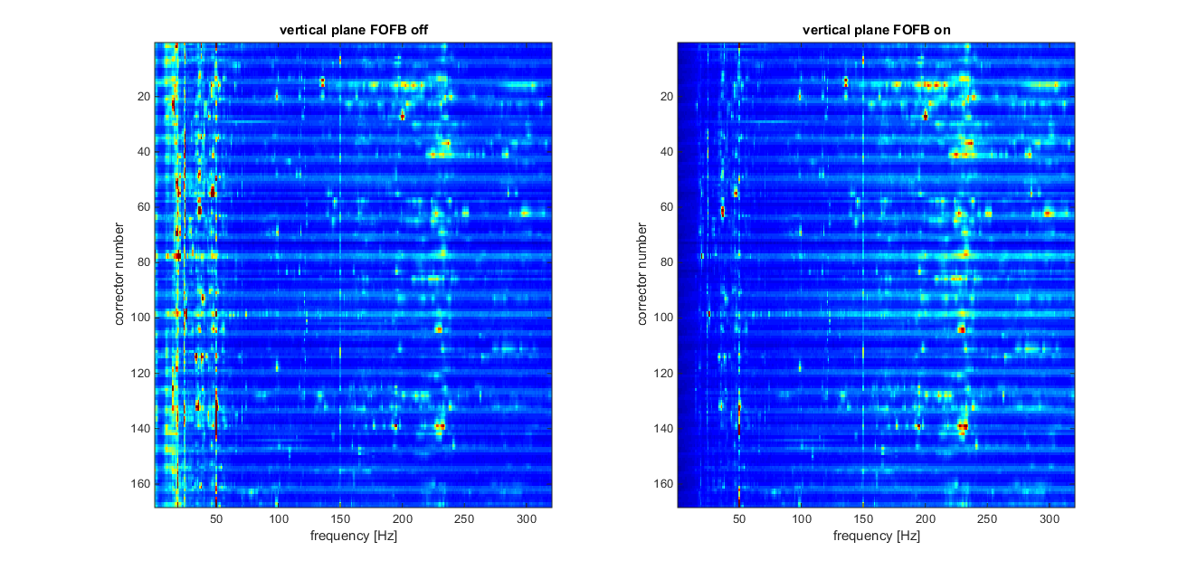
Corrector Spectra at DLS

Slide 9
Bunch-by-Bunch Monitors and FB
Worldwide population nearly dominated by a single commercial supplier WEPD27, IBIC2014 WEPG02, IBIC2016
Fundamental feedback principle still the same as 25 years ago page 2352, PAC93
Improvements concentrate on implementation
  Hardware: custom built integrated page 2649, EPAC04 or
  COTS components modularised TUCL03, IBIC2016
  Firmware/Software: More upstream processing as required to make full use of high data rate (500MS/s = 1GByte/s)

Slide 10
BbB Feedback
Control
System
RF clock
History buffer
I/Q or X/Y
A/D
converter
RF
Frontend
D
igital Signal
D/A
Modulator
where req’d
Processing
Converter
FPGA based Feedback Processor
Power
Amplifier
Button
Pickup
Kicker
A/D and D/A run synchronous with bunches, every bunch measured
RF frontend can be shared between transverse and longitudinal
Different feedback parameters/actions for individual bunches possible

Slide 11

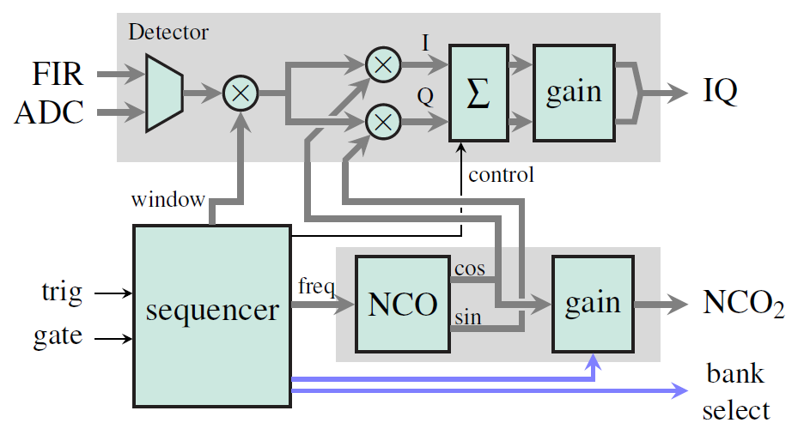
Exciting Longitudinal Modes
Each mode µ is associated with one frequency:
Program sequencer to step through µ=0…935, excite 4800 turns, measure 24000 turns, 25e9 bunches measured
Average I/Q for two synchrotron periods
MOPGF097, ICALEPCS2015
TUCL03, IBIC2016

Slide 12
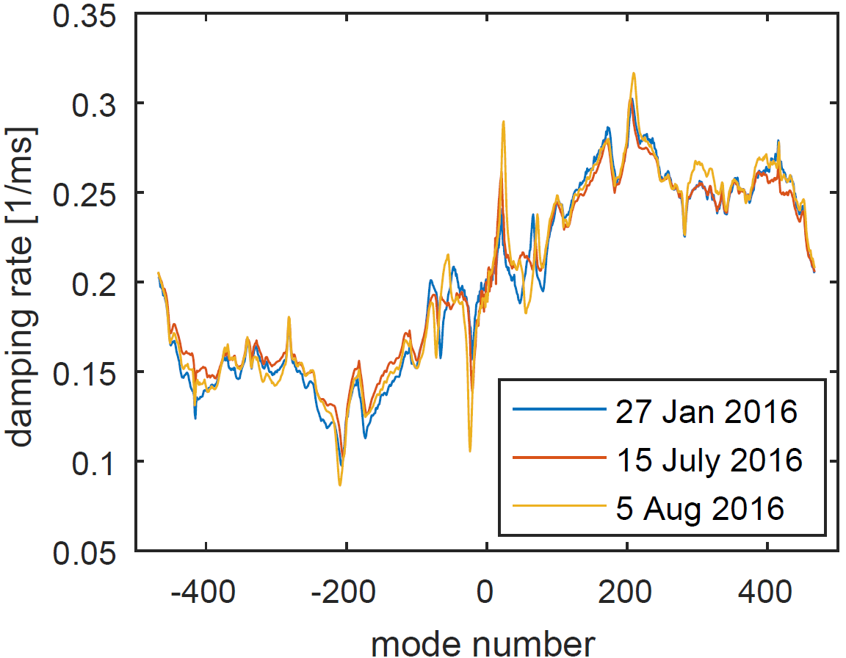
Longitudinal Damping Rates
Diamond SR / 300mA / 900 bunches
Synchrotron radiation damping
TUCL03, IBIC2016

Slide 13
Tune Monitors
Betatron and Synchrotron Tune monitoring often comes ‘for free’ integrated with the BbB system
  Typically integrated into control system MOPGF097, ICALEPCS2015
Some people prefer it ‘old style’:
  RF spectrum analyser with tracking generator connected to amplifier/strip line TH5RFP010, PAC09
  Assess turn-by-turn data after kick (conveniently available due to frequent non-closure of injection kickers and top-up) MOPF26, IBIC2013
  Typically requires specific integration into control system, tracking ‘max peak’ might not be good enough!

Slide 14
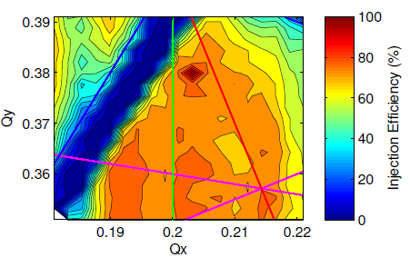
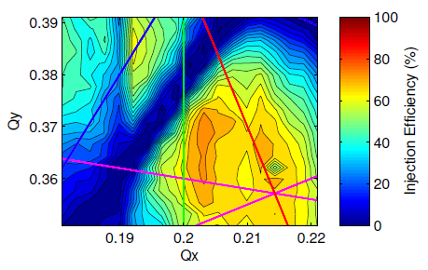
Why Tune Feedback?
Tune ‘islands’ for injection efficiency and liftime versus betatron tunes become less comfortable:
  Land sinks (Lifetime/Injection drops permanently due to ‘upgrades’, safety limits remain however)
  Smaller land with steeper slopes
  Space required for exercises (tune shift with injection)
  TUPRI082,IPAC2014

Slide 15
Photon beam position and FB
Photon / X-ray beam position measurement has lots of variations:
  In front ends
    Tungsten vanes DOI: 10.1107/S0909049597017068 WEPD22, IBIC2014
    Gold plated Diamond vanes page 539, PAC01
    Diamond photo conductor vanes MOPC10,IBIC2013
    Residual Gas MOCNB03,BIW2010
    Grazing incidence MOPG17, IBIC2016
  On beam lines, more types than could be listed here
    Fluorescent screens (P43, YAG:Ce, Diamond), scatter foils with quadrant diodes, split ionisation chambers, Silicon devices…
    Hot topic recently: Single crystal CVD diamond quadrant detector
    DOI: 10.1107/S1600577514016191 DOI: 10.1063/1.4952845 DOI: 10.1107/S090904959801509X
    DOI: 10.1016/j.diamond.2006.11.081 DOI: 10.1107/S0909049510031420

Slide 16
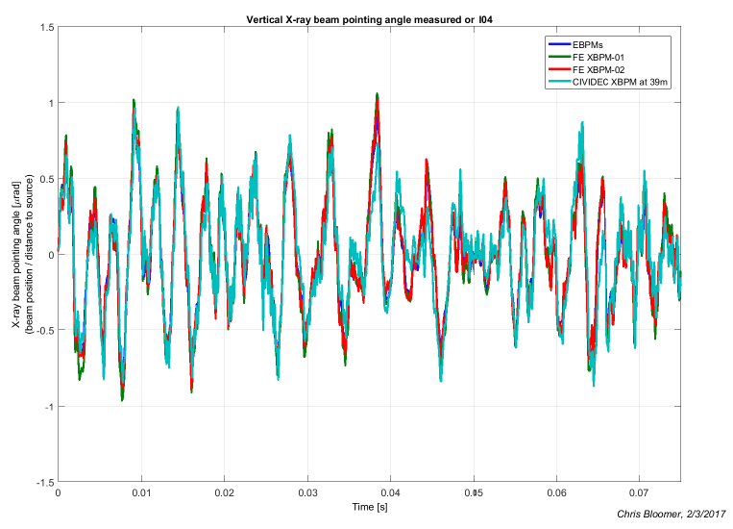
X-rays go straight!
Electron beam divergence RMS is 2.3µrad
12keV photon beam divergence RMS is ~10µrad
This is rather sophisticated instrumentation
Courtesy Chris Bloomer, DLS

Slide 17
Photon beam feedback
Not in general use so today:
  Frontend XBPMs
    Slow software loop back to change golden orbit
    WECI001, ICALEPCS2001 WEPEB047, IPAC2010
    Integration with FOFB at full rate
    MOPA39,IBIC2012
  Beamline XBPMs
    DCM/mirror control in optimum seeking
    DOI: 10.1088/1742-6596/425/4/042010
    Local mirror feedback
    Source steering DOI: 10.1109/TNS.1983.4332770

Slide 18
Beam profile and FB
Imaging techniques
  Direct projection TUPB08, DIPAC07
  X-ray pinhole camera DOI: 10.1103/PhysRevSTAB.13.02280
  X-ray coded aperture TUPB025, IBIC2015
  Fresnel zone plates THOBFI02, EPAC06
  Compound refractive lenses WEWPF12, IBIC2013
Indirect beam size measurement:
  Young’s slit interferometer, with variations WEIC02, WECC02, IBIC2012
  X-ray diffraction TUCZB1, IBIC2014
  Pi-polarisation method DOI: 10.1016/j.nima.2008.02.095
Most importantly: All these measure beam size, emittance is calculated using knowledge of Twiss parameters only!
Feedback used if emittance coupling changes start to matter MOPEA071, IPAC2013 DOI: 10.1103/PhysRevSTAB.14.034002

Slide 19
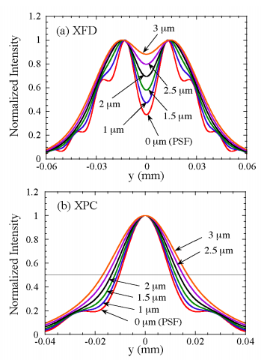
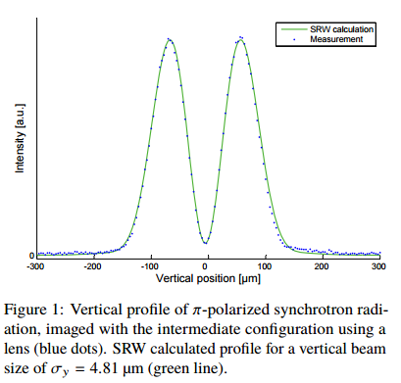
Promising Profiles
  X-ray diffraction
  TUCZB1, IBIC2014
Pi-polarisation
THPME169, IPAC2014

Slide 20
Summary
BPMs commercially available with sufficient performance, alternatives increasing
FOFB still mainly in-house developed, remains best for ultimate performance
Bunch-by-Bunch feedback/monitor commercially available, alternatives still interesting
Tune Monitors turn into feedback loops
Photon beam control might have a revival
Profile monitors see most new techniques, feedback application to be upcoming
Final Question: Will every SLS soon be running as much on AutoPilot as commercial airliners?

