Slide 1


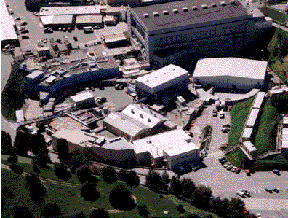
SSRL Accelerator Status & Upgrades
J. Safranek
HBSLS Workshop
Brookhaven National Laboratory
April 26-28, 2017

Slide 2
Outline
SSRL accelerator overview
Run stats
Operations Challenges
Ongoing Accelerator Improvement Projects
  Booster RF
  Lower Emittance
AIP plan for 2017-2019
Future Accelerator Enhancements

Slide 3
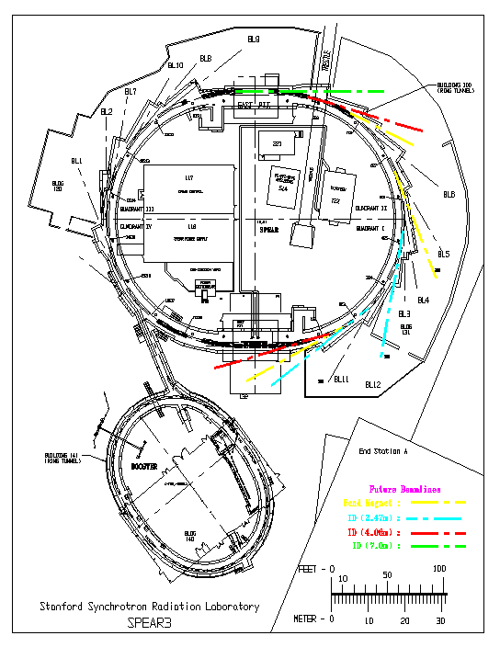
SSRL Accelerator Complex
Linac
  120 MeV
  Thermionic RF gun
  2856 MHz
  Commissioned 1990
Booster
  3 GeV
  10 Hz resonant circuit
  358 MHz
  Commissioned 1990
  Inject every 5 minutes (by the clock)
SPEAR3 Ring
  3 GeV
  500 mA
  5 minute top-off, 1% current stability
  476 MHz
  10 nm emittance
  Commissioned 2004
B120
B116-101
B117
control room
RF HVPS
B131
B118
power supplies
SLM room
B132-101
RF
B132-102
BTS
B130
LTB
120 MeV linac
3 GeV
Booster
B140

Slide 4
SPEAR3 Operations Statistics
Year | Beam Delivered (hours) | Uptime (%) | MTBF (hours) | MTTR (hours)
FY16 | 4892 | 97.5 | 193 | 4.9
FY15 | 4925 | 94.9 | 97 | 4.7
FY14 | 5176 | 98.4 | 82 | 1.2
FY13 | 5160 | 98.1 | 88 | 1.5
FY12 | 5162 | 96.8 | 51 | 1.3
FY11 | 4774 | 98.4 | 28 | 0.4
FY10 | 4870 | 95.5 | 87 | 2.3
FY09 | 5179 | 99.0 | 100 | 0.8
FY08 | 5027 | 97.1 | 63 | 1.1
AVERAGE | 5018 | 97.3 | 88 | 2.0
Vacuum and Injector Transformer
Power Outage and Injector RF

Slide 5
Injector Operations Statistics (since top-off)
Year | Uptime (%) | MTBF (hours) | MTTR (hours)
FY16 | 99.4 | 82 | 0.6
FY15 | 96.9 | 81 | 2.5
FY14 | 99.0 | 100 | 0.8
FY13 | 98.1 | 86 | 1.6
FY12 | 97.5 | 170 | 4.1
FY11 | 97.5 | 29 | 0.5
AVERAGE | 98.1 | 91 | 1.7

Slide 6
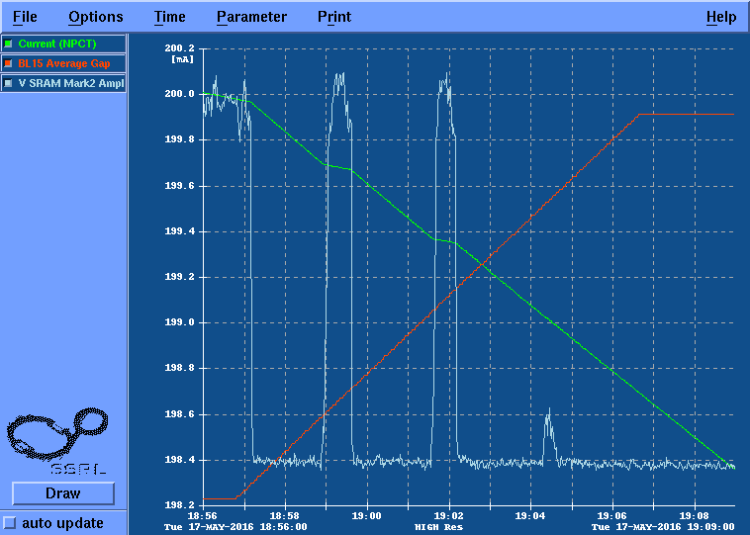
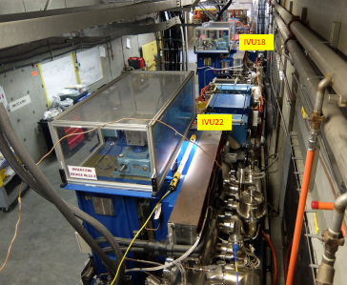
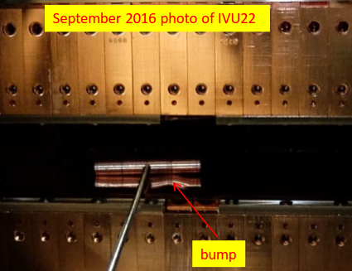
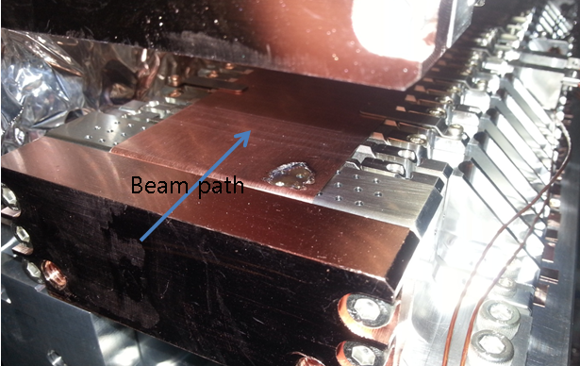
Operations Challenges
BL15, IVU driving multi-bunch instabilities
  Vertical oscillations, ~200 MHz
  Outside bandwidth of feedback system
  Plan to damp chamber mode
BL12-1&2, orbit interlock
  BL12-1 photons go through BL12-2 gap
  Discovered bumps in 12-2 current sheet
  Danger of melting 12-2 Cu sheet
Instabilities
BL15 gap
6.85
7.1
7.4
7.8
8.1 mm
6
BL12-1
BL12-2
Damage in Korean IVU
Notes:
Mention it drives multi-bunch feedback kicker
Mention now BL12-1 gap also seems reduced … work in progress.

Slide 7
Solutions to Operations Challenges
Plan for dealing with BL15:
  Short-term: increasing vertical chromaticity stabilizes beam (with some reduction in injection efficiency)
  Mid-term: install damping absorber or antenna in 2017 shutdown
  Mid-term: install ALS broad-band multi-bunch feedback kicker
  Considering conductive curtains to suppress modes in BL17
Plan for BL12-1 orbit interlock:
  FY17: open BL12-2 whenever closing BL12-1 for commissioning (software interlock has been developed)
  FY18 and beyond: Flatten BL12-2 current sheet and/or install upstream mask to protect current sheet

Slide 8
Accelerator Improvement Projects
 | FY16 | FY17 | FY18 | FY19
Booster RF SSA
Lower Emittance (10 -> 6 nm)
SPEAR3 LLRF
Multi-bunch Feedback |  | 0.6 | 1.2
Pseudo Single Bunch |  |  | 0.2 | 0.8
Resonant Crabbing |  |  | 0.9 | 1.2
Short Pulse Design
Short Pulse Project
Reliability upgrade
Ongoing projects
Performance upgrade
Notes:
Overall schedule (& budget) still a work in progress. Will need to get this story straight by Triennial. Recent addition of experienced project managers will certainly help in the process.
FY17 on, almost all performance upgrades tie in to timing mode development (even SPEAR3 LLRF & multi-bunch fdbk upgrade has some timing benefit).
300 k$ toward Short pulse FY16
~2.2 M$/year in AIP. Extra in FY16; DOE provided funding boost for high priority projects

Slide 9
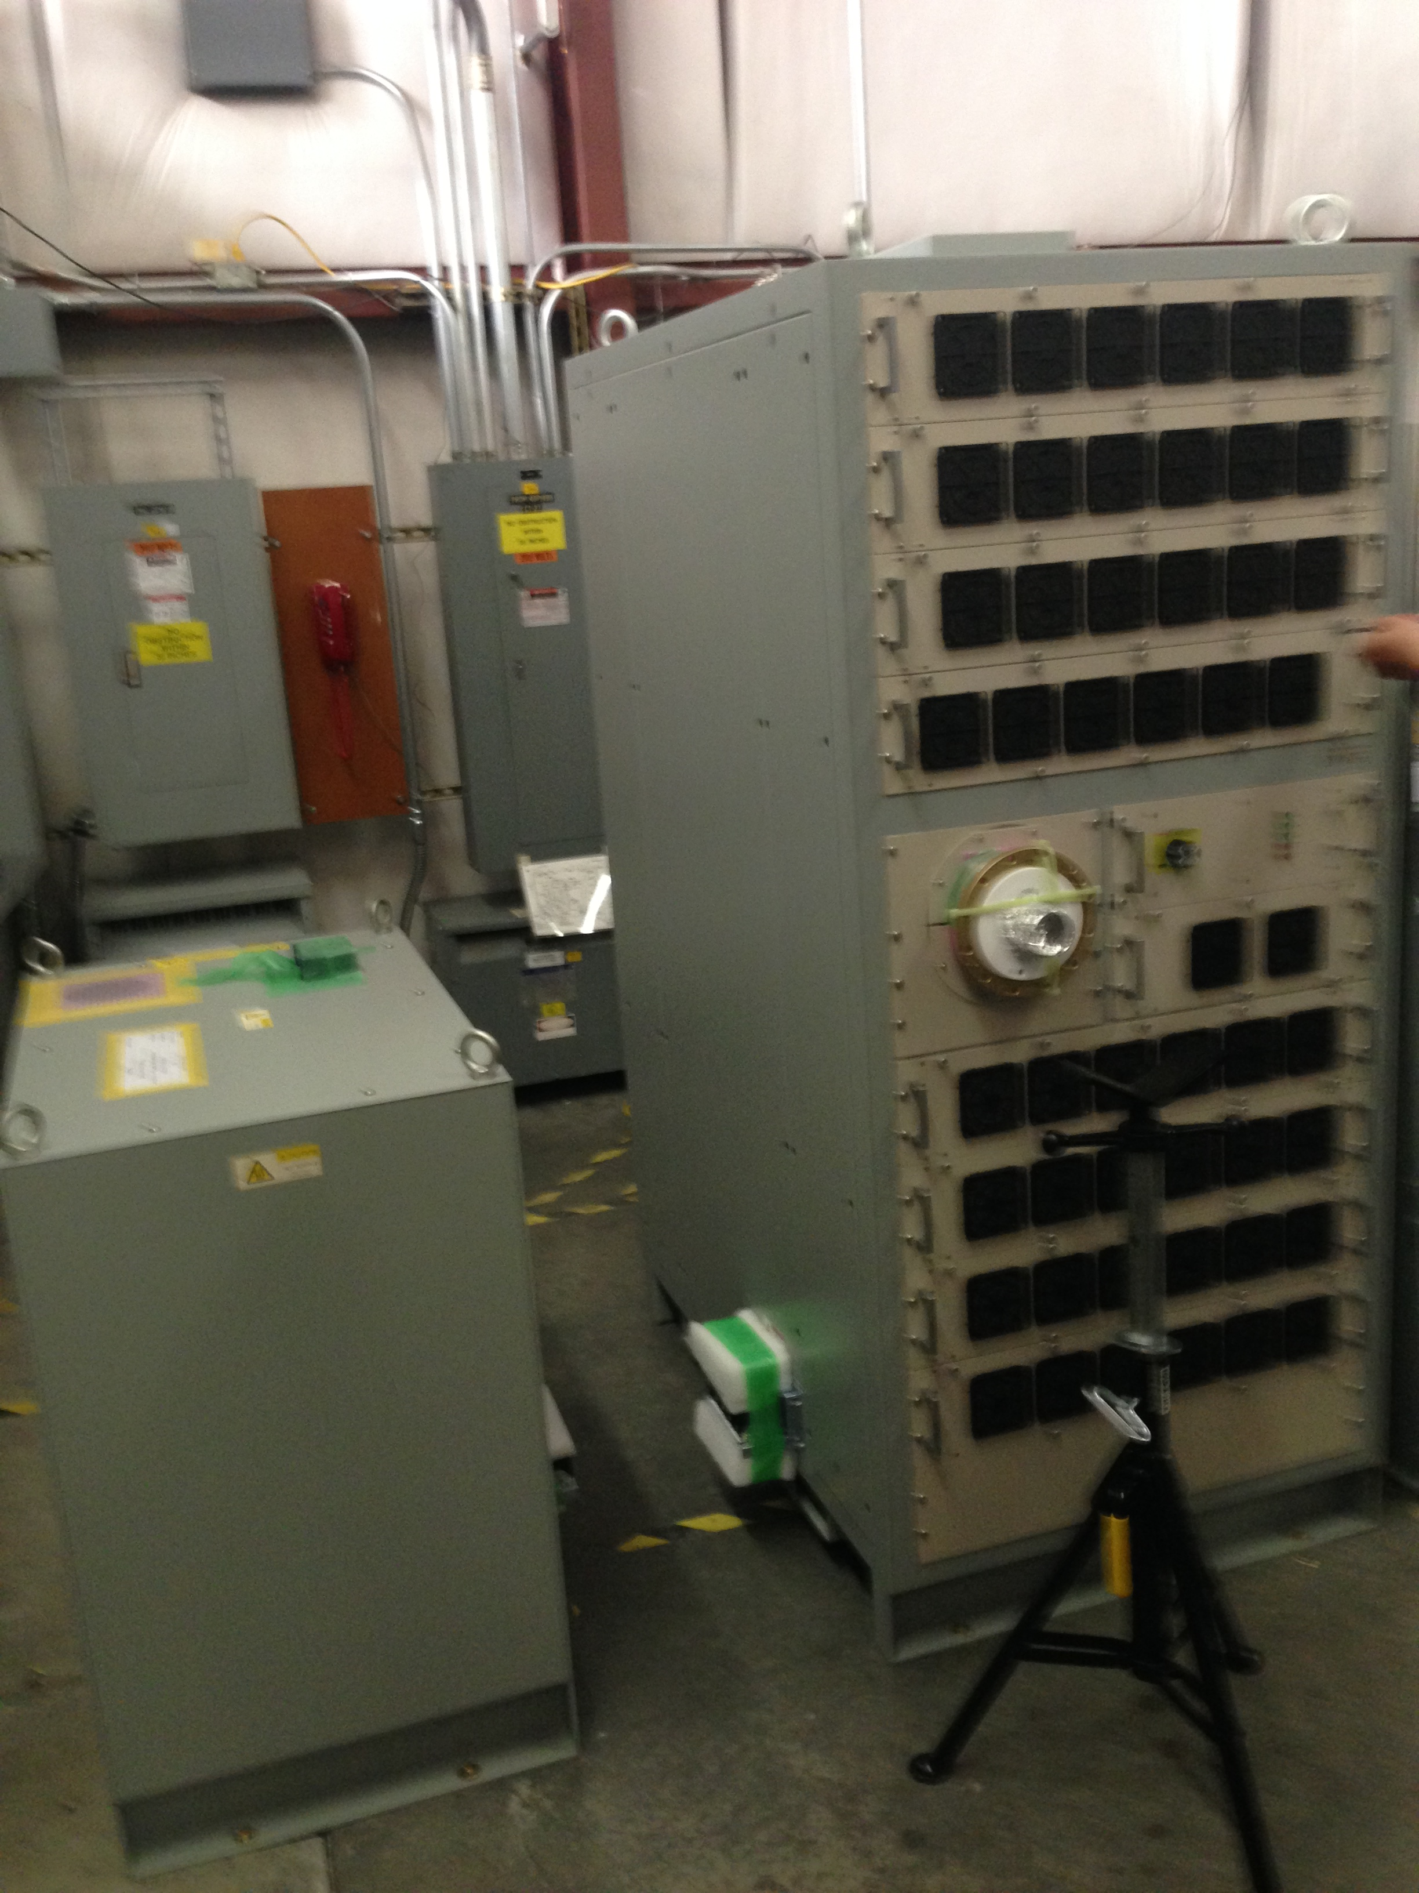
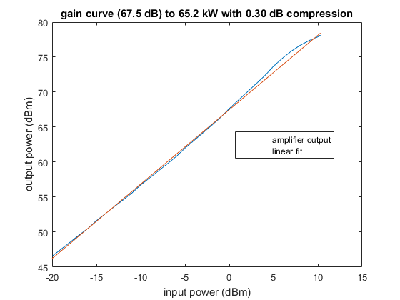
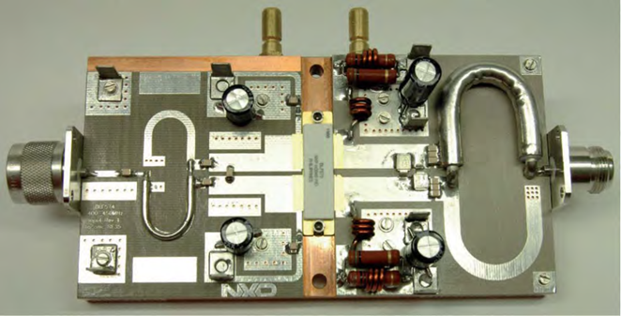
Booster RF AIP Solid State Amplifier
SSA drove waveguide, circulator and cavity at full power as part of testing
LLRF cable installation complete
Commissioning LLRF controls & circulator
Estimate FY17 Q3 system delivery for operations
SSA
Notes:
Mention testing in April week shutdown.

Slide 10
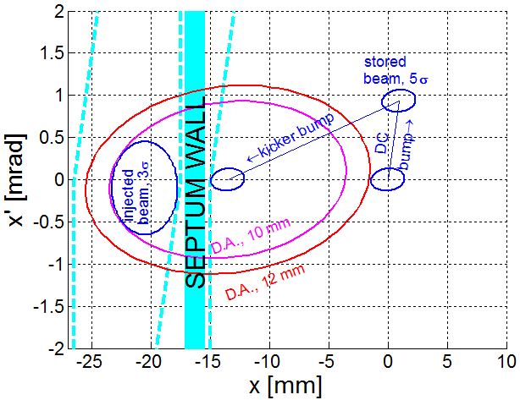
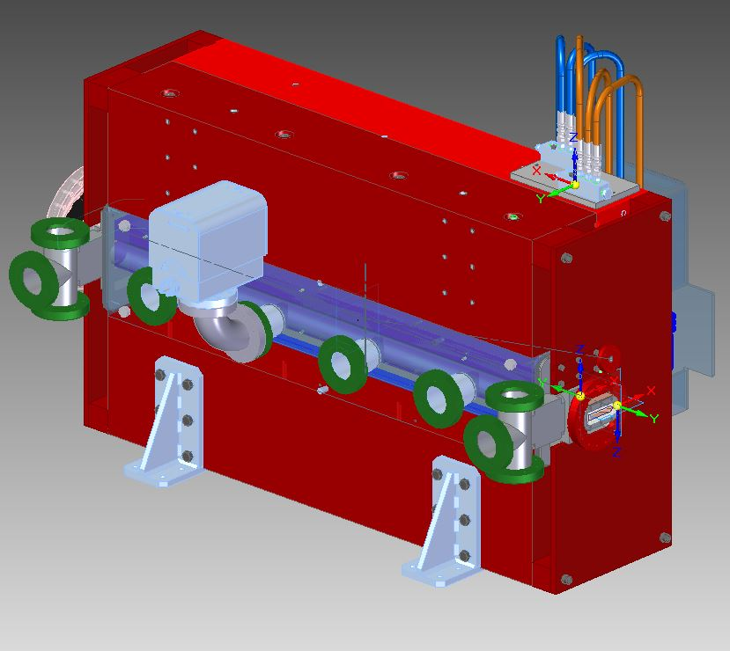
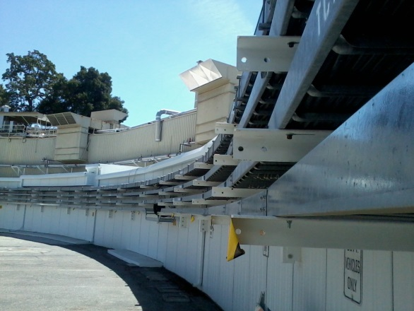
Upgrades required for 6 nm ε_{x}
Must capture the injected beam:
Improve dynamic aperture
  Increase number sextupole power supplies from 4 to 10, FY14
  Online optimization, FY15
Upgrade K2 injection kicker, FY14
New septum magnet, FY18
Improve control of injected beam, FY15
Lattice characterized during accelerator physics periods, (ongoing)
Sextupole cables, 2014
Septum magnet, 2016
Notes:
Review
Implementing lower emittance all about capturing injected beam.
Changed – completion date
Cost effective; no new sexutpole magnets.
Mention that 72 PSs gives negligible improvement over 10 PS.

Slide 11
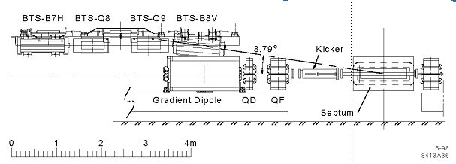

SPEAR3 Septum Magnet
Injection transport line
Septum
SPEAR3
The Challenge:
Short injection straight; steep angle
1.31 Tesla Lambertson septum
~1 Gauss stored beam field
2.5 mm wall
Challenge unique to SPEAR3
MAX-IV: 0.85 T; PLS-II: 1.1 T; APS-U: 1.0 T
Injected beam, 1.31 T
Stored beam, ~1 G
2.5 mm wall
Notes:
PLS-II: “Max Injection Field” 1.200 T, “Working Injection Field” 1.1147 T

Slide 12
Accelerator Improvement Projects
 | FY16 | FY17 | FY18 | FY19
Booster RF SSA
Lower Emittance (10 -> 6 nm)
SPEAR3 LLRF
Multi-bunch Feedback |  | 0.6 | 1.2
Pseudo Single Bunch |  |  | 0.2 | 0.8
Resonant Crabbing |  |  | 0.9 | 1.2
Short Pulse Design
Short Pulse Project
Reliability upgrade
Performance upgrade
Notes:
FY17 on, almost all performance upgrades tie in to timing mode development (even SPEAR3 LLRF & multi-bunch fdbk upgrade has some timing benefit).
300 k$ toward Short pulse FY16
~2.2 M$/year in AIP. Extra in FY16; DOE provided funding boost for high priority projects

Slide 13
SPEAR3 Low Level RF Upgrade
Improve reliability by eliminating dependence on unsupported hardware
Upgrade the SPEAR3 LLRF with the same hardware and architecture as the booster SSA
Improve performance by allowing more powerful hardware and software to address more challenging problems of future SPEAR3 projects
  Improved longitudinal stability for timing mode
Address support (succession plan) by enabling members of other SLAC RF groups to understand and work on system
Notes:
Reliability upgrade, replacing outdated equipment that would be difficult to maintain going forward.
Also will improve our longitudinal stability, which helps timing mode operation.
Timely project, because it implements the same system as used for the booster SSA LLRF, and uses the same team.

Slide 14
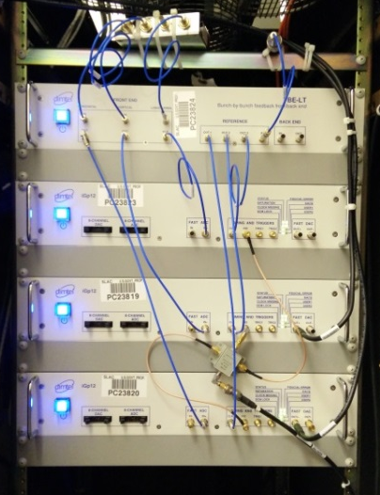
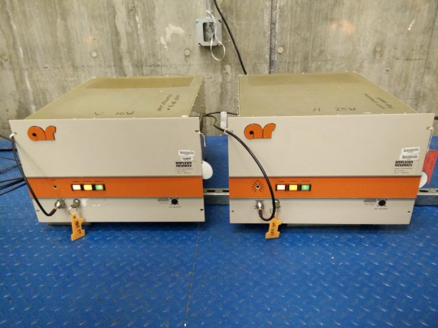
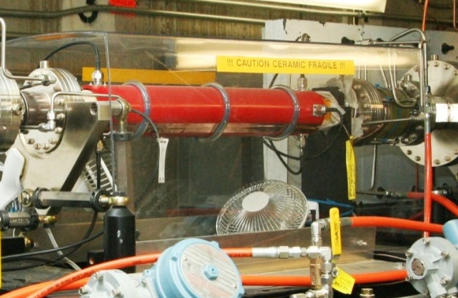
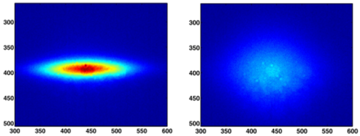
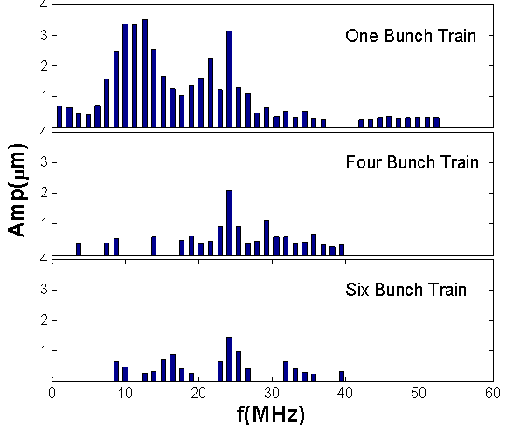
Multi-bunch Feedback System
System Components:
Dimtel FBE+iGp12
Kicker
Power Amplifiers
  80cm long; ~20Mhz bandwidth;
  Uncharacterized
**Needs Upgrade**
Commissioned 2014
From PEP-II
  model#: AR 150A220M1
  150W output power; 220 MHz
  Power limited at 25W for H, 10W for V
Sufficient to damp the ion & RW instabilities during operation
Useful diagnostic tool
  Tune measurement
  Gap transient measurement
  Beam instability measurement
Power and bandwidth limitation from the Kicker
L. Wang PRSTAB 16, 104402 (2013)
Notes:
Operating since 2014.
Three major system components – kicker needs upgrade to wider bandwidth and higher power.

Slide 15
Motivation for Kicker Upgrade
Enable chromaticity reduction at start up
Increase single bunch current limit?
Suppress resistive wall instabilities with Future IDs
Damp top-off transients faster
Improve bunch purity with bunch cleaning
Enable novel timing modes
  Resonance crabbing
  Resonant pseudo single bunch
Damp instabilities from BL15 IVUN
Notes:
Kicker upgrade will have multiple benefits for operations.
Improves beam stability in various ways.
Allows lower chromaticity, making lower emittance implementation easier.
BL15

Slide 16
Accelerator Improvement Projects
 | FY16 | FY17 | FY18 | FY19
Booster RF SSA
Lower Emittance (10 -> 6 nm)
SPEAR3 LLRF
Multi-bunch Feedback |  | 0.6 | 1.2
Pseudo Single Bunch |  |  | 0.2 | 0.8
Resonant Crabbing |  |  | 0.9 | 1.2
Short Pulse Design
Short Pulse Project
Develop timing mode
Notes:
Upgrades:
Reliability
Performance
Long term
FY17 on, almost all performance upgrades tie in to timing mode development (even SPEAR3 LLRF & multi-bunch fdbk upgrade has some timing benefit).
300 k$ toward Short pulse FY16
~2.2 M$/year in AIP. Extra in FY16; DOE provided funding boost for high priority projects

Slide 17
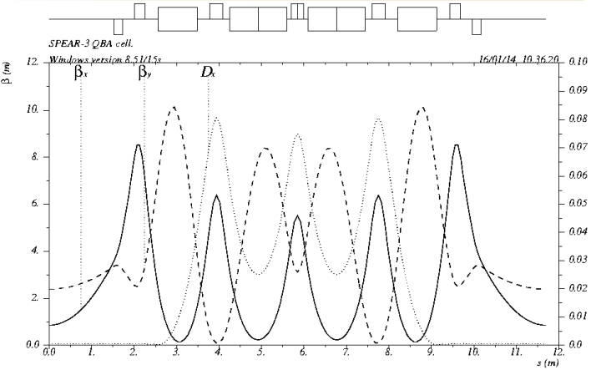
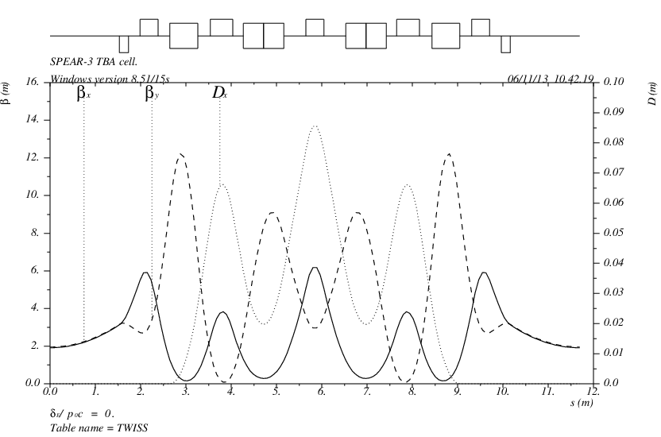
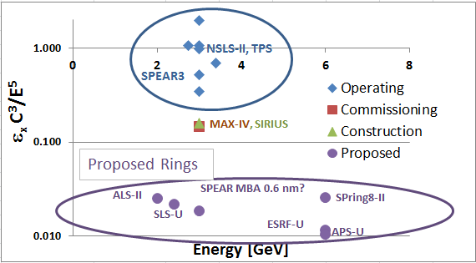
SPEAR3 Multi-Bend Achromat?
SPEAR DBA to MBA
  234 m small for 3 GeV
  11.7 m cell is short
  DBA to QBA design
Emittance scaling
  ε_{x} ~ E²/N_{dip}³
  N_{dip} ~ C/E (B-field limit)
  ε_{x} ~ E⁵/C³
  ε_{x} ~ 0.6 nm for SPEAR
M.H. Wang
x
Notes:
Mention that SLAC has been working on PEP-X design.
With BESAC review changes (PEP-X out for now), we looked at possibilities for SPEAR.
Now we have a reference point.
Show scaling that indicates ~0.6 nm is reasonable expectation
C=circumference

Slide 18
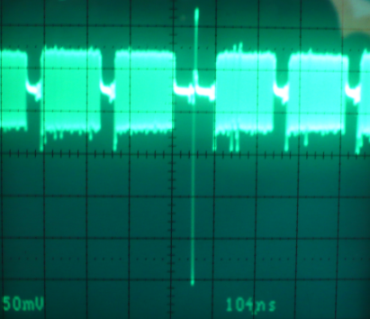
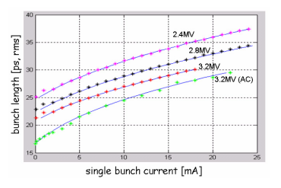
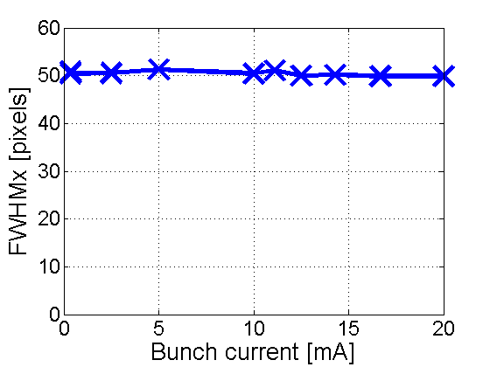
Timing mode in standard operations lattice
Standard fill pattern, 280/372 bunches filled
1 to 4 camshaft bunches
Bunch length vs. I_{bunch}
780 nsec/revolution, 1.28 MHz
4 bunch trains
3x29 nsec gaps, 1x120 nsec gap
2.1 nsec bunch spacing
1.8 mA/bunch
5 mA/camshaft; or up to 70 mA, or more…
Corbett et al., SLAC PUB 14675
No energy spread increase with bunch current.
WANT:
10¹² photons/s
<10 psec FWHM
Compatible with 500 mA, low ε_{x}
Notes:
Covered two upgrade projects that have peripheral benefit to timing mode. Now will cover upgrades directly related to developing timing mode.
First an update on our present capability.
Filled 60 mA at end of run (but stability needs more study)
60 mA camshaft drops to 52 mA in 5 minutes. Expect current to vary seesaw from 52 to 60 mA over 5 minute fills.
Also did a test filling 140 bunches (required for crab cavities) which could also provide a much larger gap around the camshaft
Going forward, want to develop timing mode that is compatible with 500 mA, low emittance operations for non-timing users.
Tangerine laser on BL15
The 10^(12) photons/s is for a 1e-4 BW
Present fill pattern: 1-69 filled, (70-82 empty), 83-151, (152-164), 165-233, (234-246), 247-315, (316-343), 344, (345-372). Three 69 bunch trains, with 13 bunch gaps, 28 bunch gaps on either side of the camshaft.
Small gaps = (13+1)*2.1 nsec = 29.4 nsec
Camshaft in the middle of a (2*28+1+1)*2.1 nsec = 122 nsec gap

Slide 19
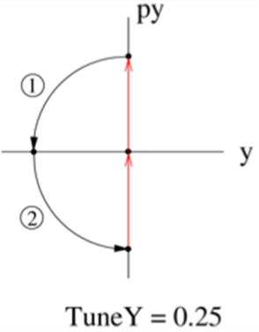
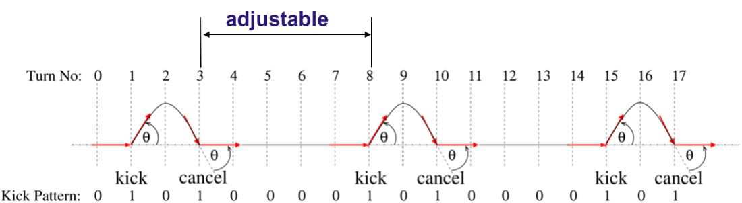
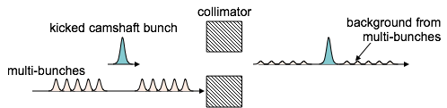
Pseudo Single Bunch
Timing mode operation demand in SPEAR3
Compatible with 500 mA, low emittance operations
Photon flux = 1x10¹² photons/second
Spatially isolated timing bunch
Successful implementation in ALS
Proved to be effective in increasing the SNR
Reduced sample damage
User selectable repetition rate up to 1.28 MHz
Reliable in operation
Kick and Cancel
(KAC)
Courtesy of D. Robin
Notes:
DRobin idea, implemented in operations at ALS.
The 10^(12) photons/s is for a 1e-4 BW

Slide 20
Short bunch performance goals for SPEAR3
Compatibility with ~500 mA, low emittance operation with minimal impact on emittance and lifetime.
Short pulse duration of order 10 ps fwhm (5 ps fwhm or less preferred).
The ability to isolate a short photon pulse in a beam line from radiation coming from other stored electron bunches.
Monochromated 8-keV photon flux (~10⁻⁴ BW after Si(111) monochromator)of order 10¹² ph/s from ~10-ps fwhm pulses.

Slide 21
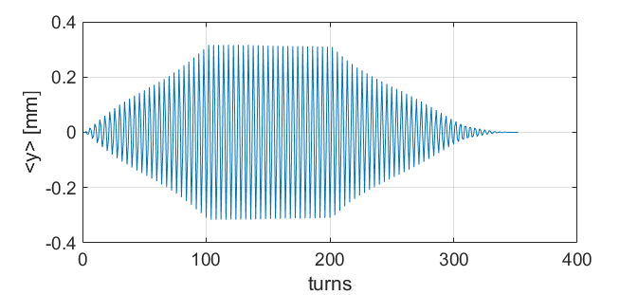
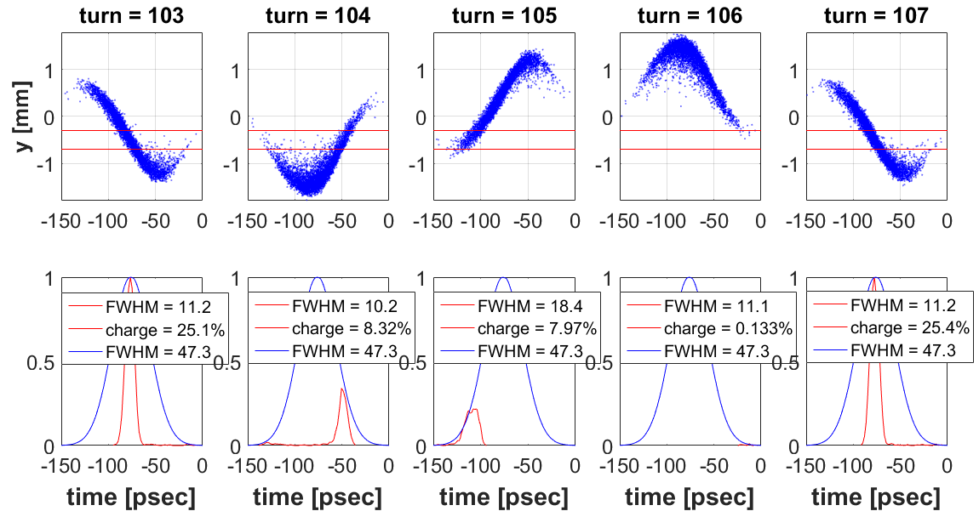
Resonant Crabbing
Kicker spec’d for fast excitation time
Resonantly excite vertical oscillation in one synchrotron oscillation period.
Excite with multi-bunch feedback
Free oscillations for ~100 turns.
Slice-ε_{y} remains small, turn-by-turn!
Set ν_{y}=6.25 for short pulses every 4 turns.
Offset slit isolates short pulse from 500 mA
Resonantly damp centroid oscillations
T_{synch}
Photon beam at BL15 slit
Notes:
Slice off-axis in y to isolate from 500 mA beam. 300 um top of slit is 4 sigmas from the peak of the 500 mA distribution.

Slide 22
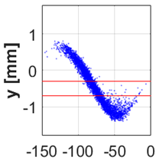
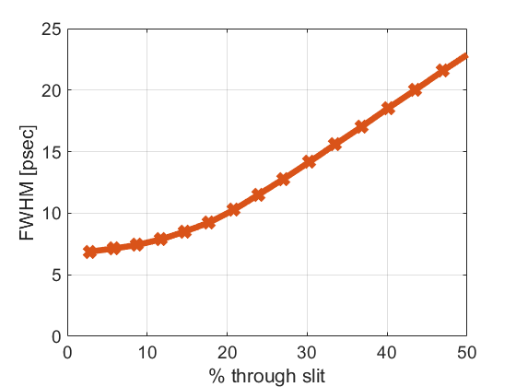
Resonant crabbing
low cost
comparable to low-α performance
500 mA, 10 nm compatible.
short photon pulses without e- CSR issues
Photon pulse at BL15 slit:
Photon pulse length vs slit width
Slit top at 4 σ_{y} of 500 mA distribution; spatial filter separating short pulse from 500 mA photons.
Determined by initial bunch length
Determined by photon pulse vertical thickness at slit

Slide 23
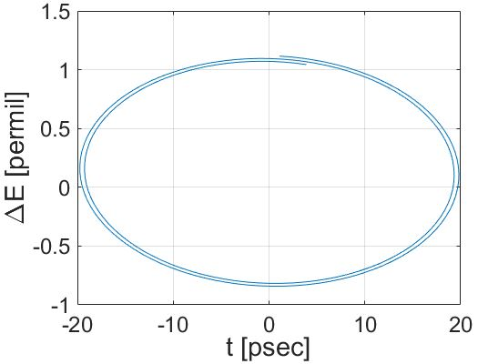
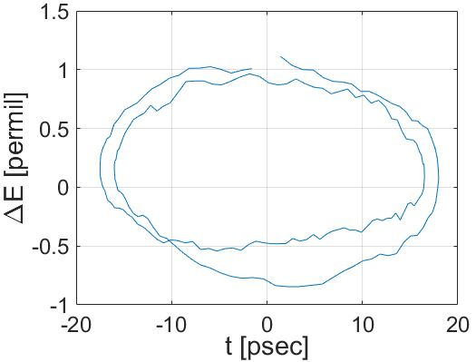
Resonant crabbing and synchrotron radiation
Synchrotron radiation adds statistical noise to longitudinal oscillations
Resonant crabbing results strongly depends on statistical model
Tracking codes need refinement to properly model resonant crabbing
Issue needs resolution in order to specify multi-bunch feedback kicker requirements
Without statistical noise
With statistical noise

Slide 24
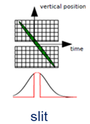
Two frequency crab cavities (2FCC), short pulses
A. Zholents et al, NIMA 425, 385 (1999)
RF deflecting cavity
RF deflecting cavity
  Tilt-and-cancel scheme for APS-SPX
Slits in beam lines slice out fraction of tilted photon pulse:
cavity at 6 x f_{RF} (2858 MHz) and cavity at 6.5 x f_{RF} (3096 MHz)
produce alternating tilted and un-tilted bunches (analogous to 2-freq RF compression for BESSY-II VSR).
500 mA stored in un-tilted bunches, order 20 mA in tilted bunch(es).

Slide 25
Short pulse performance
Short pulse mode | Pulse length (ps, fwhm) | Camshaft bunch charge (nC) | Repetition rate (MHz) | Camshaft 8 keV average flux¹ (10¹¹ g/s/0.1%BW)
Standard lattice, camshaft 13 mA | 70 | 10 | 1.28 | 80
Low-α, α/20 | 15 | 0.27 | 1.28 | 2.2
Standard lattice, w/ SRF | 7.4 | 1.6 | 1.28 | 12.8
Ten-turn circulation² | 5.2 | 0.20 | 1.28 | 1.6
One-turn circulation | 1 | 0.30 | 0.085 | 0.16
Crab cavity, large slice³ | 7.1 | 2.0 | 1.28 | 16
Crab cavity, small slice | 4.0 | 0.6 | 1.28 | 4.8
¹ SPEAR3 BL12-2 is assumed for flux calculation (λ=22mm, 67 periods, k_{max} =2.17).
² Assuming beam power of 76.8 kW from LCLS-II.
³ Charge given for slice from a 15.6 nC bunch with slitting. 1 MV deflecting voltage per cavity system is assumed.
Notes:
The photons/s is for 1e-4 BW.
Assumes perfect photon beamline imaging optics. Tom will give refined numbers to account for beamline optics tomorrow.

Slide 26
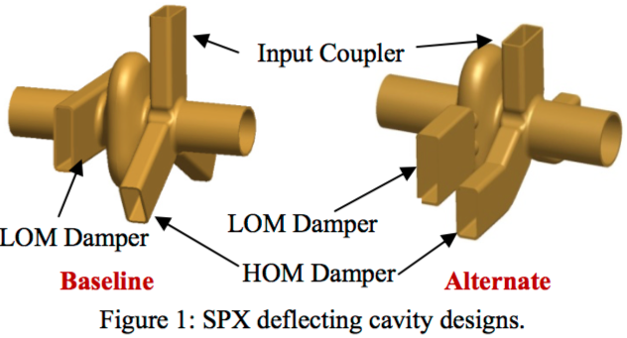
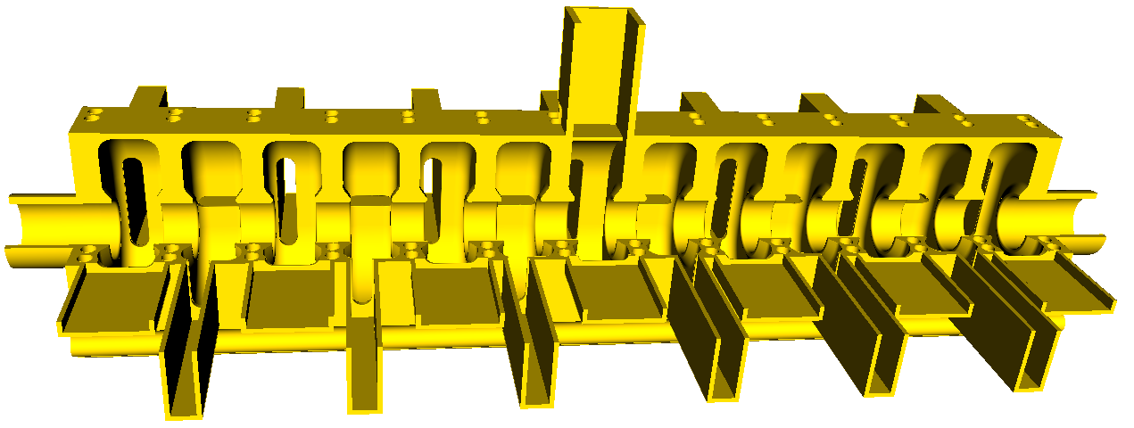
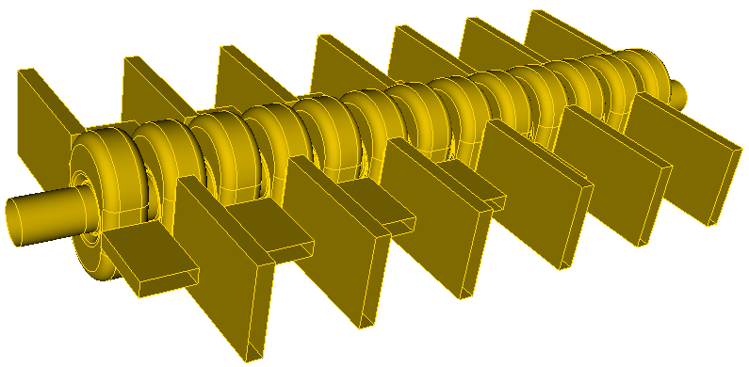
Crab cavities
Superconducting crab cavities developed for APS-SPX project:
Elliptical cavity (JLab/ANL)
QMiR cavity (FNAL/ANL)
Normal conducting, 13-cell cavity with LOM, HOM couplers (Z. Li, SLAC)
Less expensive than superconducting
Design progressing well
Notes:
Quasi-waveguide MultI-cell Resonator
Zhenghai Li has made significant progress in coming up with a 13-cell NC cavity with HOM damping.
Need further study of broadband impedance and predicted effect on SPEAR3 beam.
Impedance is a big issue. Two aspects, resonant modes that couple bunches (multi-bunch instabilities) and broadband impedance that disrupts the internal dynamics of individual bunches. Fins are for damping resonant modes. Broadband impedance – QMiR style rejected on this basis. AP effort (simulation, measurement and calculation) to better understand the existing impedance and the implications of increasing it substantially with the addition of cavities.
a

Slide 27
Investigation of 2FCC performance
Draft white paper completed January 2017
Generation of Short Pulses in SPEAR3 with Two-Frequency Crab Cavities
1. Summary
2. Single particle dynamics and performance prediction
2.1 Equilibrium distribution for tilted bunch and Short pulse performance
2.2 Crab cavity configuration for cancellation
2.3 Choice of lattice
2.4 Choice of crab cavity parameters
2.5 Effect of bunch train gap transient
2.6 RF phase noise tolerance
2.7 Injection into tilted bunch
2.8 Touschek lifetime
2.9 Crab cavity transverse field requirements
2.10 Short pulse-picking
2.11 Expected short pulse performance
3. X-ray optics
3.1 Representative beamline performance using slits for pulse duration control
3.2 Asymmetrically cut Bragg monochromator crystals for pulse compression
4. Crab cavity system
4.1 Introduction
4.2 Design parameters
4.3 Crab cavity options
5. Collective effects
5.1 Heating from monopole modes
5.2 Longitudinal coupled bunch instability threshold
5.3 Transverse coupled bunch instability threshold
5.4 Transverse impedance and TMCI threshold
6. Operational implications
7. R&D and future studies
8. Appendices
A.1 Summary of short bunch methods for SPEAR3
A.2 SLAC normal conducting cavity design
A.4 Operational information for the superconducting cavity cryogenic system
On April 19 SSRL will have committee assess the status of the concept and preliminary design for 2FCC approach to producing short photon pulses in SPEAR3.
Notes:
Steier, Byrd, Borland, Harkay, Kuske, Sergey (Fermilab),
Focus on beam dynamics – confirm that basic idea will work. Consider effect on 500 mA.

Slide 28
Summary
SPEAR3 performance is highly reliable despite a very tight budget
Given geometric constraints, an ultra-low emittance lattice is not competitive
Timing mode development a priority for future performance upgrades
  Multi-bunch feedback
  Pseudo single bunch
  Resonant crabbing
  2-frequency crab cavities

