Slide 1
RF Systems for High Brightness Synchrotrons
Jim Rose
John Cupolo, Pete Davila, Feng Gao, Brian Holub, Hengjie Ma, Carlos Marques, Keith McDonald, Jorge Oliva, Joe Papu, Bob Sikora, Chris Sorrentino, Nathan Towne, Jueri Tagger, Gabriele Bassi, Alexei Blednykh

Slide 2
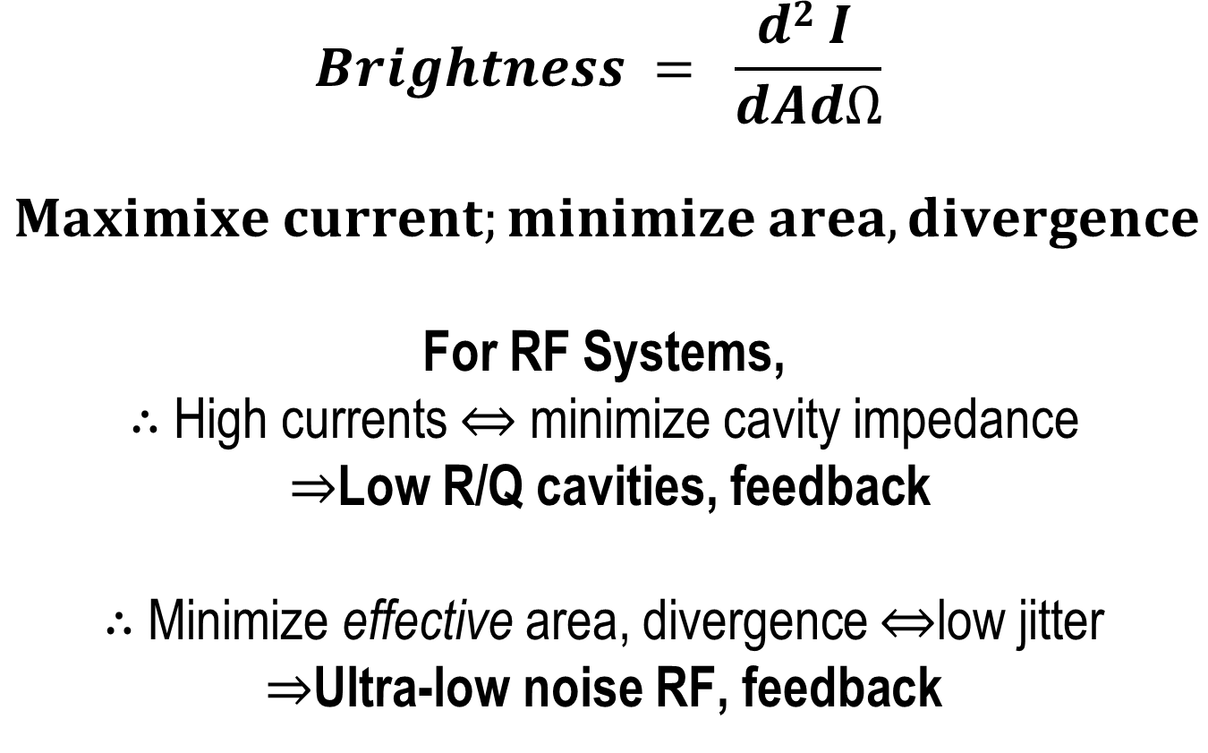
Basic RF System Design Approach for High Brightness Synchrotrons
$$Brightness = \frac{d2 I }{dAdΩ}$$
$$Maximixe current;minimize area, divergence$$
For RF Systems,
$∴$High currents ⇔ minimize cavity impedance
$⇒$Low R/Q cavities, feedback
$∴$ Minimize effective area, divergence ⇔low jitter
$⇒$Ultra-low noise RF, feedback
Notes:
This is my outline- Minimize Impedance, Low Jitter RF and Feedback

Slide 3
NSLS-II RF-Beam Parameters
Cavity
detuning
-8.3kHz
500MHz
f_{rev}
f_{s} ~ 4kHz
f_{rev}
-378kHz
+378kHz
 | Baseline | Fully Built Out
R/Q | 44.5 | 44.5
Q₀ | 5*10⁸ | 5*10⁸
Revolution Frequency | 378 kHz | 378 kHz
Total V | 3.3 M | 4.9 MV
Synchrotron Frequency | 3 kHz | 4 kHz
Number of cavities | 2 | 4
Q_{L}* | 1.2*10⁵ (7.9*10⁵) as built | 6.7*10⁴ (7.9*10⁵)
Bandwidth (FWHM) | 4 kHz (6.3 kHz) | 7.4 kHz (6.3 kHz)
Frequency detuning | -6.4 kHz | -8.3 kHz
* Q_{L} ~ 86k for minimum reflected power over all phases (preliminary)

Slide 4
RF System Parameters for Robinson Beam Stability
The stability criteria for heavily beam loaded systems can be written as
The beam is marginally stable since to match to a heavily beam loaded cavity
β ~ P_{beam}/P_{cav} and -ψ ~ φ_{s} although
-ψ/φ_{s} <1 by small amount
We can increase the stability margin by detuning the cavity by some angle χ (oOχOφ_{s}) at the cost of some reflected power, then we obtain a current limit
Where ψ = -φ_{s}+χ
For χ = 0, I₀ = 501.3 mA (Full Buildout)
For χ = 5 degrees, I₀ = 630 mA
If system is designed to be matched at full beam, small stability margin at that operating point!
Alternatively, we can manipulate the impedance R_{a} with feedback. Feedback is the
primary choice for obtaining stability, since there is no additional power required.
We retain each of these options, plus feedback around the beam/RF system for NSLS-II

Slide 5
Summary of RF field Tolerances
From the NSLS-II Beam Stability Workshop April 18-20, 2007
The momentum error effect on beam size, orbit jitter and the vertical photon beam divergence for experiments using a higher harmonic of an Insertion Device (ID) and the emittance growth from filamentation due to energy jitter was calculated. Due to the very low dispersion in the ID straights the RF phase and amplitude jitter requirements for ID’s are fairly relaxed, and the RF system phase and amplitude jitter specifications are driven by the timing dependent experiments.
 | Phase Jitter (°) | Momentum jitter Δp/p (%)
Timing-dependent experiments | 0.1 | 0.005
Vertical divergence (from momentum jitter) | 1.2 | 0.04
10% increase in σδ due to filamentation | 1.8 | 0.065
Vertical centroid | 0.82 | 0.03
Guo, Carr, Krinsky, Rose PAC2007

Slide 6
Choice of RF cavity design
Accelerator Science Advisory Committee Workshop April. 23-24, 2007
Ground Rules:
Systems will be compared at the fully built-up requirements
of 5MV, 1000kW beam power.
Both NC and SCRF systems will include a passive,
SCRF harmonic cavity for bunch lengthening, meaning there will be a LHe system of some sort.
Four approaches were studied:
CESR-B, KEK-B, PEP-II and BESSY-II cavities.
the CESR-B and the KEK-B are nearly identical in performance, we will compare the CESR-B, PEP-II and BESSY-II cavities
We were confident that both SRF and NC will work, it was a question of technical performance, cost and risk

Slide 7
BESSY Cavity Available Beam Power/Voltage
10 cavities required at 550 kV / cavity
Total installed cavity impedance 1150 ohms
Installed power/cavity
Accelerating Voltage
Freq. = 500MHz
Qo = 26700
R_shunt = 3.1MΩ
Max wall power= 100kW
Max coupler power 150kW
R/Q = 115
Total available beam power for 10 cavities 1000 kW

Slide 8
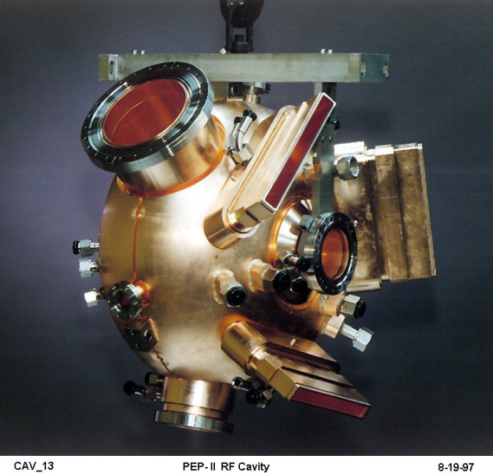
PEP-II Cavity Available Beam Power/Voltage
6 cavities required at 850 kV/cavity for 5MV
Total cavity impedance 690 ohms
Installed power/cavity
Accelerating Voltage
Freq. = 476MHz→500
Qo = 33000
R_shunt=3.8MΩ
Max wall power=100kW
window power=500kW
Total available beam power for 6 cavities 1200 kW

Slide 9
CESR-b Cavity Available Beam Power/Voltage
3 cavities required for 5MV at 1800 kV per cavity
Total cavity impedance 135 ohms
Log Scale
Accelerating Voltage
Freq. = 500 MHz
Qo = 0.75E10
R_shunt = 3.375 E10 Ω
Max wall power < 200 W
window power > 300 kW
Total available beam power for 3 cavities 810 kW
NSLS-II conceptual design was for 4 cavities: 1080 kW and 180 ohms total installed impedance

Slide 10
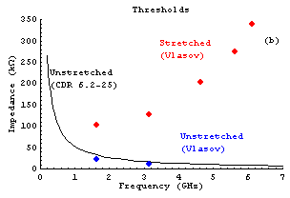
Longitudinal Coupled Bunch Instability Growth rates vs. Cavity Choice
Longitudinal coupled bunch growth
times for single RF system (unstretched)
Impedance limits calculated with self-
consistent fields using Vlasov equation
for stretched bunches
Note: damping time for bare lattice =27ms With 8 Damping Wigglers= 6ms | Growth time for 500mA
CESR-B (4cavities) bare lattice With 8 Damping wigglers | 99ms 121ms
PEP-II (6 cavities) bare lattice With 8 Damping wigglers | 13.5ms 16ms
BESSY-II (10 cavities) bare lattice With 8 Damping wigglers | 3.4ms 4.6ms
N. Towne
Initial calculations for CBI growth rates for unstretched bunches show damped
behavior for both PEP-II and CESR-B cavities. Shortened bunches, if desired,
will likely be unstable for NC cavities and possibly SCRF as well. Work continues.

Slide 11
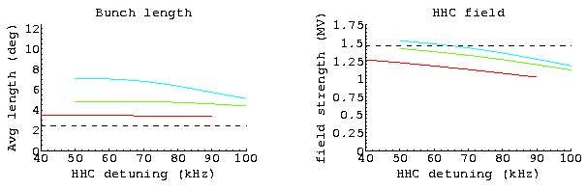
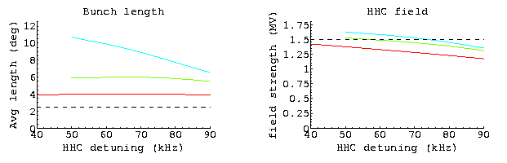
Stretched Bunch length dependence on R/Q
N. Towne
NC bunch lengths (rms ) and harmonic cavity (HHC) fields as a function of detuning for one ion gap (red) two gaps (green) and four gaps (blue). Dotted line is unstretched bunch length or optimal HHC field.
SC bunch lengths (rms ) and harmonic cavity (HHC) fields as a function of detuning for one ion gap (red) two gaps (green) and four gaps (blue). Dotted line is unstretched bunch length or optimal HHC field.

Slide 12
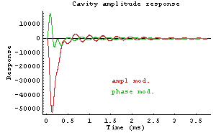
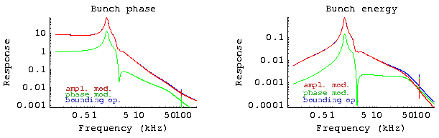
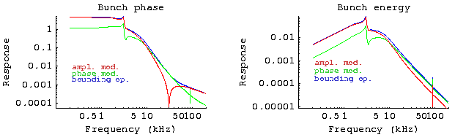
RF to Bunch Energy and Phase transfer functions
Impulse response to amplitude or phase modulation of the initial RF Fields is used to obtain the bunch phase and energy transfer functions
Normal Conducting
N. Towne
Super Conducting
Although the NC case was not explored in detail, the beam response functions are better behaved in the SC RF system due to the lower R/Q. Lower overall response functions minimize noise contributions to bunch phase and amplitude errors.

Slide 13
SCRF has the advantage that voltage is “free”
What if we achieve a 3.5% momentum
aperture? Need 5.6MV, need
additional PEP-II cavity
4% requires 6.5MV
Two additional PEP-II cavities !
Or, turn up gradient in 4 CESR-B to
1.65MV each: their limit is ~ 2.4MV!

Slide 14
RF Cavity Summary
The lower impedances of the SCRF cavities are attractive for collective effects. Stability margins are increased for CB instabilities. The effects of the ion-gap transients on bunch phase in the presence of the bunch lengthening harmonic cavity are diminished.
Risk of catastrophic vacuum failure in beam-vacuum could lead to significant down-time for SCRF systems. Mitigated by the addition of fast-acting valves bracketing the RF straights.
CESR-B and KEK-B are first generation SCRF cavities for high current rings. Significant improvements are likely to occur during the life of the machine. The infrastructure will be in place to take advantage of it.

Slide 15
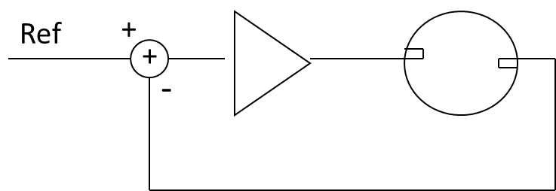
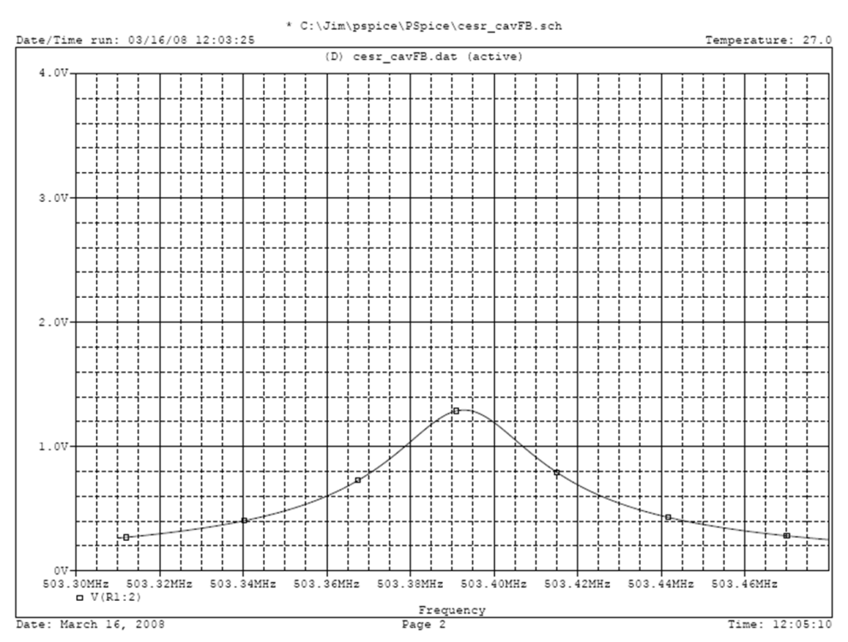
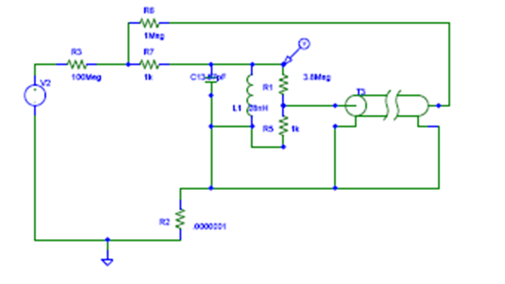
Cavity feedback: Impedance Control
Direct RF feedback

Slide 16
Feedback: Simplified Schematic
Cavity Field Controller

Slide 17
Canceling Beam Induced Voltage with Feedback Beam Study 25Jan2017
FB Closed at 126kV set point, raised, then lowered to zero
FF Voltage set to zero
126 kV beam induced voltage with 20mA
65 kV beam induced voltage with 11mA
75 mA
FB setpoint to zero, 4 kV measured
50 mA
20 mA
7kV
5 kV
11 mA
126kV at 20mA would correspond to 472kV, < 7kV induced; 7/472 = -36 dB reduction

Slide 18
NSLS-II Cavity Field Controller GUI
Features
AutoStart (FF measurement of loop delay, set return phase to 180, close loop)
AutoRamp (to final voltage)
Feedforward table (Summed with FB output)
“Perfect Limiter”
Phase/amplitude “Jump”
  Triggered for synchronous BPM data
Pulsed feedback settings for exploring stability limits (without dropping out beam)
Network Analyzer (Built in!)

Slide 19
Network analyzer in logic:
Frequency sweep vs. Tuner position At 100 kW !
(LVDT is position
read back)
Frequency axis is in the digital IF frequency of ~10 MHz where 10 MHz corresponds to the 500MHz RF frequency

Slide 20
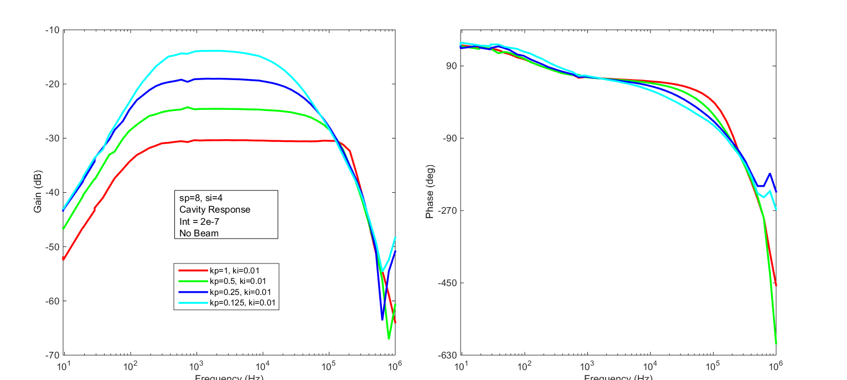
Storage Ring RF system response October 18, 2015 Studies
Varying only Proportional gain: cutoff frequency constant. Measurements made at full RF power
Cavity response with varying proportional gain (kp), fixed integral gain (ki), and no beam.
.
Carlos Marques, Jim Rose

Slide 21
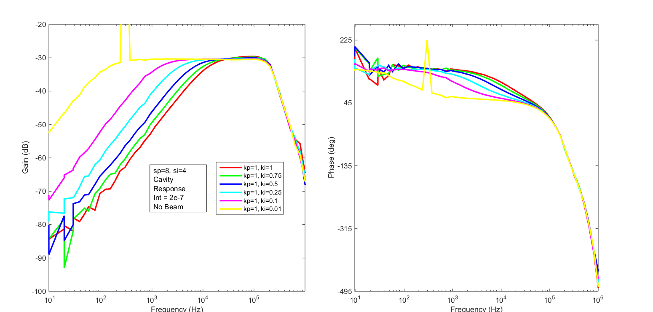
Storage Ring RF system response October 18, 2015 Studies
Varying only Integral gain changes loop cutoff frequency, low frequency gain
Cavity response by varying integral gain (ki) with fixed proportional gain (kp) and no beam.
Carlos Marques, Jim Rose

Slide 22
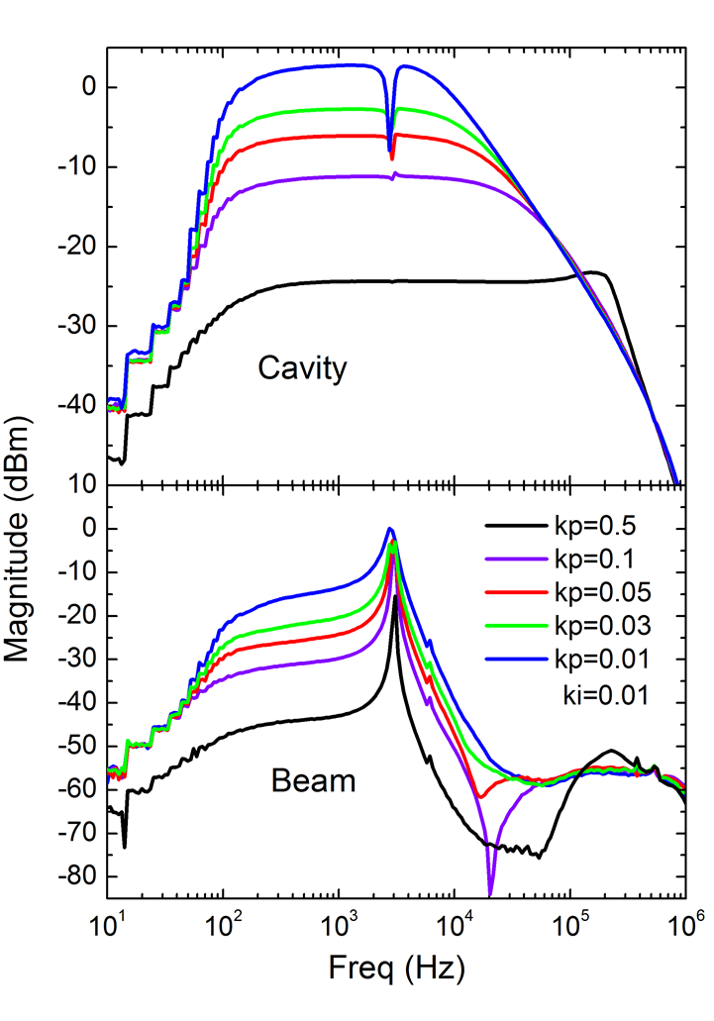
By adding a BPM sum signal, Measure beam transfer functions!
Closed Loop measurements 150mA.
Cavity magnitude response from field pickup
Beam response from BPM sum signal
Carlos Marques,
Jim Rose

Slide 23
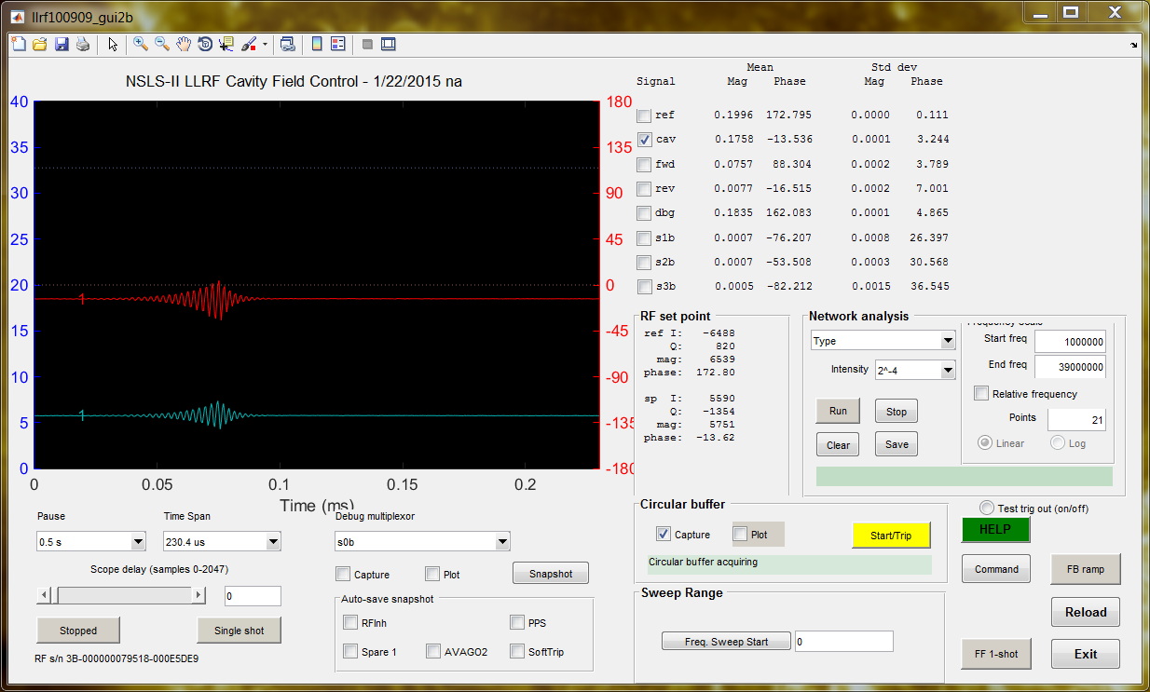
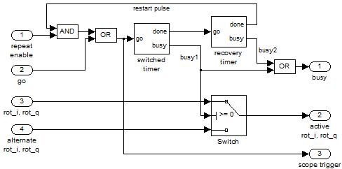
PULSED FEEDBACK GAINS
Ordinarily when loops go unstable, bad things happen. By pulsing feedback gain set points to higher values for short periods stability limits can be explored without dropping out beam, tripping RF (or worse)
Loop goes unstable but recovers when gains returned to original (safe) value
Notes:
Not only can we jump amplitude and phase setpoints but we are also able to pulse the proportional and integral gain settings of our feedback loop. Heres some data captured using this module with 1.2MV of cavity voltage where the blue curve is amplitude and red is phase. Here I show a schematic of the logic. We use this function to study stability margins with high power and beam. What we see in this data is when the gain settings are set past the stability margin and the feedback loop is brought unstable but after some time the feedback gain settings are brought back to conservative settings and the feedback system recovers.

Slide 24
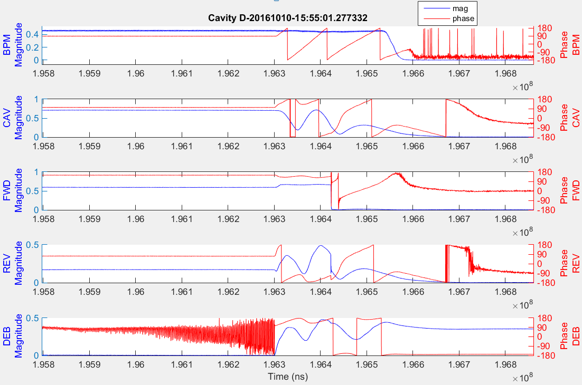
CIRCULAR BUFFER for post mortems
Notes:
Here I show some data from our circular buffer or post mortem. The data consists of 5 channels each with 250ns resolution and include the summed bpm signal cavity, forward, reverse and debug which includes feedback error signal which is what you see there in magnitude and phase and also other feedback related signals and a dedicated analog to digital converter channel. This information is stored locally in the 32Mb RAM allocated for the FPGA and yields data for approximately .2 seconds before and after the trigger event. I would like to point out our limiter circuit which is being implemented for this event where the forward power is being clipped while the phase is preserved.

Slide 25
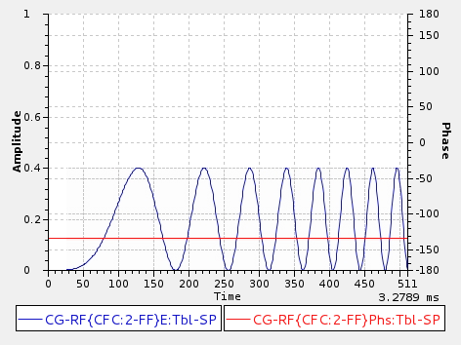
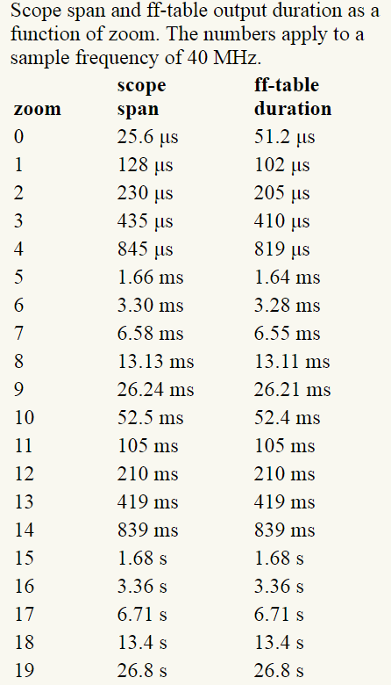
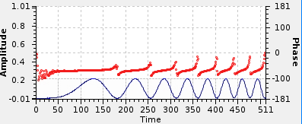
FEEDFORWARD TABLE
Feedforward Table
Measured Field
Notes:
We are also able to produce arbitrary waveforms through a feedforward table. The example above was an amplitude modulation or a chirp of the cavity field. We can simultaneously modify the cavity amplitude and phase to any allowable setpoint. The top plot represents the Feedforward table uploaded to the CFC while the bottom plot represents the cavity field measured. Both plots were generated through an EPICS interface. The “time” can be varied with the respect to a “zoom factor” covered above.

Slide 26
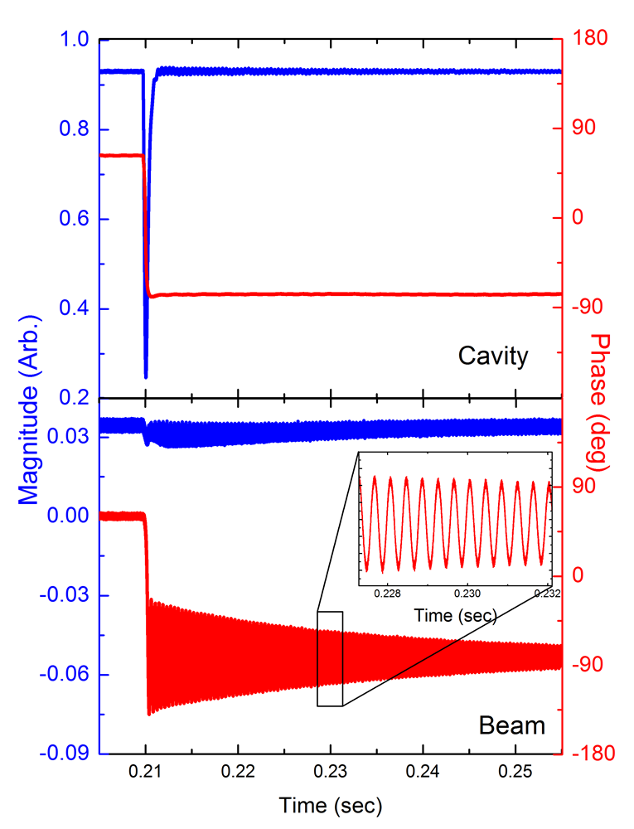
AMPLITUDE/PHASE JUMP
Phase or amplitude jump triggered by timing event is synchronized with turn by turn bpm data for measuring dynamic aperture, field non-linearities, etc. More information can be found in literature [1].
Figure to the left shows a phase jump of 120 degrees shown with beam response.
[1] G. M. Wang, et al. , “RF PINGER COMMISSIONING AND BEAM DYNAMICS STUDIES AT NSLS-II” IPAC2016, THOBA01.
Notes:
We are also have the ability to trigger different setpoint values at any given time with our amplitude/phase jump module. Here I show an experiment where we jumped the cavity phase by 120 degrees where the blue trace is the cavity field while the red is the phase. At the bottom we have a BPM sum signal that is summed and bandpass filtered which gives us a beam phase and amplitude reading. Notice that the beam phase follows the cavity phase jump and the damping waveform is indeed the synchrotron frequency. This experiment was used to measure dynamic aperture, field non-linearities, etc. More information can be found in Guimay Wans paper RF pinger commissioning and beam dynamics studies at nsls-ii.

Slide 27
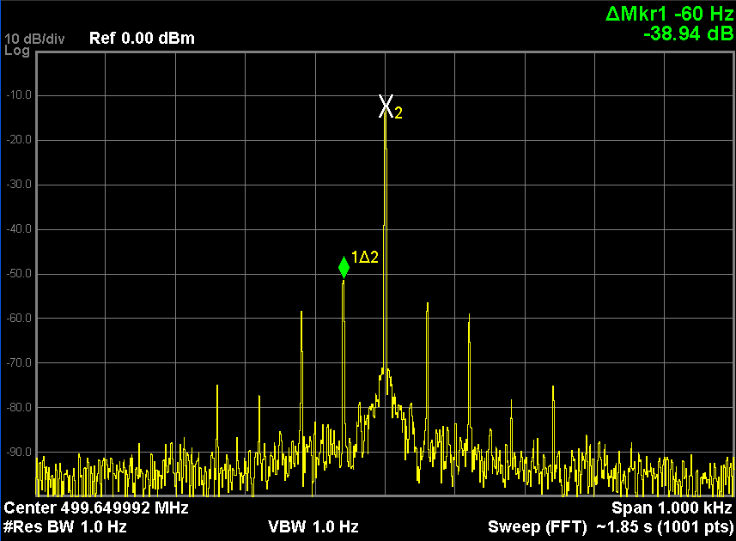
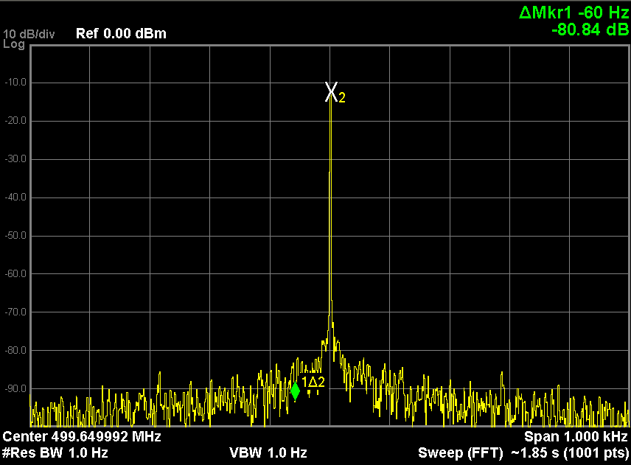
Performance Test of LLRF at TLS BR
NSLS-II digital LLRF with feedback ON
NSLS-II digital LLRF with feedback OFF
Courtesy Zong-Kai Liu, Meng-Shu Yeh and Chaoen Wang, TLS/TPS

Slide 28
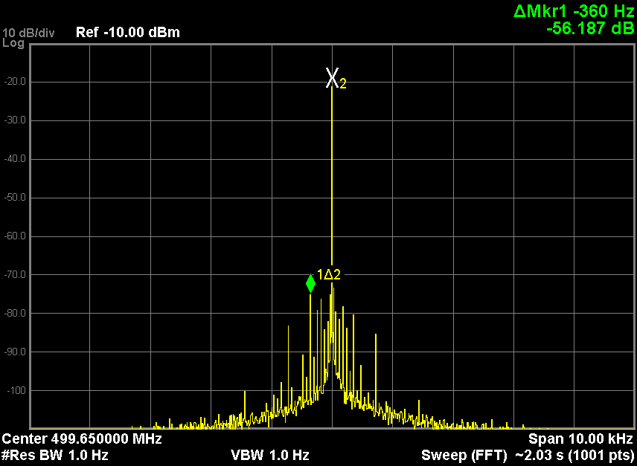
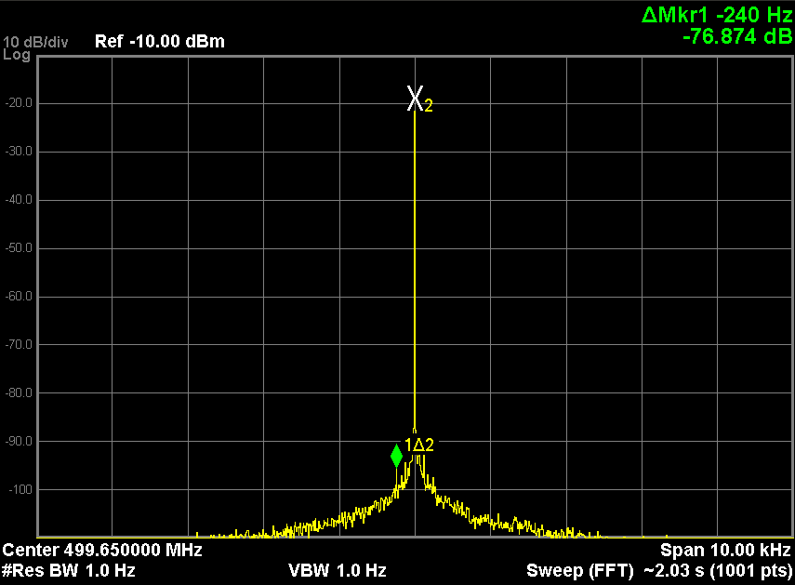
Performance Test of LLRF at TPS BR
NSLS-II digital LLRF with feedback ON
NSRRC analog LLRF with feedback ON
Courtesy Zong-Kai Liu, Meng-Shu Yeh and Chaoen Wang, TLS/TPS

Slide 29
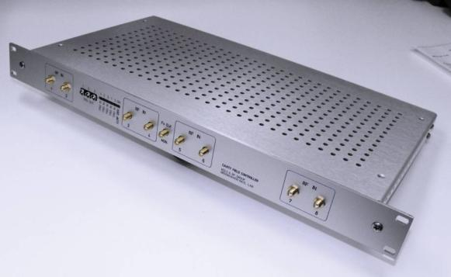
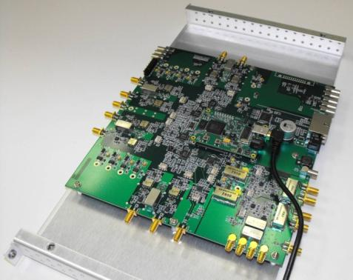
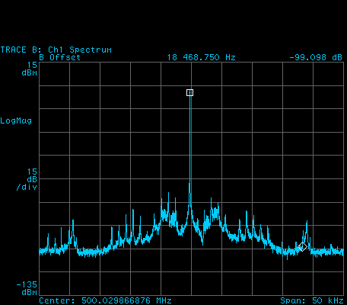
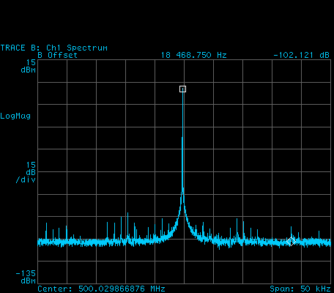
Cavity Controller Performance at CLS
Digital Field Controller
50 MHz IF
Tested at CLS on hardware nearly identical to NSLS-II: 300 kW klystron and CESR-B SRF cavity
Meets NSLS-II field spec. of 0.15 degree and 0.05%
H. Ma
CLS Analog
A=0.073%rms
φ=0.12° rms
NSLS-II
A=0.026%rms
φ=0.02°rms
CLS tests courtesy M. de Jong

Slide 30
Thank You For Your Attention

Slide 31
Backup Slides

Slide 32
PWM High Voltage switching power supply
The HVPS allows the module switching frequency to be modified to avoid exciting the beam
PWM_FREQ(0=3.125kHz and 255=800kHz) where PWM_FREQ can be set to values PWM_FREQ=0…161 FMS=FPWM/N where N is the number of modules engaged
.
We will adjust PWM_FREQ over the shutdown to avoid the synchrotron frequency
The HVPS controls also allows setting the weights of the switching algorithm to minimize the 60 (50) Hz harmonics

Slide 33
Effect of RF jitter on the beam:
Amplitude modulation of the RF fields leads to momentum deviations of the beam, Likewise phase modulations translate into amplitude modulations again leading to momentum deviations. The momentum errors affect beam size and orbit jitter as follows:
The beam size in the center of the 5 m straight is given by
Since the dispersion is near zero (~1mm) and the natural energy spread is <0.001 the second term is negligible and the beam size becomes
σ _{x,y}= 40μm, 2.4 μm
Orbit jitter is given as σ_{x,y} = σ_{δ}∙η_{x,y ,} σ_{x′,y’} = σ_{δ}∙η_{x′,y’}
Because of the near zero dispersion in the ID straights, this is not the limiting factor
in determining the RF tolerances
Timing experiments in IR beamlines impose limit of phase variations
to be <5% of bunch length: Phase error limit of +/- 0.12 degrees and 0.005% Δp/p

Slide 34
Vertical Divergence from momentum jitter for
ID higher harmonic users
The vertical photon beam divergence for a experiment using a
higher harmonic of an Insertion Device (ID) is given by¹
Where n is the harmonic of the ID being used, N the number of periods,
L the length of the ID, σδ the momentum deviation, εy the vertical emittance
of the electron beam and βy the vertical beta function of the lattice at the insertion
device location. For NSLS-II εy ~8 x 10-3 nm⋅Rad and βy ~ 1m at the ID straights,
L ~3m, N~100. Because of the n² dependence, the worst case is for n >> 3 where
the two terms on the right hand side of equation (1) are comparable.
Thus for a 10 % increase in beam size the momentum jitter must be 40% of the
inherent momentum spread, or equivalently a phase jitter of 1.2 degrees.

Slide 35
Emittance growth from filamentation due to energy jitter
where f = (Δp/p)/σδ is the relative kick factor.
For a 10% increase in σ_{δ}, f ~ 0.65 or Δ_{p/p} = 6.5 x 10⁻⁴.
The corresponding phase jitter is given by
where h is the harmonic number (1300), α_{c} is the momentum
compaction factor = .00037 and ν_{s} ~0.01, Δφ = 1.8 degrees.
NSLS-II Beam Stability Workshop April. 18-20, 2007

Slide 36
6. Attempt to make C closer to D,
I = 250mA, Vcav = 1.5MV+1.5MV, Load Angle = -15°
Cavity Response: Top C; Middle C; Bottom D.
C: Kp = 0.012
Ki = 0.05
C: Kp = 0.001, ki = 0.4 =>
Kp = 0.001, ki = 1.0
D: Kp = 0.012
Ki = 0.05

Slide 37
6. Attempt to make C closer to D,
I = 250mA, Vcav = 1.5MV+1.5MV, Load Angle = -15°
Beam Response: Top C; Middle C; Bottom D.
C: Kp = 0.012
Ki = 0.05
C: Kp = 0.001, ki = 0.4 =>
Kp = 0.001, ki = 1.0
D: Kp = 0.012
Ki = 0.05

Slide 38
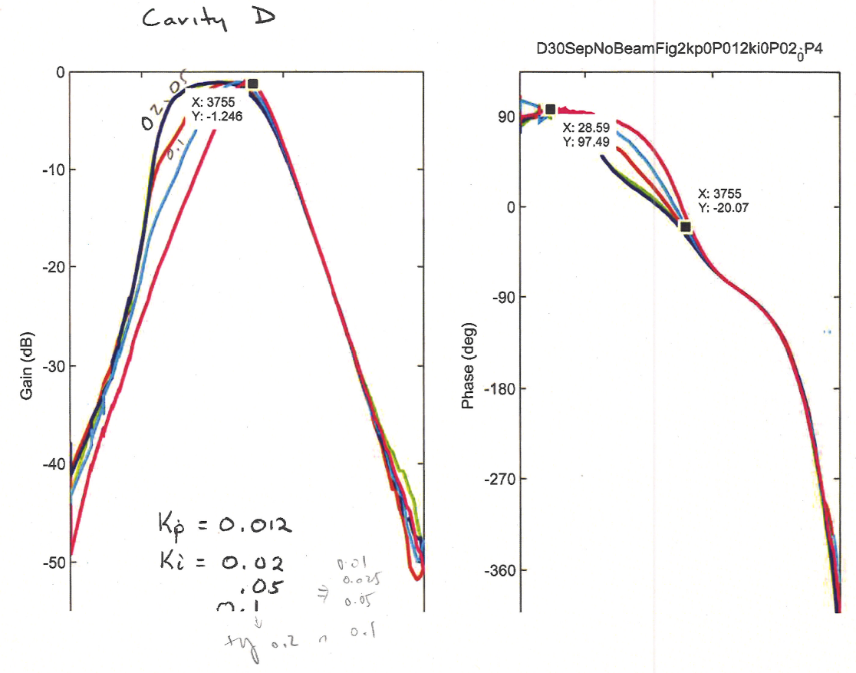
NA Measured vs Calculated. Assume Phase delay 450/(1MHz*360) = 1.25us. 12/22/2016
Sweep ki:
Model
Measured data

