Slide 1


LBNL/UCB FY25 Site Report
USNDP Meeting
30 October 2025
Lee Bernstein
Department of Nuclear Engineering
University of California - Berkeley
Nuclear Science Division
Lawrence Berkeley National Laboratory
Andrew S. Voyles
13 June 2018 – Program Review for NSSC2 – TA1
Notes:
Emerging trends for next-generation (targeted & personalized) nuclear medicine:
Targeted alpha therapy (5-10 MeV)
40-80 μm range → single cell
Targeted Auger therapy (20 eV – 1 keV)
1 nm – 2 μm → cellular nucleus
Theranostic medicine
Simultaneous imaging and therapy

Slide 2
Our Group is a Nutshell
Contribute to ENSDF evaluation (Basunia)
Rapidly provide “bespoke” databases as spelled out in WANDA, NSAC-ND, LRP leveraged by non-NP funding
(n,x) data for nuclear energy, national security and nonproliferation, AI/ML Isotope Production tools
Baghdad Atlas, pyEGAF, paceENSDF (Hurst)
Scintillator properties (Laplace, Goldblum)
Curiosity-driven science (Nuclear Astrophysics, RIBs,)
Quasicontinuum Data Evaluation (Wiedeking)
β-p BeapR horizontal evaluation (Batchelder)
Perform targeted measurements to address nuclear data needs using neutron and proton beams (Voyles, Matters)

Slide 3
FY25 Personnel & FTE Breakdown*
Name | Position | USNDP Activity | USNDP % | Other support
L.A. Bernstein | Joint Faculty | Coord, Measure., (n,n’γ) | 37.5% | NA-22, UC, Bakar Fellow
M. Wiedeking | Staff | QC evaluation | 70% | DARPA, LBNL, NA-22
M.S. Basunia | Staff | ENSDF | 80% | NA-241
D.A. Matters | Staff | Capture data | 20% | NA-22, MDA, LBNL
B.L. Goldblum | Joint Faculty | AI/ML, Scint. Database | 0% | UCB, NA-22
A.M. Hurst | Staff (UC) | (n,γ), (n,n’γ) | 55% | NA-22
J.C. Batchelder | Staff (UC) | β-p direct & delayed Eval. | 50% | Isotope Program
A.S. Voyles | Staff (UC) | Reac. measure., comp. | 0% | Isotope Program
J.A. Brown | Staff (UC) | ²³⁸U(n,n’γ), (n,f) yields | 0% | DOE-NE/NA-22
T. Laplace | Staff (UC) | Scintillator R&D/ QC Eval. | 25% | NA-22
K. Malatji | PD (UC) | QC Evaluation | 50% | LLNL (NA-117)
D. Thatcher | GS/Staff | Stopping powers | 0% | 88-Inch Cyclotron Ops
K. Meyers | GS | Reaction eval. (n,n’γ) | 0% (50% max) | SSAA Fellow (50%) (NA-11)
S. Tannous | GS | ²³⁸U(n,xnγ) | 0% (50% max) | SSAA Fellow (50%) (NA-11)
C.J. Henderson | GS | Baghdad Atlas | 25% (50% max) | UC Fellow (25%)
I. Hernandez | GS | FP decay data | 0% (50% max) | SSGF Fellow
A. Lee | GS | Ag(p,x), Tl(p,xγ) | 0% (50% max) | Isotope Program, UCB
E. Rice | GS | ⁷⁰Fe, Shape Isomer | 0% (50% max) | LBNL-NSD
*USNDP Fraction≈30%

Slide 4
Publications (8+2 accepted) (#7 on hidden)
2025Ch12: F.-Q.Chen, Y.F.Niu, Y.Sun, M.Wiedeking; Origin of the Low-Energy Enhancement of the γ-Ray Strength Function; Phys.Rev.Lett. 134, 082502 (2025). https://10.1103/PhysRevLett.134.082502
2025Ja06: R.E.Jacob, S.M.Tannous, L.A.Bernstein, J.Brown, T.Ostermayr, Q.Chen, D.H.G.Schneider, C.B.Schroeder, J.van Tilborg, E.H.Esarey, C.G.R.Geddes; Enhanced Isomer Population via Direct Irradiation of Solid-Density Targets Using a Compact Laser-Plasma Accelerator; Phys.Rev.Lett. 134, 052504 (2025). https://10.1103/PhysRevLett.134.052504
2025In01: V.W.Ingeberg, S.Siem, M.Wiedeking, et. al., for the ISOLDE Collaboration; Nuclear level density and γ-ray strength function of 67Ni and the impact on the i process; Phys.Rev. C 111, 015803 (2025). https://10.1103/PhysRevC.111.015803
2025Kh05: S.B.Kholil, M.Sh.Uddin, M.M.Hasan, A.K.Chakraborty, M.A.Shariff, A.S.Voyles, I.Spahn; Excitation functions of proton-induced nuclear reactions on titanium; Radiochim.Acta 113, 89 (2025). https://10.1515/ract-2024-0347
2024Ud02: M.S.Uddin, S.Sudar, M.S.Basunia, I.Spahn, A.S.Voyles, A.Hermanne, L.A.Bernstein, B.Neumaier, S.M.Qaim; Cross sections for the formation of 84m, gRb, 83Rb, and 82mRb in 86Sr(d, x) reactions up to deuteron energies of 49 MeV: Competition betweena-particle and multinucleon emission processes; Phys.Rev. C 110, 064608 (2024). https://10.1103/PhysRevC.110.064608
Irradiation-induced gas production in REBCO-based magnet materials used for future compact fusion reactors. Chris Reis, Chase Gesteland, Mehdi Balooch, Kooknoh Yoon, Jonathan Lee, Masami Iio, Toru Ogitsu, Makoto Yoshida, Hamilton Parrish, Ella Yarossi, Tengming Shen, Yongqiang Wang, Lee Bernstein, Soren Prestemon and Peter Hosemann. Journal of Applied Physics. Materials. J. Appl. Phys. 137, 235101 (2025). https://doi.org/10.1063/5.0263824
2 PRL & 1 Nature accepted

Slide 5

Structure Compilation/Evaluation Overview (M.S. Basunia)
Nuclides/Mass chain (Basunia): total 37 nuclides
A = 25 (9 nuclides) –Published NDS 205, 1 (2025)
A = 81 (15 nuclides) – Published NDS 199, 368 (2025)
A = 166 (18 nuclides) – Submitted
A = 169 (16 nuclides) – Reviewer Comments Received
Reviewed one mass chain
Archived Articles
722 articles scanned (by UCB Undergraduate students Kevin Truong and Nick Alvarez) and sent to upload at the X4pdf repository (621 uploaded).

Slide 6
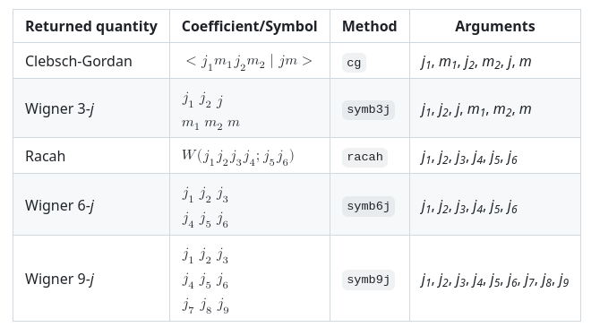
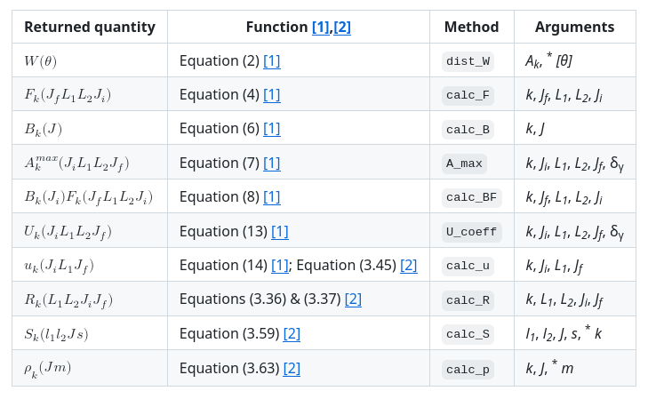

PyGammaRAD (A.M. Hurst): Python project for Gamma-Ray Angular Distributions
Angular-distribution coefficient and tensor calculator
Vector-coupling calculator
Open-source, available on GitHub and PyPI.
Reference article in preparation
Calculate coefficients and couplings for any arbitrary J, L, m value.
Generate tabulated data in machine-readable CSV and JSON formats.
Contextual data suitable for ML applications.
Modular program allows for straightforward integration into larger codebases.
[1] T. Yamazaki, Tables of Coefficients for Angular Distribution of Gamma Rays from Aligned Nuclei, Nucl. Data, Sect. A, Vol. 3, Num. 1 (1967).
[2] H.J. Rose, D.M. Brink, Angular Distributions of Gamma Rays in Terms of Phase-Defined Reduced Matrix Elements, Rev. Mod. Phys., Vol. 39, Num. 2, p. 306 (1967).

Slide 7

Photon Strength Function and Nuclear Level Density databases (M. Wiedeking)
Photon Strength Function (PSF) database:
Annual update of database scheduled for end of 2025 (added 53 new assessed data files including 13 new nuclei.
Assignment of quality indicator for Oslo method data (highest number of data below S_{n})
Outlier analysis to identify issues with data and/or recommended models that needs to be investigated.
Nuclear Level Density (NLD) database:
NLD CRP started in 2025 with anticipated database dissemination in 2028
LBNL/UCB responsible for 10 action items including compilation and assessment of NLD data. Comparison of model to experimental NLD, among others.
USNDP Traineeship:
4-year funded evaluator traineeship for quasi-continuum data. Thibault Laplace and Kgashane Malatji.

Slide 8

Berkeley Evaluated Alpha & proton Radioactivity (BEA_{p}R*) from Li to Og! An Online Global Heavy Charged Particle Database/Horizontal Evaluation
Complete (as possible) evaluation of heavy charged particle emitters on the proton-rich side, providing a comprehensive overview of the topic.
Physics motivated! – In many cases levels in daughter nuclei have only been observed via heavy charged particles.
Aids researchers and provide a teaching tool.
Systematics
Relationships between E & BR
Competition between decay modes
Involves the entire chart of the nuclides
Evaluated data gives recommended values based on all available experimental data.
Organized by T_{z} and A-chain
Targeted (and complete) references – different from NSR
All papers with information on the given nucleus including conference proceedings and reports. Explicit refs for T_{1/2}, Energy, BR, etc.
4262 unique references
Completed June 2025. Added information from 9 new papers since then..
1453 heavy charged emitters from 1241 nuclei
Database updated as new papers come out (Website updated ≈2 every other month)
• 203 ß⁺-p emitters
• 15 ß⁺-2p emitters
• 5 ß⁺-3p emitters
• 23 ß⁺-α emitters
• 31 ß⁺-fission emitters
• 2 ß⁻-α emitters
• 2 ß⁻-fission emitter
2 β⁺−αp/β⁺−pα emitters
81 direct proton emitters
9 direct 2p emitters
907 direct alpha emitters
155 Spontaneous fission
22 cluster (¹⁴C, ²⁴Ne, etc.) emitters
Allows users to look at data trends leading to the discovery of new physical phenomena.
+
-
-
14 24
https://nucleardata.berkeley.edu/research/betap.html
Jon Batchelder

Slide 9
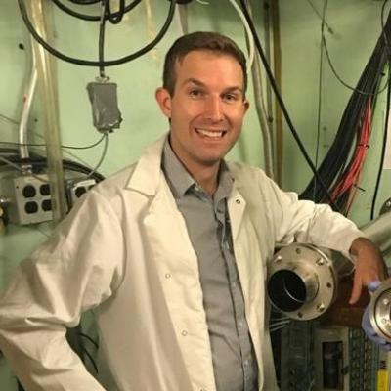
Nuclear Data for Isotope Production & Neutron Applications
Experimental Work
p+Be neutron spectrum characterization - January 2025
Sn(p,x)¹¹⁹Sb cross section measurements for Auger therapeutic applications – 9/25
Ta(p,x)^{177,180m}Ta cross section measurements for Auger therapeutic applications – 9/25
Publications
3 published manuscripts¹, 3 submitted manuscripts²
Student Training
UCB: A. Lee (Ph.D.)
U. Oslo: H. Ekeberg (Ph.D.), E. Martinsen (Ph.D), C. Tokstad (M.S.), E. Brynildsen (M.S.)
UCD: L. Korkelia (Ph.D.)
Contributions
⁵⁶Co source production to support CUORE calibration - November 2024
¹⁶⁹Yb source production to support ND-funded microcalorimeter nuclear data effort (w/ NA-241) - January 2025
⁸²Sr source production to support DOE Basic Environmental Science - September 2025
Neutron materials damage testing for IFE optics - June 2025
Lecturer (A. Voyles) for the 2025 Exotic Beam Summer School and 2025 Targetry HIPPOCampus Summer School
Engagement
Isotope Production Nuclear Data Issues (IPNDI) End-User Requests (spread the word!): Improved (p,γ) and (n,γ) production cross sections and decay data for ⁹⁷Zr, ⁷¹Zn, ⁶⁵Ni
1 https://doi.org/10.1103/PhysRevC.110.064608
https://doi.org/10.1515/ract-2024-0347
https://doi.org/10.1515/ract-2024-0375
2 https://doi.org/10.48550/arXiv.2506.19012
https://doi.org/10.48550/arXiv.2507.21746
https://doi.org/10.48550/arXiv.2506.13948
Andrew Voyles

Slide 10
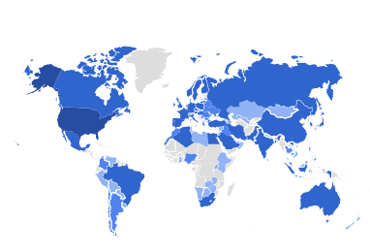
Nuclear Data Program Engagement Metrics
URL: nucleardata.berkeley.edu
FY25 Statistics: 6,958 unique visitors.
Up from 5.8k in FY24, 5.1k in FY23
Demographics:
53% USA
24% Europe
17% Asia
2% N. America
2% Africa
1% S. America
1% Oceania
Curie analysis package:
4,308 installations
Areas visited:
22% homepage
22% databases
19% personnel
14% research areas
8% ATLAS
6% WANDA
4% BEApR (+196 downloads)
2% Codes
1% FYCoM
0.4% IPNDI
0.4% FIER
0.3% NSEI
Andrew Voyles

Slide 11
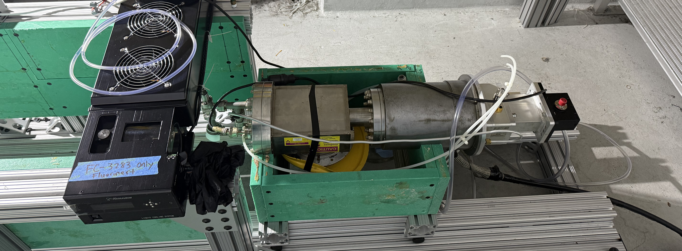
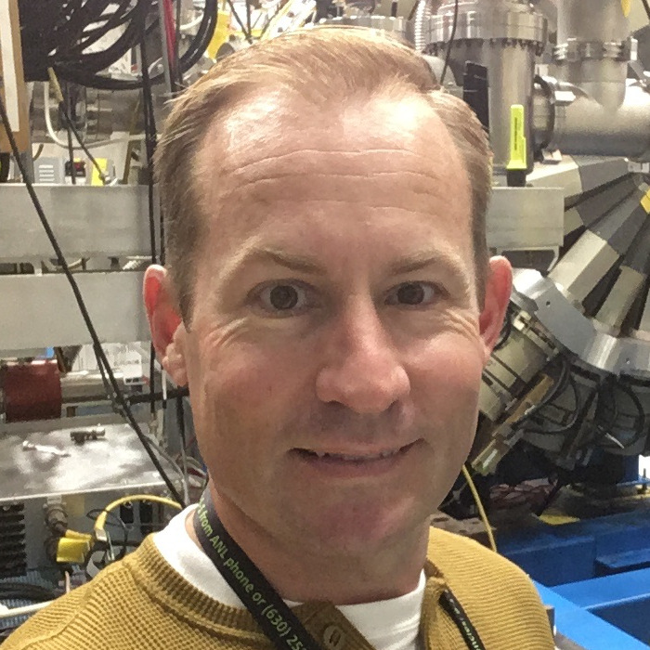
LBNL Neutron Capabilities
Cave 0 (High Level) – Matters, Voyles
Max Cave 0 flux neutron flux: 10¹² n/s/cm²*
Electronics (w/Missile Defense Agency) & Fusion Materials (w/LLNL-NIF) Testing
Cave 5 (Spectroscopy) – Goldblum/Brown/Laplace
Breakup in Vault with 7-22 m flight path.
Location of the GENESIS and STOF arrays (nonproliferation & stewardship science)
Scintillator development & calibration
UC Berkeley Nuclear Technology Lab -
Batchelder, Henderson
DT neutron generator with Associated Particle Imaging!
≈ 10⁸ n/s with 2-3% tagged
New NA-11 to perform tagged σ_{nSEE} measurements (Siefman)
nExuS @ UCB
*J.T. Morrell et al., Phys. Rev. C 108, 024616 (2023).
David Matters

Slide 12
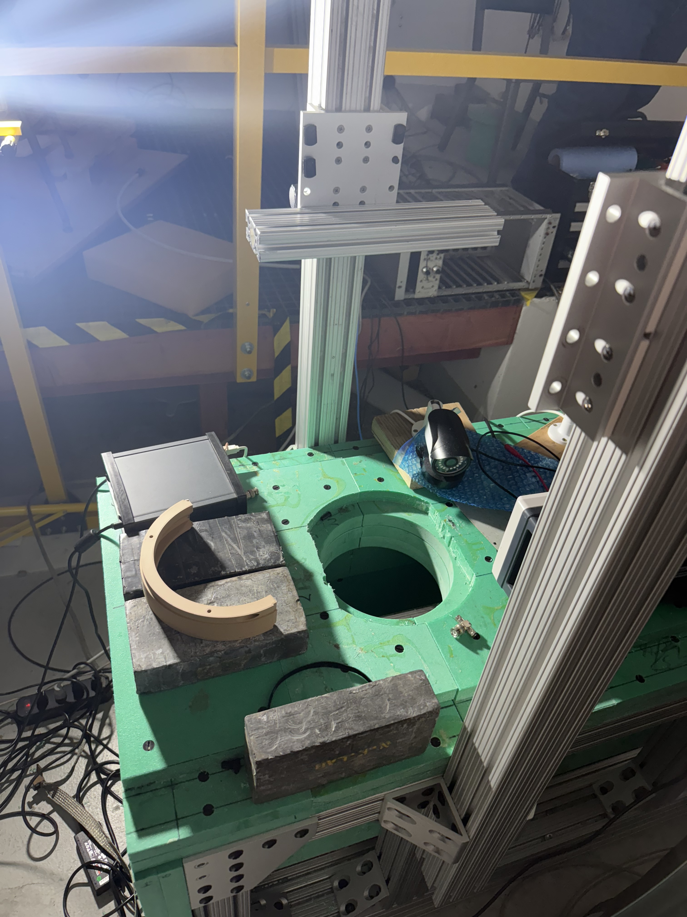
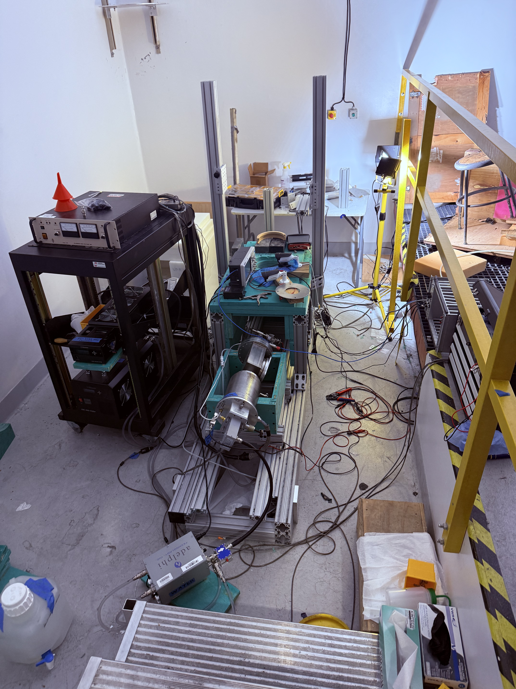
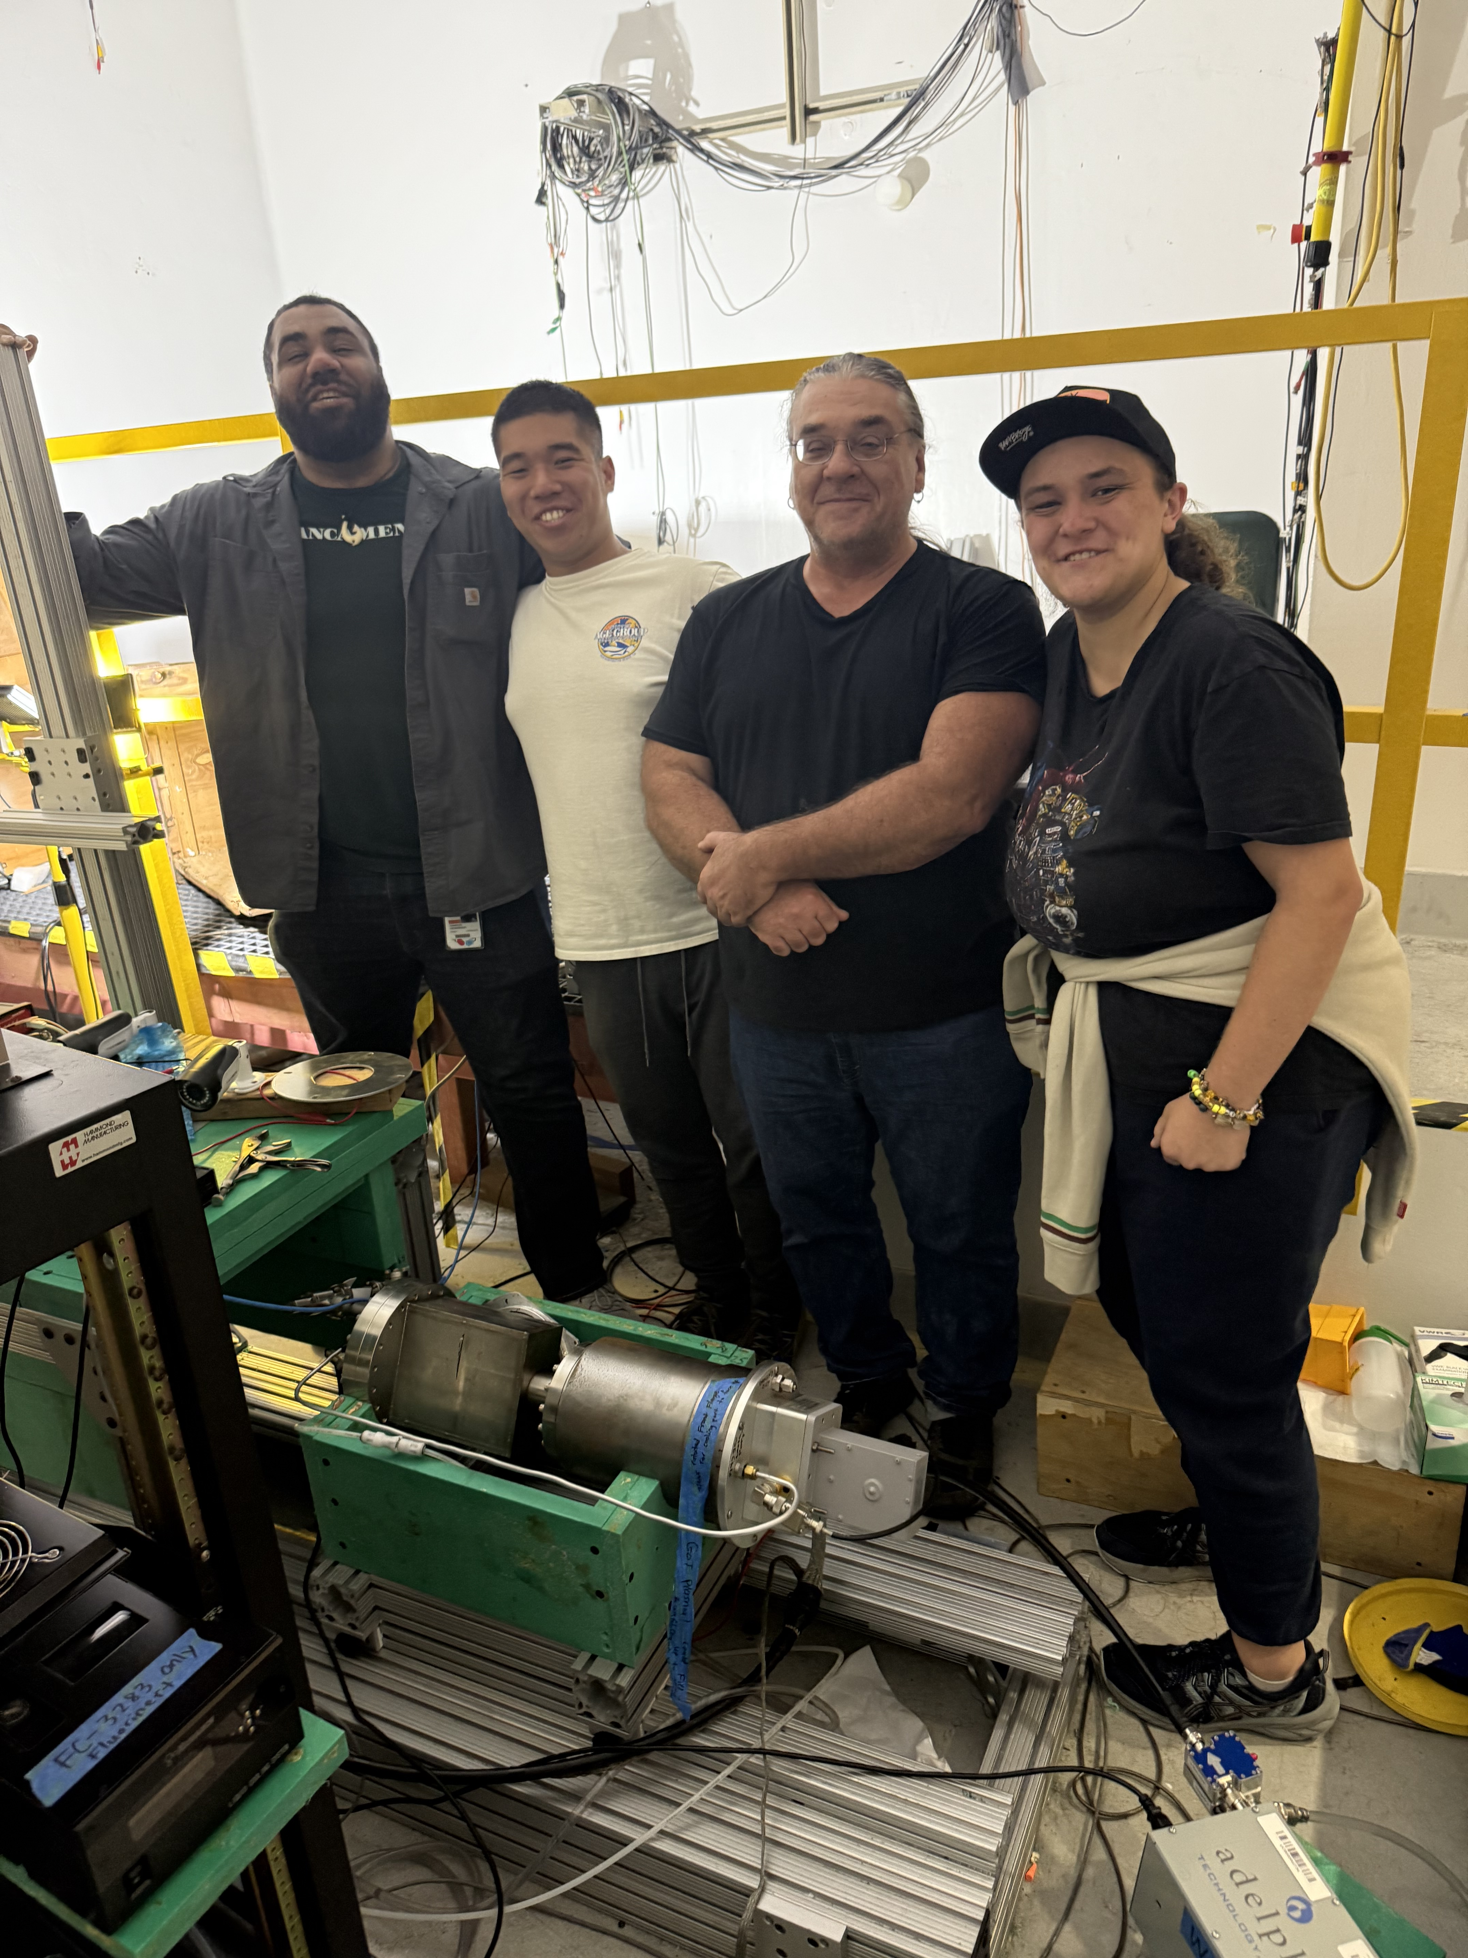
Neutron Excitation Observatory Under Soda Hall (nExus)
Borated Polyethylene
“Doghouse”
(Removes untagged neutrons
ZnO scintillator
(α-detector)
Tagged neutron port
Joe Henderson
Batch
Tagged
Neutrons
Target
45°
Sean Tang
Microwave Source
(generates plasma)
Danica Zagala

Slide 13
Planning/Future
Establish QC evaluation as a core USNDP mission.
Grow our strong connections to aerospace exploration & national security and medical isotope customers
Expanded nSEE work at the 88-Inch (Matters, Voyles)
New nSEE work using nExuS (Batchelder, Siefman)
Stopping power measurements @ the 88-Inch (Thatcher)
Generate new (p,x), (n,x) data for isotope production (Voyles)
Generate new decay data for isotope production (Basunia)
Develop AI/ML, specifically NLP entity extraction tools (Goldblum) and perform JSON distillation of existing data
Succession planning
Several of us are getting long in the tooth & we’d like to keep our trainees & in the program

Slide 14
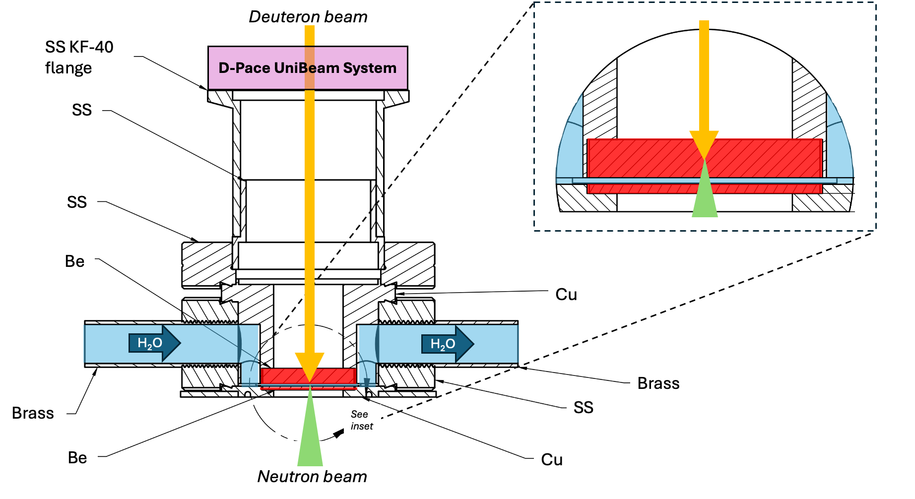
Neutron Capabilities

Slide 15
Publications (8+2 accepted) (#6 on hidden)
2025Ch12: F.-Q.Chen, Y.F.Niu, Y.Sun, M.Wiedeking; Origin of the Low-Energy Enhancement of the γ-Ray Strength Function; Phys.Rev.Lett. 134, 082502 (2025). https://10.1103/PhysRevLett.134.082502
2025Ja06: R.E.Jacob, S.M.Tannous, L.A.Bernstein, J.Brown, T.Ostermayr, Q.Chen, D.H.G.Schneider, C.B.Schroeder, J.van Tilborg, E.H.Esarey, C.G.R.Geddes; Enhanced Isomer Population via Direct Irradiation of Solid-Density Targets Using a Compact Laser-Plasma Accelerator; Phys.Rev.Lett. 134, 052504 (2025). https://10.1103/PhysRevLett.134.052504
2025In01: V.W.Ingeberg, S.Siem, M.Wiedeking, et. al., for the ISOLDE Collaboration; Nuclear level density and γ-ray strength function of 67Ni and the impact on the i process; Phys.Rev. C 111, 015803 (2025). https://10.1103/PhysRevC.111.015803
2025Kh05: S.B.Kholil, M.Sh.Uddin, M.M.Hasan, A.K.Chakraborty, M.A.Shariff, A.S.Voyles, I.Spahn; Excitation functions of proton-induced nuclear reactions on titanium; Radiochim.Acta 113, 89 (2025). https://10.1515/ract-2024-0347
2024Ud02: M.S.Uddin, S.Sudar, M.S.Basunia, I.Spahn, A.S.Voyles, A.Hermanne, L.A.Bernstein, B.Neumaier, S.M.Qaim; Cross sections for the formation of 84m, gRb, 83Rb, and 82mRb in 86Sr(d, x) reactions up to deuteron energies of 49 MeV: Competition betweena-particle and multinucleon emission processes; Phys.Rev. C 110, 064608 (2024). https://10.1103/PhysRevC.110.064608
Irradiation-induced gas production in REBCO-based magnet materials used for future compact fusion reactors. Chris Reis1, Chase Gesteland, Mehdi Balooch, Kooknoh Yoon, Jonathan Lee, Masami Iio, Toru Ogitsu, Makoto Yoshida, Hamilton Parrish, Ella Yarossi, Tengming Shen, Yongqiang Wang, Lee Bernstein, Soren Prestemon and Peter Hosemann. Journal of Applied Physics. Materials. J. Appl. Phys. 137, 235101 (2025). https://doi.org/10.1063/5.0263824
In Memory of Dr. Richard B. Firestone. J Tuli, L. Bernstein, A. Hurst, S Basunia - Nuclear Data Sheets 200: 1.2025.
12C(𝑛,𝑛₁′𝛾) partial 𝛾-ray cross section measured using the GENESIS array. J. M. Gordon, B. L. Goldblum, J. A. Brown, T. A. Laplace, J. C. Batchelder, D. L. Bleuel, C. A. Brand, B. Buckley, A. Georgiadou, C. J. Henderson, T. S. Johnson, J. W. Lee, K. Myers, T. S. Nagel, J. R. Sebastian, A. S. Voyles, and L. A. Bernstein. Phys. Rev. C 111, 044608 (2025). https://doi.org/10.1103/PhysRevC.111.044608.

