Slide 1
γ – ray intensity determination by Monte Carlo templet fitting
J.H. Kelley – North Carolina State University and
Triangle Universities Nuclear Lab
This material is based upon work supported by the U.S. Department of Energy, Office of Science, Office of Nuclear Physics.

Slide 2
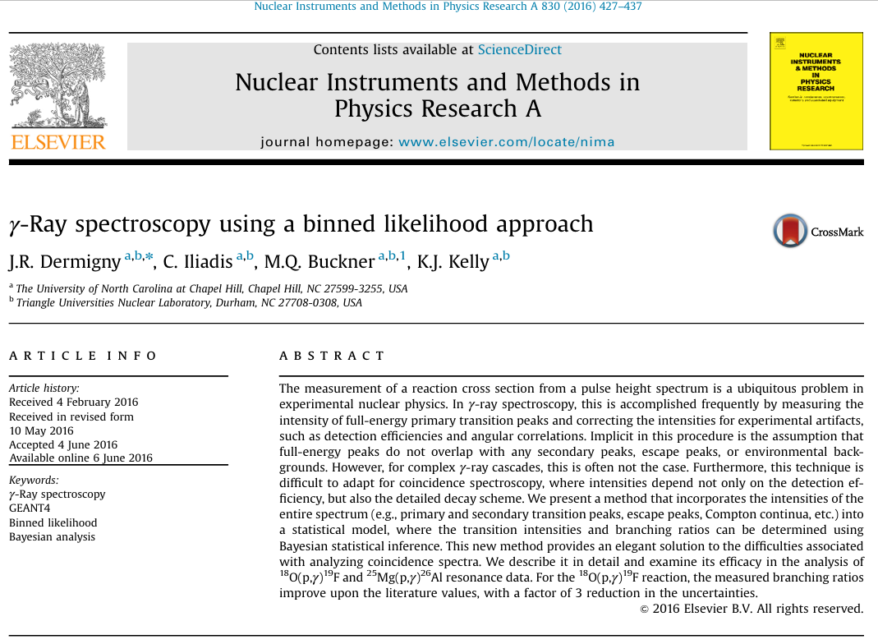

Slide 3
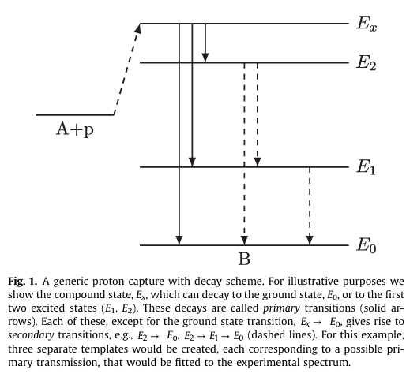
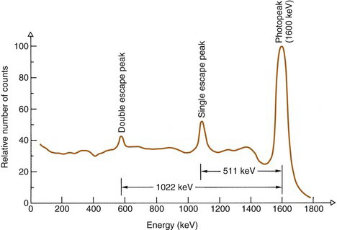
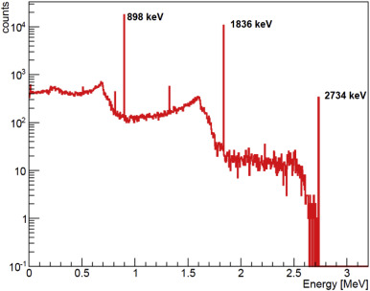
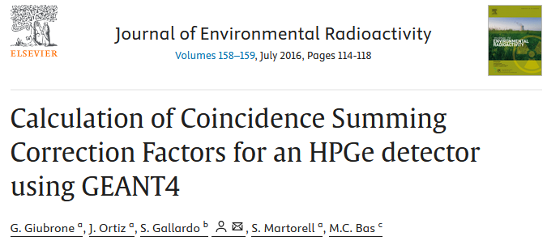
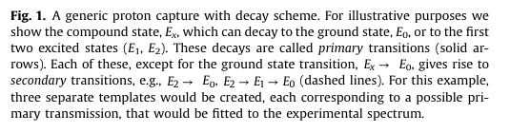
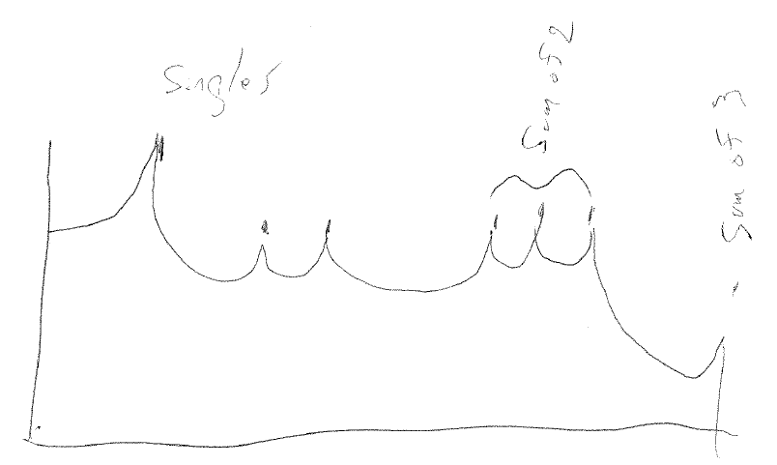
Templates
C
Monte Carlo accounts for singles and coincidences
A
https://radiologykey.com/pulse-height-spectrometry/
B
B
A
C
The method is motivated by the reality that >>90% of events fall inside the Compton detector response function.

Slide 4
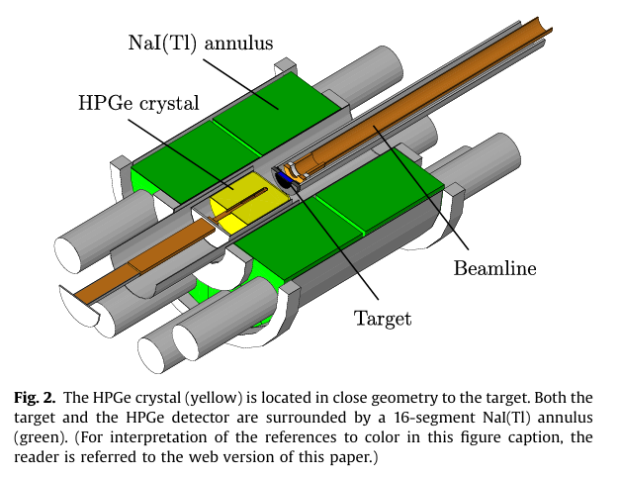
Detector configuration in the published example

Slide 5
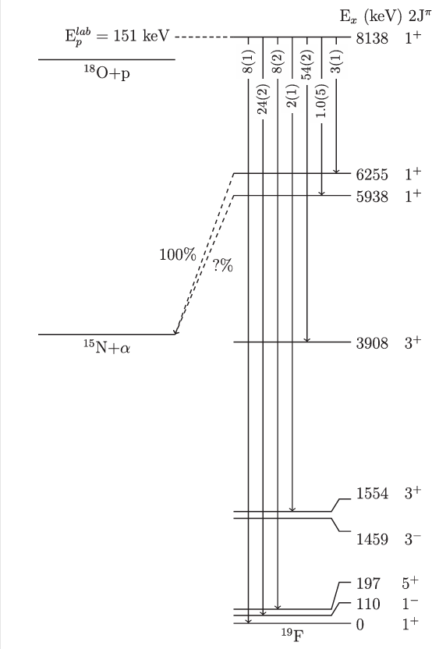
Levels involved in 18O(p,g)
What are the templates?

Slide 6
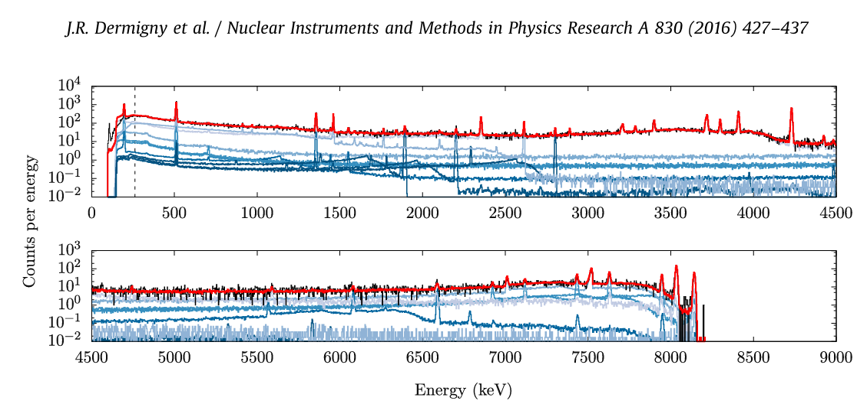
Measurements and fit
a

Slide 7
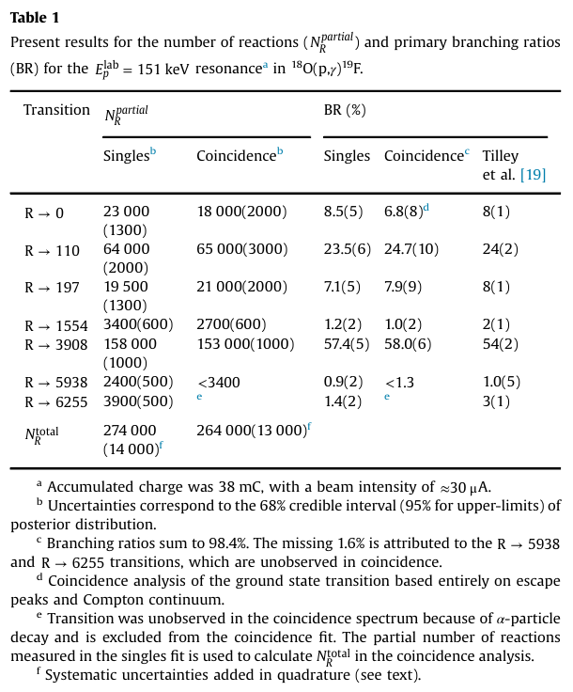
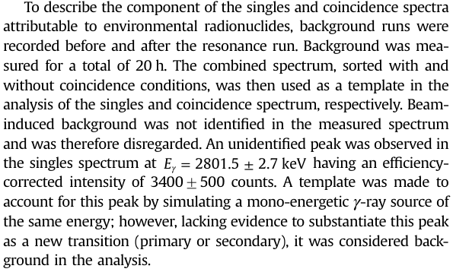
Experimental Results

Slide 8
Return at 3:55

Slide 9
Discussion
How do we weight these results?
Any discussion?

