Slide 1
Comments on Spectroscopic Factors from an Astrophysical Perspective
Lijie Sun Nuclear Data Group
Experimental Nuclear Science Department, FRIB

Slide 2
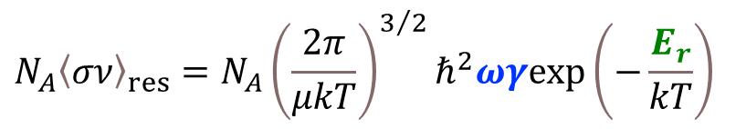
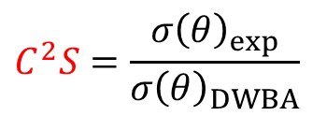
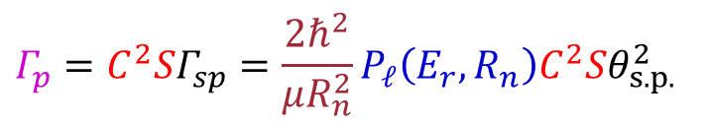
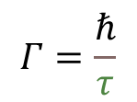
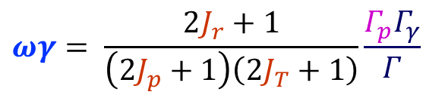
Thermonuclear Charged-particle Reactions
Resonant reaction rate
$$N_{A}{〈σν〉}_{res}=N_{A}{\left(\frac{2π}{μkT}\right)}^{3/2}ℏ^{2}ωγexp\left(−\frac{E_{r}}{kT}\right)$$
Resonance strength
Proton partial width
$$Γ_{p}=C^{2}SΓ_{sp}=\frac{2ℏ^{2}}{μR_{n}^{2}}P_{𝓁}\left(E_{r},R_{n}\right)C^{2}Sθ_{s.p.}^{2}$$
$$ωγ= \frac{2J_{r}+1}{\left(2J_{p}+1\right)\left({2J}_{T}+1\right)}\frac{Γ_{p}Γ_{γ}}{Γ}$$
$$Γ=\frac{ℏ}{τ}$$
Spectroscopic factor
$$C^{2}S=\frac{{σ\left(θ\right)}_{exp}}{{σ\left(θ\right)}_{DWBA}}$$
C. Iliadis, Nuclear Physics of Stars (Wiley-VCH, Weinheim, 2015)

Slide 3

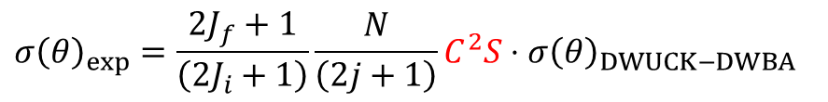


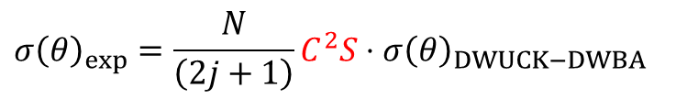
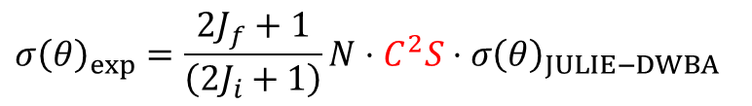

Spectroscopic Factors from DWBA
$${σ\left(θ\right)}_{exp}=\frac{2J_{f}+1}{\left(2J_{i}+1\right)}\frac{N}{\left(2j+1\right)}C^{2}S⋅{σ\left(θ\right)}_{DWUCK−DWBA}$$
Stripping reactions:
(d,p), (d,n), (³He,d), (t,d), (α,t)
$${σ\left(θ\right)}_{exp}=\frac{2J_{f}+1}{\left(2J_{i}+1\right)}N⋅C^{2}S⋅{σ\left(θ\right)}_{JULIE−DWBA}$$
$${σ\left(θ\right)}_{exp}=\frac{N}{\left(2j+1\right)}C^{2}S⋅{σ\left(θ\right)}_{DWUCK−DWBA}$$
Pickup reactions:
(p,d), (n,d), (d,³He), (d,t), (t,α), (³He,α)
$${σ\left(θ\right)}_{exp}=N⋅C^{2}S⋅{σ\left(θ\right)}_{JULIE−DWBA}$$
$${σ\left(θ\right)}_{exp}=C^{2}S⋅{σ\left(θ\right)}_{Ptolemy−DWBA}$$
$${σ\left(θ\right)}_{exp}=C^{2}S⋅{σ\left(θ\right)}_{Fresco−DWBA}$$
$$σ_{exp}=R_{s}⋅C^{2}S⋅σ_{sp−eikonal}$$
Knockout reactions

