Slide 1
Decay modes listed in ENSDF
John Kelley
NCSU and TUNL
This material is based upon work supported by the U.S. Department of Energy, Office of Science, Office of Nuclear Physics.

Slide 2
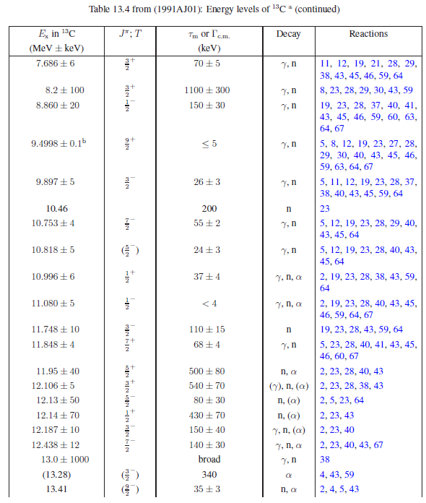

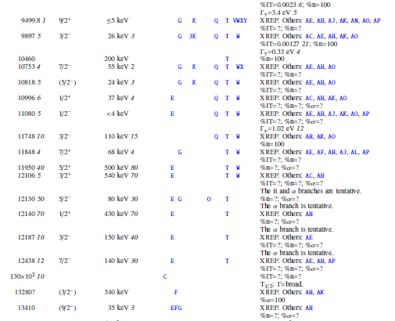
Historically: Energy Levels of Light Nuclei

Slide 3


A few general questions
I learned that listing “%Mode=?” is acceptable
.
- But I once heard a user joking that “?” must imply the mode is uncertain.
- ⁹Be(α,nγ)
- How best to write the decay mode?
%n>0; %a>0 is true
%n>0; %a<100 is true
%n<100; %a>0 is true
%n<100; %a<100 is true

Slide 4
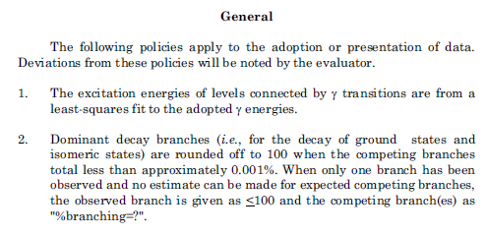
A few general questions
To my best searching of the ENSDF database, only g.s. and isomers are listed with a decay mode branching ratio.
In this case, for a common unbound level, I suggest:
Observed decay modes may be listed in a comment, and when known, absolute decay branches may be listed in a level continuation record.

