Slide 1
chatNSR: An AI-Enhanced Nuclear Science References Knowledge Base
R. Arcilla
US Nuclear Data Program Annual Meeting 2025
October 28-31, 2025

Slide 2



Motivation
Why automate keyworded abstract generation?
Volume Challenge
Growing nuclear science literature (~5,000+ annually) strains current manual keywording capacity.
Time Intensive
Manual keywording requires ~3.5 hours (average) per article.
Limited Coverage
Manual keywording limits timeliness and breadth of NSR knowledge base content.
Discovery Issues
Inconsistent keywording limits paper discoverability.
Cost Inefficiency
Manual keywording demands significant resources.
Generated by Recraft on 6/11/25 by R. Arcilla
Generated by GPT Image on 6/11/25 by R. Arcilla
Generated by GPT Image on 6/11/25 by R. Arcilla

Slide 3

The chatNSR Project
Current Focus:
Keywording, most tedious, costly activity (60-70% NSR prep activities)
Key AI Technologies in Use
Open-Source Large Language Models (LLMs)
Understand user queries/instructions and generate keyworded abstract
Cache-Augmented Generation (CAG)
Loads entire article into LLM's extended context window (Knowledge Cache) for efficient, more accurate keywording
Retrieval-Augmented Generation (RAG)
Finds contextually relevant parts of article in vector DB for LLM’s use in keywording
System Prompt Engineering (SYSPROMPT) + Few-shot Learning
User instructions to guide LLMs + examples from 682-paper dataset
Fine Tuning
Adapting LLM to perform better on keywording
Generated by Recraft on 6/11/25 by R. Arcilla
Generated by GPT Image on 6/11/25 by R. Arcilla
Generated by GPT Image on 6/10/25 by R. Arcilla
Generated by GPT Image on 6/11/25 by R. Arcilla

Slide 4
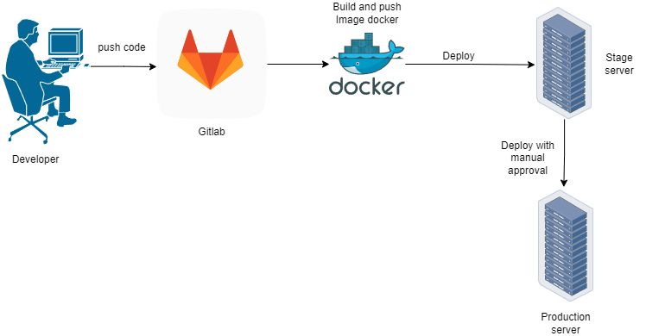
The chatNSR Project
e-PDFs
Architectural Overview: Two-Path Automation Workflow
Document Input
Article enters the automation pipeline
Size Assessment
System determines article’s token count
Path Selection
CAG for smaller articles (≤100k tokens = 100 pages), RAG for larger ones (>100k tokens)
Keyword Output
Keyword abstracts generated via optimal path
1
Article Input
User Query
1
Generated by Recraft on 6/11/25 by R. Arcilla
2
Article Size
?
2
≤ 100k
>100k
3
CAG
3
RAG
Generated by GPT Image on 6/11/25 by R. Arcilla
4
Keyword Abstract
4
Keyword Abstract
Generated by GPT Image on 6/10/25 by R. Arcilla
Generated by GPT Image on 6/11/25 by R. Arcilla

Slide 5
Cache-Augmented Generation (CAG)
Workflow
PDF Ingestion
Article enters system and undergoes initial parsing
Markdown Conversion
Content structure preserved in clean Markdown format
Context Preloading
Full article loaded into LLM’s Knowledge Cache
System Prompt + Few-Shot Learning
LLM guided by engineered instructions + examples
Response Output
Keyword abstracts delivered to user
e-PDFs
1
1
PDF Ingestion
User Query
2
Generated by GPT Image on 6/10/25 by R. Arcilla
Generated by Recraft on 6/11/25 by R. Arcilla
2
3
Markdown Conversion
3
LLM
4
Context Preloading
Knowledge
Cache
User
Query
Markdown Database
Generated by GPT Image on 6/11/25 by R. Arcilla
5
4
Generated by GPT Image on 6/11/25 by R. Arcilla
5
Keyword Abstract
Sysprompt +
Few-shot
Generated by GPT Image on 6/10/25 by R. Arcilla
Generated by GPT Image on 6/11/25 by R. Arcilla
Generated by GPT Image on 6/11/25 by R. Arcilla

Slide 6
Retrieval-Augmented Generation (RAG)
Workflow
Document Processing
PDF ingestion and conversion to markdown format.
Chunking & Embedding
Document segmentation and vector representation creation.
Retrieval Mechanism
Query-based selection of relevant document sections.
Generation with Prompting + Few-shot Learning
LLM processes retrieved chunks with specialized instructions.
Output Delivery
Keyword abstract returned to requesting user.
e-PDFs
1
5
2
Generated by GPT Image on 6/10/25 by R. Arcilla
PDF Ingestion
User Query
Keyworded Abstract
Generated by Recraft on 6/11/25 by R. Arcilla
3
1
3
Output
Markdown Conversion
LLM
Sysprompt + Few-shot
4
User Query
Retrieval
4
5
Chunking/ Embedding
2
Generated by GPT Image on 6/11/25 by R. Arcilla
Vector DB
Generated by GPT Image on 6/11/25 by R. Arcilla
Generated by GPT Image on 6/11/25 by R. Arcilla

Slide 7
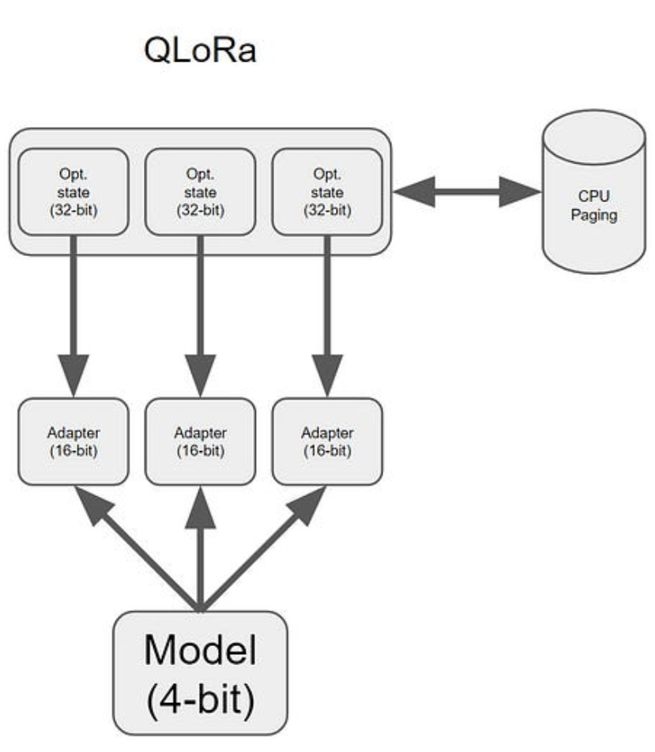
Fine Tuning
Platform
Ubuntu workstation, 376 GB RAM, 4 TB SSD (RAID)
Dual Intel Xeon 3.0 GHz CPU
Dual Nvidia A6000 GPUs (96 GB VRAM)
Training Dataset
682 high-quality NSR/PRC entries
Publication Years: 2000 - 2025
LLM: Qwen3:30B (7/2005) 4-bit Quantized
Trained 1-2% of LLM’s parameters
Accuracy: 58.5%
Decision: Do not use fine-tuned LLM
Generated by GPT Image on 6/10/25 by R. Arcilla
Trainable Parameters
(300M – 600M)
Frozen Parameters
(30 B)
Generated by GPT Image on 6/11/25 by R. Arcilla

Slide 8
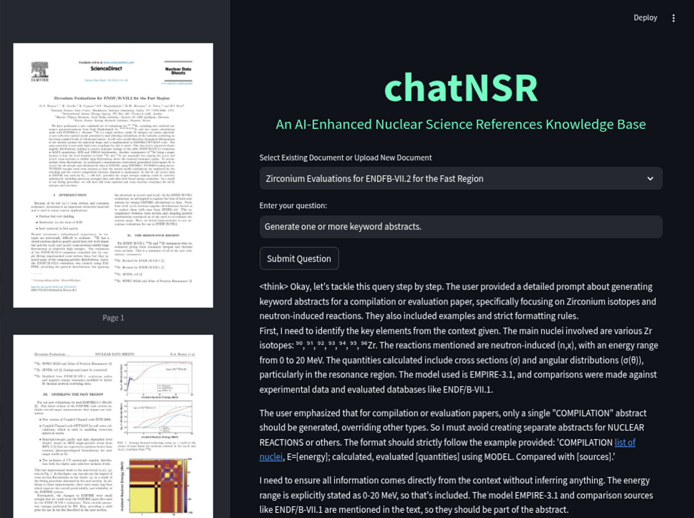
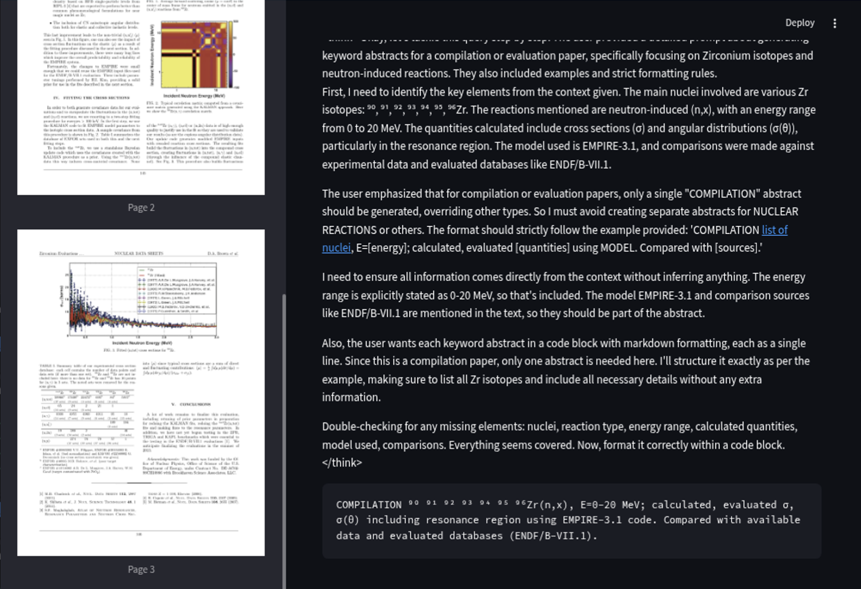
EXAMPLE: Keywording D.A. Brown’s article “Zirconium Evaluations for ENDF/ B-VII.2 for the Fast Region”
Human-Written
COMPILATION ^{90, 91, 92, 93, 94, 95, 96}Zr(n, x), E=0=20 MeV; calculated, evaluated σ, σ(θ) including resonance region using EMPIRE-3.1 code. Compared with available data and evaluated databases.
chatNSR-Generated
COMPILATION ⁹⁰ ⁹¹ ⁹² ⁹³ ⁹⁴ ⁹⁵ ⁹⁶Zr(n,x), E=0-20 MeV; calculated, evaluated σ, σ(θ) including resonance region using EMPIRE-3.1 code. Compared with available experimental data and evaluated databases (ENDF/B-VII.1, JENDL-4. 0).
Generated by Recraft on 6/11/25 by R. Arcilla

Slide 9
chatNSR-Generated Abstract Samples
PHYSICAL REVIEW C 110, L032801 (2024)
Novel approach to infer the 2 H (p, γ ) 3 He angular distribution: Experimental results and comparison with theoretical calculations
Keyworded Abstract:
NUCLEAR REACTIONS ²H(p,γ)³He, E=30-280 keV; measured γ-ray spectra, peak shape; deduced angular distribution via peak shape analysis, Legendre coefficients A₀, a₁, a₂, a₃; compared with ab initio calculations using PHH method with AV18/UIX potentials; deduced that theoretical A₀ values disagree by ~10% with experiment, while a₂ shows excellent agreement, indicating reliable prediction of E1 transition dominance. Comparison with Tisma et al. [9] data. LUNA-400 accelerator, Gran Sasso National Laboratories, Assergi (AQ), Italy.
PHYSICAL REVIEW C 110, L031302 (2024)
Evolution of shell gaps in the neutron-poor calcium region from invariant-mass spectroscopy of 37,38 Sc, 35 Ca, and 34 K
Keyworded Abstract:
NUCLEAR STRUCTURE ³⁴K,³⁵Ca,³⁷Sc,³⁸Sc; measured ground-state masses and low-lying excitation energies using invariant-mass spectroscopy of proton decays from ⁹Be(³⁷Ca, X) reactions at NSCL, Michigan State University; deduced trends in neutron and proton separation energies, showing weakening of the Z = 20 shell gap for N ≤ 18 and evidence for a N = 16 subshell closure after removal of Wigner energy; compared with USDC shell-model calculations. Facility: National Superconducting Cyclotron Laboratory, Michigan State University, East Lansing, Michigan, USA. Comparison with AME2020.

Slide 10

Current Status
Testing
Dozens of open-source LLM’s tested
682-article dataset (covers 7 NSR topics) for few-shot learning and LLM training
Qwen3:30B (7/2025) 8-bit has highest accuracy
Qwen3:30B (7/2025) 4-bit failed accuracy test
Accuracy
80-85% accuracy for articles ≤ 5 pages
70-76% accuracy for articles > 5 pages
Methods and Tools in Use
Continuous human feedback to LLM
AI-assisted coding and prompt engineering
PhysBERT (LBNL) model for embedding and retrieval
IBM Docling software for PDF-to-Markdown conversion
Qwen3:30B (7/2025) 8-bit LLM for keyword generation
Generated by DALL·E 3 on 5/19/25 by R. Arcilla

Slide 11
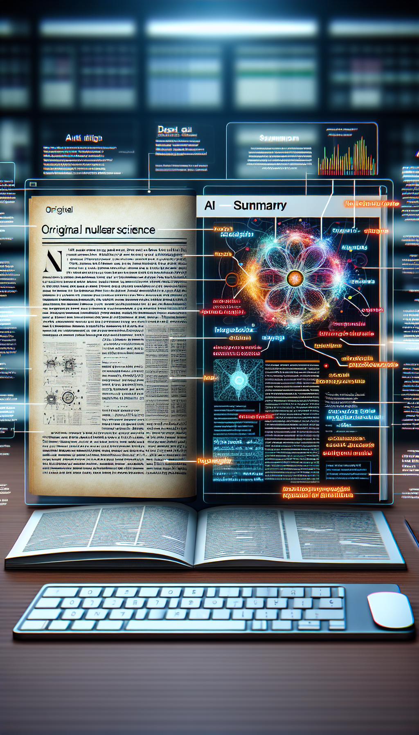
Summary and Conclusion
Keywording Automation
Article (7 NSR topics) high-volume ingestion in few-shot learning enhances LLM’s accuracy
CAG, RAG, System Prompts, Few-shot Learning prevent LLM hallucination.
PDF-to-Markdown conversion improves LLM’s article understanding
On-premise Keywording
Open-source LLMs and AI tools demonstrate cost-free, flexible, adaptable keywording
More secure environment behind BNL FireWall
Compliant with DOE rules and copyright laws
Generated by DALL·E 3 on 5/19/25 by R. Arcilla
Generated by Recraft on 6/11/25 by R. Arcilla

Slide 12

Future Direction
LLM capability and size
Move to more advanced Qwen3, 235B (full precision) for higher accuracy.
Training Dataset
Increase volume from 682 to 5,000 high-quality NSR articles
Multi-modal support
Processing of article’s figures, photos, charts, plots, equations
Computational resources
Perform fine-tuning on NN’s GPU server.
- 8 Nvidia H100 GPUs (8 x 80 GB = 640 GB )
Generated by DALL·E 3 on 5/19/25 by R. Arcilla
Generated by DALL·E 3 on 5/19/25 by R. Arcilla
Generated by Recraft on 6/11/25 by R. Arcilla
Generated by Recraft on 6/11/25 by R. Arcilla

Slide 13

Thank you so much for your attention!
This work is sponsored by the Office of Nuclear Physics, Office of Science of the U.S. Department of Energy under Contract No. DE-SC0012704 with Brookhaven Science Associates, LLC.

Slide 14
Backup Slides

Slide 15

Advantages of the Two-Path Automation Approach
Universal Scalability
System handles articles of any length.
Processing adapts to content size automatically.
Consistent Quality
Keyword abstract coherence maintained across both workflows.
Keyword abstract remains relevant regardless of article size.
Resource Efficiency
Computational resources allocated based on article needs.
Simpler approach (CAG) used when possible.
Workflow Integration
Unified API endpoint despite dual backend systems.
Seamless integration with existing document processes.
Generated by Recraft on 6/11/25 by R. Arcilla

