Slide 1
Nuclear Science References (NSR)/ Experimental Nuclear Reaction Data (EXFOR)
B. Pritychenko¹
1 National Nuclear Data Center, Brookhaven National Laboratory, Upton, NY 11973-5000, USA
USNDP Meeting, October 28-31, 2025

Slide 2
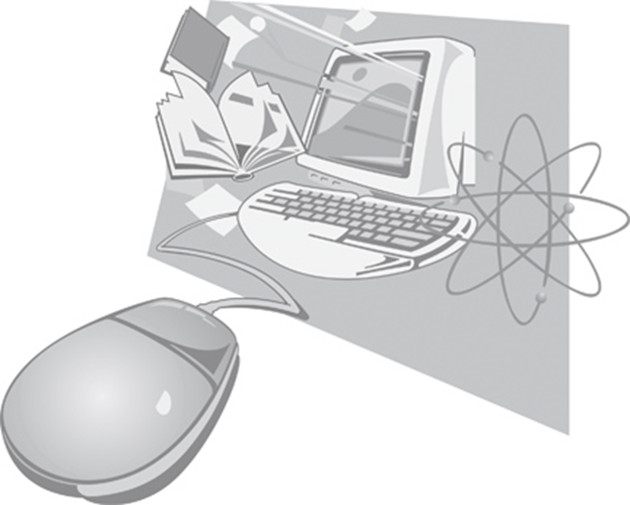
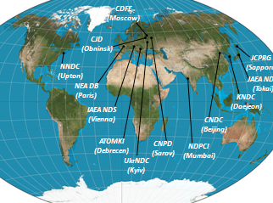
Nuclear Compilation Databases
Nuclear reaction, structure, and bibliography compilations were strengthened by the Manhattan Project.
There are several major compilation databases at USNDP:
Nuclear Science References (NSR): all low- and intermediate-energy references for a broad use.
Experimental Nuclear Reaction Data (EXFOR): low- intermediate-energy nuclear reaction compilations. Presently run by the Nuclear Reaction Data Centres (NRDC) internationally.
eXperimental Unevaluated Nuclear Data List (XUNDL): ENSDF project/NSDD network, presented by Libby.

Slide 3
NSR FY 2025 Statistics
Total number of entries: 2,541
Total number of keyworded entries: 1,254
Total number of corrected entries: 717
DB updates: 179
Dictionaries updates:
476 new nuclei
89 new reactions
6 new decays
6 new journals
6,281 new authors
NSR, September 30, 2025: 252,240 entries and 203,910 keyworded abstracts

Slide 4
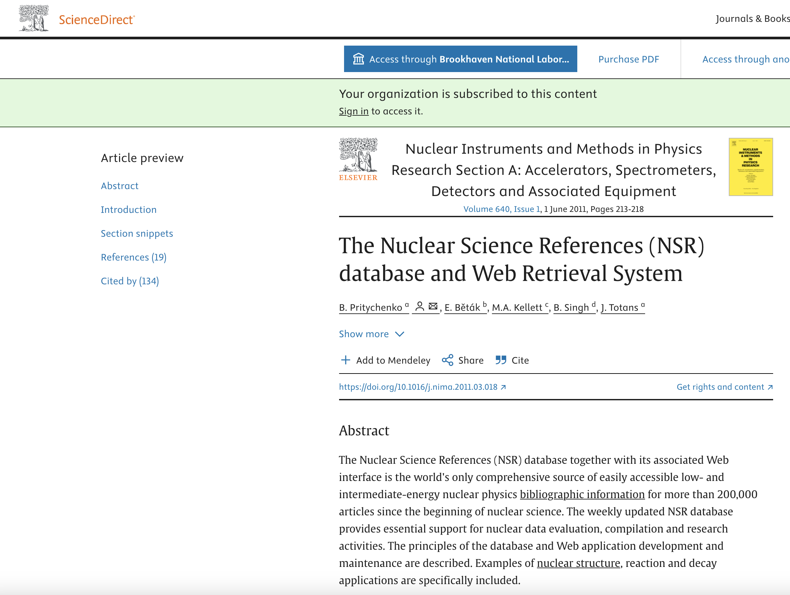
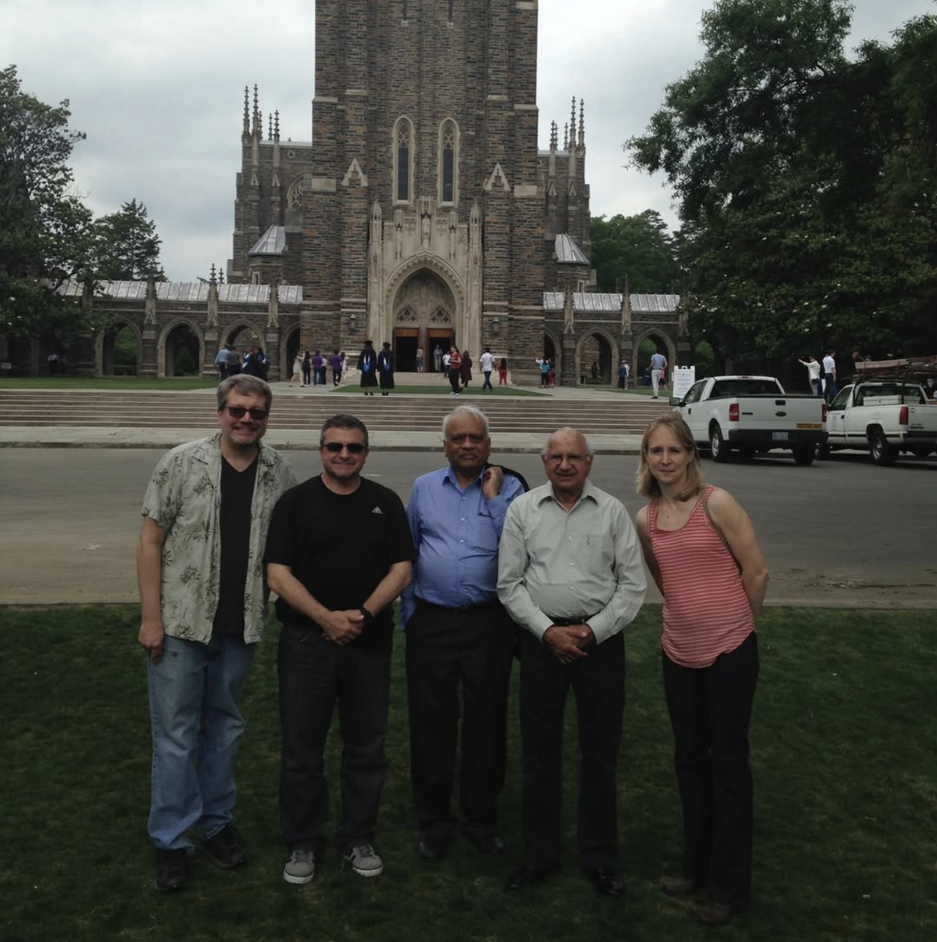
Recent NSR Contributions: 2009-2025
The total number of references went from under 200K to more than 250K
Missing references: over 8K previously missed publications were added.
6K updated entries, 20K+ keyworded abstracts by NNDC. (8/15/2025).
Complete coverage of Nuclear Data Conferences.
NSR Web “AND” search for Author, Nucleus, and Reaction instead of “OR” for Author and Nucleus.
NSR was integrated with EXFOR Web Interface (IAEA, V. Zerkin).
NSR PDFs were stored in the EXFOR-NSR PDF database (IAEA: V. Zerkin, L.Vrapcenjak, BNL: J. Totans).
NSR entries preparations from PR/C, EPJ/A, and NP/A using BibTex and RIS files since 2011 => Complete authors lists.
NSR database as physics project: publications and citations.
Productive and close cooperation with the NSDD/McMaster group.

Slide 5
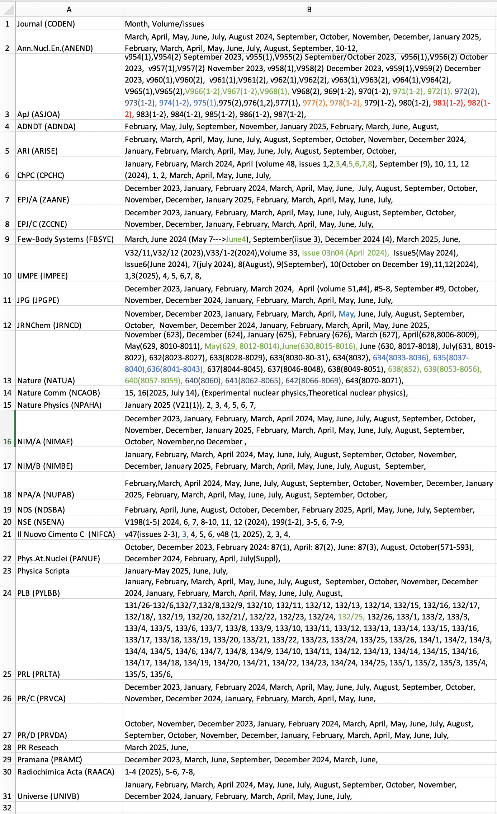
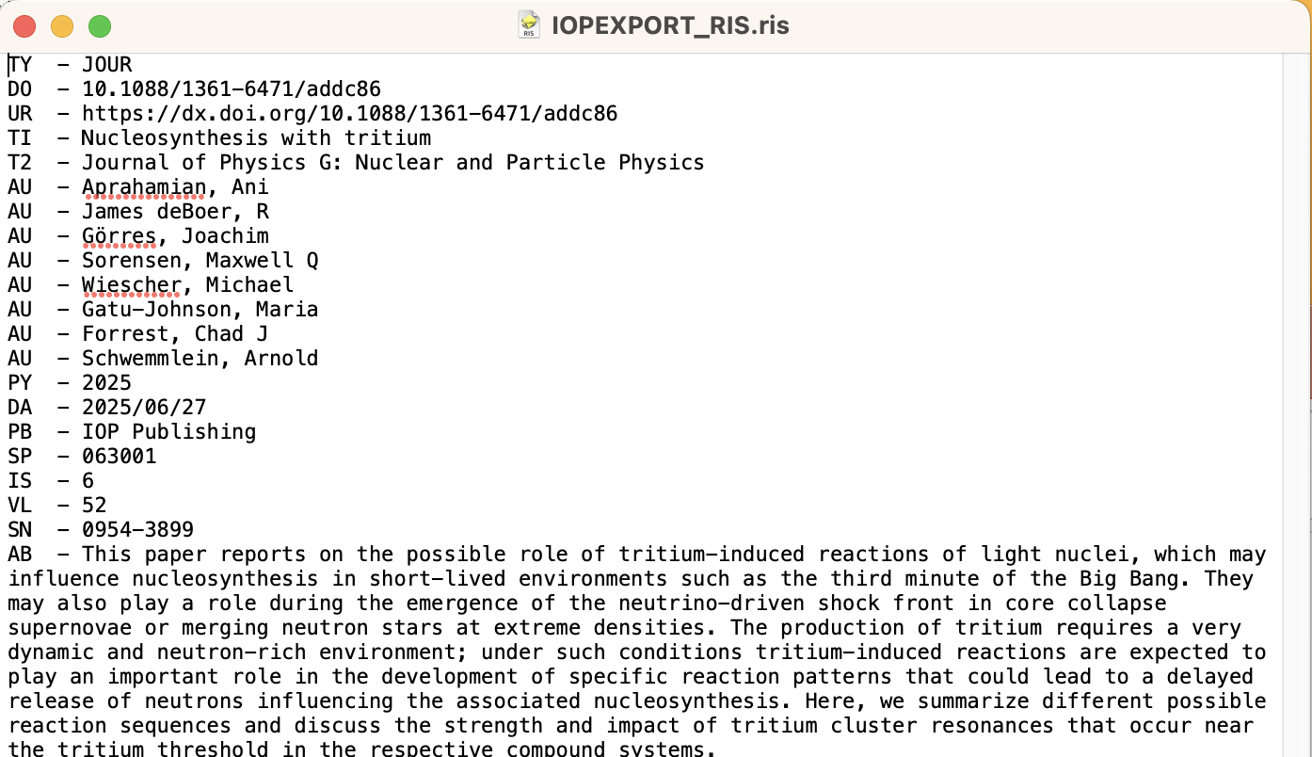

Current NSR Entries Preparation
Journals are scanned regularly, and J. Totans retired in December 2023, Balraj and Dima are no longer available; while NSR runs every week and we had to produce the journal scans.
Balraj Singh told me that we have a dozen relevant journals: NSR is based on regular scans of 30 journals.
Journals provide BiBTex and .ris files.
Java code to read BibTex/RIS files and produce new NSR entries was extended from 3 to 29 journals (Nuovo Cimento C does not support BibTex or RIS).
Ben Shu produced extensive PR/C scrapping code for Cat in April 2024-2025—more details in Ben’s presentation on NSR workflow automation.
Cat Dunn generates PR/C input files using Ben’s code.
Please don't hesitate to contact Cat for all NSR-related issues if needed.

Slide 6
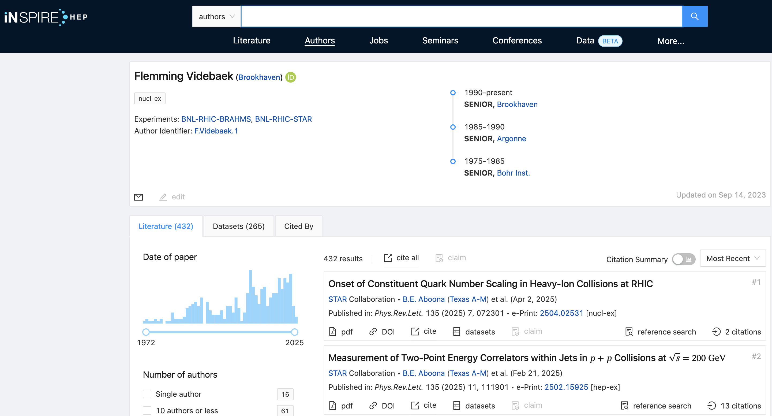
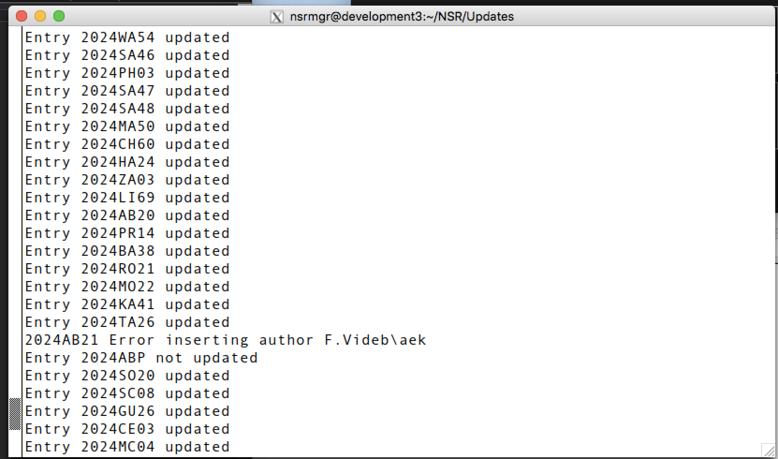
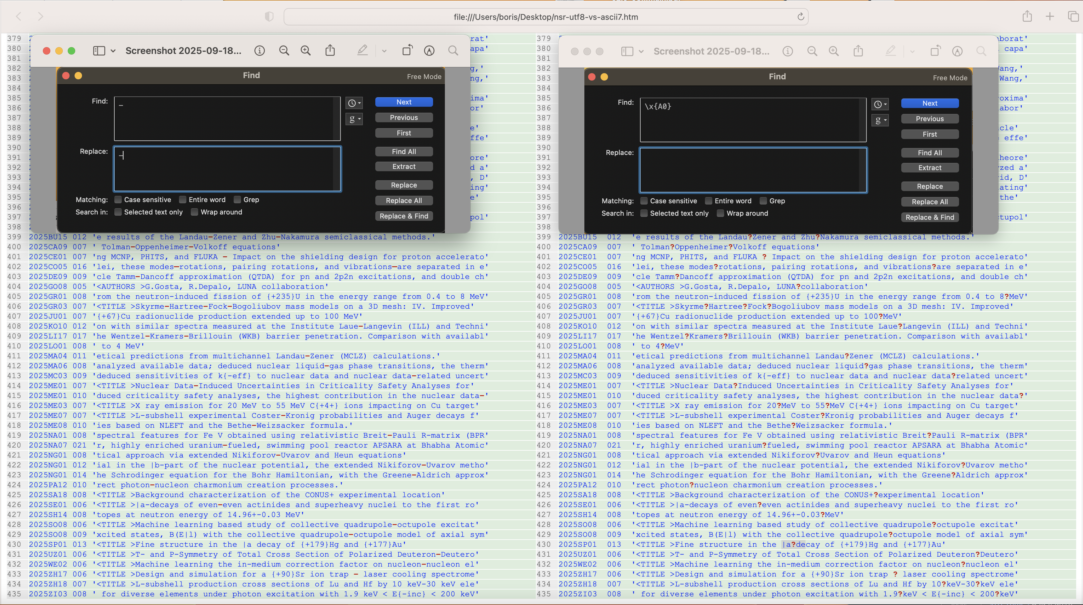
Issues with the Automated System: Non-ASCII Characters
The preparation cannot be fully automated.
MariaDB accepts 128 ASCII character input, while names include Non-ASCII.
Non-ASCII characters are characters that are not part of the basic 7-bit ASCII character set. ASCII, or American Standard Code for Information Interchange, uses 7 bits to represent 128 characters, including English letters, numbers, punctuation, and some control characters.
As of Unicode version 16.0, there are 292,531 assigned characters with code points, covering 168 modern and historical scripts, as well as multiple symbol sets.
Viktor found 435 NON-ASCII characters in NSR, most frequent – and space characters, 384 entry.

Slide 7
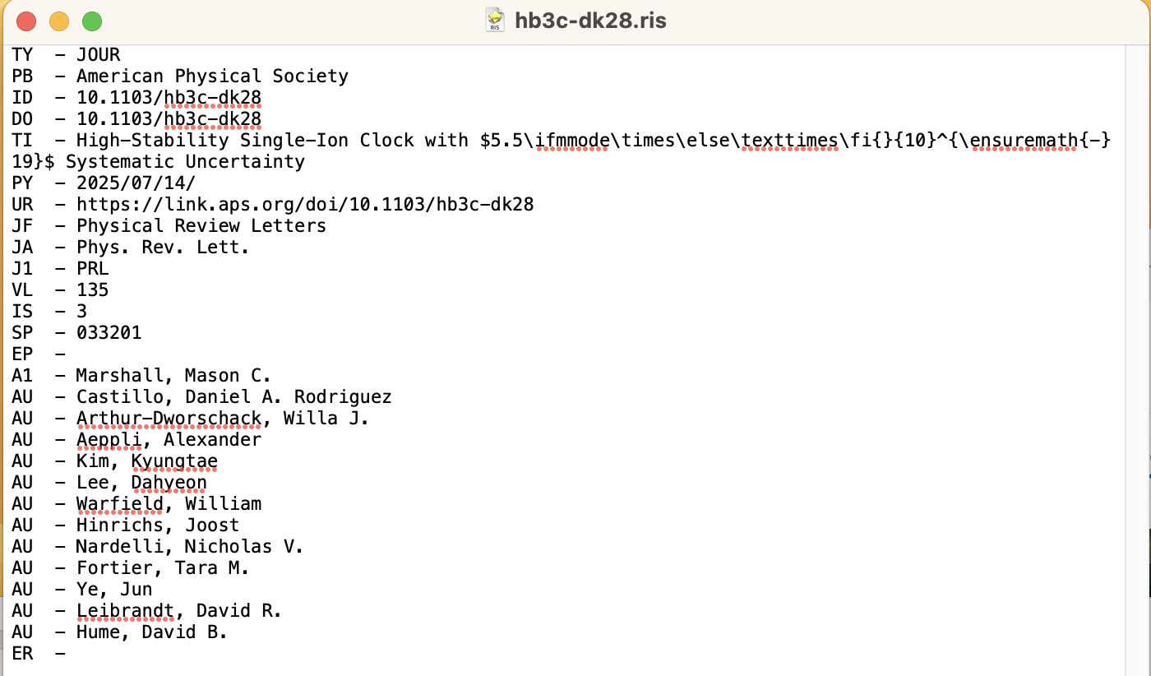
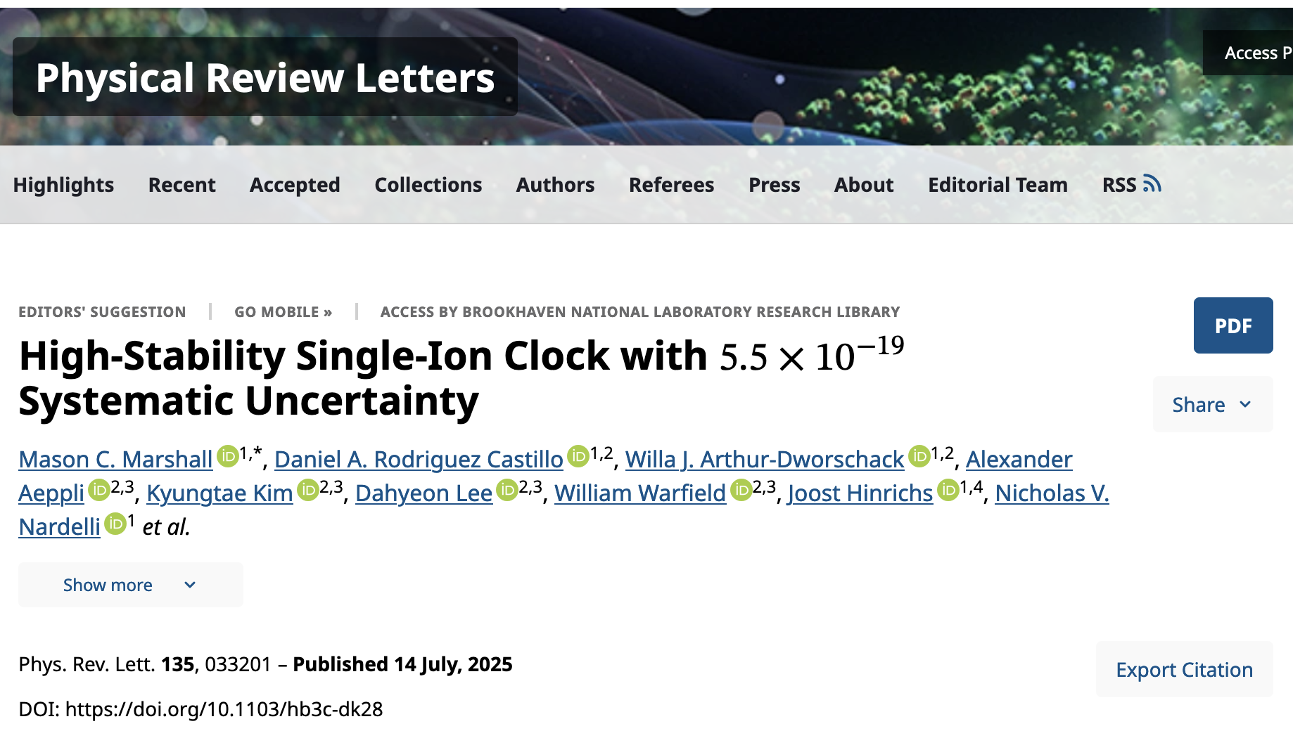
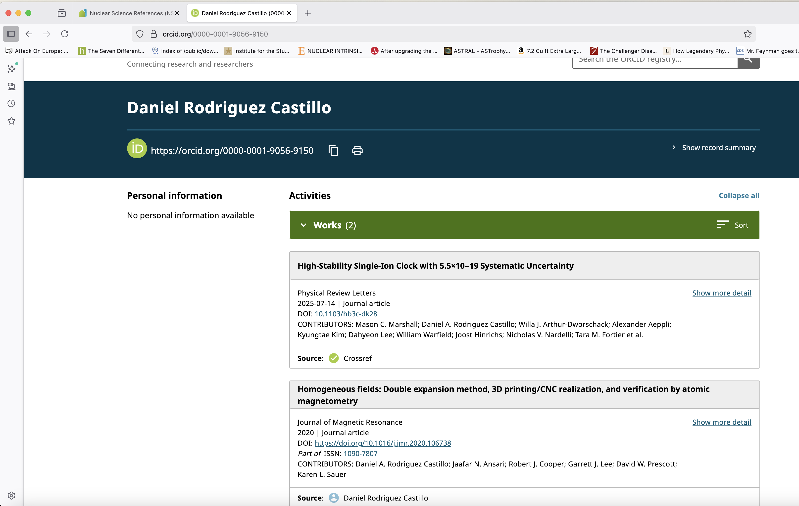
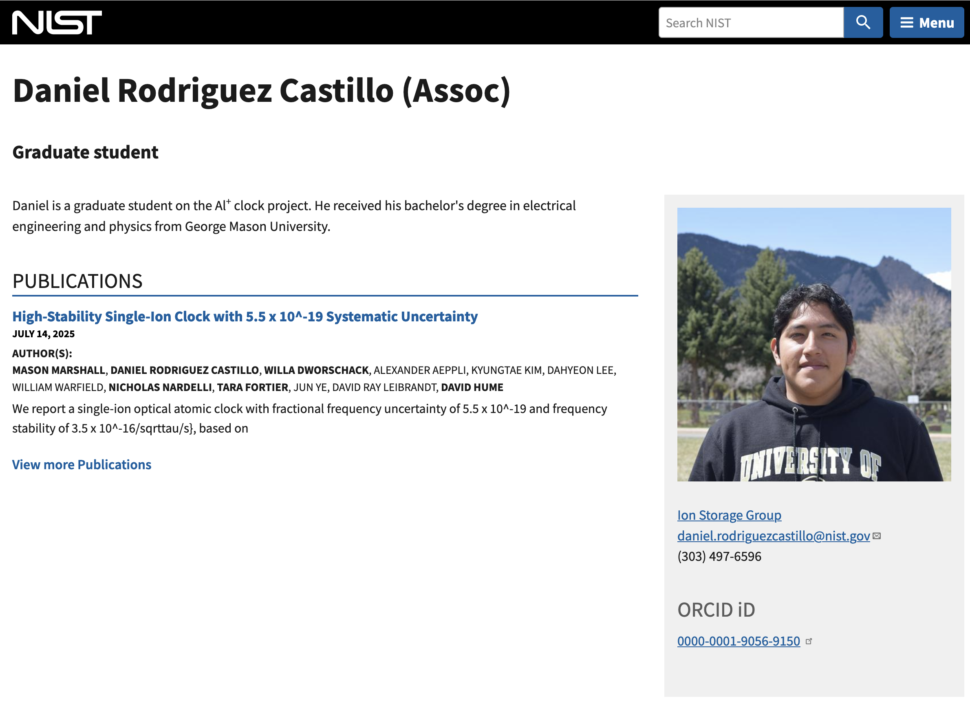
Issues with the Automated System: Double-Barrelled Surnames
I’m not aware of a single journal that handles two-word last names properly in BibTex or RIS (APS, Springer, Elsevier, IOP).
Two-word last names, also known as double-barrelled surnames, are surnames that consist of two separate words, often joined by a hyphen.
INSPIRE has a full-time employee who resolves names.

Slide 8
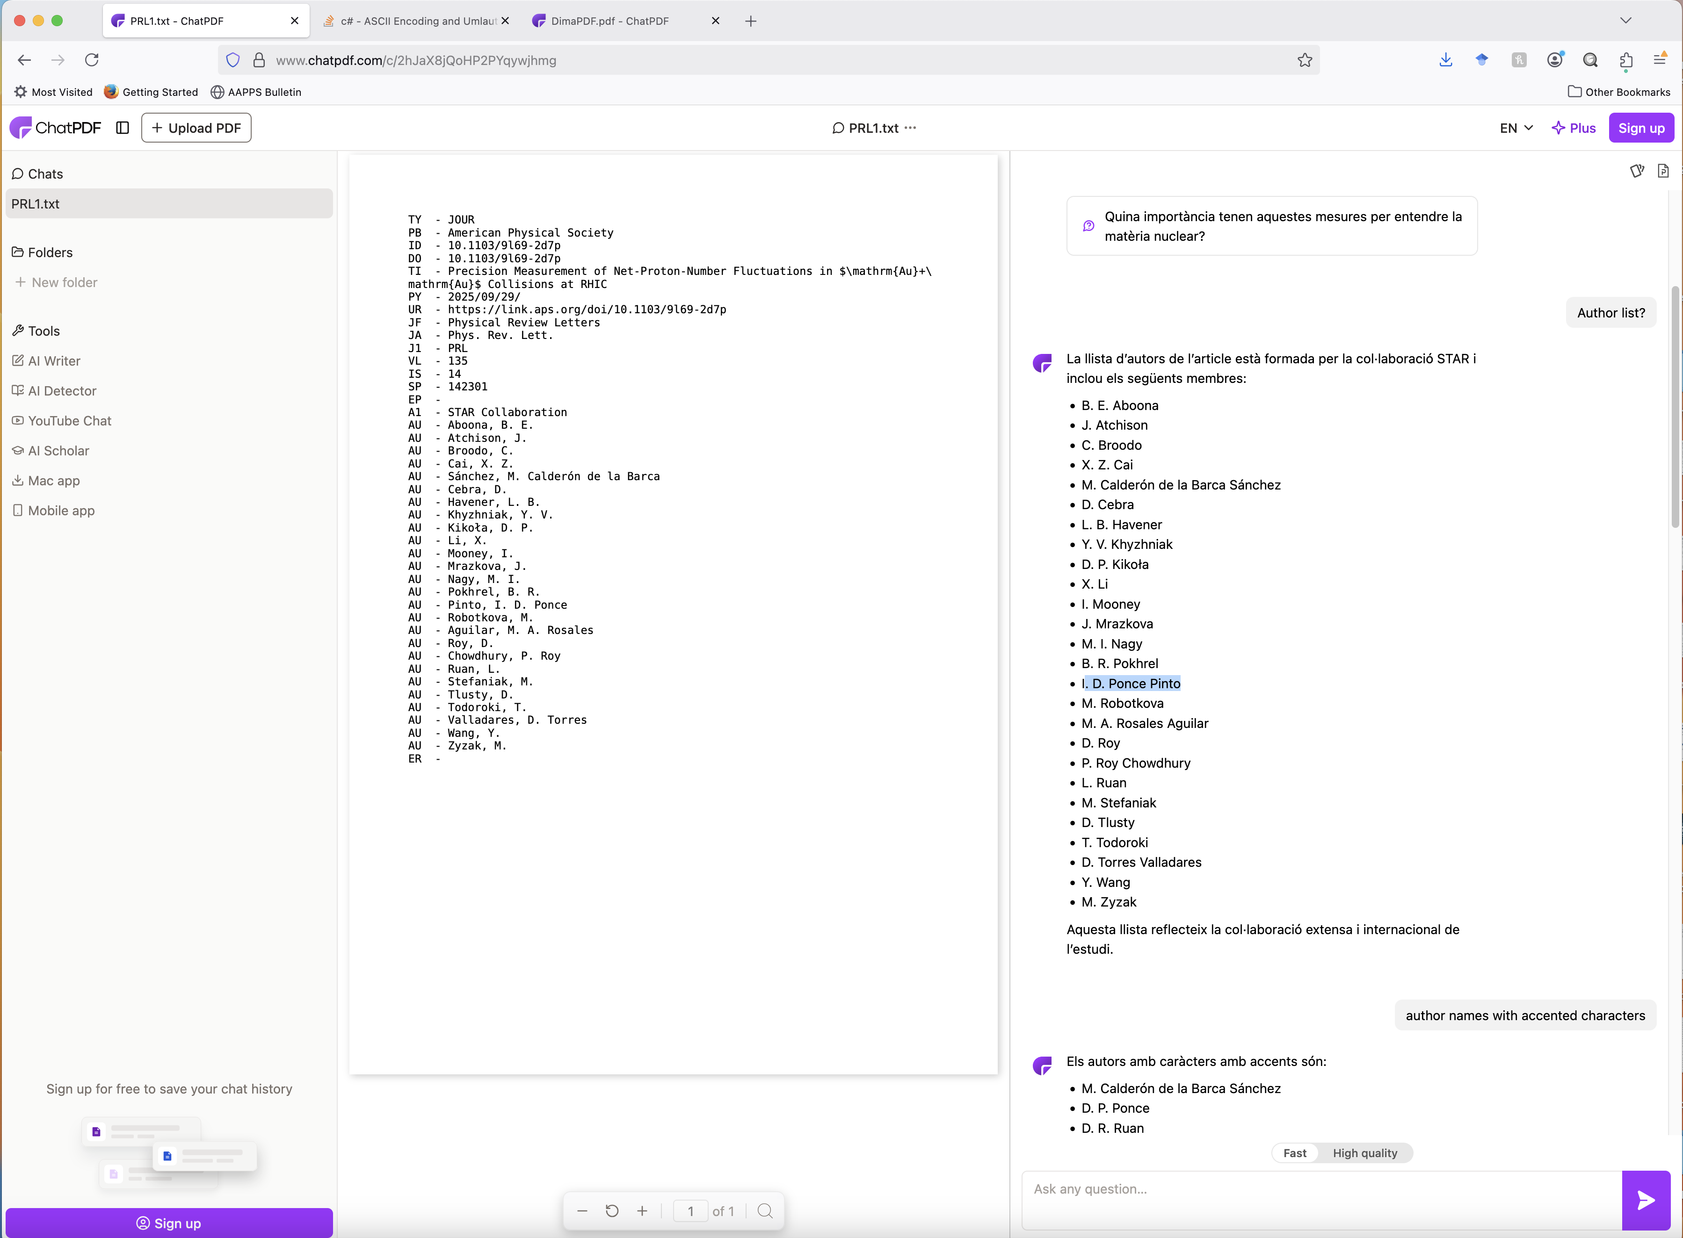
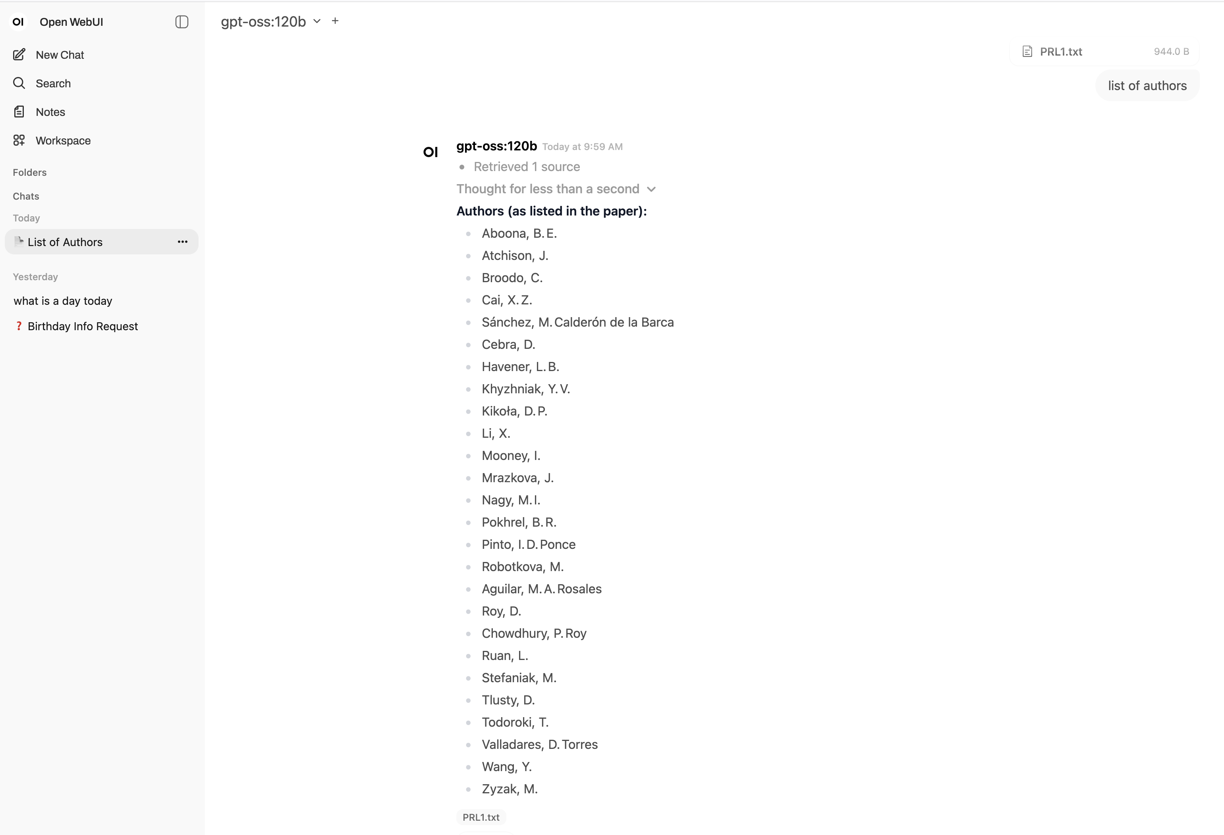
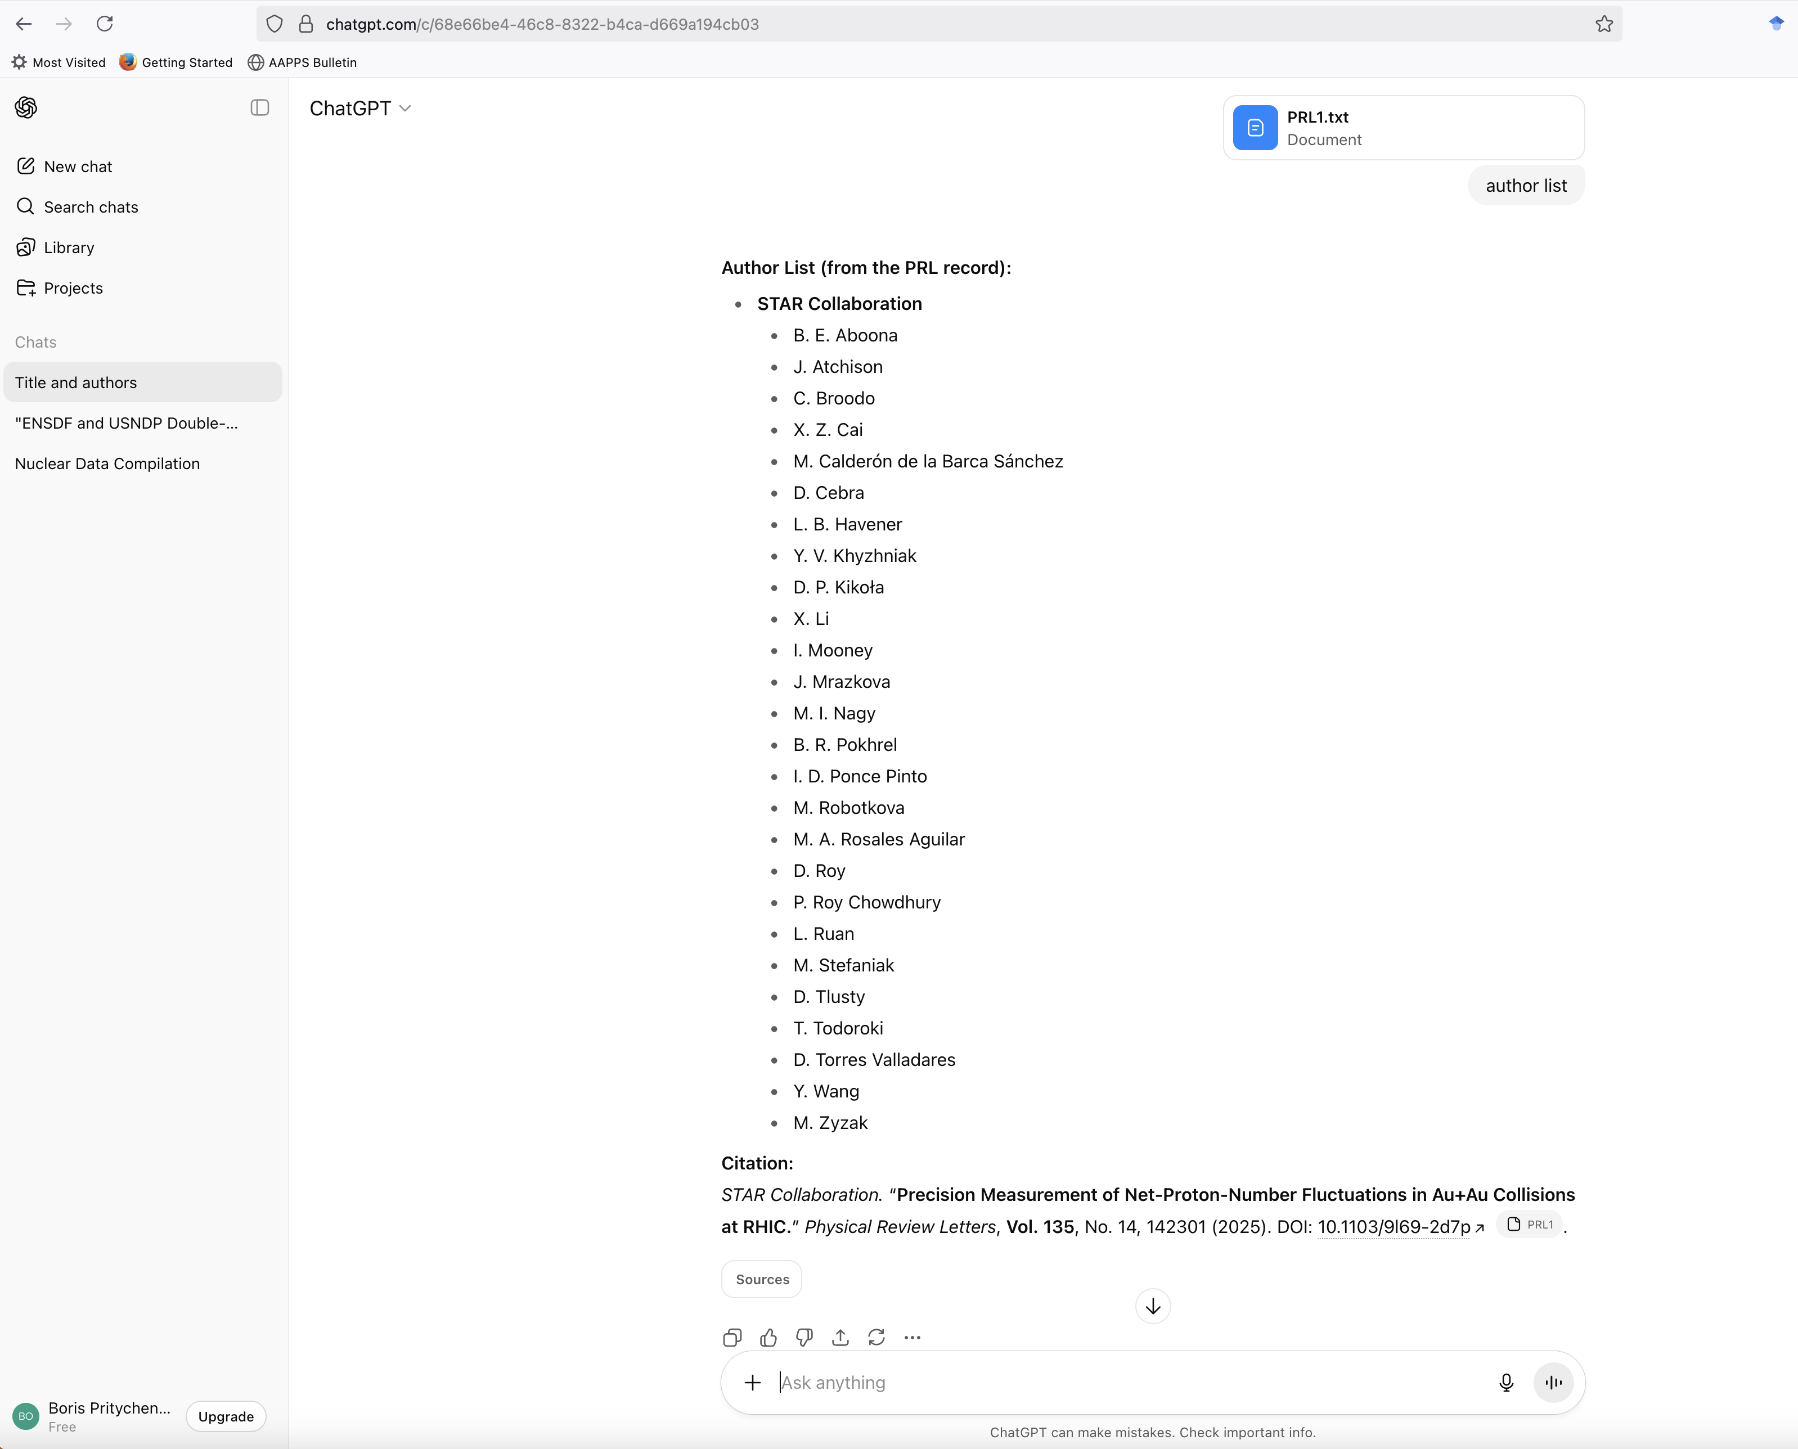
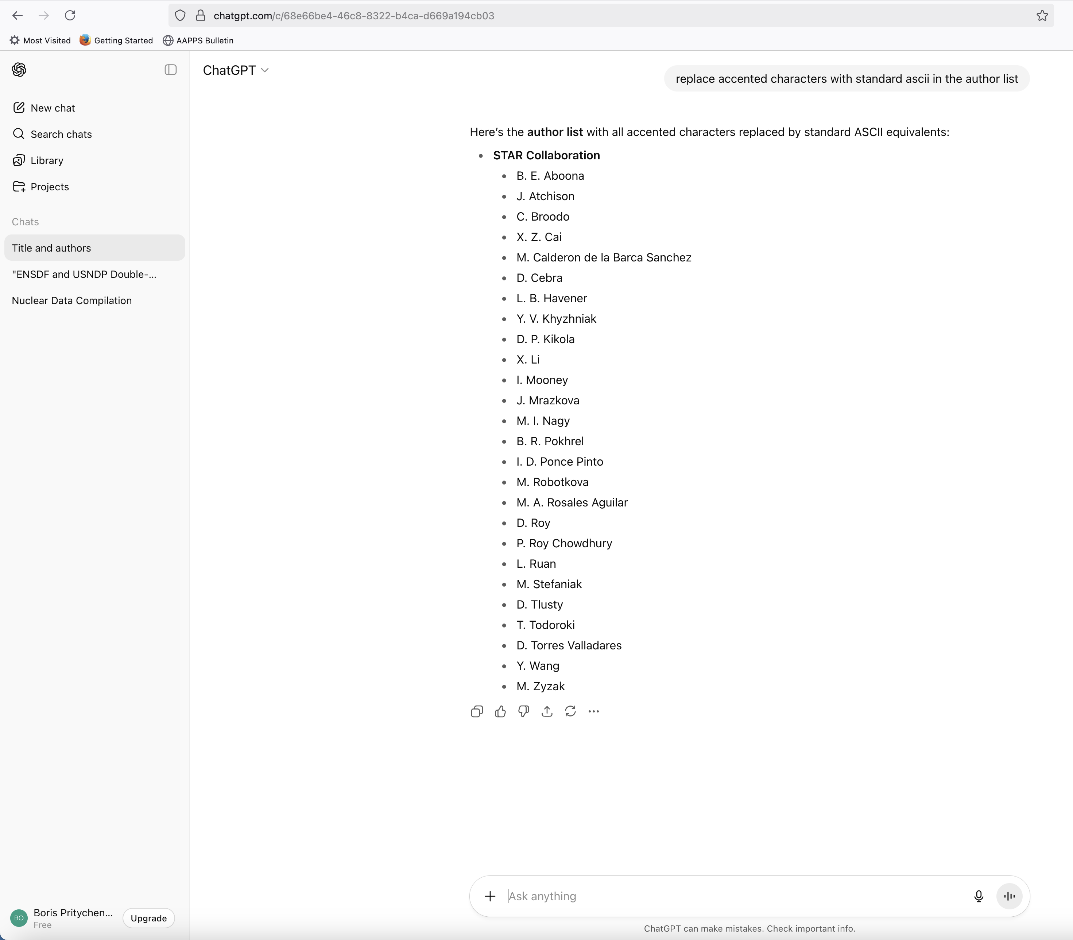
Double-Barrelled Surnames: ChatPDF, ChatGPT BNL vs Web
ChatPDF is ChatGPT for academics.
ChatPDF/ChatBNL training stopped in the middle of 2024.
ChatGPT searches the Web.
ChatBNL is a single workstation, it is slow.
PRL *.ris file was uploaded to all engines.
Prompt: Author list?
Prompt: replace accented characters with standard ascii in the author list

Slide 9
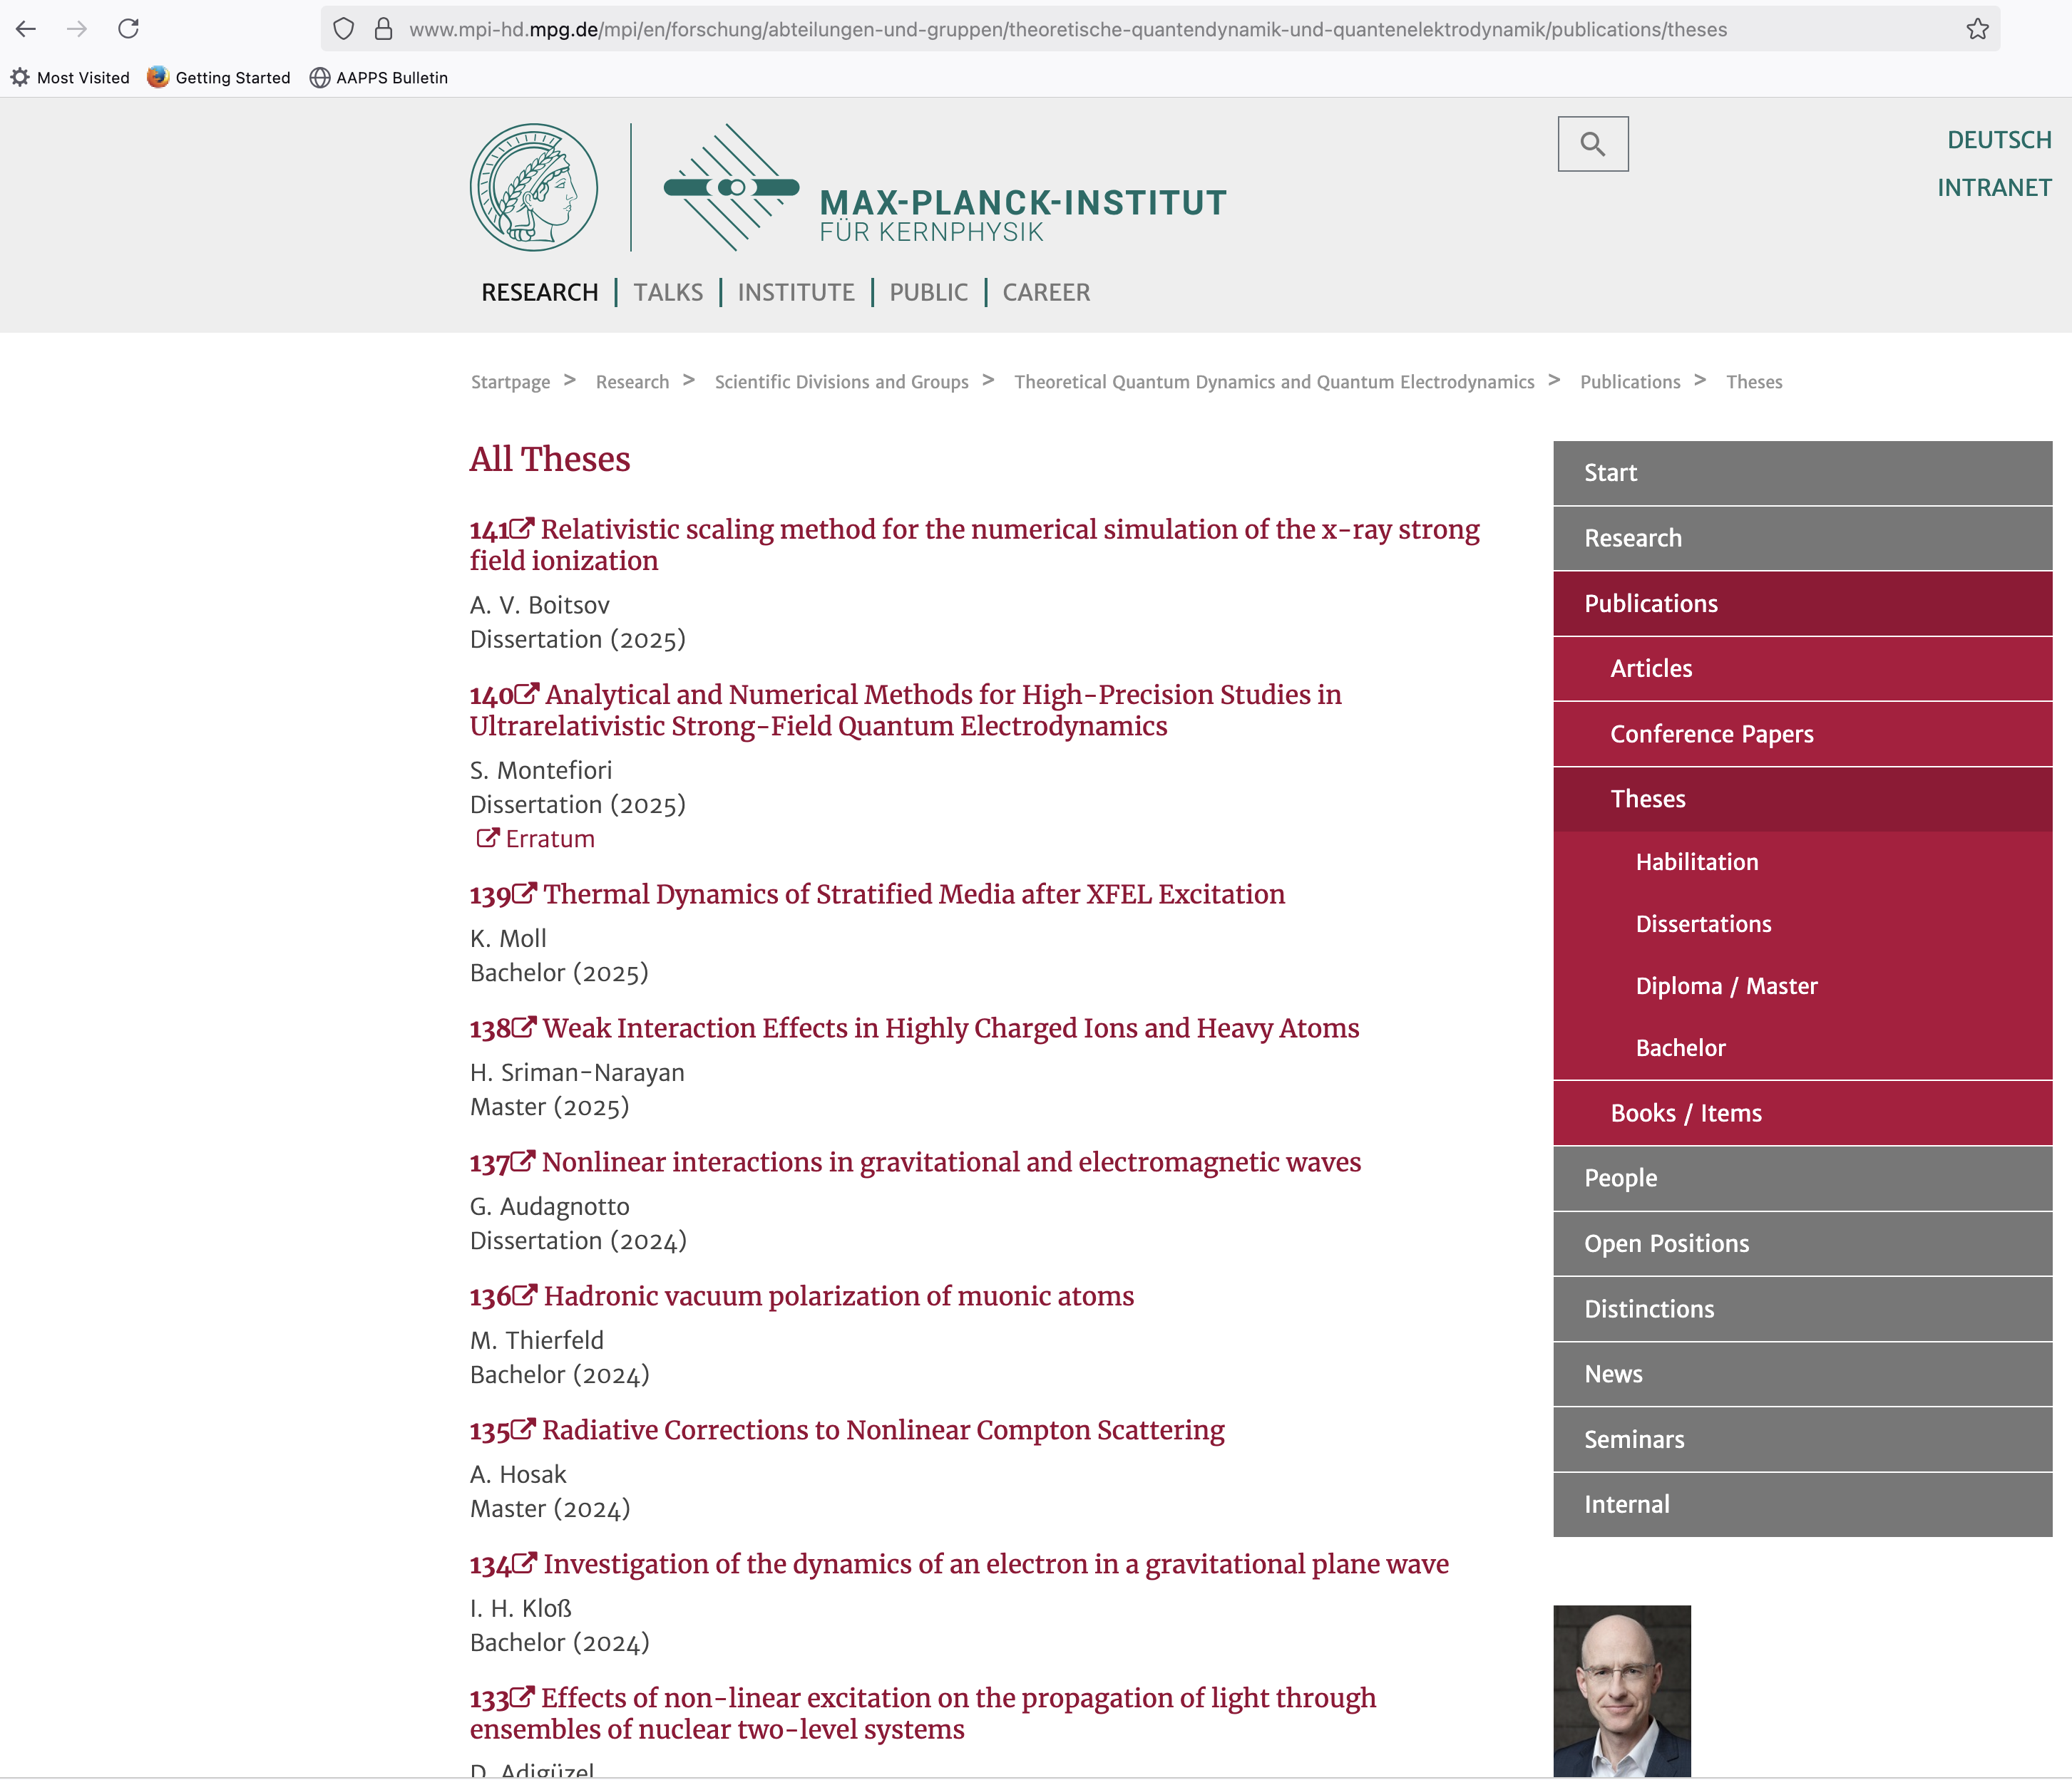
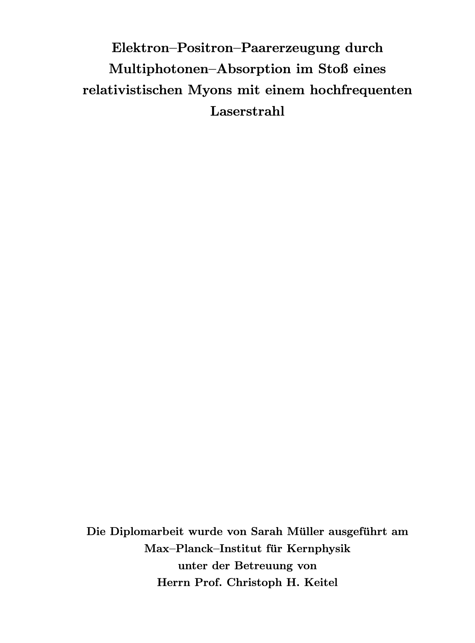
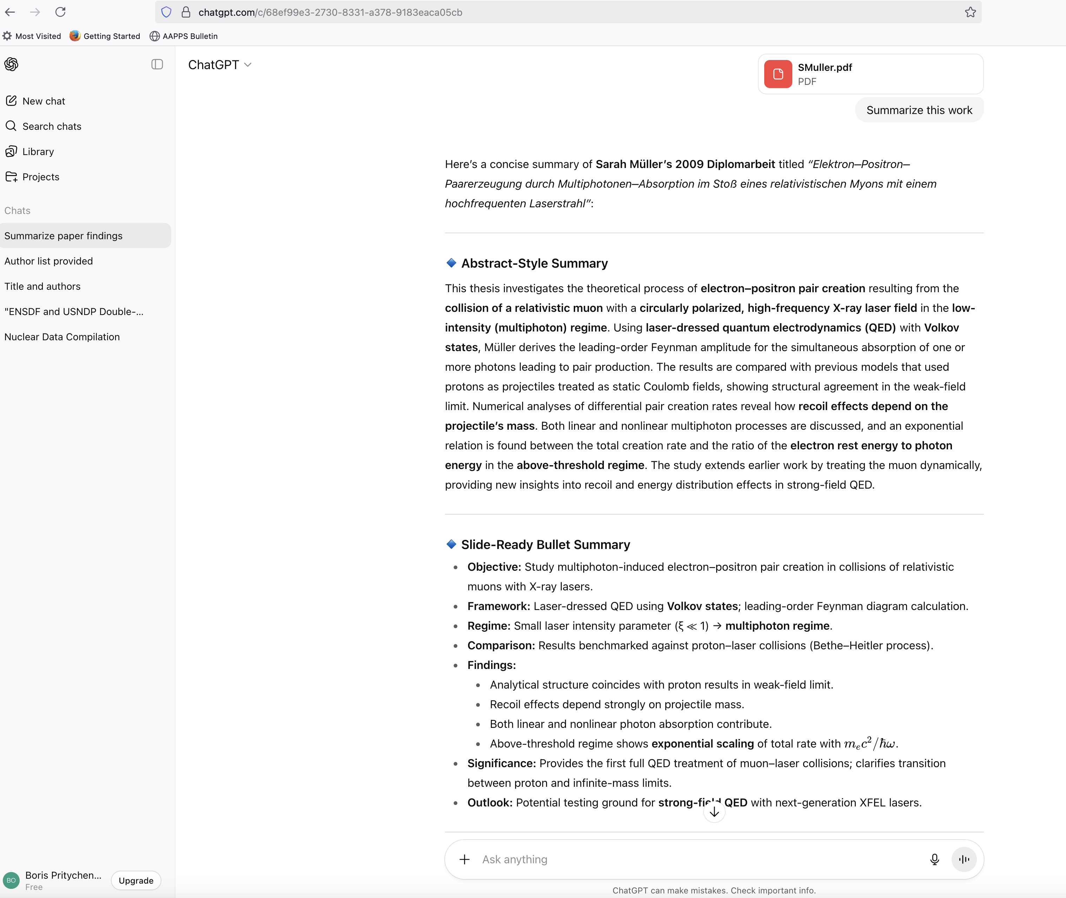
German Language PDF
NSR often receives Ph.D./Master dissertations in foreign languages and keywords generation is a problem because Google translate accepts a few paragraphs.
Max-Planck Institute Theses: https://www.mpi-hd.mpg.de/mpi/en/forschung/abteilungen-und-gruppen/theoretische-quantendynamik-und-quantenelektrodynamik/publications/theses.
21Elektron–Positron–Paarerzeugung durch Multiphotonen–Absorption im Stoß eines relativistischen Myons mit einem hochfrequenten Laserstrahl, S. Müller and C. H. Keitel, Diploma (2009).
BNL and Web Prompt: Summarize this work. ChatGPT resolves issues with foreign languages in NSR.

Slide 10
NSR Keyworded Abstracts
Keywords reflect new (produced by authors) information in the article (Introduced by K.Way in support of the ENSDF project 30-40 years before the Internet, later adopted by NP and other journals).
Present Topics: Atomic Masses, Atomic Physics, Compilation, Nuclear Moments, Nuclear Reactions, Nuclear Structure, Radioactivity.
Currently, keywords are produced manually (a labor-intensive process).
Ramon Arcilla is exploring ChatGPT for keywords generation. Ramon will provide details in the next presentation.
Donnie Mason is developing interactive Web applications for keywords.
We have more than 200,000 keyworded abstracts (203,795/252,103=80.83%), so why not use machine learning or advanced ChatGPT?

Slide 11
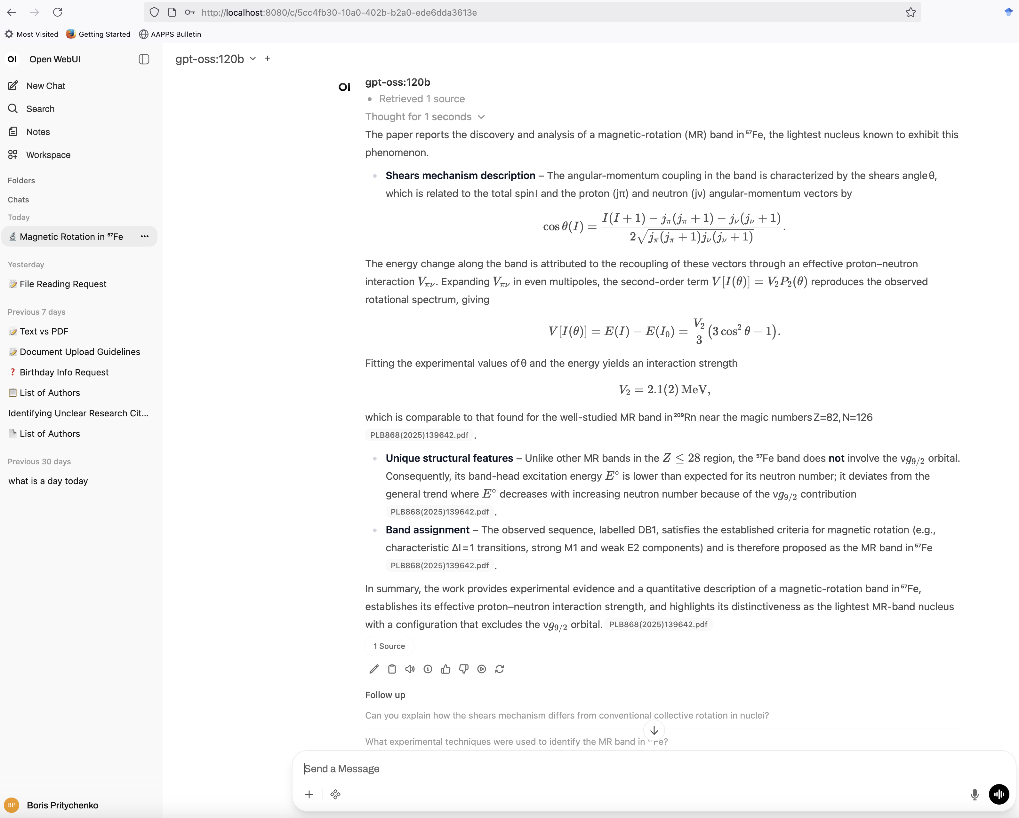
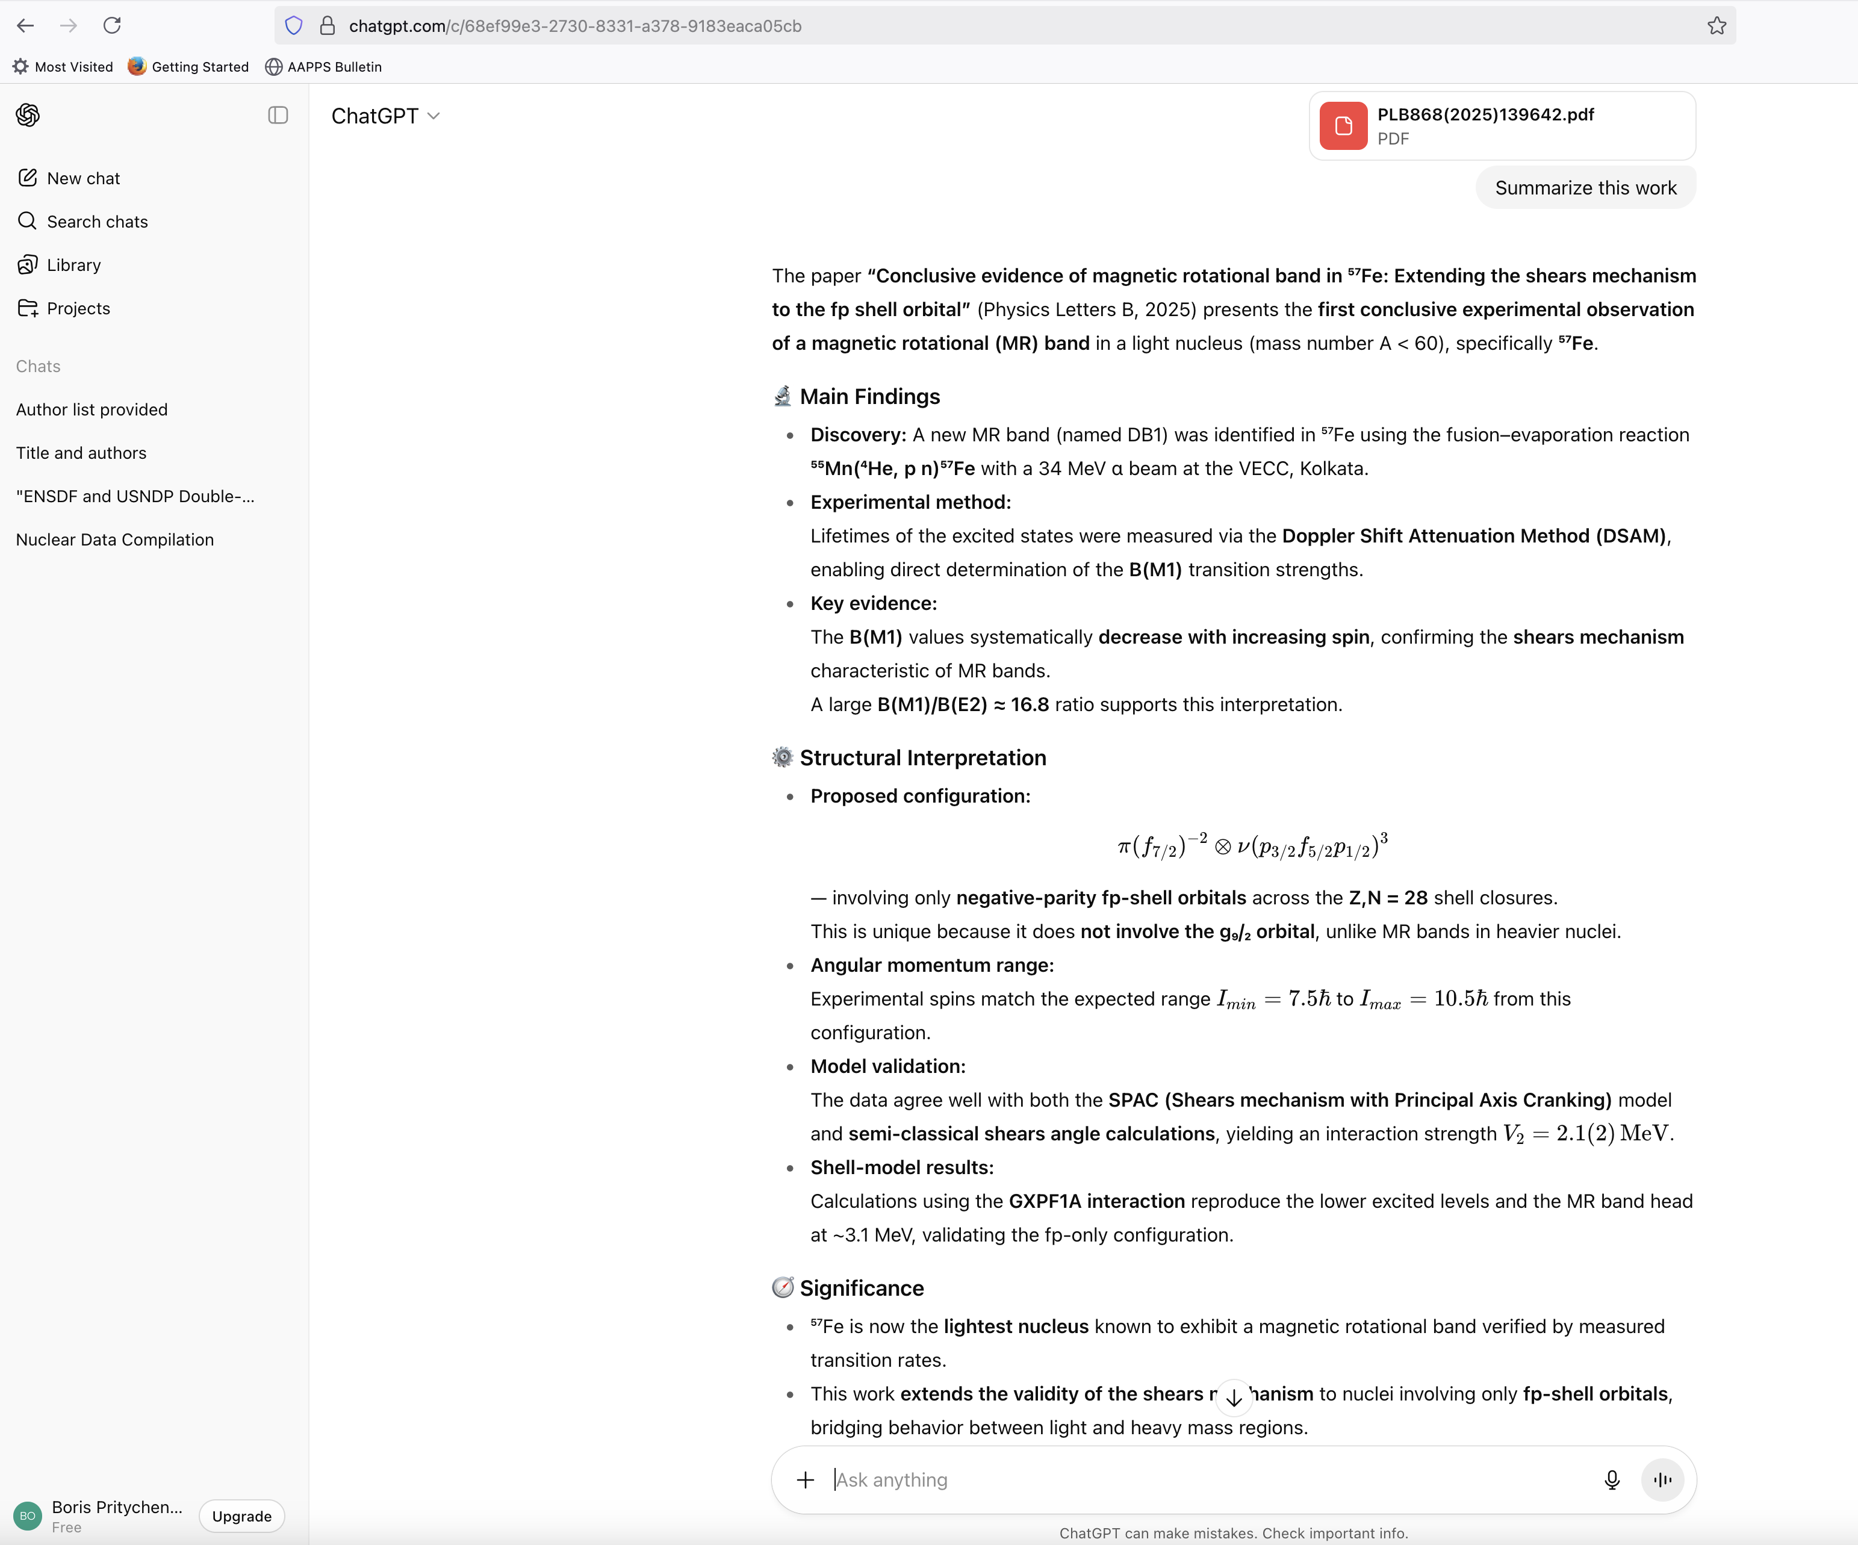
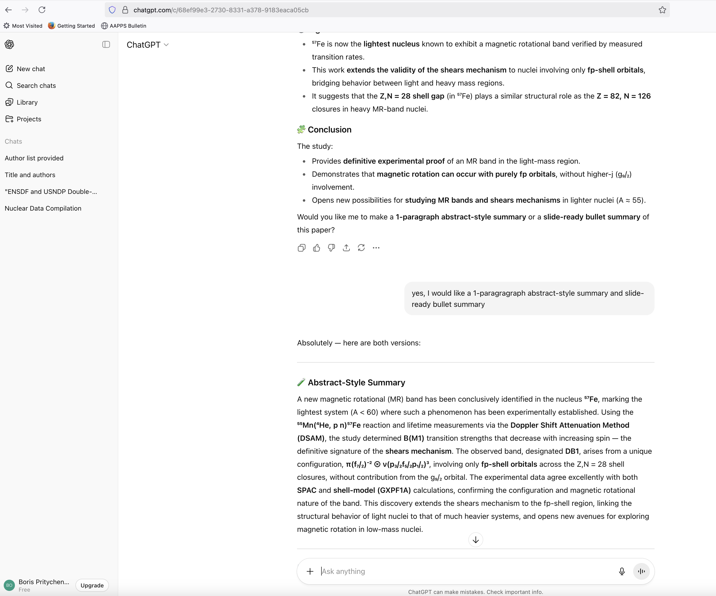
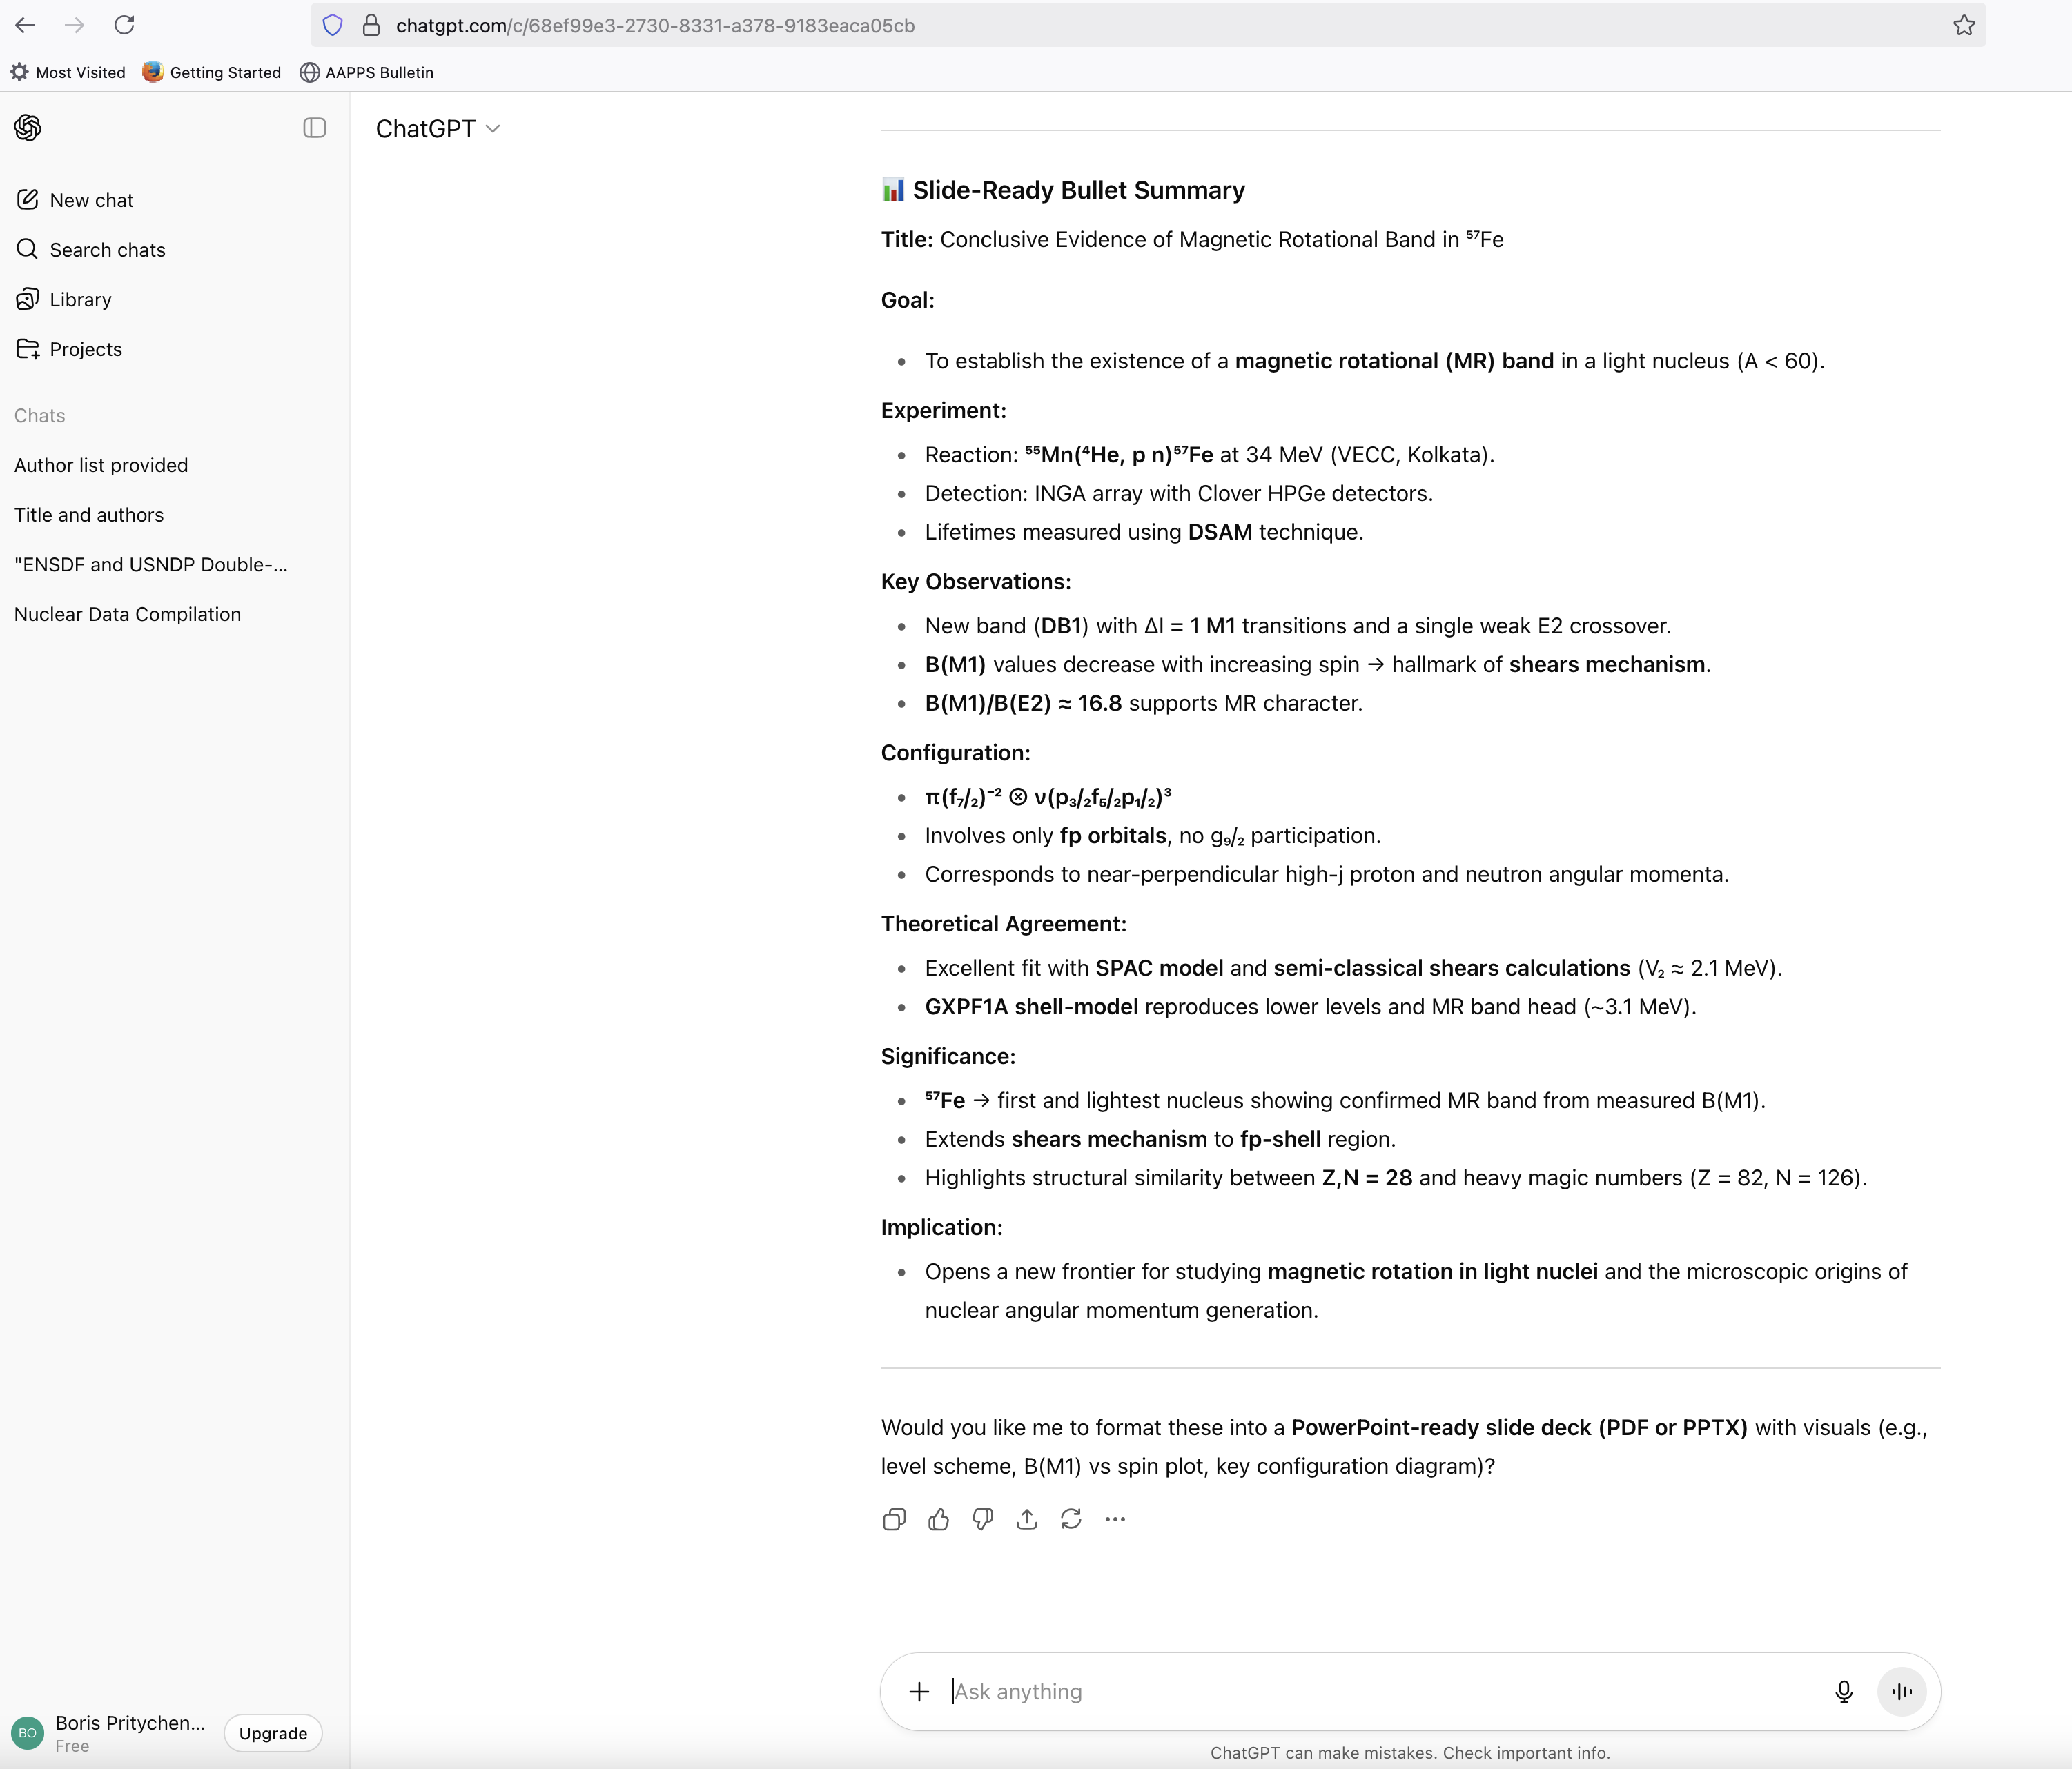
Keywords1: ChatGPT BNL vs Web
PLB open access (since 2014) article uploaded in ChatGPT: 2025Ba33.
Human keywords: NUCLEAR REACTIONS ⁵⁵Mn(α, np), E=34 MeV; measured reaction products, Eγ, Iγ; deduced level energies, J, π, T_{1/ 2}, B(M1), Magnetic Rotational (MR) band. Comparison with the shell model calculations. Indian National Gamma Array (INGA), the K-130 cyclotron at the Variable Energy Cyclotron Centre, Kolkata.
BNL ChatGPT& Web ChatGPT
Prompt: Summarize this work
More Complex prompt in progress.

Slide 12
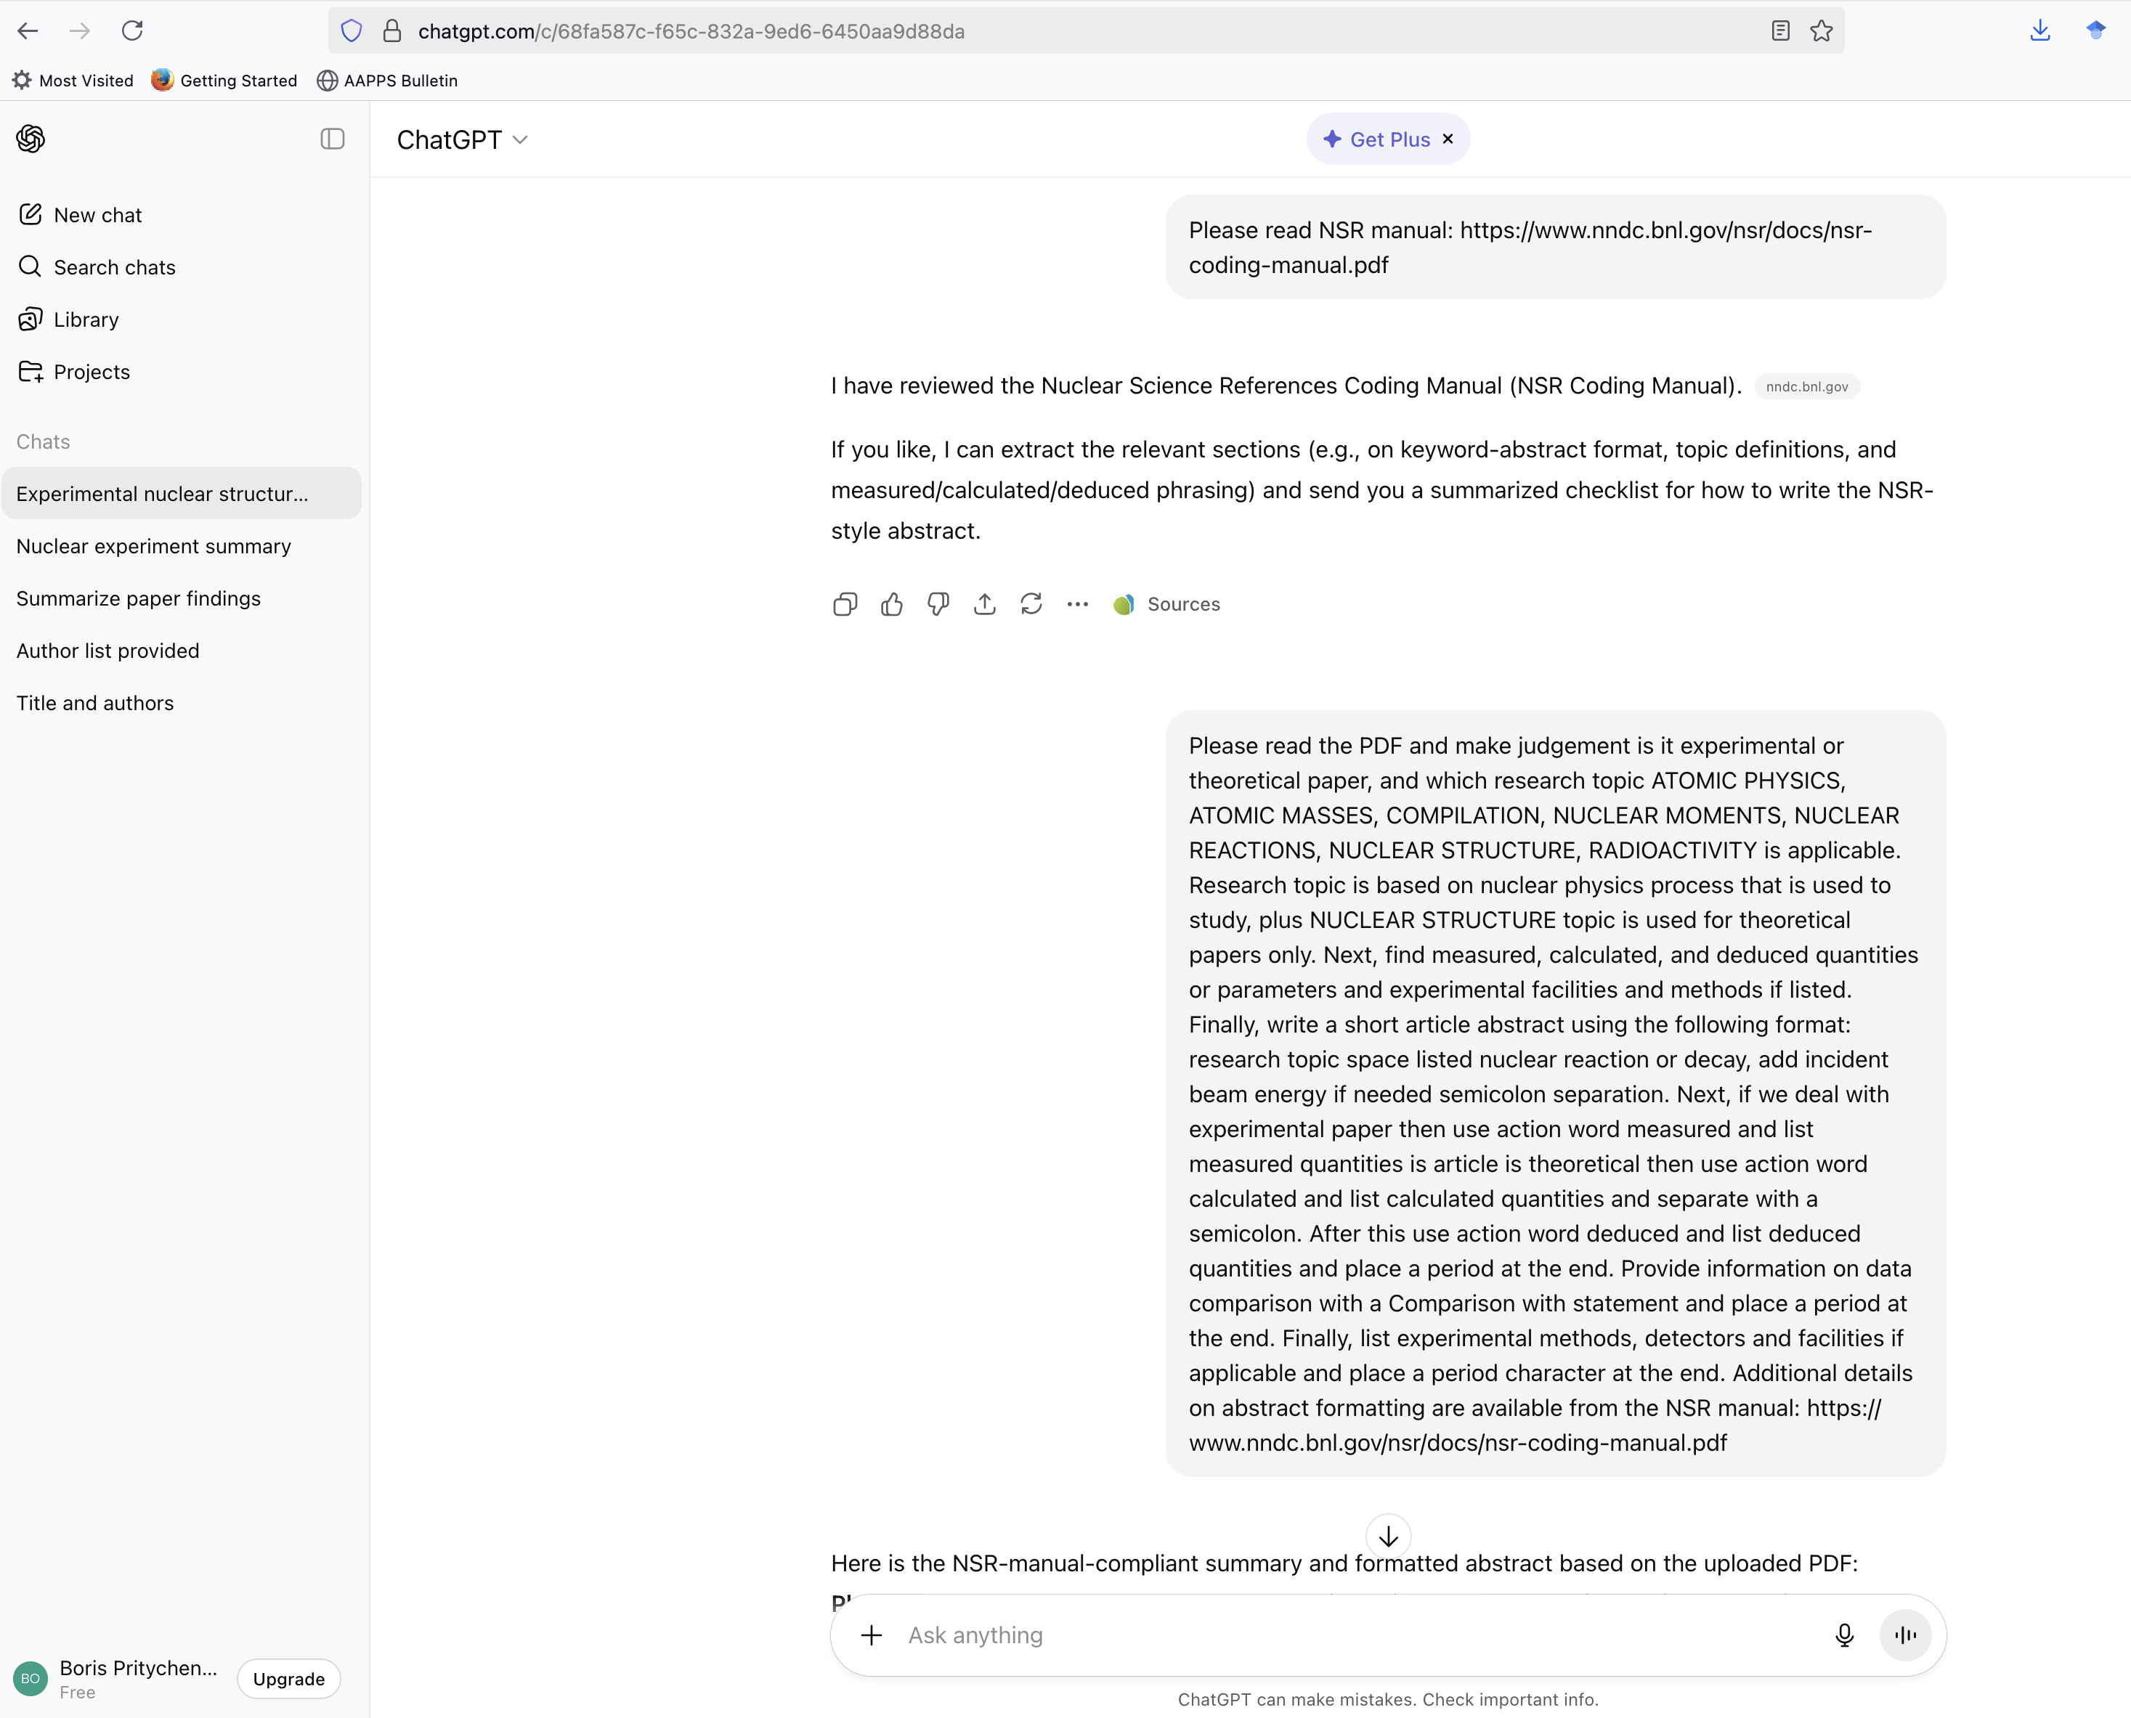
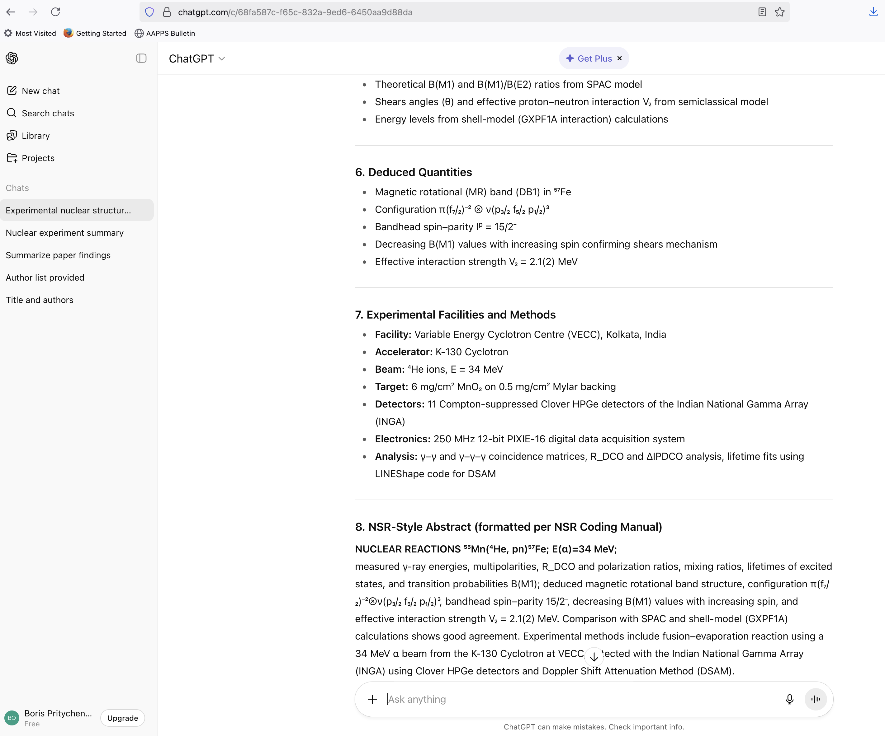
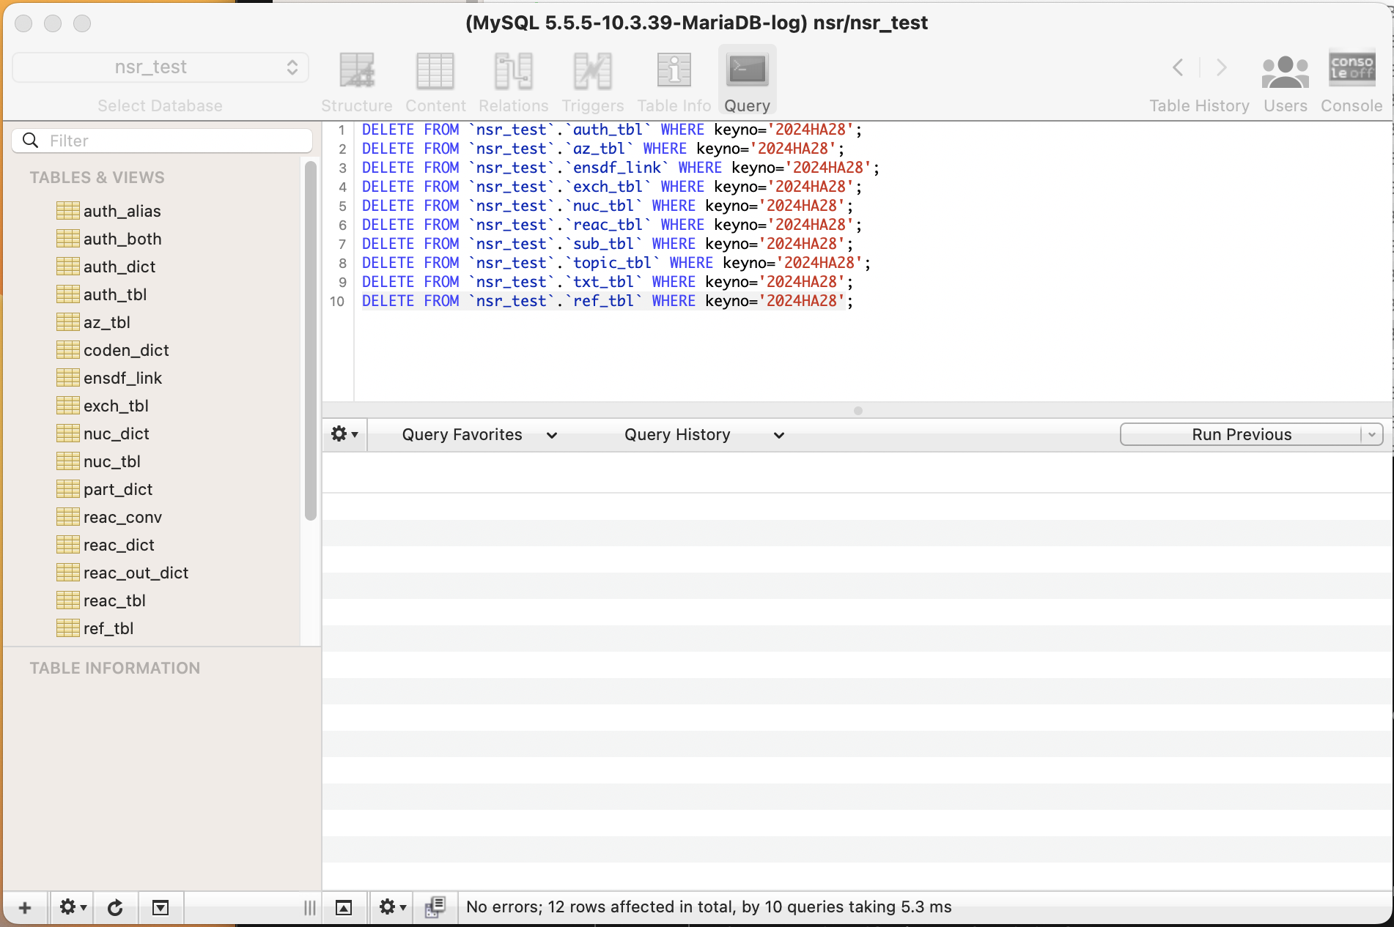
Keywords2: ChatGPT BNL vs Web
PLB open access (since 2014) article uploaded in ChatGPT: 2025Ba33.
Human keywords: NUCLEAR REACTIONS ⁵⁵Mn(α, np), E=34 MeV; measured reaction products, Eγ, Iγ; deduced level energies, J, π, T_{1/ 2}, B(M1), Magnetic Rotational (MR) band. Comparison with the shell model calculations. Indian National Gamma Array (INGA), the K-130 cyclotron at the Variable Energy Cyclotron Centre, Kolkata.
BNL ChatGPT& Web ChatGPT
Prompt: Summarize this work
More Complex prompt in progress.

Slide 13
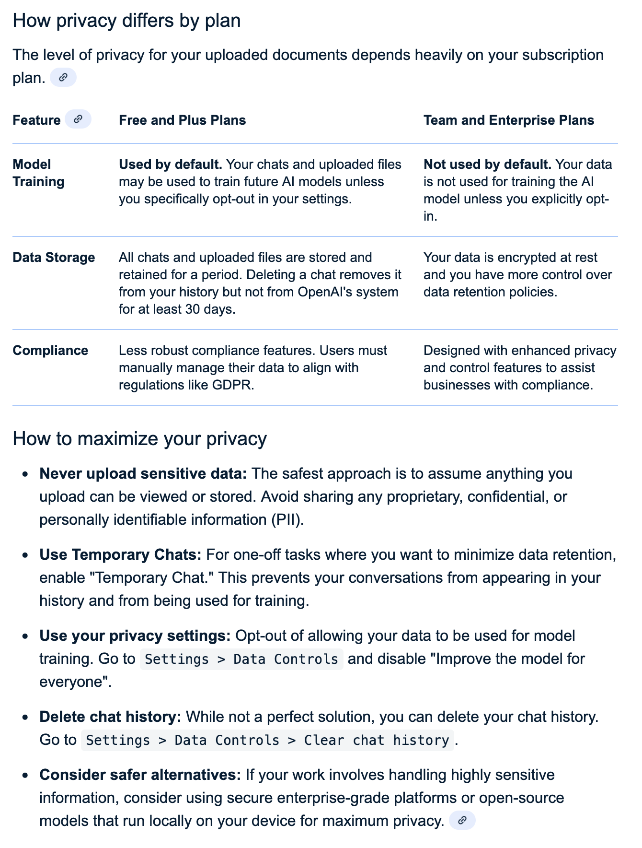
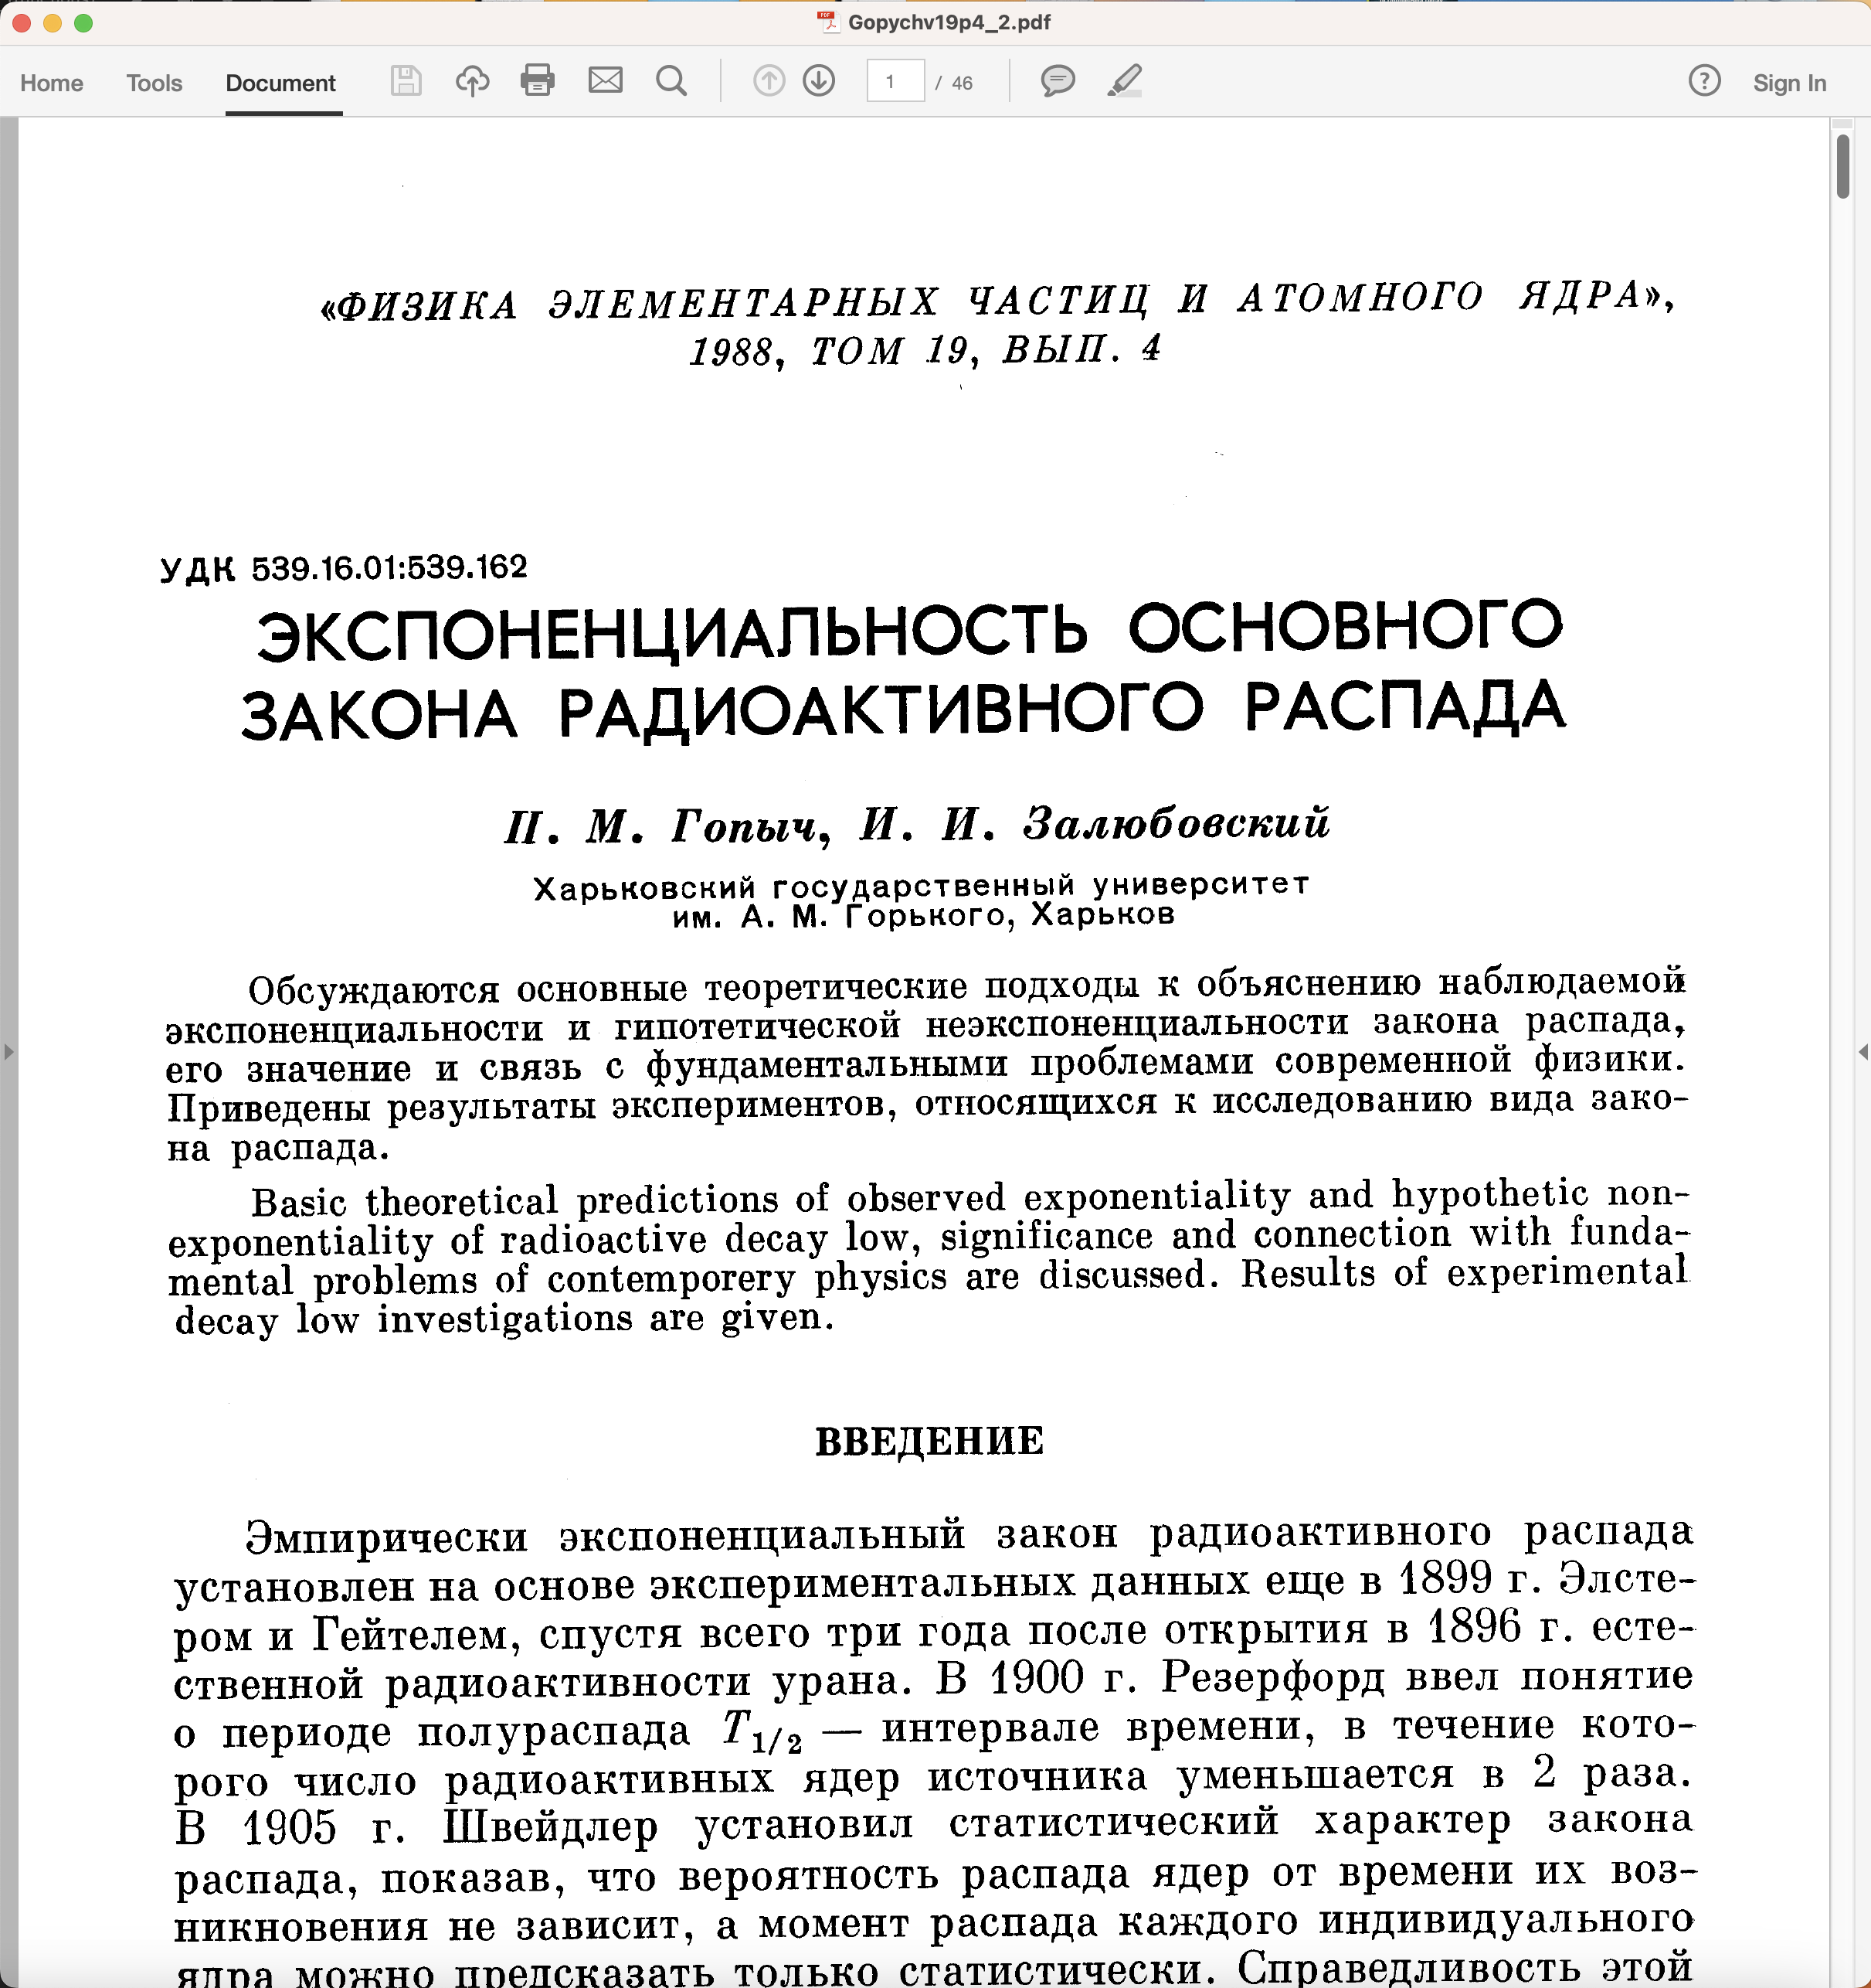
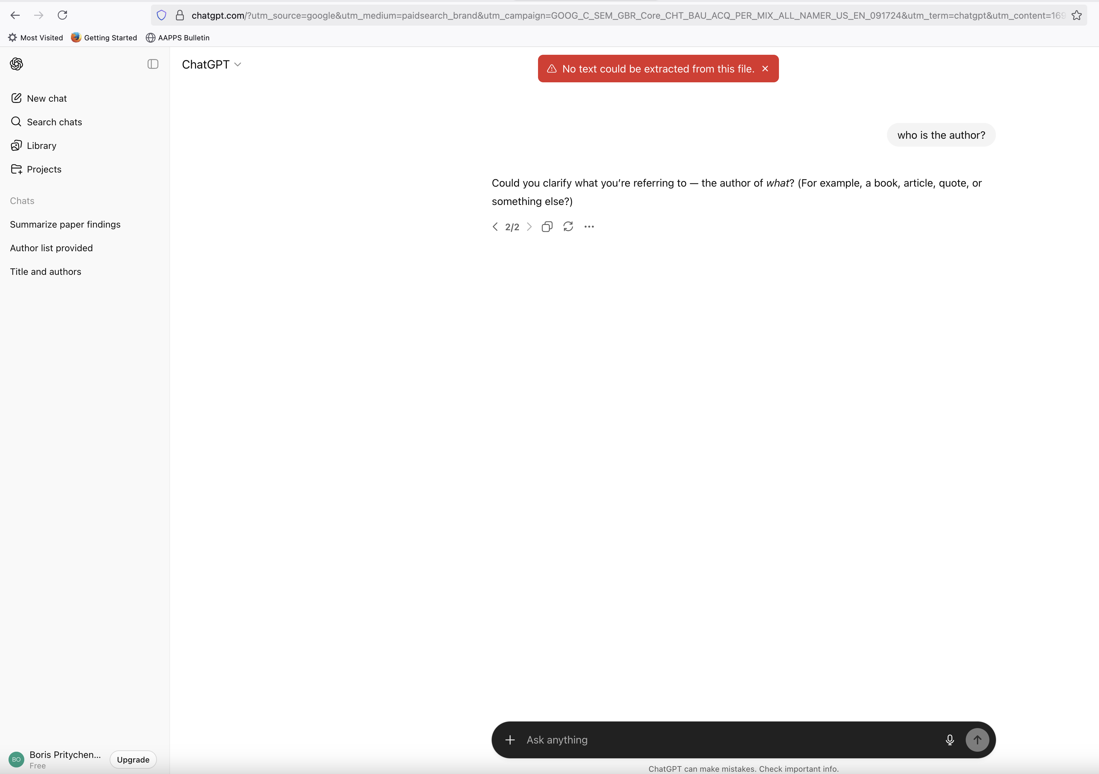
ChatGPT Reading Limitations
ChatGPT cannot read scanned PDFs in foreign languages.
ChatGPT can do many things, but it cannot replace NSR compilers in 100% of cases.
Open Access documents.
Temporary Chat mode + Data Controls/Improve the model for everyone Off setting.

Slide 14
EXFOR FY 2026 Statistics
118 new (Often in consultations with authors) and 385 corrected entries
23 preliminary and 17 final transmissions (Refereed compilations)
8 internal EXFOR DB updates
B. Pritychenko: 84 new and 9 corrected
O.Gritzay (no longer available): 34 new
O.Schwerer: 372 corrected
N.Otsuka: 4 corrected

Slide 15
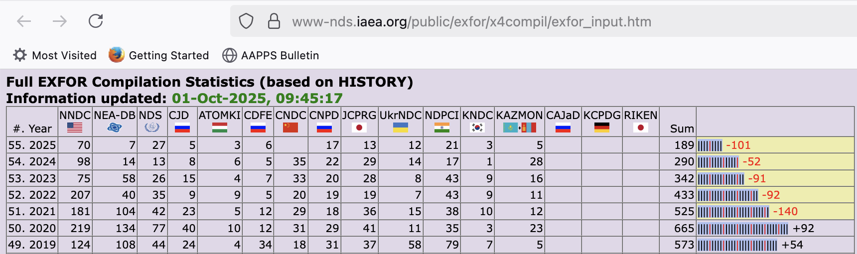
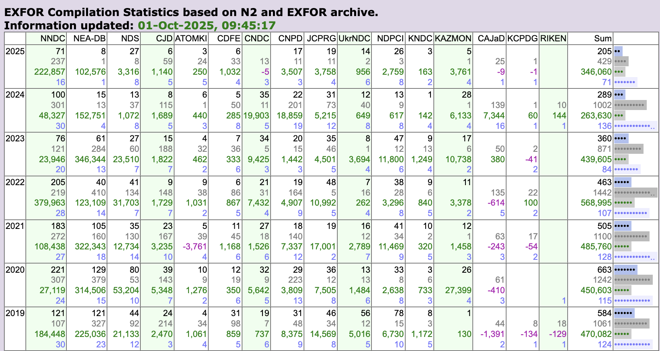
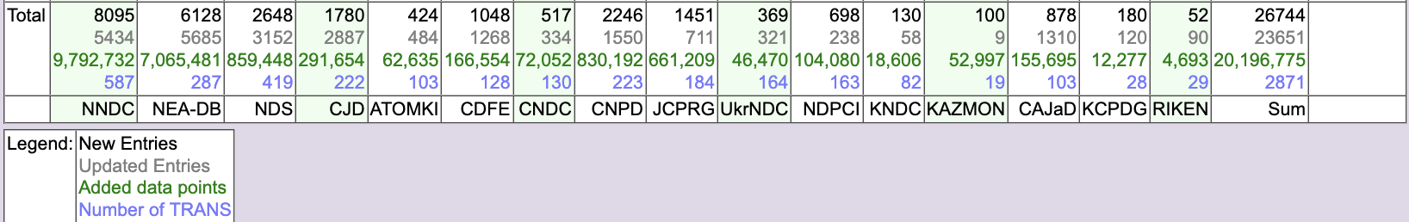
The IAEA EXFOR compilation control system, Calendar Years
EXFOR compilation control system is one of the tools used for this co-ordination (Developed by Viktor Zerkin, IAEA, retired on October 31, 2023).
Top panel: New entries only.
Bottom panel: New and Updated entries, number of data points and transmissions.
Overall performance of the Area #1 is very good.
Potential issue is EXFOR maintenance or correction of existing entries.
Area #1 has the largest number of entries 8,095. Only 5,434 (~67.1%) of entries were corrected. One calendar year ago the corrected entries number was ~61.3%.
Total number of data points is 9,792,732.

Slide 16
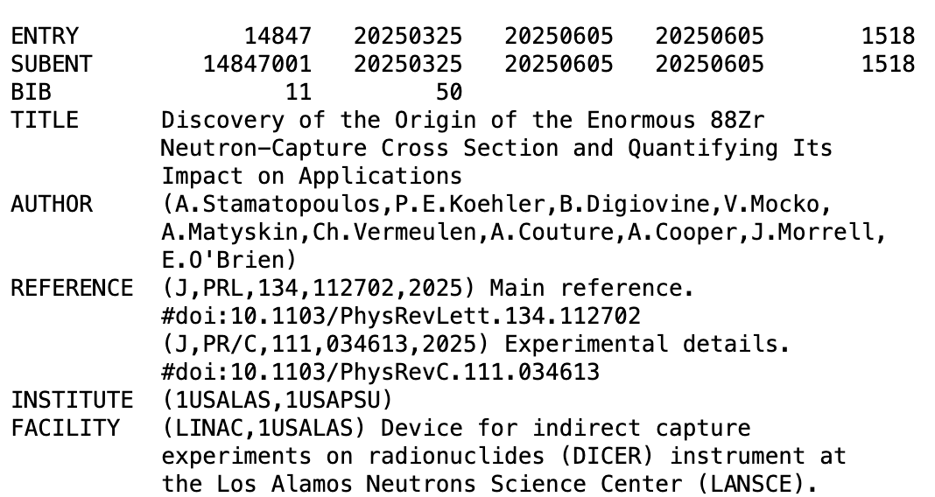
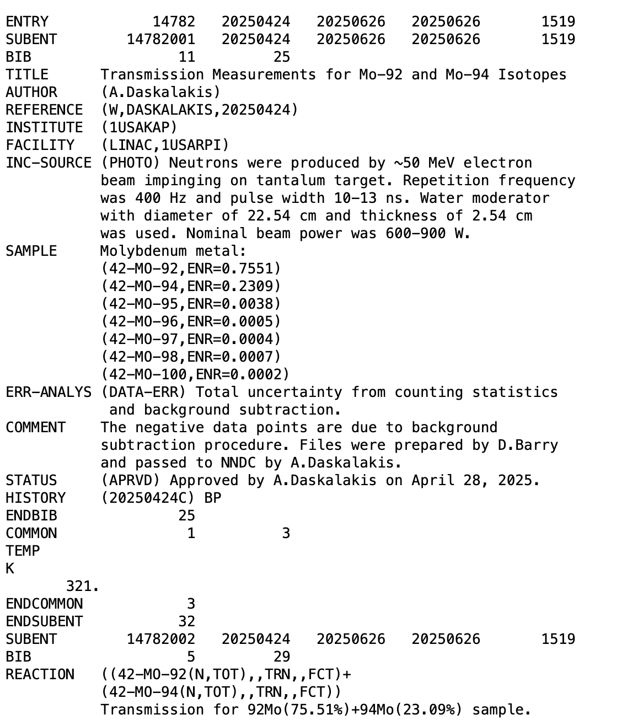
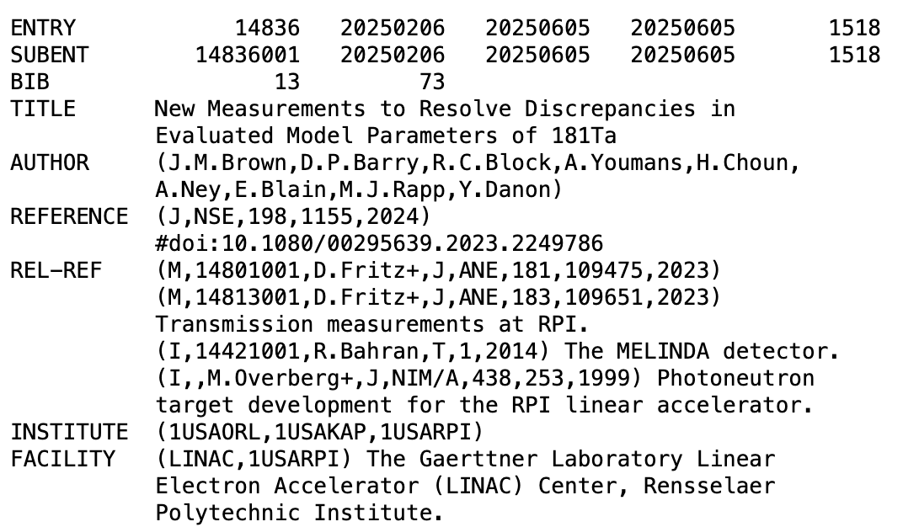
Recent EXFOR entries
#14847: A. Stamatopoulos et al., Discovery of the Origin of the Enormous 88Zr Neutron-Capture Cross Section and Quantifying Its Impact on Applications
Our data reveal a resonance at 0.171 eV and result in a thermal neutron-capture cross section of 771 000±31 000 b, in good agreement with the recently published value. In contrast, the neutron-capture resonance integral extracted from our data is 15 210±670 b and is roughly a factor of 200 smaller than the recently reported value.
#14836: J.M. Brown et al., New Measurements to Resolve Discrepancies in Evaluated Model Parameters of 181Ta
To resolve discrepancies in evaluated cross sections among major nuclear data libraries, energy-differential neutron transmission and radiative capture yield of ¹⁸¹Ta were measured from 0.15 to 100 keV using multiple sample thicknesses.
#14782: A. Daskalakis, D. Barry, Transmission Measurements for Mo-92 and Mo-94 Isotopes
~200,000 lines of data, 12.5 MB

Slide 17
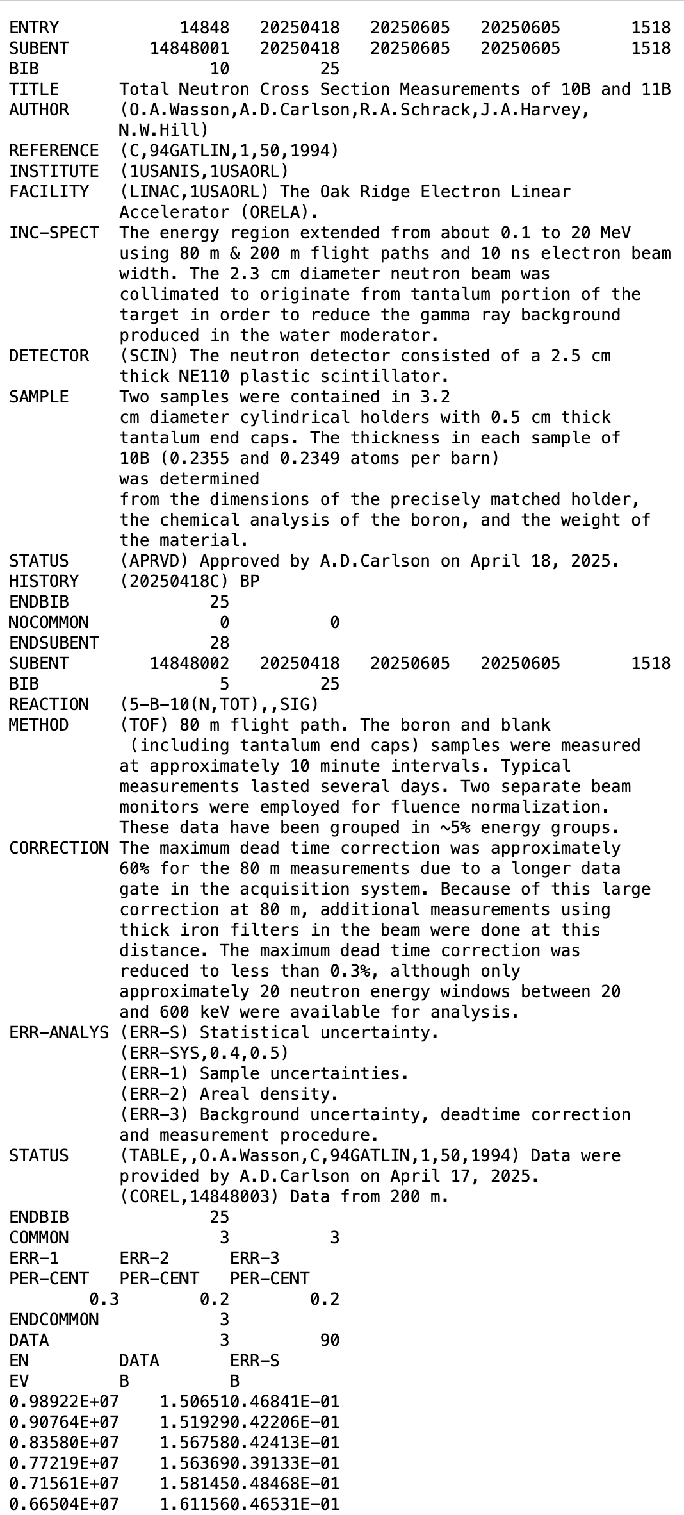
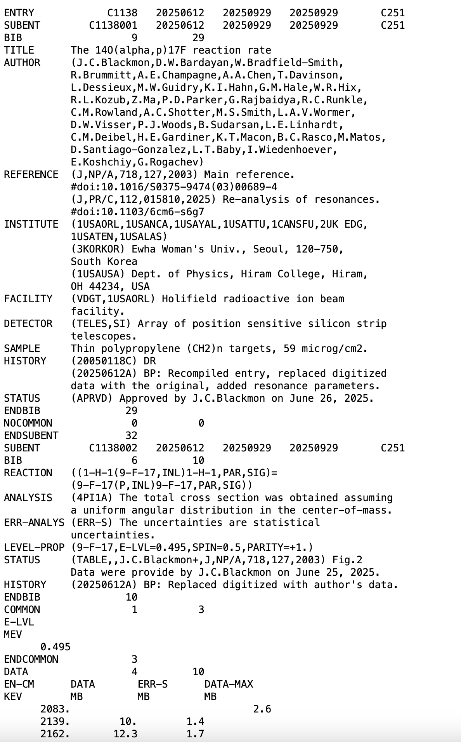
Not Recent Experiments
#14848: Total Neutron Cross Section Measurements of 10B and 11B
I was recently contacted by Allan Carlson, who provided data from a 1994 publication.
It was released as TRANS.1518.
2003 publication of J. Blackmon et al., C1138. It is digitized in EXFOR because the compiler failed to obtain data from the author.
While working on the C3072 compilation, it was discovered that the LSU group re-analyzed C1138 and extracted resonance parameters.
I contacted the group and secured a commitment to provide the 2003 data.
Sometimes it is possible to recover 20-30-year-old data.

Slide 18
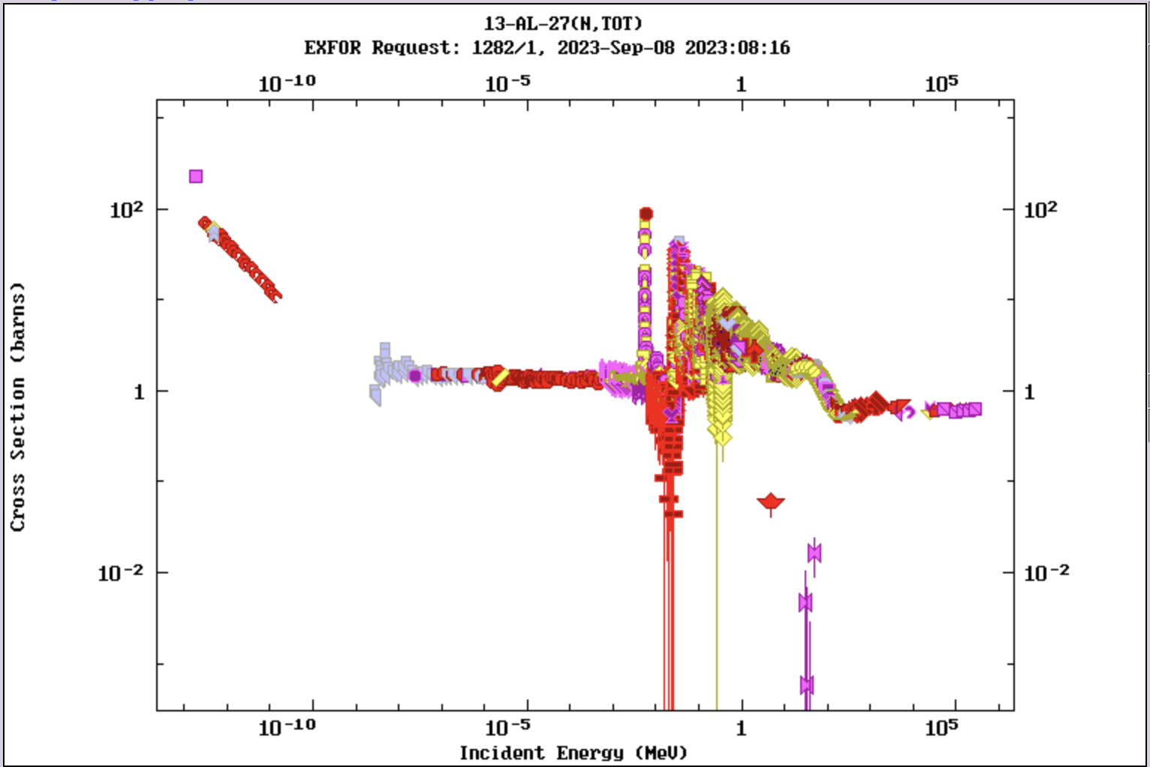
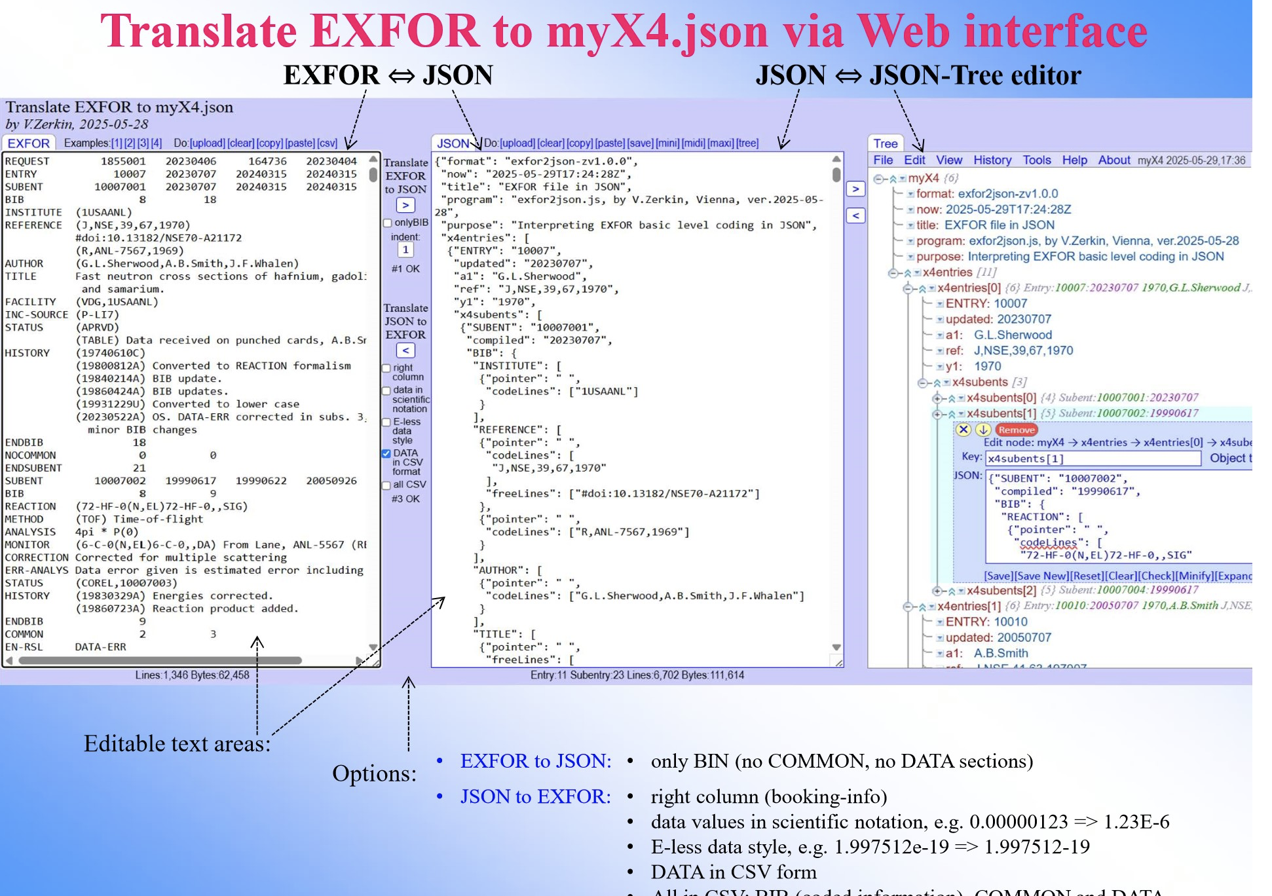
EXFOR Database Modernization
EXFOR is 75-year-old: It has to capitalize on modern computer technologies: Automatization of the EXFOR life and production cycle
NEA WPEC SG54: Curated EXFOR: developing a machine-readable, comprehensive, and corrected by evaluators experimental nuclear reaction database
New data formats: JSON (JavaScript Object Notation) lightweight data interchange format for EXFOR is now in progress at the SG54 (N.Otuka, V.Zerkin,…).
Compilation of corrected EXFOR data sets: AIACHNE, EXFOR Web DB,...
SG54 collaboration: BNL, IAEA, LBNL, NEA-DB, Los Alamos, LLNL, ORNL, …

