Slide 1
Tables of Neutron Thermal Cross Sections, Westcott Factors, Resonance Integrals, Maxwellian Averaged Cross Sections, Astrophysical Reaction Rates, and r-process Abundances Calculated from the ENDF/B-VIII.1, JEFF-3.3, JENDL-5.0, BROND-3.1, and CENDL-3.2 Evaluated Data Libraries
Boris Pritychenko
National Nuclear Data Center, Brookhaven National Laboratory, Upton, NY 11973-5000, USA
November 5, 2024
USNDP 2024

Slide 2
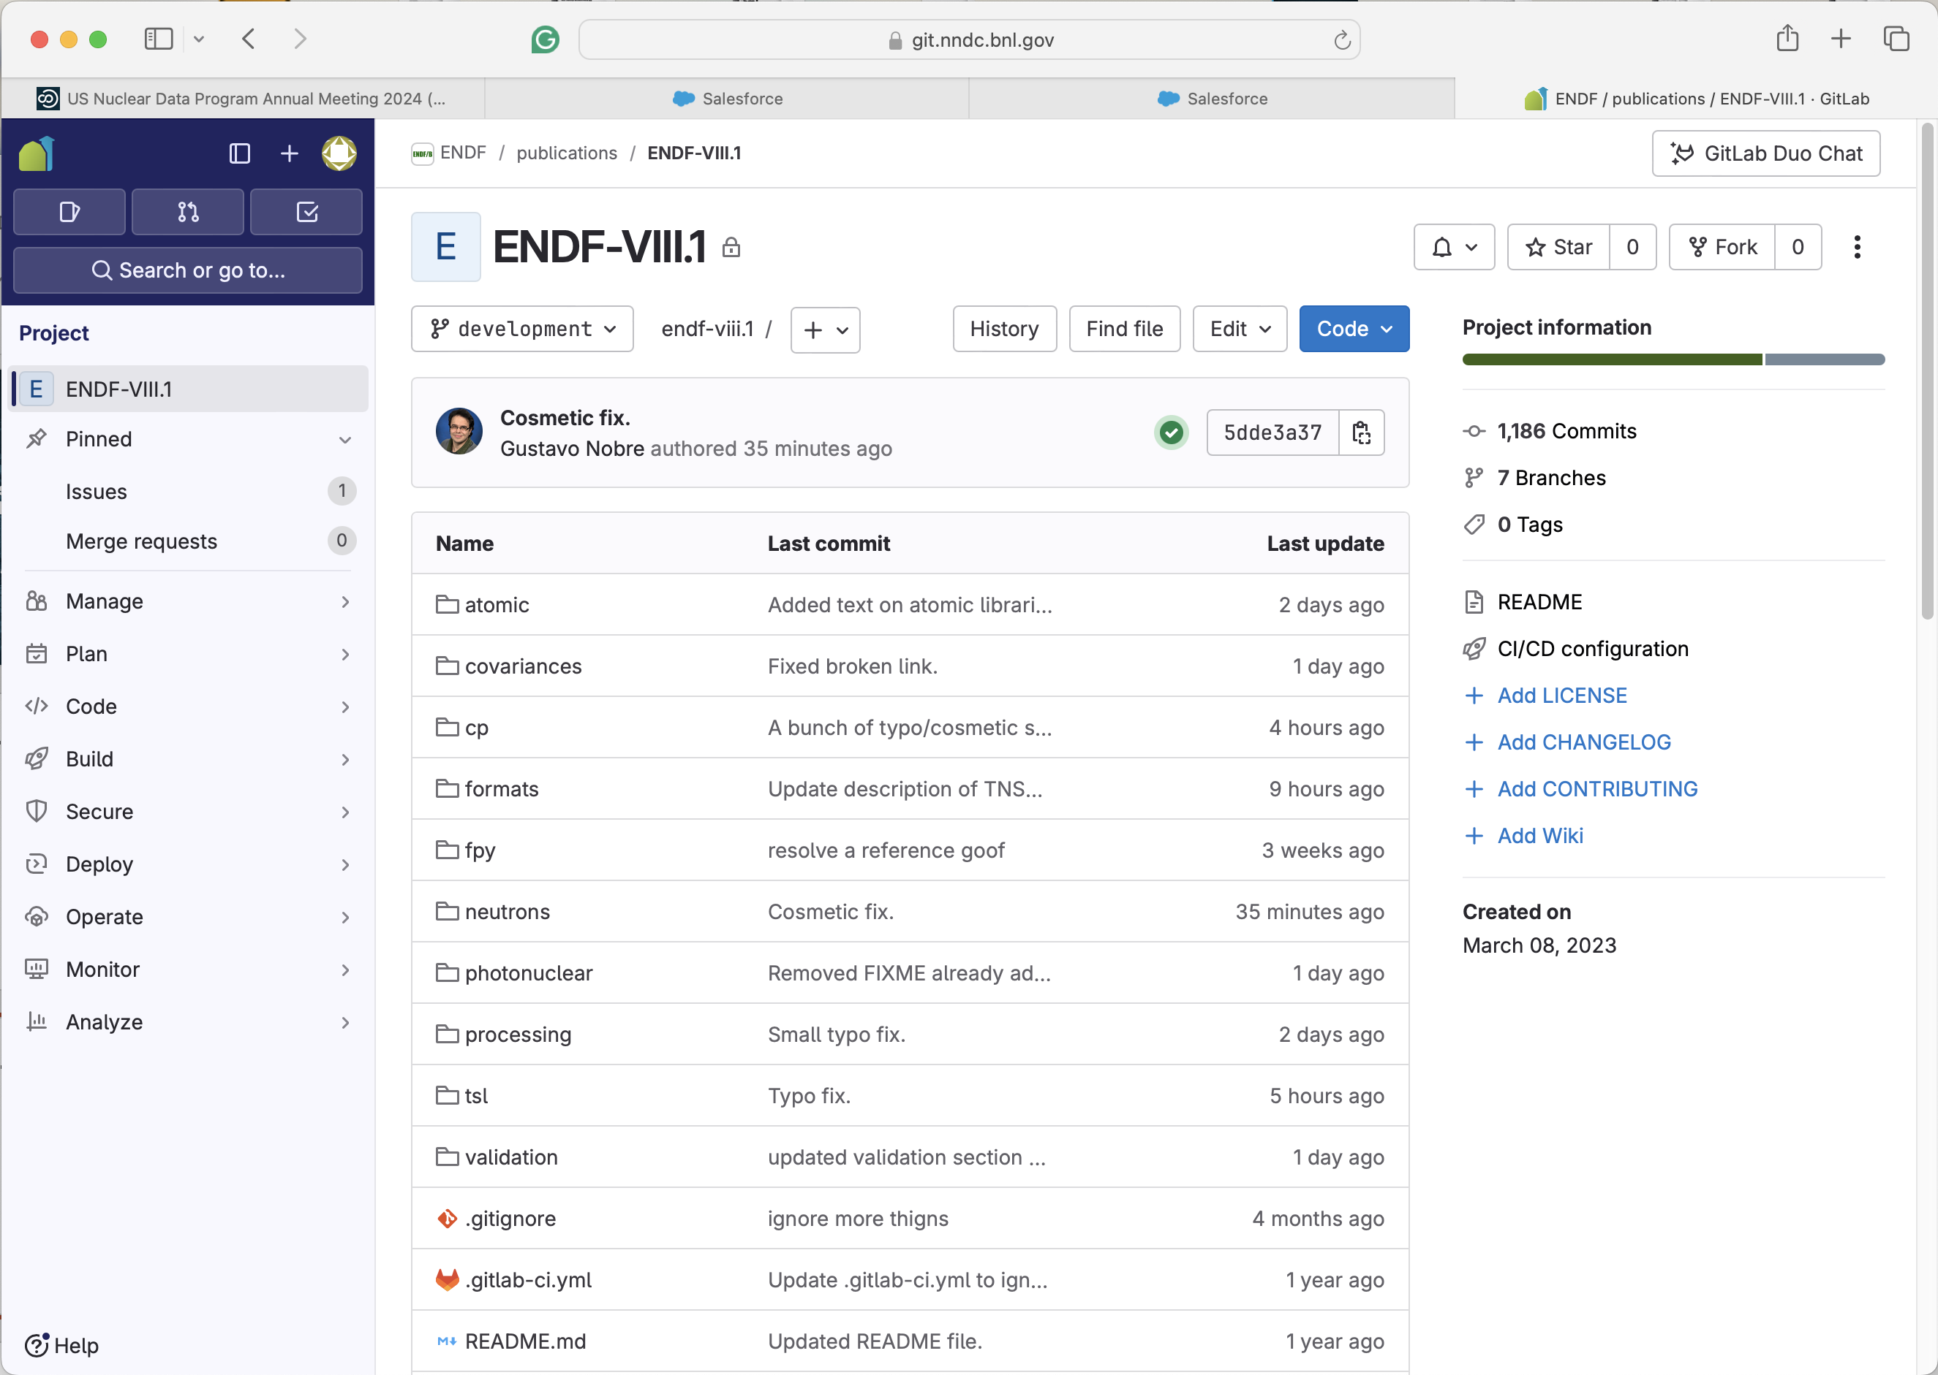
ENDF/B-VIII.1Library Release
The CSEWG collaboration released the ENDF/B-VIII.1 library in FY 2024—many details are in G. Nobre's (BNL) presentation.

Slide 3
ENFG/B-VIII.1 Integral Values
For the ENDF/B-VIII.1 library validation purposes, Neutron Thermal Cross Sections, Westcott Factors, Resonance Integrals, Maxwellian Averaged Cross Sections, Astrophysical Reaction Rates, and r-process Abundances were calculated.
The calculation was extended to JEFF-3.3, JENDL-5.0, CENDL-3.2, and BROND-3.1 libraries.
We Doppler-broaden evaluated reaction data at 293.16 ◦ K and extracted thermal cross sections for (n,γ), (n,fission), and (n,el) from the libraries.
Results were compared with the Atlas of Neutron Resonances (2018), ASTRAL and EXFOR libraries.

Slide 4
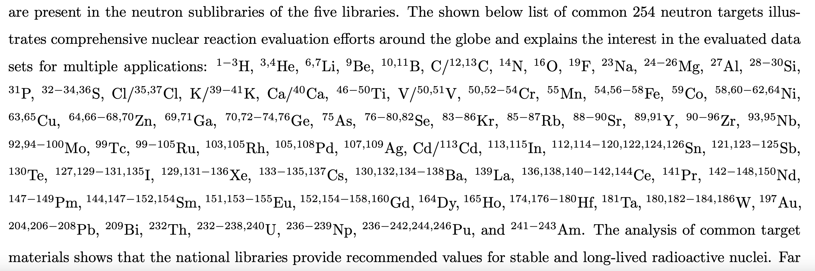
Unified Neutron Material Grid
How many neutron materials are in the five major libraries: 849.
How materials are present in all libraries: 254.
The 254 common neutron materials

Slide 5
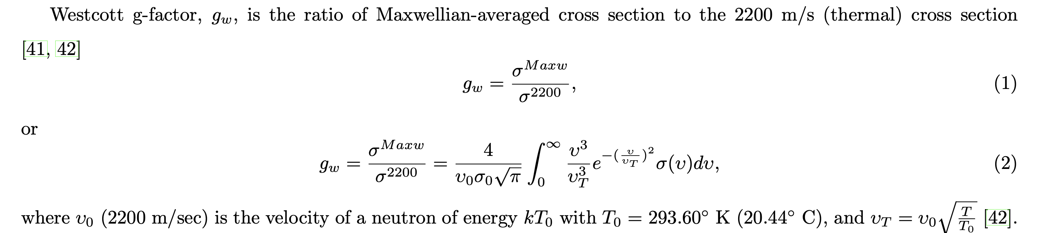
Westcott Factors
Westcott factors
Large Westcott factors >2 indicate spectra merging issues in ENDF libraries.
Elastic Westcott factors ~1.12, consistent with the 2012 calculation.
In the Atlas, we notice several typos in the reference book where neutron capture factors for 59Ni, 141Ce, 152Gd, 160−161Dy, 168Er, and 173Lu are not displayed correctly.

Slide 6
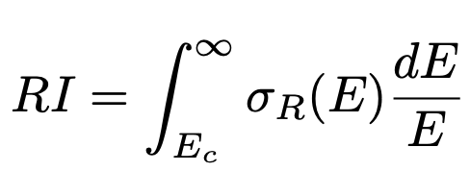
Resonance Integrals (RI)
They are defined by Lamarsh in a quasi-physical interpretation as “...the resonance integral is equal to the integral of the [effective] absorption [capture] cross section over the resonance region which is necessary to account for the observed neutron absorption rate in a flux equal to that existing in the absence of the resonances.”
The integrals for (n,γ), (n, fission), and (n, el) were calculated and compared with the Atlas of Neutron Resonances (2018).

Slide 7
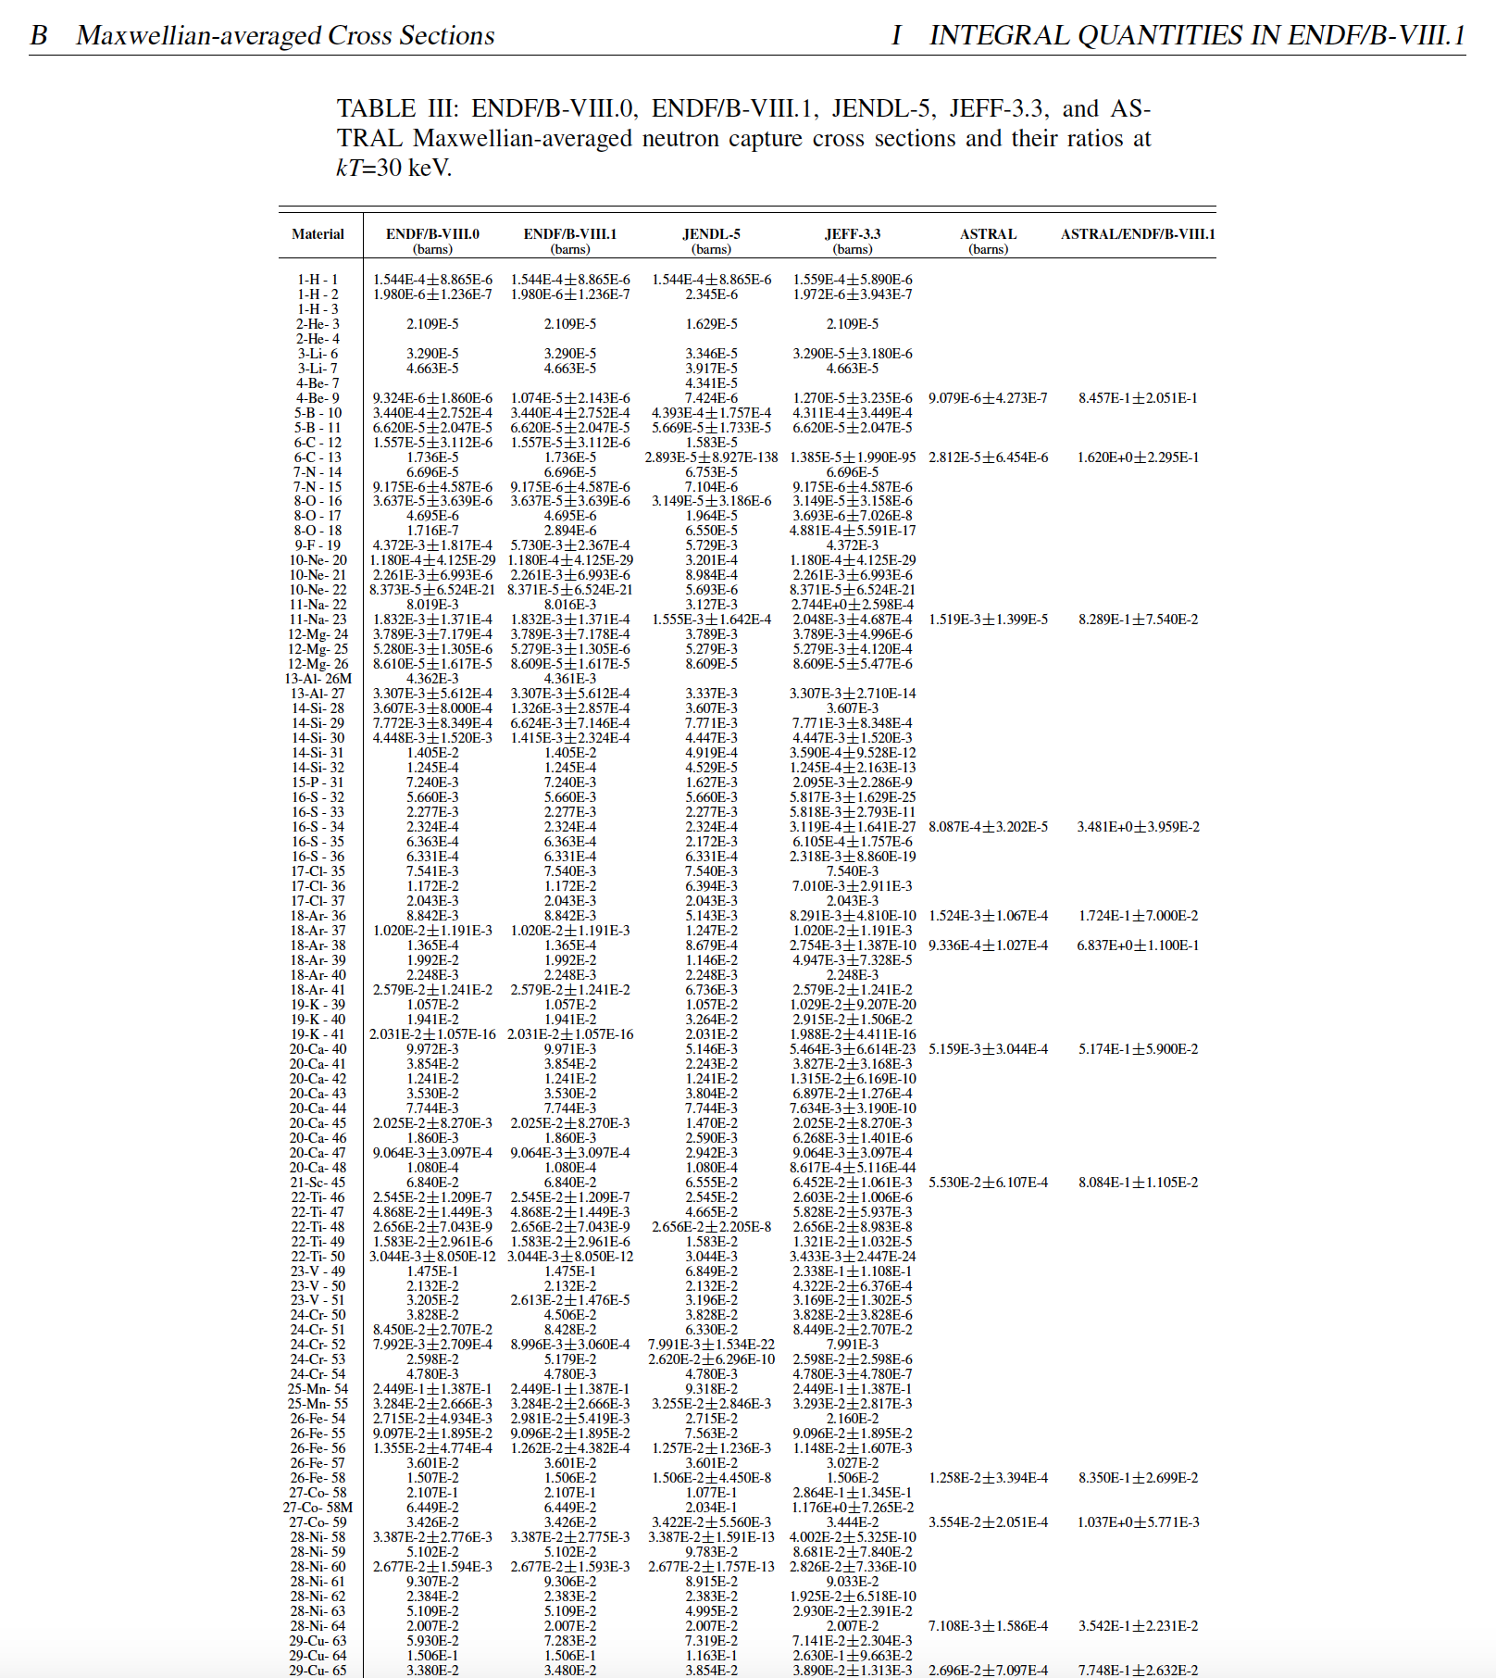
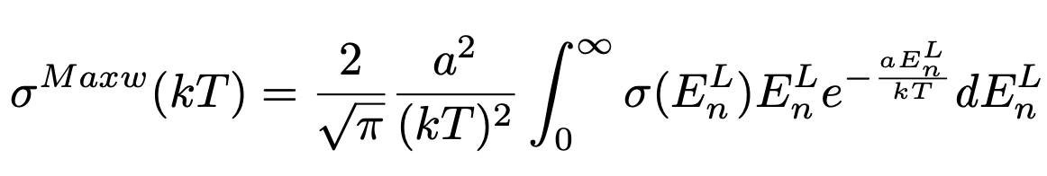
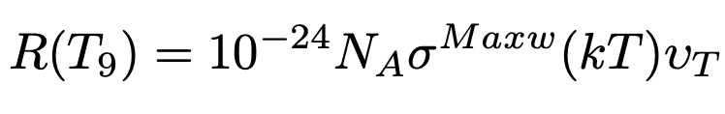
Maxwellian-Averaged Cross Sections (MACS)
Fission and capture MACS were calculated for kT=8, 25, 30, 90, and 1420 keV
Capture kT=30 keV values are listed in the ENDF/B-VIII.1 paper.
The ASTRAL library is used for comparative purposes: https://exp-astro.de/astral/.
Astrophysical reaction rates were calculated for the five temperatures

Slide 8
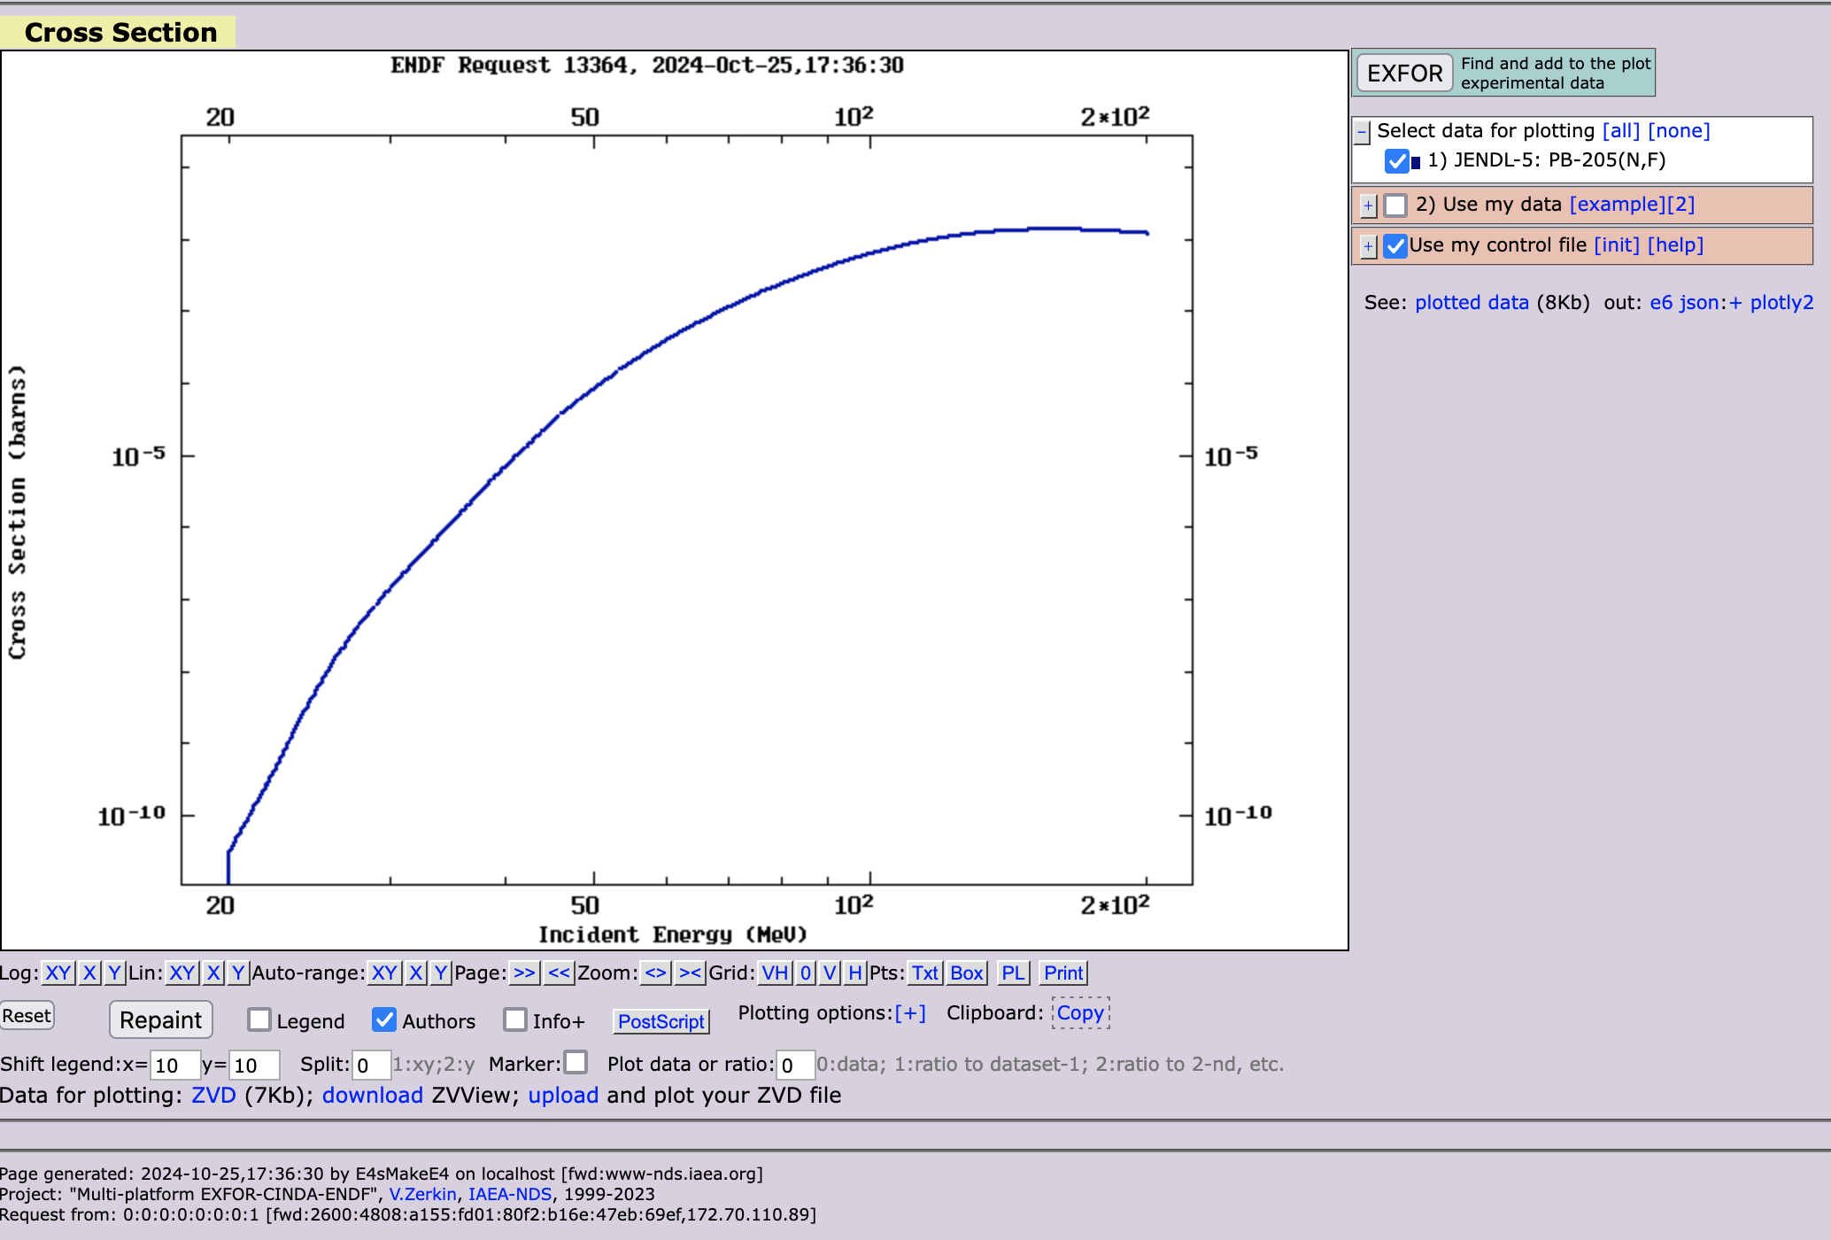
JENDL-5.0 Fission MACS
JENDL-5.0 has non-zero fission cross sections for ²⁰⁵Pb above 20 MeV, and no experimental data in EXFOR.
As a result, MACS of 1.569E-296 barns is calculated for kT =30 keV, 7.641E-105 b for kT=90 keV, and 2.331E-14 b at kT=1420 keV.
The kT=1420 keV value is larger than superheavy element production cross section but smaller than the neutrino interaction.
A similar situation is also observed in ^{211,222}Rn, where fission starts from 6.5 and 4 MeV, respectively.

Slide 9
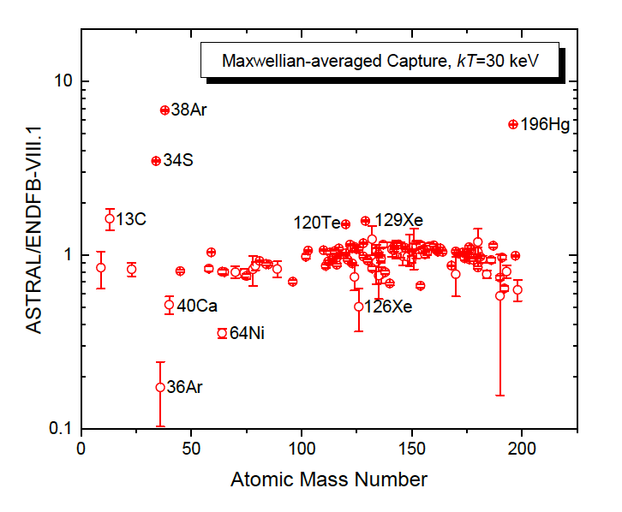
Comparison of ENDF/B-VIII.1 and ASTRAL MACS
The analysis of the ratios shows agreements in most cases and strong deviations in ¹³C, ³⁴S, ^{36,38}Ar, and ¹⁹⁶Hg and minor deviations in ⁴⁰Ca, ⁶⁴Ni, ¹²⁰Te, and ^{126,129}Xe cases.
The analysis of the EXFOR database shows that there are no experimental data for ^{36,38}Ar and ¹²⁶Xe above thermal region, and the observed differences are due to the issues with theoretical modeling.
In cases of ¹²⁹Xe and ¹⁹⁶Hg, ASTRAL results are based on single measurements that could be deficient.
In ⁴⁰Ca we need to consider three contradictory measurements and choices of ENDF and ASTRAL evaluators.

Slide 10
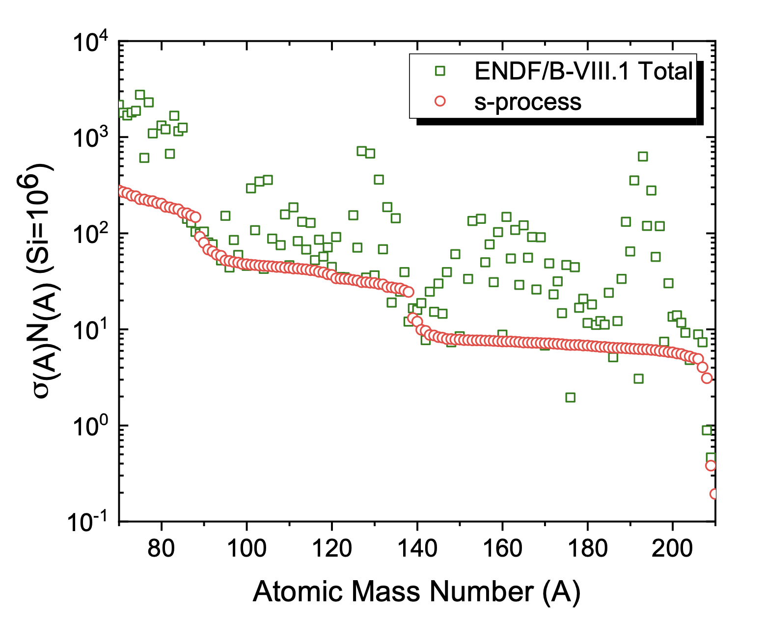
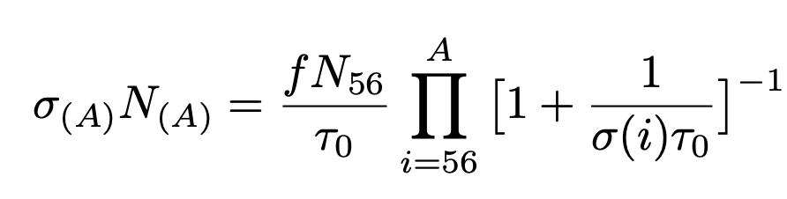
s-Process
Slow-neutron capture (s-process) is reasonably well understood. It starts from 56Fe and follows the valley of stability.
σN systematics for equilibrium conditions in AGB stars
The total ENDF/B-VIII.1 values include s- and r- (rapid neutron capture) processes.

Slide 11
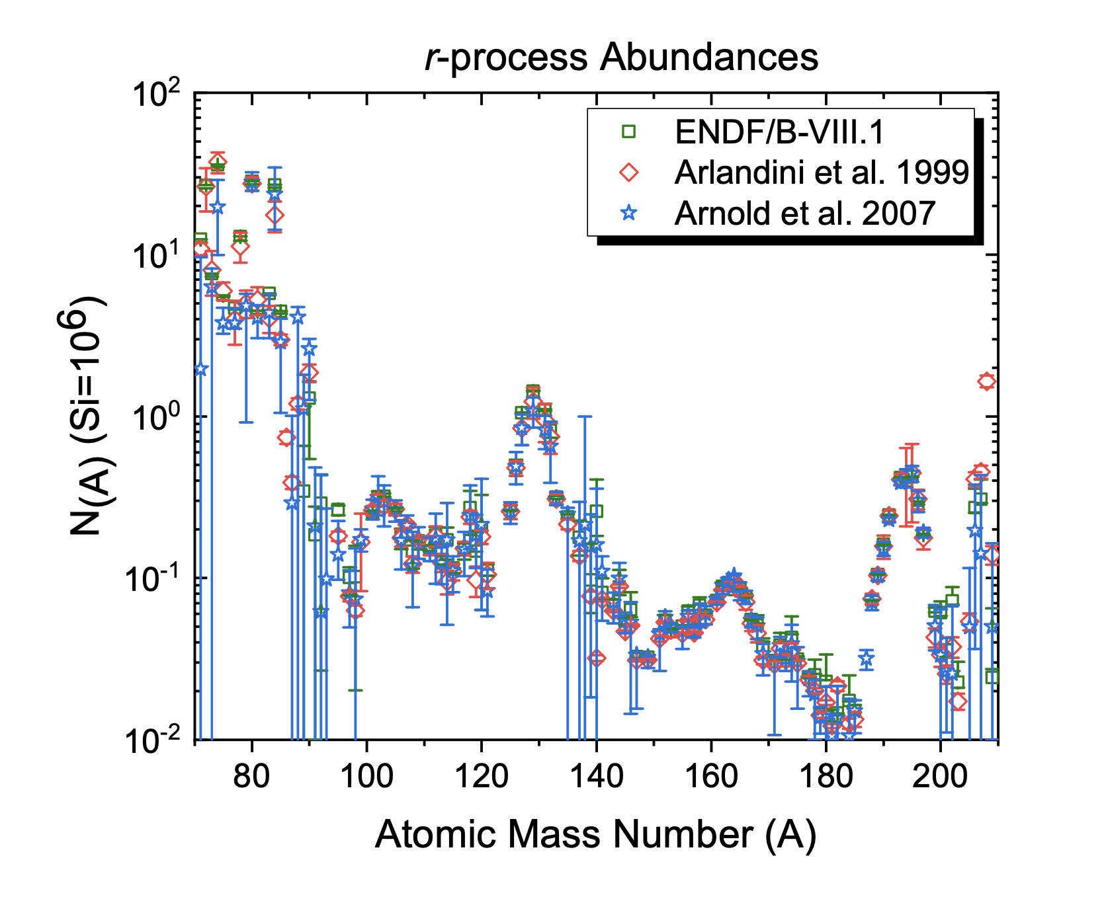
ENDF/B-VIII.1 r-process Abundances
The r-process abundances were extracted using ENDF/B-VIII.1 Maxwellian-averaged Cross Sections and Solar system abundances.
Results agree well with Arlandini et al., and Arnould et al.

Slide 12
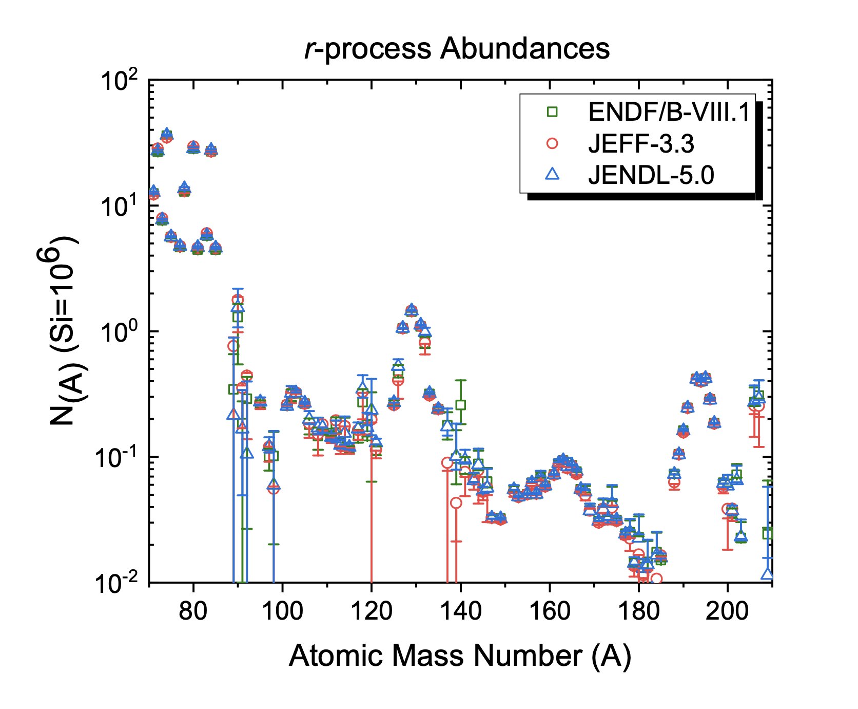
ENDF/B-VIII.1, JEFF-3.3, and JENDL-5.0 r-Process Abundances
Calculation was extended to JEFF-3.3 and JENDL-5.0 libraries.
CENDL-3.2, and BROND-3.1 do not have a sufficient number of target nuclei for the s- process.
Results are comparable with ENDF/B-VIII.1; however, cerium evaluation in ENDF/B-VIII.1 provides a clear preference for the ENDF/B library.

Slide 13
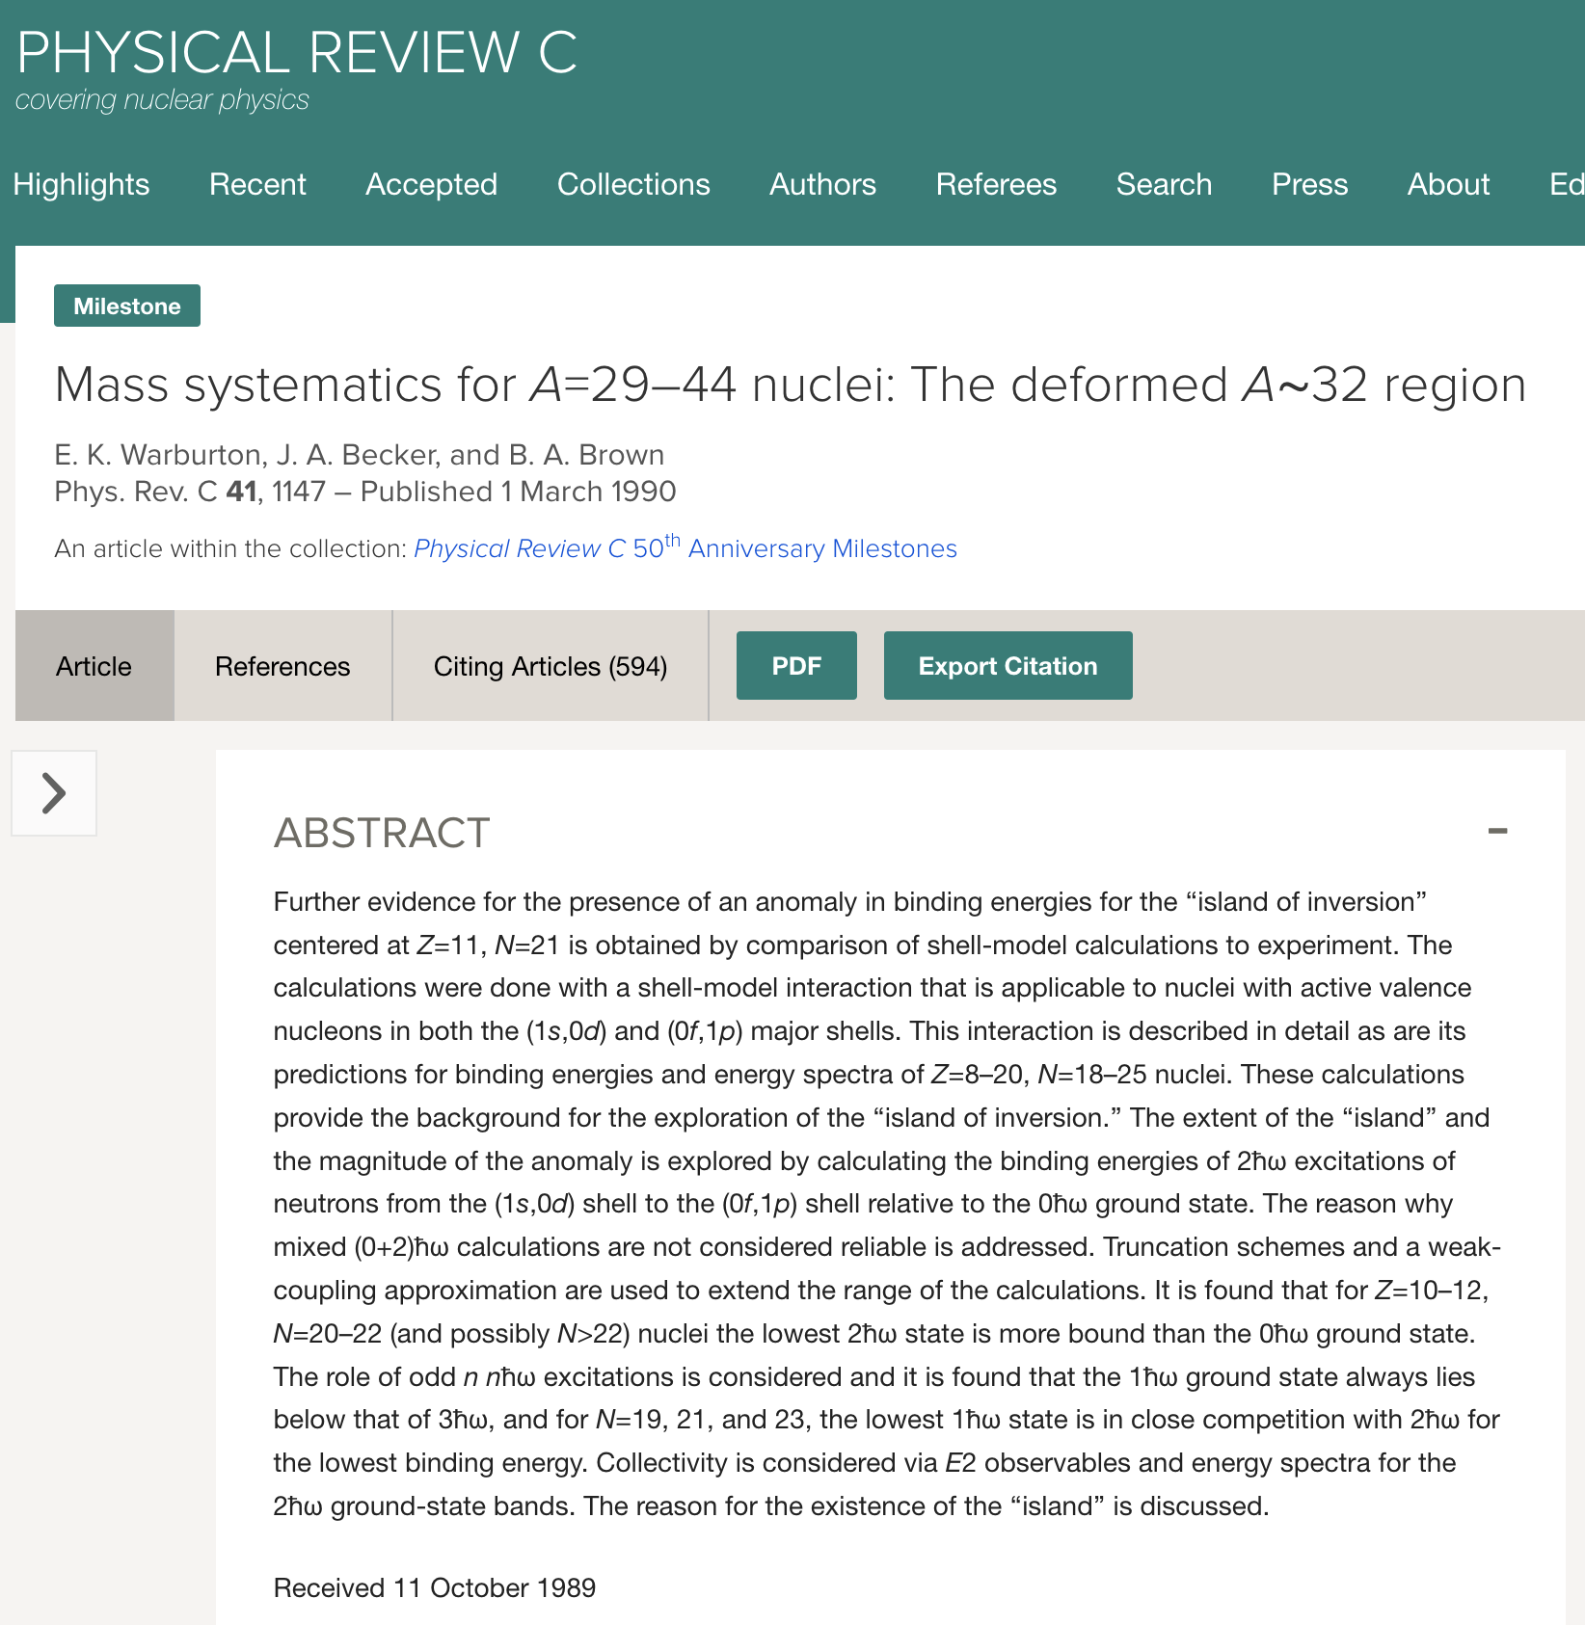
Nuclear Structure and Stellar Abundances
Observing the second N=82 and the third N=126 r-process peaks provides strong evidence of the existence of neutron magic numbers beyond the valley of stability.
At the same time, the lack of the first r-process peak may indicate that N=50 is not a good quantum (magic) number for neutron-rich nuclei or neutron reaction flow changes for medium nuclei.
We experimentally studied the island of inversion near N=20 in the last 30 years (³²Mg, ³¹Na, ²²O, …); there are several islands predicted since the work E. K. Warburton, J. A. Becker, and B. A. Brown
The observed synergy between nuclear astrophysics and nuclear structure physics requires additional research and close cooperation between the two communities.

Slide 14
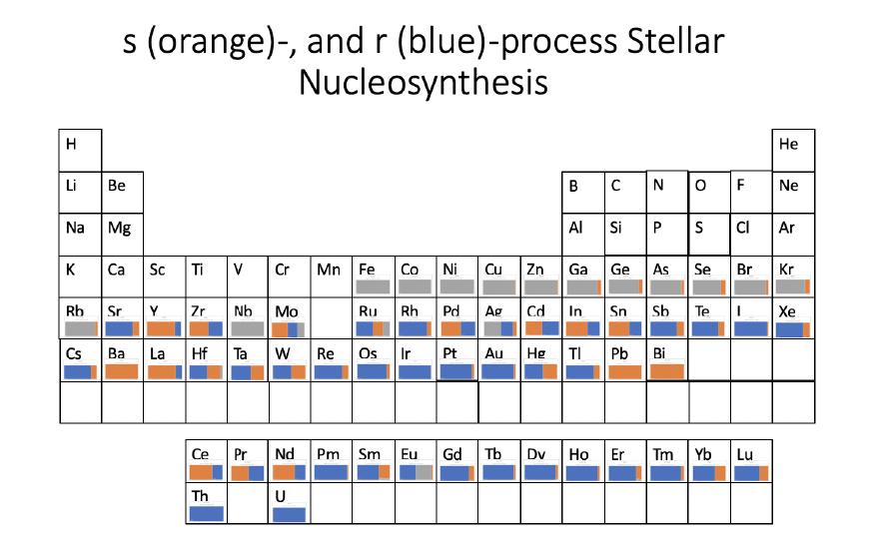
Takeaways
Integral values for the five major libraries were calculated and compared with benchmarks and the EXFOR library.
ENDF/B-VIII.1 is the best-evaluated nuclear data library for astrophysics.
R-process abundances for ENDF/B-VIII.1, JEFF-3.3, and JENDL-5.0 have been calculated.
Cerium evaluation (¹⁴⁰Ce) helped to improve ENDF/B; revisiting barium (¹³⁸Ba) cross sections is needed.

