Slide 1
ENDF/B-VIII.1
Covariance Testing
Oscar Cabellos (UPM)
Universidad Politécnica de Madrid (UPM), Madrid, Spain
E-mail: oscar.cabellos@upm.es

Slide 2
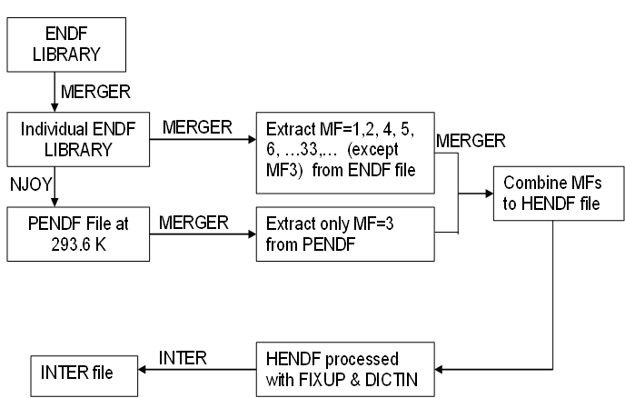
1. Processing in JANIS format
Processing ENDF/B-VIII.1 into JANIS format:
HENDF + INTER + BOXER (33g and 238g)
Figure 2. Example of input deck to process in PENDF format
moder /tape20 from MERGER
20 -31
reconr /Reconstruct XS data
-31 -32
' PENDF tape ' /
9437 2 /
.005 /
' MAT=pu239 ENDF Library:JENDL-5.0upd' /
' Processed NJOY2016-UPM,2023 '
0/
broadr /Doppler broaden XS
-31 -32 -33
9437 1 /
.005 /
293.60
0/
thermr / Add thermal scattering data
0 -33 -34
0 9437 12 1 1 0 0 1 221 0
293.60
0.005 10.0
unresr
-31 -34 -35
9437 1 1 0 /
293.60
1.0e+10 /
0/
heatr / Add heating kerma and damage energy
-31 -35 -36 40/
9437 7 0 0 0 2/
302 303 304 318 401 403 407 /
heatr / Add heating kerma and damage energy
-31 -36 -37 41/
9437 6 0 0 0 2 0 1/
442 443 444 445 446 447 /
gaspr /Gas production
-31 -37 -38
moder
-38 26
stop
tape20 = ENDF file
=====================
Figure 1. Flowchart of processing JANIS database from ENDF tapes
NJOY2016.76
BOXER file
MF31/32/33/34 and MF35
VERSION 7.01

Slide 3
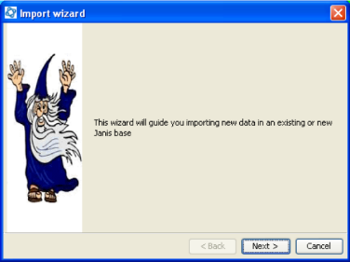
1. Processing in JANIS format
Processing ND libraries into JANIS format:
JEFF-4T?, JENDL-5.0-upd, …
ENDF/B-VIII.1
Logs reported when importing JANIS database
Covariances for some Tungsten (W) files only in 33 energy groups – 238 failed in covr!
# - HENDF: Hybrid format ENDF+PENDF including KERMA and DAMAGE cross-sections
# - INTER
# - BOXER: covariances MF31, MF32/MF33, MF34 and MF35
Download at the following links – “UN-OFFICIAL JANIS Databases”:
ENDF/B-VIII.1 with BOXER in 33g: https://drive.upm.es/s/mzGbRoZt5CBw20G
ENDF/B-VIII.1 with BOXER in 238g: https://drive.upm.es/s/zNq9ww0JJf0DJUy
password: janis
See the “Readme.txt” file, it explains how to download and import the database in JANIS
Import WIZARD tool: Use the “Database > Import Wizard”
Steps:
- Use “JANIS toolbar -> Database –> Load” function
- Set “.h2.db file” to select the downloaded “h2.db” file
- Set “Root Folder” to the folder where the “h2.fb” is located
(Leave the other default options are they are)

Slide 4
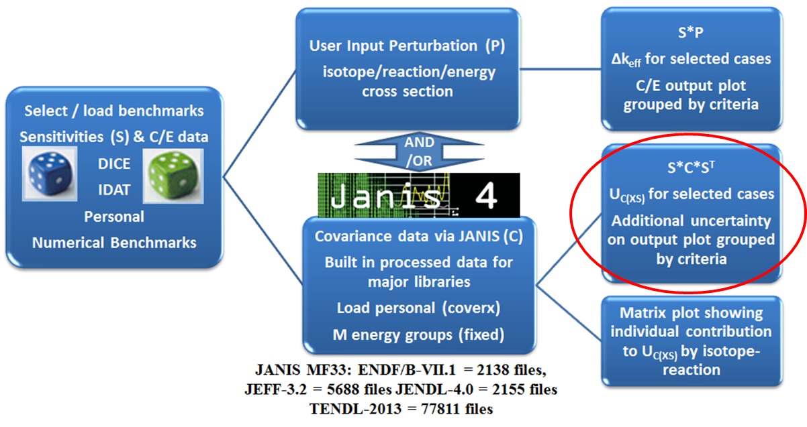
2. Verification ND Uncertainties
Verification ND Uncertainties in ICSBEP Benchmarks using NDAST Tool
HENDF - ENDF/B-VIII.1: Uncertainty Quantification in ICSBEP using NDaST
U233 – U235 - U238 – Pu239
The impact of uncertainties due to:
XSs (σ)
Nubar (ν)
P1-elastic
PFNS (χ)
with Ein =100keV
http://www.oecd-nea.org/ndast/

Slide 5
Uncertainty Quantification with ENDF/B-VIII.1: ICSBEP/Pu cases
Verification ND uncertainties: PU cases
Fissile material |  | PU | PU
Spectrum |  | FAST | INTER | MIXED | THERM
Number of Benchmarks |  | 152 | 4 | 9 | 624/637
Experimental Uncertainty (pcm) |  | 334 | 710 | 587 | 426
Total (pcm) | ENDF/B-VIII.1 | 653 | 434 | 387 | 450
 | ENDF/B-VIII.0 | 921 | 1403 | 1055 | 1099
 | ENDF/B-VII.1 | 436 | 565 | 459 | 625
Cross-sections (with correlations) | ENDF/B-VIII.1 | 520 | 248 | 154 | 108
Cross-sections | ENDF/B-VIII.0 | 857 | 1368 | 983 | 998
 | ENDF/B-VII.1 | 409 | 546 | 356 | 500
P1-elastic | ENDF/B-VIII.1 | 66 | - | - | -
P1-elastic | ENDF/B-VIII.0 | 66 | - | - | -
 | ENDF/B-VII.1 | - | - | - | -
nubar | ENDF/B-VIII.1 | 385 | 350 | 349 | 430
nubar | ENDF/B-VIII.0 | 300 | 271 | 275 | 308
 | ENDF/B-VII.1 | 76 | 88 | 114 | 168
PFNS NOTE: Ein=100keV | ENDF/B-VIII.1 | 27 | 25 | 53 | 59
PFNS | ENDF/B-VIII.0 | 117 | 106 | 265 | 297
 | ENDF/B-VII.1 | 118 | 106 | 265 | 297
Uncertainty Quantification in ICSBEP using NDaST
only Pu239 covariances (33g)
↓
↓
↓
↓
↑
↓
↓

Slide 6
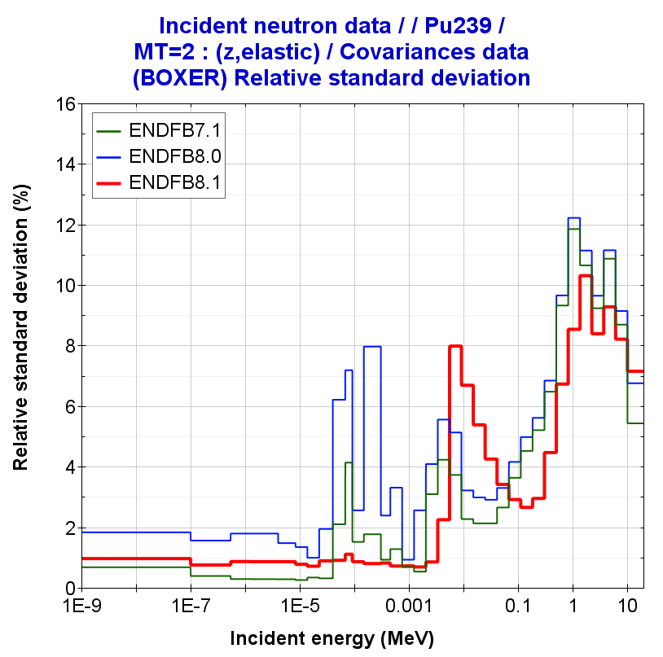
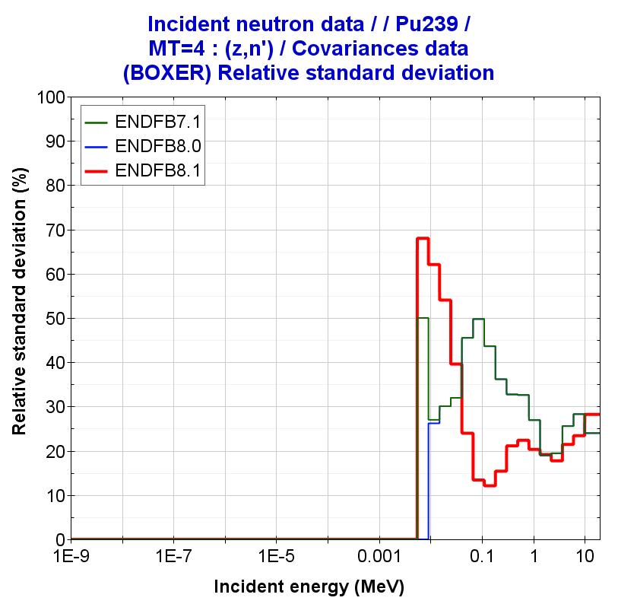
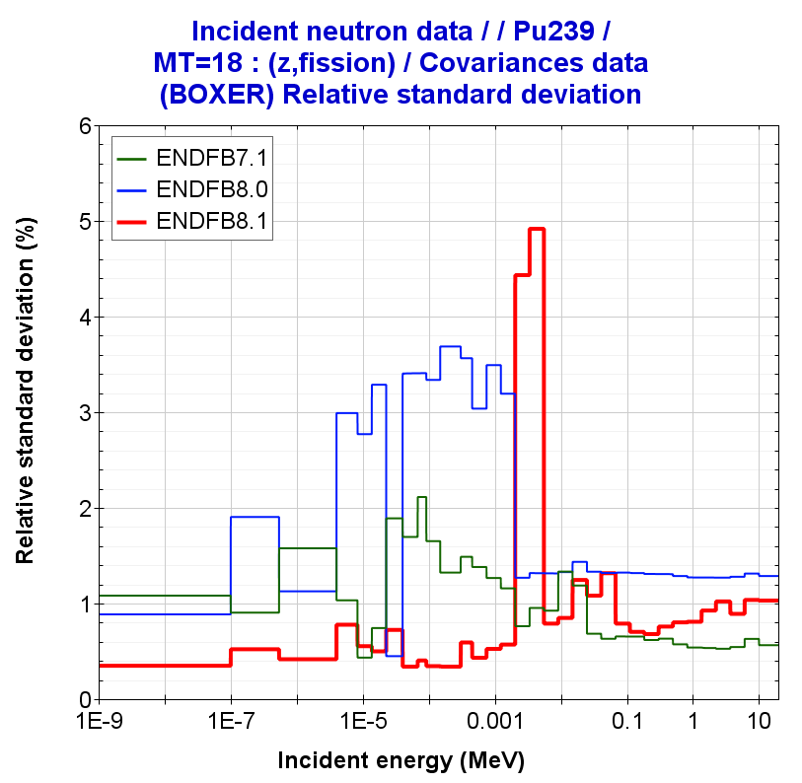
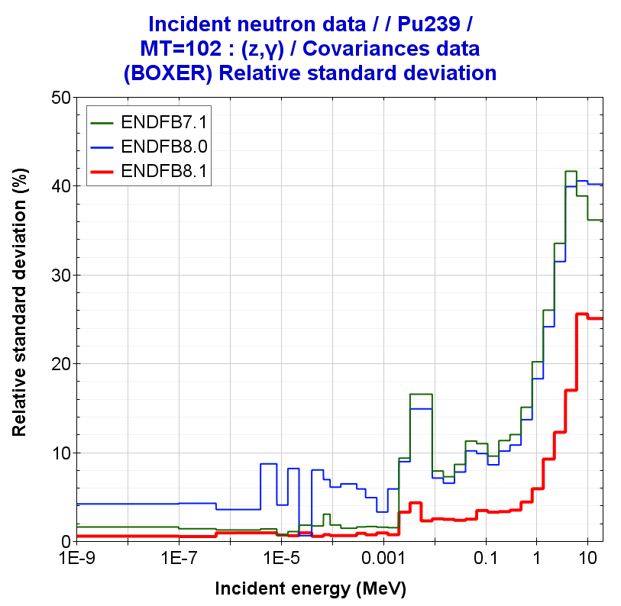
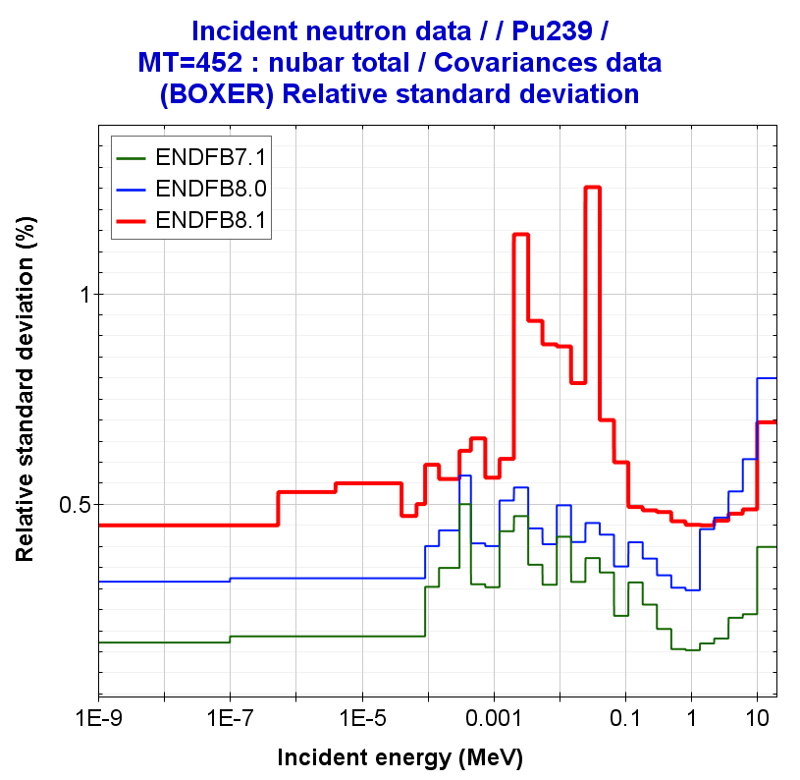
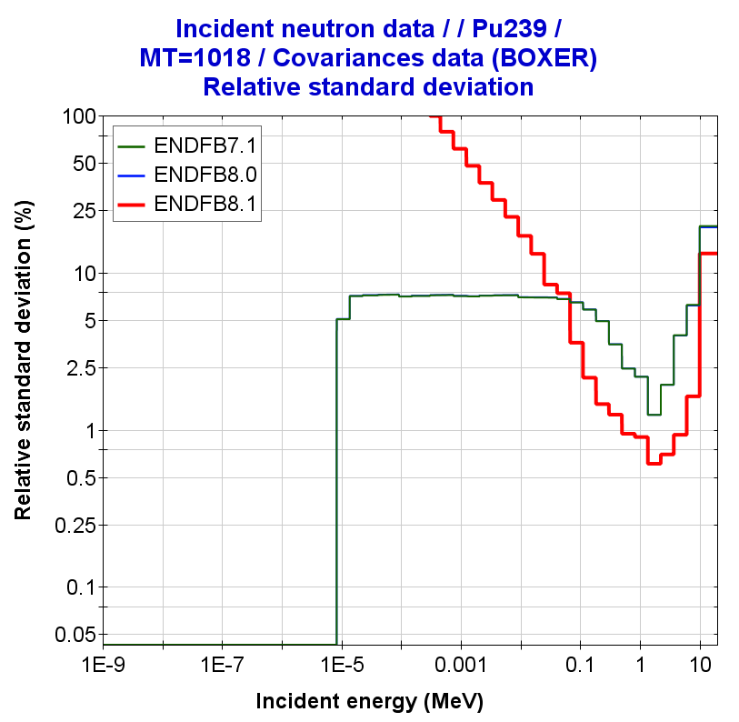
PU239 covariances
Pu239(n,elastic)
Pu239(n,inelastic)
Pu239(n,fission)
1
2
Pu239(n,gamma)
Pu239(nubar)
Pu239(PFNS)
3
4
Eincident =100keV

Slide 7
Table 1. Bias and nuclear data uncertainties in PU-MET-FAST-001 (Jezebel)
 | JEFF-3.3 | ENDF/B-VIII.0 | ENDF/B-VIII.1 | ENDF/B-VII.1 | JENDL-5.0
Exp. Uncertainty | ±110 | ±110 | ±110 | ±110 | ±110
|C-E|* | 68 | 15 | 68 | 12 | 61
 | UNCERTAINTIES in keff
Nubar | 413 | 318 | 417 | 82 | 210
PFNS | 443 | 181*/181⁺ | 39*/74⁺ | 182*/182⁺ | 273
Fission | 305 | 903 | 542 | 330 | 668
Elastic | 90 | 460 | 341 | 435 | 195
Inelastic | 150 | 789 | 651 | 789 | 250
Capture | 30 | 67 | 19 | 74 | 60
elasticP1 | - | 150 | 150 | - | 150
Correlated Sum | 645 | 1054 | 779 | 557 | 832
↑
↓
↓
↓
↓
↓
↓
↓
↓
Note: (values in pcm)
NDAST – Uncertainty Quantification using 1st-order approximation “Sandwich formula”
* Calculations (C) performed with MCNP6-1.0
NOTE: *PFNS covariance Eincident =100keV (default value); ⁺ PFNS covariance Eincident =1MeV

Slide 8
Uncertainty Quantification with ENDF/B-VIII.1: ICSBEP/U233 cases
Verification ND uncertainties: U233 cases
Fissile material |  | U233 | PU
Spectrum |  | FAST | INTER | MIXED | THERM
Number of Benchmarks |  | 8 | 29 | 8 | 194
Experimental Uncertainty (pcm) |  | 174 | 670 | 601 | 600
Total (pcm) | ENDF/B-VIII.1 | 810 | 1001 | 1026 | 1018
 | ENDF/B-VIII.0 | 810 | 1132 | 1155 | 1131
 | ENDF/B-VII.1 | 754 | 486 | 472 | 495
Cross-sections (with correlations) | ENDF/B-VIII.1 | 640 | 145 | 161 | 347
Cross-sections | ENDF/B-VIII.0 | 640 | 315 | 329 | 514
 | ENDF/B-VII.1 | 724 | 364 | 297 | 206
P1-elastic | ENDF/B-VIII.1 | - | - | - | -
P1-elastic | ENDF/B-VIII.0 | - | - | - | -
 | ENDF/B-VII.1 | - | - | - | -
nubar | ENDF/B-VIII.1 | 475 | 479 | 490 | 539
nubar | ENDF/B-VIII.0 | 484 | 496 | 501 | 508
 | ENDF/B-VII.1 | 211 | 319 | 367 | 447
PFNS NOTE: Ein=100keV | ENDF/B-VIII.1 | 137 | 867 | 887 | 758
PFNS | ENDF/B-VIII.0 | 95 | 967 | 987 | 837
 | ENDF/B-VII.1 | - | - | - | -
Uncertainty Quantification in ICSBEP using NDaST
only U233 covariances (33g)
↓
↓

Slide 9
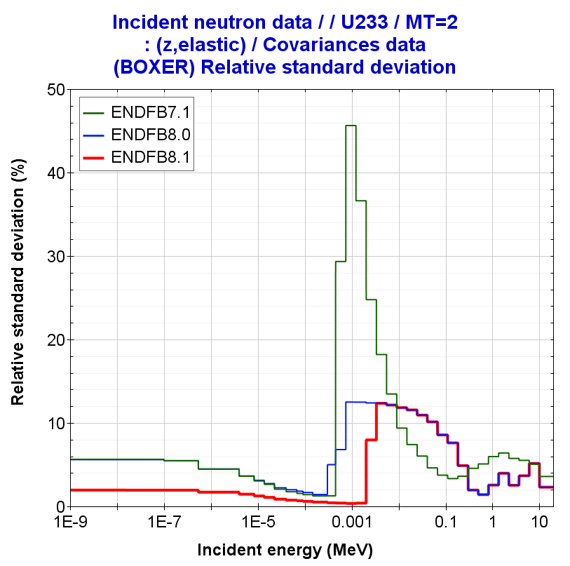
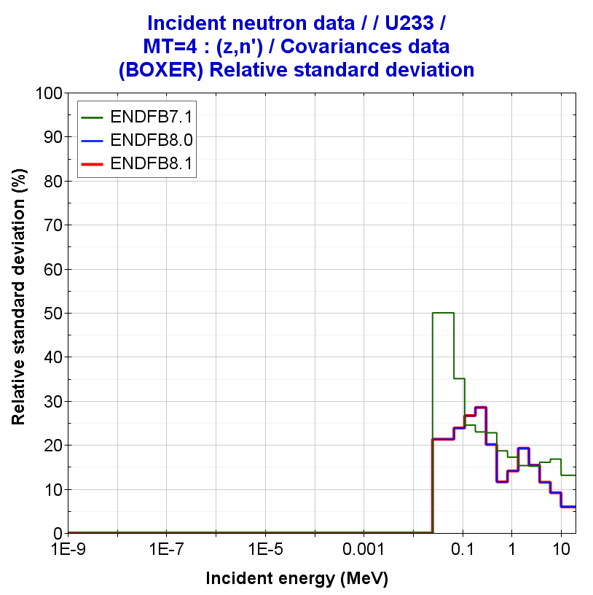
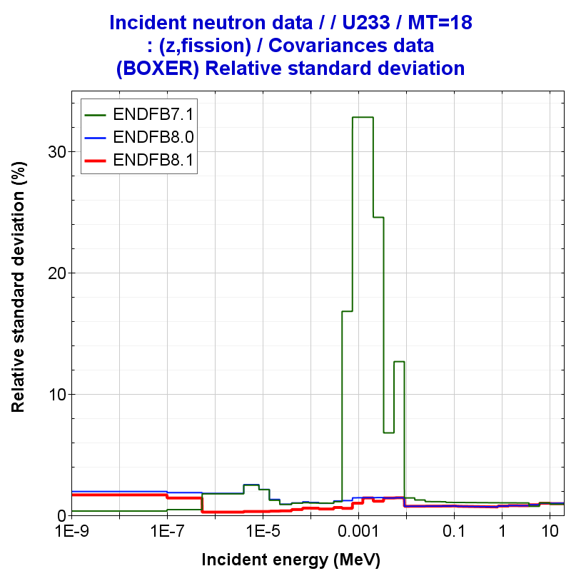
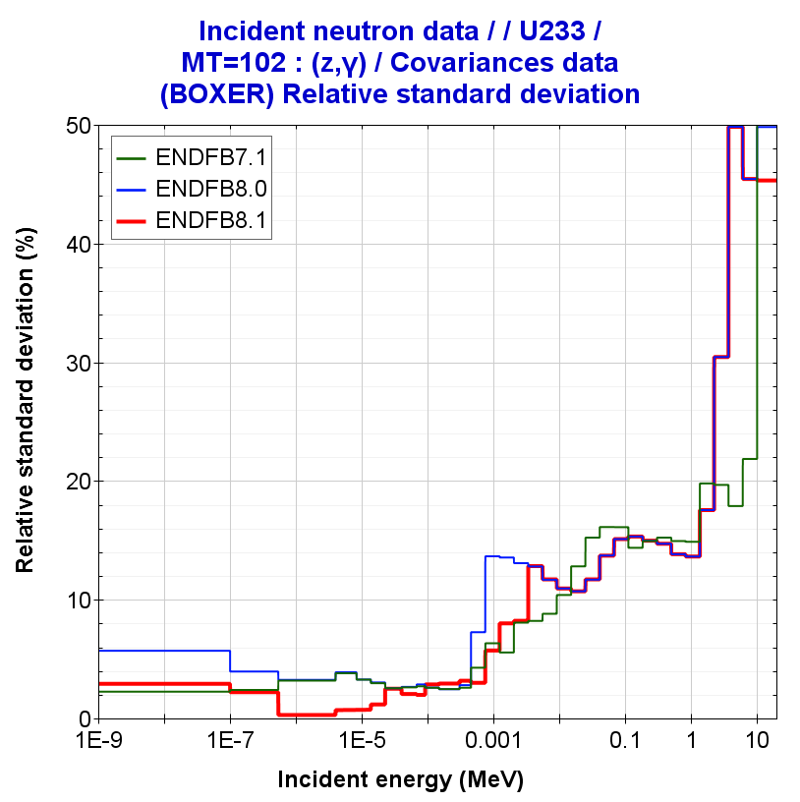
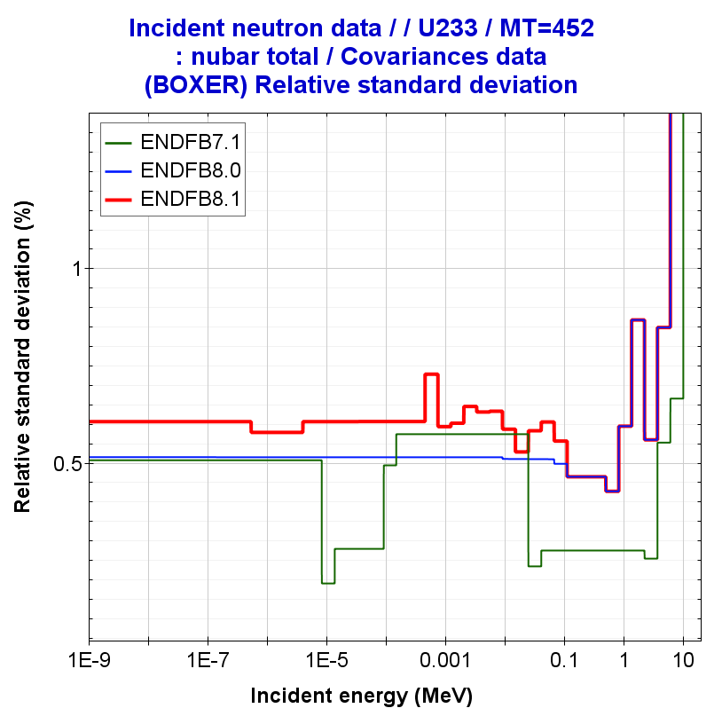
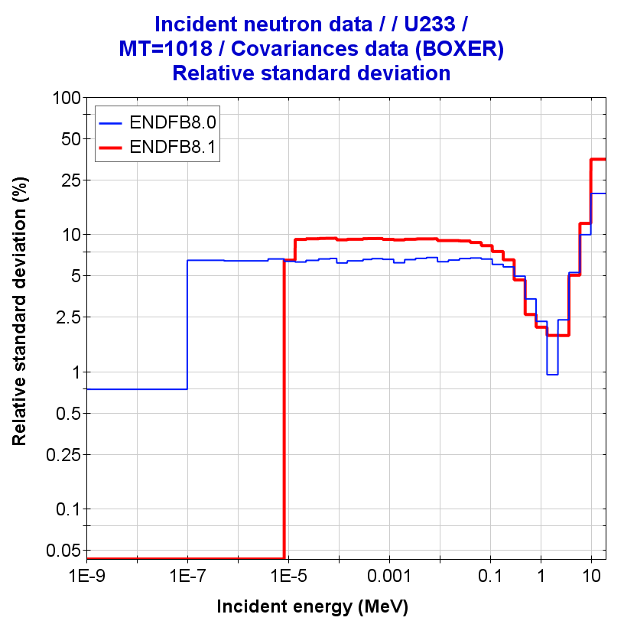
U233 covariances
U233(n,elastic)
U233(n,inelastic)
U233(n,fission)
U233(n,gamma)
U233(nubar)
U233(PFNS)
Eincident =100keV

Slide 10
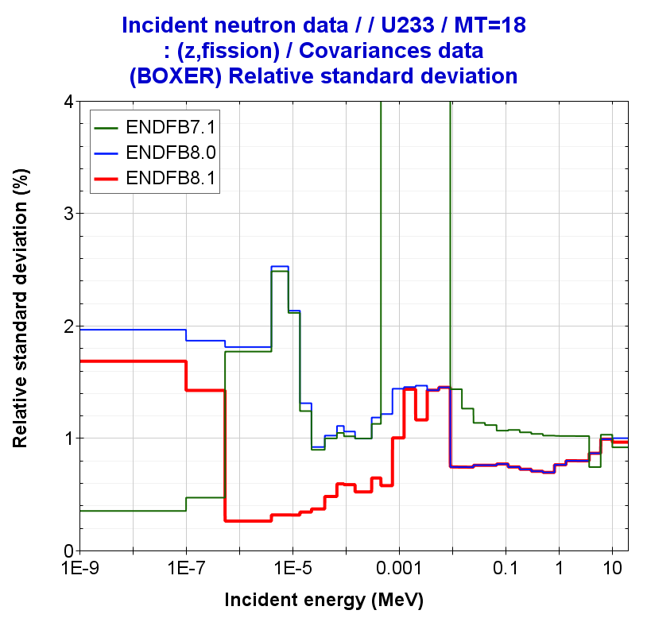
U233 covariances
U233(n,elastic)
U233(n,inelastic)
U233(n,fission)
U233(n,gamma)
U233(nubar)
U233(PFNS)
Eincident =100keV

Slide 11
Uncertainty Quantification with ENDF/B-VIII.1: ICSBEP/HEU cases
Verification ND uncertainties: HEU cases
HENDF/ENDF/B-VIII.1: Uncertainty Quantification in ICSBEP using NDaST
Fissile material |  | HEU | PU
Spectrum |  | FAST | INTER | MIXED | THERM
Number of Benchmarks |  | 477 | 21 | 78 | 798
Experimental Uncertainty (pcm) |  | 225 | 310 | 415 | 473
ENDF/B-VIII.1 only U235 covariances | Total (pcm) | 891 | 638 | 558 | 473
KJE | Cross-sections* | 811 | 514 | 442 | 144
 | P1-elastic | 53 | 13 | 13 | -
 | nubar | 357 | 341 | 322 | 435
 | PFNS⁺ | 29 | 60 | 61 | 98
ENDF/B-VIII.1 only U238 covariances | Total (pcm) | 52 | 63 | 13 | 6
 | Cross-sections* | 47 | 61 | 11 | 6
 | P1-elastic | 9 | - | -
 | nubar | 16 | 10 | 6 | 1
 | PFNS⁺ | 5 | 3 | 1 | 0
U235 covariances (33g)
U238 covariances (33g)
Calculations with NDaST: only U235/238 covariances
NOTE: *Cross-sections (with correlations)
NOTE: ⁺PFNS covariance with Ein=100keV

Slide 12
Uncertainty Quantification with ENDF/B-VIII.1: ICSBEP/HEU cases
Verification ND uncertainties: HEU cases
Fissile material |  | HEU | PU
Spectrum |  | FAST | INTER | MIXED | THERM
Number of Benchmarks |  | 477 | 21 | 78 | 798
Experimental Uncertainty (pcm) |  | 225 | 310 | 415 | 473
Total (pcm) | ENDF/B-VIII.1 | 891 | 638 | 558 | 473
 | ENDF/B-VIII.0 | 911 | 758 | 649 | 497
 | ENDF/B-VII.1 | 1350 | 1920 | 1266 | 978
Cross-sections (with correlations) | ENDF/B-VIII.1 | 811 | 514 | 442 | 144
Cross-sections | ENDF/B-VIII.0 | 816 | 545 | 470 | 155
 | ENDF/B-VII.1 | 1207 | 1748 | 1062 | 233
P1-elastic | ENDF/B-VIII.1 | 53 | 13 | 13 | -
P1-elastic | ENDF/B-VIII.0 | - | - | - | -
 | ENDF/B-VII.1 | - | - | -
nubar | ENDF/B-VIII.1 | 357 | 341 | 322 | 435
nubar | ENDF/B-VIII.0 | 402 | 501 | 435 | 457
 | ENDF/B-VII.1 | 544 | 597 | 550 | 658
PFNS NOTE: Ein=100keV | ENDF/B-VIII.1 | 29 | 60 | 61 | 98
PFNS | ENDF/B-VIII.0 | 29 | 60 | 61 | 98
 | ENDF/B-VII.1 | 210 | 334 | 346 | 622
Uncertainty Quantification in ICSBEP using NDaST
only U235 covariances (33g)
↓
↓
<- Differences in XS-correlations
↓

Slide 13
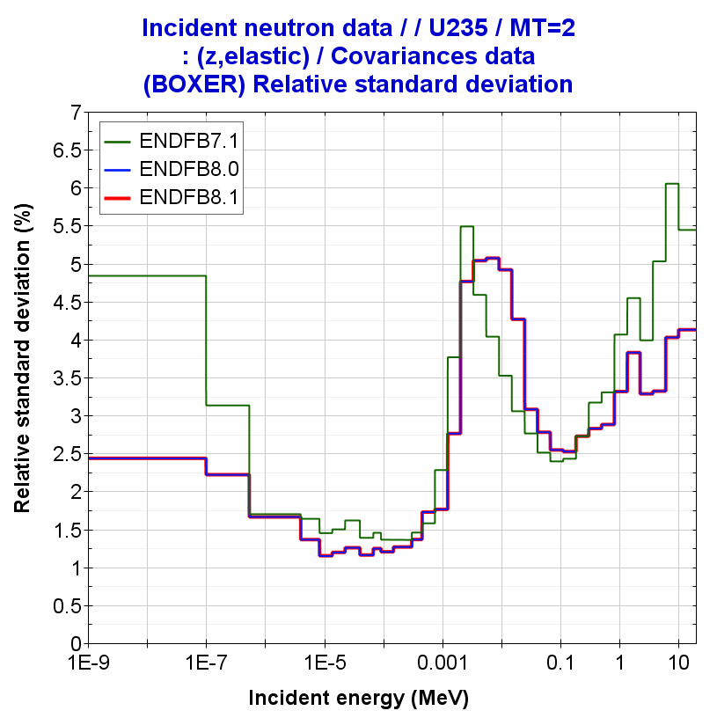
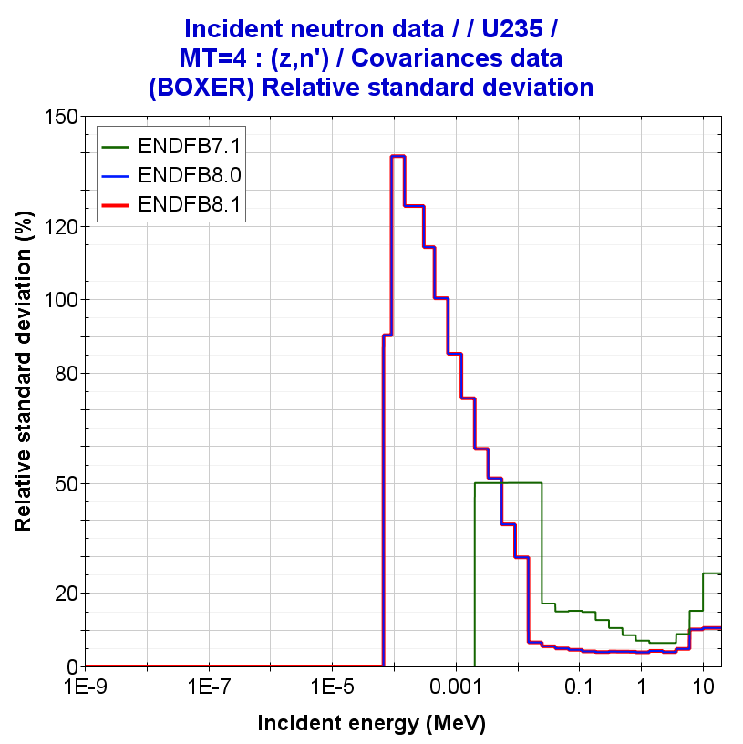
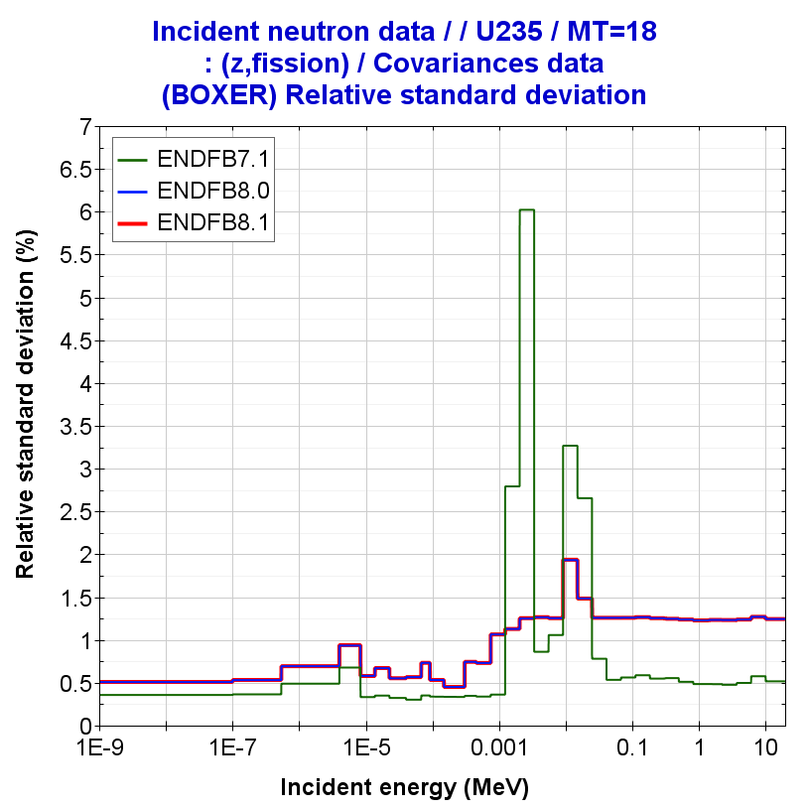
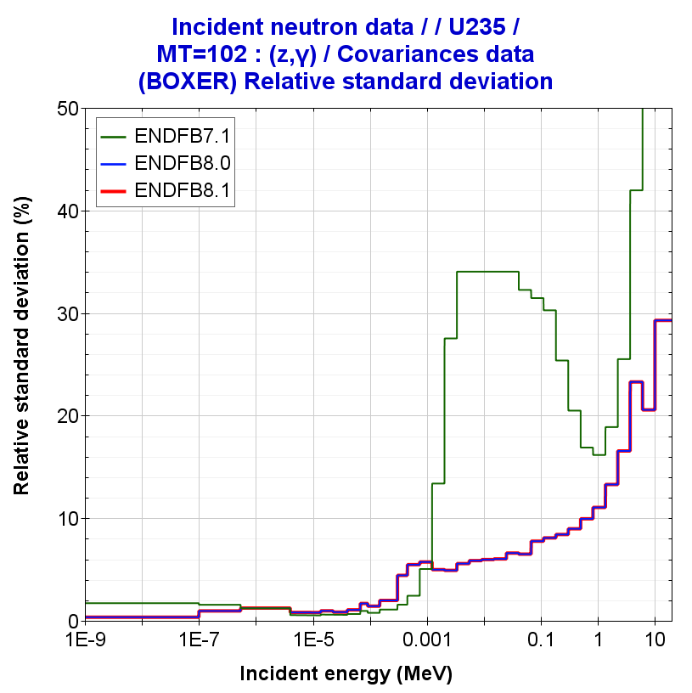
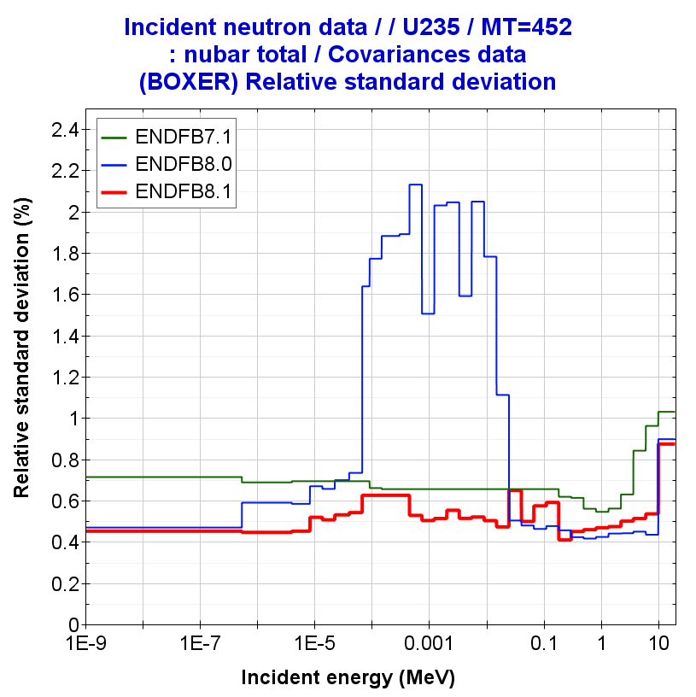
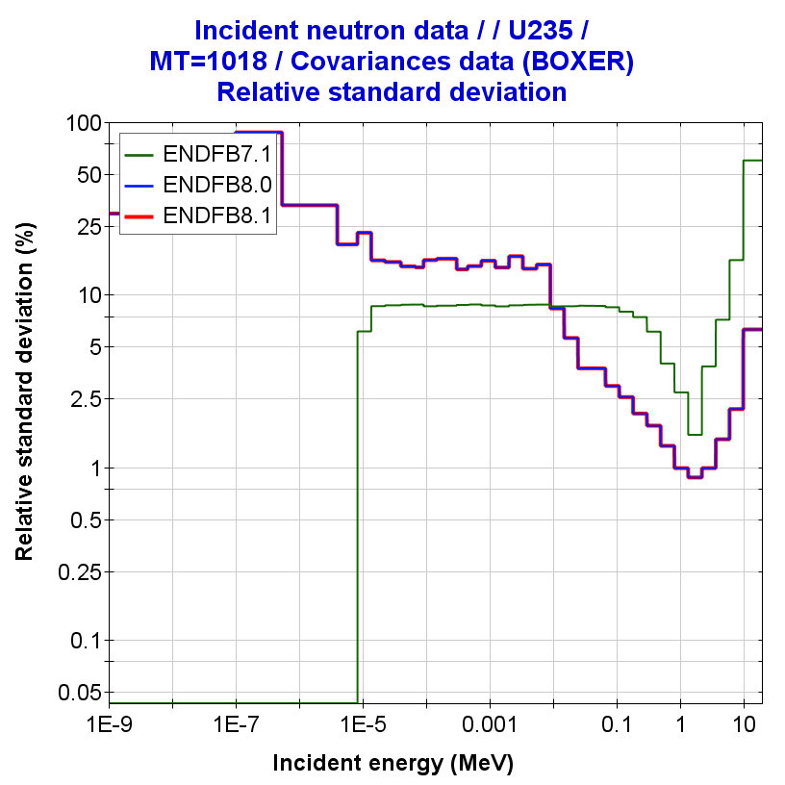
U235 covariances
U235(n,elastic)
U235(n,inelastic)
U235(n,fission)
U235(nubar)
U235(PFNS)
U235(n,gamma)
Eincident =100keV

Slide 14
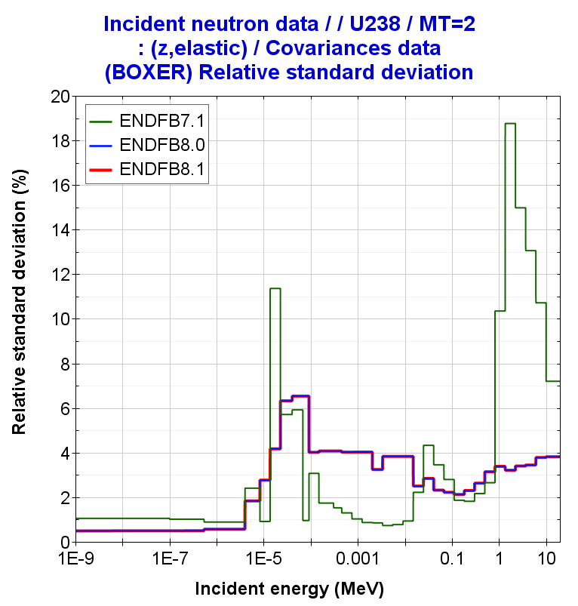
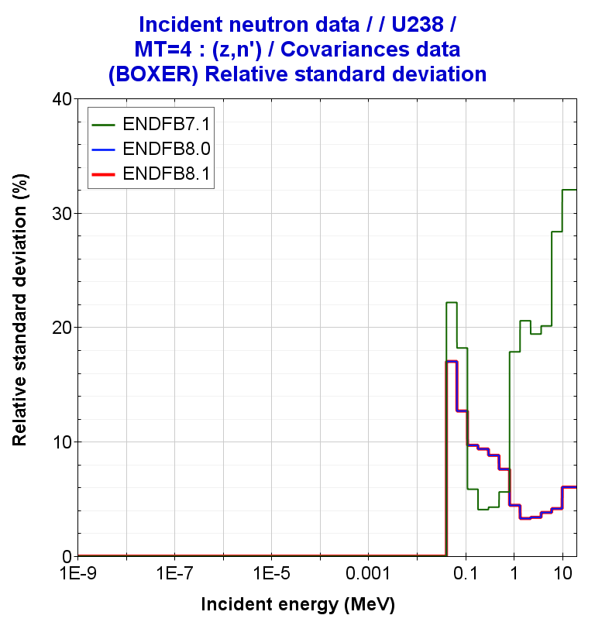
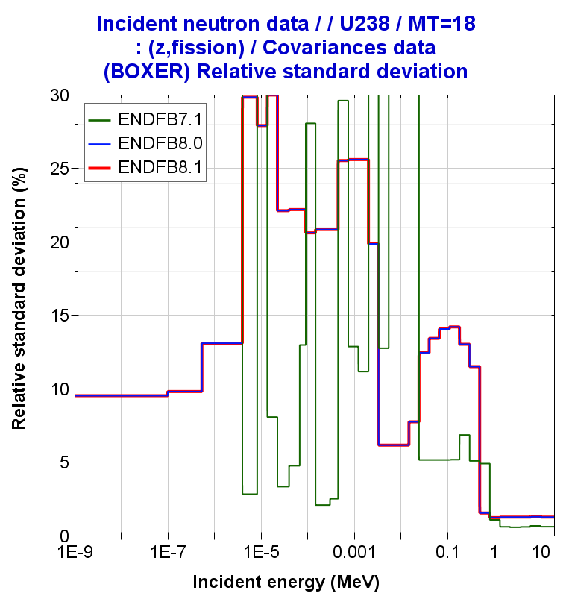
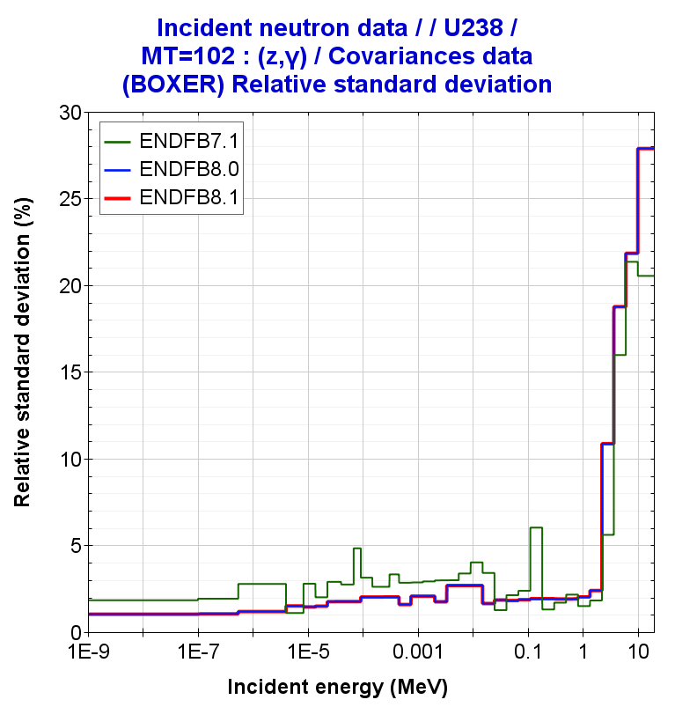
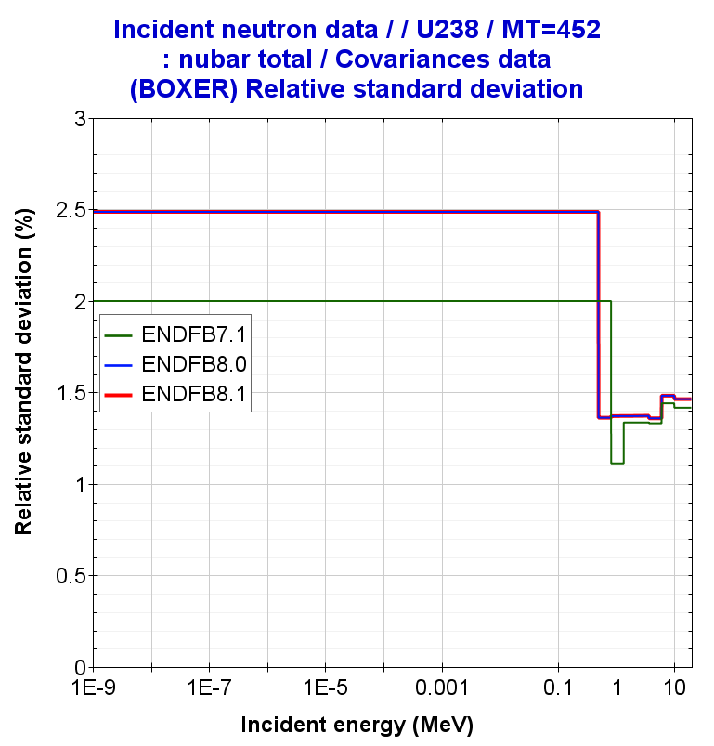
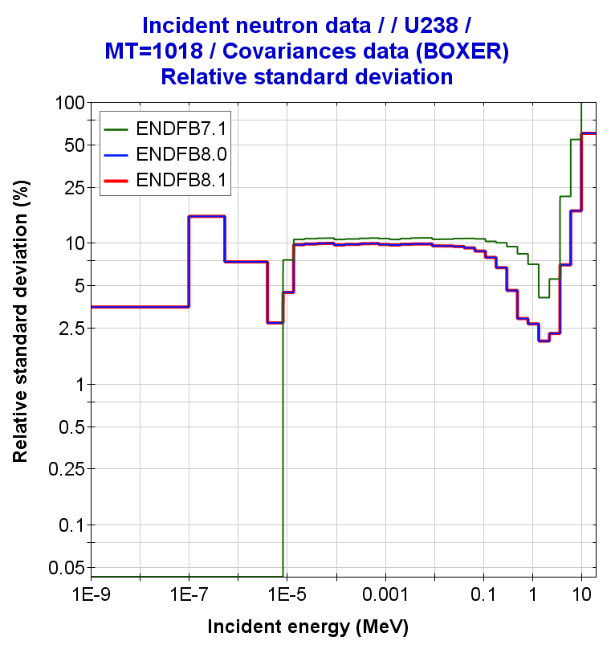
U238 covariances
U238(n,elastic)
U238(n,inelastic)
U238(n,fission)
U238(nubar)
U238(PFNS)
U238(n,gamma)
Eincident =100keV

Slide 15
Table 2. Bias and nuclear data uncertainties in HEU-MET-FAST-001 (Godiva)
 | JEFF-3.3 | ENDF/B-VIII.0 | ENDF/B-VIII.1 | ENDF/B-VII.1 | JENDL-5.0
Exp. Uncertainty | ±100 | ±100 | ±100 | ±100 | ±100
|C-E| | 16 | 6 | 0 | 8 | 74
 | UNCERTAINTIES
Nubar | 510 | 400 | 388 | 545 | 272
PFNS | 364* | 31*/115⁺ | 31*/72⁺ | 257*/257⁺ | 169*
Fission | 648 | 788 | 788 | 269 | 475
Elastic | 109 | 276 | 276 | 293 | 421
Inelastic | 698 | 244 | 244 | 608 | 679
Capture | 375 | 281 | 282 | 869 | 272
elasticP1 | - | - | 216 | - | 422
Correlated Sum | 1342 | 1036 | 1038 | 1211 | 1104
NOTE: (values in pcm)
NDAST – Uncertainty Quantification using 1st-order approximation “Sandwich formula”
Calculations (C) performed with MCNP6-1.0
NOTE: *PFNS covariance Eincident =100keV (default value); ⁺ PFNS covariance Eincident =1MeV

Slide 16
Uncertainty Quantification with ENDF/B-VIII.1: ICSBEP/IEU cases
Verification ND uncertainties: IEU cases
HENDF/ENDF/B-VIII.1: Uncertainty Quantification in ICSBEP using NDaST
Fissile material |  | IEU | PU
Spectrum |  | FAST | INTER | MIXED | THERM
Number of Benchmarks |  | 58 | 8 | 8 | 143
Experimental Uncertainty (pcm) |  | 175 | 166 | 360 | 514
ENDF/B-VIII.1 only U235 covariances | Total (pcm) | 768 | 611 | 450 | 467
KJE | Cross-sections* | 714 | 528 | 220 | 131
 | P1-elastic | - | - | - | -
 | nubar | 277 | 297 | 367 | 430
 | PFNS⁺ | 65 | 40 | 70 | 121
ENDF/B-VIII.1 only U238 covariances | Total (pcm) | 409 | 292 | 130 | 57
 | Cross-sections* | 336 | 246 | 119 | 55
 | P1-elastic | - | - | - | -
 | nubar | 206 | 149 | 49 | 12
 | PFNS⁺ | 101 | 41 | 14 | 6
U235 covariances (33g)
U238 covariances (33g)
Calculations with NDaST: only U235/238 covariances
NOTE: *Cross-sections (with correlations)
NOTE: ⁺PFNS covariance with Ein=100keV

Slide 17
Uncertainty Quantification with ENDF/B-VIII.1: ICSBEP/IEU cases
Verification ND uncertainties: IEU cases
Fissile material |  | IEU | PU
Spectrum |  | FAST | INTER | MIXED | THERM
Number of Benchmarks |  | 58 | 8 | 8 | 143
Experimental Uncertainty (pcm) |  | 175 | 166 | 360 | 514
Total (pcm) | ENDF/B-VIII.1 | 768 | 611 | 450 | 467
 | ENDF/B-VIII.0 | 800 | 726 | 521 | 492
 | ENDF/B-VII.1 | 1688 | 1853 | 938 | 1045
Cross-sections (with correlations) | ENDF/B-VIII.1 | 714 | 528 | 220 | 131
Cross-sections | ENDF/B-VIII.0 | 716 | 561 | 254 | 143
 | ENDF/B-VII.1 | 1539 | 1740 | 598 | 264
P1-elastic | ENDF/B-VIII.1 | - | - | - | -
P1-elastic | ENDF/B-VIII.0 | - | - | - | -
 | ENDF/B-VII.1 | - | - | - | -
nubar | ENDF/B-VIII.1 | 277 | 297 | 367 | 430
nubar | ENDF/B-VIII.0 | 348 | 454 | 554 | 543
 | ENDF/B-VII.1 | 486 | 540 | 436 | 650
PFNS NOTE: Ein=100keV | ENDF/B-VIII.1 | 65 | 40 | 70 | 121
PFNS | ENDF/B-VIII.0 | 65 | 40 | 70 | 121
 | ENDF/B-VII.1 | 474 | 288 | 413 | 768
Uncertainty Quantification in ICSBEP using NDaST
only U235 covariances (33g)
↓
↓
Differences in XS-correlations
↓

Slide 18
Uncertainty Quantification with ENDF/B-VIII.1: ICSBEP/IEU cases
Verification ND uncertainties: IEU cases
Fissile material |  | IEU | PU
Spectrum |  | FAST | INTER | MIXED | THERM
Number of Benchmarks |  | 58 | 8 | 8 | 143
Experimental Uncertainty (pcm) |  | 175 | 166 | 360 | 514
Total (pcm) | ENDF/B-VIII.1 | 409 | 292 | 130 | 57
 | ENDF/B-VIII.0 | 466 | 309 | 157 | 63
 | ENDF/B-VII.1 | 795 | 365 | 365 | 137
Cross-sections (with correlations) | ENDF/B-VIII.1 | 336 | 246 | 119 | 55
Cross-sections | ENDF/B-VIII.0 | 403 | 267 | 148 | 61
 | ENDF/B-VII.1 | 689 | 300 | 360 | 135
P1-elastic | ENDF/B-VIII.1 | - | - | - | -
P1-elastic | ENDF/B-VIII.0 | - | - | - | -
 | ENDF/B-VII.1 | - | - | - | -
nubar | ENDF/B-VIII.1 | 206 | 149 | 49 | 12
nubar | ENDF/B-VIII.0 | 206 | 149 | 49 | 12
 | ENDF/B-VII.1 | 199 | 144 | 48 | 12
PFNS NOTE: Ein=100keV | ENDF/B-VIII.1 | 101 | 41 | 14 | 6
PFNS | ENDF/B-VIII.0 | 101 | 41 | 14 | 6
 | ENDF/B-VII.1 | 320 | 131 | 36 | 18
Uncertainty Quantification in ICSBEP using NDaST
only U238 covariances (33g)

Slide 19
Uncertainty Quantification with ENDF/B-VIII.1: ICSBEP/LEU cases
Verification ND uncertainties: LEU cases
HENDF/ENDF/B-VIII.1: Uncertainty Quantification in ICSBEP using NDaST
Fissile material |  | LEU | PU
Spectrum |  | FAST | INTER | MIXED | THERM
Number of Benchmarks |  | 1 | - | 5 | 1565
Experimental Uncertainty (pcm) |  | 274 | - | 353 | 240
ENDF/B-VIII.1 only U235 covariances | Total (pcm) | 793 | - | 614 | 451
KJE | Cross-sections* | 721 | - | 536 | 156
 | P1-elastic | - | - | - | -
 | nubar | 329 | - | 296 | 419
 | PFNS⁺ | 29 | - | 25 | 47
ENDF/B-VIII.1 only U238 covariances | Total (pcm) | 125 | - | 158 | 171
 | Cross-sections* | 118 | - | 140 | 160
 | P1-elastic | - | - | - | -
 | nubar | 41 | - | 72 | 59
 | PFNS⁺ | 7 | - | 11 | 11
U235 covariances (33g)
U238 covariances (33g)
Calculations with NDaST: only U235/238 covariances
NOTE: *Cross-sections (with correlations)
NOTE: ⁺PFNS covariance with Ein=100keV

Slide 20
Uncertainty Quantification with ENDF/B-VIII.1: ICSBEP/LEU cases
Verification ND uncertainties: LEU cases
Fissile material |  | LEU | PU
Spectrum |  | FAST | INTER | MIXED | THERM
Number of Benchmarks |  | 1 | - | 5 | 1565
Experimental Uncertainty (pcm) |  | 274 | - | 353 | 240
Total (pcm) | ENDF/B-VIII.1 | 793 | - | 614 | 451
 | ENDF/B-VIII.0 | 832 | - | 685 | 471
 | ENDF/B-VII.1 | 1253 | - | 1019 | 752
Cross-sections (with correlations) | ENDF/B-VIII.1 | 721 | - | 536 | 156
Cross-sections | ENDF/B-VIII.0 | 734 | - | 562 | 163
 | ENDF/B-VII.1 | 1110 | - | 857 | 237
P1-elastic | ENDF/B-VIII.1 | - | - | - | -
P1-elastic | ENDF/B-VIII.0 | - | - | - | -
 | ENDF/B-VII.1 | - | - | - | -
nubar | ENDF/B-VIII.1 | 329 | - | 296 | 419
nubar | ENDF/B-VIII.0 | 392 | - | 388 | 437
 | ENDF/B-VII.1 | 532 | - | 509 | 640
PFNS NOTE: Ein=100keV | ENDF/B-VIII.1 | 29 | - | 25 | 47
PFNS | ENDF/B-VIII.0 | 29 | - | 25 | 47
 | ENDF/B-VII.1 | 231 | - | 203 | 290
Uncertainty Quantification in ICSBEP using NDaST
only U235 covariances (33g)
↓
↓
Differences in XS-correlations
↓

Slide 21
CONCLUSION
Processing in JANIS format
ENDF/B-VIII.1 into JANIS Database -> to be used in NDAST (see links in slide 3)
Testing Covariances using NDaST in ICSBEP
How to use the covariance nuclear data of general-purpose nuclear data libraries?
End-USERS: A–priori covariance data to create specific “application” or industrial ND libraries
Evaluators: A–priori covariance data for ND adjustment and/or assimilation
USERS & Evaluators: A-priori covariance data to perform a Target Accuracy Requirement (TAR) to feed HPRL
U233 | PFNS | Large uncertainties in E80 and E81: -> INTER-MIXED-THERM
Pu239 | Nubar | Similar values in E80 and E81
 | Cross-sections | Significant reduction of unc. in fission in E81 -> INTER-MIXED and THERM
Pu239 | PFNS | Lower values than E80 ~25-60 pcm
Pu239 | Nubar | Higher values than E80 THERM: Significant change…. 308 pcm → 430 pcm
 | Cross-sections | Ver low values in INTER, MIXED and THERM cases !! < 250 pcm Significant reduction in FAST cases: 857 -> 520
U235 | PFNS | No changes with E80
Pu239 | Nubar | FAST/MIXED/INTER/THERM: lower values than E80
 | Cross-sections | Similar values to E80 … small differences due to cross-correlations
U238 | PFNS/nubar/XSs | Similar values to E80

Slide 22


Acknowledgments
This work is part of the APRENDE project (Addressing PRiorities of Evaluated Nuclear Data in Europe) that has received funding from the European Union’s HORIZON-EURATOM
under grant agreement No. 101164596

Slide 23
Backup slides

Slide 24
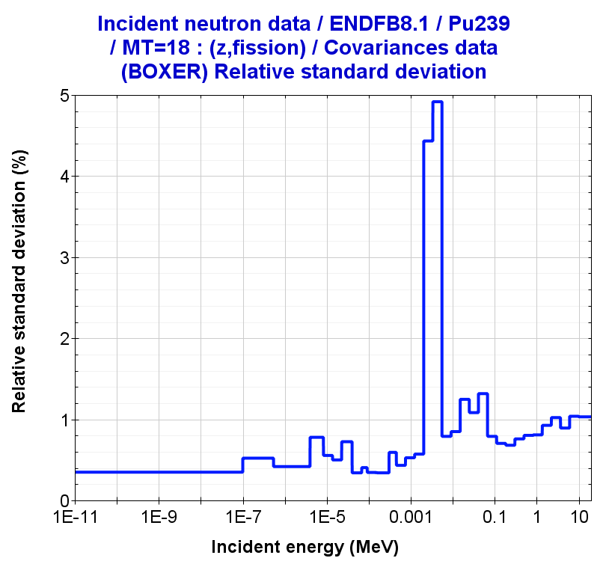
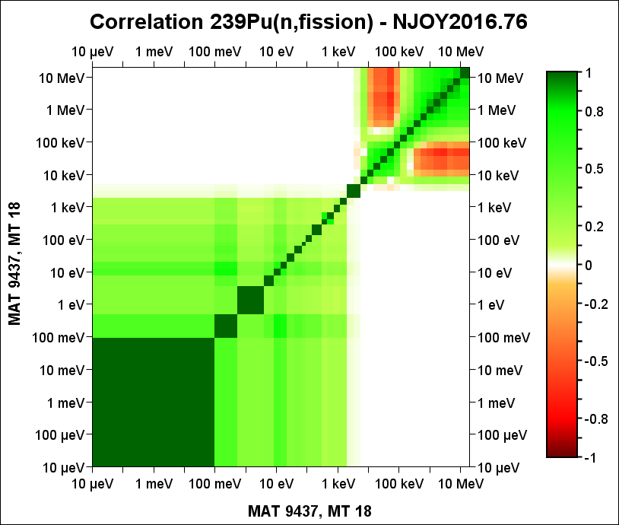
Processing into BOXER format
Processing ND/MF32+MF33 in BOXER format
moder /
1 21
'094-Pu-239 '
20 9437 /
0/
reconr /
21 22
'094-Pu-239 '
9437 2 /
0.005 /
'Reconstructed'/
'Processed'/
0/
broadr /
21 22 23
9437 1 0 0 0./
0.005 /
300.0 /
0/
unresr /
21 23 24
9437 1 1 0 /
300.0 /
1.0E+10 /
0 /
groupr /
21 24 0 31/
9437 1 0 2 0 1 1 1 /
'GENDF- 238g' /
300.0
1.E10
238 /
1.00000E-05
1.00000E-04
5.00000E-04
…
1.73300E+07
2.0000E+07 /
3/
3 18/
3 251/
3 452 nubar_t/
3 455 nubar_d/
3 456 nubar_p/
5 455 nubar_spc/
0/
0/
errorr
21 24 0 77 /
9437 1 2 1 1 /
1 300.0 / Just only one temperature
0 33 /
33 /
1.00000E-05
1.00000E-01
…
6.06531E+06
1.00000E+07
1.9640E+07 /
covr
77 0 81 /
1/
/
/
9437 0 0 0 /
viewr
81 82
covr
77 78 /
4 1
'LIB_JENDL-5.0upd ' /
'BOXER format'/
9437 0 0 0 /
stop
Figure 1. Input deck to process MF32/33 covariances
tape20 = ENDF Pu239
=====================

Slide 25
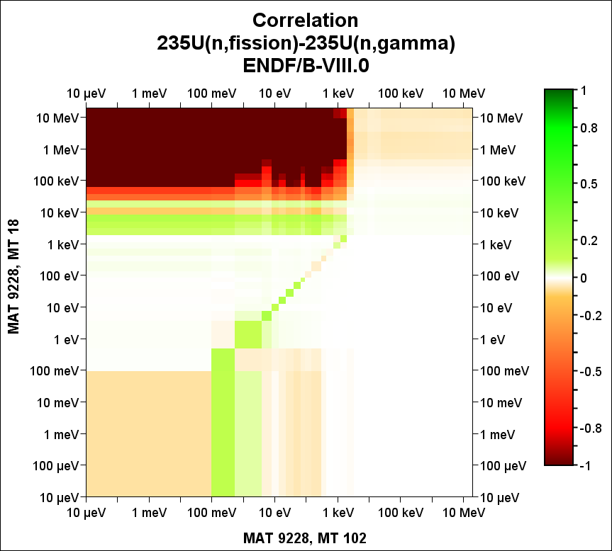
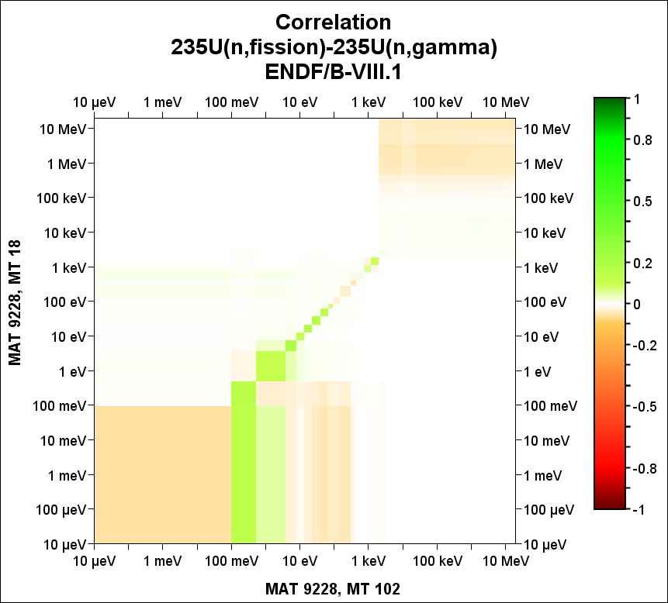
Processing into BOXER format
Processing ND/MF32+MF33 in BOXER format

Slide 26
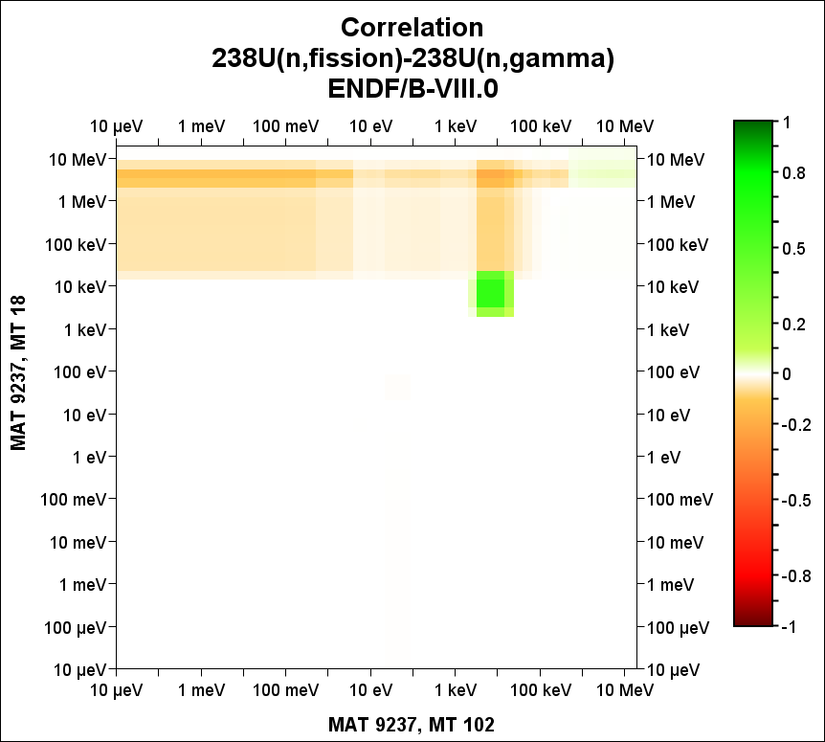
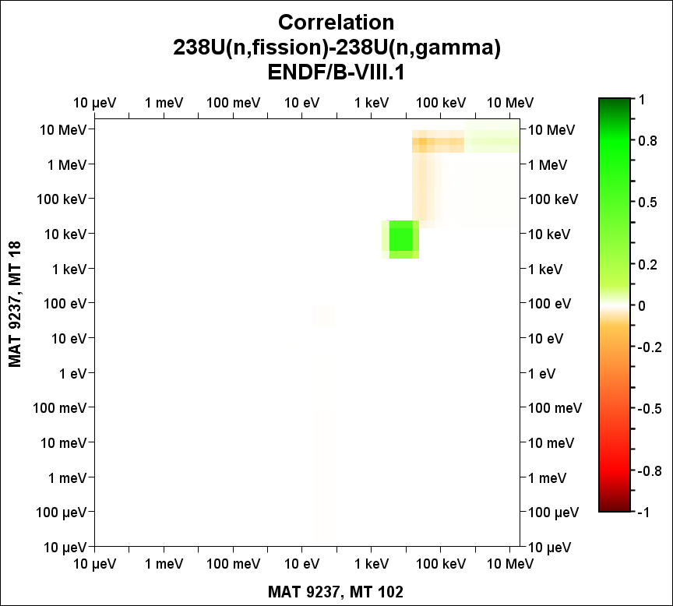
Processing into BOXER format
Processing ND/MF32+MF33 in BOXER format

Slide 27
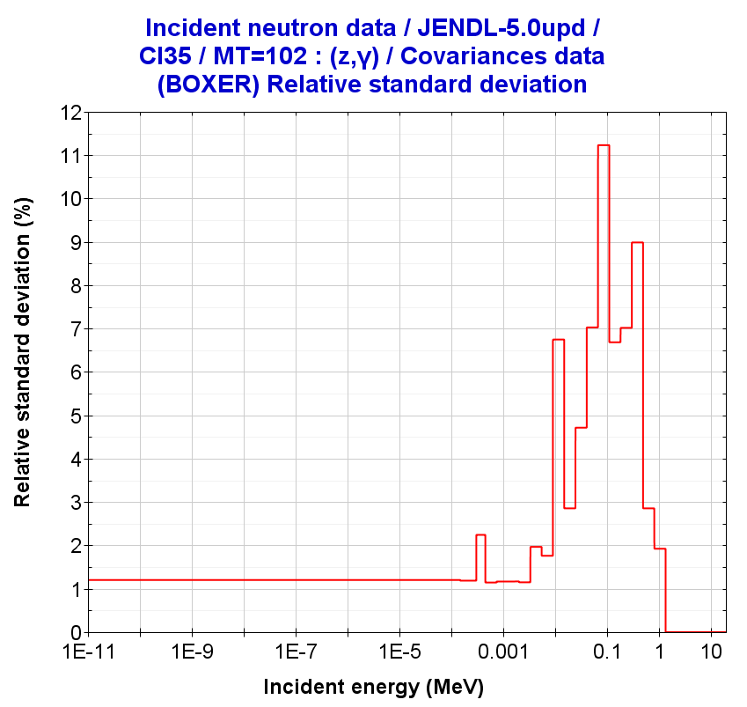
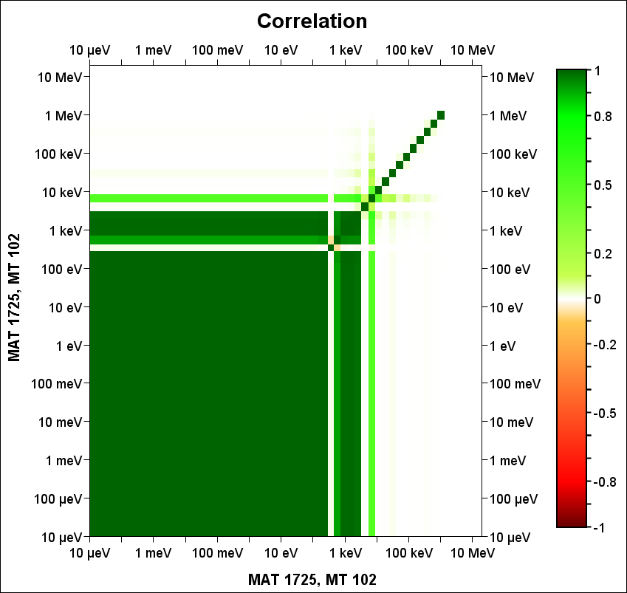
Processing into BOXER format
Processing ND/MF32 “only” in BOXER format
Figure 2. Input deck to process covariances in files with MF32-only
moder
1 21
'017-Cl-35 '
20 1725 /
0/
reconr
21 22
'017-Cl-35 '
1725 2 /
0.005 /
'Reconstructed'/
'Processed'/
0/
broadr
21 22 23
1725 1 0 0 0./
0.005 /
300.0 /
0/
unresr
21 23 24
1725 1 1 0 /
300.0 /
1.0E+10 /
0 /
errorr
999/
21 88/
1 / MT1
2 / MT2
102 / MT102
600 / MT600
0/
errorr
88 24 0 77 /
1725 1 2 1 1 /
1 300.0 / Just only one temperature
0 33 /
33 /
1.00000E-05
1.00000E-01
5.40000E-01
…
1.00000E+07
1.9640E+07 /
covr
77 0 81 /
1/
/
/
1725 0 0 0 /
viewr
81 82
covr
77 78 /
4 1
'LIB_JENDL-5.0upd ' /
'BOXER format'/
1725 0 0 0 /
stop
Materials only MF32
JENDL-5.0:
Cl35, Cr50, Cr54
JEFF-4T2.2
Cl35, Cl37
Cu63, Cu65
Pa231, Pa233
Pu240, Am241
tape20 = ENDF Cl35
==================

Slide 28
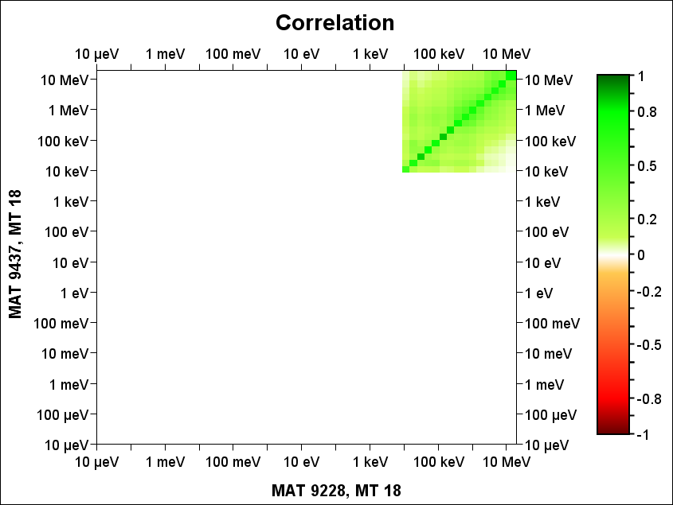
Processing into BOXER format
Processing ND/MF33 –cc in MATs in BOXER format
moder /
2 99
' 9437 and 9228' /
91 9437 /
92 9228 /
0/
errorr
21 0 99 26 61 /
9437 1 2 1 1 /
1 300.0 / Just only one temperature
2 33 /
9228 18 /
0 /
33 /
1.00000E-05
1.00000E-01
…
1.00000E+07
1.9640E+07 /
covr
26 0 81 /
1/
/
/
9437 18 9228 18 /
viewr
81 82
covr
26 27 /
4 1
'LIB_JENDL-5.0upd ' /
'BOXER format'/
9437 18 9228 18 /
stop
Figure 3. Input deck to process MF33 covariances between different materials (example JENDL5)
tape21 = ENDF Pu239
tape91 = GENDF-238g Pu239
tape92 = GENDF-238g U235
tape61 = input cov. tape77(ERRORR output) for U235
=====================================================

Slide 29
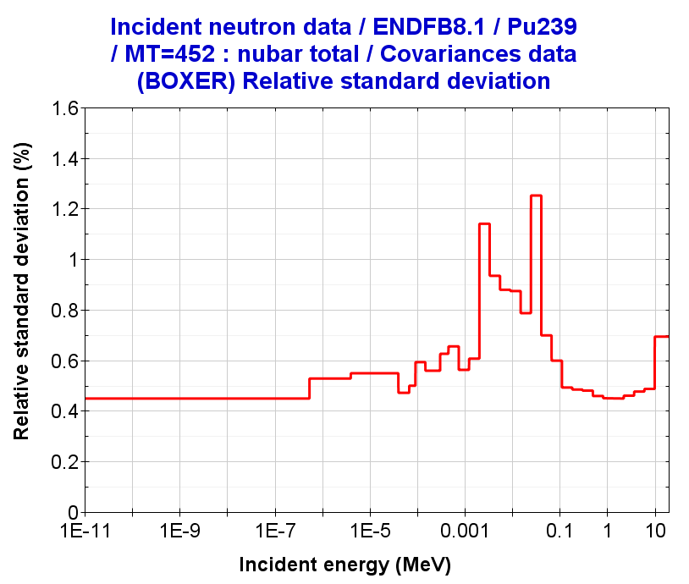
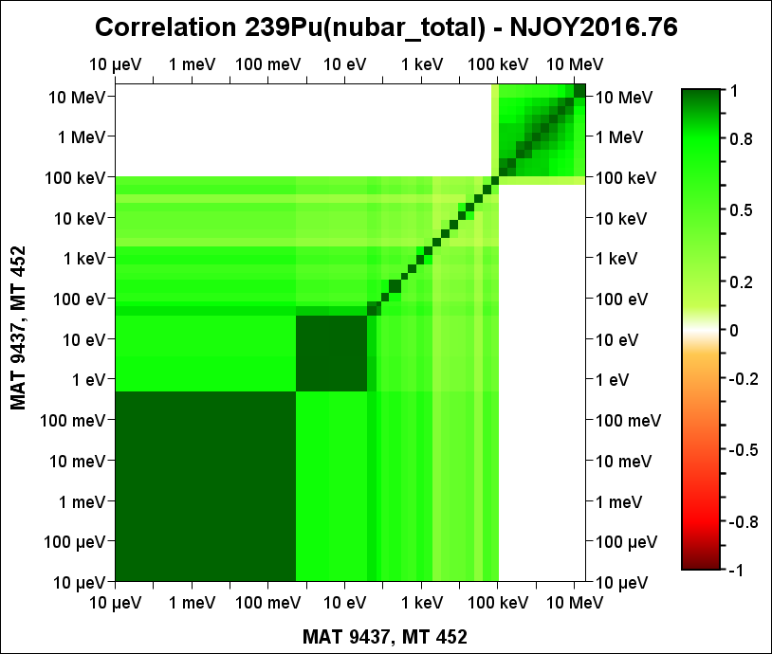
Processing into BOXER format
Processing ND/MF31 in BOXER format
groupr /
21 24 0 31/
9437 1 0 2 0 1 1 1 /
'GENDF- 33g' /
300.0
1.E10
33 /
1.00000E-05
1.00000E-01
…
3.67879E+06
6.06531E+06
1.00000E+07
1.9640E+07 /
3/
3 452 nubar_t/
3 455 nubar_d/
3 456 nubar_p/
5 455 nubar_spc/
0/
0/
errorr
21 0 31 41 /
9437 1 2 1 1 /
1 300.0 / Just only one temperature
0 31 /
33 /
1.00000E-05
1.00000E-01
…
6.06531E+06
1.00000E+07
1.9640E+07 /
covr
41 0 81 /
1/
/
/
9437 0 0 0 /
viewr
81 82
covr
41 71 /
4 1
'LIB_JENDL-5.0upd ' /
'BOXER format'/
9437 0 0 0 /
stop
Figure 4. Input deck to process MF31 covariances
tape21 = ENDF Pu239
tape24 = PENDF Pu239
=====================

Slide 30
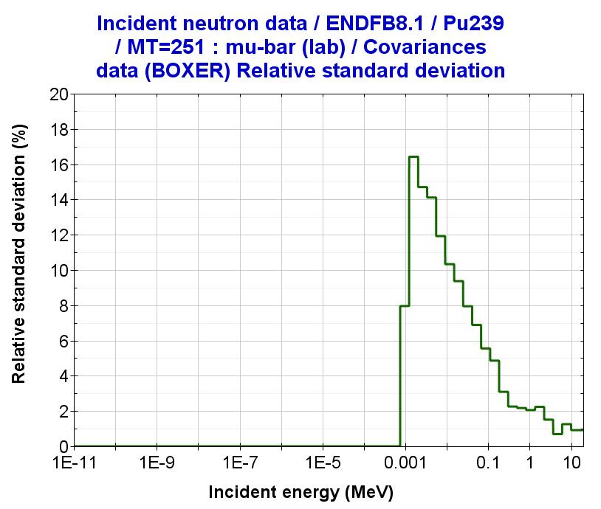
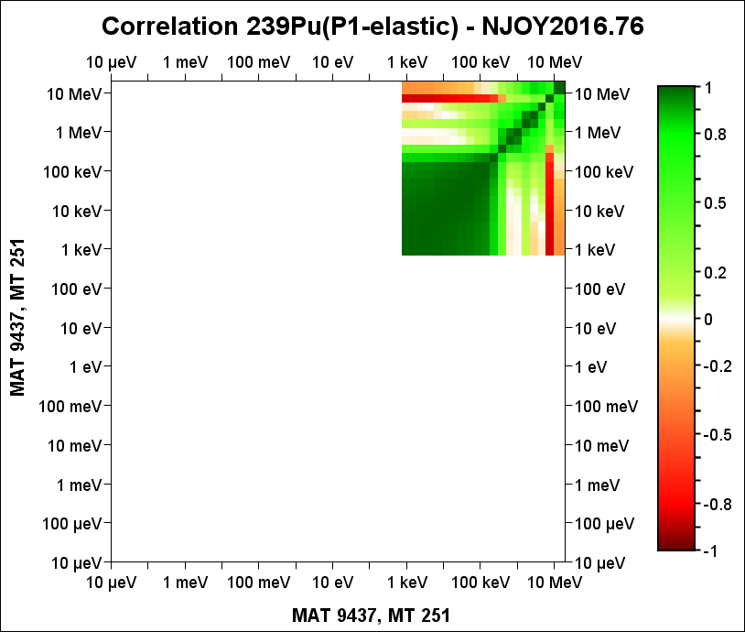
Processing into BOXER format
Processing ND/MF34 in BOXER format
groupr
21 24 0 31/
9437 1 0 2 5 1 1 1 /
'GENDF- 33g' /
300.0
1.E10
33 /
1.00000E-05
1.00000E-01
..
1.00000E+07
1.9640E+07 /
3/
3 251/
0/
0/
errorr
21 0 31 42 /
9437 1 2 1 1 /
1 300.0 / Just only one temperature
0 34 /
33 /
1.00000E-05
1.00000E-01
..
6.06531E+06
1.00000E+07
1.9640E+07 /
covr
42 0 81 /
1/
/
/
9437 0 0 0 /
viewr
81 82
covr
42 72 /
4 1
'LIB_JENDL-5.0upd ' /
'BOXER format'/
9437 0 0 0 /
stop
Figure 5. Input deck to process MF34 covariances
tape21 = ENDF Pu239
tape24 = PENDF Pu239
=====================

Slide 31
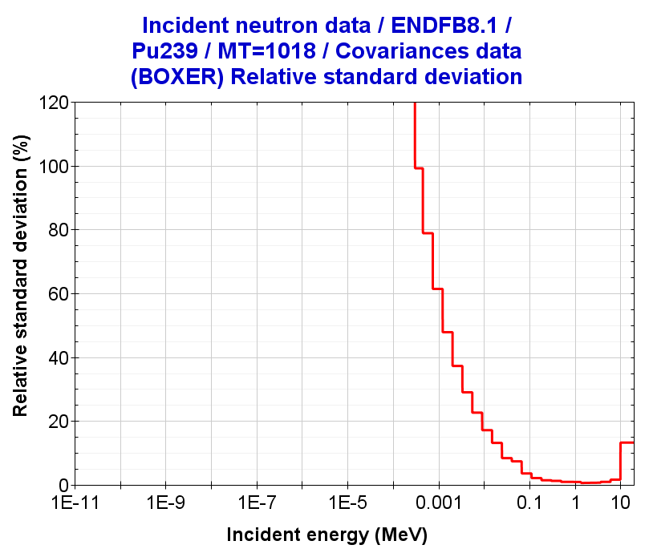
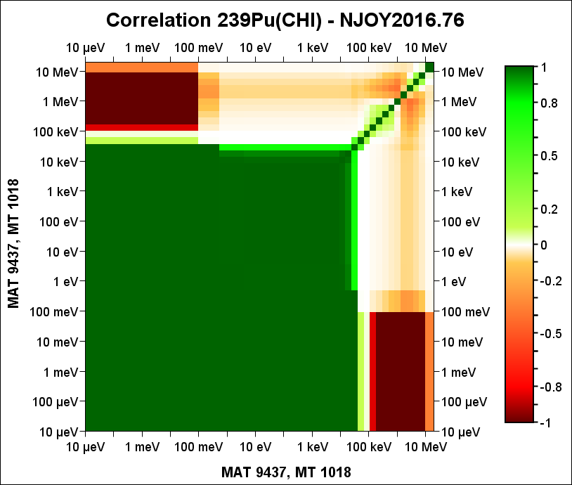
Processing into BOXER format
Processing ND/MF35 in BOXER
Figure 6. Input deck to process MF35 covariances
groupr /
21 24 0 31/
9437 1 0 2 0 1 1 1 /
'GENDF- 33g' /
300.0
1.E10
33 /
1.00000E-05
1.00000E-01
..
1.00000E+07
1.9640E+07 /
3/
3 18/
3 452 nubar_t/
3 455 nubar_d/
3 456 nubar_p/
5 455 nubar_spc/
5 18 nubar_spc/
3 452 nubar_t/
3 455 nubar_d/
3 456 nubar_p/
5 455 nubar_spc/
5 18 nubar_spc/
0/
0/
errorr
21 0 31 40 /
9437 1 2 1 1 /
1 300.0 / Just only one temperature
0 35 1 1 -1 1.0000E+05 /
33 /
1.00000E-05
1.00000E-01
..
1.00000E+07
1.96400E+07 /
covr
40 0 81 /
1/
/
/
9437 0 0 0 /
viewr
81 82
covr
40 70 /
4 1
'LIB_JENDL-5.0upd ' /
'BOXER format'/
9437 0 0 0 /
stop
tape21 = ENDF Pu239
tape24 = PENDF Pu239
=====================

