Slide 1
Recent Standards Work
(High Fidelity Covariances result from this Work)
Allan D. Carlson
NIST Associate
Presented at
The CSEWG Meeting
Nov. 4-7, 2024

Slide 2
Outline of Recent Work on the Neutron Standards
Measurements of Neutron Cross Section Standards Proposed, Underway or Completed.
Including results presented at the Oct 2023 Standards meeting.
Due to time limitations for this presentation mostly very recent work will be discussed. The reference cross section areas below will not be shown:
Prompt γ-ray production Reference cross section measurements.
⁷Li(n, n’)γ and ⁴⁸Ti(n,n’)γ Reference cross sections.
There is an emphasis on encouraging experiments using new methods for obtaing data to help the understanding of unrecognized systematic uncertainties.

Slide 3
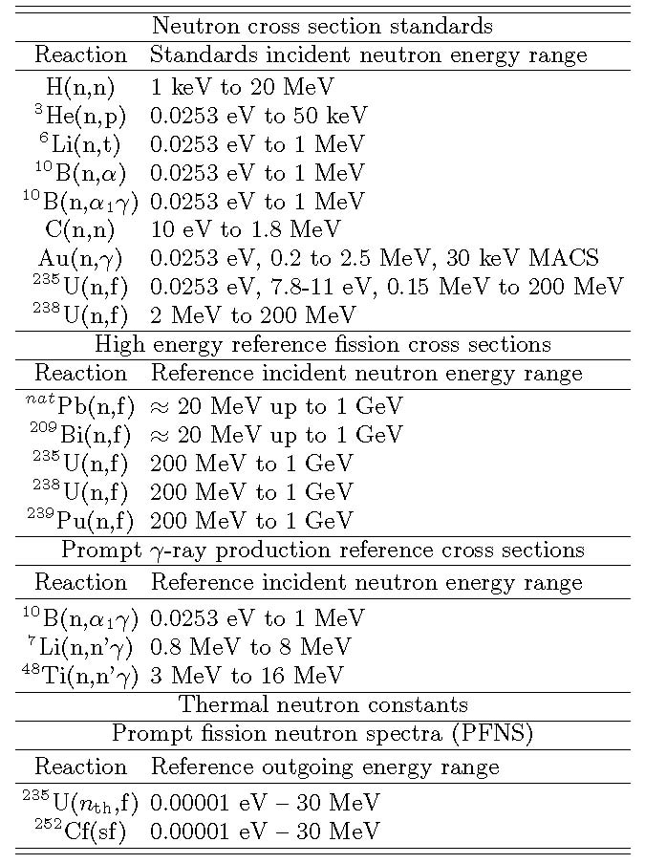
The thermal constants are the responsibility of the standards group because they are accurately known. A non-cross section thermal constant used as a standard is ---------
The subject of Denise’s talk

Slide 4
⁶Li(n,t) Measurements
New measurements were made of the ⁶Li(n,t) cross section relative to the ²³⁵U(n,f) standard at IPPE by Prusachenko.
A pulsed quasi-monoenergetic neutron beam from the ²H(d,n)³He reaction was used to obtain measurements for energies from 4.75 to 7.5 MeV.
Though these data are significantly above the present standards energy region, they will have an impact through the use of R-Matrix analyses and can possibly allow extension of the standard..
Measurements are being made by Anastasiou et al. of the ²³⁵U(n,f)/⁶Li(n,t) cross section ratio with the NIFFTE fission TPC.
The expected energy range is from about 0.1 MeV up to 3 MeV (possibly 4 MeV). The data will impact evaluations of both the ²³⁵U(n,f) and ⁶Li(n,t) cross sections.
Some results of this work were given by Anastasiou at the ND2022 conference and the 2023 standards meeting .
The present results are very preliminary.

Slide 5
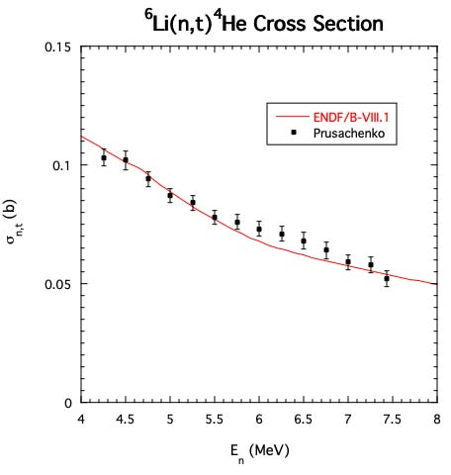
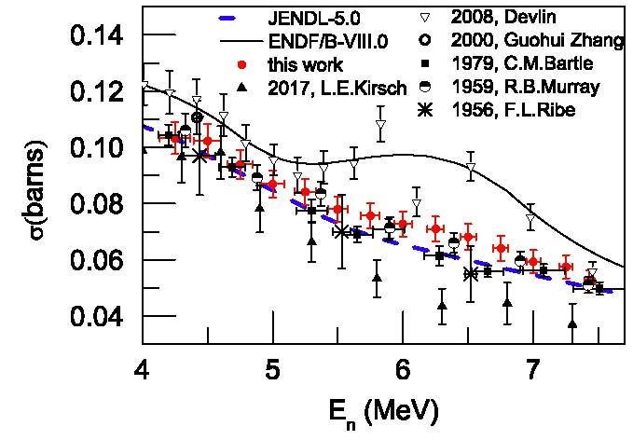
⁶Li(n,t) Cross Section Measurements by Prusachenko

Slide 6
⁶Li(n,t) and ¹⁰B(n,α) and ¹⁰B(n,α₁) Measurements at CSNS
Extensive measurements of the ⁶Li(n,t) angular distribution by Bai et al. for energies from 1 eV to 3 MeV
Angular distribution data were also obtained by Jiang et al. for the boron standards from 1 eV to 2.5 MeV
For both of these experiments there are some concerns due to the use of the ²³⁵U(n, f) cross section for fluence determination where it is not a standard.
Since the experimental conditions for the two measurements were the same, the fluence concern was eliminated by re-processed the experimental data and obtaining ratios of the measurements.
The integrated data shown here will be used using GMApy, a Python based analysis replacing the GMA analysis formerly used. The angular distribution shape data for the two experiments will be used in R-matrix analyses. These data will be used with earlier measurements to obtain final results.
The ⁶Li angular distribution data can be seen in
Huaiyong Bai, et al Chinese Phys. C 44, 2020 014003.
The ¹⁰B angular distribution data can be seen in
The Haoyu Jiang et al Chinese Phys. C 43, 2019 124002.
The ratios of the angle-integrated cross sections for the ¹⁰B(n, α)⁷Li divided by the ⁶Li(n, t)⁴He reactions vs energy

Slide 7
Measurements Directly Related to the ¹⁰B(n,α) Standard and ¹⁰B(n,α₁γ) Measurements
Very recent work at Ohio University.
Several measurements of the ¹⁰Be(p,n)¹⁰B reaction in the thesis of Jones-Aberty.
Massey et al. at Ohio University have measured ¹⁰B(n,Z) reactions for neutron energies from 2 to 20 MeV.
The work was done at the LANSCE WNR facility (Phys. Rev. C 105, 054612 (2022)).
All of these data can be used in R-matrix fits to improve the ¹⁰B(n,α) standards.

Slide 8
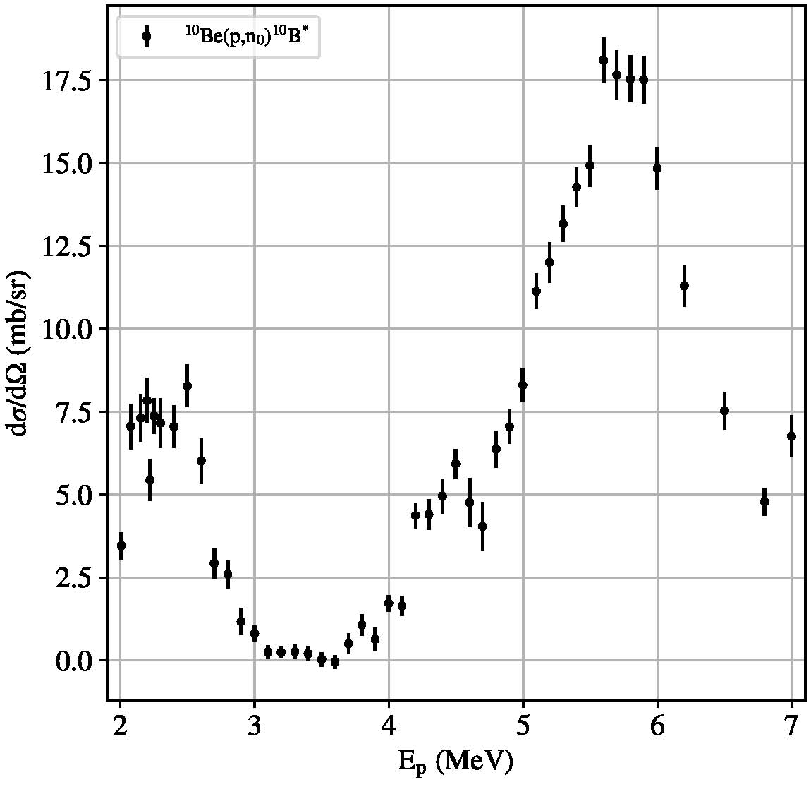
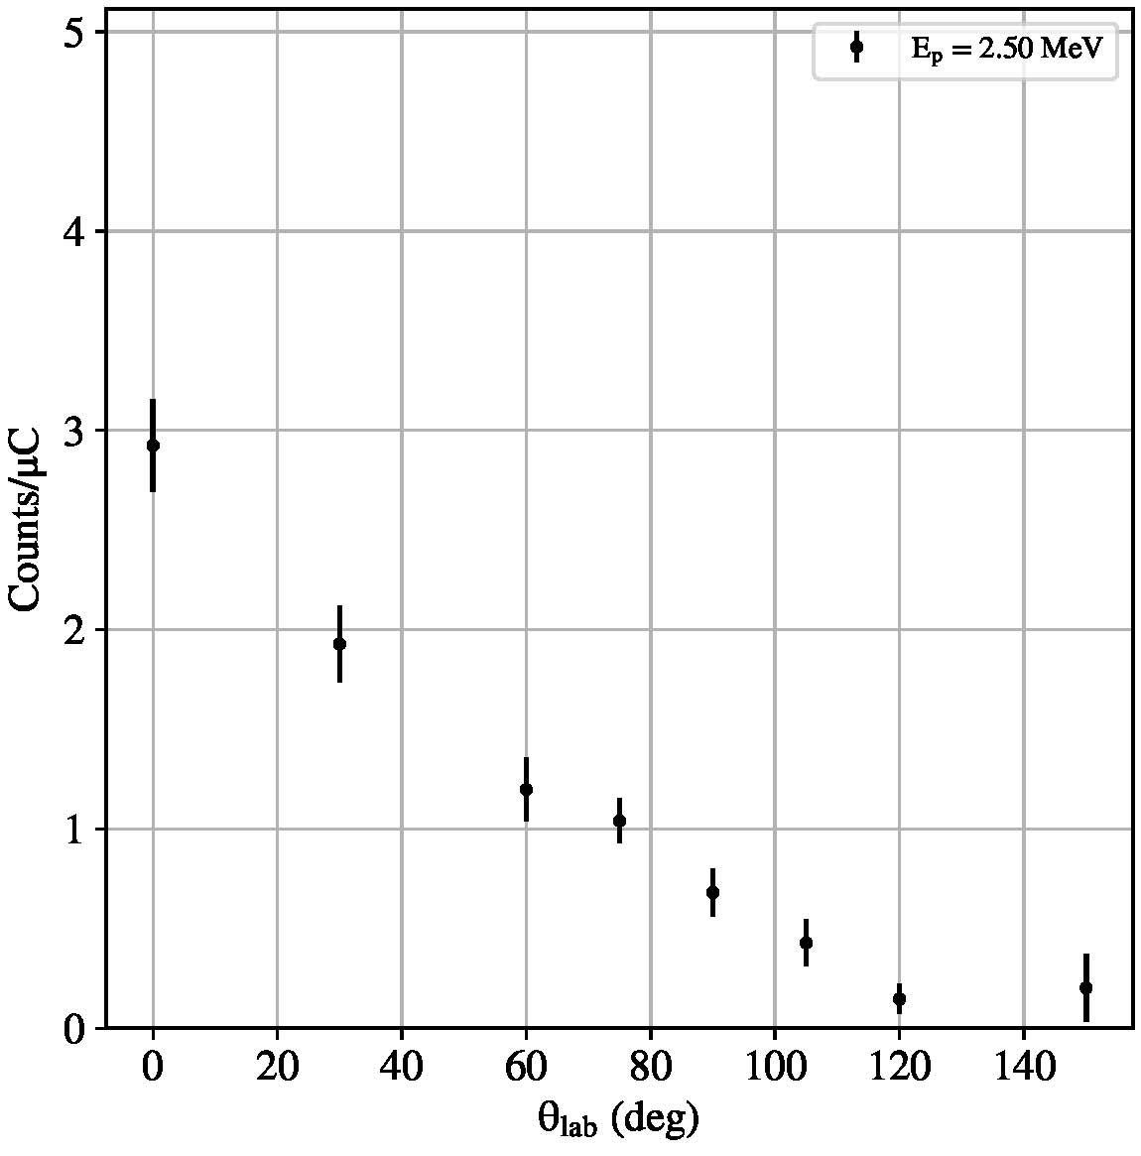
Measurements Directly Related to the ¹⁰B(n,α) Standard and ¹⁰B(n,α₁γ) Measurements
Measurements of the ¹⁰Be(p,n₀)¹⁰B diferential cross section at 0º by Jones-Aberty
Measurements of the ¹⁰Be(p,n₀)¹⁰B angular distribution versus θ_{lab} by Jones-Aberty

Slide 9
¹⁰B(n,x)⁷Li and Li Measurements
Extension in the energy ranges to above 1 MeV of the ⁶Li(n,t) and ¹⁰B standards may be possible with the work by Anastasiou et al., Bai et al., Jiang et al. and the Ohio University data.
The It is important to extend the energy range of these standards to above 1 MeV, the present limit of this standard. That would allow convenient overlap with the H(n,n) standard.

Slide 10
C(n,n) Cross Section
The most recent evaluation of the carbon standard by Hale was done by combining ¹²C and ¹³C R-matrix evaluations to obtain the elemental cross section that is the standard.
Measurements have been made by Vanhoy on ¹³C that should improve the new evaluation of the carbon
Standard.
Carbon scattering measurements by Kelly at LANL are also underway that should impact the new evaluation.
The most recent angular distribution measurements have been completed at GELINA by Gkatis et al.
Energies were covered from 10 mV to 20 MeV ( thus covering the standards energy range).
8 angles were measured between 16.2 and 163.8 degrees.

Slide 11
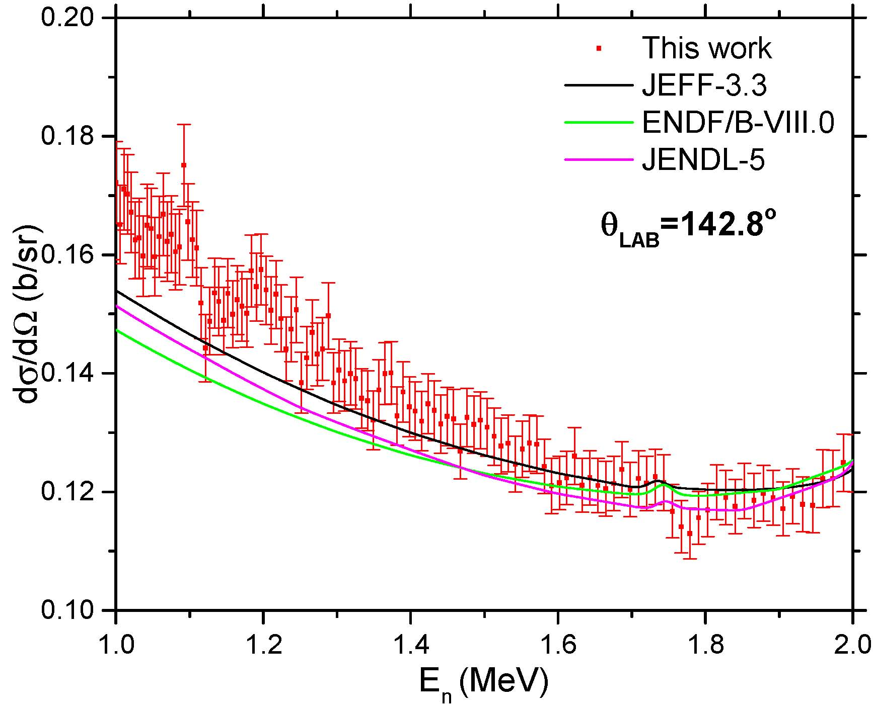
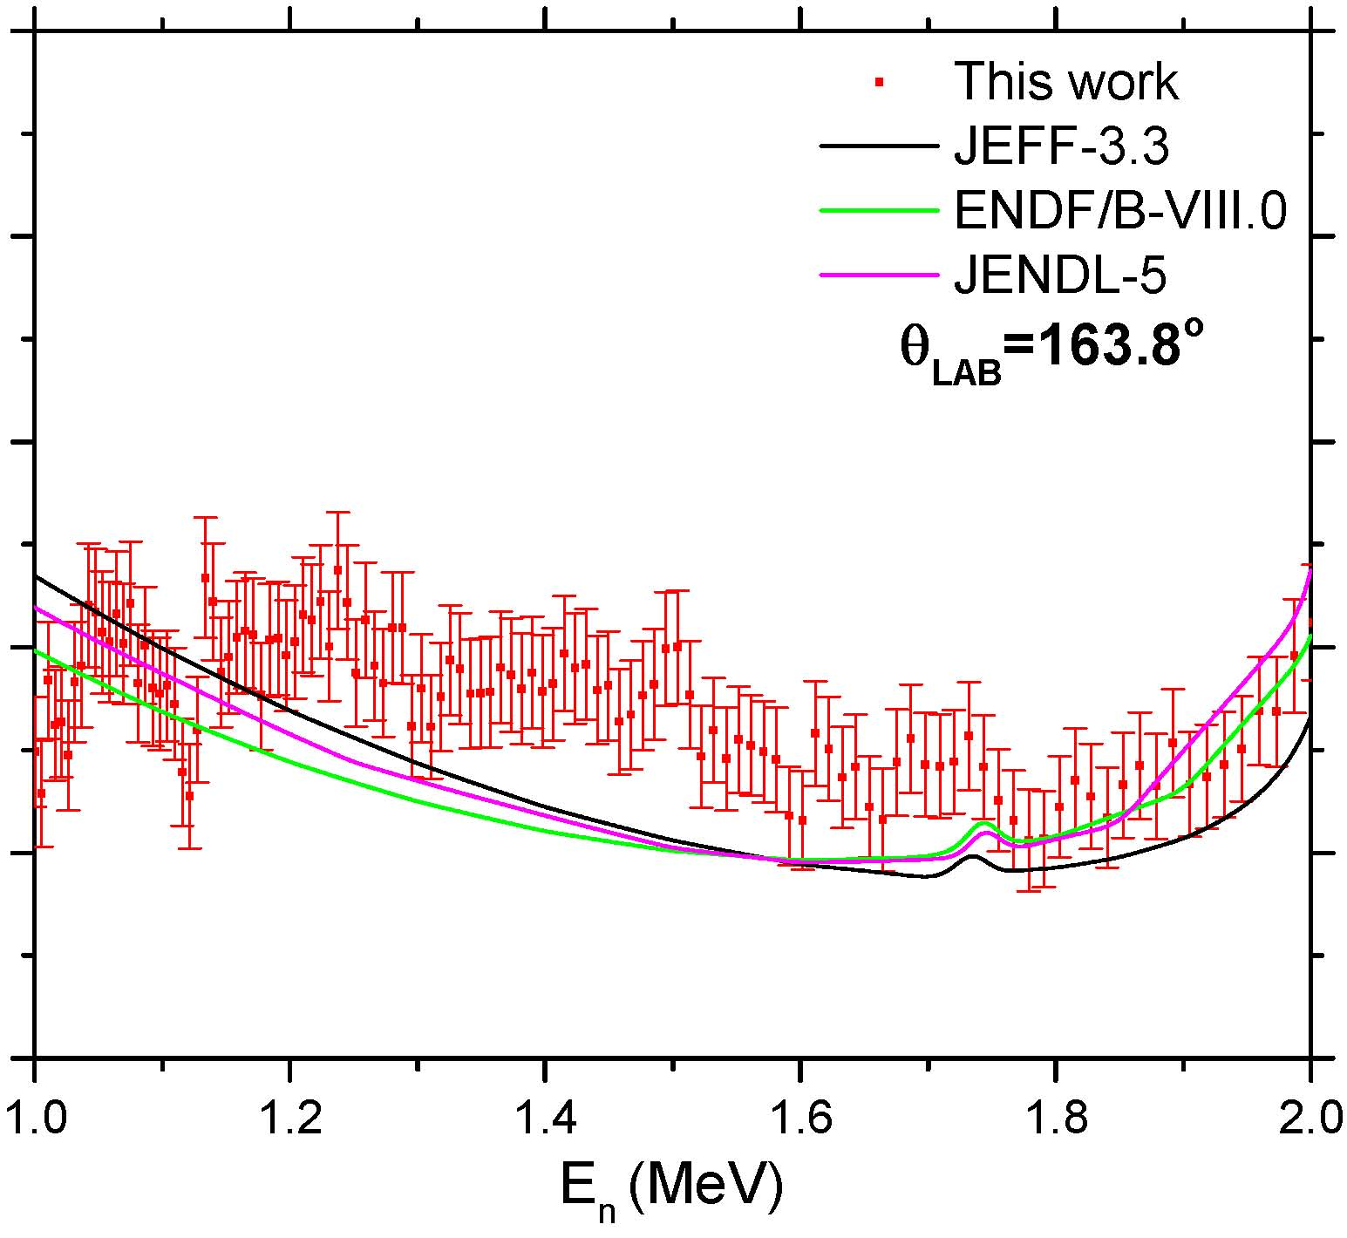
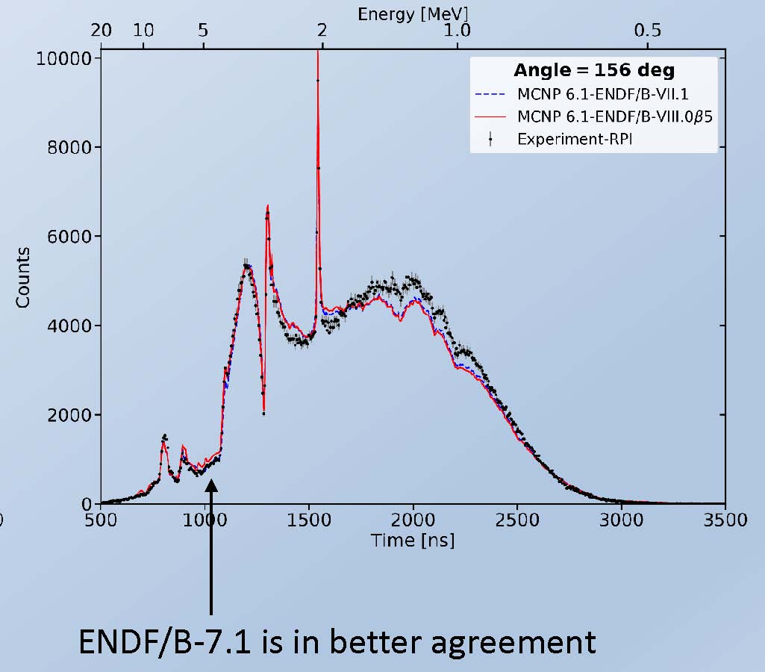
C(n,n) Cross Section
Comparison of Angular distribution measurements by Gkatis et al. with Danon
Gelina Measurements by Gkatis et al.
RPI Measurements by Danon
Disagreement

Slide 12
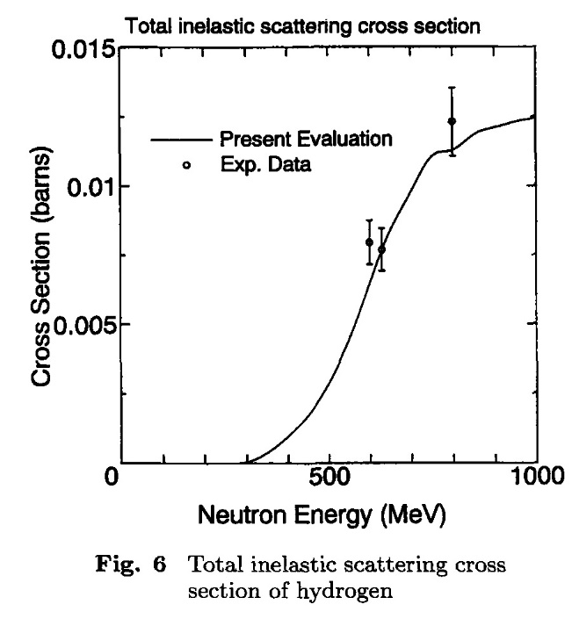
Absolute measurements by Manna et al. in the n_TOF collaboration were made of the ²³⁵U(n,f) cross section relative to hydrogen scattering from 20 MeV to 450 MeV.
These data have been finalized and the publication is just now available.
The results up to 450 MeV are similar to those of the ²³⁵U(n,f) Reference cross section The present standard is limited to 200 MeV. There is a strong need for these measurements to higher neutron energies.
They had to contend with problems at higher neutron
energies where inelastic scattering produces proton
energies such that it is difficult to separate the elastic and
inelastic protons.
Uranium Fission Cross Section Measurements

Slide 13
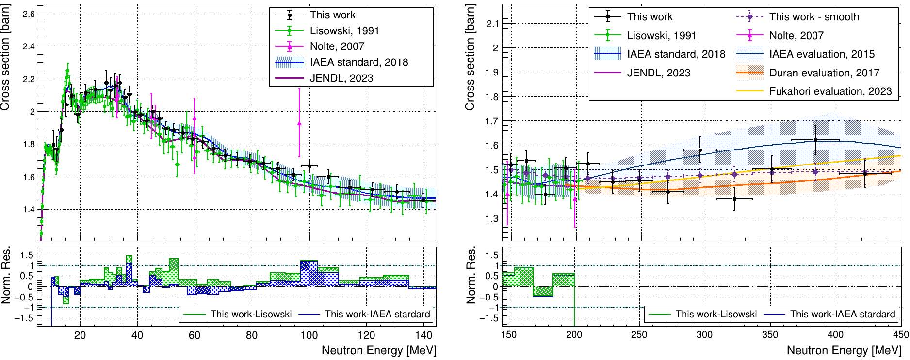
²³⁵U(n,f) Cross Section Measurements by Manna et al.

Slide 14
New measurements at PTB of the ²³⁸U(n,f) fission cross section by Belloni.
Made at 2.5 and 14.8 MeV relative to hydrogen scattering.
Measurements at the China Spallation Neutron Source.
²³⁵U(n,f) cross sections measurements by Chen.
Relative to the hydrogen scattering standard-shape data.
For the extension up to 70 MeV problems were noted due to the use of double bunches. The unfolding causes a problem that is worsened when statistical uncertainties are large.
More work is planned.
They now extend from 10 to 66 MeV.
The ²³⁸U(n,f)/²³⁵U(n,f) cross section ratio by Wen, et al. from 1 to 20 MeV.
Uranium Fission Cross Section Measurements (cont.)

Slide 15
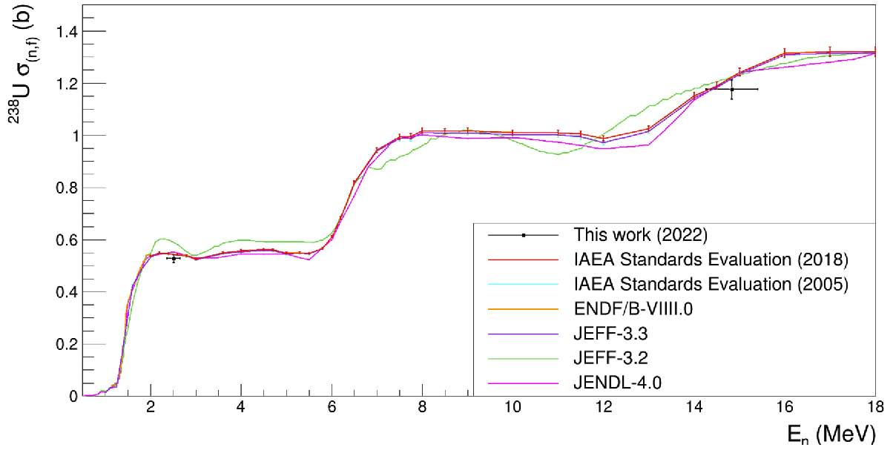
²³⁸U(n,f) Cross Section Measurements by Belloni et al. at PTB

Slide 16
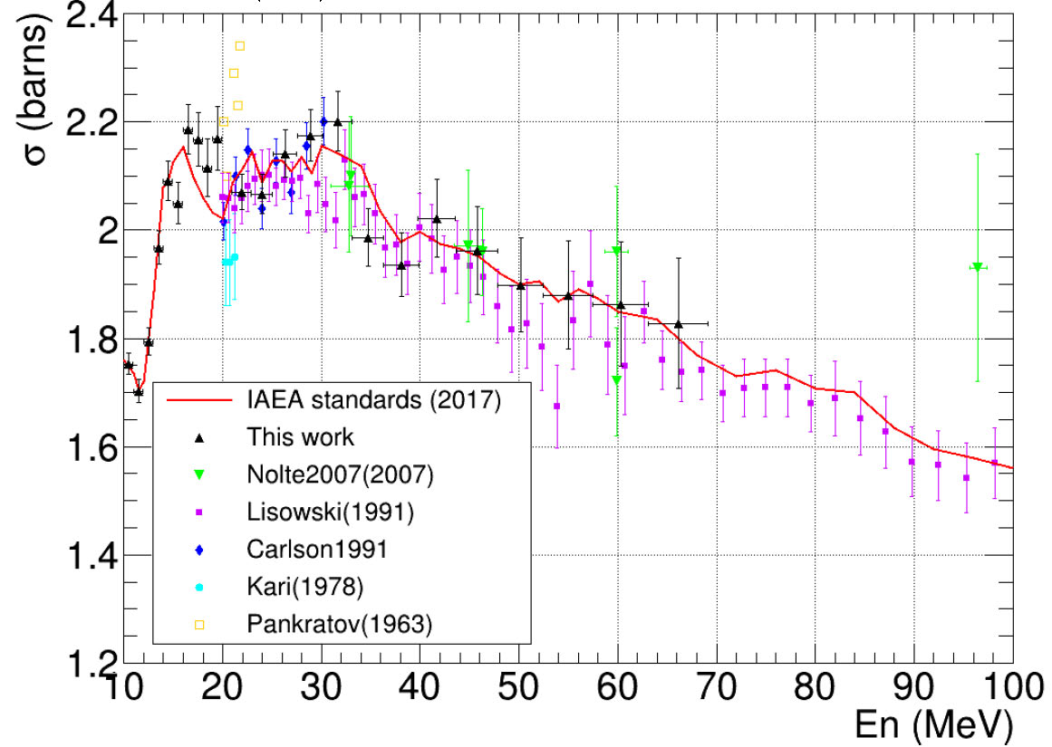
²³⁵U(n,f) Cross Section Measurements by Chen at CSNS Facility

Slide 17
Beginning with the standards for the ENDF/B-VI evaluation, very “clean” integral data were used.
The data used were measurements of the ²³⁵U(n,f) and ²³⁹Pu(n,f) cross sections in the ²⁵²Cf spontaneous fission neutron field (Spectrum Averaged Cross Sections, SACSs).
Since there is a relatively small change in the cross section for these nuclides over most of the energy range of the ²⁵²Cf spectrum, an accurate determination of the cross section is possible. The result is also only weakly dependent on the uncertainty in the spectrum shape. These integral data basically help provide normalization for the standards evaluation.
It was initially not possible to use ratios of SACS since GMA could not handle them.
With ratios, the dependence on neutron fluence is removed.
A new Python based code was written by Schnabel (gmapy) so that ratios can now being used.
Using the the ²³⁹Pu(n,f)/ ²³⁵U(n,f) SACS ratio data, the ²³⁸U(n,f)/ ²³⁵U(n,f) SACS ratio data and the data in the GMA data base has led to a new preliminary evaluation of the standard cross sections. For this evaluation an energy dependent USU is being investigated. A number of energy regions are selected and USU is determined for each region as an average for the different datasets in that region,
This work has led to improved agreement of the evaluation with experimental SACS values and significant agreement with the NIFFTE ²³⁹Pu(n,f) /²³⁵U(n,f) cross section ratios.
Use of Integral Data

Slide 18
New ²³⁹Pu(n,f)/²³⁵U(n,f) cross section ratio measurements by Dongwi et al. made at LANSCE by the NIFFTE collaboration have very recently been published. They were made with an improved sample.
These data are higher than the standards evaluation by about 2% but are in agreement in shape. They do agree within their uncertainties. The new data agree very well with the previous NIFFTE work. In their recent paper they indicate that the new and previous results should both be treated as absolute but highly correlated. In the publication of their previous measurement, because of concerns about normalization, they indicated the data should be treated as shape results.
As noted previously, work with gmapy led to a new preliminary standards evaluation that yielded a ²³⁹Pu(n,f)/²³⁵U(n,f) cross section ratio in very good agreement with the new NIFFTE ²³⁹Pu(n,f)/²³⁵U(n,f) cross section ratio measurements.
Also measurements have been made of the ²³⁹Pu(n,f)/⁶Li(n,t) cross section ratio with the NIFFTE fission TPC.
These data will impact evaluations of both the ²³⁹Pu(n,f) and ⁶Li(n,t) cross sections. These data are not finalized.
Plutonium Fission Cross Section Related Measurements

Slide 19
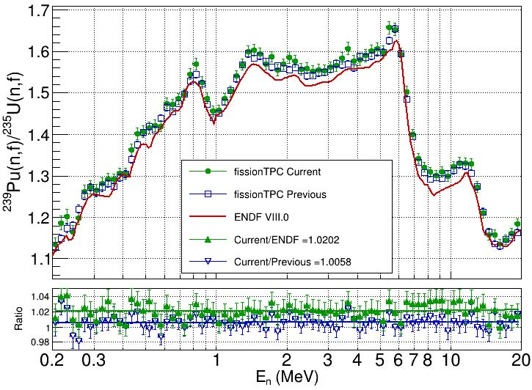
New NIFFTE ²³⁹Pu(n,f)/ ²³⁵U(n,f) Cross Section Ratio compared with the Standards Evaluation

Slide 20
Comparison of measurements of neutron source emission rate CRR(III)-K9.Cf
A single ²⁵²Cf source is sent to a number of laboratories throughout the world
Brazil, Canada, China, Czech Republic, Britain, France, Italy, Japan, Russia, and USA
The measured rate at each laboratory using their techniques is sent to an impartial pilot institute
The results were tabulated and led to a publication in Metrologia
Such work is valuable to ensure that each laboratory is obtaining consistent results
Results that deviate from the mean require investigation to find sources of error

Slide 21
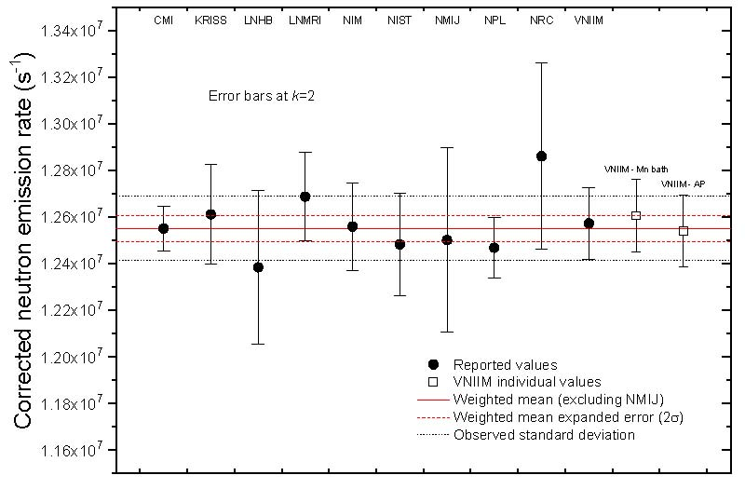
Results of the ²⁵²Cf Inter-comparison Work

Slide 22
Summary-what is needed
Improved experimental work is necessary for all the standards
An emphasis is on work using different experimental methods to improve our understanding of uncertainties.
Especially the boron and lithium standards so the upper energy bound can be increased.
Also for gold capture that has some of the largest uncertainties for the standards.
Extension of the hydrogen standard to about 150 MeV and possibly higher (work is underway by Hale and Paris).
It is now 20 MeV but there are cross section ratio data to much higher energies
Note that changes to a standard are not allowed for a given version but extensions are allowed
Further work on unrecognized sources of uncertainty )USU)
An understanding of the energy dependence of USU
Consider improved evaluation techniques for the standard cross sections

