Slide 1
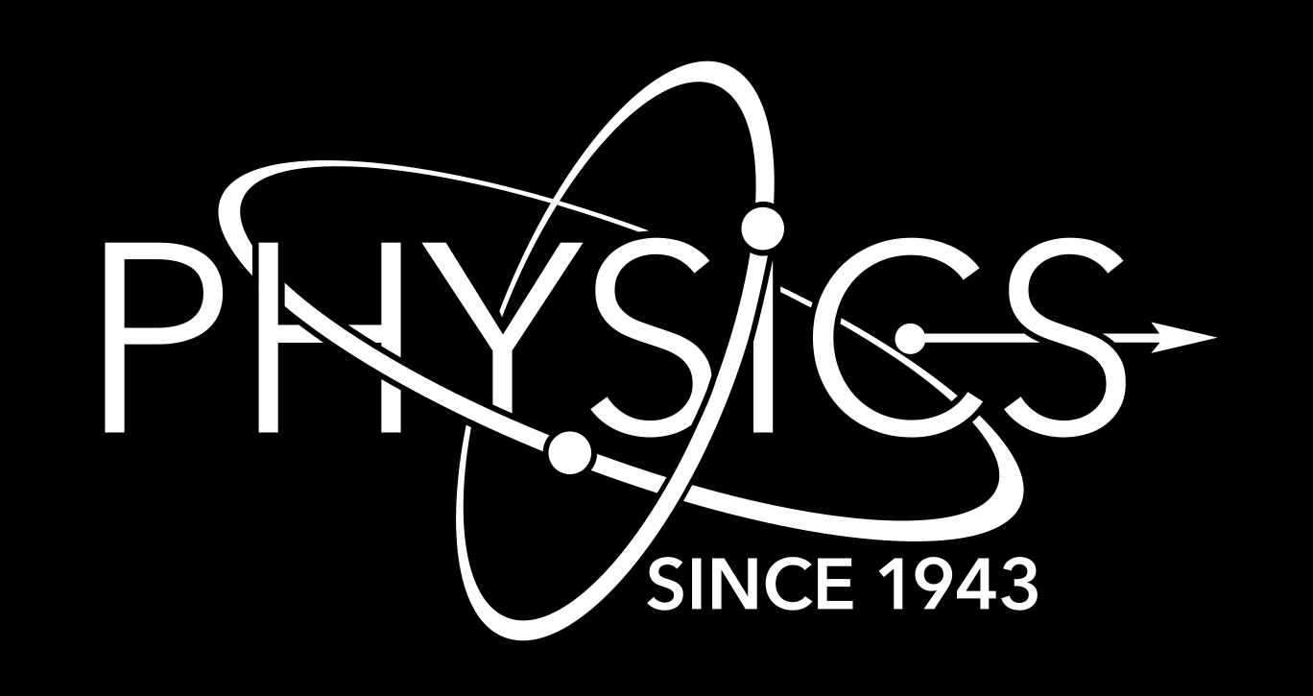
⁸⁸Zr+n: the kick-off to study small radioactive samples with DICER at LANSCE*
Experiendo cognoscitur
Th. Stamatopoulos¹, P. Koehler¹, A. Couture¹, B. DiGiovine², A. Matyskin³, V. Mocko⁴, J. Morrel⁴, E. O’Brien⁴, J. Ullmann¹, C. Vermeulen⁴
Physics Division, Los Alamos National Laboratory, 87545, NM, USA
Weapons Stockpile Modernization Division, 87545, NM, USA
Radiation Science & Engineering Center, College of Engineering, Pennsylvania State University
Chemistry Division, Los Alamos National Laboratory, 87545, NM, USA
*Funded by LANL/LDRD-DR, OES
Nuclear Data Week, Brookhaven National Laboratory
November 4th – 8th, 2024
LA-UR-24-31649

Slide 2
Table of Contents
Neutron capture on radionuclides
Traditional neutron transmission measurements
Non-traditional neutron transmission at LANL
The ⁸⁸Zr experimental campaign

Slide 3
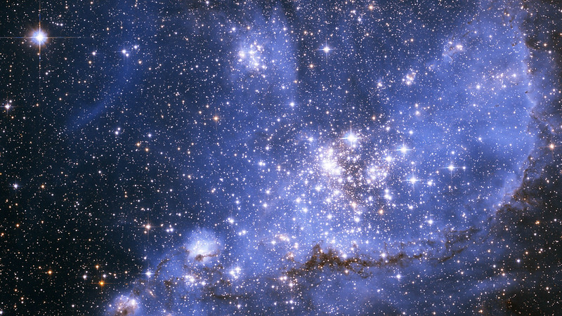
Neutron capture on radionuclides

Slide 4
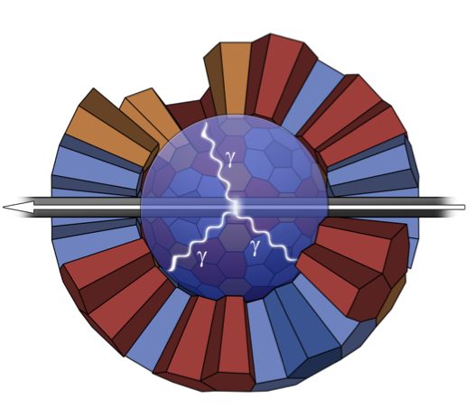
Neutron capture measurements
(n,γ) cross sections are important for:
Basic nuclear physics
Astrophysics
Nuclear criticality safety
Advanced reactors
Radiochemical diagnostics
Safeguards
Gamma detectors are close to the sample and detect the gammas from the de-excitation.
Works fine for stable or moderately radioactive samples.
A new indirect technique is proposed to study radionuclides:
Neutron transmission experiments to measure the (n,tot) cross section
R-Matrix fits of the resonances seen in the transmission spectrum
Fit results to calibrate the Nuclear Statistical Model and tightly constrain (n,γ)

Slide 5
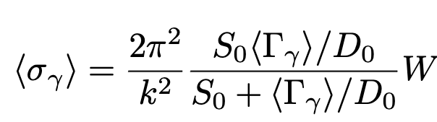
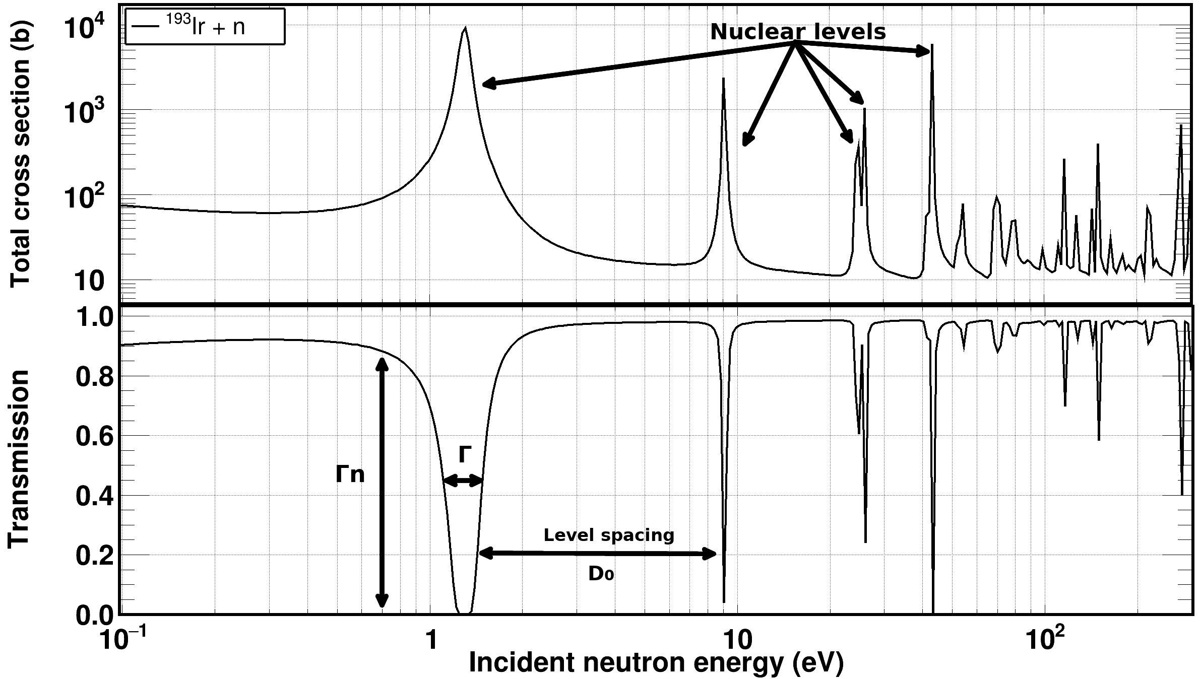
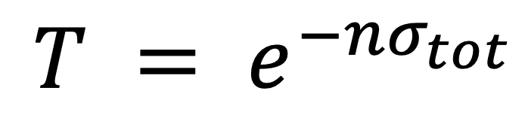

The technique in a nutshell
$$=f(\text{Γ},\text{Γ}\text{n}, D_{0})$$

Slide 6
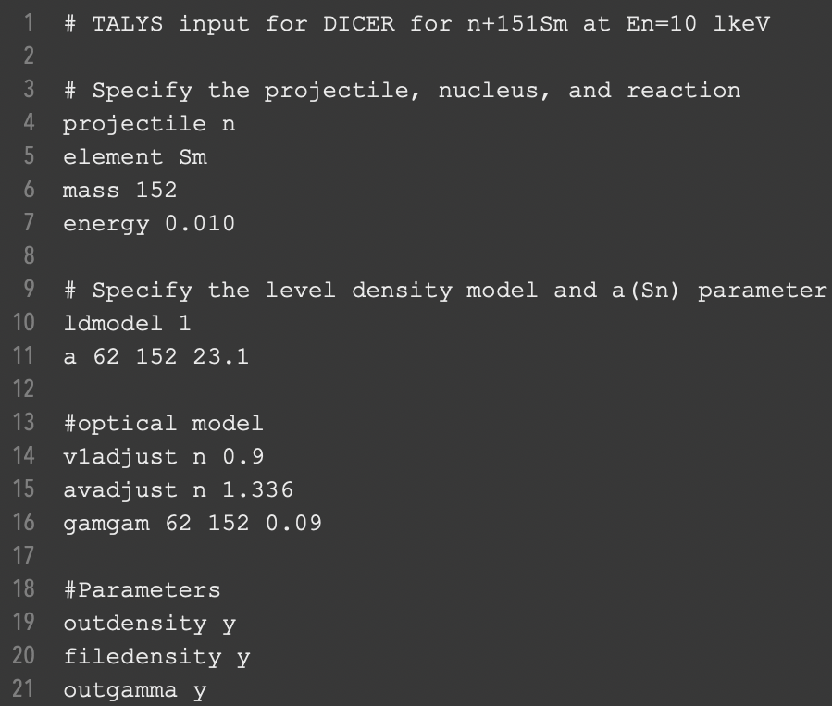
Proof of principle: in brief
Data on ¹⁵¹Sm(n,tot) from Kirouac and Einland (10.1103/PhysRevC.11.895)
Resonance data up to 300 eV (120 resonances)
Resonances were fitted with SAMMY
13 Γ_{γ} values were obtained
<Γ_{γ}> = 96.5(14) meV
Level spacing D₀ = 1.10(7) eV
Strength function 10⁴xS₀ = 3.58(59)
TALYS was adjusted to these values and compared with recent (n,γ) data
Level density parameter α(S_{n})
Optical model potential depth
Optical model potential diffuseness
Photon strength function was normalized to give the <Γ_{γ}> value https://nds.iaea.org/talys/tutorials/talys.pdf
Good agreement with the data in EXFOR

Slide 7
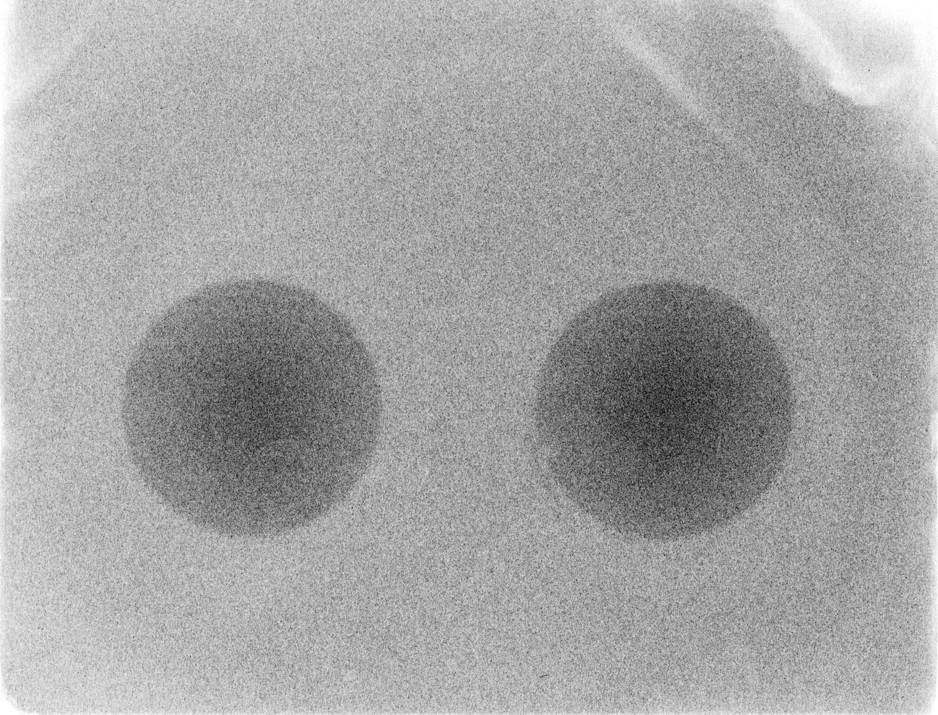
Traditional neutron transmission measurements

Slide 8
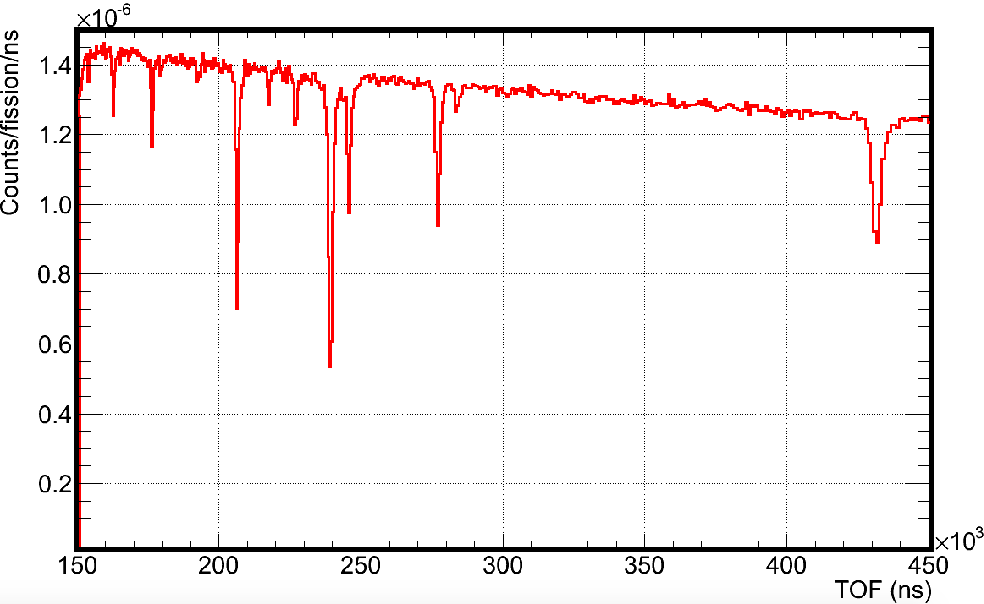
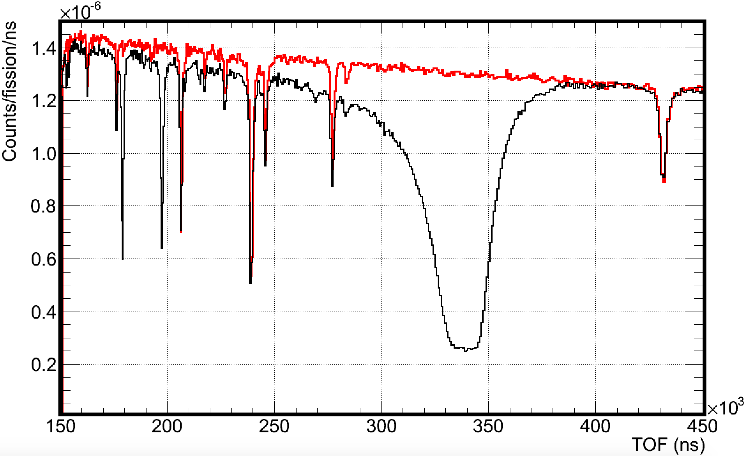

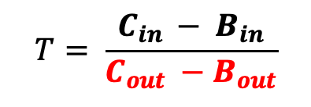
Traditional transmission measurements: How to
The neutron spectrum (C_{out}) and backgrounds (B_{out}) are recorded by a neutron detector (sample out)
A sample, (~cm in diameter), is installed and absorption dips appear (sample in)
The transmission T is the ratio sample in/out
Transmission measurements provide information on the total (Γ) and neutron (Γ_{n}) widths and the level spacing (D₀) Γ : Transmission dip width Γ_{n} : Transmission dip depth D₀: Distance between transmission dips
~10m
~10m
Collimator
Neutron
detector
Neutron
beam
Γ
$$T= \frac{C_{in }− B_{in}}{C_{out} −B_{out}}$$
Γ_{n}
D₀
$$=f(\text{Γ},\text{Γ}\text{n}, D_{0})$$

Slide 9

Traditional transmission measurements: More challenges
Sample cycling is needed therefore a positioning system must be utilized.
Positioning systems have a finite accuracy and that’s a serious bottleneck, in cycling small and radioactive samples
Repositioning precision and risk mitigation
Precise repeatability of the sample’s position, relative to the collimation system, is not necessarily ensured.
What if…the sample didn’t have to move…?

Slide 10
Non-traditional measurements: Binocular approach
Binocular mode of operation: Simultaneous measurement of sample in and out
2 non-parallel beam lines, 1mm in diameter that point to the same area on the neutron production target.
No precise repositioning concerns, as long as the sample is precisely positioned beforehand: metrology network ~10μm and ~10 mdeg accuracy
Knowing where a pencil lead is positioned across the length of a basketball court
Added bonus: measurements are completed in half the time!
Not to scale
Collimator
Target/moderator
Neutron
detectors
Neutron
beam
~15m
~15m

Slide 11
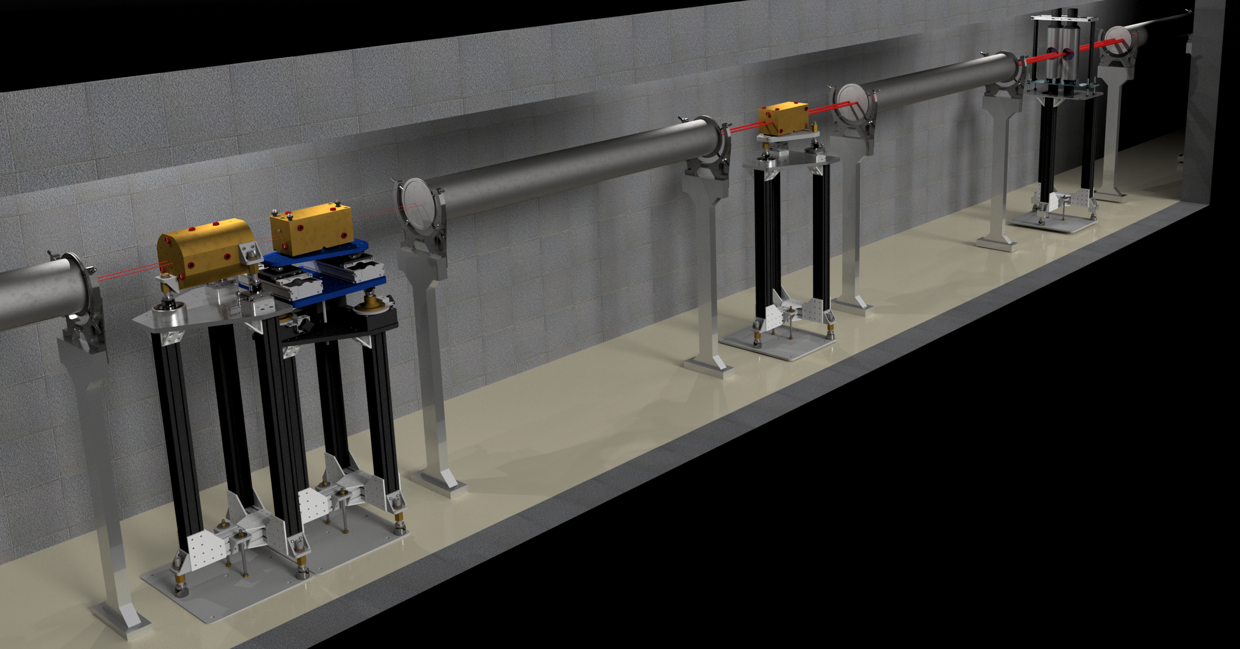
Non-traditional neutron transmission measurements

Slide 12
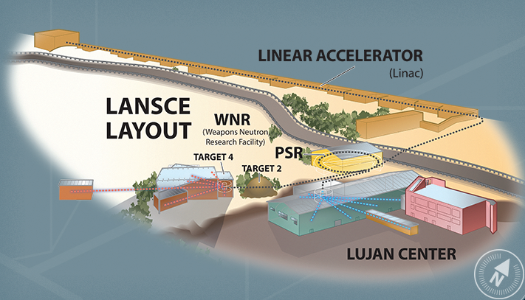
The Los Alamos Neutron Science Center - LANSCE
500-800 MeV protons
keV – MeV neutrons
meV – keV neutrons

Slide 13
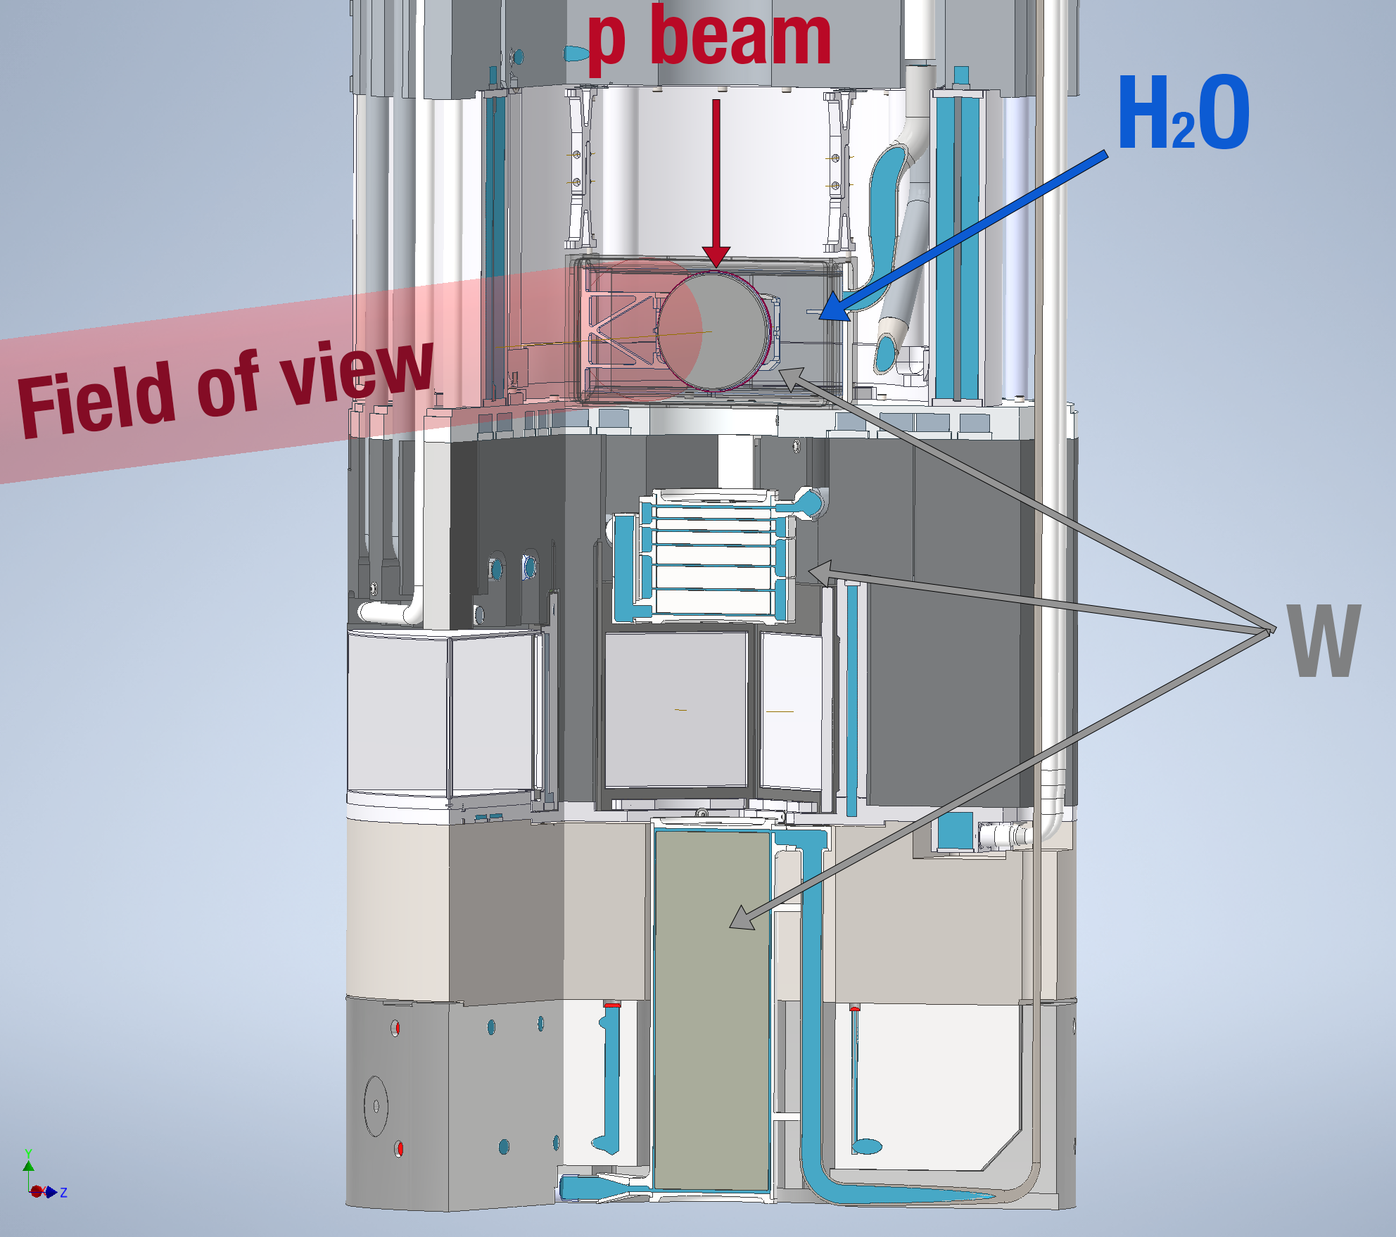
Mark-IV (M4) : New neutron target at Lujan, est. 2022
800MeV protons impinge on a 3-way split W target.
DICER points to the H₂O moderator and the target
Simulation

Slide 14
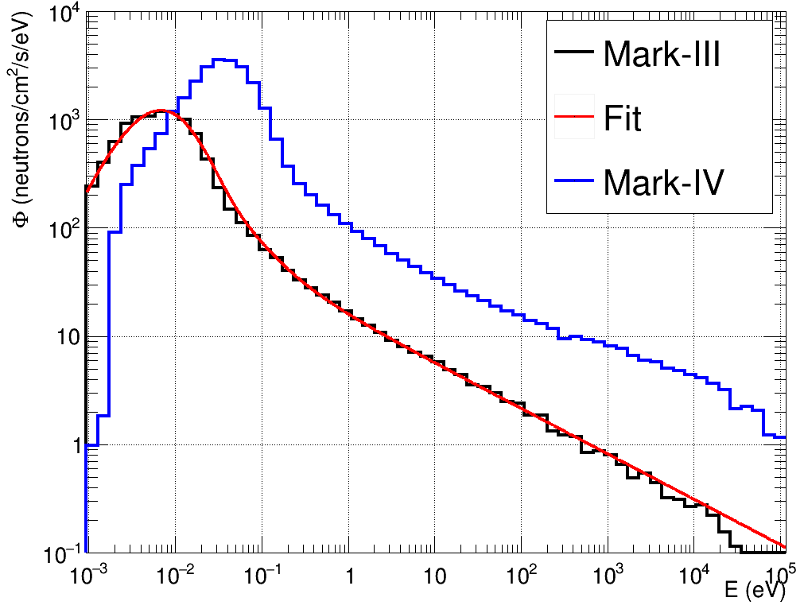
Neutron spectrum
Mark-IV provides an enhanced keV spectrum compared to Mark-III
Mark-IV is expected to improve the neutron energy resolution
Preliminary

Slide 15
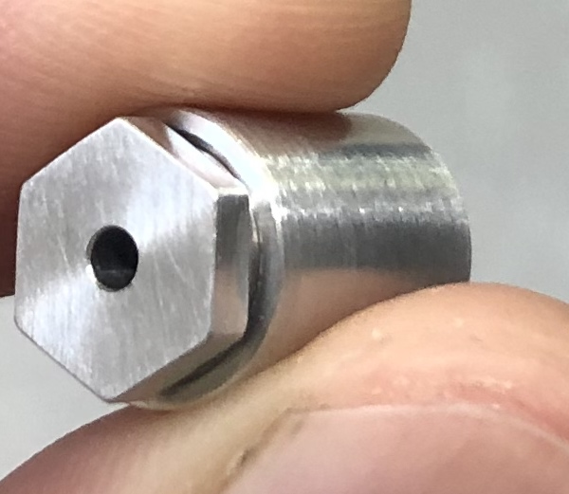
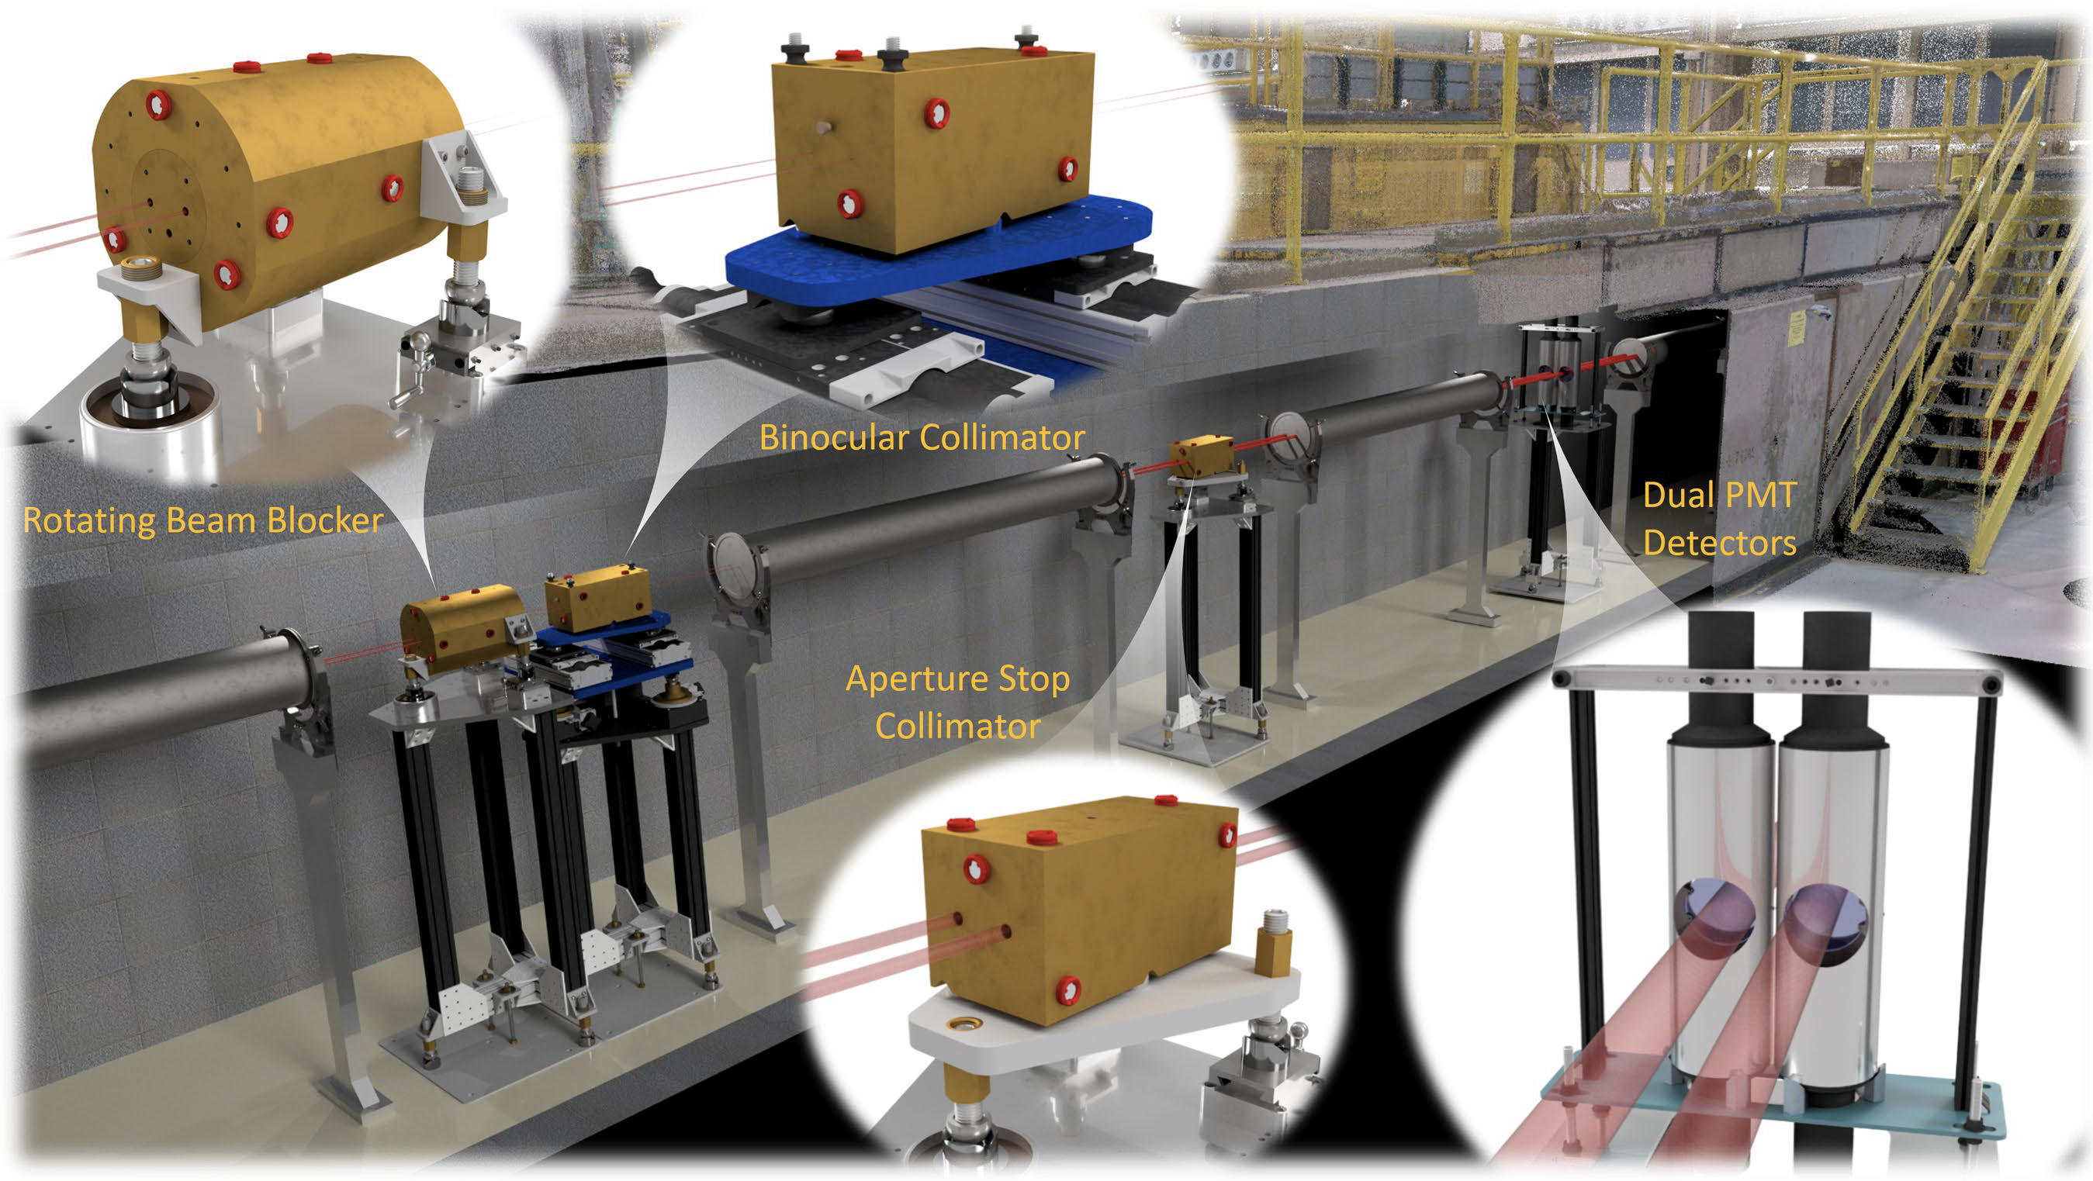
Description of the apparatus:
Device for Indirect Capture Experiments on Radionuclides
A. Stamatopoulos et al., NIMA (1025) 166166, 2022
A. Stamatopoulos et al., IEEE Trans. Nucl. Science 70, (2023)
A. Stamatopoulos et al., Neutron News 33, 12 – 14 (2022)

Slide 16
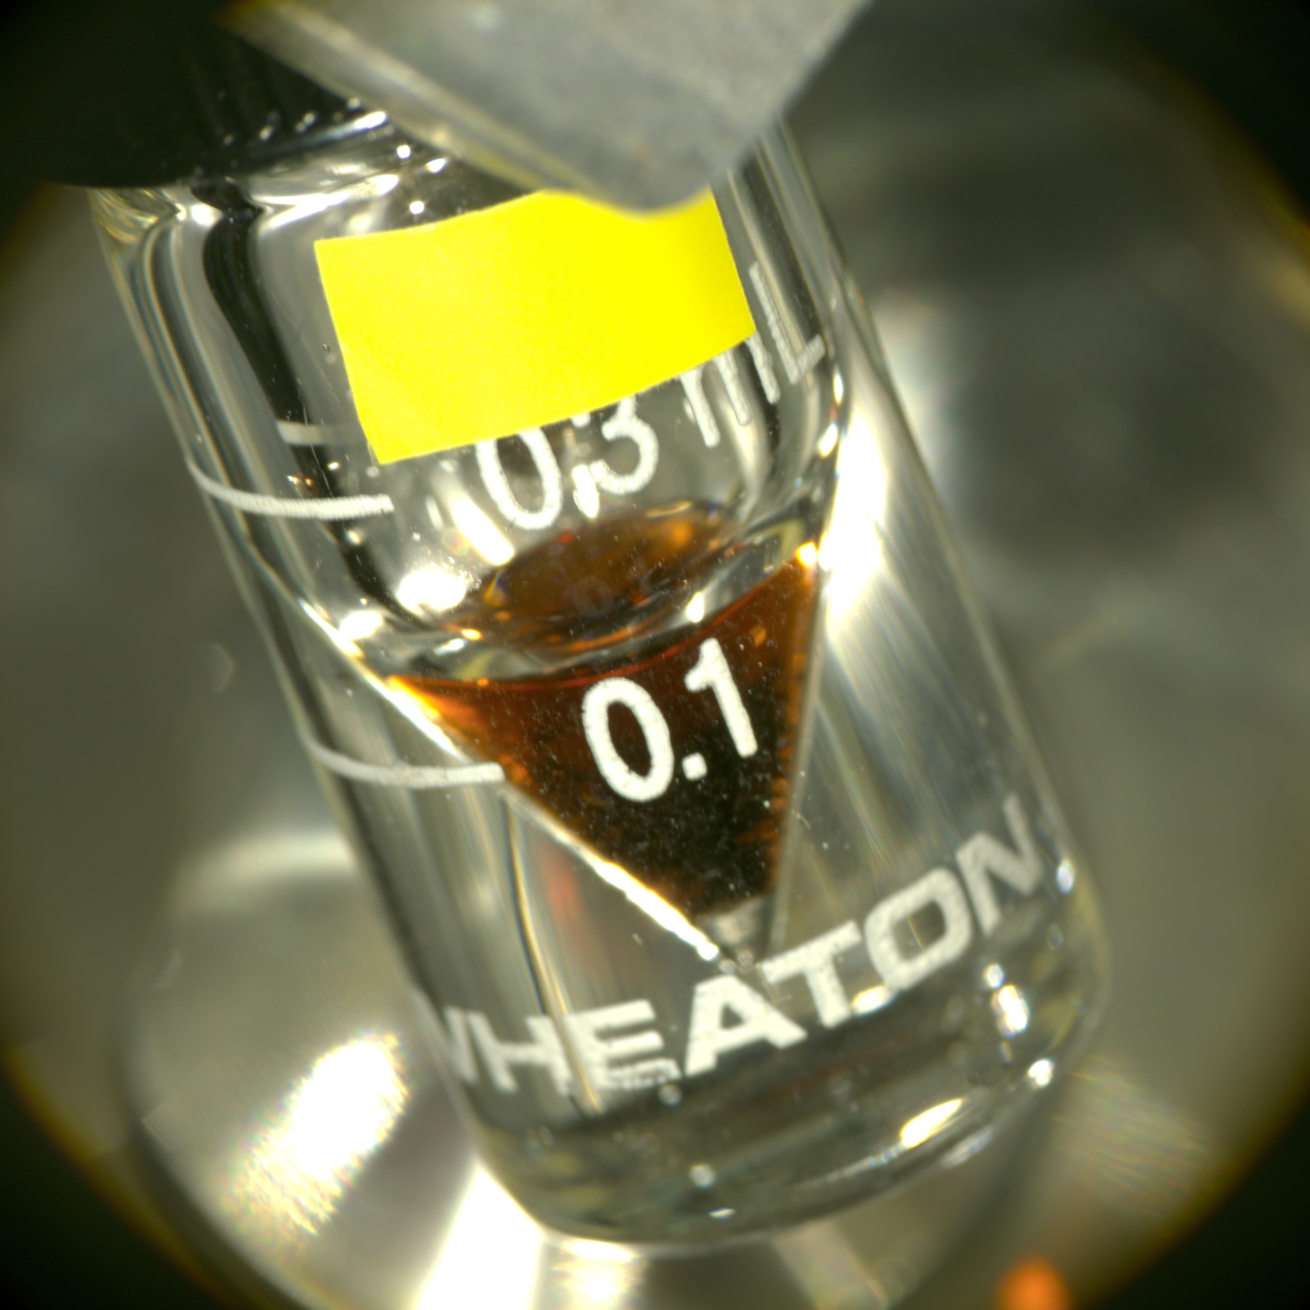
The 88Zr experimental campaign

Slide 17
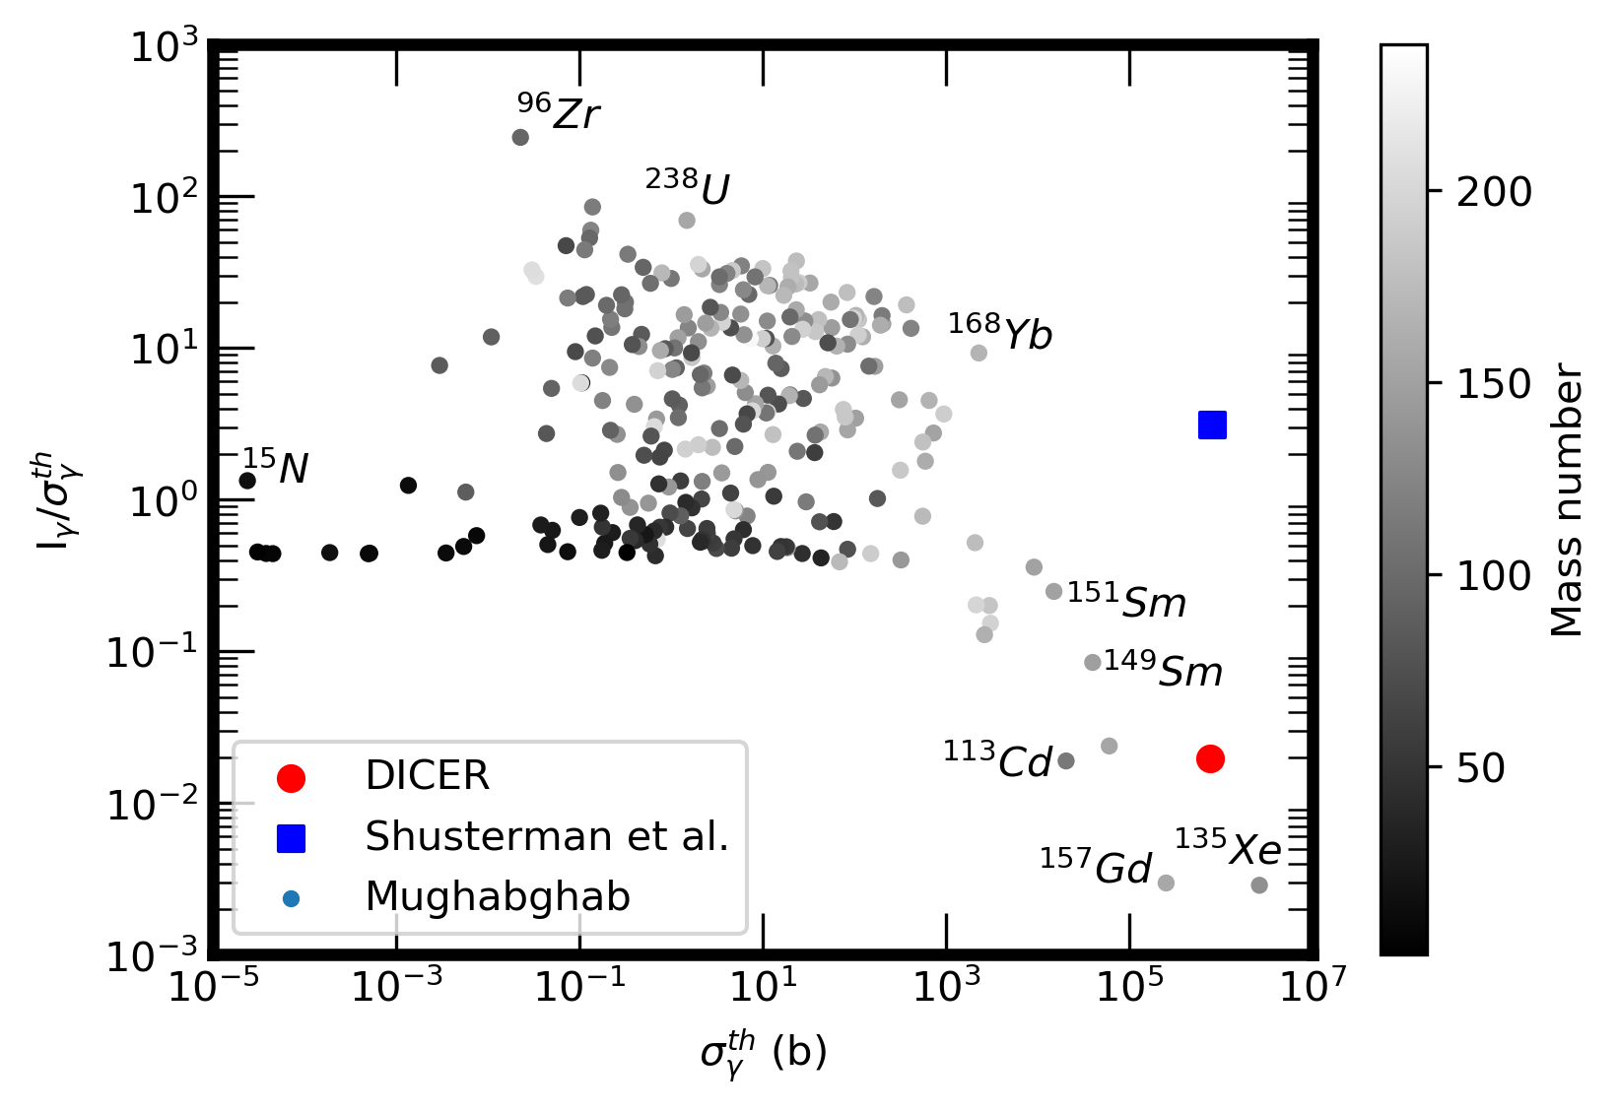
The curious case of ⁸⁸Zr (t_{1/2} = 83.4 days)
LLNL: σ_{γ}^{th} = 0.861(69) Mb Shusterman et al., Nature 565, p 328 (2019)
LLNL: I_{γ} = 2.530(280) Mb Shusterman et al., PRC 103 124614 (2021)
Systematic study taking data from Mughabghab reveals that this is an odd combination

Slide 18
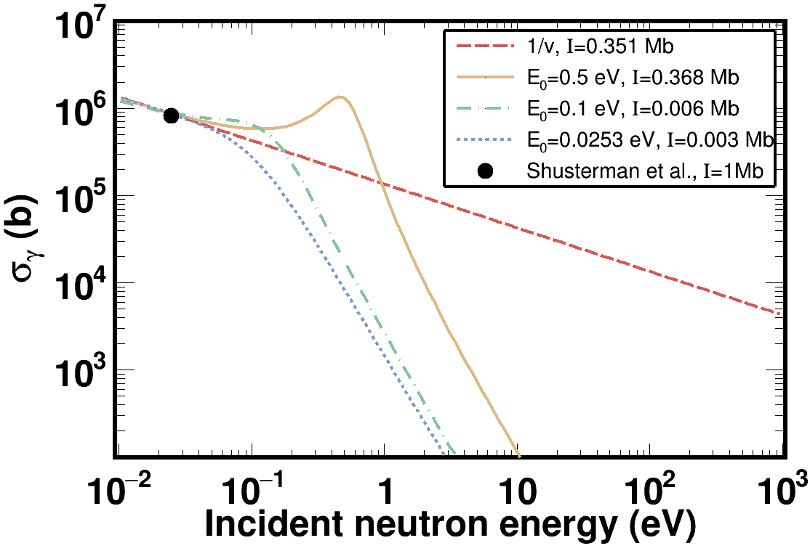
The curious case of ⁸⁸Zr (t_{1/2} = 83.4 days)
It’s even hard to model such combination
SAMMY with different combinations didn’t yield such an enormous I_{γ}.

Slide 19
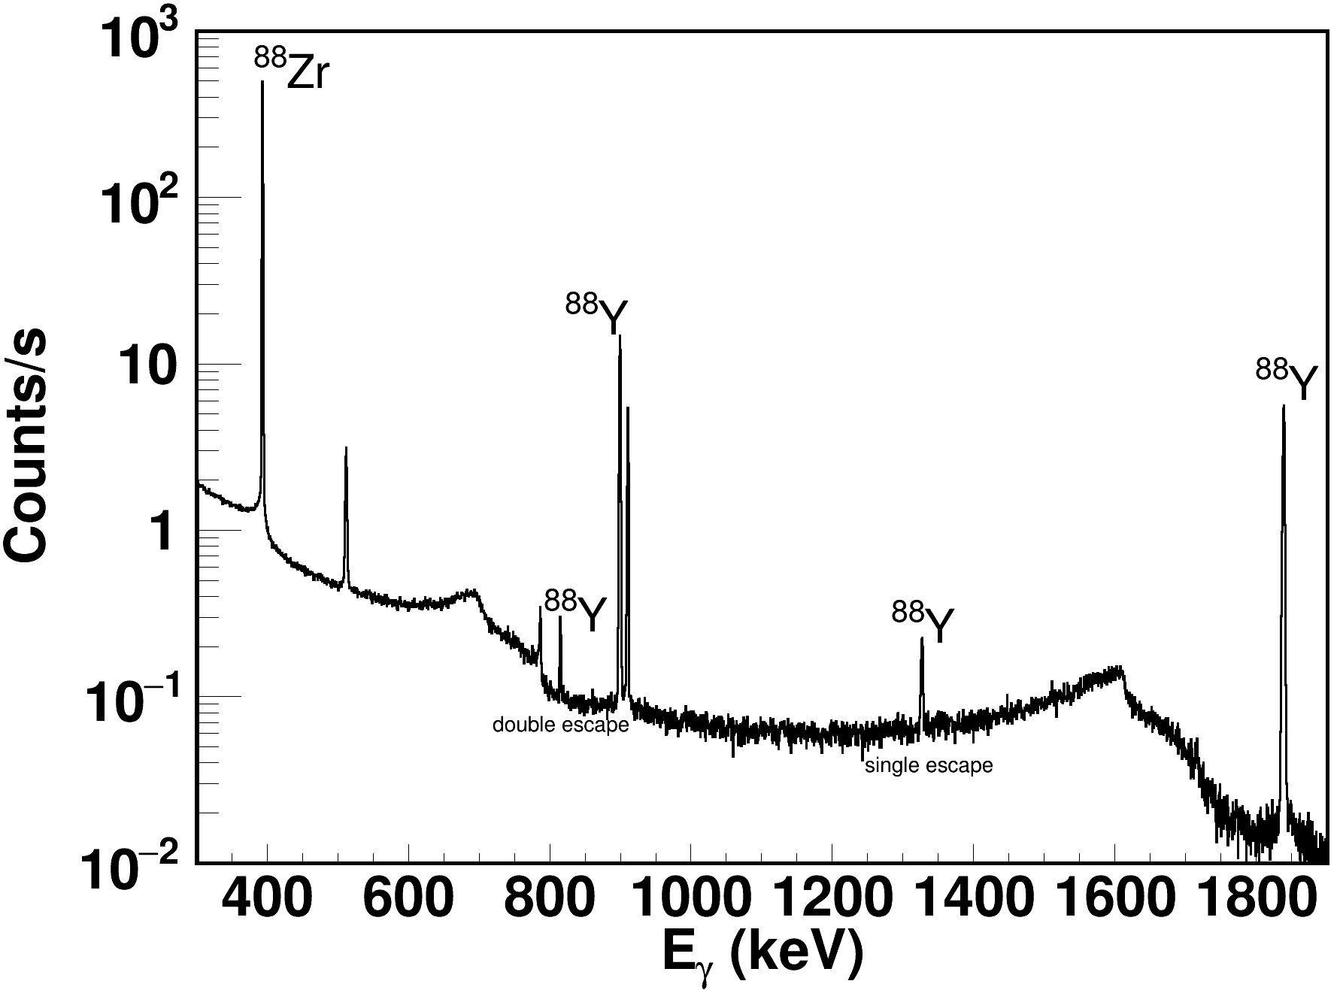
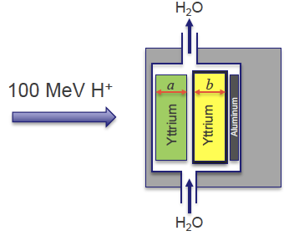
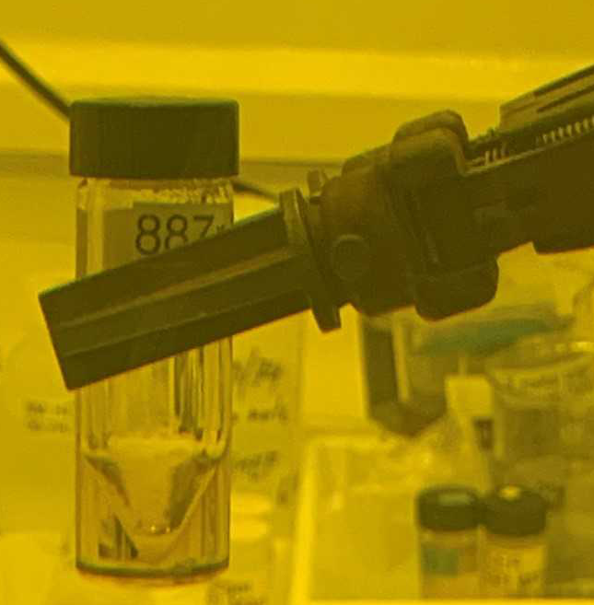
DICER - IPF synergy: The ⁸⁸Zr case
The radioactive sample fabrication relies on the synergy between DICER and IPF
Proton irradiation of a suitable bulk material
Chemical separation and purification (600 mCi, 10 mL ⁸⁸Zr + D₂O●6mol/L DCl )
Gamma spectroscopy
A. Matyskin et al, Scientific Reports 13, 1736 (2023)
A. Stamatopoulos et al., EPJ., Conf. 260, 03006 (2022)
A. Stamatopoulos et al., J. Radioanal. Nucl. Chem. 331, (2022)

Slide 20
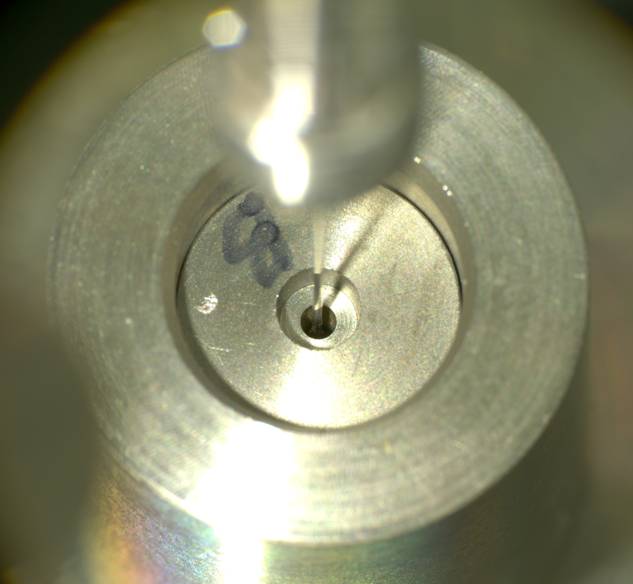
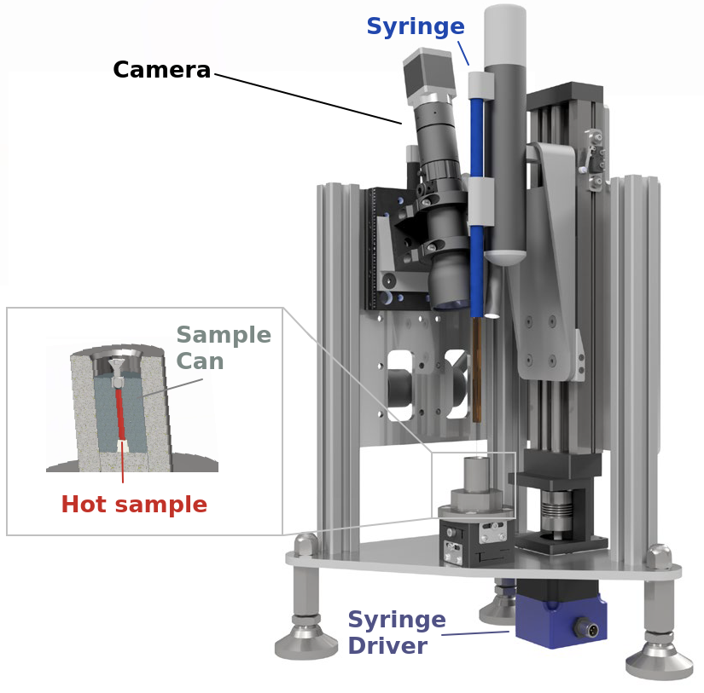
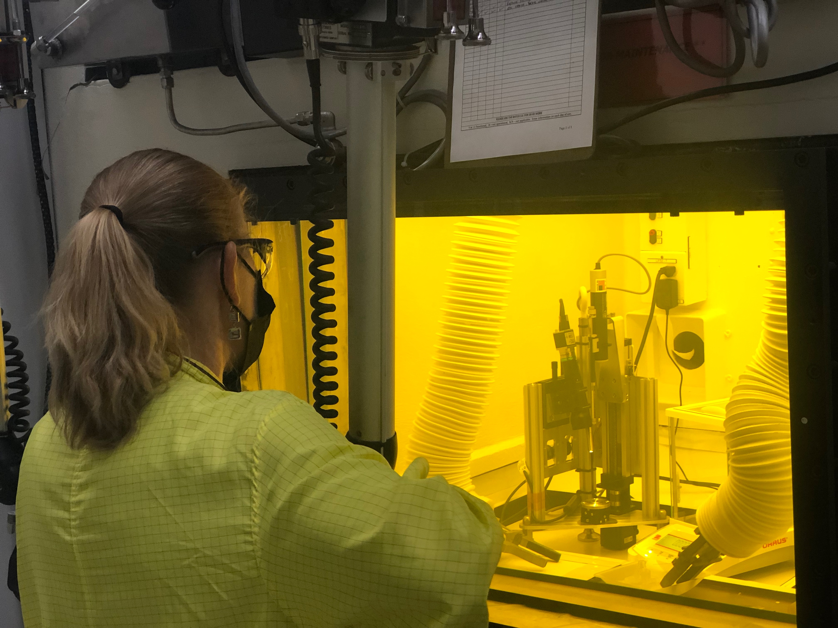
Development of filling station
Operations have to take place in a hot cell with a remote handling capability

Slide 21
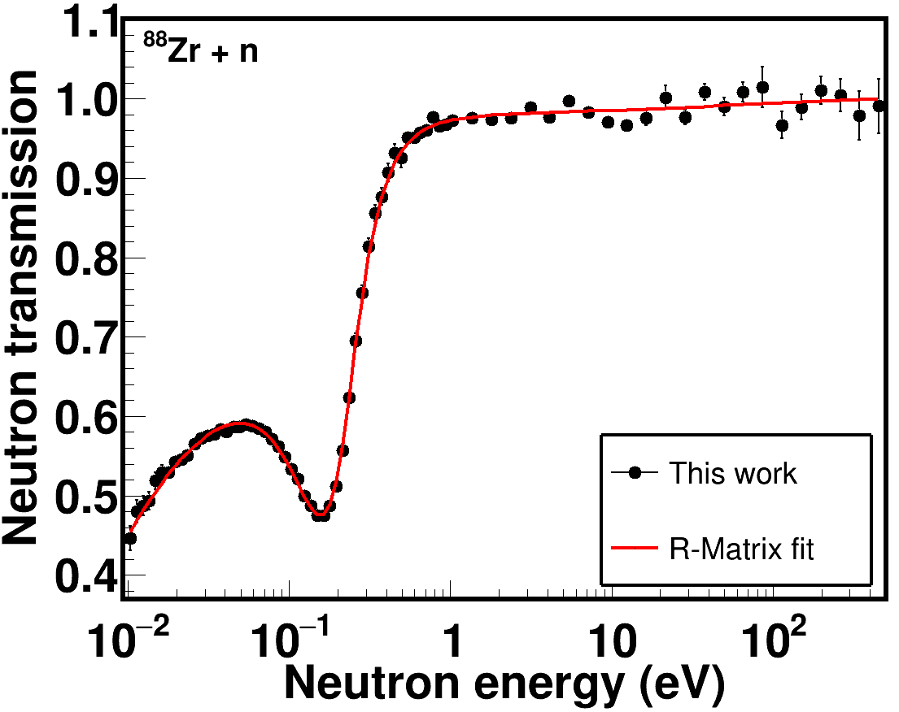
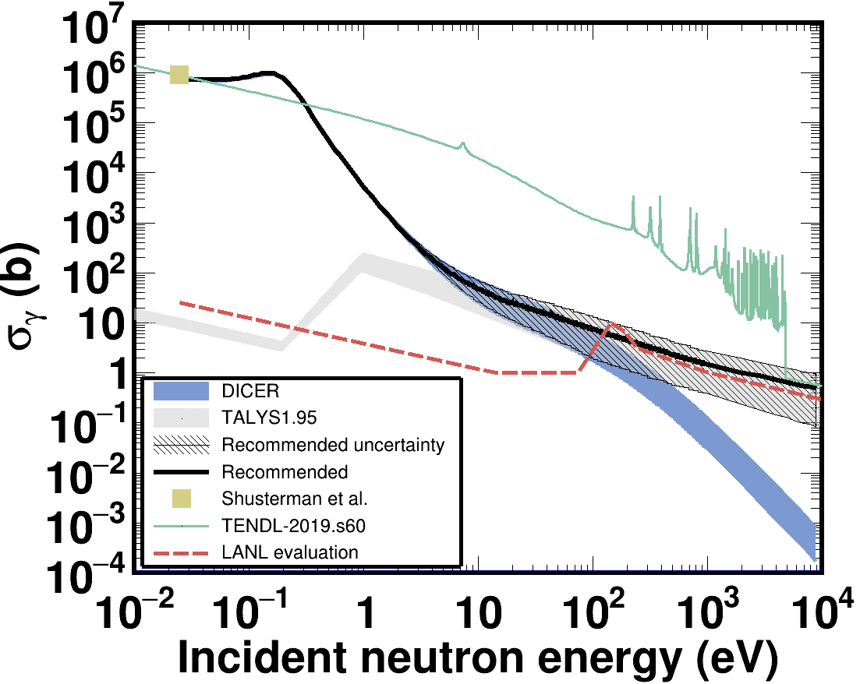
Results
Compatible cross section: σ^{th}_{DICER} = 771(31) kb vs σ^{th}_{LLNL} = 861(69) kb
Incompatible resonance integral: I_{DICER} = 15.21(67) kb vs I_{LLNL} = 2530.0(280) kb
1 keV MACS in agreement with LANL evaluation MACS_{DICER} = 1.6(12) b. vs MACS_{LANL} = 1.1 b
Phys. Rev. Lett : In press

Slide 22
The curious case of ⁸⁸Zr (t_{1/2} = 83.4 days)

Slide 23

Thank you for your attention!

Slide 24
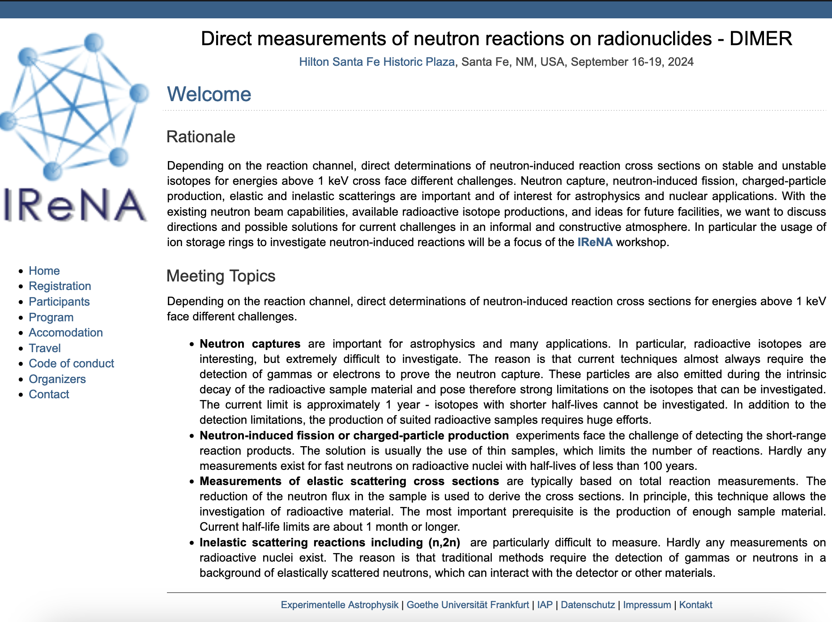
https://exp-astro.de/meetings/dimer/index.php

Slide 25
⁹Back-up slides

Slide 26
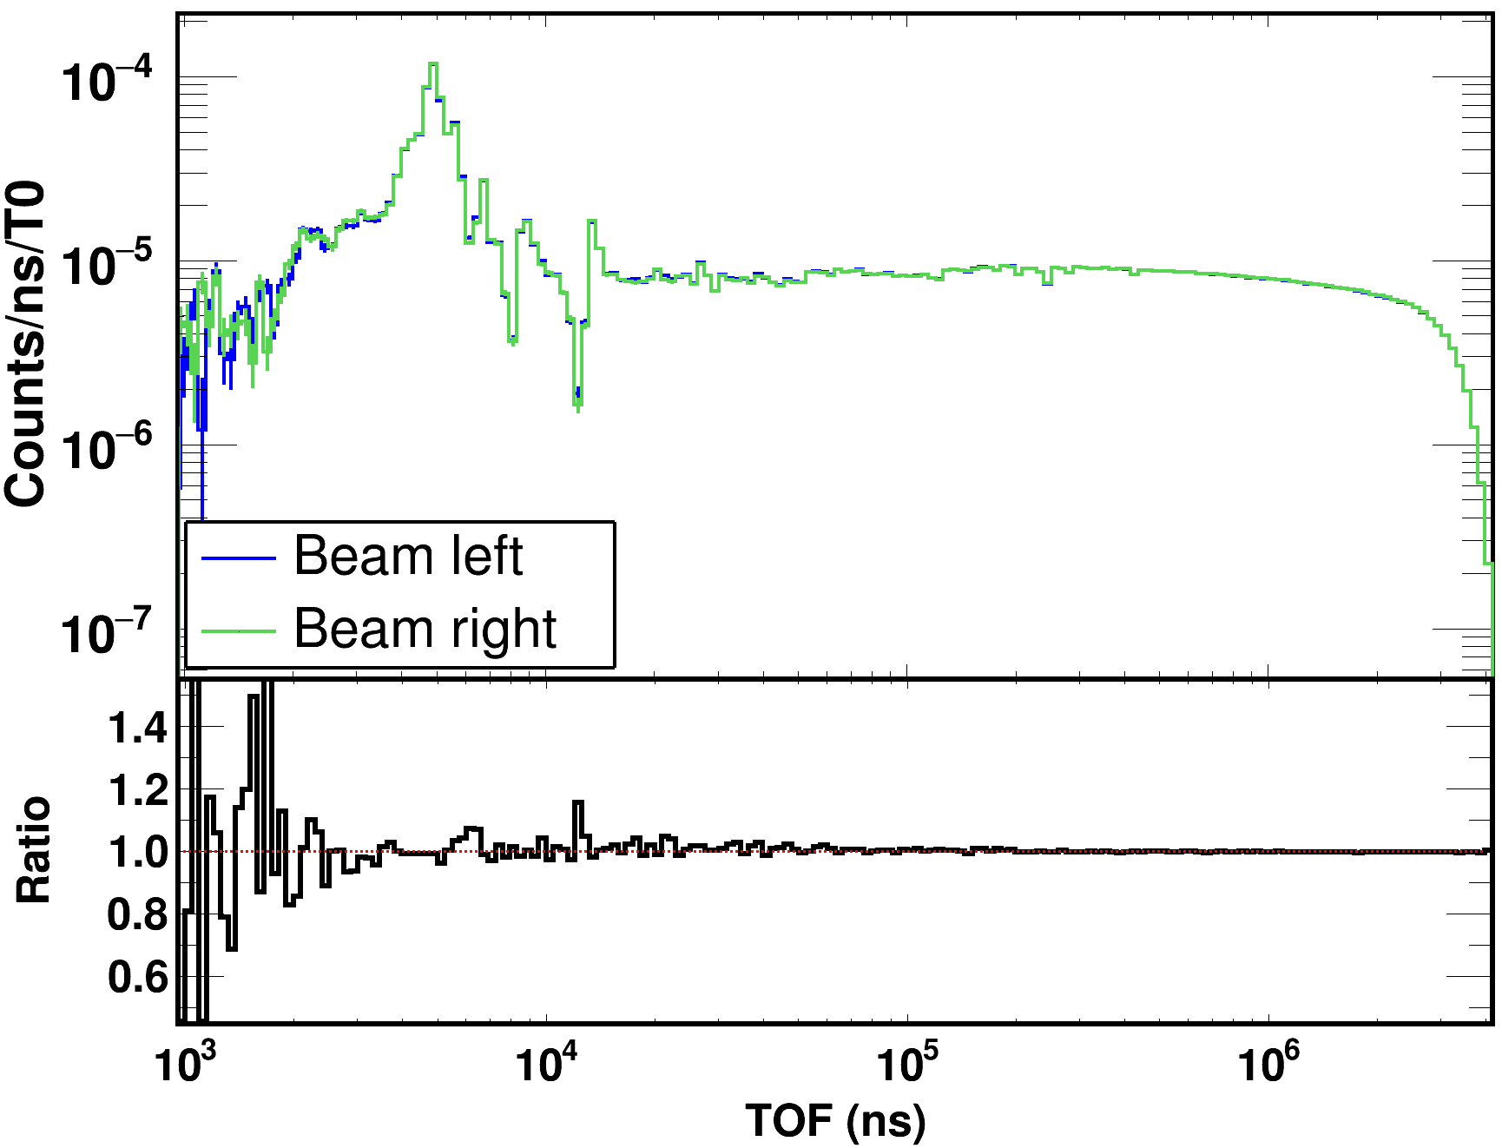
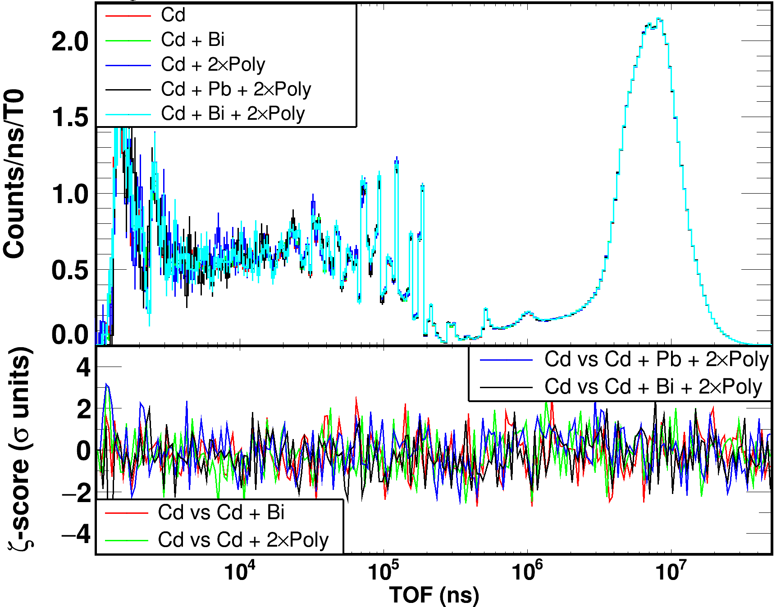
Sanity checks
Flux monitor
Binocular collimator
Does the binocular idea work?
Flux * efficiency: Left vs Right
Paddle configuration: should not affect the flux monitor

Slide 27
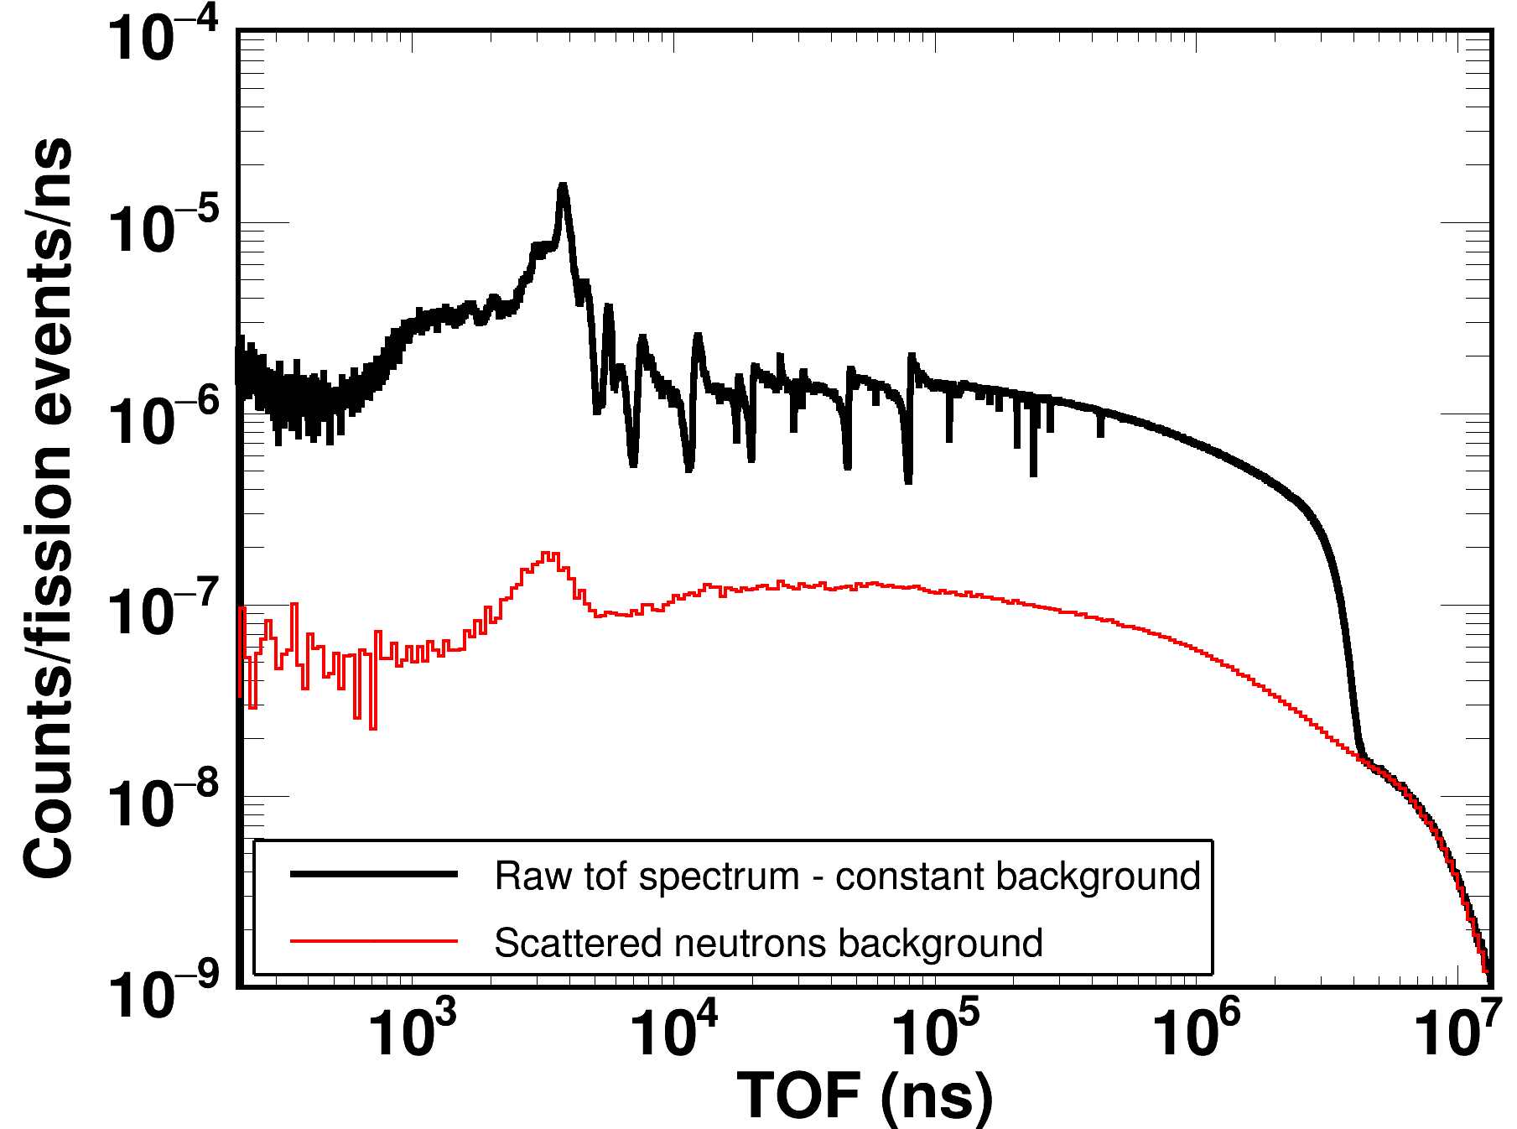
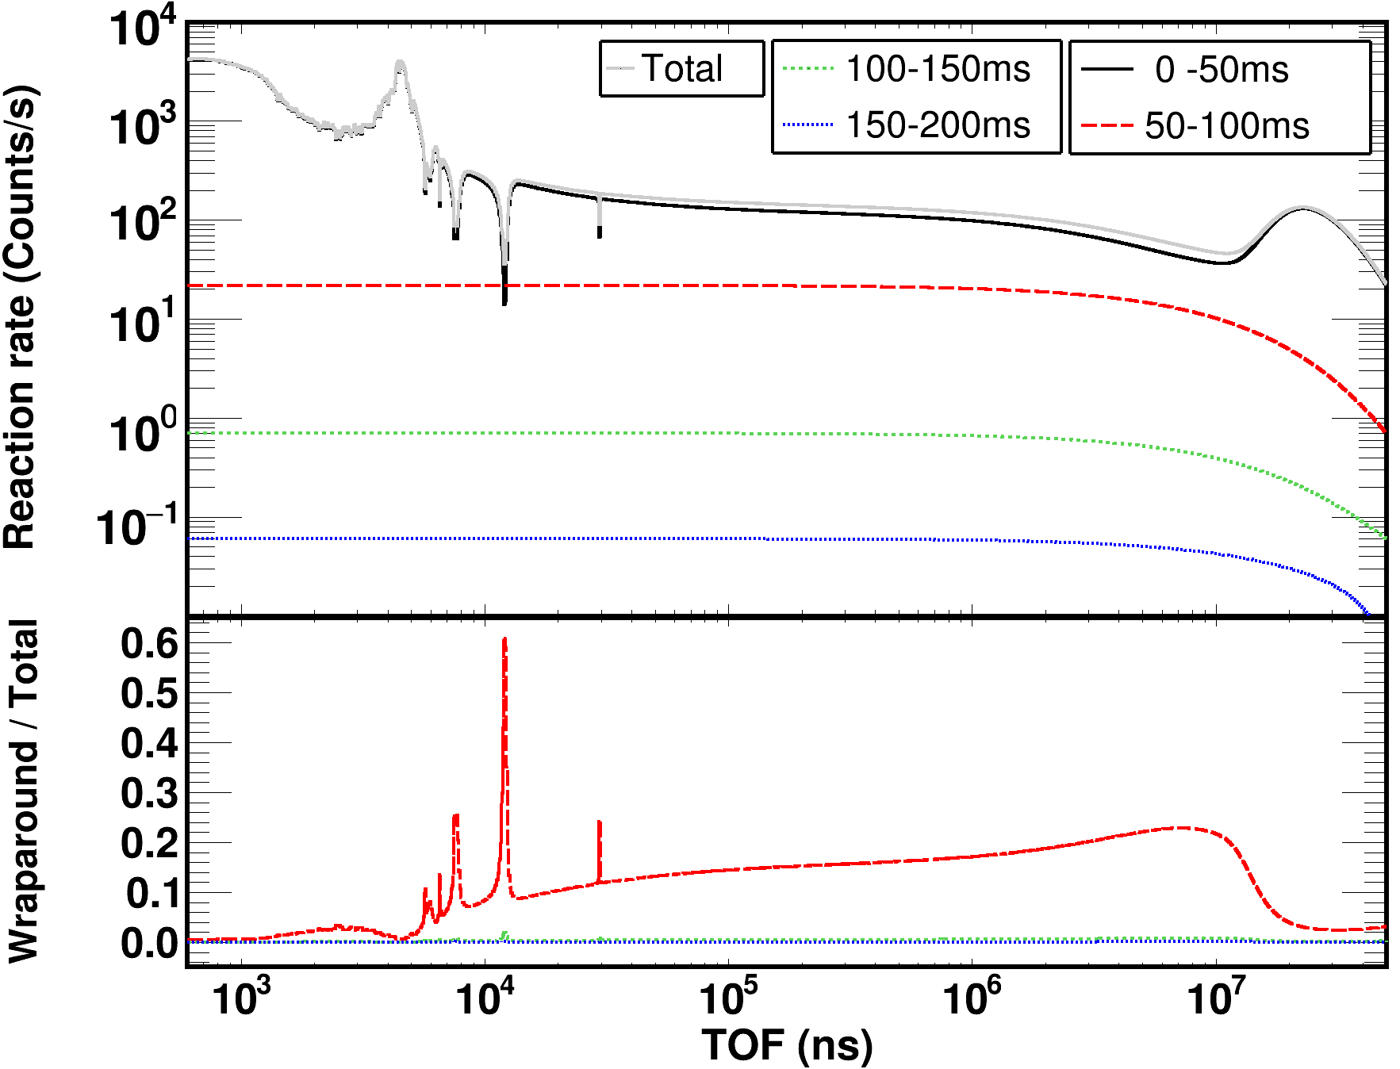
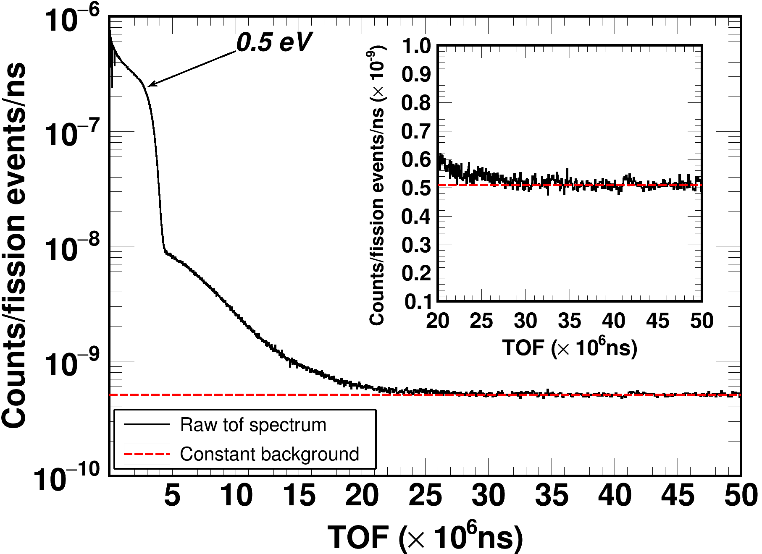
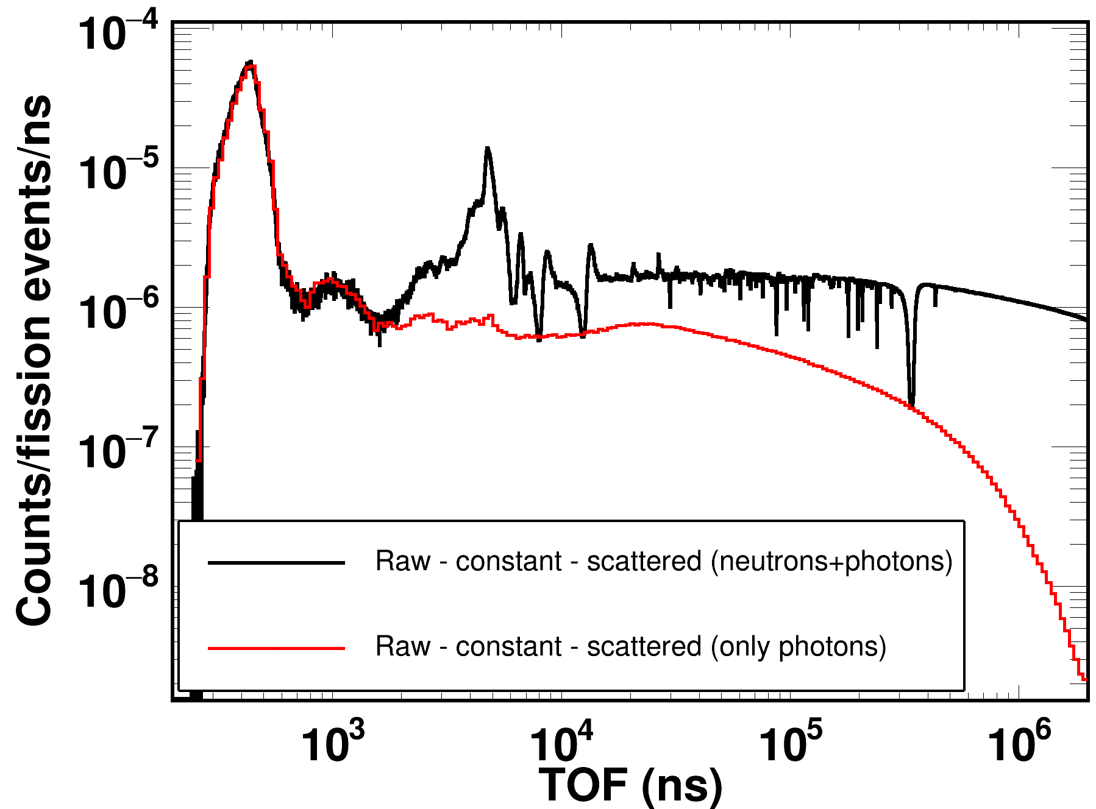
Backgrounds

Slide 28
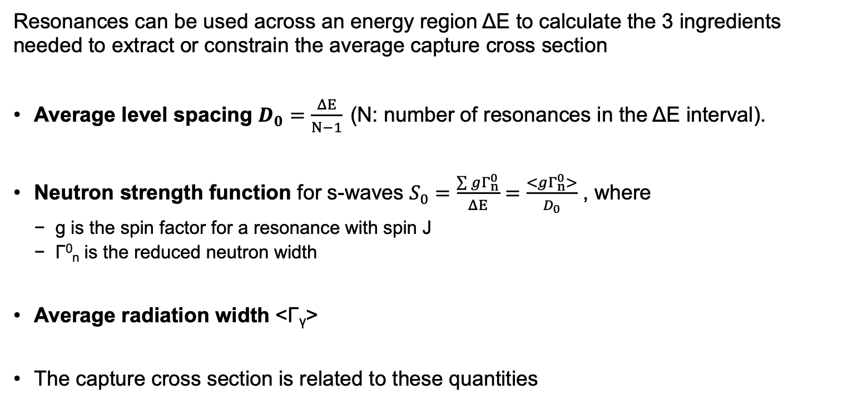

The technique in a nutshell
Resonances can be used across an energy region ΔΕ to calculate the 3 ingredients needed to extract or constrain the average capture cross section
Average level spacing $D_{0}=\frac{ΔE}{N−1}$ (N: number of resonances in the ΔΕ interval).
Neutron strength function for s-waves $S_{0}=\frac{\sum{gΓ_{n}^{0}}}{ΔE}=\frac{<gΓ_{n}^{0}>}{D_{0}}$ , where
g is the spin factor for a resonance with spin J
Γ⁰_{n} is the reduced neutron width
Average radiation width <Γ_{γ}>
The capture cross section is related to these quantities
$$=f(\text{Γ},\text{Γ}\text{n}, D_{0})$$
k : Wave number
W : Width fluctuation factor
Notes:
n the Hauser-Feshbach formalism, the width fluctuation factor represents the effect of the statistical fluctuations in the nuclear levels on the width (or probability) of a particular reaction channel. It accounts for the fact that the widths of these levels are not fixed values but can vary due to the uncertainty principle of quantum mechanics. Essentially, it helps to adjust the predicted cross sections for nuclear reactions to better match experimental data.

Slide 29
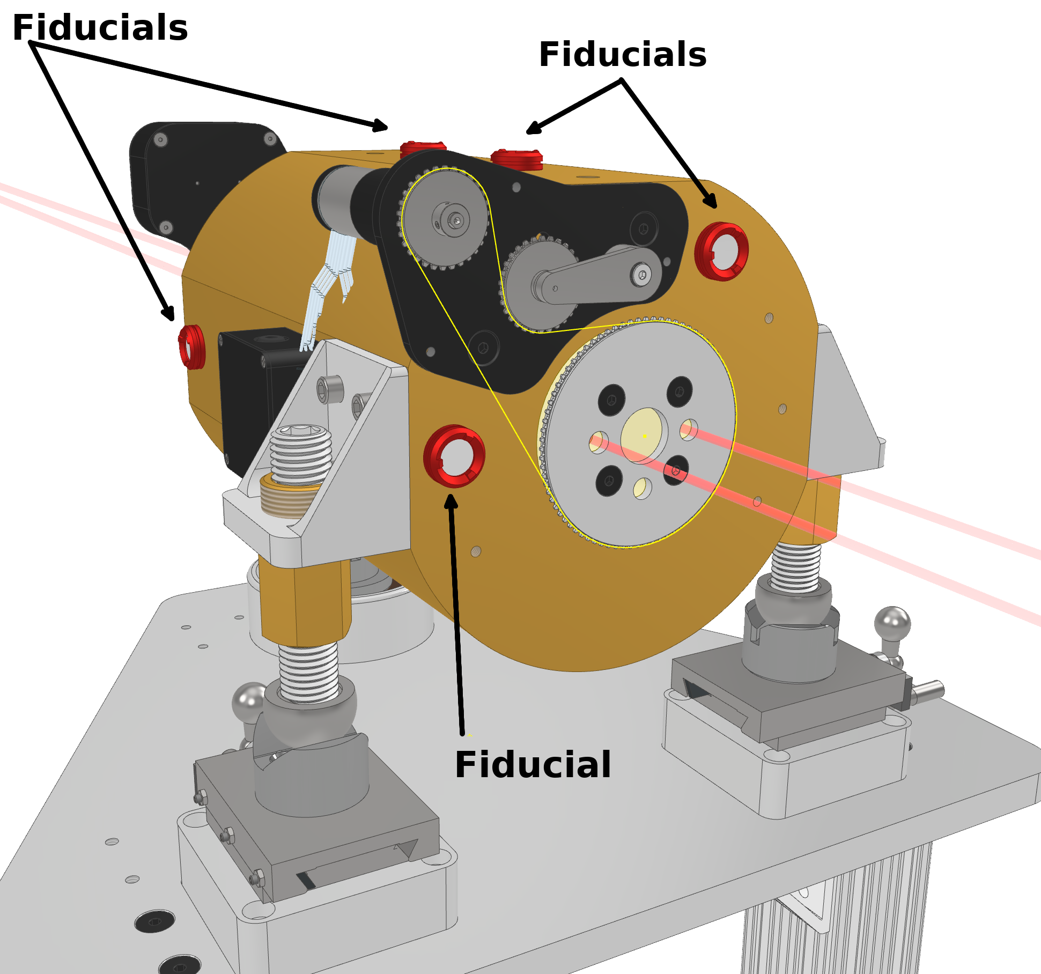
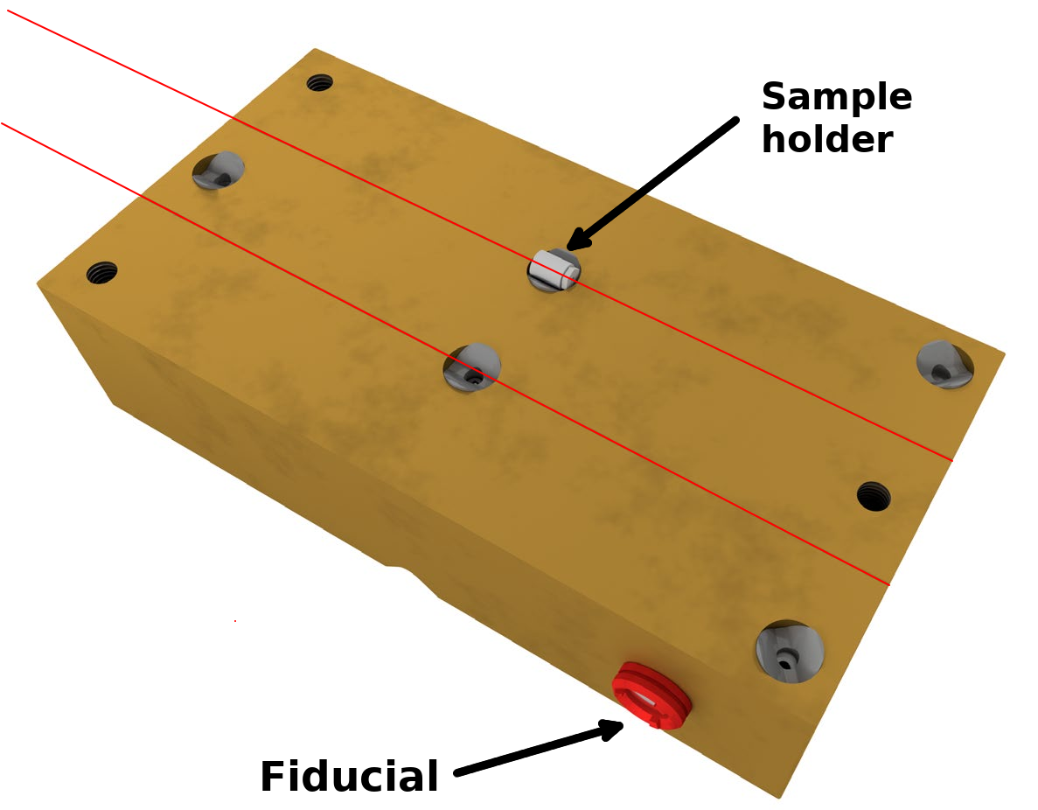
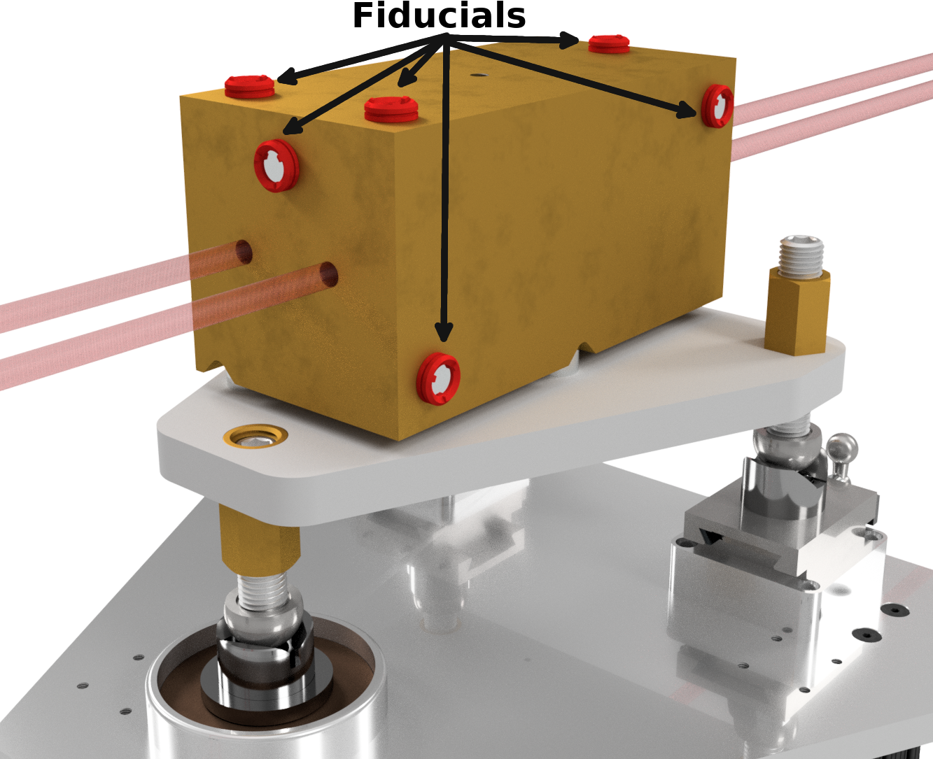
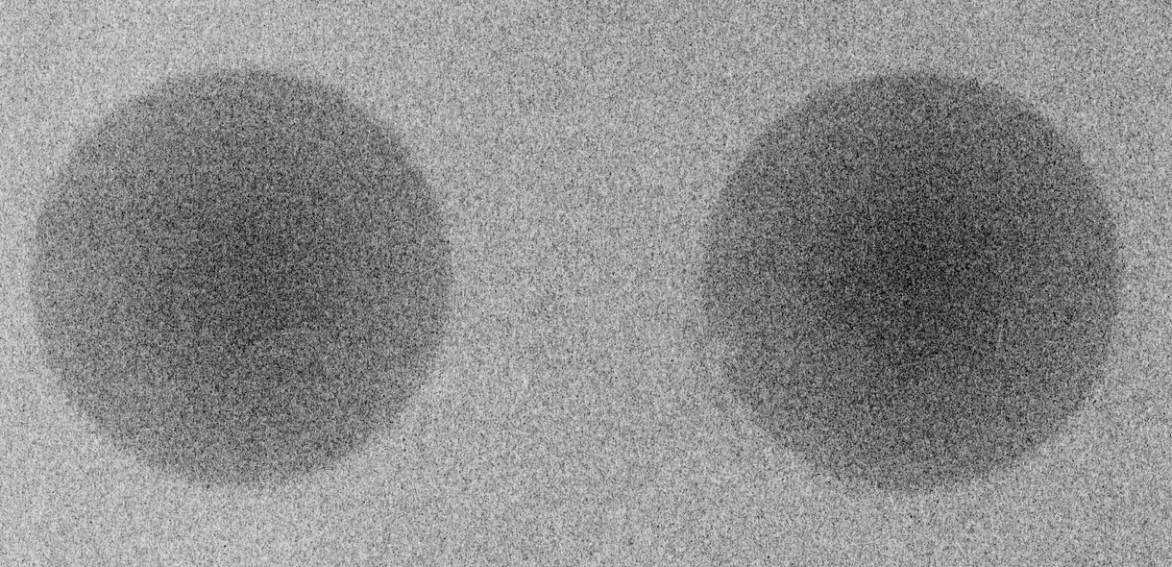
Sophisticated collimation system
Rotating beam blocker
Binocular collimator
Aperture stop
Cuts off the beam penumbra
Ensures two sharp beam spots at a 31 m, 9.5 cm in diameter
Rotating inner cylinder with 3 holes
30 cm in length
Provides 0 - 2 beams
Stepped design to avoid neutron stream paths
Remotely controlled
Divided in a top and bottom part
Sample is installed in the collimator in the Maxwell kinematic stops
1.5 cm length, 1 cm diameter sample envelope
1 mm collimation
Kinematic stops ensure repeatability when installing the top part.

