Slide 1
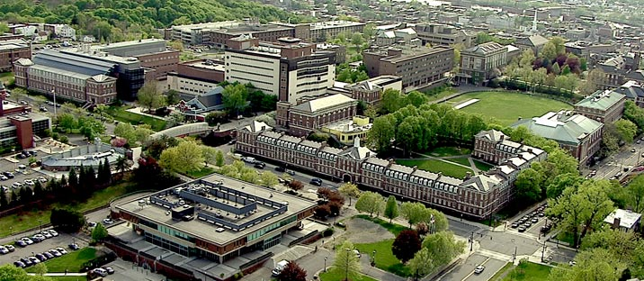
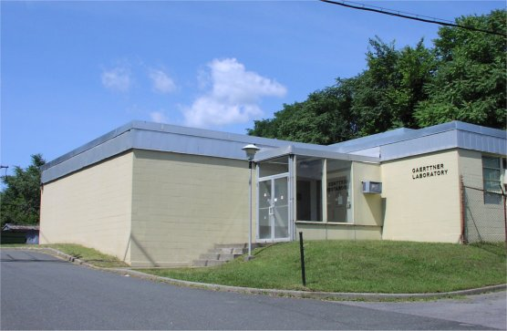
Overview of Nuclear Data Measurement and Analysis at RPI
Y. Danon, A. Golas, K. Keparutis, I. Parker, S. Singh, G. Siemers, and B. Wang
Gaerttner LINAC Center, Rensselaer Polytechnic Institute, Troy, NY 12180
D. Barry, A. Daskalakis, B. Epping, M. Rapp, and T. Trumbull
Naval Nuclear Laboratory, P.O. Box 1072, Schenectady, NY 12301
Rensselaer Polytechnic Institute
Gaerttner LINAC Center
CSEWG meeting, November 4-8, 2024
This work was partially supported by the Nuclear Criticality Safety Program, funded and managed by the National Nuclear Security Administration for the U.S. Department of Energy and Naval Reactors, partially performed under appointment to the Rickover Fellowship Program in Nuclear Engineering sponsored by Naval Reactors (NR) Division of the National Nuclear Security Administration (NNSA), and partially based upon work supported by the U.S. Department of Energy, Office of Science, Office of Nuclear Physics, under Award Number DE-SC0024679.
Notes:
Go over the list of authors and sponsors (KAPL, NCSP, SSAA, SNS, RPI).

Slide 2
Outline
Measurements and Evaluation of ⁵⁴Fe (S. Singh)
Neutron-induced γ-ray spectra measurements (K. Keparutis, I. Parker)
Thermal neutron die-away measurements (B. Wang)
Zirconium Evaluation Progress (G. Siemers)
URR improvement to SAMMY (A. Golas)

Slide 3
Measurements and Evaluation of ⁵⁴Fe S. Singh

Slide 4
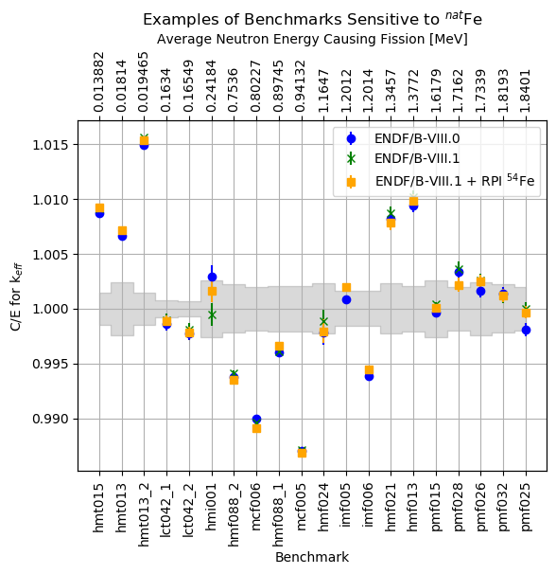
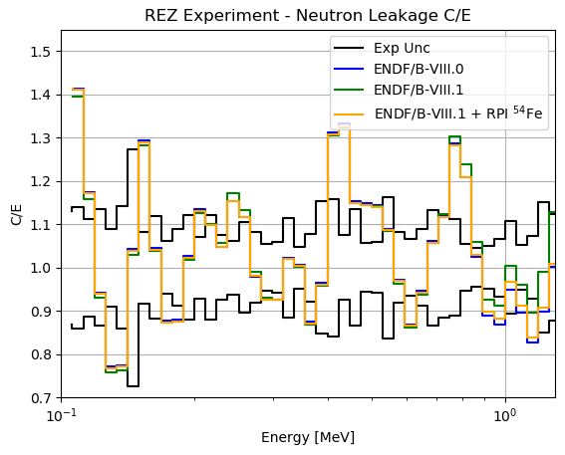
⁵⁴Fe Project Overview
Motivation:
Criticality safety calculations require high accuracy nuclear data to reduce uncertainties
⁵⁴Fe neutron cross sections have not been well-studied relative to ⁵⁶Fe.
Project Goals:
Perform new RRR evaluation for ⁵⁴Fe cross section in the keV region using RPI and EXFOR nuclear data.
Perform radiative capture and transmission measurements of ⁵⁴Fe in the keV energy region

Slide 5
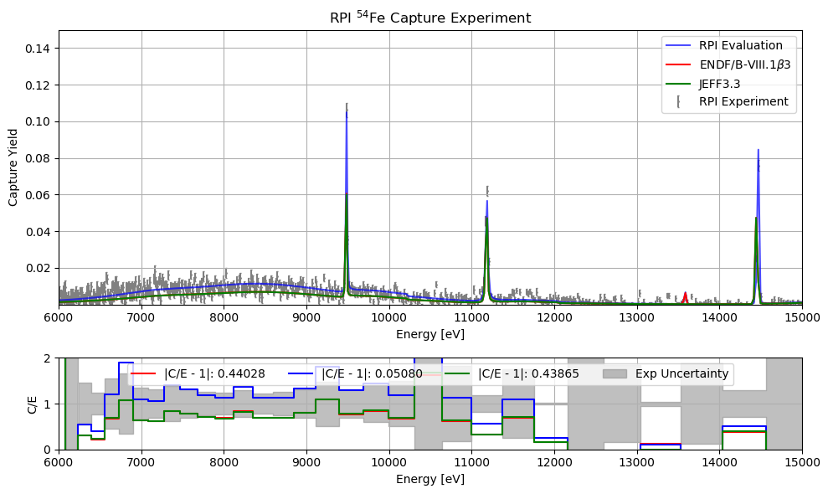
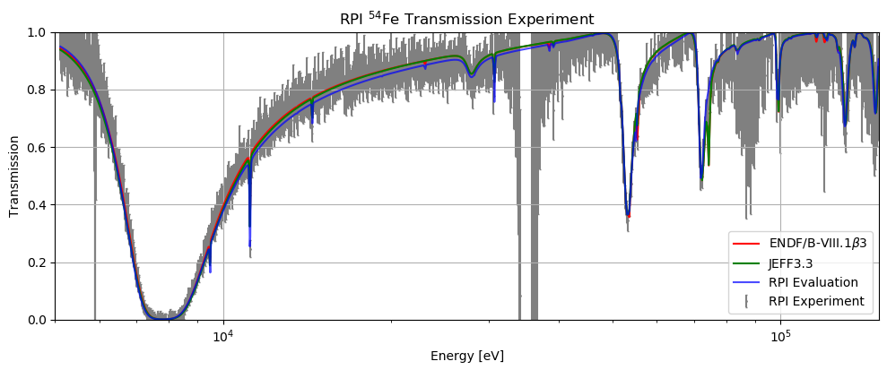
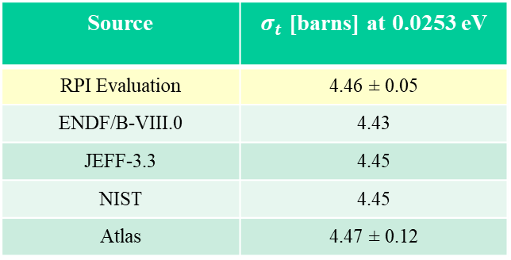
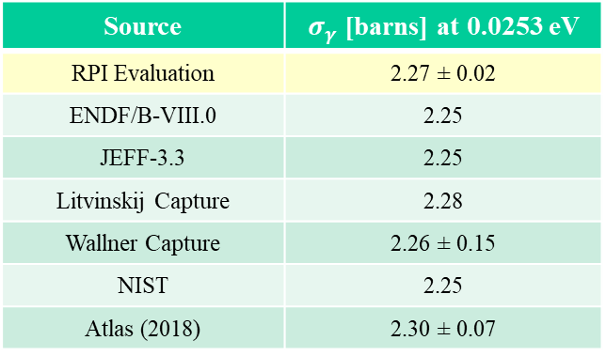
RPI Evaluation Results
Source | $σ_{γ}$ [barns] at 0.0253 eV
RPI Evaluation | 2.27 ± 0.02
ENDF/B-VIII.0 | 2.25
JEFF-3.3 | 2.25
Litvinskij Capture | 2.28
Wallner Capture | 2.26 ± 0.15
NIST | 2.25
Atlas (2018) | 2.30 ± 0.07
Experiment or Evaluation | Value [mb] @ 30 keV
ENDF/B-VIII.0 | 27.13
RPI Eval | 29.8 ± 0.9
KADoNiS-0.3 | 29.6 ± 1.3
n_TOF Exp | 30.8 ± 1.6
Allen Exp | 33.6 ± 2.7
Source | $σ_{t}$ [barns] at 0.0253 eV
RPI Evaluation | 4.46 ± 0.05
ENDF/B-VIII.0 | 4.43
JEFF-3.3 | 4.45
NIST | 4.45
Atlas | 4.47 ± 0.12

Slide 6
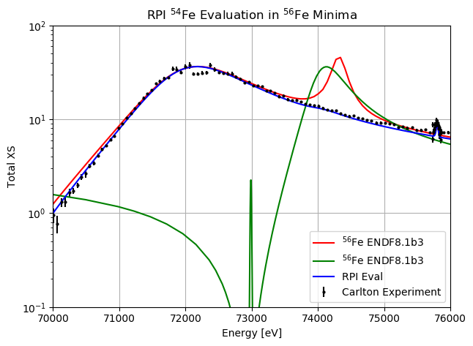
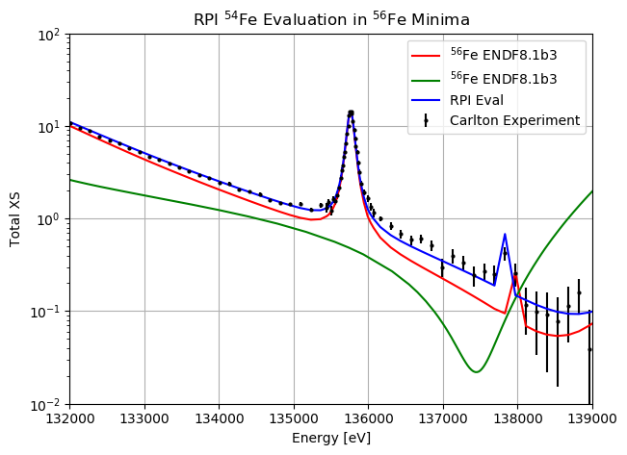
RPI Evaluation Results
54
54

Slide 7
Neutron-Induced γ-ray Spectra Measurements at the RPI LINAC K. Keparutis and I. Parker
This work was partially performed under appointment to the Rickover Fellowship Program in Nuclear Engineering sponsored by Naval Reactors (NR) Division of the National Nuclear Security Administration (NNSA). ​
This material is partially based upon work supported by the U.S. Department of Energy, Office of Science, Office of Nuclear Physics, under Award Number DE-SC0024679.

Slide 8
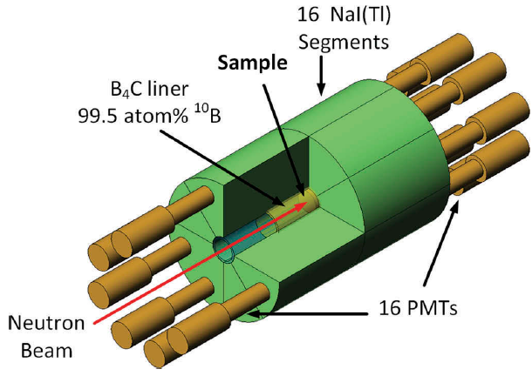
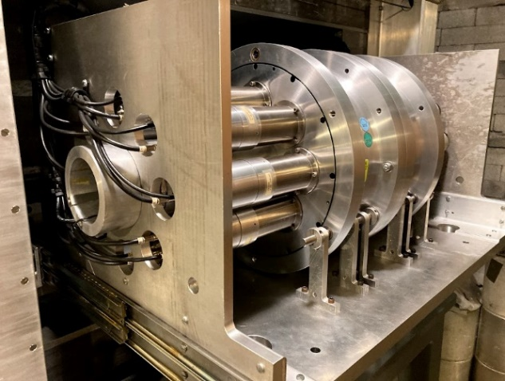
RPI Neutron-Induced γ-ray Spectra Measurements
Measurements coupled with updated simulation methods provide a tool that can be used to assess the accuracy of γ-ray production data stored in nuclear data libraries
Samples measured at RPI with incident neutron energies of 0.01-100 eV: ⁵⁶Fe, ⁵⁵Mn, ⁵⁹Co, ^{nat}Ta, ^{nat}U, ²³⁵U, ^{nat}Cd, ^{nat}Au, ^{nat}In, and NaCl
Updated simulation method: mod-MCNP6.2/DICEBOX
γ-ray cascades generated using DICEBOX and transported through the detector geometry
Writes an output file that saves γ-ray energy deposition in detector segments (enables event-by-event analysis including coincidence)
Motivation: improving γ-ray production data
Increase the accuracy of reactor and shielding calculations
Understand the effects of γ-ray heating in nuclear reactors
Improve isotope identification for active neutron interrogation
Awarded DOE Grant (FY23-25) as a follow-on project with the GRIN collaboration: Development of Benchmark Measurements for Capture Gamma Cascades
(DE-SC0024679)
Benchmark deliverables: measurement data, simulation tools, and benchmark template

Slide 9
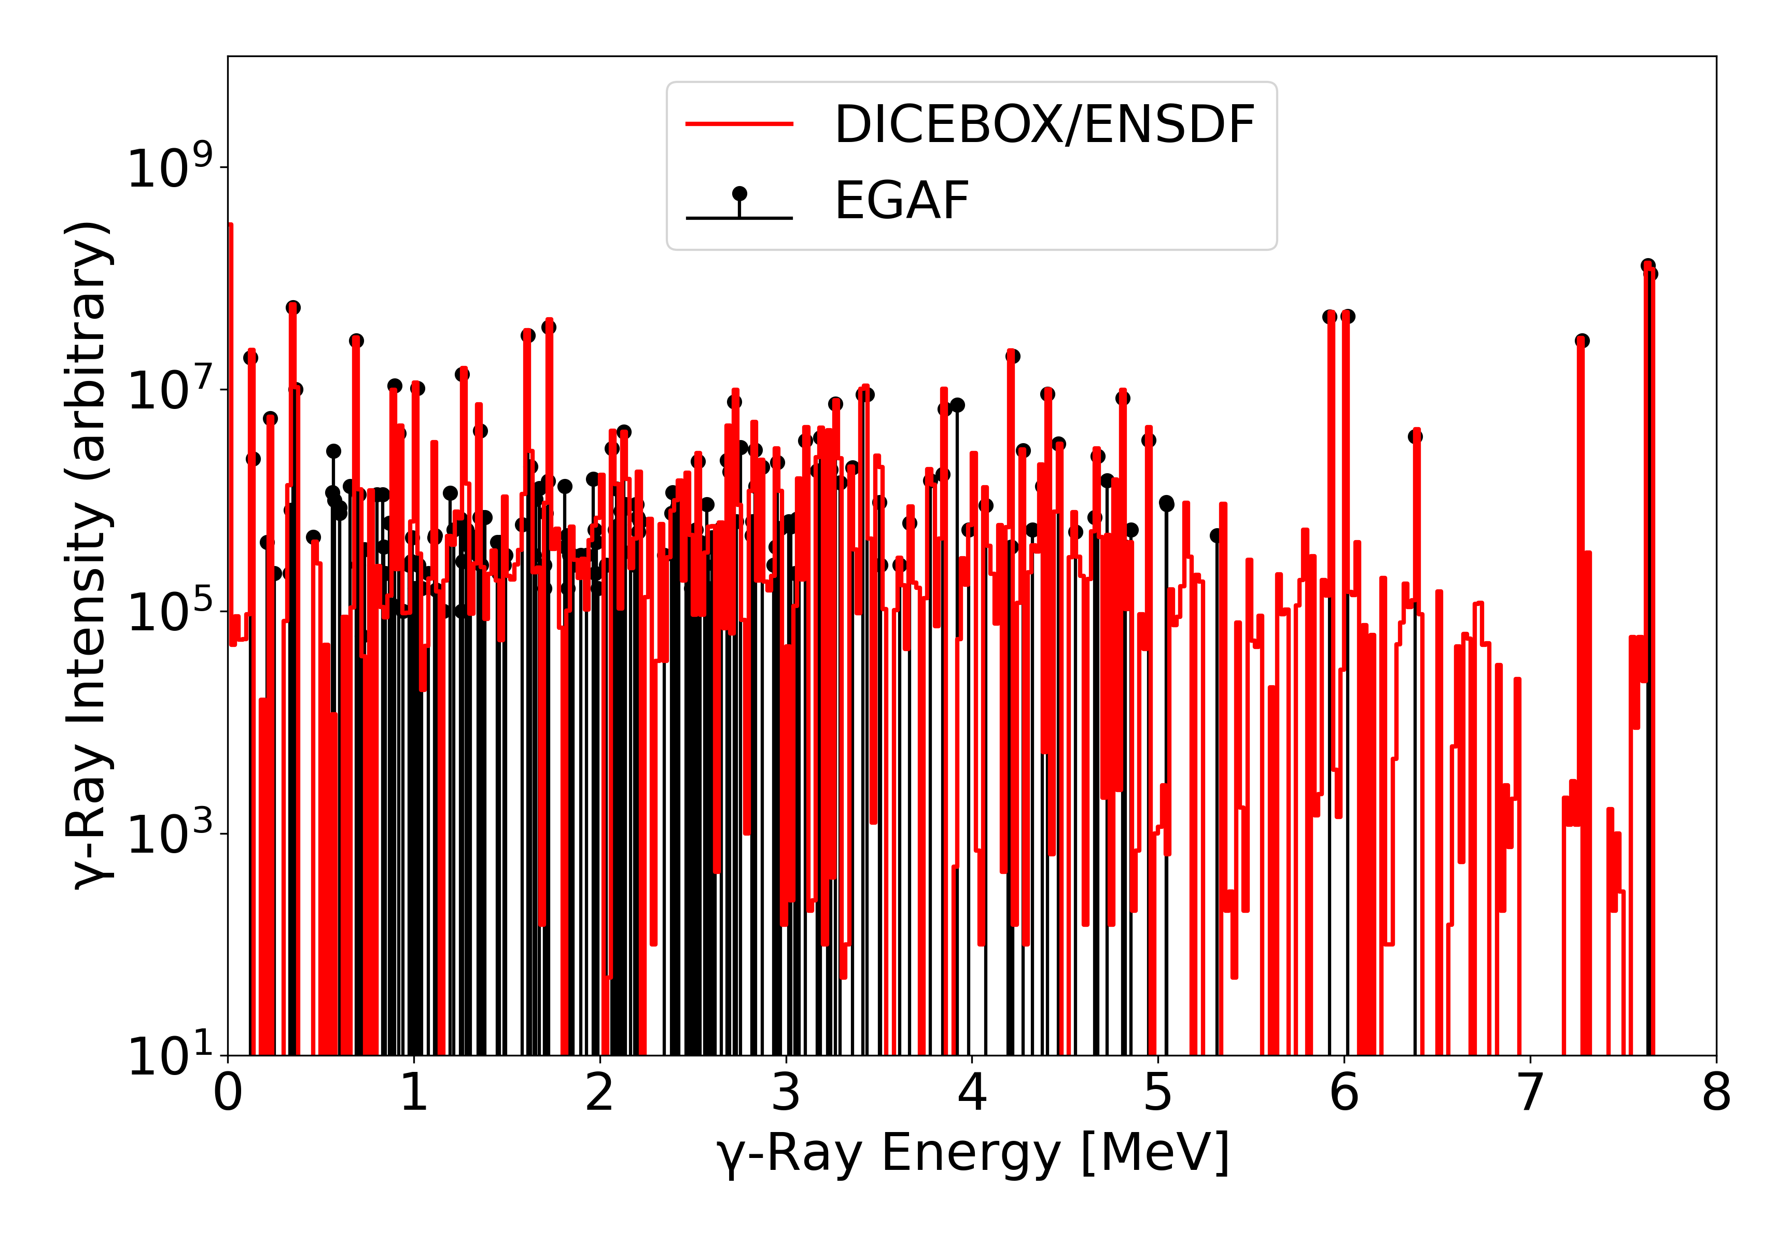
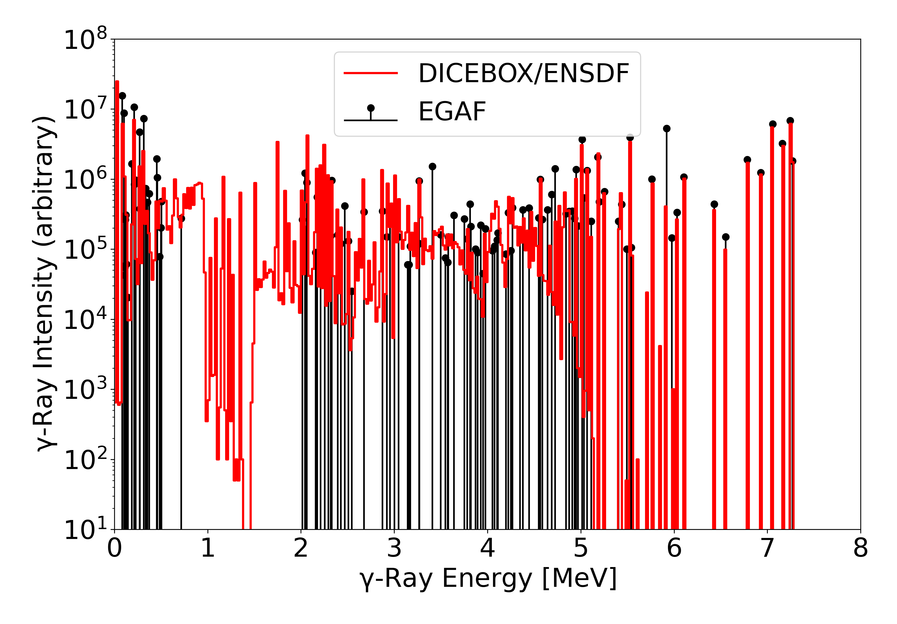
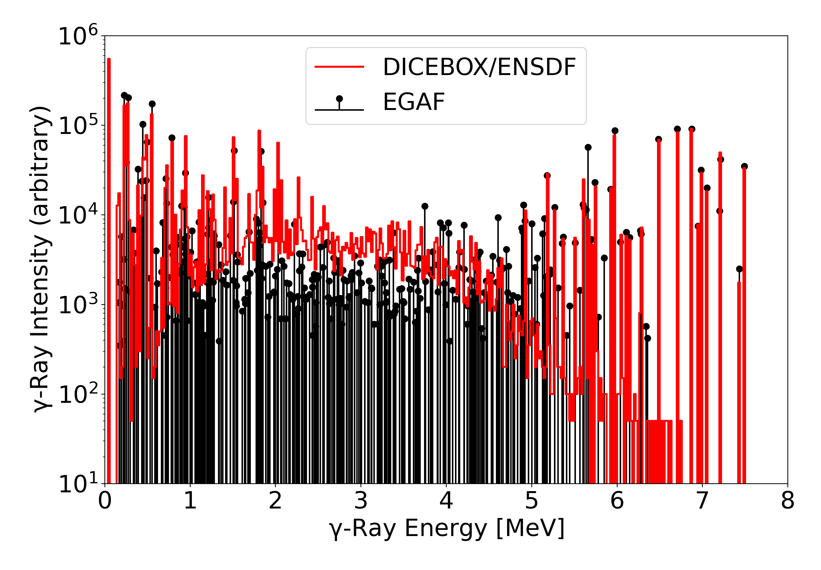
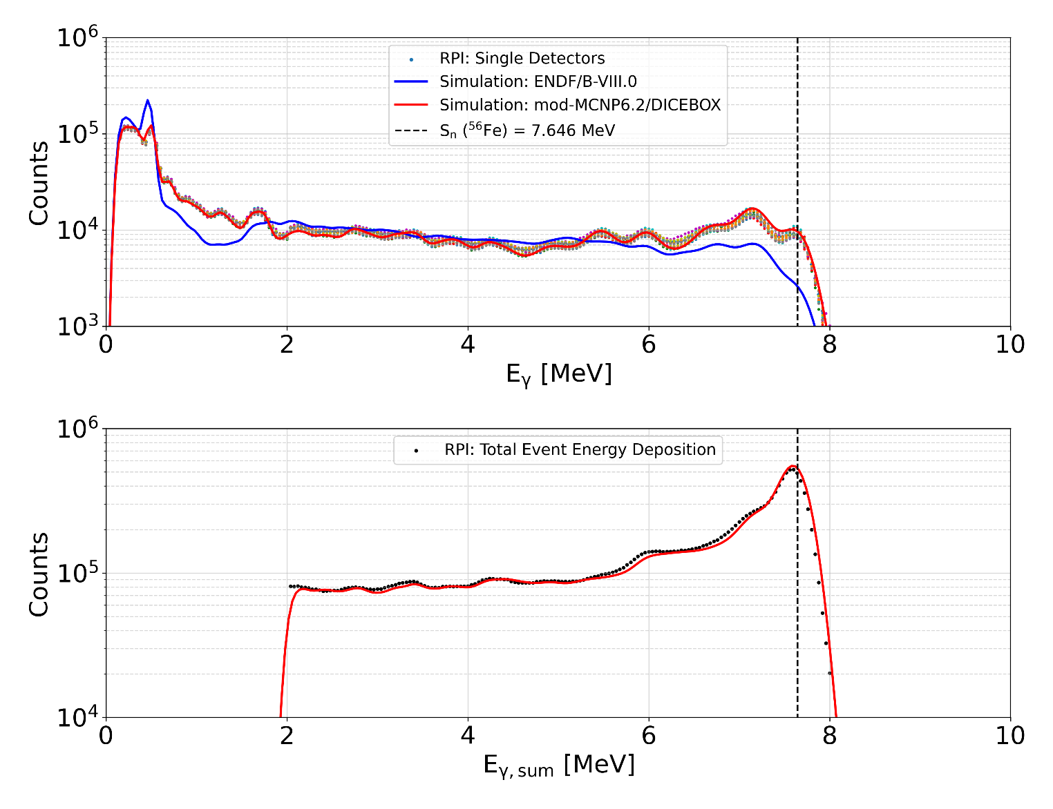
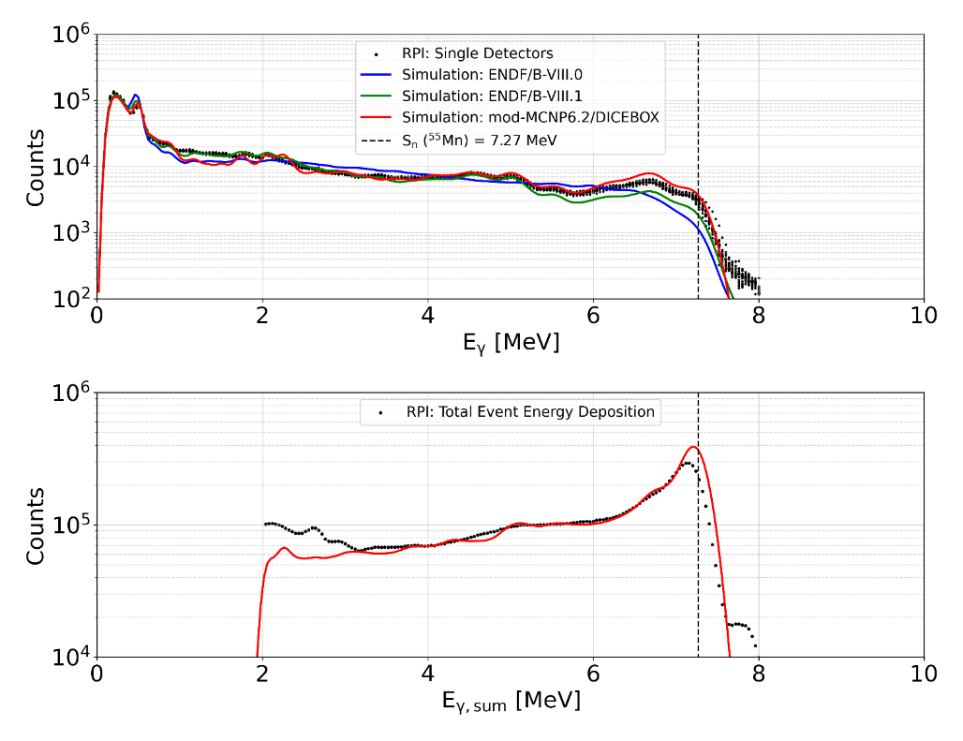
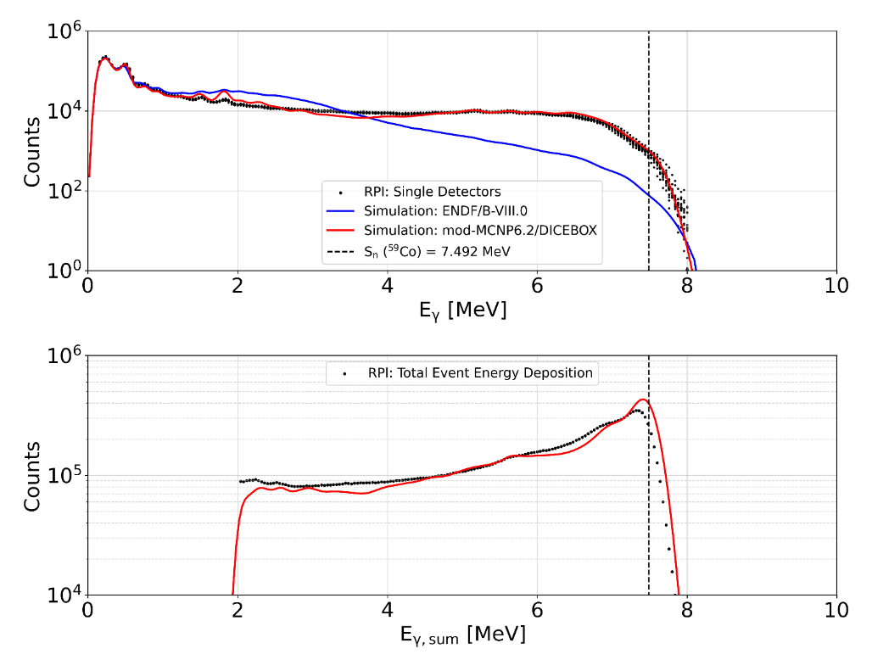
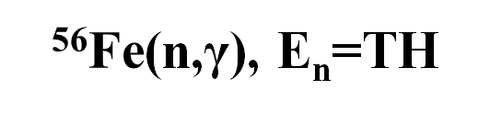
$\text{5}\text{6}\text{Fe}$(n,γ), E_{n}=TH
⁵⁵Mn(n,γ), E_{n}=TH
⁵⁹Co(n,γ), E_{n}=TH
⁵⁶Fe discrete levels from R. B. Firestone et. al., Phys. Rev. C 95, 014328 (2017)
No statistical models
⁵⁵Mn & ⁵⁹Co discrete levels from ENSDF (n,γ), E=TH data
LD model: Back-Shifted Fermi Gas (BSFG)
E1 PSF: Modified General Lorentzian (MGLO)
M1 PSF: Single-Particle (SP)
E2 PSF: Standard Lorentzian (SLO)
Parameters from RIPL-3
Cu in sample
RPI experimental data (black points) are results for 0.01 $≤E_{n}(eV)≤$ 1.0 and 2.0 $≤E_{γ,sum}(MeV)≤$ 8.0

Slide 10
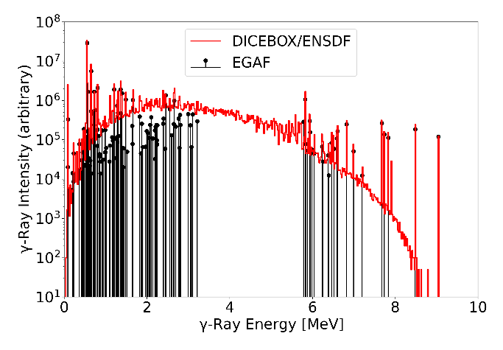
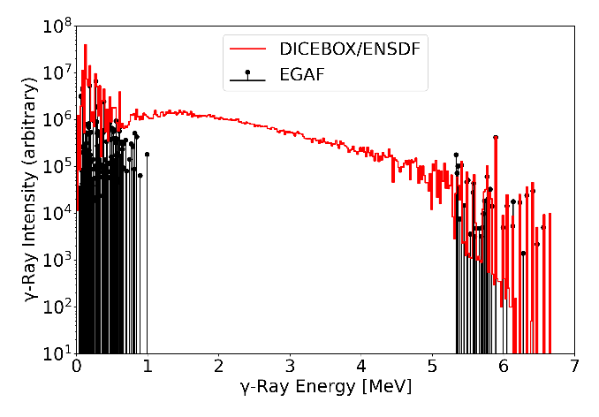
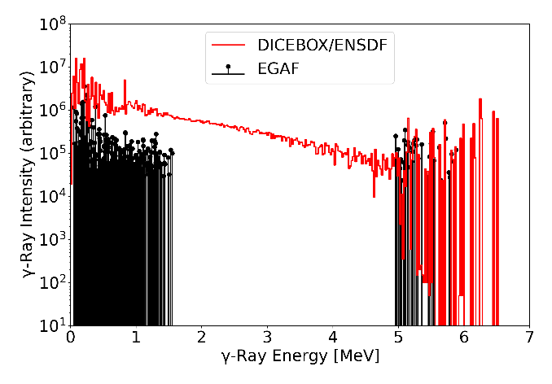
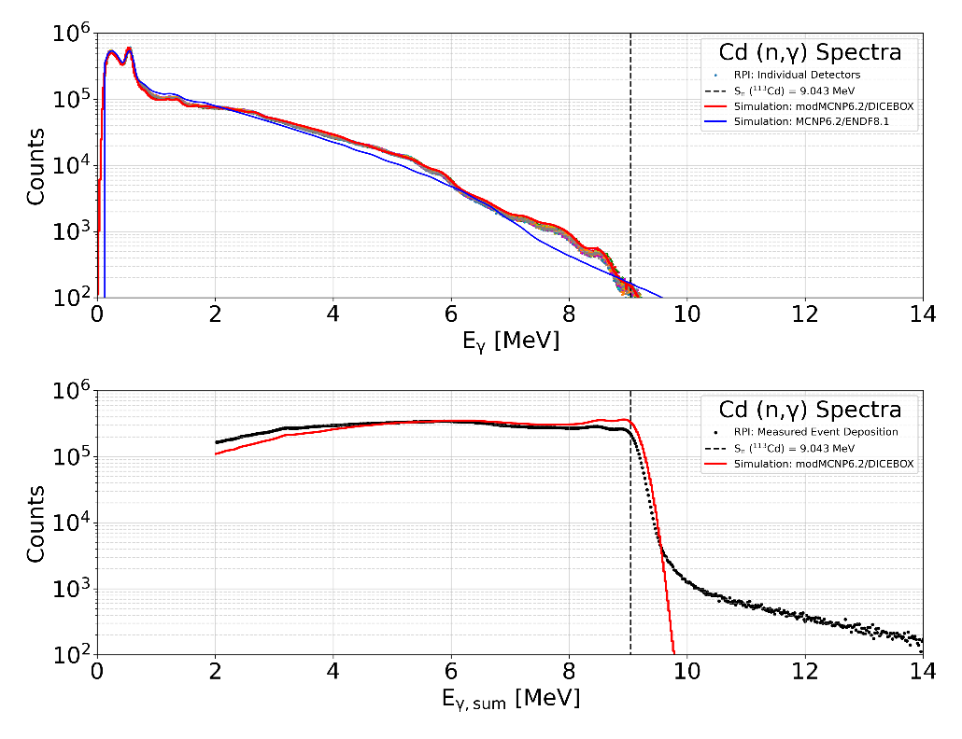
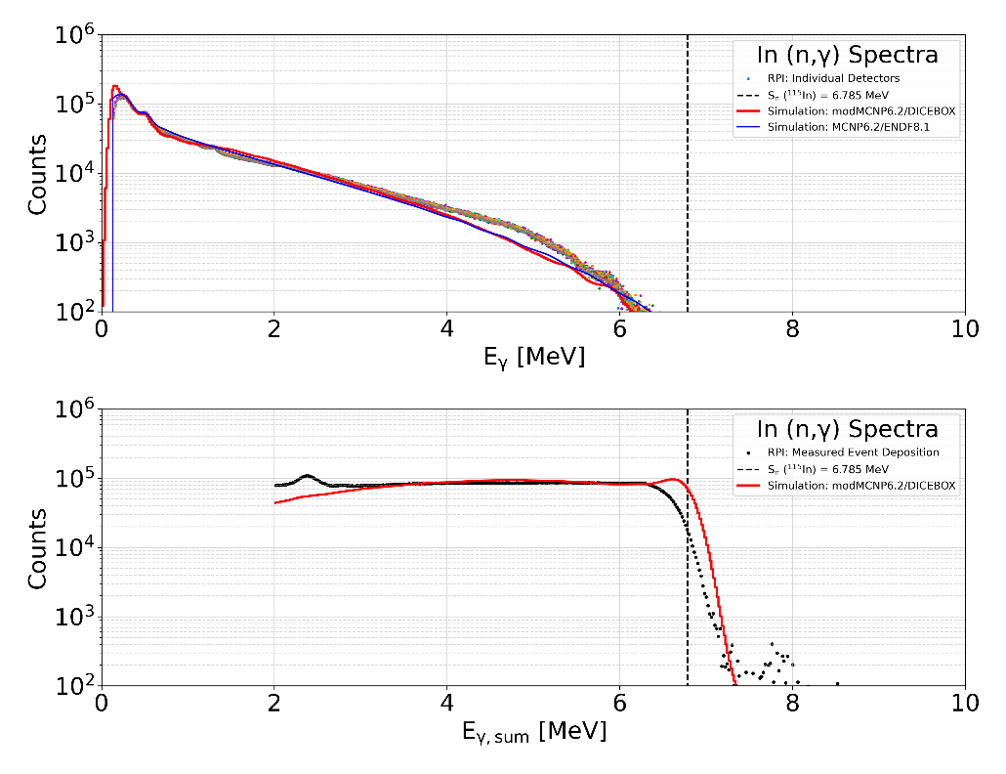
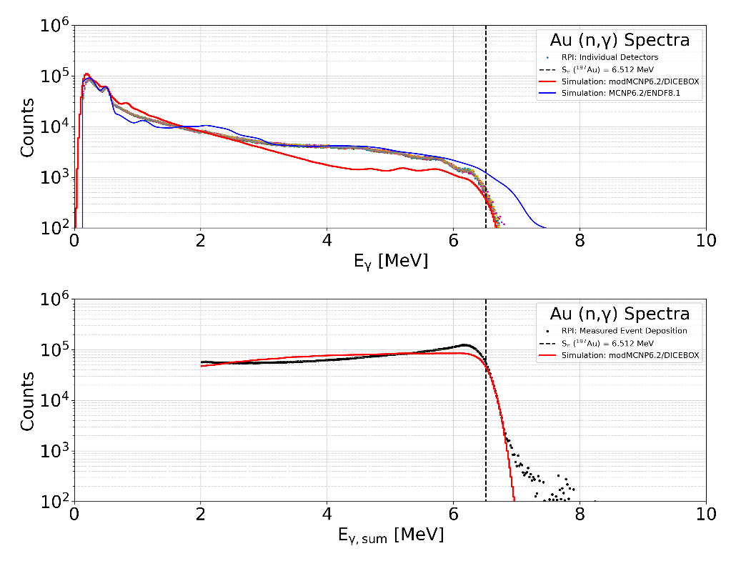
¹¹³Cd(n,γ), E_{n}=TH
¹¹⁵In(n,γ), E_{n}=TH
¹⁹⁷Au(n,γ), E_{n}=TH
LD model: Back-Shifted Fermi Gas (BSFG)
E1 PSF: Standard Lorentzian (SLO)
M1 PSF: Single-Particle (SP)
E2 PSF: Standard Lorentzian (SLO)
Parameters from RIPL-3
¹¹³Cd, ¹¹⁵In, & ¹⁹⁷Au discrete levels are from ENSDF (n,γ), E=TH data
RPI experimental data (black points) are results for 0.01 $≤E_{n}(eV)≤$ 1.0 and 2.0 $≤E_{γ,sum}(MeV)≤$ 20.0

Slide 11
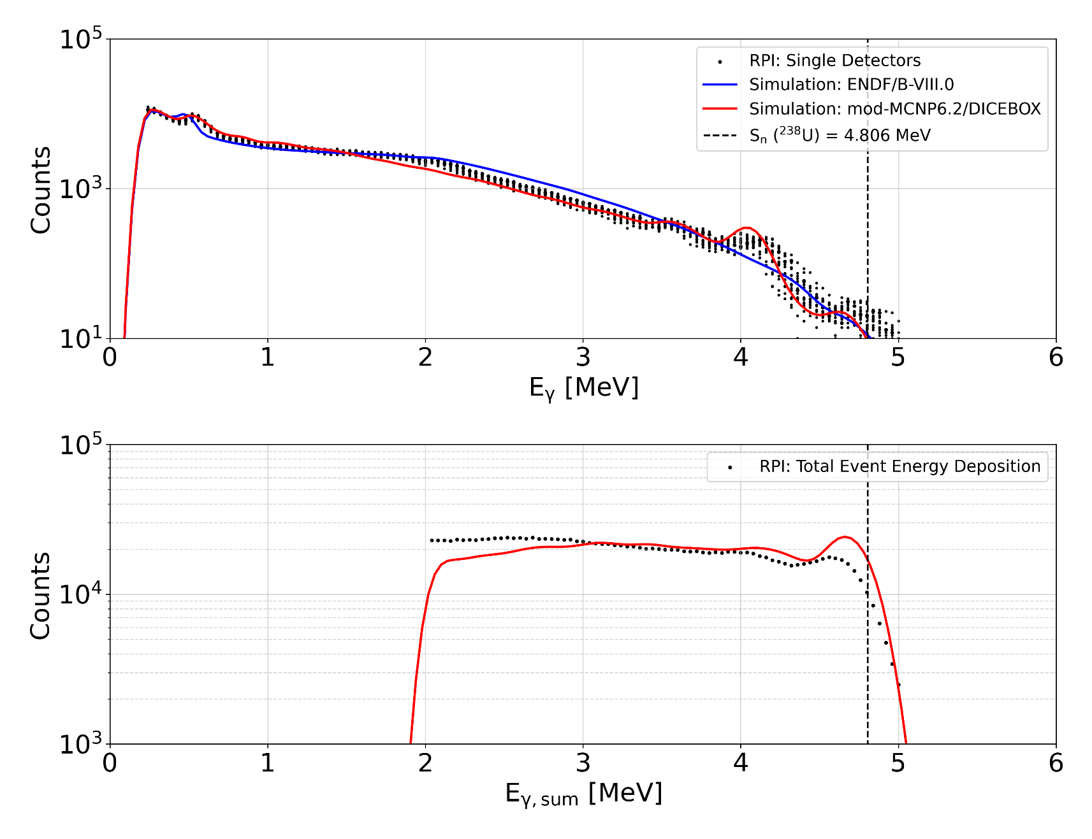
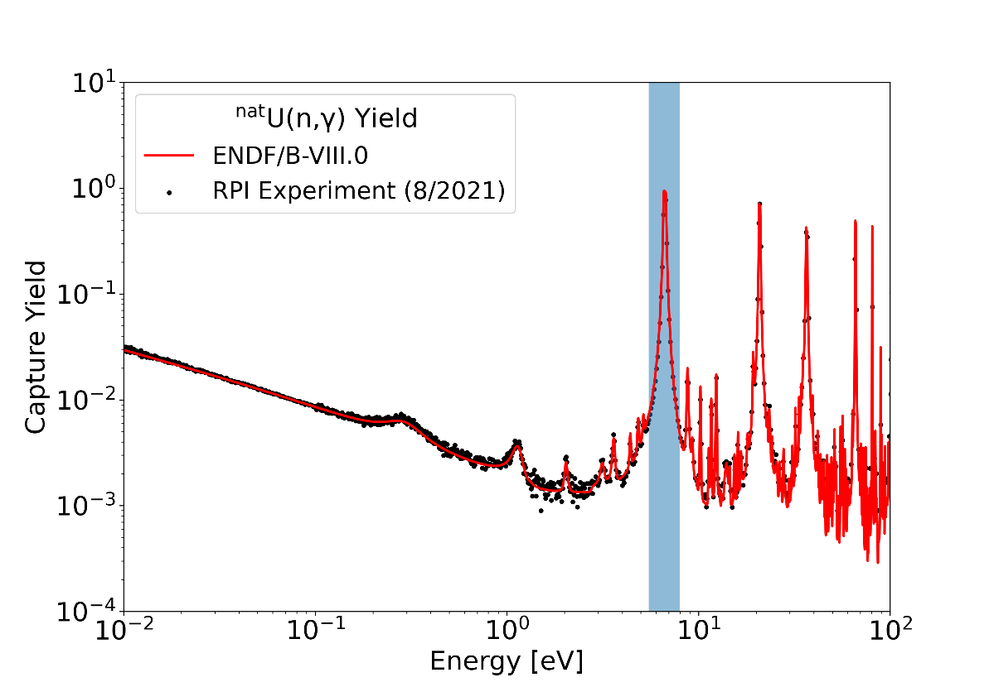
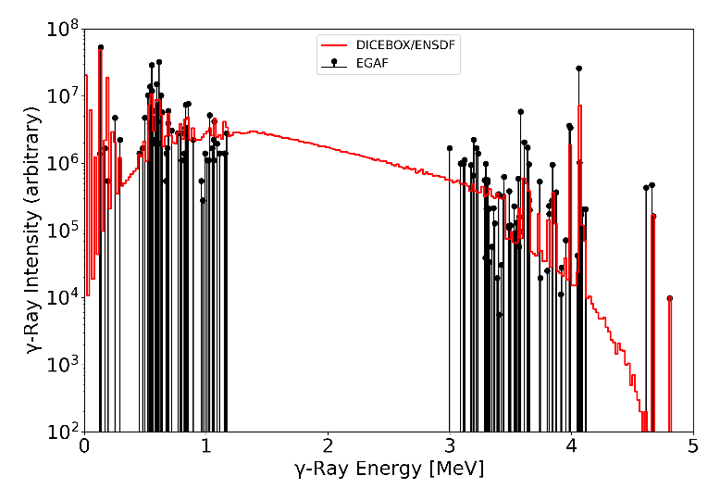
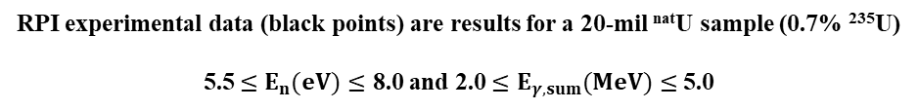
γ-ray Spectra for Specific Resonances
²³⁸U(n,γ), E_{n}=6.67 eV
Capture-dominated ²³⁸U resonance: E_{n}=6.67 eV
Discrete levels from ENSDF (n,γ), E=TH data​
​
LD model: Back-Shifted Fermi Gas (BSFG)​
E1 PSF: Modified General Lorentzian (MGLO)​
M1 PSF: Single-Particle (SP)​
E2 PSF: Standard Lorentzian (SLO)​
Parameters from RIPL-3​
RPI experimental data (black points) are results for a 20-mil ^{nat}U sample (0.7% ²³⁵U) 5.5 $≤E_{n}(eV)≤$ 8.0 and 2.0 $≤E_{γ,sum}(MeV)≤$ 5.0

Slide 12
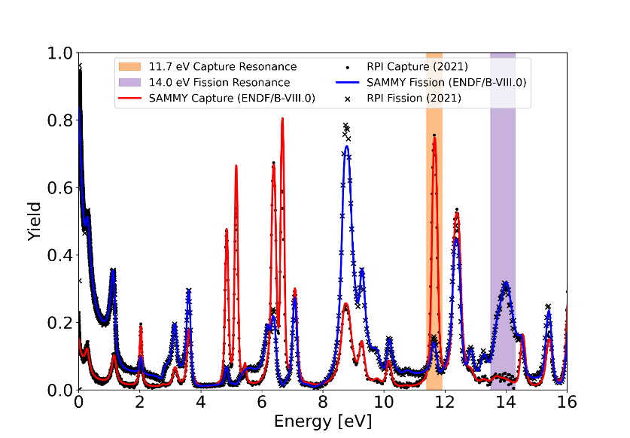
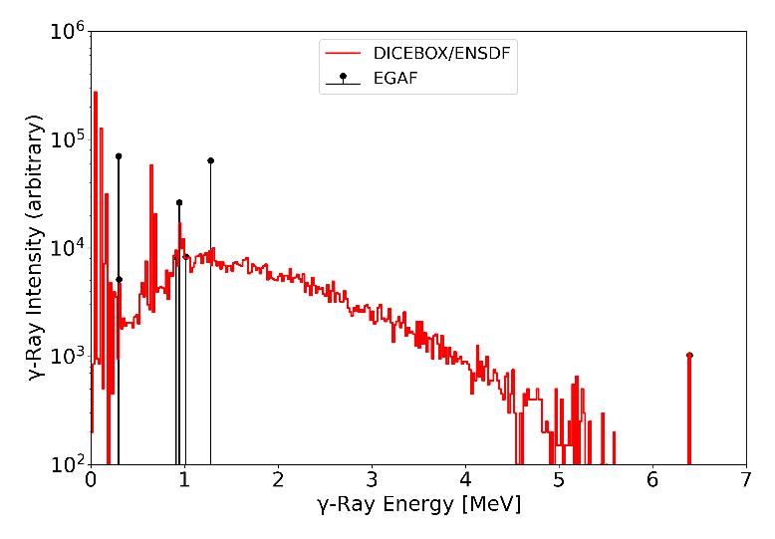
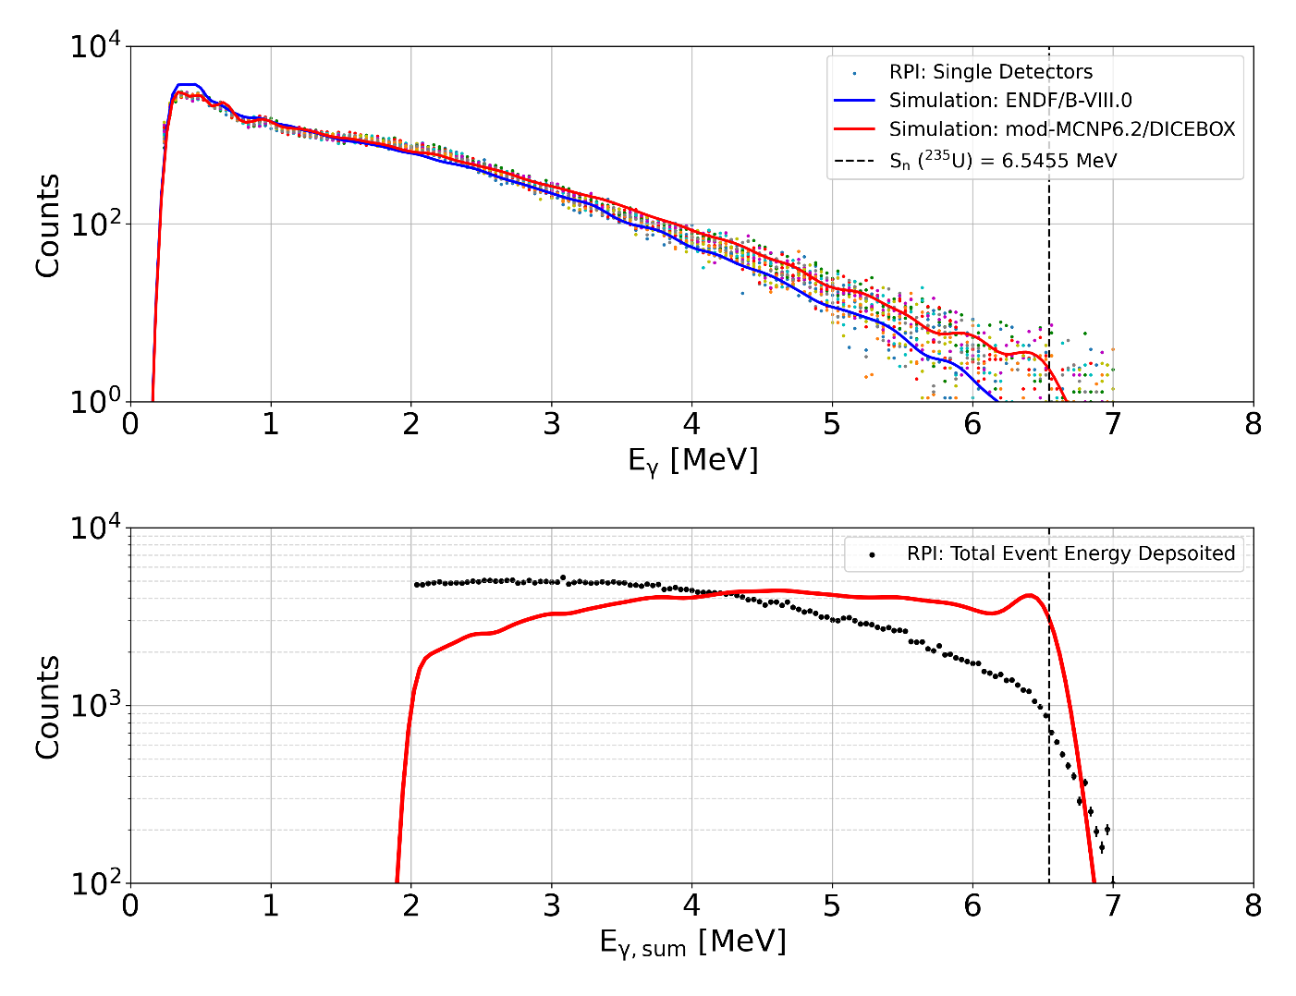
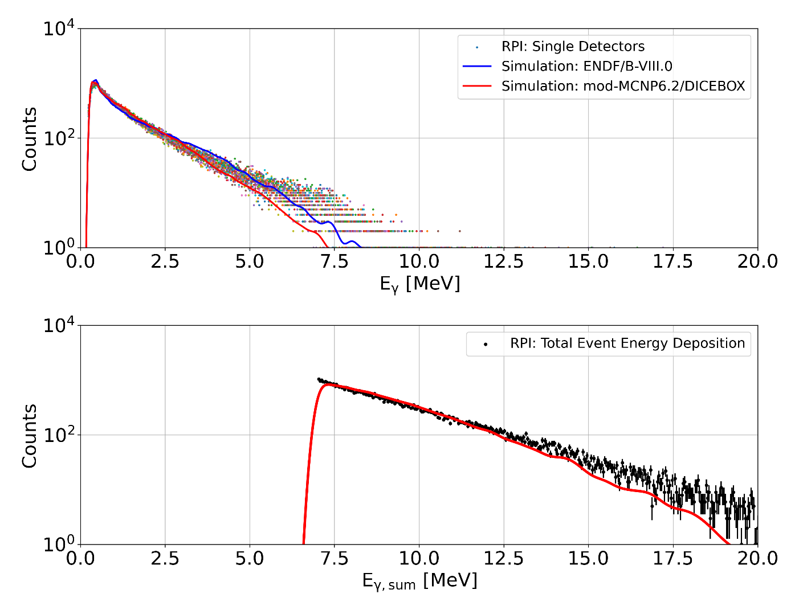
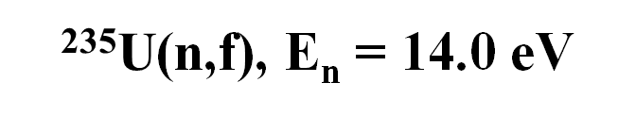
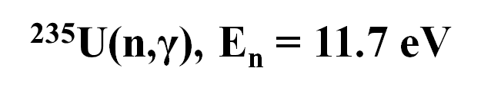
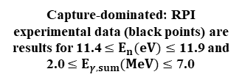
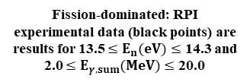
Capture-dominated resonance:
E_{n} = 11.7 eV
Fission-dominated resonance:
E_{n} = 14.0 eV
$\text{235}\text{U}$(n,γ), E_{n} = 11.7 eV
$\text{235}\text{U}$(n,f), E_{n} = 14.0 eV
Discrete levels are from ENSDF (n,γ), E=TH data
LD model: Back-Shifted Fermi Gas (BSFG)
E1 PSF: Standard Lorentzian (SLO)
M1 PSF: Single-Particle (SP)
E2 PSF: Standard Lorentzian (SLO)
Parameters from RIPL-3
Capture-dominated: RPI experimental data (black points) are results for 11.4 $≤E_{n}(eV)≤$ 11.9 and 2.0 $≤E_{γ,sum}(MeV)≤$ 7.0
Fission-dominated: RPI experimental data (black points) are results for 13.5 $≤E_{n}(eV)≤$ 14.3 and 2.0 $≤E_{γ,sum}(MeV)≤$ 20.0

Slide 13
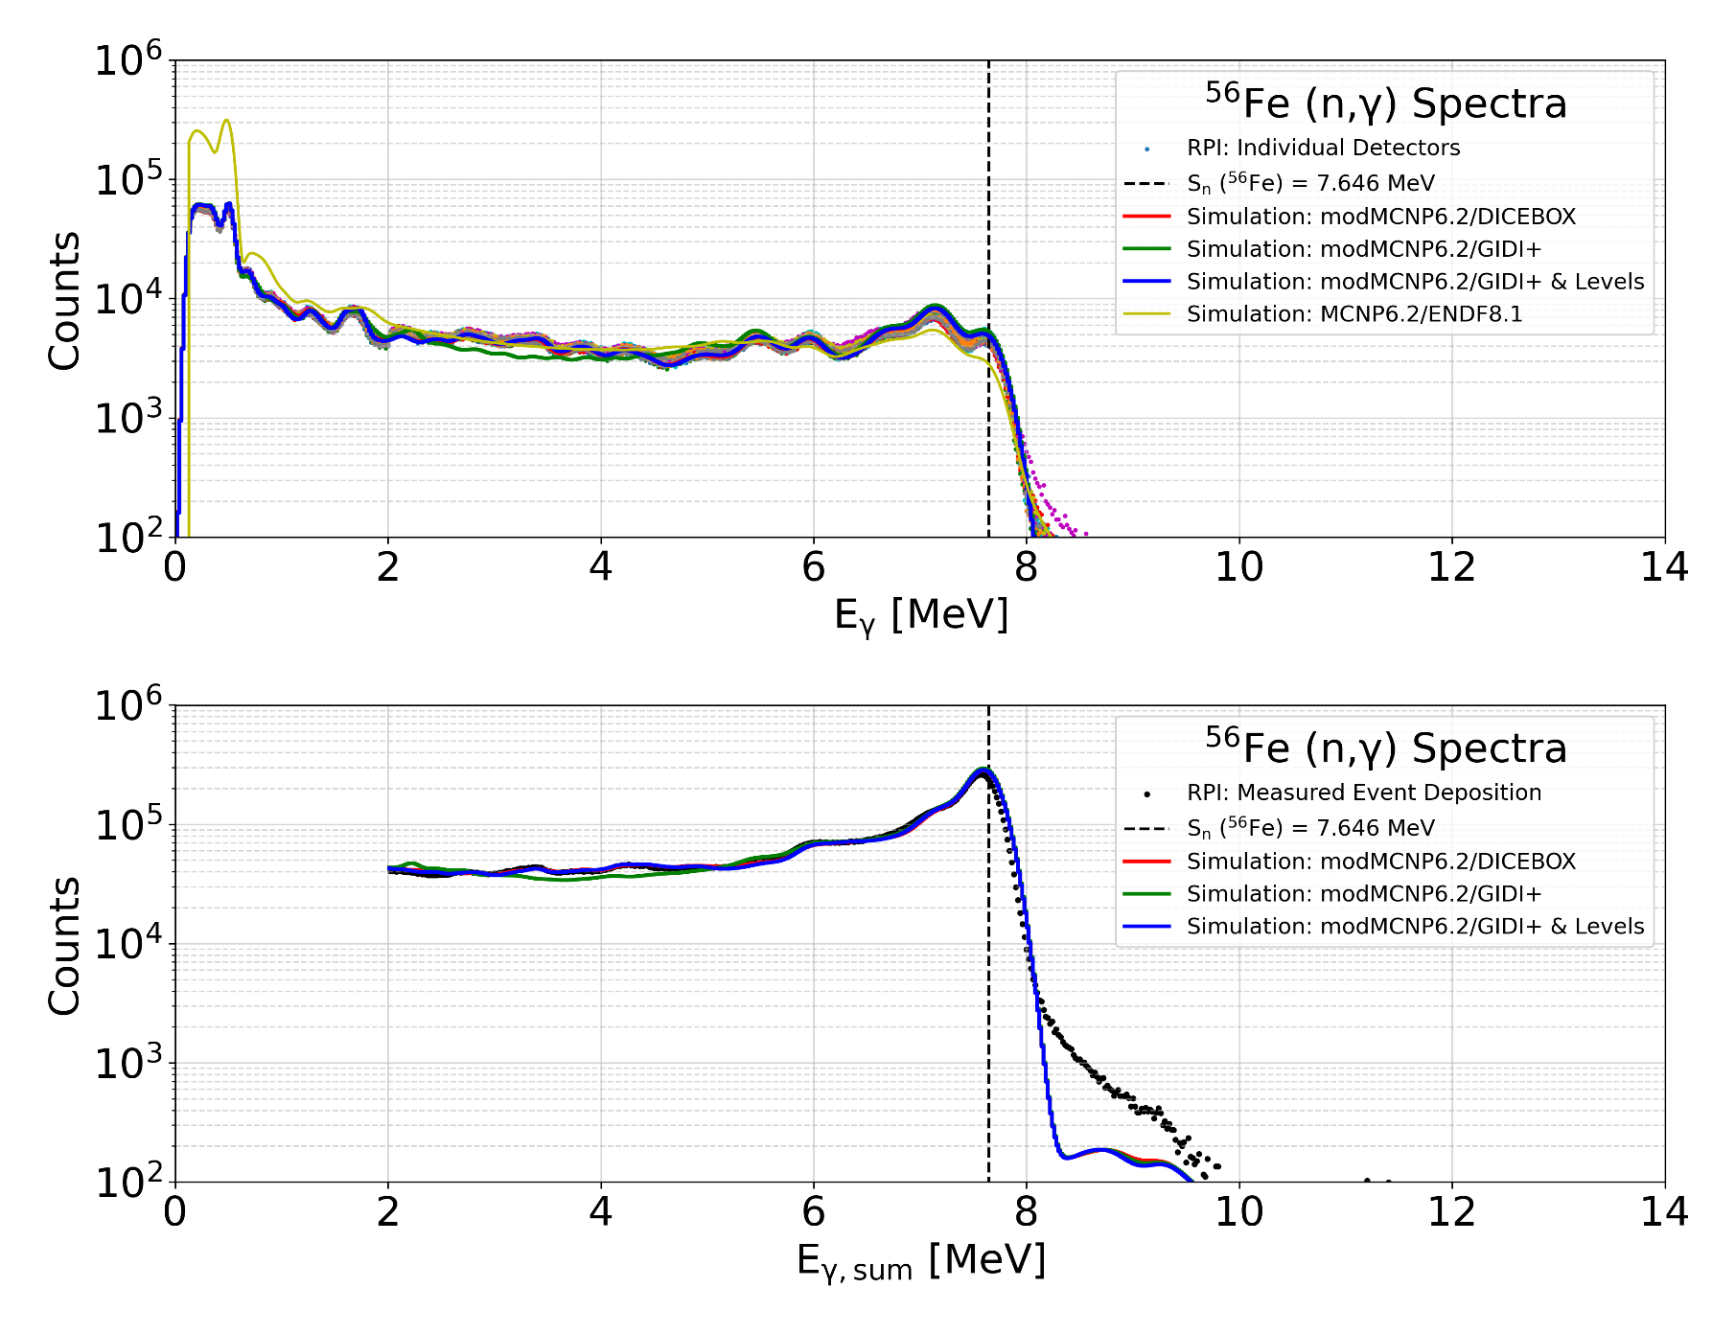
Cascade Generators – DICEBOX/GIDI+
Work of Ian Parker & Emanuel Chimanski
modMCNP6.2 requires total energy deposition to be > 2 MeV, MCNP6.2 does not
1 week visit in September to work with Emanuel/GRIN to compare DICEBOX and GIDI+
GIDI+ uses ENSDF evaluated discrete levels
Primary E_{γ} = [7.646 – 5.921 MeV]
GIDI+ & Levels uses similar discrete levels to DICEBOX
(R. B. Firestone et. al., Phys. Rev. C 95, 014328 (2017))
Validation complete of cascade generators; both perform equally well when inputs have accurate discrete levels

Slide 14
Thermal neutron die-away measurements B. Wang

Slide 15
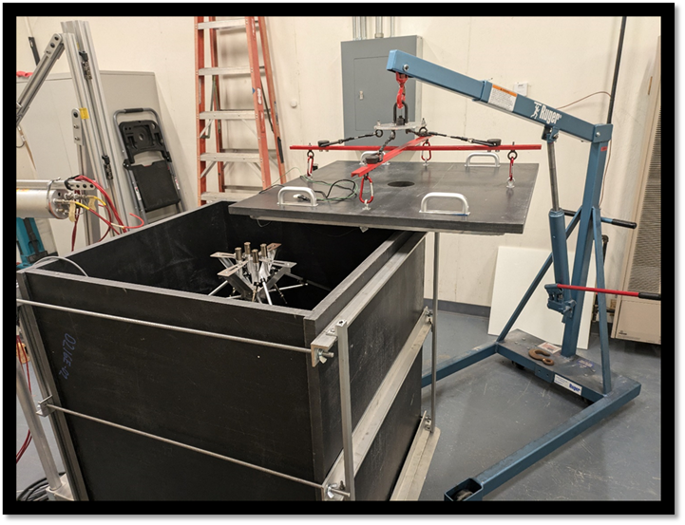
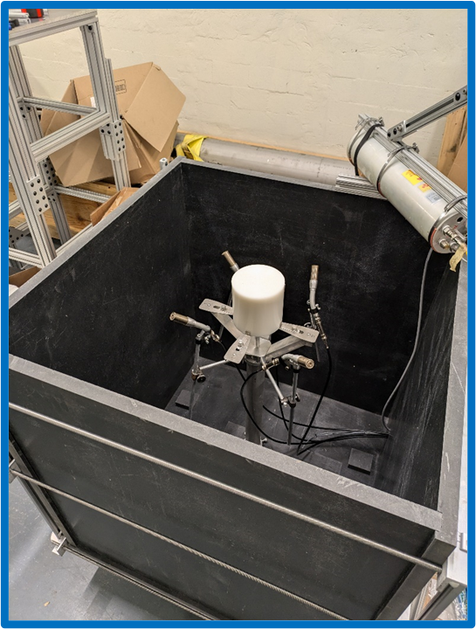
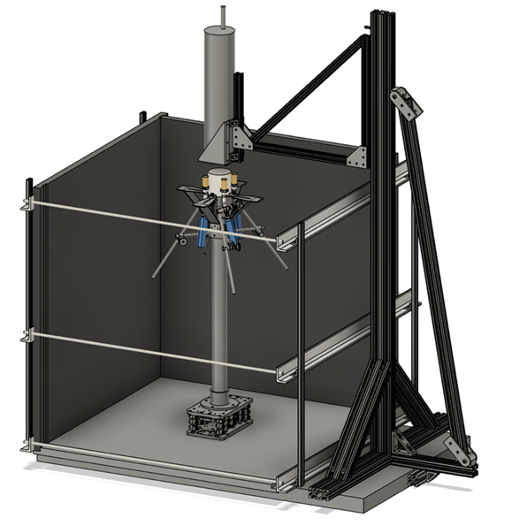
Pulsed Neutron Die Away Experiments for TSL Validation at RPI
Benjamin H. Wang
Nuclear Engineering PhD Student
Department of Mechanical, Aerospace and Nuclear Engineering
Rensselaer Polytechnic Institute, Troy, NY, 12180
Gaerttner LINAC Center– Rensselaer Polytechnic Institute
11/05/2024
Notes:
Introduction slide.

Slide 16
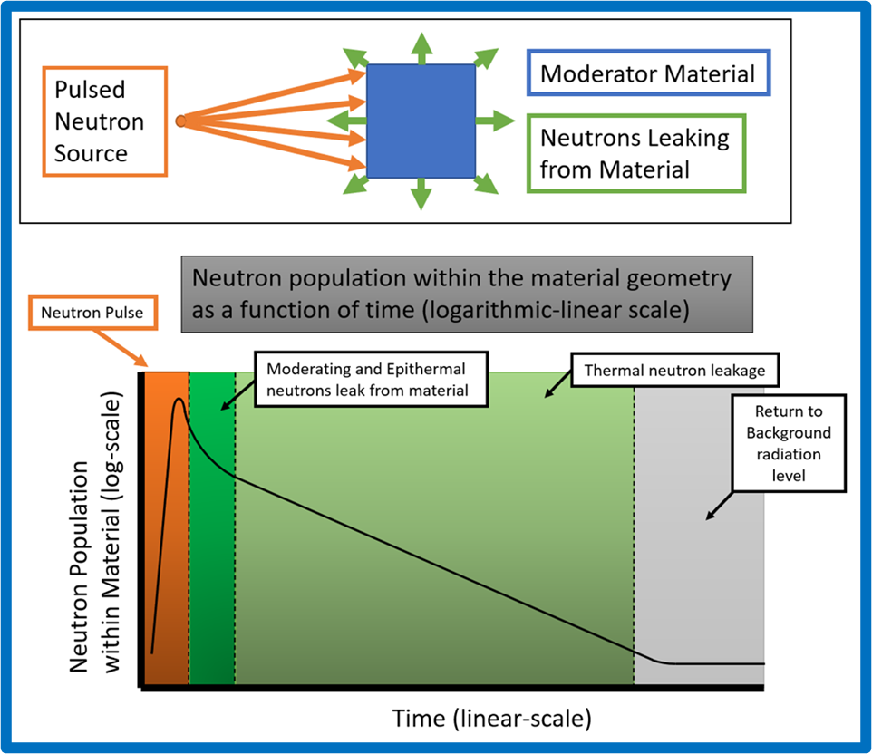
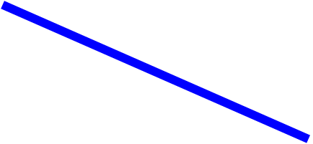

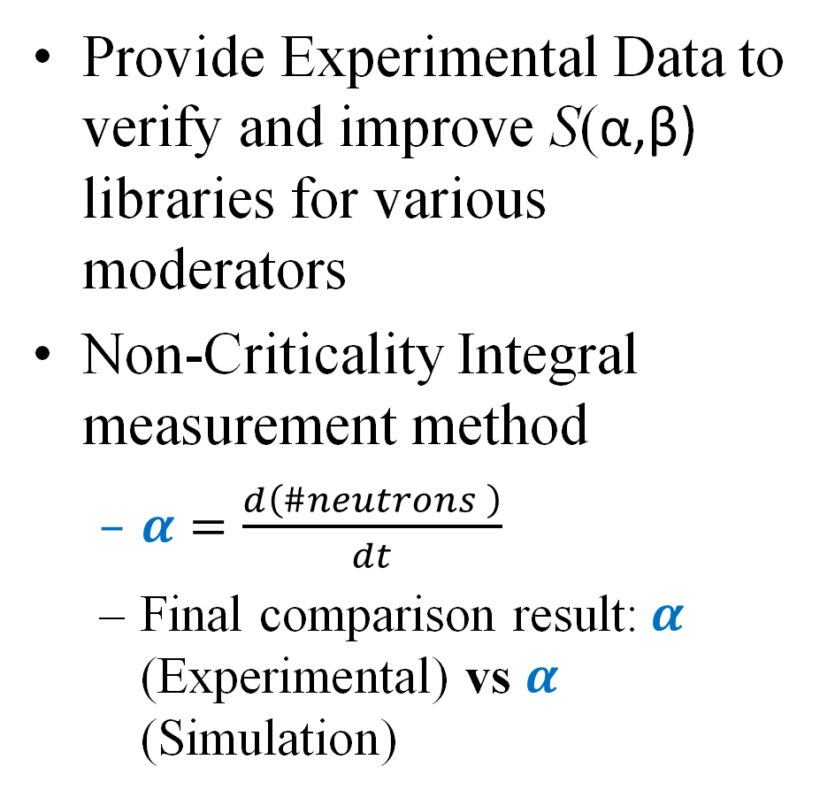
Motivation
Provide Experimental Data to verify and improve S(α,β) libraries for various moderators
Non-Criticality Integral measurement method
$α=\frac{d\left(\#neutrons \right)}{dt}$
Final comparison result:$α$ (Experimental) vs $α$ (Simulation)

Slide 17
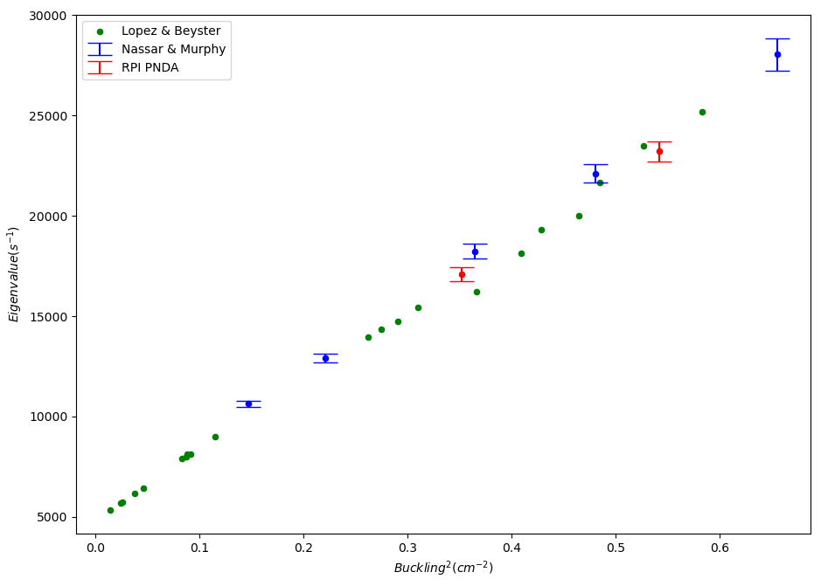
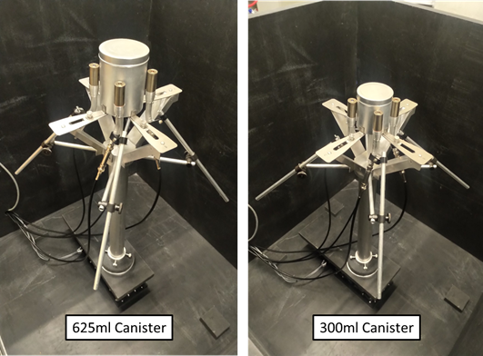
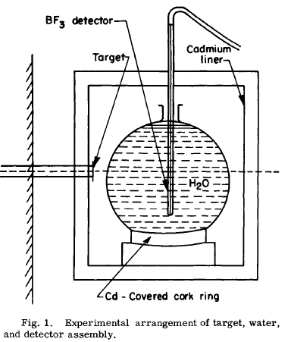
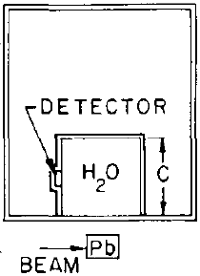
System Validation, Historical Water measurements
Water validation measurement of system performance
625 ml canister
R = 4.39 cm
H = 9.71 cm
300ml canister
R = 3.65 cm
H = 6.77 cm
Lopez & Beyster (1962)
Water Cuboids
Nassar & Murphy (1969)
Water Spheres
RPI PNDA Tests
Water Cylinders
RPI PNDA results fall within ballpark of historical PNDA results of water
Preliminary/Testing
W.M. Lopez, J.R. Beyster, Nuclear Science and Engineering, Measurement of Neutron Diffusion Parameters in Water by the Pulsed Neutron Method, 12:2, 190-202 (1962)
S.F. Nasser and G. Murphy, Nuclear Science and Engineering, Pulsed-Neutron Diffusion Parameters in Spherical Water Systems, 35:1, 70-79 (1969)

Slide 18
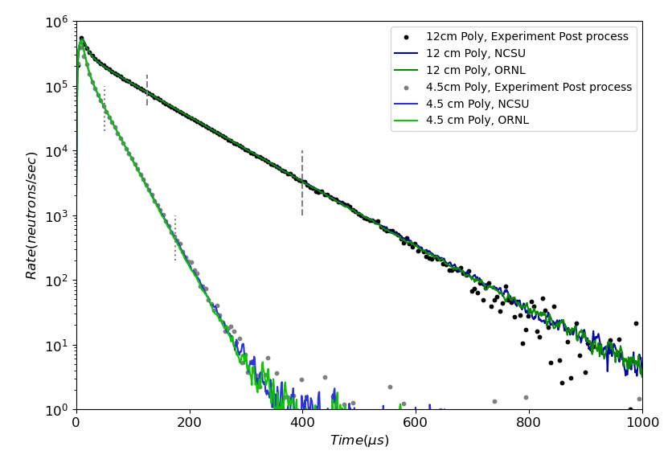
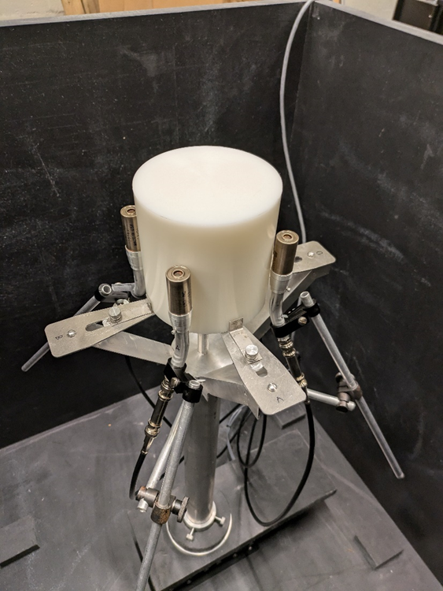





Initial Polyethylene Results
12 cm Sample
4.5cm Sample

Slide 19




Polyethylene Eigenvalue Comparison (ENDFVIII.1b2)
Fit range: 125us to 400us
Fit range: 50us to 175us
12 cm Sample
4.5cm Sample

Slide 20
Zirconium Evaluation Progress
G. Siemers

Slide 21
New for ENDF/B-IX
RRR: New evaluations will use R-Matrix resonance parameterization determination over MLBW. Evaluations will incorporate new ORNL isotopic transmission and capture measurements. New transmission measurement from HDZR (pending data reduction).
URR: New evaluations will leverage the new implementation of SESH in SAMMY.
Fast: New evaluations with modern version of EMPIRE using new soft-rotor OMP developed for Zr. Evaluations will leverage new ^{nat}Zr transmission from RPI, DT validation data from China, and others.
Isotope | New ORNL/GEEL Measurement Status | RRR Evaluation | URR Evaluation | Fast Evaluation
Zr-90 | Complete | RPI – NNL - ORNL | RPI – NNL - ORNL | RPI – BNL
Zr-91 | Complete | RPI – NNL - ORNL | RPI – NNL - ORNL | RPI – BNL
Zr-92 | 2024/2025 | ORNL | NNL - ORNL | BNL
Zr-94 | 2025/2026 | ORNL | NNL - ORNL | BNL
Zr-96 | N/A | ORNL | NNL - ORNL | BNL

Slide 22


⁹⁰Zr Resonance Fitting
Main objectives:
Provide an R-Matrix evaluation to replace MLBW
Address several width/spin deficiencies
Extend RRR as far as achievable
Verify agreement of datasets between different institutions
Initial fitting was done in 2022/2023 of ORELA transmission data
Along with transmission data reduction of GELINA data
Updated fits to GELINA capture data

Slide 23

Extending ⁹⁰Zr Resolved Resonance Region
SAMMY fitting is being performed to extend the resolved resonance region of ⁹⁰Zr above the current limit of 200 keV present in ENDF/B-VIII.0. More fitting and work with external levels is required.

Slide 24

Beginnings of ⁹⁰Zr Fast
Soft rotational coupled-channels optical model potential developed by Capote and Soukhovitskii specifically for Zr isotopes (RIPL 609)
Investigation of different OMPs present in RIPL and elsewhere is first step
Finlay 1993 measurements suspected to be natural ZrO₂ sample

Slide 25
Improvements in SAMMY URR analysis A. Golas

Slide 26





Motivation
Goal is to define $⟨T⟩$ as a function of $⟨σ⟩$
$$\left\langle T\right\rangle ≠e^{−n⟨σ⟩}$$
Code exists called SESH which calculates $C_{T}$, the self-shielding correction factor
SESH simulates resonances using average parameters and their known distributions
Calculates $⟨σ⟩$ and $⟨T⟩$ from Monte Carlo sampling
Uses these quantities to calculate $C_{T}$
$$\left\langle T\right\rangle ≈0.6$$
$$e^{−n⟨σ⟩}≈0.2$$
$$C_{T}≈3.0 \\ \left\langle T\right\rangle =e^{−n⟨σ⟩}C_{T}$$

Slide 27



Accomplishments
Transmission and capture correction factors both validated and integrated into the main SAMMY branch
Implemented new Multi-Isotope parsing scheme for URR
Before
After
Transmission
Measurement
$$\left\langle σ_{t}\right\rangle$$
SESH
Corrected $\left\langle σ_{t}\right\rangle$
SAMMY
Measurement
Data
$$\left\langle T\right\rangle , ⟨Y⟩$$
New Resonance Parameters
ENDF Library
Have resonance
parameters converged?
Resonance
Parameters
No
SAMMY
Done!
ENDF Library
Resonance
Parameters
Done!
Notes:
Add before/after instead of arrow

Slide 28

Resolving Modeling Issues
Current SAMMY limitation: Only performs self-shielding correction on monotopic samples
Thicker sample measurements are needed for accurate URR evaluations
Implementing multi-isotope self-shielding corrections into SAMMY is non-trivial and complicated
Significant disagreement with transmission correction factor when testing with Zr
Attributable to different energy dependent parameter models
SAMMY and MCNP now agree much more strongly

Slide 29
Summary
New capture and transmission measurements for ⁵⁴Fe will help improve resonance parameter evaluation
Neutron capture γ-ray cascade spectra and yields were measured in the resolved resonance region and compared to evaluations using mod-MCNP-6.2/DICEBOX simulations
Helps assess current nuclear structure data
mod-MCNP6.2 event-by-event simulation techniques were developed
Work under the FY23 NDIAWG FOA will further develop the nuclear data and simulation methods to provide benchmarks for neutron induced capture γ-ray cascades
Pulsed neutron die-away method was developed as a tool to provide data for validation of TSLs
^{90,92}Zr evaluations are in progress. Initial fits to ⁹⁰Zr and initial work in the fast region.
New feature in SAMMY will enable fitting of neutron transmission and capture yield in the URR
Embedding self-shielding code SHESH in SAMMY

