Slide 1

Berkeley Group Nuclear Data Measurements Program
(mostly GENESIS)
Lee A. Bernstein
Department of Nuclear Engineering
University of California - Berkeley
Nuclear Science Division
Lawrence Berkeley National Laboratory
https://nucleardata.berkeley.edu

Slide 2
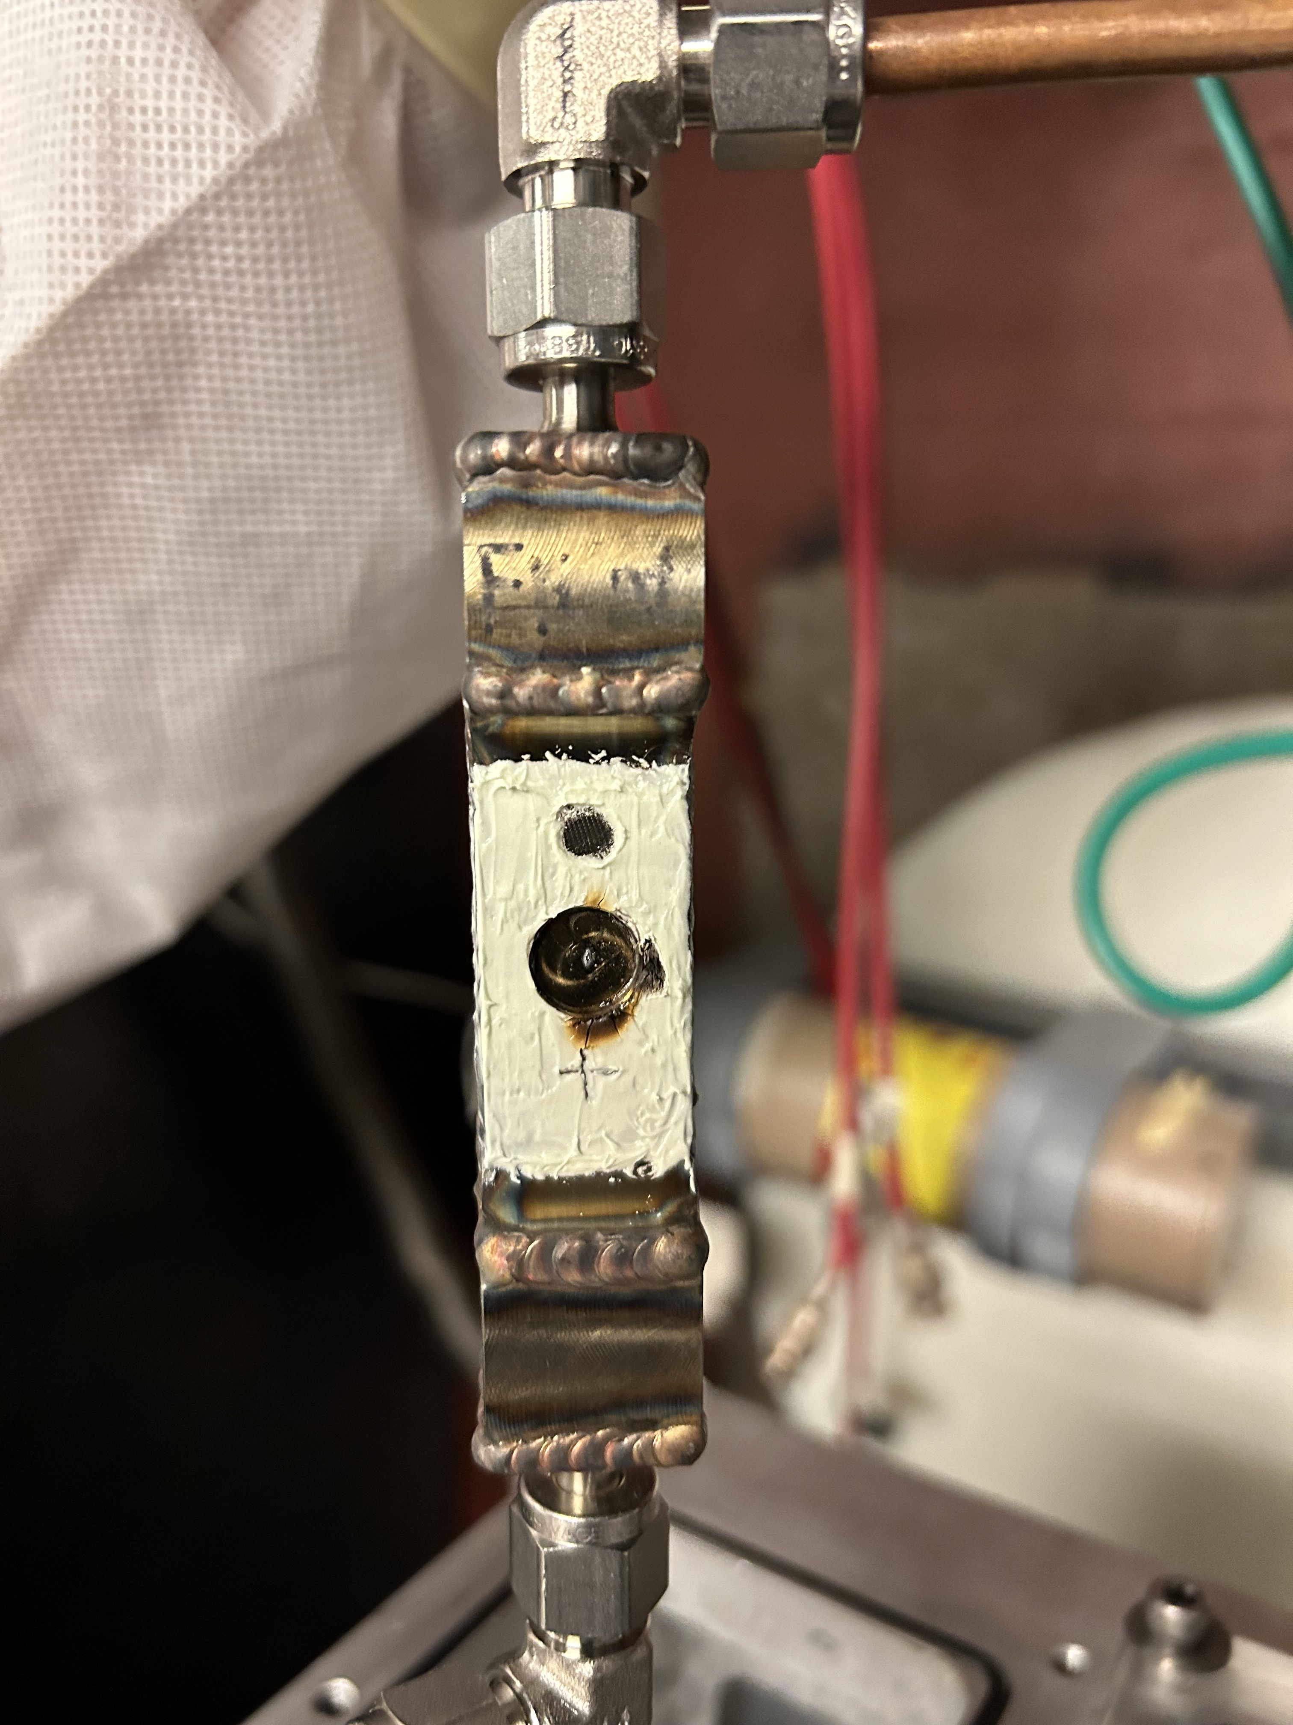
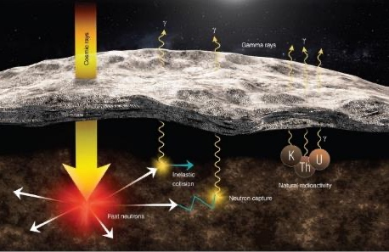
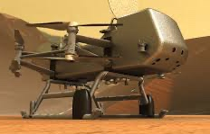

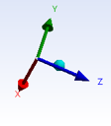
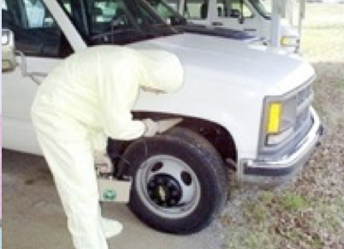
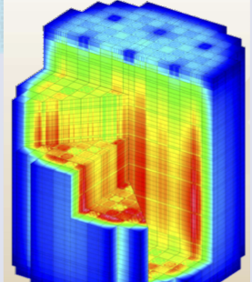
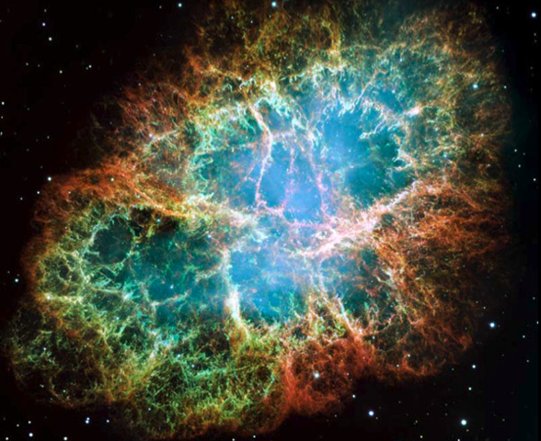
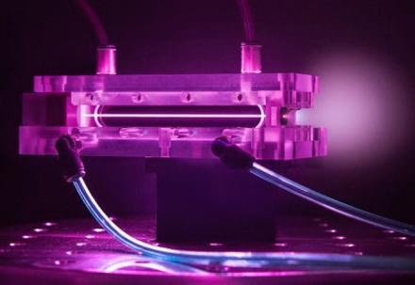
I’m going to present a short sample of some of our nuclear data measurements for applications
Medical Isotopes (Voyles, Apgar)
Space Exploration
Gamma-rays
Cosmic rays
Fast neutrons
Natural
Radioactivity
DOE-IP
NASA
MDA
NorthStar
Pharmaceutical
LBNL/UCB Measurements Program
National Security
Energy
Atomic-Nuclear interaction & RSF
DOE-NNSA
DOE-Nuclear Energy
DOE Nuclear Physics
Google
(Time Permitting)
Notes:
Replace figures as appropriate

Slide 3
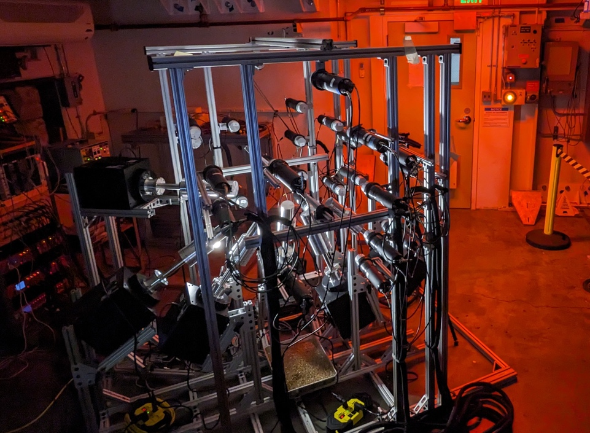
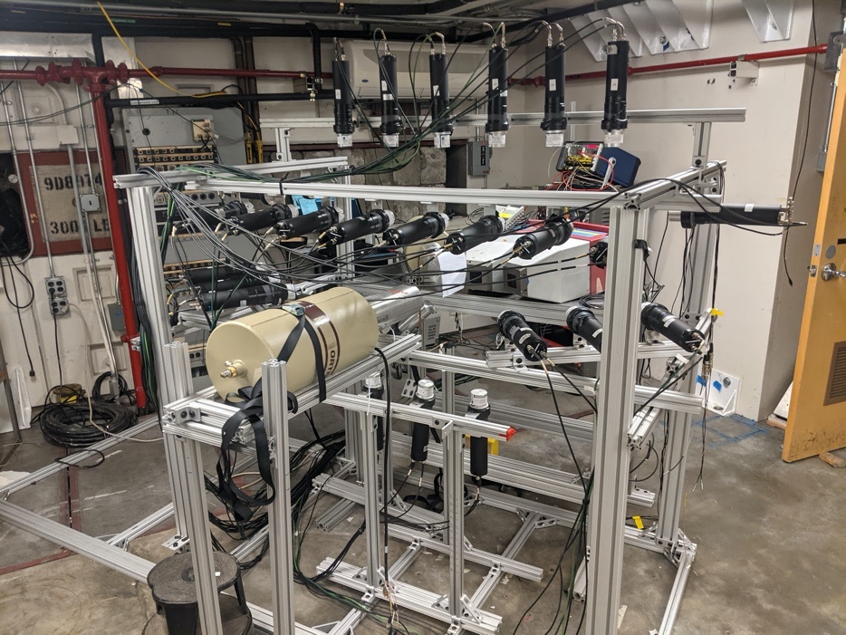
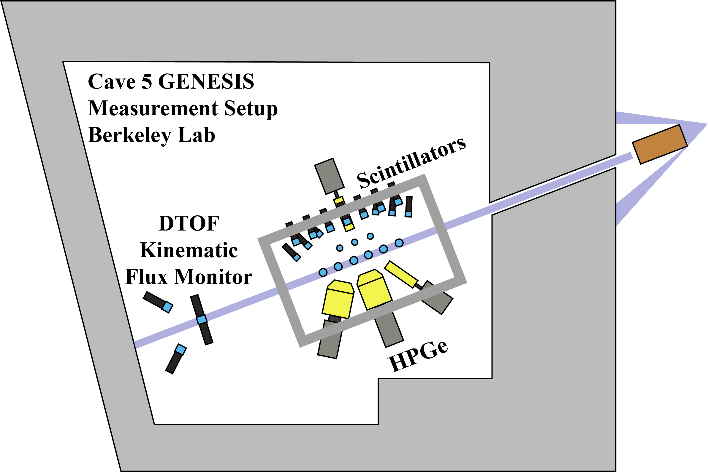


We built the Gamma Energy Neutron Energy Spectrometer for Inelastic Scattering (GENESIS) to measure coincident (n,xnγ) cross sections
Thick target Deuteron Breakup Neutron Source
“GENESIS 2.0”
GENESIS
D-beam
Chris Brand
Josh Brown
The combination of HPGe, neutron detectors and an energy-limited neutron spectrum provides differential + integral tests of all parts of a nuclear reaction model (OMP, γSF, NLD…)

Slide 4
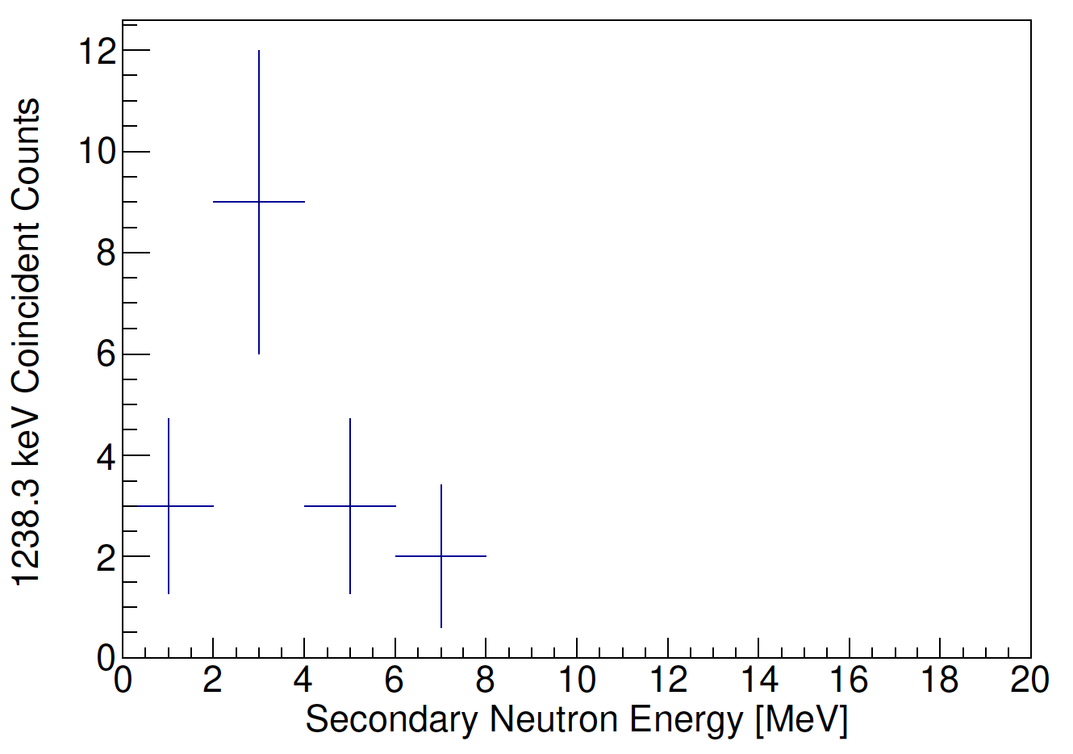
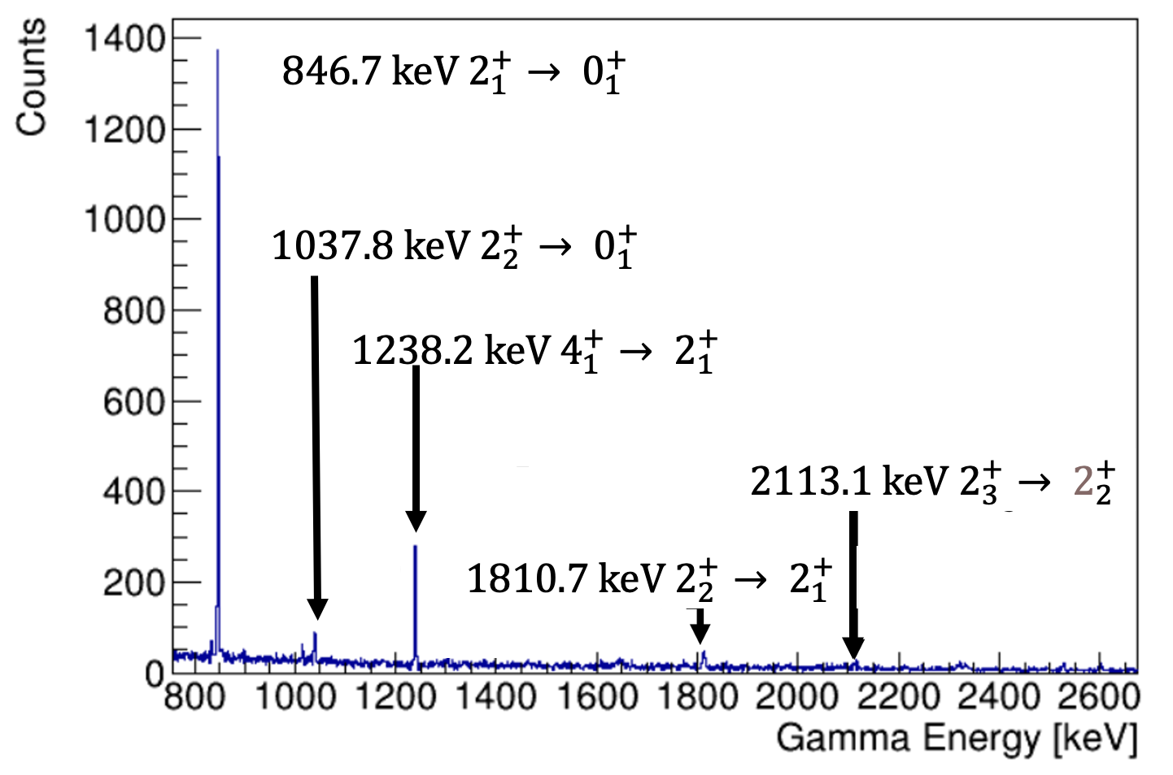


Our initial effort with GENESIS was a proof-of-principle studying ⁵⁶Fe(n,n’γ)
⁵⁶Fe(n,n’γ)
gated on prompt neutrons
S. McConchie, et al., Technical Report No. ORNL/TM-2021/1900, 2021.
N_{n}(E_{n},θ_{n}) gated on the
1238 keV $4_{1}^{+}→ 2_{1}^{+}$
Priority | Elements
First | C, N, O, Na, Al, Si, Fe, Cu, Pb, W, U, Pu
Follow-up | He, Li, Be, B, Cl, Cr, Mn, Ni, Ge, Br, Cd, I, Cs, La
Remaining | F, Mg, P, S, Ar, K, Ca, Ti, As, Kr, Mo, Sn, Sb, Xe, Gd, Bi, Np, Am, Tm
“GENESIS: Gamma Energy Neutron Energy Spectrometer for Inelastic Scattering.” J.M. Gordon et al., NIM A 1061 (2024) 169120.
Gamma-rays up to 10 MeV measured for incident E_{n} from 10 keV to 20 MeV
Our initial work has focused on nuclei for advanced reactors and nonproliferation: ⁵⁶Fe, ²³⁸U, ³⁵Cl and ²³Na
J.M. Gordon
*https://doi.org/10.1016/j.nima.2024.169120

Slide 5
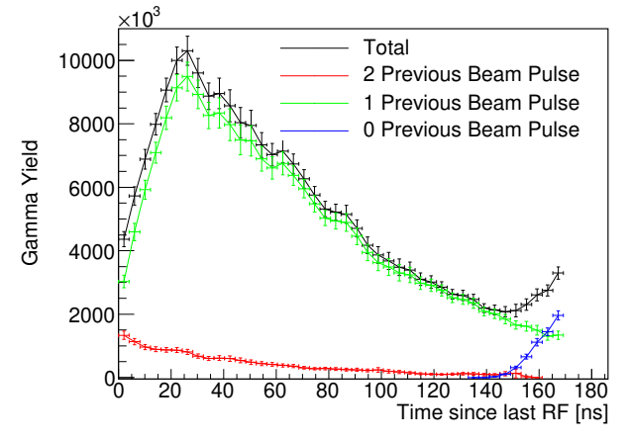
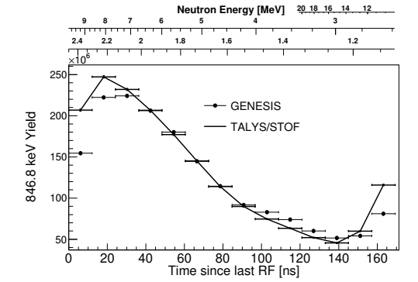

We use a forward fit process to determine optimal reaction modeling parameters for multiple incident neutron energies
Spectrometer
Simulation
Input: ENSDF, NLD, RSF, OMP
Calculate γ-ray, neutron observables
Joey Gordon
σ_{γ/n’}(E_{n},θ_{n’}) from Talys
Publication
GENESIS σ_{γ/n’}(E_{n},θ_{n’})
χ²
minimization
Realistic values were obtained for all parameters except neutron OMP using only γ-ray partial cross sections
$$2_{1}^{+} → 0_{1}^{+} Yield$$
Contributions from all beam pulses were well-modeled
Next Step included the neutron spectral data N_{ν}(E_{ν} ,θ_{ν} )
χ²/dof=1.6
J.M. Gordon Ph.D. dissertation, December 2023. https://escholarship.org/uc/item/3mm226cb

Slide 6
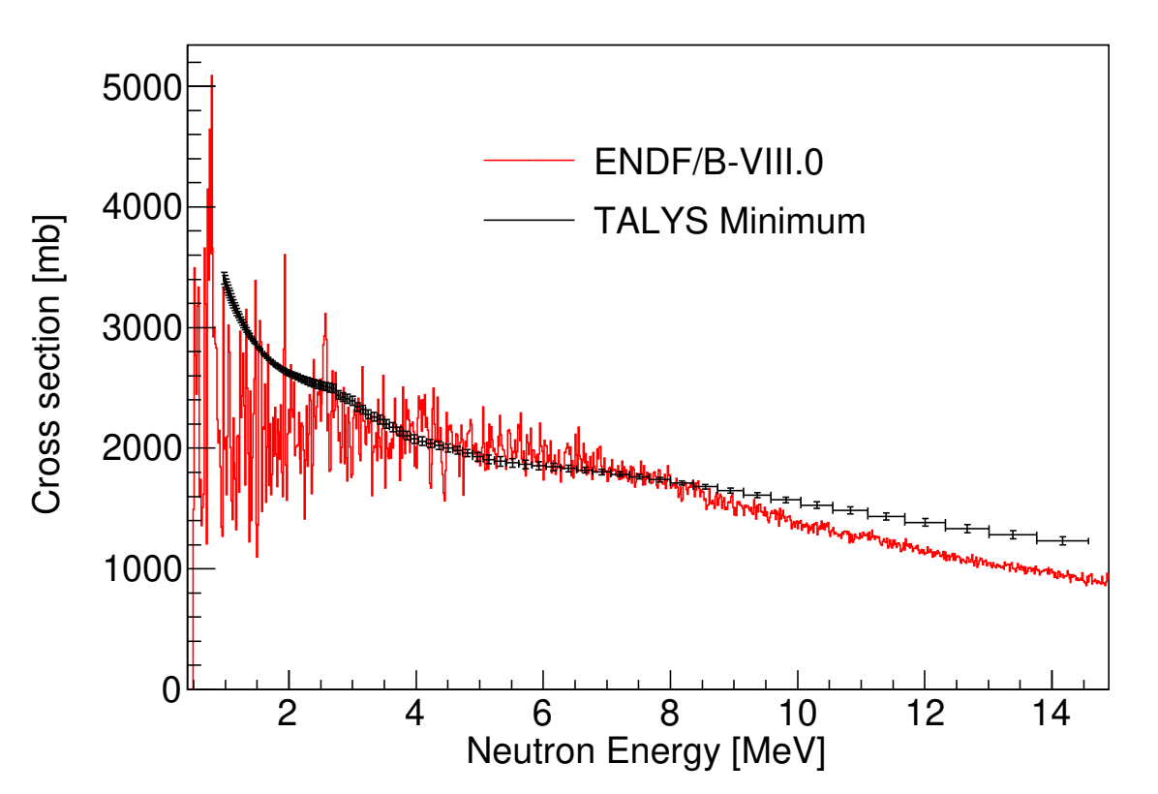
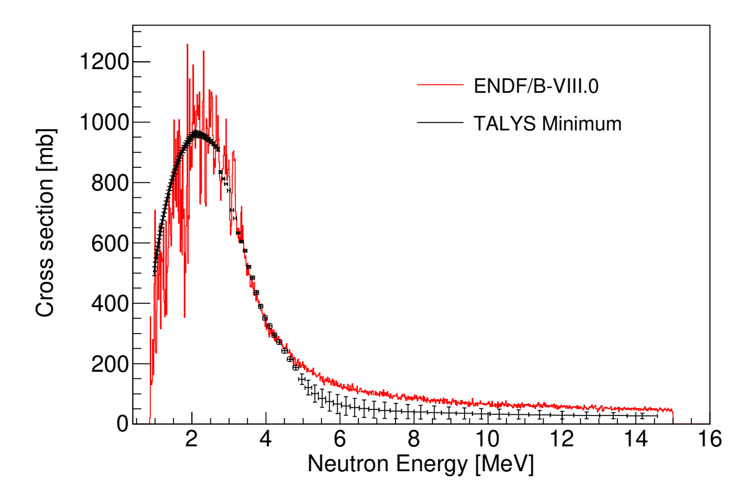
We use a forward fit process to determine optimal reaction modeling parameters for multiple incident neutron energies
Spectrometer
Simulation
Input: ENSDF, NLD, RSF, OMP
Calculate γ-ray, neutron observables
Joey Gordon
σ_{γ/n’}(E_{n},θ_{n’}) from Talys
Publication
GENESIS σ_{γ/n’}(E_{n},θ_{n’})
χ²
minimization
σ_{Elastic} was successfully predicted as well
This approach isn’t limited to observed channels
χ²/dof=1.6
J.M. Gordon Ph.D. dissertation, December 2023. https://escholarship.org/uc/item/3mm226cb

Slide 7
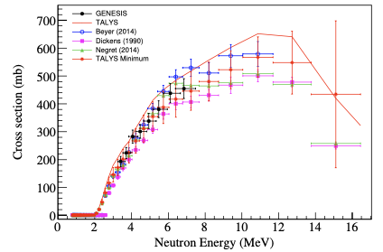
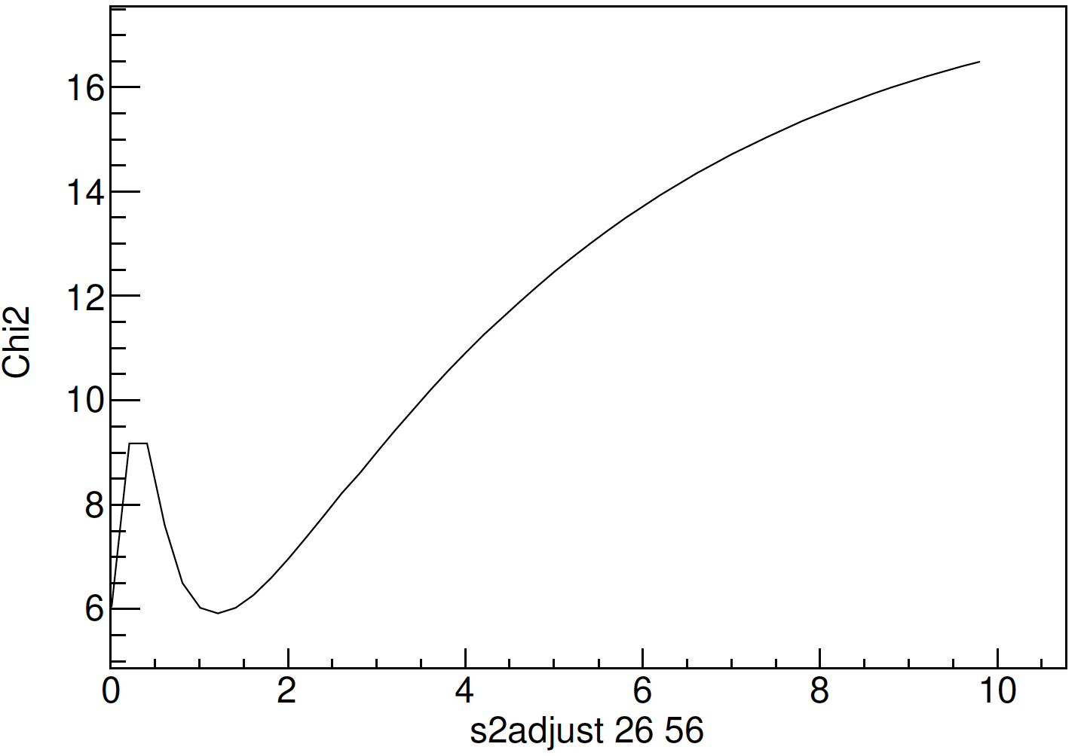
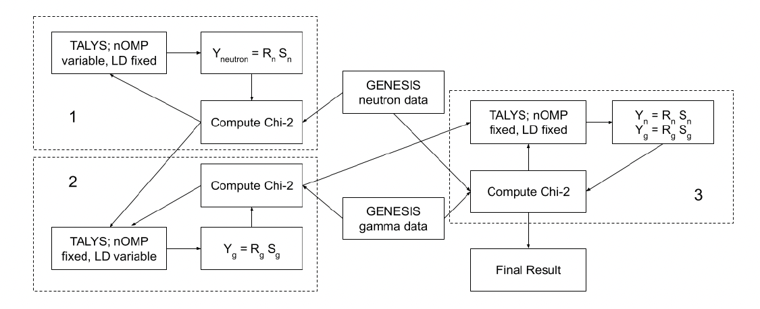
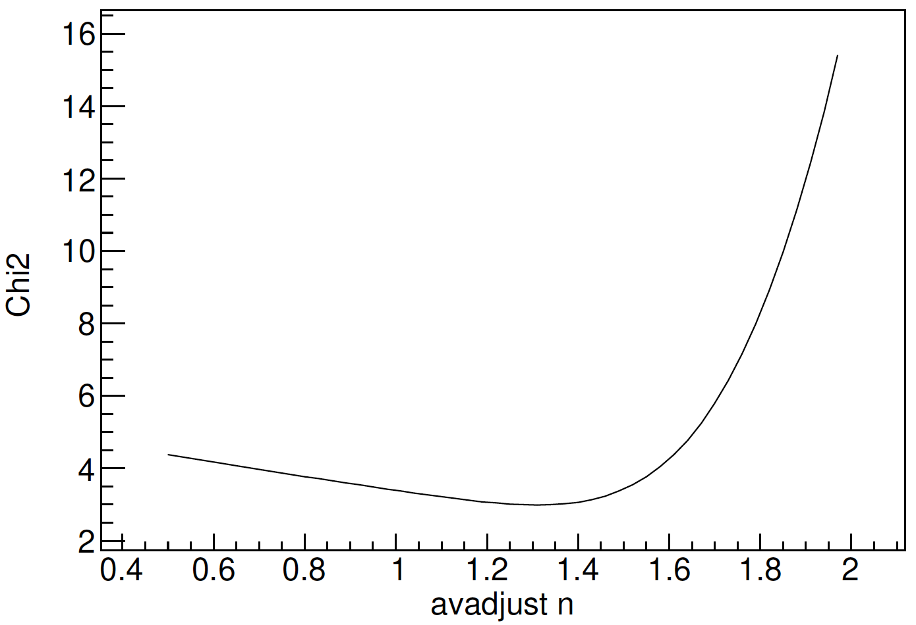
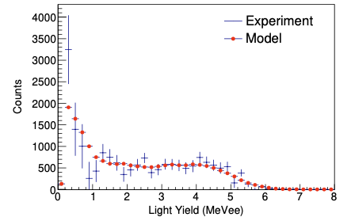

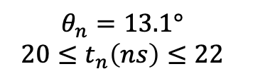
The actual minimization approach involves three steps
Joey Gordon
χ² for s2adjust
1238 keV $4_{1}^{+}→ 2_{1}^{+}$
$$θ_{n}=13.1°$$
$${20≤t}_{n}\left(ns\right)≤22$$
χ² for avadjust
J.M. Gordon Ph.D. dissertation, December 2023. https://escholarship.org/uc/item/3mm226cb
Notes:
847 keV Mn-56

Slide 8
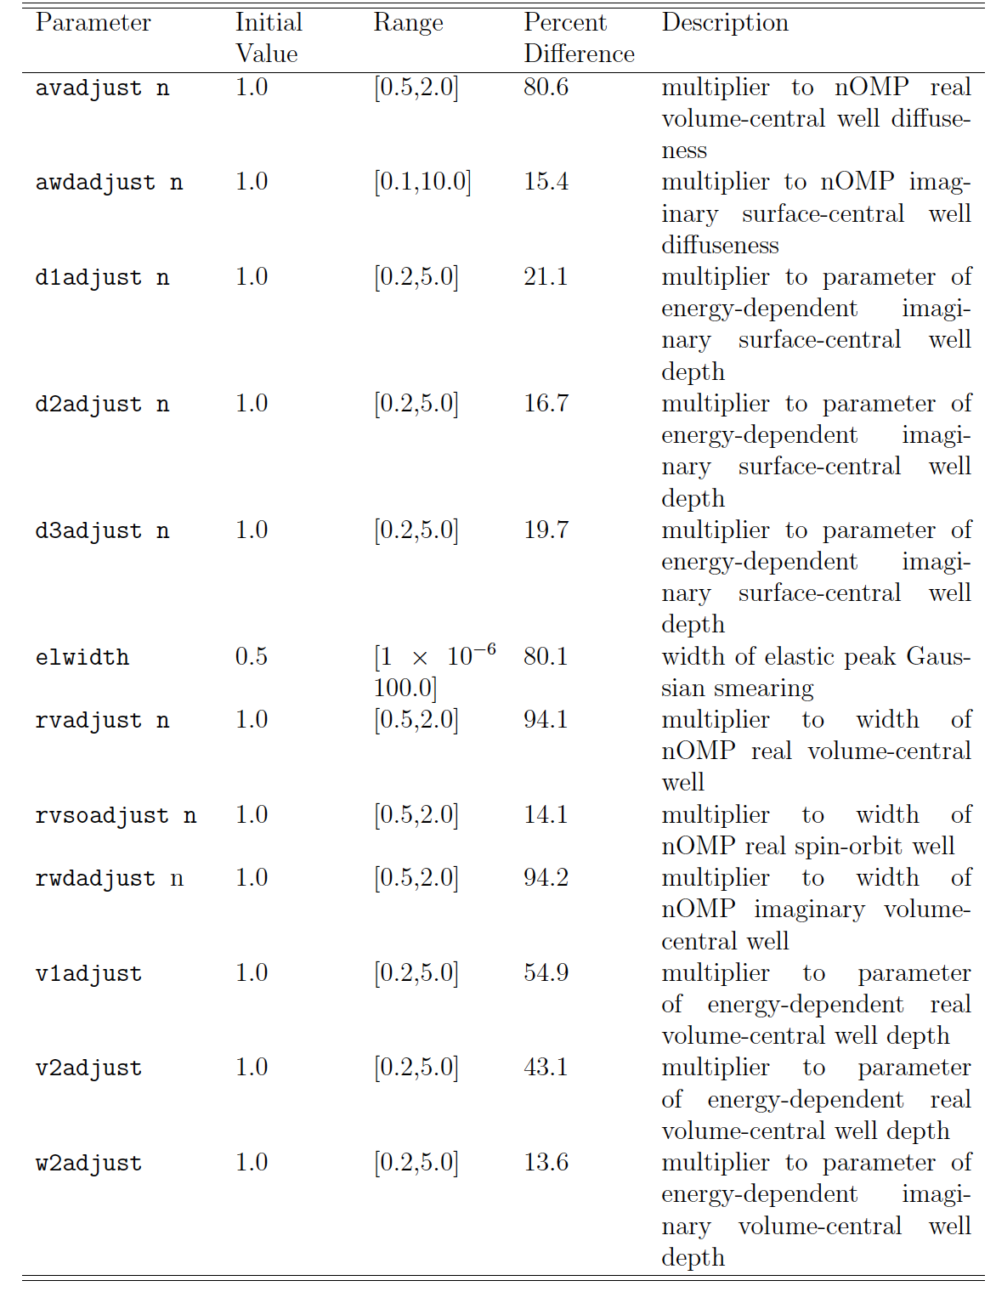
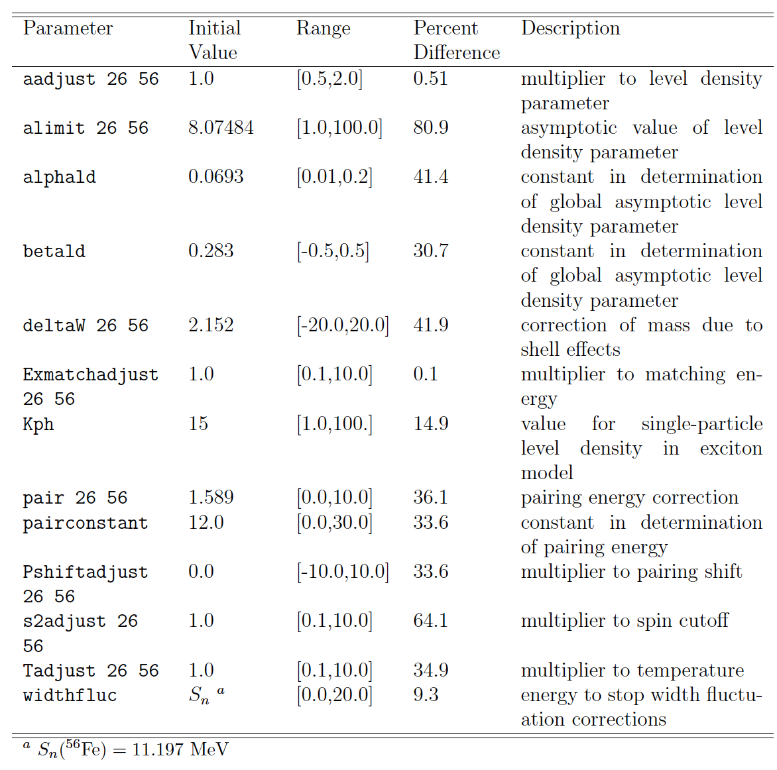
The final values
Neutrons
Gammas
Joey Gordon
J.M. Gordon Ph.D. dissertation, December 2023. https://escholarship.org/uc/item/3mm226cb
Notes:
847 keV Mn-56

Slide 9
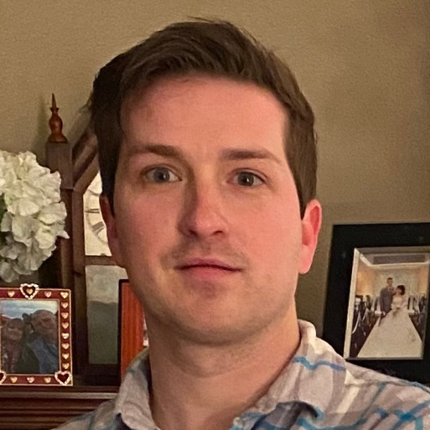
We also performed a 3-part ³⁵Cl(n,x) measurement for MCFRs
Differential Experiment #3
³⁵Cl(n,p) and ³⁵Cl(n,α) relative to 6Li(n,t)α from a CLYC (Ce:Cs₂Li⁶YCl₆) Active Target
Differential Experiment #2
³⁵Cl(n,xγ) & ³⁵Cl(n,γ) using a NaCl tablet
D-beam
Neutron Source
Integral Experiment #1
Production of ³⁵S and ³²P via ³⁵Cl(n,p) and ³⁵Cl(n,α) on a NaCl tablet (Ni monitor foil)
Experiments performed in 2021 & 2022
Tyler Nagel

Slide 10
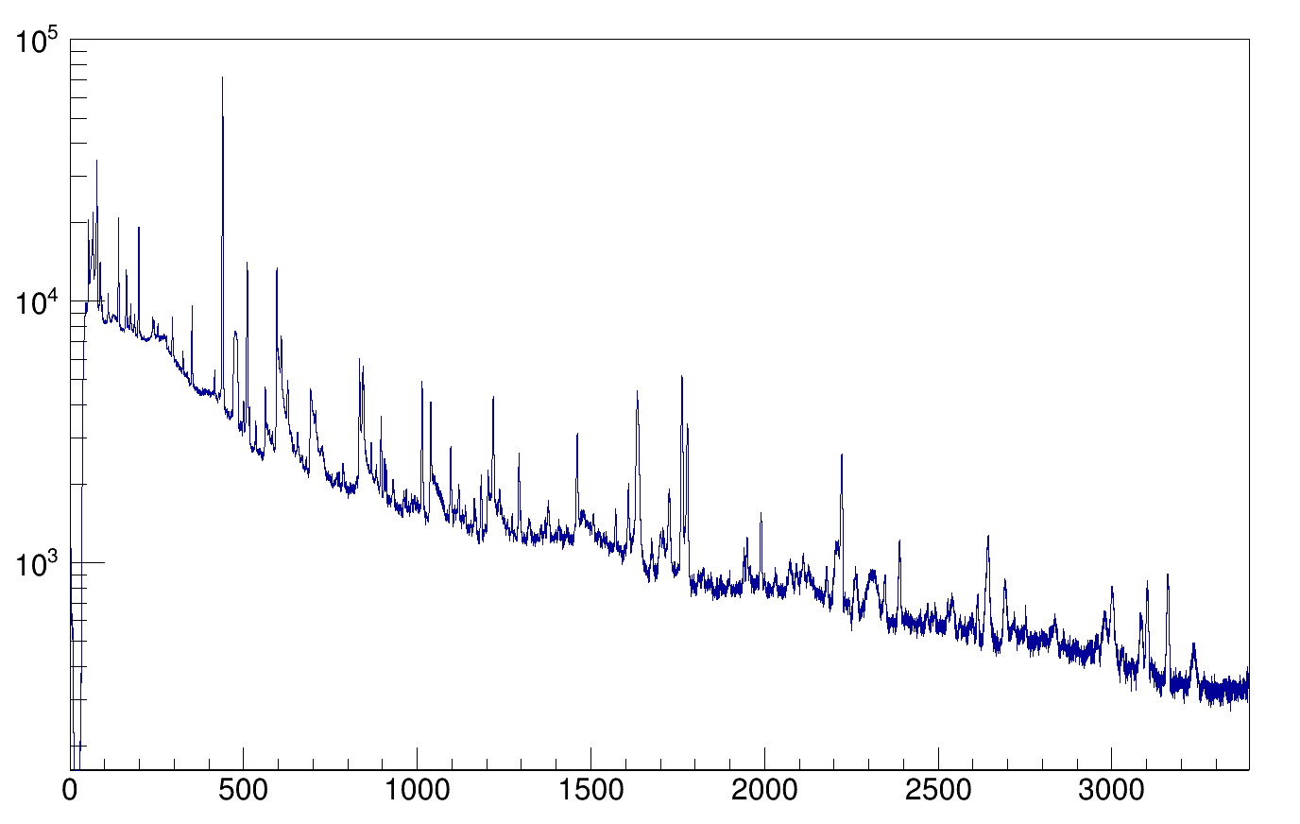
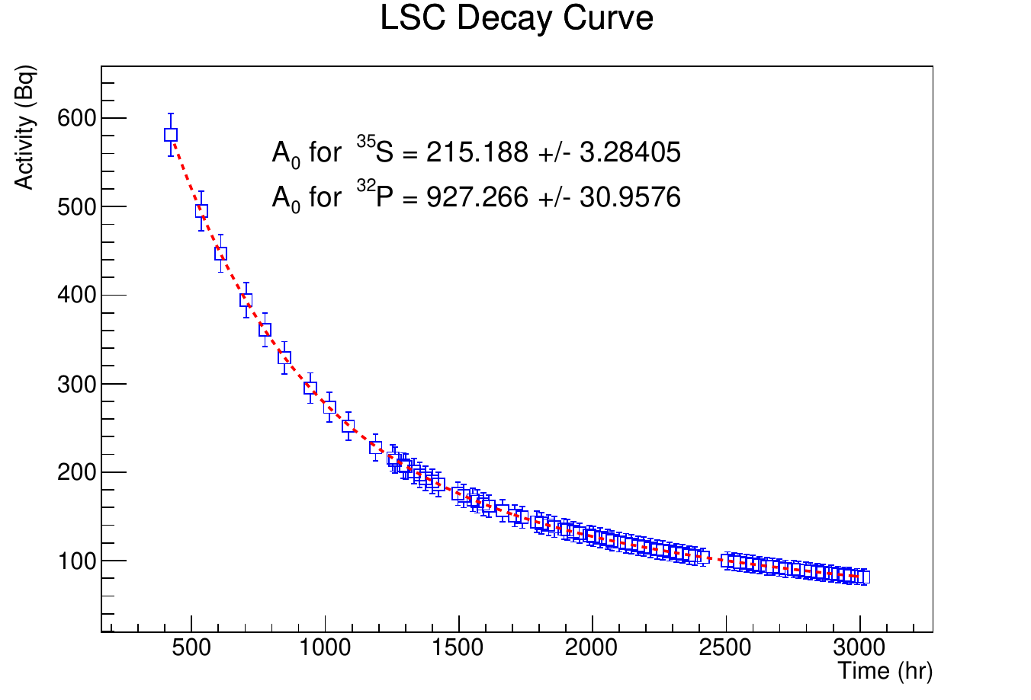
We also used GENESIS to perform simultaneous energy differential and integral measurements of the ³⁵Cl(n,p), (n,α) and (n,n’γ) cross sections
⁶Li(n,⍺)t
⁶Li(n,⍺)t
CLYC-6 @ 9 m
²³Na(n,n’γ)
³⁵Cl(n,p₀)
³⁵Cl(n,n’γ)
⁶Li(n_{th},⍺)t
³⁵Cl(n,p₀)
³⁵Cl(n,pɣ)
CLYC-6 @ 4.5 m
Counts
D-beam
³⁵Cl(n,pγ)³⁵S
γ-ray energy (keV)
Neutron Source
Tyler Nagel
“Measurement of energy-differential ³⁵Cl(n,p₀)³⁵S cross section via ratio with ⁶Li(n,α)t.” T. Nagel et al., Phys. Rev. C 110, 034612 (2024)

Slide 11
We’ve been working to determine isotope production rates at different beam energies using the stacked target method
VERY thick Al Degraders
(lowers the beam energy)
γ-ray
detector
Monitor Foils
Beam
Foil of Interest
Irradiate a stack of foil that includes monitor targets that where the reaction rates are known and targets we want to determine the production rate on and “beam degraders” which lower the beam energy.
Put the targets in front of the γ-ray detector after the experiment to measure the decay of the radioactive products formed during irradiation.
This allows the production rate of the unknown target to be determined relative to the known targets.
Notes:
Beam current and energy measured using activation monitors and beam-current integrators. High current (≤1500 W) and modest beam energies allow for very short irradiations and quick sample extraction facilitating the measurement of activities with t-1/2 ≥ 10 min.

Slide 12
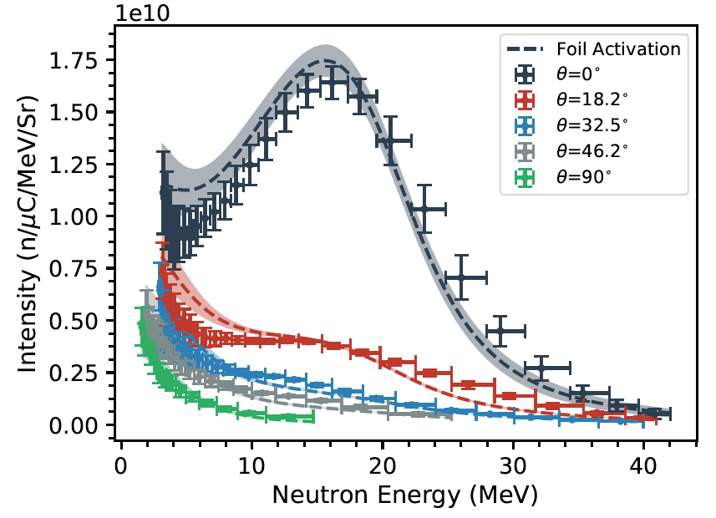
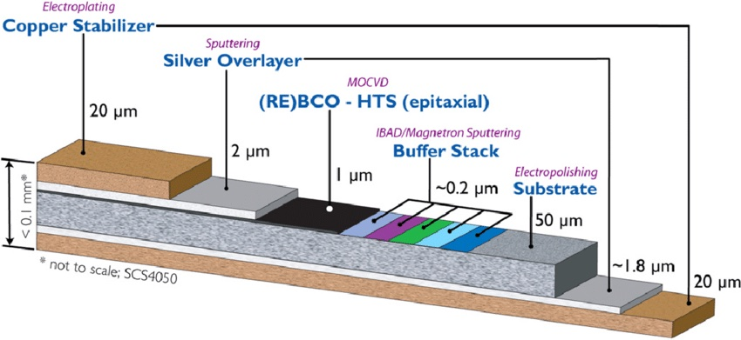
We’ve developed a high-power target for intense neutron bombardments of materials for fusion & single event effects
Target tested in August 2024, with sponsorship from MDA and NorthStar
40 MeV deuterons*
=1.4x10¹¹ n/s/cm² @ 1 cm
=2.0x10¹⁰ n/s/cm² @ 10 cm
=2.2x10⁵ n/s/cm² @ 10 m
50 MeV deuterons*
=7.5x10¹² n/s/cm² @ 1 cm
=1.2x10¹¹ n/s/cm² @ 10 cm
=6.7x10⁵ n/s/cm² @ 10 m
The intense fast, forward-focused neutrons from TTDB at the LBNL 88-Inch Cyclotron is a powerful capability for measuring:
gas production & materials damage in high-temp superconductors
final-stage optics for ICF
neutron shielding & single-event effects for space applications
J.T. Morrell, PRC 108, 024616 (2023)
*Assumes 20 µA beam and 0°

Slide 13
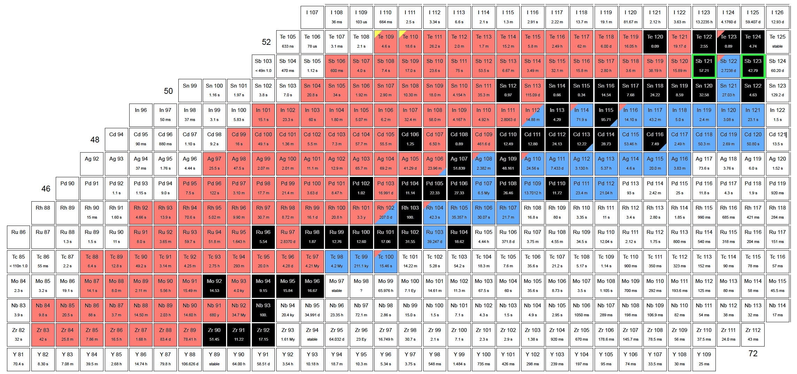

Onto Isotope Production! We performed (p,x) measurements at 50 MeV (LBNL), 100 MeV (LANL) and 200 MeV (BNL) on ^{121,123}Sb
⁹³Nb
100%
Over 200 nuclei populated with 16 independent + 10 cumulative excitation functions measured for ^{nat}Sb(p,x)
Isomer ratios for ^{119,121}Te^{m,g} show that ρ(J) and that neutron optical model parameters need adjustment..wait for the paper…
Catherine Apgar

Slide 14
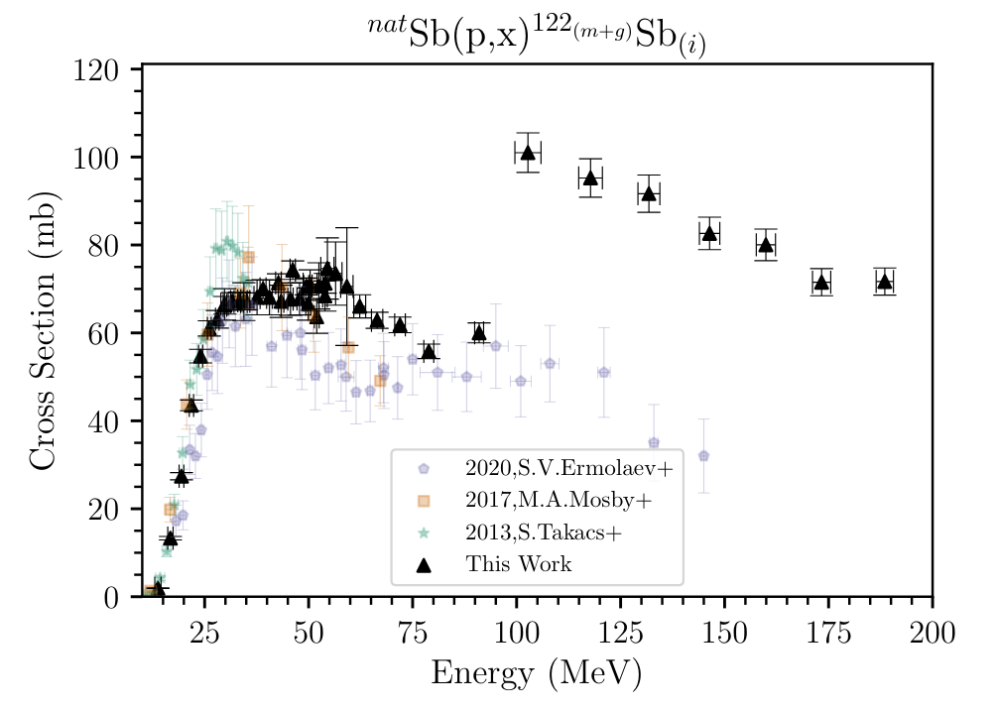
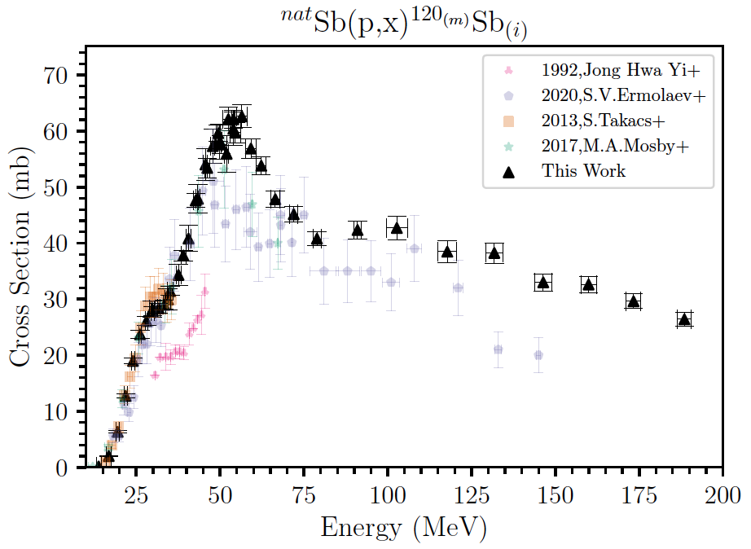
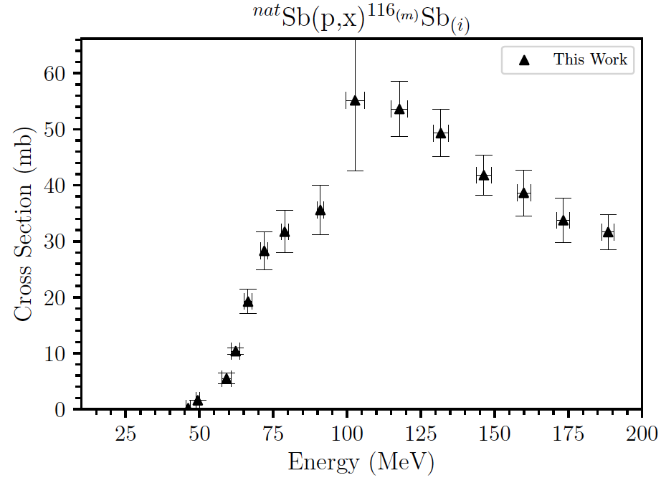
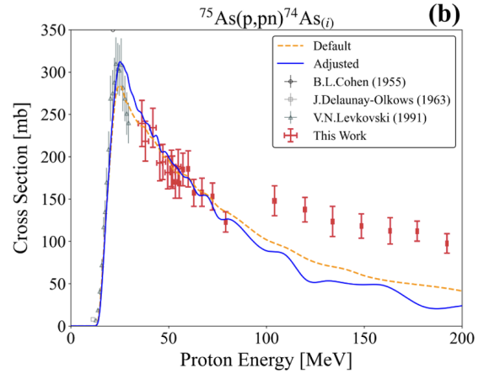
Catherine Apgar saw evidence of significant secondary neutron production in ^{nat}Sb(p,x) data at E_{p}=200 MeV
LBNL (50 MeV)
LANL
(100 MeV)
BNL
(200 MeV)
LBNL (50 MeV)
LANL
(100 MeV)
BNL
(200 MeV)
LBNL (50 MeV)
LANL
(100 MeV)
BNL
(200 MeV)
¹²³Sb(p,pn)¹²²Sb
+¹²³Sb(n,2n)¹²²Sb
¹²¹Sb(p,pn)^{120m}Sb
+¹²¹Sb(n,2n)^{120m}Sb
¹²¹Sb(p,p5n)^{116m}Sb
+¹²¹Sb(n,6n)^{116m}Sb
It turns out we saw this as well in our 2021 As data as well²
⁷⁵As(p,pn)⁷⁴As
+⁷⁵As(n,2n)⁷⁴As
Secondary neutrons are a challenge and an opportunity for isotope production
Catherine Apgar
¹C. Apgar, PhD Thesis, UCB (2024)
²M.B. Fox, PRC 104, 064615 (2021)

Slide 15
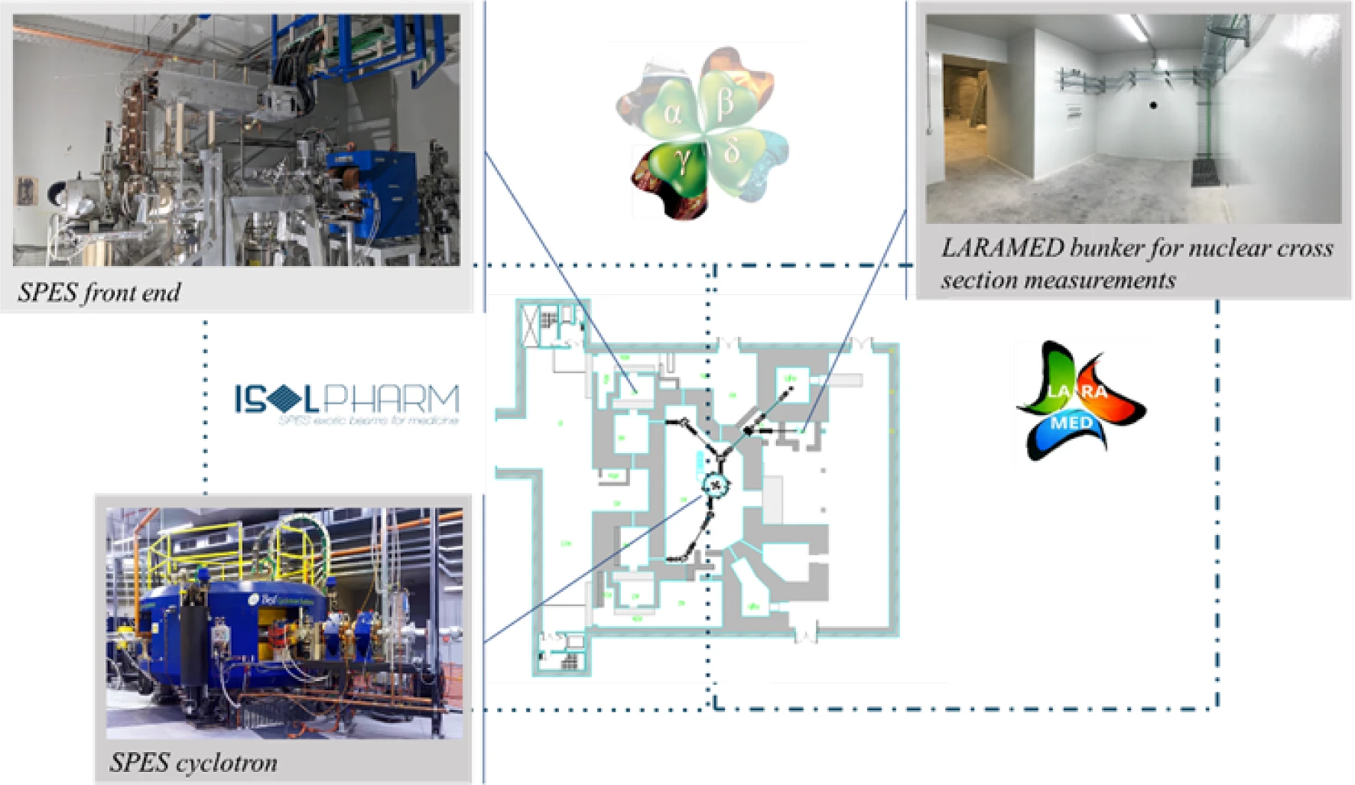

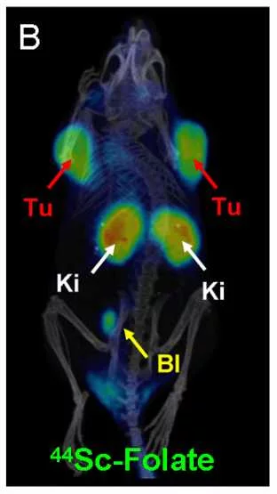
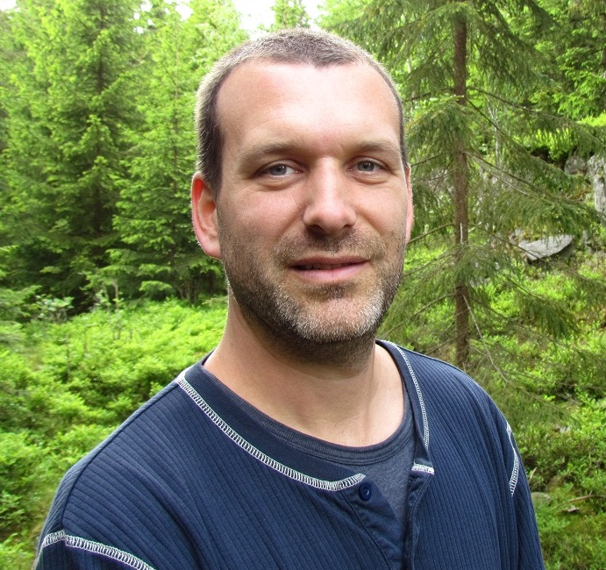
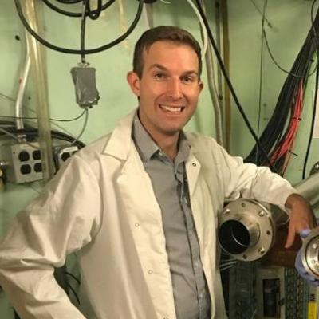
We’re establishing a Berkeley/Oslo/INFN-SPES-Legnaro collaboration to resolve discrepancies in reaction modeling
Sc(p,x)⁴⁴Ti →⁴⁴Sc PET generator
Ag(p,x)¹⁰⁷Cd for Auger therapy
Deformed → near-spherical enriched Nd, Eu, Sm targets for improved reaction models (collaboration w/ A. Koning)
Data analysis by UiO students
Single-foil and stacked-target irradiations will provide insight into secondary neutrons at high-E_{p} facilities
Mathis Wiedeking
Andrew Voyles
M.B. Fox, PRC 104, 064615 (2021)
C. Apgar, PhD Thesis, UCB (2024)

Slide 16
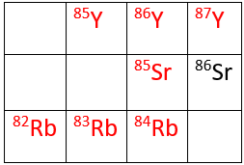

Our group has performed a series of measurements, reaction modeling and decay studies related to the production of radionuclides near the PET imaging nucleus ⁸⁶Y
SrCO₃ target enriched ⁸⁶Sr (96.4%) irradiated with proton and deuteron beams at 88-inch cyclotron, LBNL, and BC1710 cyclotron, FZJ, Jülich.
Medical Isotope production cross sections
Decay studies
  γ emission probability
  γ± emission probability
Reaction dynamics
  (p,xn)
  (d,xn), (d,x)
(p,n)
⁸⁶Sr(p,n)^{86m,g}Y
⁸⁶Sr(p,2n)^{85m,g}Y
(d,xn)
⁸⁶Sr(d,n)^{87m,g}Y,
⁸⁶Sr(d,2n)^{86m,g}Y
⁸⁶Sr(d,3n)^{85m,g}Y
(d,x)
⁸⁶Sr(d,α)^{84m,g}Rb,
⁸⁶Sr(d,αn)⁸³Rb
⁸⁶Sr(d,α2n)^{82m}Rb
7 Publications since 2020:
2020Ba30: Phys.Rev. C 101, 064619 (2020)
2020Ud01: Radiochim.Acta 108, 747 (2020)
2022Ud01: Molecules 27, 768 (2022)
2022Ud02: Eur.Phys.J. A 58, 67 (2022)
2022Ud03: Radiochim.Acta 111, 81 (2022)
2024Ud01: Eur.Phys.J. A 60, 128 (2024)
2024UdAA: PRC (submitted)
This is all part of a long and fruitful collaboration with
Prof. S. Qaim (FZJ-Julich), and Dr. M.S. Uddin (BAEC-Bangladesh)
M.S. Basunia

Slide 17
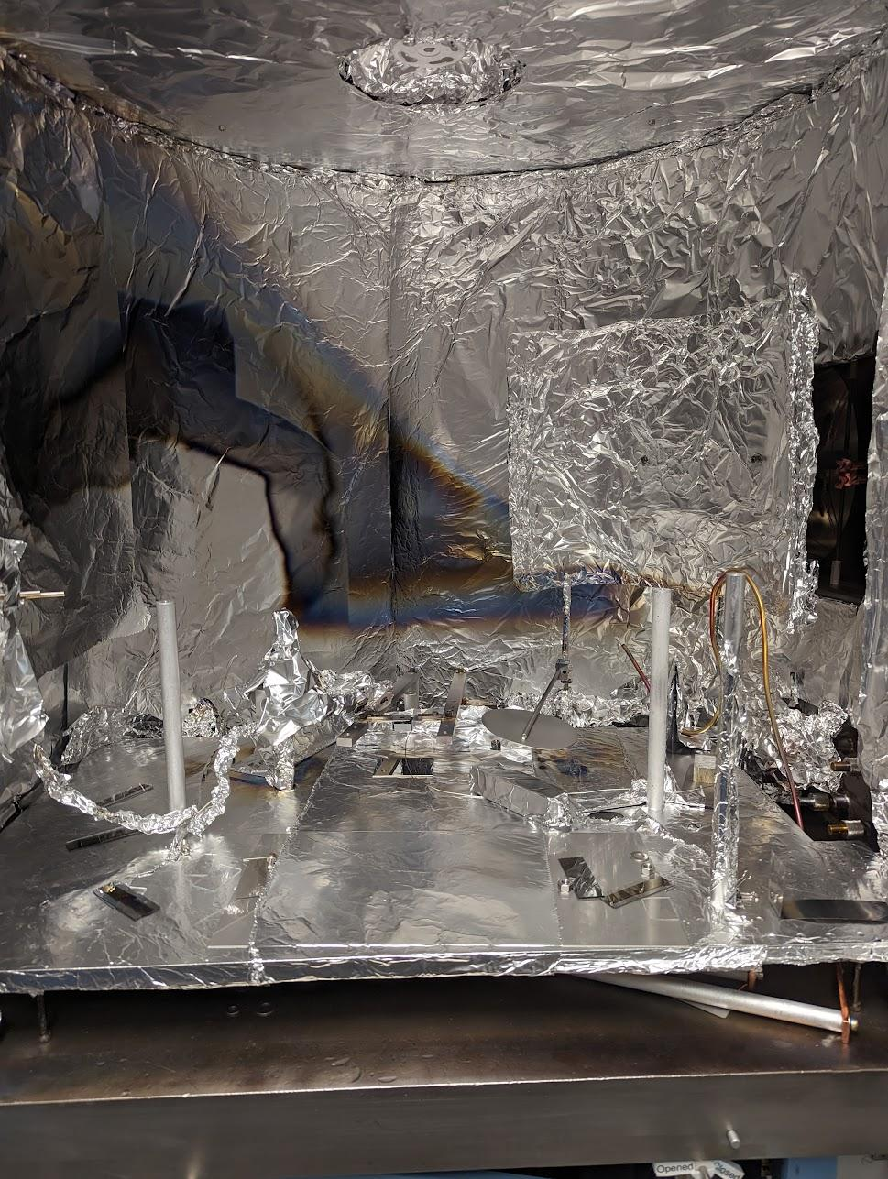
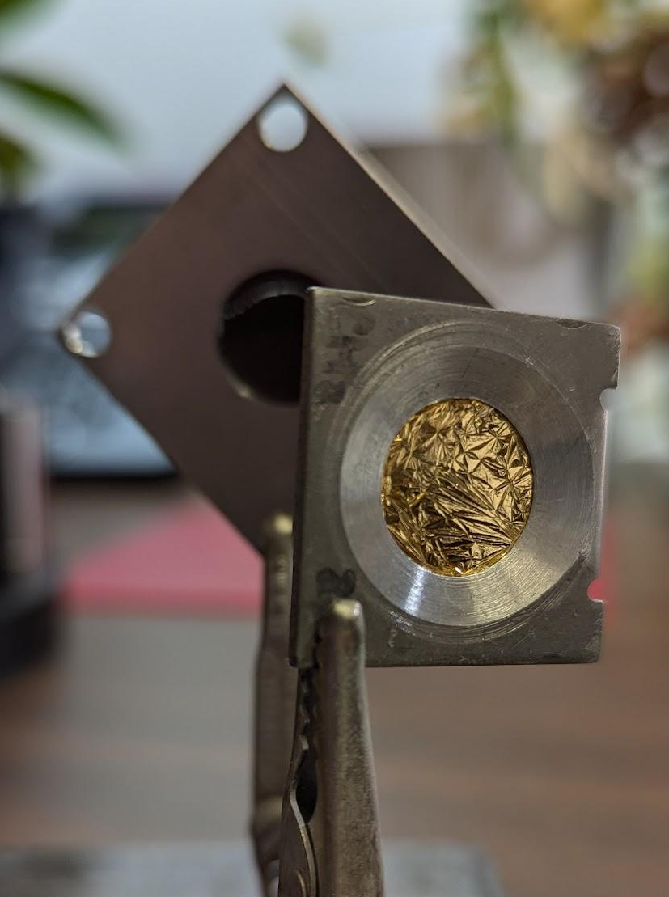
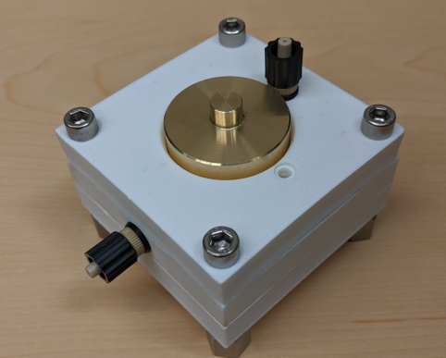
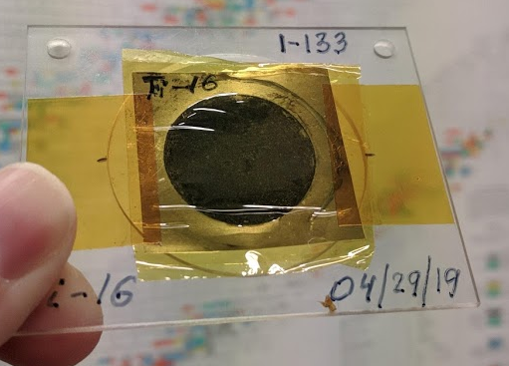
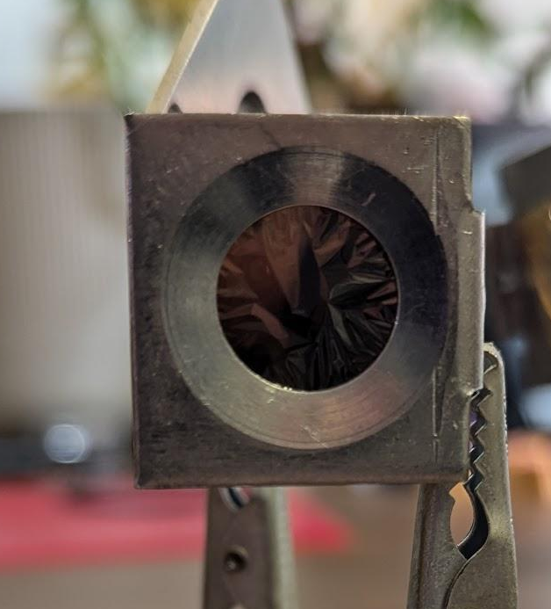
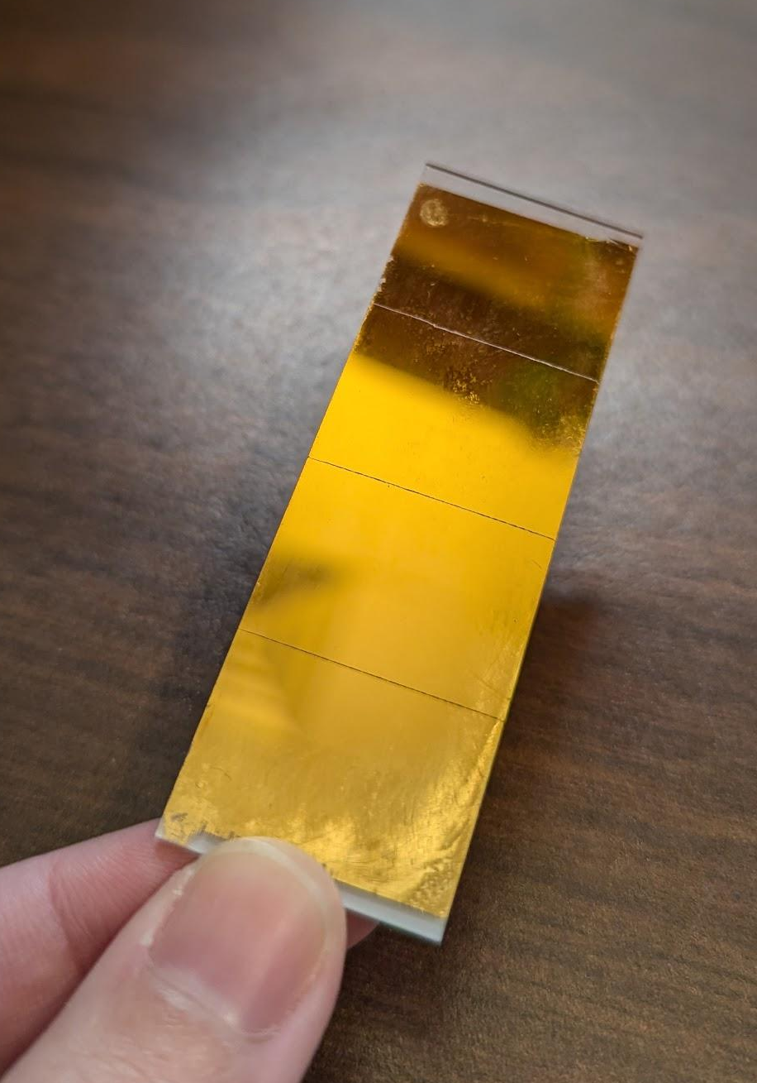
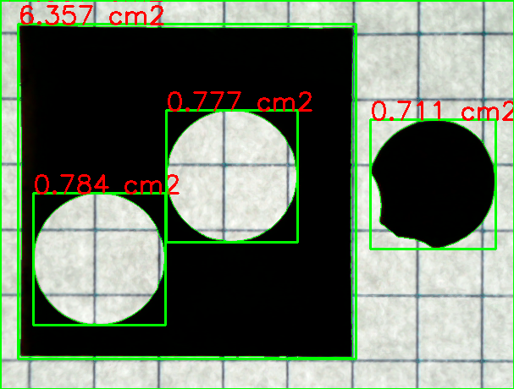
We’ve developed target fabrication capabilities to support current and future measurements
10 µg/cm² Au
20 µg/cm² C
2 mg/cm² As (Electrodeposition)
Computer Vision based areal density measurement tool¹
70 µg/cm² Au
Vacuum Deposition
Other Capabilities:
Thin-Foil Rolling, Pressed Pellets, Sedimentation
Actinide Targets (²²⁹Th, ²⁴¹Am, ²⁴⁰Pu) - coming soon!
Andrew Voyles
[1] https://github.com/avoyles/ArealDensityCam

Slide 18
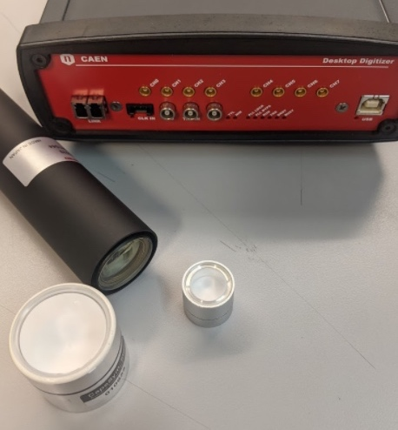

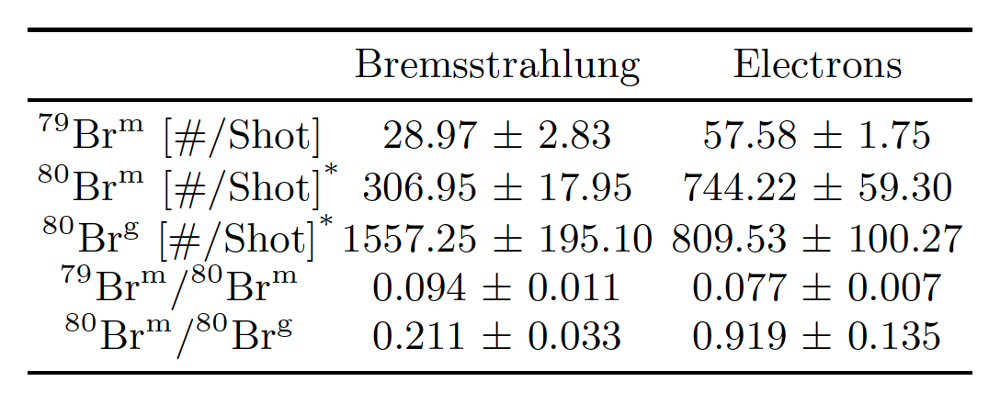


We have been using ultra-high flux (10²⁸⁺ e/cm²/s) e’s and γ’s from a fs laser to perform photoexcitation measurements
Use a LaBr detector for use as a ^{79,81}Br active target.
Install adjustable Bremsstrahlung converter (energy selection via geometry, few pC/MeV expected)
Use both photons and electrons to populate ^{79m}Br, ^{80g}Br and ^{80m}Br
LaBr “active target”
⁷⁹Br
QC
^{80g}Br
(stable)
^{80m}Br (4.4 h)
^{80g}Br (17.7 m)
Electron
Beam
Laser
Brem. Converter
Magnet
15-35 MeV Electrons
15-35 MeV photons
Dispersion
Magnet
Energy/Charge Scintillator
$$φ_{γ}≈{10}^{18} /{{cm}^{2}}s$$
Active Detector
$$φ_{e}≈{10}^{27} /{{cm}^{2}}s$$
Target Chamber Floor
Electrons are ≈4 times as effective at changing J
The isomer on population ratio depends on both ρ(E_{x} ) & F(E_{γ} )

Slide 19


CY2023-2024 BAND Ph.D. Dissertations
“Simultaneous Measurements of Secondary Gamma Rays and Neutrons from Fast Neutron Scattering on ⁵⁶Fe with GENESIS”
  Joseph Gordon – December 2023 UCB Post-doc
“Techniques in Live Neutron Spectroscopy”
Christopher Brand – December 2023 – LLNL Staff
“Isomer Population Control in Solid-Density Targets using Compact Laser-Plasma Accelerators”
  Robert E. Jacob– May 2024 LBNL Postdoc
“Production of ^{117m}Sn and ^{119m}Te via Proton Bombardment on Natural Antimony: Applications for Charged Particle Reaction Modeling and Theranostics”
  Catherine Apgar– May 2024 LANL Postdoc
“³⁵Cl(n,x) Cross Section Measurement”
  Tyler Nagel– May 2024 LANL Postdoc
Future Colleagues - Our most valuable product

Slide 20





Collaborators and Sponsors
GENESIS
J.A. Brown¹, C. Brand², D.L. Bleuel², J.M. Gordon¹, B.L. Goldblum^{1,3} Catherine E. Apgar^{1*}, T. Laplace¹, Amanda M. Lewis^{1**}, Jon Morrell^{1*}, T. Nagel^{1***}
Isotope Production via (p,x), (d,x) reactions
Andrew S. Voyles¹, Catherine E. Apgar^{1***}, M.S. Basunia², Jon C. Batchelder¹, Eva R. Birnbaum⁴, Cathy S. Cutler⁵, Morgan B. Fox¹, Arjan Koning⁵, Amanda M. Lewis^{1**}, Dmitri Medvedev⁵, Jon Morrell^{1*}, Ellen O’Brien⁴, S.M. Qaim⁶, Michael A. Skulski⁴, M.S. Uddin⁷, Etienne Vermeulen⁴, M. Wiedeking³
Isomer manipulation @ BELLA
J.A. Brown¹, C. Geddes², R. Jacob², T. Ostermayr², C. Schroeder^{2,1}, D.H.G. Schneider²
¹ University of California-Berkeley Dept. of Nuclear Engineering
²Lawrence Livermore National Laboratory
³ Lawrence Berkeley National Laboratory
⁴ Los Alamos National Laboratory
⁵ Brookhaven National Laboratory
⁵ International Atomic Energy Agency
⁶Forschungzentrum Jülich
⁷Bangladesh Atomic Energy Agency
*Now at Brookhaven National Laboratory
**Now at UT-Knoxville
***Now at Los Alamos National Laboratory

