Slide 1
Cu covariance study including impacts on past (and future) experiments
J. Hutchinson, P. Brain, T. Cutler, M. Devlin, N. Gibson, N. Kleedtke, R. Little, D. Neudecker, M. Rising
CSEWG 2024

Slide 2
Overview
Why do we care about Cu nuclear data?
Current state of Cu63 and Cu65 covariances
Impact on specific critical experiments
DISCLAIMER: this is from the point of view of a user of processed covariance data
NOTE: the scope of this study has been focused to date (only certain nuclides/reactions, covariances within single nuclide/reaction only, no angular distributions)
NOTE2: unless otherwise specified, correlations (not covariances) are plotted

Slide 3
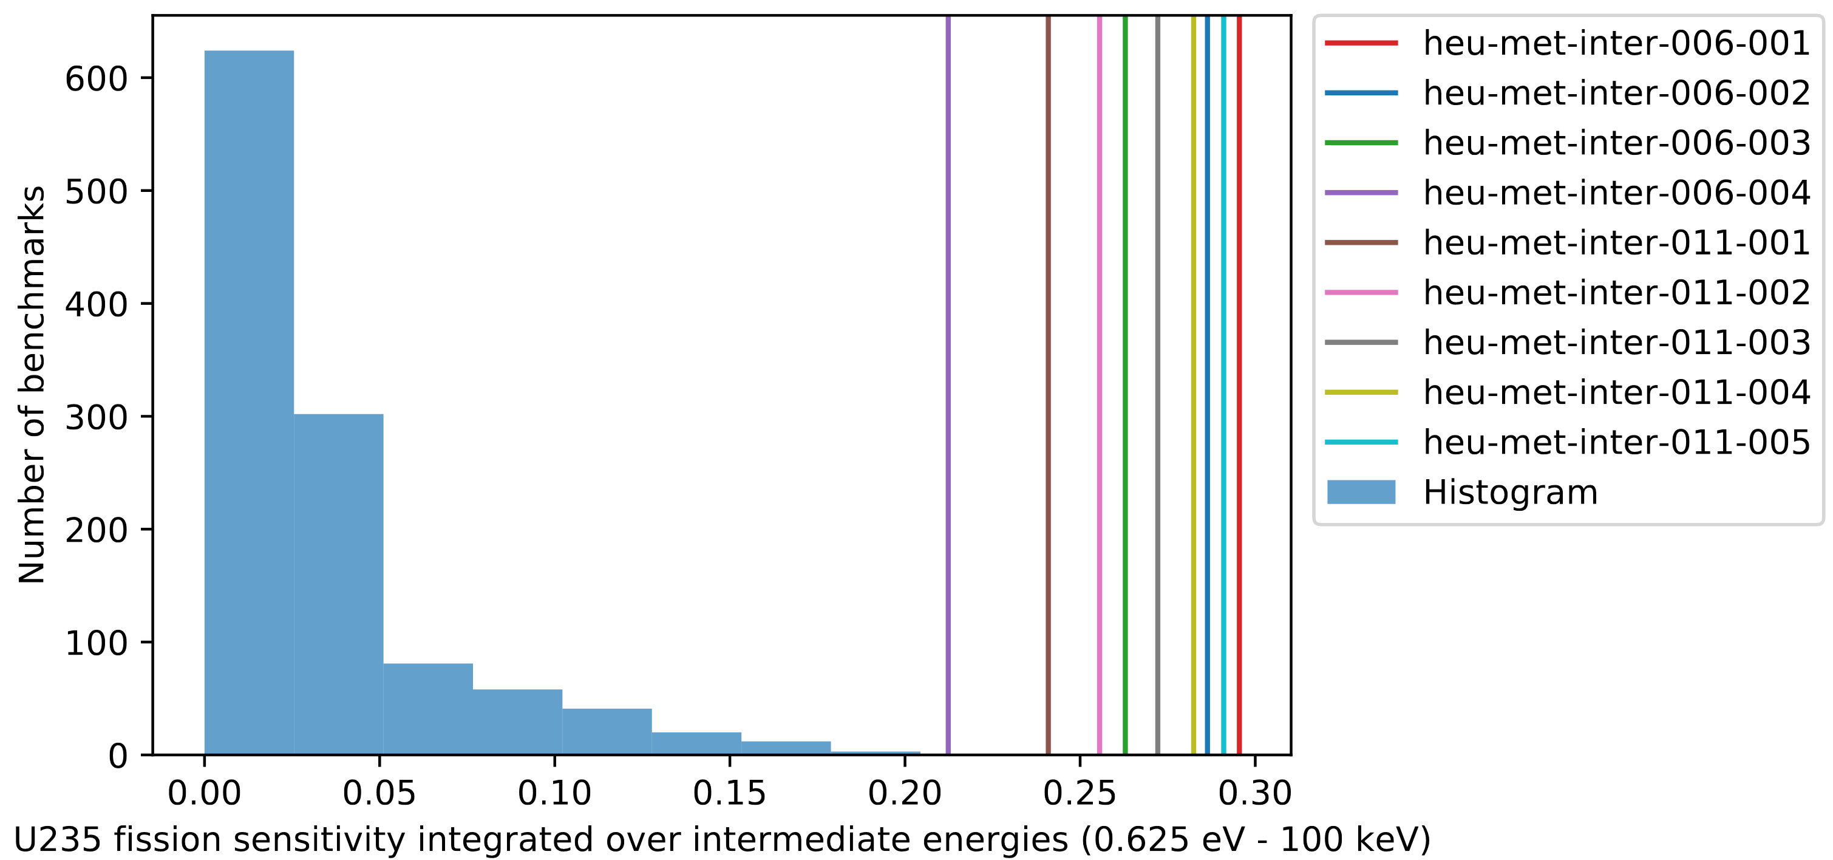
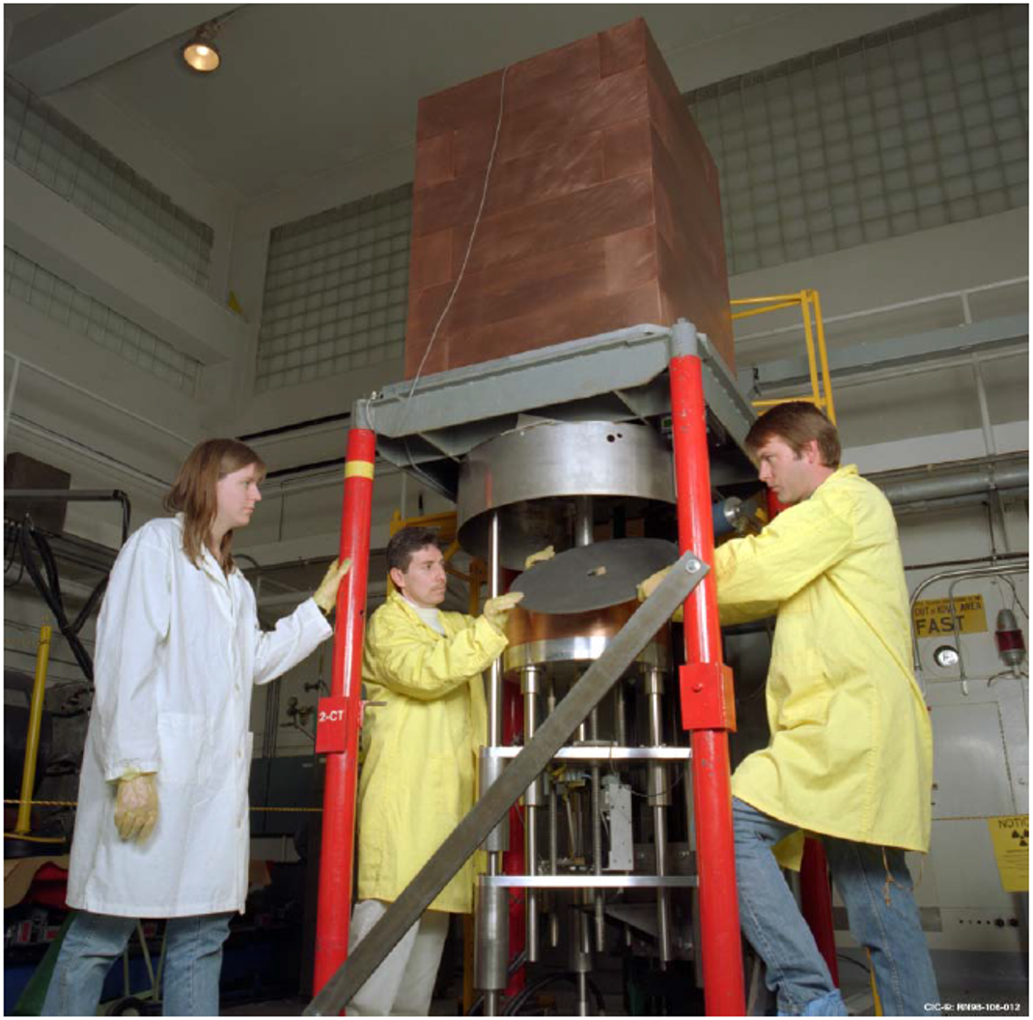
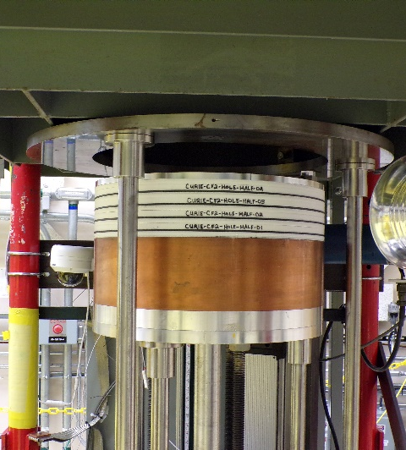
Why do we care about Cu nuclear data?
Histogram of the number of benchmarks sensitive to U235 fission at intermediate energies
Copper does have some uses in the nuclear industry (corrosion barrier for waste), but it is also useful for intermediate energy criticality experiments
  Cu is a useful reflector for intermediate energy experiments
  Therefore useful to help validate actinide materials at intermediate energies (which is a high priority mission need)
  Zeus series of experiments use a lot of Cu but are among the most sensitive intermediate energy experiments
Some critical experiment design metrics utilize covariance data

Slide 4
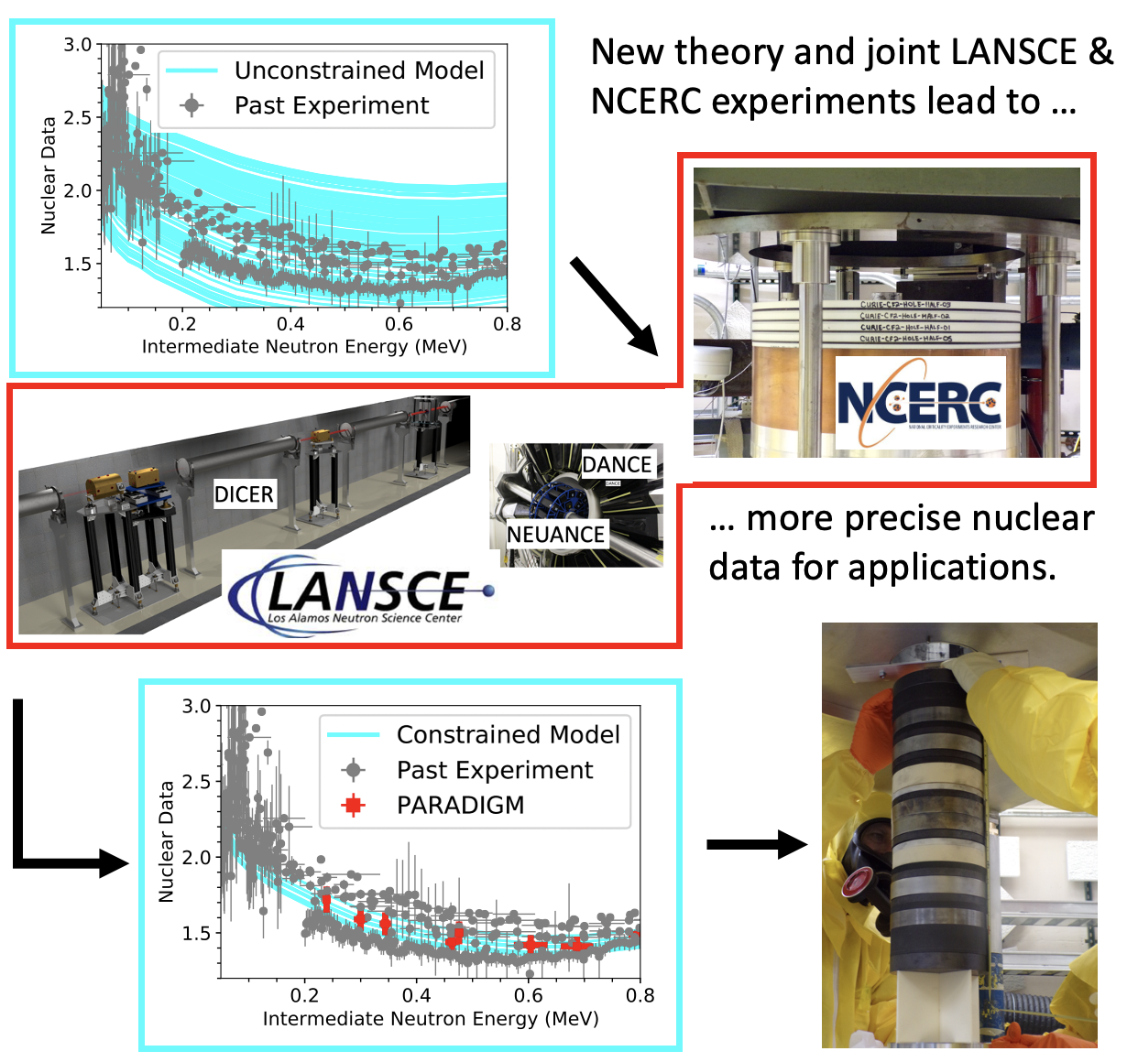
PARADIGM tackles issues in actinide intermediate energy nuclear data (ND) by transforming the ND pipeline
Couples capabilities provided by new LANSCE MARK-IV neutron target with NCERC integral experiments and nuclear theory
Utilizes machine learning for experiment design
Focused on ²³⁹Pu from 1-600 keV
Will include two integral experiment configurations (1-30 keV and 30-600 keV)
  When simulations shown here were run, the team was deciding between 6 configurations

Slide 5
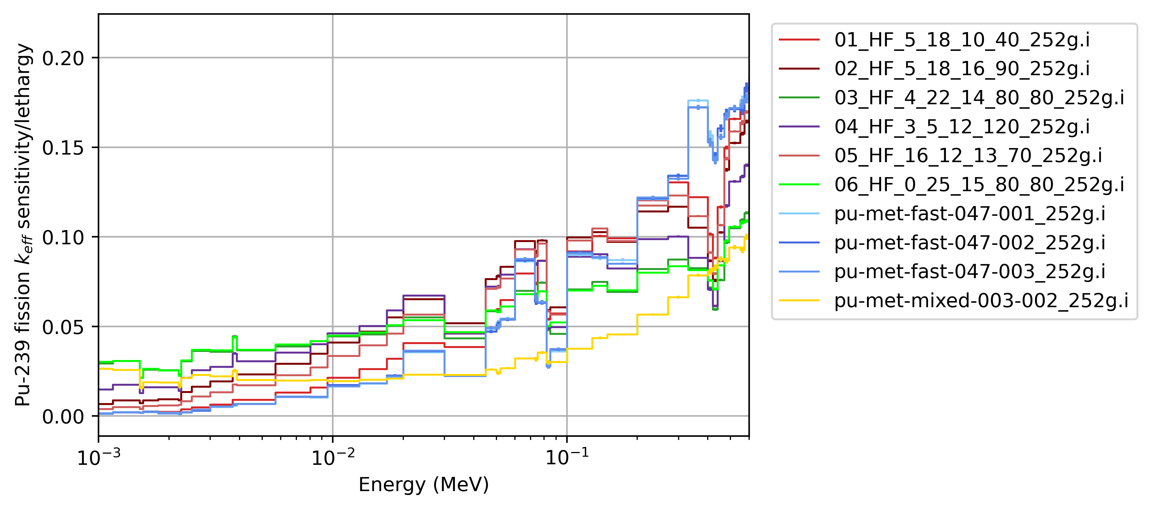
252 group, Pu239 fission keff sensitivity
PARADIGM candidate files
Reds: Alumina + boron
Greens: Alumina + graphite
Purple: Alumina
Blues: Jupiter
Gold: PMM003-002
Integrated 1-30 keV
Integrated 30-600 keV
Name | Sens
06_HF_0_25_15_80_80_252g.i | 1.298E-01
03_HF_4_22_14_80_80_252g.i | 1.291E-01
04_HF_3_5_12_120_252g.i | 1.208E-01
02_HF_5_18_16_90_252g.i | 1.014E-01
05_HF_16_12_13_70_252g.i | 8.075E-02
pu-met-mixed-003-002_252g.i | 6.899E-02
01_HF_5_18_10_40_252g.i | 5.082E-02
pu-met-fast-047-002_252g.i | 4.047E-02
pu-met-fast-047-003_252g.i | 4.018E-02
pu-met-fast-047-001_252g.i | 3.980E-02
Name | Sens
05_HF_16_12_13_70_252g.i | 2.850E-01
02_HF_5_18_16_90_252g.i | 2.849E-01
pu-met-fast-047-001_252g.i | 2.811E-01
01_HF_5_18_10_40_252g.i | 2.806E-01
pu-met-fast-047-002_252g.i | 2.798E-01
pu-met-fast-047-003_252g.i | 2.795E-01
04_HF_3_5_12_120_252g.i | 2.491E-01
06_HF_0_25_15_80_80_252g.i | 2.116E-01
03_HF_4_22_14_80_80_252g.i | 2.106E-01
pu-met-mixed-003-002_252g.i | 1.443E-01
Sensitivities using MCNP

Slide 6
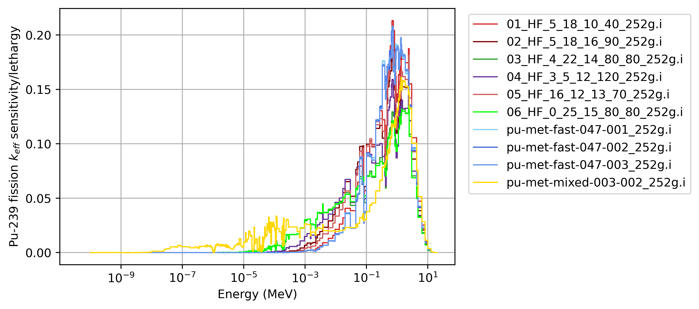
252 group, Pu239 fission keff sensitivity
PARADIGM candidate files
Reds: Alumina + boron
Greens: Alumina + graphite
Purple: Alumina
Blues: Jupiter
Gold: PMM003-002
Sensitivities using MCNP

Slide 7
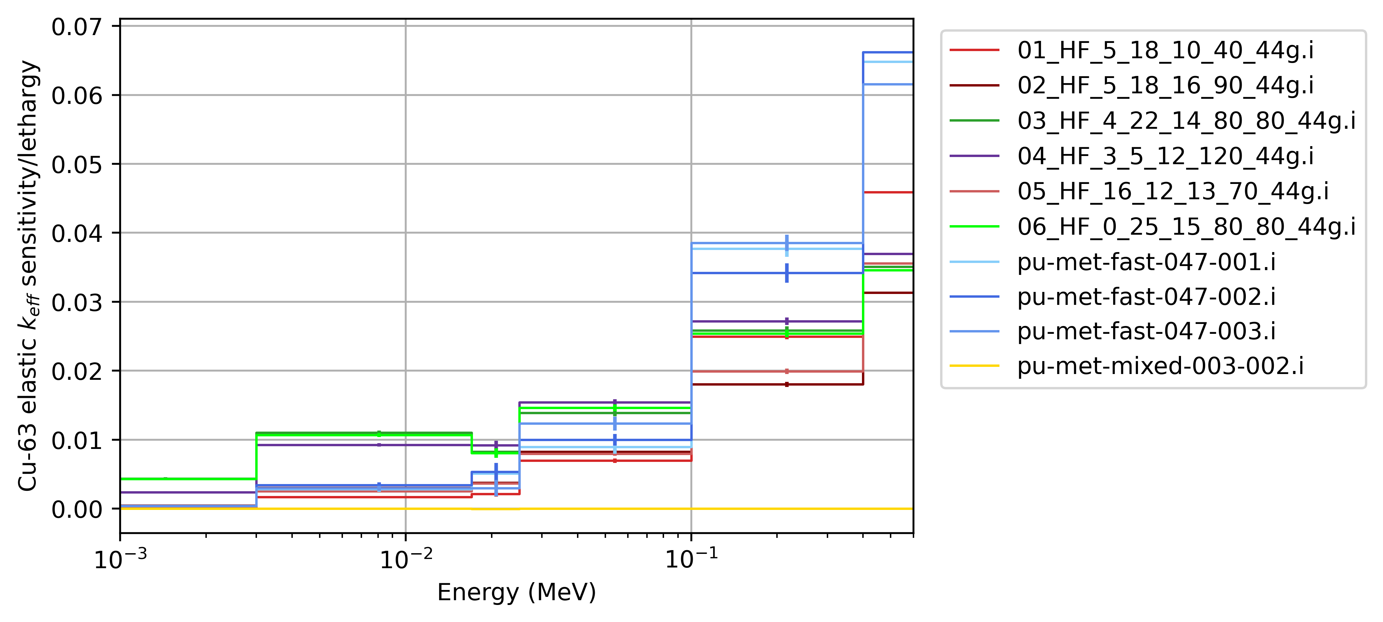
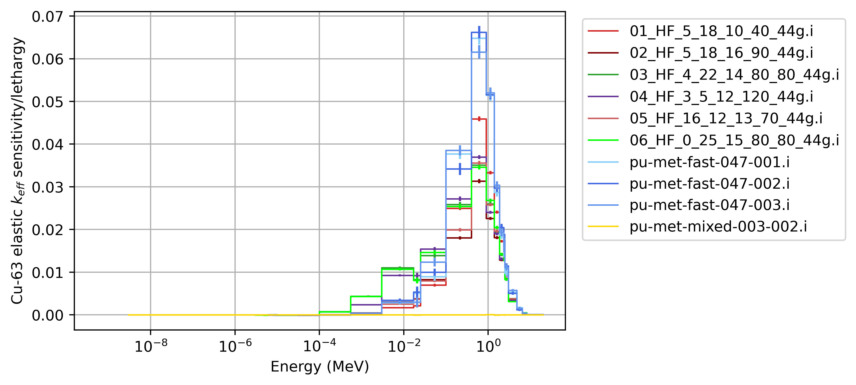
44 group, Cu63 elastic keff sensitivity
PARADIGM candidate files
Reds: Alumina + boron
Greens: Alumina + graphite
Purple: Alumina
Blues: Jupiter
Gold: PMM003-002
Sensitivities using MCNP

Slide 8
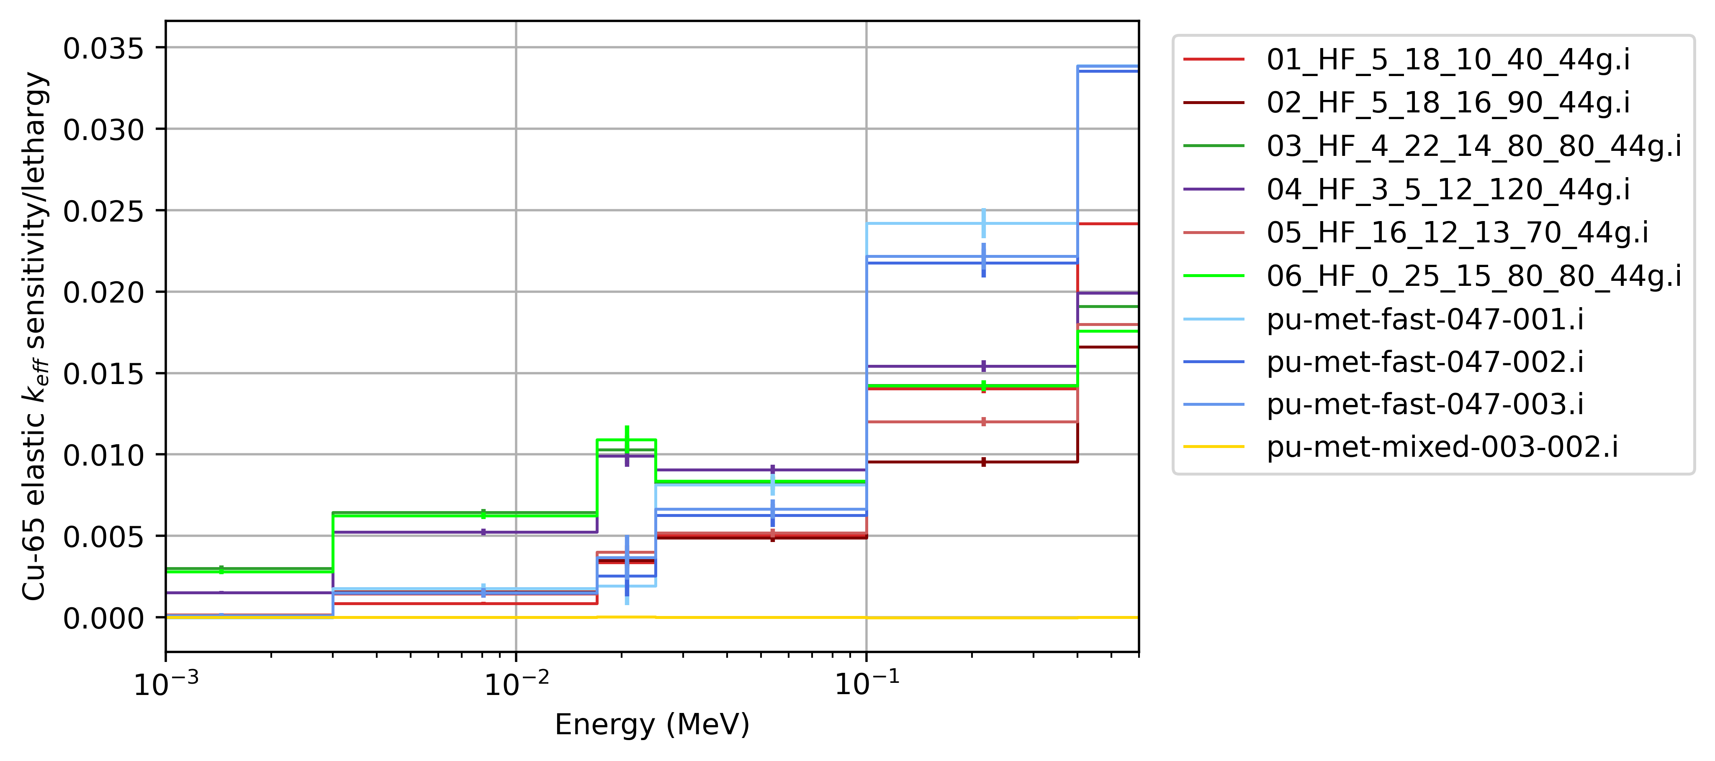
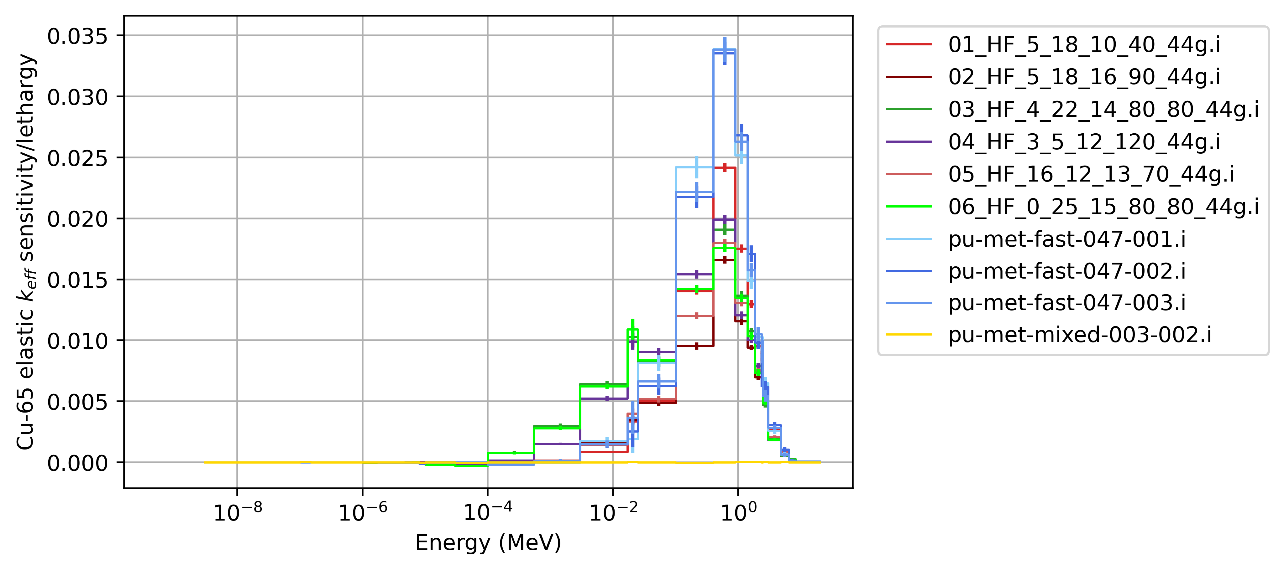
44 group, Cu65 elastic keff sensitivity
PARADIGM candidate files
Reds: Alumina + boron
Greens: Alumina + graphite
Purple: Alumina
Blues: Jupiter
Gold: PMM003-002
Sensitivities using MCNP

Slide 9
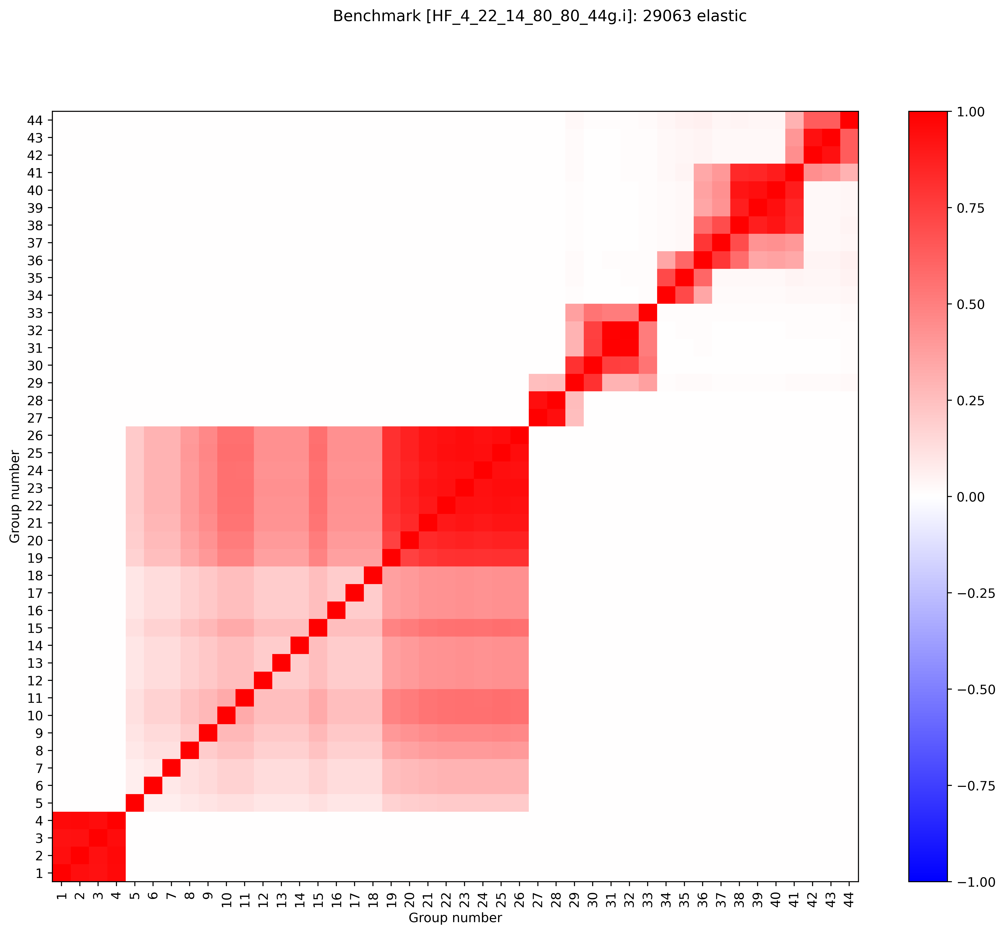
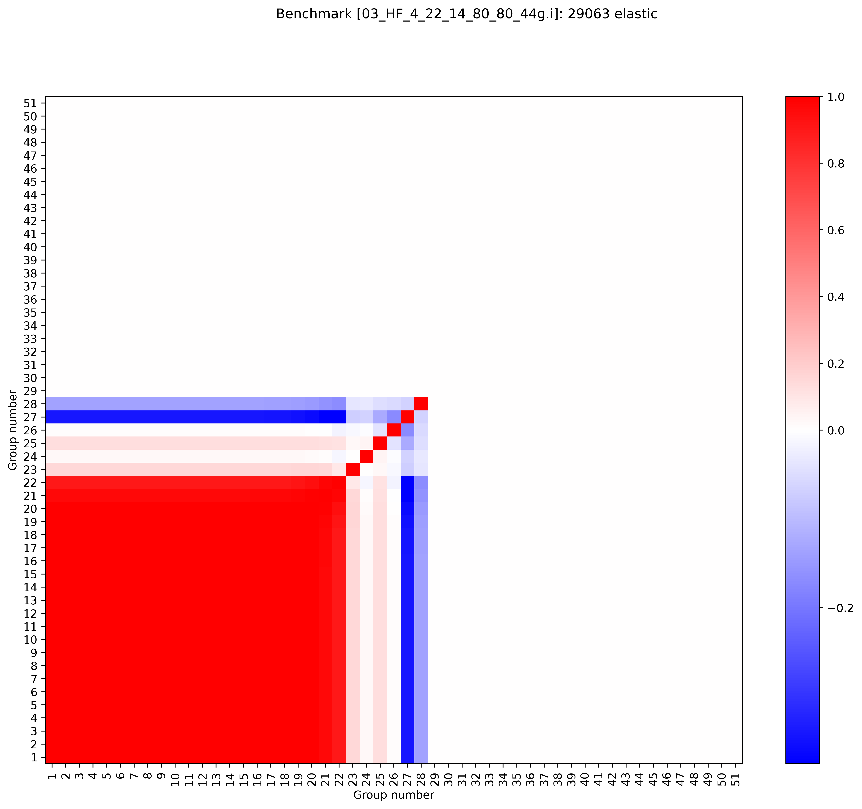
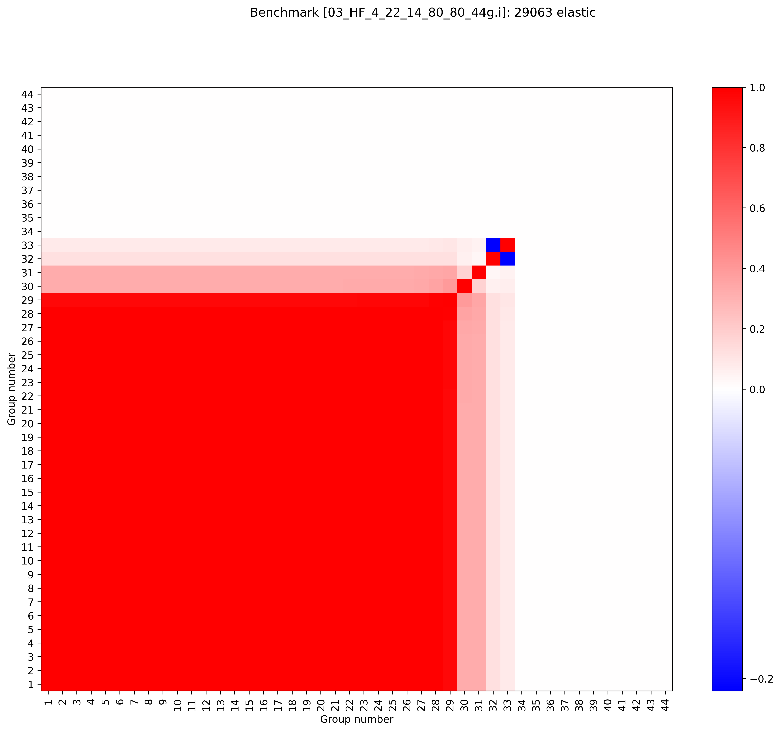
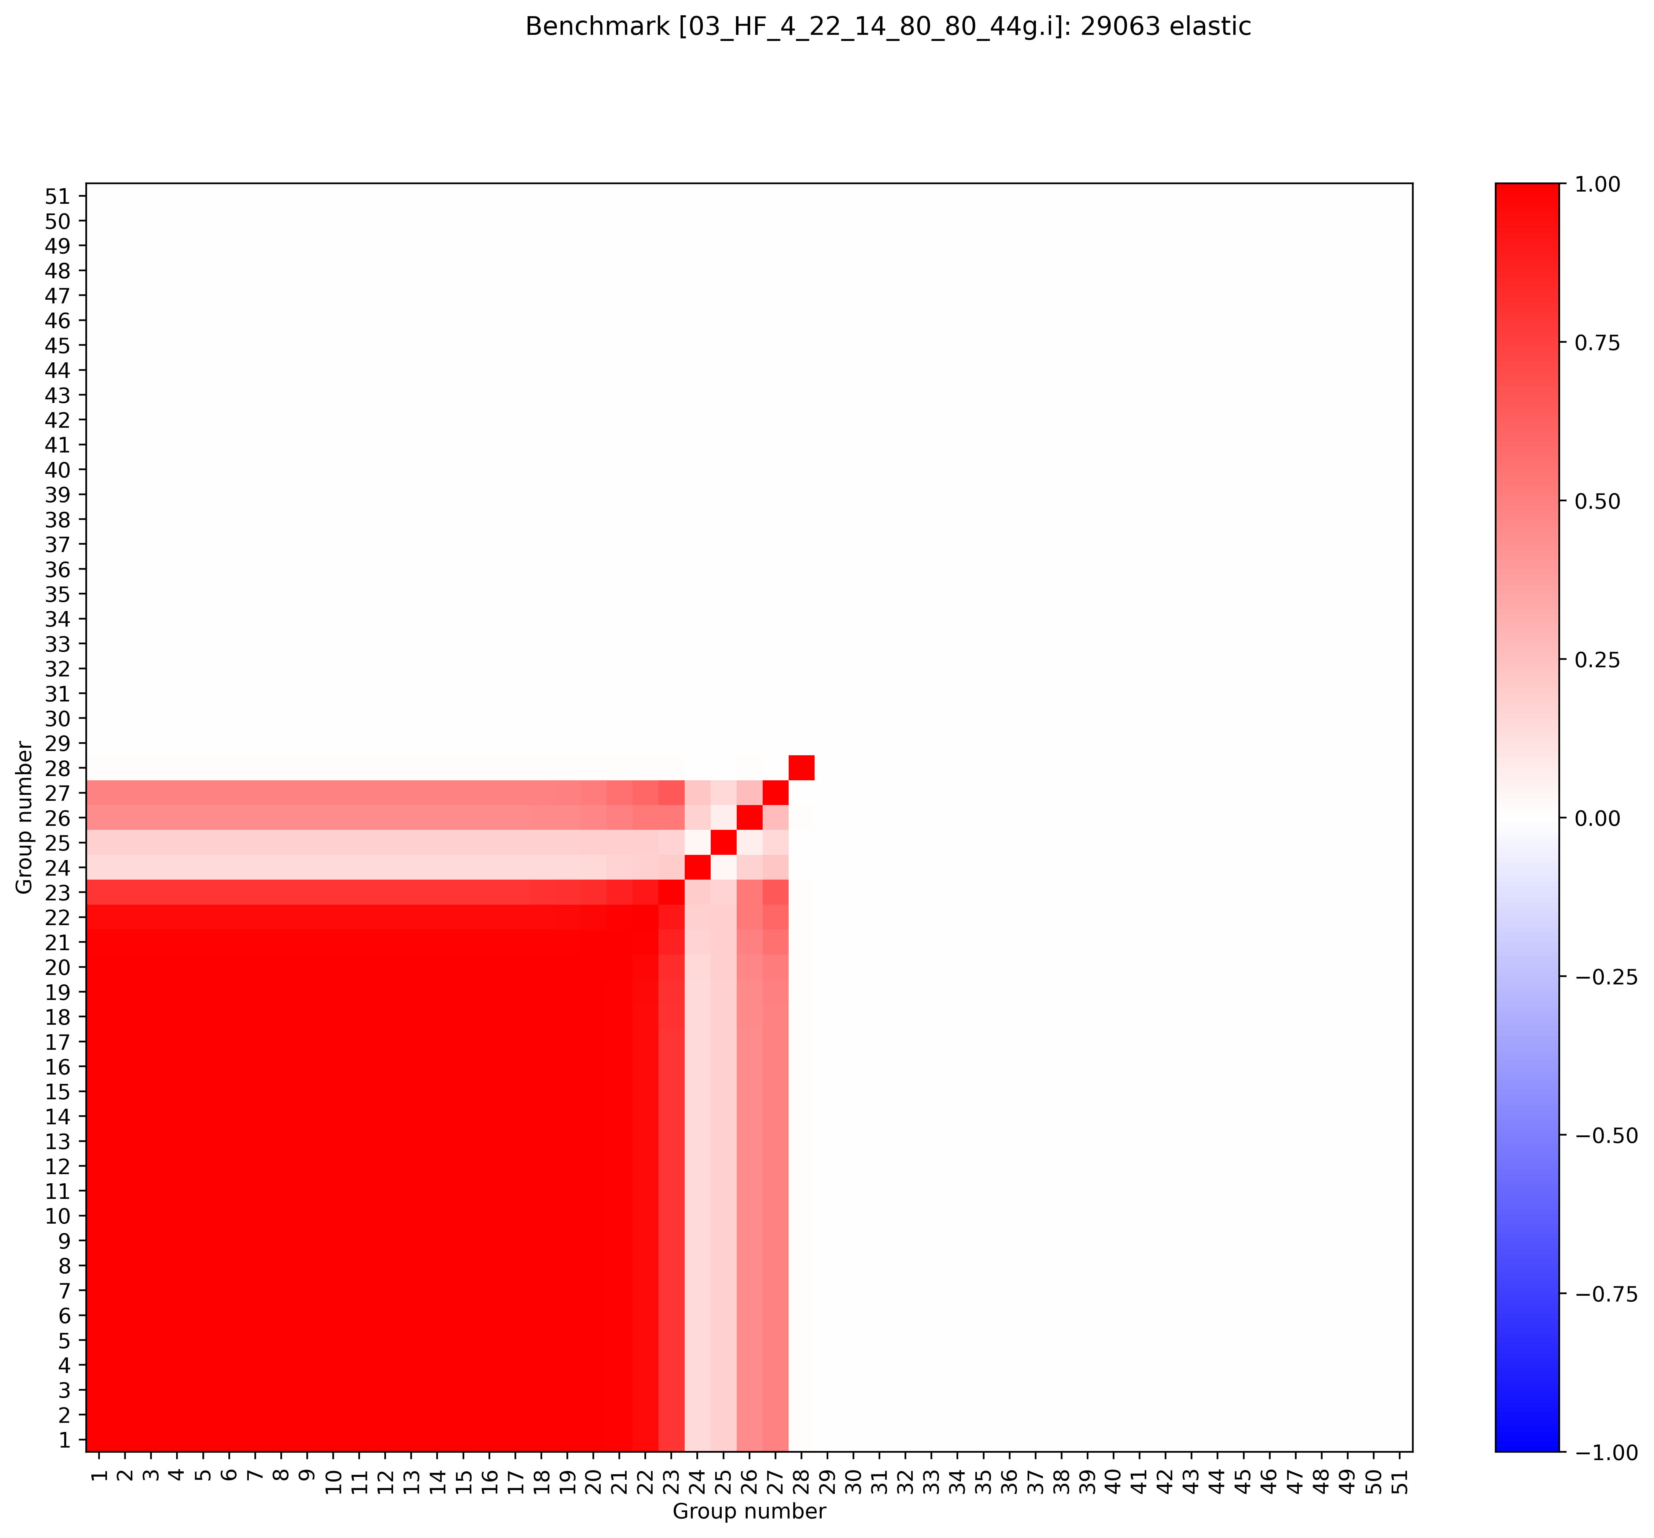
Cu63 elastic
BLO/7.1, 44 group, ACE
8.1, 51 group, JSON
ENDF8.0+8.1 are missing high energy covariances.
  No data above ~400-500 keV
  This will be common among other reactions too
Note that for many actinide intermediate energy experiments, Cu63 elastic peaks at 700 keV or so (and matters all the way up to 5 MeV or so)
8.0, 44 group, ACE
8.0, 51 group, JSON
Right plot file path: \\myhome.lanl.gov\216313\++Data\codes\lab\whisper-tk\whisper-tk\applications\Output\PARADIGM_09_cov_testing
\\slip.lanl.gov\NCERC\Documents\Projects\Active IER Projects\IER_622 (PARADIGM)\simulations\whisper-tk_output
8.1 plot path: \\myhome.lanl.gov\216313\++Data\codes\lab\whisper-tk\Output\PARADIGM_07_e80_e81JSON_51_nomods

Slide 10
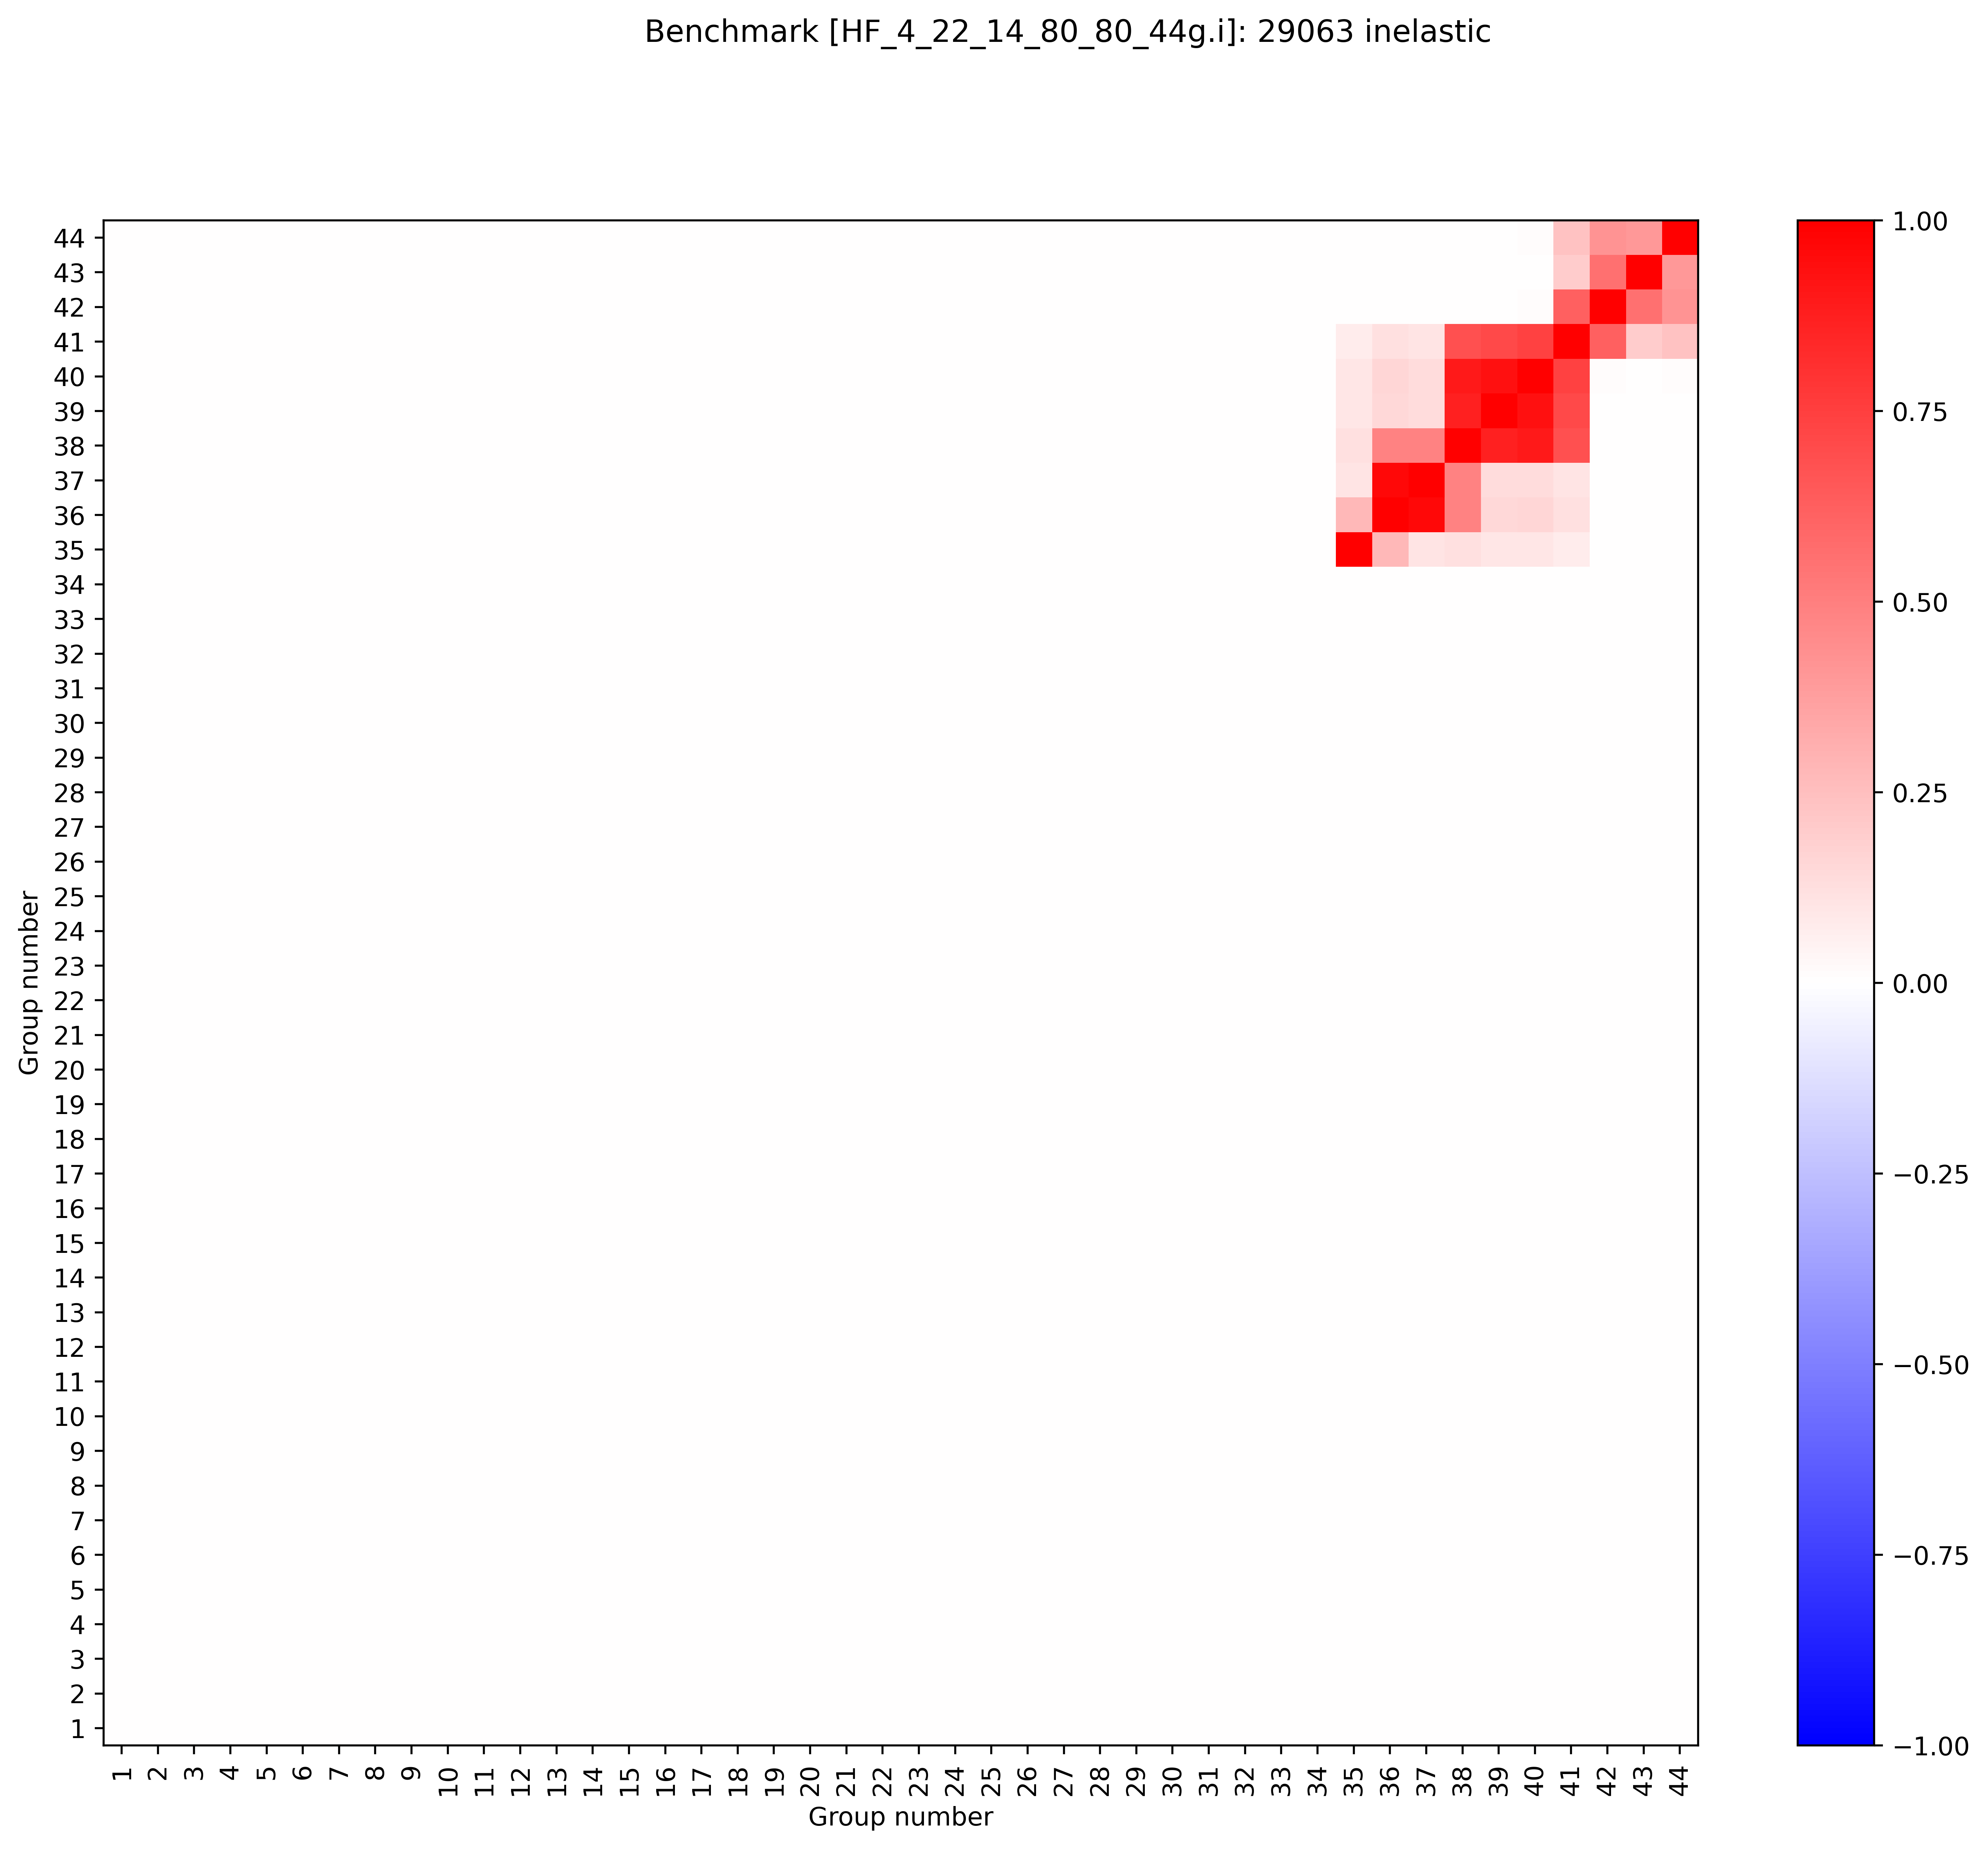
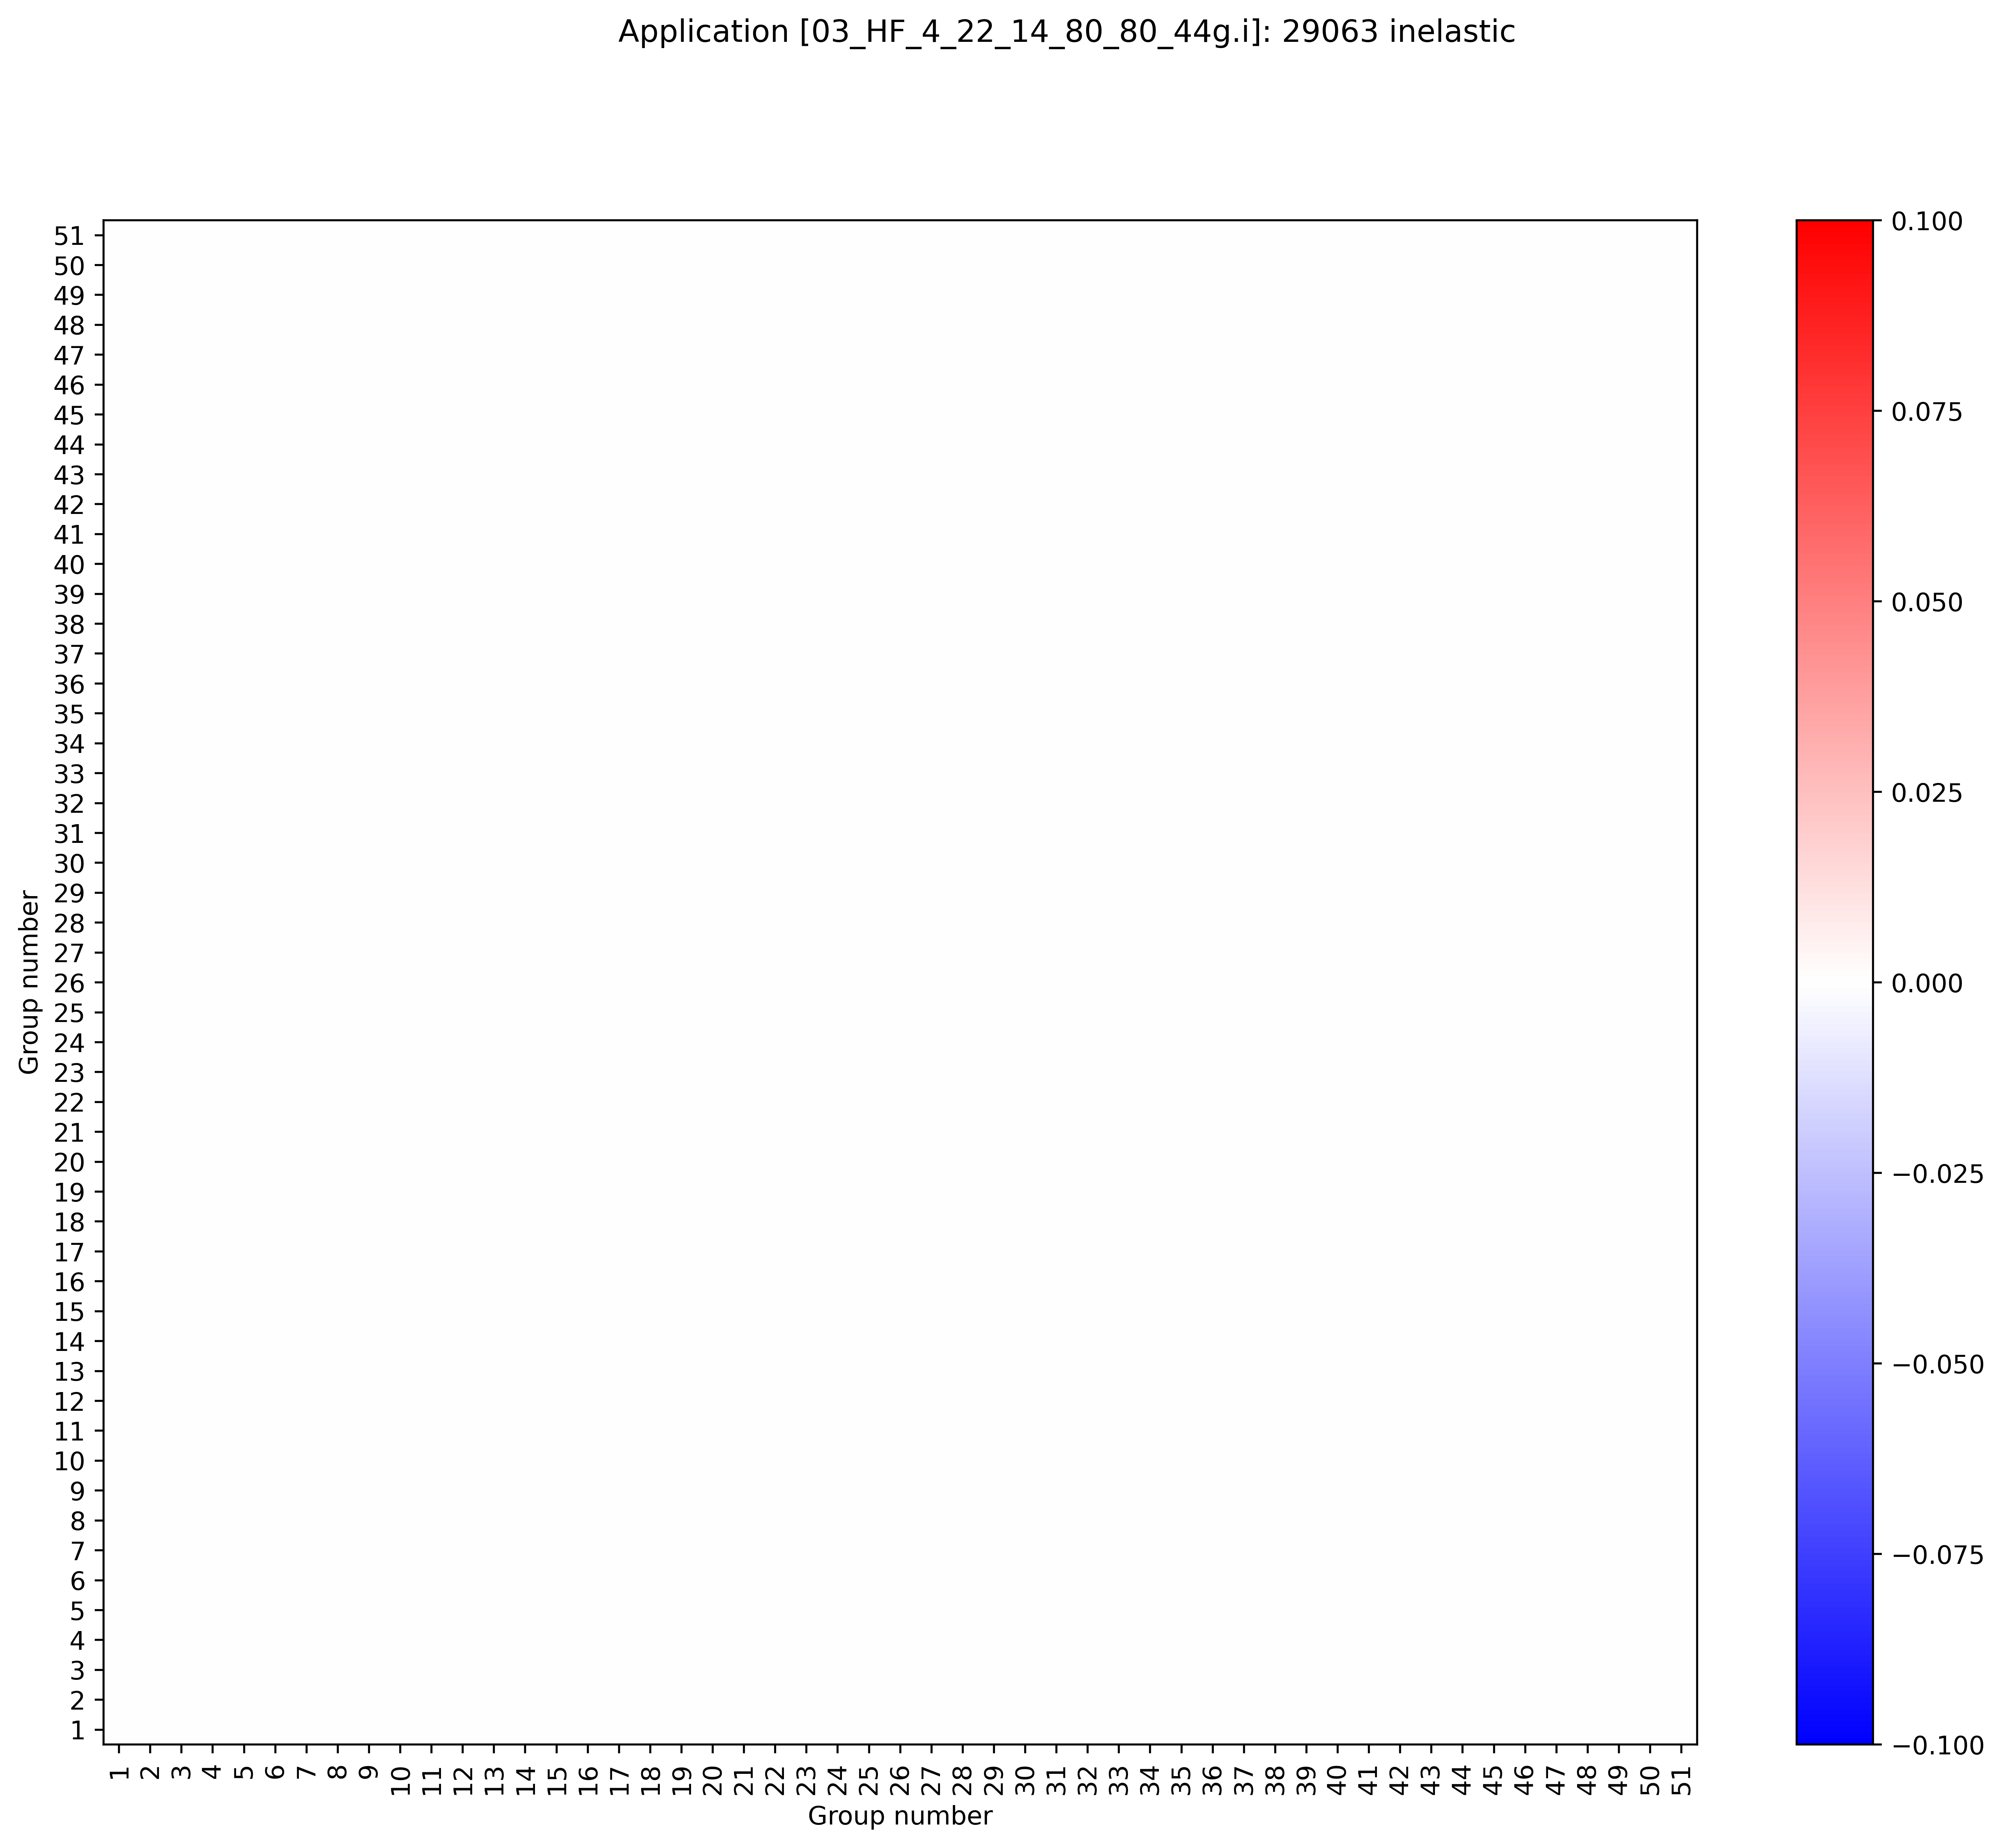


Cu63 inelastic
8.1, 51 group, JSON
ENDF8.0+8.1 covariances do not exist
BLO/7.1, 44 group, ACE
8.0, 44 group, ACE
8.0, 51 group, JSON
Right plot file path: \\myhome.lanl.gov\216313\++Data\codes\lab\whisper-tk\whisper-tk\applications\Output\PARADIGM_09_cov_testing
8.1 plot path: \\myhome.lanl.gov\216313\++Data\codes\lab\whisper-tk\Output\PARADIGM_07_e80_e81JSON_51_nomods

Slide 11
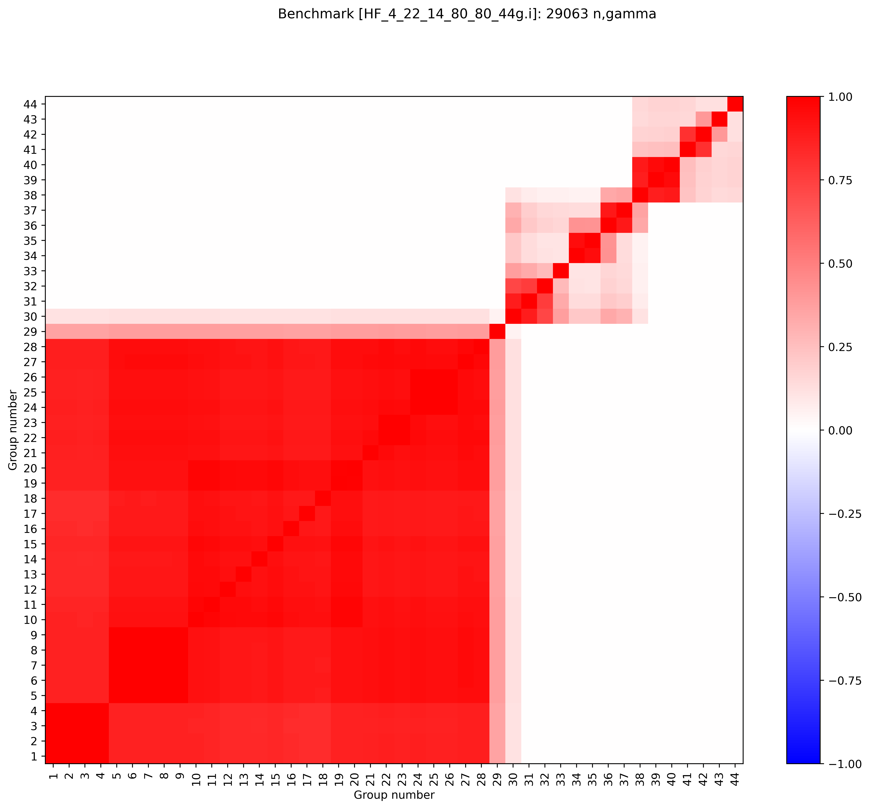
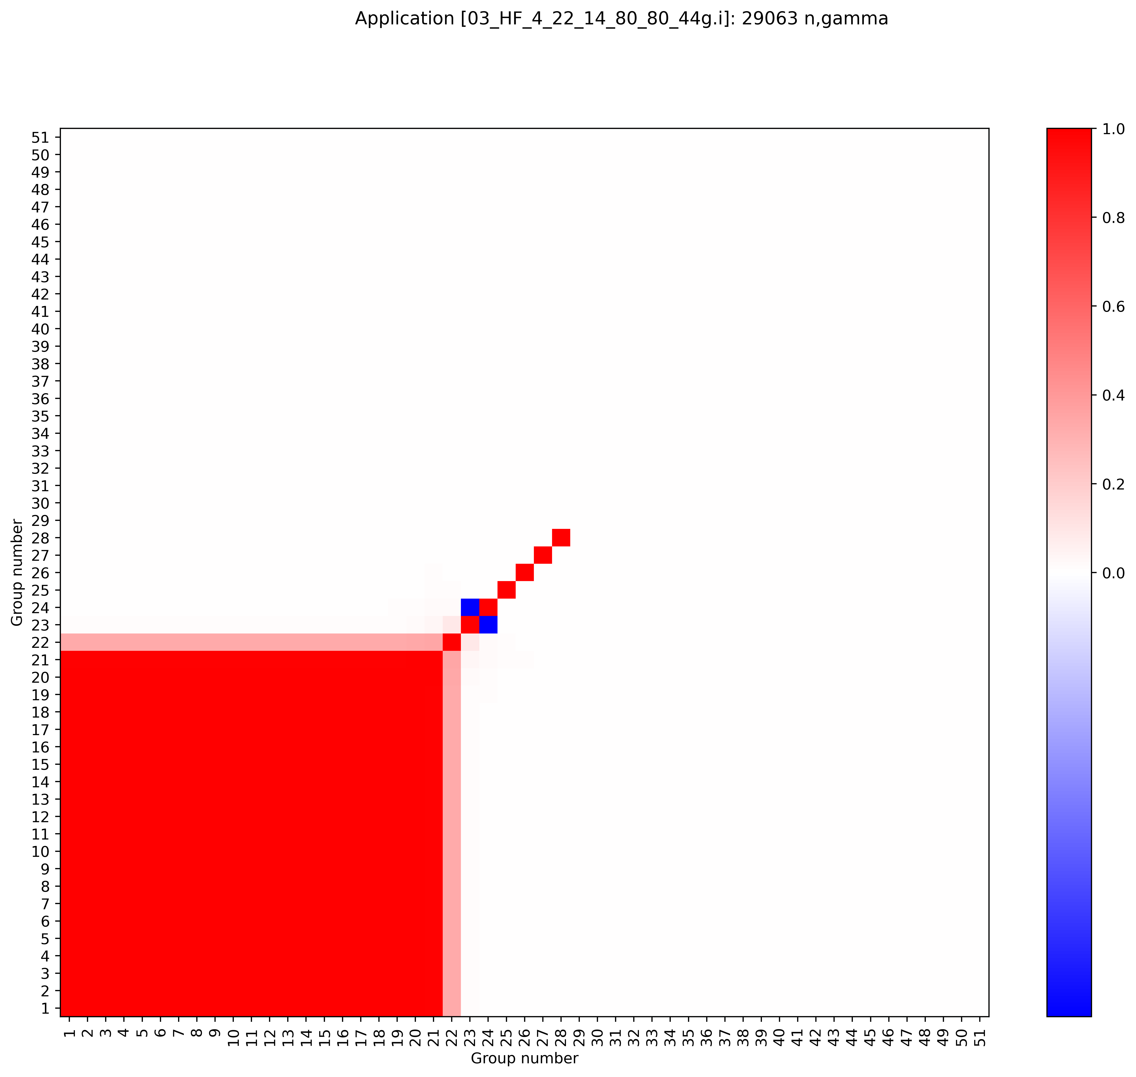
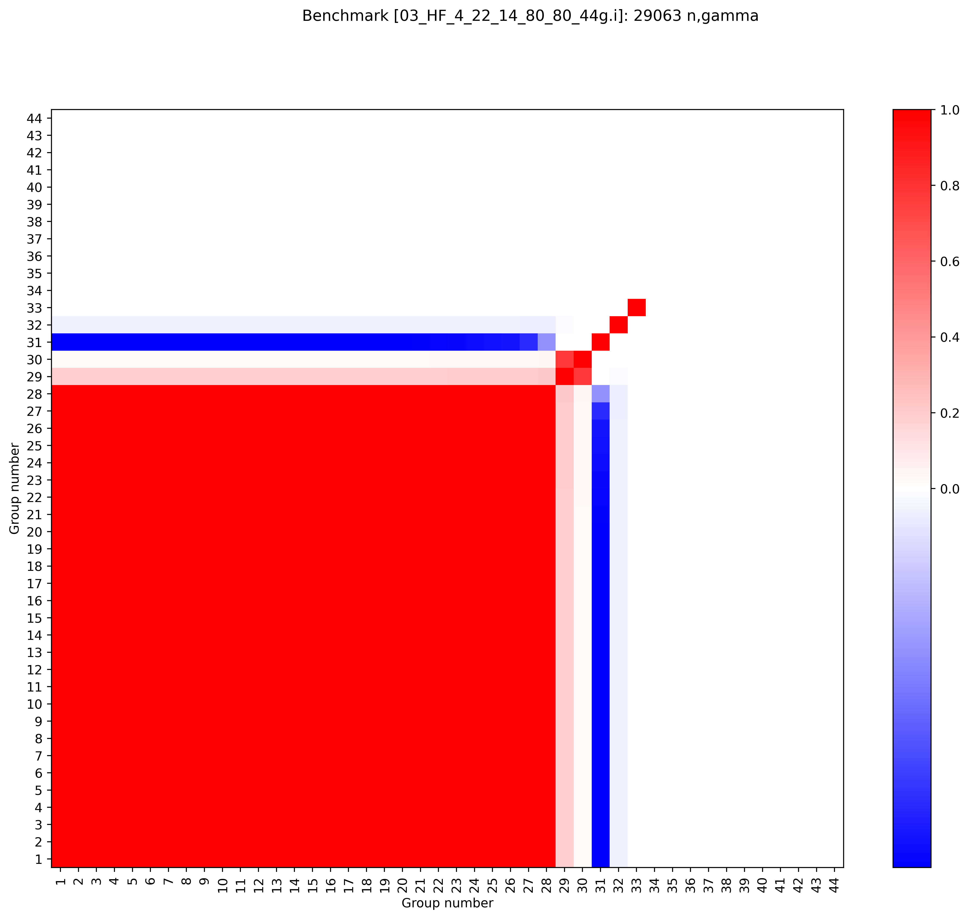
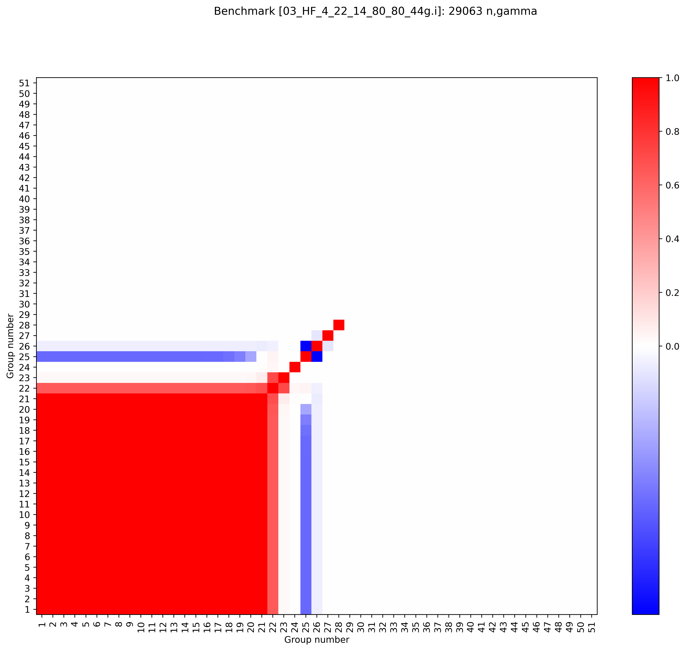
Cu63 (n,gamma)
BLO/7.1, 44 group, ACE
8.1, 51 group, JSON
ENDF8.0+8.1 are missing covariances above ~400-500 keV
  For actinide intermediate energy experiments, Cu63 (n,gamma) matters until 2-3 MeV
Issues in ENDF8.0+8.1 are not obvious from correlation plot
8.0, 44 group, ACE
8.0, 51 group, JSON
Right plot file path: \\myhome.lanl.gov\216313\++Data\codes\lab\whisper-tk\whisper-tk\applications\Output\PARADIGM_09_cov_testing
8.1 plot path: \\myhome.lanl.gov\216313\++Data\codes\lab\whisper-tk\Output\PARADIGM_07_e80_e81JSON_51_nomods

Slide 12
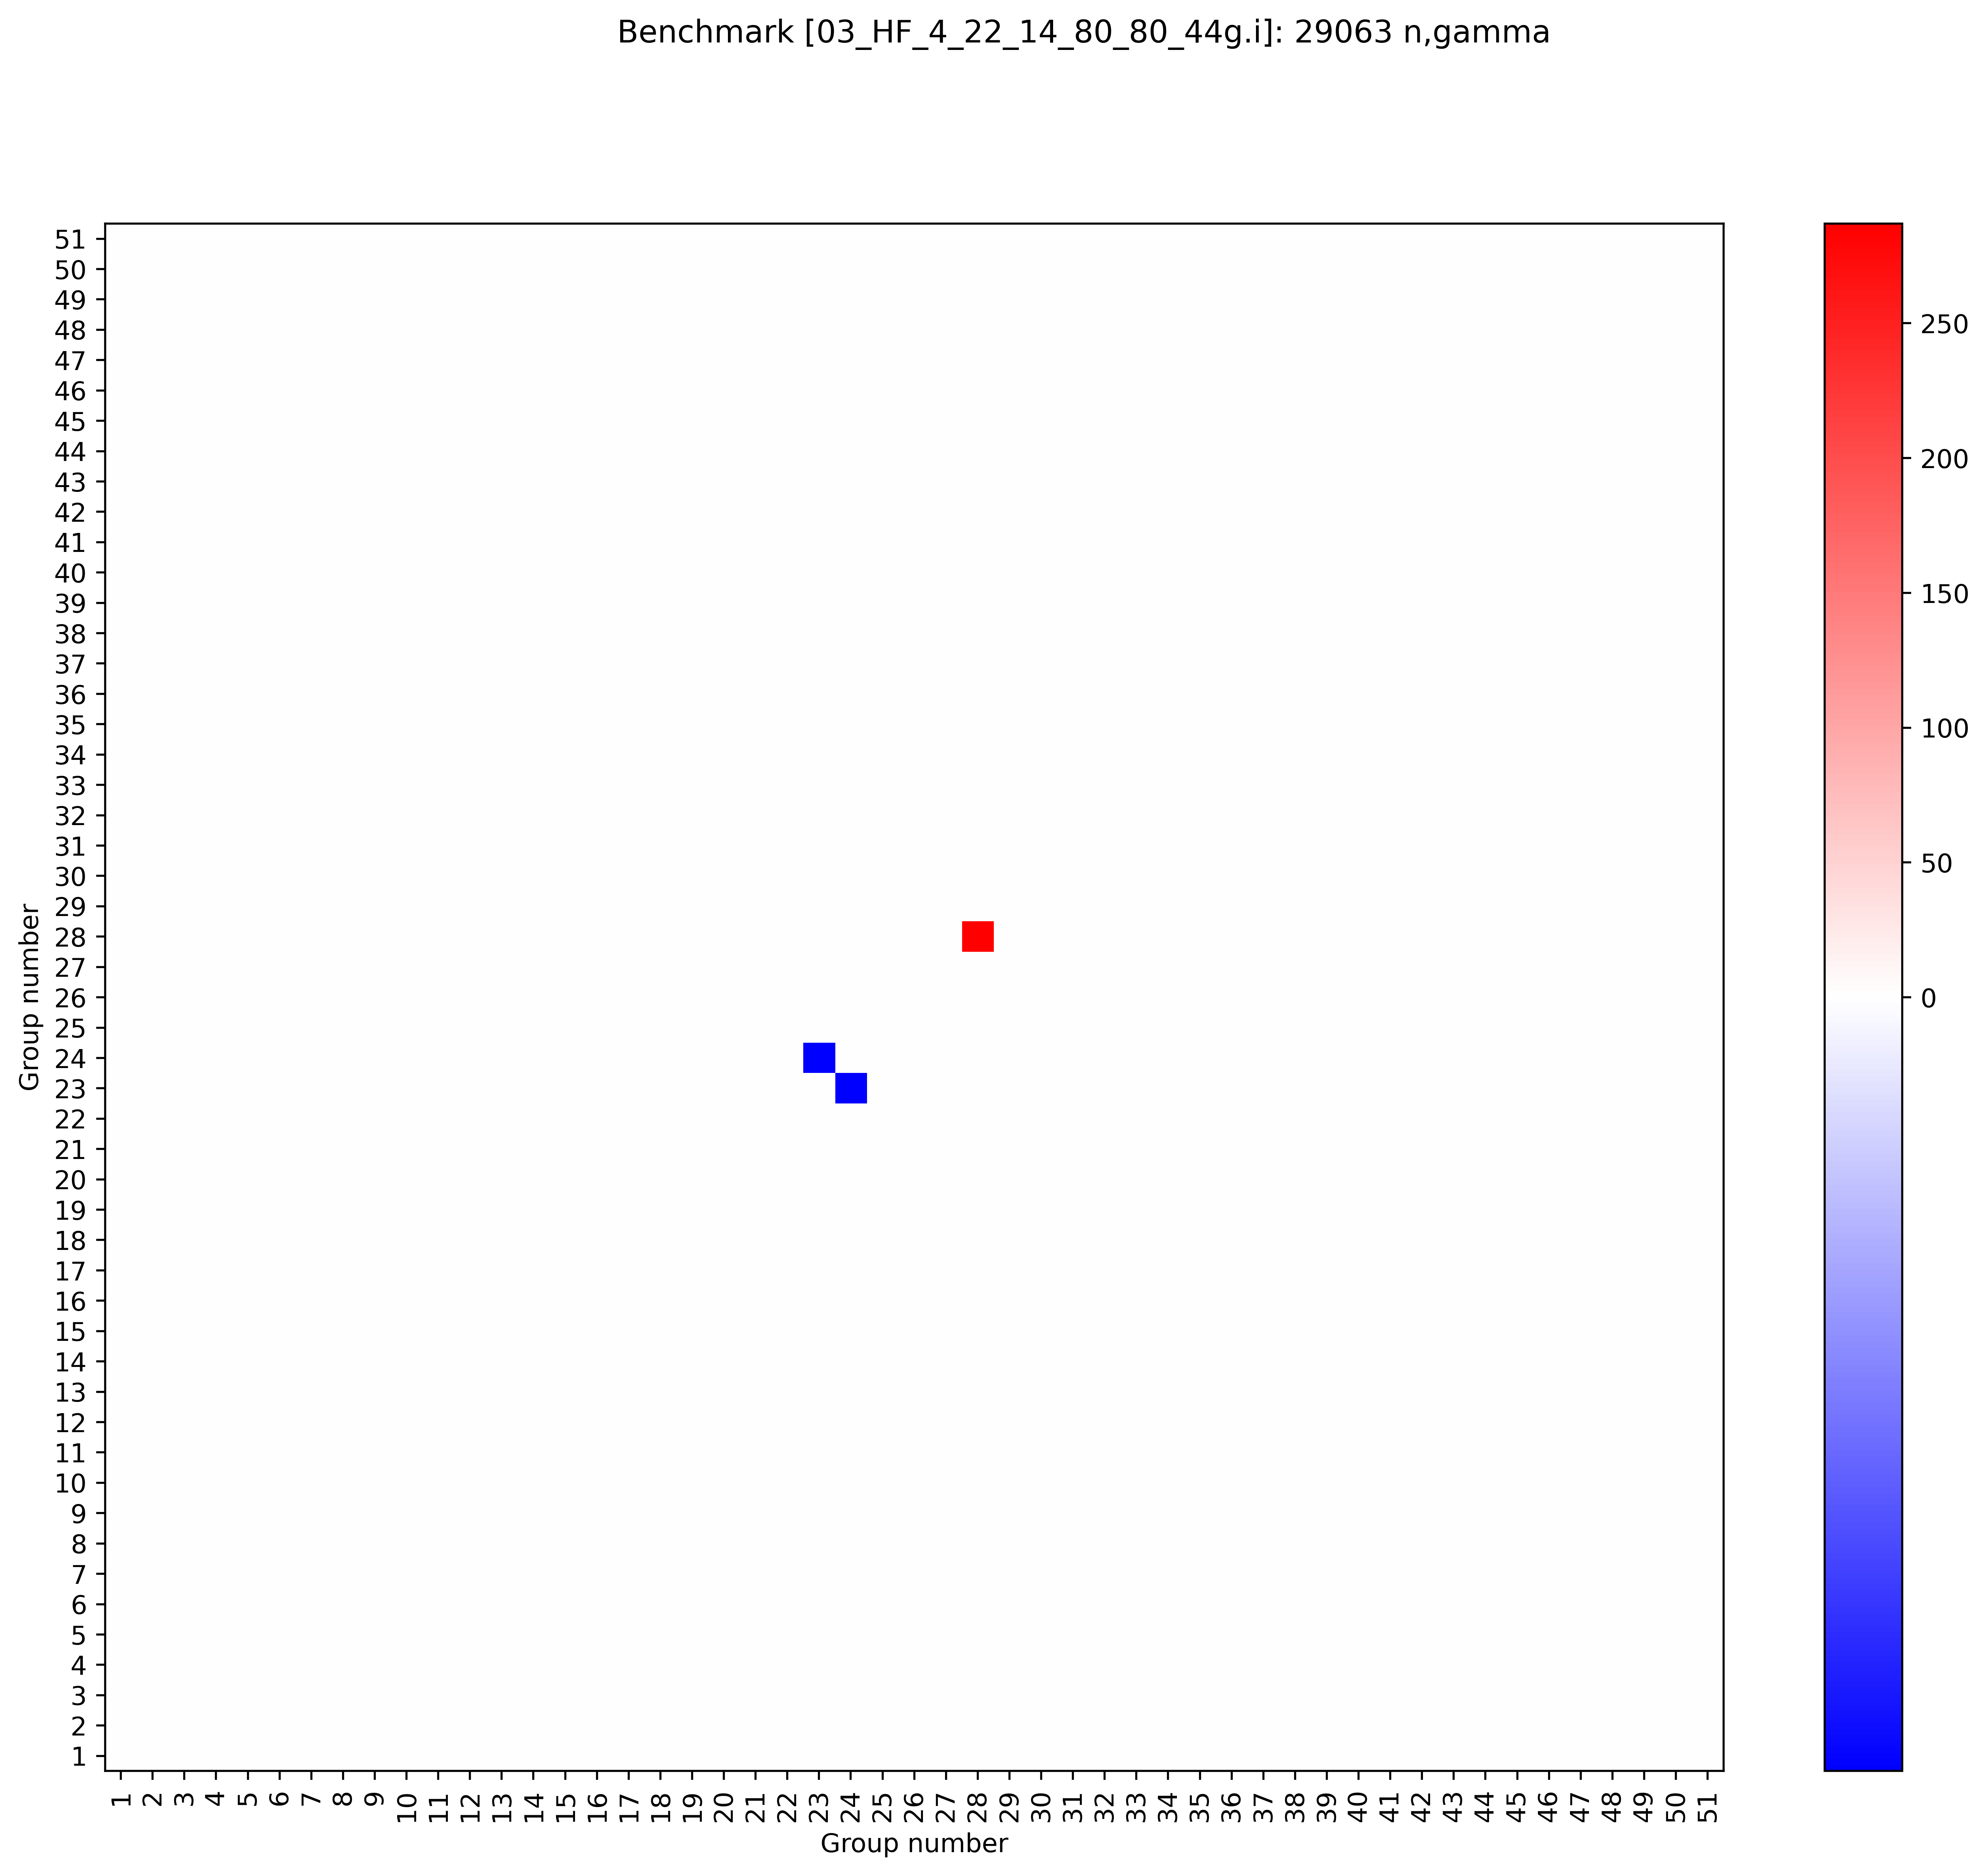
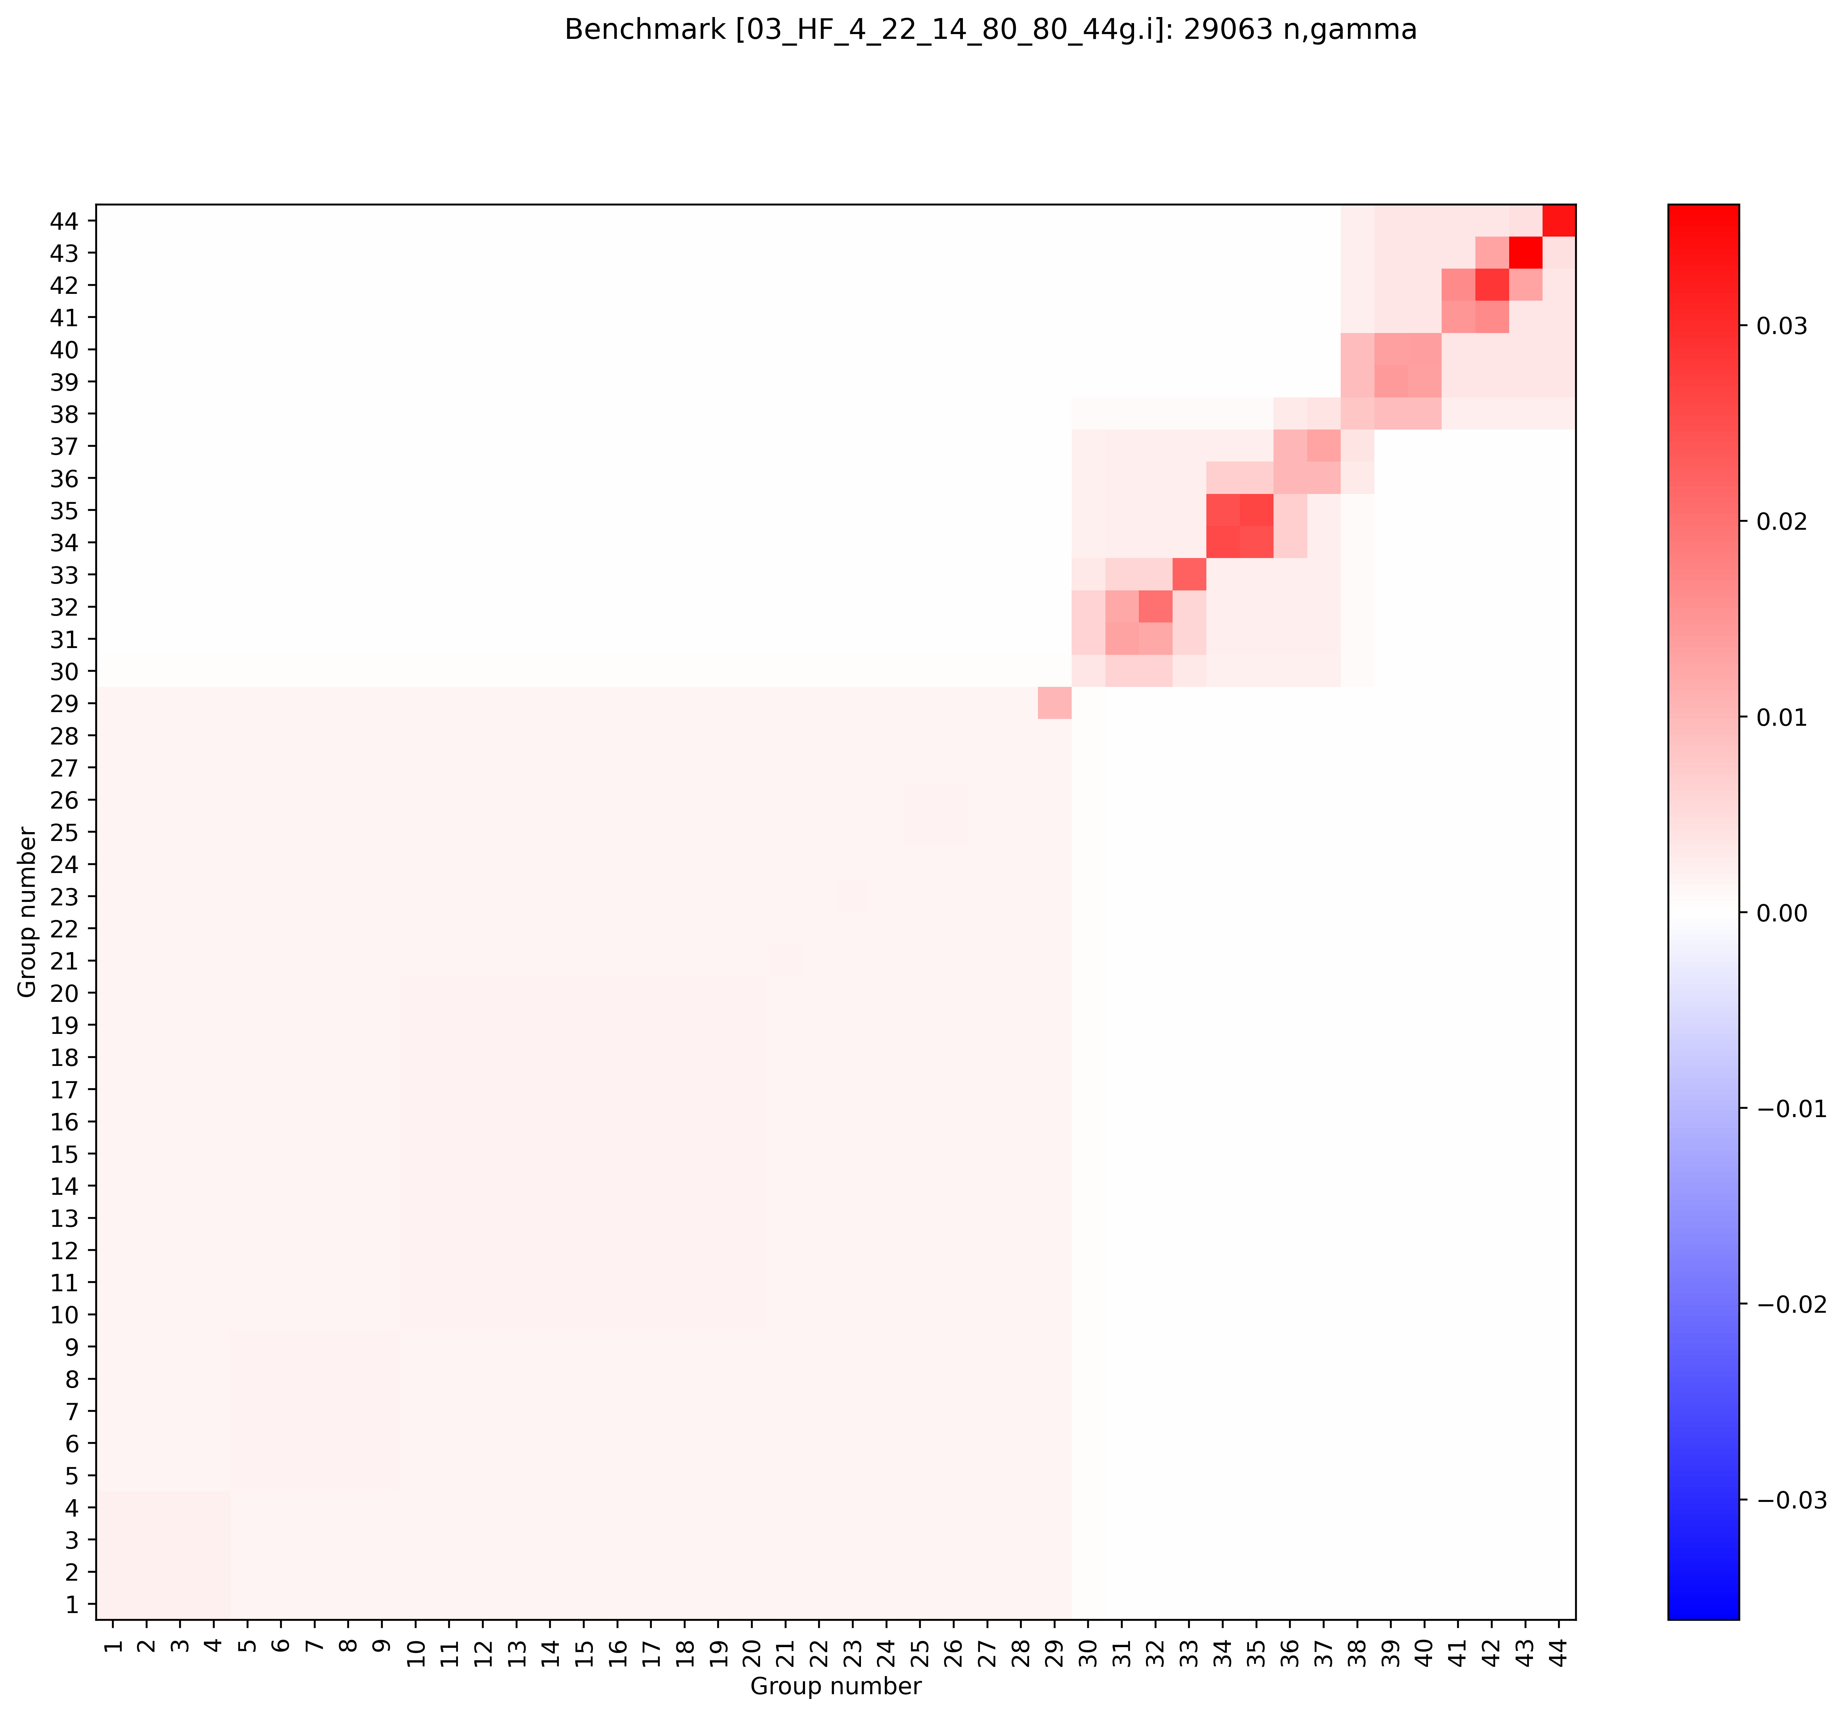
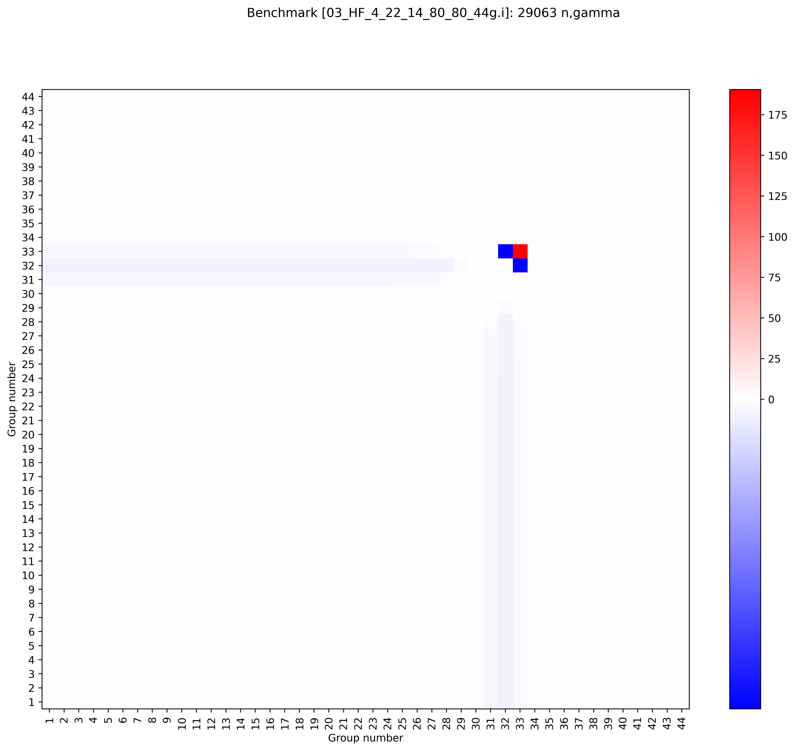
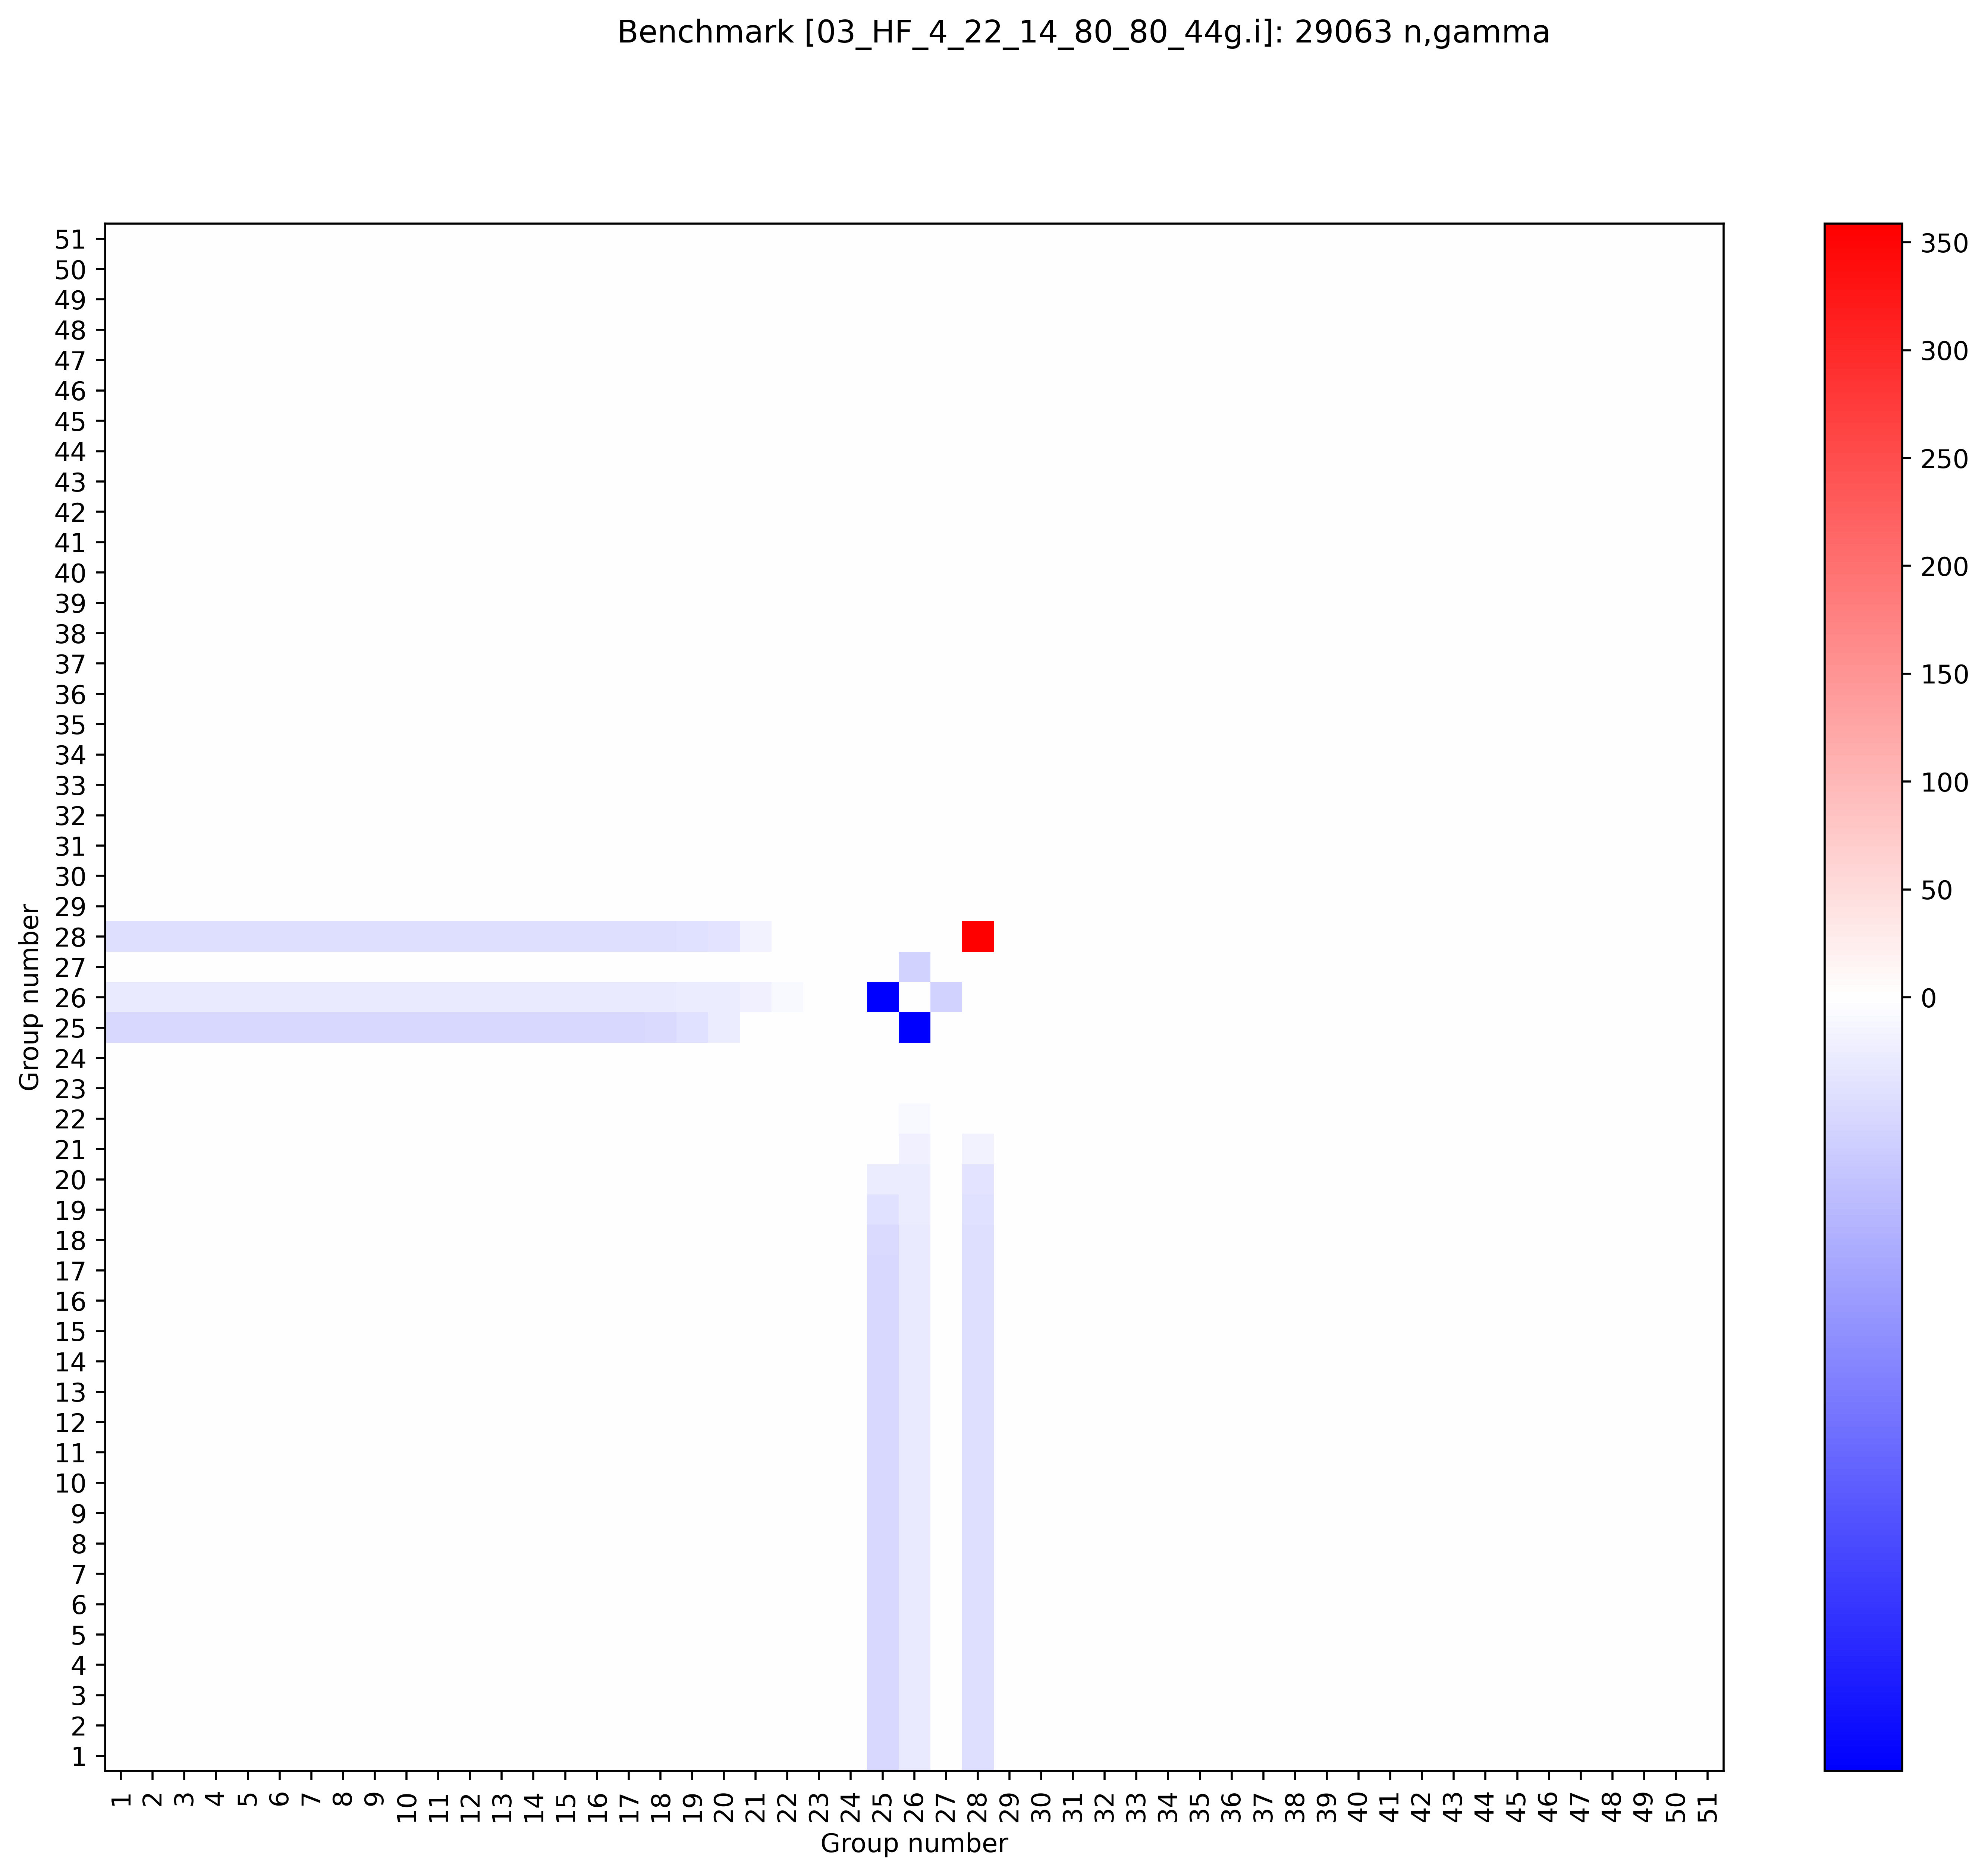
Cu63 (n,gamma) covariances
Plotting covariances (instead of correlations) shows issue in ENDF8.0+8.1
  Not color bar values
Having a single energy bin with huge covariance will result in a very large impact on k_{eff} uncertainty (for any system with non-zero sensitivity)
8.1, 51 group, JSON
BLO/7.1, 44 group, ACE
8.0, 44 group, ACE
8.0, 51 group, JSON
Right plot file path: \\myhome.lanl.gov\216313\++Data\codes\lab\whisper-tk\whisper-tk\applications\Output\PARADIGM_09_cov_testing
8.1 plot path: \\myhome.lanl.gov\216313\++Data\codes\lab\whisper-tk\Output\PARADIGM_07_e80_e81JSON_51_nomods

Slide 13
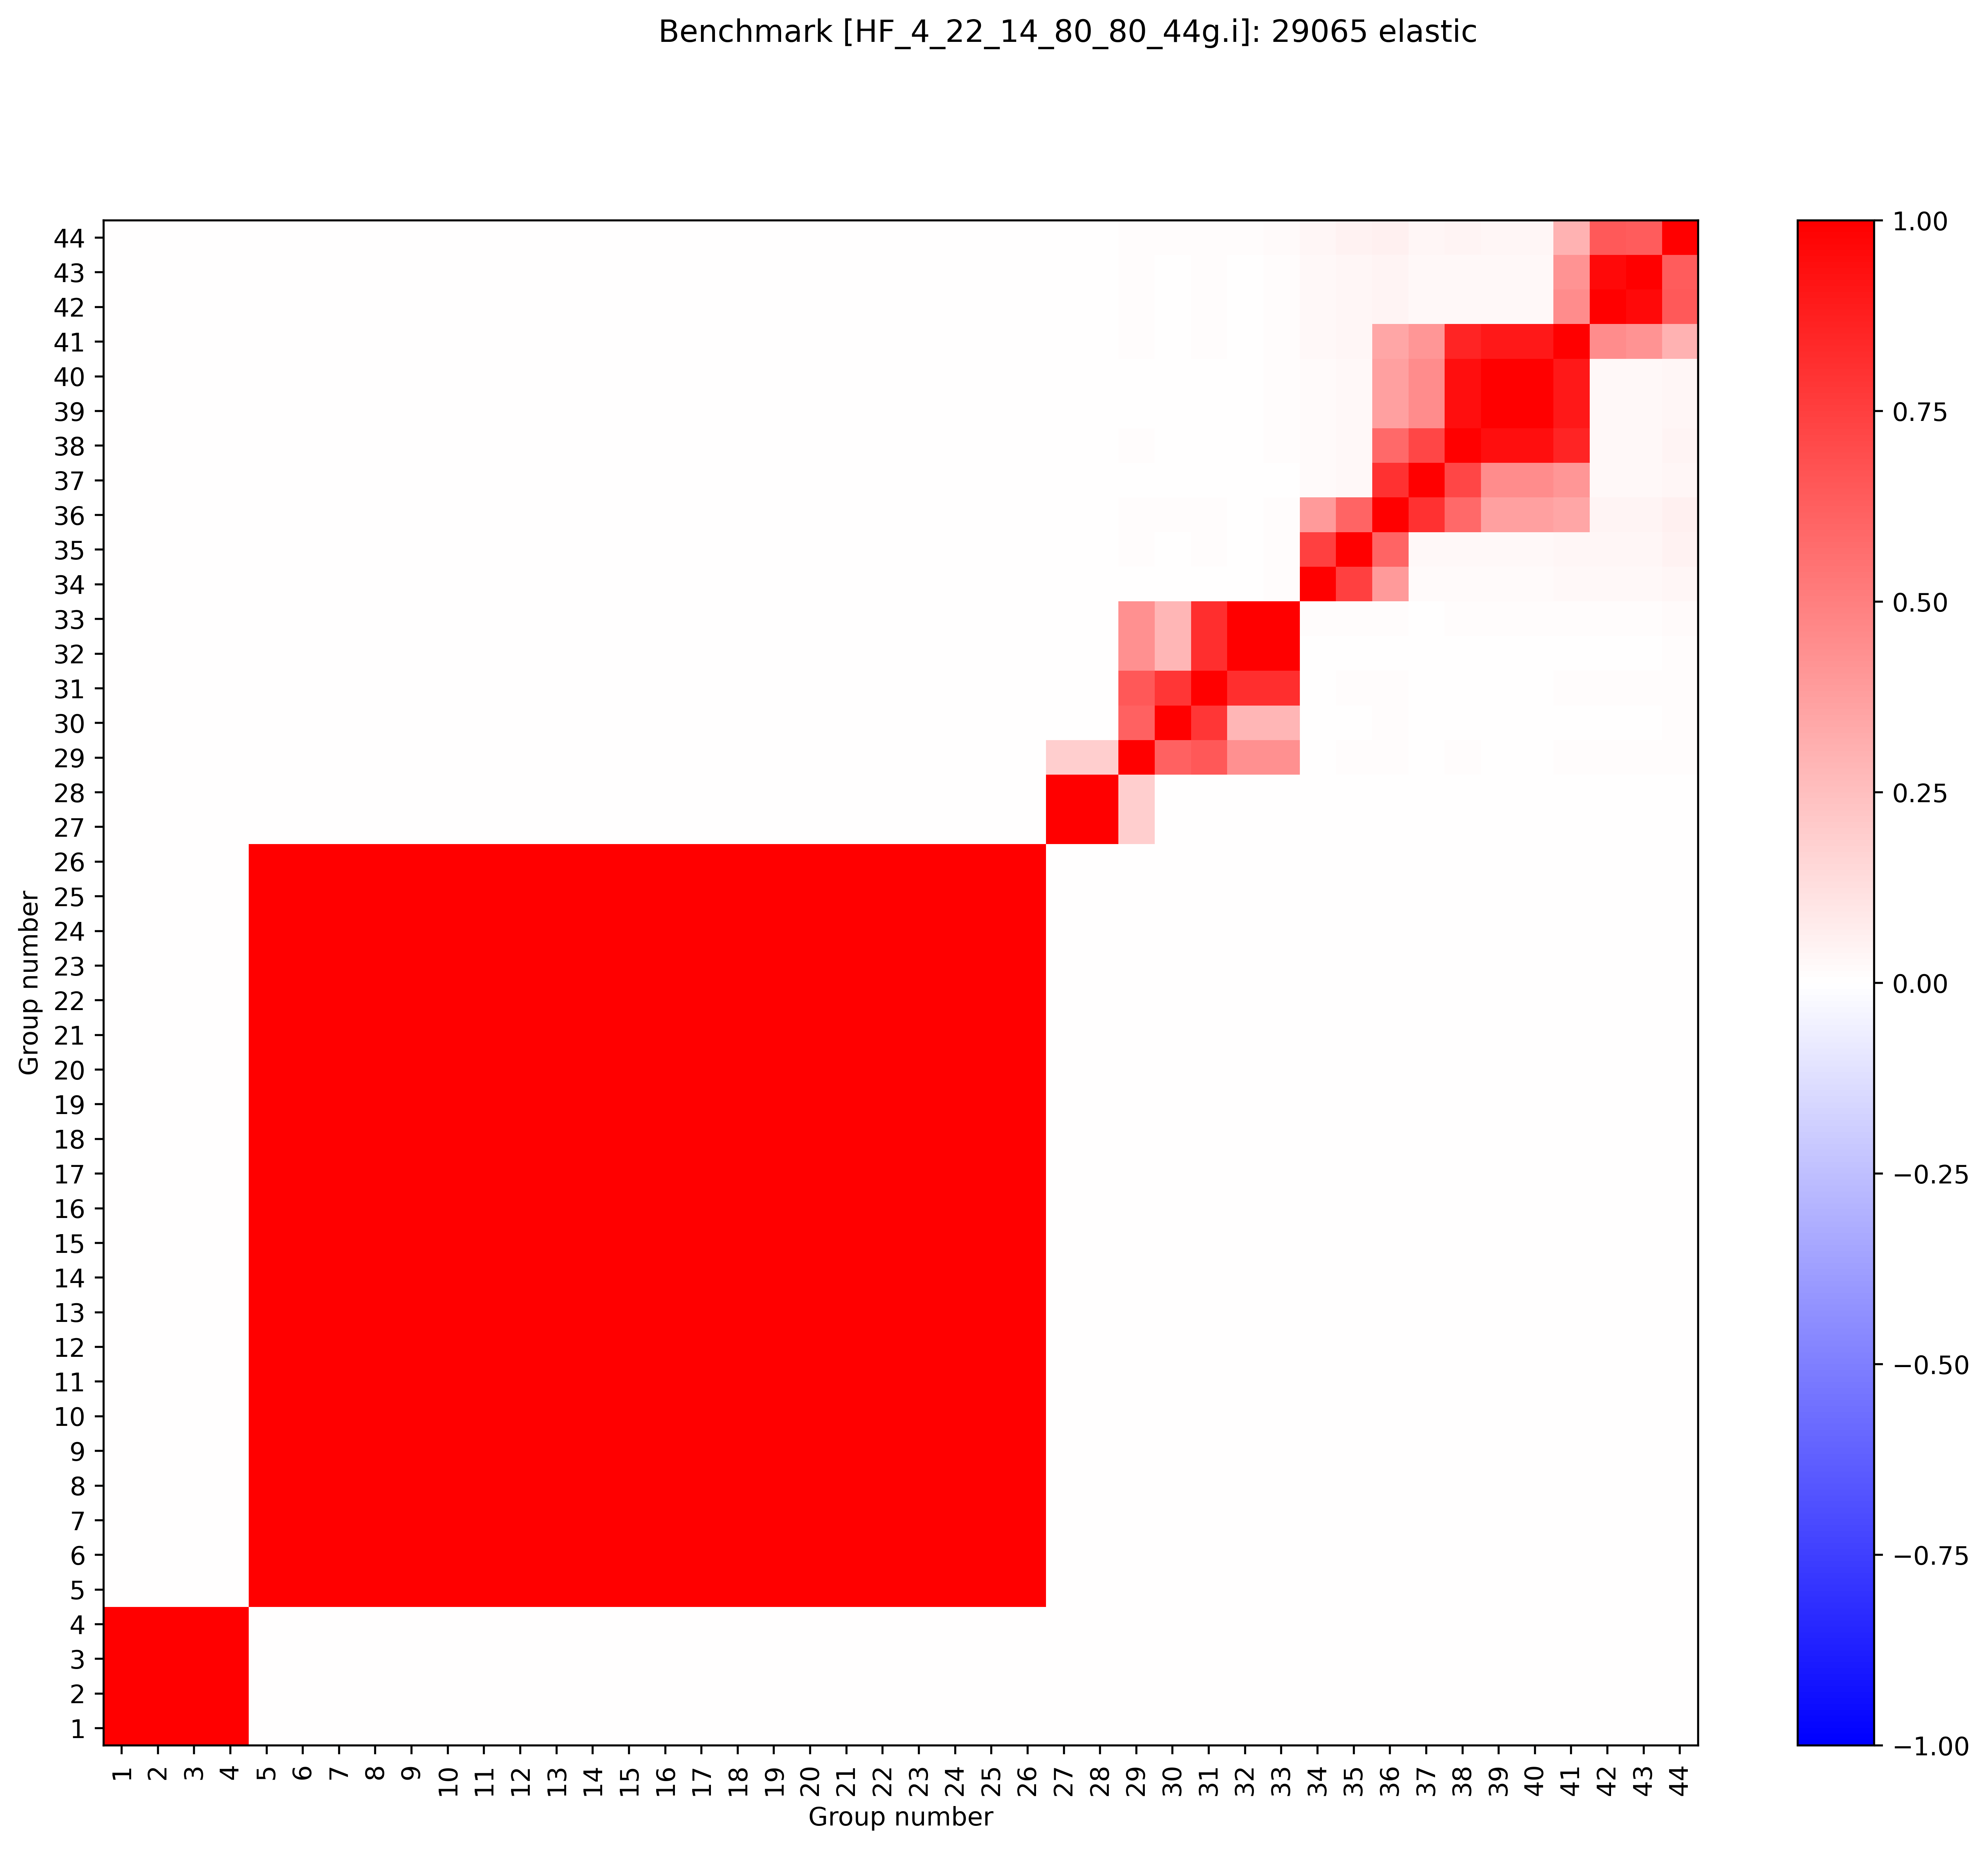
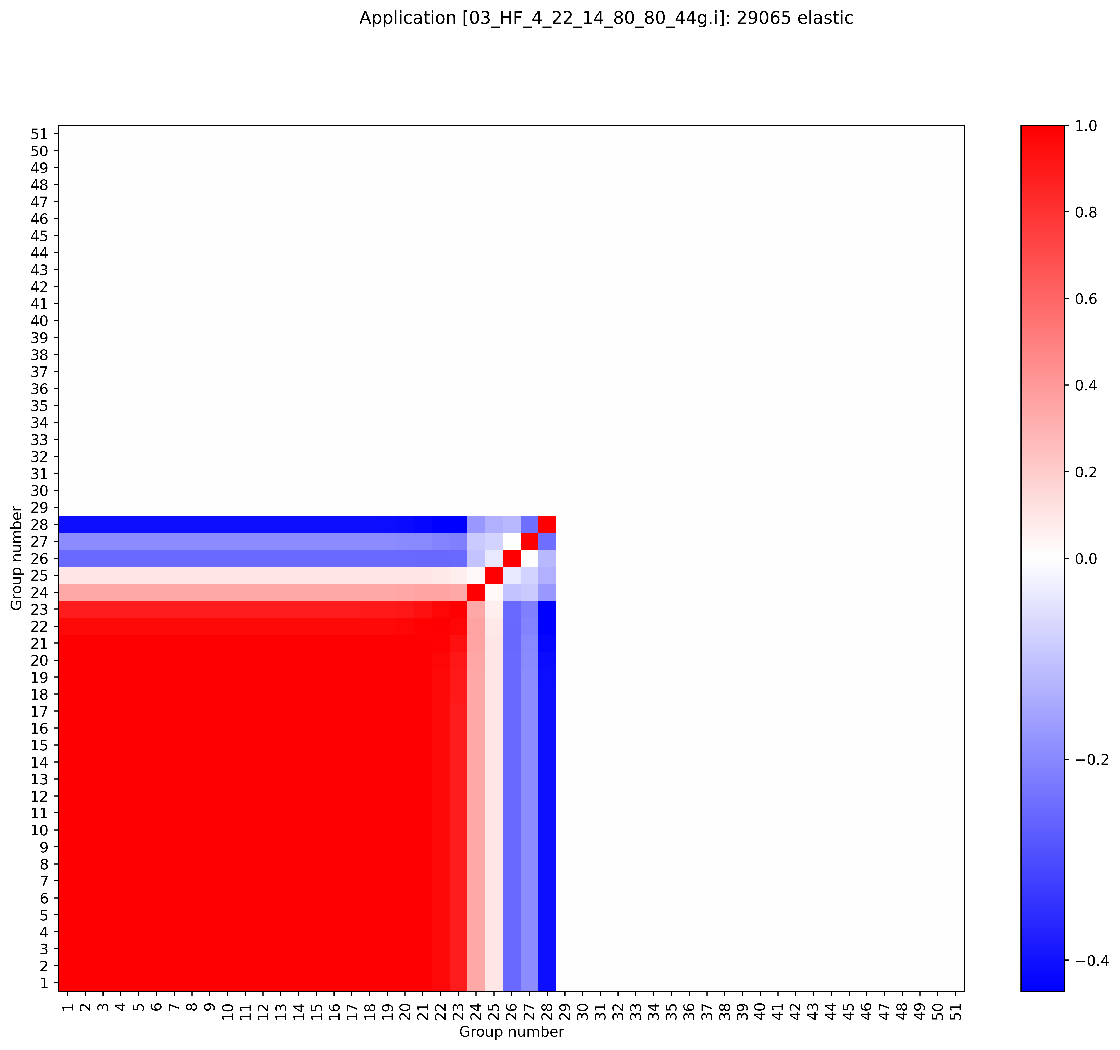

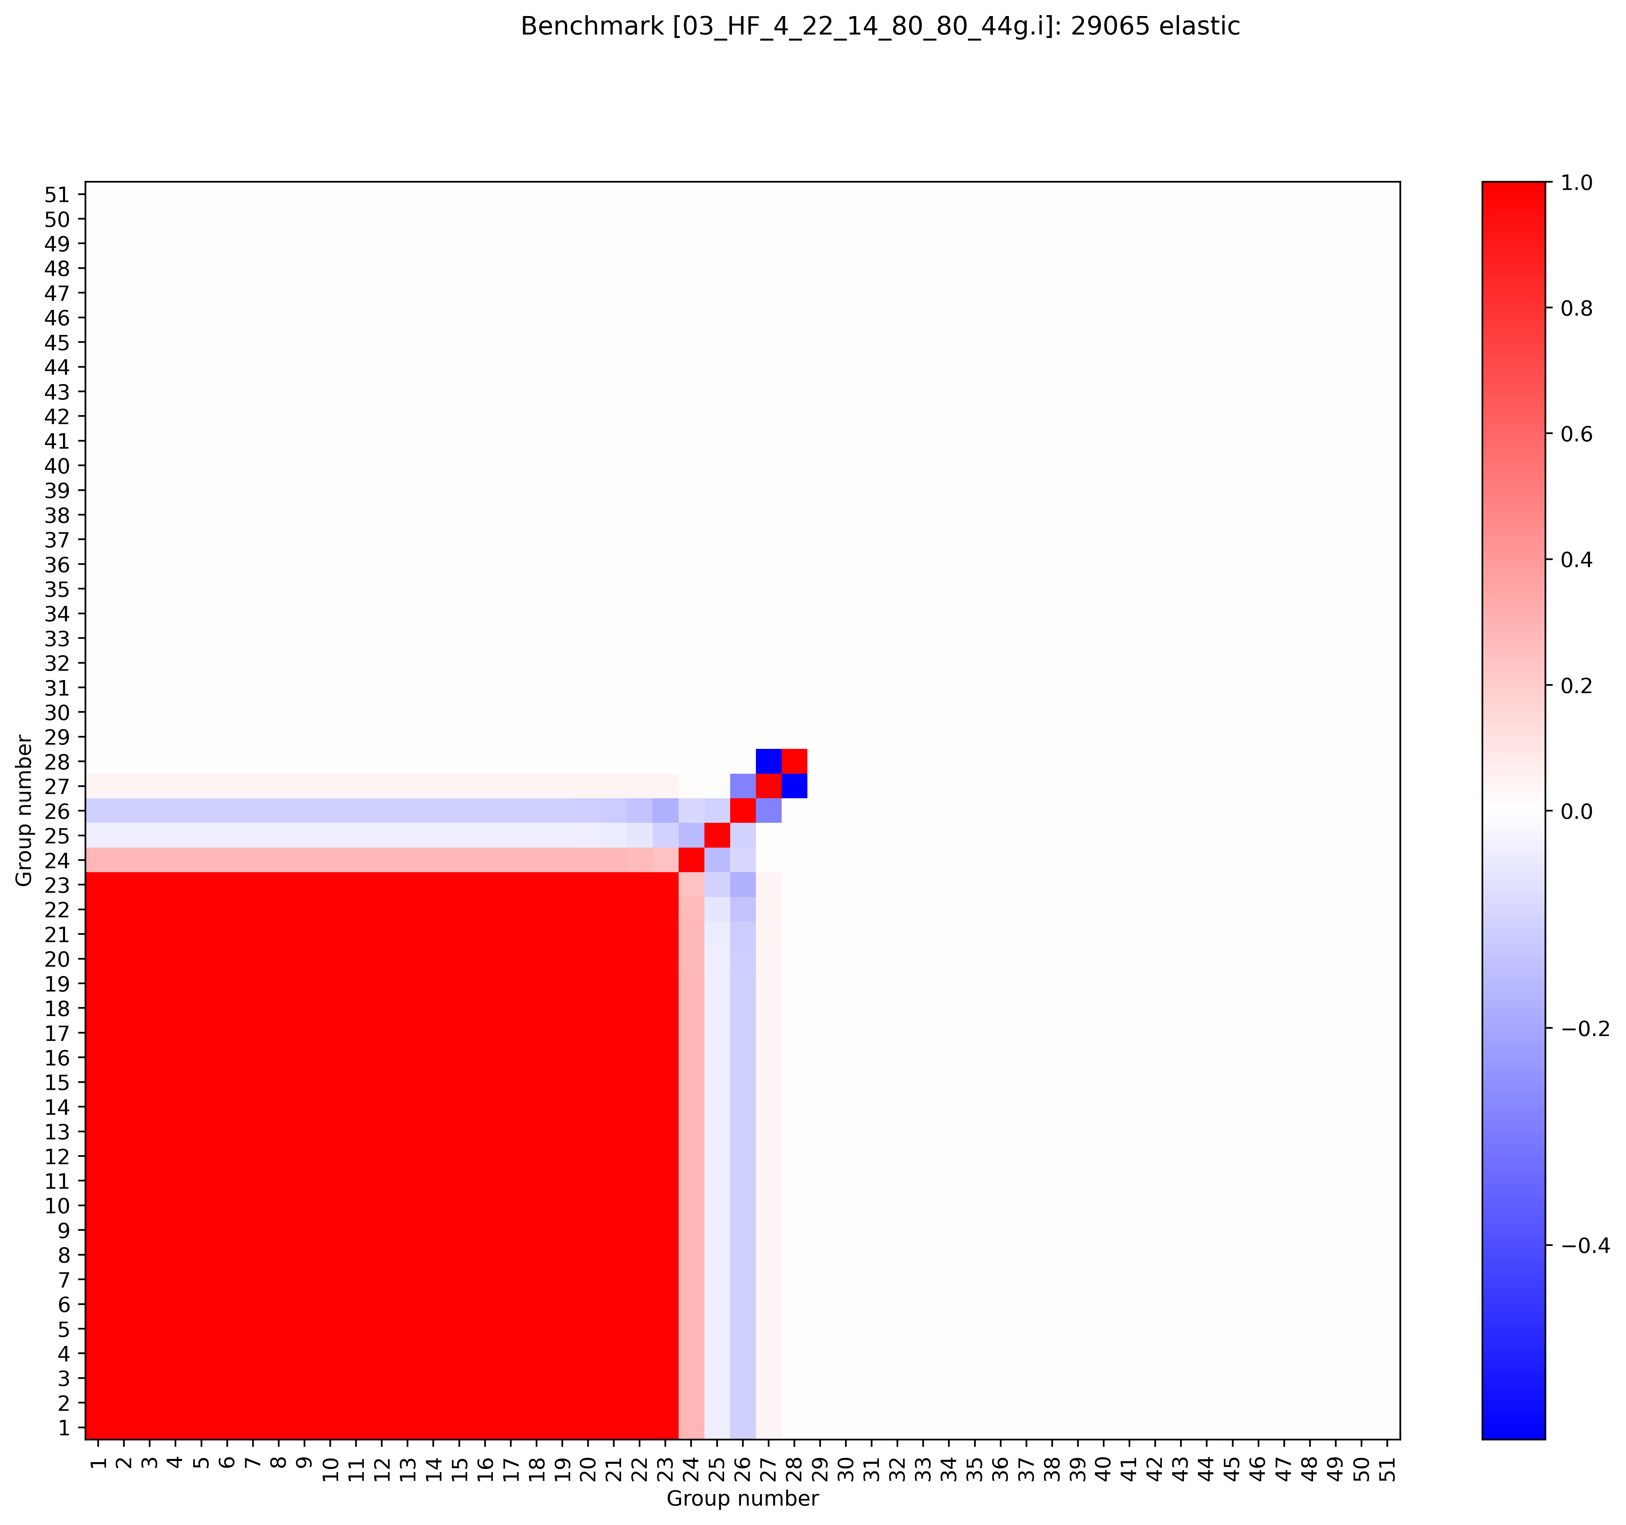
Cu65 elastic
BLO/7.1, 44 group, ACE
8.1, 51 group, JSON
ENDF8.0+8.1 is missing some high energy covariances
8.0, 44 group, ACE
8.0, 51 group, JSON
Right plot file path: \\myhome.lanl.gov\216313\++Data\codes\lab\whisper-tk\whisper-tk\applications\Output\PARADIGM_09_cov_testing
8.1 plot path: \\myhome.lanl.gov\216313\++Data\codes\lab\whisper-tk\Output\PARADIGM_07_e80_e81JSON_51_nomods

Slide 14




Cu65 inelastic
ENDF8.0+8.1 covariances do not exist
8.1, 51 group, JSON
BLO/7.1, 44 group, ACE
8.0, 44 group, ACE
8.0, 51 group, JSON
Right plot file path: \\myhome.lanl.gov\216313\++Data\codes\lab\whisper-tk\whisper-tk\applications\Output\PARADIGM_09_cov_testing
8.1 plot path: \\myhome.lanl.gov\216313\++Data\codes\lab\whisper-tk\Output\PARADIGM_07_e80_e81JSON_51_nomods

Slide 15

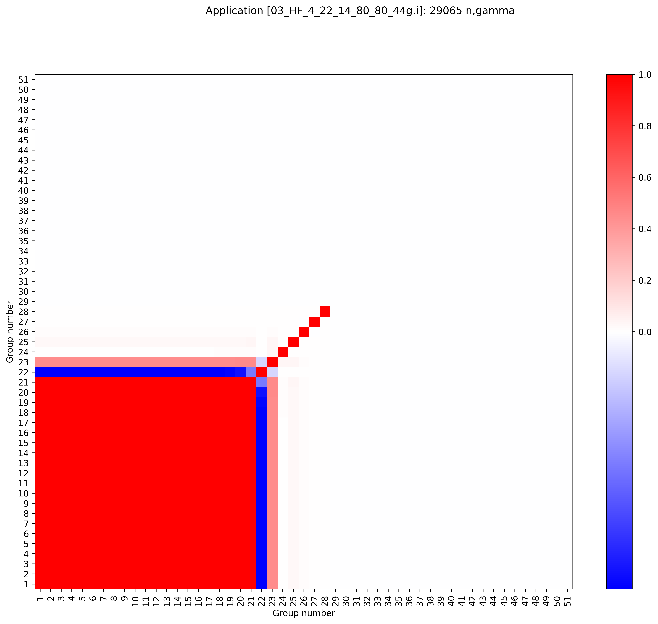

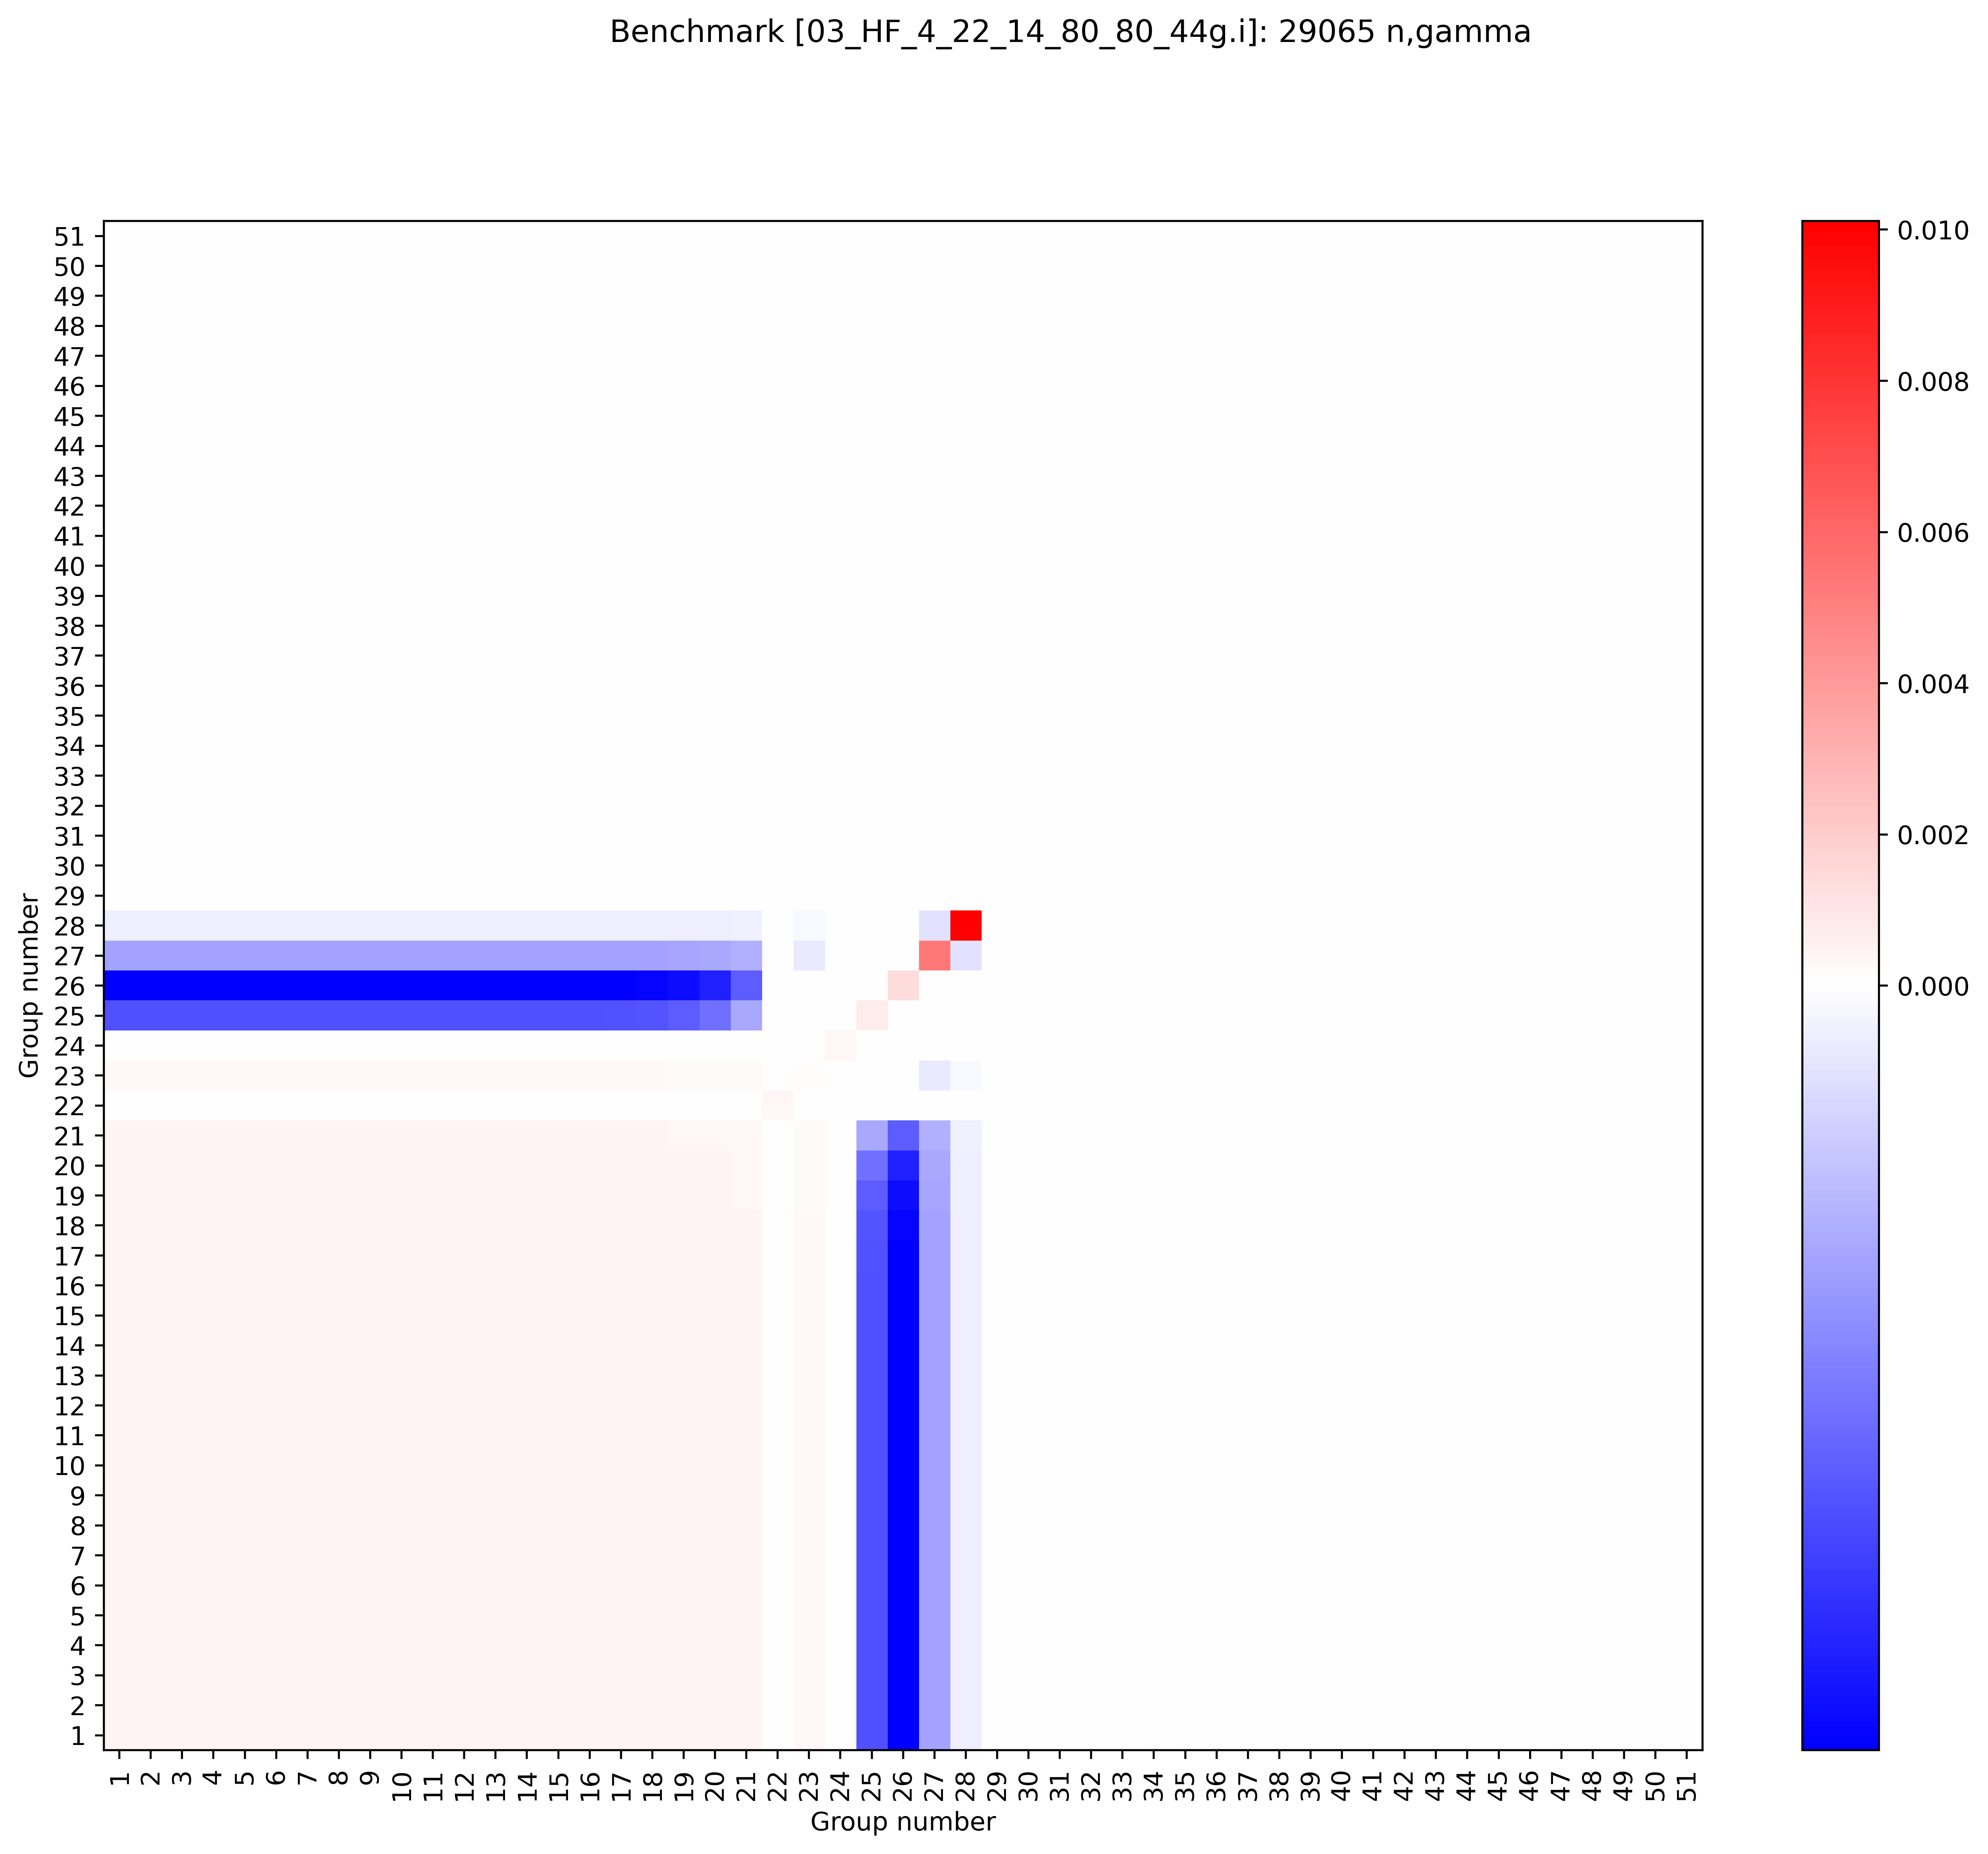
Cu65 (n,gamma)
BLO/7.1, 44 group, ACE
8.1, 51 group, JSON
ENDF8.0+8.1 is missing some high energy covariances
8.0, 44 group, ACE
8.0, 51 group, JSON
Right plot file path: \\myhome.lanl.gov\216313\++Data\codes\lab\whisper-tk\whisper-tk\applications\Output\PARADIGM_09_cov_testing
8.1 plot path: \\myhome.lanl.gov\216313\++Data\codes\lab\whisper-tk\Output\PARADIGM_07_e80_e81JSON_51_nomods

Slide 16




(n,p) reactions
Cu63: 8.0, 51 group, JSON
Cu65: 8.0, 51 group, JSON
Covariances do not exist for Cu63 and Cu65 (n,p) in ENDF 8.0 nor 8.1
Cu63: 8.1, 51 group, JSON
Cu65: 8.1, 51 group, JSON

Slide 17
Cu63 elastic
\\myhome.lanl.gov\216313\++Data\codes\lab\whisper-tk\Output\PARADIGM_01_e71_ACE_44_Cu_nomods

Slide 18
Benchmark | BLO 44 group ACE | 8.0 44 group ACE | 8.0 51 group JSON | 8.1 51 group JSON
heu-met-fast-072-001 | 784 | 760 | 195 | 172
heu-met-fast-072-003 | 655 | 576 | 131 | 113
heu-met-fast-073-001 | 1031 | 617 | 166 | 147
heu-met-fast-102-001 | 793 | 752 | 177 | 157
heu-met-fast-102-002 | 787 | 811 | 161 | 143
heu-met-fast-102-003 | 810 | 785 | 159 | 142
heu-met-fast-102-004 | 787 | 801 | 168 | 150
heu-met-inter-006-001 | 530 | 641 | 113 | 91
heu-met-inter-006-002 | 542 | 654 | 109 | 88
heu-met-inter-006-003 | 604 | 751 | 122 | 102
heu-met-inter-006-004 | 697 | 819 | 144 | 126
heu-met-inter-011-001 | 732 | 1103 | 166 | 149
heu-met-inter-011-002 | 702 | 1023 | 168 | 148
heu-met-inter-011-003 | 674 | 951 | 147 | 129
heu-met-inter-011-004 | 674 | 912 | 141 | 124
heu-met-inter-011-005 | 641 | 888 | 135 | 119
ieu-met-fast-025-001 | 486 | 587 | 121 | 107
ieu-met-fast-025-002 | 512 | 549 | 116 | 103
ieu-met-fast-025-003 | 490 | 577 | 113 | 100
ieu-met-fast-025-004 | 509 | 589 | 119 | 105
pu-met-fast-047-001 | 892 | 640 | 153 | 135
pu-met-fast-047-002 | 903 | 676 | 155 | 137
pu-met-fast-047-003 | 885 | 748 | 140 | 124
01_HF_5_18_10_40 | 615 | 392 | 105 | 93
02_HF_5_18_16_90 | 462 | 492 | 85 | 76
03_HF_4_22_14_80_80 | 693 | 849 | 140 | 118
04_HF_3_5_12_120 | 674 | 838 | 146 | 126
05_HF_16_12_13_70 | 504 | 454 | 90 | 80
06_HF_0_25_15_80_80 | 691 | 882 | 138 | 116
Average | 681 | 728 | 139 | 121
Cu63 elastic
k_{eff} unc (in pcm) shown to the right
8.0 JSON and 8.1 are smaller than BLO
  Since they are missing high energy covariances
Not clear why 8.0 ACE is so different compared to 8.0 JSON?

Slide 19
Cu63 inelastic

Slide 20
Benchmark | BLO 44 group ACE | 8.0 44 group ACE | 8.0 51 group JSON | 8.1 51 group JSON
heu-met-fast-072-001 | 40 | 0 | 0 | 0
heu-met-fast-072-003 | 42 | 0 | 0 | 0
heu-met-fast-073-001 | 111 | 0 | 0 | 0
heu-met-fast-102-001 | 52 | 0 | 0 | 0
heu-met-fast-102-002 | 54 | 0 | 0 | 0
heu-met-fast-102-003 | 51 | 0 | 0 | 0
heu-met-fast-102-004 | 57 | 0 | 0 | 0
heu-met-inter-006-001 | 36 | 0 | 0 | 0
heu-met-inter-006-002 | 40 | 0 | 0 | 0
heu-met-inter-006-003 | 47 | 0 | 0 | 0
heu-met-inter-006-004 | 64 | 0 | 0 | 0
heu-met-inter-011-001 | 57 | 0 | 0 | 0
heu-met-inter-011-002 | 58 | 0 | 0 | 0
heu-met-inter-011-003 | 45 | 0 | 0 | 0
heu-met-inter-011-004 | 43 | 0 | 0 | 0
heu-met-inter-011-005 | 44 | 0 | 0 | 0
ieu-met-fast-025-001 | 21 | 0 | 0 | 0
ieu-met-fast-025-002 | 19 | 0 | 0 | 0
ieu-met-fast-025-003 | 22 | 0 | 0 | 0
ieu-met-fast-025-004 | 20 | 0 | 0 | 0
pu-met-fast-047-001 | 62 | 0 | 0 | 0
pu-met-fast-047-002 | 59 | 0 | 0 | 0
pu-met-fast-047-003 | 60 | 0 | 0 | 0
01_HF_5_18_10_40 | 55 | 0 | 0 | 0
02_HF_5_18_16_90 | 34 | 0 | 0 | 0
03_HF_4_22_14_80_80 | 54 | 0 | 0 | 0
04_HF_3_5_12_120 | 52 | 0 | 0 | 0
05_HF_16_12_13_70 | 41 | 0 | 0 | 0
06_HF_0_25_15_80_80 | 54 | 0 | 0 | 0
Average | 48 | 0 | 0 | 0
Cu63 inelastic
k_{eff} unc (in pcm) shown to the right
Due to covariances not existing, everything other than BLO shows 0 uncertainty…

Slide 21
Cu63 (n,gamma)

Slide 22
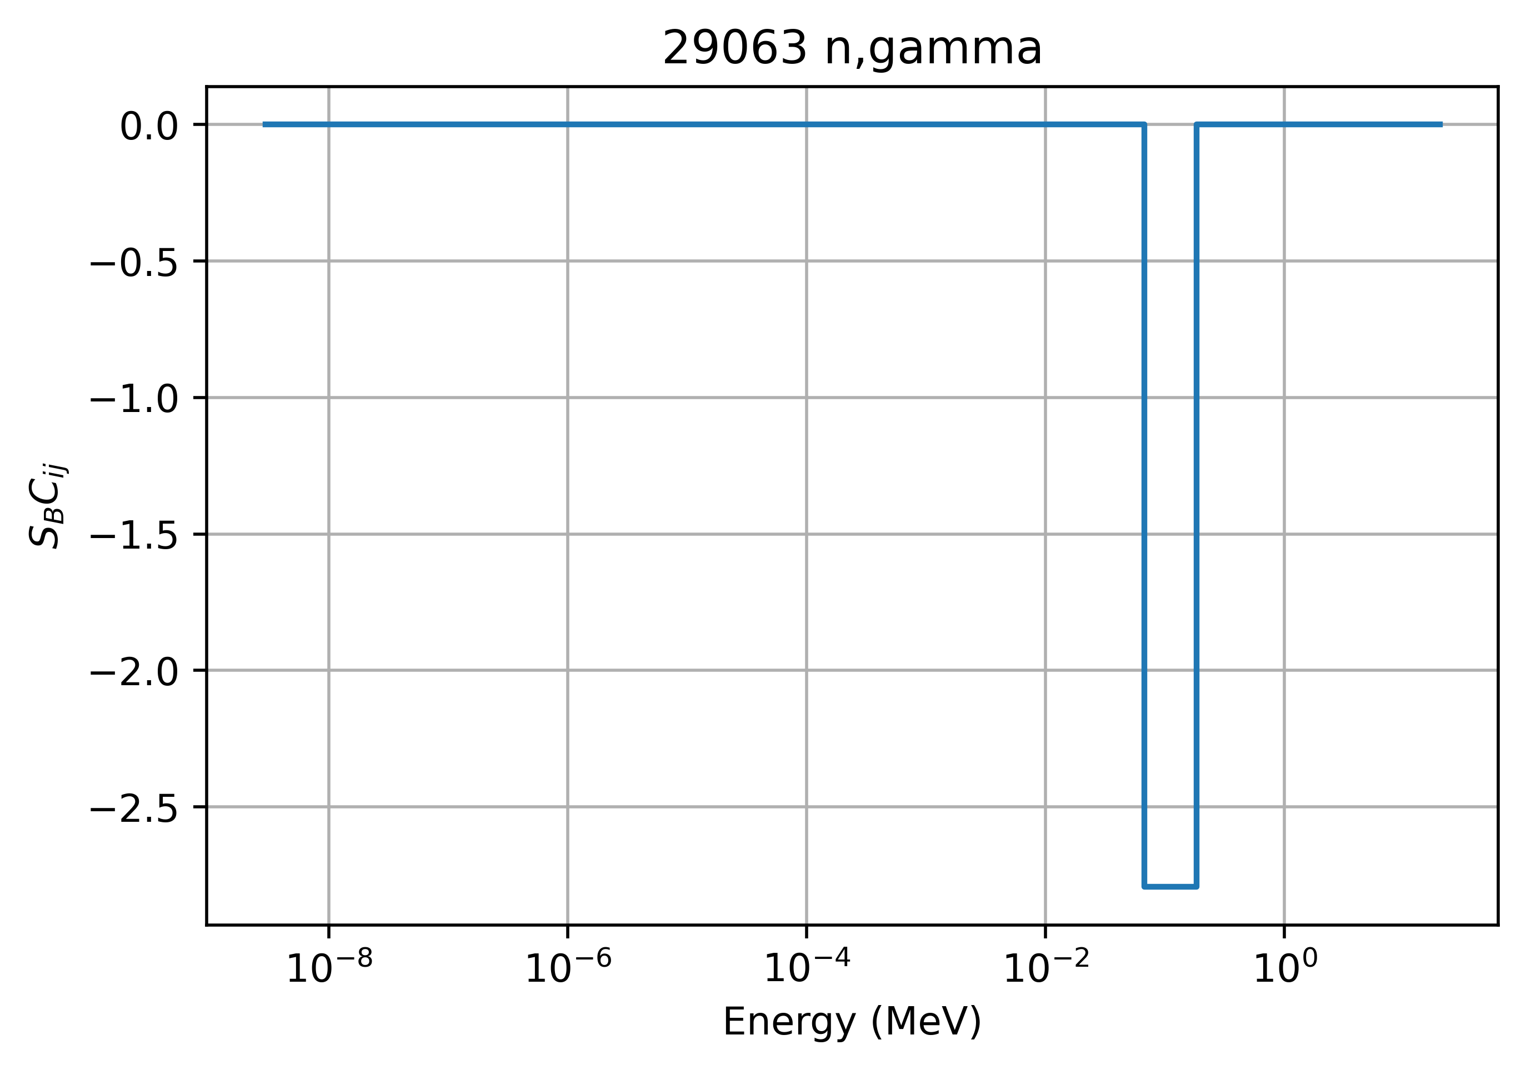
Benchmark | BLO 44 group ACE | 8.0 44 group ACE | 8.0 51 group JSON | 8.1 51 group JSON
heu-met-fast-072-001 | 367 | 8679 | 18823 | 16841
heu-met-fast-072-003 | 297 | 6391 | 13150 | 11766
heu-met-fast-073-001 | 389 | 7924 | 18462 | 16518
heu-met-fast-102-001 | 352 | 8543 | 16585 | 14839
heu-met-fast-102-002 | 353 | 8559 | 16654 | 14901
heu-met-fast-102-003 | 355 | 8567 | 16782 | 15015
heu-met-fast-102-004 | 356 | 8661 | 16797 | 15028
heu-met-inter-006-001 | 295 | 6241 | 9602 | 8591
heu-met-inter-006-002 | 293 | 6406 | 10019 | 8964
heu-met-inter-006-003 | 297 | 6691 | 10662 | 9540
heu-met-inter-006-004 | 320 | 7853 | 13082 | 11704
heu-met-inter-011-001 | 316 | 8847 | 11780 | 10540
heu-met-inter-011-002 | 313 | 8551 | 10979 | 9824
heu-met-inter-011-003 | 311 | 8083 | 10039 | 8983
heu-met-inter-011-004 | 308 | 7837 | 9486 | 8488
heu-met-inter-011-005 | 307 | 7564 | 9064 | 8111
ieu-met-fast-025-001 | 225 | 5795 | 10958 | 9805
ieu-met-fast-025-002 | 226 | 5801 | 10960 | 9807
ieu-met-fast-025-003 | 226 | 5852 | 10999 | 9841
ieu-met-fast-025-004 | 226 | 5845 | 11038 | 9876
pu-met-fast-047-001 | 352 | 8155 | 16135 | 14436
pu-met-fast-047-002 | 353 | 8154 | 16164 | 14462
pu-met-fast-047-003 | 353 | 8083 | 16100 | 14404
01_HF_5_18_10_40 | 193 | 3940 | 8206 | 7343
02_HF_5_18_16_90 | 218 | 5229 | 9326 | 8344
03_HF_4_22_14_80_80 | 392 | 9285 | 14682 | 13135
04_HF_3_5_12_120 | 327 | 8158 | 12990 | 11622
05_HF_16_12_13_70 | 201 | 4599 | 8657 | 7745
06_HF_0_25_15_80_80 | 401 | 9486 | 14987 | 13408
Average | 308 | 7372 | 12868 | 11513
Cu63 (n,gamma)
k_{eff} unc (in pcm) shown to the right
8.0 and 8.1 are VERY large!
  100% of uncertainty from a single large value in the covariance

Slide 23
Cu63 (n,p)

Slide 24
Benchmark | BLO 44 group ACE | 8.0 44 group ACE | 8.0 51 group JSON | 8.1 51 group JSON
heu-met-fast-072-001 | 19 | 0 | 0 | 0
heu-met-fast-072-003 | 20 | 0 | 0 | 0
heu-met-fast-073-001 | 64 | 0 | 0 | 0
heu-met-fast-102-001 | 28 | 0 | 0 | 0
heu-met-fast-102-002 | 28 | 0 | 0 | 0
heu-met-fast-102-003 | 29 | 0 | 0 | 0
heu-met-fast-102-004 | 29 | 0 | 0 | 0
heu-met-inter-006-001 | 22 | 0 | 0 | 0
heu-met-inter-006-002 | 23 | 0 | 0 | 0
heu-met-inter-006-003 | 25 | 0 | 0 | 0
heu-met-inter-006-004 | 34 | 0 | 0 | 0
heu-met-inter-011-001 | 33 | 0 | 0 | 0
heu-met-inter-011-002 | 31 | 0 | 0 | 0
heu-met-inter-011-003 | 26 | 0 | 0 | 0
heu-met-inter-011-004 | 25 | 0 | 0 | 0
heu-met-inter-011-005 | 24 | 0 | 0 | 0
ieu-met-fast-025-001 | 17 | 0 | 0 | 0
ieu-met-fast-025-002 | 17 | 0 | 0 | 0
ieu-met-fast-025-003 | 17 | 0 | 0 | 0
ieu-met-fast-025-004 | 17 | 0 | 0 | 0
pu-met-fast-047-001 | 41 | 0 | 0 | 0
pu-met-fast-047-002 | 41 | 0 | 0 | 0
pu-met-fast-047-003 | 41 | 0 | 0 | 0
01_HF_5_18_10_40 | 31 | 0 | 0 | 0
02_HF_5_18_16_90 | 26 | 0 | 0 | 0
03_HF_4_22_14_80_80 | 34 | 0 | 0 | 0
04_HF_3_5_12_120 | 30 | 0 | 0 | 0
05_HF_16_12_13_70 | 27 | 0 | 0 | 0
06_HF_0_25_15_80_80 | 34 | 0 | 0 | 0
Average | 29 | 0 | 0 | 0
Cu63 (n,p)
k_{eff} unc (in pcm) shown to the right
Similar to Cu63 inelastic

Slide 25
Cu65 elastic

Slide 26
Benchmark | BLO 44 group ACE | 8.0 44 group ACE | 8.0 51 group JSON | 8.1b4 51 group JSON
heu-met-fast-072-001 | 380 | 8 | 12 | 29
heu-met-fast-072-003 | 341 | 9 | 11 | 20
heu-met-fast-073-001 | 496 | 5 | 10 | 23
heu-met-fast-102-001 | 401 | 8 | 10 | 27
heu-met-fast-102-002 | 395 | 9 | 11 | 28
heu-met-fast-102-003 | 398 | 9 | 12 | 31
heu-met-fast-102-004 | 402 | 8 | 11 | 30
heu-met-inter-006-001 | 298 | 14 | 17 | 21
heu-met-inter-006-002 | 336 | 15 | 18 | 21
heu-met-inter-006-003 | 339 | 13 | 15 | 22
heu-met-inter-006-004 | 376 | 13 | 16 | 31
heu-met-inter-011-001 | 432 | 16 | 20 | 39
heu-met-inter-011-002 | 425 | 15 | 19 | 37
heu-met-inter-011-003 | 400 | 19 | 20 | 37
heu-met-inter-011-004 | 414 | 20 | 21 | 36
heu-met-inter-011-005 | 427 | 17 | 21 | 35
ieu-met-fast-025-001 | 240 | 6 | 7 | 20
ieu-met-fast-025-002 | 255 | 6 | 7 | 18
ieu-met-fast-025-003 | 241 | 7 | 7 | 18
ieu-met-fast-025-004 | 251 | 8 | 7 | 17
pu-met-fast-047-001 | 432 | 10 | 9 | 22
pu-met-fast-047-002 | 416 | 7 | 10 | 22
pu-met-fast-047-003 | 413 | 7 | 10 | 24
01_HF_5_18_10_40 | 327 | 5 | 7 | 16
02_HF_5_18_16_90 | 243 | 5 | 6 | 14
03_HF_4_22_14_80_80 | 407 | 14 | 18 | 26
04_HF_3_5_12_120 | 392 | 13 | 16 | 29
05_HF_16_12_13_70 | 274 | 6 | 7 | 16
06_HF_0_25_15_80_80 | 400 | 14 | 18 | 27
Average | 364 | 11 | 13 | 25
Cu65 elastic
k_{eff} unc (in pcm) shown to the right
8.0 JSON and 8.1 are much smaller than BLO
  Because they are missing high energy covariances

Slide 27
Cu65 inelastic

Slide 28
Benchmark | BLO 44 group ACE | 8.0 44 group ACE | 8.0 51 group JSON | 8.1b4 51 group JSON
heu-met-fast-072-001 | 13 | 0 | 0 | 0
heu-met-fast-072-003 | 15 | 0 | 0 | 0
heu-met-fast-073-001 | 41 | 0 | 0 | 0
heu-met-fast-102-001 | 19 | 0 | 0 | 0
heu-met-fast-102-002 | 18 | 0 | 0 | 0
heu-met-fast-102-003 | 19 | 0 | 0 | 0
heu-met-fast-102-004 | 18 | 0 | 0 | 0
heu-met-inter-006-001 | 12 | 0 | 0 | 0
heu-met-inter-006-002 | 14 | 0 | 0 | 0
heu-met-inter-006-003 | 17 | 0 | 0 | 0
heu-met-inter-006-004 | 24 | 0 | 0 | 0
heu-met-inter-011-001 | 22 | 0 | 0 | 0
heu-met-inter-011-002 | 20 | 0 | 0 | 0
heu-met-inter-011-003 | 18 | 0 | 0 | 0
heu-met-inter-011-004 | 17 | 0 | 0 | 0
heu-met-inter-011-005 | 14 | 0 | 0 | 0
ieu-met-fast-025-001 | 7 | 0 | 0 | 0
ieu-met-fast-025-002 | 8 | 0 | 0 | 0
ieu-met-fast-025-003 | 7 | 0 | 0 | 0
ieu-met-fast-025-004 | 7 | 0 | 0 | 0
pu-met-fast-047-001 | 23 | 0 | 0 | 0
pu-met-fast-047-002 | 23 | 0 | 0 | 0
pu-met-fast-047-003 | 23 | 0 | 0 | 0
01_HF_5_18_10_40 | 19 | 0 | 0 | 0
02_HF_5_18_16_90 | 12 | 0 | 0 | 0
03_HF_4_22_14_80_80 | 17 | 0 | 0 | 0
04_HF_3_5_12_120 | 17 | 0 | 0 | 0
05_HF_16_12_13_70 | 13 | 0 | 0 | 0
06_HF_0_25_15_80_80 | 18 | 0 | 0 | 0
Average | 17 | 0 | 0 | 0
Cu65 inelastic
k_{eff} unc (in pcm) shown to the right
All 0 other than BLO

Slide 29
Cu65 (n,gamma)

Slide 30
Benchmark | BLO 44 group ACE | 8.0 44 group ACE | 8.0 51 group JSON | 8.1b4 51 group JSON
heu-met-fast-072-001 | 104 | 19 | 26 | 9
heu-met-fast-072-003 | 85 | 13 | 18 | 8
heu-met-fast-073-001 | 106 | 17 | 25 | 9
heu-met-fast-102-001 | 99 | 18 | 24 | 9
heu-met-fast-102-002 | 100 | 18 | 24 | 8
heu-met-fast-102-003 | 100 | 18 | 24 | 8
heu-met-fast-102-004 | 100 | 18 | 24 | 8
heu-met-inter-006-001 | 90 | 13 | 11 | 13
heu-met-inter-006-002 | 89 | 13 | 14 | 11
heu-met-inter-006-003 | 91 | 13 | 16 | 10
heu-met-inter-006-004 | 96 | 16 | 19 | 9
heu-met-inter-011-001 | 99 | 18 | 19 | 9
heu-met-inter-011-002 | 98 | 17 | 18 | 9
heu-met-inter-011-003 | 100 | 15 | 17 | 11
heu-met-inter-011-004 | 99 | 14 | 16 | 10
heu-met-inter-011-005 | 98 | 15 | 15 | 11
ieu-met-fast-025-001 | 64 | 12 | 16 | 5
ieu-met-fast-025-002 | 64 | 12 | 16 | 6
ieu-met-fast-025-003 | 65 | 12 | 16 | 6
ieu-met-fast-025-004 | 65 | 12 | 16 | 6
pu-met-fast-047-001 | 99 | 17 | 23 | 9
pu-met-fast-047-002 | 99 | 17 | 23 | 9
pu-met-fast-047-003 | 100 | 17 | 23 | 9
01_HF_5_18_10_40 | 47 | 8 | 11 | 3
02_HF_5_18_16_90 | 59 | 11 | 14 | 6
03_HF_4_22_14_80_80 | 119 | 19 | 22 | 14
04_HF_3_5_12_120 | 98 | 17 | 20 | 10
05_HF_16_12_13_70 | 52 | 10 | 12 | 5
06_HF_0_25_15_80_80 | 122 | 20 | 23 | 15
Average | 90 | 15 | 19 | 9
Cu65 (n,gamma)
k_{eff} unc (in pcm) shown to the right
8.0 JSON and 8.1 are smaller than BLO
  Because they are missing high energy covariances

Slide 31
Cu65 (n,p)
All are 0-1 pcm

Slide 32
Conclusions
Cu nuclear data is important (and important for actinide intermediate energy nuclear data)
There seem to be major issues (at least with the processed data I was using) for some reactions:
  Missing fast covariances in ENDF8.0+8.1
  Cu63 (n,gamma) also has a separate issue
Cu covariances could definitely use an update for ENDF9.0

Slide 33
Other nuclide/reactions I have seen major issues with in ENDF8.0
Ni60 inelastic
Ni60 (n,p)
Ca40 elastic
Ca40 (n,gamma)
U235 (n,gamma)
DISCLAIMER: these have not been investigated in detail. Issues could be in covariances or in processing

Slide 34




Acknowledgments
Research reported in this publication was supported by the U.S. Department of Energy LDRD program at Los Alamos National Laboratory.
NCERC is supported by the DOE Nuclear Criticality Safety Program, funded and managed by the National Nuclear Security Administration for the Department of Energy.
Los Alamos National Laboratory is operated by Triad National Security, LLC, for the National Nuclear Security Administration of the US Department of Energy under Contract No. 89233218CNA000001.

