Slide 1
Ta-181 URR Covariance
Jesse M. Brown
Oak Ridge National Laboratory
Cross Section Evaluation Working Group (CSEWG) Meeting
Nov 4th – 8th, 2024

Slide 2
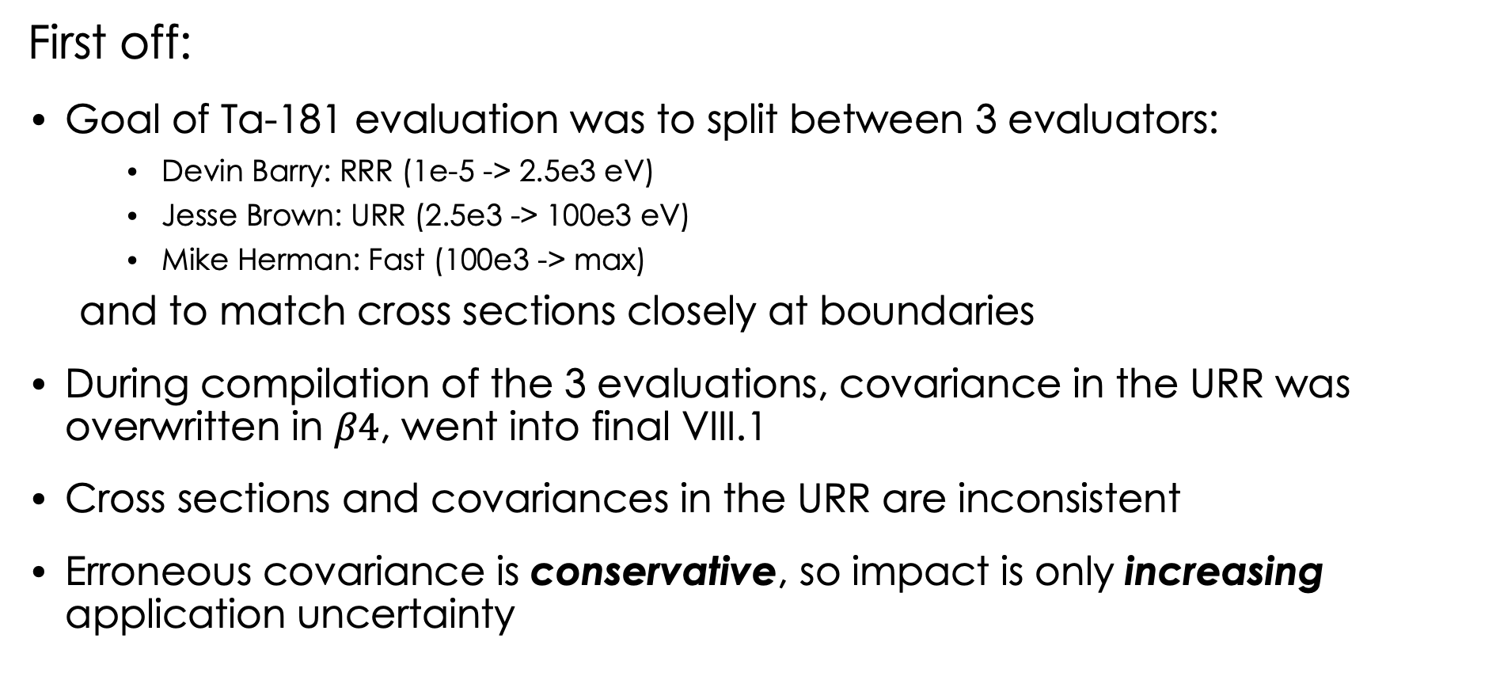
Error found in $β4$ and VIII.1
Cross sections = correct
Covariance = incorrect
First off:
Goal of Ta-181 evaluation was to split between 3 evaluators:
    Devin Barry: RRR (1e-5 -> 2.5e3 eV)
    Jesse Brown: URR (2.5e3 -> 100e3 eV)
    Mike Herman: Fast (100e3 -> max)
  and to match cross sections closely at boundaries
During compilation of the 3 evaluations, covariance in the URR was overwritten in $β4$, went into final VIII.1
Cross sections and covariances in the URR are inconsistent
Erroneous covariance is conservative, so impact is only increasing application uncertainty

Slide 3
URR Covariance
Evaluation included many datasets, outlined in:
  publication (accepted, not published yet)
  ”Big paper”
  ENDF/B-VIII.1 file
Evaluated with SAMMY using FITACS implementation
  ”Initial”/prior based on average RRR parameters
  “Final”/posterior from Bayesian posterior
Main datasets:
  Total/Transmission data
  Radiative capture yield/XS data

Slide 4
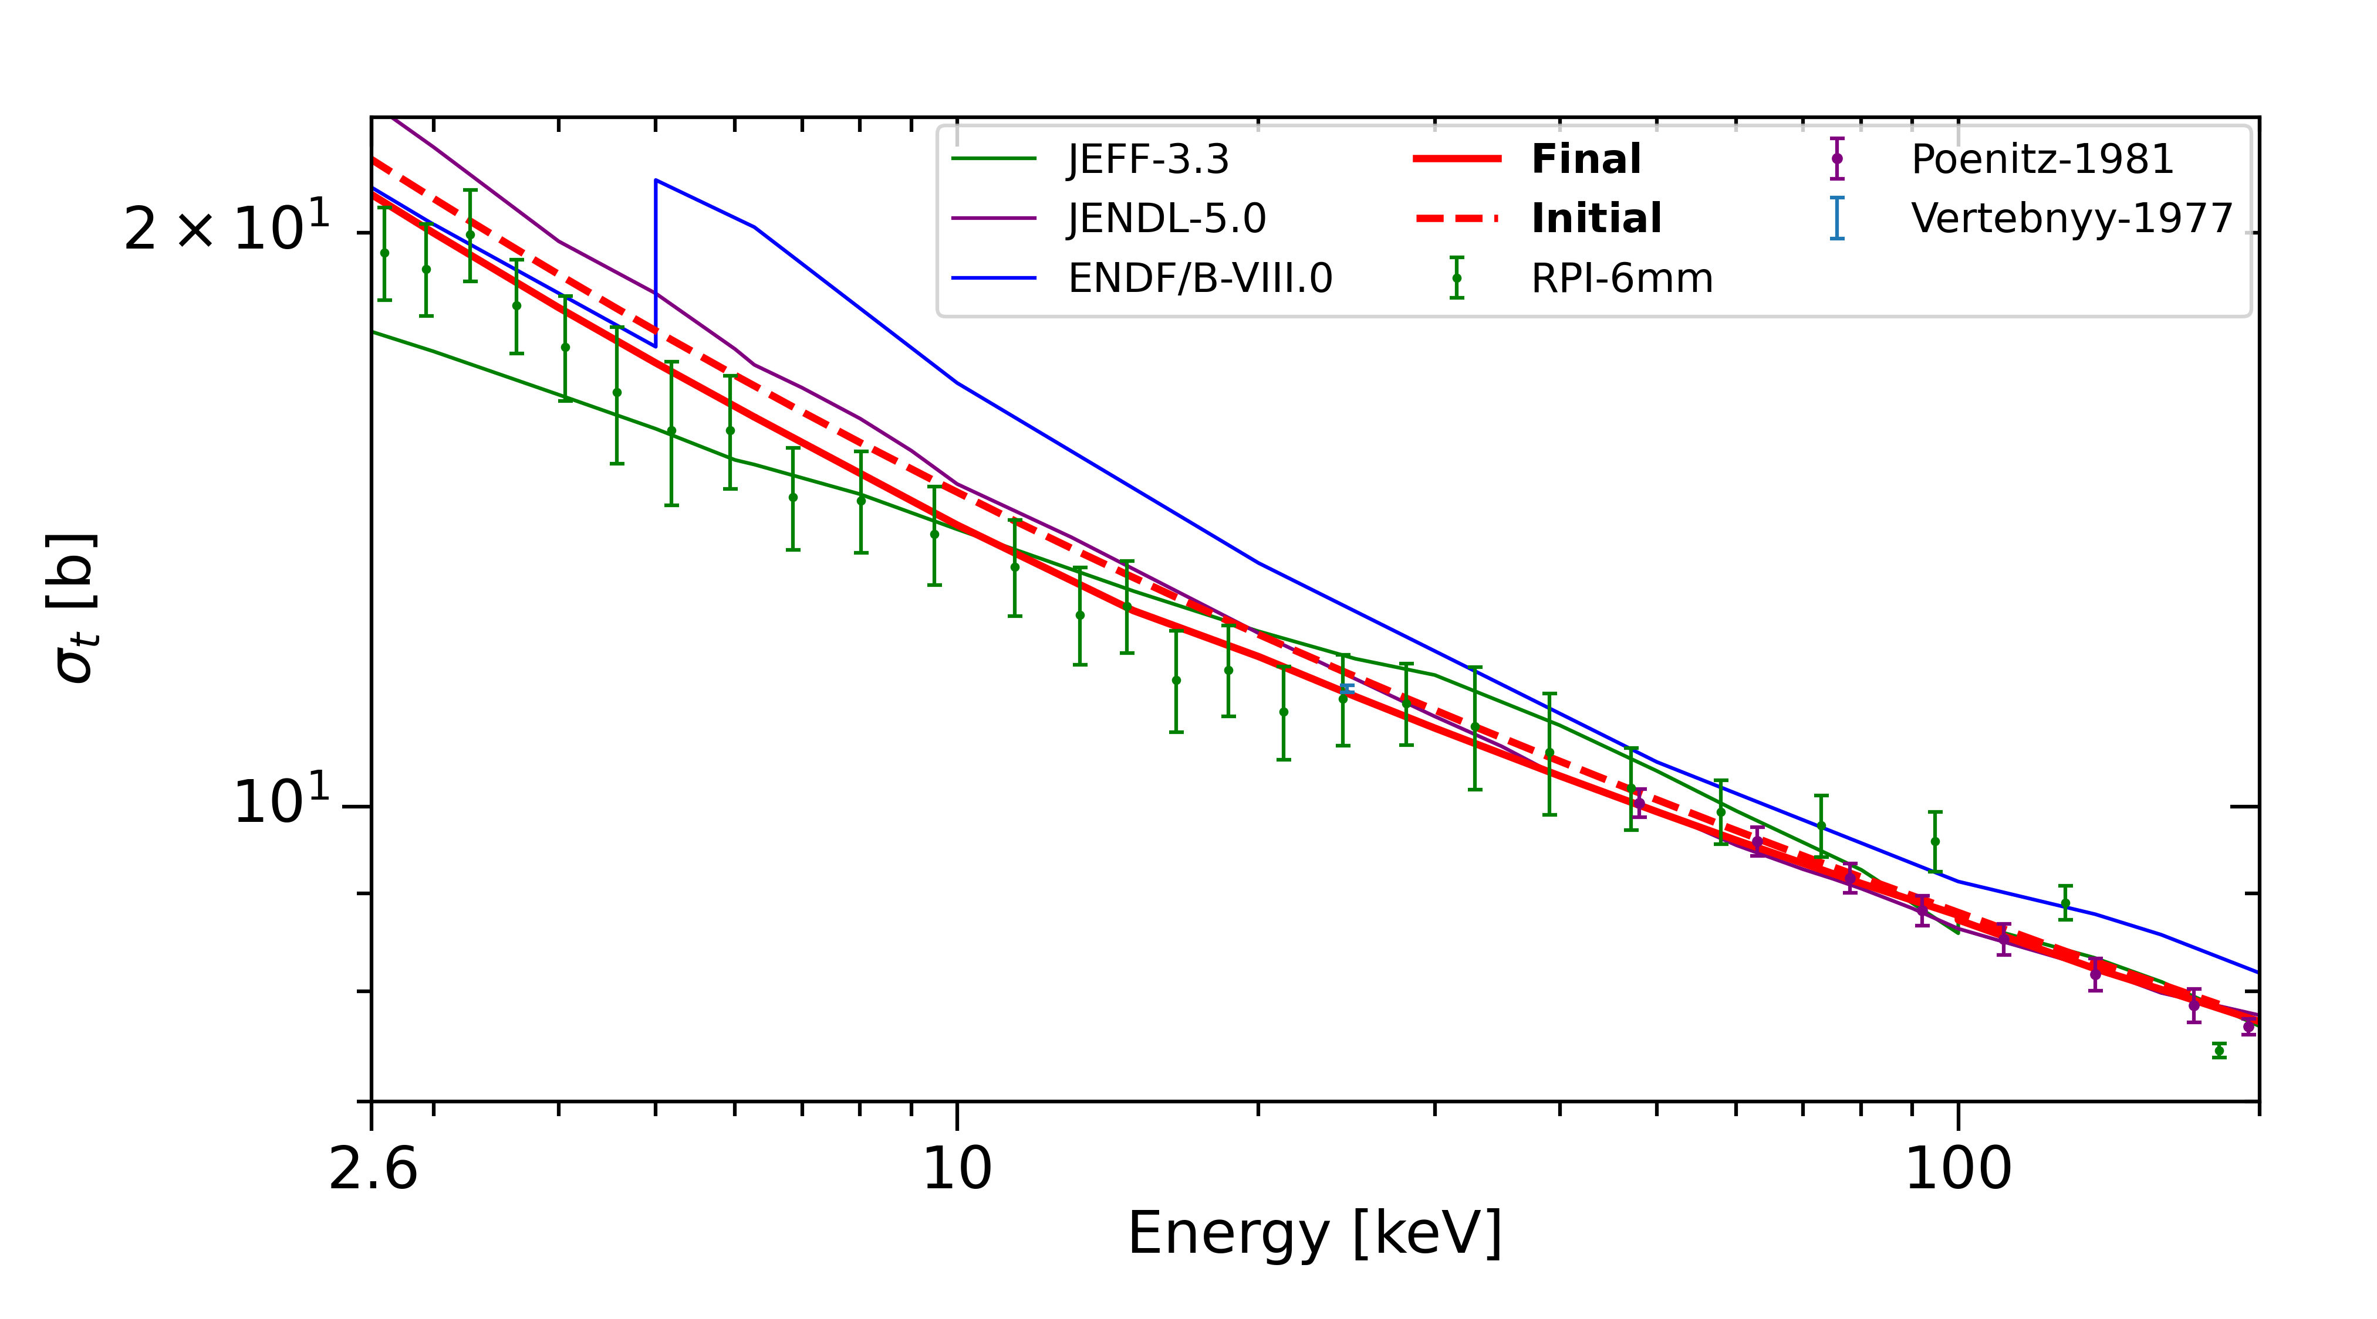
Total XS and Transmission data

Slide 5
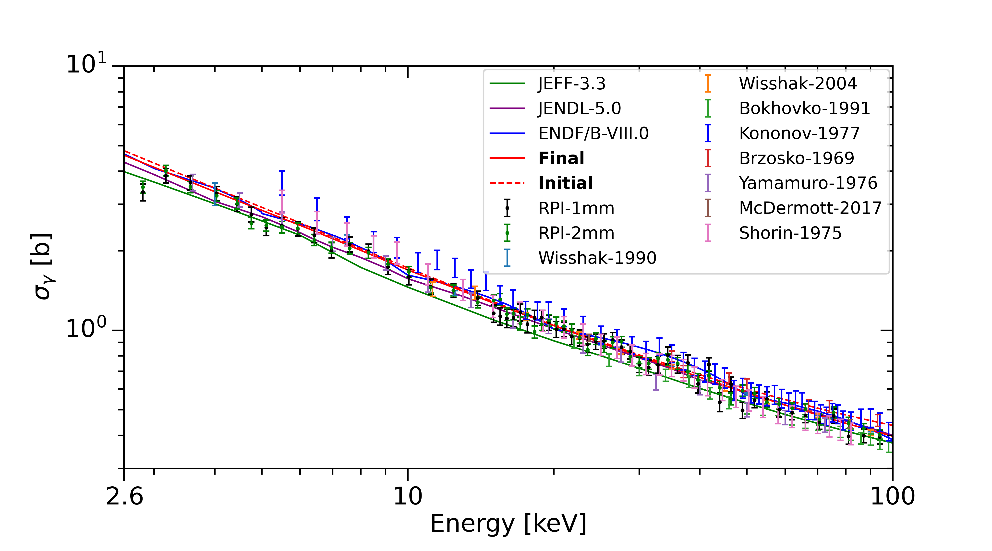
Capture XS and Yield data

Slide 6
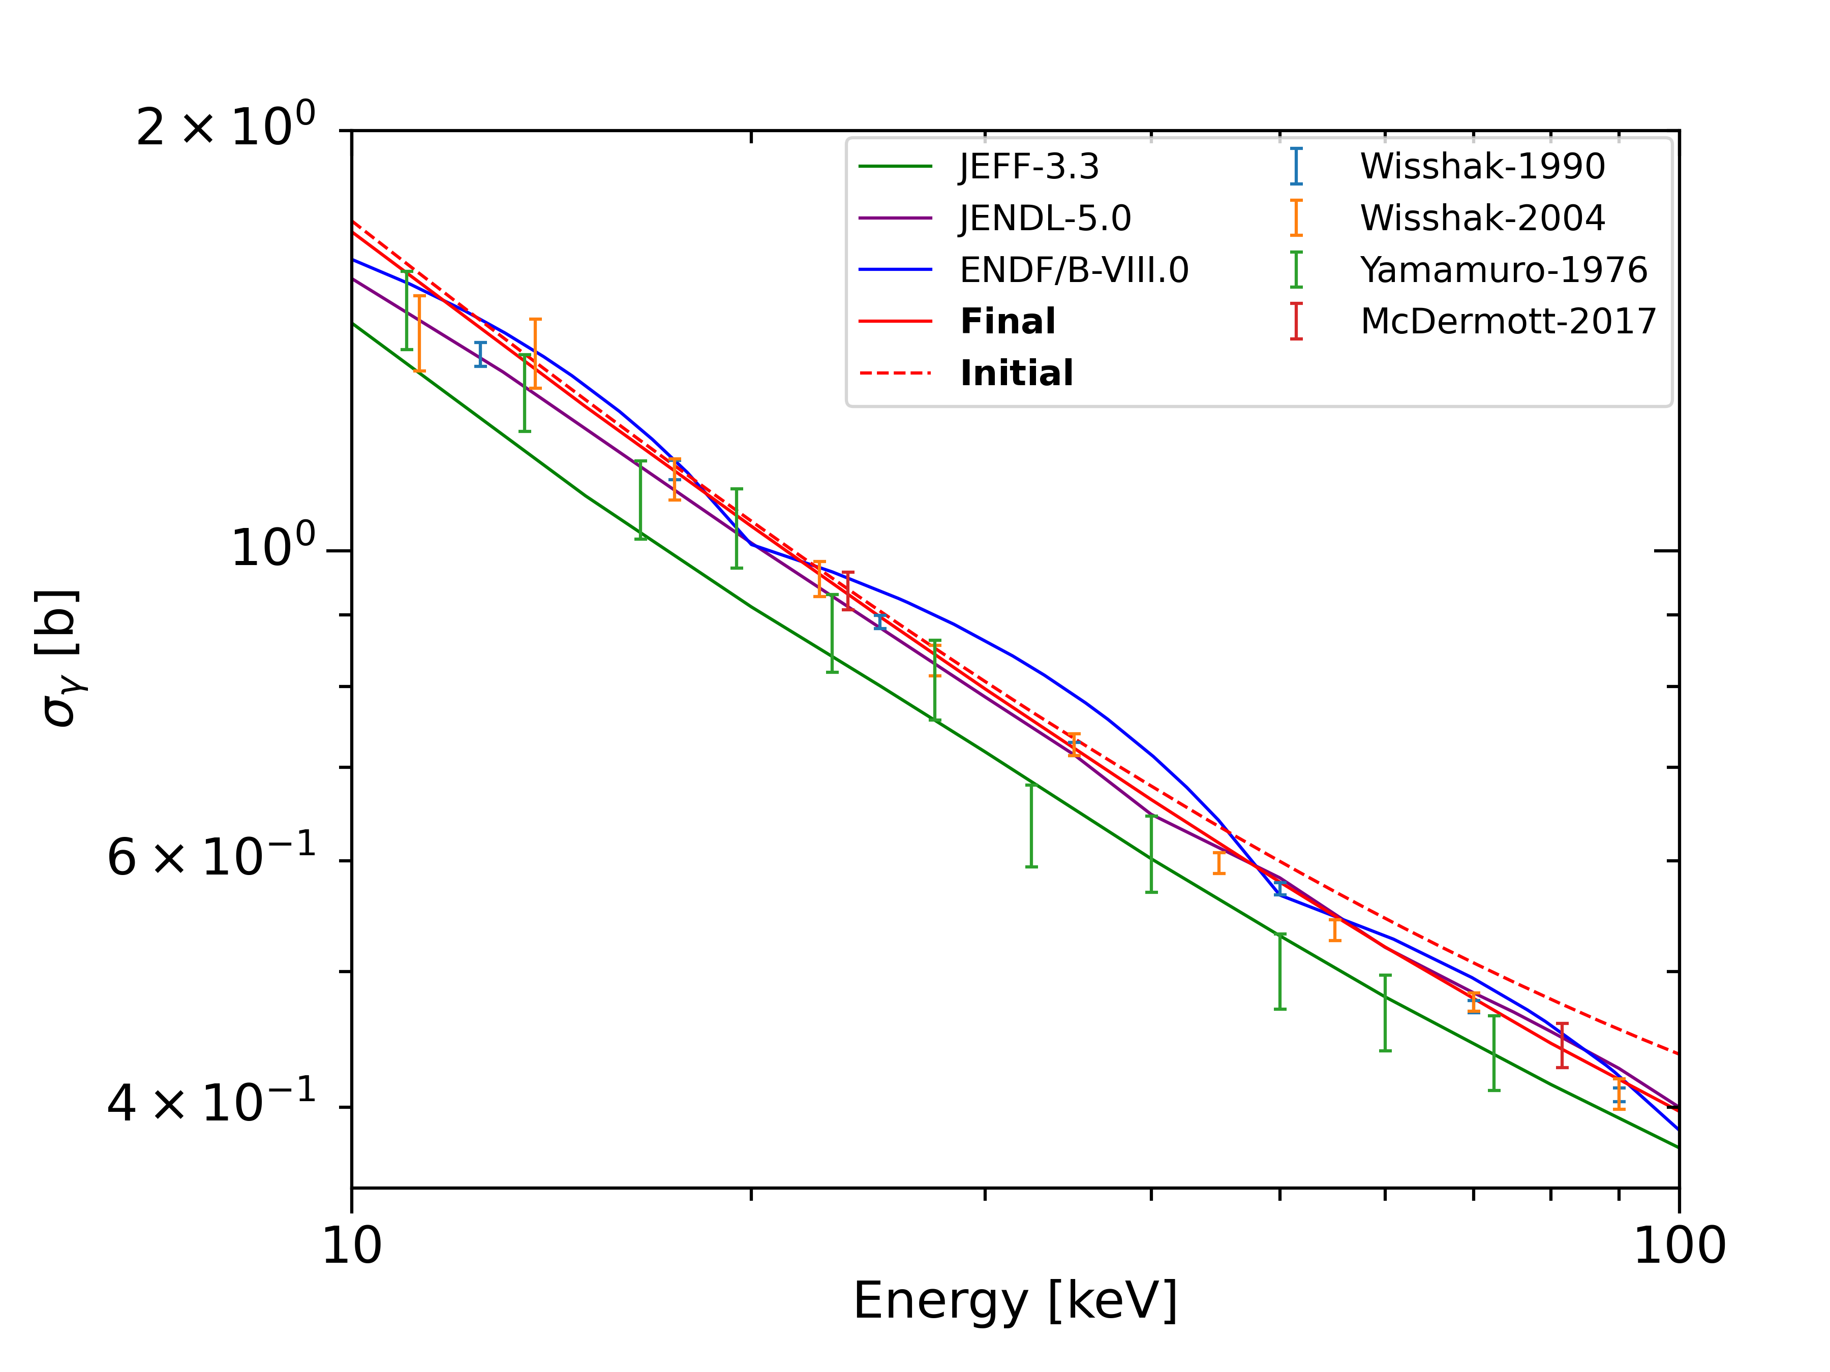
Capture XS and Yield data

Slide 7
Lowest Uncertainty in Datasets
Lowest uncertainty in total cross section:
  Poentiz – 1981, 1.7% @ 48 keV
  I added prior normalization uncertainty of 1% to account for any missing background uncertainty
Lowest uncertainty in capture cross section:
  Wisshak – 1991, 1% @ 60 keV; 2004, 1.5% @ 60 keV
  I treated as statistical, and added ~2% and 4% normalization uncertainty, respectively, to the prior from the normalization to Au

Slide 8
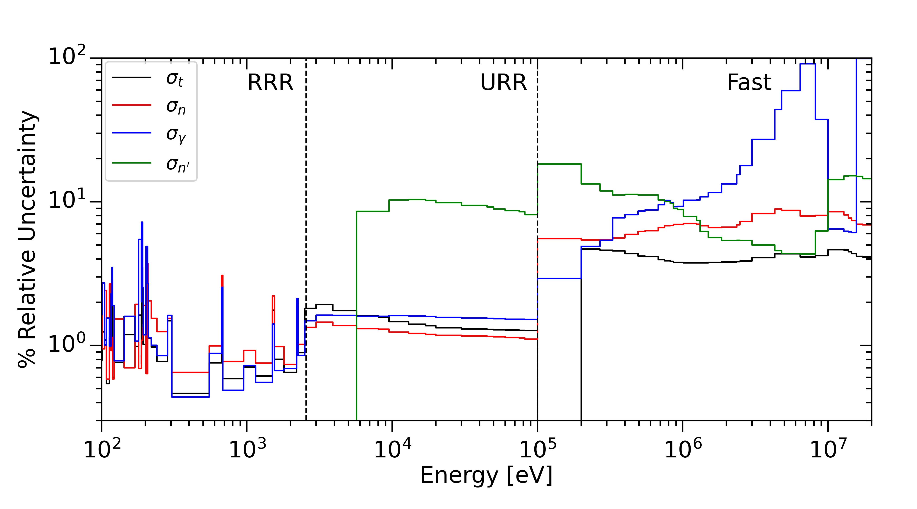
Standard deviation in $β3$

Slide 9
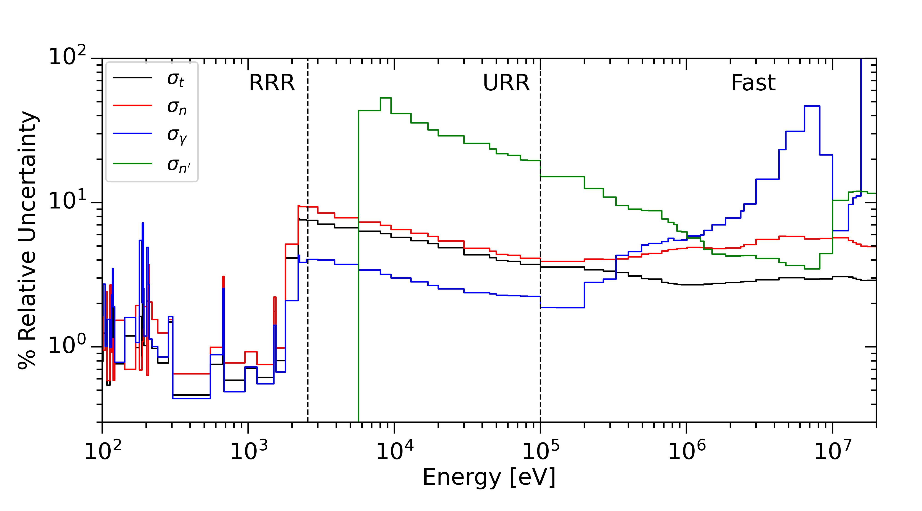
Standard deviation in VIII.1

Slide 10
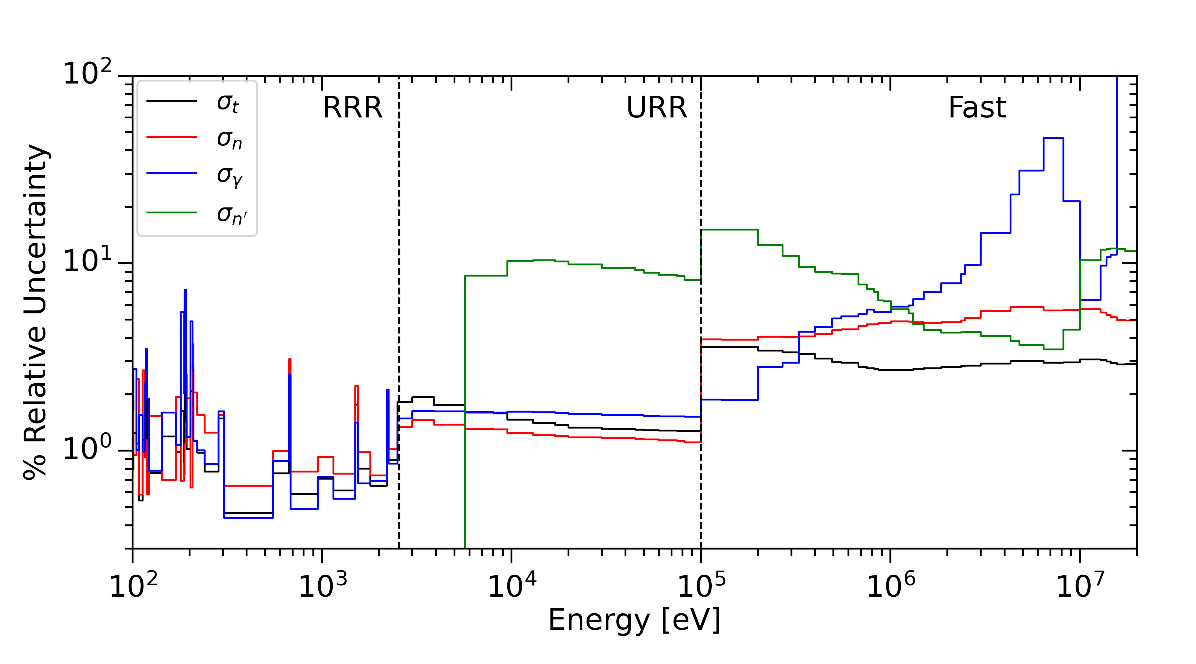
Standard deviation for Errata

Slide 11
Standard deviation for Errata
If you think these uncertainties are too small, please read:
Belanger, H., Lewis, A., & Barry, D. (2023). Comparison and evaluation of resolved resonance region covariance representations. Journal of Nuclear Science and Technology, 61(2), 192–205. https://doi.org/10.1080/00223131.2023.2279303

Slide 12
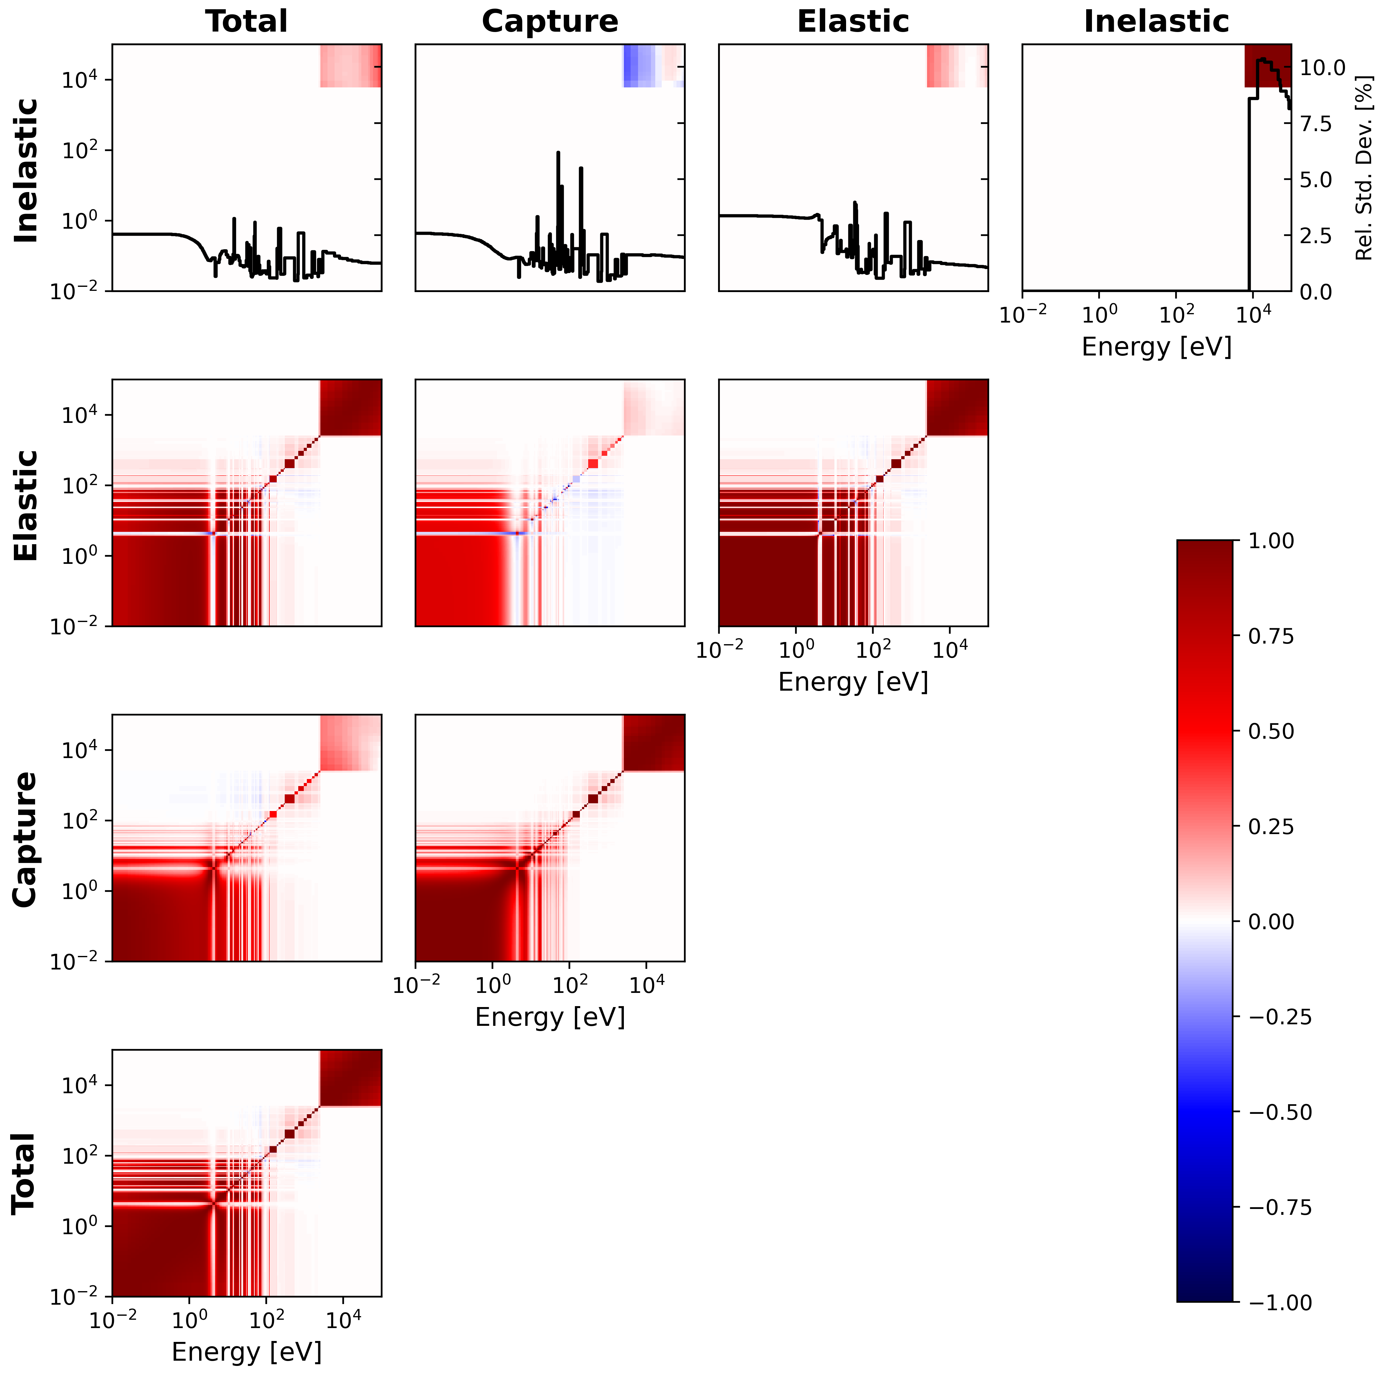
Covariance
RRR/URR boundary = 2.5 keV

Slide 13
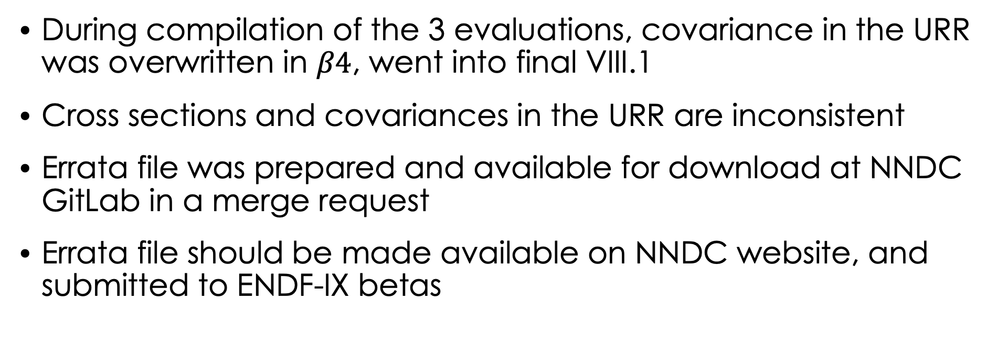
Summary
During compilation of the 3 evaluations, covariance in the URR was overwritten in $β4$, went into final VIII.1
Cross sections and covariances in the URR are inconsistent
Errata file was prepared and available for download at NNDC GitLab in a merge request
Errata file should be made available on NNDC website, and submitted to ENDF-IX betas

Slide 14
Acknowledgements
This work was supported by the Nuclear Criticality Safety Program, funded and managed by the National Nuclear Security Administration for the US Department of Energy
The Nuclear Data Group at ORNL, the RPI Nuclear Data Team, and Mike Herman

Slide 15
Additional slides

