Slide 1
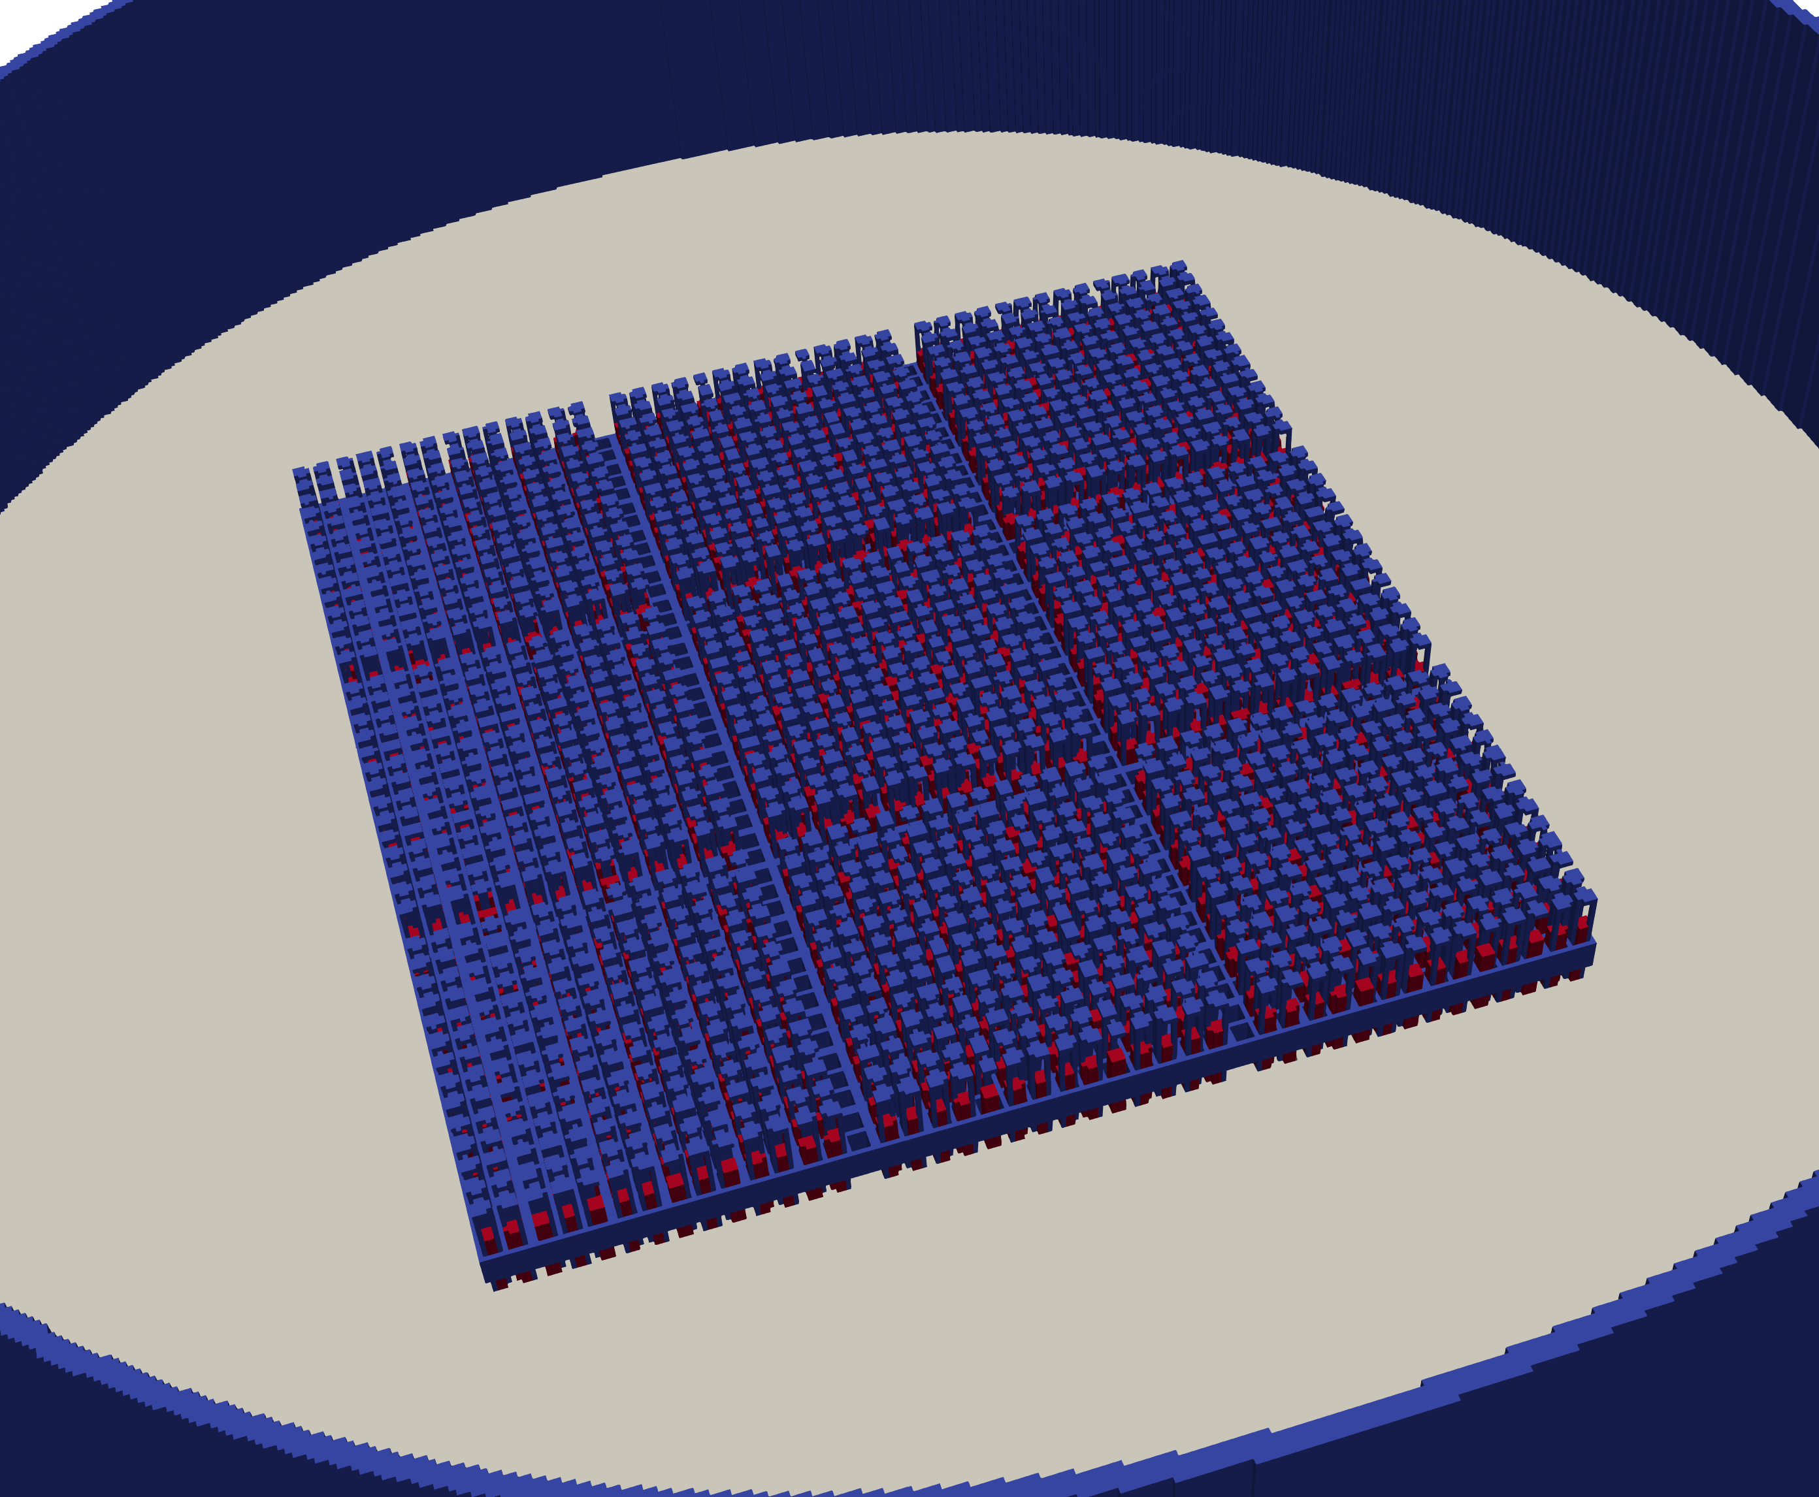
SSP Data Testing
Charles Wemple, William C. Dawn, William Madsen, Joshua Hykes, Tung Nguyen, and Rodolfo Ferrer
Studsvik Scandpower Inc.
CSEWG 2025 Validation

Slide 2
Overview of SSP Data Testing
Multiple codes
  CASMO5
  Helios2
  Peacock
Critical configurations and lattice depletions
  k_{eff}
  Reaction rates and power distributions
  Isotope inventory
  Effective delayed neutron parameters
Compare E8R1 to E7R1 (our “gold standard”)

Slide 3

What’s a Peacock?
General geometry, continuous energy,
Monte Carlo code being developed by SSP
Augment capabilities currently provided by SSP
(e.g., CASMO5 & Helios2)
Support advances in nuclear reactor designs
NQA-1 Quality Assurance compliant,
10 CFR Part 21 adherent, and SSP support
Ease of use:
  Consumer-grade computers
  User-friendly input
  Pre-built cross section libraries with temperature dependence
  Built-in depletion capability

Slide 4
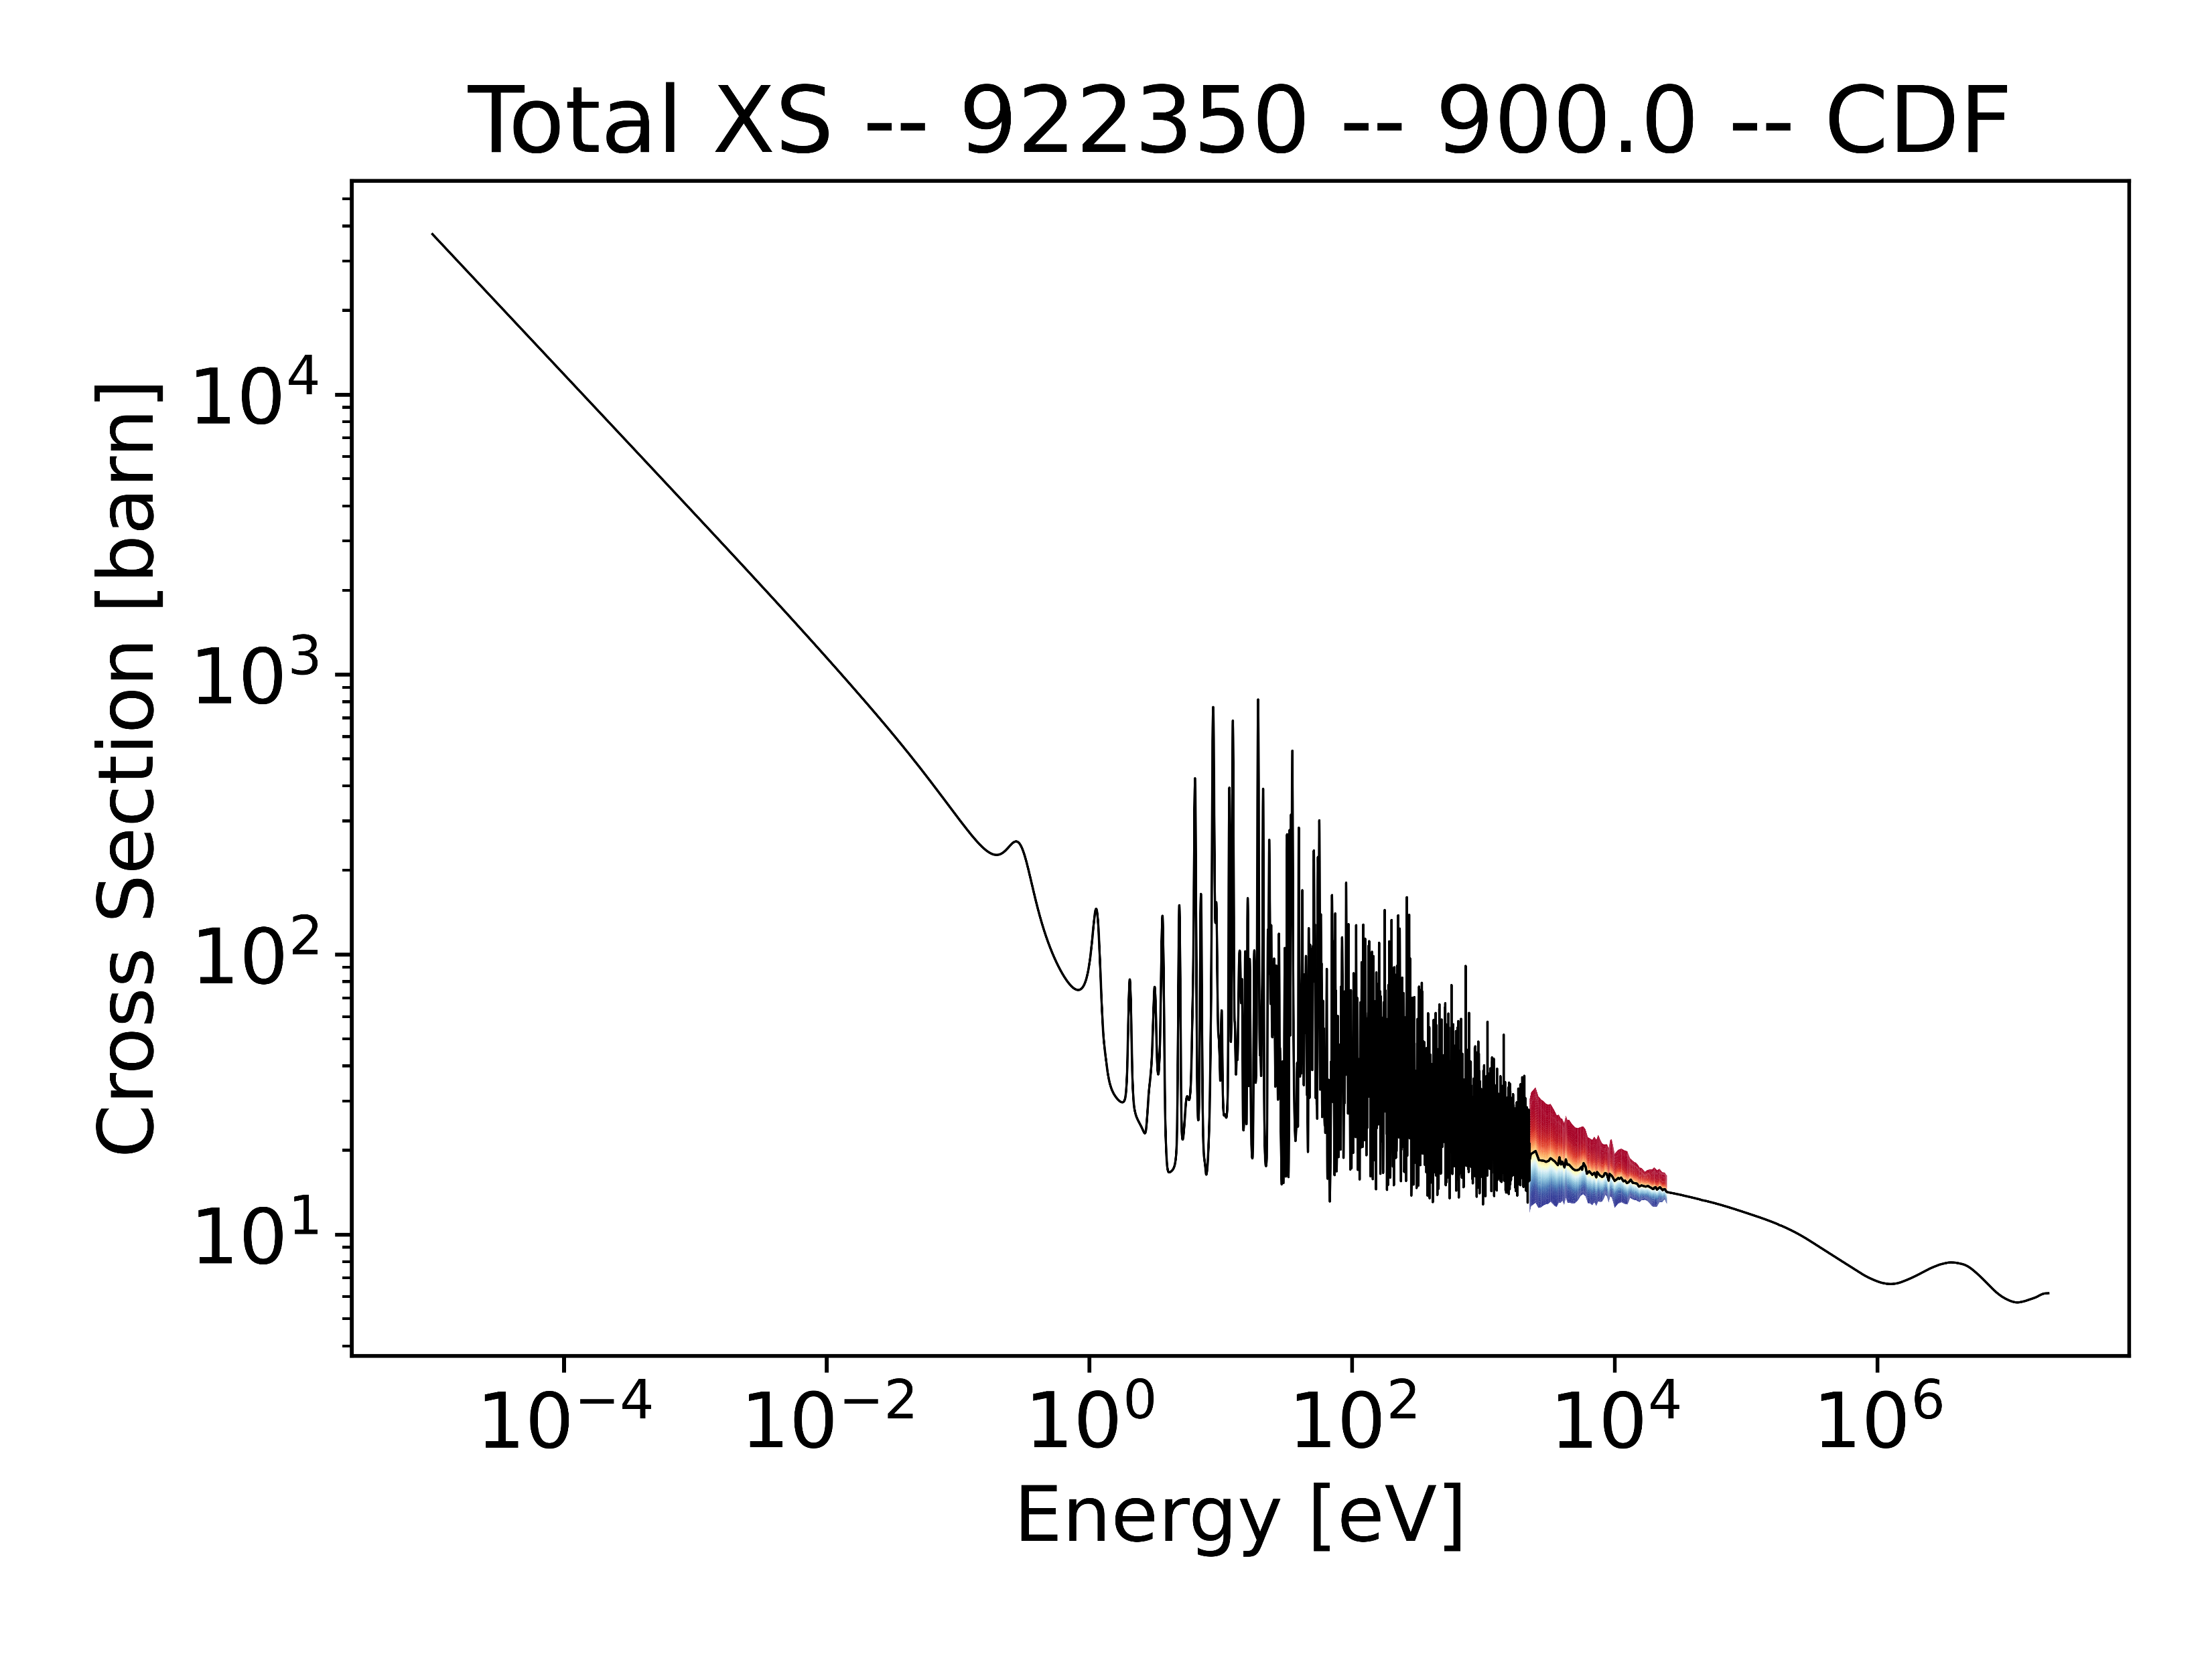
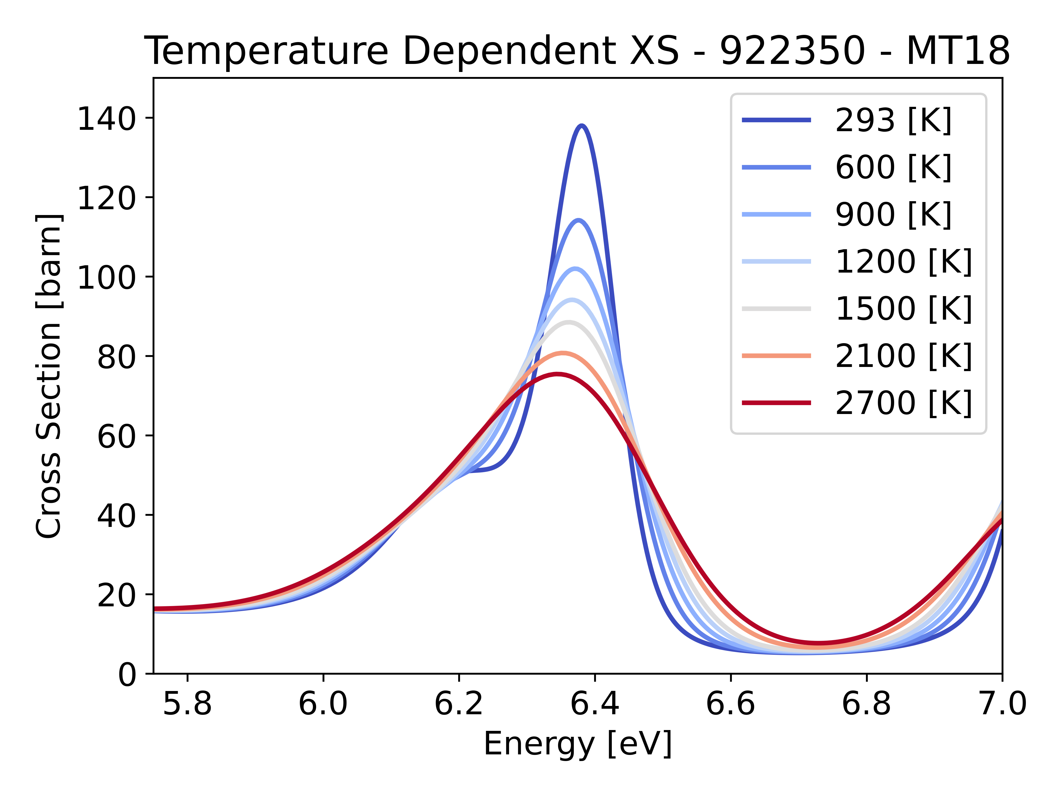
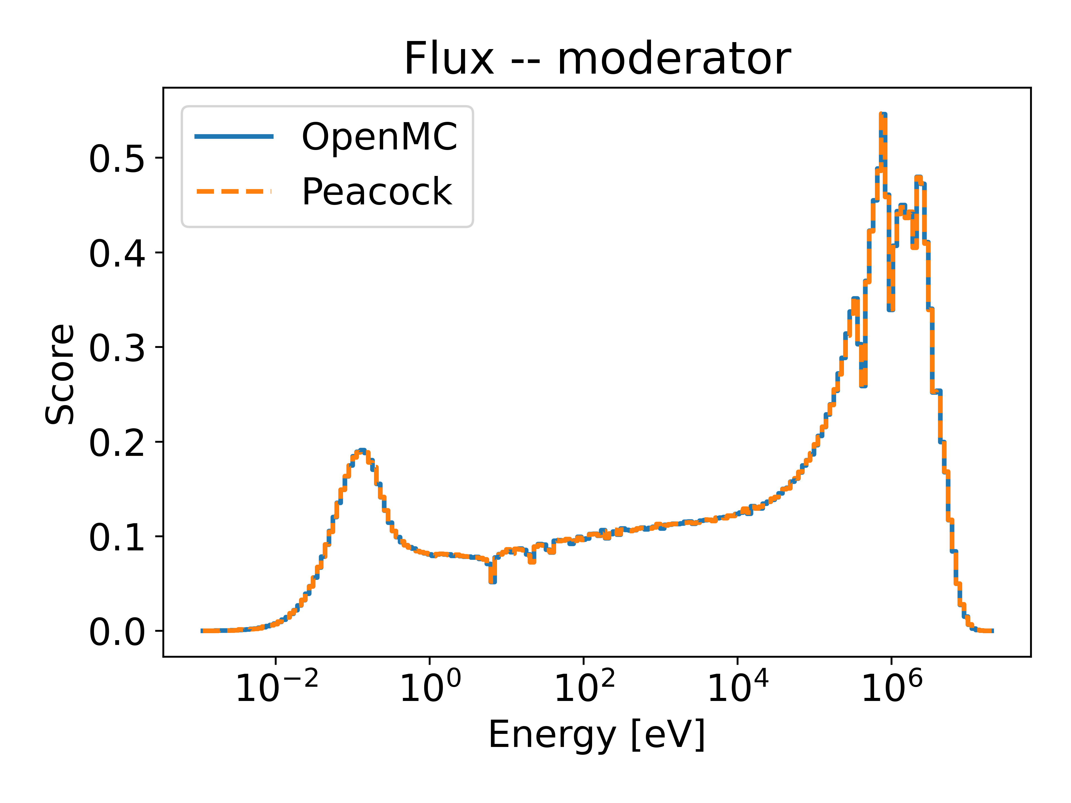
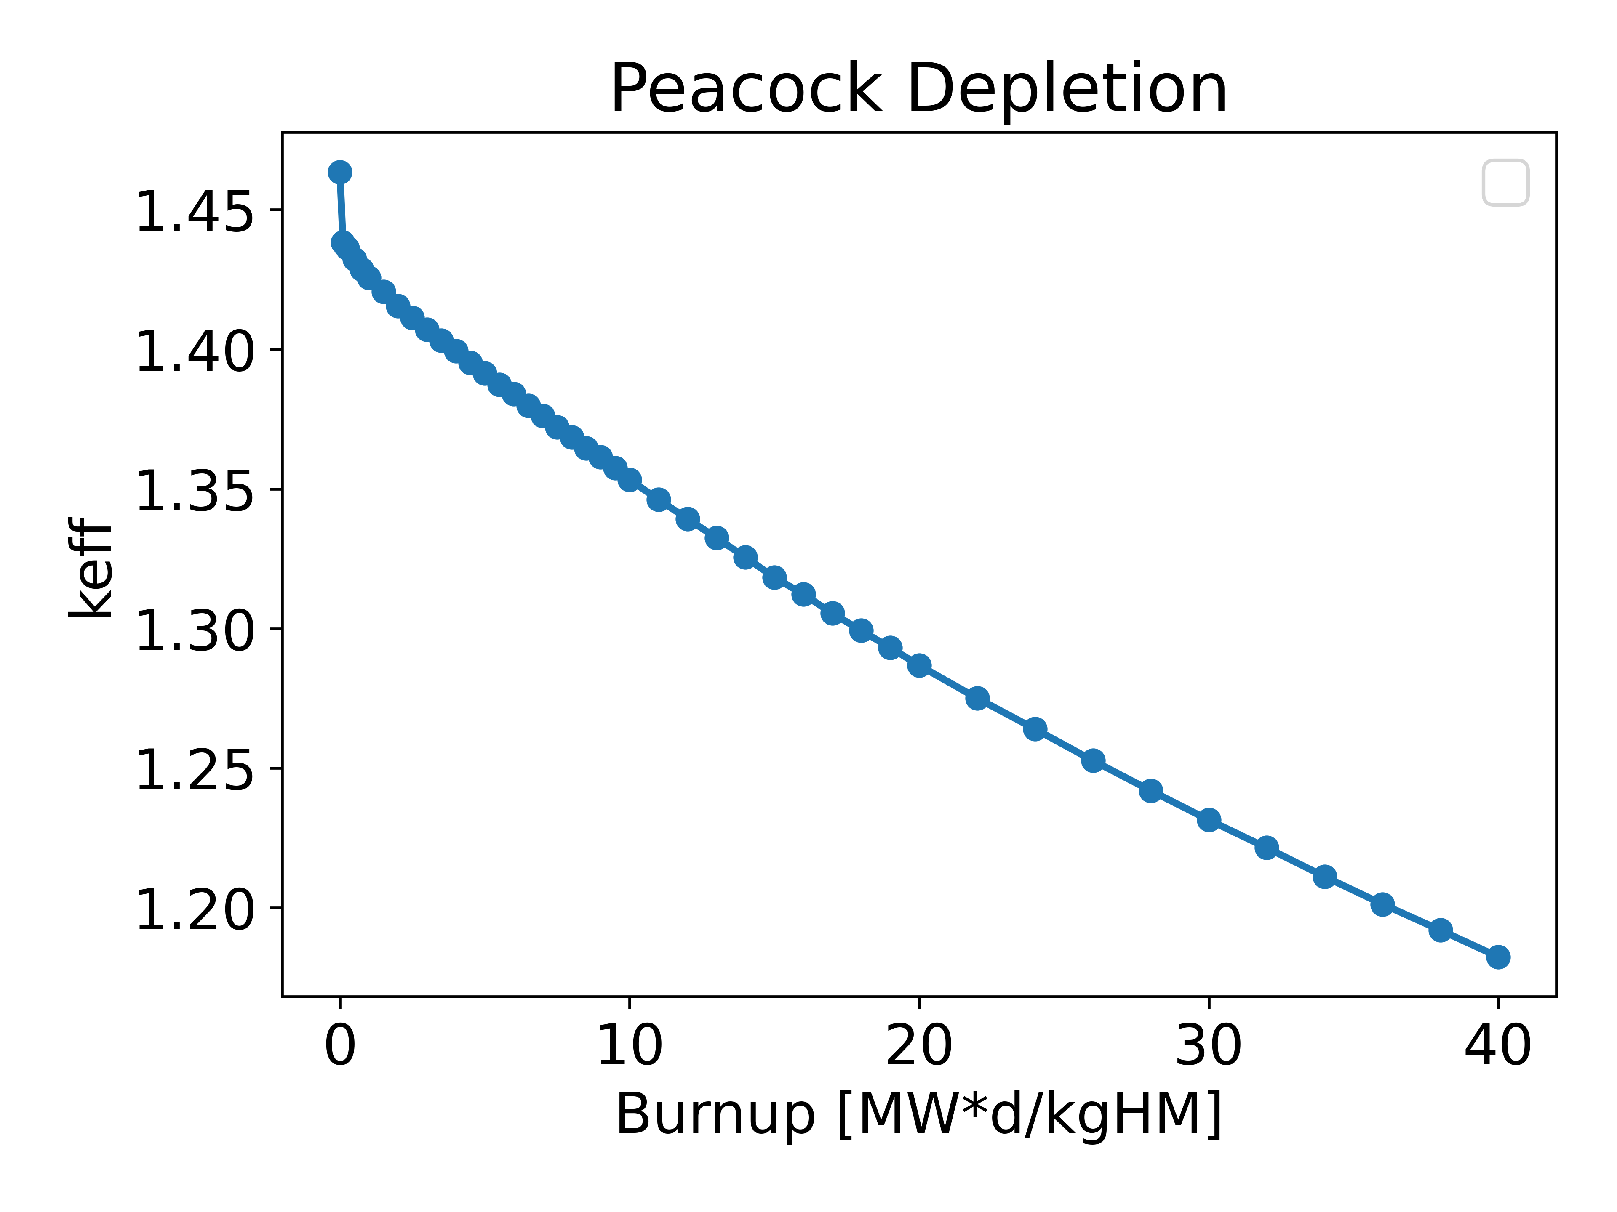
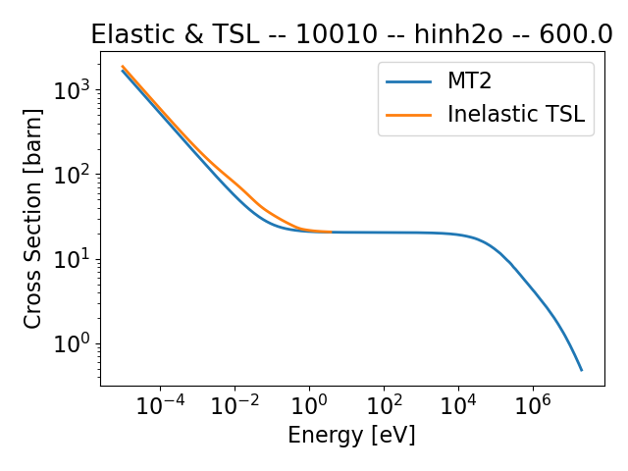



State of the Peacock
$$x$$
$${\hat{Ω}}^{′}$$
$$\hat{Ω}$$
Input processing from YAML
Surface tracking
Continuous energy physics for neutron transport
  Grid Unionization and Thinning (GUT) in library
  Thermal Scattering Laws
  Unresolved Resonance Region ptables
  Resonance Upscattering
Tallies for flux and reaction rates
Shared memory parallelism (OpenMP)
Depletion
Temperature interpolation
$$z$$
$$y$$

Slide 5
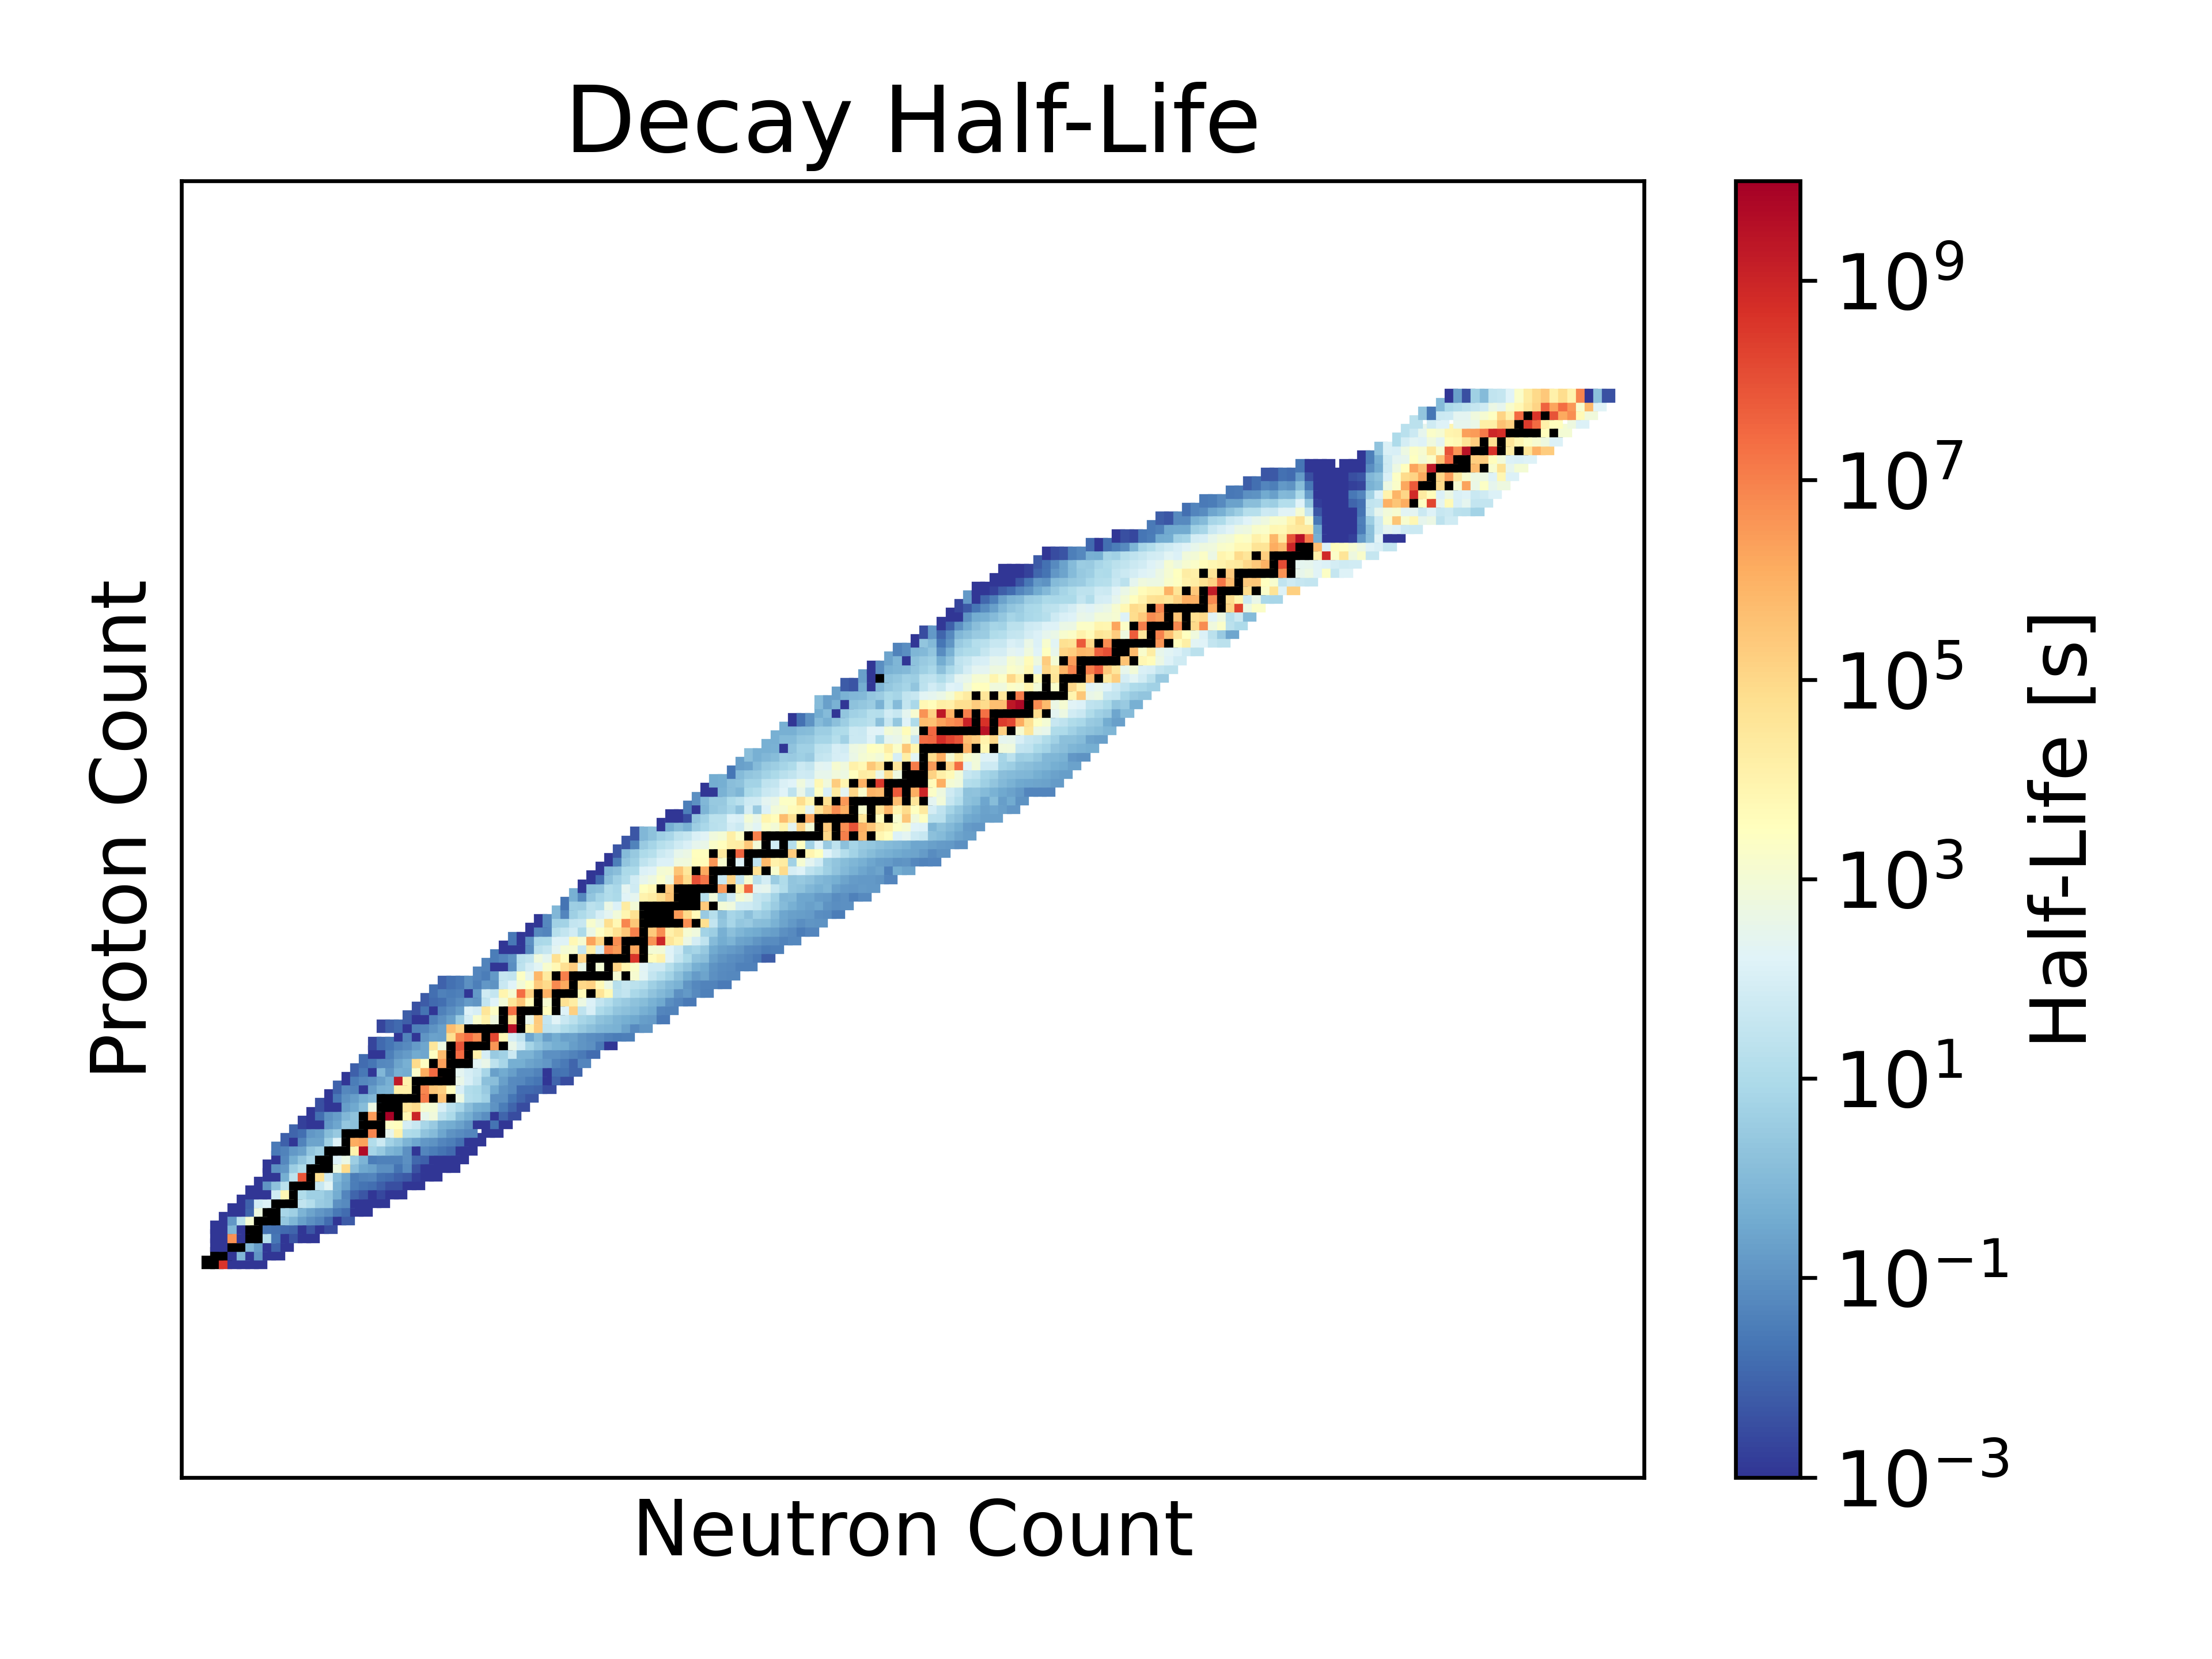
Depletion Data
“Full” chains with all available decay data from ENDF (>3700 nuclides)
>900 cross section nuclides – ENDF and TENDL
>2,200 nuclides tracked (fission system)
>16,000 depletion reactions tracked
~10 GB of memory required for all nuclear data

Slide 6
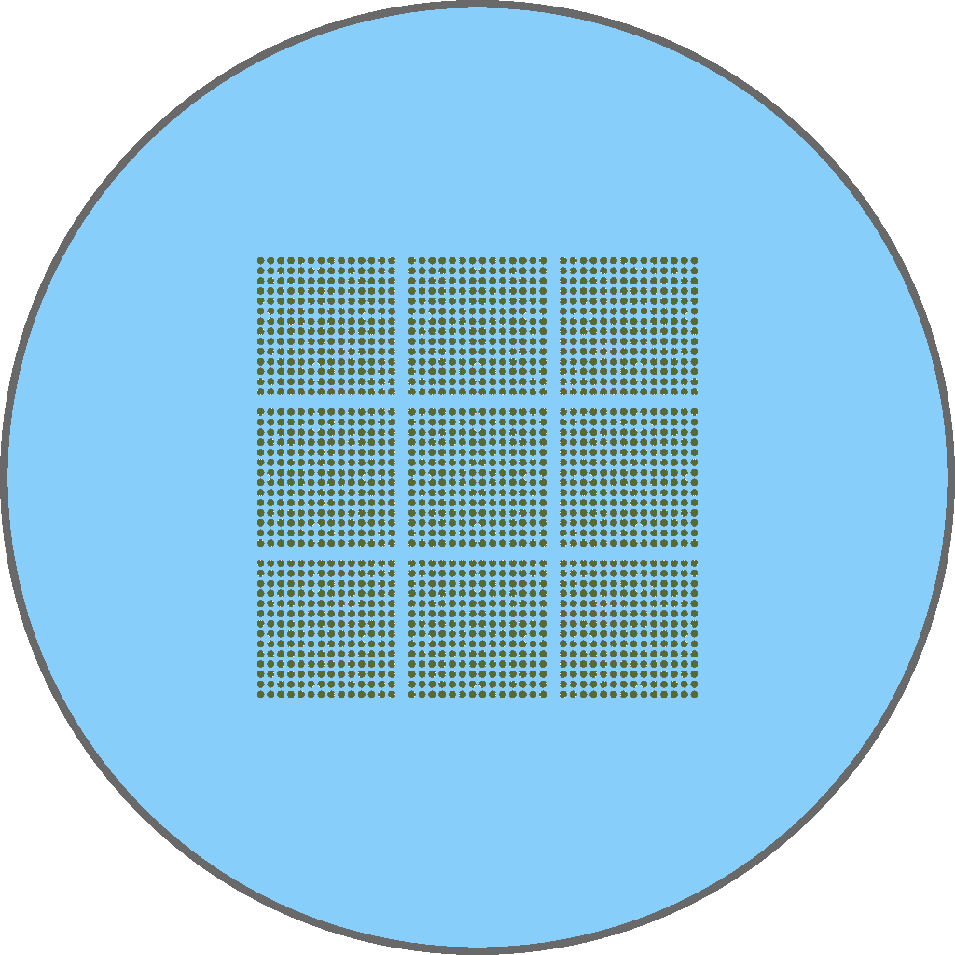

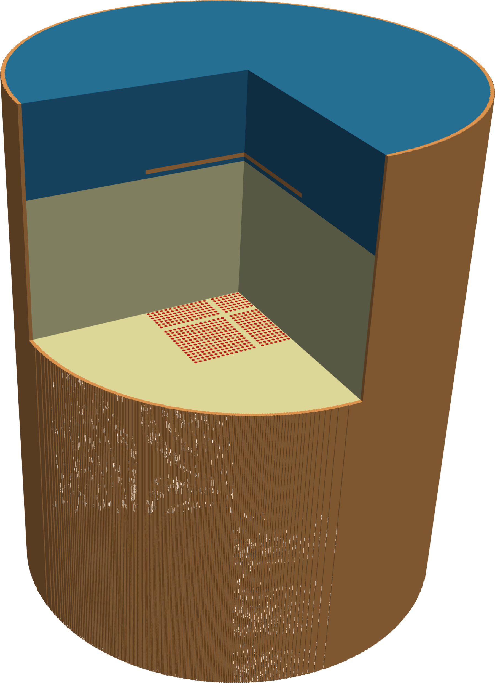
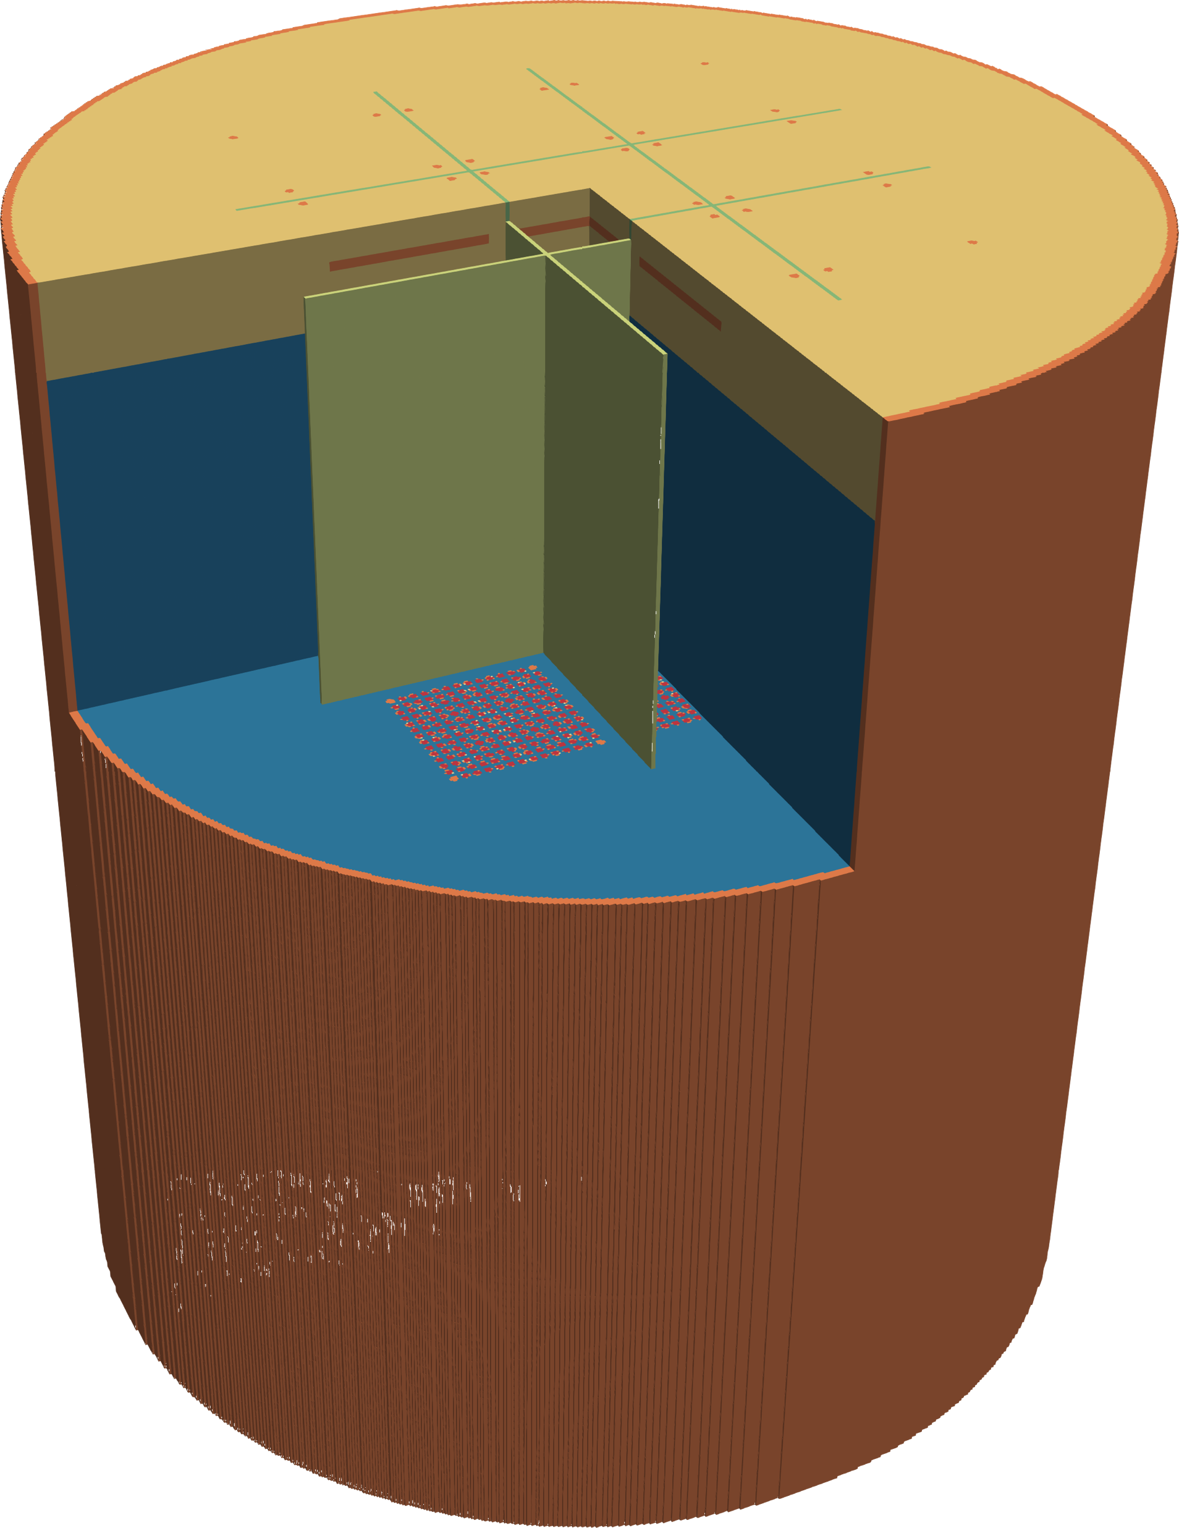
Peacock Validation
To-date, >200 ICSBEP cases
  Classics – Godiva, Jezebel, Flattop, Big10
  Various fuels – U, Pu, U-Pu, U-233
  Lattices and solutions
  Reflected and bare
  Various materials - B, Na, Gd, W, H2O, D2O, poly
  More in the pipeline
Libraries tested
  E7R1 – coarse (127k) and fine (236k)
  E8R1 fine (263k)
Compares very well with other MC codes
LCT-011 (Case 3)
LCT-051 (Case 14)

Slide 7
HMI006 (Zeus graphite)
Set of four criticals
Thin HEU metal plates separated by graphite plates of varying thickness
Copper reflector
  15cm axial
  Radial reflector is a box, 88x88x124cm RPP
Historically, calculations have not compared well with measured k_{eff}
Excellent test of Cu evaluations

Slide 8
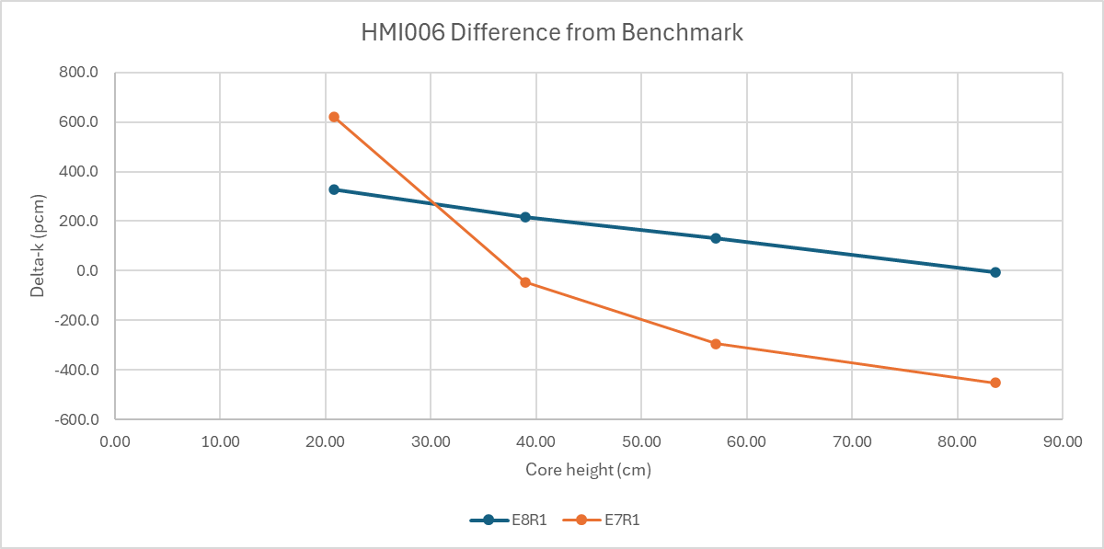
HMI006 (Zeus graphite)
Great improvement in E8R1 results v. E7R1
Still a dependence on core height
  Indicative of issues with Cu secondary angular distributions? Or Cu inelastic scattering?

Slide 9
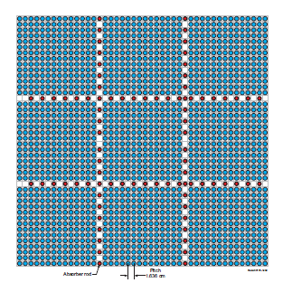
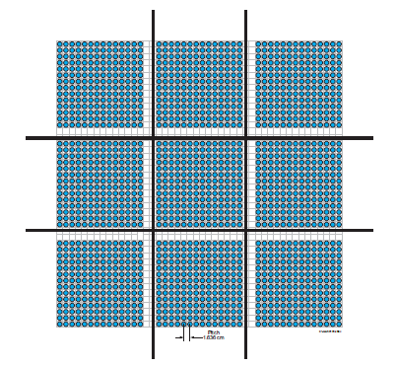
LCT011 and LCT051 (B&W-1484)
Series of lattice criticals to simulate PWR spent fuel pool
  Array of 9 pseudo-assemblies
    14x14 pin array, Al clad, 2.459 w/o UO2 fuel
    Light water moderator/reflector (borated and unborated)
    Criticality achieved by varying moderator height
  Absorbers between pseudo-assemblies
    LCT011 – B₄C absorber rods
    LCT051 – SS304 or borated (0.001% by weight) Al plates

Slide 10
LCT011 Results
Highlighted cases have solid B4C absorber rods
No trends with EALF, moderator height, boron concentration

Slide 11
LCT051 Results
Highlighted cases have borated Al absorber plates
No trends with EALF, moderator height, boron concentration

Slide 12
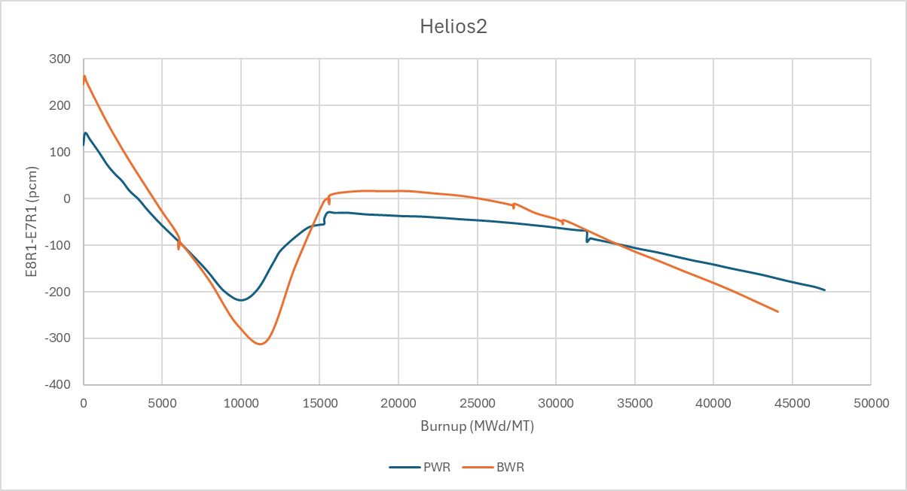
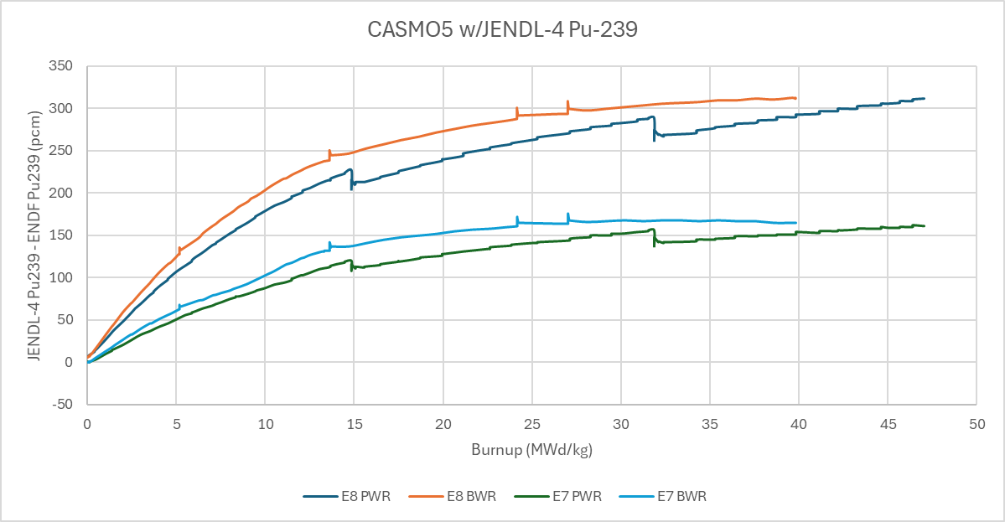
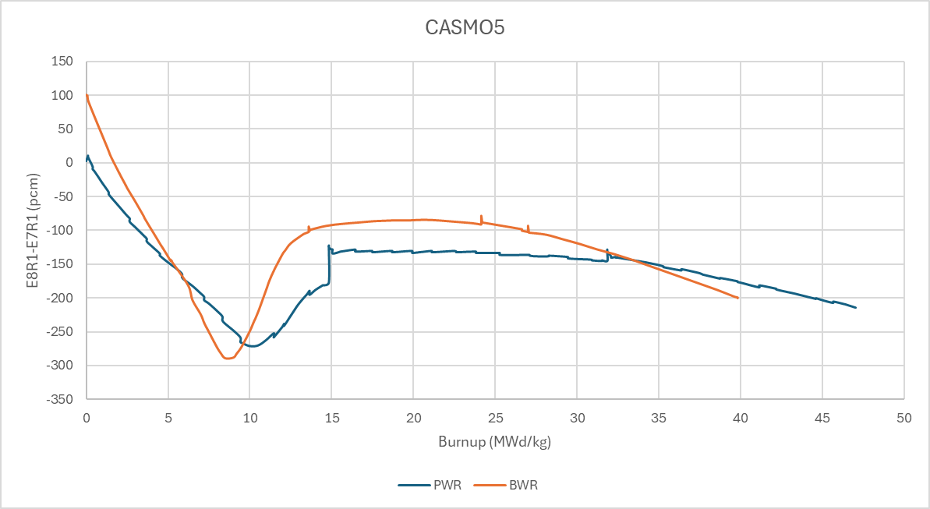
Lattice Depletions
Actual PWR (Takahama-3) and BWR (Fukushima Daiini-2) assemblies*
Depleted for multiple simulated reactor cycles with CASMO5 and Helios2 codes
* Y. Nakahara, et al., Nuclear Technology 137 111, February 2002

