Slide 1
Potential for Validation Data from Radioisotope Production at ORNL
November 6, 2025
January 9, 2026 | Nuclear Data Week “2025”
William (B.J.) Marshall & Victor Bautista
Radioisotope Science and Technology Division

Slide 2
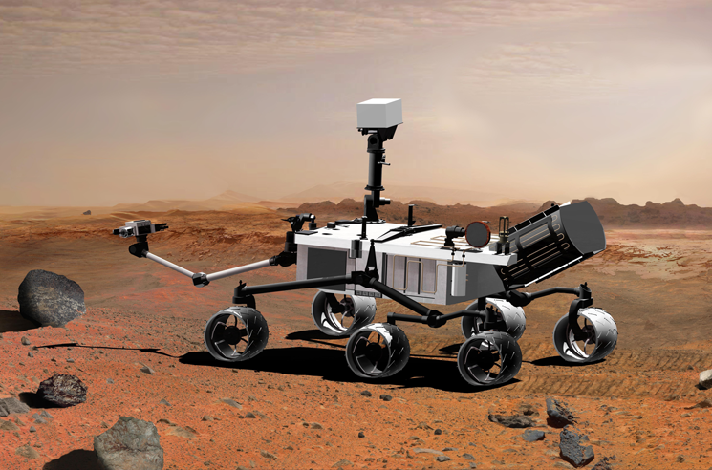
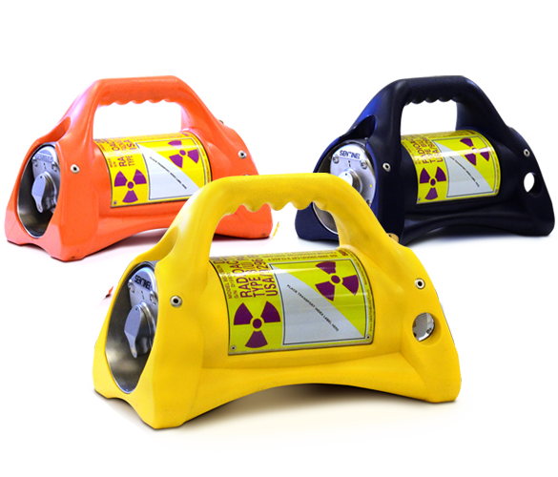
Outline
HFIR description and operations
Potentially relevant codes and tools
Unknowns and uncertainties that need to be quantified
Example data
Conclusions

Slide 3
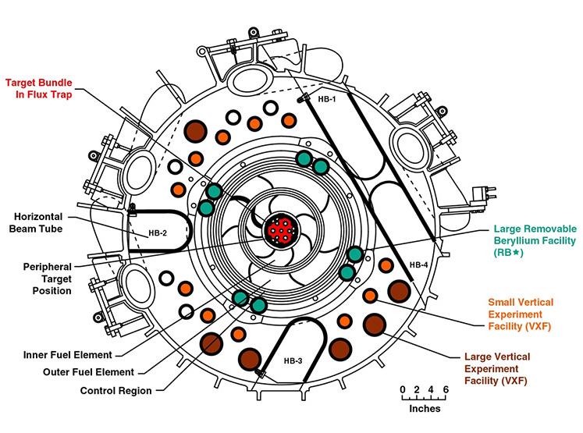
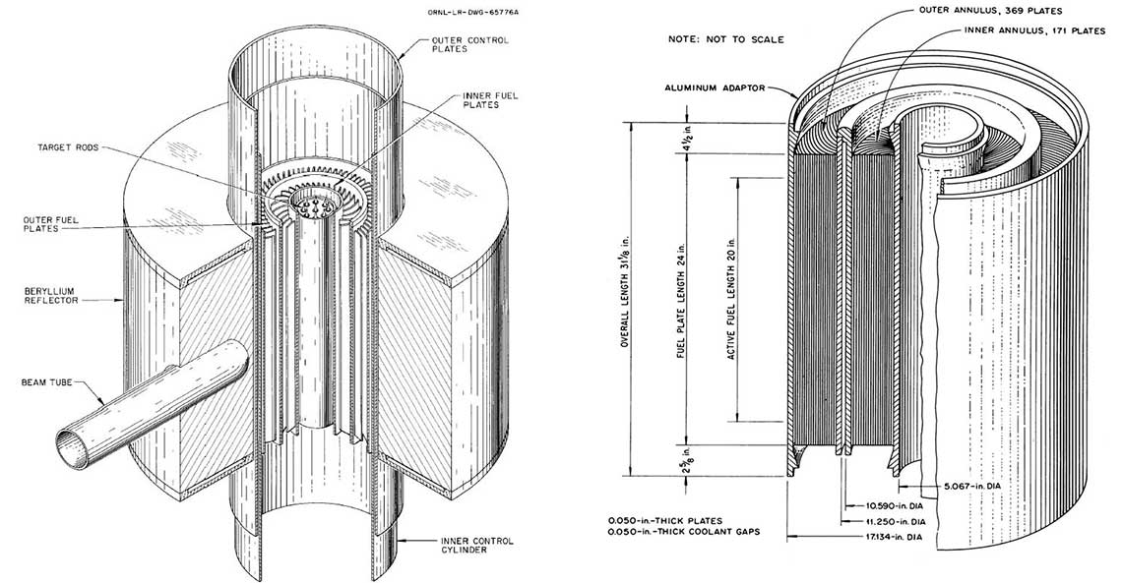
High Flux Isotope Reactor (HFIR) description and operations
HFIR is a unique research reactor
Central flux trap intended for transplutonium production
Beryllium reflector with numerous irradiation facilities
Beam tubes for neutron scattering
Cylindrical core approximately 2’ (~60 cm) tall and 15” (~38 cm) outer diameter
5” (12.7 cm) OD for central flux trap
85 MW thermal power, ~23 day cycles
Peak thermal flux ~2 × 10¹⁵ n/cm² s in flux trap
Thermal flux in the reflector ranges from about 5 × 10¹⁴ to 1 × 10¹⁵ n/cm² s

Slide 4
Potentially relevant codes and tools
High-fidelity modeling and simulation for radioisotope production uses combinations of MCNP and ORIGEN
Many calculations performed explicitly with MCNP flux tally input to standalone ORIGEN calculation
HFIRCON couples an ORNL variant of MCNP5 with MSX_DEPLETE, a variant of ORIGEN
MCNP calculations can obviously use any ACE-formatted data
ORIGEN defaults to JEFF-3.0/A library but other data can be used
HFIRCON defaults to ENDF/B-VII.1 data
Other low-fidelity tools are used for specific nuclides (²⁵²Cf) or for scoping

Slide 5
Unknowns and uncertainties
Operational uncertainties need to be quantified and propagated
Power level, flow rate, temperature distributions, etc.
The impact of typical assumptions needs to be investigated
Other experiments/targets are typically neglected
MCNP/ORIGEN typically assumes beginning of cycle control cylinder positions
Typically assume room temperature nuclear data
Flux tallied in 56, 238, or 252 groups
Chemical processing losses and process variability are not well understood by the radiation transport staff

Slide 6
Potential strategies to address unknowns and uncertainties
Neutron activation analysis laboratory uses one of the vertical experiment facilities in the permanent Be reflector
Irradiation of flux monitors in various locations in multiple campaigns over the years – ideally also in new permanent Be reflector after installation
Develop better, deliberate communication with chemistry groups to enhance understanding of measured quantities and associated uncertainties
Integration of thermal-hydraulic analyses with respect to temperatures
In summary, the process to quantify uncertainties and demystify unknowns is a combination of measurements and analyses, modeling and simulation, and improved communication.

Slide 7
Example data: ^{166m}Ho (1/2)
Prediction of specific activity of ^{166m}Ho produced in HFIR flux trap was 1.32 mCi/g
Measured specific activity was 0.61 mCi/g
Investigation identified widely varying ^{166m}Ho(n, γ)¹⁶⁷Ho cross sections among Mughabghab, JEFF-3.0/A, TENDL-2019, and ENDF/B-VII.1
Calculations with JEFF-3.0/A, TENDL-2019, and ENDF/B-VII.1 indicate TENDL-2019 yields closest prediction
Plot on next slide
See ORNL/TM-2023/3208 for more details

Slide 8
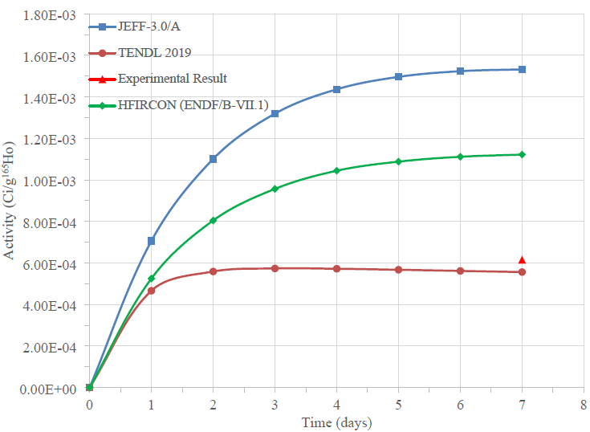
Example data: ^{166m}Ho (2/2)

Slide 9
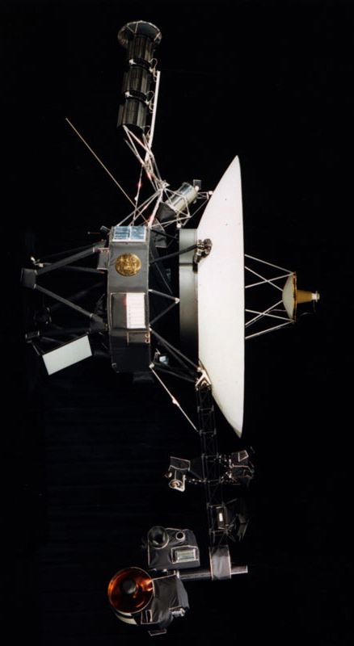
Conclusions
Radioisotope production calculations and measurements represent an untapped source of validation data for nuclear data evaluation
A significant amount of uncertainty and process quantification is needed to improve the utility of these data
There is interest at ORNL in developing and executing the necessary program to perform this quantification, though funding is currently uncertain
Potential for a future stream of validation data to support evaluations for radioisotopes of programmatic interest to the DOE Isotope Program

Slide 10
Thanks for your time and attention!

