Slide 1
PARADIGM: PARallel Approach of Differential and InteGral Measurements First Look at the use of PARADIGM for ND Validation
A. McHugh, P. Brain, T. Cutler, A. D’Agostino, M. Devlin, D. Neudecker, R. Weldon
CSWEG 2025
Brookhaven National Laboratory
01/06/2026 – 01/09/2026
LA-UR-25-31728

Slide 2
Presentation Overview
1.
PARADIGM Project Motivations
2.
PARADIGM Assemblies
3.
Measurements Conducted
4.
Results
5.
Conclusions & Ongoing Work

Slide 3
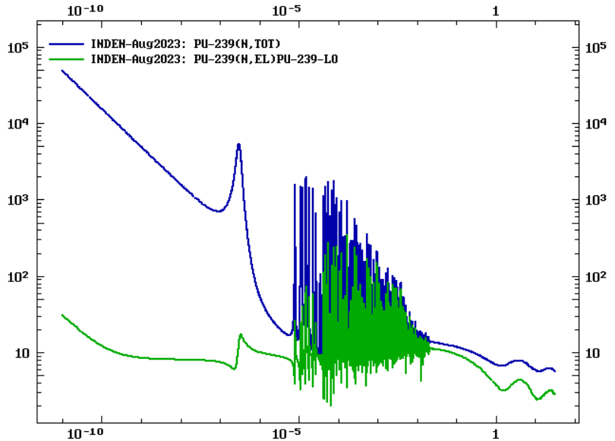
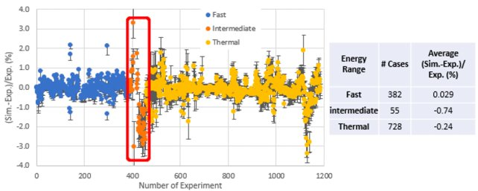

PARADIGM Motivation
Aim: Reduce uncertainty in nuclear data for ²³⁹Pu in the 1-600 keV energy range by 50%
1-600 keV Energy Range:
²³⁹Pu Nuclear data of many reactions are poorly understood between 1-600 keV.
Energy range lies between the resolved resonance region and the fast range, encompassing the unresolved resonance region
Little integral experimental data is available in this energy range (accounts for under 5% of experiments in the ICSBEP benchmark suite)
Example ENDF Pu-239 Cross Section Data
Target Energy Range
Cross Section (b)
Historic Integral Experiments
1 keV
600 keV
Incident Energy (MeV)
Number of ICSBEP Benchmarks and their $\frac{C}{E} k_{eff}$ values for fast, intermediate, and thermal energy ranges. [1]

Slide 4
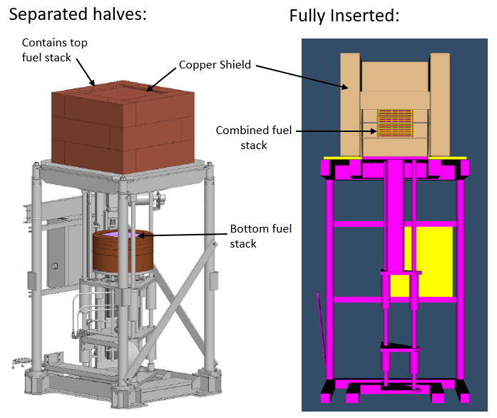
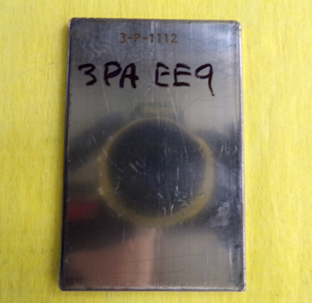
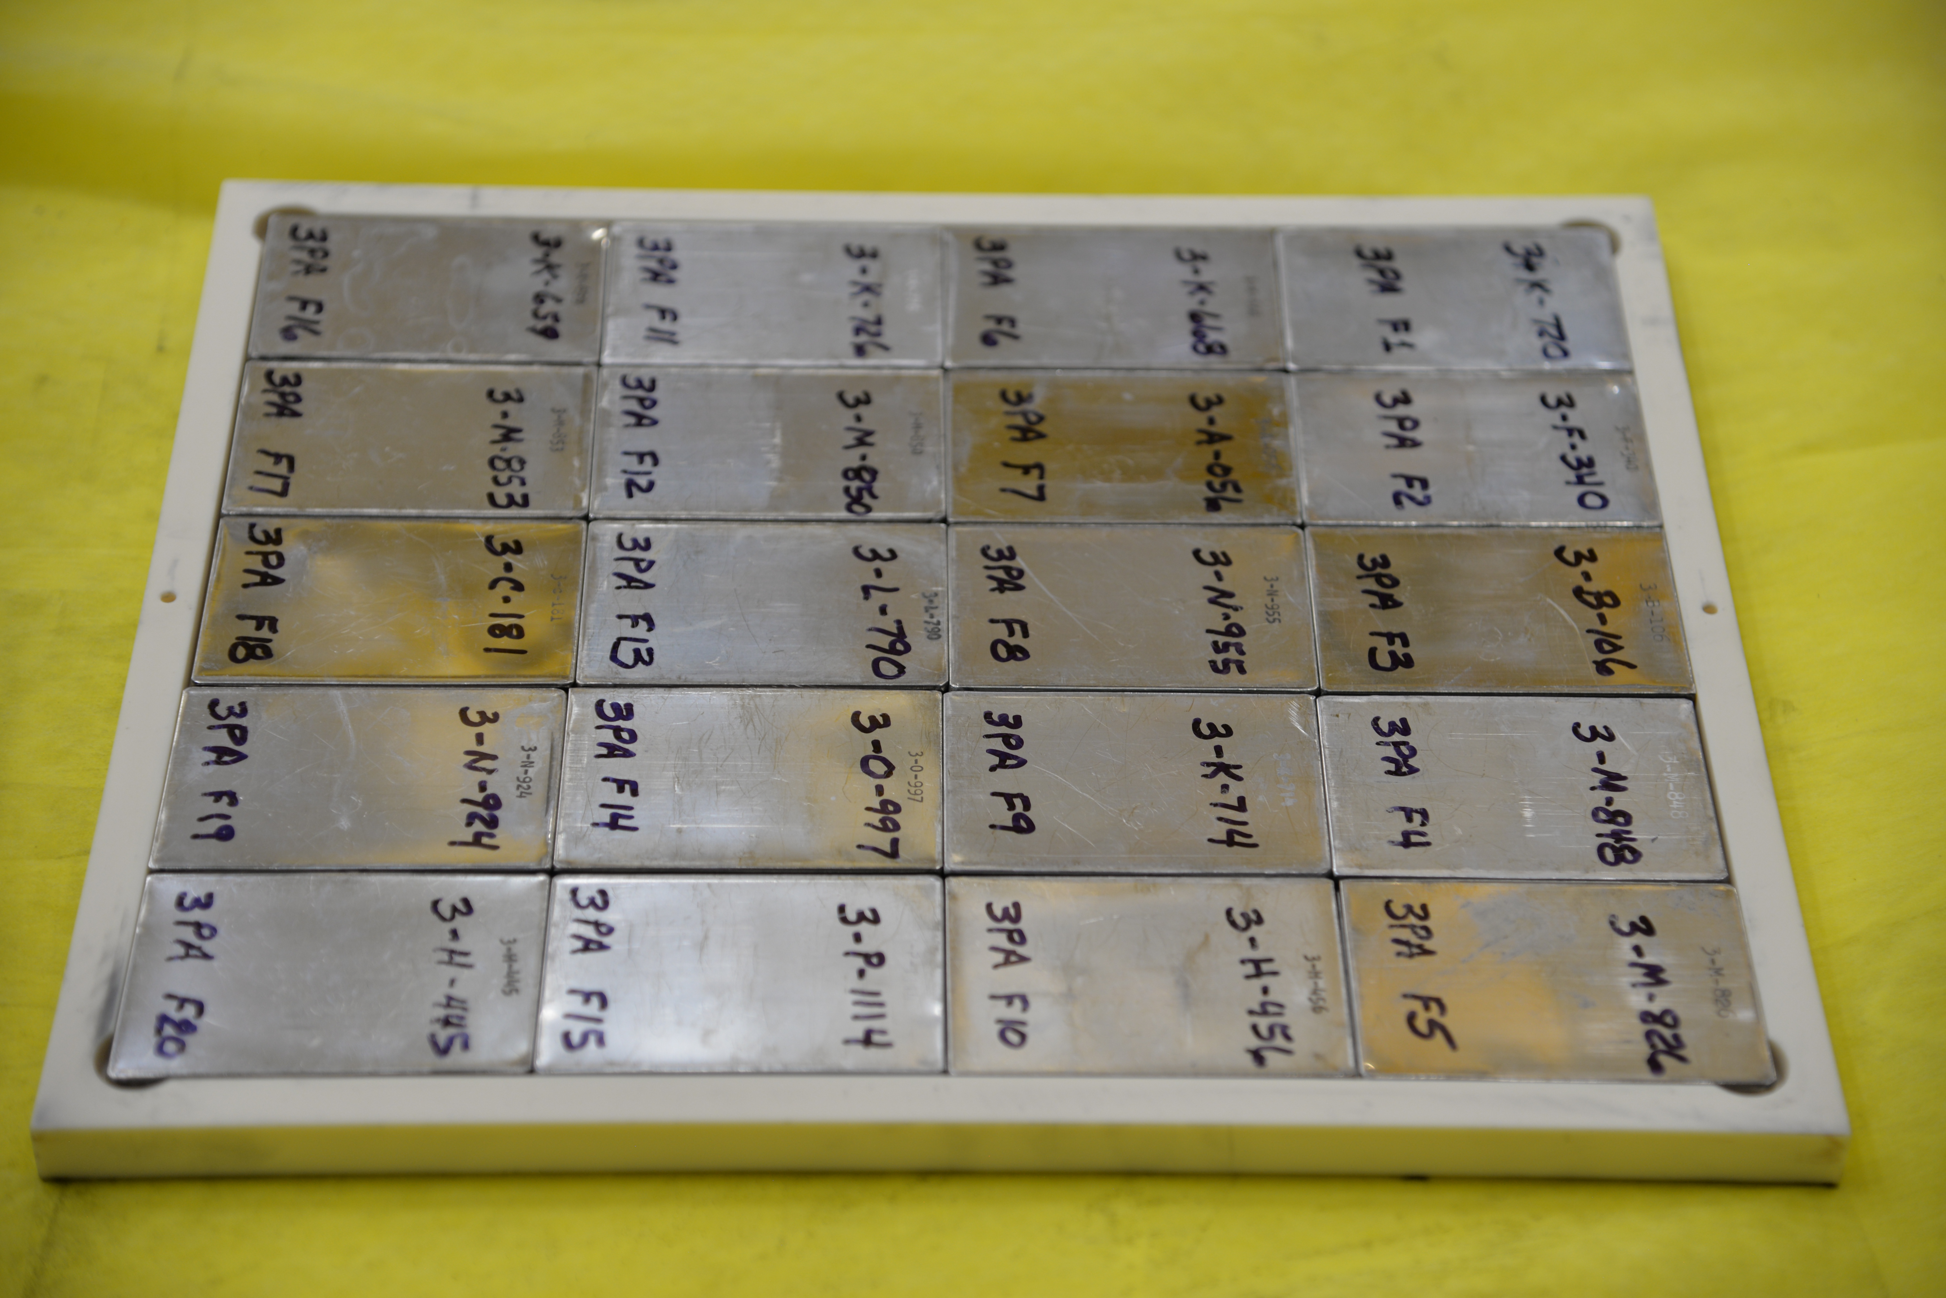
The PARADIGM Assemblies
The 1-600 keV energy range of interest is split into two assemblies
Justification: To isolate sensitivities in lower energies, two moderating material combinations are used.
Table 1. Isotopic composition of a single ZPPR PANN plate [2].
Experimental Platform & Shielding:
Fuel:
Isotope | Mass (g)
²³⁸Pu | 0.0002
²³⁹Pu | 98.900
²⁴⁰Pu | 4.7000
²⁴¹Pu | 0.0400
²⁴²Pu | 0.0090
²⁴¹Am | 0.2300
Al | 1.1600
Zero Power Physics Reactor (ZPPR) Plutonium Aluminum No Nickle (PANN) plates
Approximately 95 wt.% ²³⁹Pu
Fuel is arranged in 4x5x2 configuration in Alumina Tray
Contains top fuel stack
Copper shielding
Combined Fuel stack
Single ZPPR Plate
Complete Fuel Tray

Slide 5
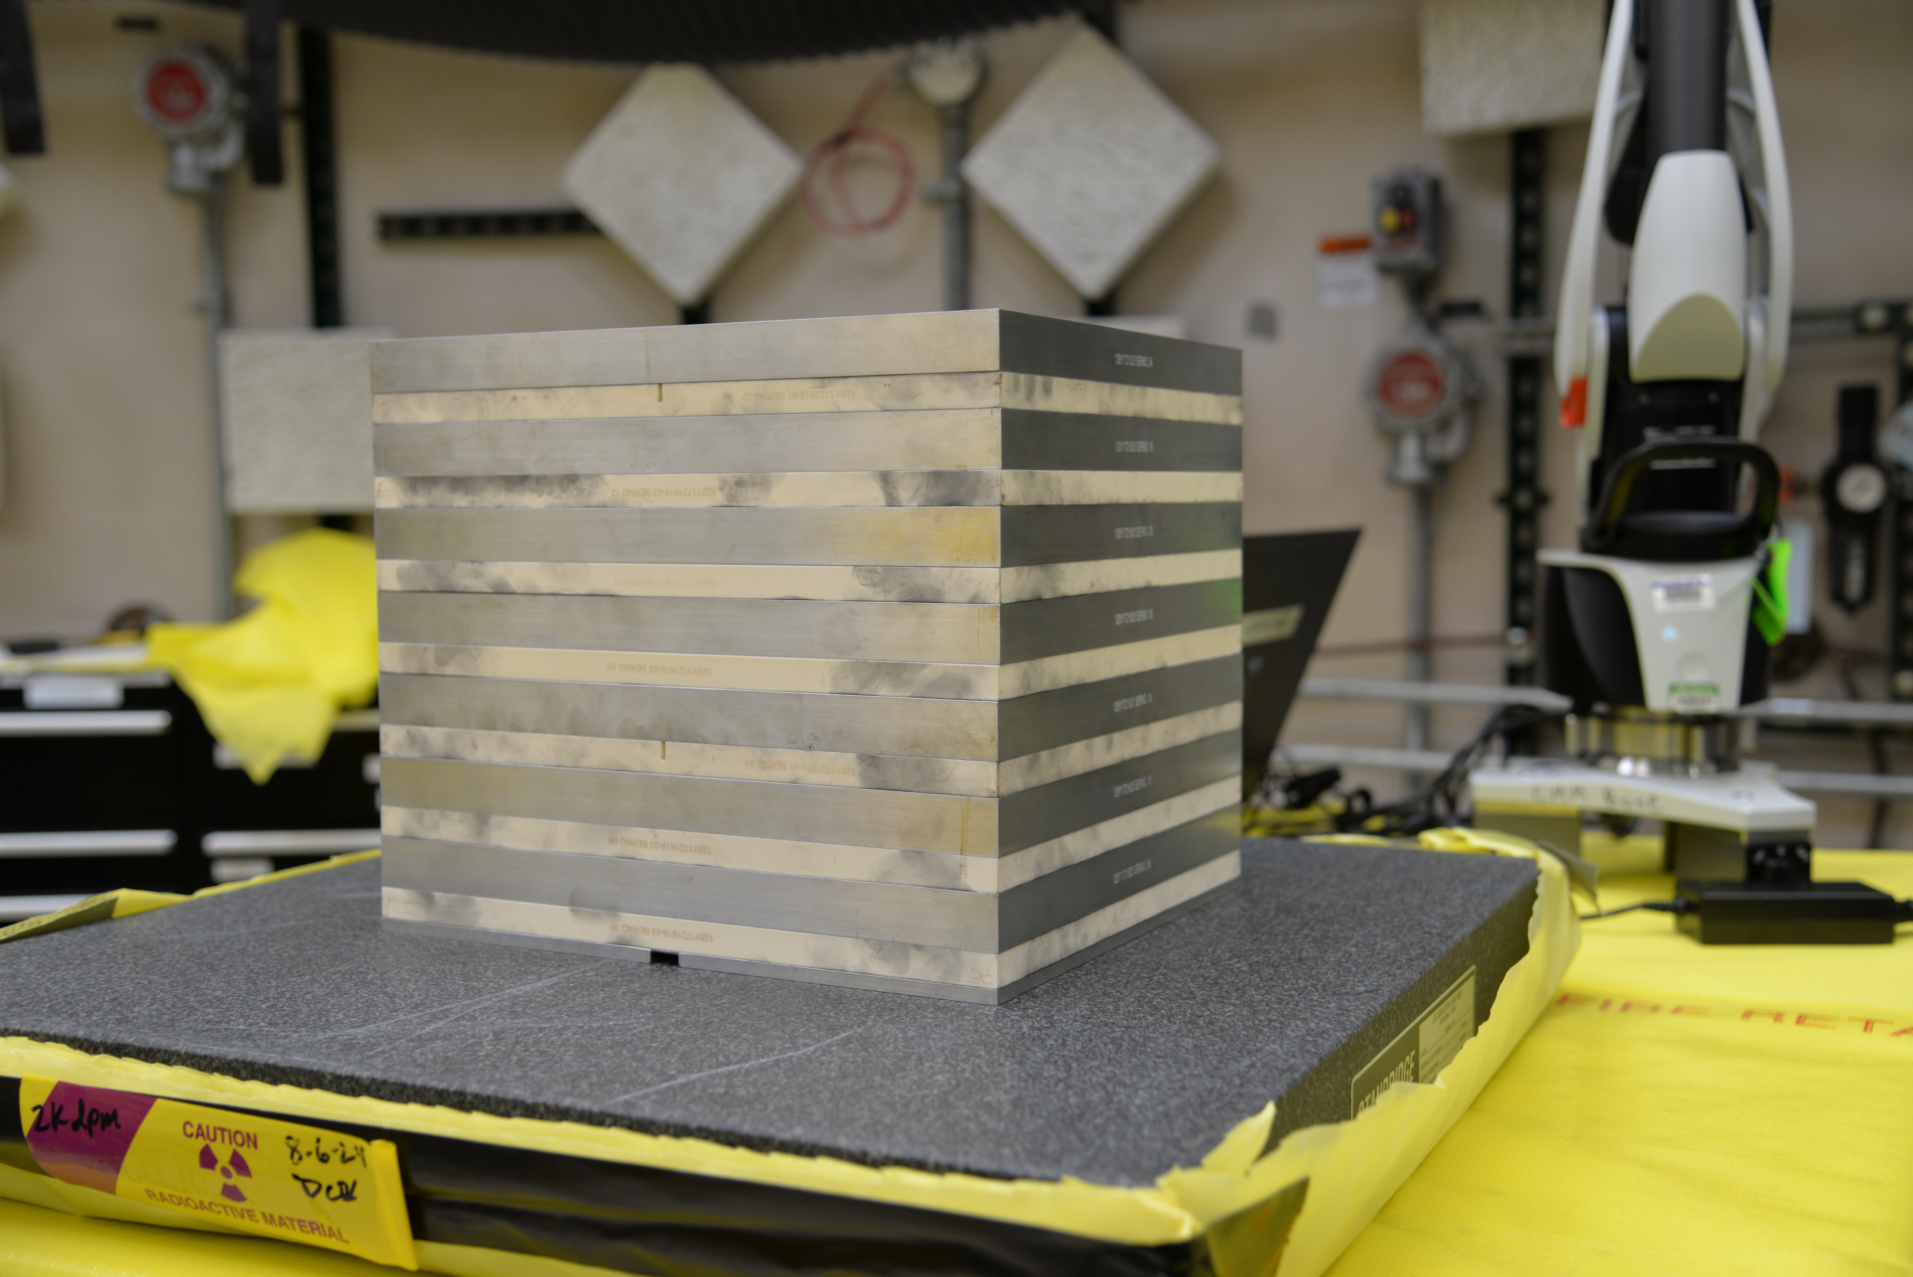
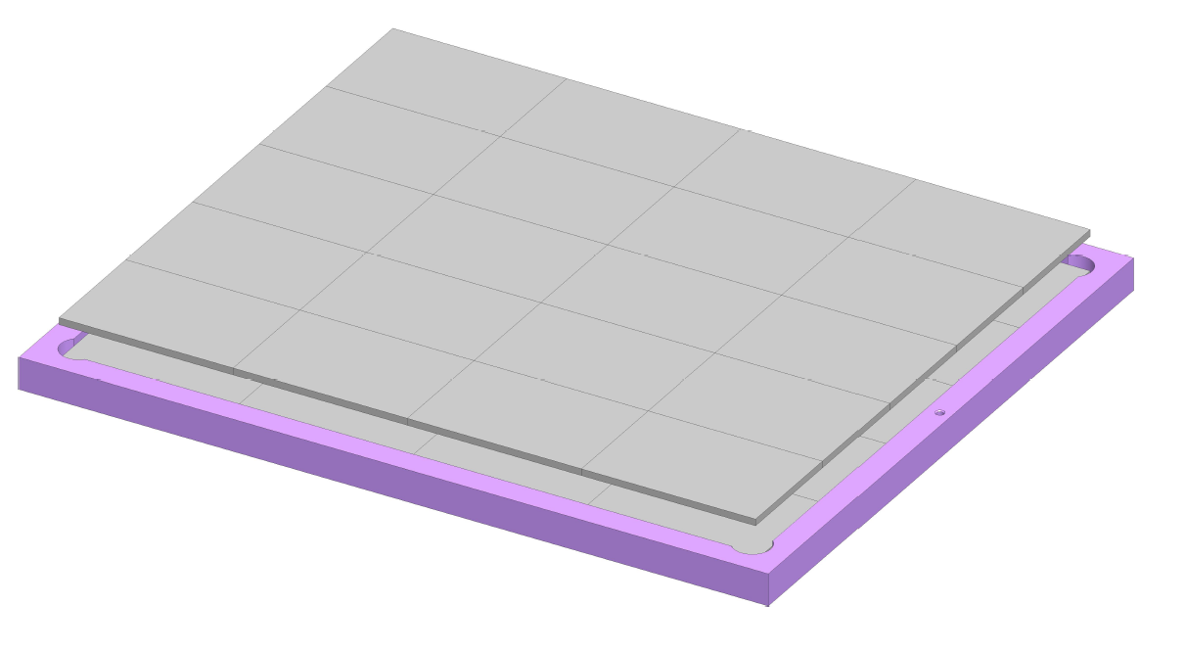


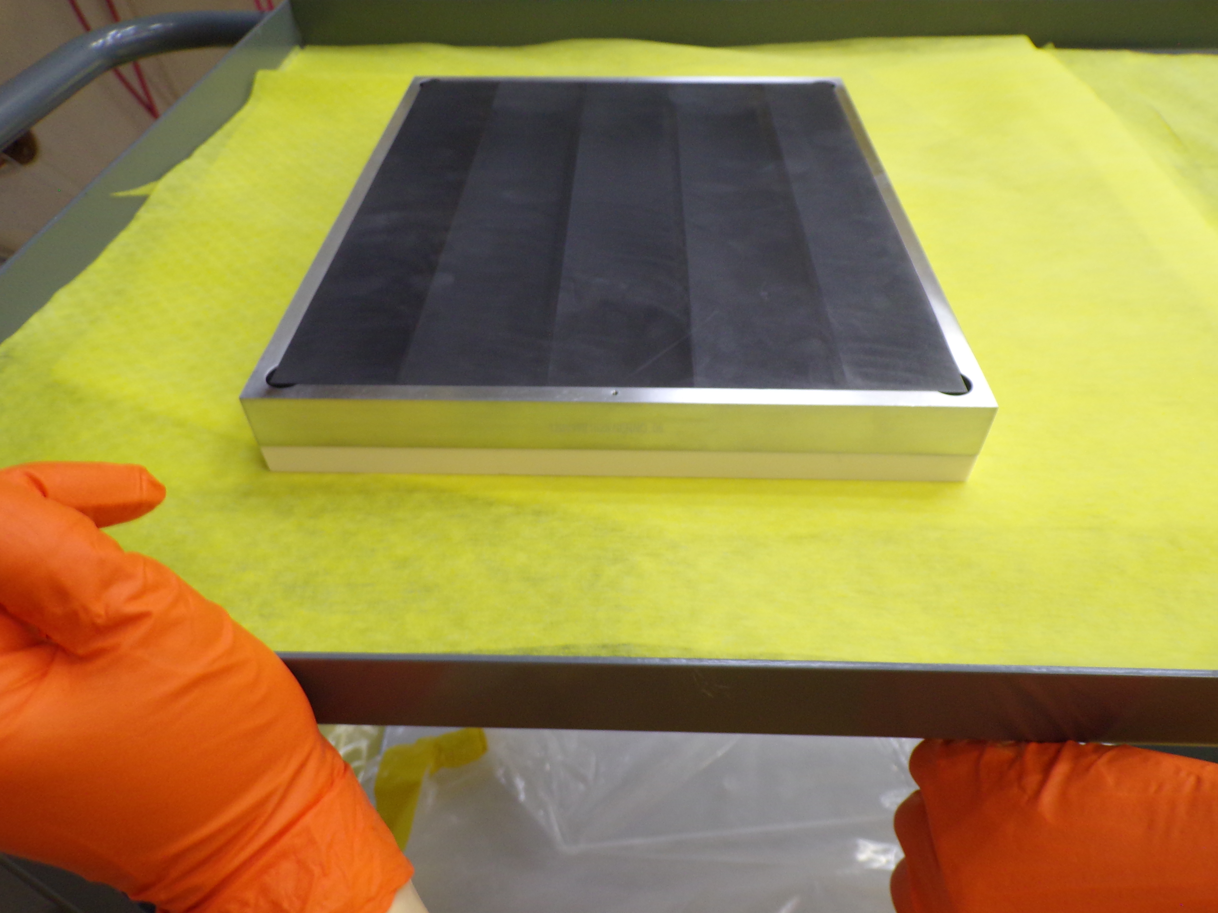
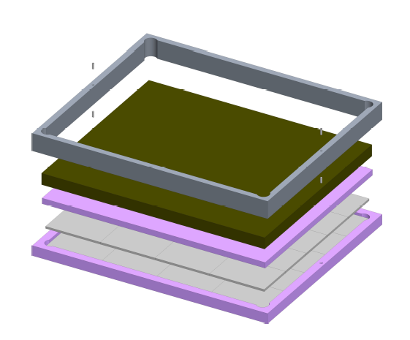



The PARADIGM Assemblies
To moderate the outgoing neutrons of each assembly to the target energy regime, differing interstitial materials are used:
Configuration 1: 30-600 keV
ZPPR Plates
Alumina Tray
Configuration 2: 1-30 keV
Aluminum Frame
Graphite
Alumina Layer
Alumina Tray
ZPPR Plates
Notes:
THE SLIDE IS AWESOME. I will definitely steal this in the future

Slide 6
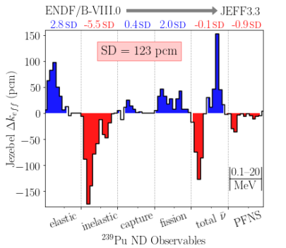


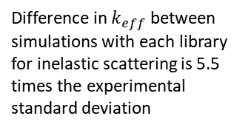
Measurements: Compensating error and $k_{eff}$
Validation and adjustment of ND is heavily reliant on integral experiments.
Conventionally, ND adjustment is conducted with $k_{eff}$ values from integral experiments
$k_{eff}$ is simultaneously sensitive to many ND creating unconstrained physics spaces which may hide compensating errors.
Simulated results of the Jezebel benchmark from the EUCLID project with ENDF/B-VIII.0 and JEFF3.3 are both within one standard deviation of the experimental value
Despite this, ND between JEFF3.3 and ENDF/B-VIII.0 differ substantially:
The combination of each of these differences across all reactions cancel each other out.
Adjustment of ND with reference to just one value ($k_{eff}$) obscures compensating error in these unconstrained physics spaces
Difference in $k_{eff}$ between simulations with each library for inelastic scattering is 5.5 times the experimental standard deviation

Slide 7
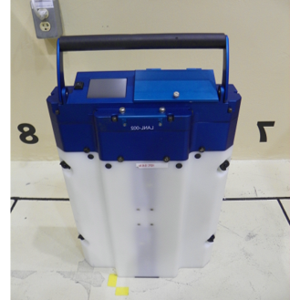
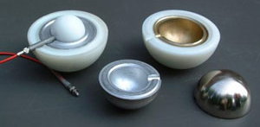
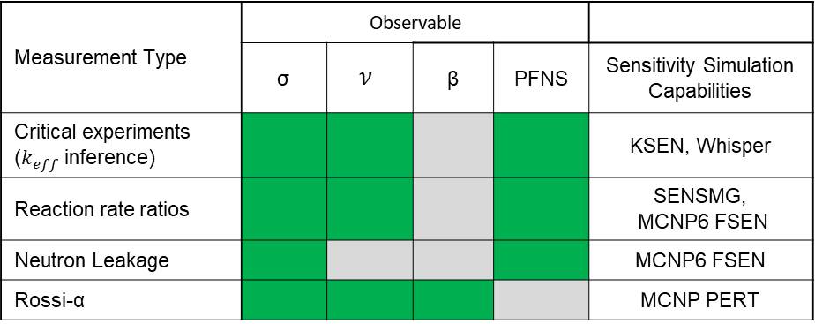

Multiple Measurements beyond $k_{eff}$
Different measurement types provide different data types and have different sensitivities
using multiple measurements, we can get complimentary data that reduce unconstrained physics spaces
With multiple responses (not only $k_{eff}$), ND may be better constrained, enabling compensating errors to be resolved and allow a reduction of ND uncertainty.
Table 1. Overview of Measurement Types conducted for PARADIGM
Measurement ​Type | Observable​
 | σ​ | $$ν$$ | β​ | PFNS​ | Sensitivity Simulation Capabilities
Critical experiments​ ($k_{eff}$inference) |  |  | ​ |  | KSEN, Whisper
Reaction rate ratios​ |  |  | ​ |  | SENSMG, MCNP6 FSEN
Neutron Leakage ​ |  | ​ | ​ |  | MCNP6 FSEN
Rossi-α​ |  |  |  | ​ | MCNP PERT

Slide 8
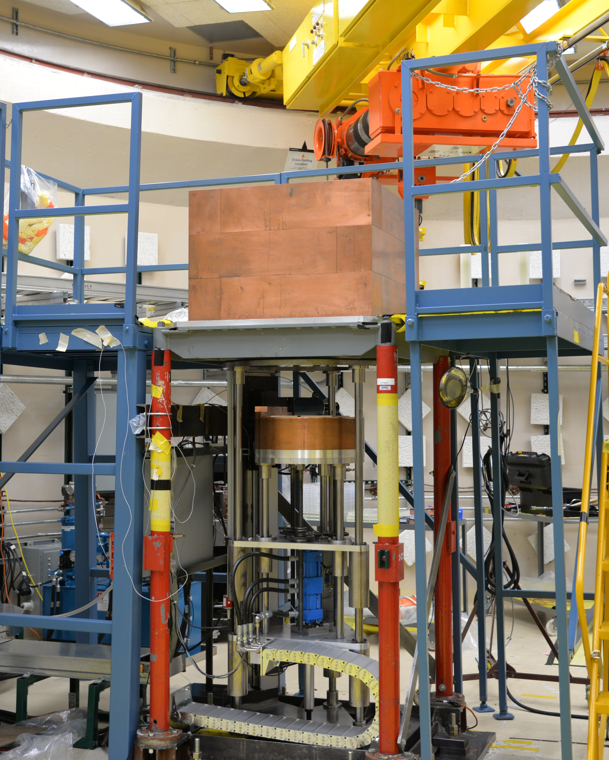
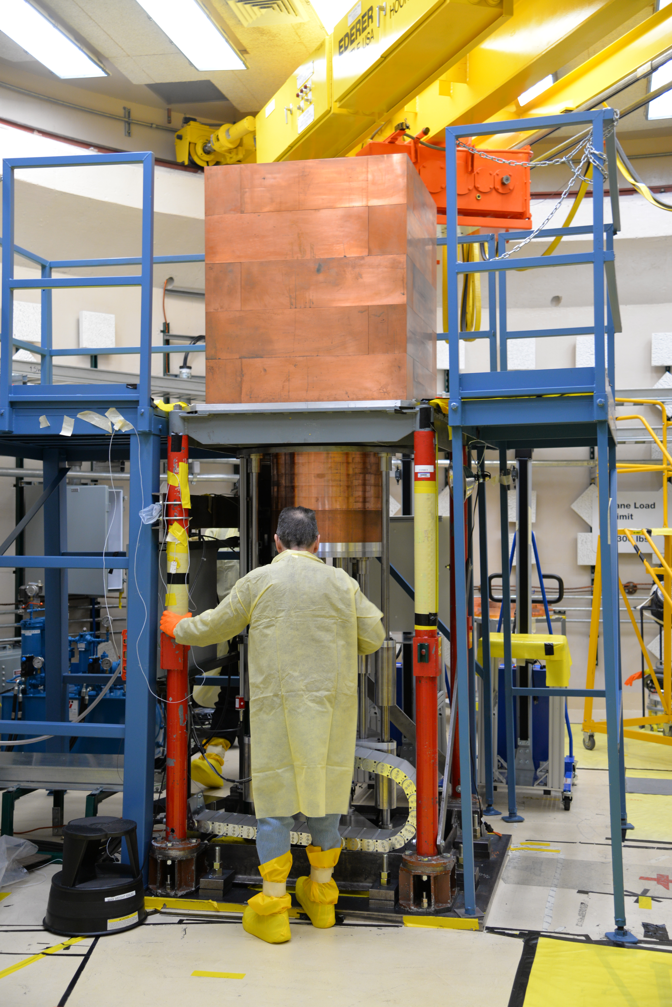

Critical Experiments
$$ρ\left(\$\right)=\frac{{(k}_{eff}−1)}{{(k}_{eff}β_{eff})}=Λω+\sum_{i=1}^{6}{\frac{β_{i}ω}{ω+λ_{i}}}$$
Low Energy Configuration:
1 – 30 keV energy range
8 units in top stack
7 fuel layers in bottom stack
Total 592 ZPPR Plates
High Energy Configuration:
30 – 600 keV Energy Range
5 fuel layers on top stack
4 fuel layers on bottom stack
Total 316 ZPPR Plates
Higher Energy
Lower Energy
Notes:
Fuel layers and number of plates adjusted

Slide 9

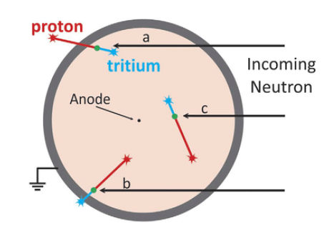
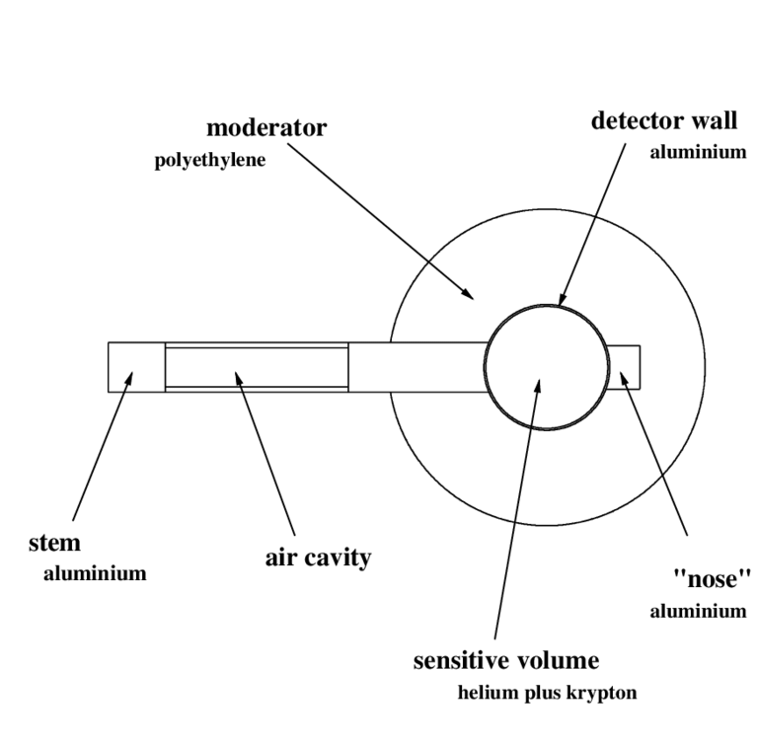
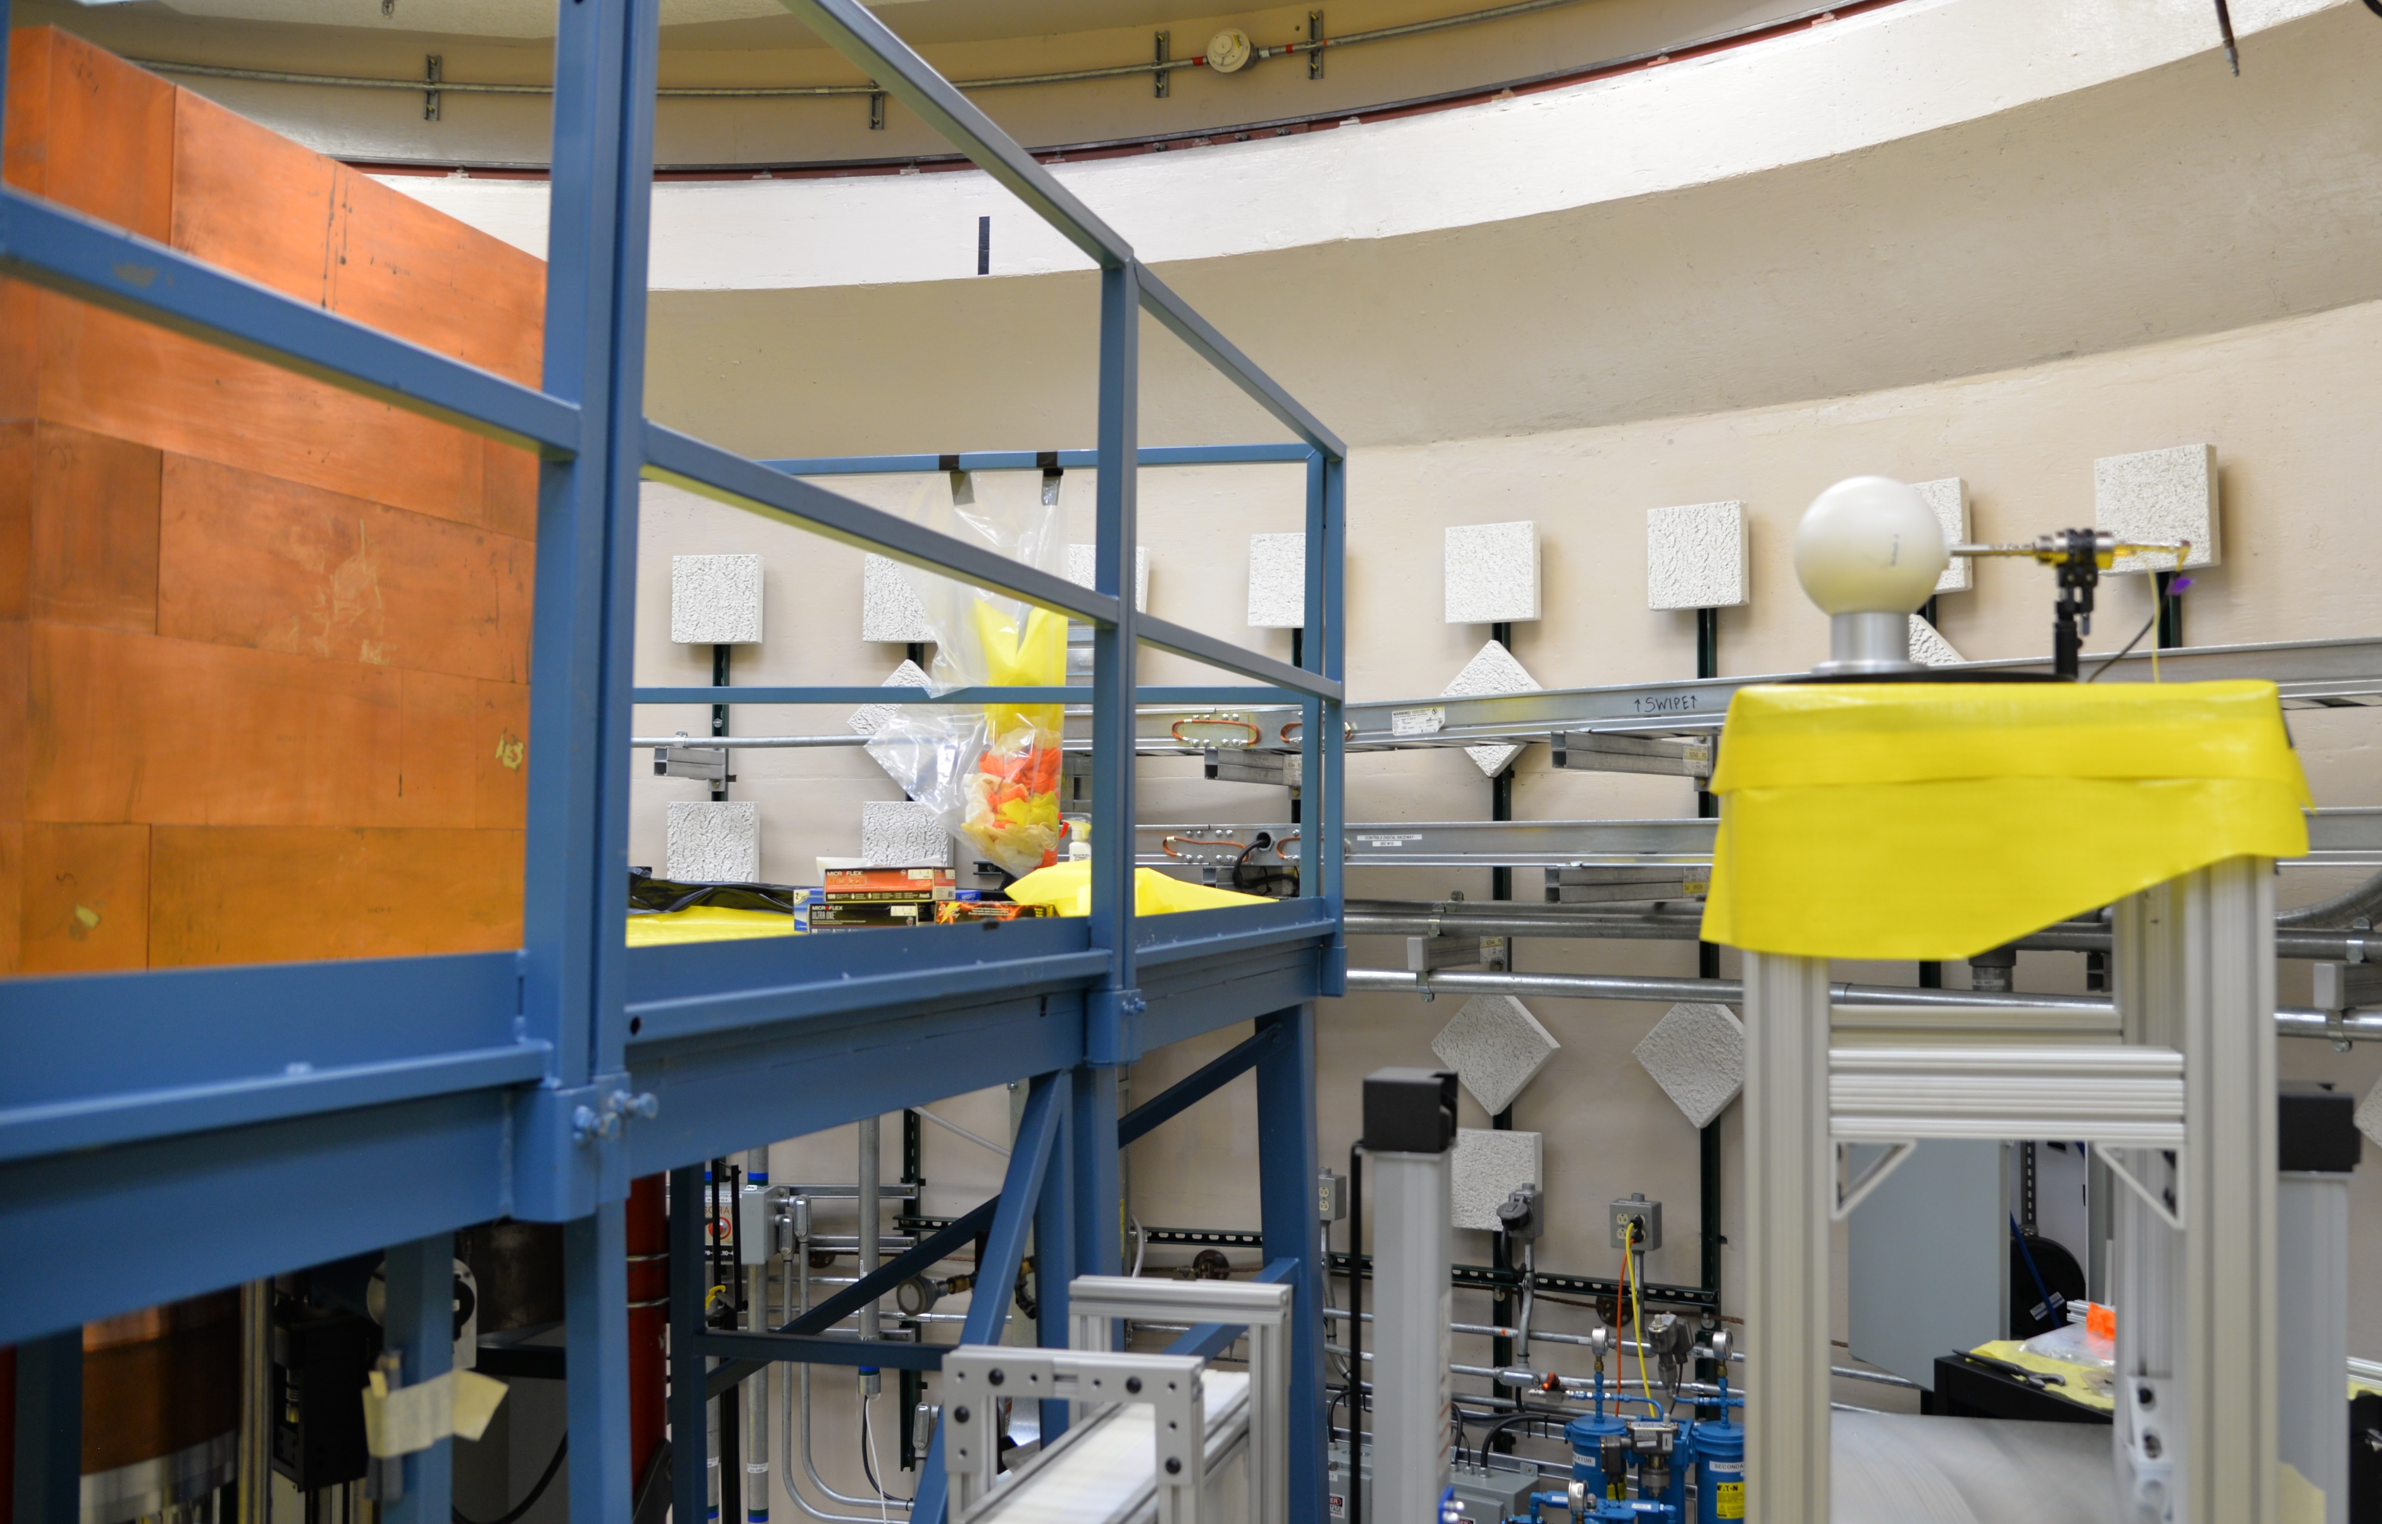
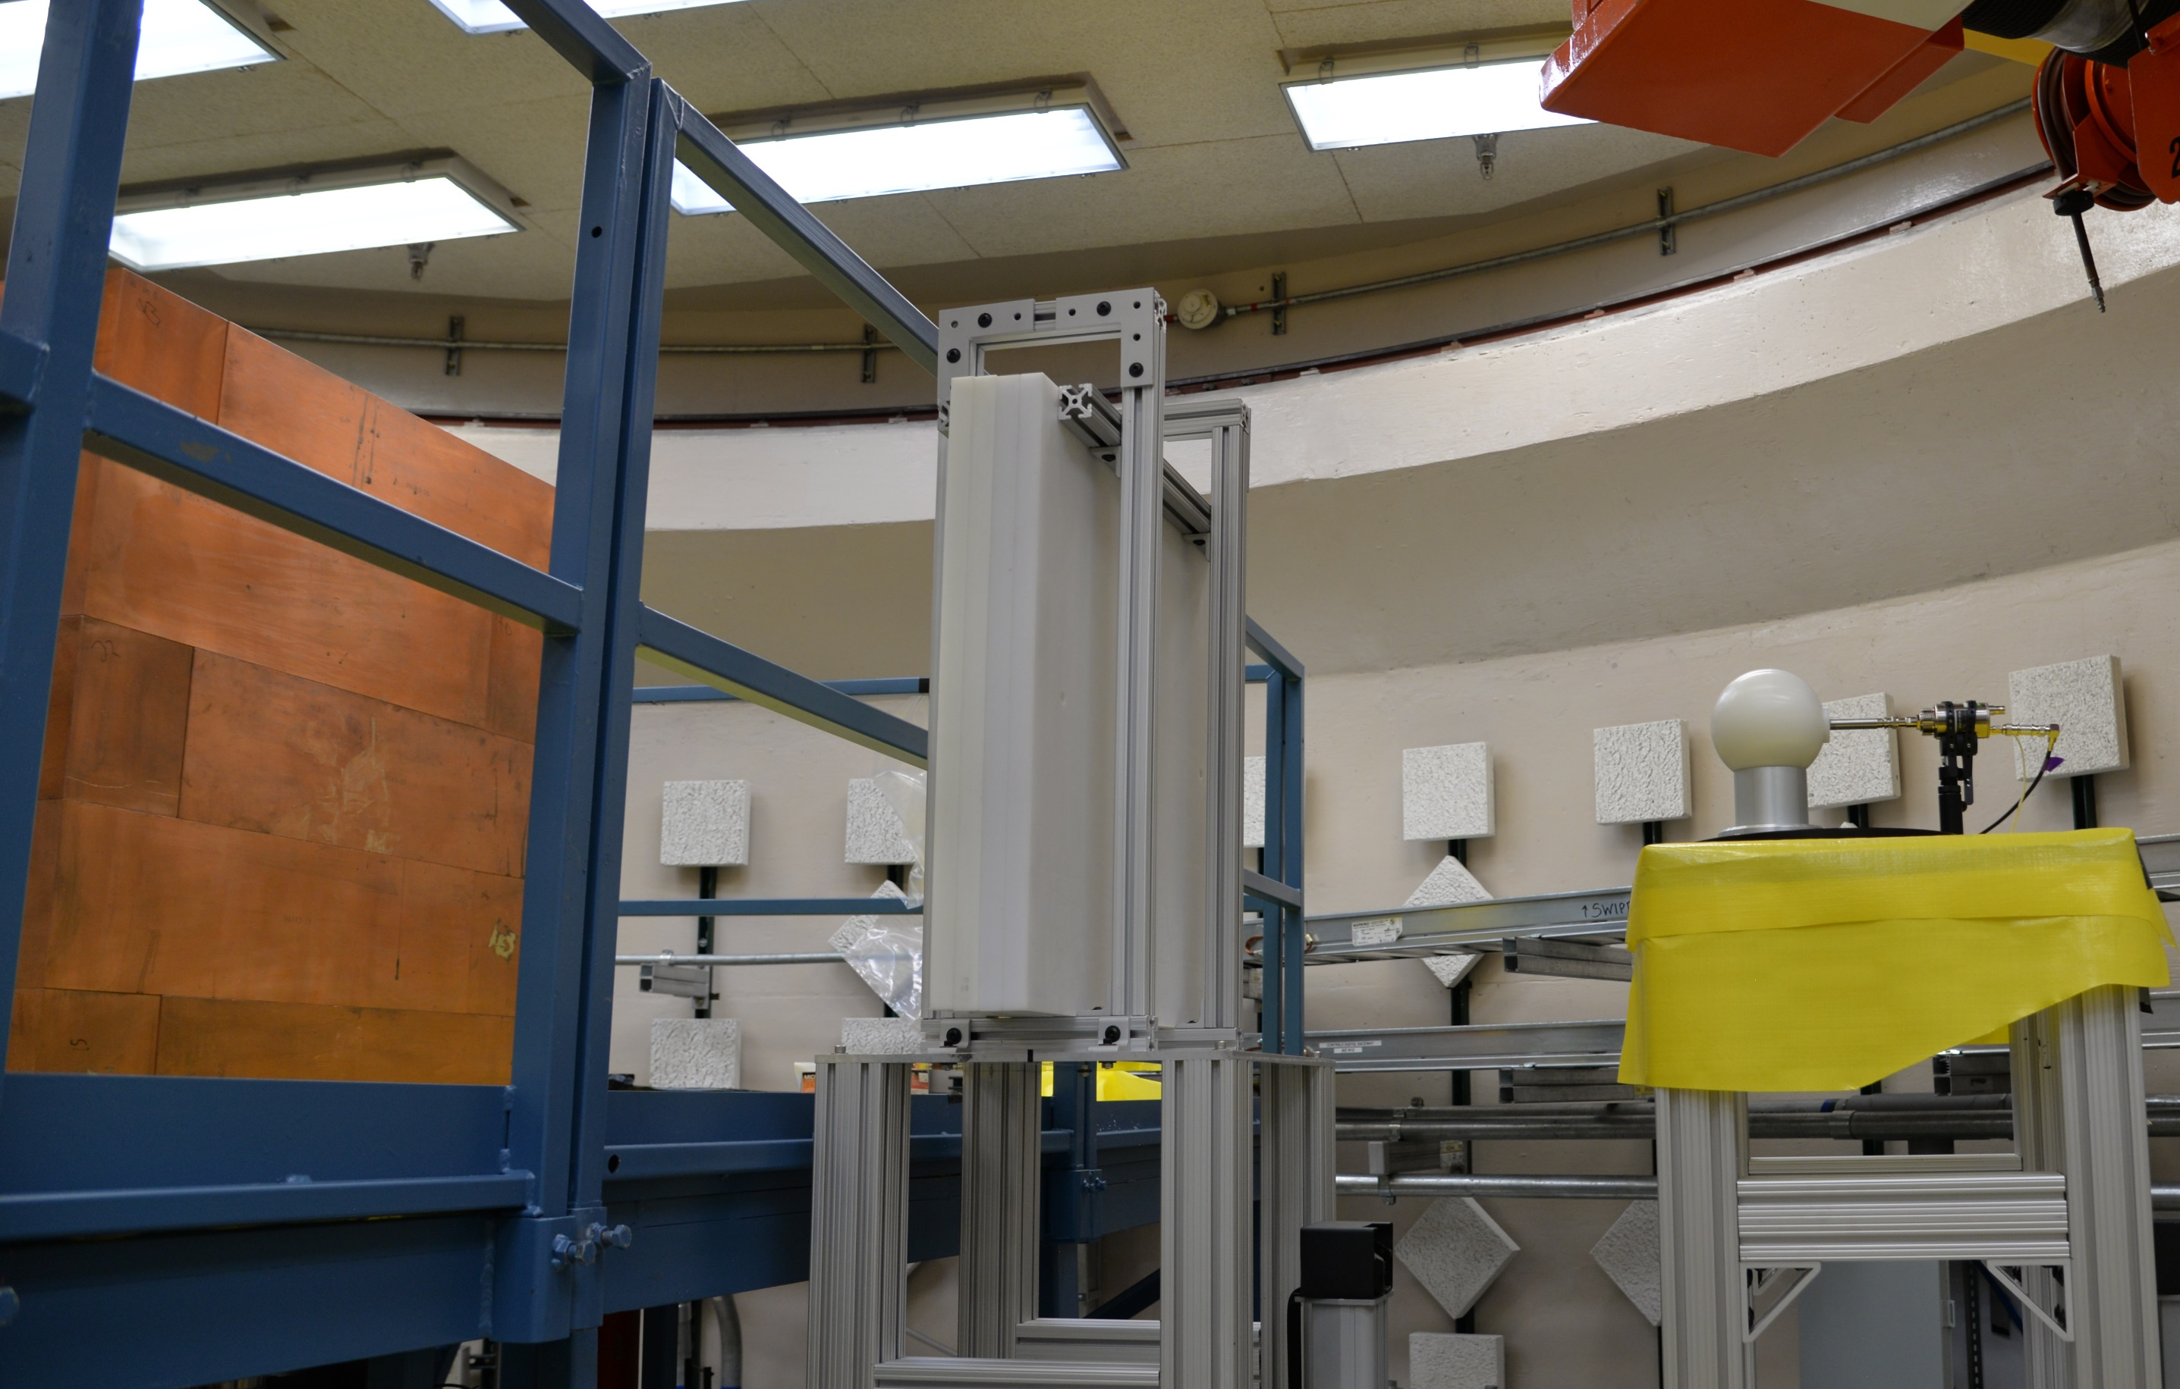
Neutron Leakage Measurements
Set of 6 Bonner sphere spectrometers (BSS):
He-3 proportional counter surrounded by polyethylene sphere
Polyethylene spheres of varying diameters are used (3”, 4”, 5”, 6”, 8”, 10”)
Measurement Details:
Conducted with subcritical arrangement to avoid overwhelming detectors
Significant sensitivity to room return necessitates use of shadow shield
Each sphere undergoes subsequent irradiation: once with shadow shield and once without
Unshielded
Shielded
Direct neutrons
Scattered neutrons
Scattered neutrons
Notes:
Good

Slide 10
Sensitivities

Slide 11





LA-UR-25-31582
Calculating ND Sensitivities: Manual Perturbation
First order sensitivity is calculated via central difference approximation:
$$S_{(R,x)}=\frac{x}{R_{0}}\frac{∂R}{∂x}$$
$$x$$
ND quantity of interest
$$R_{+}$$
simulated response with positively perturbed ND
$$R_{−}$$
simulated response with negatively perturbed ND
$$R_{0}$$
simulated response with unperturbed ND
$$S_{(R,x)}≈\frac{R_{+}−R_{−}}{2R_{0}p}$$
$$p$$
fractional perturbation amount
Well established method, similar approach is implemented in the PERT card of MCNP, but manual perturbation is required for sensitivities to ND other than cross sections.
Computationally intensive, requires 2 simulations for each energy group and an individual simulation for each ND quantity of interest

Slide 12
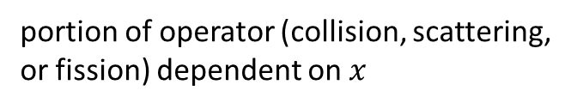
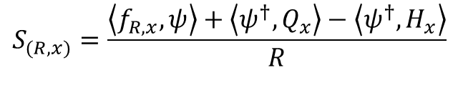



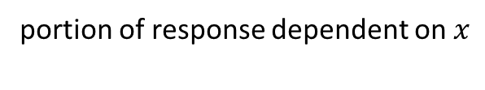




LA-UR-25-31582
Calculating ND Sensitivities: FSEN Tool
First order sensitivity is calculated via adjoint weighting, in method like the KSEN tool
Details of FSEN card methodology outlined in [1]
$$x$$
Nuclear Data quantity
$$S_{(R,x)}=\frac{\left\langle f_{R,x},ψ\right\rangle +\left\langle ψ^{†},Q_{x}\right\rangle −\left\langle ψ^{†},H_{x}\right\rangle }{R}$$
$$f_{R,x}$$
portion of response dependent on $x$
$$ψ^{†}$$
adjoint angular flux
$$Q_{x}$$
portion of source dependent on $x$
More computationally efficient, enables the calculation of multiple sensitivities simultaneously.
$$H_{x}$$
portion of operator (collision, scattering, or fission) dependent on $x$
$$R$$
Response
New tool, so requires more extensive verification of calculated result
[1] J. R. Lamproe et al. “Preliminary verification of the MCNP perturbation and fixed-source tallysensitivity tools.” Annals of Nuclear Energy, volume 194, p. 110040 (2023). URL https://www.sciencedirect.com/science/article/pii/S0306454923003596
Notes:
FSEN has been shown previously to work on low multiplication systems (keff ~0.6) EUCLID but now PARADIGM is using it for keff ~1 for Bonner Spheres

Slide 13
Results

Slide 14
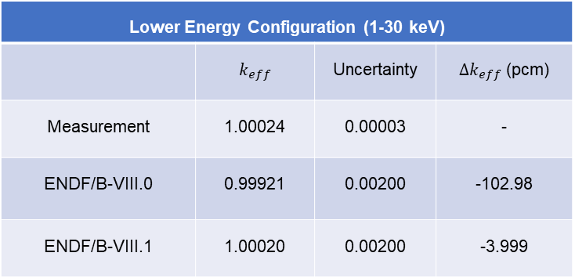
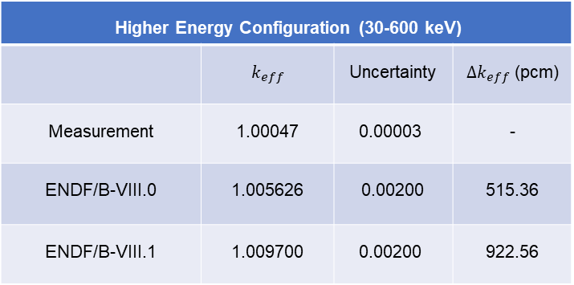
PARADIGM $k_{eff}$: Simulation-Measurement Comparison
Bias for the higher energy configuration is more significant than the low energy configuration
Large change is seen between ENDF/B-VIII.0 and ENDF/B-VIII.1 ND libraries
​ Higher Energy Configuration​ (30-600 keV)
 | $k_{eff}$​ | Uncertainty | ${∆k}_{eff}$​ (pcm)
Measurement​ | 1.00047​ | $$\text{0.00003}$$ | -
ENDF/B-VIII.0​ | 1.005626 | 0.00200 | 515.36
ENDF/B-VIII.1​ | 1.009700 | $$\text{0.00200}$$ | 922.56
Lower Energy Configuration (1-30 keV)
 | $k_{eff}$​ | Uncertainty | ${∆k}_{eff}$​ (pcm)
Measurement​ | 1.00024 | 0.00003 | -
ENDF/B-VIII.0​ | 0.99921 | 0.00200 | -102.98
ENDF/B-VIII.1​ | 1.00020 | 0.00200 | -3.999

Slide 15
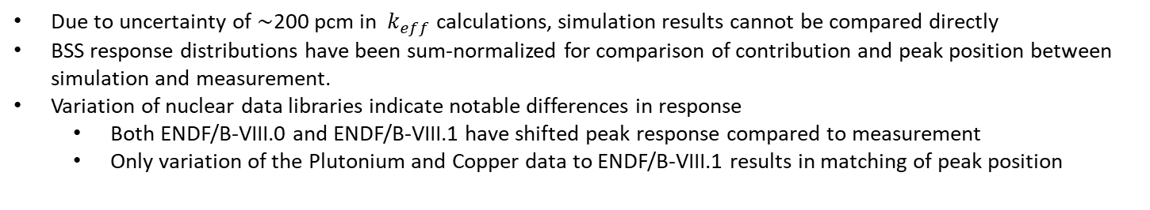
BSS Response: Low Energy Configuration (1-30 keV)
Due to uncertainty of $\sim$200 pcm in $k_{eff}$ calculations, simulation results cannot be compared directly
BSS response distributions have been sum-normalized for comparison of contribution and peak position between simulation and measurement.
Variation of nuclear data libraries indicate notable differences in response
Both ENDF/B-VIII.0 and ENDF/B-VIII.1 have shifted peak response compared to measurement
Only variation of the Plutonium and Copper data to ENDF/B-VIII.1 results in matching of peak position

Slide 16
BSS Response: High Energy Configuration (30-600 keV)
Results for low energy configuration are reflected in the unshielded case of high energy configuration
ENDF/B-VIII.1 and ENDF/B-VIII.0 both underestimate the peak position (4”)
This is not seen for shielded case
This peak position shift indicates that there is an overestimation of mean energy of the neutron flux leaving the assembly
Matching with the adjustment of only Pu and Cu ENDF/B-VIII.1 indicates existence of compensating error

Slide 17
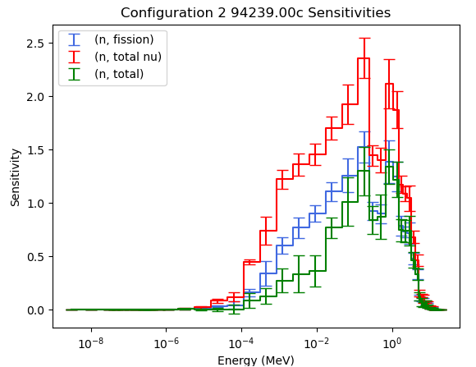
Preliminary Calculated Sensitivities
Sensitivities presented for the 5” BSS response to the low energy (1-30 keV) configuration
Good matching is achieved between two sensitivity calculation methods, one via manual perturbation of ND files and one with novel MCNP FSEN [4] tool
Sensitivities are very large for multiple reactions, indicating this is an impactful measurement and tool for adjustment of ND
²³⁹Pu Sensitivities for Multiple Reactions
Sensitivity
Energy (MeV)

Slide 18
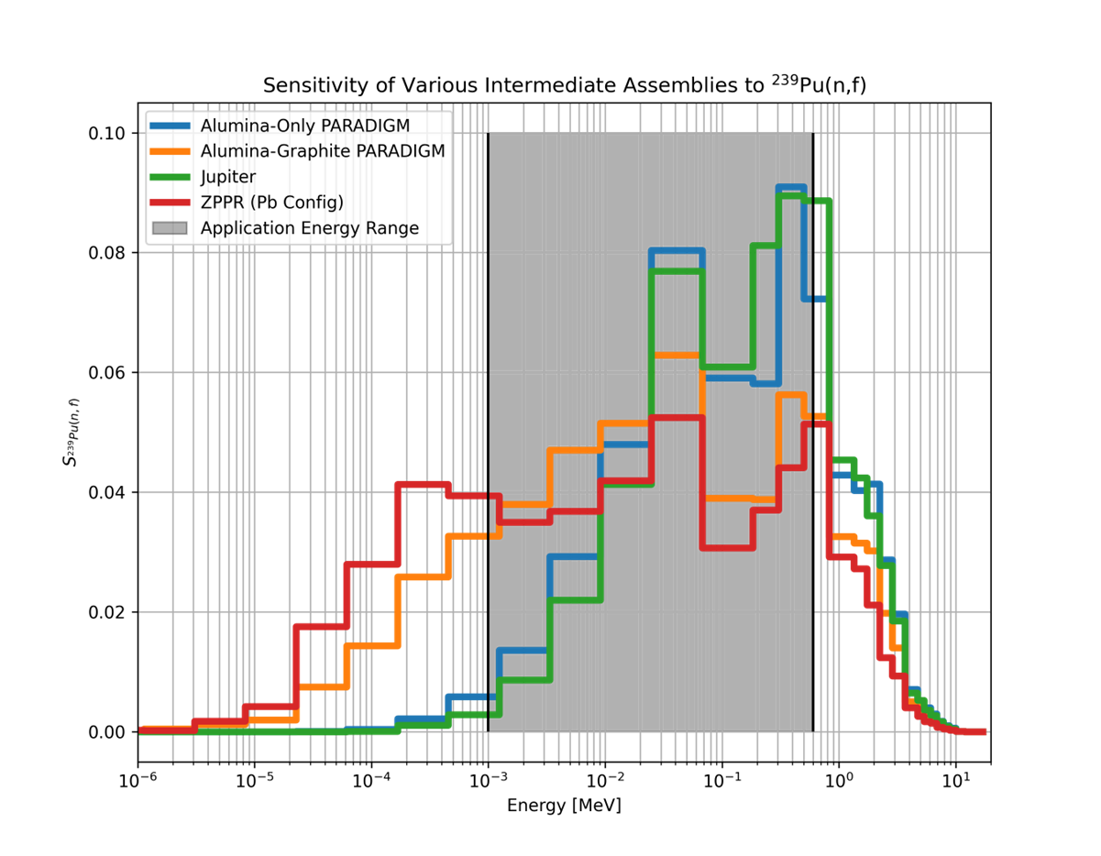
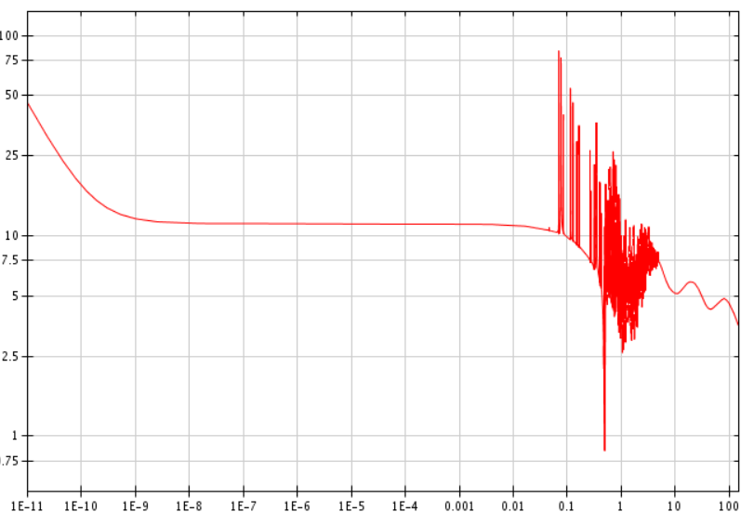
Preliminary $k_{eff}$ sensitivities
$k_{eff}$ sensitivities calculated from the PARADIGM assembly show good agreement with sensitivities calculated from prior assemblies either matching or exceeding these
PARADIGM is built with materials that have better nuclear data:
{{
²⁰⁸Pb(n, total) Cross Section
Cross Section (b)
Jupiter and ZPPR both use Lead
Energy (MeV)

Slide 19
Conclusions and Ongoing Work
PARADIGM has successfully been executed with two integral experiment configurations and multiple complimentary measurements
Current simulation results indicate significant bias in the higher energy configuration, with use of ENDF/B-VIII.1 driving the bias larger
Use of ENDF/B-VIII.0 and ENDF/B-VIII.1 both cause a shift in the simulation of mean energy of the neutron flux leaving the assembly
Analysis indicates the existence of compensating error
Full nuclear data sensitivities are currently being generated for key reactions and isotopes to conclude the integral experiment portion of the PARADIGM project

Slide 20
References
[1] Cutler, T. et al. (2024) ‘The PARADIGM Project: An Integral Experiment Optimized to Reduce Plutonium Intermediate Energy Nuclear Data Uncertainties’, in American Nuclear Society (ANS) Annual Meeting. 1st edn. Las Vegas: American Nuclear Society (Innovation in Nuclear Criticality Safety), pp. 716–719.
[2] Di Fulvio, A., Shin, T. H., Jordan, T., Sosa, C., Ruch, M. L., Clarke, S. D., Chichester, D. L., & Pozzi, S. A. (2017). Passive assay of plutonium metal plates using a fast-neutron multiplicity counter. Nuclear Instruments and Methods in Physics Research Section A: Accelerators, Spectrometers, Detectors and Associated Equipment, 855, 92–101. https://doi.org/10.1016/j.nima.2017.02.082
[3] Kleedtke, N., Haeck, W., & Hutchinson, J. (2023). Utilization of ACE nuclear data file toolkit ACEtk to calculate relative sensitivity coefficients of point-kinetics parameters. Annals of Nuclear Energy, 193, 110031. https://doi.org/10.1016/j.anucene.2023.110031
[4] Lamproe, J. R., Cutler, T. E., Hua, M. Y., Hutchinson, J. D., Rising, M. E., Clarke, S. D., & Pozzi, S. A. (2023). Preliminary verification of the MCNP perturbation and fixed-source tally sensitivity tools. Annals of Nuclear Energy, 194, 110040. https://doi.org/10.1016/j.anucene.2023.110040

