Slide 1
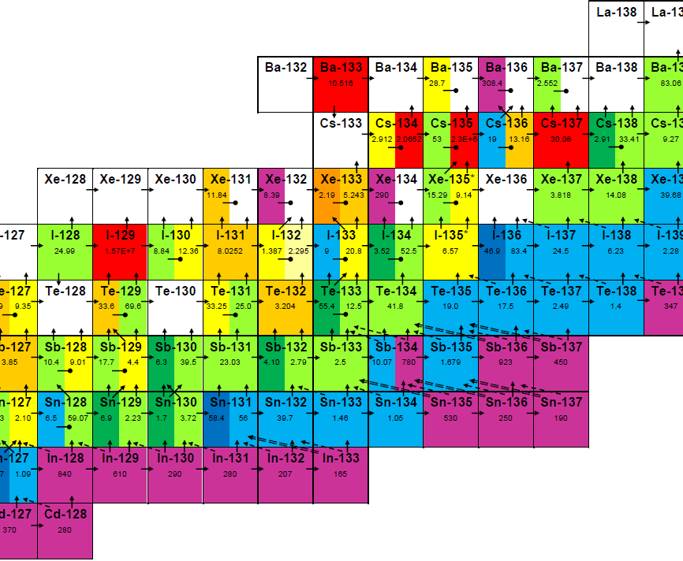
Depletion Data (or the Lack Thereof) in ENDF Data Files
Charles Wemple, William C. Dawn, Joshua Hykes, Teodosi Simeonov, Rodolfo Ferrer, and Joel Rhodes III
Studsvik Scandpower Inc.
CSEWG 2025 Formats and Processing

Slide 2
Fission Product Cross Sections
Many important nuclides have not been re-evaluated in this century
Many others have not been evaluated since 1980s
Many relatively short half-life nuclides don’t exist in ENDF (we borrow from TENDL)
Work is underway to help resolve many of these deficiencies

Slide 3
Branching Data
Important nuclide/reaction pairs missing from ENDF
  ¹⁴⁷Pm MT102 – >500pcm impact on depletion calculations!!!
  ¹²⁶Te MT102
  ¹³⁴Xe MT102
These influence the top 50 absorbers during depletion – reactivity significant
Branching fractions needed for SSP depletion chains (blue = present in ENDF)
  MT102: 92234, 93235, 95241, 95243, 99253, 32074, 32076, 32078, 34078, 34080, 34082, 35079, 35081, 35083, 36082, 36084, 37083, 37085, 37089, 38084, 38086, 39089, 39090, 39092, 41092, 41093, 41093m, 41094, 41096, 41097, 41097m, 41098, 41098m, 42092, 43101, 45101, 45102, 45102m, 45103, 45103m, 45104, 45104m, 45105, 45105m, 46108, 46110, 47107, 47107m, 47108, 47108m, 47109, 47109m, 47110, 47110m, 47112, 47114, 47115, 47115m, 47116, 47116m, 47117, 47117m, 48114, 48116, 48118, 48120, 49113, 49113m, 49115, 49115m, 49116, 49116m, 49117, 49117m, 49118, 49118m, 49119, 49119m, 49120, 49120m, 49121, 49122, 49126, 50112, 50116, 50118, 50120, 50122, 50124, 50126, 50127, 50128, 50128m, 50129, 50129m, 50130, 50130m, 51121, 51123, 51125, 51128, 51129, 51129m, 52120, 52122, 52124, 52126, 52128, 52130, 52132, 53129, 53131, 53132m, 53133, 53133m, 53135, 54130, 54132, 54134, 55133, 55134m, 55137, 56134, 58138, 59141, 59143, 59147, 61147, 61151, 63151, 63153, 65157, 66164, 67165, 27059, 67163, 70168, 71175, 71176, 72177, 72177m, 72178, 72178m, 72178n, 72179, 72179m, 72179n, 72181, 74184, 75185, 75187, 75189, 76188, 76189m, 76190, 77191, 77192, 77192m, 77192n, 77193, 47106, 48110, 48112, 49114, 49114m, 71173, 71177, 71877, 73179, 73181, 74178
  MT16: 92236, 93237, 95243

Slide 4
Branching Cross Section Representations
Good – ¹⁶⁹Tm (6925) – complete, one-to-one correspondence, summation consistency
Bad – ²³⁵U (9228) MT4 – different energy grids, branch sums inconsistent with MF3
Ugly – ¹⁸²W (7431) – where is MF3 MT22?!?
Why? – ²³⁴U has MF8 MT16, MT17, and MT102 referencing MF3
Preferable: branching fractions instead of branching XS

Slide 5
MT5, or the Case of the Disappearing Reaction
In E7R1, U-238 has an explicit MT37 XS
In E8R1, U-238 does not have an explicit MT37 XS
  MF6 neutron emission suggests that (n,4n) was folded into MT5
  This sort of change makes depletion chain construction more difficult
  Also introduces inconsistencies between ENDF versions

