Slide 2
Ta181 Covariances and Integral Experiments
J. Hutchinson, P. Brain, T. Cutler, N. Gibson, N. Kleedtke, R. Little, I. Michaud, D. Neudecker, M. Rising
CSEWG 2025

Slide 3
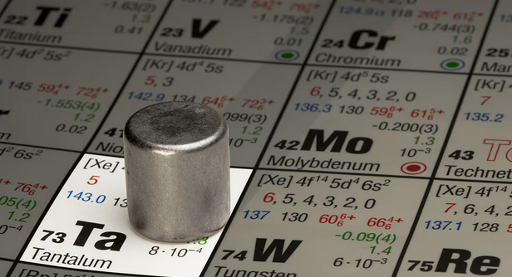
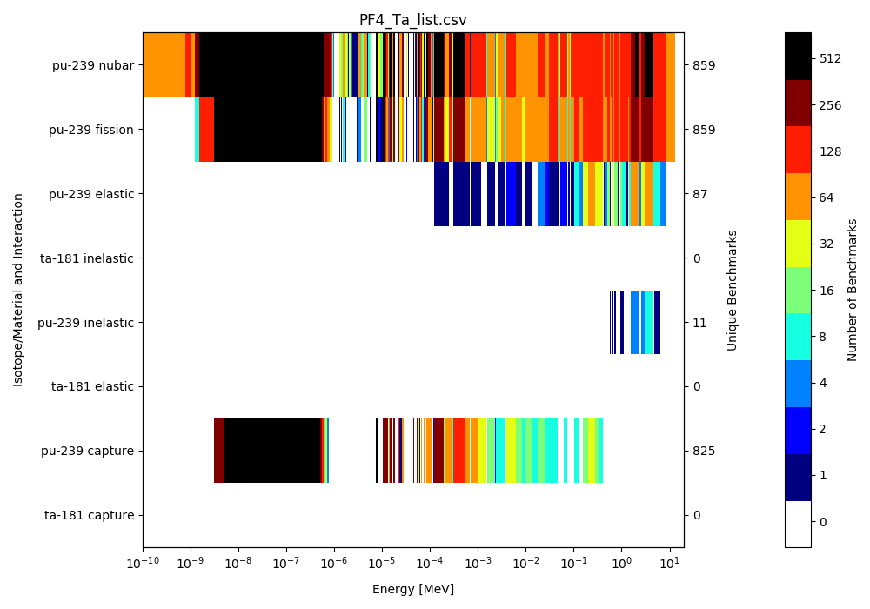
Ta nuclear data needs
Ta is a refractory metal with high melting point and high corrosion resistance.
Useful for plutonium processing operations
All processes with significant quantities of fissionable material must follow ANSI/ANS-8 series standards:
ANSI/ANS-8.1: “Where applicable data are available, subcritical limits shall be established on bases derived from experiments…”
Criticality safety evaluations utilize predictive simulations
Relies on codes to be correct and for nuclear data to be accurate
Critical and subcritical experiments are required for validation
The International Criticality Safety Benchmark Evaluation Project (ICSBEP) contains over 5000 cases
But, for many nuclides such as Ta, there are no experiments
And often those same nuclides can lead to large uncertainties for applications
Until 2022, there was 1 experiment sensitive to Ta.
5 new cases were added in 2022.

Slide 4
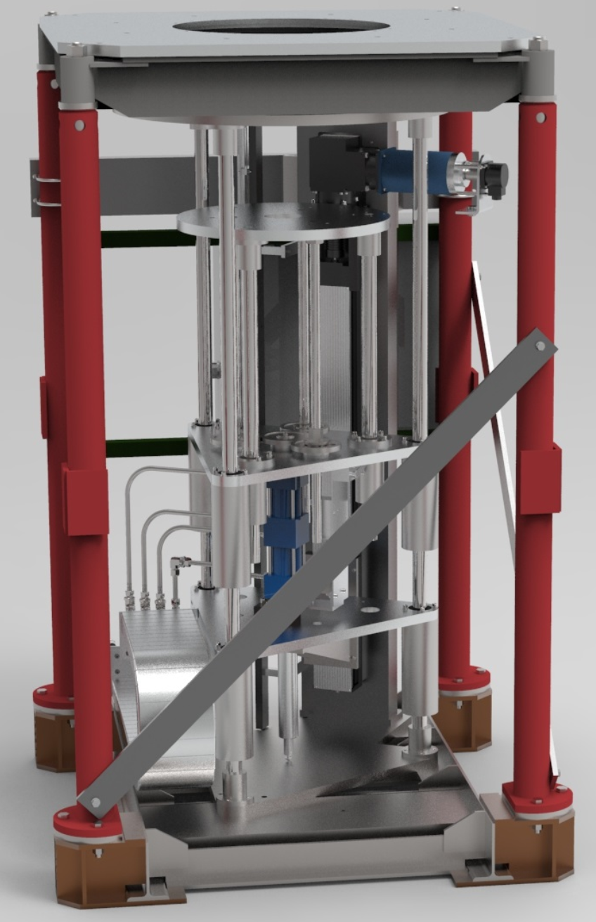
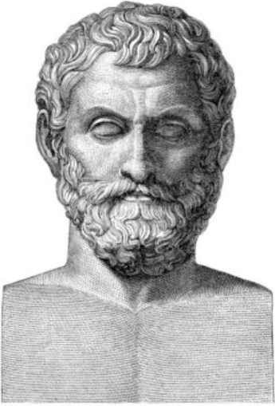
Thales project goals
Thales project
Explore Ta nuclear data sensitivity/uncertainty for applications
Designing integral experiments to provide additional validation data for nuclear criticality safety of Ta reflected Pu applications
In addition, this project will
Help identify other nuclear data uncertainty drivers of subcritical margins for criticality safety applications.
Improve machine learning as applied to design of criticality experiments.
Thales experiment will take place at the National Criticality Experiments Research Center (NCERC)
ARCHIMEDES
NDML
EUCLID
Comet critical assembly machine at NCERC
Named after Thales of Miletus
Thales

Slide 5
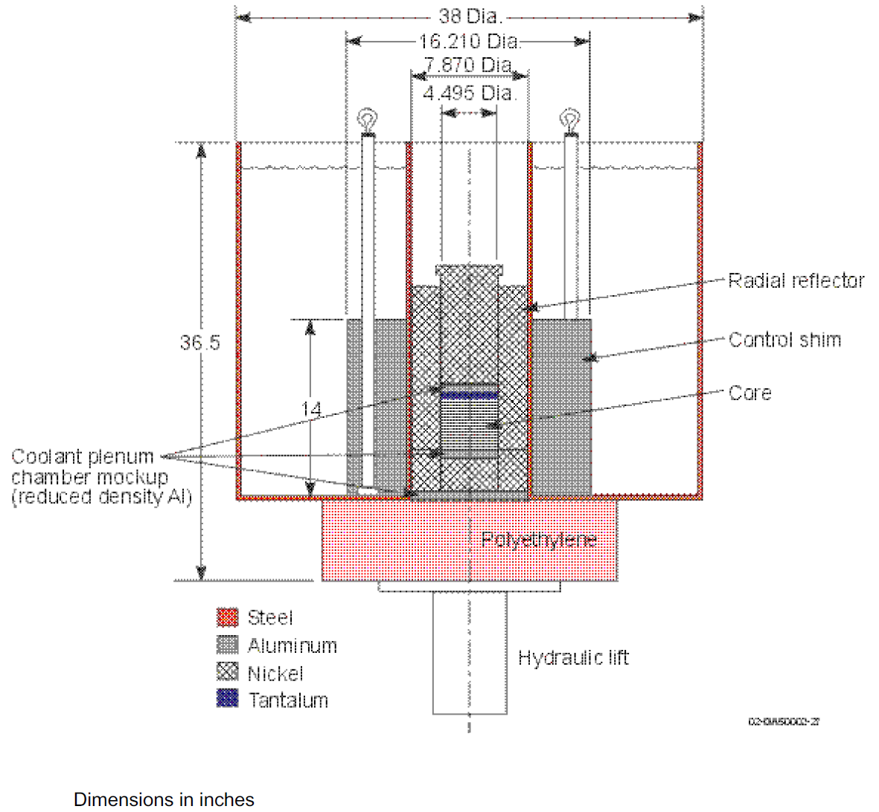
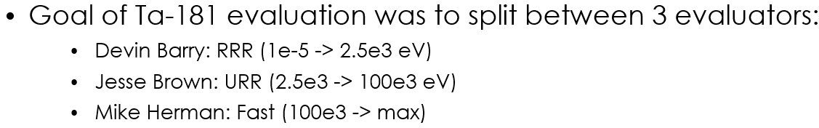
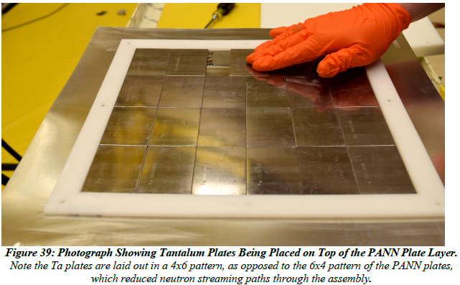
Ta181 has been a high DOE-NCSP priority for years
J. Brown, “Ta-181 URR Covariance”, CSEWG 2024.
Previous benchmarks
PU-MET-FAST-045-006
PU-MET-MIXED-003-001
Previous Thales work:
Application down-selection: ANS Winter 2024
Experiment design: NCSD 2025
Nuclear data sensitivity, uncertainty, and similarity metrics: NCSD 2025
This work focuses on comparing 7.1 (with 7.1/BLO covariances) to 8.1

Slide 6
Investigation of Ta-181 Correlations
7.1/BLO
ENDF/B-VIII.1
Energy
Energy
Notes:
More cross-reaction correlations in ENDF/B-VIII.1

Slide 7
Investigation of Ta-181 Correlations
ENDF/B-VIII.1
7.1/BLO
Min 𝜌 = -0.9926
Min 𝜌 = -2.3940
Max 𝜌 = 9.8552
Max 𝜌 = 1.0000000000000002
Notes:
BLO covariances have very minor round-off issues
Many ENDF/B-VIII.1 covariances have major issues making them unusable

Slide 8
Investigation of Ta-181 Relative Uncertainties
7.1/BLO
ENDF/B-VIII.1
Energy
Reductions across the board, but a bit hard to see when looking at all reactions

Slide 9
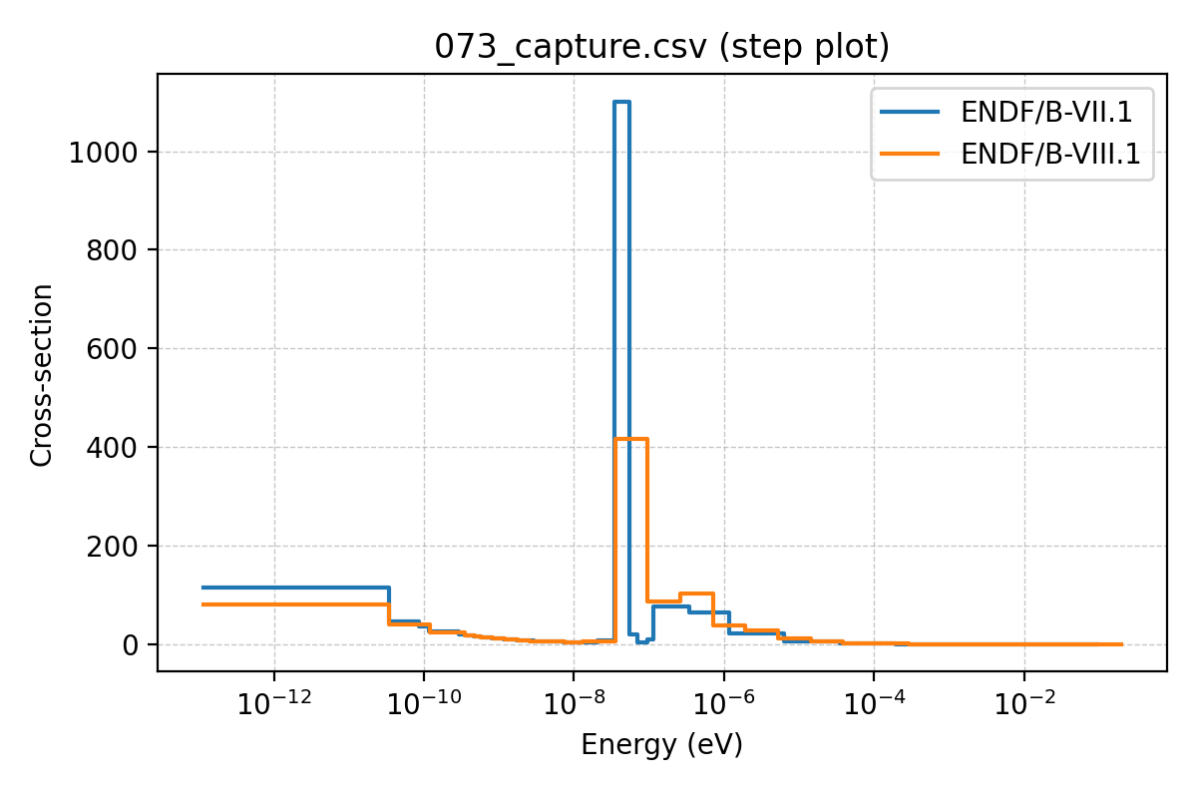
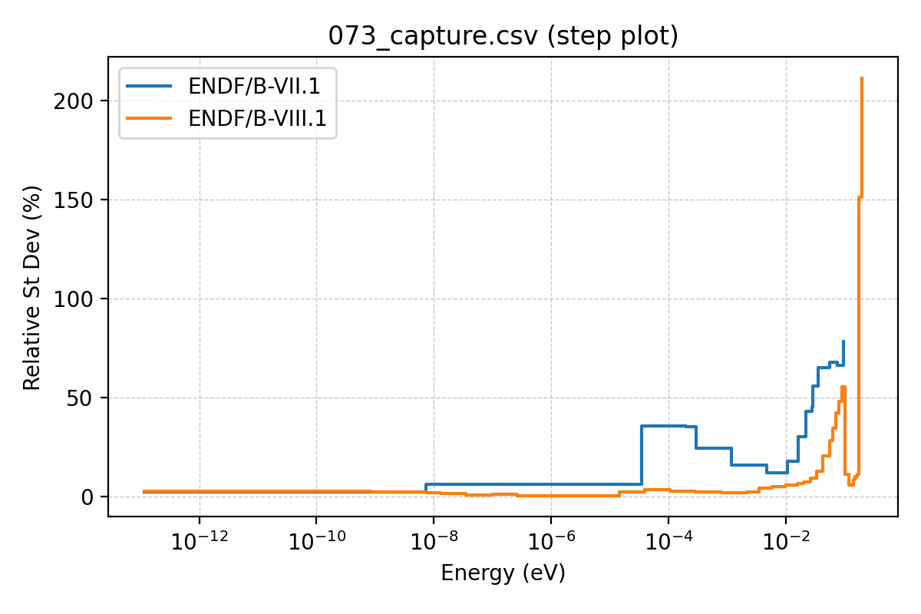
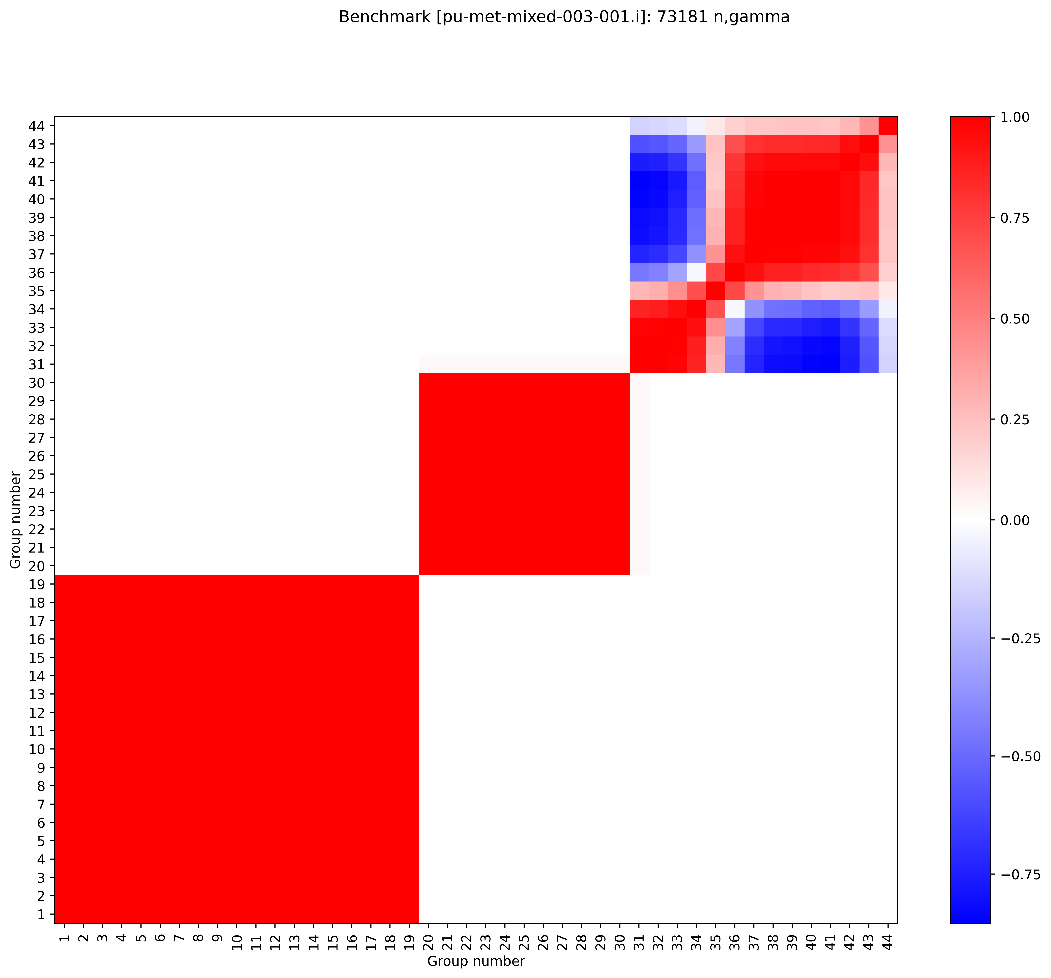
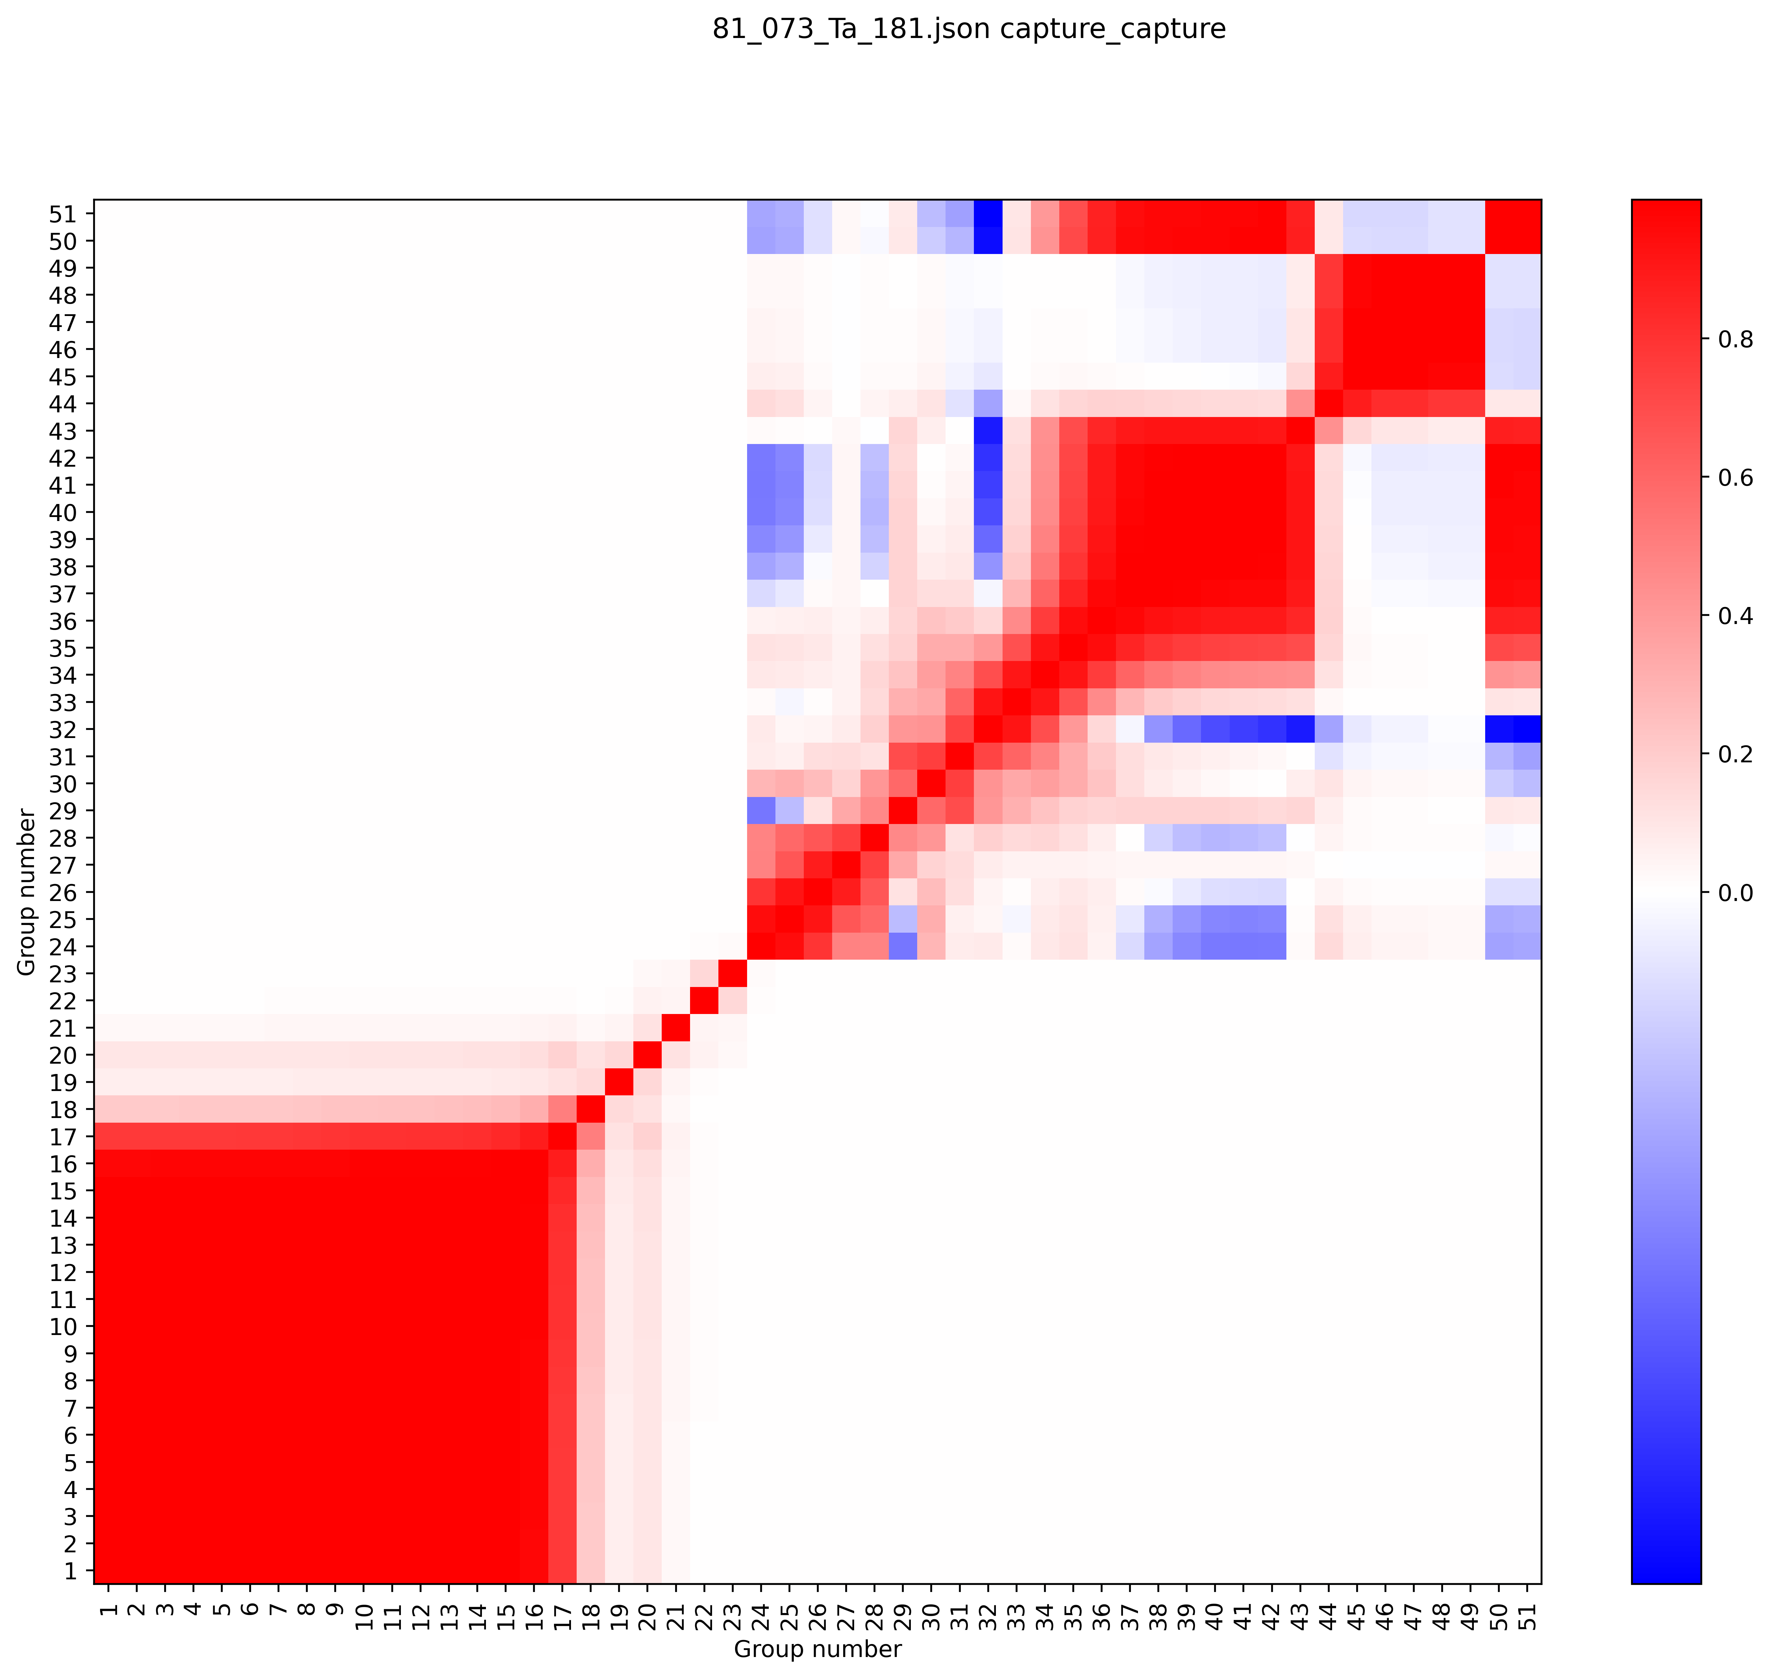
Capture comparison
This is NOT a direct comparison
Based on available data
7.1/BLO: 44 groups
8.1: 51 groups
The important comparisons, however are:
General shape of cross-sections at top
Fact that relative uncertainties are much smaller for 8.1 (as expected)
7.1/BLO correlation plot
8.1 correlation plot

Slide 10
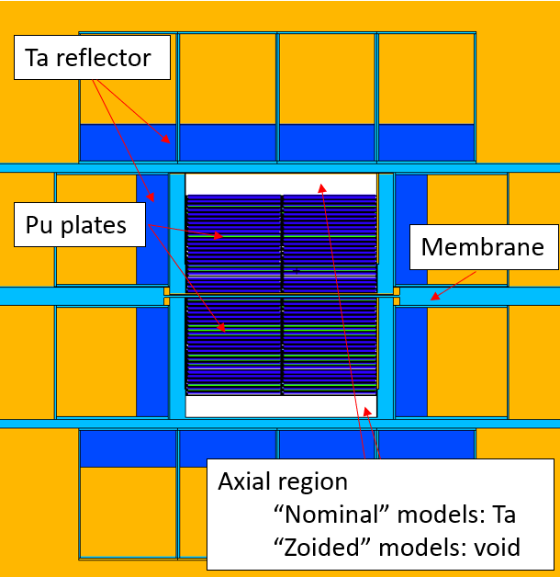
Experiment design models
Axial void will be provided by Al spacers
From V3 build (Brain NCSD 2025)
Models vary by
Amount of Ta reflector
Material in axial region
Number of Pu plates (adjusted for criticality)
Model name | Ta thickness (in) | Ta thickness (cm) | Material in axial region
Nominal_0_31_Crit | 0.125 | 0.3175 | Ta
Nominal_0_63_Crit | 0.25 | 0.635
Thales_Nominal_1_27_Crit | 0.5 | 1.27
Thales_Nominal_2_54_Crit | 1 | 2.54
Thales_Nominal_5_8_Crit | 2 | 5.08
Thales_Nominal_8_89_Crit | 3.5 | 8.89
ZOIDED_MAX_0_63_00_Crit | 0.25 | 0.635 | Void
ZOIDED_MAX_1_27_00_Crit | 0.5 | 1.27
ZOIDED_MAX_2_54_00_Crit | 1 | 2.54
“Zoided” = Z-axis voided
Colors are darker as the total Ta mass increases

Slide 11
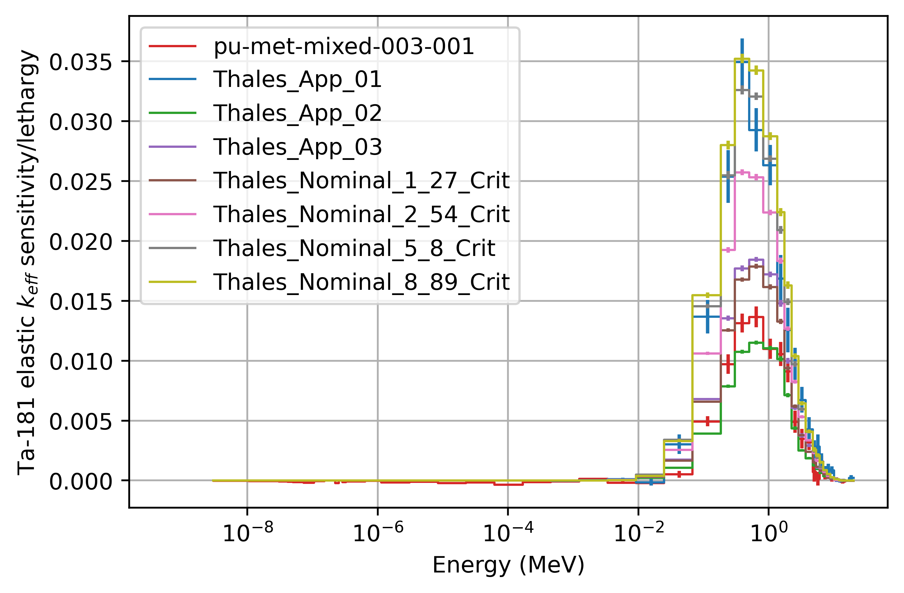
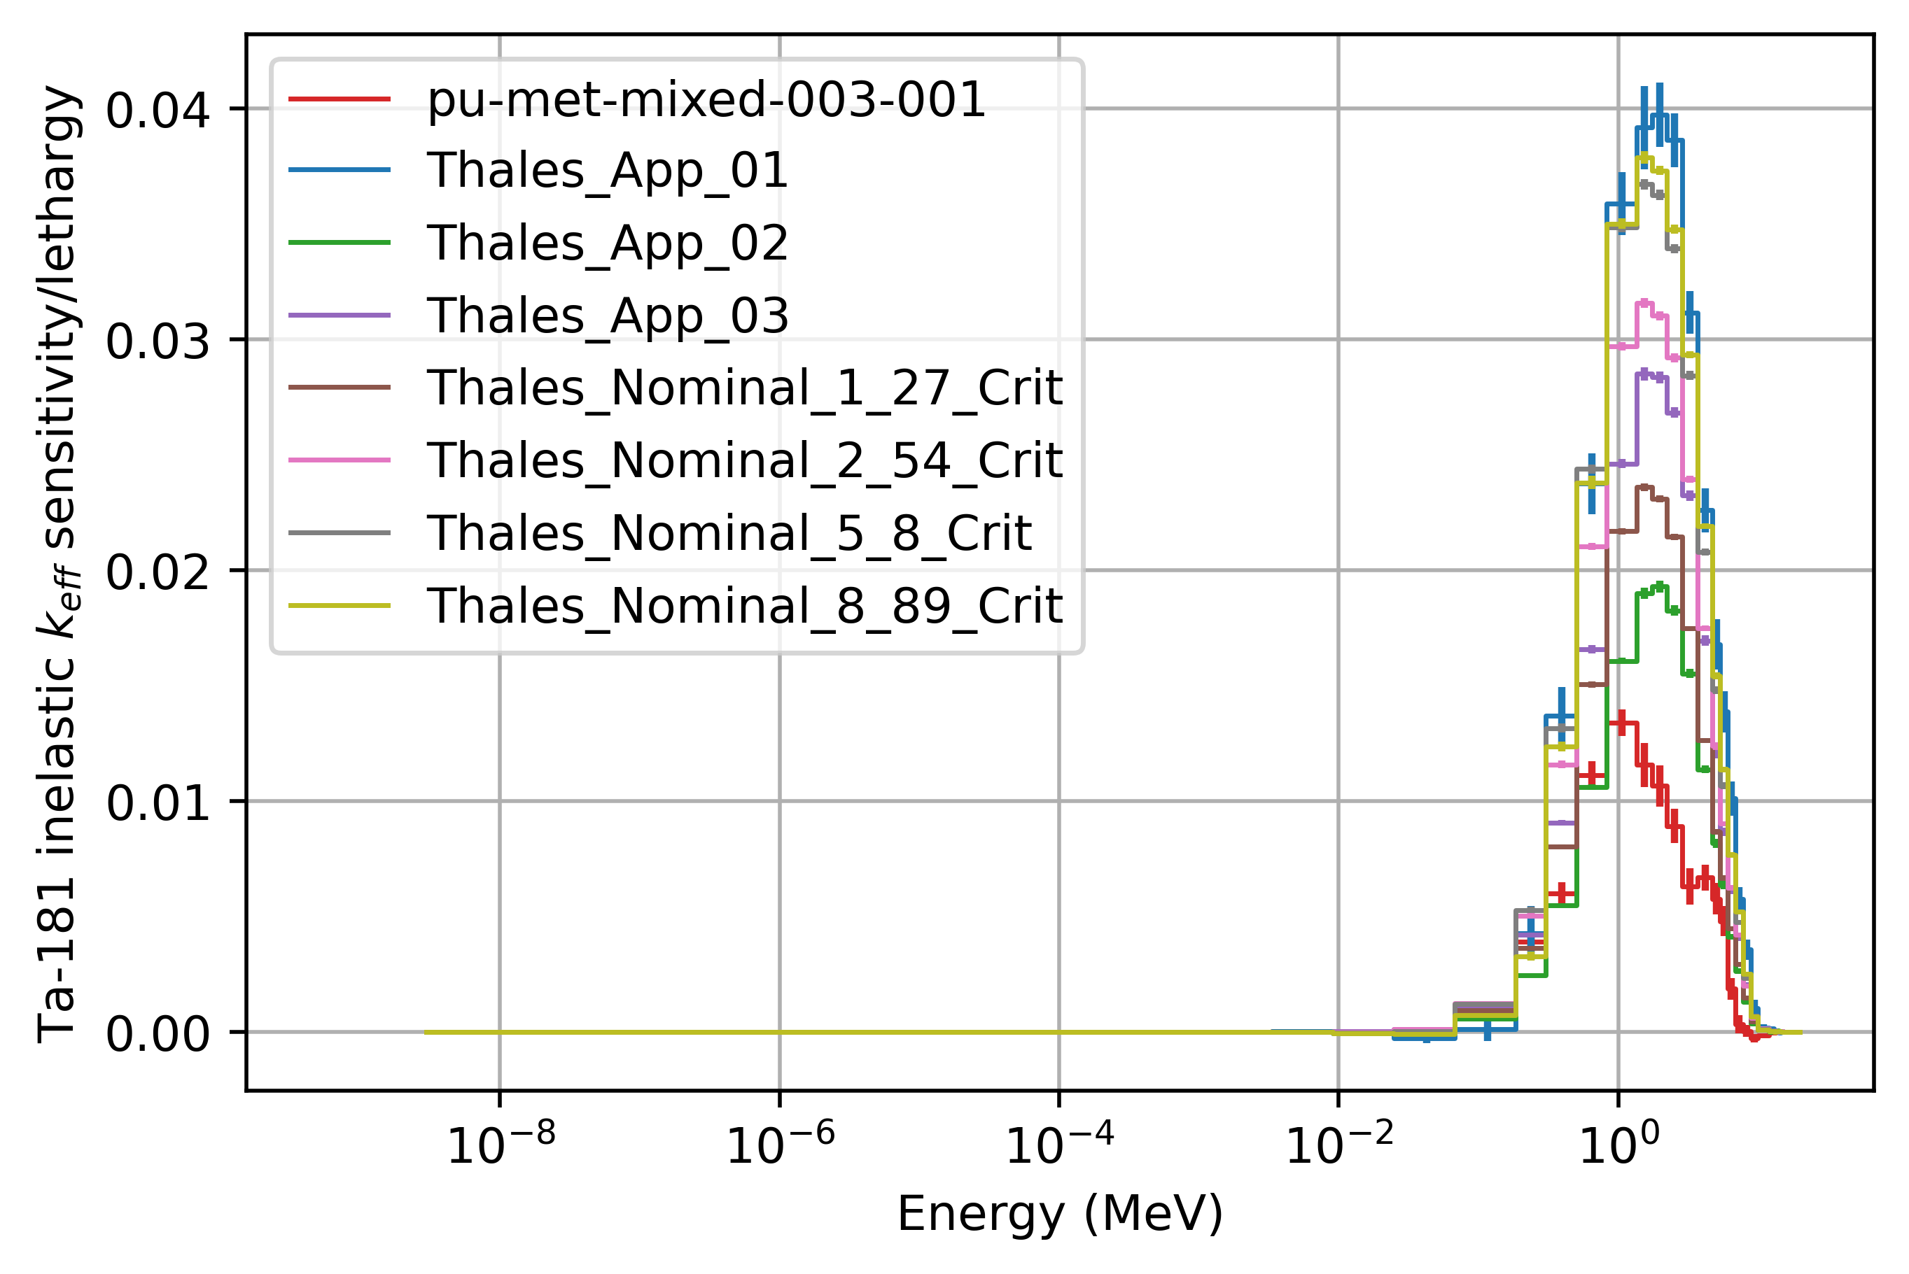
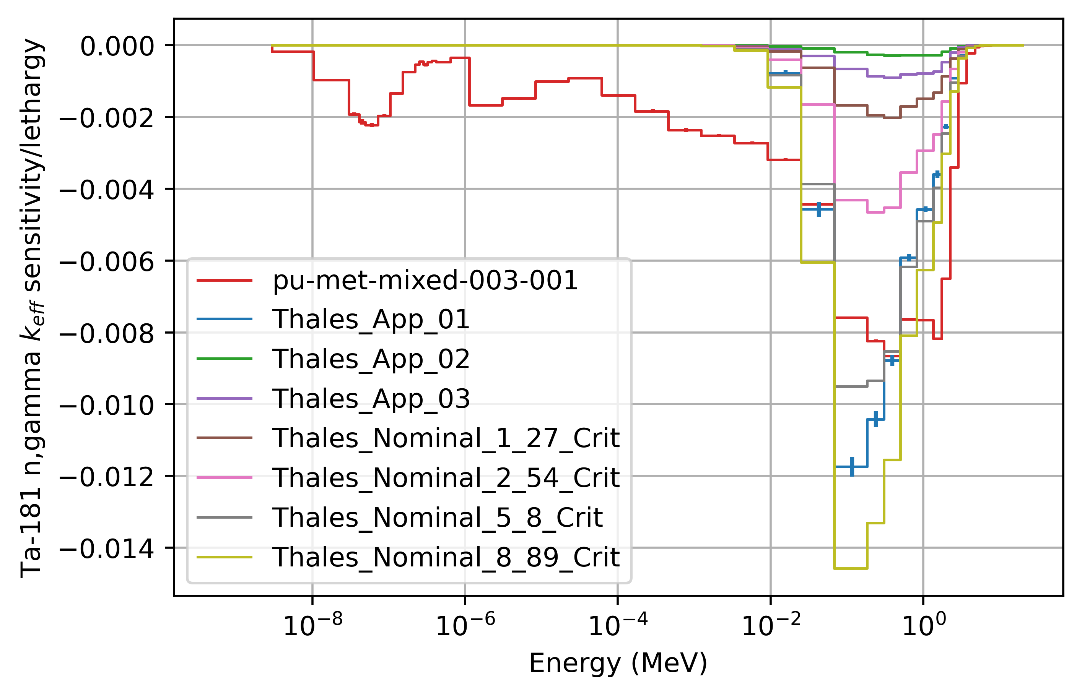
keff sensitivities
Applications/experiments with thick Ta are (not surprisingly) very sensitive to Ta181 scattering
All sensitivity is in the fast energy range
elastic
inelastic
n,gamma

Slide 12
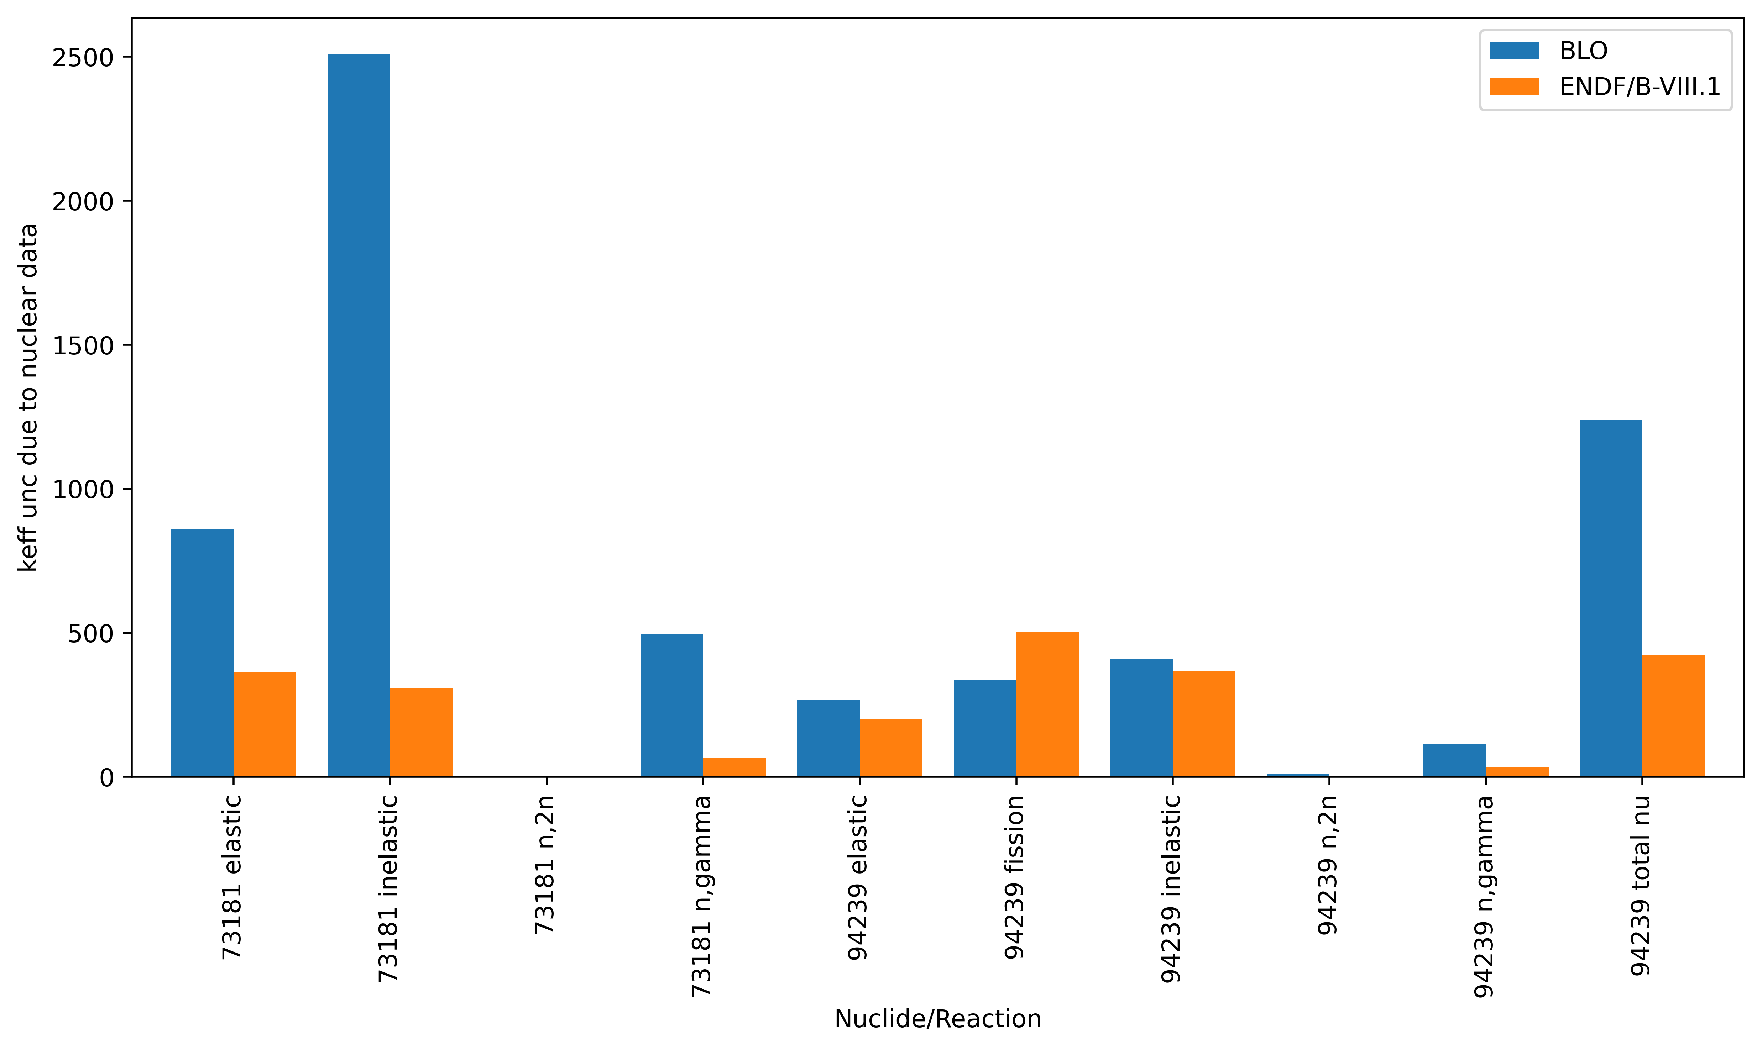
Thales_App_01
Results: nuclear data unc
The unc in k_{eff} due to Ta181 nuclear data dramatically decreased from the BLO covariance library to ENDF/B-VIII.1
Expected due to the VIII.1 work on Ta181
That being said, the uncertainty for Ta181 is still >700 pcm for VIII.1
This drastic change in the covariance data means that c_{k} results will shift compared to future work
Also true for other metrics that use covariance data
Nuclide | Reaction | BLO | ENDF/B-VIII.1
73181 | elastic | 861 | 364
73181 | inelastic | 2509 | 307
73181 | n,gamma | 497 | 65
94239 | elastic | 268 | 202
94239 | fission | 337 | 504
94239 | inelastic | 409 | 366
94239 | n,gamma | 116 | 33
94239 | total nu | 1239 | 424
Total |  | 3013 | 917
\\slip.lanl.gov\NCERC\Software\whisper-tk\Output\Thales_22_e80_e81JSON_51_nof_noi

Slide 13
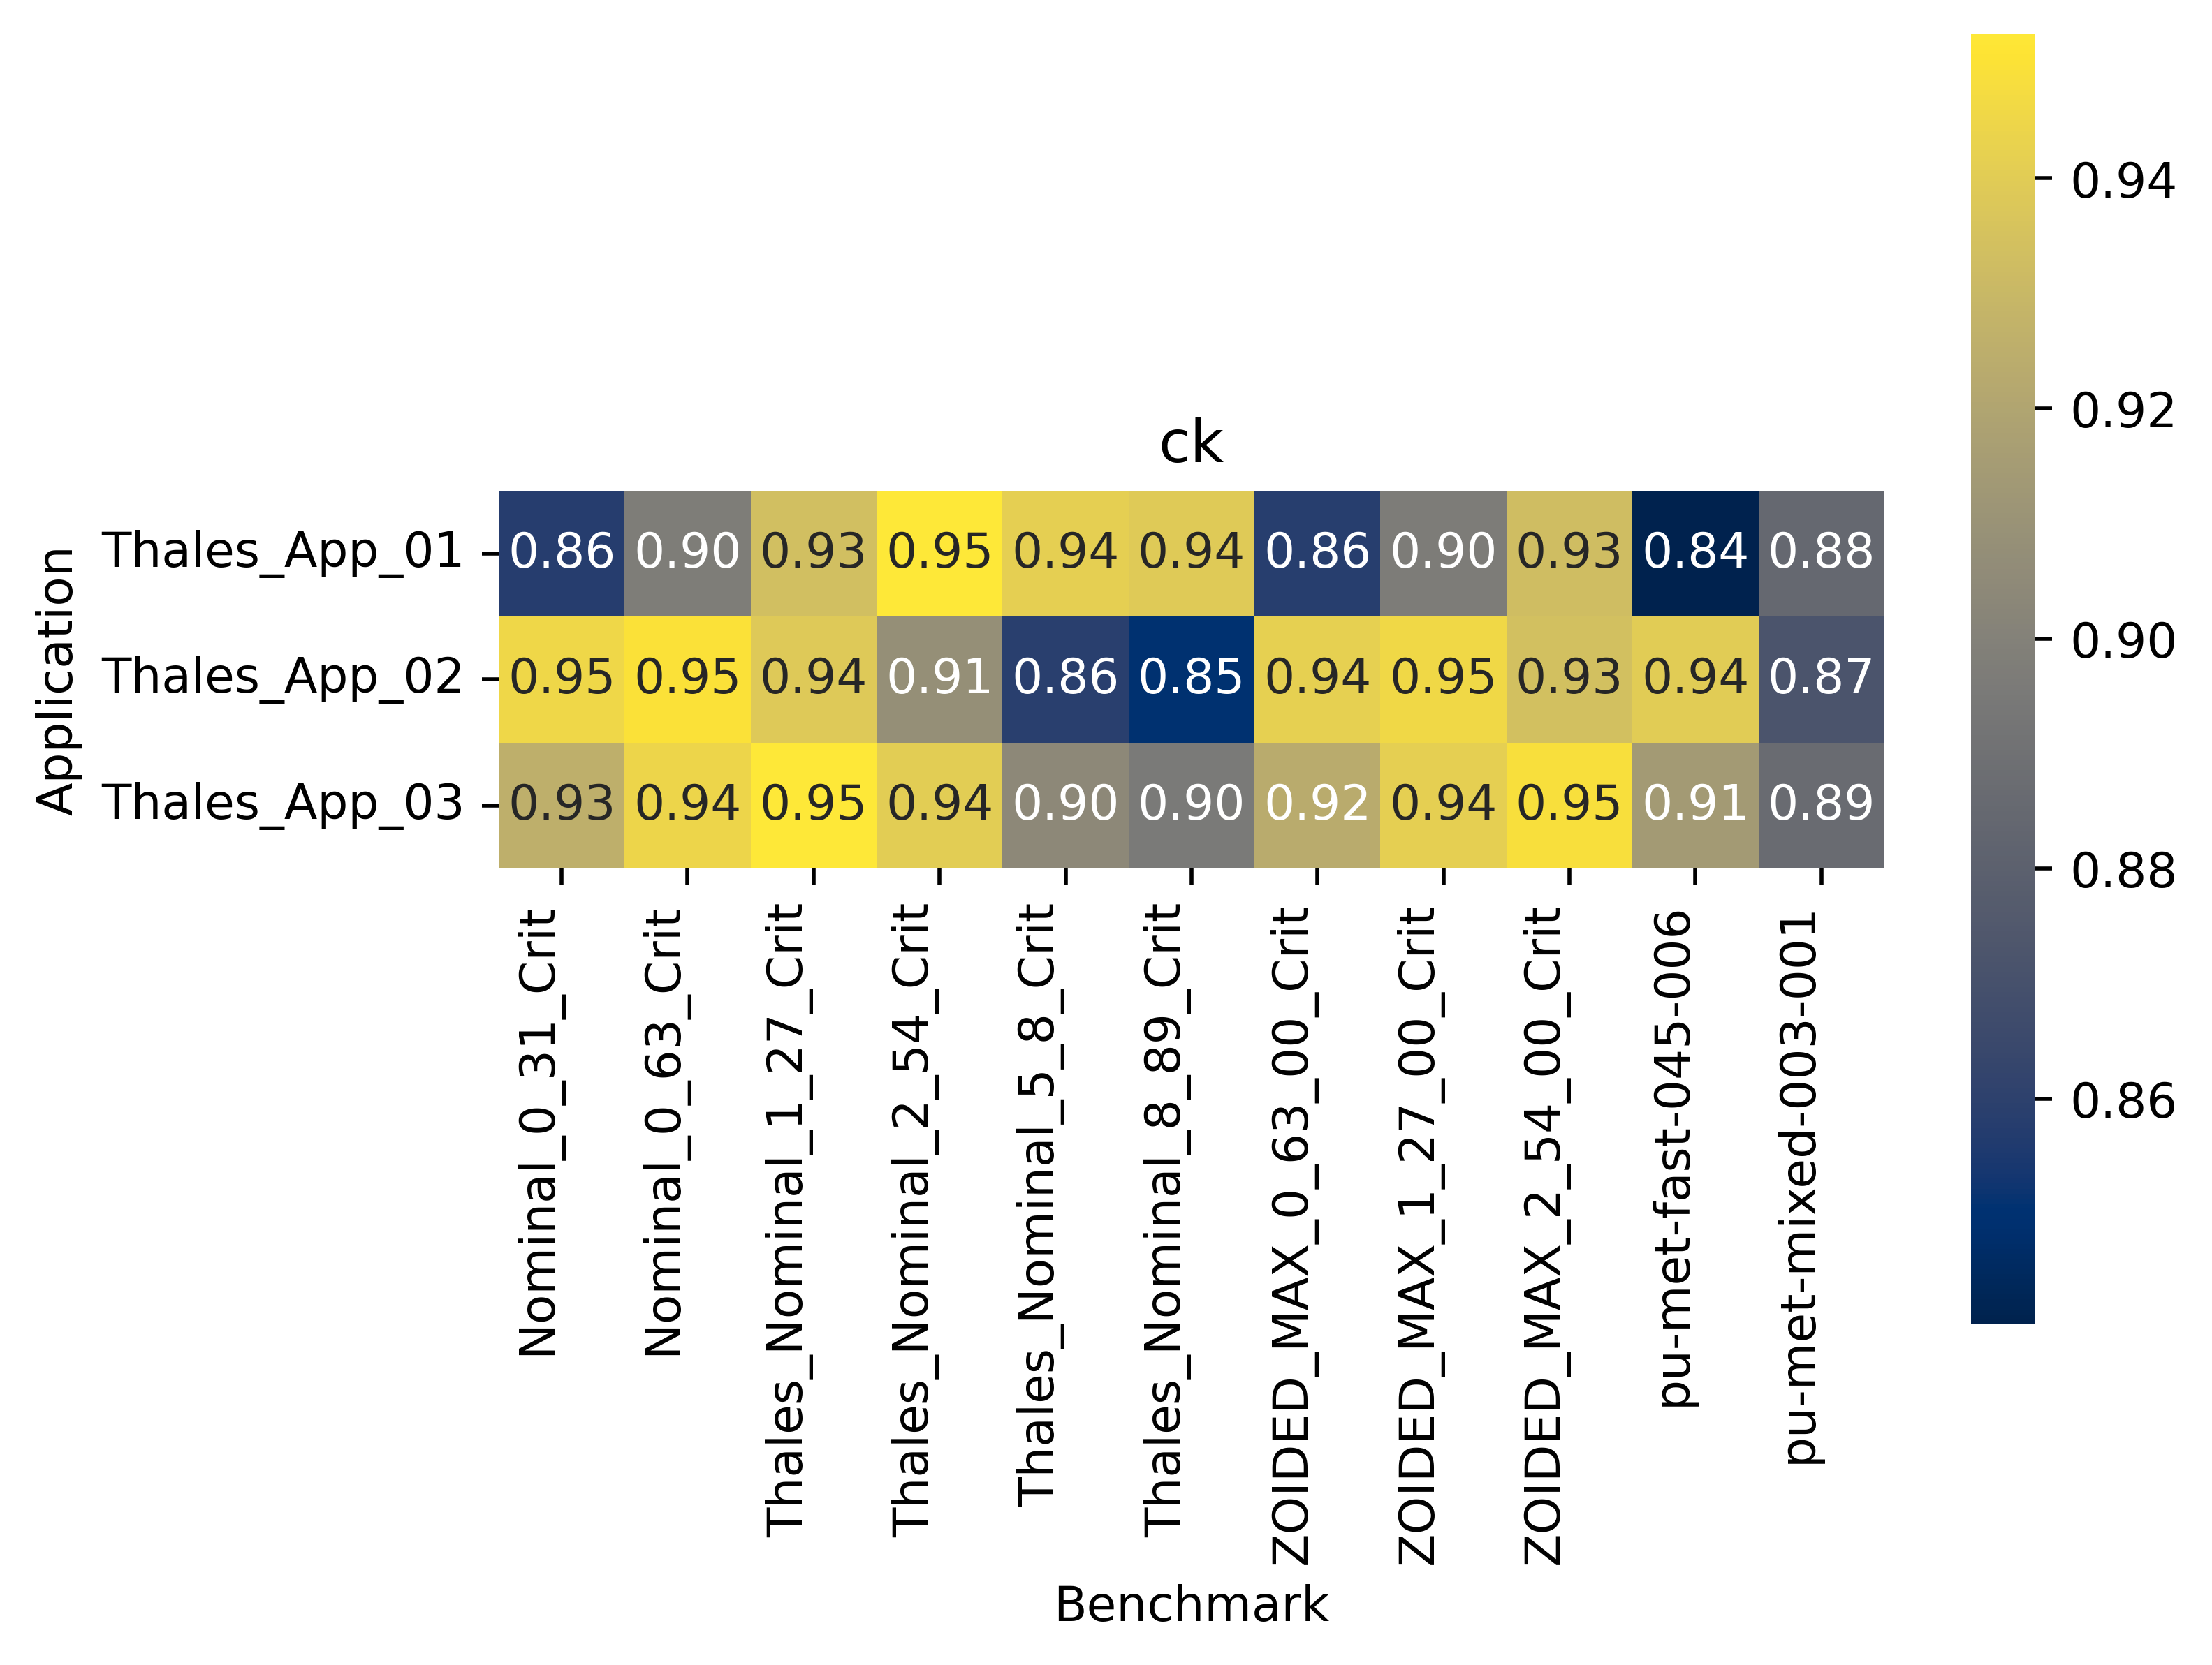
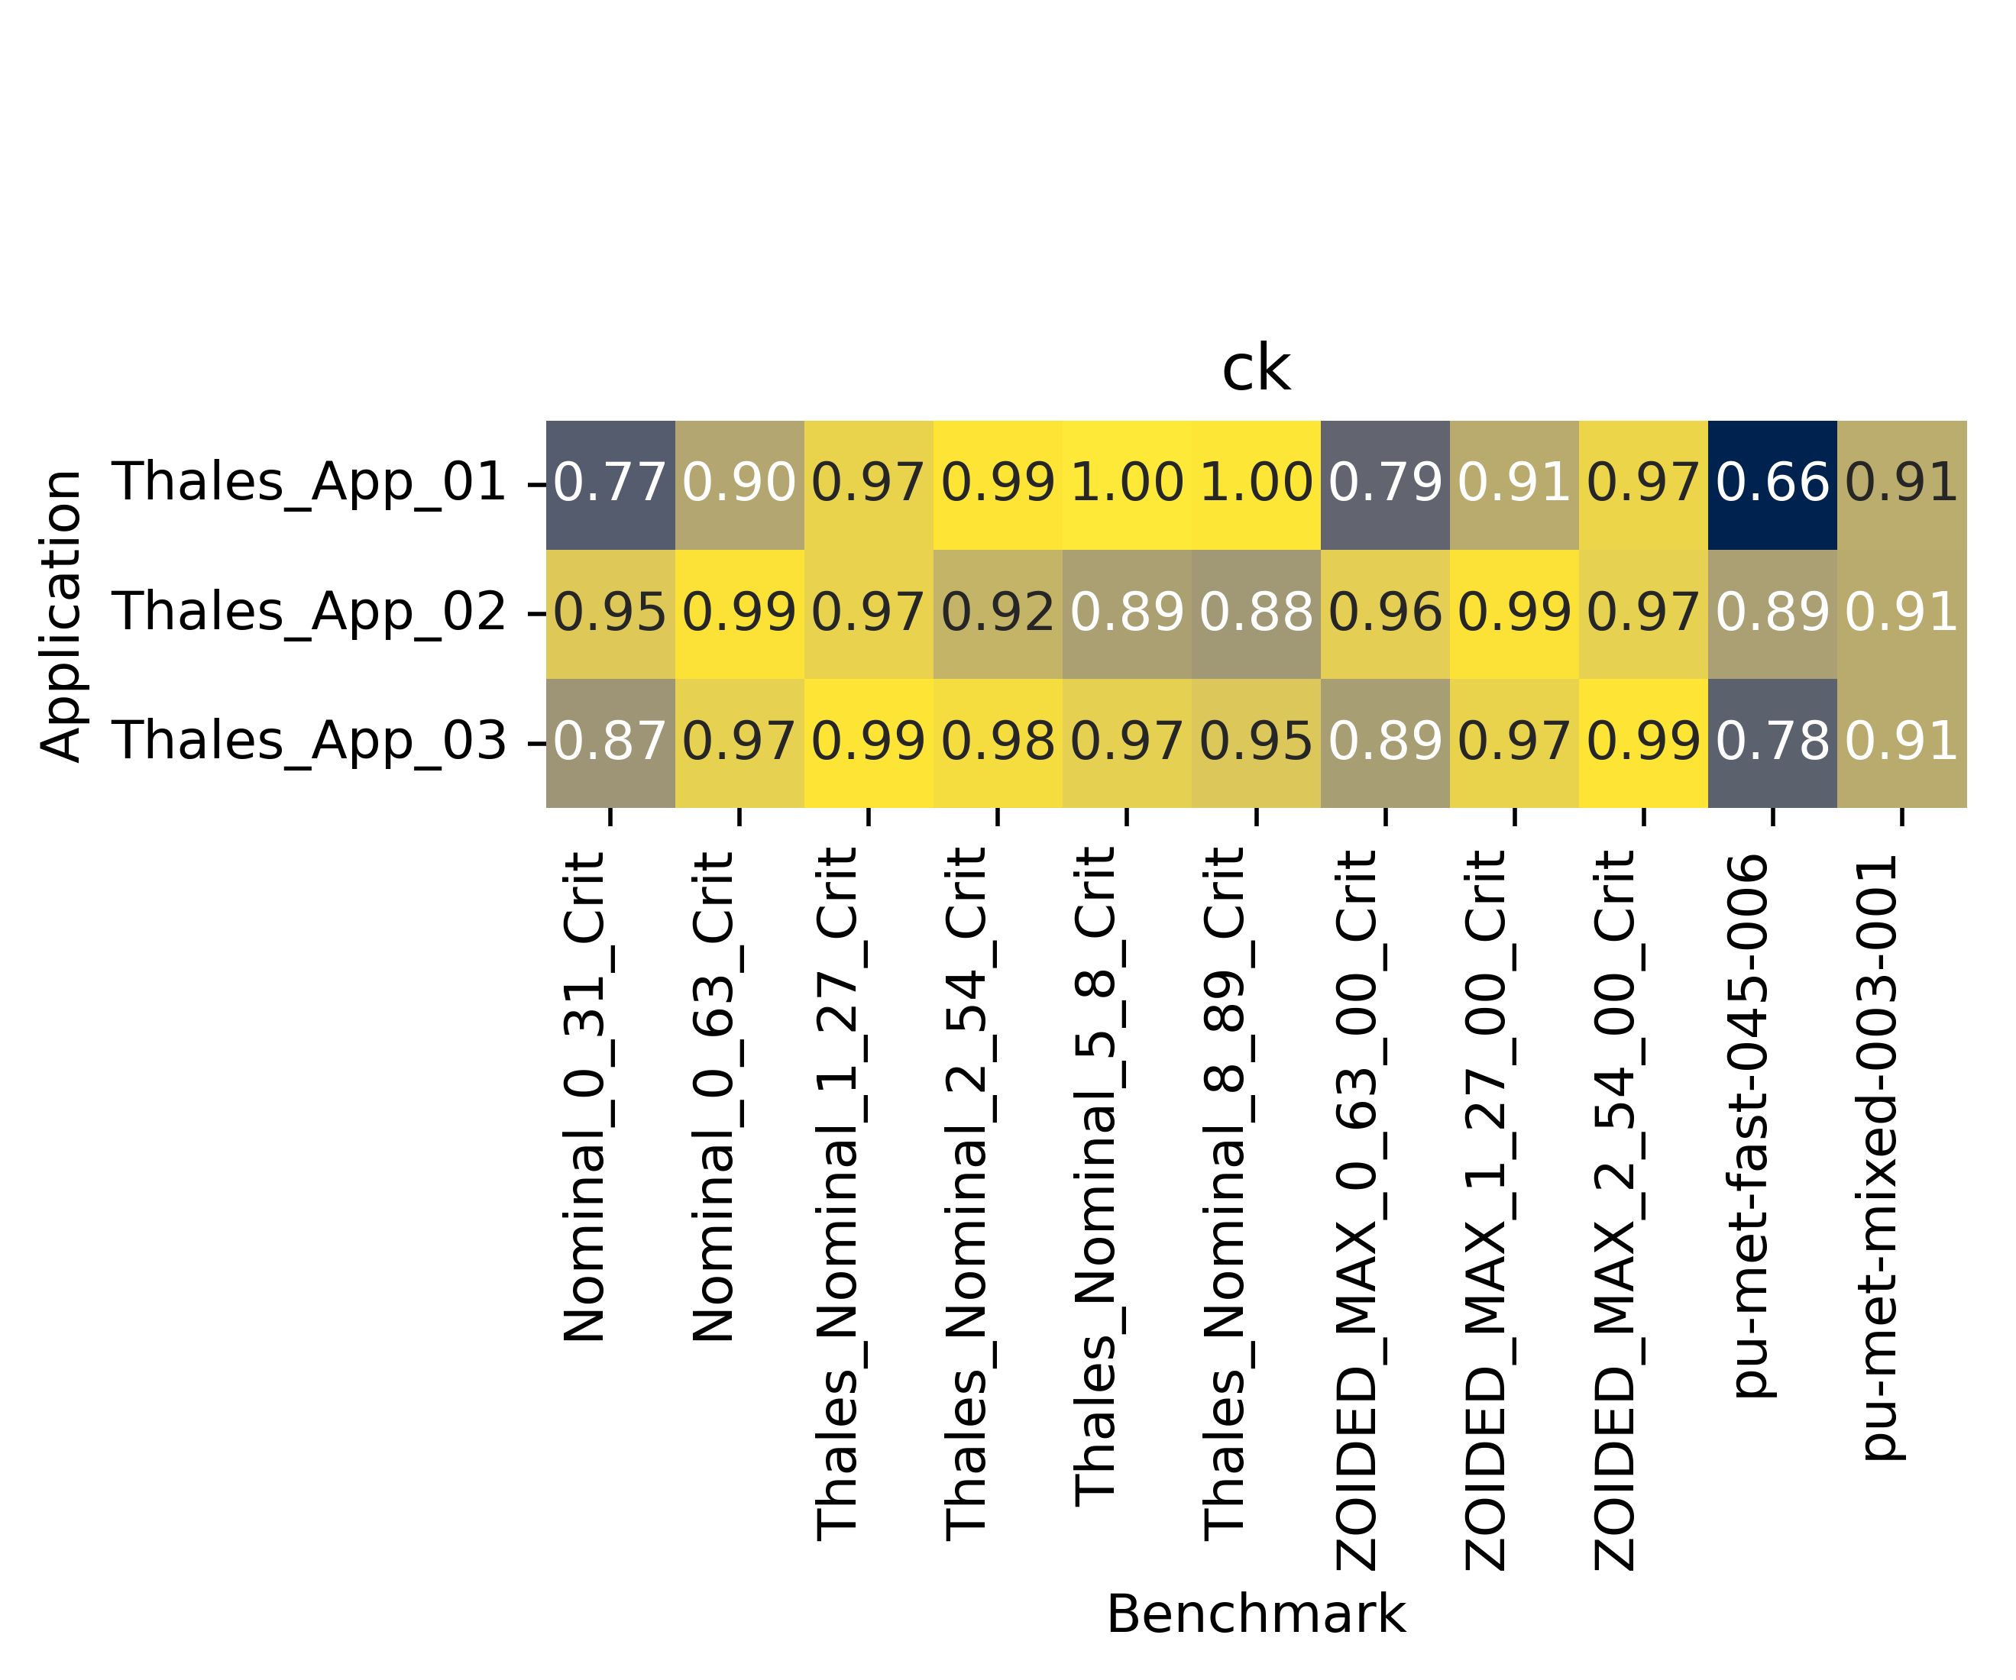
Results: c_{k}
Shift in c_{k} results from BLO (left) to VIII.1 covariances (right)
These numbers go from 1 (least Ta mass) to 9 (most Ta mass)
1 3 5 7 8 9 2 4 6
1 3 5 7 8 9 2 4 6
Most Ta
Least Ta
ck is generally lower for VIII.1
\\slip.lanl.gov\NCERC\Software\whisper-tk\Output\Thales_22_e80_e81JSON_51_nof_noi

Slide 14
Conclusions
Nuclear data uncertainties and similarity metrics were investigated for the Thales design
Nuclear data uncertainties decrease dramatically from BLO to ENDF/B-VIII.1 covariances
But Ta181 is still a large contributor to total nuclear data uncertainty
Similarity metrics were utilize to down-select among proposed experiment design files
Four configurations can be utilized to have good performance for all of the metrics

Slide 15
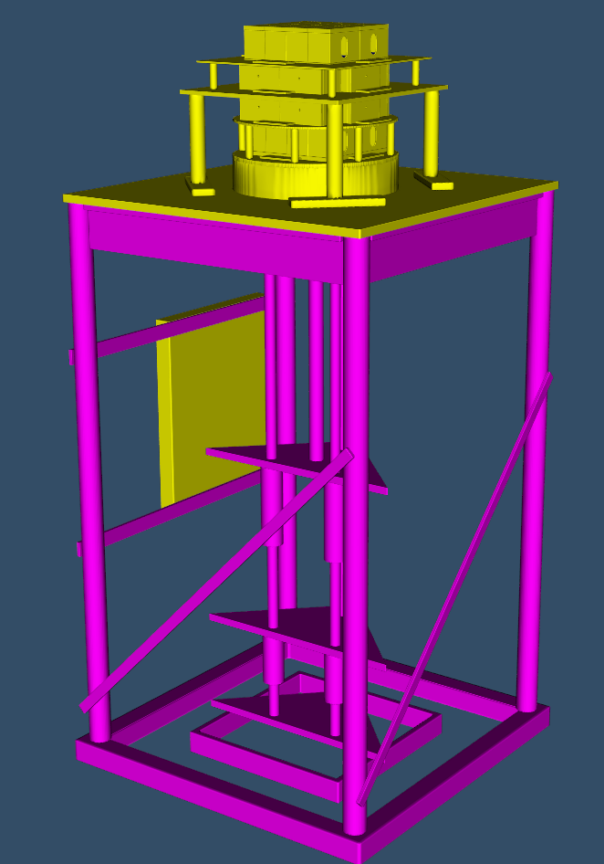
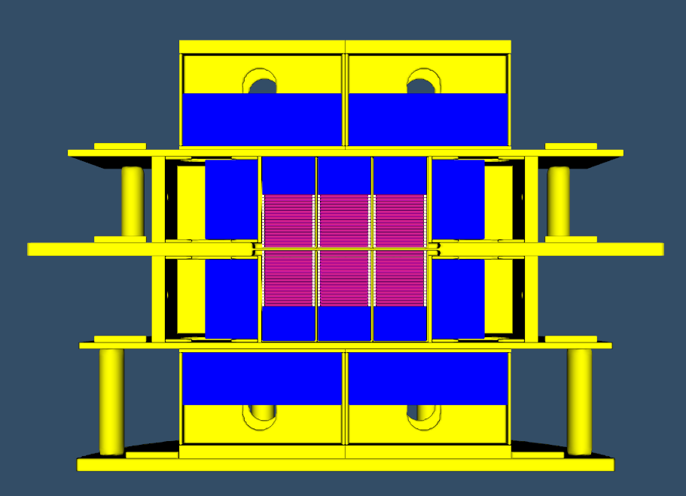
Future work
Procure all materials
Perform experiments at NCERC!

Slide 16
Many ENDF/B-VIII.[0,1] ND Covariances Need Fixing
Before successful usage in NCS/Whisper applications, correlations in ND covariances should only exist between -1,1.
Some numerical round-off issues are typically not concerning
Nearly half of the ENDF/B-VIII.[0,1] covariances are likely unusable by Whisper as is
Number of Isotopes with Inappropriate Correlations | Whisper-1.1 (407) | ENDF/B-VIII.0 (246) | ENDF/B-VIII.1 (266)
# 𝜌 < -1 # 𝜌 > +1 | 23 (5%) 162 (40%) | 136 (55%) 241 (98%) | 149 (56%) 264 (99%)
# 𝜌 < -1.00015 # 𝜌 > +1.00015 | 0 0 | 136 (55%) 127 (52%) | 149 (56%) 140 (53%)
# 𝜌 < -1.1 # 𝜌 > +1.1 | 0 0 | 130 (53%) 125 (51%) | 145 (55%) 137 (52%)

Slide 17


Acknowledgments
NCERC is supported by the DOE Nuclear Criticality Safety Program, funded and managed by the National Nuclear Security Administration for the Department of Energy.
Los Alamos National Laboratory is operated by Triad National Security, LLC, for the National Nuclear Security Administration of the US Department of Energy under Contract No. 89233218CNA000001.

Slide 18
Backup

Slide 19
Investigation of Ta-181 Relative Covariances
7.1/BLO
ENDF/B-VIII.1
Energy
Energy
Notes:
More reactions and smaller uncertainties in ENDF/B-VIII.1

Slide 20
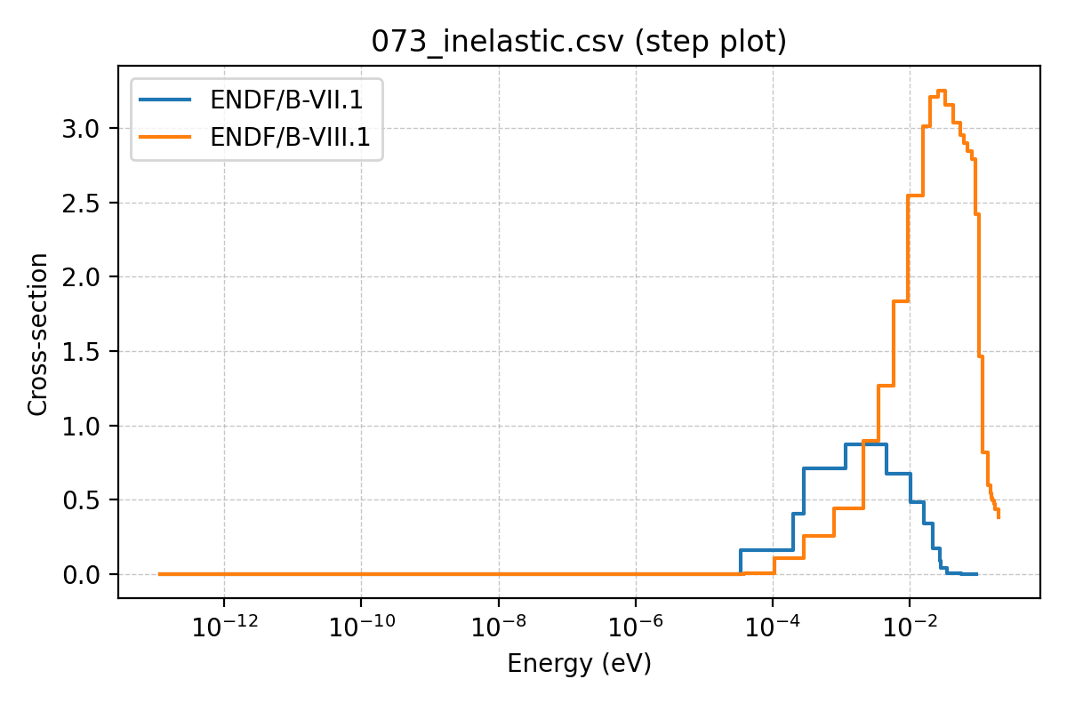
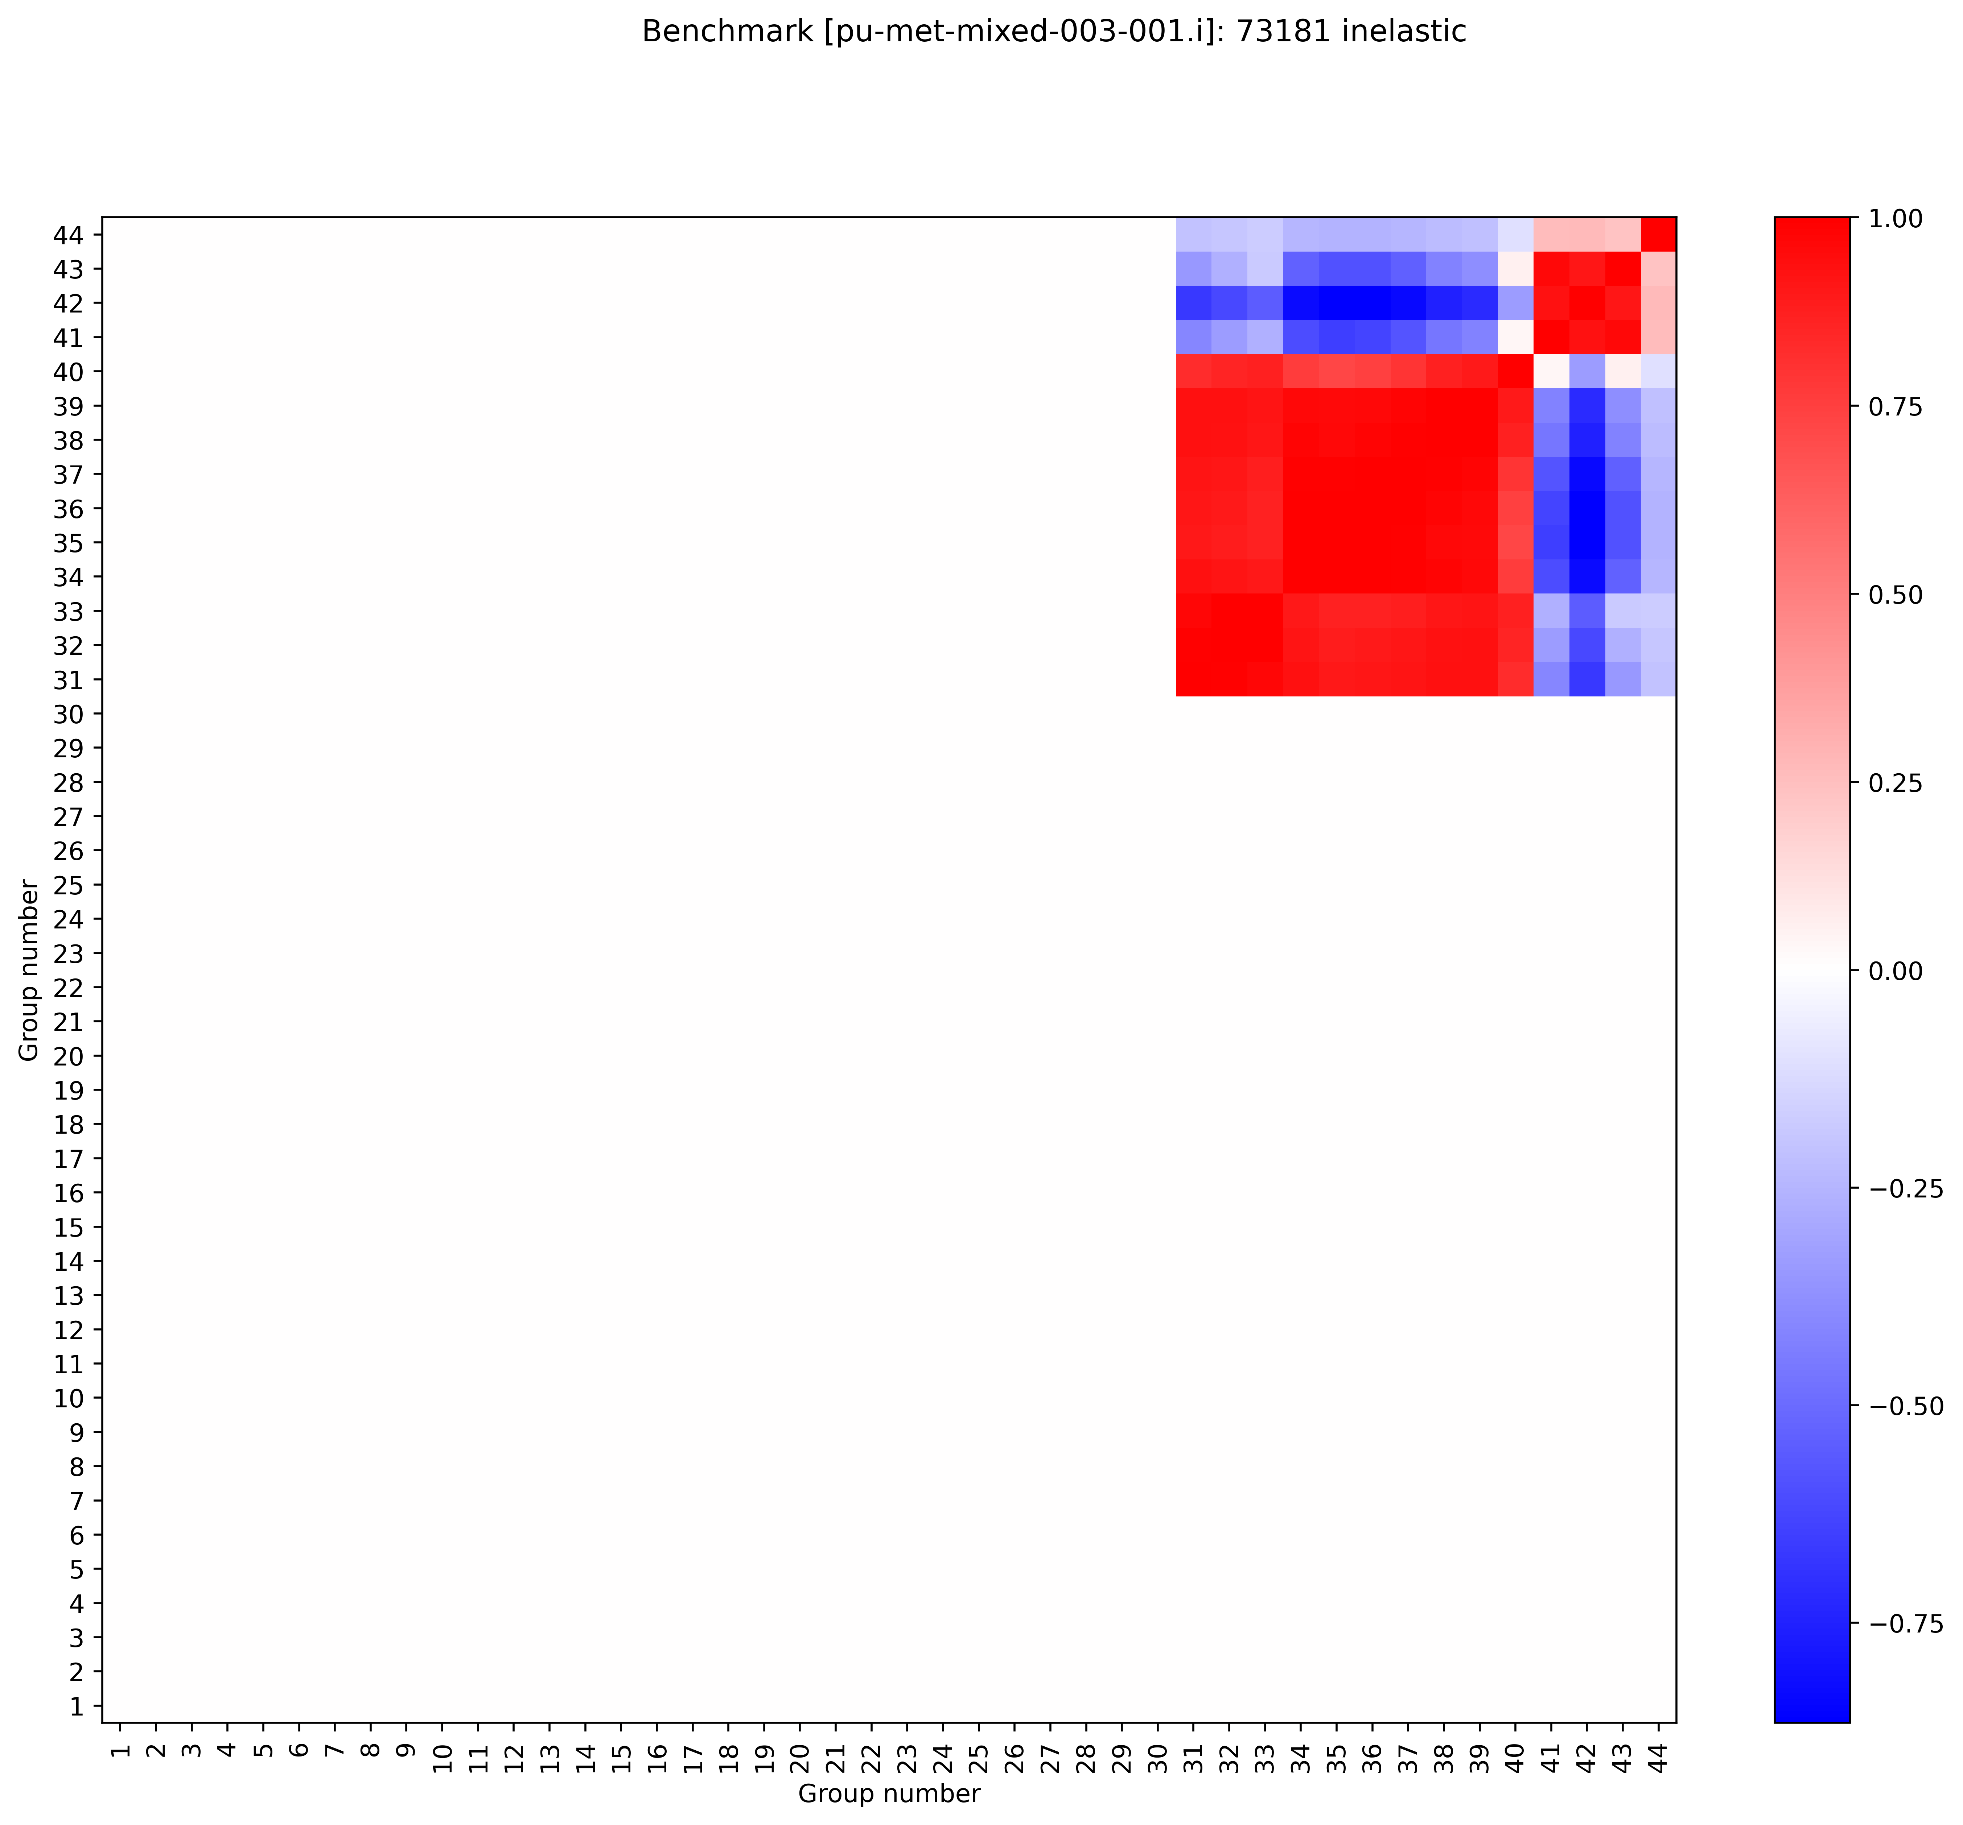
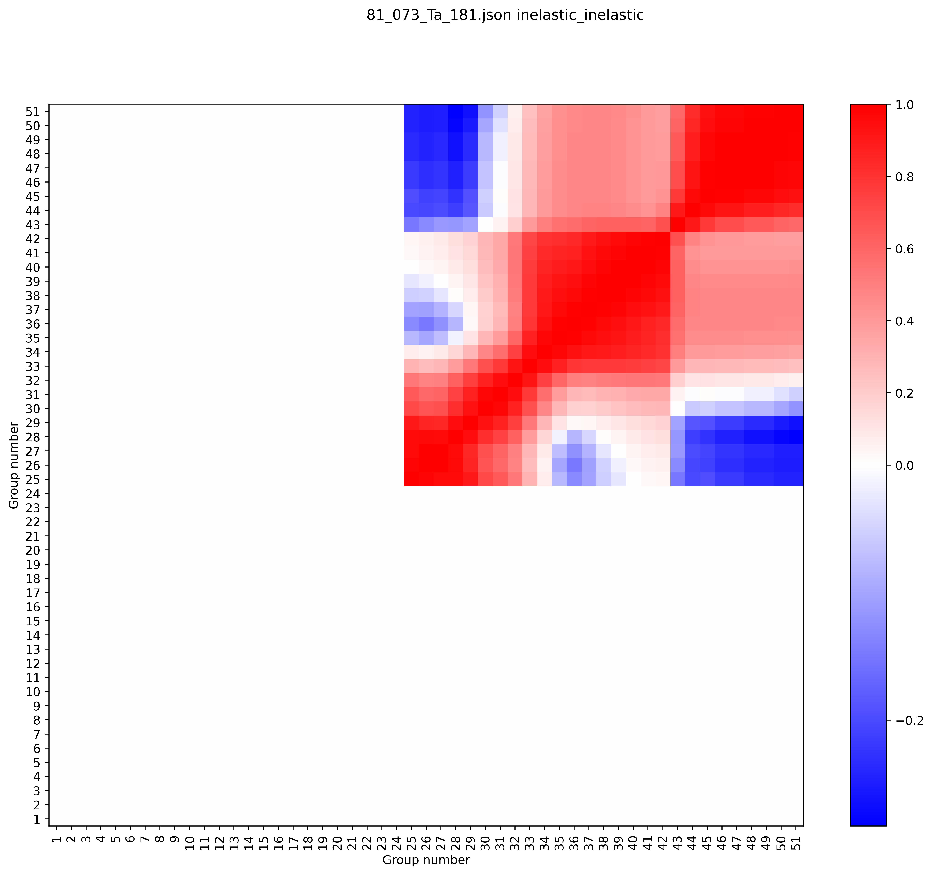
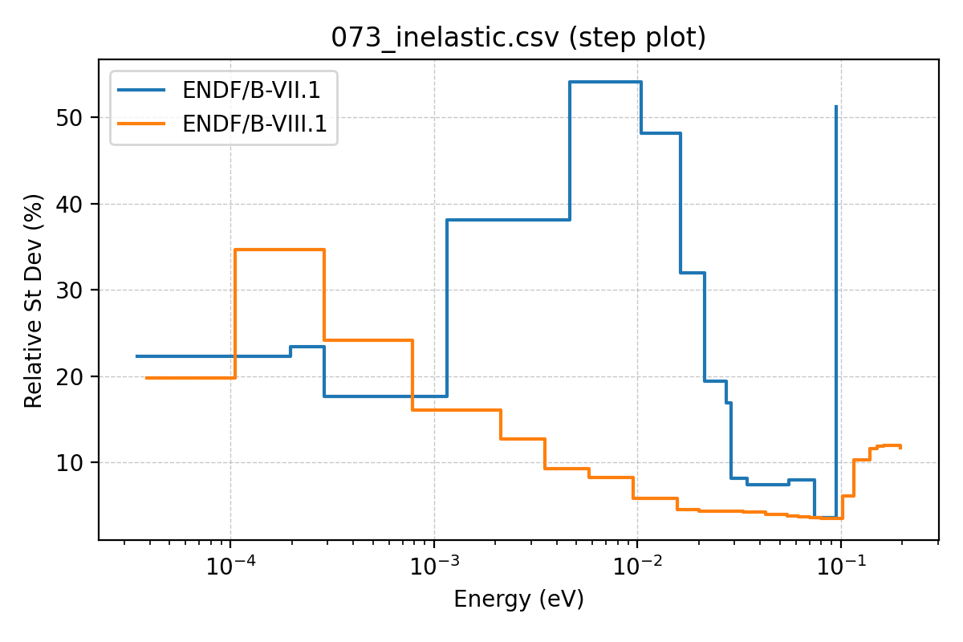
Inelastic comparison
7.1/BLO correlation plot
8.1 correlation plot

Slide 21
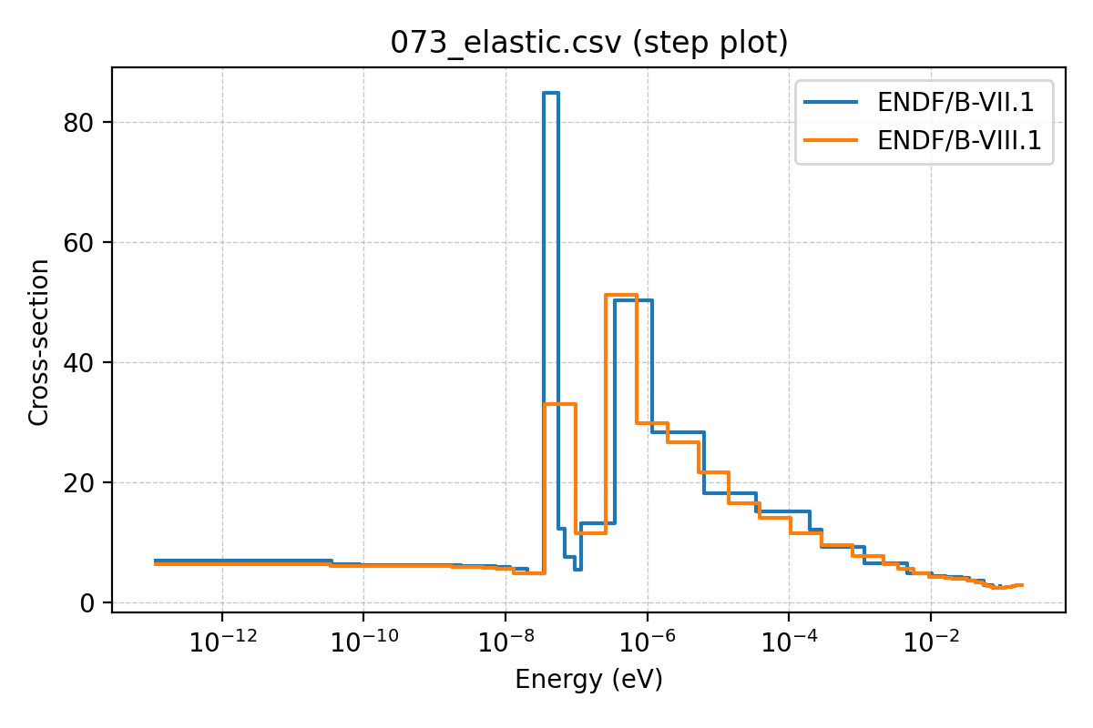
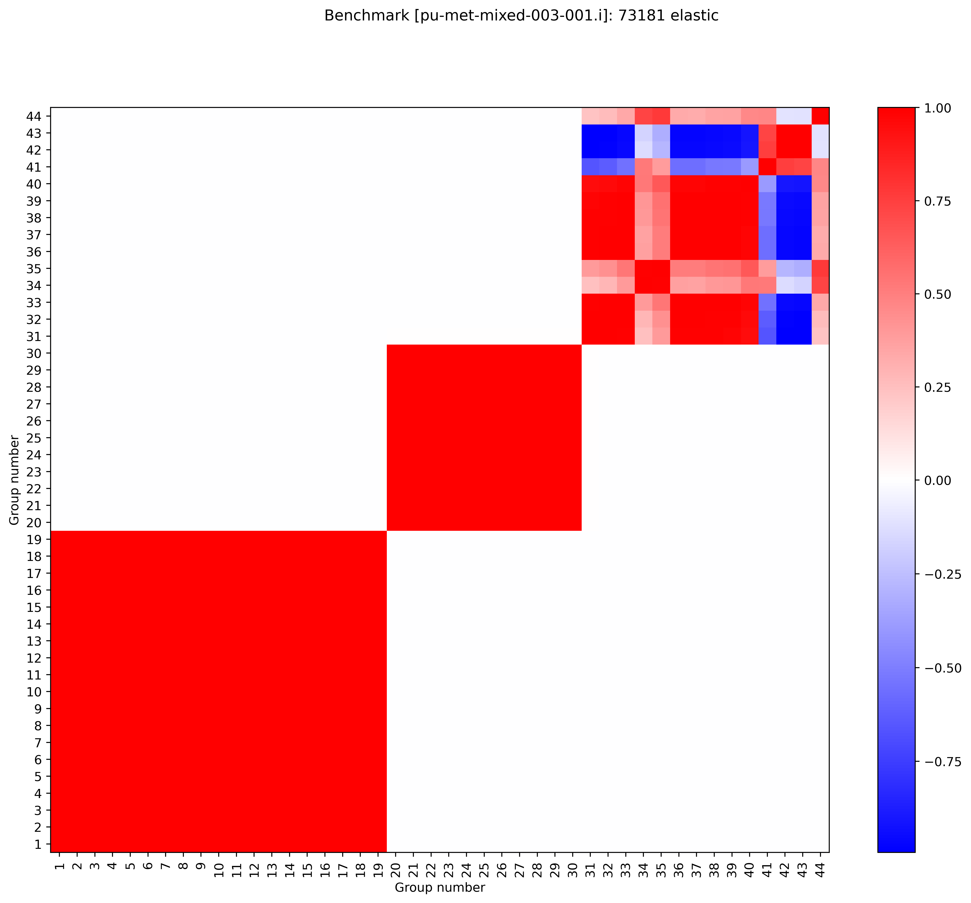
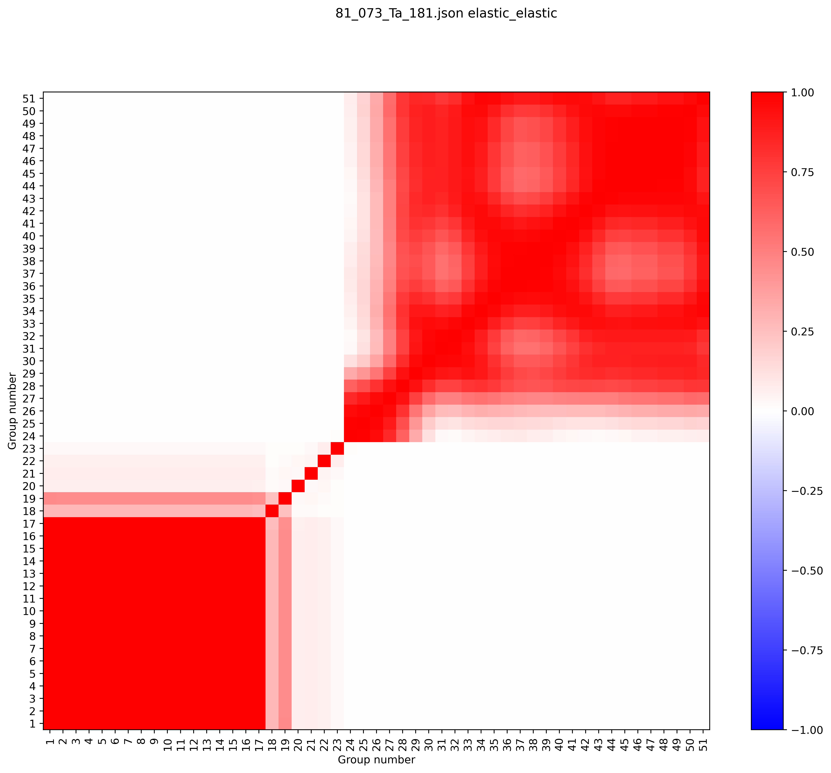
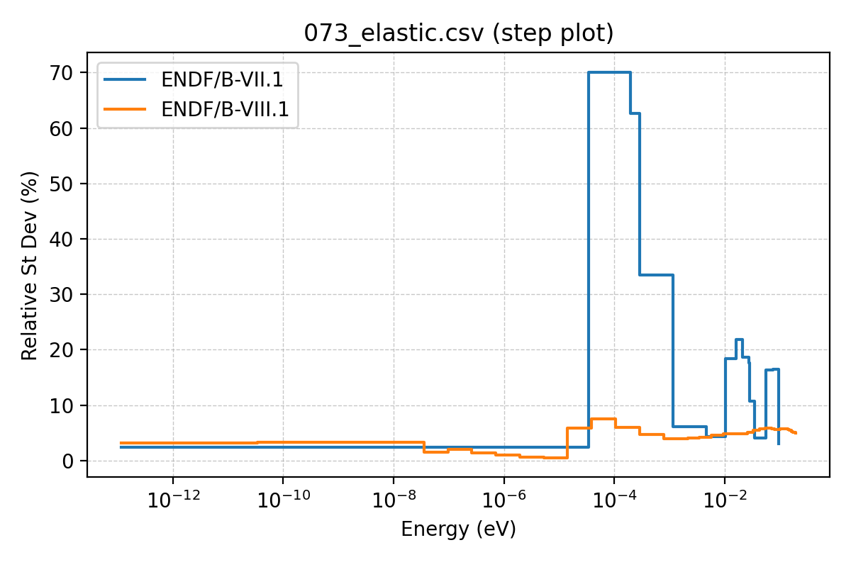
Elastic comparison
Also a dramatic reduction for 8.1
7.1/BLO correlation plot
8.1 correlation plot

Slide 22
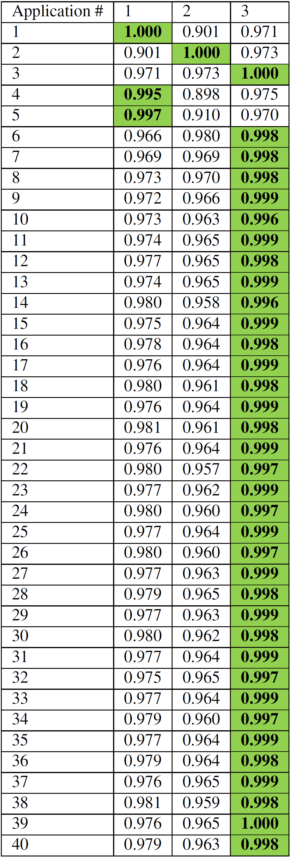
Similarity metric results
All values with c_{k}>0.99 are shown in green.
From previous work:
c_{k} for the 40 applications.
Actually a 40x40 matrix.
Values along the diagonal are 1 by definition.
A01 has c_{k}>0.99 for A04 and A05.
Application A02 has c_{k}<0.99 compared to other applications.
A03 has c_{k}>0.99 for A06-A40.
A maximum of three application models (A01, A02, and A03) are needed.
One could argue that 0.99 is too strict.
If so, maybe only 1 model is needed.
Results of filtered c_{k} (only ¹⁸¹Ta elastic or inelastic) are not shown:
>0.99 between each pair of the 40 applications.

Slide 23
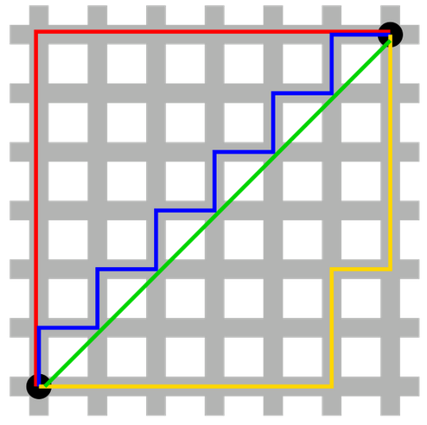
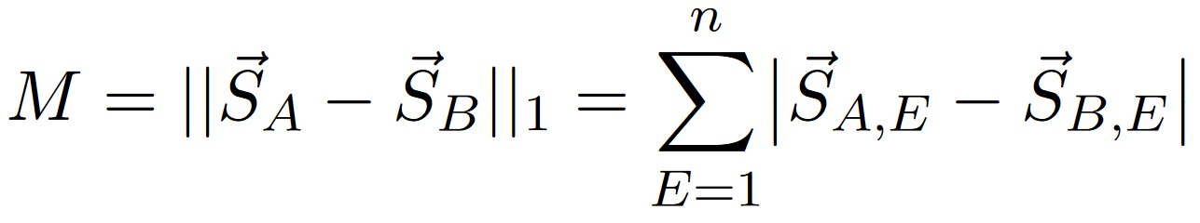
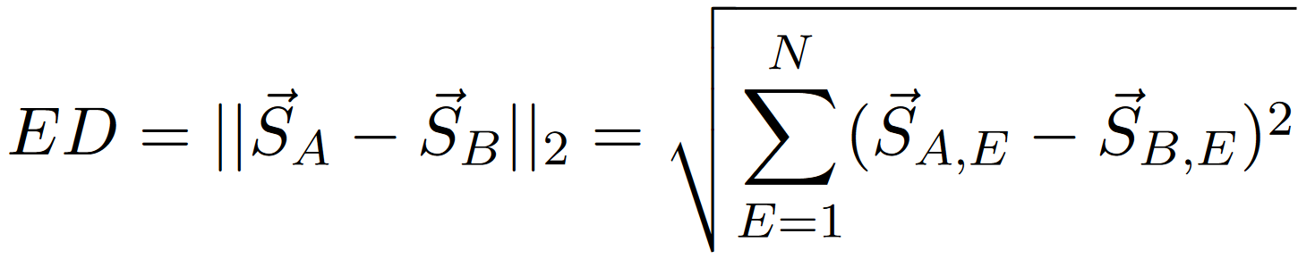
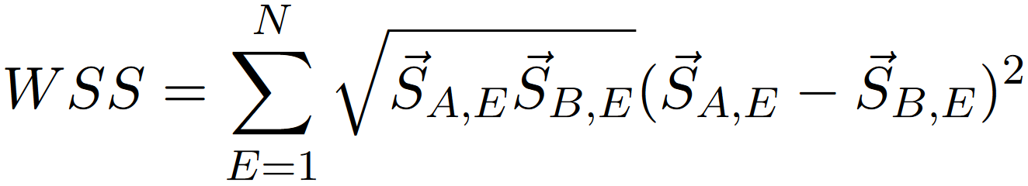
Methodology
B
Note that these three metrics are really only applicable if the sensitivity vectors are filtered
You can still compute it using all reactions, but the results won’t make sense
So all of these equations are assuming the vectors are filtered (to Ta181 scattering)
Additional nomenclature notes:
1 and 2 are the L1 and L2 norms
E refers to energy
A
Taxicab geometry, Wikipedia

Slide 24
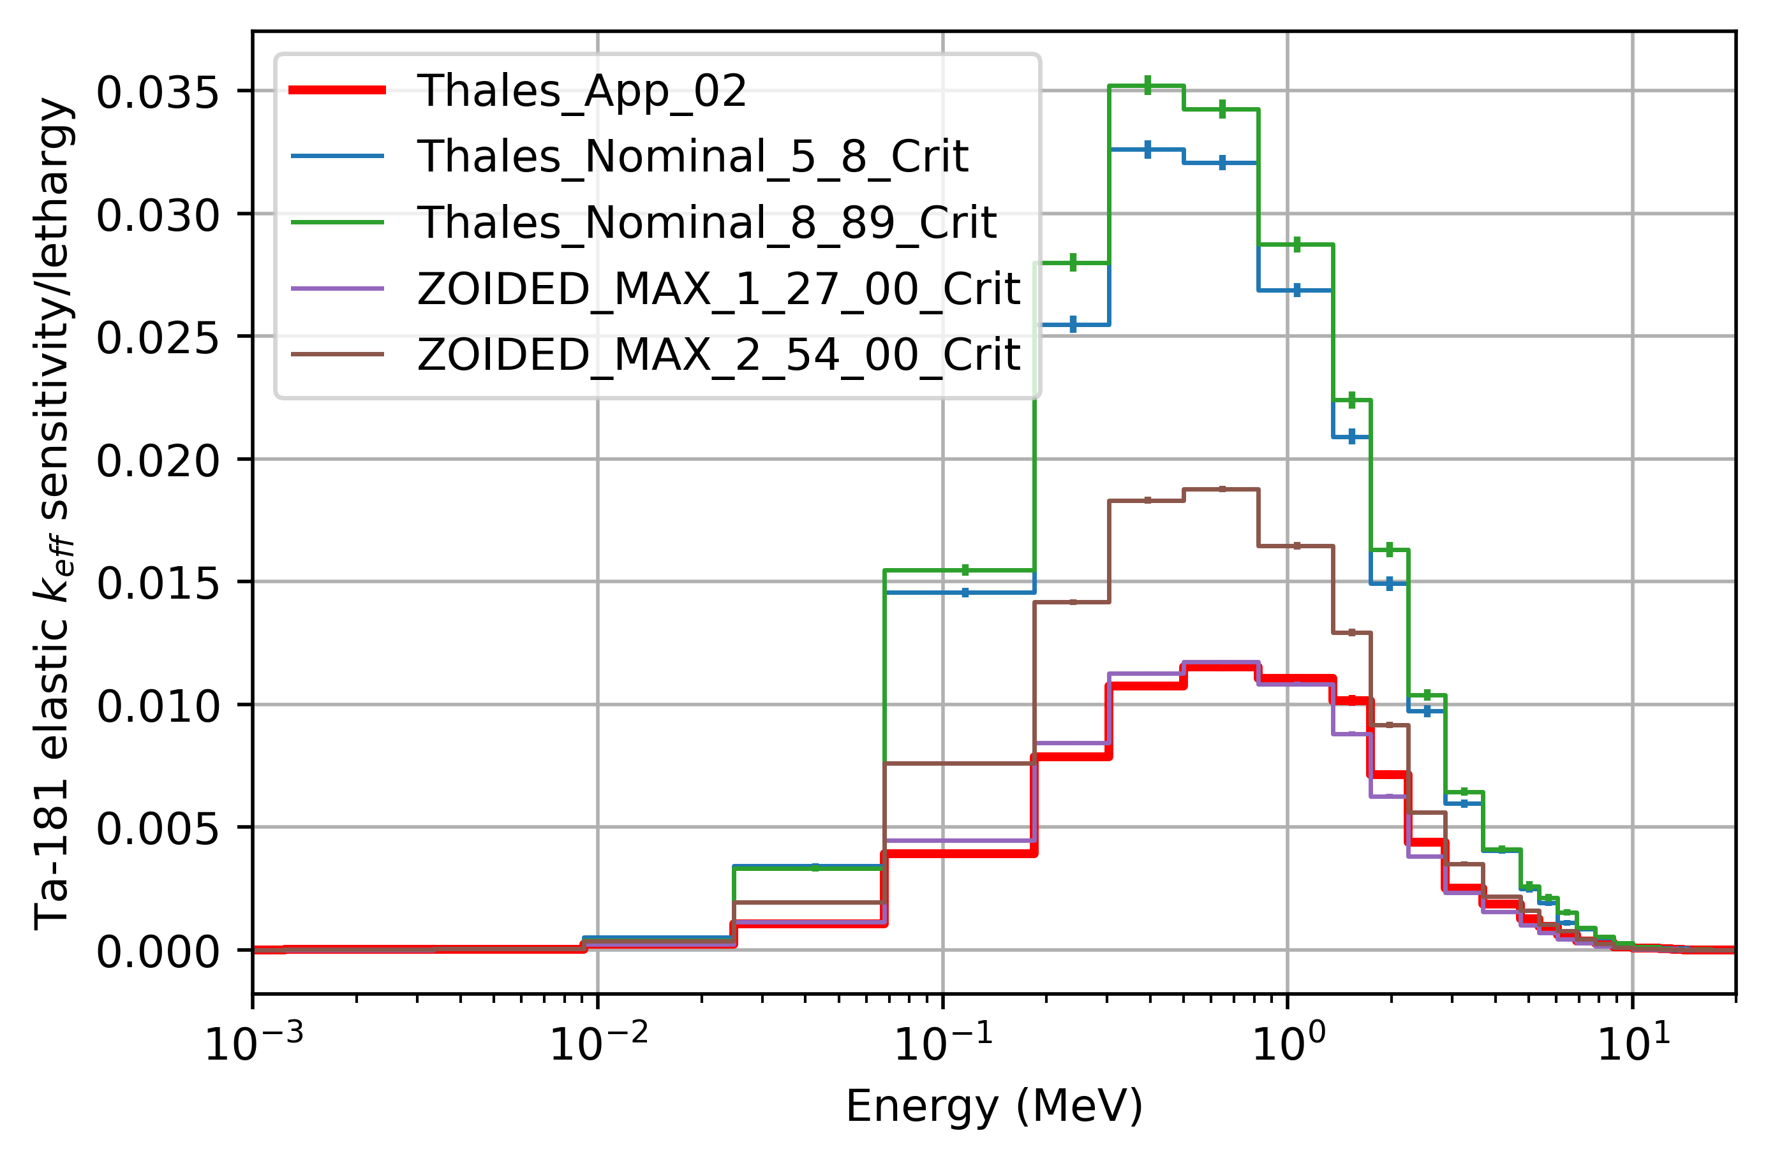
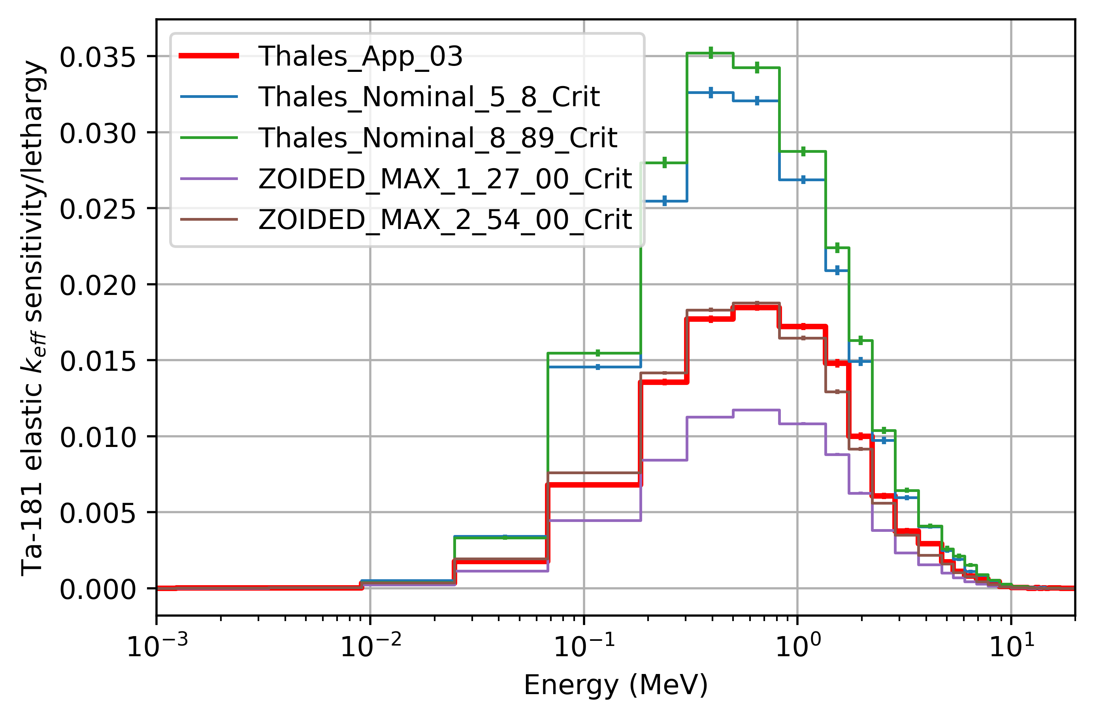
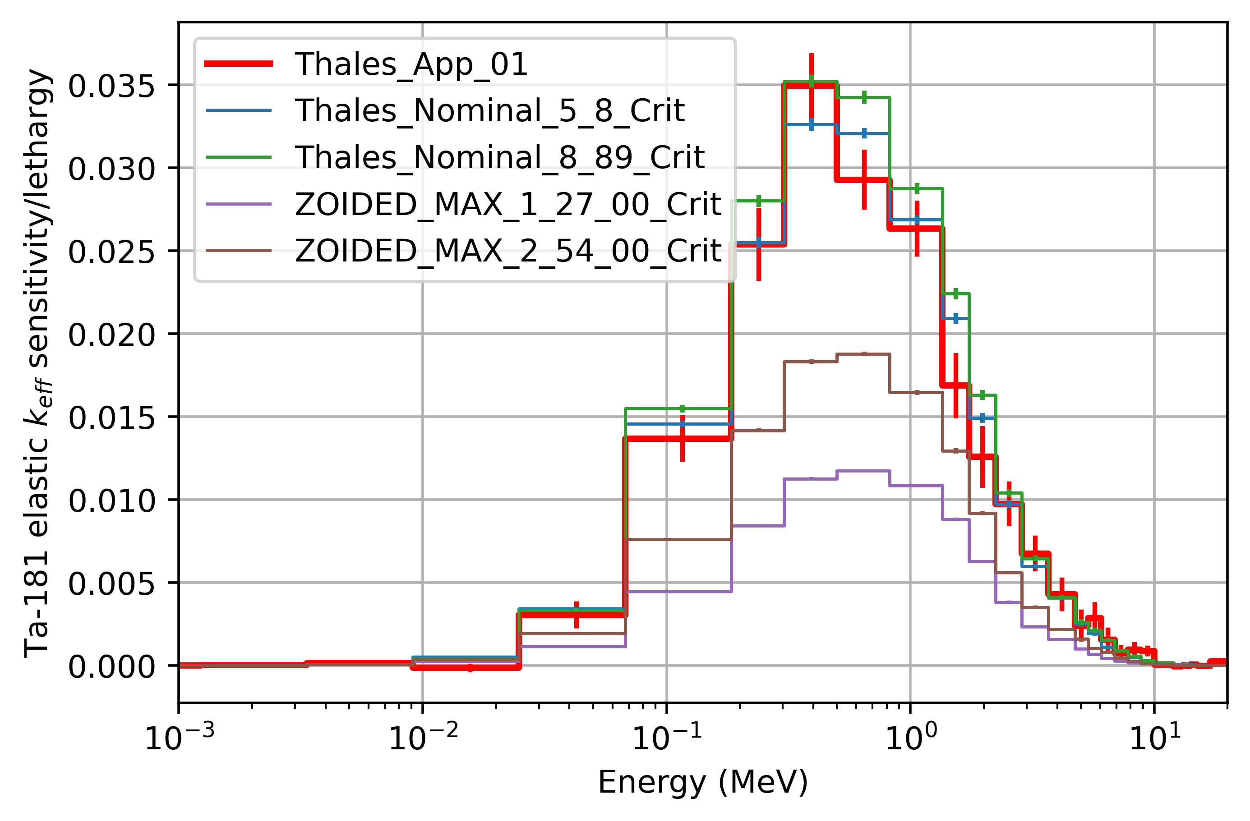
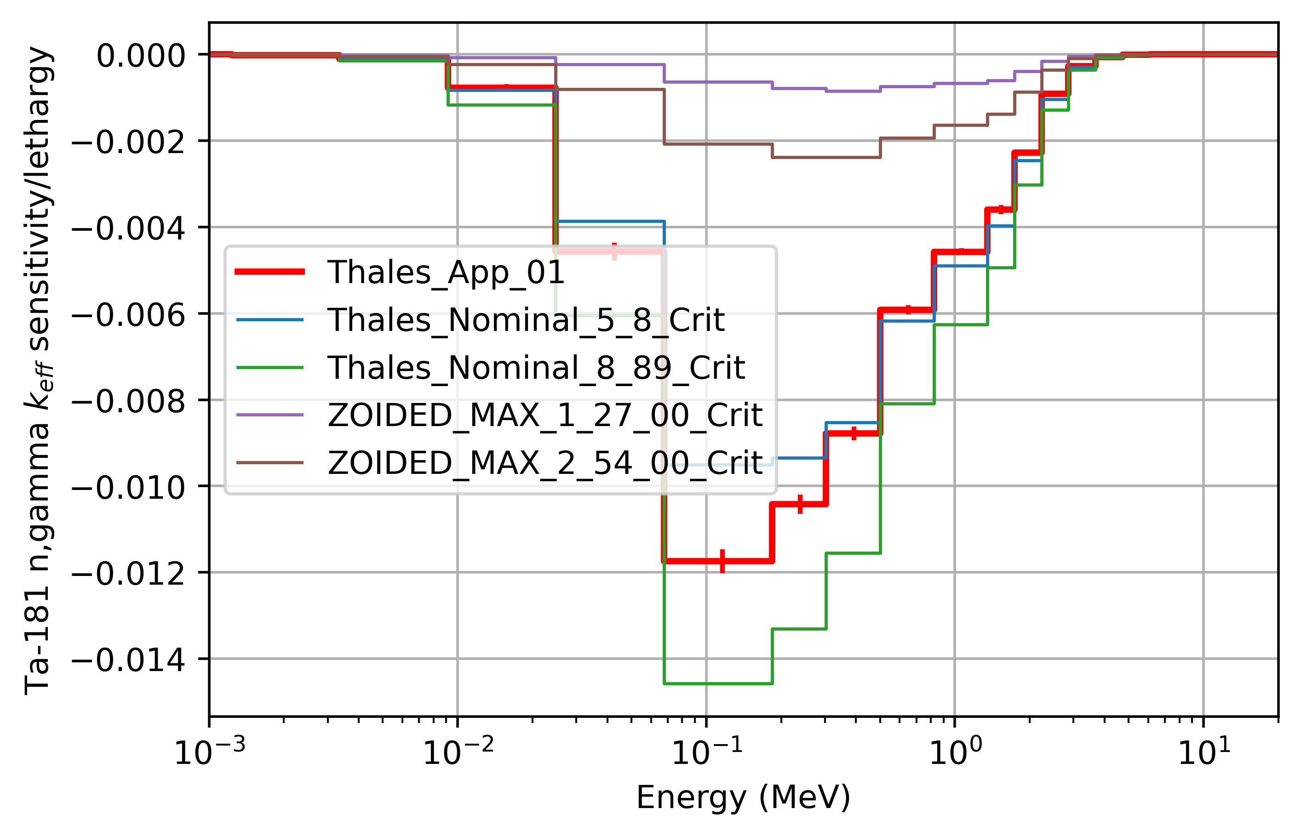
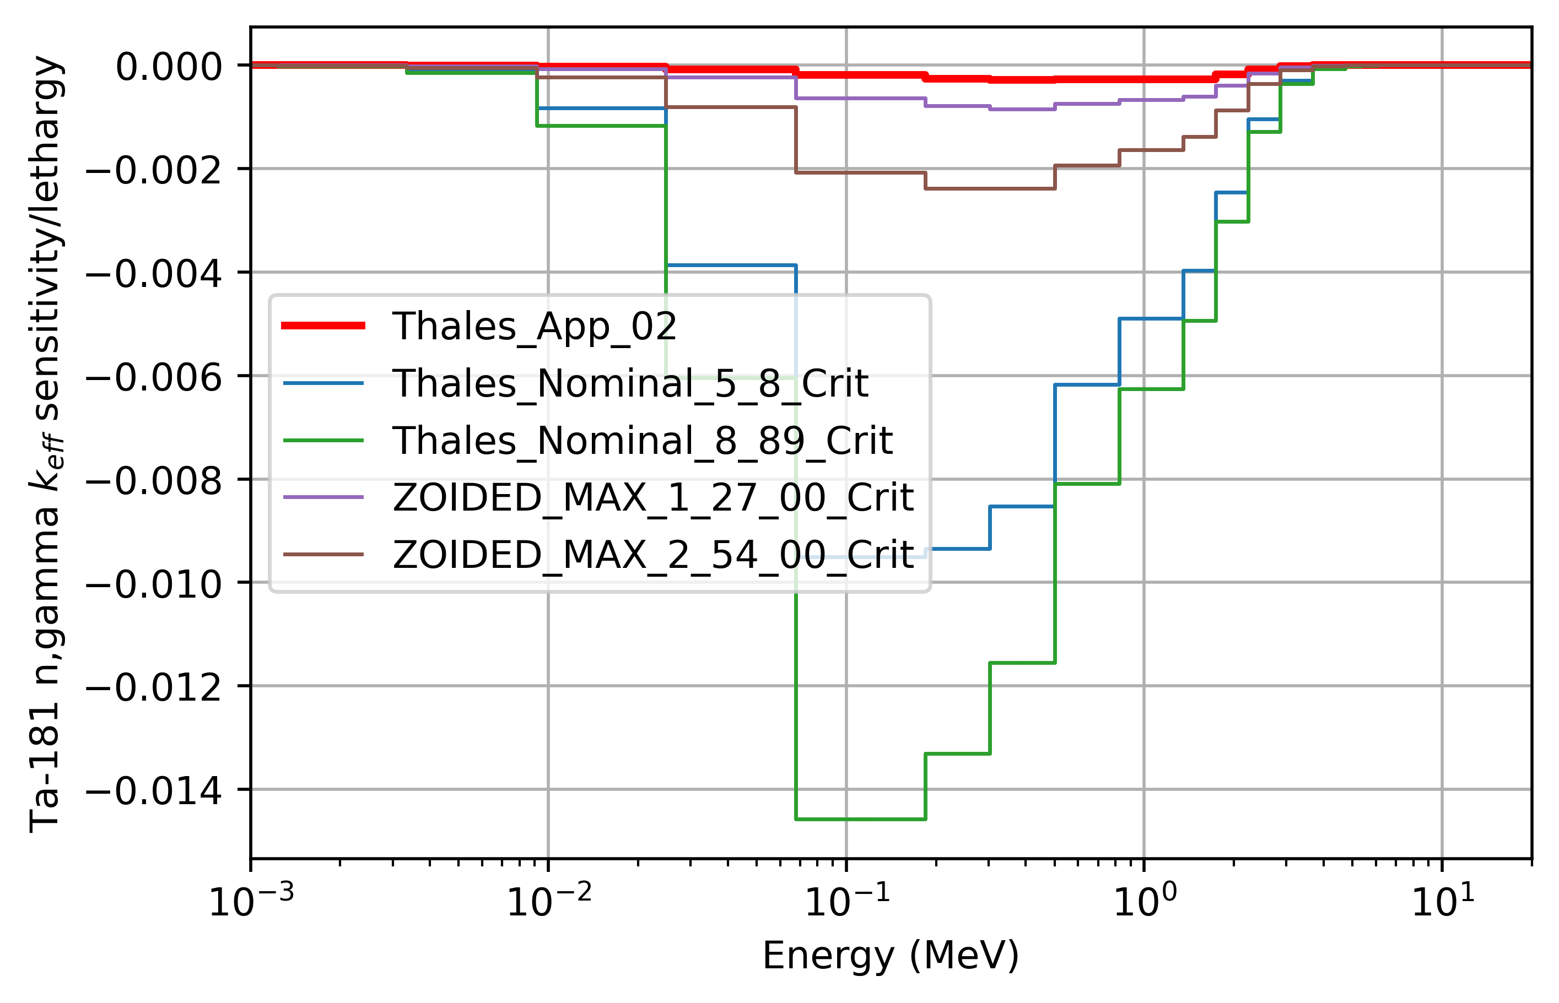
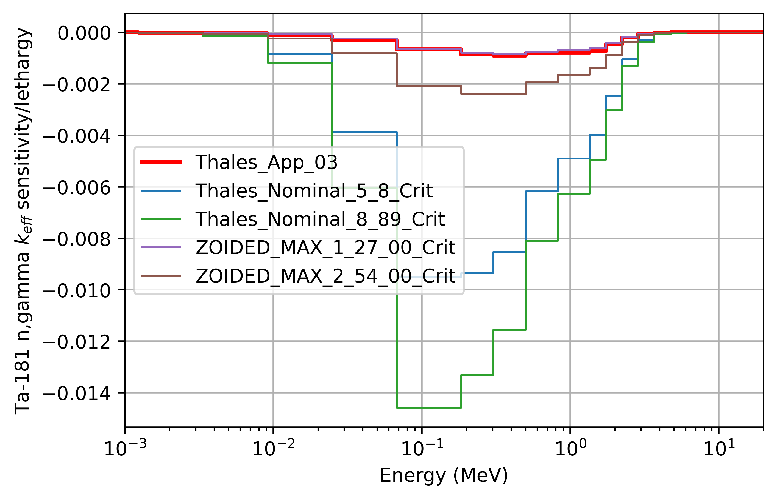
Results: summary

Slide 25
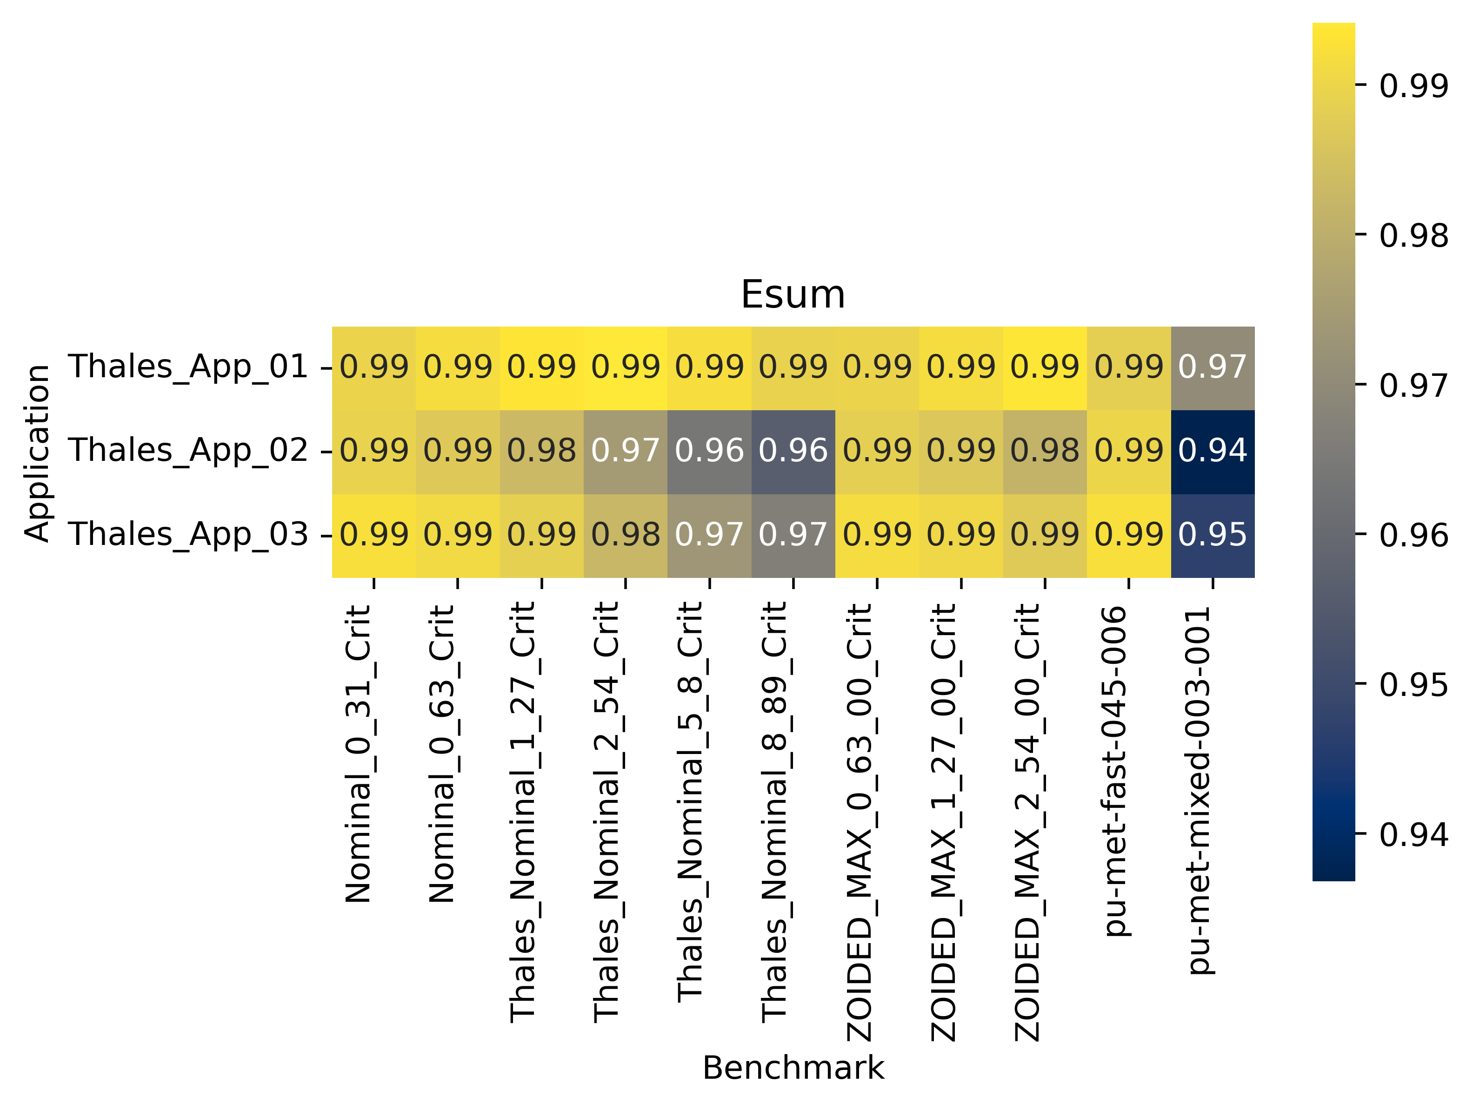
Results: E_{sum}
E_{sum} is not very interesting since nearly all values are >0.99
Note that PMF045-006 has values of >0.99 for all three applications
These results include all nuclide/reaction pairs and the results are being dominated by Pu239
\\slip.lanl.gov\NCERC\Software\whisper-tk\Output\Thales_22_e80_e81JSON_51_nof_noi

Slide 26
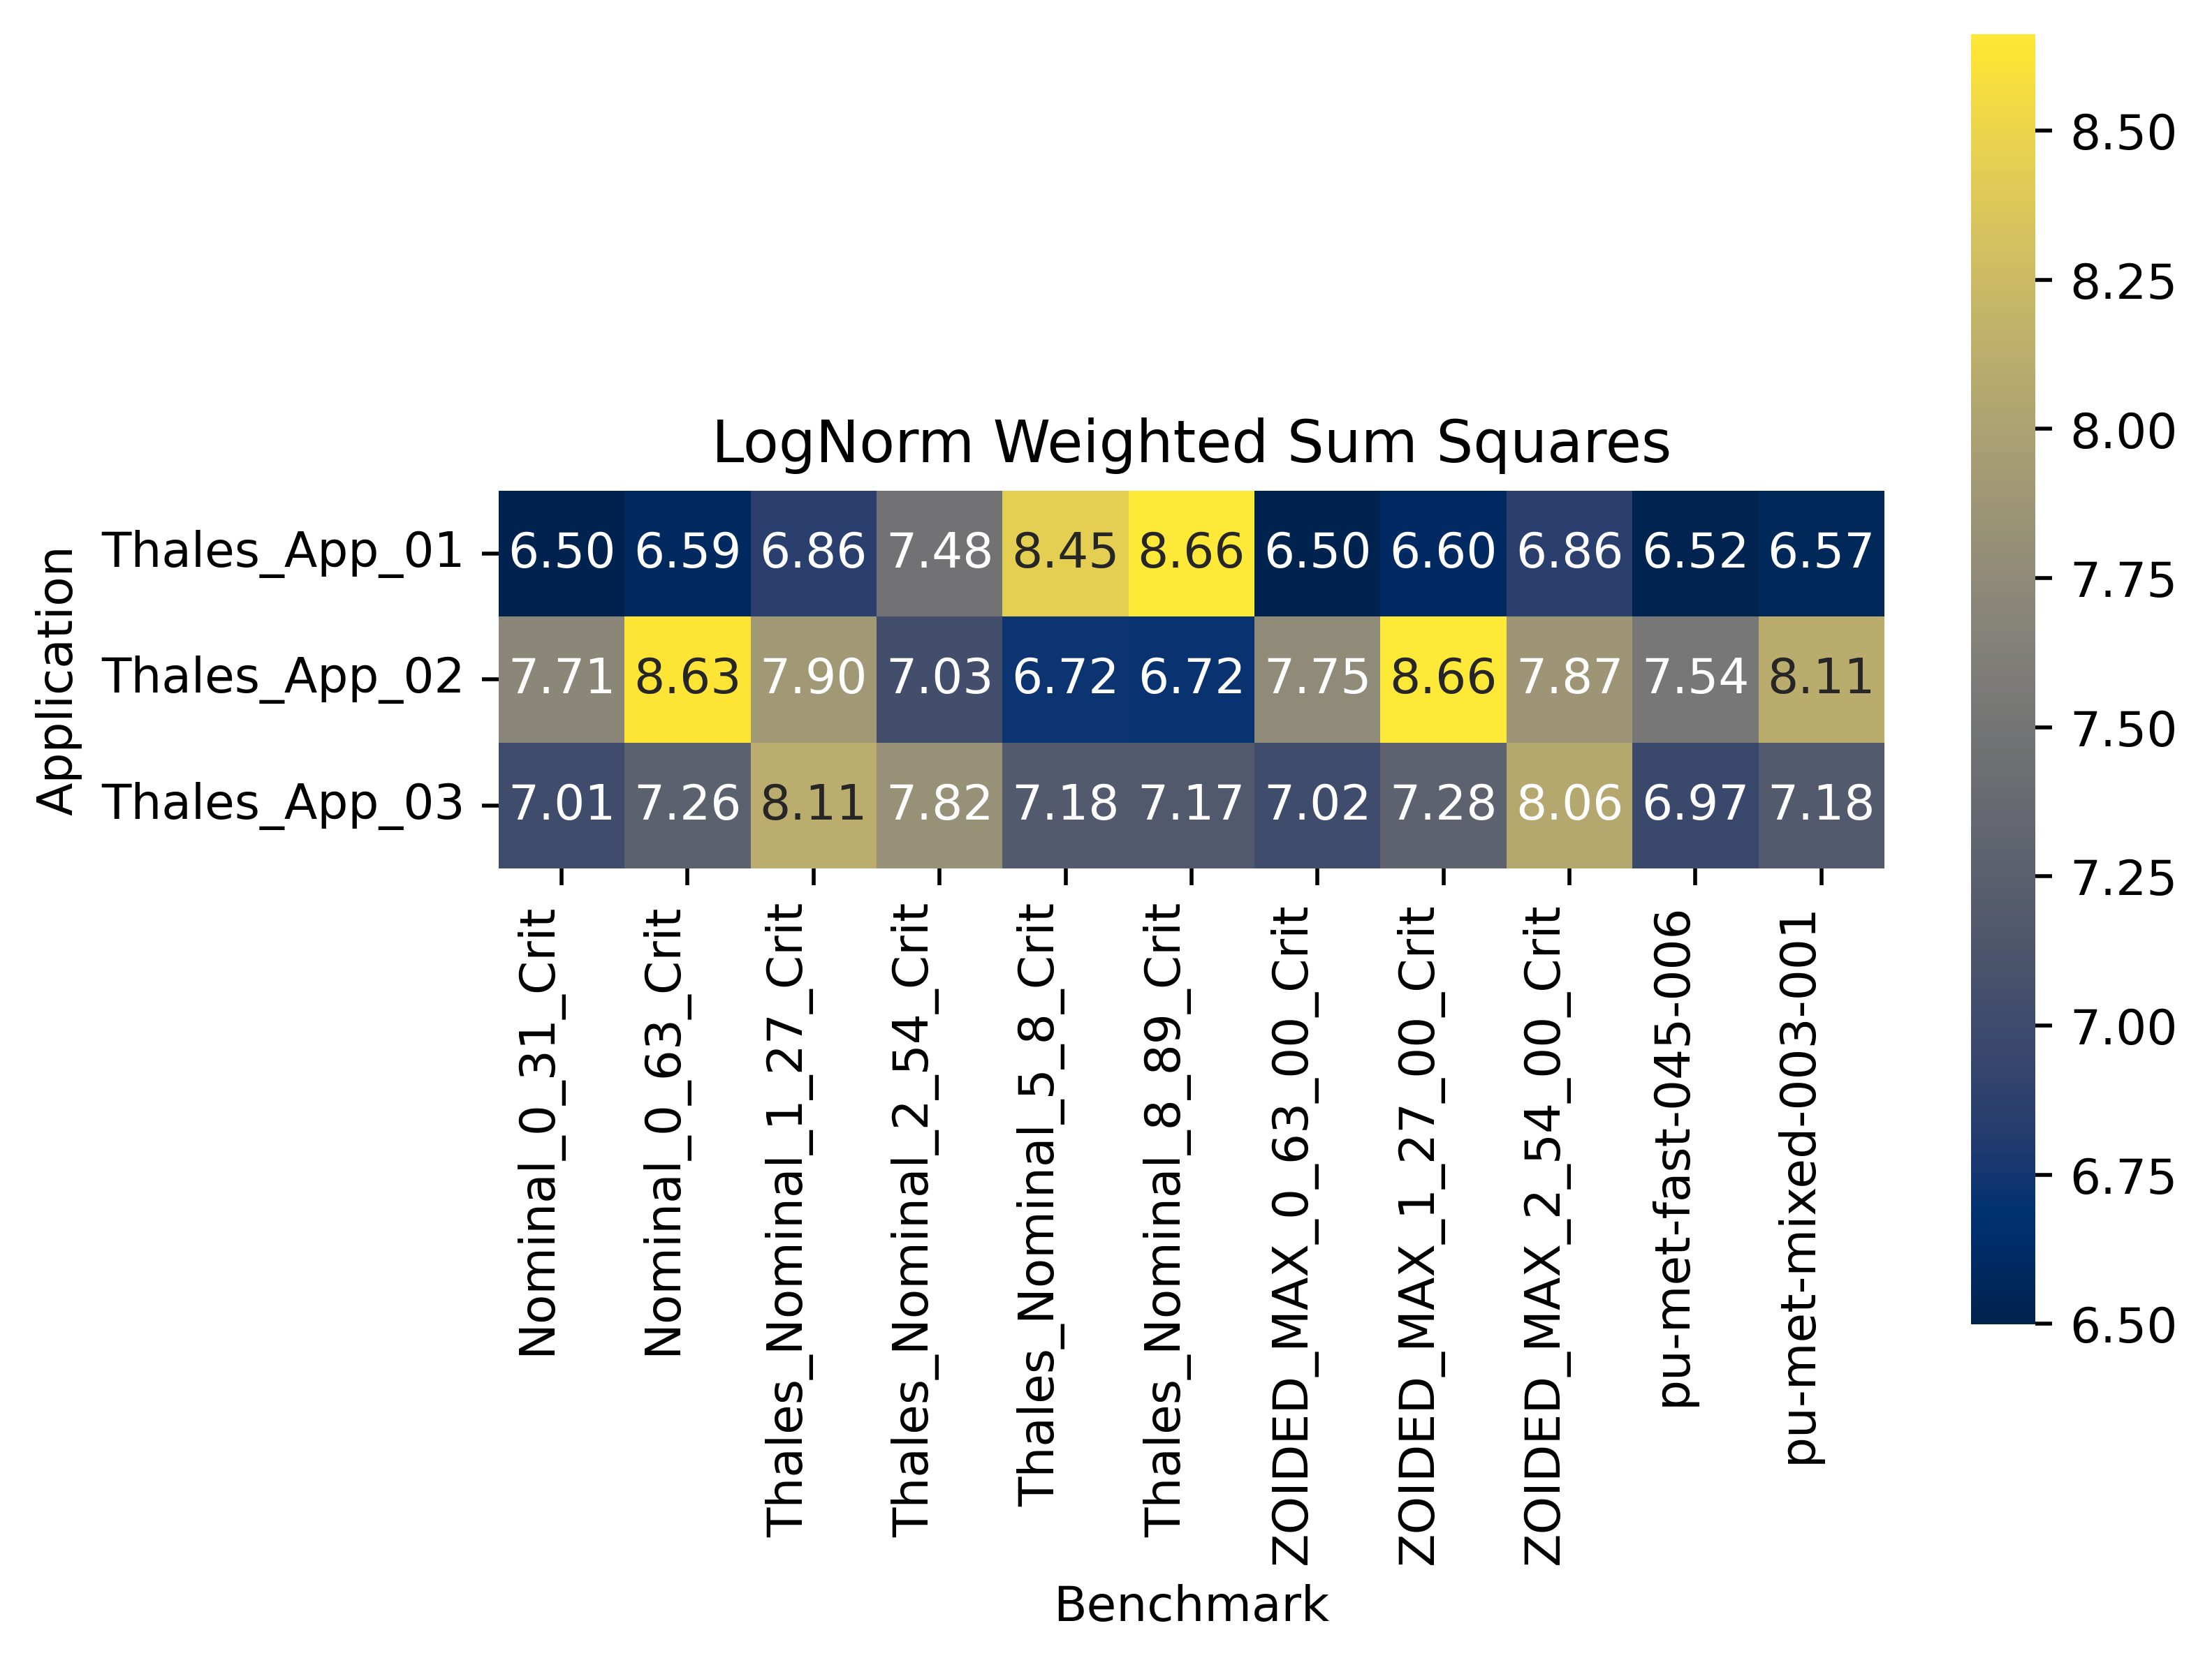
Results: WSS (Ta181 inelastic)
Filtered on Ta181 inelastic
\\slip.lanl.gov\NCERC\Software\whisper-tk\Output\Thales_21_e80_e81JSON_51_Ta181in_noi

Slide 27
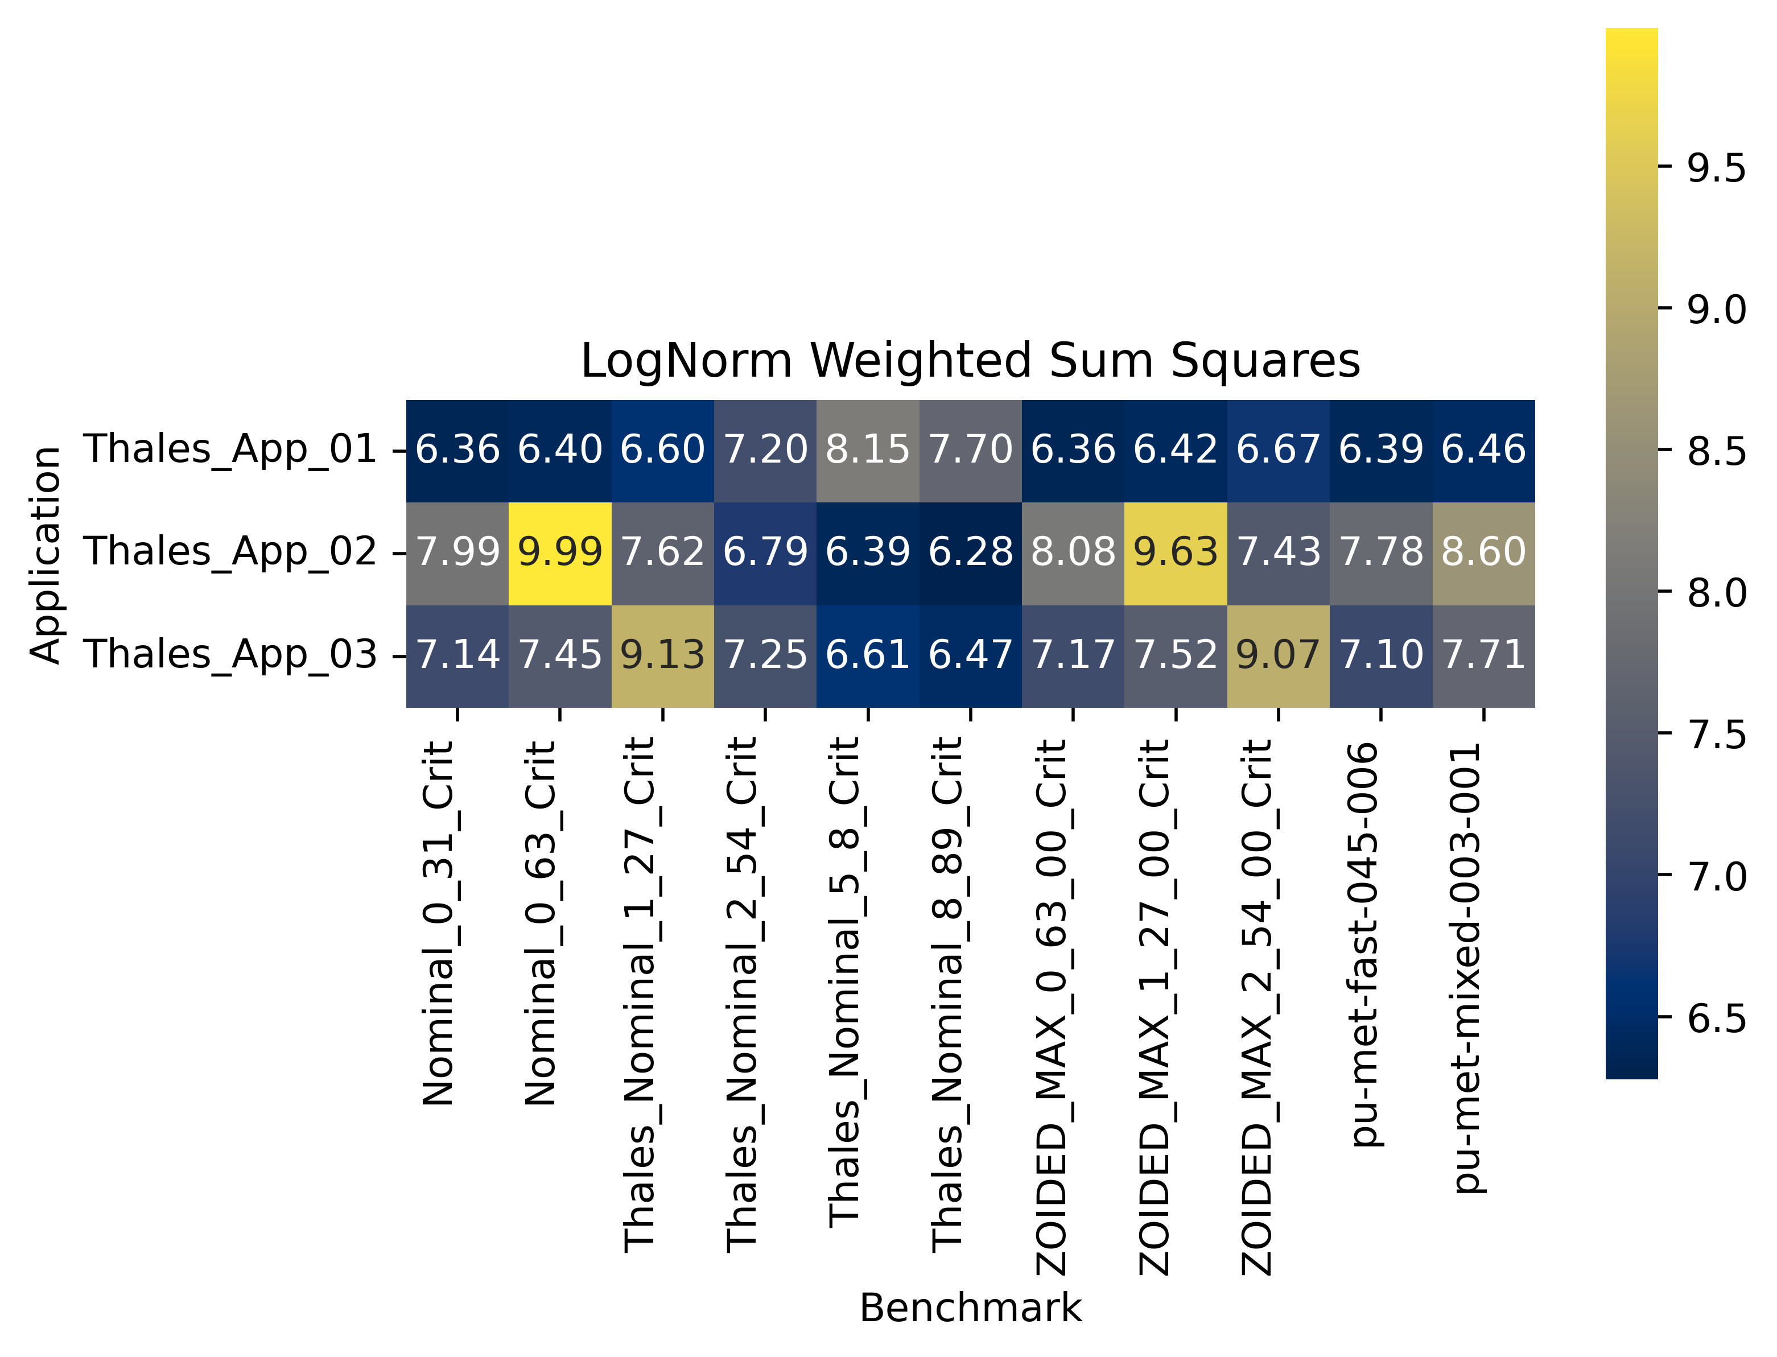
Results: WSS (Ta181 elastic)
Filtered on Ta181 elastic
\\slip.lanl.gov\NCERC\Software\whisper-tk\Output\Thales_23_e80_e81JSON_51_Ta181el_noi

Slide 28
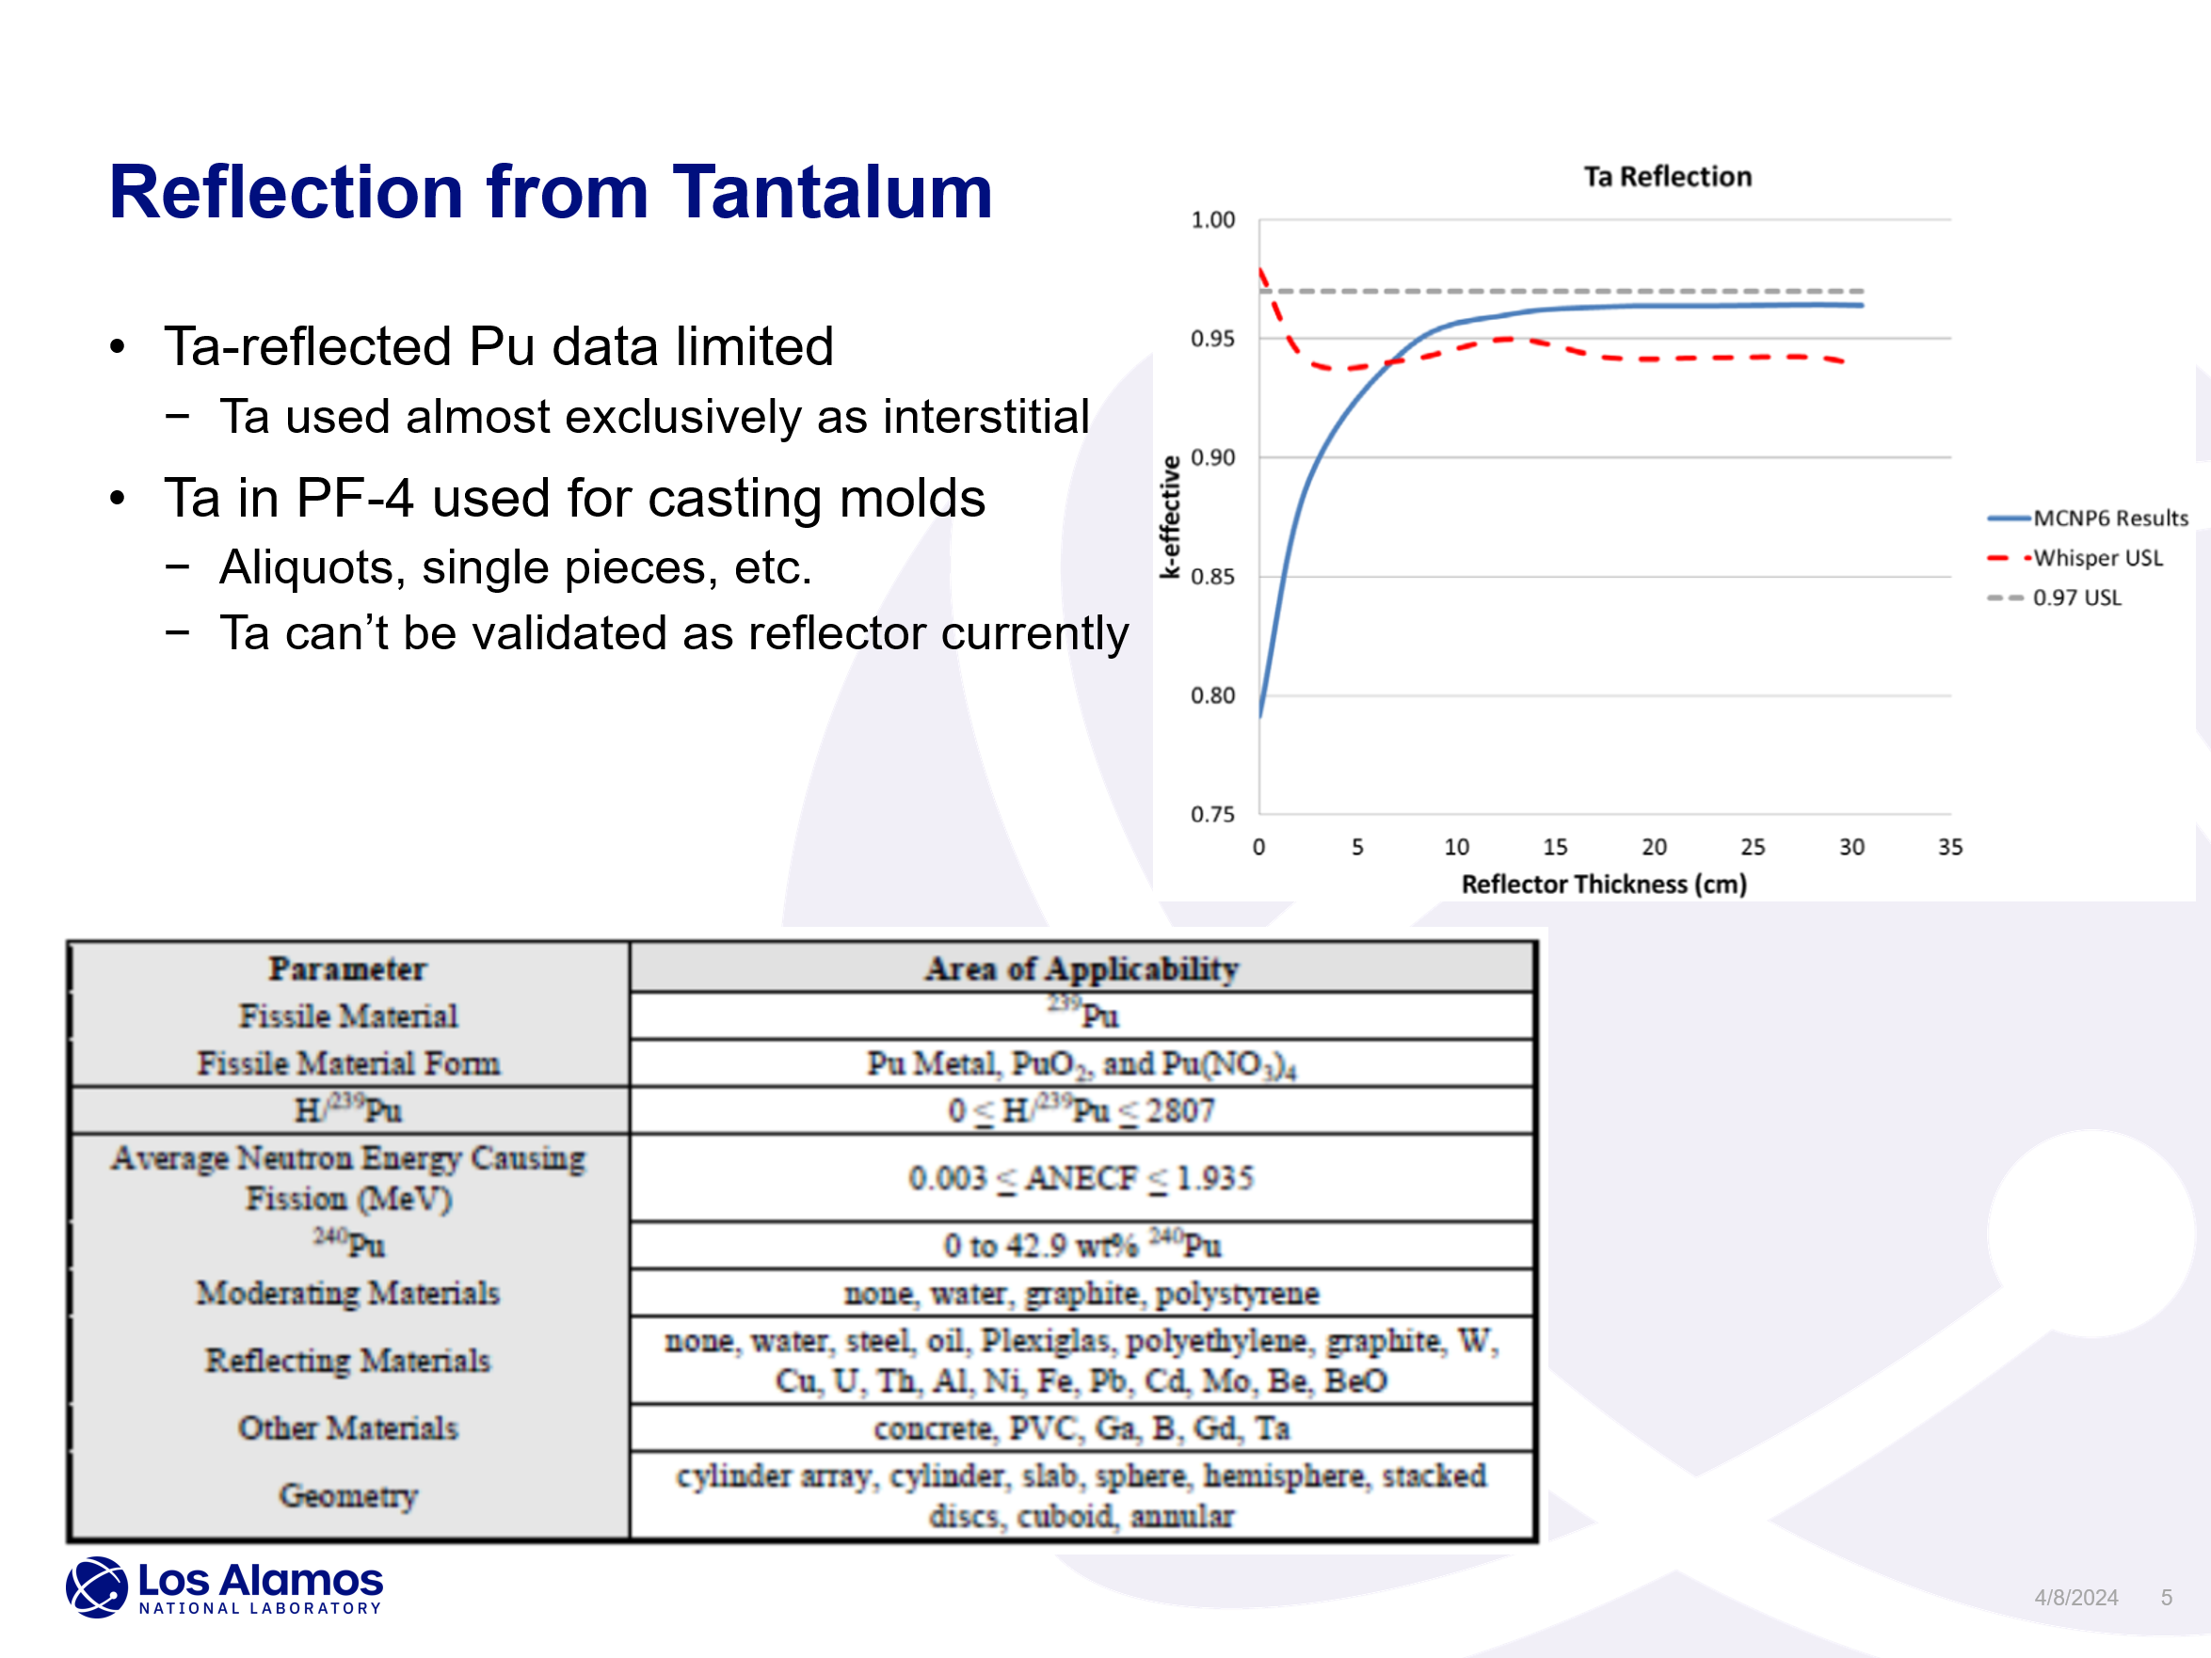
Ta need documented by LANL NCS
Slide at right is from a presentation in May 2023: A. Smiley, J. Alwin, “LANL Nuclear Criticality Safety Needs for Experimental Data,” TEX2.0 Meeting, LA-UR-23-24612.
Presented to a workshop with criticality safety professionals across the DOE complex.
Conclusions slide states:
Highest priorities:
Intermediate Pu PARADIGM
Ta reflection Thales
Chlorine CWS

Slide 29
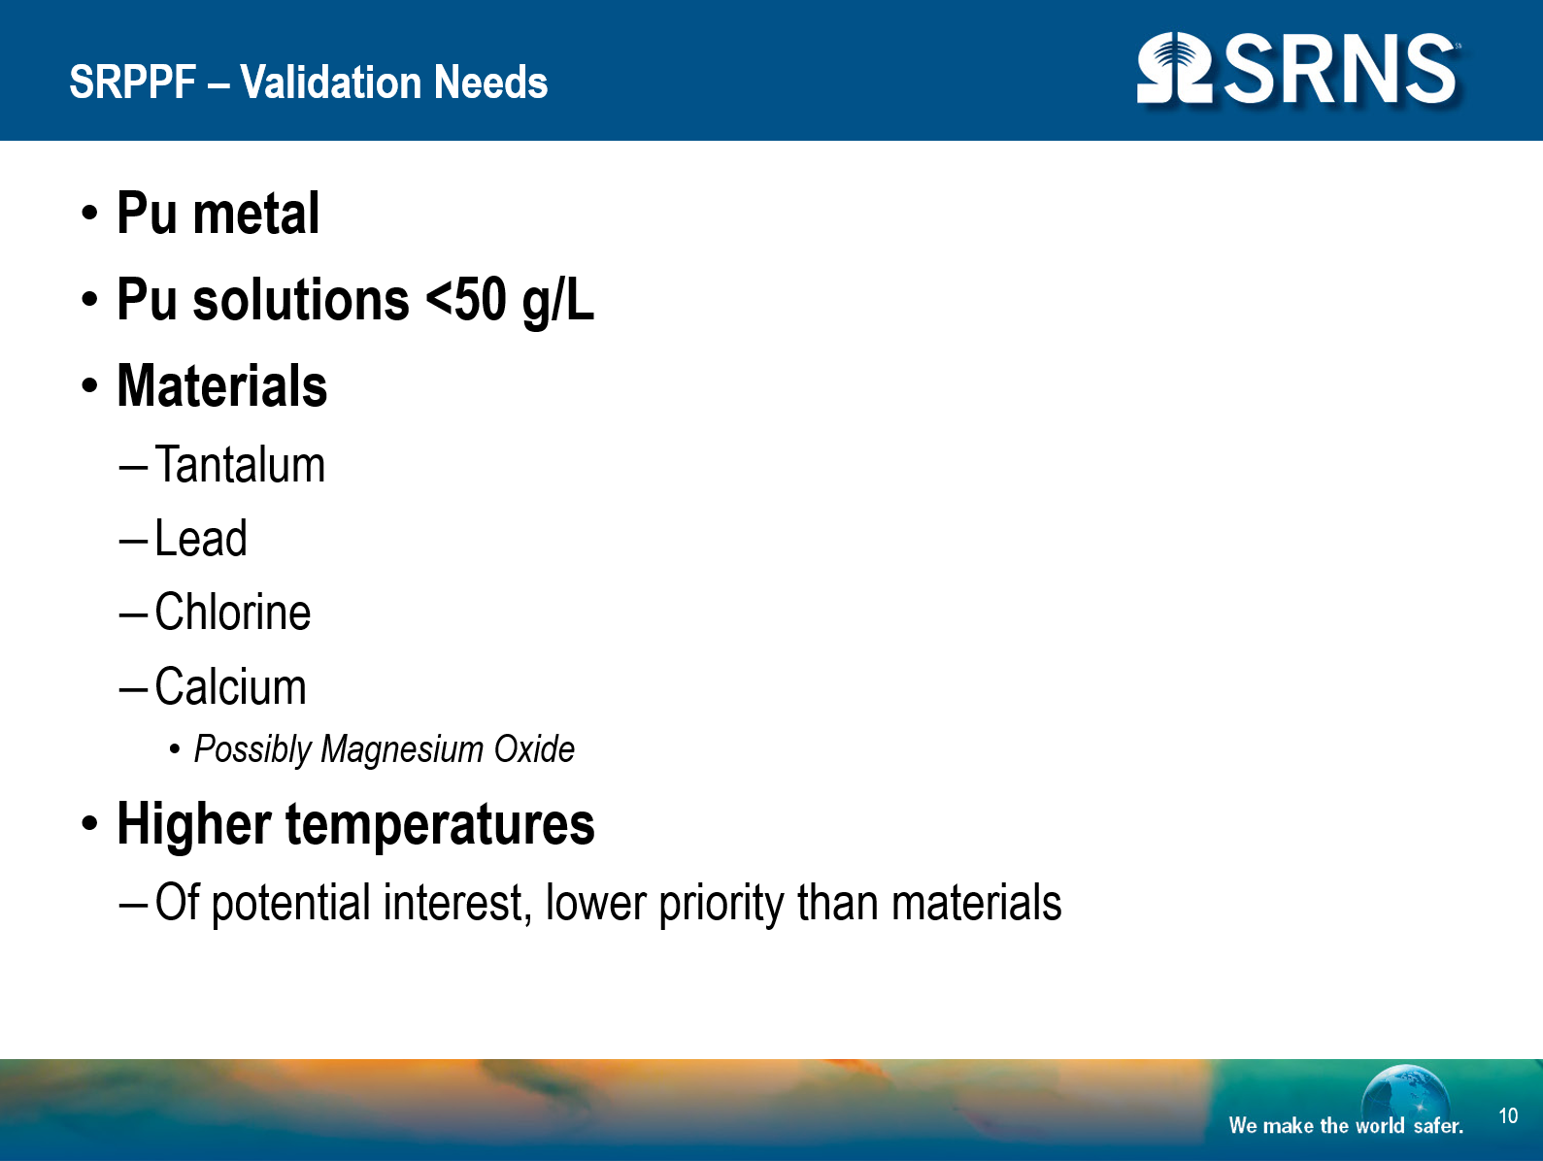
Ta need also documented by SRS
Slide at right is from a presentation in May 2023: A. Szasz, “Savannah River Site Input for TEX 2.0,” TEX2.0 Meeting.
The bottom right shows all of the high priority needs established at the meeting across the complex.
High
SNM | Reflectors | Absorbers | Other
Pu239 int | Ta fast | Cl, Li | Poly PNDA
U235 int and epithermal | Be thermal |  | Lucite PNDA
MOX all energies
HALEU all energies
High-priority list identified at TEX 2.0 meeting in May 2023

Slide 30
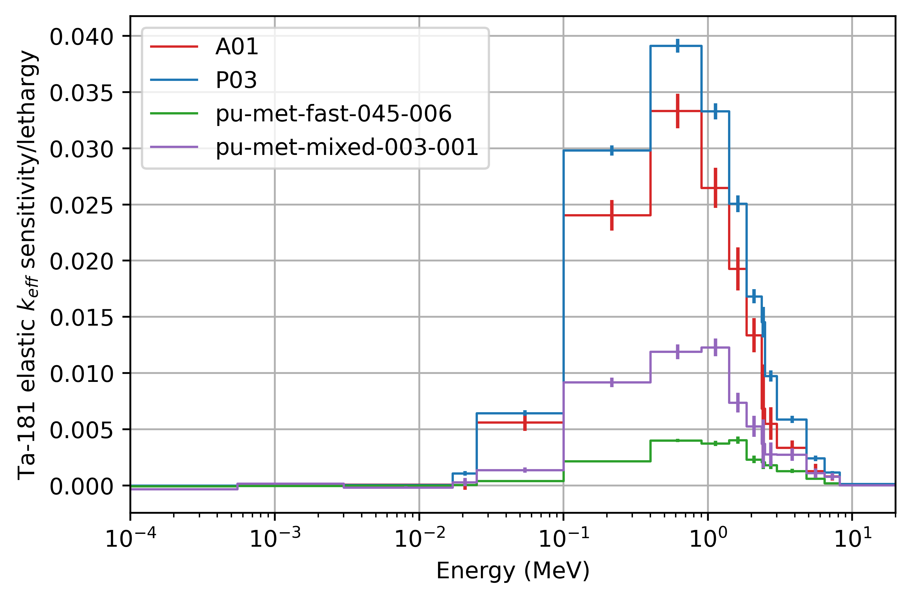
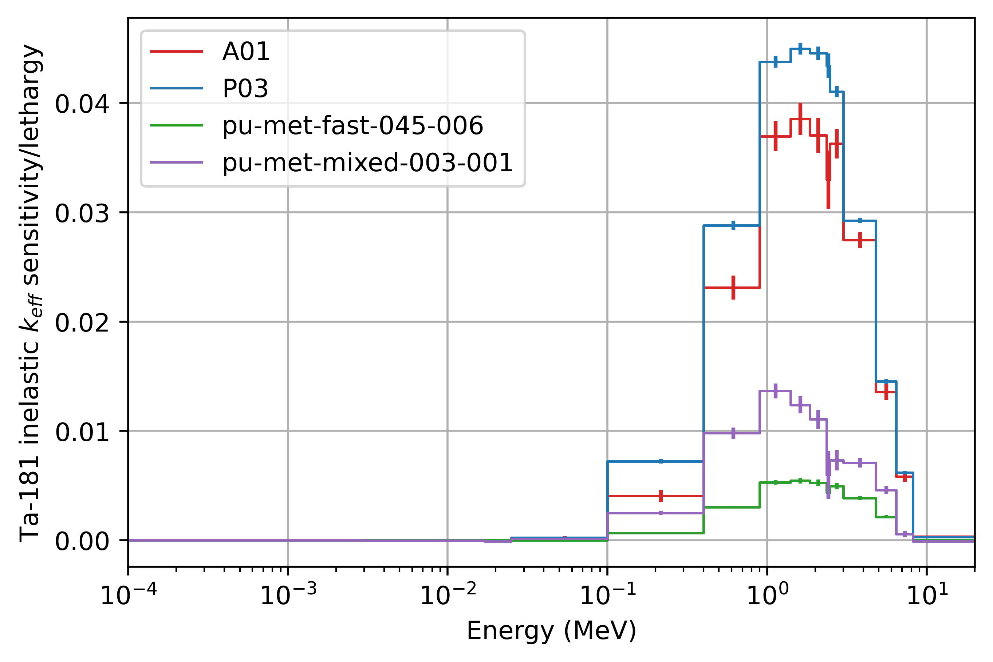
Sensitivity results
Sensitivity to ¹⁸¹Ta scattering.
This figure includes the application A01 (largest Ta scattering sensitivities).
Also includes PU-MET-FAST-045-006 and PU-MET-MIXED-003-001.
These are the specific cases with highest ¹⁸¹Ta inelastic scattering.
Series labeled P03 is a simple proposed design.
Pu cuboid with Ta reflection.

Slide 31
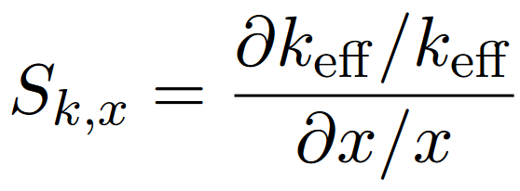
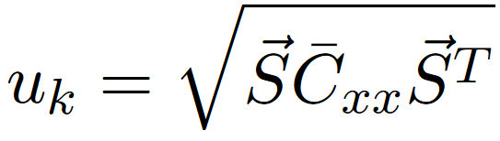

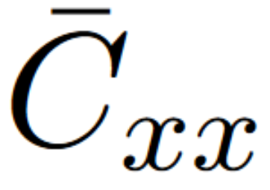
Methodology
Similarity metrics are useful at comparing two models
Traditionally an application and a benchmark
Also applications to each other (see previously slide)
And applications to proposed experiment designs (focus of this work)
All similarity metrics in this work utilize sensitivities (S_{k,x}) of the system k_{eff} to a nuclear data (x) calculated via
x can be a nuclide reaction cross-section, ν, etc.
The uncertainty in k_{eff} due to nuclear data uncertainty:
S is a vector of sensitivities
T is the transpose of the vector
C is the nuclear data covariance matrix

Slide 32
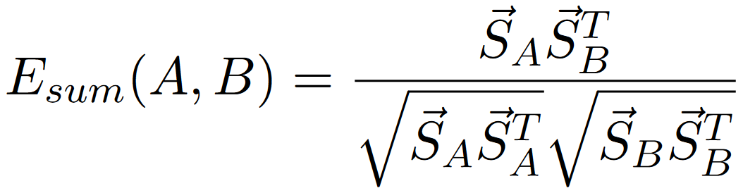

Methodology
E_{sum} similarity metric
A and B are two models
E_{sum} is a measure of the shared sensitivities
c_{k} similarity metric
A measure of the shared nuclear data uncertainty
For all similarity metrics, the sensitivity vectors and covariance matrix can be filtered to only include reactions of interest
For this work, isolated data of Ta181 elastic and inelastic scattering are investigated
There are other similarity metrics that can also be of use, especially when utilizing filtered data

Slide 33

Methodology
B
There are many distance metrics in mathematics
Manhattan distance (M)
Sum of absolute value of difference in vector elements
Red, blue, and yellow in image at right
Euclidean distance (ED)
Sum of squares of the vectors
Green in image at right
Weighted sum of squares (WSS)
Similar to ED, but imposes a weight of the geometric mean
For this work the results are scaled to
A
Taxicab geometry, Wikipedia

Slide 34
Methodology
What is a good match between two models?
For all metrics used here, higher numbers mean a better match
Might seem non-intuitive for M and ED, but I did some normalization
For all but WSS, 1 is a perfect match
For WSS, there is no upper limit, but higher is better
For c_{k}, criticality safety applications often say that a value of 0.9 or higher is a “good” match
Metric | Perfect match
E_{sum} | 1
c_{k} | 1
M | 1
ED | 1
WSS | N/A, higher is better

Slide 35
Results: c_{k}
PMM003-001 has c_{k} values slightly below 0.9
Still very useful for validation!
PMM045-006 also has high c_{k} values
But there are reasons why this benchmark might not be the best for validation
As expected, designs with lower Ta thickness (<1.27 cm) have lower c_{k} for Thales_App_01
As thickness increases, it reaches 0.95 and seems to plateau
Thales_App_02 is highest when 1.27 cm thick Ta or less is present
Thales_App_03 falls between the other two applications
These numbers go from 1 (least Ta mass) to 9 (most Ta mass)
1 3 5 7 8 9 2 4 6
\\slip.lanl.gov\NCERC\Software\whisper-tk\Output\Thales_22_e80_e81JSON_51_nof_noi

Slide 36

Results: D Opt
Using 8.1 covariances
Shows importance of case with most Ta
Also shows that any of the cases have a fairly large D Opt by themselves
Large drop-off in cumulative D Opt after first experiment
\\slip.lanl.gov\NCERC\Software\whisper-tk\Output\Thales_21_e80_e81JSON_51_Ta181in_noi

Slide 37




Best configurations (cm Ta thickness) for each metric
Results: summary
Many of the metrics yielded similar results, so not shown
Available in backup slides
At right is the best configuration for each metric
Red are the four configurations that were selected: “zoided” 1.27, “zoided” 2.54, nominal 5.08, nominal 8.89 cm

Slide 38

Results: summary, App 1
Another way to think of the results:
Plot at right has value for each metric
Compare:
Blue to orange: how high is the down-selected configurations compared to the best value of all models run?
Blue to green: how much better is the down-selected configurations compared to existing benchmarks?
Note: results were normalized for WSS

Slide 39

Results: summary, App 2
Another way to think of the results:
Plot at right has value for each metric
Compare:
Blue to orange: how high is the down-selected configurations compared to the best value of all models run?
Blue to green: how much better is the down-selected configurations compared to existing benchmarks?
Note: results were normalized for WSS

Slide 40

Results: summary, App 3
Another way to think of the results:
Plot at right has value for each metric
Compare:
Blue to orange: how high is the down-selected configurations compared to the best value of all models run?
Blue to green: how much better is the down-selected configurations compared to existing benchmarks?
Note: results were normalized for WSS

Slide 41

Results: Manhattan distance (Ta181 inelastic)
Filtered on Ta181 inelastic
Shows that for Thales_App_01, thick Ta reflection is best
As expected, thin Ta for Application 2 and moderate amount for Application 3
Filtered on Ta181 inelastic
1 3 5 7 8 9 2 4 6
Run 21 + 23 but for BLO
\\slip.lanl.gov\NCERC\Software\whisper-tk\Output\Thales_21_e80_e81JSON_51_Ta181in_noi

Slide 42

Results: Manhattan distance (Ta181 elastic)
Filtered on Ta181 inelastic
Shows that for Thales_App_01, thick Ta reflection is best
As expected, thin Ta for Application 2 and moderate amount for Application 3
Filtered on Ta181 elastic
\\slip.lanl.gov\NCERC\Software\whisper-tk\Output\Thales_23_e80_e81JSON_51_Ta181el_noi

Slide 43

Results: Euclidean distance (Ta181 inelastic)
Same findings as Manhattan distance
Filtered on Ta181 inelastic
\\slip.lanl.gov\NCERC\Software\whisper-tk\Output\Thales_21_e80_e81JSON_51_Ta181in_noi

Slide 44

Results: Euclidean distance (Ta181 elastic)
Filtered on Ta181 elastic
\\slip.lanl.gov\NCERC\Software\whisper-tk\Output\Thales_23_e80_e81JSON_51_Ta181el_noi

