Slide 1
Update on FY work at BNL
A. Mattera, A. Sonzogni, E. McCutchan,
P. De-Sosoo, C. Sears, C. Billings

Slide 2
Outline
Fission product yields compilation
Isomeric yield ratios compilation / evaluation
Revisiting E_{n}
FY dashboard
Future work

Slide 3
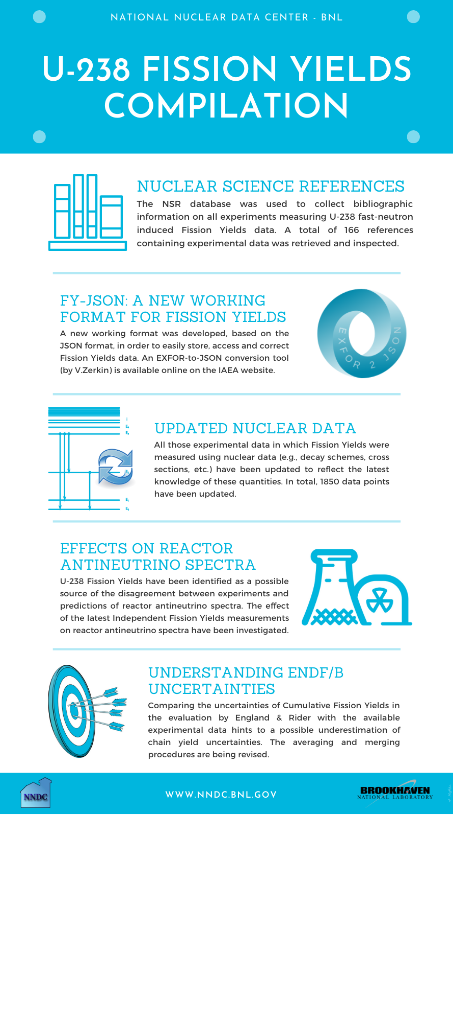
Fission Yield Compilation
The NSR database is used as the starting point of the compilation to collect bib information on all experiments measuring Fission Yields.
V. Zerkin developed an EXFOR-to-JSON conversion tool (online). We developed a working format based on this
All experimental data that used decay data have been updated to reflect the most current values available

Slide 4

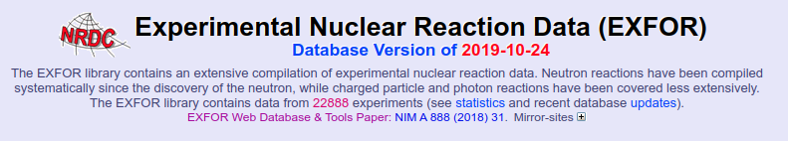
A working format for experimental FY data
Adapting the format of experimental files to the needs of FY compilation (simpler, lighter, more intuitive)
Make it easier to access, plot, verify and update experimental values currently stored in EXFOR
Standardized units & uncertainties
V. Zerkin

Slide 5
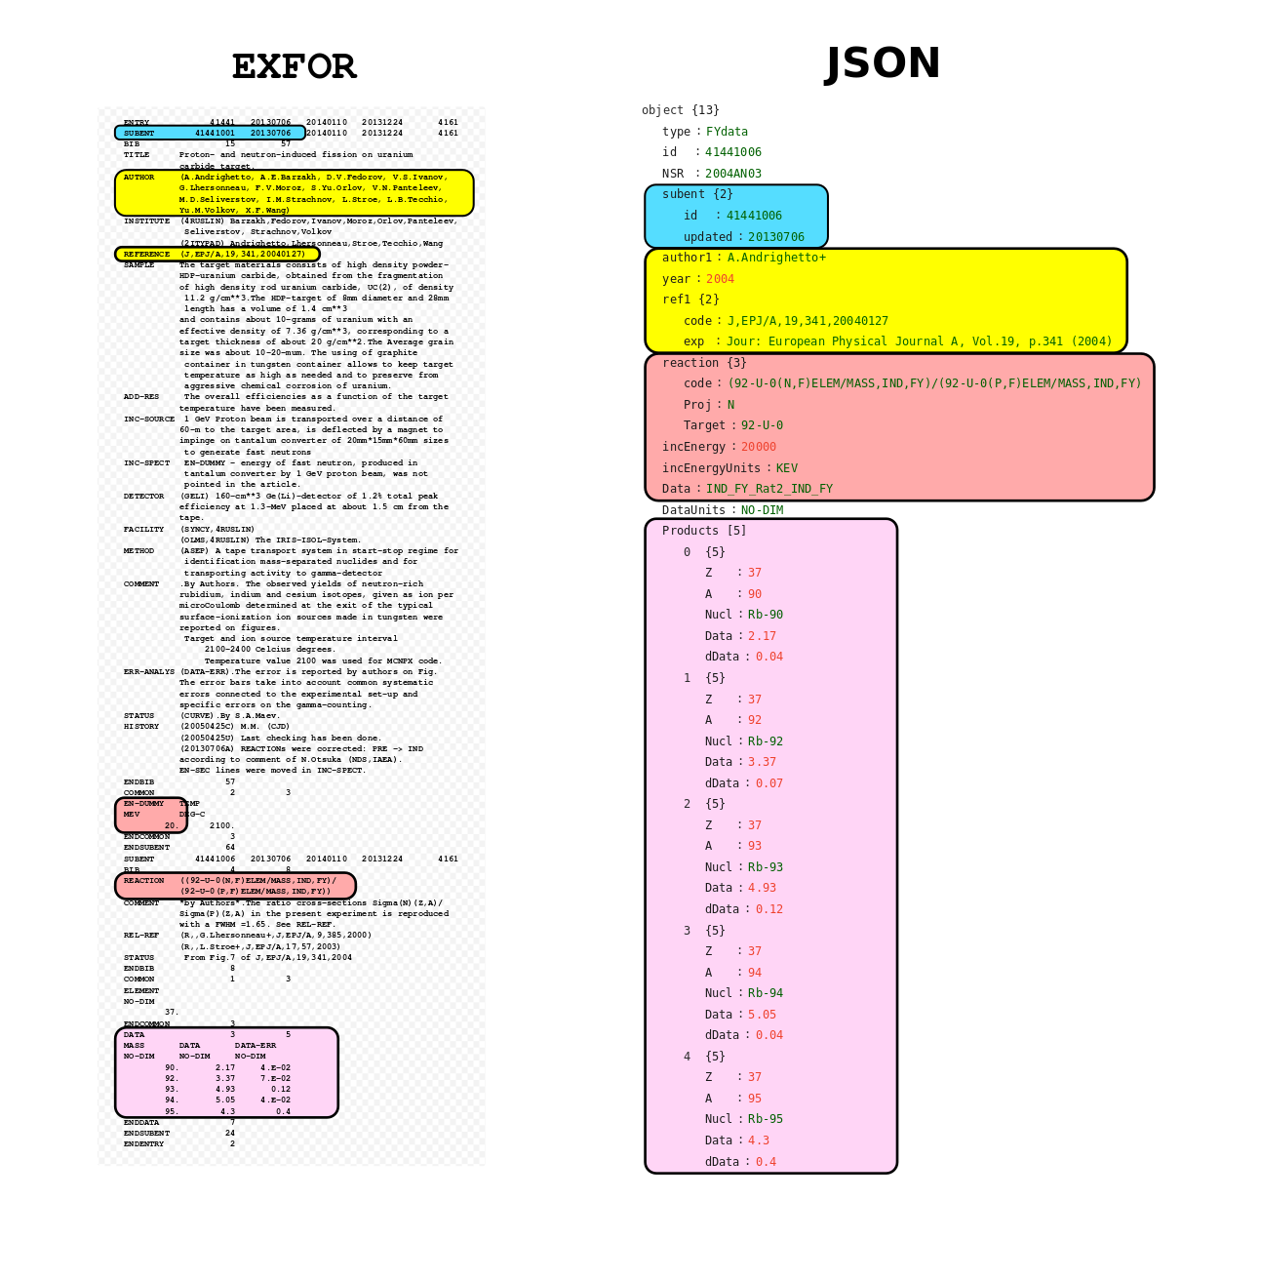
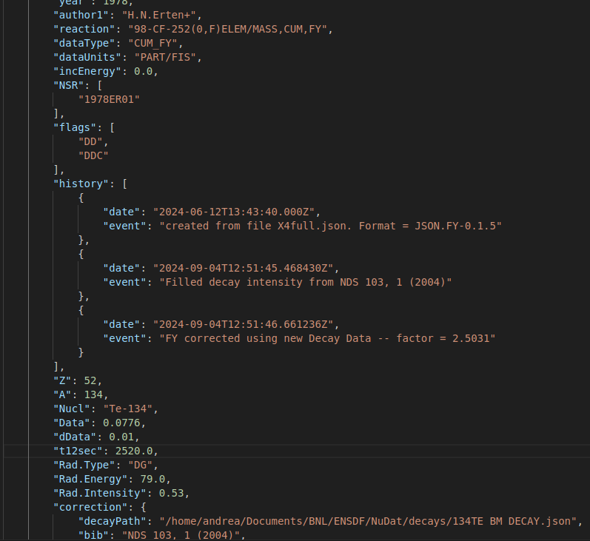
A working format for experimental FY data
Simpler data:
less information
uniform units & uncertainties
uniform nuclide ID
decay data easier to access
modern DB-ready format
can store additional information
keeps history of changes
Notes:
We looked into what fields were essential for a FY evaluation, and we dropped all those that weren't.
We are not trying to replicate EXFOR, but just have a format that allows us to

Slide 6
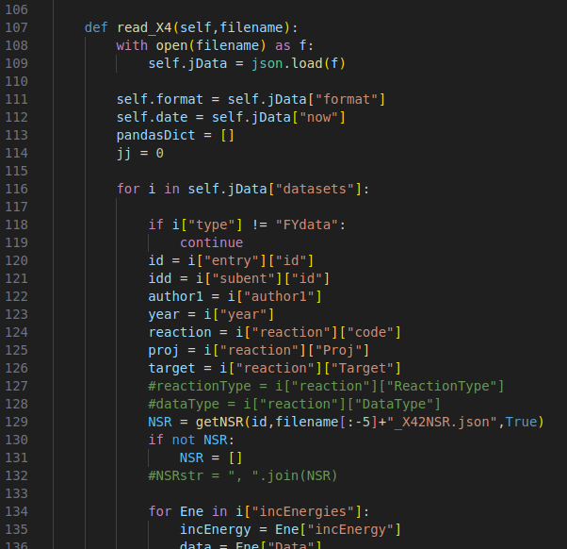
JSON_FY python package
reads and cleans JSON from EXFOR
implements checks and corrections:
values (outliers / wrong units)
uncertainties (too low / not reported / …)
corrections for decay data
produce plots to study, check and correct data

Slide 7
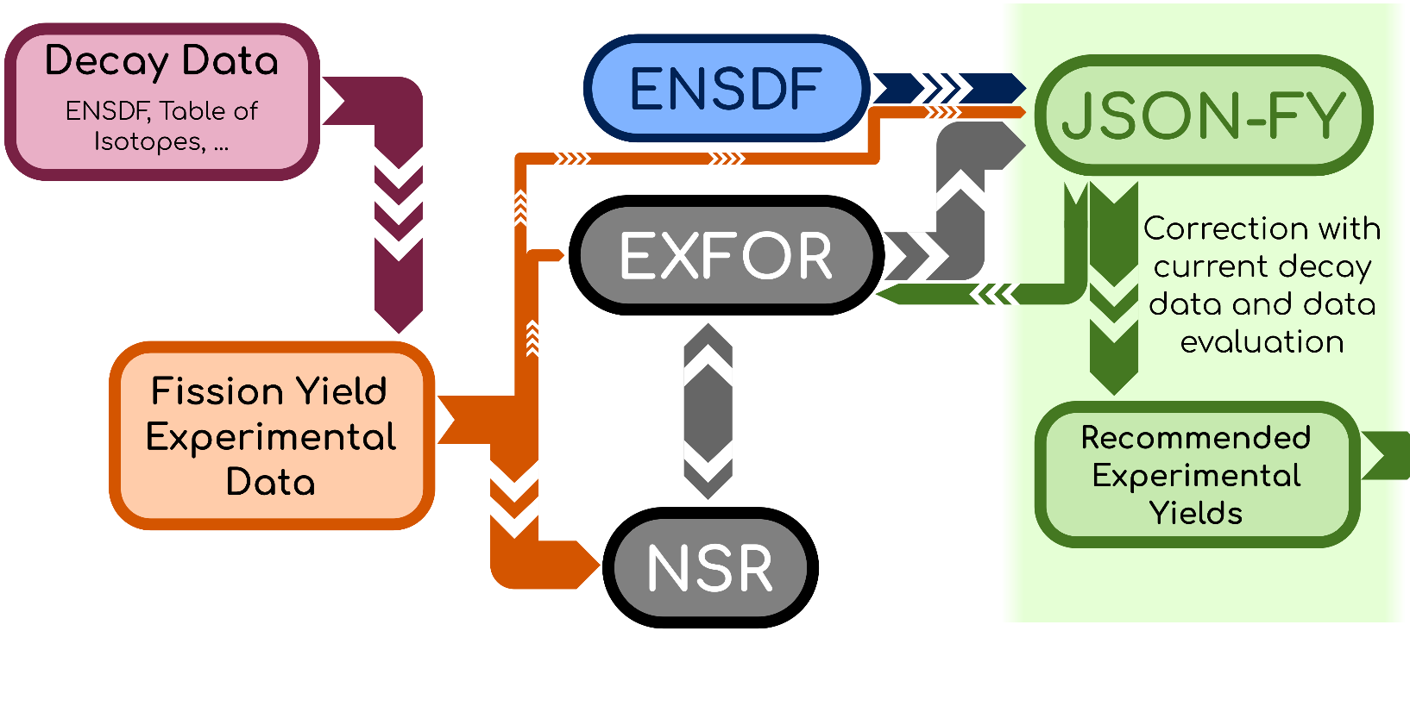
Modern tools to update old data
Evaluation

Slide 8

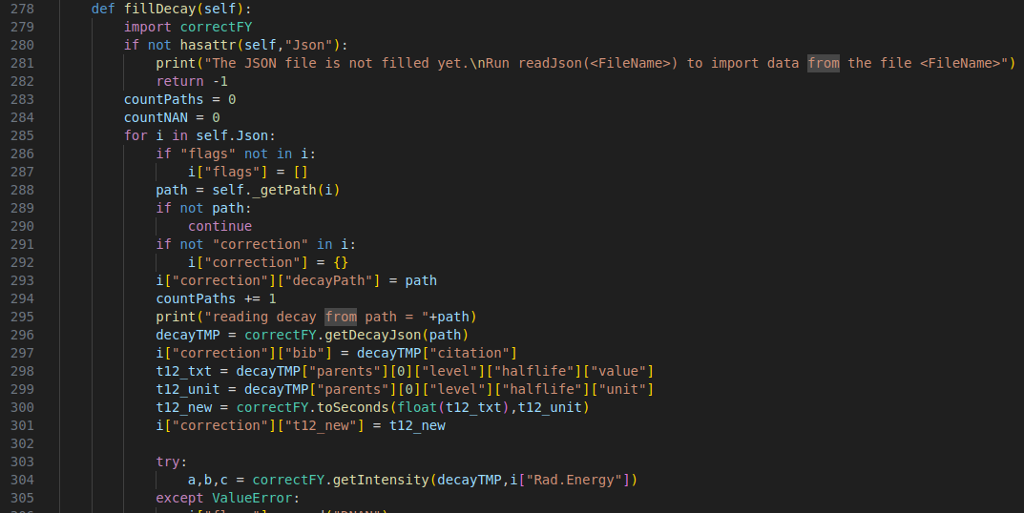

Decay data corrections
X4
Fill JSON_FY class with decay data from NuDat
Correction of .json files -- ORG values and new decay data stored in the db entry
ORIGINAL PAPER
check that uncertainty on the FY is compatible with uncertainty on DD
WITH NO EXPLICIT MENTION OF THE NUCLEAR DATA VALUES IN THE ORIGINAL PAPER, IT IS ALMOST IMPOSSIBLE TO CORRECT AND USE RESULTS FROM DECADES-OLD PAPERS WITH THEIR REPORTED UNCERTAINTY
Create FY plots

Slide 9
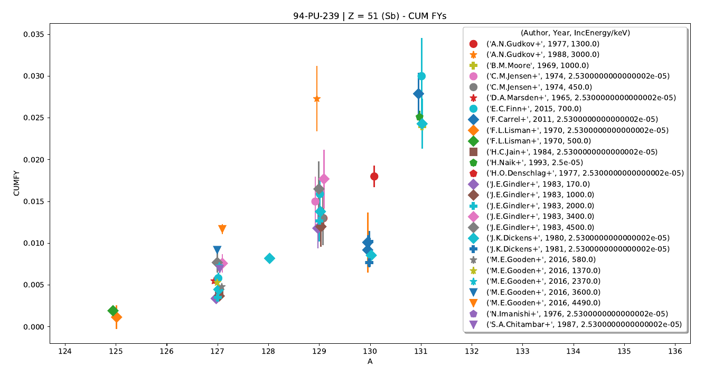
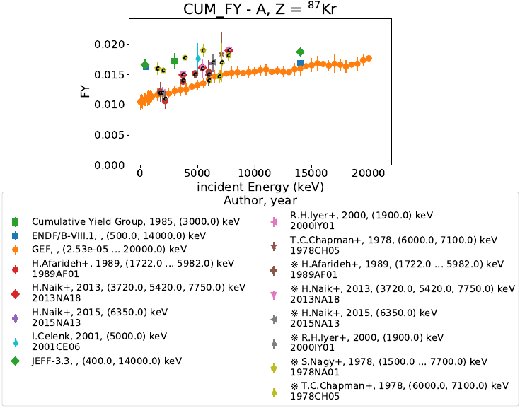
Data cleanup / annotation / flagging
COMPILATION, CLEANUP, CORRECTION OF:
²³⁸U, ^{239,241}Pu, ²³⁵U, ²⁵²Cf
A distributions / Z distributions
FY as a function of incident energy

Slide 10
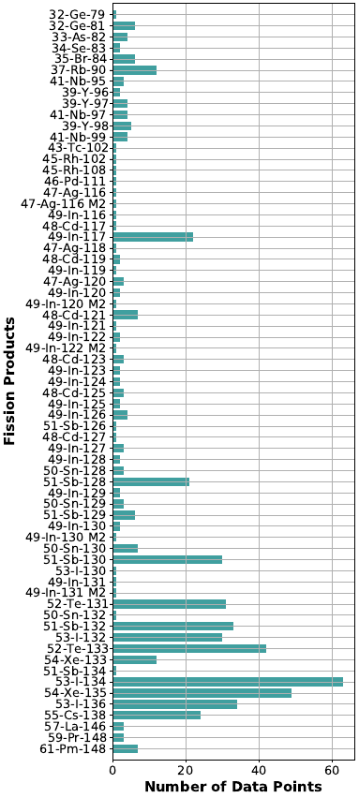
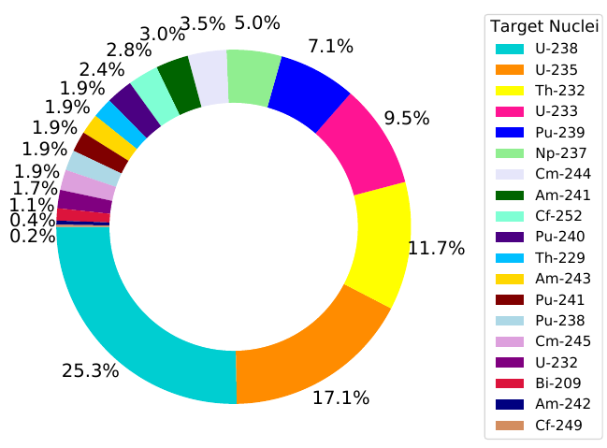
Evaluation of Isomeric Yield Ratios
We retrieved and compiled 538 independent isomeric yield ratios, from 39 compound nuclei, and 62 unique fission products.
5x the amount of data available to Madland & England when they developed the model
Wealth of new data can be used to benchmark new models for the prediction of IYRs

Slide 11
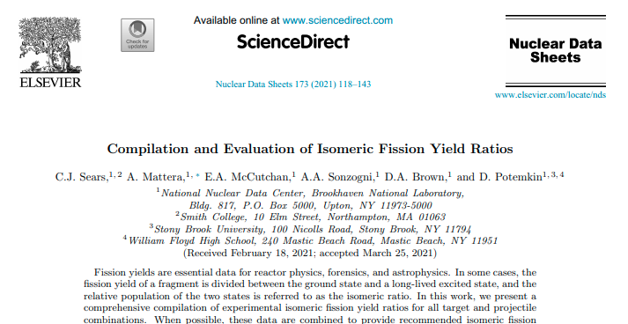
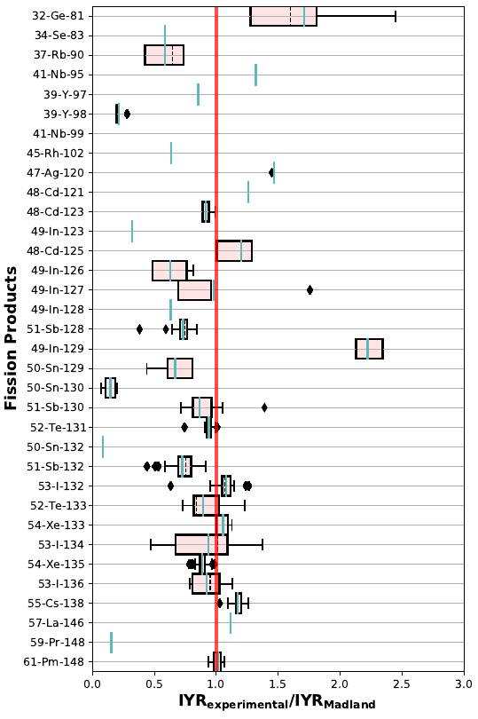
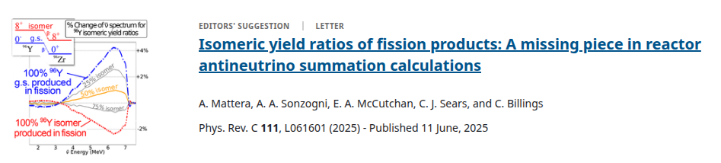
Evaluation of Isomeric Yield Ratios
averaging of IYR for low-energy n-induced fission (E_{n} < 2 MeV)
identification of outliers (decay data, isomeric state assignments, trends vs IYR in other measured systems)
new recommended experimental yields often incompatible with the Madland & England model
studied the impact of recommended IYRs on antineutrino spectra

Slide 12
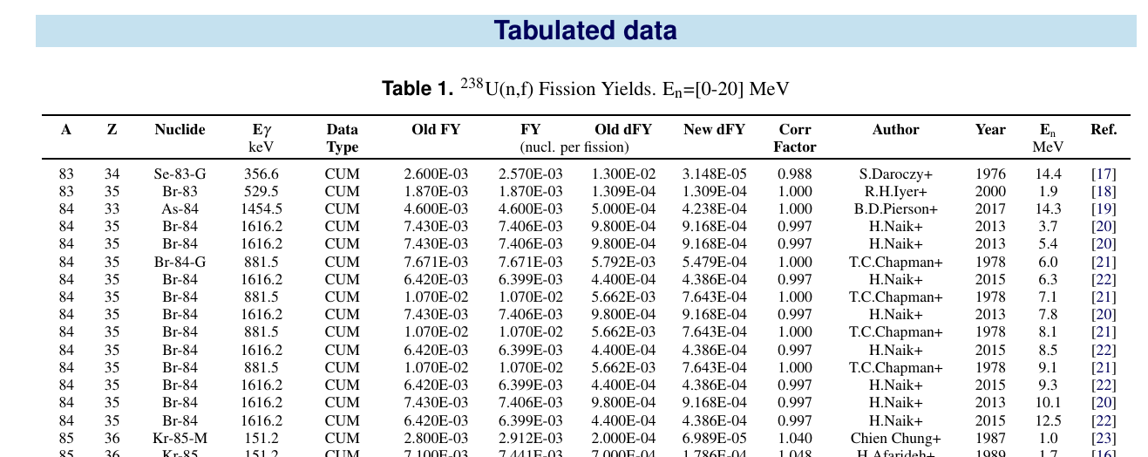

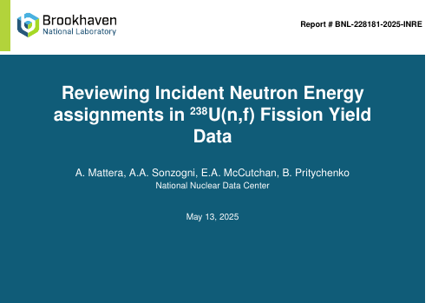
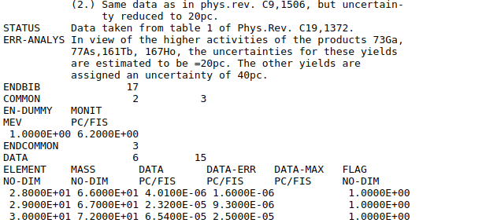

Revisiting E_{n}
how do we get the En for non-thermal fission?
Rao and Iyer measured at the same facility, but reported energy is different
compiled ²³⁸U data -- wealth of energy-dependent data
EN-DUMMY
checking all EN-DUMMY in EXFOR FYs, group by facility and include the energy spectrum and an average energy as En

Slide 13
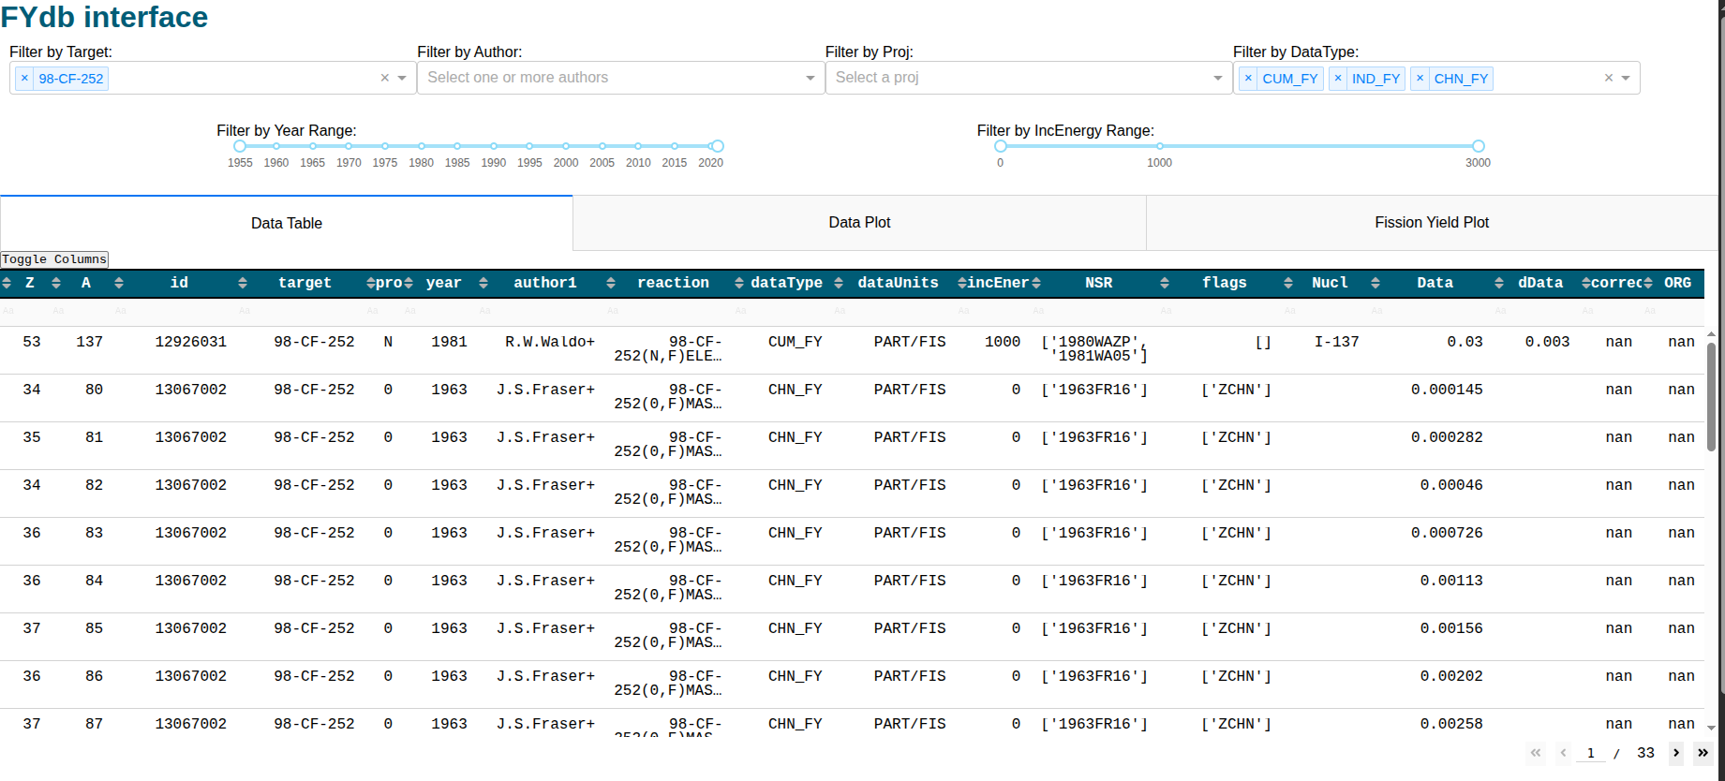
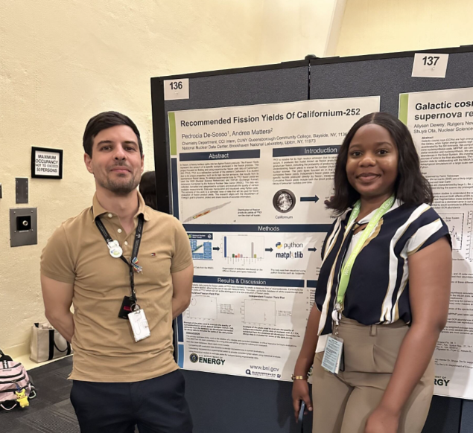
FYdb dashboard
upload compiled data to NNDC gitlab
develop a dashboard to access, visualize and edit the FYdb
Pedrocia De-Sosoo

Slide 14
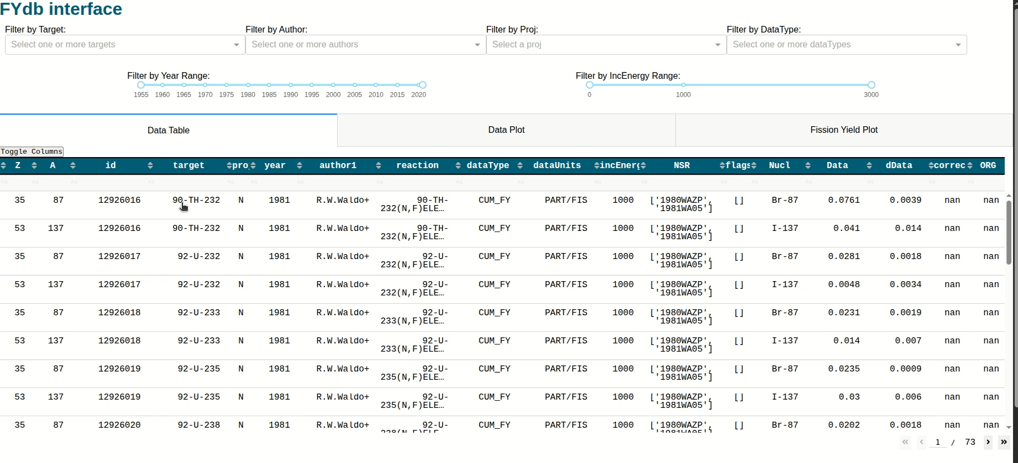
FYdb
dashboard

Slide 15
Summary
Developed JSON_FY format from EXFOR
Compiled and updated FY data for major actinides and ²⁵²Cf
Compiled IYR and recommended values
Corrected energy "EN-DUMMY" for ²³⁸U
Developing a FY dashboard to access / visualize / edit FY data

Slide 16
Acknowledgements
The work at Brookhaven National Laboratory was sponsored by the Office of Nuclear Physics, Office of Science of the U.S. Department of Energy under Contract No. DE-SC0012704 with Brookhaven Science Associates, LLC. This research was also funded by the National Nuclear Security Administration, Defense Nuclear Nonproliferation Research and Development (NNSA DNN R&D). This project was supported in part by the U.S. Department of Energy, Office of Science, Office of Workforce Development for Teachers and Scientists (WDTS) under the Community College Internships Program (CCI) and the Science Undergraduate Laboratory Internships Program (SULI).

Slide 19
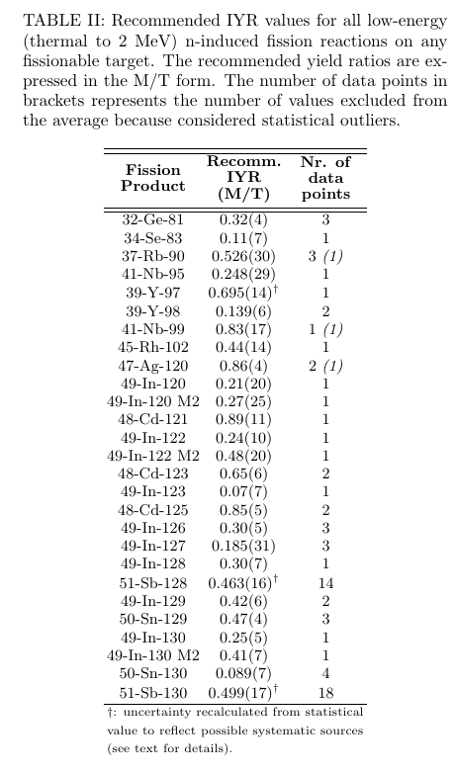

Recommended Experimental Yields
Use the recommended experimental values in evaluations for the available nuclides.
More experimental data needed for additional fission products and fissioning systems
The evaluation can be the cornerstone for testing future theoretical models

Slide 20
Revisiting E_{n}
compiled ²³⁸U data -- we
alth of energy-dependent data

Slide 21
Revisiting E_{n}
how do we get the En for non-thermal fission?
compiled ²³⁸U data -- we
alth of energy-dependent data

Slide 22
Revisiting E_{n}
how do we get the En for non-thermal fission?
Rao and Iyer measured at the same facility, but reported energy is different
compiled ²³⁸U data -- we
alth of energy-dependent data

Slide 23
Revisiting E_{n}
how do we get the En for non-thermal fission?
Rao and Iyer measured at the same facility, but reported energy is different
compiled ²³⁸U data -- we
alth of energy-dependent data

Slide 24
Revisiting E_{n}
how do we get the En for non-thermal fission?
Rao and Iyer measured at the same facility, but reported energy is different
compiled ²³⁸U data -- we
alth of energy-dependent data
EN-DUMMY

Slide 25
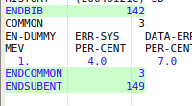
Revisiting E_{n}
how do we get the En for non-thermal fission?
Rao and Iyer measured at the same facility, but reported energy is different
compiled ²³⁸U data -- we
alth of energy-dependent data
EN-DUMMY

Slide 26
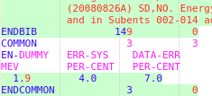
Revisiting E_{n}
how do we get the En for non-thermal fission?
Rao and Iyer measured at the same facility, but reported energy is different
compiled ²³⁸U data -- we
alth of energy-dependent data
EN-DUMMY

Slide 27

Revisiting E_{n}
how do we get the En for non-thermal fission?
Rao and Iyer measured at the same facility, but reported energy is different
compiled ²³⁸U data -- we
alth of energy-dependent data
EN-DUMMY

Slide 28
Modern tools to update old data
Evaluation

Slide 29
Modern tools to update old data
Evaluation

