Slide 1
LLNL FPY Modeling and Evaluation
CSWEG 2025
January 6th, 2026
Nicolas Schunck | NACS

Slide 2
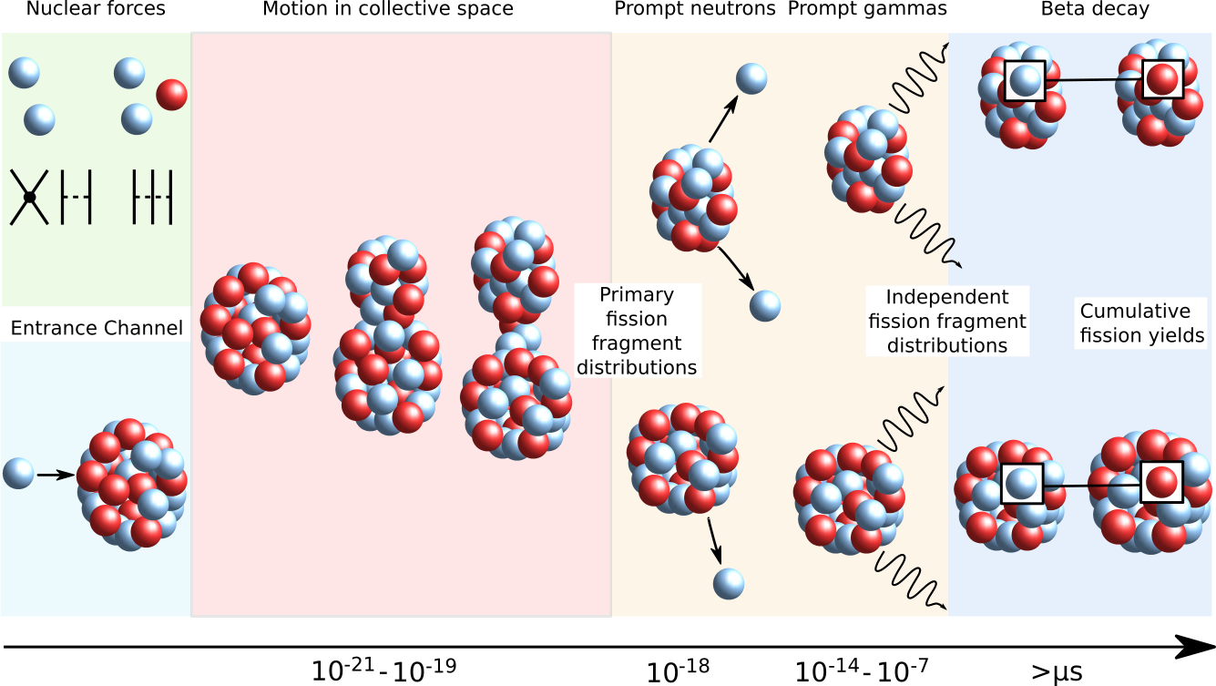
Fission products (yields, PFNS, PFGS, etc.) depend on a set of initial conditions modeled by theory
Prepared by LLNL under Contract DE-AC52-07NA27344.
Notes:
2

Slide 3
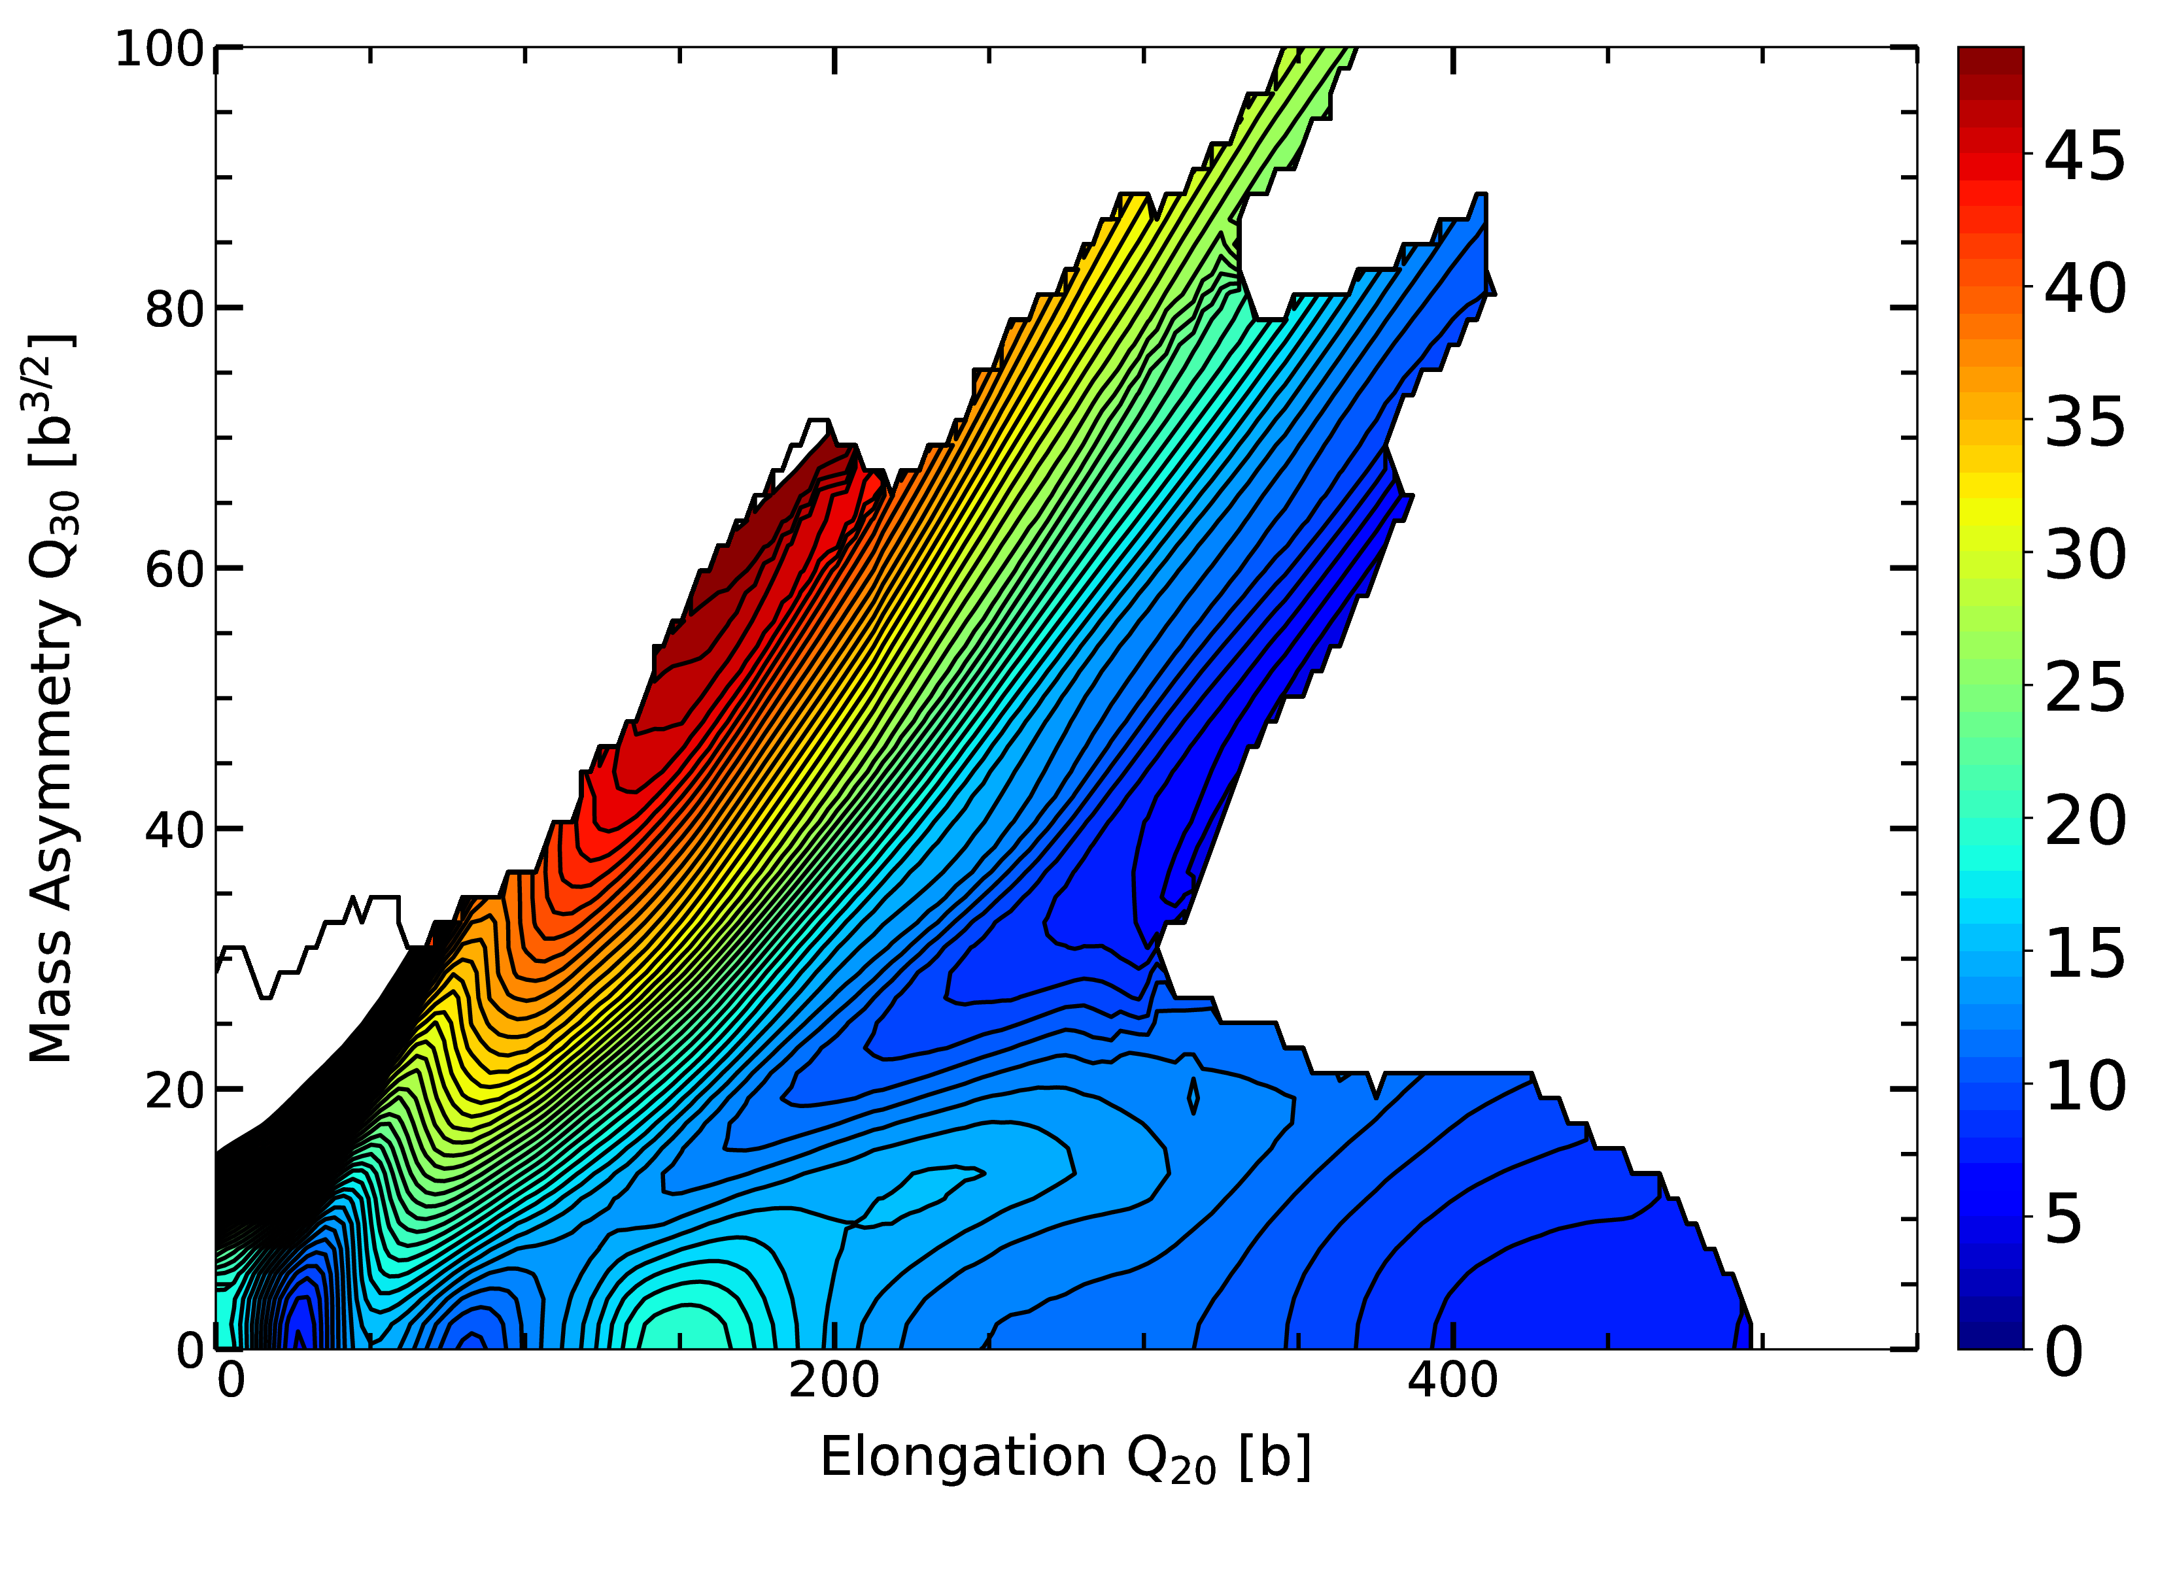
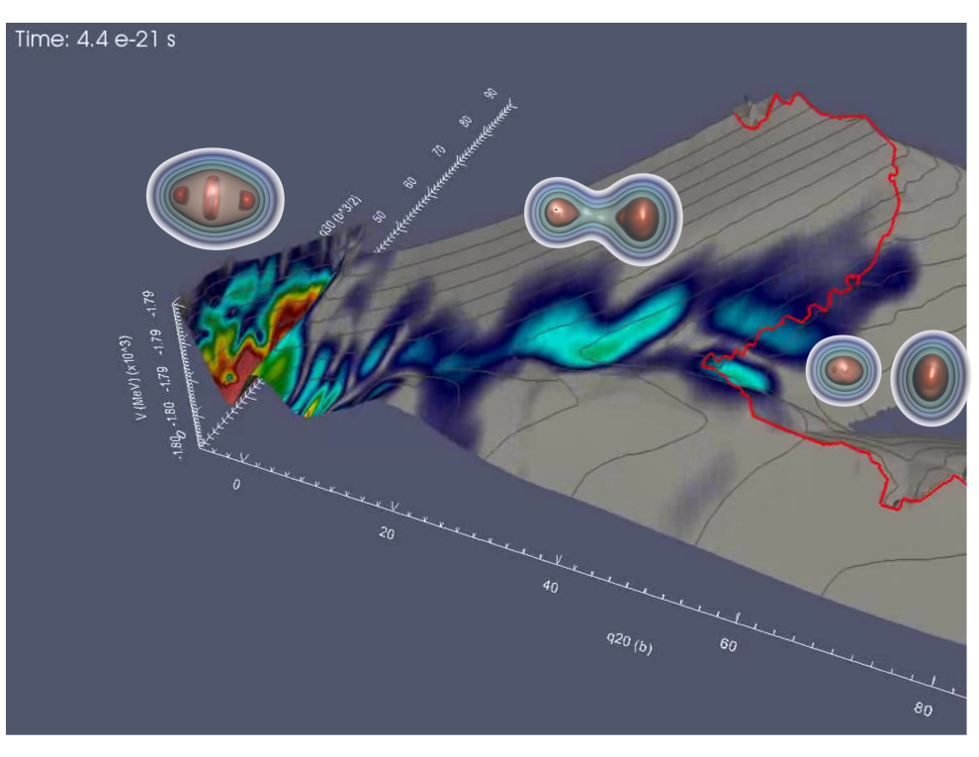
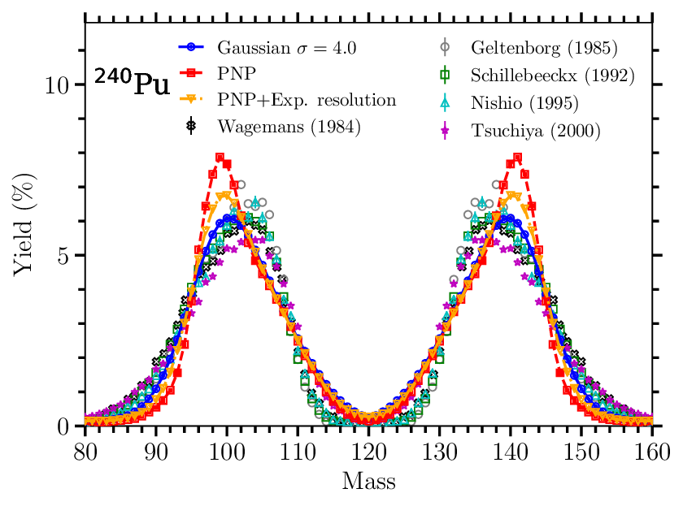
LLNL develops and applies fundamental nuclear theory to provide inputs to physics-based fission event models
Static nuclear properties
Time-dependent dynamics
Actual observables
Particle number (PNP)
Spin distribution (AMP)
Excitation energy (PNP, TDHFB)
Fission fragment distributions (TDGCM)
Real-time fission events (TDHFB)
Fission evaluation (FETA)

Slide 4
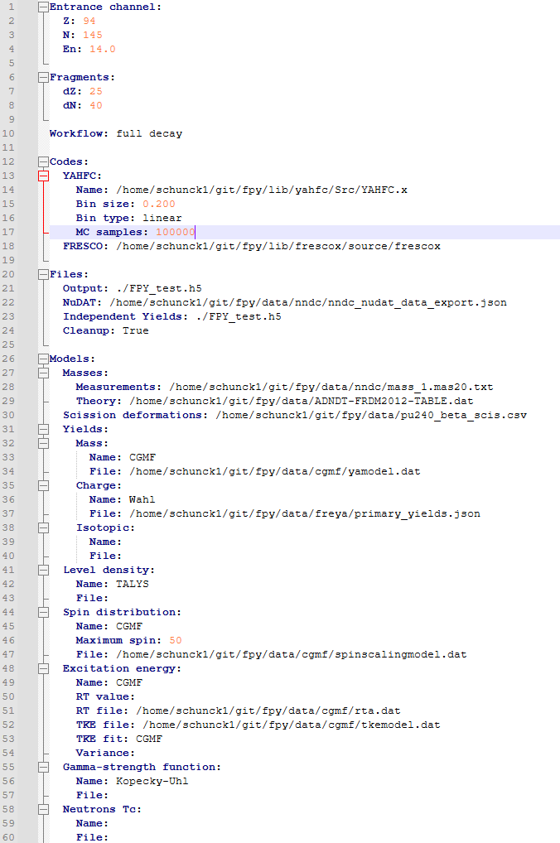
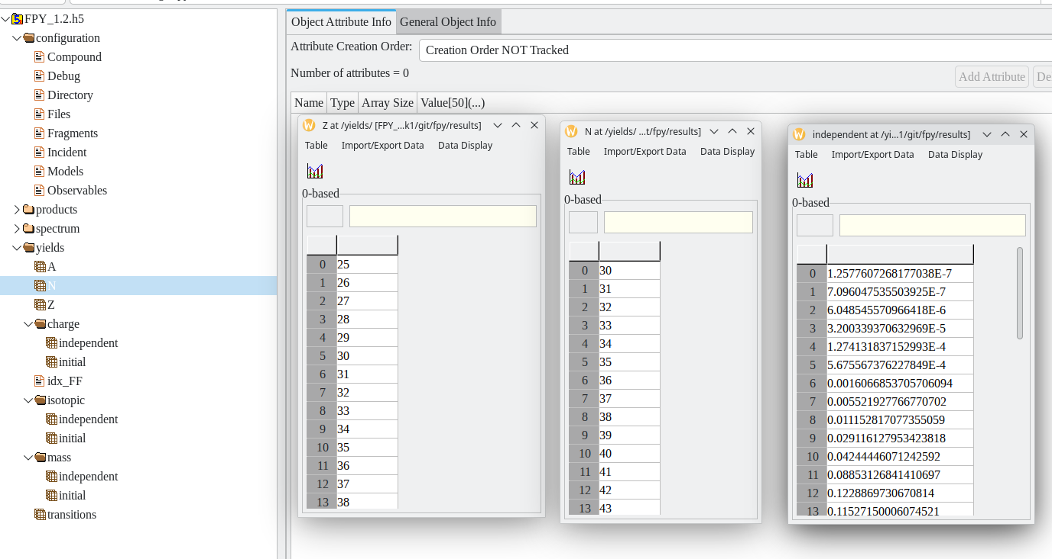
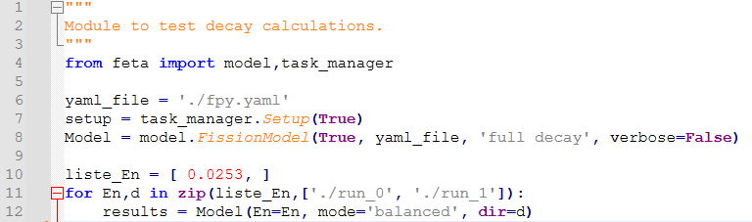
Fission Evaluations Tools and Analytics (FETA) is the LLNL equivalent to CGMF to compute fission observables
Ease of use, modularity
Built-in parallelism: automatically decays fragments with MPI
Preset nuclear models and/or user-supplied inputs for everything
Output stored in HDF5 file
Single YAML input file
Simple Callable class

Slide 5
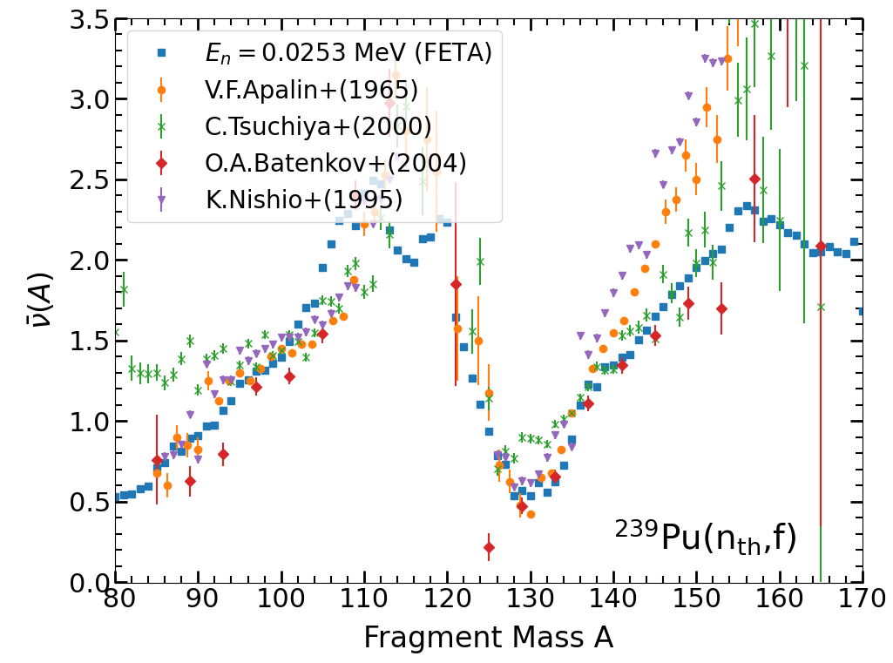
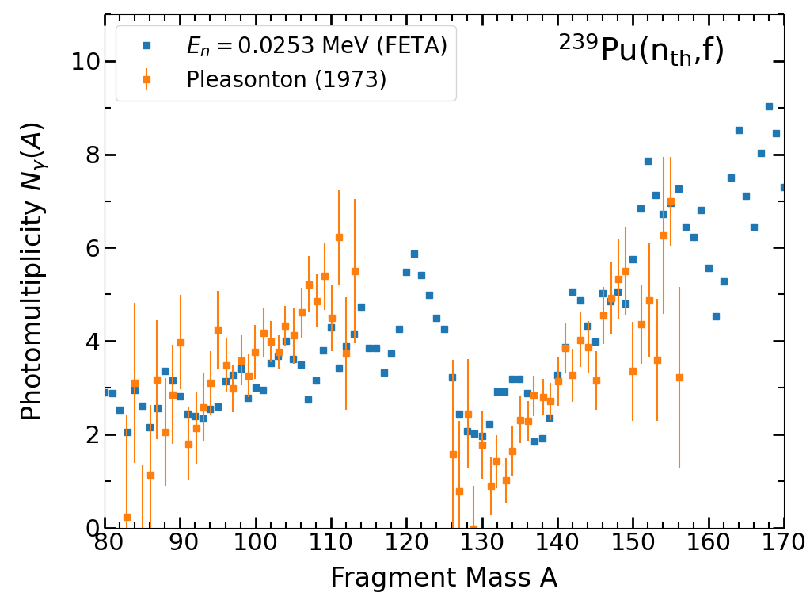
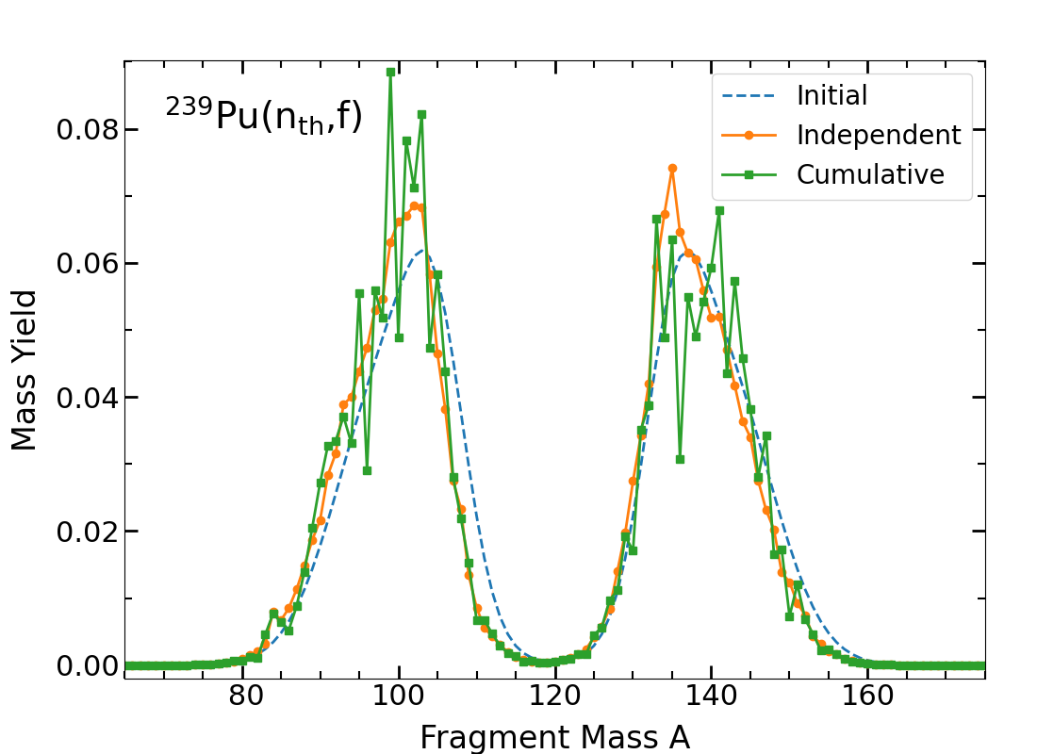
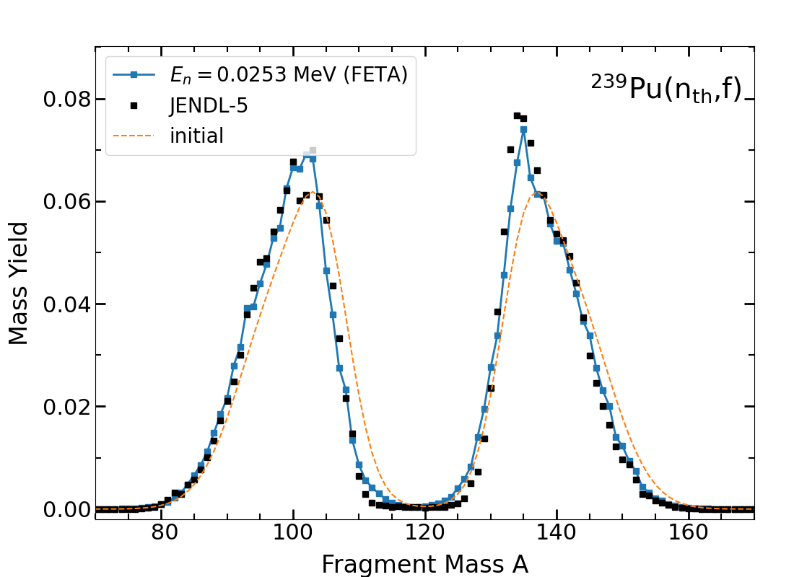
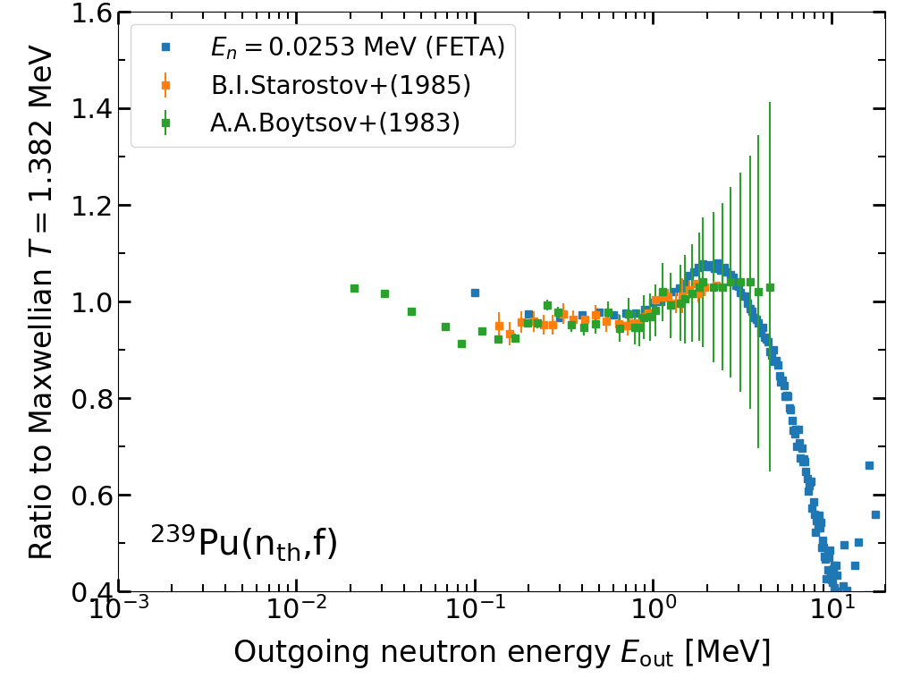
FETA was successfully validated against CGMF
FETA-2 = independent yields and prompt fission spectrum
FETA-3 += cumulative yields (and chain yields)

Slide 6
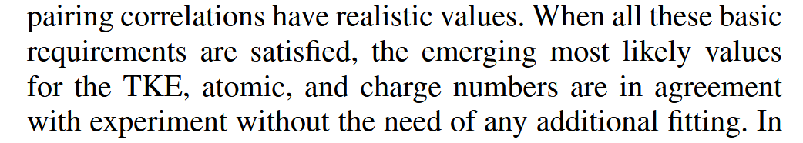
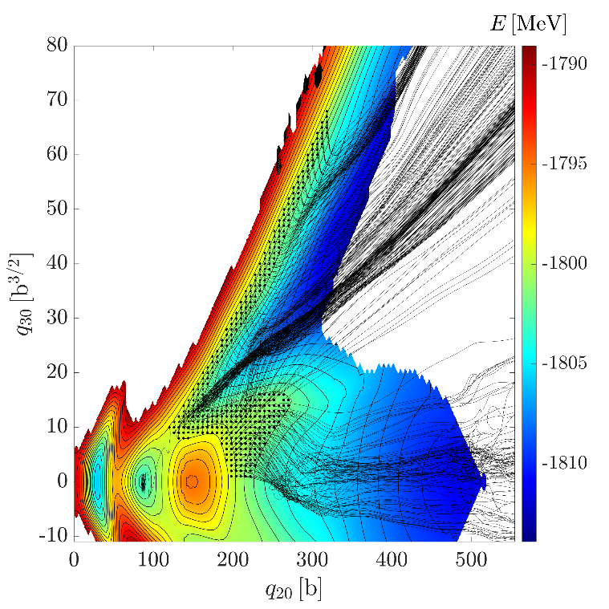
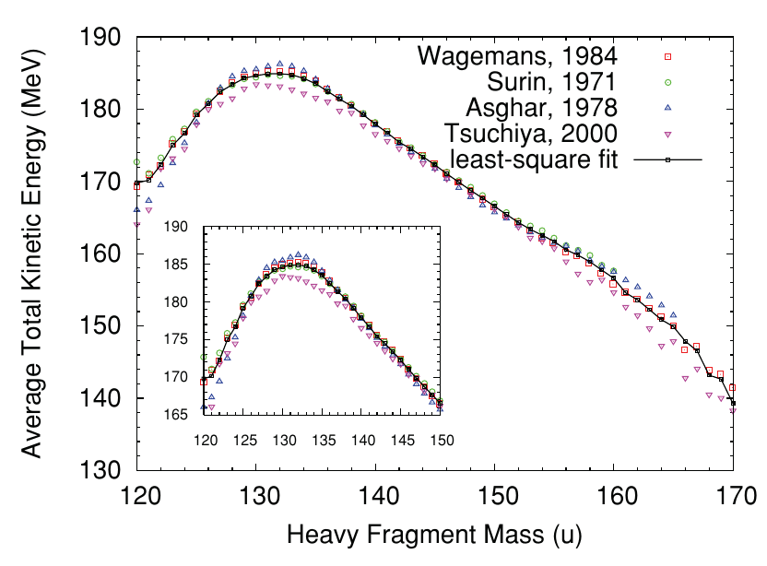
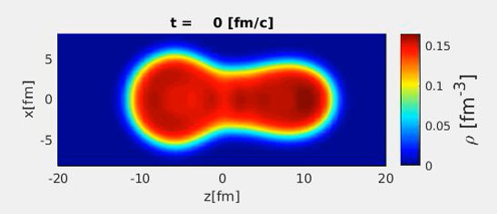
Time-dependent Hartree-Fock-Bogoliubov is a theory to compute real-time fission events
Quantum-mechanical time evolution of fissioning system
Predicts TKE and fission fragment excitation energies
Very promising early results (by multiple groups)
Phys. Rev. C 100, 034615 (2019)

Slide 7

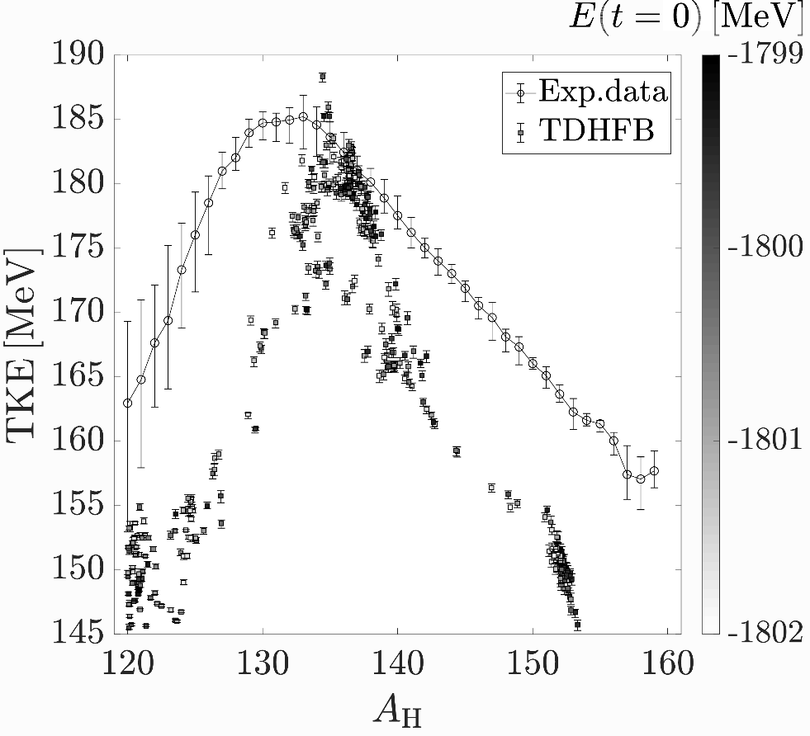
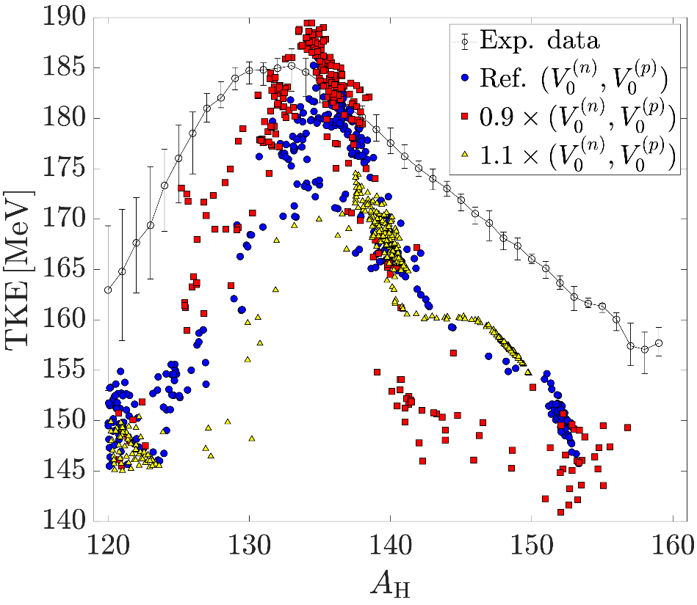
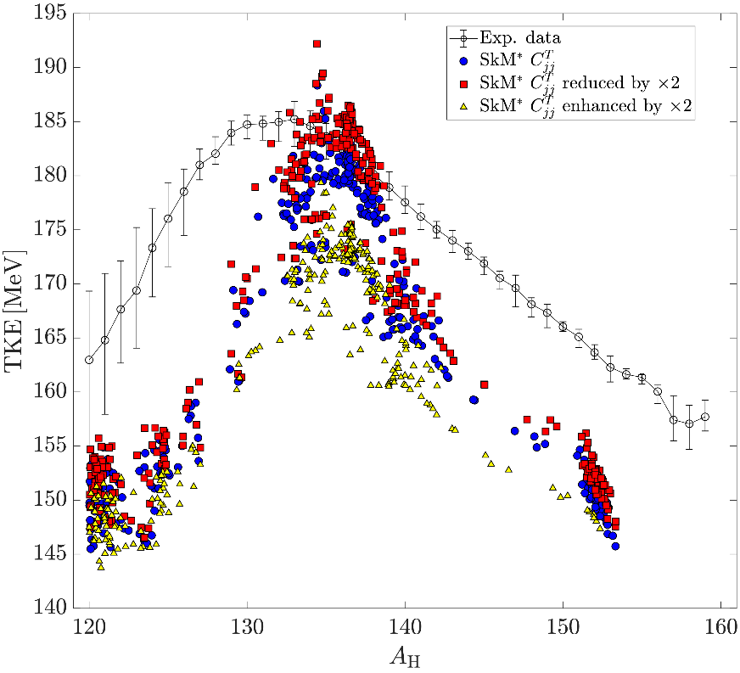
TDHFB fails to reproduce TKE and excitation energies outside most likely fission
arXiv:2510.06701
TDHFB with “best” Skyrme functional underpredicts TKE by 20 MeV outside most likely fission
Increasing pairing (=system should fission earlier, hence larger TKE) does not solve the problem
Time-odd channel of the functional improves agreement… but breaks continuity equation (think: matter flow not conserved)

Slide 8

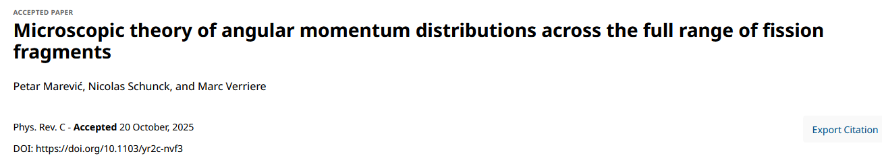
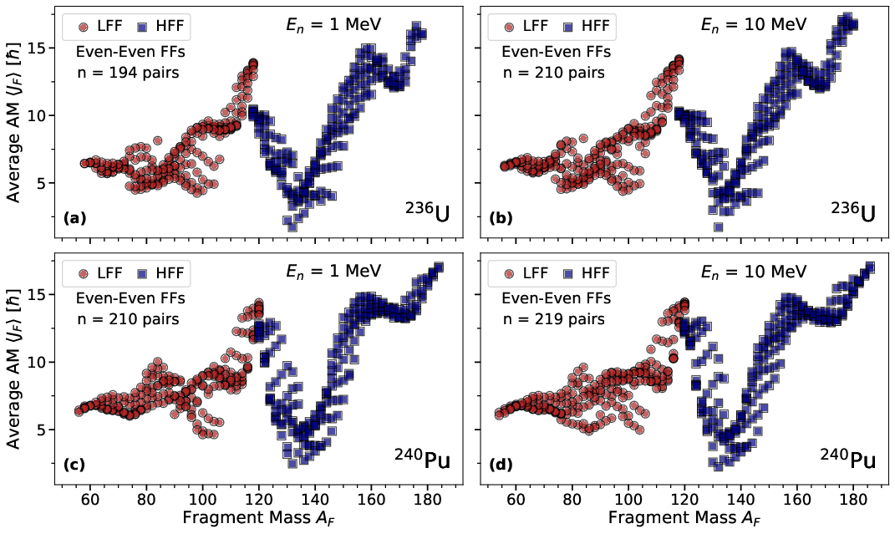
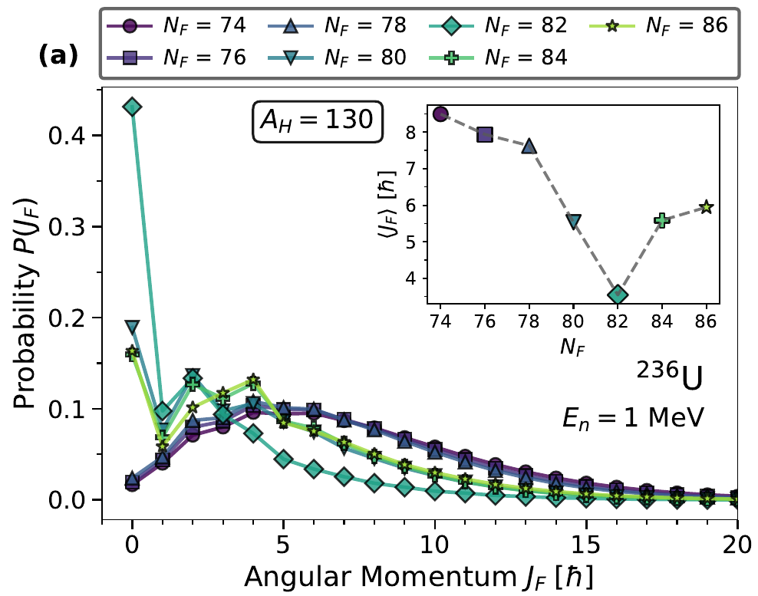
Symmetry restoration + large-amplitude collective motion give spin distributions of all fission fragments
arXiv:2506.10777
2D PES for ²³⁶U and ²⁴⁰Pu
Quintuple projection at scission
TDGCM+GOA evolution
Projection-TDGCM folding

Slide 9
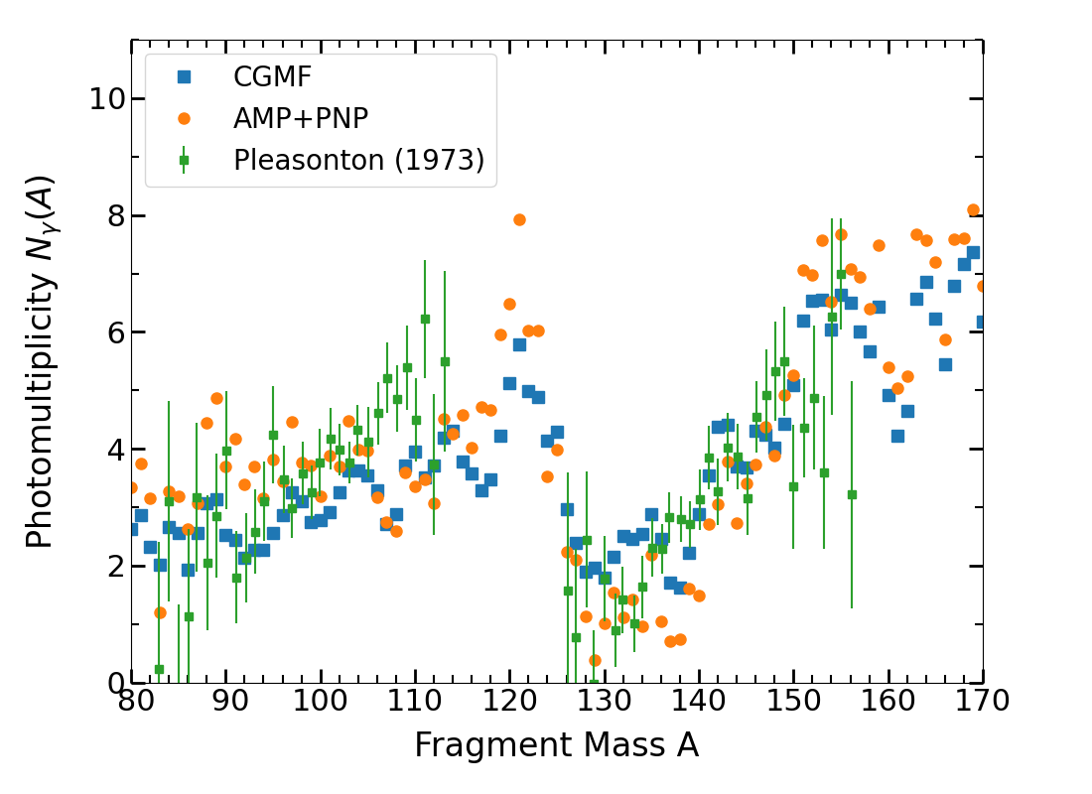
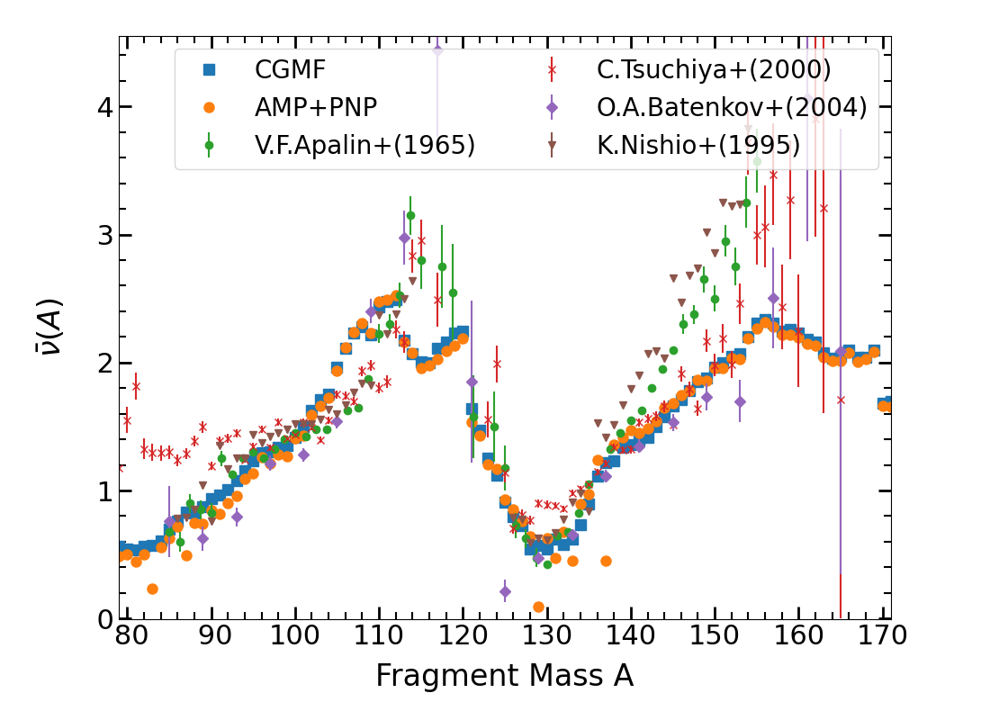
Microscopic spin distributions reproduce PFNS/PFGS as well as phenomenological inputs fitted to data!

Slide 10
Conclusions
Predictive fission modeling requires a complete workflow that includes
Structure and fission theory to predict initial conditions of fission fragments
Structure and reaction theory to simulate prompt emission
Decay data (experimental or theoretical) to compute cumulative yields and delayed emission
FETA provides analogue of CGMF at LLNL and complements FREYA (much faster but more phenomenological)
Dr. Spin and Mr. Excitation energy: microscopic theory excels at predicting spin distributions but fails at excitation energies

