Slide 1

Fission product yield data
for basic physics research and applications
Anton Tonchev
on behalf of the LLNL-LANL-TUNL collaboration
Nuclear Data Week, Jan 6 – 9, 2026, Brookhaven National Laboratory

Slide 2
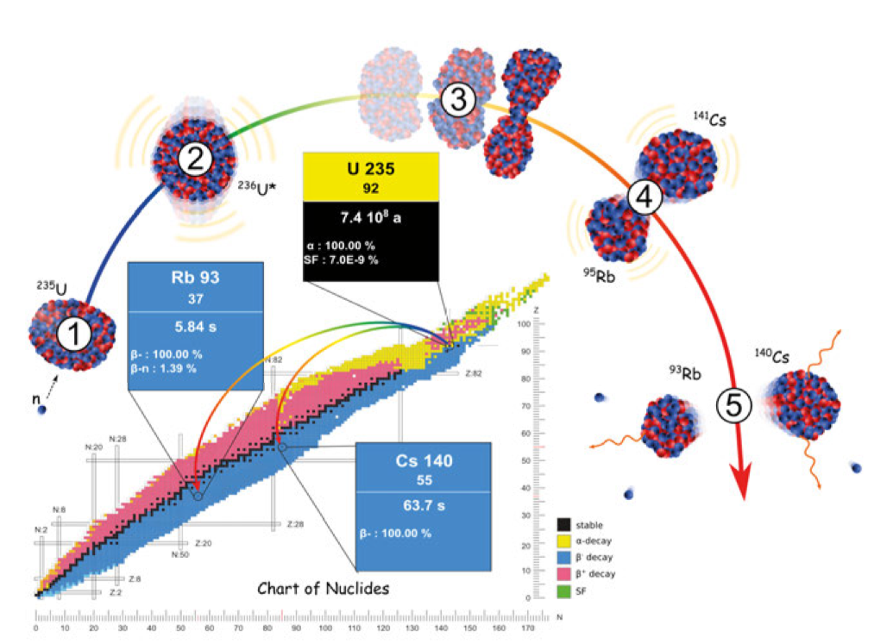

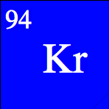
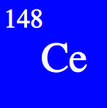
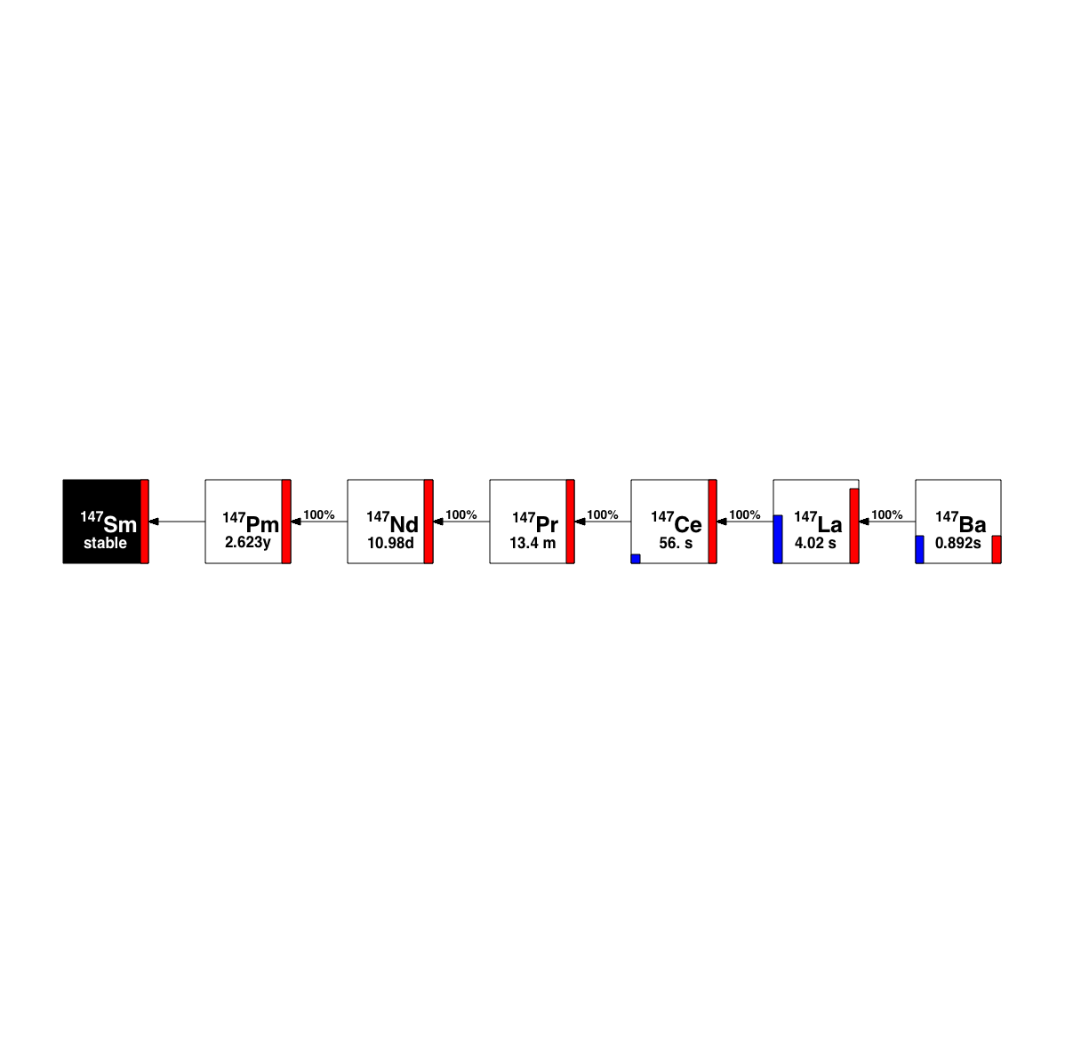

The Fission Process and its Observables
10⁻²¹ s
10⁻²² s
10⁻²⁰ s
¹⁴⁸Ce
1 A neutron captures on ²³⁹Pu
2 Compound nucleus of ²⁴⁰Pu
²⁴⁰Pu deforms and elongates
4 ²⁴⁰Pu scissions into two FFs
5 Independent yields: FPs de-
excite by prompt n and γs
Cumulative yields
²⁴⁰Pu*
²³⁹Pu
92
⁹²Kr
10⁻¹⁸-10⁻¹⁰ s
γ
n
⁹⁰Kr
¹⁴⁷Ce
T_{1/2} = 1.8 s
γ
n
n
6
γ
6
T_{1/2} = 56 s
0.1-10⁶ s
A=147
Independent yields
β⁻
β⁻
β⁻
β⁻
β⁻
β⁻
Cumulative yields
long-lived
(standard)
short-lived
(jackrabbit)
very short-lived
(RABITTS)
Developed different activation techniques to access a wide range of isobaric members
LLNL-PRES-868963
This work was performed under the auspices of the U.S. Department of Energy by Lawrence Livermore National Laboratory under contract DE-AC52-07NA27344. Lawrence Livermore National Security, LLC

Slide 3
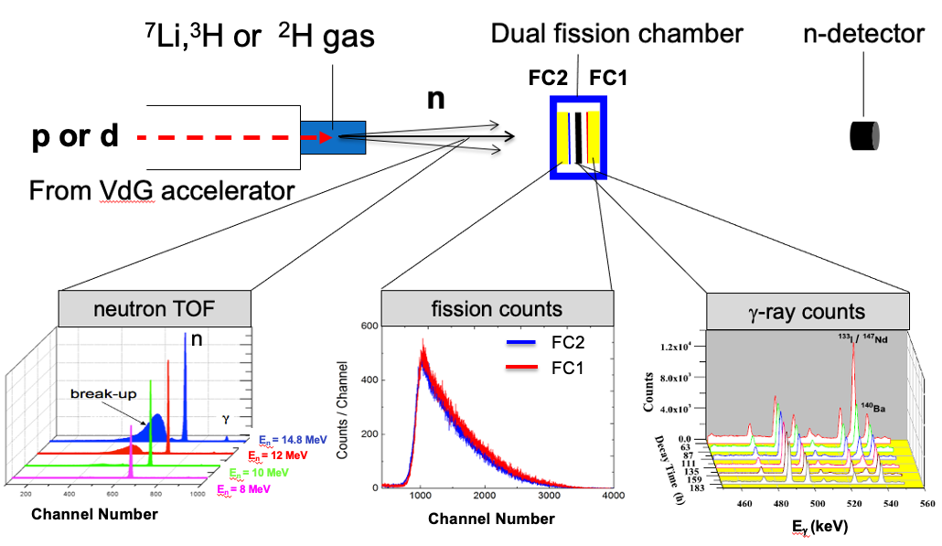

Measurement of Long-Lived Fission Products Using Monoenergetic Neutron Beams
(²³⁵U, ²³⁸U, ²³⁹Pu)
Fission Product Yield = N_{X} / N_{fis}
N_{X} = number of atoms of a specific fission product
N_{fis} = total number of fissions

Slide 4
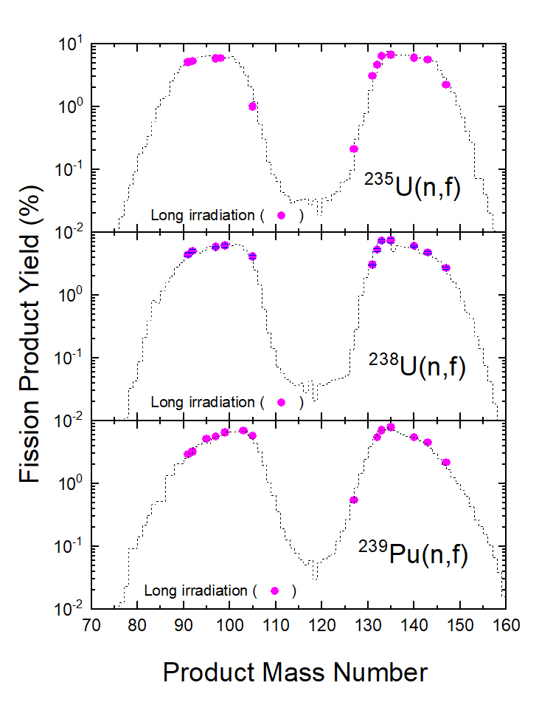
Long-Lived Fission Product Yields
Primary Fission Distribution
Completed: 18 FPYs @ 11energies from ²³⁵U, ²³⁸U, and ²³⁹Pu
A. Tonchev et al. Nucl. Data Sheets, 202, 12 (2025)
Notes:
We complete the measurements of 16 cumulative FPYs from the three actinides.

Slide 5
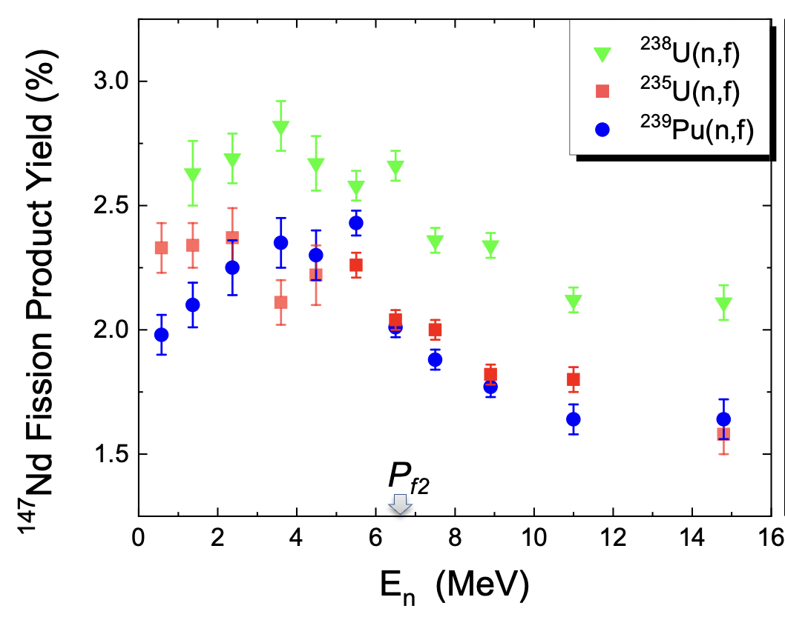
¹⁴⁷Nd FPY from Neutron-Induced Fission of ²³⁵U, ²³⁸U, and ²³⁹Pu
At higher energies (~5.0 to 14.8 MeV), the slope of ¹⁴⁷Nd is negative for all three fissile actinides
At lower energies (0.5 to 5 MeV), there is a slight positive slope for ²³⁹Pu and ²³⁸U, and constant for ²³⁵U
The overturn, occurring around 5 MeV, take place below the second-chance fission threshold
P_{f2}

Slide 6
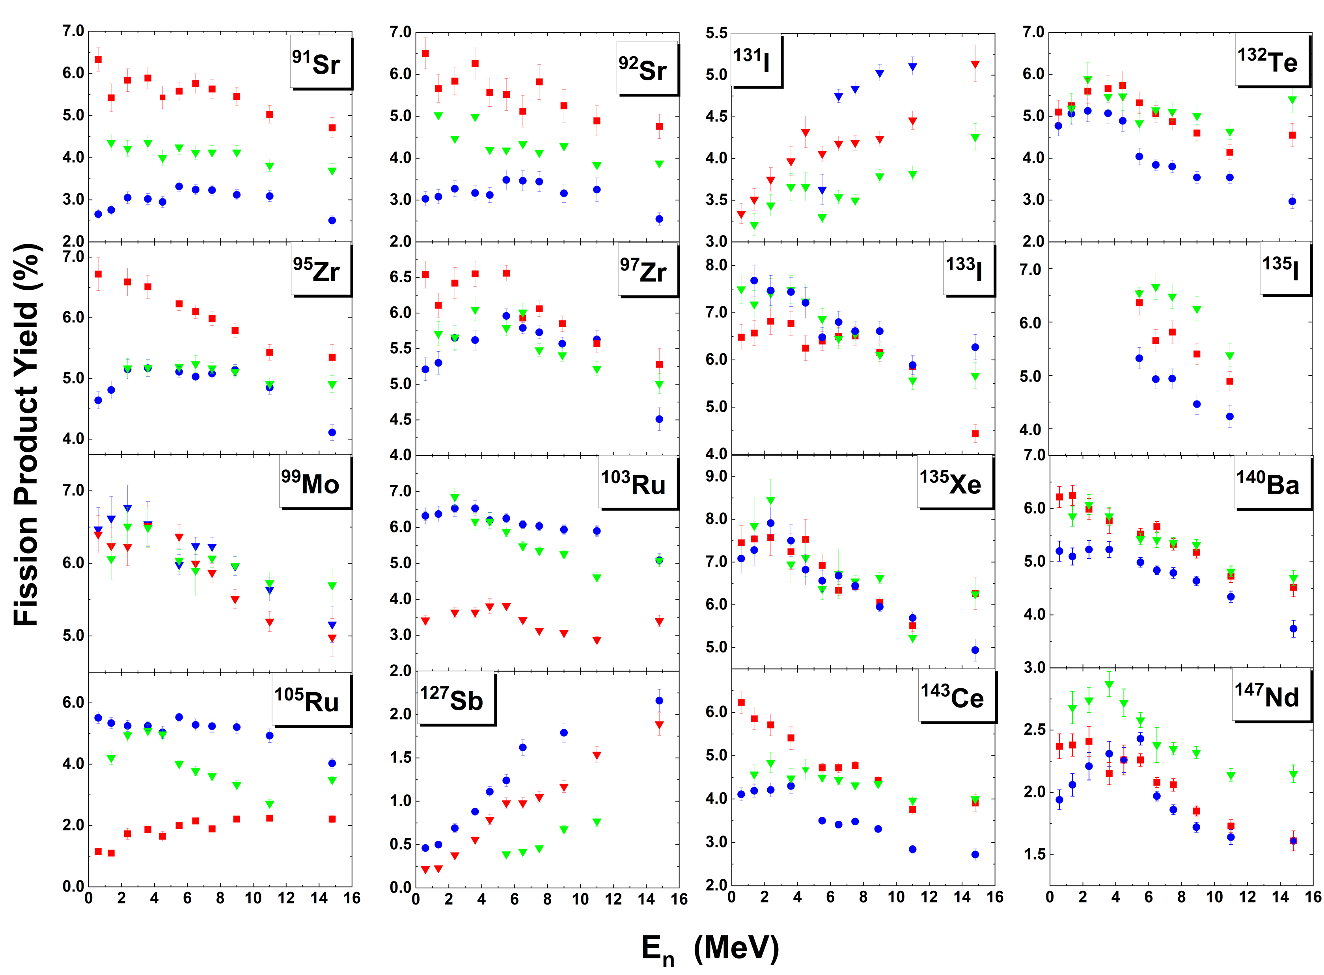
FPYs from ²³⁵U(n,f) [ ], ²³⁸U(n,f) [ ], and ²³⁹Pu(n,f) [. ]
P_{f2}
P_{f3}
P_{f2}
P_{f3}
P_{f2}
P_{f3}
P_{f2}
P_{f3}
A. Tonchev et al. NDS, 202, 12 (2025)

Slide 7
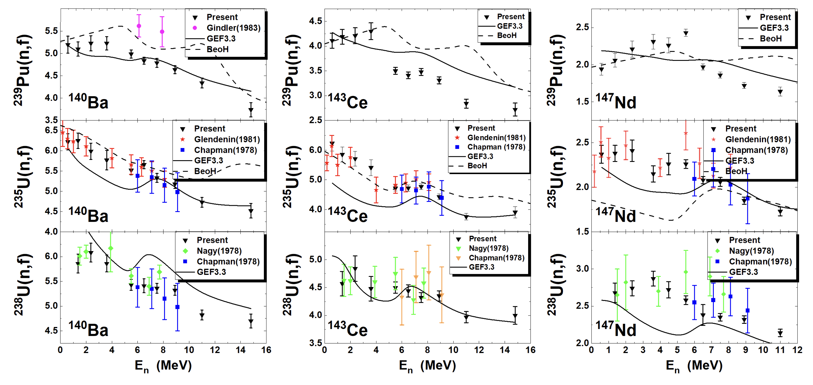
Comparison with GEF and BeoH
A.E. Lovell, T. Kawano, et al. Phys. Rev. C 103, 014615 (2021)
A.E. Lovell, T. Kawano, et al. EPJ Web of Conferences 284, 04015 (2023)
K.H. Schmidt, et al., Nuclear Data Sheets 131, 107 (2016)

Slide 8
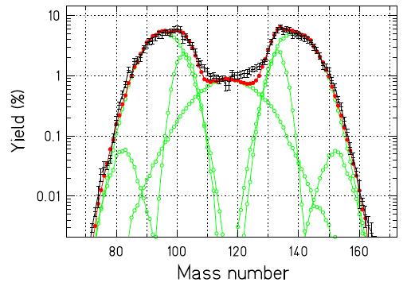
Fission Product Mass Distribution: What Have We Learned So Far?
²³⁵U(n,f)
At higher energies, 5 – 15 MeV:
All is consistent with what we know
The symmetric FPYs steeply increase
The two asymmetric FPY’s slightly decrease
The very asymmetric FPY’s (the wings) slightly increase

Slide 9
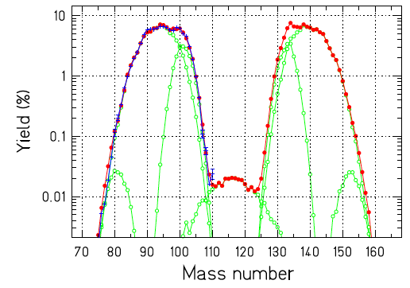
Fission Product Mass Distribution: What Have We Learned So Far?
²³⁵U(n,f)
At higher energies, 5 – 15 MeV:
All is consistent with what we know
The symmetric FPYs steeply increase
The two asymmetric FPY’s slightly decrease
The very asymmetric FPY’s (the wings) slightly increase
At intermediate energies, 0.5 – 5 MeV:
A new phenomenon!
Some high yields from the two asymmetric mass distributions increase
S2
S2
S1
S1
SL
GEF 3.1 Calculations
Expand the theoretical capabilities to understand the evolution of the FPY at low neutron energies
LLNL-PRES-868963
This work was performed under the auspices of the U.S. Department of Energy by Lawrence Livermore National Laboratory under contract DE-AC52-07NA27344. Lawrence Livermore National Security, LLC

Slide 10
Short-Lived Fission Product Yields
Primary Fission Distribution
Completed: 18 FPYs @ 11energies from ²³⁵U, ²³⁸U, and ²³⁹Pu
Measured: > 40 FPYs @ 8 energies
from ²³⁵U, ²³⁸U, and ²³⁹Pu
Notes:
We also obtained FPY data from 46 FPs from short-lived fission isotopes using JackRabbit technique.

Slide 11
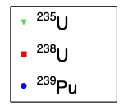
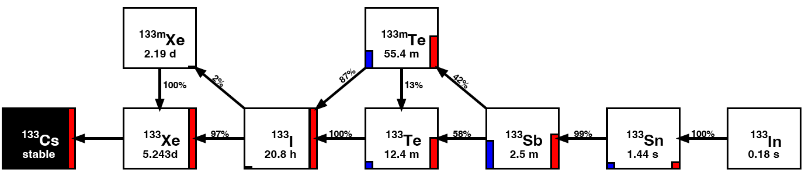
FPYs from Neutron Induced Fission of
²³⁵U, ²³⁸U, and ²³⁹Pu at E_{n}= 4.6 MeV
Fission product yield data with half-lives from minutes to hours
A. Ramirez et al. 107, 05408 (2023)
Notes:
11

Slide 12
FPYs from Neutron Induced Fission of
²³⁵U, ²³⁸U, and ²³⁹Pu at E_{n}= 9.0 MeV
Fission product yield data with half-lives from minutes to hours
J. Silano et al. Prepared for publication
Notes:
12

Slide 13
Very Short-Lived Fission Product Yields
Primary Fission Distribution
Completed: 18 FPYs @ 11energies from ²³⁵U, ²³⁸U, and ²³⁹Pu
Measured: > 40 FPYs @ 8 energies
from ²³⁵U, ²³⁸U, and ²³⁹Pu
Measured: > 50 FPYs @ 6 energies
from ²³⁵U, ²³⁸U, and ²³⁹Pu
Notes:
And now we demonstrated measurements of 87 FPs using RABITT system.
This project will give a complete picture of the fission product yield landscape; from the initial distribution produced directly by fission, through the complex, time-dependent evolution of the yields from β-decay and neutron emission, and finally the “end of the road” of the decay, the final distribution of stable nuclei.

Slide 14
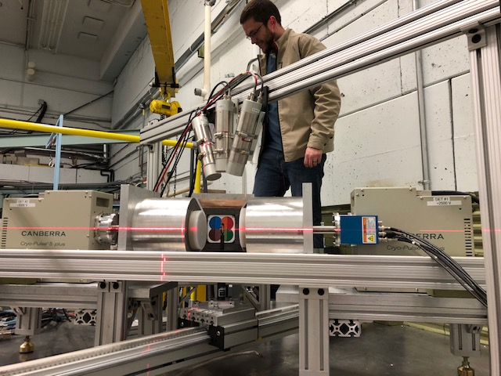

Measurement of Short-Lived Fission Products Using RABITTS
Counting Area
Irradiation Area
RApid
Belt-driven
Irradiated
Target
Transfer
System
CeBr₃
Clover
BEGe
10 m
Fully automated system moves targets between irradiation and counting positions
Maximum speed 10 m/s
FPY data for FPs with half-lives of sub-second to a few minutes
Developed analytical methods to process complex gamma-ray spectra
A=133
JACK-RABBIT
Independent yields
Cumulative yields
S. Finch et al. NIMA 1025, 166127 (2022)
Reaching the very short-lived fission product yields

Slide 15
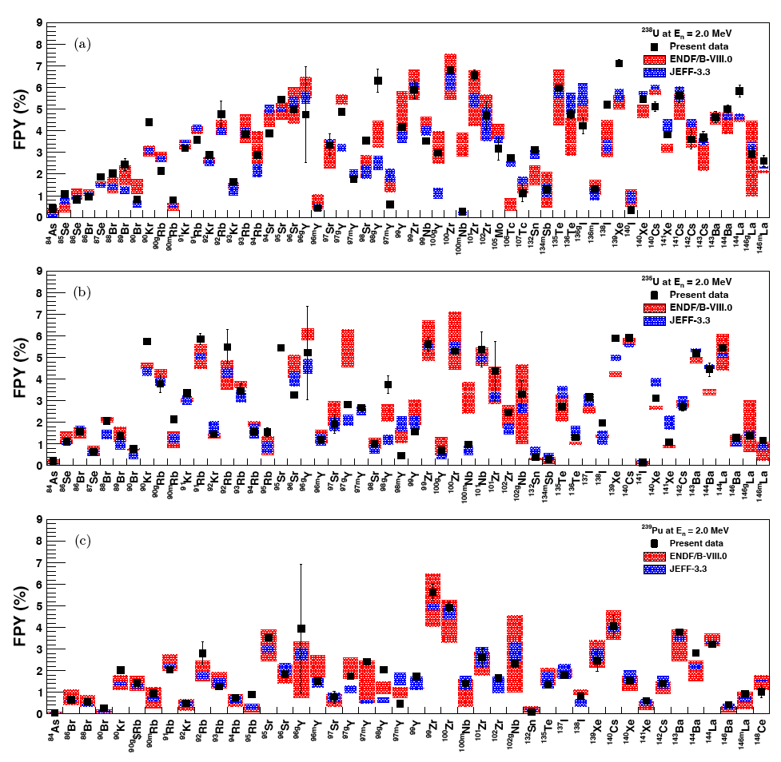
FPYs to Support Reactor Anti-Neutrino Anomaly
²³⁸U(n,f)
E_{n}= 2 MeV
²³⁵U(n,f)
E_{n}= 2 MeV
²³⁹Pu(n,f)
E_{n}= 2 MeV

Slide 16
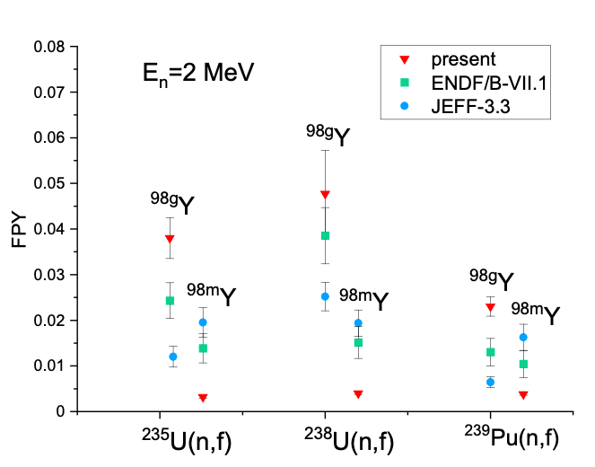
Isomeric Fission Yield Ratios at E_{n} = 2 MeV
O.J. Sears, A. Mattera et al. NDS, 173 118 (2021)
A. Mattera et al. PRC 111, L061601 (2025)
Isomeric Fission Yield Ratios – the Larger Discrepancy from the Evaluation
LLNL-PRES-868963
This work was performed under the auspices of the U.S. Department of Energy by Lawrence Livermore National Laboratory under contract DE-AC52-07NA27344. Lawrence Livermore National Security, LLC

Slide 17
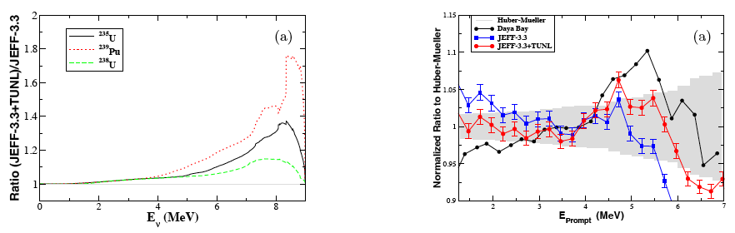
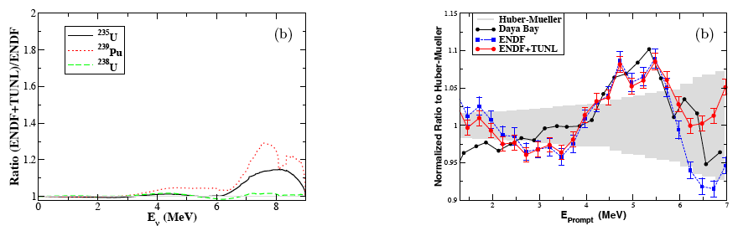
FPYs to Support Reactor Anti-Neutrino Anomaly
W. Tornow et al. submitted for publication

Slide 18
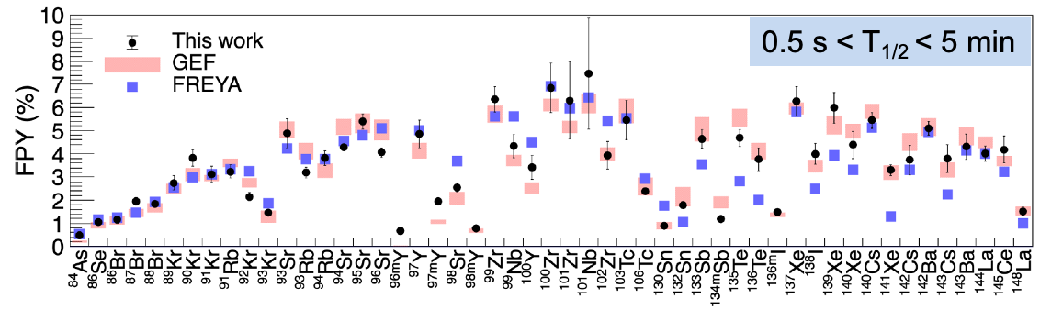
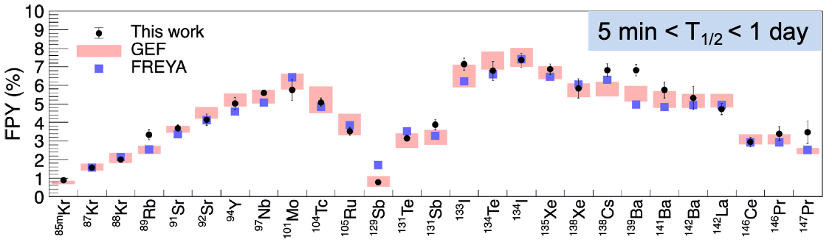
Short-Lived FPYs from ²³⁸U(n,f) at E_{n}=4.6 MeV
A. Ramirez et al. 107, 05408 (2023)
The RABITTS is Broadening the Fission Product Yield Experimental Data

Slide 19
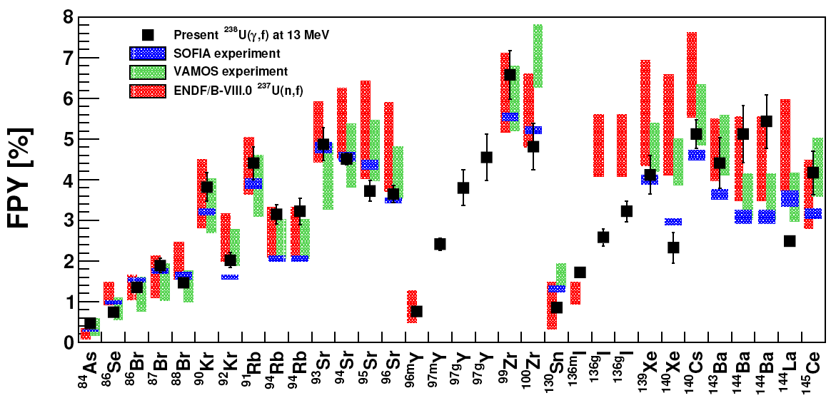
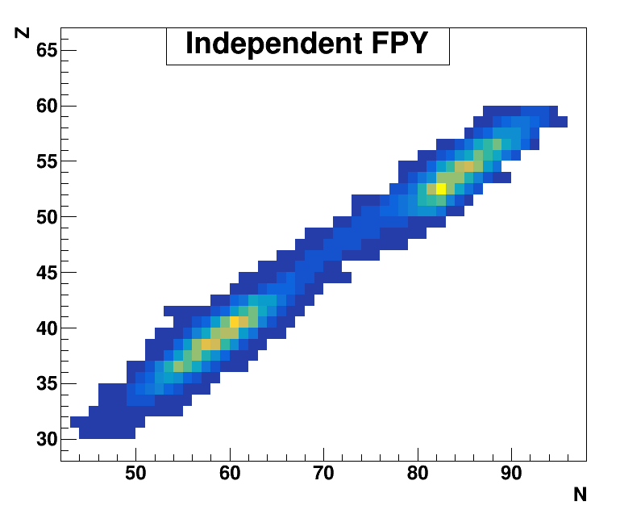
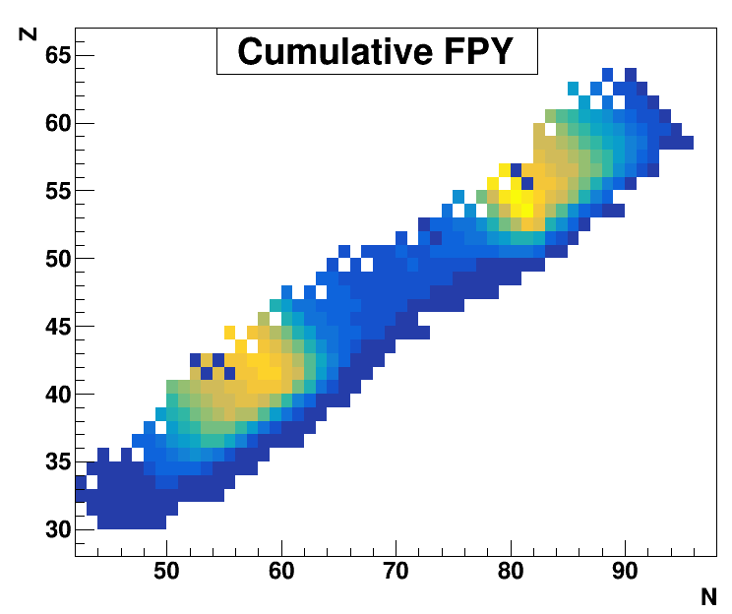
Comparison between HIGS cumulative and SOFIA and VAMOS independent FPY measurements
SOFIA
VAMOS
HIGS
I. Tsorxe et al. Accepted in Phys. Rev. C (2026)
SOFIA 2017: Pellereau et al. PRC 95, 054603 (2017)
VAMOS 2018: Ramos et al. PRC 97, 054612 92018)

Slide 20


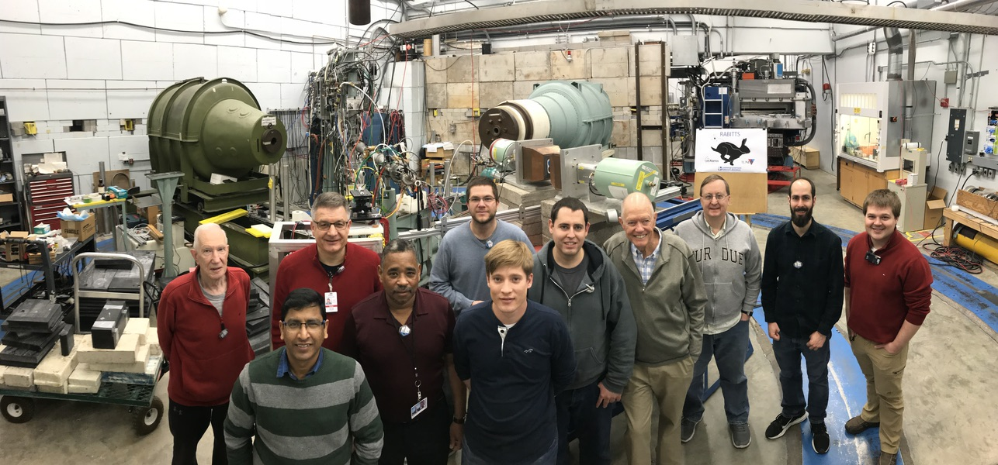
Acknowledgements
R. MALONE
A. RAMIREZ
N. SCHUNCK
J. SILANO
M. STOYER
A. TONCHEV
M. VERRIERE
T. BREDEWEG
M. CHADWICK
M. GOODEN
D. VIEIRA
J. WILHELMY
S. FINCH
A. BRACHO
I. TSORXE
F. KRISHI
C. HOWELL
W. TORNOW

Slide 21
Error estimation on the FPY Measurements:
Relative FPY Ratio
1. Statistical uncertainties of γ-ray peak counts (1-2%)
2. Relative HPGe detector efficiency (1-2% including the fit)
Absolute FPY energy dependency:
Statistical error of γ-ray peak counts (1-3%)
Absolute detector efficiency (2-3% including the fit)
Branching ratios (0.2 – 8% (¹⁴⁷Nd))
Absolute FC efficiency (3% experimentally, 0.5% simulation)
Kinematic focusing (up to 1.4%)
Isotopic corrections (0.2% for ²³⁹Pu, larger for ²³⁵U)
Low energy neutrons (<1%)
Neutron flux fluctuation correction (<0.3%)
Efficiency conversion ratio between close and standard geometry (<1%)
True coincidence summing (<1.5%)
Random coincidence summing (<0.2%)
Sample weight (<0.4%)
Self-absorption of γ-ray (0.3 – 3%)

Slide 22
Summary of all FPY measurements at TUNL on ²³⁹Pu, ²³⁵U, and ²³⁸U (1/1/2013 - 11/30/2024)
18 Cumulative FPYs at 11 neutron energies: days < T_{1/2} < weeks
40 Jack-Rabbit FPYs at 8 neutron energies: hour< T_{1/2} <day
60 RABITTS FPYs at 7 neutron energies: sub-second < T_{1/2} < 5 minutes
E_{n} (MeV) | n_{th} | 0.060 | 0.56 | 1.37 | 2.37 | 3.6 | 4.6 | 5.5 | 7.5 | 6.5 | 9.0 | 11 | 13 | 14.8
Cumulative Data Taken | 2016 |  | 235U 239Pu | 235U 238U 239Pu | 235U 238U 239Pu | 235U 238U 239Pu | 235U 238U 239Pu | 235U 238U 239Pu | 235U 238U 239Pu | 235U 238U 239Pu | 235U 238U 239Pu | 235U 238U 239Pu | NOT | 235U 238U 239Pu
Cumulative Data Analysis and Publication | Analyzed for 235U |  | Publi shed | Publi shed | Publi shed | Publi shed | Publi shed | Publi shed | Publi shed | Publi shed | Publi shed | Publi shed | To be measu-red | Publi shed
Jack-Rabbit Data Taken | NOT | NOT | 235U 239Pu | 235U 238U 239Pu | 235U 238U 239Pu | 235U 238U 239Pu | 235U 238U 239Pu | NOT | NOT | 235U 238U 239Pu | 235U 238U 239Pu | NOT | NOT | 235U 238U 239Pu
Jack-Rabbit Data Analysis | NOT | NOT | 235U 239Pu NOT | 235U 238U 239Pu NOT | In progress (Berkeley GS) | NOT | 235U 238U 239Pu Published |  |  | In progress (Berkeley GS) | 235U 238U 239Pu Analyzed |  |  | 235U 238U 239Pu In progress
RABITTS Data Taken | NOT | 235U 239Pu | 235U 239Pu | 235U 238U 239Pu | 235U 238U 239Pu | NOT | 235U 238U 239Pu | NOT | NOT | NOT | 235U 238U 239Pu | NOT | NOT | 235U 238U 239Pu
RABITTS Data Analysis |  | In progress Duke GS | In progress Duke GS | NOT | NOT |  | 238U Published |  |  |  | NOT |  |  | NOT

Slide 23
Isomeric Fission Yield Ratios
O.J. Sears, A. Mattera et al. NDS, 173 118 (2021)
A. Mattera et al. PRC 111, L061601 (2025)
Isomeric Fission Yield Ratios – the Larger Discrepancy from the Evaluation
LLNL-PRES-868963
This work was performed under the auspices of the U.S. Department of Energy by Lawrence Livermore National Laboratory under contract DE-AC52-07NA27344. Lawrence Livermore National Security, LLC

Slide 24
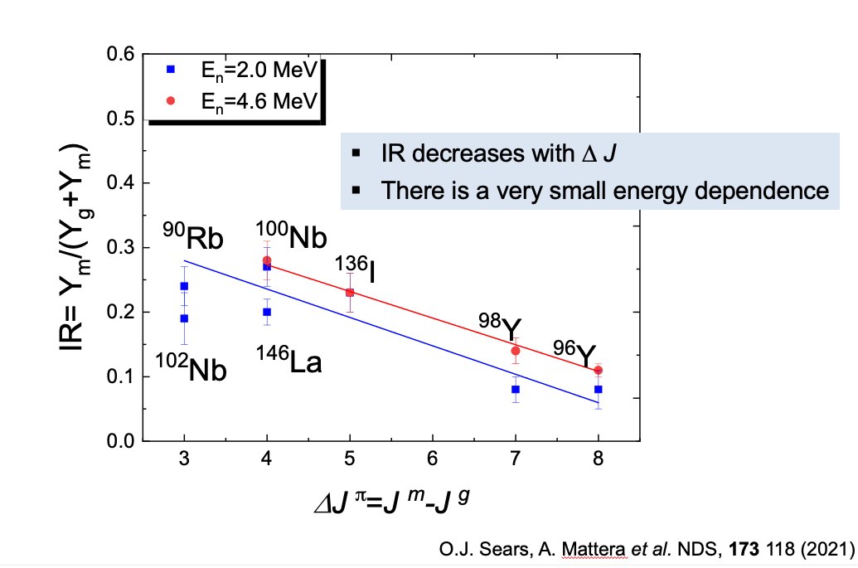
Isomeric Fission Yield Ratios from ²³⁸U(n,f)
A. Mattera et al. PRC 111, L061601, 2025

Slide 25
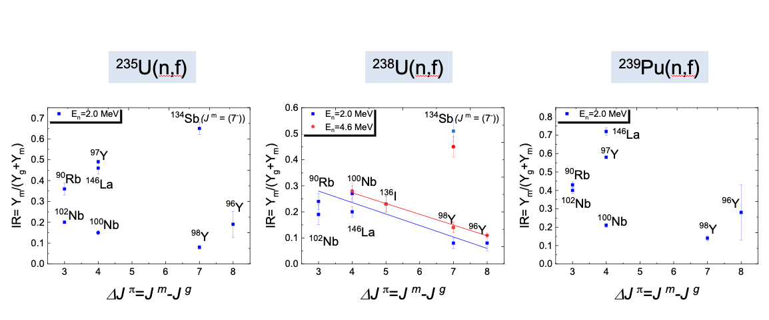
Isomeric Fission Yield Ratios from ²³⁵U(n,f), ²³⁸U(n,f) and ²³⁹Pu(n,f)
There is no strong correlation between IRs and FPs spin differences for even-odd target nucleus
Deduce the average spin <I> of the fragment
LLNL-PRES-868963
This work was performed under the auspices of the U.S. Department of Energy by Lawrence Livermore National Laboratory under contract DE-AC52-07NA27344. Lawrence Livermore National Security, LLC

Slide 26
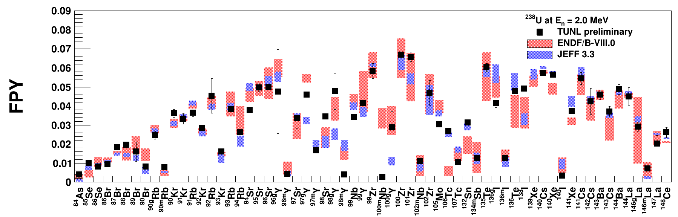
FPYs from ²³⁸U(n,f) to Support Reactor Anti-Neutrino Anomaly
²³⁸U(n,f)
E_{n}= 2 MeV
60 short-lived fission products with half-lives from seconds to minutes on ²³⁵U, ²³⁸U, and ²³⁹Pu at E_{n} = 0.06, 0.5, 2.0, 4.6, 9.0, and 14.8 MeV
Support nuclear data evaluation groups to identify the most important FPs contributing to the reactor anti-neutrino anomaly and the so called “bump”
Isomeric fission-yield or isomeric ratios are the largest source of discrepancy from evaluations
W. Tornow et al. prepared for publication

Slide 27
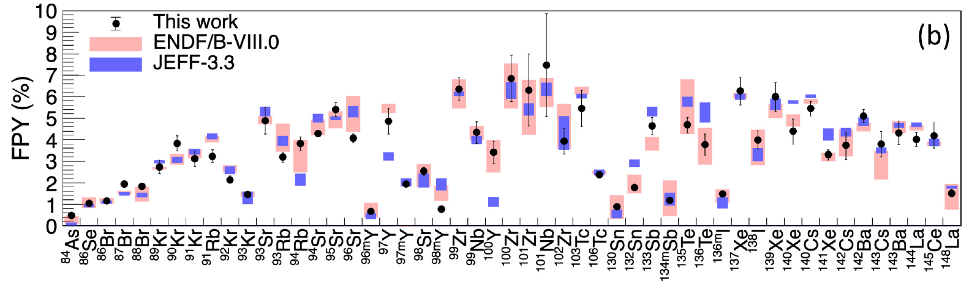

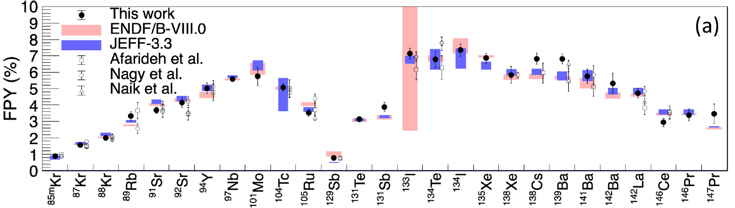

Short-Lived FPYs from ²³⁸U(n,f) at E_{n}=4.6 MeV
A. Ramirez et al. 107, 05408 (2023)

Slide 28
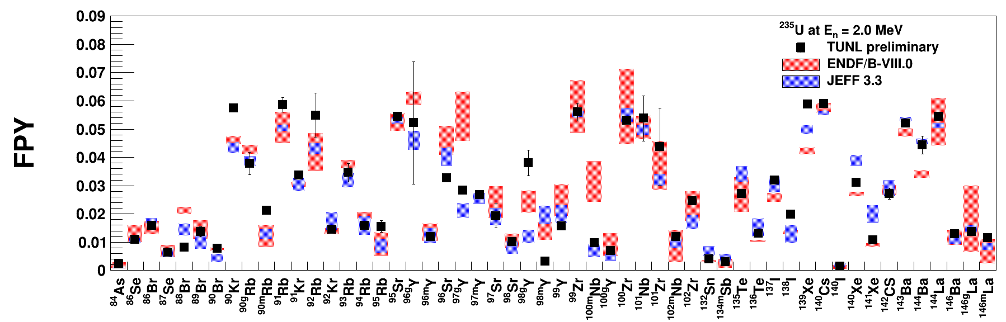
FPYs from ²³⁵U(n,f) to Support Reactor Anti-Neutrino Anomaly
²³⁵U(n,f)
E_{n}= 2 MeV
More than 50 FPYs for ²³⁵U(n,f) at E_{n} = 2.0 MeV
Technique can measure fission products in both isomeric state and ground state
Largest source of discrepancy from evaluations
W. Tornow et al. prepared for publication

Slide 29
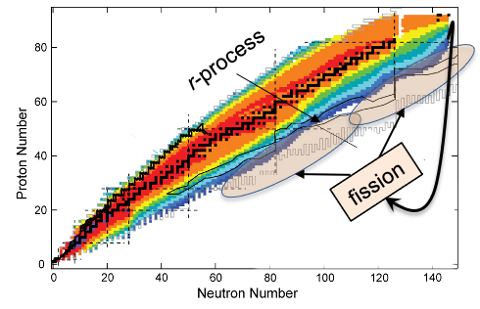
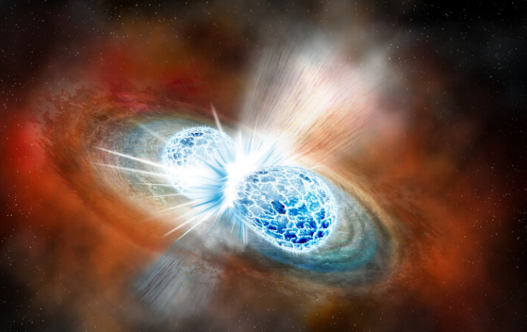
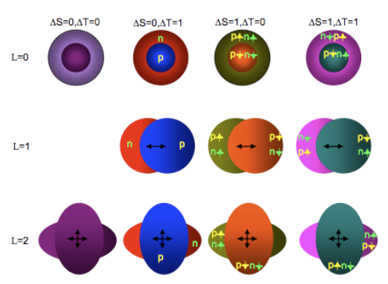
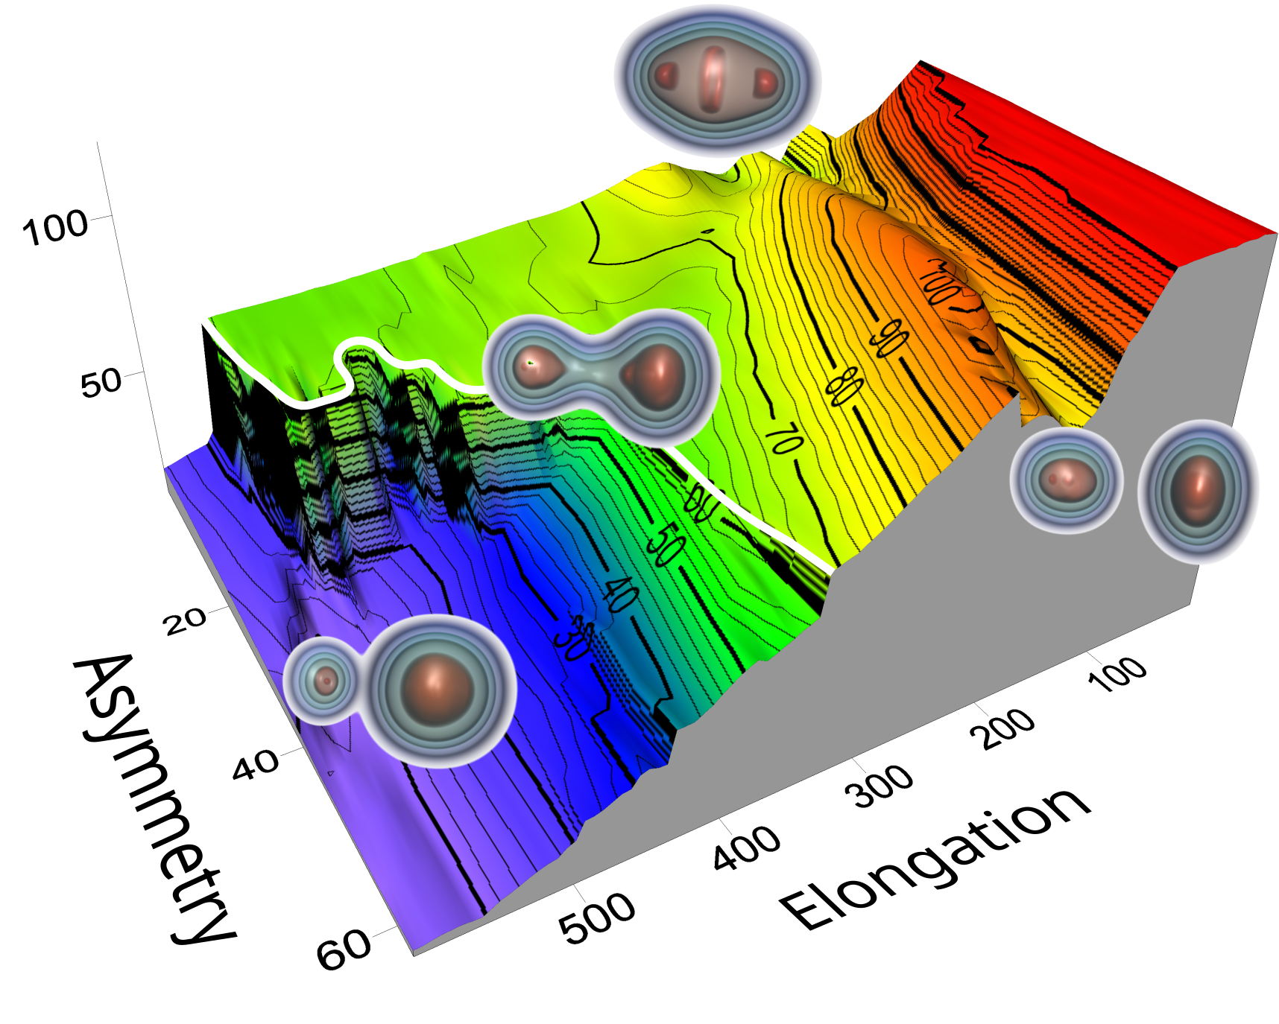
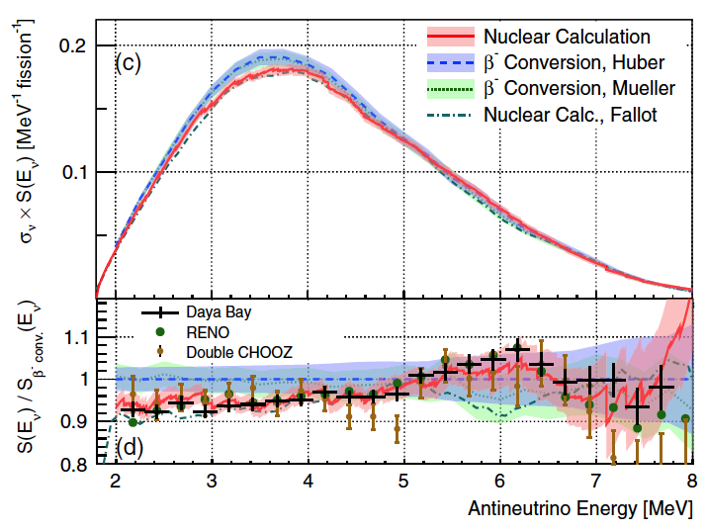
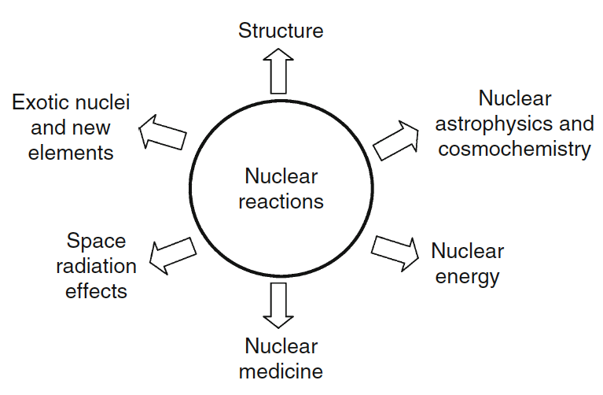
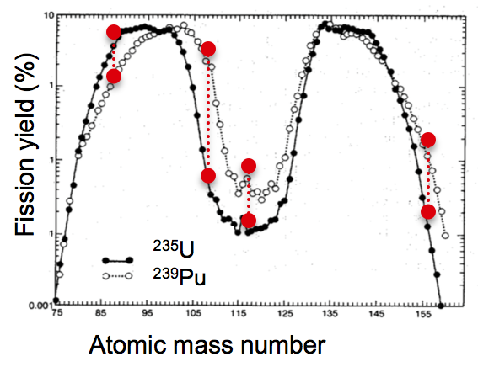
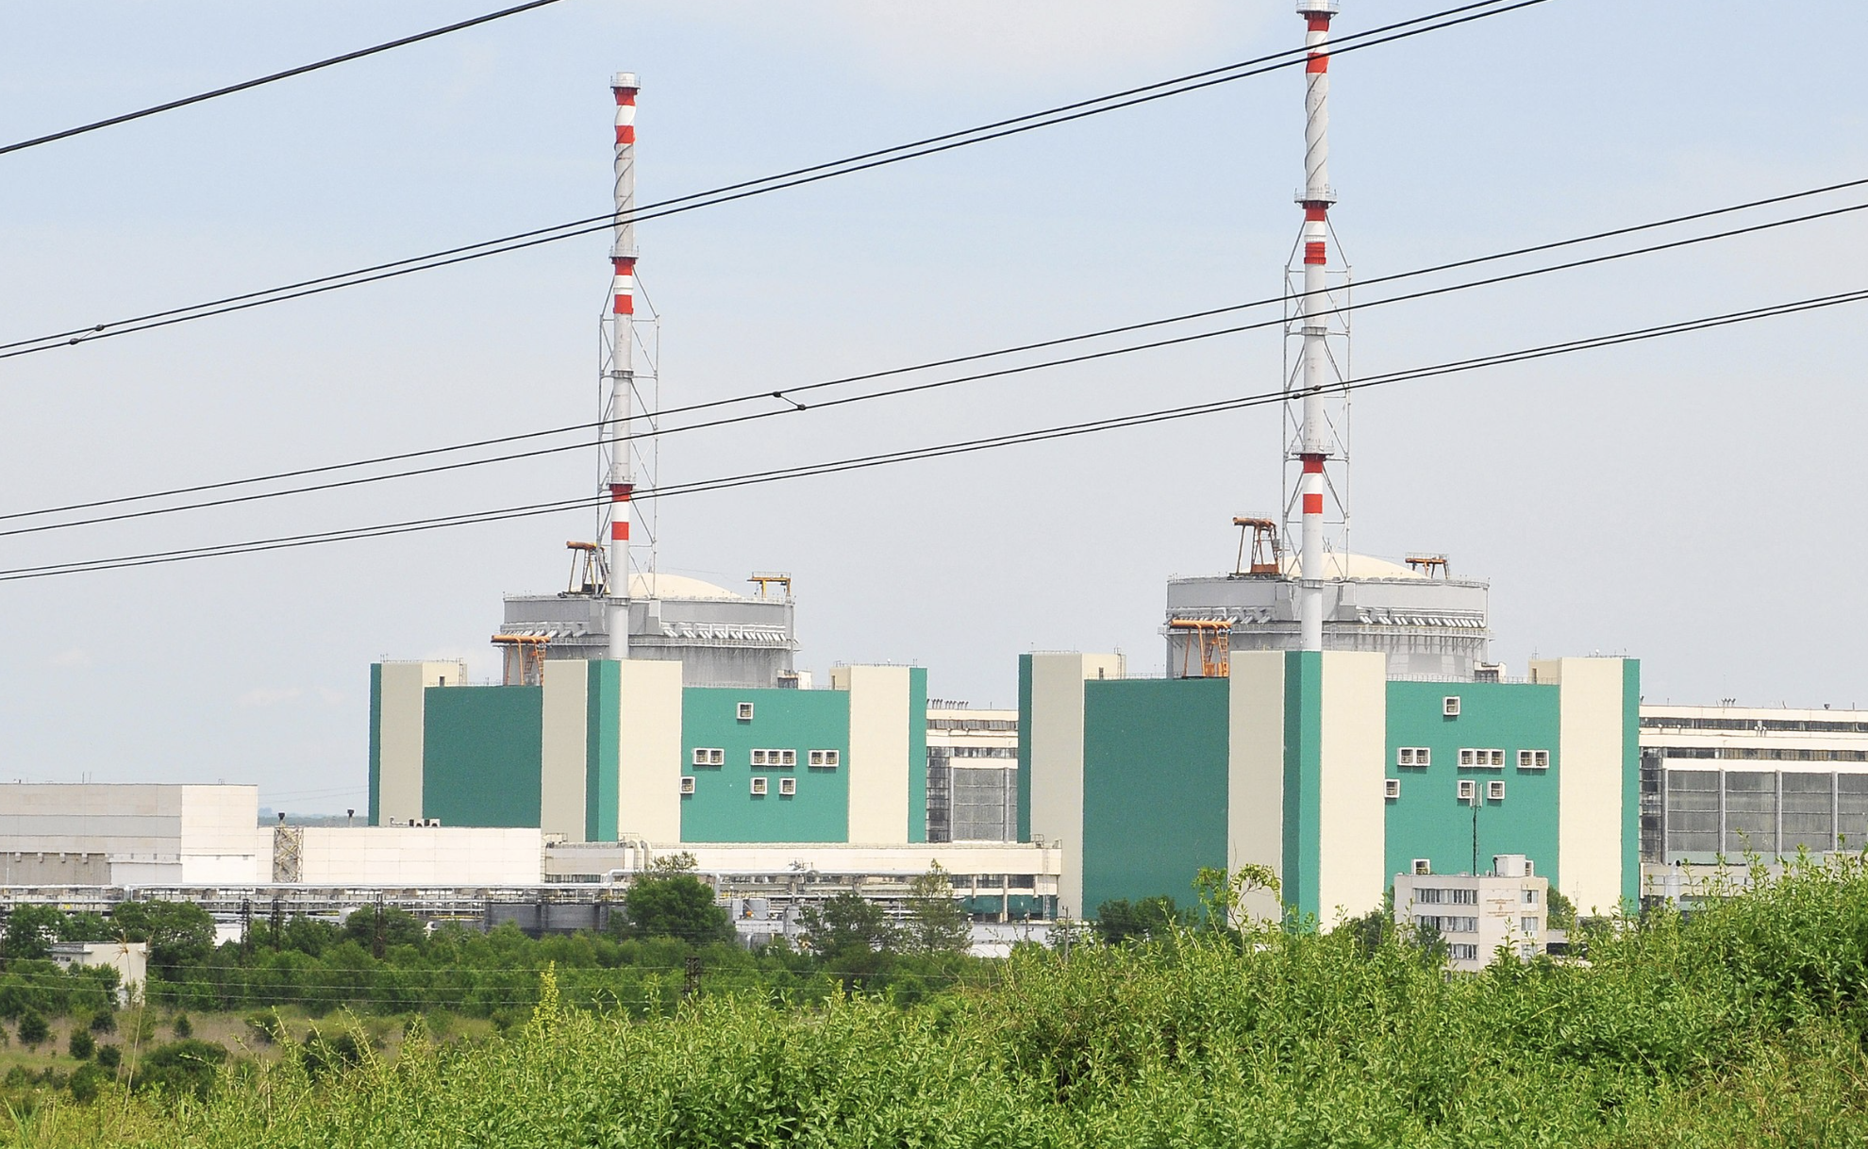

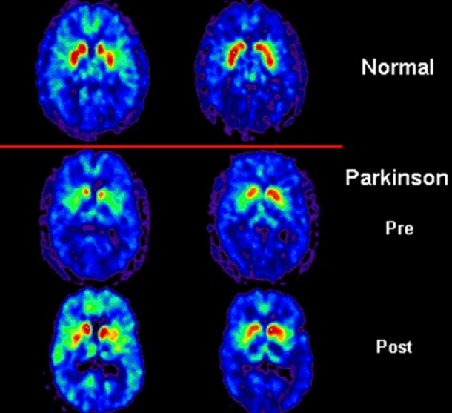
Fission Product Yield Observables in a Broader Context
NSM
Basic Science
Nuclear Astrophysics
New fission
Database
Reactor
Neutrino
Study
Fission
Yields
Nuclear Energy
Nuclear Forensics
Radiosotope Production
Application

Slide 30
Fission Fragment Distribution*
Primary Fission Distribution
* T.R. England and B.F. Rider LA-SUB-94-170
Notes:
Let me summarize the outcome of these measurements. This figure represents the FPY real estate. The data is from England and Rider.

Slide 31
The Open Problem with Energy Dependent FPY Prediction
The existing measurements of energy dependencies are too scarce for deriving systematics which are complete enough to develop a semi-empirical model for reliable predictions.
The dependence of fission yields on neutron energy is a quite complex and theoretical predictions of the energy dependence of fission product yields are not accurate and reliable enough for applications purposes.
Systematic studies of fission probability and fragment yields as function of E for various compound nuclei across the nuclear chart are fundamental to constrain theoretical models of fission.
The isomeric yield model in its present form can produce reliable estimates only where sufficient experimental data are available.
Measurements of fission observables as a function of E provide crucial insights into the interplay between nuclear structure effects, dissipation, and the dynamics of the large-amplitude deformation process leading to scission.
The control of the properties of the compound nuclei populated allows disentangling the entrance channel effects from intrinsic properties of the fissioning system, and it provides a means to benchmark energy dependent model ingredients such as level densities, barrier heights, and the role of shell ects.
Many More Experimental Data are Necessary to Develop the Systematics Needed for the Derivation of Appropriate Model Parameters
LLNL-PRES-868963
This work was performed under the auspices of the U.S. Department of Energy by Lawrence Livermore National Laboratory under contract DE-AC52-07NA27344. Lawrence Livermore National Security, LLC

