Slide 1
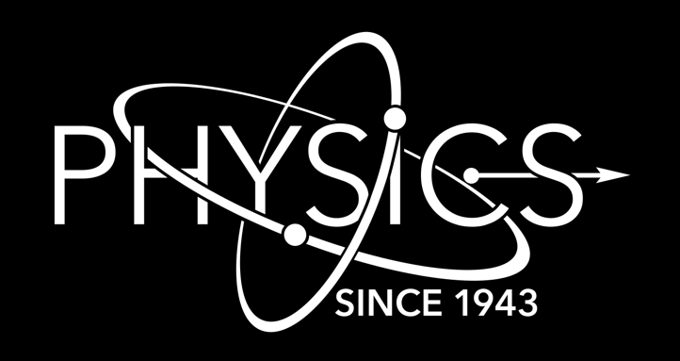
Measurement updates from DICER at LANSCE*
Experiendo cognoscitur
Th. Stamatopoulos¹, P. Koehler¹, R. Amberger¹, S. Chasapoglou¹, A. Couture¹, T. Cutler², M. Devlin¹, D. Neudecker³, B. DiGiovine⁴, A. Matyskin⁵, V. Mocko⁶, J. Morrel⁶, E. O’Brien⁶, G. Rusev⁶, J. Ullmann¹, C. Vermeulen⁶
Physics Division, Los Alamos National Laboratory, 87545, NM, USA
Nuclear Engineering and Nonproliferation Division, , Los Alamos National Laboratory, 87545, NM, USA
Computational Physics Division, Los Alamos National Laboratory, 87545, NM, USA
Weapons Engineering Verification & Validation Division, Los Alamos National Laboratory, 87545, NM, USA
Radiation Science & Engineering Center, College of Engineering, Pennsylvania State University
Chemistry Division, Los Alamos National Laboratory, 87545, NM, USA
*Funded by LANL/LDRD-DR, LANL/LDRD-ECR, OES, NCSP
Nuclear Data Week, Brookhaven National Laboratory
January 5th – 9th, 2025
LA-UR-25-31845

Slide 2
Table of Contents
Brief DICER description
Completed measurements and status
Freshly-performed measurements
Near-future measurments

Slide 3
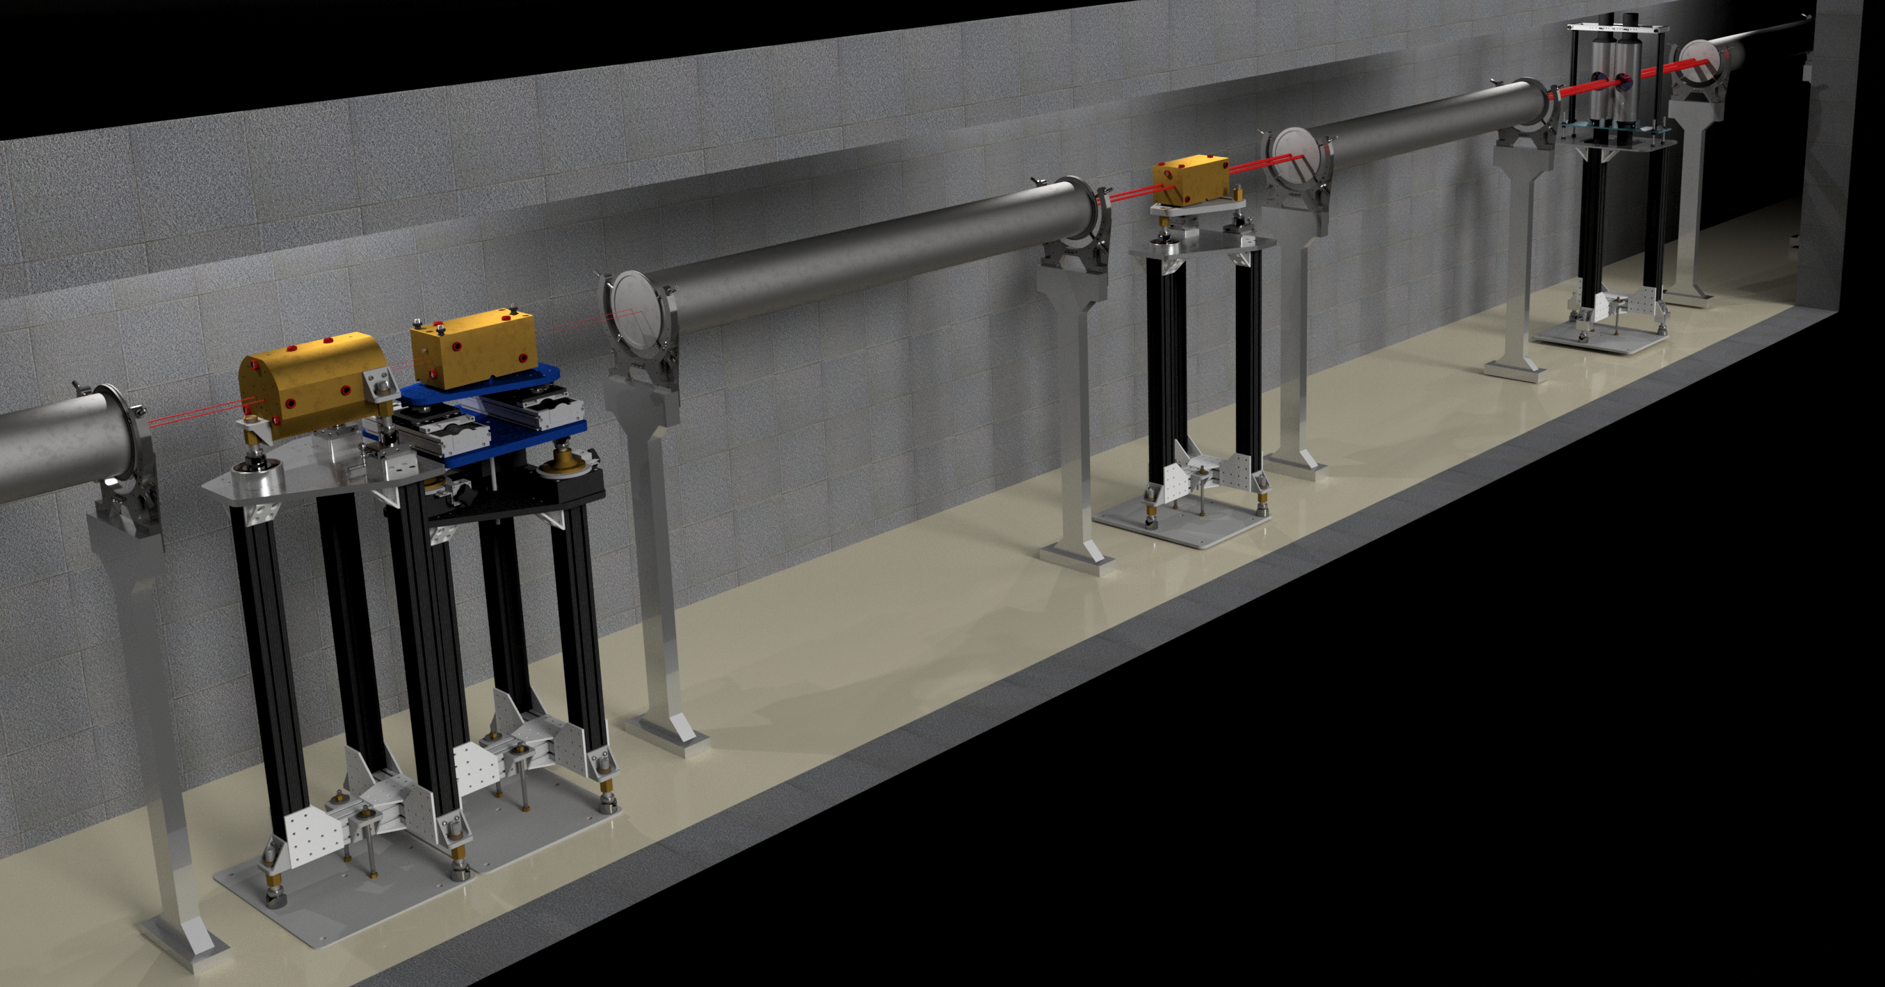
Brief DICER description

Slide 4
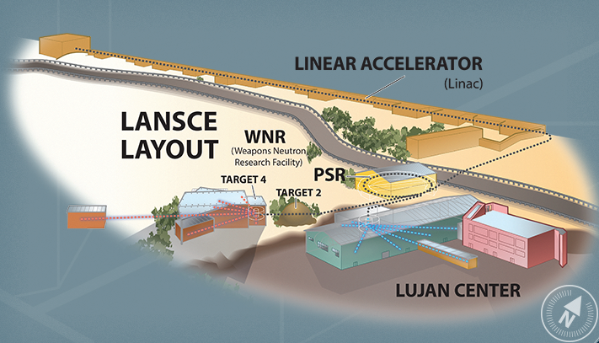
The Los Alamos Neutron Science Center - LANSCE
500-800 MeV protons
keV – MeV neutrons
meV – keV neutrons

Slide 5
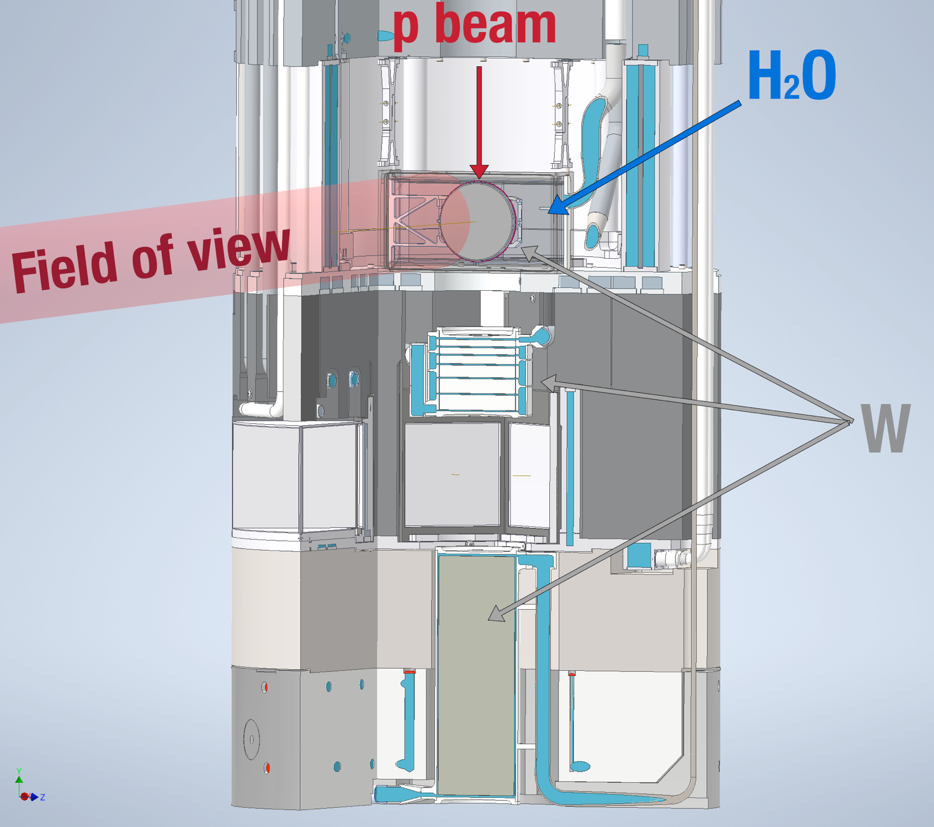
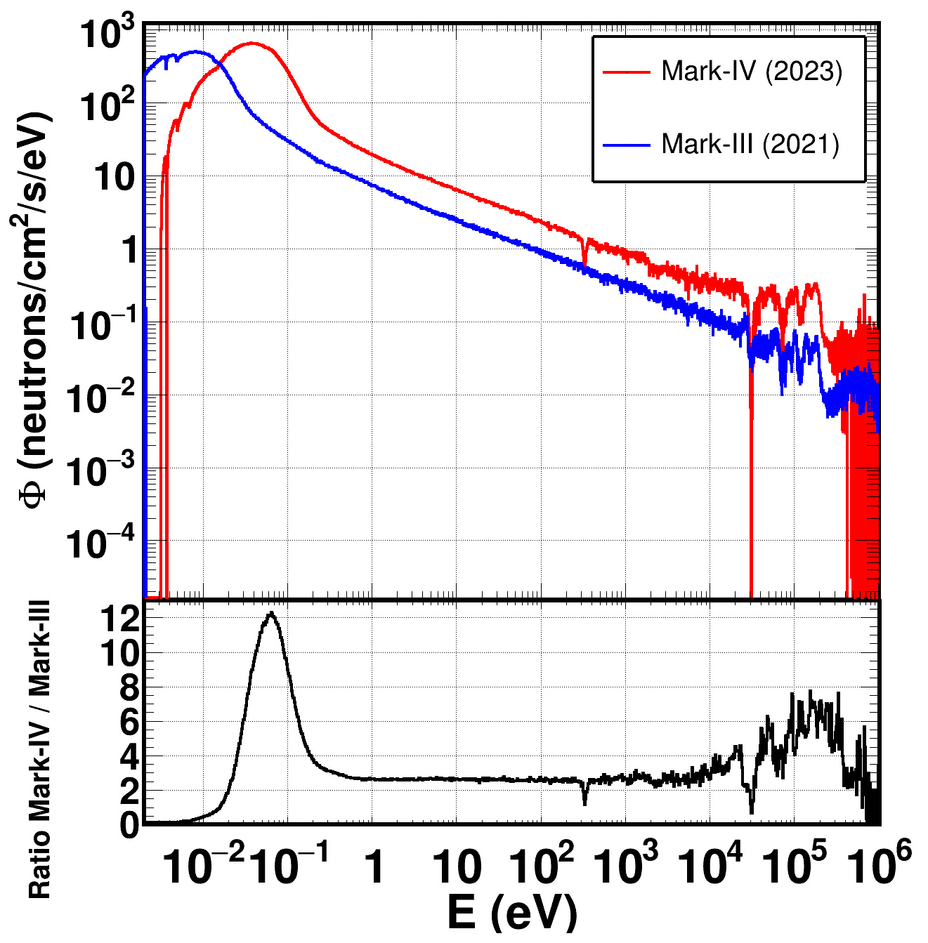
Mark-IV (M4) : New neutron target at Lujan, est. 2022
800MeV protons impinge on a 3-way split W target.
H₂O moderator
Neutrons from 5 meV to >300 keV
Improved resolution
Preliminary

Slide 6
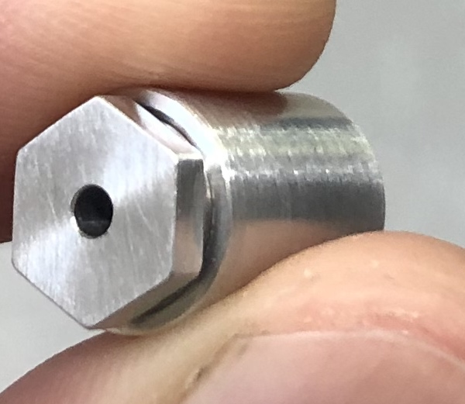
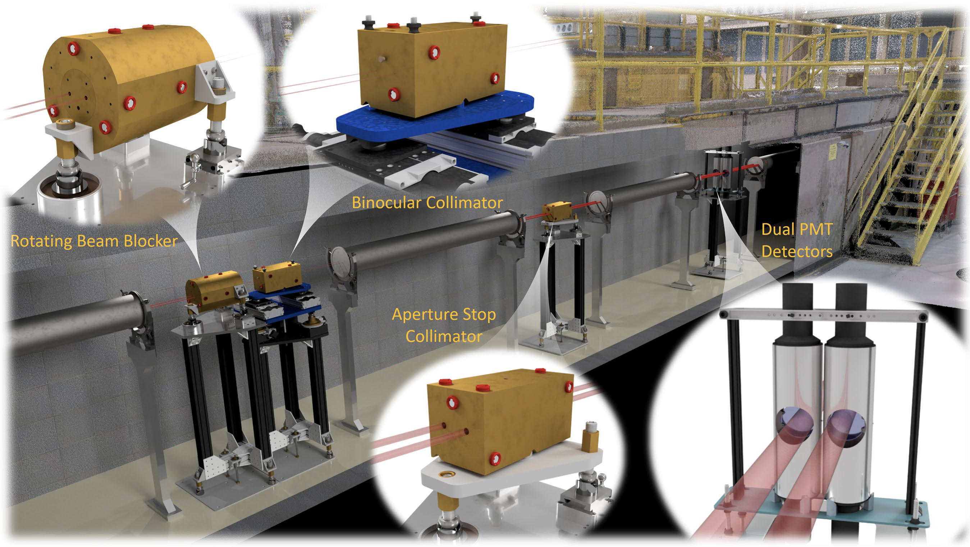
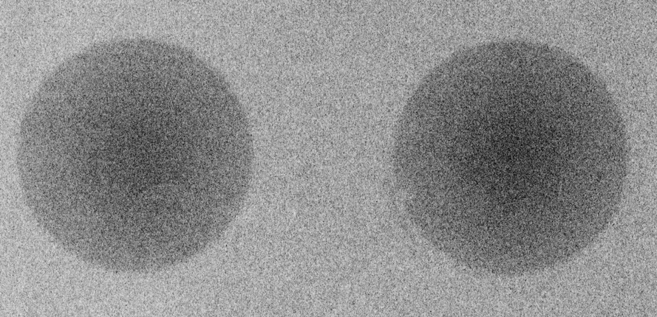
DICER: Device for Indirect Capture Experiments on Radionuclides
Binocular 1- and 0.1-mm collimation: simultaneous sample –in/out measurements
Minimization of sample size ( from ng)
Useful for radioactive or hard-to-get samples
A. Stamatopoulos et al., NIMA (1025) 166166, 2022
A. Stamatopoulos et al., IEEE Trans. Nucl. Science 70, (2023)
A. Stamatopoulos et al., Neutron News 33, 12 – 14 (2022)

Slide 7
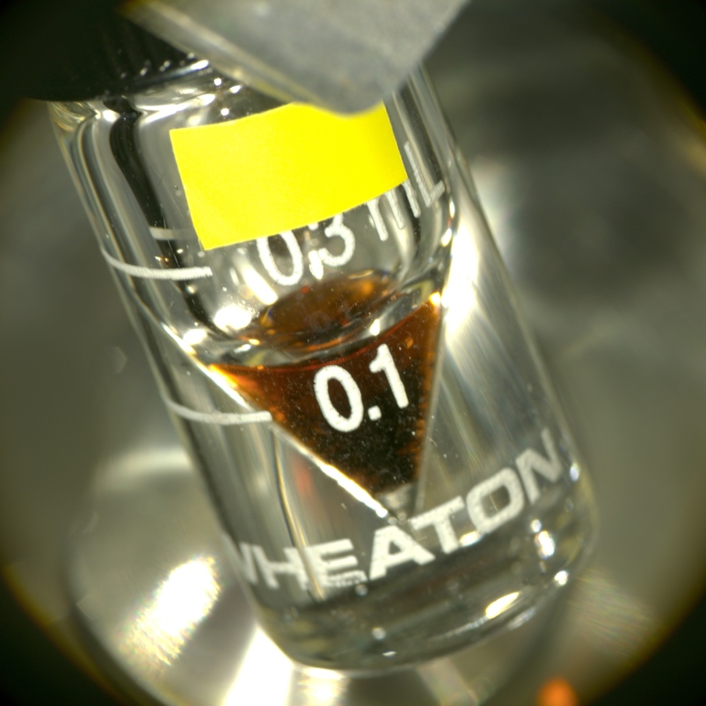
Completed measurements and status

Slide 8
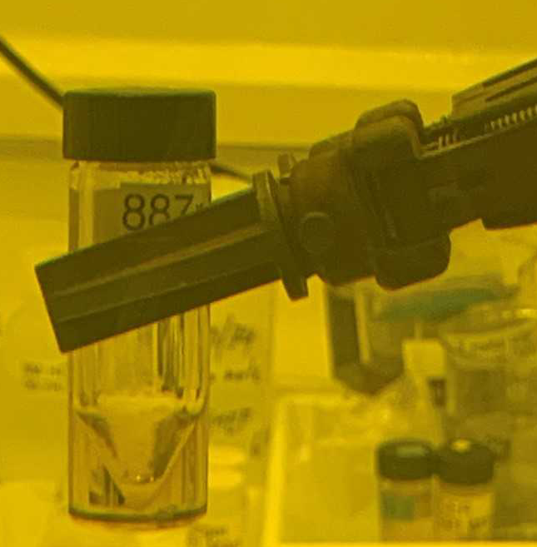
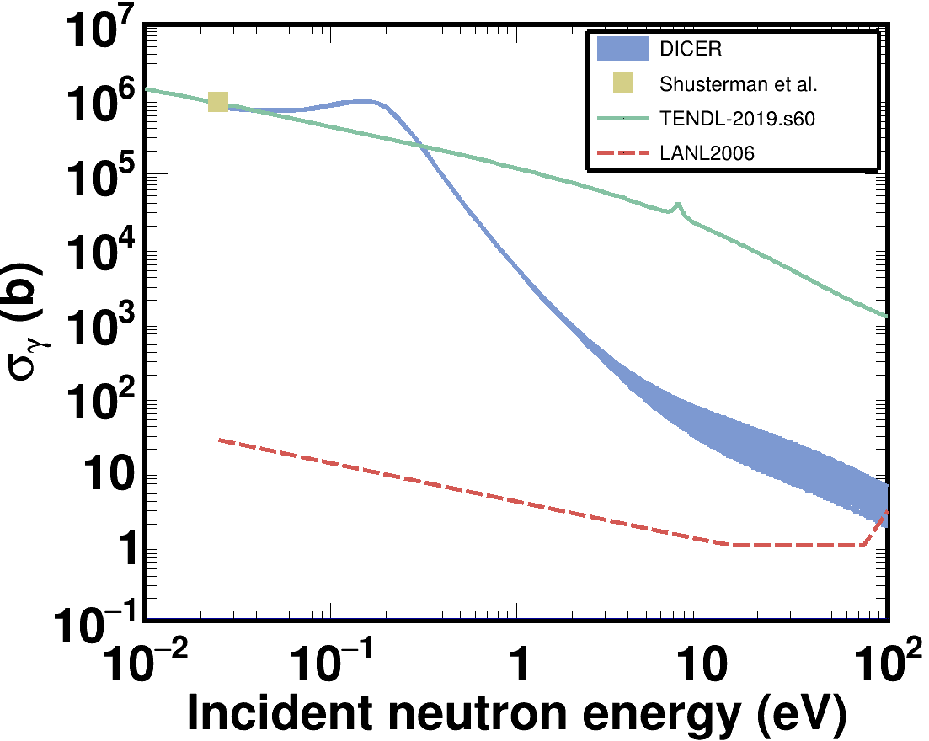
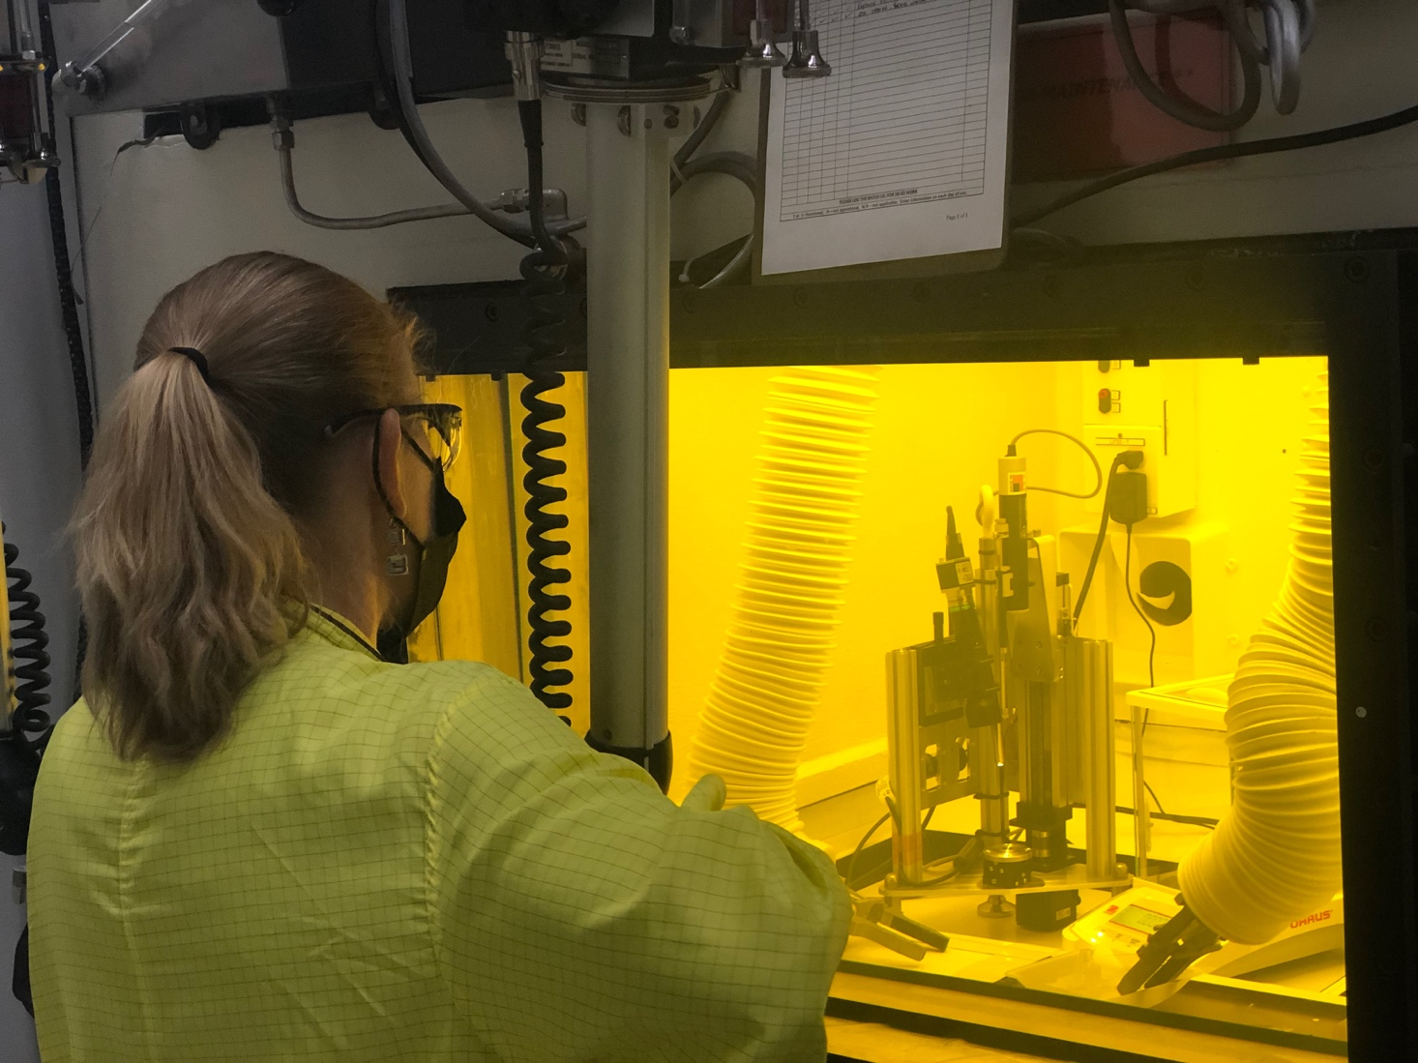
⁸⁸Zr, funded by LANL-LDRD and OES
LLNL: σ_{γ}^{th} = 0.861(69) Mb, I_{γ} = 2.530(280) Mb
  2nd largest σ_{γ}^{th} , largest I_{γ} , odd combination
Worked with Isotope Production Facility at LANSCE and produced a liquid 10uL 88Zr sample

Slide 9
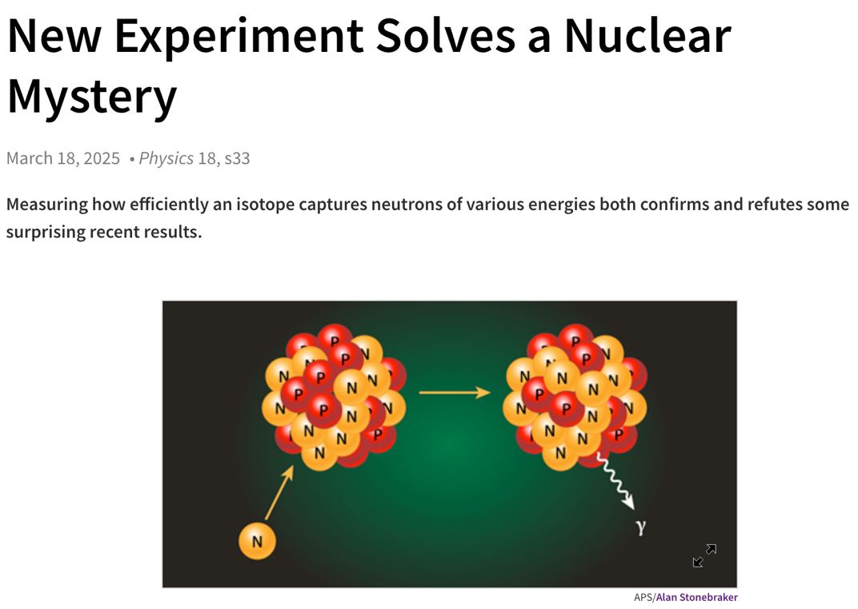
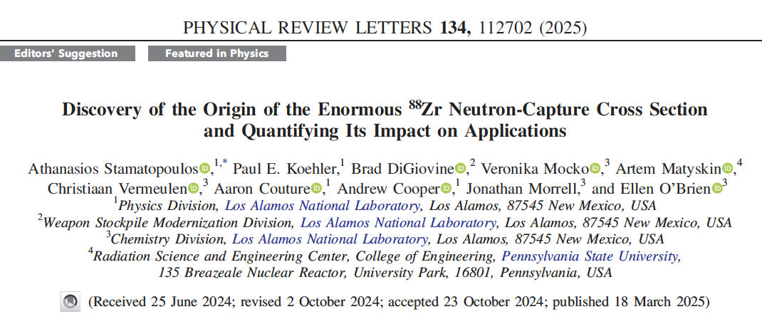
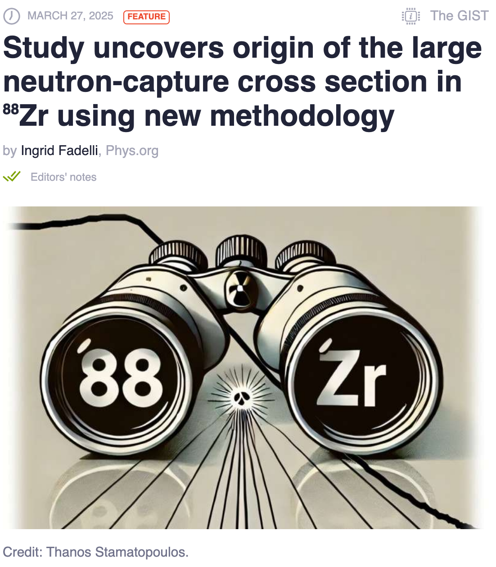
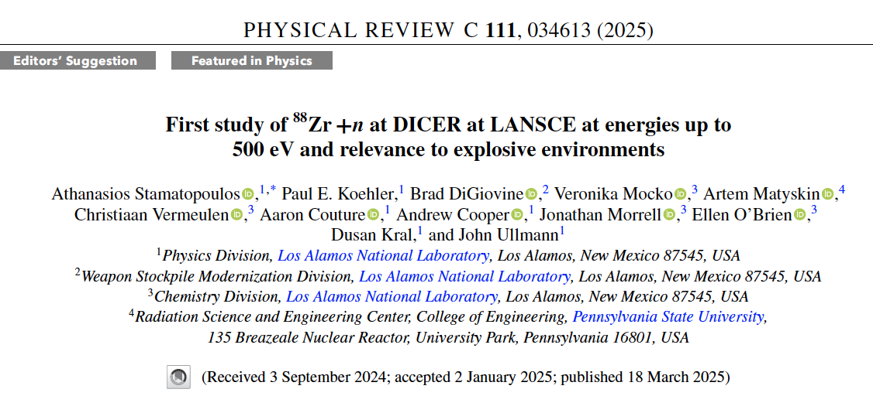
⁸⁸Zr, funded by LANL-LDRD and OES
Results published in Phys. Rev. Lett. and C.
Already compiled in EXFOR (2025ST03)
Next ENDF

Slide 10
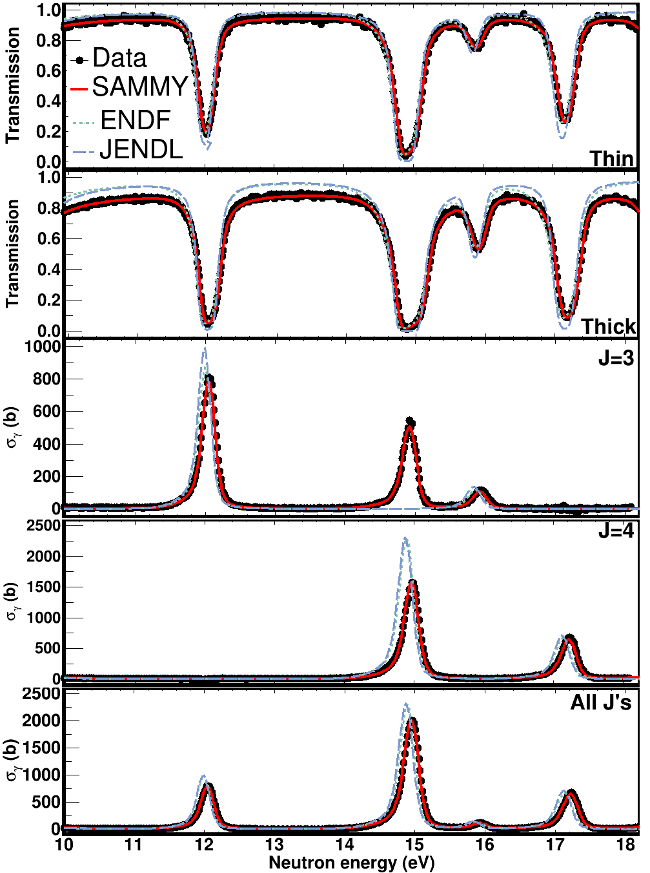
^{147,149}Sm, funded by NCSP (¹⁴⁹Sm) and LANL-LDRD(¹⁴⁷Sm)
Transmission data with DICER
4 samples (2x12 mg thick, 2x5 mg thins)
No H₂O, confirmation via ThermoGalvanic Analysis (TGA)
Capture data were taken with DANCE in the early 2000s
DANCE data were used to extract:
  Spins based on multiplicity
  Capture cross section
Sequential R-Matrix fits with SAMMY
215 resonances were resolved up to 521 eV
  Only 157 in ENDF/VIII.1, JEFF-3.3 & JENDL-5
38 different spins in ENDF/JEFF
41 different spins in JENDL
Improved:
  Resonance parameters
  Level spacings D_{0,i}
  Strength functions S_{0,I}
Results will be submitted to Phys. Rev. Lett. and C
More info on LA-UR-23-32571
Our graduate student Ryan Amberger from Texas A&M is
working on ¹⁴⁷Sm

Slide 11
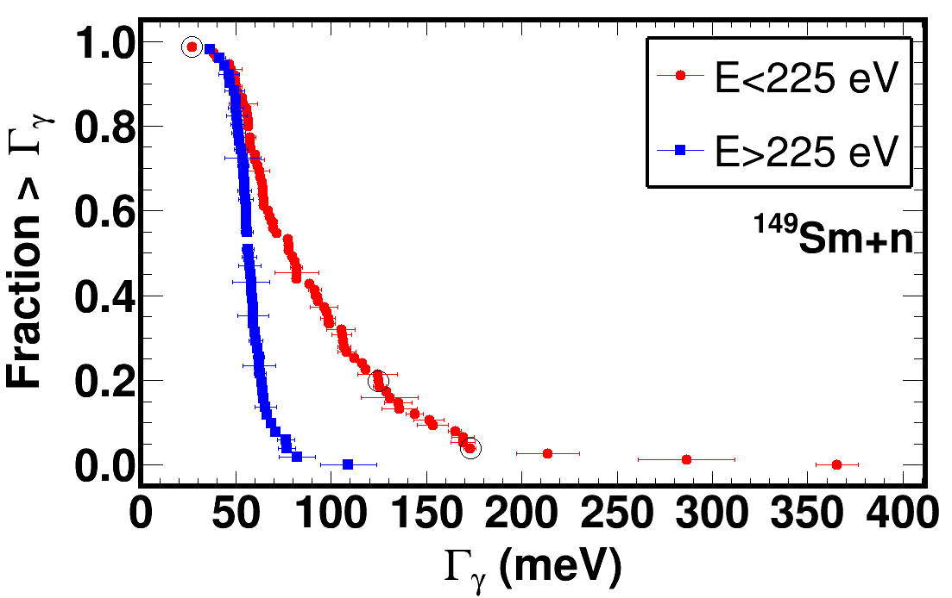
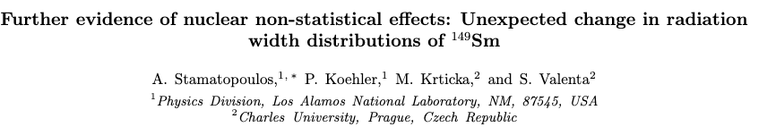
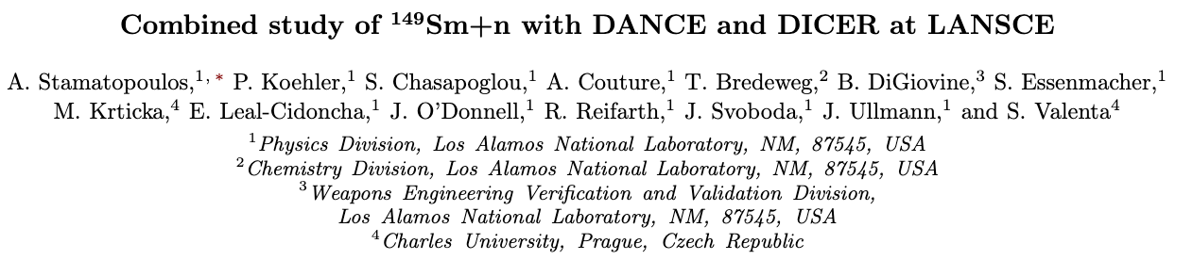
^{147,149}Sm, funded by NCSP (¹⁴⁹Sm) and LANL-LDRD(¹⁴⁷Sm)
Statistically significant change in the Γγ distributions around 200 eV was observed.
Findings will be submitted for publication to Phys. Rev. Lett. (similar findings in ¹⁴⁷Sm)

Slide 12
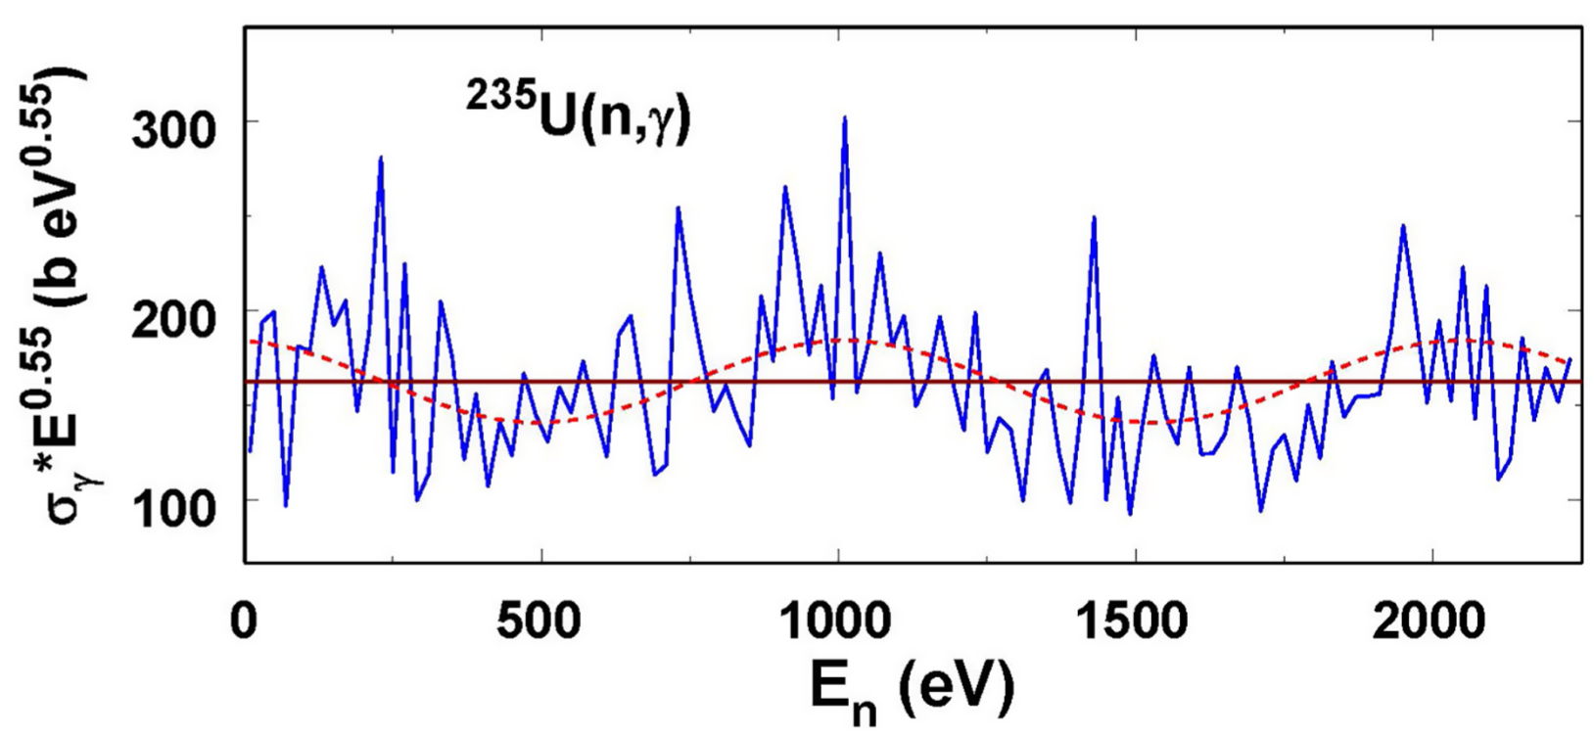
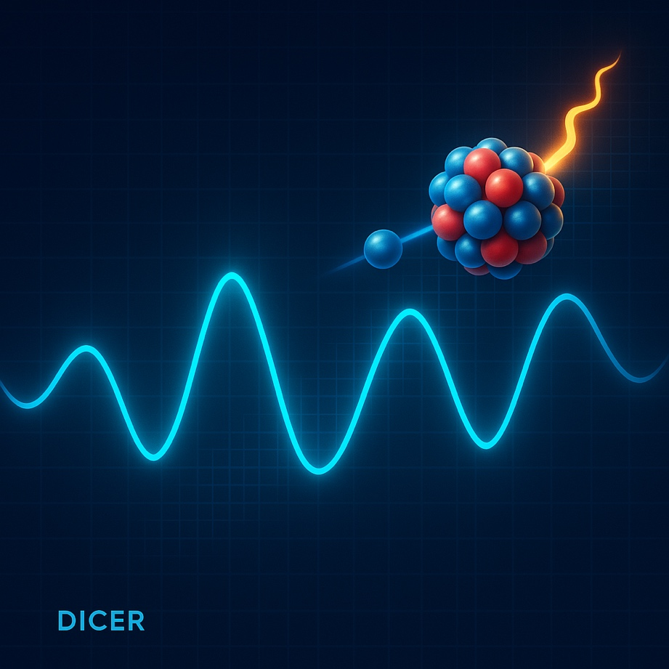
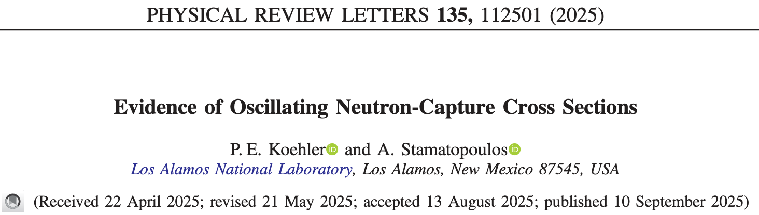
^{147,149}Sm, funded by NCSP (¹⁴⁹Sm) and LANL-LDRD(¹⁴⁷Sm)
Sm work gave rise to an interesting observation
Neutron-capture cross sections are exhibiting a statistically significant oscillating behavior

Slide 13
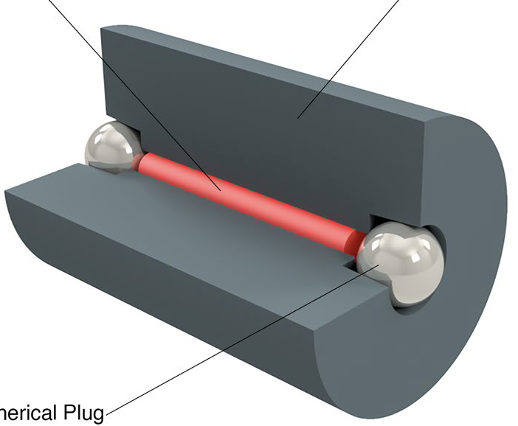
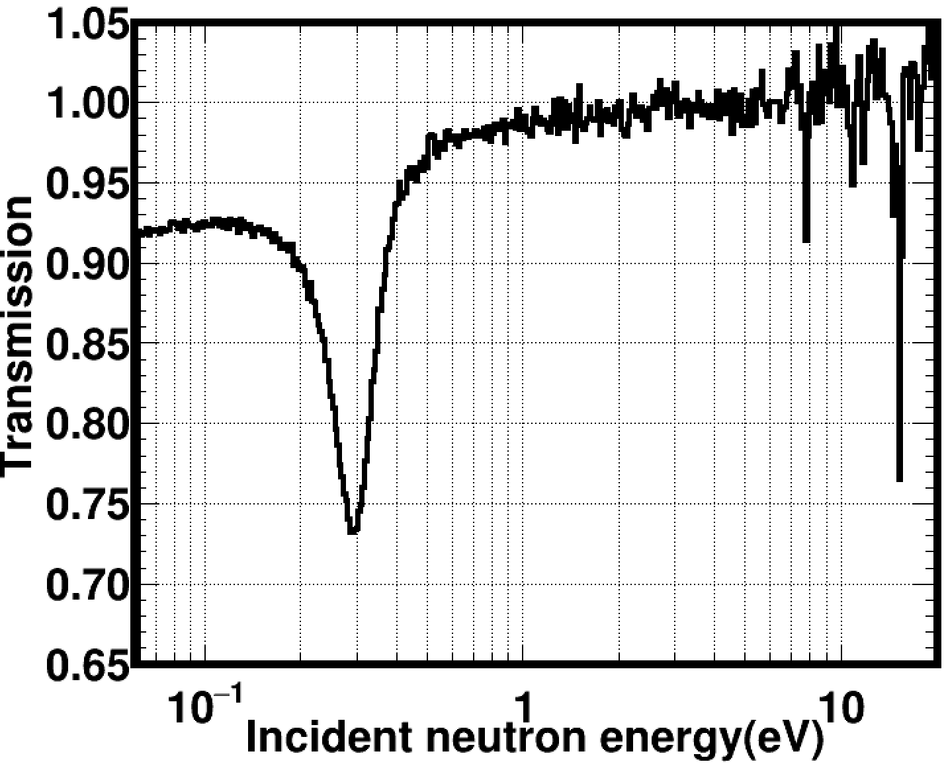
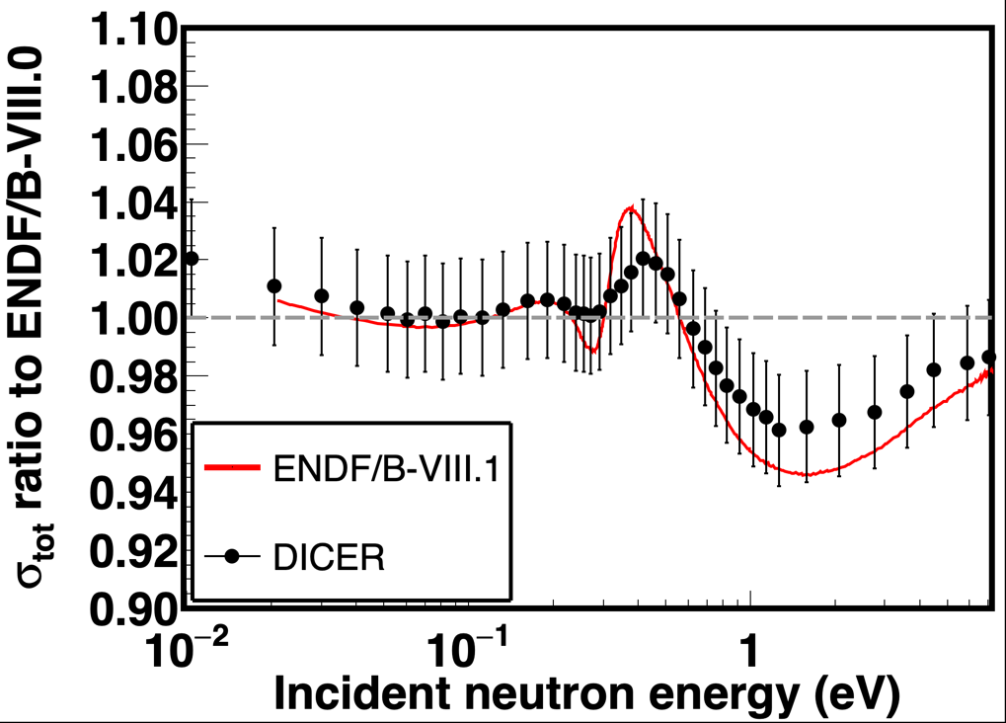
²³⁹Pu, funded by NCSP
A 99.96% pure 1 mg ²³⁹PuCl₄ in 6M DCl liquid sample was fabricated at LANL
Sample was free of measurable ²⁴⁰Pu
Preliminary results favor the ENDF/B-VIII.0 evaluation
Analysis is almost complete and a manuscript will be
submitted for publication to Phys. Rev. C.
²³⁹Pu
W canister
Preliminary
Pb spherical plug
Preliminary
²³⁹Pu
²⁴⁰Pu
²³⁹Pu

Slide 14
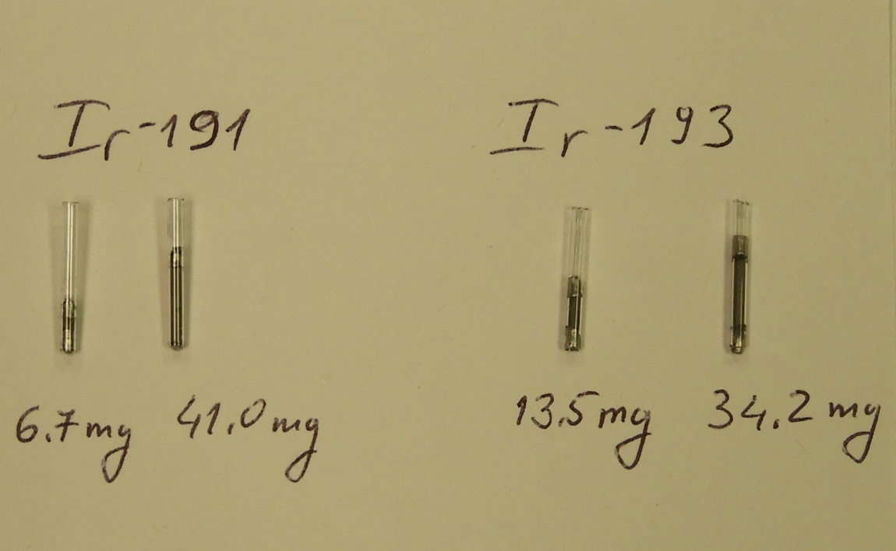
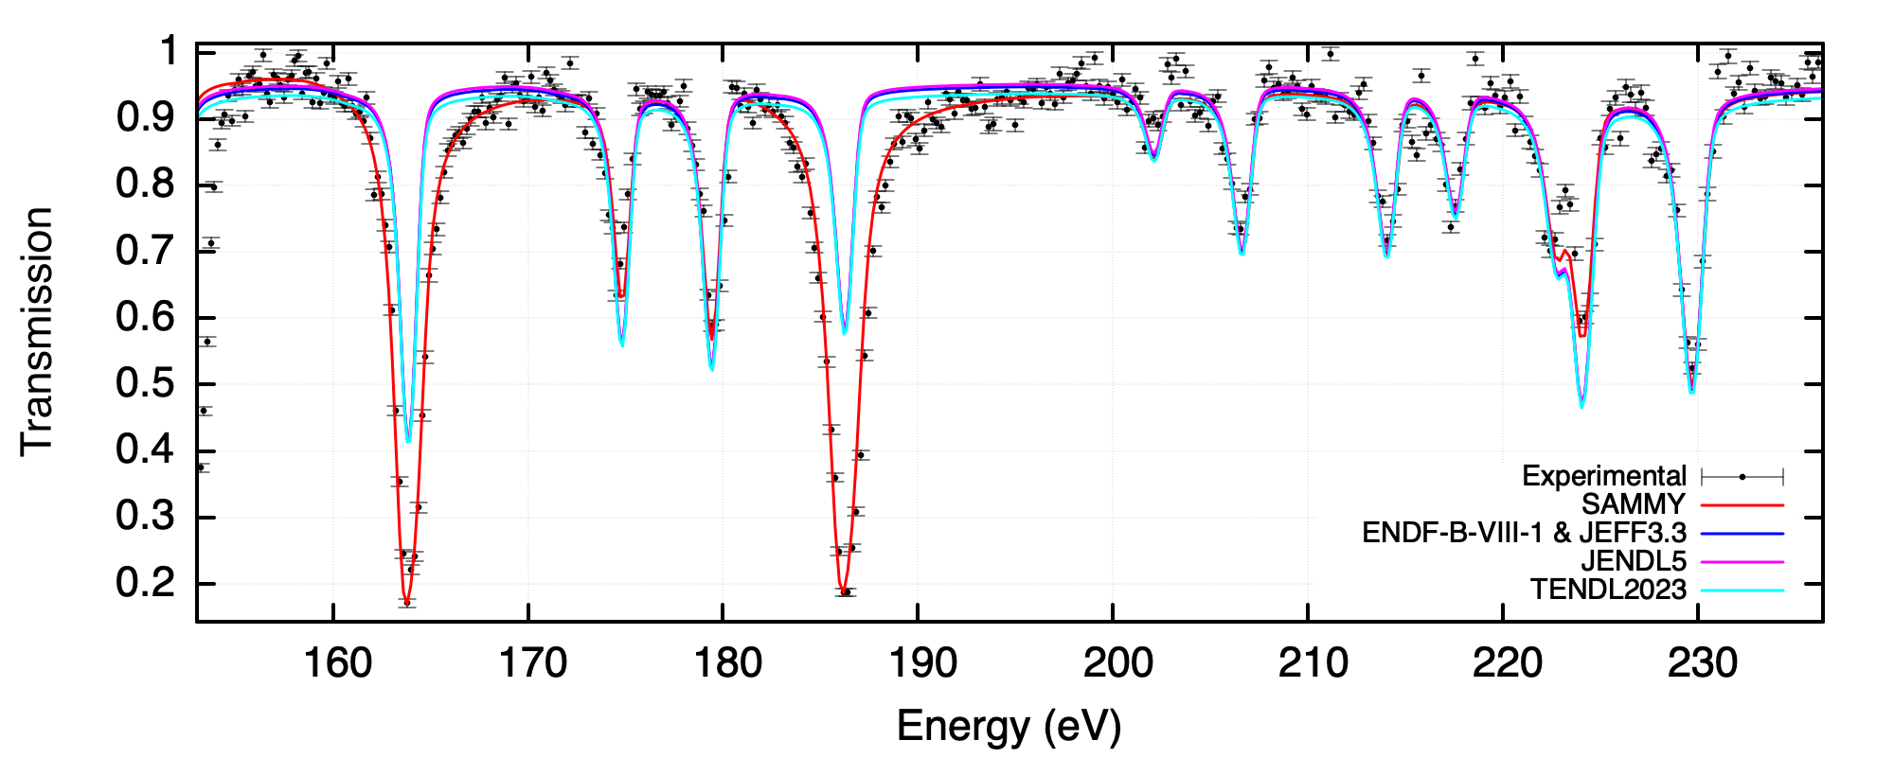
^{191,193}Ir, funded by LANL-LDRD
Transmission data with DICER
4 samples (2 x thicks, 2 x thins)
Capture data were taken with DANCE in the early 2000s
DANCE data were used to extract:
  Spins based on multiplicity (done)
  Capture cross section (to be done)
R-Matrix fits with SAMMY on the DICER data on all 4 data-sets
Work started in 2021, paused but is now being resumed by our postdoc Sotiris Chasapoglou
Differences with current evaluations
Work will conclude in the coming months
¹⁹³Ir thick

Slide 15
Freshly performed measurements and status

Slide 16
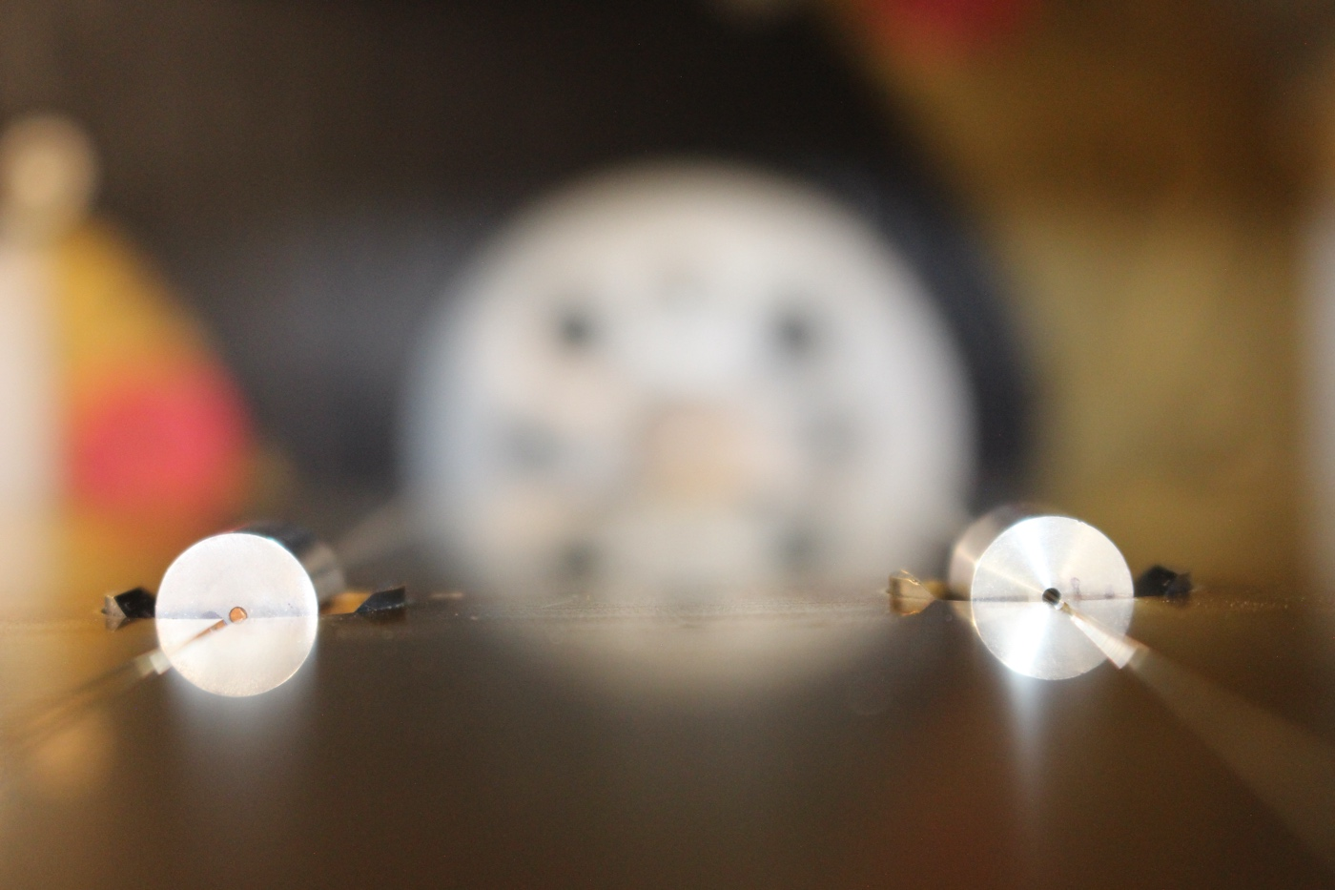
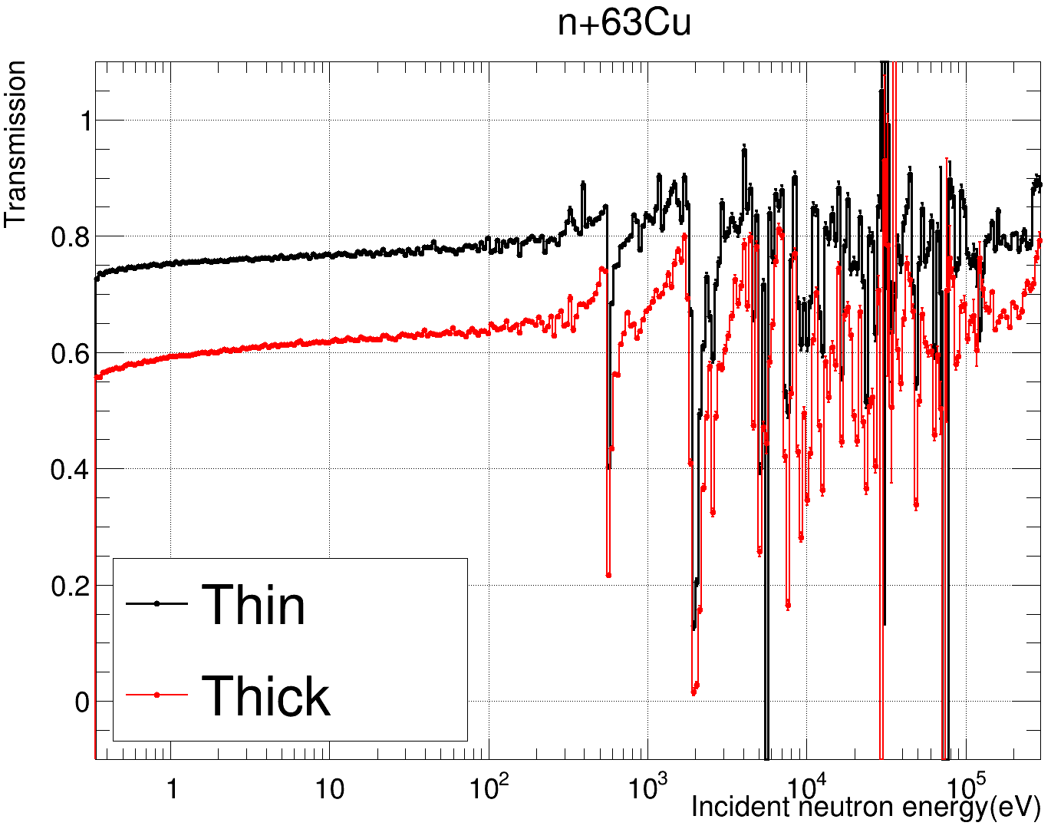
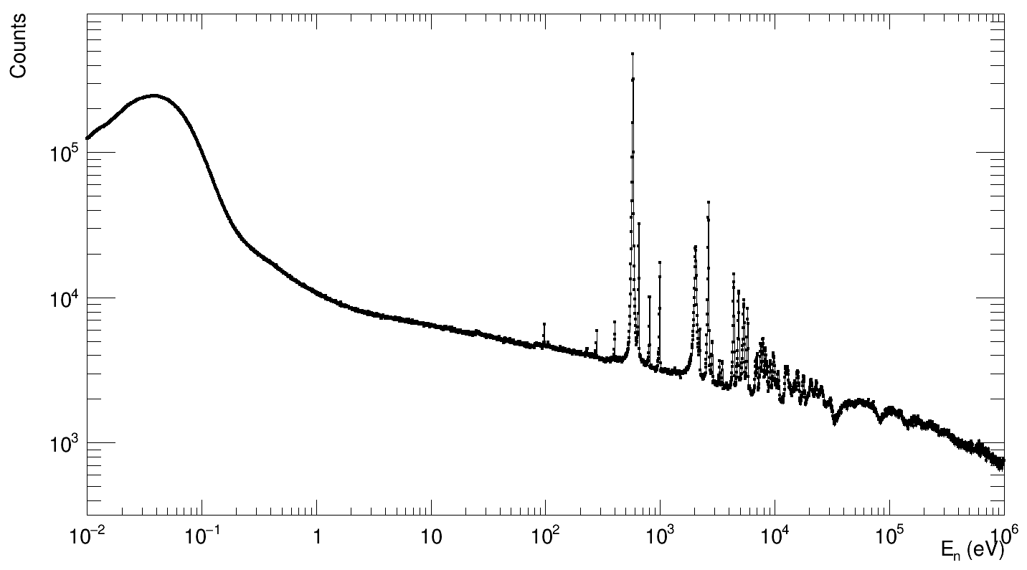
⁶³Cu, funded by LANL-LDRD
Through the PARADIGM LDRD project ⁶³Cu(n,tot) was identified as an important experiment to showcase a new nuclear data pipeline, employing machine learning algorithms, differential and integral measurements and theory
Thin and thick samples were cast at ORNL
Older DANCE data are being analyzed as well
Efforts are expected to finish by the end of 2026
Preliminary
Preliminary DANCE counts

Slide 17
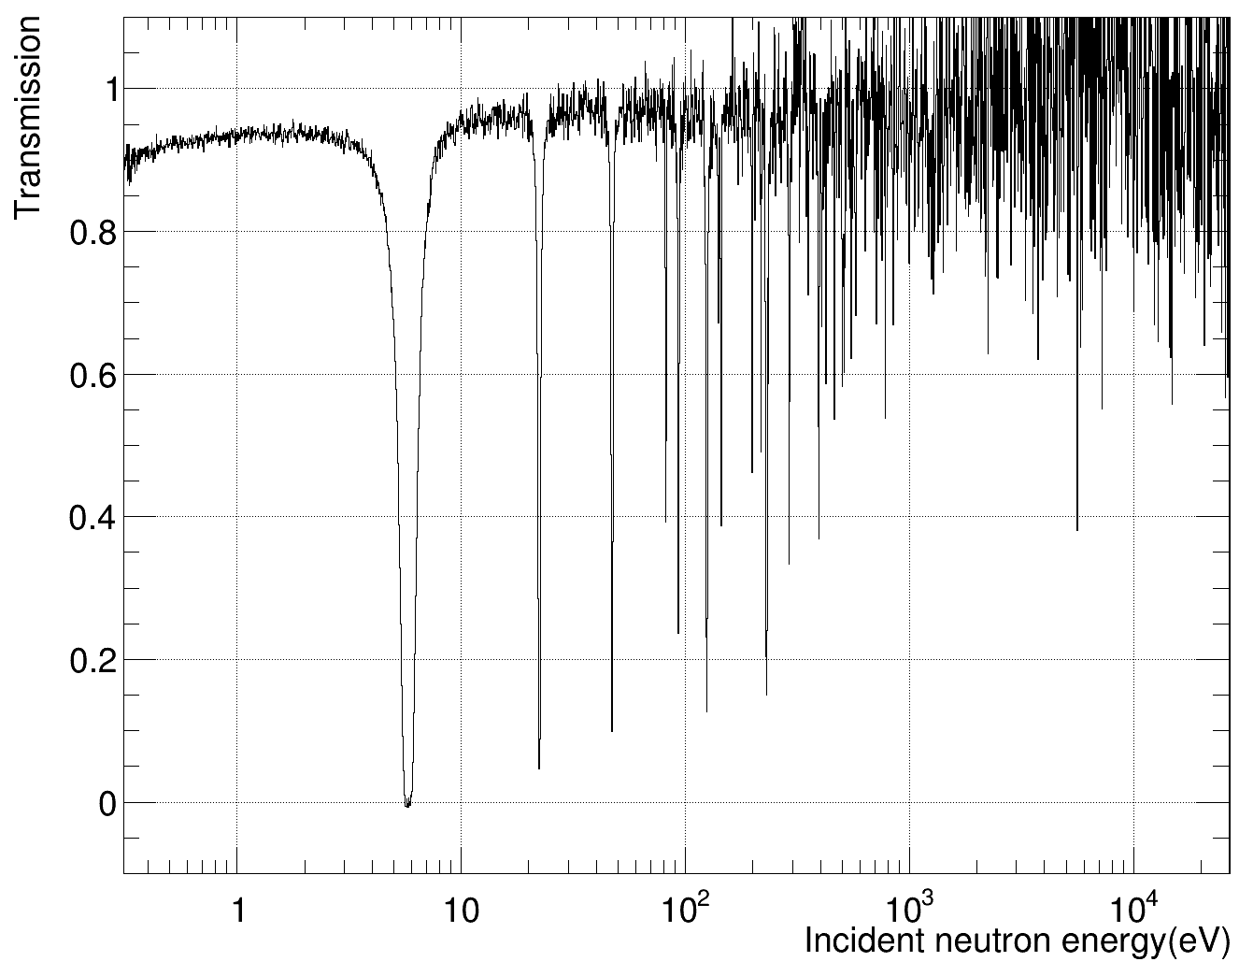
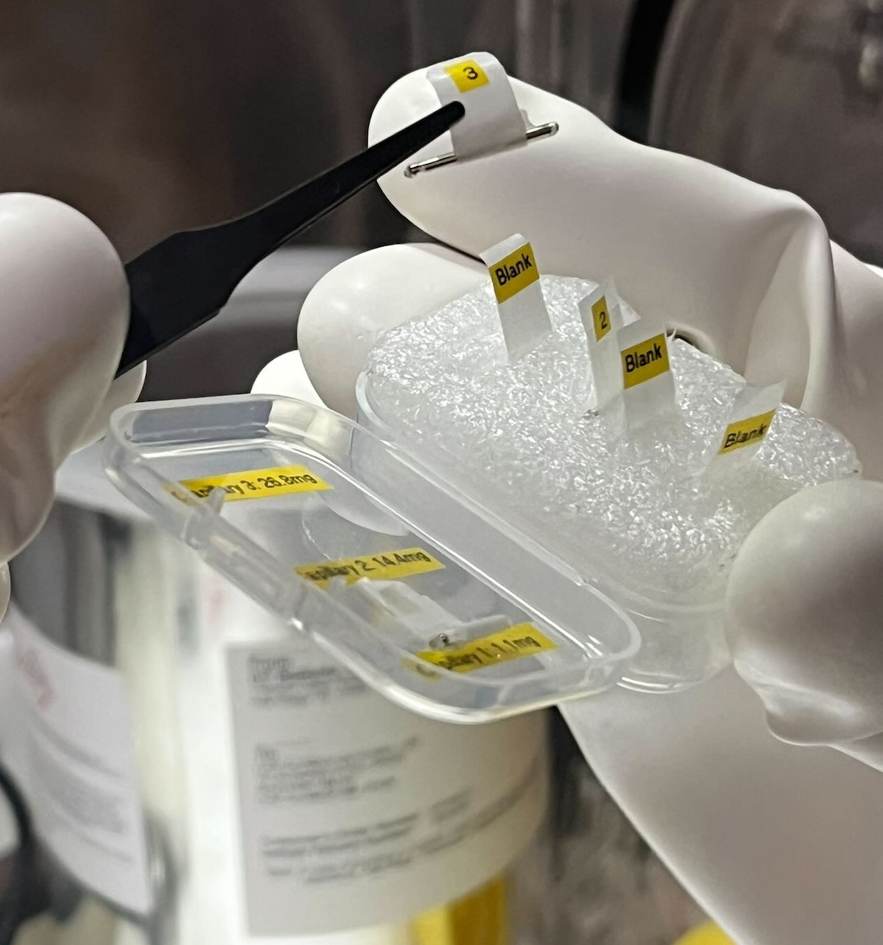
¹³³Cs, funded by NCSP
2 metallic Cs samples we measured at DICER
  1.1 mg
  14.4 mg
First ever metallic Cs measurement, as far as I know
Data were taken from sub thermal to 10’s keV
Measurement finished in late 2025

Slide 18
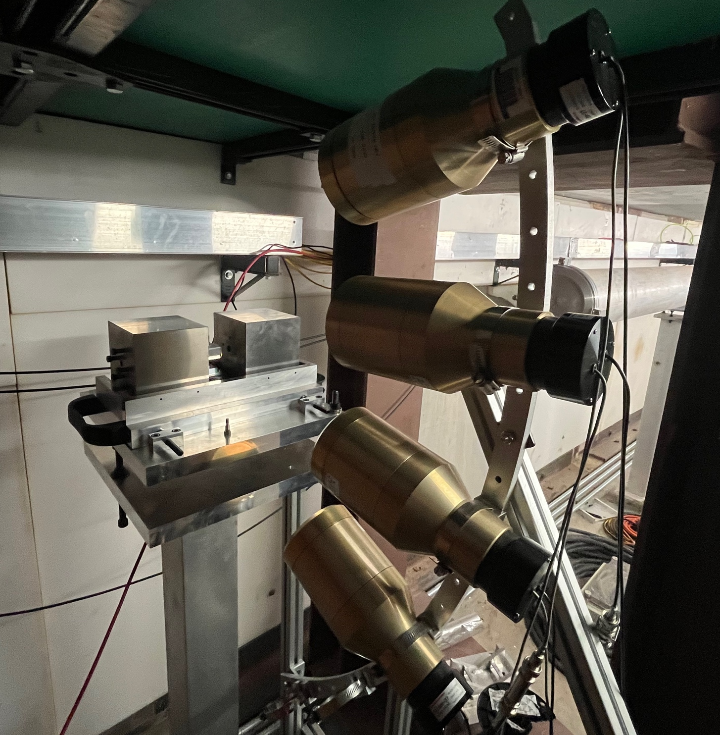
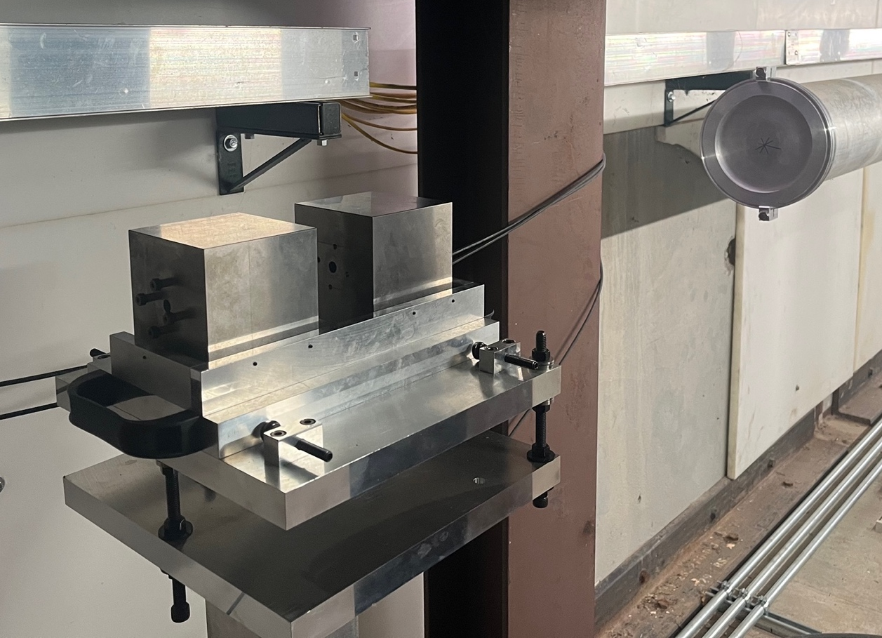
Development of DICER64
Through a LANL-LDRD early career award, a new DICER variant at 64 m is being developed
Data were taken with Bi, Au, Rh, Fe to understand the performance and asses the feasibility of a new instrument
Promising results: significantly improved signal/background compared to DICER
Testing the idea of simultaneous transmission and prompt-gamma activation analysis (PGAA)

Slide 19
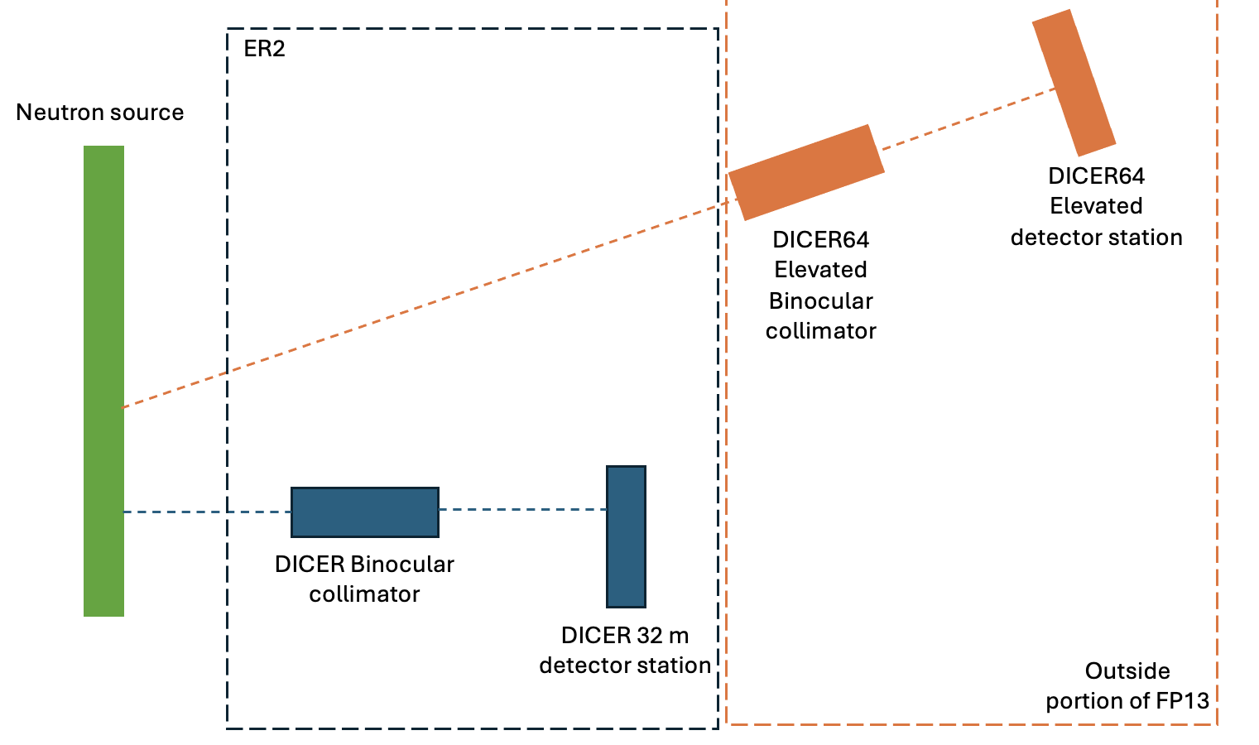
Development of DICER64
Through a LANL-LDRD early career award, a new DICER variant at 64 m is being developed
Data were taken with Bi, Au, Rh, Fe to understand the performance and asses the feasibility of a new instrument
Promising results: significantly improved signal/background compared to DICER
Testing the idea of simultaneous transmission and prompt-gamma activation analysis (PGAA)
Exploring the idea for independent DICER/DICER64 instruments, with changeable field of views

Slide 20
Near-future measurements

Slide 21
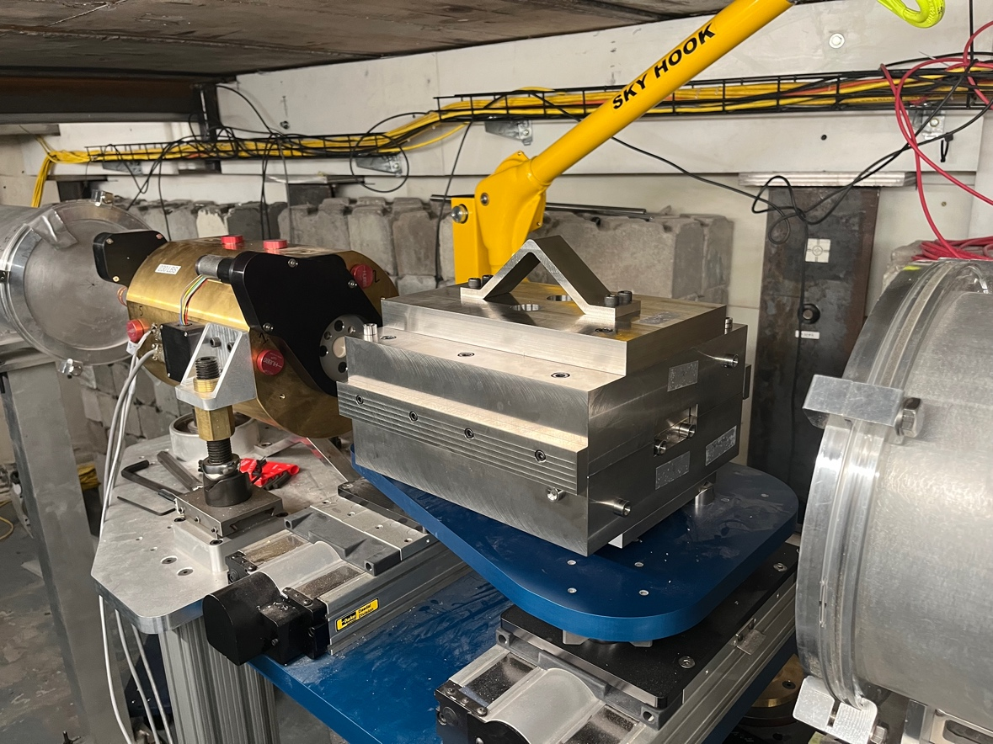
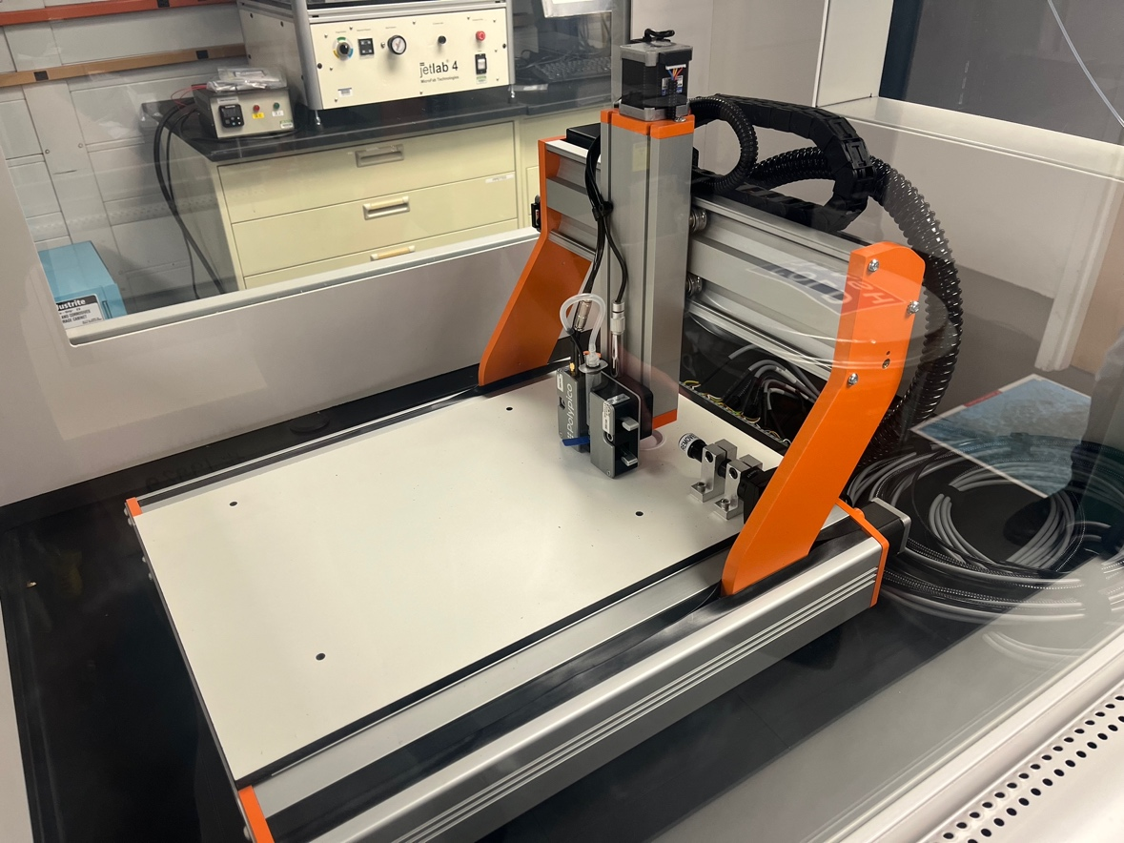
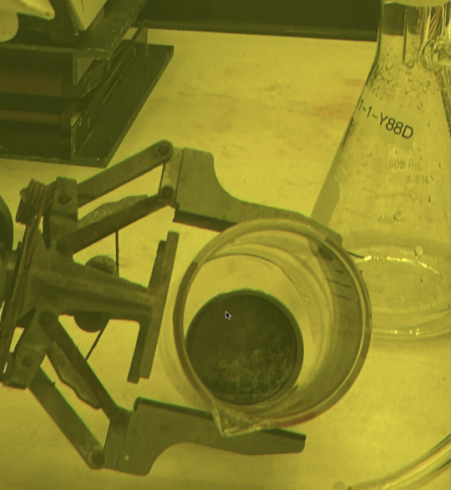
⁸⁸Y, funded by OES
The first ever time-of-flight measurement on ⁸⁸Y is planned for Fall 2026
Development of 0.1 mm collimator (Au collimator with heavy W shielding)
Development of Y chemistry (YOCl)
Development of microjet printing technique to fabricate the sample
Development of 88Y production from (p,xn) reactions on Sr
2 Ci, 150 ug sample

Slide 22
List of performed and near-future experiments
Performed | To be performed
88Zr | 88Y
149Sm | 238U
147Sm | 151Sm
239Pu | 143Nd
191Ir | 35Cl
193Ir | 171Tm
63Cu | 135Xe (?)
103Rh
95Mo
133Cs
197Au
TRISO fuel
natBi
natCd
natGd
natZr
DCl
*sponsor-less

Slide 23
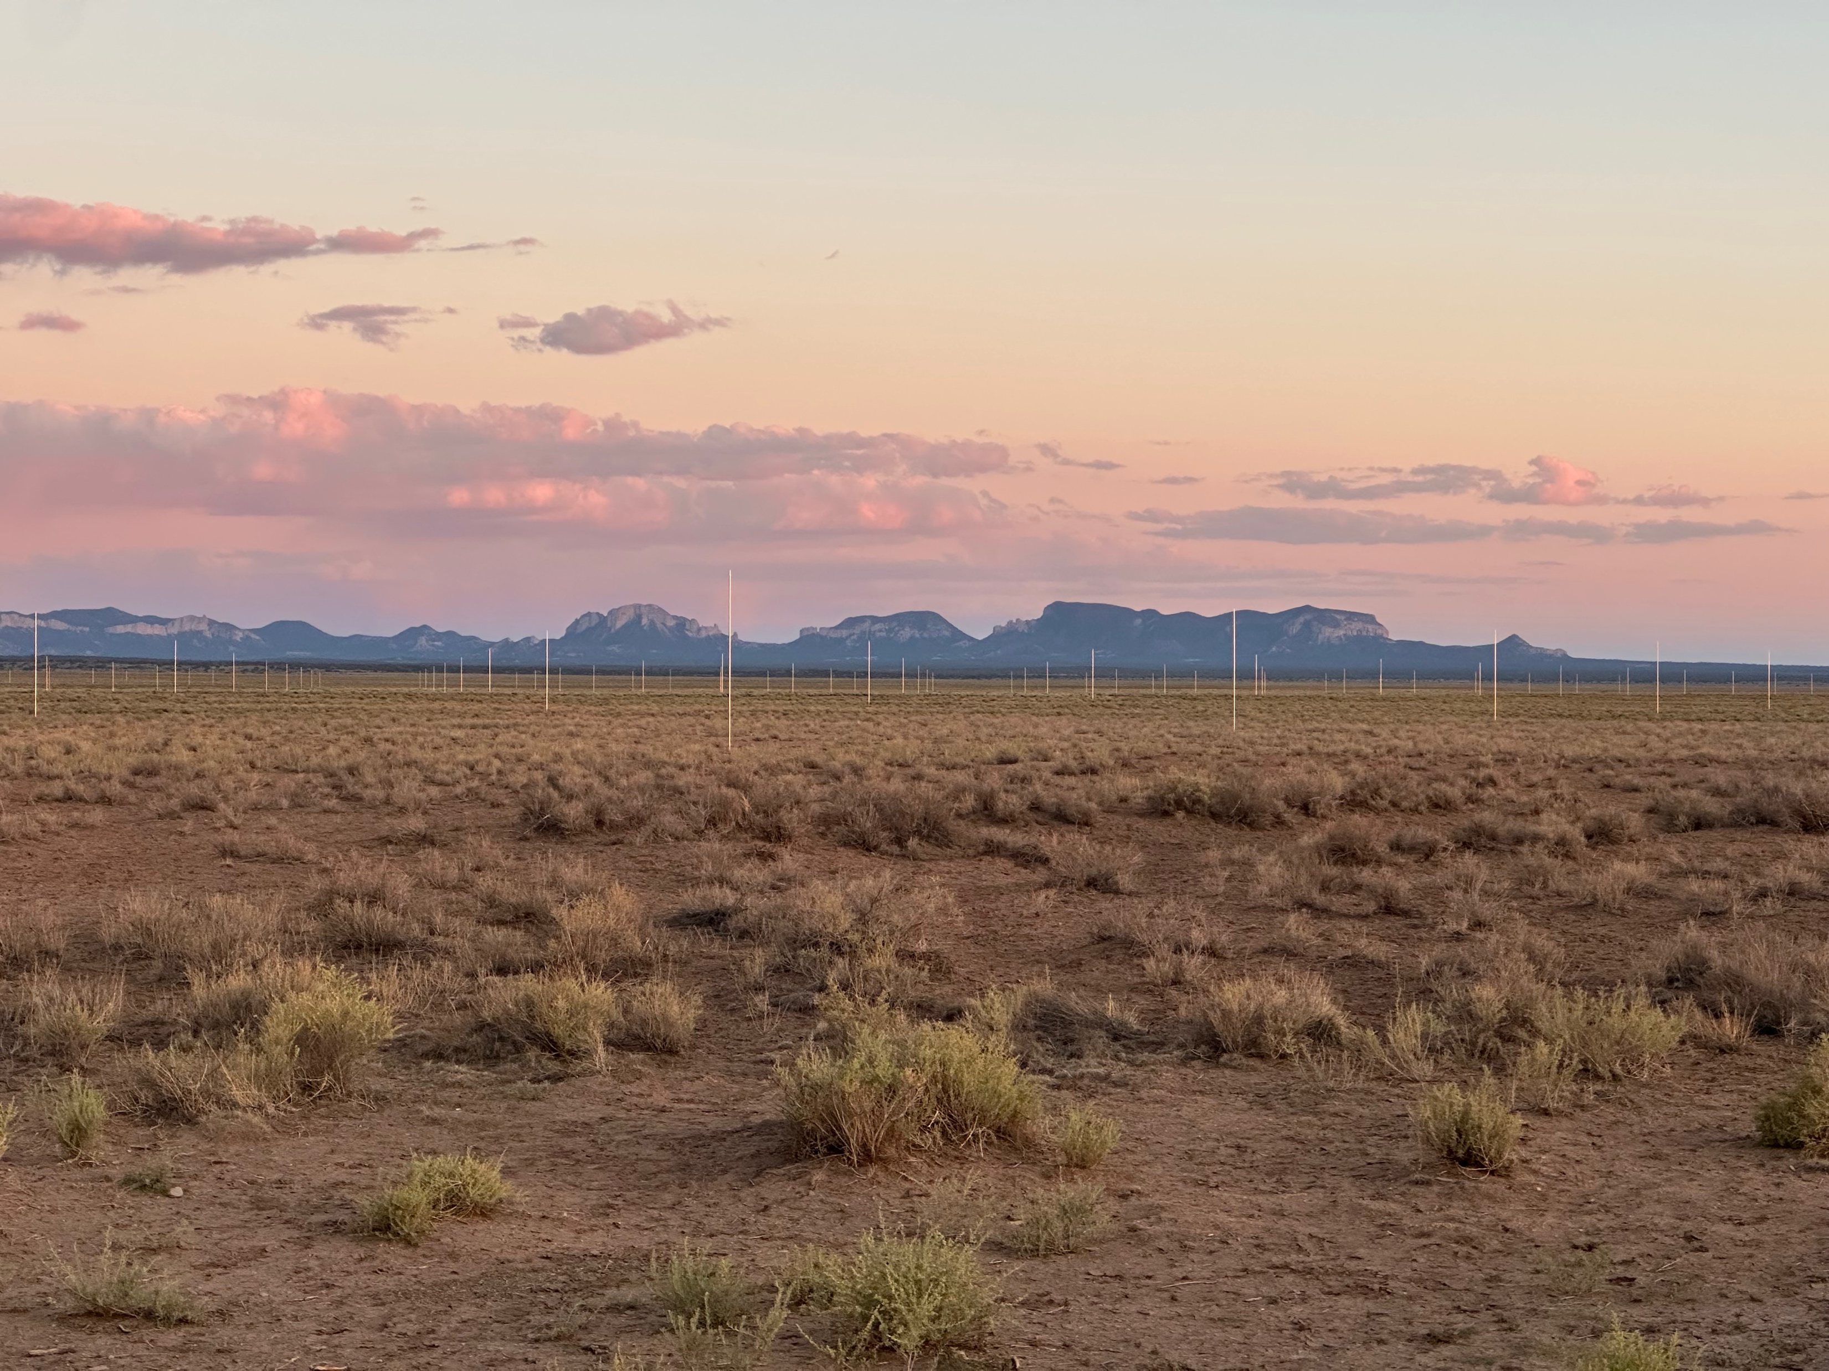
Thank you for your attention!

Slide 24
⁹Back-up slides

Slide 25
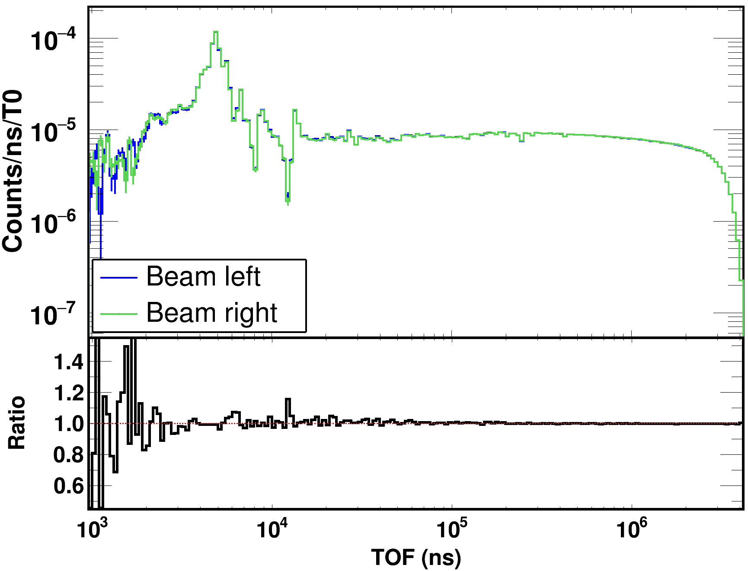
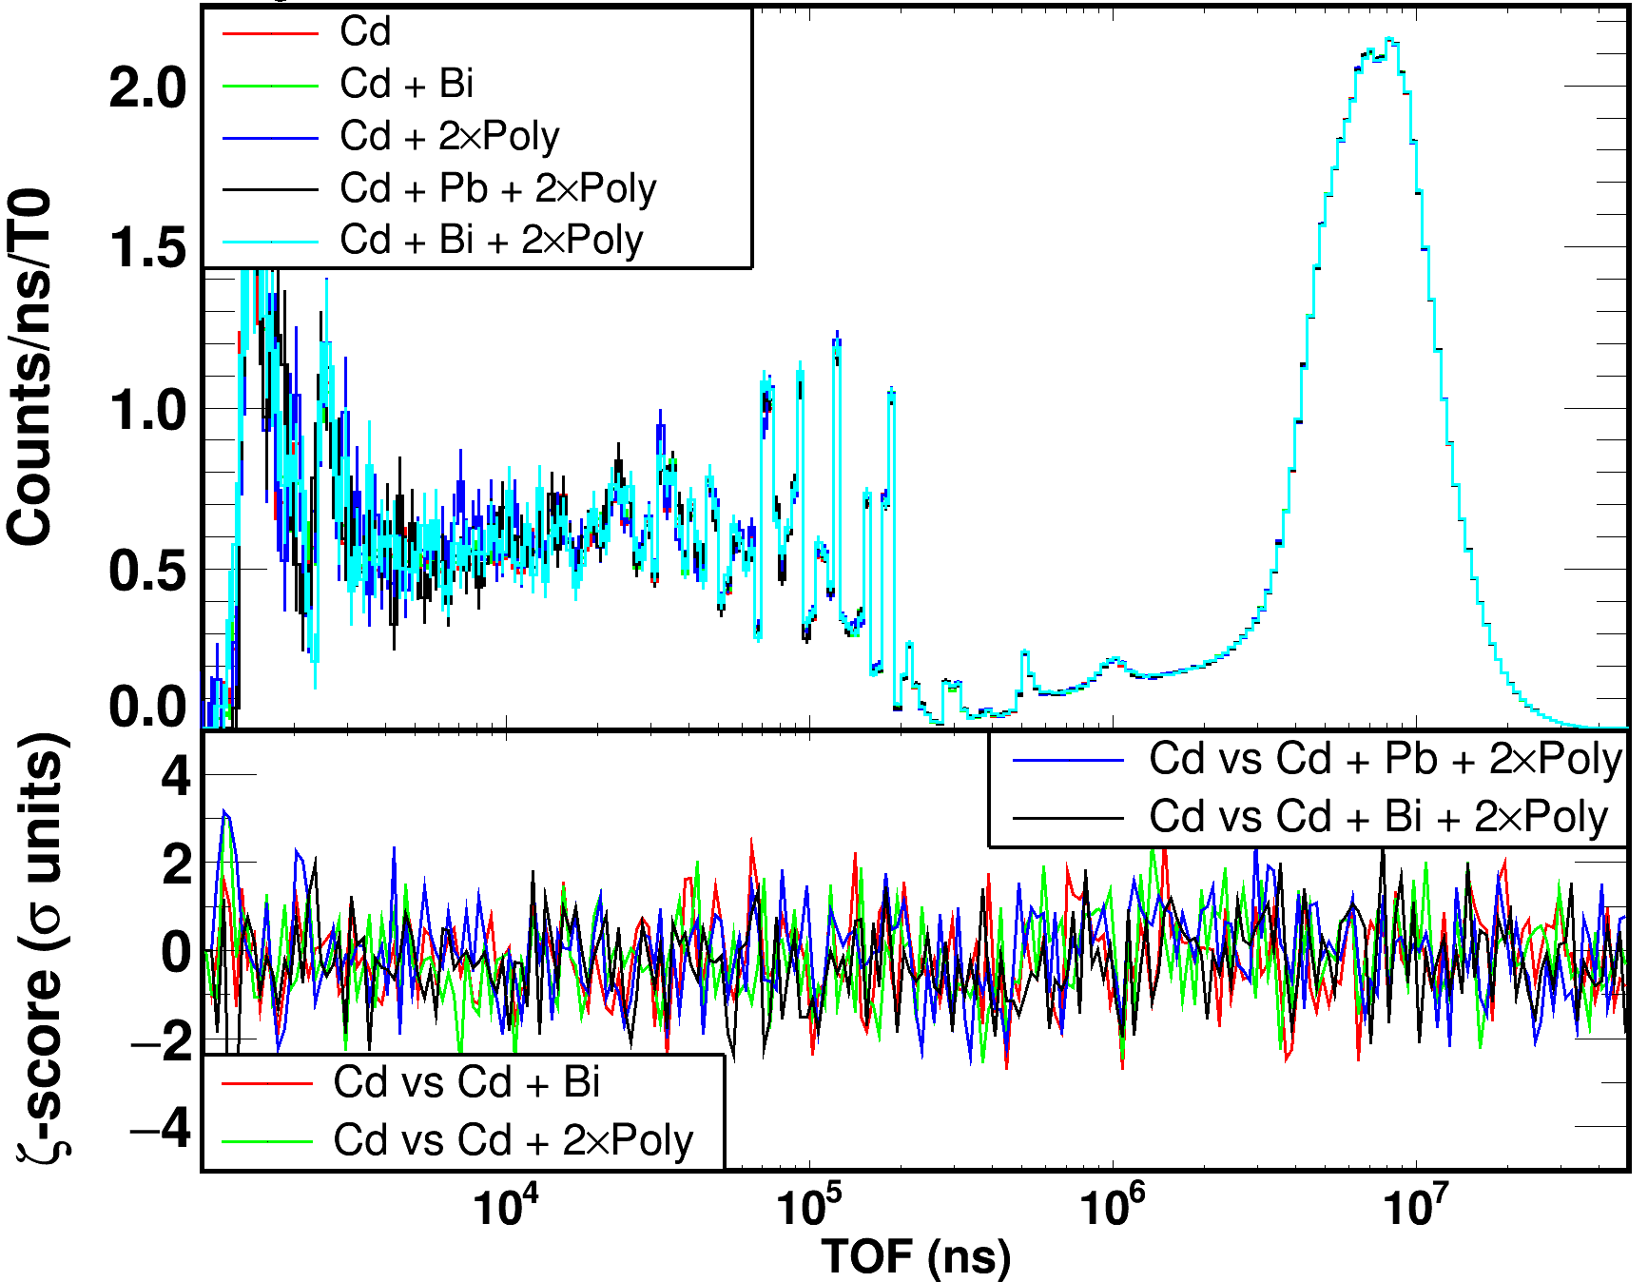
Sanity checks
Flux monitor
Binocular collimator
Does the binocular idea work?
Flux * efficiency: Left vs Right
Paddle configuration: should not affect the flux monitor

Slide 26
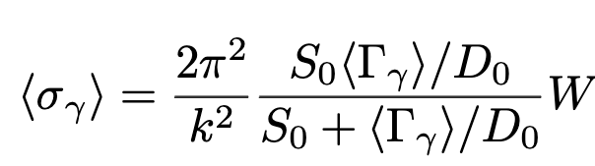
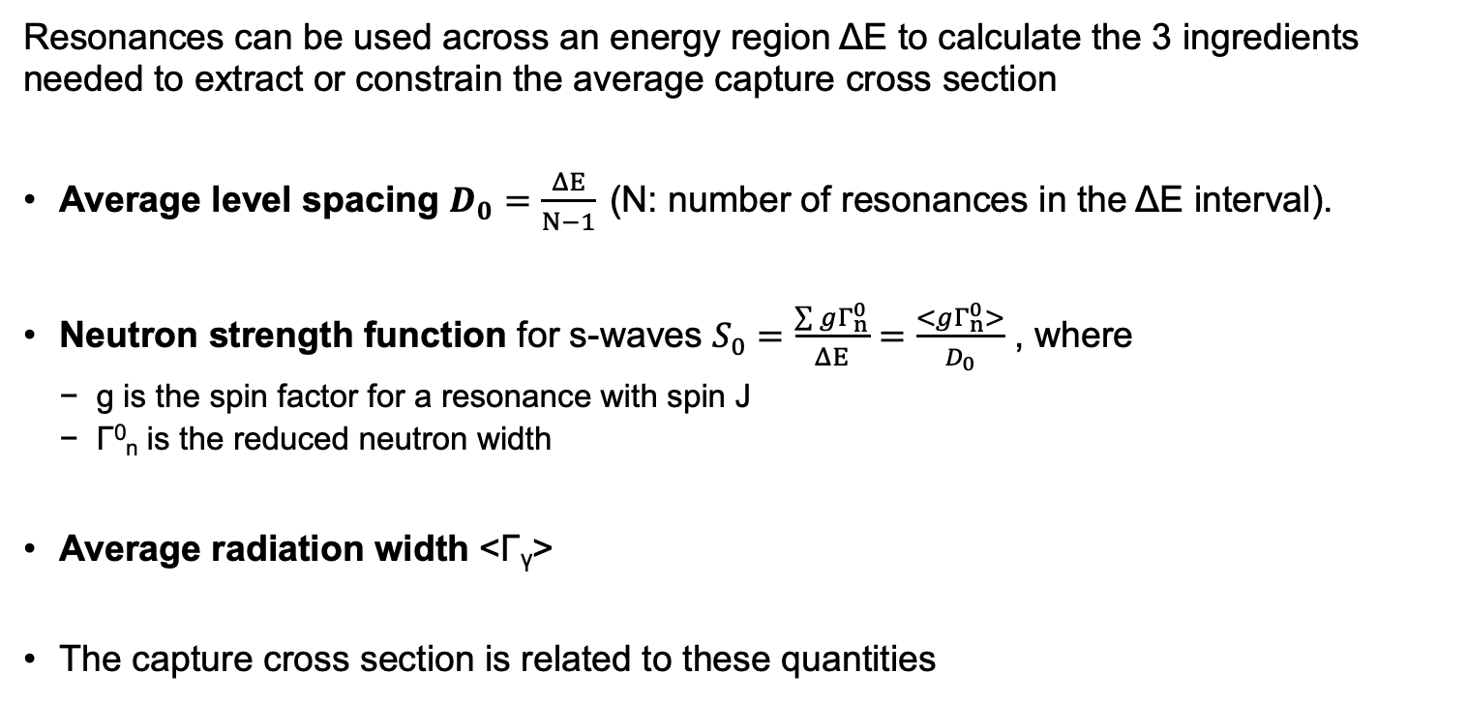

The technique in a nutshell
Resonances can be used across an energy region ΔΕ to calculate the 3 ingredients needed to extract or constrain the average capture cross section
Average level spacing $D_{0}=\frac{ΔE}{N−1}$ (N: number of resonances in the ΔΕ interval).
Neutron strength function for s-waves $S_{0}=\frac{\sum{gΓ_{n}^{0}}}{ΔE}=\frac{<gΓ_{n}^{0}>}{D_{0}}$ , where
  g is the spin factor for a resonance with spin J
  Γ⁰_{n} is the reduced neutron width
Average radiation width <Γ_{γ}>
The capture cross section is related to these quantities
$$=f(\text{Γ},\text{Γ}\text{n}, D_{0})$$
k : Wave number
W : Width fluctuation factor
Notes:
n the Hauser-Feshbach formalism, the width fluctuation factor represents the effect of the statistical fluctuations in the nuclear levels on the width (or probability) of a particular reaction channel. It accounts for the fact that the widths of these levels are not fixed values but can vary due to the uncertainty principle of quantum mechanics. Essentially, it helps to adjust the predicted cross sections for nuclear reactions to better match experimental data.

Slide 27
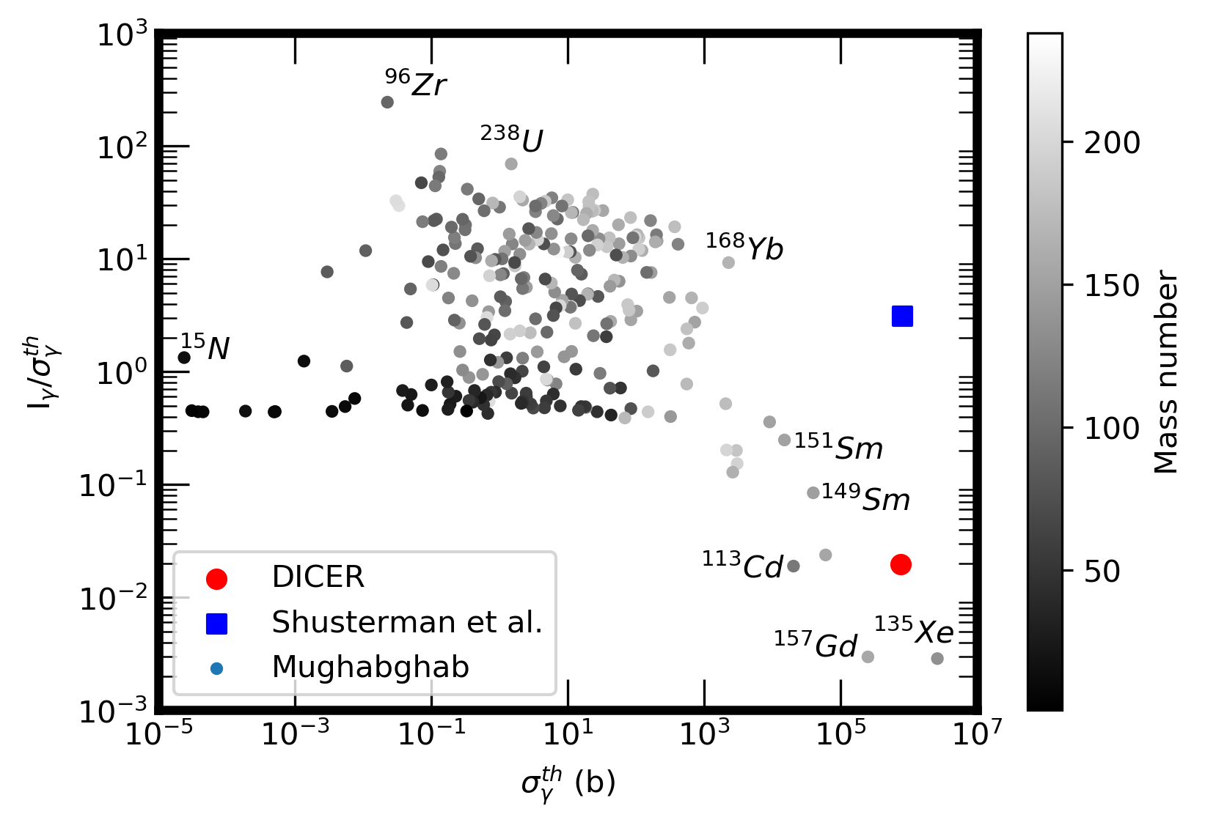
The curious case of ⁸⁸Zr (t_{1/2} = 83.4 days)

Slide 28
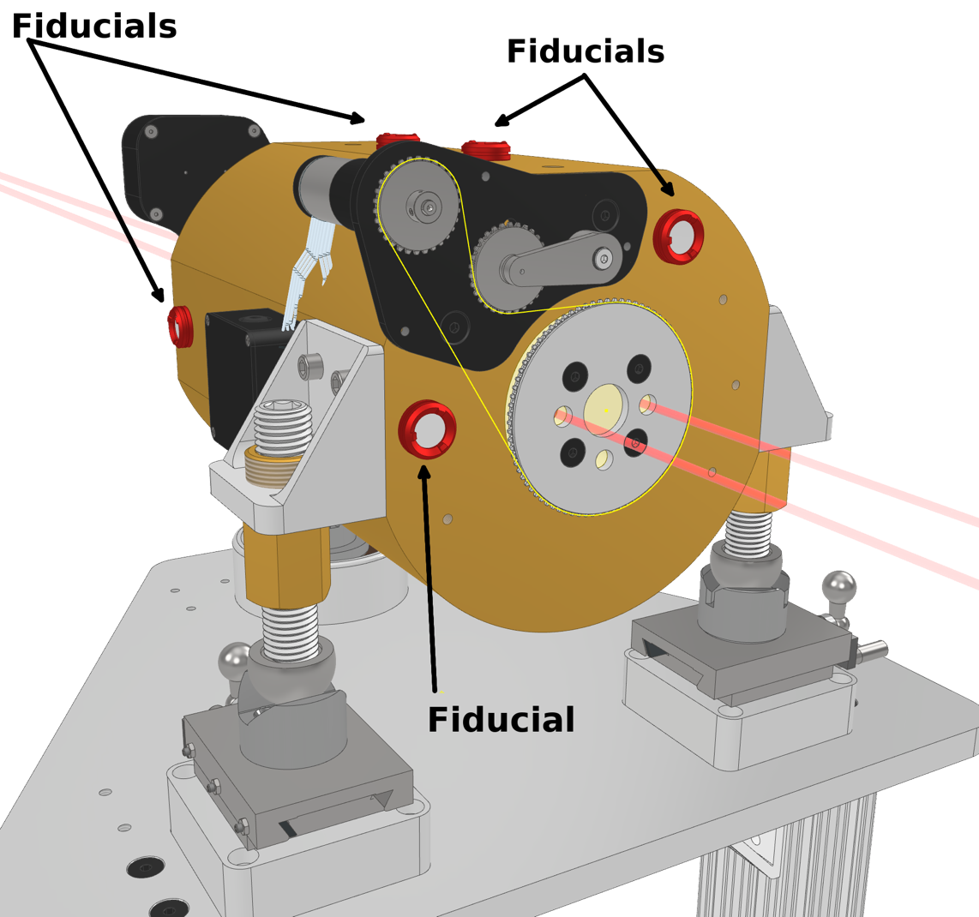
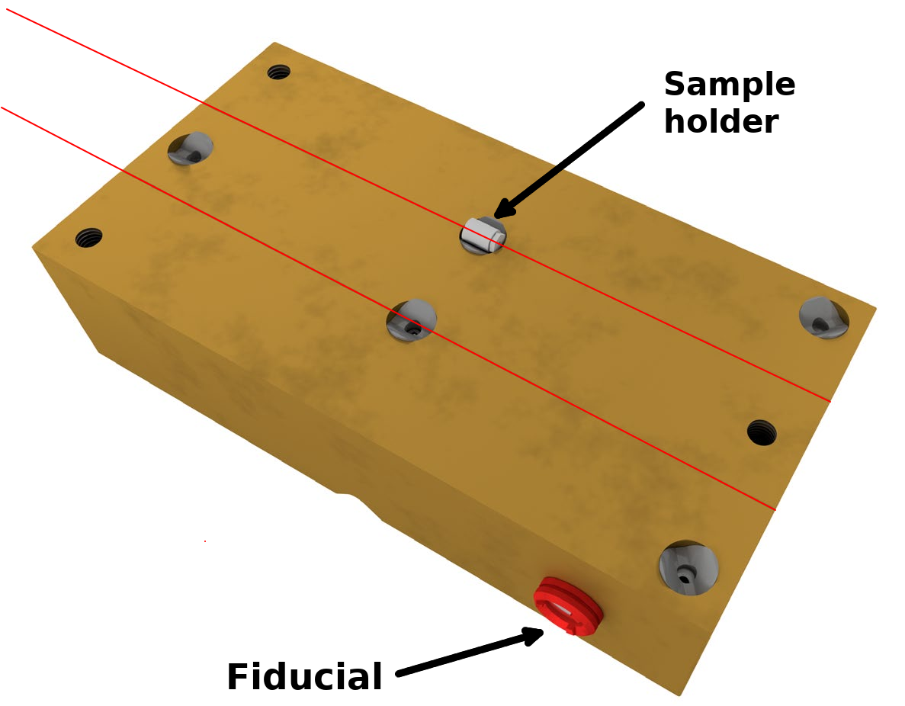
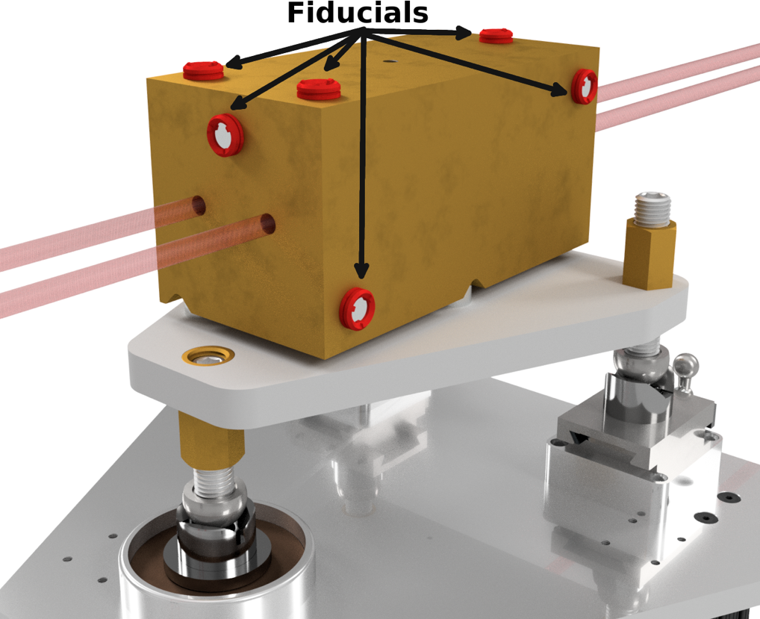

Sophisticated collimation system
Rotating beam blocker
Binocular collimator
Aperture stop
Cuts off the beam penumbra
Ensures two sharp beam spots at a 31 m, 9.5 cm in diameter
Rotating inner cylinder with 3 holes
30 cm in length
Provides 0 - 2 beams
Stepped design to avoid neutron stream paths
Remotely controlled
Divided in a top and bottom part
Sample is installed in the collimator in the Maxwell kinematic stops
1.5 cm length, 1 cm diameter sample envelope
1 mm collimation
Kinematic stops ensure repeatability when installing the top part.

