Slide 1
Recent Standards Work
Allan D. Carlson
NIST Associate
Presented at
The CSEWG Meeting
Nov. 4-7, 2025

Slide 2
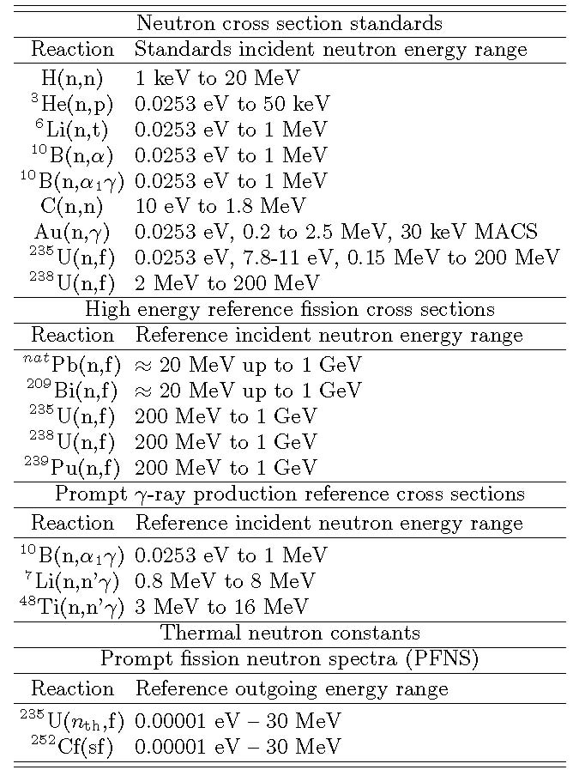

Slide 3
¹H(n,n)¹H Measurements
  New work at the CSNS on this standard was presented at the ND2025 conference :
    Haizheng Chen, for neutron energies from 100 to 500 keV using a multipurpose TPC.
    Kang Sun, for angular distribution measurements for neutron energies from 0.45 to 8.5 MeV.
    Both of these measurements are preliminary and use a Multipurpose time projection chamber (MTPC). It is possible that they are tests of the detector system-not really standards data
The hydrogen standard is limited to 20 MeV at the present time. R-matrix work is underway at LANL to extend the energy range.

Slide 4
⁶Li(n,t) Measurements
Recent measurements of this cross section are relative to the ²³⁵U(n,f) standard at IPPE by Prusachenko for energies from 4.75 to 7.5 MeV.
  Though these data are significantly above the present standards energy region, they will have an impact through the use of R-matrix analyses.
Measurements have been made by Anastasiou et al. of the ²³⁵U(n,f)/⁶Li(n,t) cross section ratio with the NIFFTE TPC from about 0.1 MeV up to about 3 MeV. When analyzed, the data will impact evaluations of both the ²³⁵U(n,f) and ⁶Li(n,t) cross sections.
Preliminary CSNS data were presented at the ND2025 conference by Chen Hongkun. The detector is a MTPC. Integrated cross sections as a function of neutron energy and the differential cross section have been measured. Additional work is required on the efficiency and pile up corrections. The plot shown here is of very preliminary data.
If experimental data and R-matrix results are consistent, the hope is that the energy range of the standard can be extended to above 1 MeV, the present maximum energy of the standard.

Slide 5
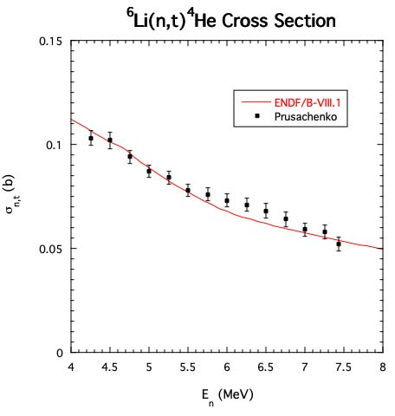
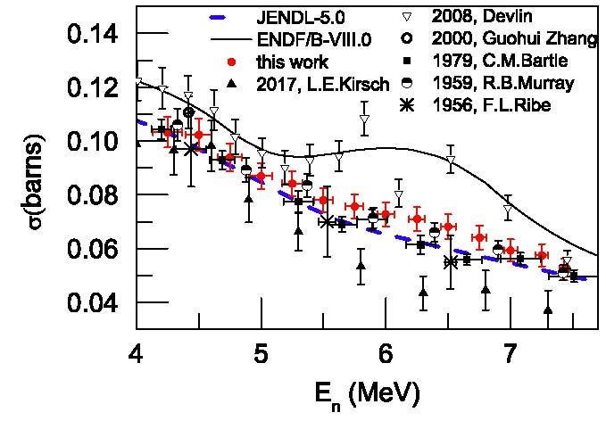
⁶Li(n,t) Cross Section Measurements by Prusachenko in RED

Slide 6
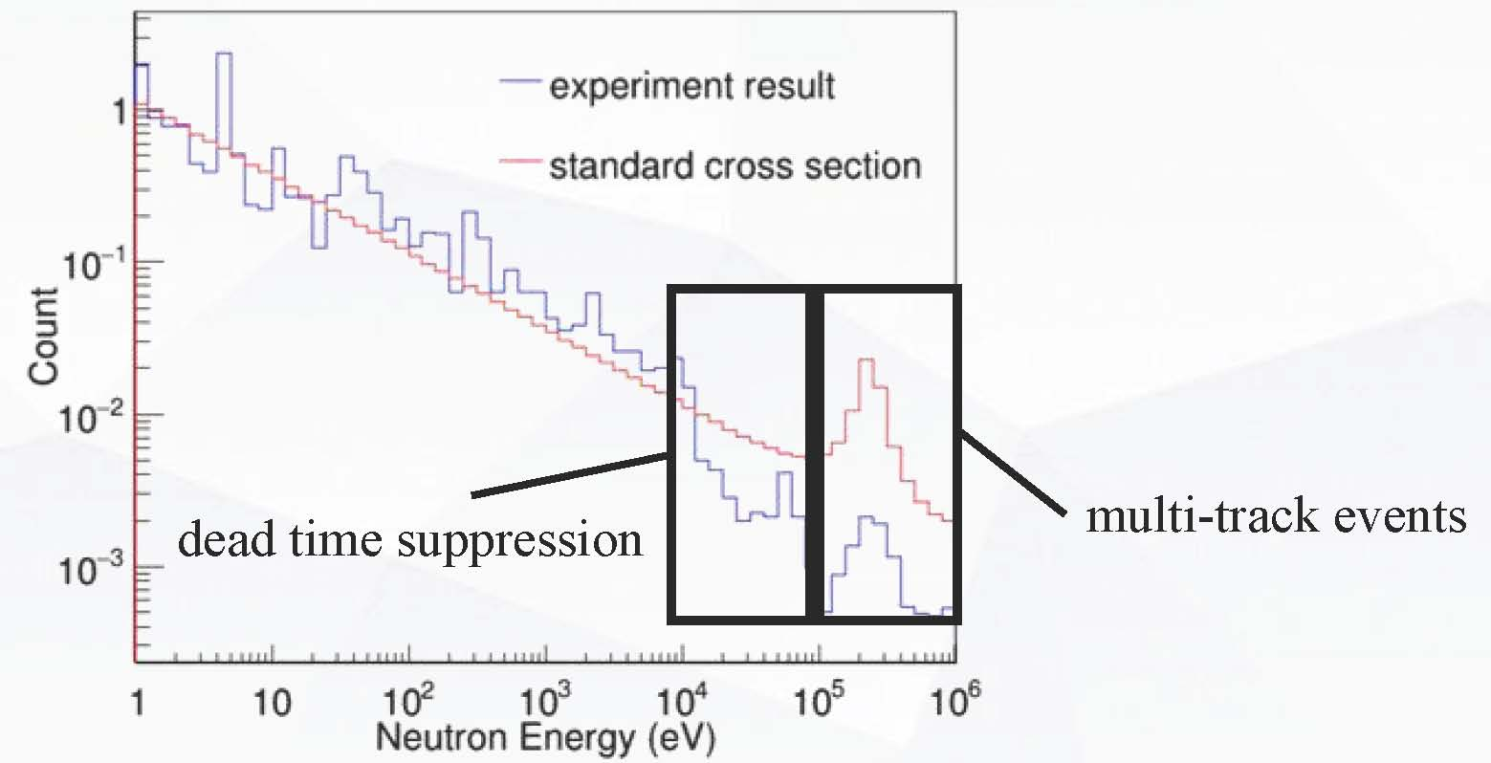
⁶Li(n,t) Cross Section Preliminary Measurements by Chen Hongkun

Slide 7
C(n,n) Cross Section
The most recent evaluation of the carbon standard by Hale was done by combining ¹²C and ¹³C R-matrix evaluations to obtain the elemental cross section that is the standard.
Measurements have been made by Vanhoy on ¹³C that should improve the new evaluation of the carbon
Standard..
Carbon scattering measurements by Kelly at LANL are also underway that should impact the new evaluation.
The most recent angular distribution measurements have been completed at GELINA by Gkatis et al.
  Energies were covered from 10 mV to 20 MeV ( thus covering the standards energy range).
  8 angles were measured between 16.2 and 163.8 degrees.

Slide 8
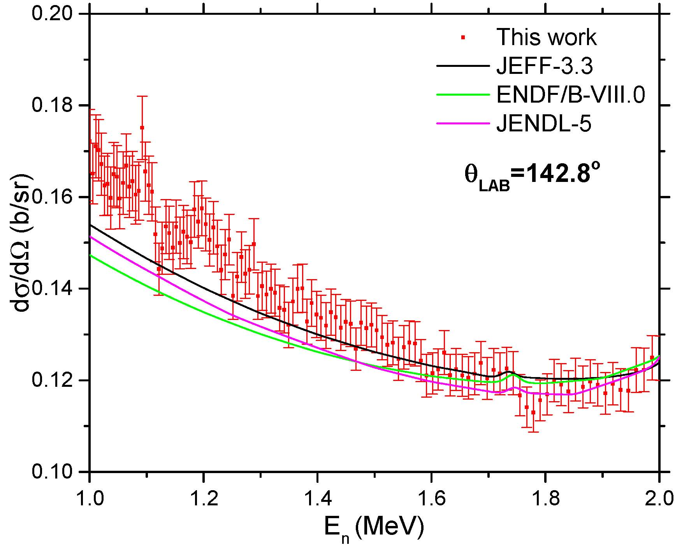
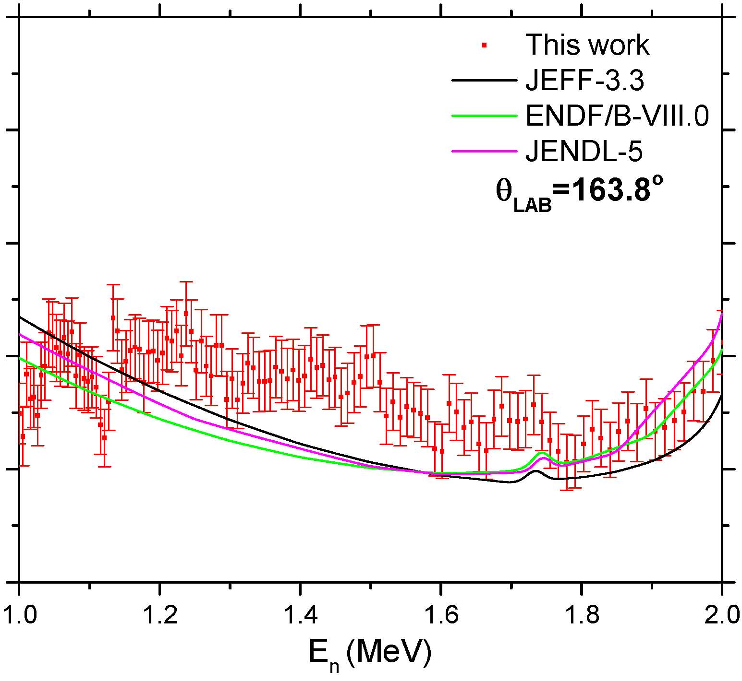
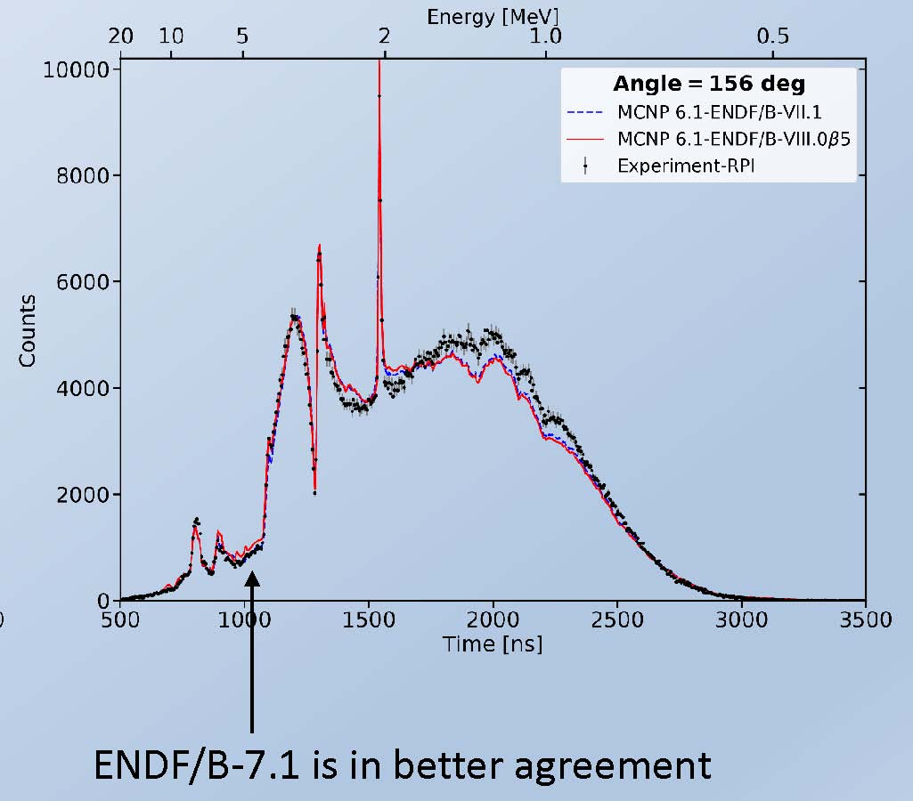
C(n,n) Cross Section
Comparison of Angular distribution measurements by Gkatis et al. with Danon
Gelina Measurements by Gkatis et al.
RPI Measurements by Danon
Disagreement

Slide 9
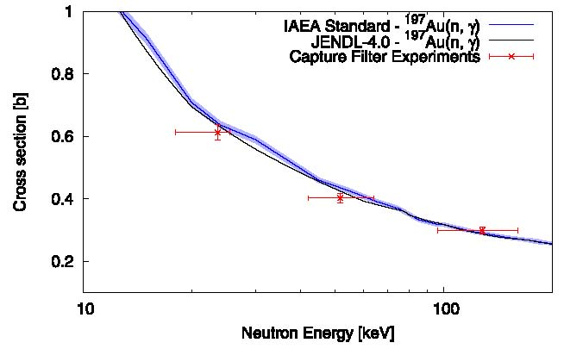
Gold Capture Measurements
GG
    There are no recent measurements of the Au(n,γ) cross section in the standards energy region. New measurements are needed to improve this standard.
      Data obtained by Rovira et al, at –J-PARC,
      that are relative to the ⁶Li(n,t) standard are shown in the figure. Silicon and Iron filters were used to produce almost monoenergetic peaks but they are broadened due to the double bunch mode used to take the data.
      The recent measurements by X-in-Rong Hu at CSNS
      (relative to ²³⁵U(n,f) in region where it is not a standard) and
      also those of Vansola at the BARC-TIFR facility in India (relative to ¹¹⁵In(n,γ)) can not be used in the evaluation.
Gold Capture Measurements by Rovira

Slide 10
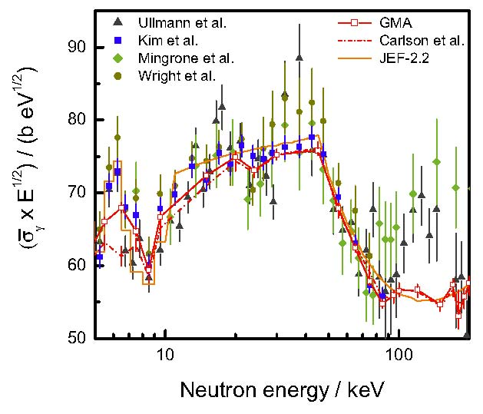
²³⁸U(n,γ) Measurements
    The status of the ²³⁸U(n,γ) cross section
    experimental data is shown in the figure.
    Few new measurements are available.
    Work at n_TOF was reported at the ND2025 conference by Emilio Mendoza Cembrano. When finalized it may improve the database for this cross section.
    Recent ²³⁸U(n,γ) Cross Section Measurements

Slide 11
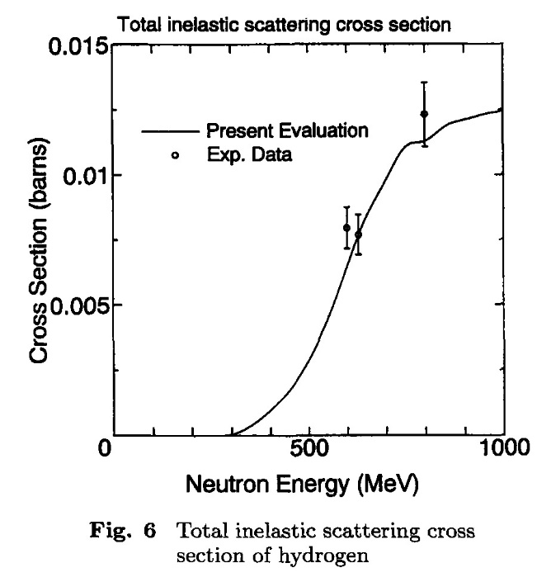
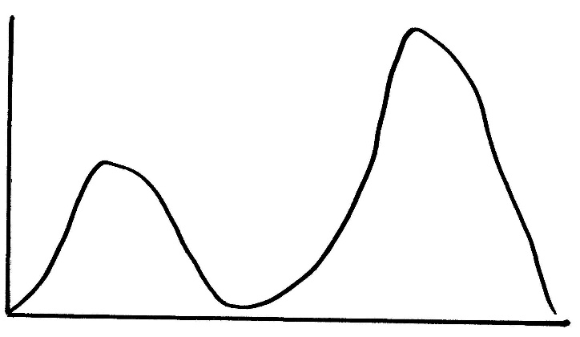
Absolute measurements by Manna et al. in the n_TOF collaboration were made of the ²³⁵U(n,f) cross section relative to hydrogen scattering from 20 MeV to 450 MeV.
  These data have been finalized and published.
  The results up to 450 MeV are similar to those of the ²³⁵U(n,f) Reference cross section The present standard is limited to 200 MeV. There is a strong need for these measurements to higher neutron energies.
  They had to contend with problems at higher neutron
  energies where inelastic scattering produces proton
  energies such that it is difficult to separate the elastic and
  inelastic protons. At 1 GeV, the total inelastic cross
  Section is about half the total elastic total cross section.
At the ND2025 conference,
Manna indicated they plan
to use a method to remove
inelastic protons using the
difference in proton energy.
Uranium Fission Cross Section Measurements
Elastic protons
Inelastic protons
Proton Energy

Slide 12
New measurements at PTB of the ²³⁸U(n,f) fission cross section by Belloni.
  Made at 2.5 and 14.8 MeV relative to hydrogen scattering. They are slightly below the standard but agree within their uncertainties.
Measurements of the ²³⁵U(n,f) fission cross section have been made by Michalopoulou from thermal up to 100 keV –but not in the standards energy region.
Measurements at the China Spallation Neutron Source.
  ²³⁵U(n,f) and ²³⁸U(n,f) cross sections measurements by Chen.
    Relative to the hydrogen scattering standard-shape data.
    For the extension up to 70 MeV problems were noted due to the use of double bunches. The unfolding causes a problem that is worsened when statistical uncertainties are large.
    More work is planned. Possibly with the MTPC
    They now extend from 10 to 66 MeV.
Uranium Fission Cross Section Measurements (cont.)

Slide 13
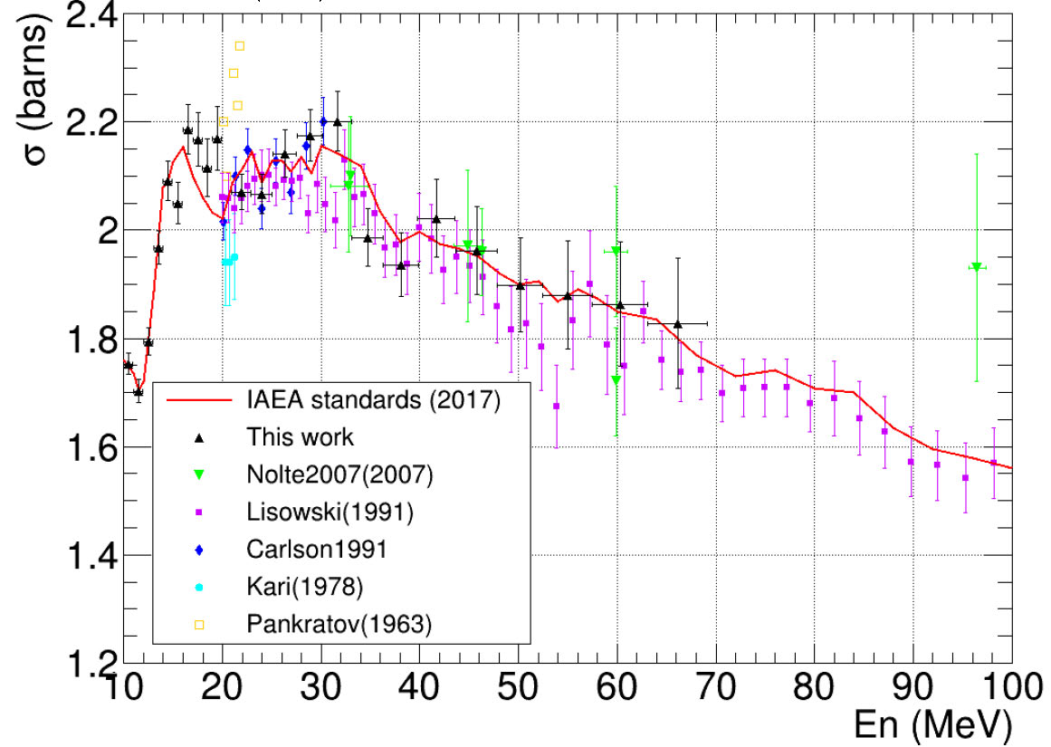
²³⁵U(n,f) Cross Section Preliminary Measurements by Chen at CSNS Facility BLACK Triangles

Slide 14
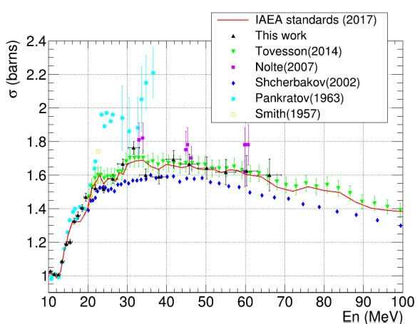
²³⁸U(n,f) Cross Section Preliminary Measurements by Chen at CSNS Facility BLACK Triangles

Slide 15
²³⁸U(n,f)/²³⁵U(n,f) Cross Section Ratio Measurements
Very resent highly accurate results have been obtained by Silano et al. at TUNL The results agree well with the standards evaluation except at 6.4 MeV where the data are just slightly below the evaluation.
A recent measurements is by Vorobyev at the GNEIS facility at the Petersburg Nuclear Physics Institute. The data obtained extend from 0.3 to 500 MeV.
The 2023 data by Ren were obtained at the CSNS facility and extend up to 200 MeV.
The data obtained by Wen were also obtained at the CSNS before the Ren measurements, basically to verify their experimental technique. They are very highly correlated with the Ren results. They agreed with the standard within their uncertainties.

Slide 16
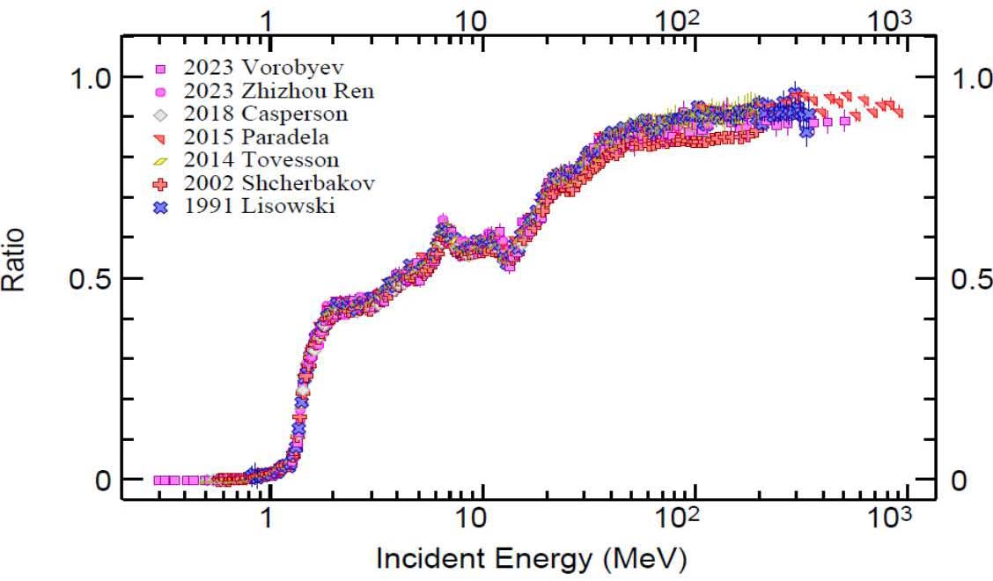
Measurements of the ²³⁸U(n,f)/²³⁵/U(n,f) Cross Section Ratio

Slide 17
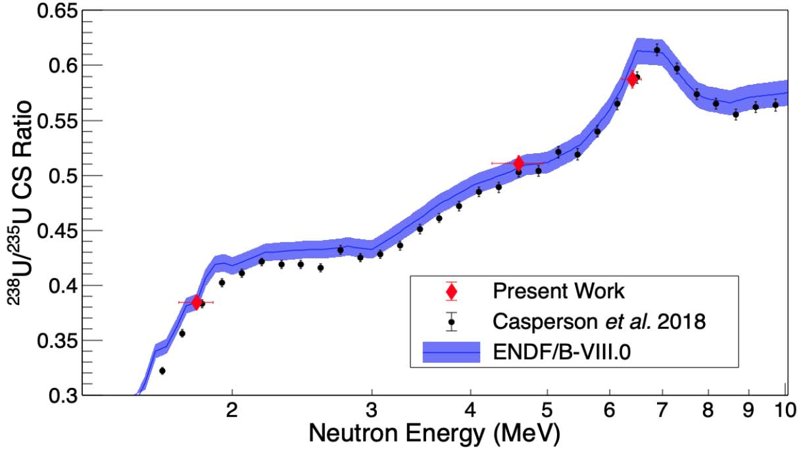
Measurements of the ²³⁸U(n,f)/²³⁵/U(n,f) Cross Section Ratio by Salino et al. in RED

Slide 18
²³⁹P(n,f) cross section measurements by Adrian Sanchez Caballero et al. from 0.02 ev to 10 MeV at the n_TOF facility were presented at the ND2025 conference.
A measurement at 4.6 MeV with an uncertainty of 1.3% was made by Salino at TUNL. It agrees exactly with the standards evaluation.
²³⁹Pu(n,f)/²³⁵U(n,f) cross section ratio measurements by Dongwi et al. made at LANSCE by the NIFFTE collaboration have very recently been published. They were made with an improved sample.
  These data are higher than the standards evaluation by about 2% but are in agreement in shape. They do agree within their uncertainties. The new data agree very well with the previous NIFFTE work
        There are new GMAPY results for the ²³⁹Pu(n,f)/²³⁵U(n,f) cross section ratio in the ²⁵²Cf PFNS. Use of SACS ratios in the GMAPY analysis led to an increase by 1.017 in that ratio.
        For the 2 NIFFTE TPC data sets, Current/ENDF=1.0202 and current/Previous=1.0058. If we assume each experiment has equal weight in combining the experiments, we obtainTPCs/ENDF=.1.017 in excellent agreement with the improved evaluation.
        For the 2 TPC results, the evaluation and both experiments all appear to have the same shape so the use of the energy range of the ²⁵²Cf PFNS is satisfactory for comparison of the data sets.
  Also measurements have been made of the ²³⁹Pu(n,f)/⁶Li(n,t) cross section ratio with the NIFFTE fission TPC. These data will impact evaluations of both the ²³⁹Pu(n,f) and ⁶Li(n,t) cross sections. They data are not finalized.
Plutonium Fission Cross Section Related Measurements

Slide 19
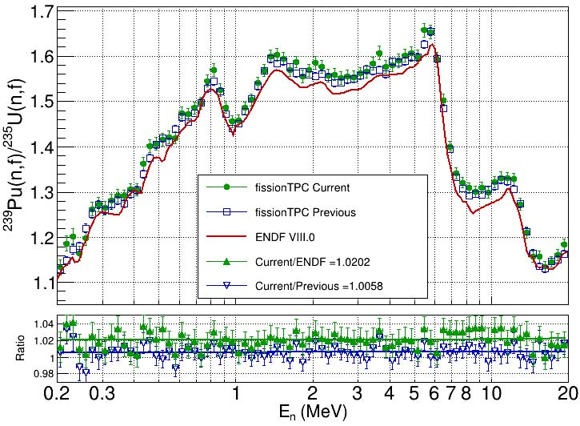
      New NIFFTE ²³⁹Pu(n,f)/ ²³⁵U(n,f) Cross Section Ratio compared with the Standards Evaluation

Slide 20
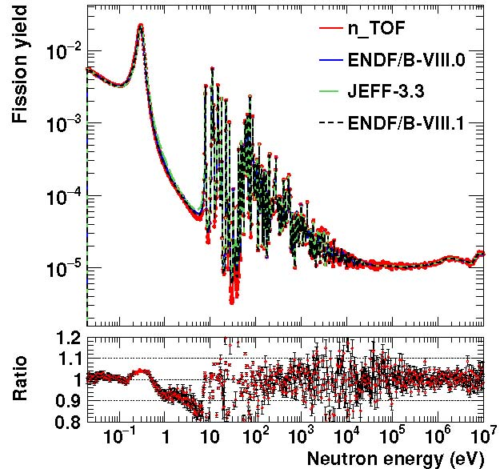
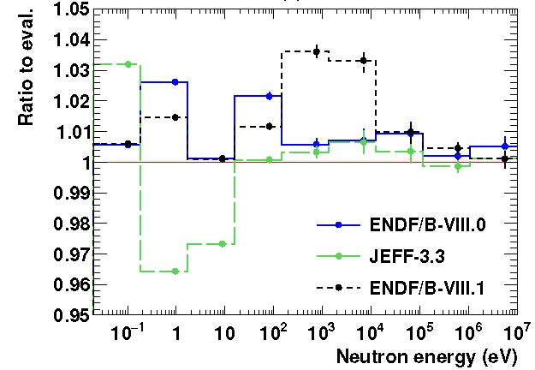
²³⁹P(n,f) cross section measurements and uncertainties at n_TOF by Adrian Sanchez Caballero et al.

Slide 21
Evaluation Activities
Schnabel continues work on the use of the Python based code GMAPY that replaces GMA. It uses Maximum likelihood and Markov Chain Monte Carlo methods.
  The energy dependence of USU has been studied. For the previous work ,USU was treated as energy independent
  Ratios of Spectrum Averaged Cross Sections (SACS) are now possible - not possible with GMAP.
      Those ratios are independent of determination of neutron fluence. They are very accurate and provide improved normalization data for standards evaluations. (addition of Schroder data to Mannhart work)
        There are new GMAPY results for the ²³⁹Pu(n,f)/²³⁵U(n,f) cross section ratio in the ²⁵²Cf PFNS. Use of SACS ratios in the GMAPY analysis led to an increase by 1.017 in that ratio.
        For the 2 NIFFTE TPC data sets, Current/ENDF=1.0202 and current/Previous=1.0058. It will be assumed that each experiment has equal weight in combining the experiments, so we obtainTPCs/ENDF=.1.017 in excellent agreement with the improved evaluation.
        For the 2 TPC results, the evaluation and both experiments all appear to have the same shape so the use of the energy range of the ²⁵²Cf PFNS is satisfactory for comparison of the data sets.

Slide 22
Evaluation Activities (continued)
The AIACHNE collaboration headed by Denise Neudecker evaluated the ²⁵²Cf(sf) PFNS. It is important that the standard was updated, and agrees with the Mannhart result and now is in a form that can conveniently updated in the future.
Keegan et al. at LANL measured the ²⁵²Cf(sf) PFNS relative to C(n,n) and ⁹Be(n,n) elastic scattering cross sections.
  The results, that extend from 0.62 MeV to 12.1 MeV agree with the new AIACHNE evaluation verifying the new evaluation using new techniques.
    For the region from 0.62 MeV to 1.62 MeV those measurements were relative to the C(n,n) reaction where it is a standard.

Slide 23
Summary-what is needed
Improved experimental work is necessary for all the standards
An emphasis is on work using different experimental methods to improve our understanding of uncertainties.
  Especially the boron and lithium standards so the upper energy bound can be increased.
    Also for gold capture that has some of the largest uncertainties for the standards.
Extension of the hydrogen standard to about 150 MeV and possibly higher (work is underway by Hale and Paris).
  It is now 20 MeV but there are cross section ratio data to much higher energies
  Note that changes to a standard are not allowed for a given version but extensions are allowed
Further work on unrecognized sources of uncertainty )USU)
  An understanding of the energy dependence of USU
Consider improved evaluation techniques for the standard cross sections

