Slide 1
Zr92 Measurements at GELINA
CSEWG Meeting Jan 6th – 9th, 2026
Klaus Guber¹, Jesse M. Brown¹, Carlos Paradela², Wiliam Hillman³
¹Oak Ridge National Laboratory, ²EC-JRC Geel, ³ University of Manchester
Notes:
Accessing Title Slide Options
The standard ORNL presentation template includes five branded title slide layouts:
Title | Standard. The preferred layout for lab-wide and general presentations. Features a default aerial photograph of the lab.
Title | Custom Image. Allows replacement of the default background with a custom full-slide image (16:9 or 4:3 landscape format).
Title | Custom Portrait Image. Supports inclusion of a custom 4:3 portrait image positioned next to the introductory text.
Title | Custom Landscape Image. Supports inclusion of a custom 16:9 landscape image positioned next to the introductory text.
Title | Text Only. Offers additional space for longer titles and multiple presenters.
Additional Lab-approved title slides specific to directorates and user facilities are available in PowerPoint under the following folders: Custom Title Slides and User Facility Templates, located in Presentation Templates.
Custom Title Slide Guidelines
Image Rights. Any custom images, graphics, or photography must be owned by ORNL or used with documented permission from the original creator or source.
Appropriate Image Use. Select images that work well with the layout. Ensure the focal point of the image is not obscured by the title text and white overlay box.
Relevance and Impact. Visuals are a key element of effective communication. Whenever possible, use imagery that enhances the message of your presentation and reflects ORNL’s mission and values.
Quality and Clarity. Use high-resolution images for clarity on large screens. Avoid overly complex or dark images that may conflict with the title text.
Text-Only Option. If no appropriate or approved imagery is available, or if imagery is not permitted for the subject matter, the Title | Text Only layout provides a clean, professional alternative.
Learn more about ORNL presentations
https://ornl.sharepoint.com/sites/branding/SitePages/presentations.aspx

Slide 2

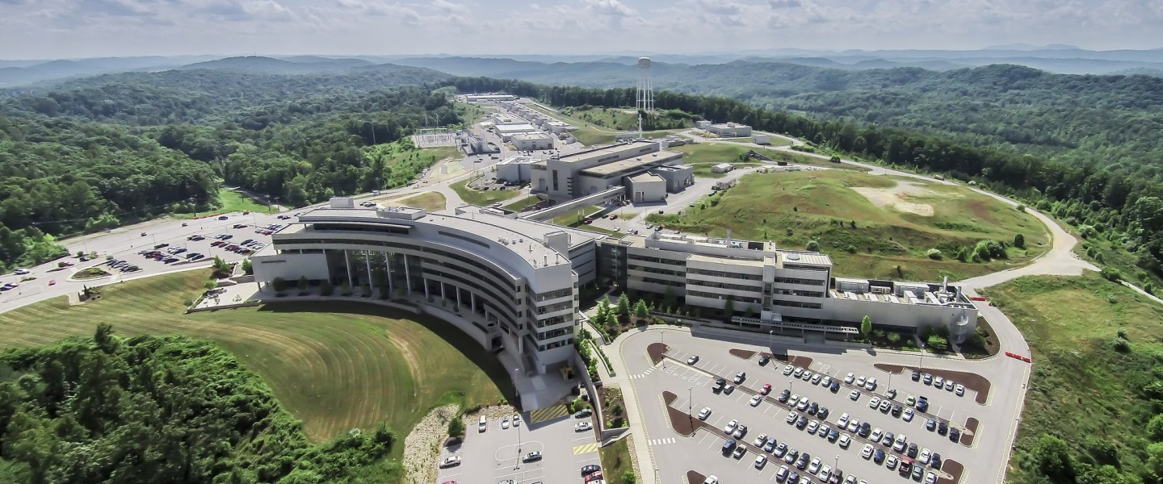

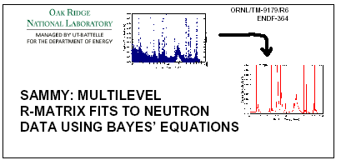
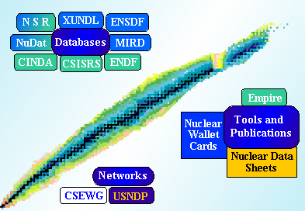
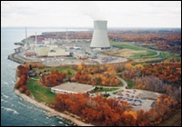
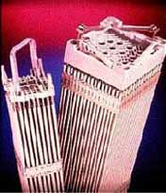
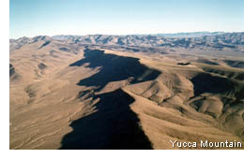
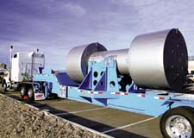
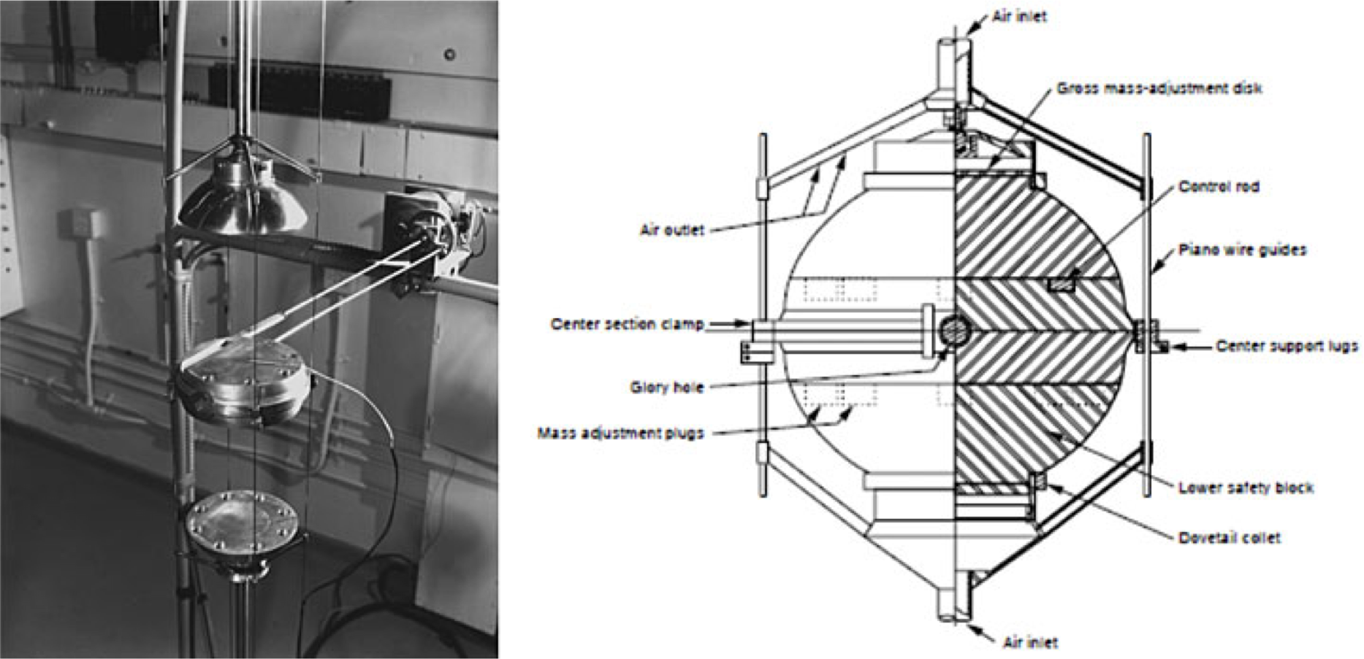
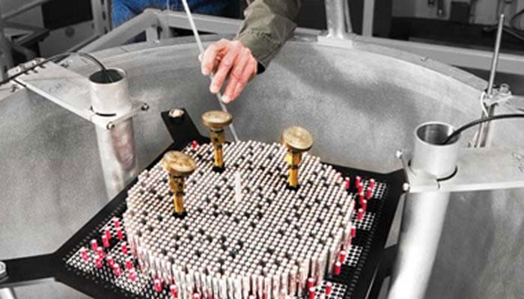
Basic Science Cross Section
GELINA
Cross Section Evaluations
Applications
ORNL ND
Support
for NCSP
Applications
Computational Modeling
and Processing
Integral Experiments
SCALE
AMPX
ND testing and adjustments

Slide 3
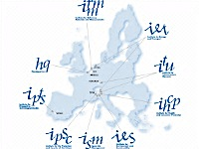
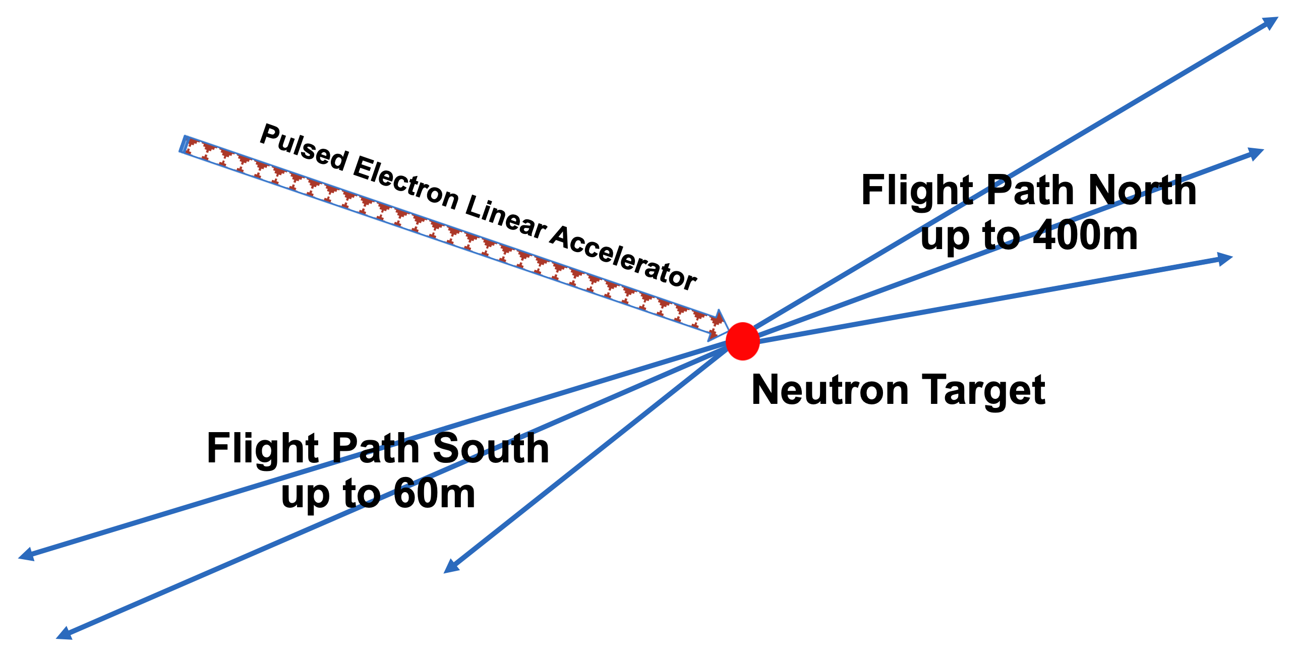
GELINA
Time-of-flight facility
Pulsed white neutron source
  (10 meV < E_{n} < 20 MeV)
Multi-user facility with
10 flight paths (10–400 m)
Measurement stations have special equipment to perform the following:
  Total cross section measurements
  Partial cross section measurements
Pulse width : 1 ns
Frequency : 40–800 Hz
Average current : 4.7–75 μA
Neutron intensity :1.6 10¹²–2.5 10¹³ n/s

Slide 4
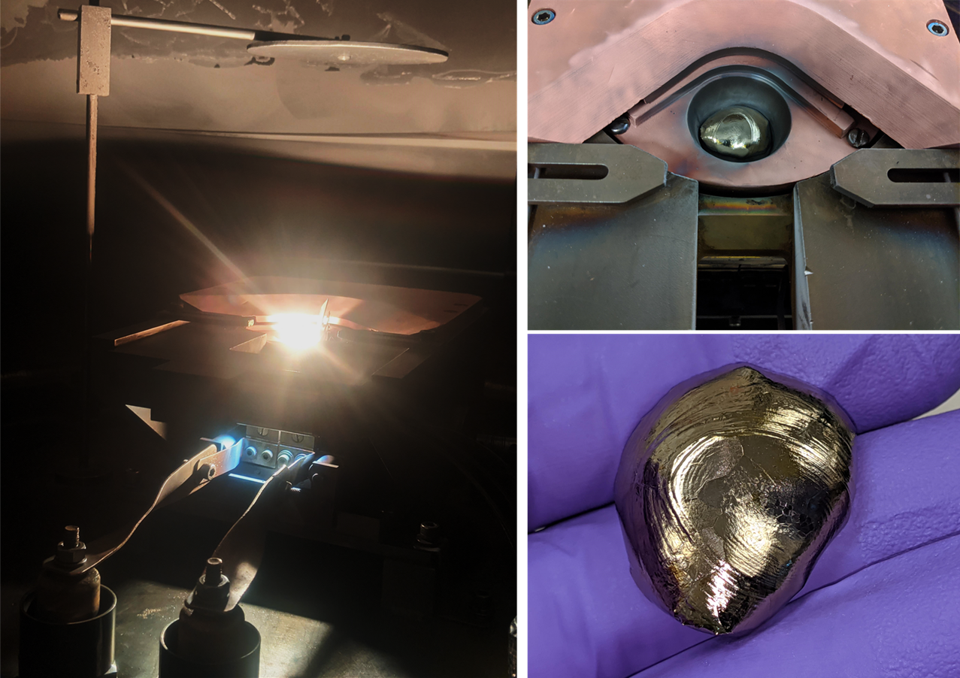

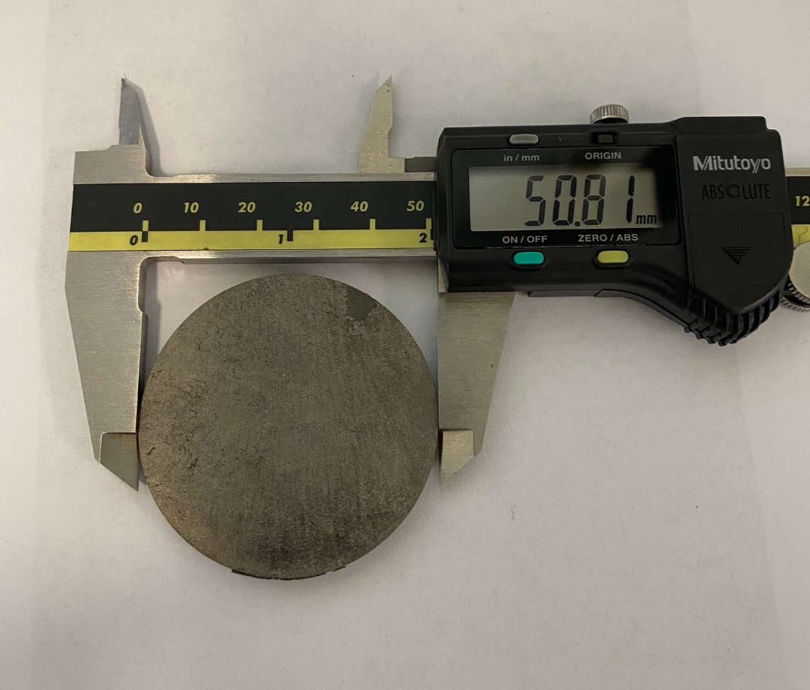
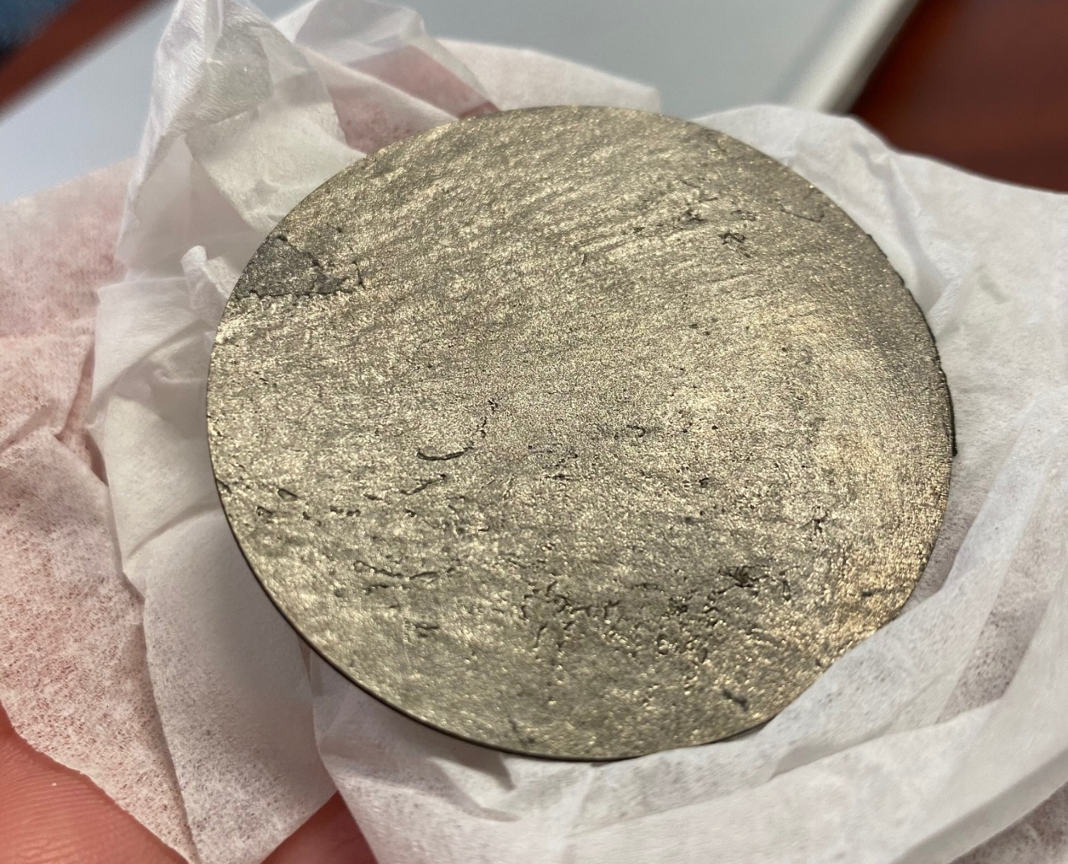
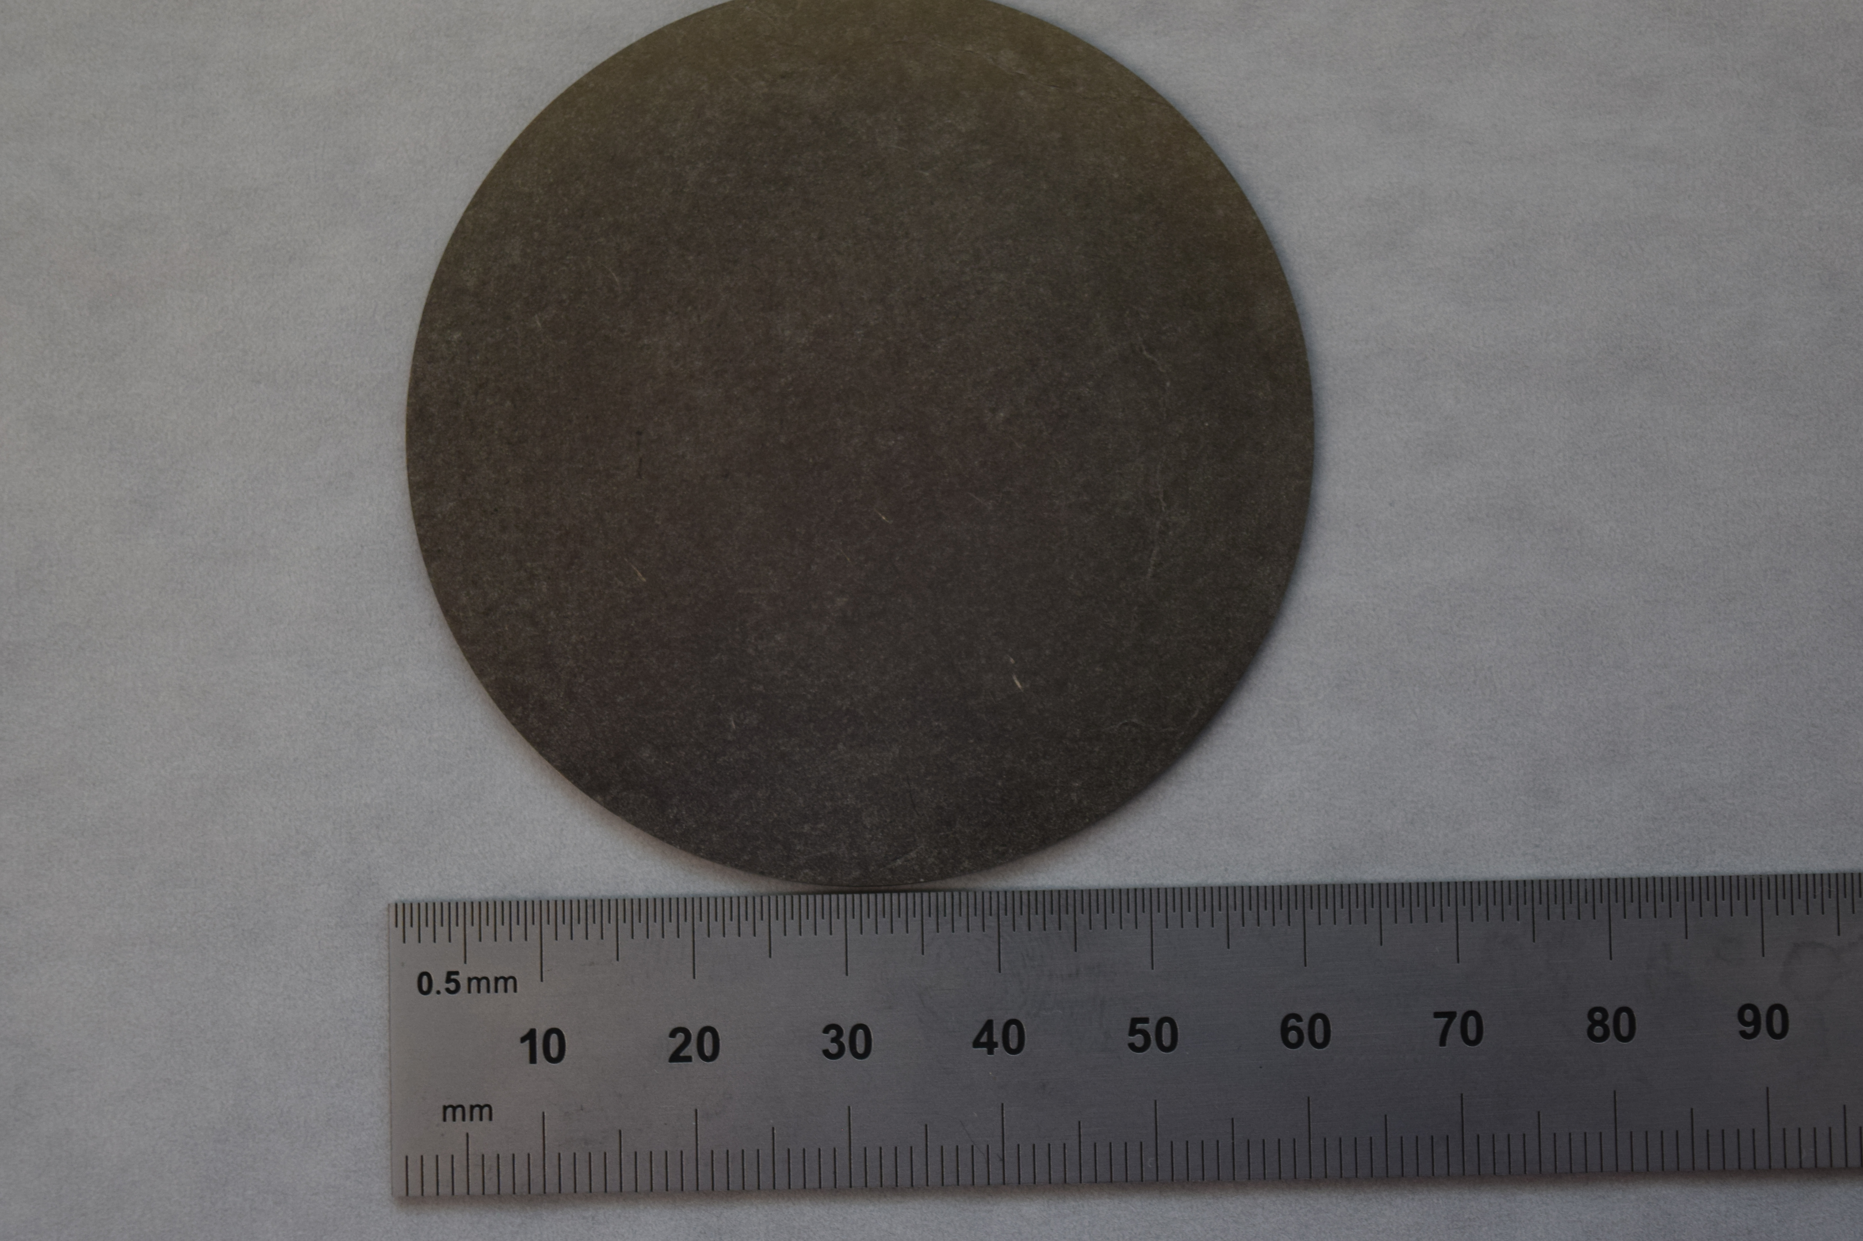
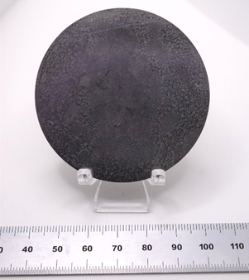
^{90,91,92, 94}Zr sample
Zr-90 has a closed neutron shell, hence, the capture cross section is very small for the Zr isotopes.
Isotopic enriched material is usually in a compound form which contain a strong neutron scatterer
Metallic samples are the first choice for capture experiments, as they help reduce backgrounds from sample scattered neutrons due to the lack of scattering compound material such as H,O and C
Cost to produce a metallic sample is about 40 K.
⁹⁰Zr
⁹¹Zr
⁹²Zr

Slide 5
Zr-92 Data Reduction Progress
AGL -> AGS is traditional software from GELINA
  Used to reduce Zr-90 and Zr-91 data, now complete
  Confident in results
  Full suite of dead-time correction, monitor normalization, etc.
  Works on limited hardware (32-bit app on Unix-like)

Slide 6
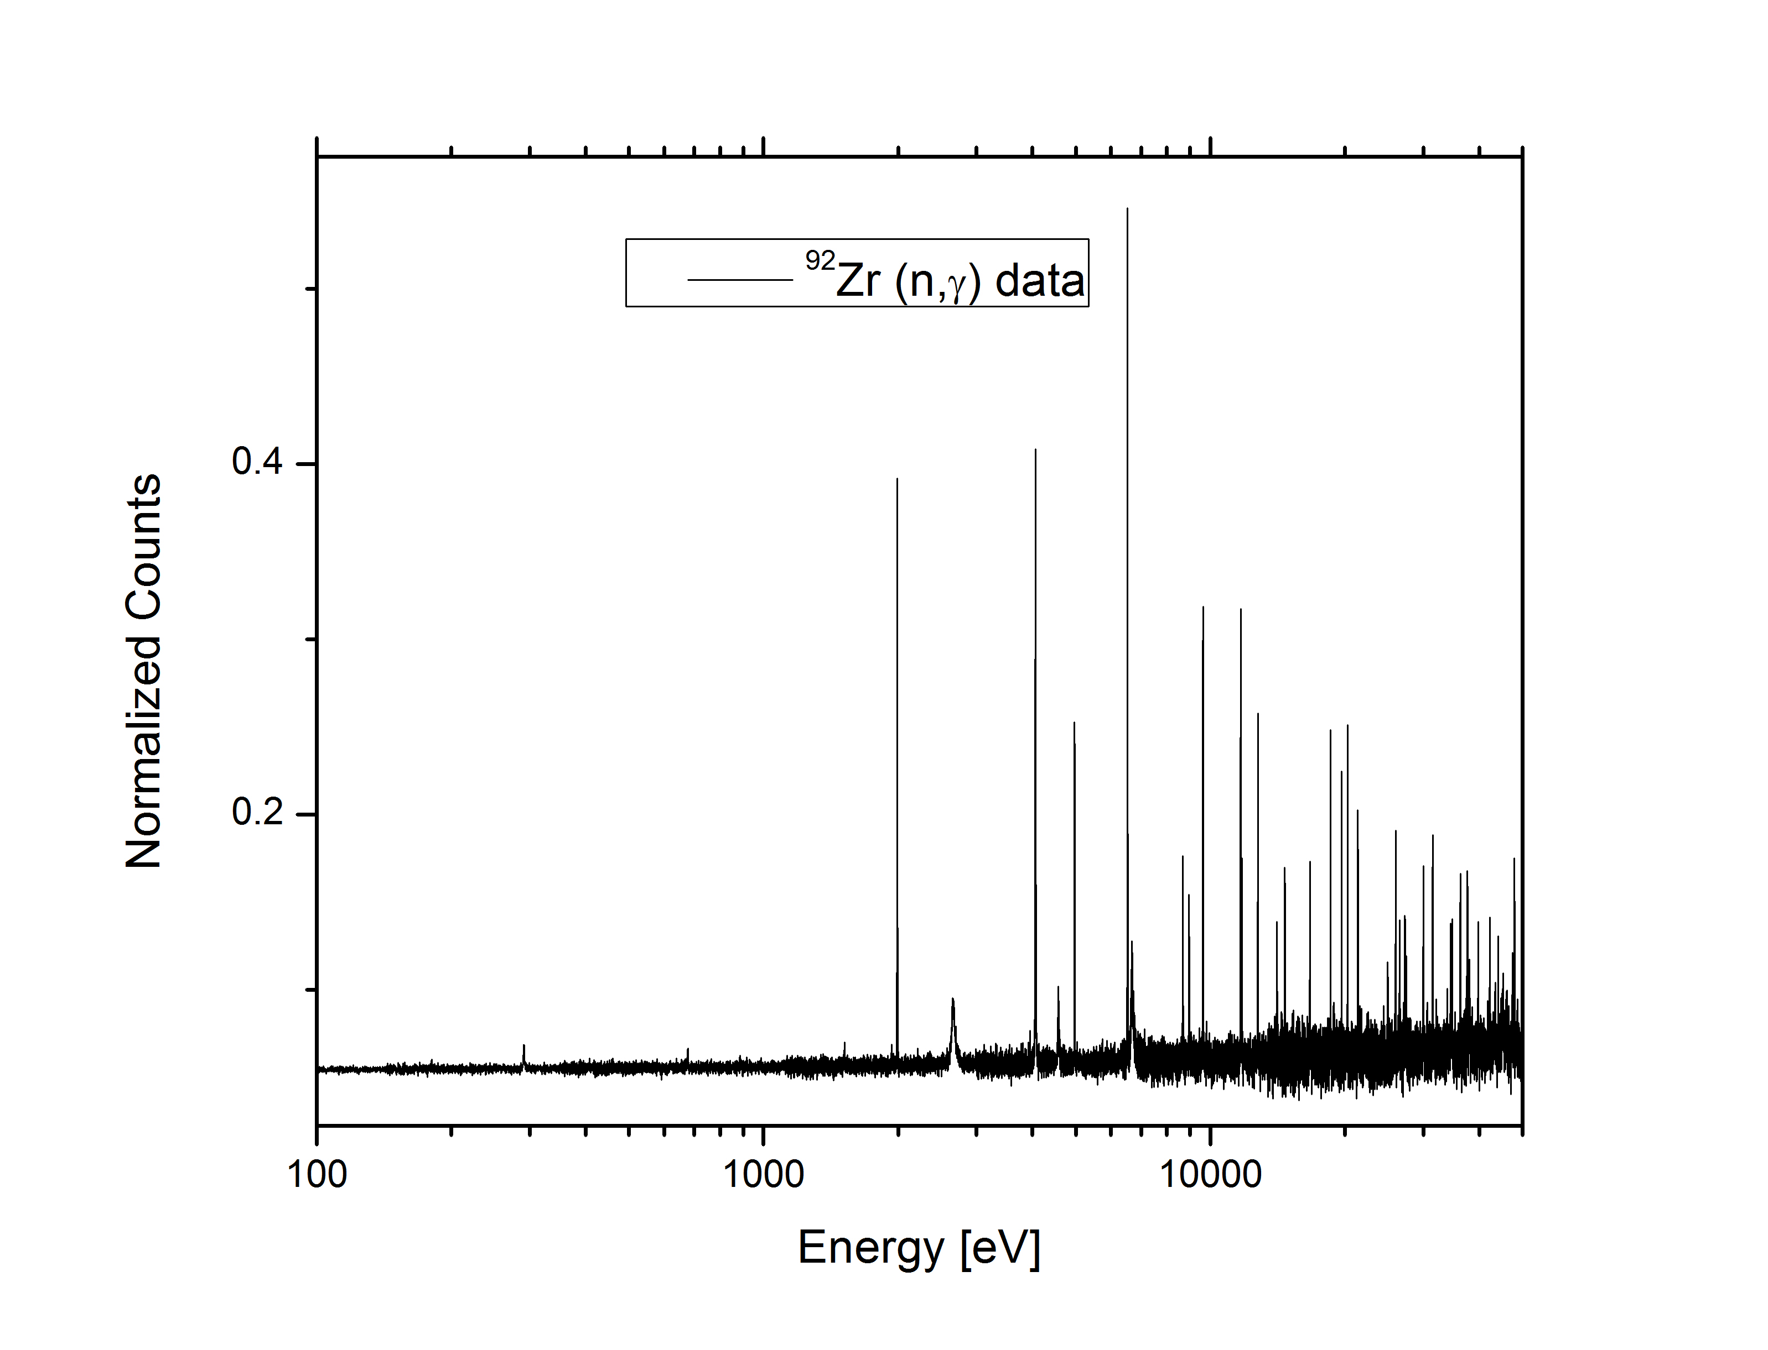
Zr-92 (n,γ) Data
Data measured at GELINA FP14 60m, data reduction not yet finalized

Slide 7
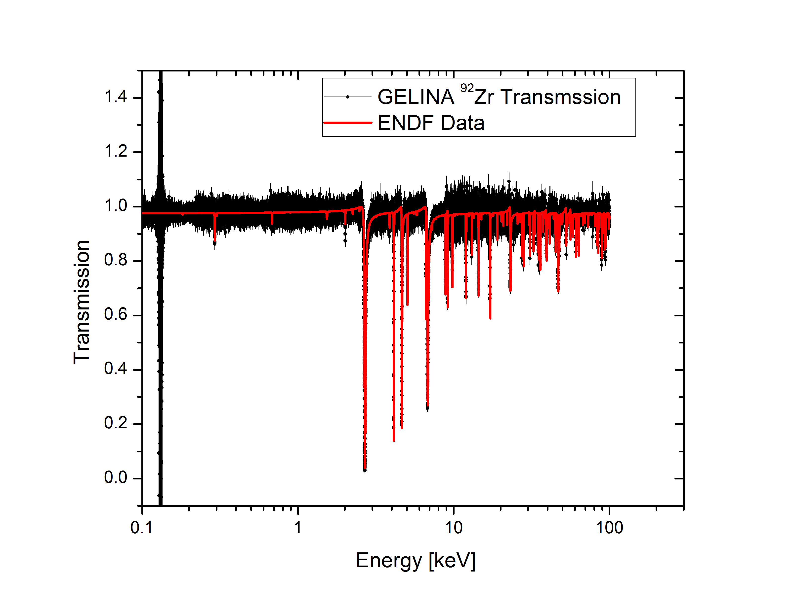
Zr-92 GELINA compared to ENDF

Slide 8
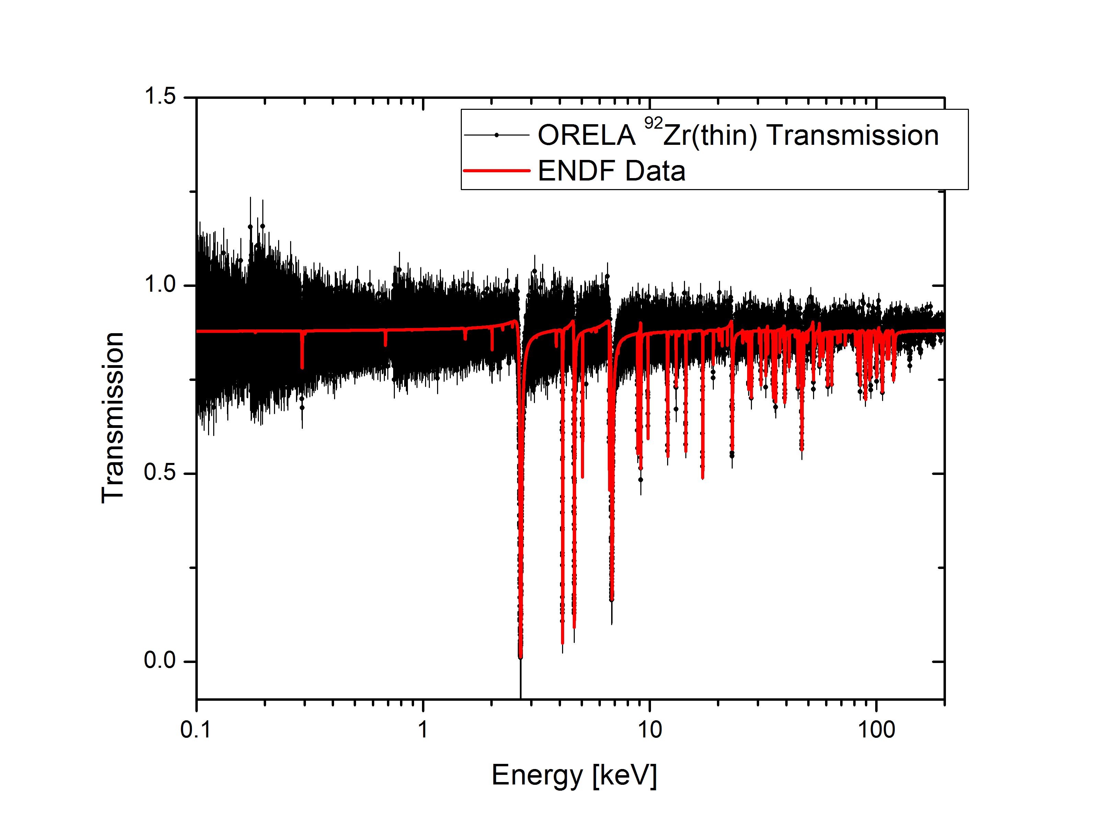
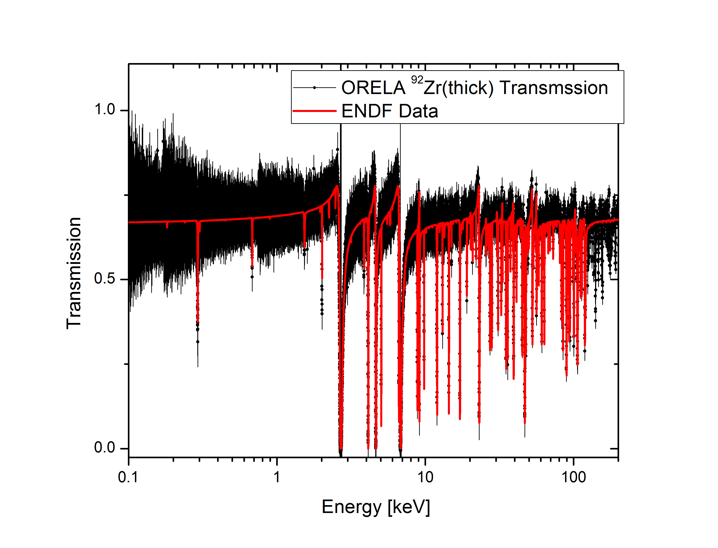
Zr-92 Transmission compared to ENDF/B

Slide 9
Status of NCSP experiments at EC-JRC Geel
 | W | Cu | Ca | Ce | V | La | Zr
Sample | Metallic disks 182,183,184,186 2009–2011 | Metallic disks 63 and 65 2011–2012 | Metallic disks Nat Ca 2013–2014 | Metallic disks Nat Ce, Ce-142 oxide 2014–2015 2018–2019 | Metallic disks 2015–2016 | Nat La metallic disks 2017–2018 | Nat Zr metallic disks ^{90,91,92,94}Zr 2016–2017 2021–2023
Experiments GELINA | 60 m, 30 m (n,γ) transmission | 60 m (n,γ) | 60 m (n,γ) transmission | Nat Ce 60 m (n,γ) Nat Ce transmission, ¹⁴²Ce experiments completed | 60 m (n,γ) transmission | 60 m (n,γ) transmission | Nat Zr 60 m (n,γ) + transmission ^{90,91,92}Zr transmission and (n,γ) data
Data sorting | Finished 60 m + transmission | Finished 60 m | Finished 60 m transmission | Finished for thin and thick sample, ¹⁴²Ce data sorting finalized | Finished for thin and thick sample | Finalized | Finished for thin and thick natural sample, ^{90,91,92}Zr (n,γ)+ transmission,)
Reduced to cross section | X-section, transmission | X-section | X-section transmission 0.6, 1.0, 5 cm samples | 2 mm X-section 2 mm transmission 10 mm transmission ¹⁴²Ce data | Thin X-section 0.35 and 2 mm, transmission | X-section, transmission | ^{90,91,92}Zr transmission + (n,γ)
Data testing | Data ready for evaluation | Data ready for evaluation | Data ready for evaluation | Data ready for evaluation | Data ready for evaluation | Data ready for evaluation | In progress ^{90,91}Zr Data ready for evaluation
Analysis and evaluation | Finalized and submitted to National Nuclear Data Center | Finalized and submitted to National Nuclear Data Center | Finalized and submitted to National Nuclear Data Center | Finalized and submitted to National Nuclear Data Center | Finalized and submitted to National Nuclear Data Center | In progress Final stages, i.e. join RRR with HE evaluation | In progress RPI PhD Student ORNL

Slide 10
Summary
First cut of Zr-92 data reduction is been completed
Combination of Zr-90 and Zr-91 will enable some evaluations but still have to wait for Zr-92 final data and Zr-94 measurements for full analysis of Zr.

Slide 11
People supporting JRC experiments and evaluations
Peter Schillebeeckx, EC-JRC Geel
Carlos Paradela, EC-JRC Geel
Stefan Kopecky, EC-JRC Geel
Ruud Wynats, EC-JRC Geel
Mike Zach, Jenny Conner, ORNL/Isotopes
Goran Arbanas, Jesse Brown, Chris Chapman, Luiz Leal, Jordan McDonnell, Marco Pigni, Klaus Guber, ORNL-ND group
Acknowledgments
This work was supported by the DOE Nuclear Criticality Safety Program, funded and managed by the National Nuclear Security Administration for the US Department of Energy
Additionally, this work was also supported by JRC-Geel and the European Union

