Slide 1
The present status of the EXFOR project
B. Pritychenko¹
1 National Nuclear Data Center, Brookhaven National Laboratory, Upton, NY 11973-5000, USA
USNDP Meeting, October 28-31, 2025

Slide 2

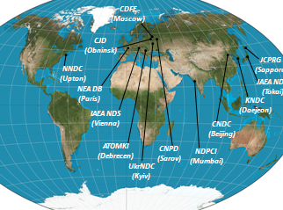
Nuclear Compilation Databases
Nuclear reaction, structure, and bibliography compilations were strengthened by the Manhattan Project.
There are several major compilation databases at USNDP:
  Nuclear Science References (NSR): all low- and intermediate-energy references for a broad use.
  Experimental Nuclear Reaction Data (EXFOR): low- intermediate-energy nuclear reaction compilations. Presently run by the Nuclear Reaction Data Centres (NRDC) internationally.
  eXperimental Unevaluated Nuclear Data List (XUNDL): ENSDF project/NSDD network.

Slide 3
Area #1 EXFOR FY 2026 Statistics
NNDC is responsible for the Area #1 (USA and Canada) compilations
118 new (Often in consultations with authors) and 385 corrected entries
23 preliminary and 17 final transmissions (Refereed compilations)
8 internal EXFOR DB updates
B. Pritychenko (0.5 FTE): 84 new and 9 corrected
O. Gritzay (no longer available): 34 new
O. Schwerer (volunteer): 372 corrected
N. Otsuka (volunteer): 4 corrected

Slide 4
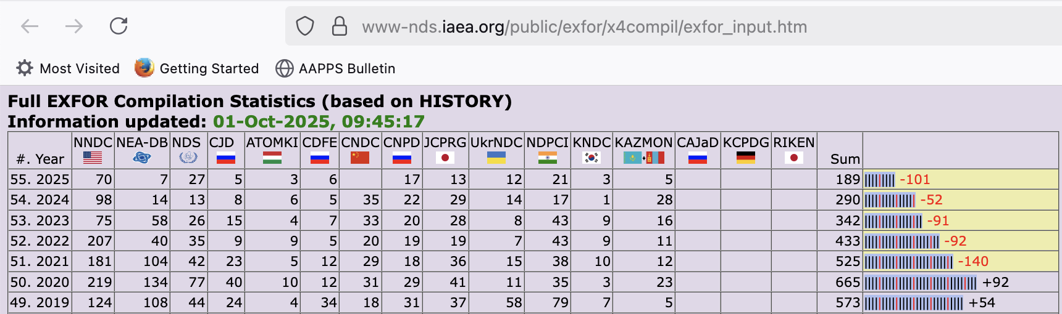
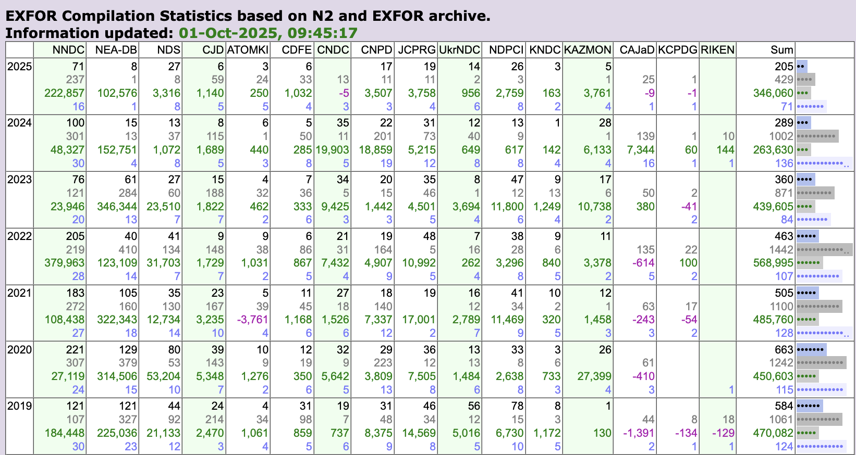
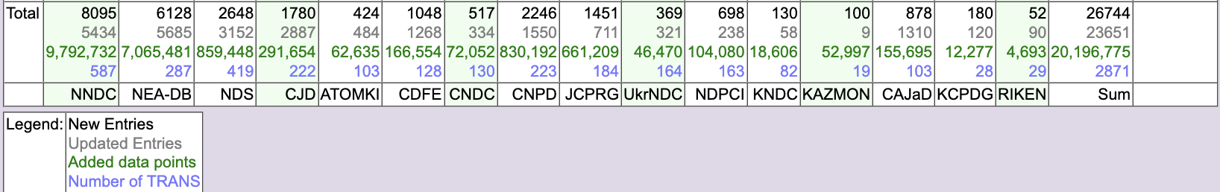
NRDC Statistics (Calendar Years)
EXFOR compilation control system is one of the tools used for this co-ordination (Developed by Viktor Zerkin, IAEA, retired on October 31, 2023).
Top panel: New entries only.
Bottom panel: New and Updated entries, number of data points and transmissions.
Overall performance of the Area #1 is very good.
Potential issue is EXFOR maintenance or correction of existing entries.
Area #1 has the largest number of entries 8,095. Only 5,434 (~67.1%) of entries were corrected. One calendar year ago the corrected entries number was ~61.3%.
Total number of data points is 9,792,732.

Slide 5
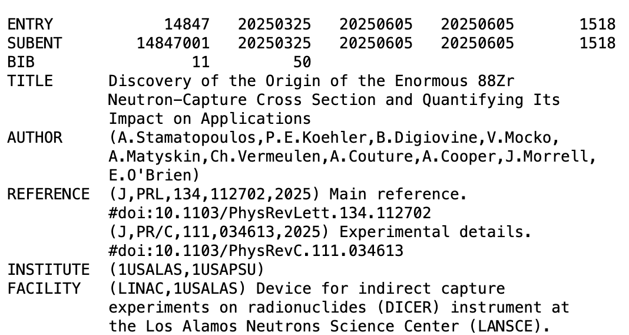
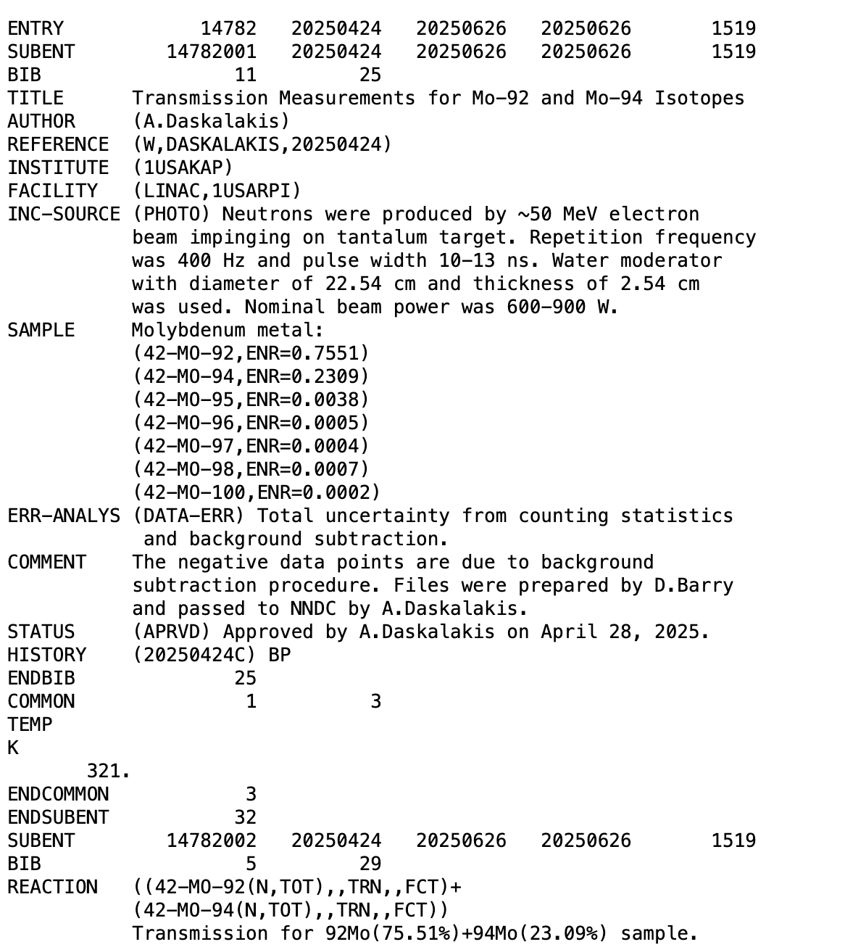
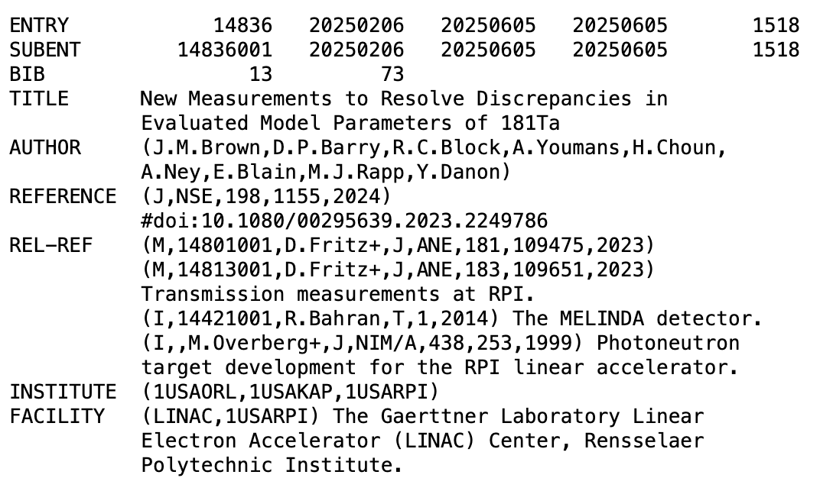
Recent EXFOR entries
#14847: A. Stamatopoulos et al., Discovery of the Origin of the Enormous 88Zr Neutron-Capture Cross Section and Quantifying Its Impact on Applications
  Our data reveal a resonance at 0.171 eV and result in a thermal neutron-capture cross section of 771 000±31 000 b, in good agreement with the recently published value. In contrast, the neutron-capture resonance integral extracted from our data is 15 210±670 b and is roughly a factor of 200 smaller than the recently reported value.
#14836: J.M. Brown et al., New Measurements to Resolve Discrepancies in Evaluated Model Parameters of 181Ta
  To resolve discrepancies in evaluated cross sections among major nuclear data libraries, energy-differential neutron transmission and radiative capture yield of ¹⁸¹Ta were measured from 0.15 to 100 keV using multiple sample thicknesses.
#14782: A. Daskalakis, D. Barry, Transmission Measurements for Mo-92 and Mo-94 Isotopes
  ~200,000 lines of data, 12.5 MB

Slide 6
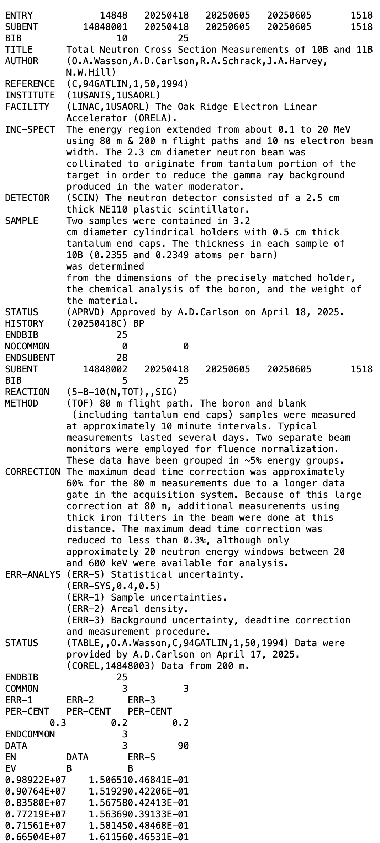
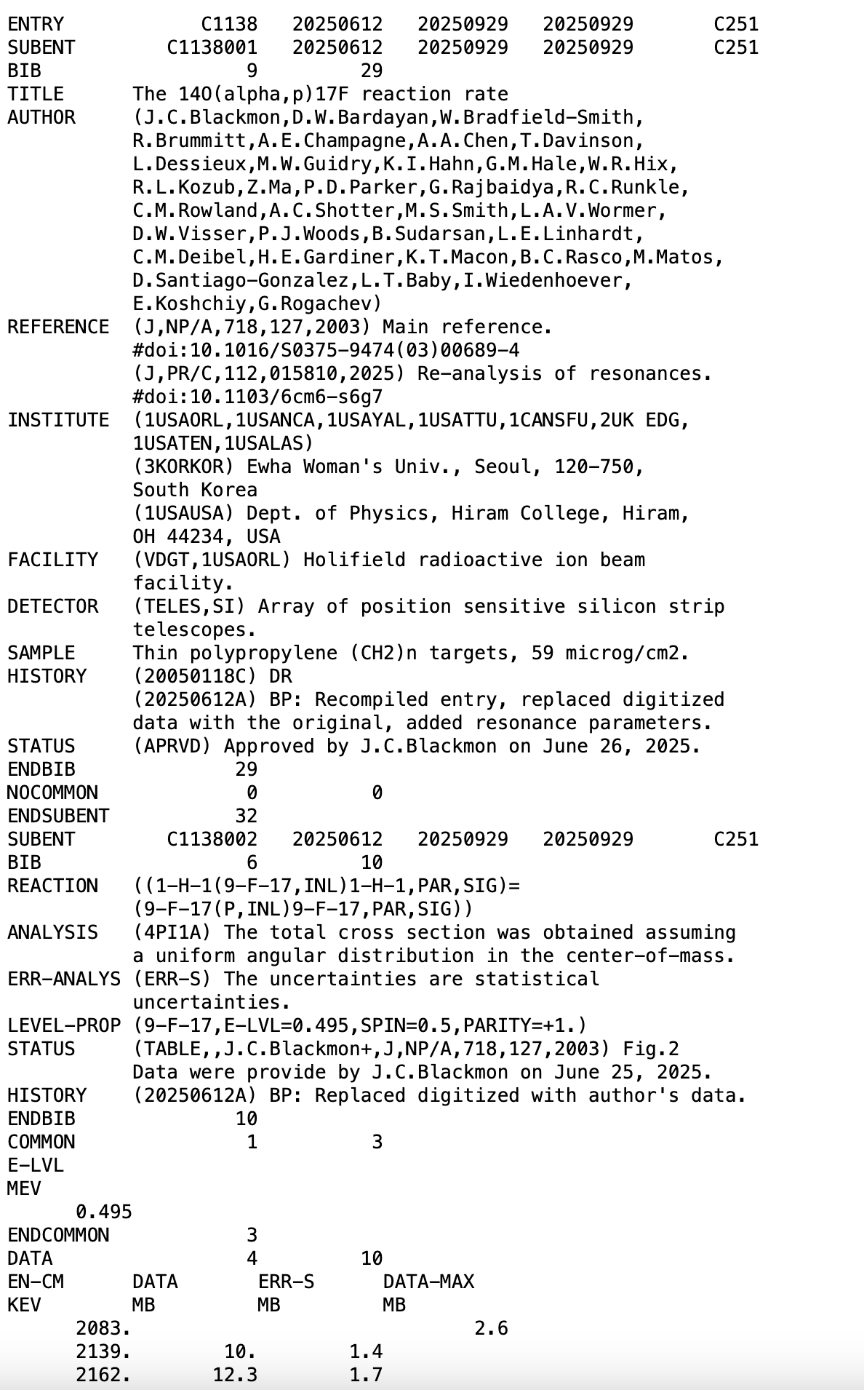
Not Recent Experiments
#14848: Total Neutron Cross Section Measurements of 10B and 11B
I was recently contacted by Allan Carlson, who provided data from a 1994 publication.
It was released as TRANS.1518.
2003 publication of J. Blackmon et al., C1138. It is digitized in EXFOR because the compiler failed to obtain data from the author.
While working on the C3072 compilation, it was discovered that the LSU group re-analyzed C1138 and extracted resonance parameters.
I contacted the group and secured a commitment to provide the 2003 data.
Sometimes it is possible to recover 20-30-year-old data.

Slide 7
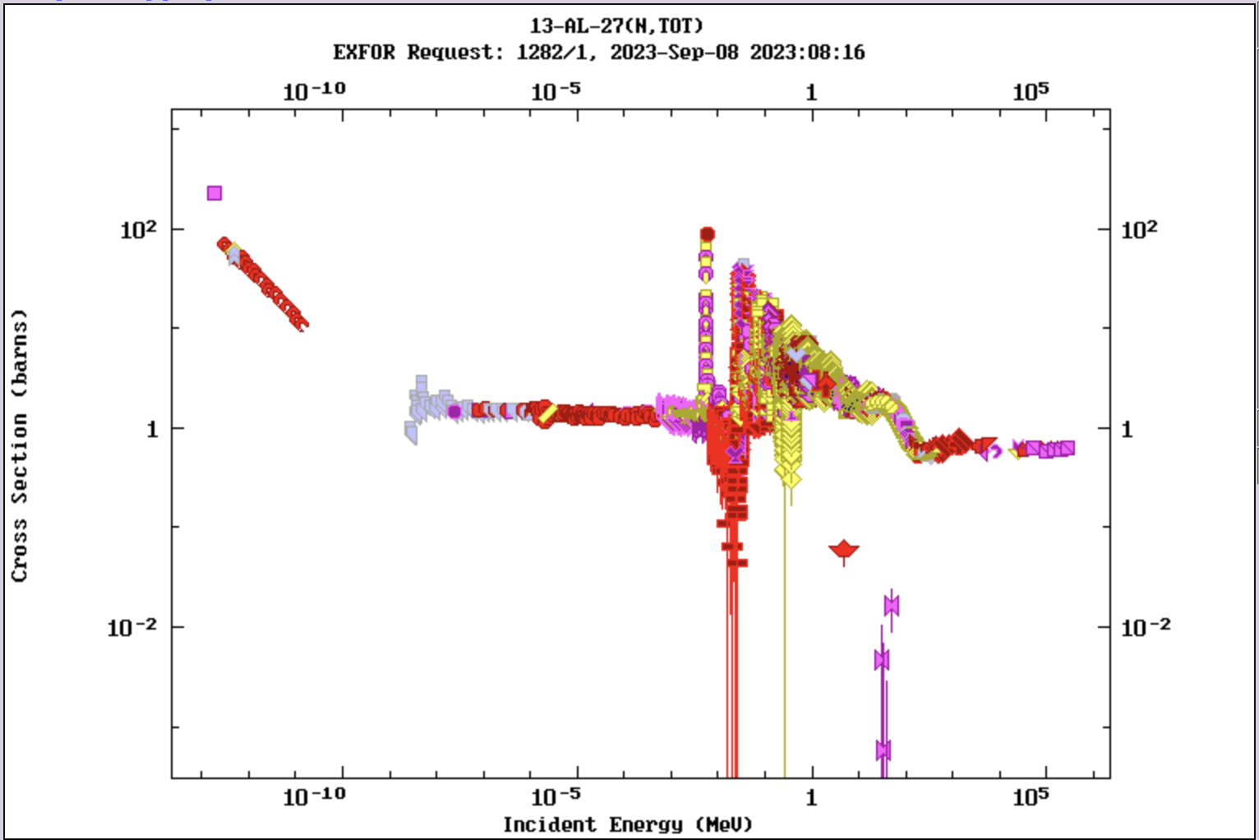
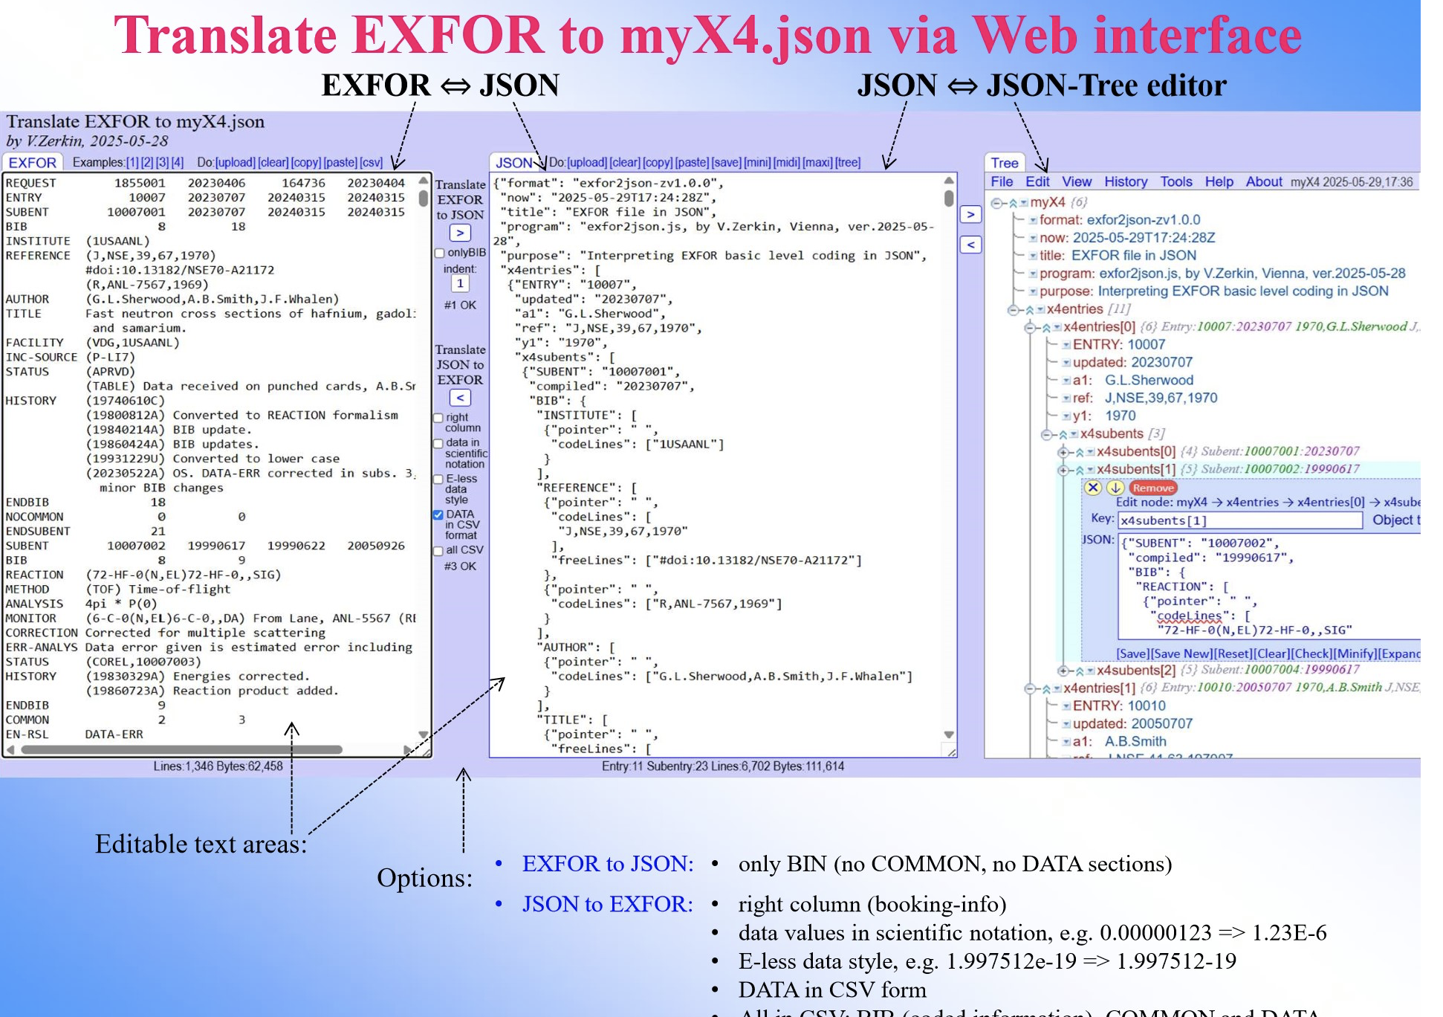
EXFOR Database Modernization
EXFOR is 75-year-old: It has to capitalize on modern computer technologies.
NEA WPEC SG54: Curated EXFOR: developing a machine-readable, comprehensive, and corrected by evaluators experimental nuclear reaction database
New data formats: JSON (JavaScript Object Notation) lightweight data interchange format for EXFOR is now in progress at the SG54 (N.Otuka, V.Zerkin,…).
Compilation of corrected EXFOR data sets: AIACHNE, EXFOR Web DB, corrected Karlsruhe,...
SG54 collaboration: BNL, IAEA, LBNL, NEA-DB, Los Alamos, LLNL, ORNL, …

