Slide 1
Activation Library Use in Target Design and Analysis for Radioisotope Production
November 6, 2025
January 9, 2026 | Nuclear Data Week “2025”
William (B.J.) Marshall
Radioisotope Science and Technology Division

Slide 2
Outline
HFIR description and operations
Radioisotopes produced at HFIR
Codes, tools, and data
Conclusions

Slide 3
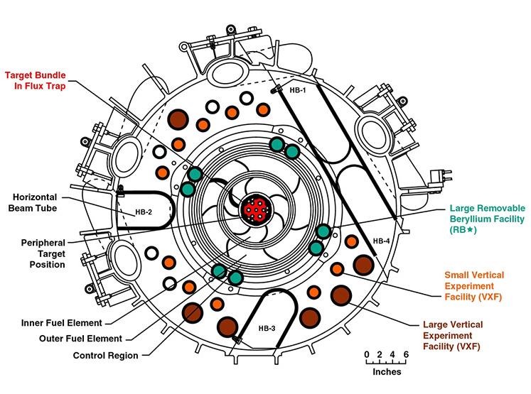
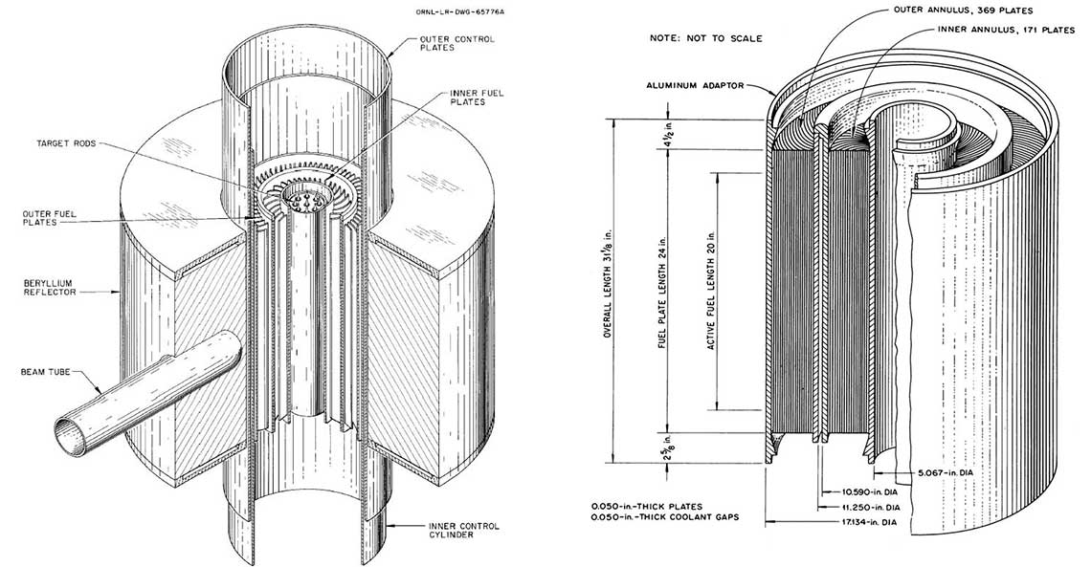
High Flux Isotope Reactor (HFIR) description and operations
HFIR is a unique research reactor
Central flux trap intended for transplutonium production
Beryllium reflector with numerous irradiation facilities
Beam tubes for neutron scattering
Cylindrical core approximately 2’ (~60 cm) tall and 15” (~38 cm) outer diameter
5” (12.7 cm) OD for central flux trap
85 MW thermal power, ~23 day cycles
Peak thermal flux ~2 × 10¹⁵ n/cm² s in flux trap
Thermal flux in the reflector ranges from about 5 × 10¹⁴ to 1 × 10¹⁵ n/cm² s

Slide 4
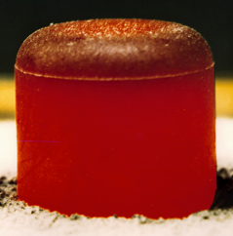
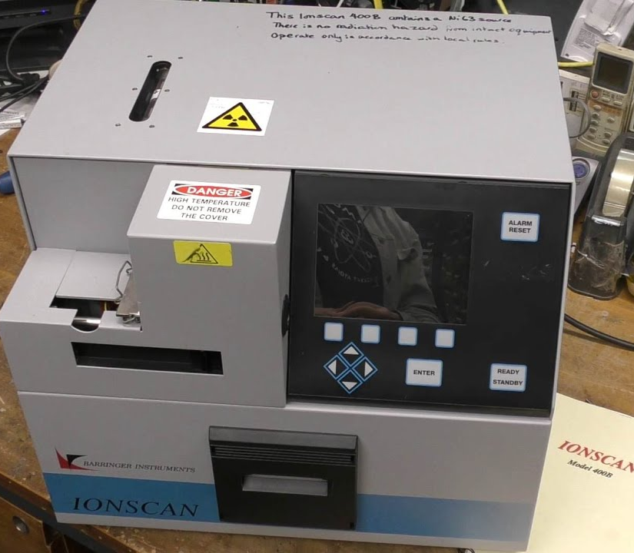
Radioisotope products
²⁵²Cf: Part of the original and still primary mission of HFIR for the DOE Isotope Program
Generated in the flux trap from Cm target material provided by Savannah River
²³⁸Pu: Heat source for NASA RTGs
²³⁷NpO₂ feed material from INL originally generated at Savannah River
Irradiation for multiple cycles in the Be reflector
Anything else DOE Isotope Program desires
Industrial sources for radiography and other applications
Medical sources for therapy, diagnostics, or both

Slide 5
Target design, analysis, and qualification radiation transport tools
“Fit-for-purpose” or “Low-fidelity” tools
“General purpose” or “High-fidelity” tools
TCOMP
Prediction of ²⁵²Cf production
Nuclear data have been tuned to give accurate predictions based on past campaigns
ISOCHAIN
Simplified, user-friendly code for approximate activation and decay calculations
Nuclear data derived from “Lockheed Martin” Chart of the Nuclides or input by user
These tools do not directly use released, evaluated nuclear data.
MCNP/ORIGEN
Flux tally from static MCNP calculation input to ORIGEN for activation and decay calculation
LANL-generated ACE data for MCNP and ORNL-generated AMPX data for ORIGEN
HFIRCON
Coupling of MCNP with ORIGEN to do cycle simulation including depletion, activation, decay, heat generation
In both standalone ORIGEN and HFIRCON, the JEFF-3.0 activation library is the primary source of nuclear data for depletion and activation.

Slide 6
Conclusions
Radioisotope production calculations would benefit from a new activation library, especially if it is consistent with ENDF data used in transport calculations
ORNL radioisotope production predictions and measurements may be helpful in providing validation for activation library evaluations
Other HFIR users may also be able to provide feedback
Neutron activation analysis laboratory
Fuel irradiation
Other materials irradiations

Slide 7
Thanks for your time and attention!

