Slide 1
TSL Validation using HTR-PROTEUS
John D. Bess (JFA), Volkan Seker (UMich), Olin W. Calvin (INL), Zachary D. Bevans (INL), Spencer C. Ercanbrack (INL), Javier Ortensi (X-energy, formerly INL)
CSEWG : Nuclear Data Week 2025 @ BNL January 6-9, 2025

Slide 2
Objective
Calculation of eigenvalues for HTR-PROTEUS cores using MCNP and various ENDF/B nuclear data libraries
-VII.0, -VII.1, -VIII.0, and -VIII.1
Y-axis is (C-E)/σ, where C = calculated eigenvalue, E = benchmark experiment eigenvalue, and σ = 1σ uncertainty in benchmark value
Ideally, a good calculation falls within 1, 2, or 3σ
Using revised HTR-PROTEUS critical configurations
Look at the results; what stands out?

Slide 3
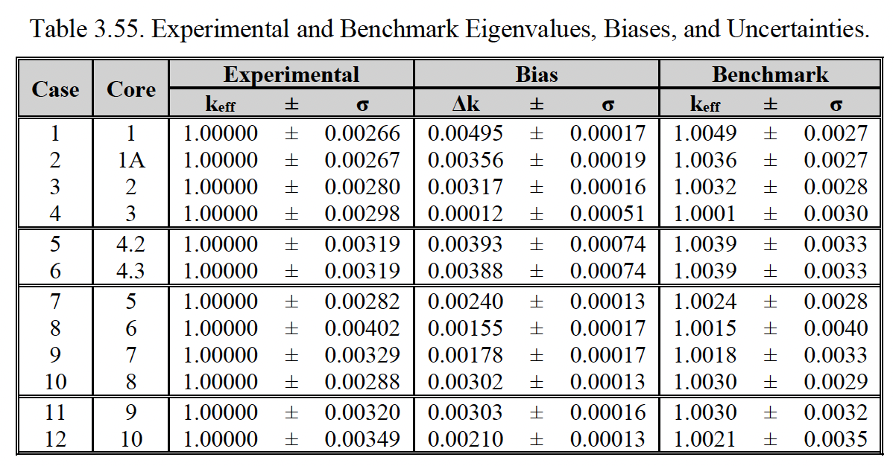
Target HTR-PROTEUS Values (to be submitted to next ICSBEP TRG)

Slide 4
Graphite TSL has a significant impact upon eigenvalue calculation.
As-expected, it is less pronounced in “water ingress” cores: 3, 6, 7, and 10.
Most 100% graphite TSL results within 3σ

Slide 5
TSL impact about the same.
The drop in eigenvalue is due to the increase in carbon absorption cross section
Most 100% graphite TSL results within 3σ

Slide 6
Something isn’t right with the free gas treatment of carbon
The porosity of HTR-PROTEUS graphite is ~25%
Less spread in “water ingress” cores
Most TSL results within 2σ

Slide 7
Something isn’t right with the free gas treatment of carbon
The porosity of HTR-PROTEUS graphite is ~25%, ²³⁵U is 16.7%
10% vs. 20% ²³⁵U TSL had no real impact
Impact of s_{d} minor
Most TSL results within 2σ

Slide 8
Improvement of 100% graphite TSL with ENDF/B library evolution
Most 100% graphite TSL results within 3σ

Slide 9
?

