Slide 1
On the Use of URR in Fe-56
Andrej Trkov, Yaron Danon, Roberto Capote
Jozef Stefan Institute, Ljubljana, Slovenia
Rensselaer polytechnic institute, Troy, USA
International Atomic Energy Agency, Vienna, Austria

Slide 2
Background
Starting point: ⁵⁶Fe evaluation in ENDF/B-VIII.1
Report “Resonance Self-Shielding: Why it is so Important”, LLNL-TR-2011238 by Red Cullen
  Argues that URR is needed in evaluations
  All evaluations since (at least) ENDF/B-V.2 have tabulated cross sections above the RRR
  In addition, JEF-2.2 includes URR from 863 keV to 3 MeV
QUESTIONs:
Is URR necessary?
Does it cause double-counting of self-shielding?

Slide 3
Current situation
All evaluations since (at least) ENDF/B-V.2 have fluctuating tabulated cross sections above the RRR
In addition, JEF-2.2 is the only one that includes URR from 863 keV to 3 MeV
QUESTIONs:
Is URR necessary?
Does it cause double-counting of self-shielding?

Slide 4
WPEC Vol 15
Working Party on Evaluation Cooperation (WPEC) in Vol. 15 recommends to use fluctuating pointwise data above the RRR, when available.
Link to WPEC Vol 15 document:
“Nuclear Energy Agency (NEA) - International Evaluation Co-operation, Volume 15”

Slide 5
Adding URR to the Fe-56 evaluation
Several trials were made, the most important being:
“e81_URR” Addition of the URR from JEF-2.2 up to 3 MeV.
“e81_URR3” Reduction of the s-wave resonance widths in the energy-independent URR parameters by a factor of 1000.
“e81_URR3n” Reduction of the s-wave resonance widths in the energy-independent URR parameters by a factor of 1000, reduction of the URR energy range to 1.75 MeV.
“e81_URR3q” Reduction of the s-wave resonance widths in the energy-independent URR parameters by a factor of 1000, reduction of the URR energy range to 1.75 MeV, restoration of the first discrete inelastic cross section from ENDF/B-VIII.0 (corresponding to the measurement by Negret) up to 1.75 MeV.

Slide 6
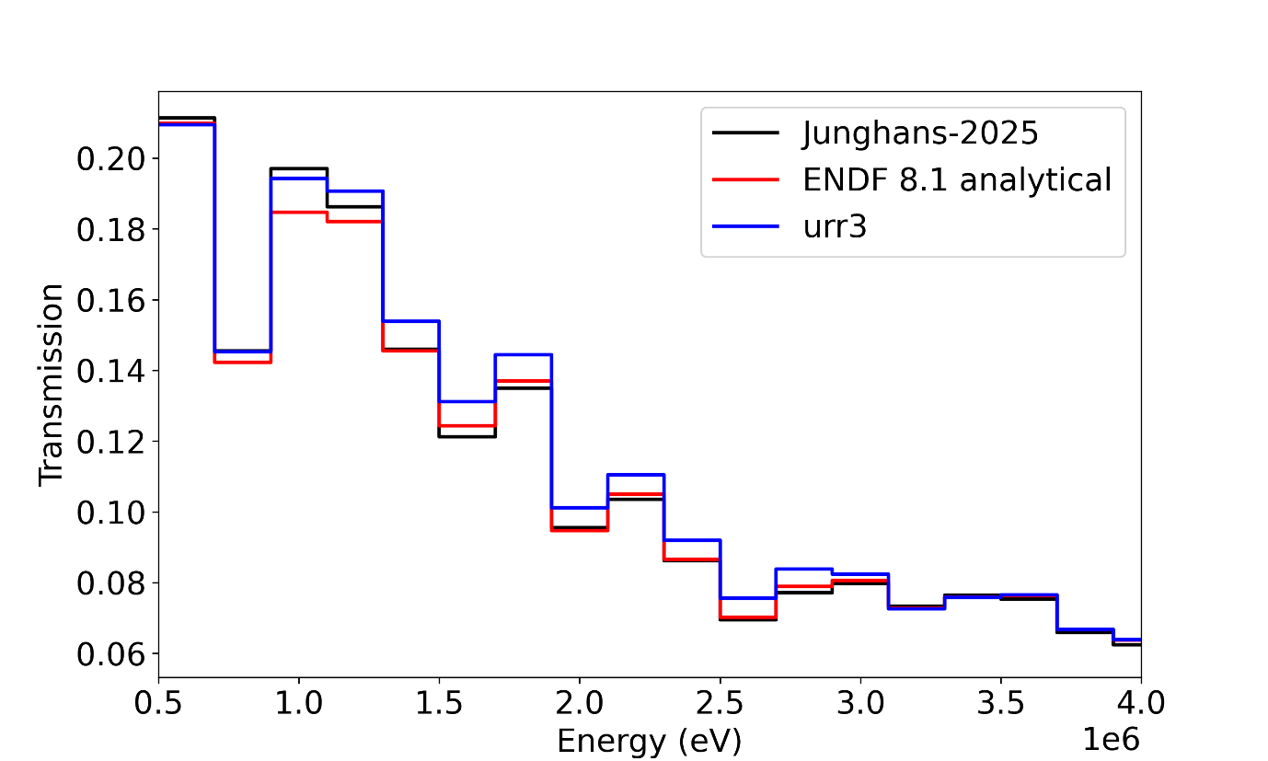
Thick target transmission measurement by Junghans

Slide 7
e81_URR
The cross sections in ENDF/B-VIII.1 (red) accurately reproduce the measured spectrum (black) above about 1.75 MeV, which implies that above this energy no corrections from the URR parameters are needed. Inclusion of the URR parameters above 1.75 MeV result in an over-prediction of the spectrum (blue).
Below 1.75 MeV the uncorrected ENDF/B-VIII.1 cross sections under-predict the measured spectrum, which indicates that some contribution to the self-shielding is probably missing.

Slide 8
e81_URR3
In the “URR3” evaluation the URR extends to 3 MeV and the average resonance widths for the s-wave resonances were reduced by a factor 1000
With the full “e81_URR3” implementation the agreement in the predicted spectrum just above the RRR improves significantly.
The calculated spectrum is over-predicted above about 1.25 MeV

Slide 9
e81_URR3n
Restricting the URR to 1.75 MeV improves the spectrum prediction above this energy.
The spectrum is still over-predicted in the energy range 1.25-1.75 MeV

Slide 10
e81_URR3n

Slide 11
e81_URR3q
In ENDF/B-VIII.0 the inelastic cross sections follow measured values by Negret
This caused under-prediction of the leakage spectrum from a 100 cm sphere with a Cf-252 source by 40 %
In ENDF/B-VIII.1 the inelastic cross section was reduced by up to 15 %
In the “e81_URR3q” the original inelastic cross section by Negret were restored.

Slide 12
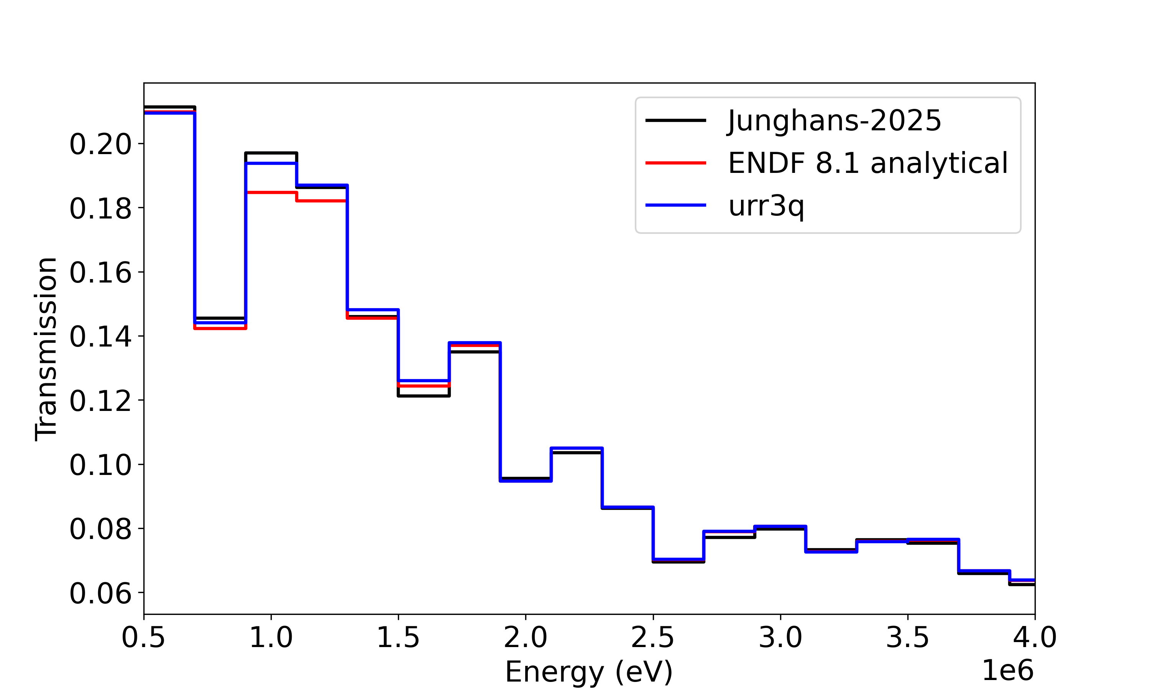
e81_URR3q

Slide 13
Conclusions
A possible solution for an improved Fe-56 evaluation was found:
  Add URR from JEF-2.2,
  Reduce the URR range to 1.75 MeV,
  Reduce the average resonance widths of the s-wave resonances by a factor 1000
  Restore the measured inelastic cross sections from ENDF/B-VIII.0 that correspond to the measured values by Negret.
Improved performance is observed in reproducing thick transmission measurements.
The impact on other benchmarks is being tested.

Slide 14
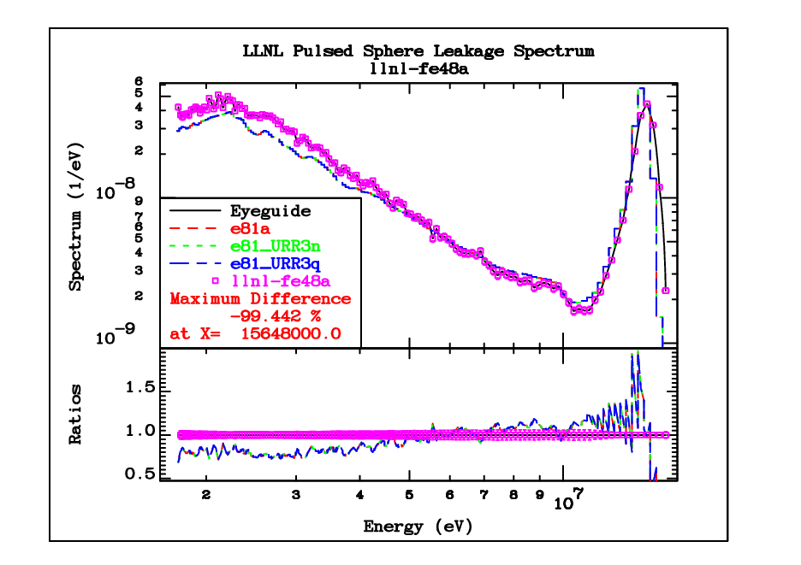
Livermore pulsed sphere (D-T source)
The impact is very small

Slide 15
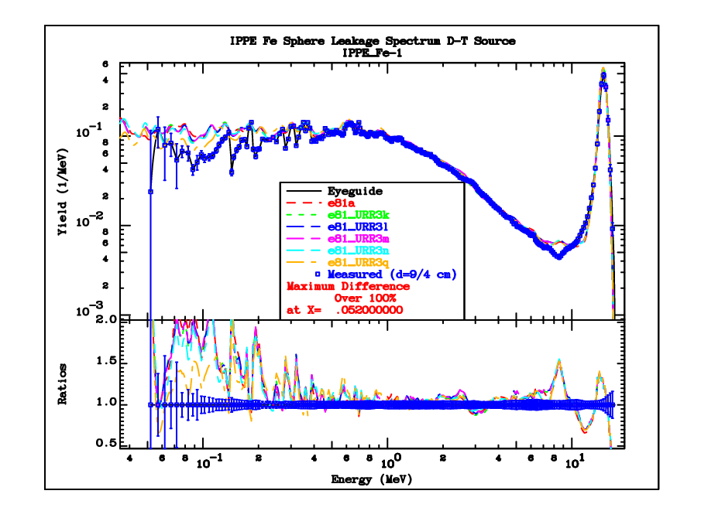
Leakage from IPPE sphere-1 (D-T)

Slide 16
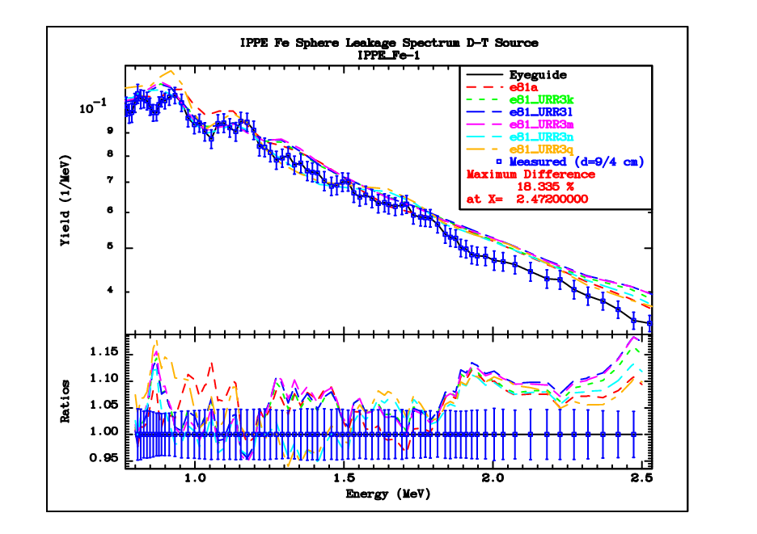
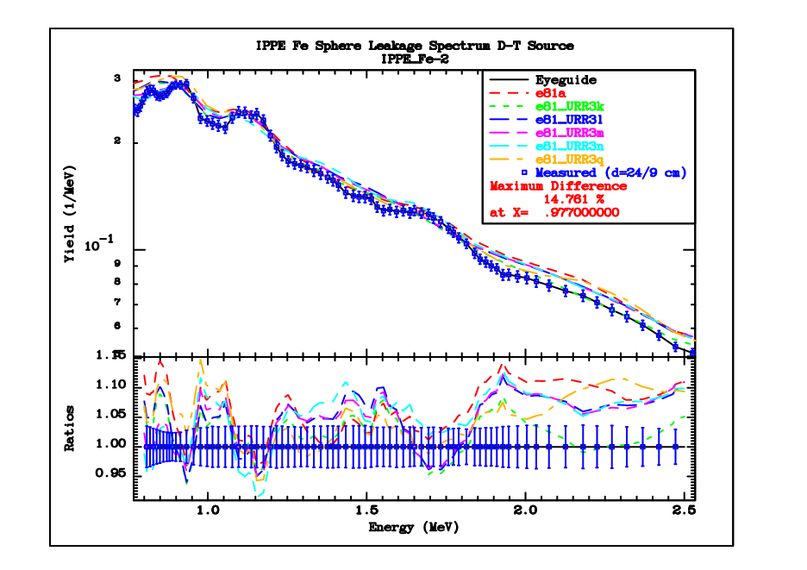
Leakage from IPPE sphere-1,2 (D-T)

Slide 17
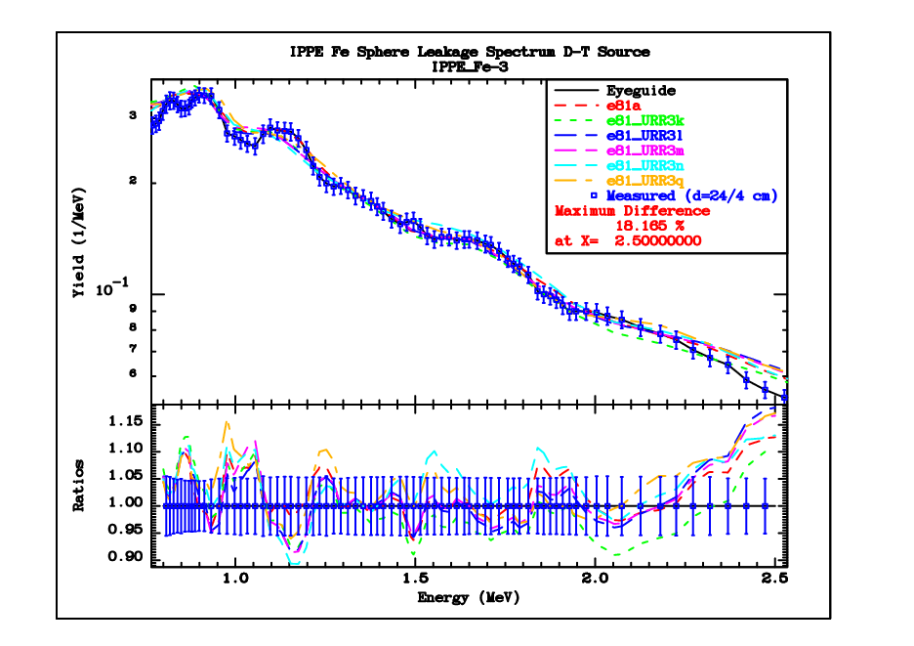
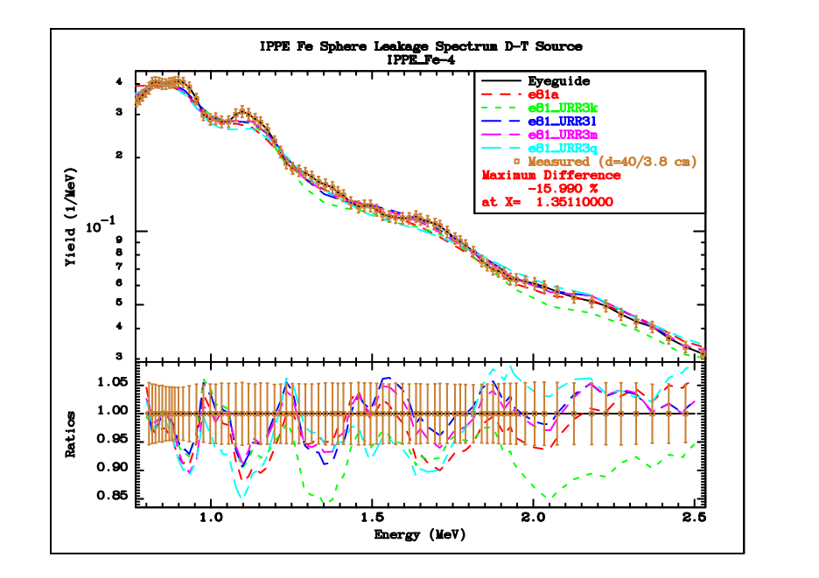
Leakage from IPPE sphere-3,4 (D-T)

Slide 18
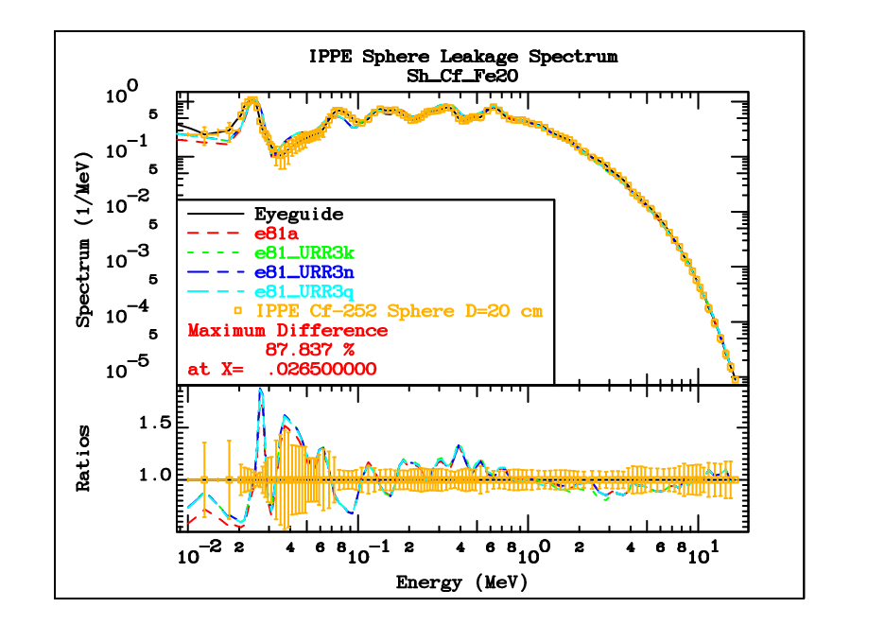
Leakage from 20cm IPPE sphere (Cf252)
Spheres of different thicknesses were measured
The focus is in the region above the resolved resonance range

Slide 19
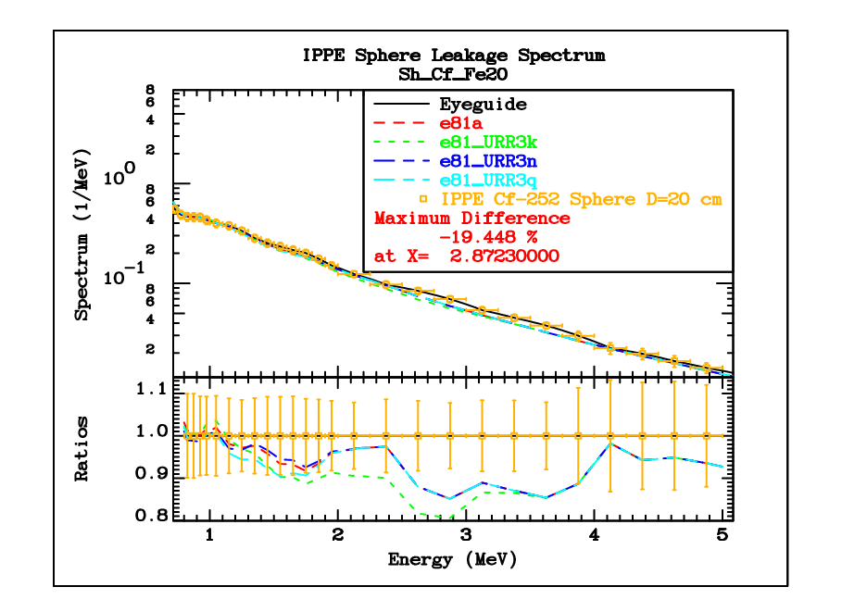
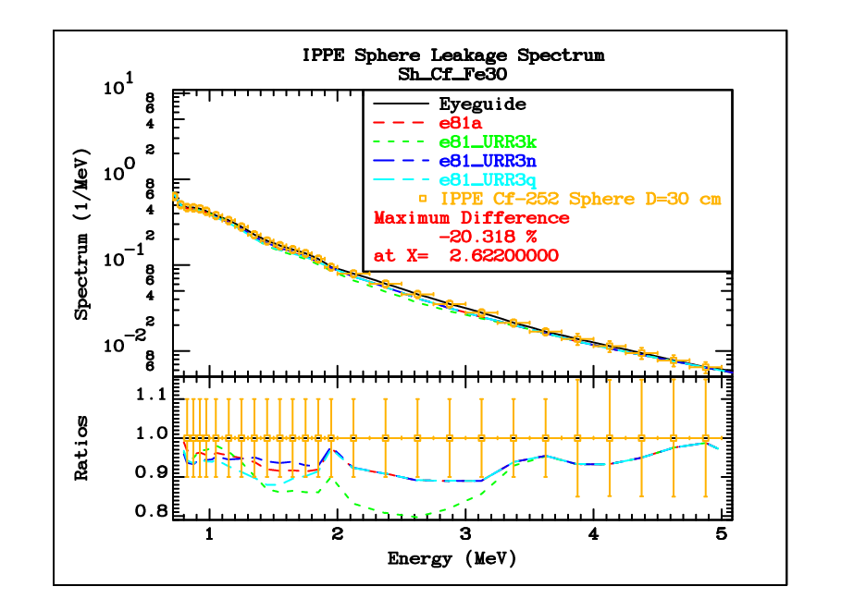
Leakage from IPPE spheres (Cf252)

Slide 20
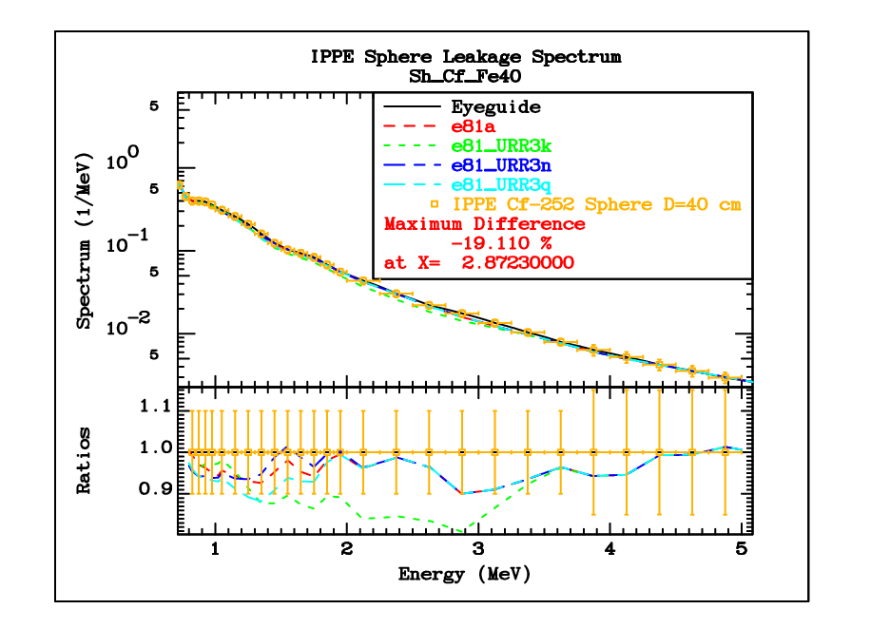
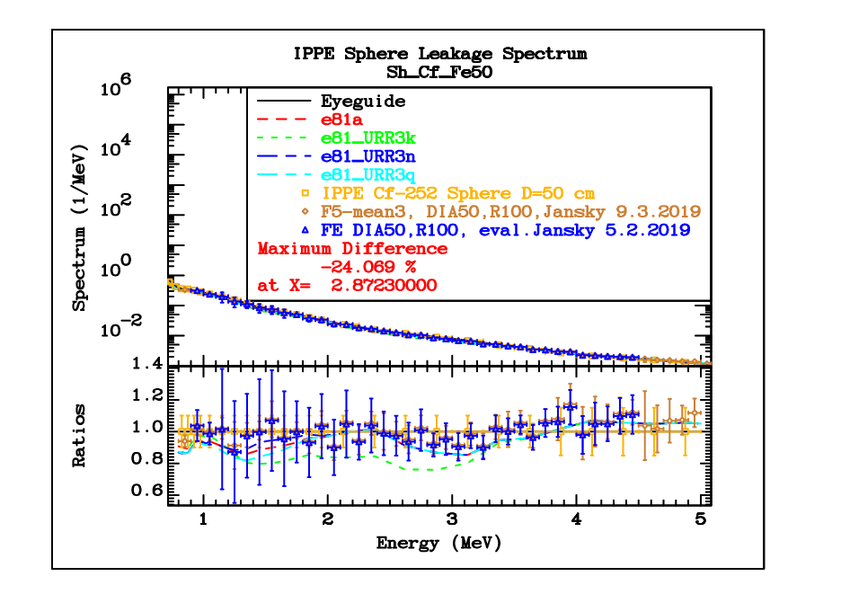
Leakage from IPPE spheres (Cf252)

Slide 21
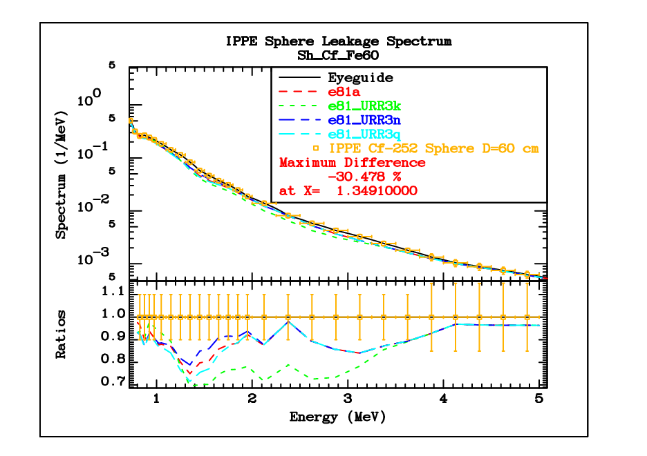
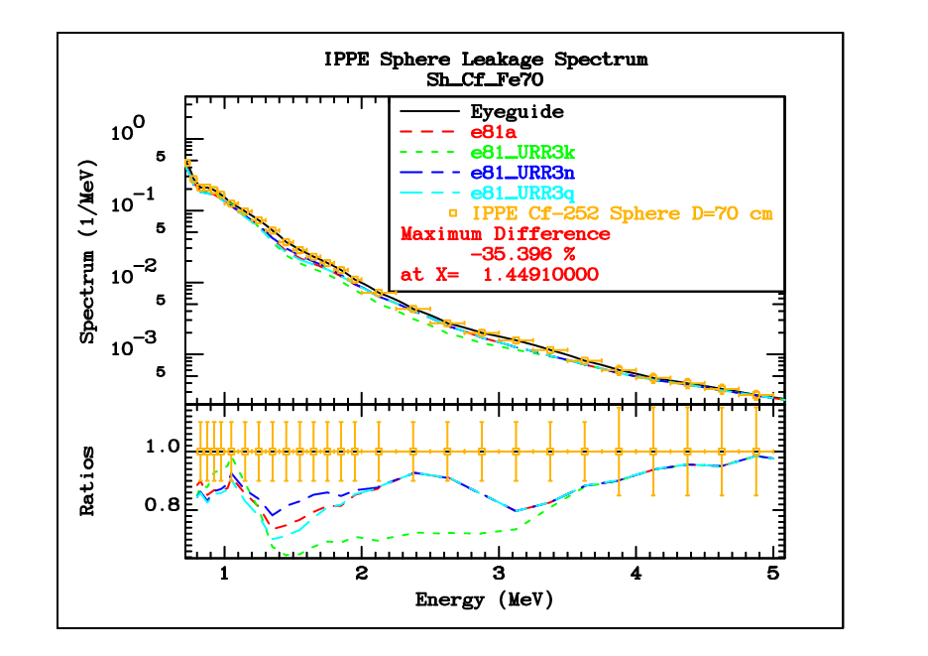
Leakage from IPPE spheres (Cf252)

Slide 22
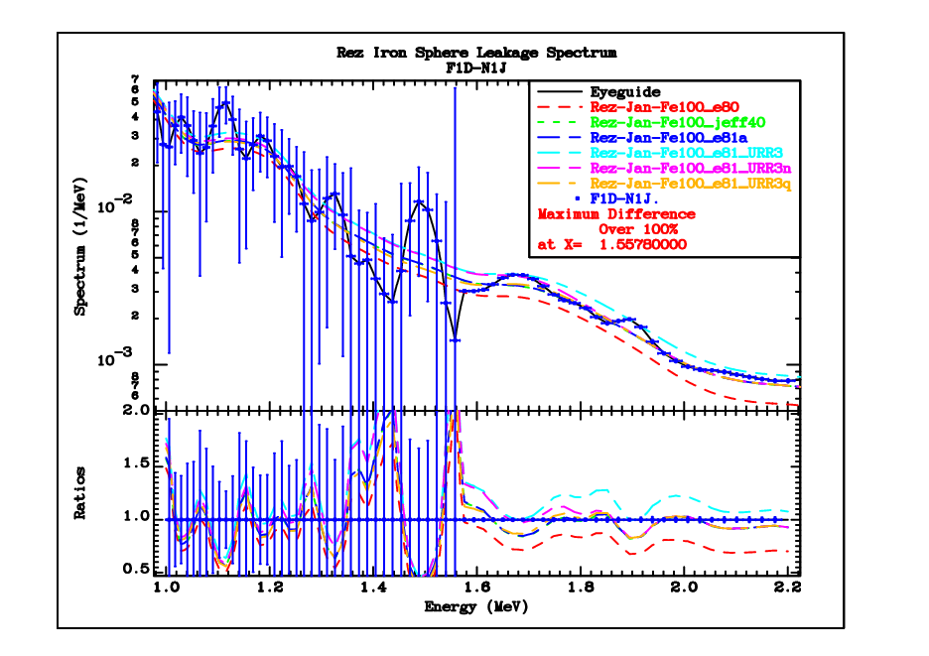
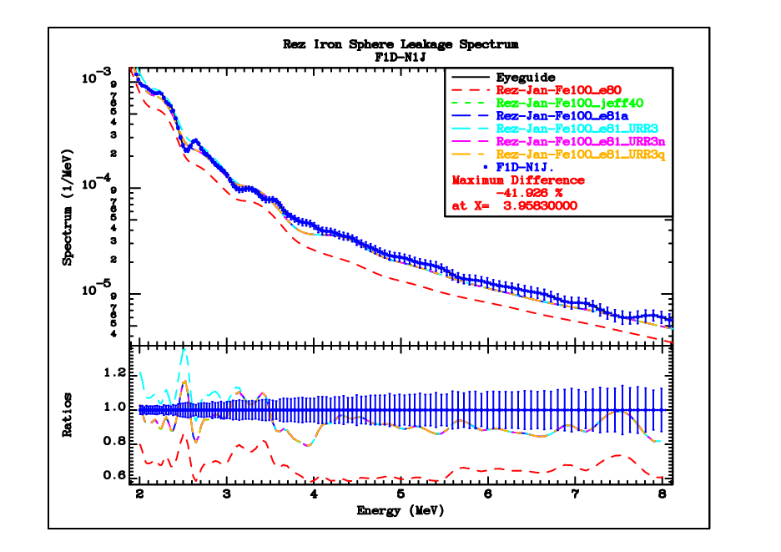
Leakage from Rez 100cm sphere (Cf252)

Slide 23
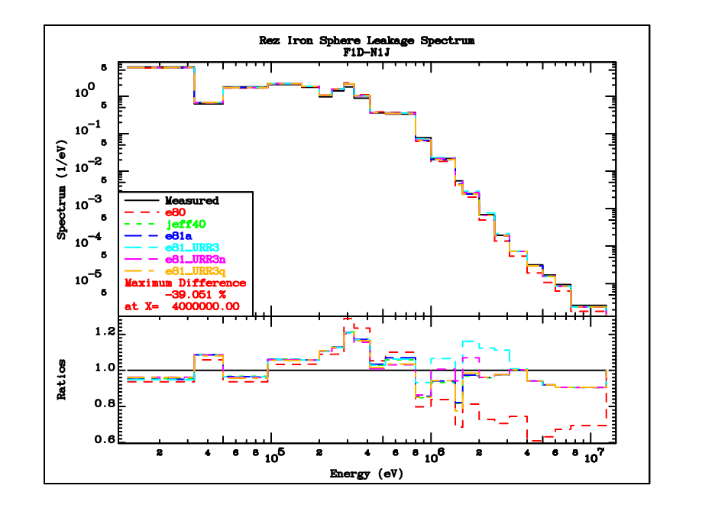
Leakage from Rez 100cm sphere (Cf252)

Slide 24
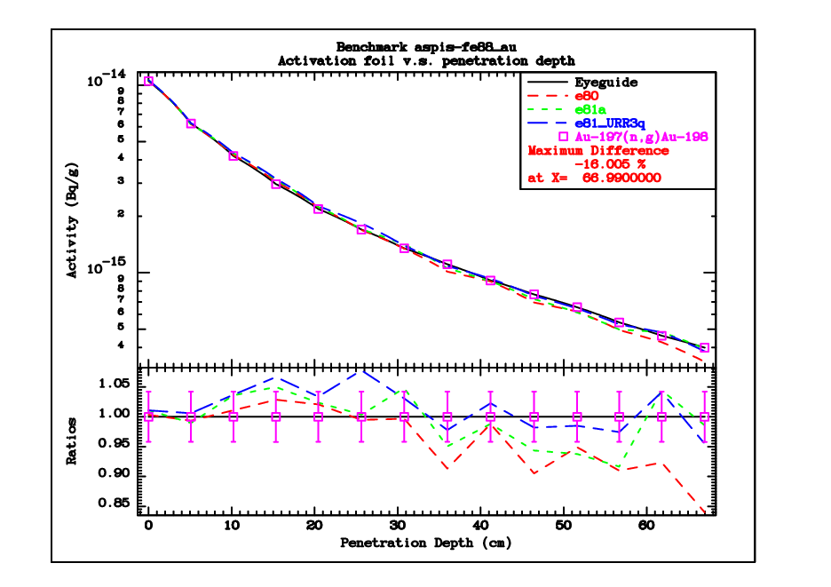
ASPIS-88
Activation of gold is in excellent agreement
Activation of aluminium foils probably has a systematic error and is not shown
There seems to be a problem with Rh103(n,n’) and In115(n,n’). The source specifications need to be checked, since the problems with these monitores are not apparent in other benchmarks

Slide 25
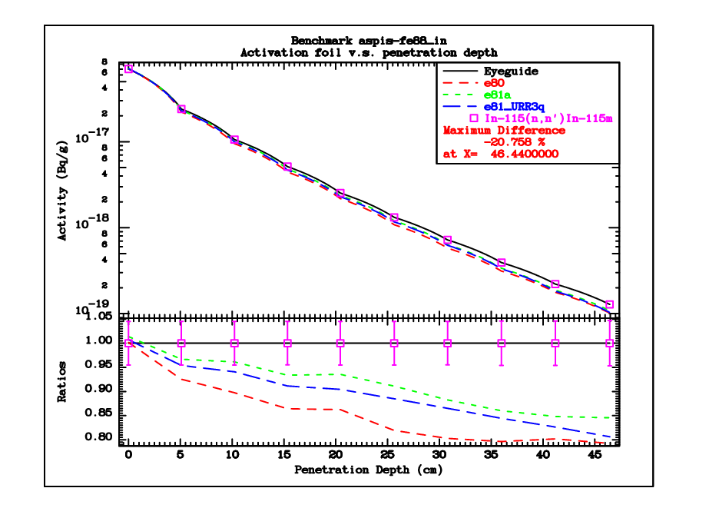
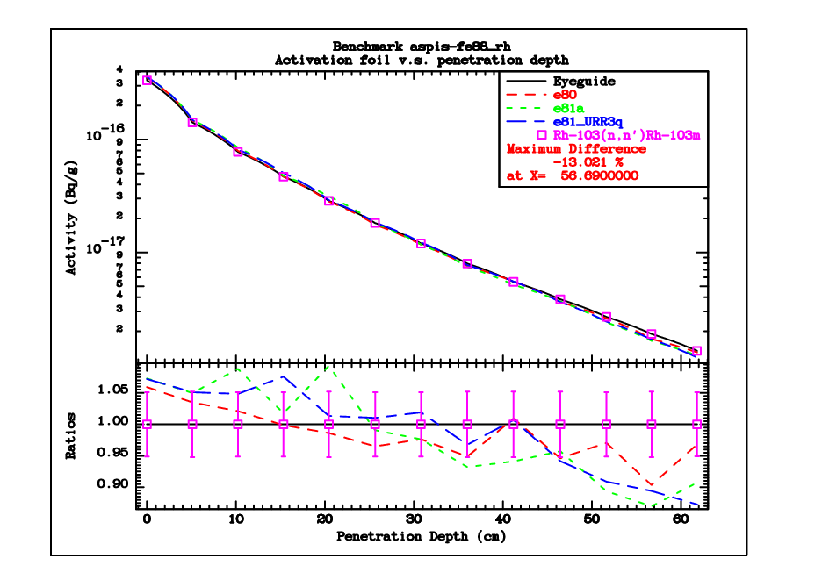
ASPIS-88

Slide 26
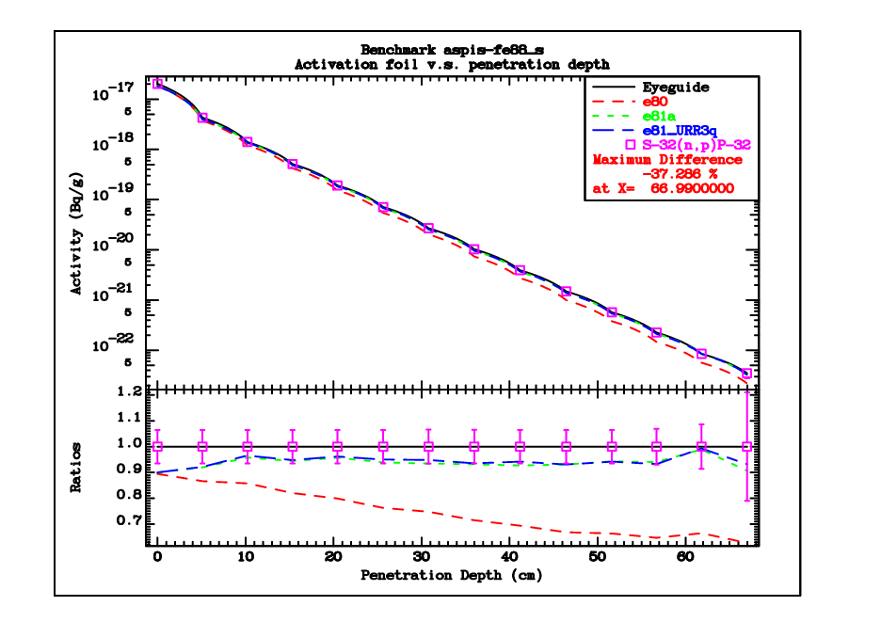
ASPIS-88

Slide 27
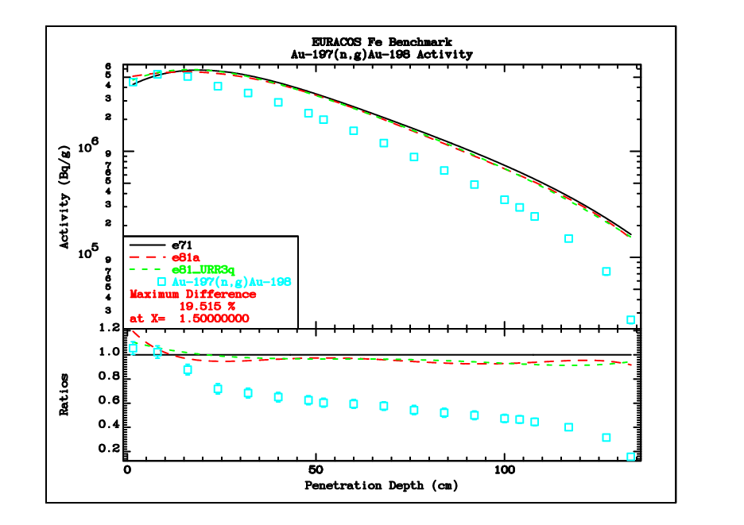
EURACOS
The EURACOS benchmark specifications are generally considered less reliable.

Slide 28
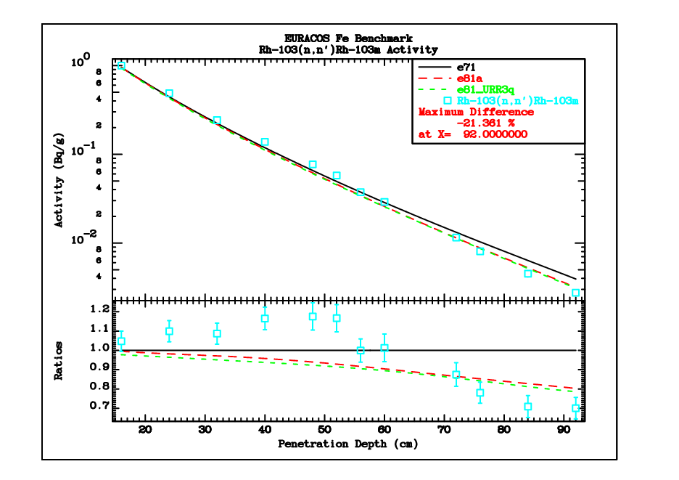
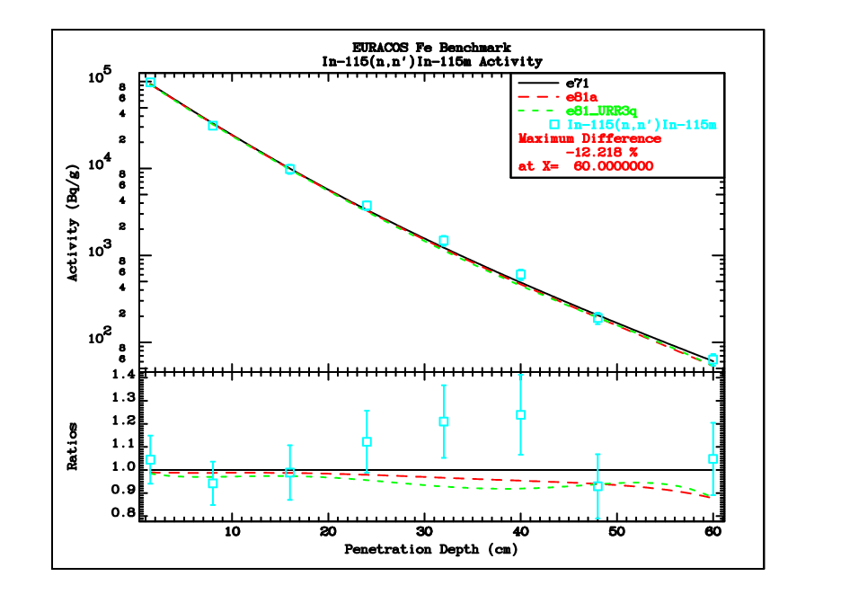
EURACOS

Slide 29
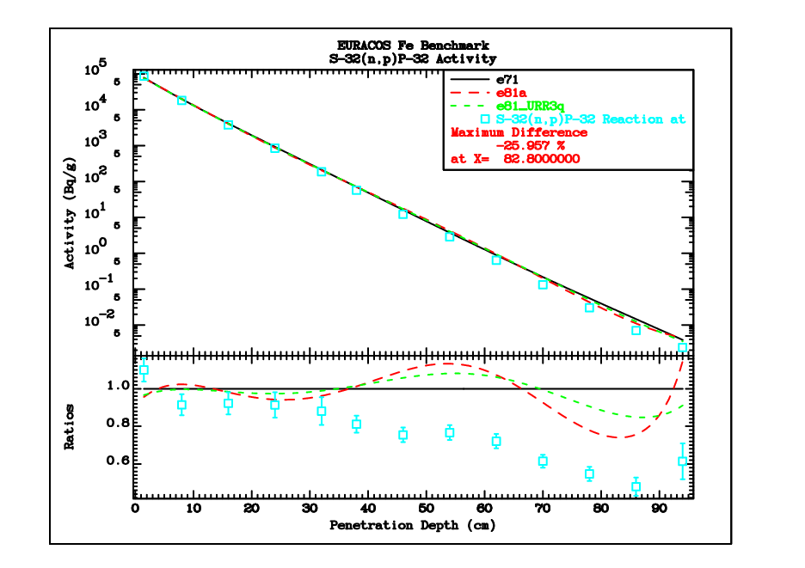
EURACOS

Slide 30
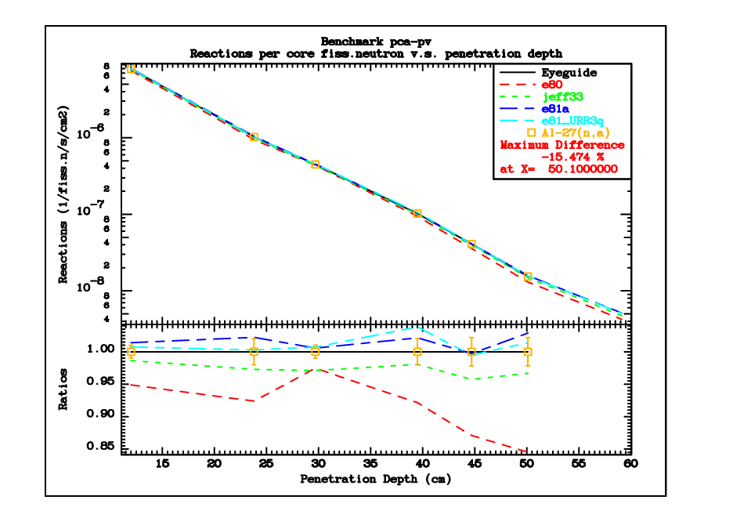
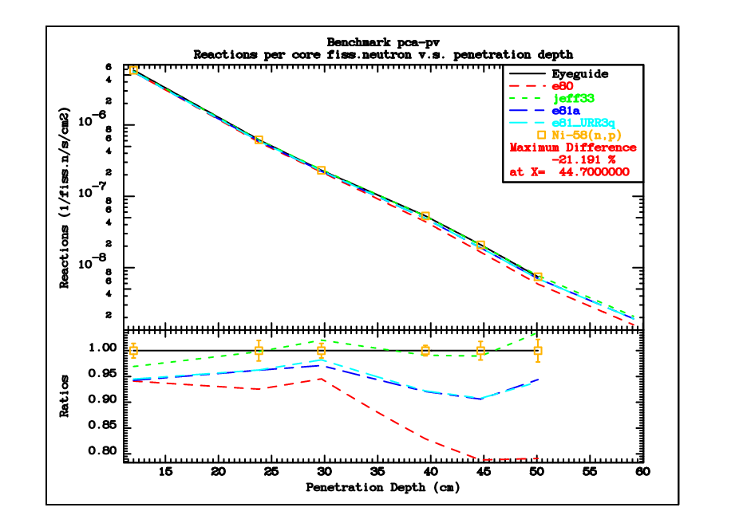
PCA-pv

Slide 31
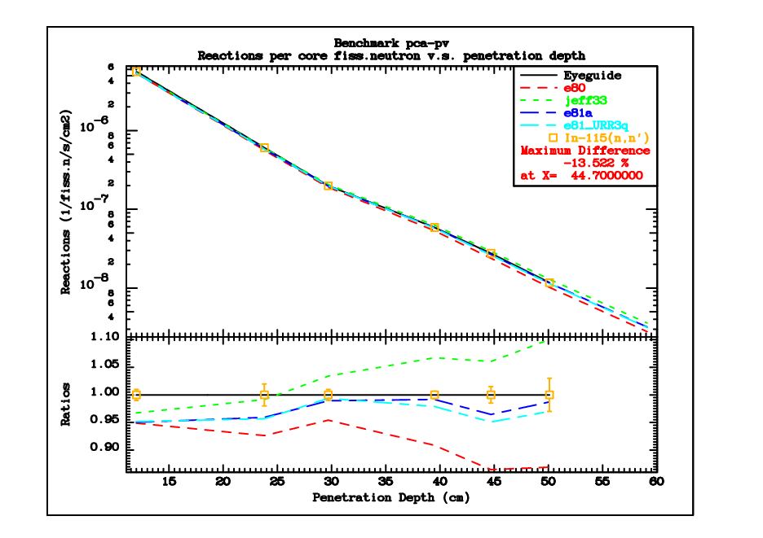
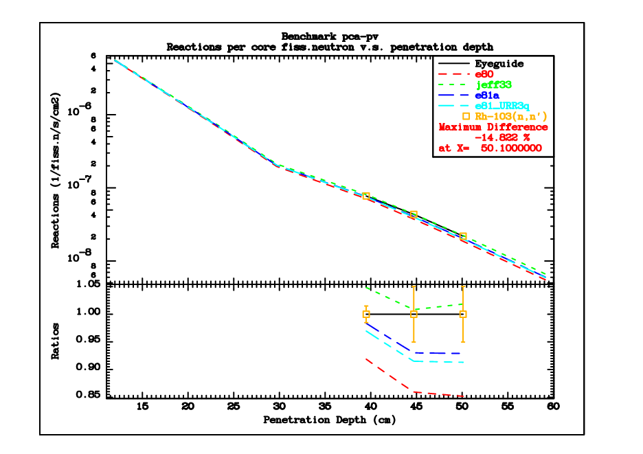
PCA-pv

Slide 32
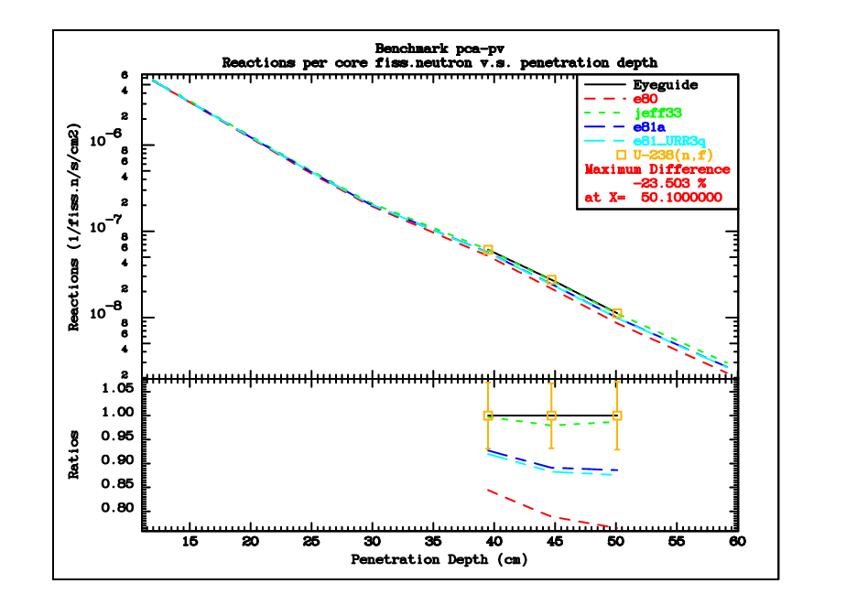
PCA-pv

