Slide 1
NCSU/ORELA Neutron Thermalization in Graphite ICSBEP Benchmark – LLNL COG Results
Dave Heinrichs
Soon Kim

Slide 2
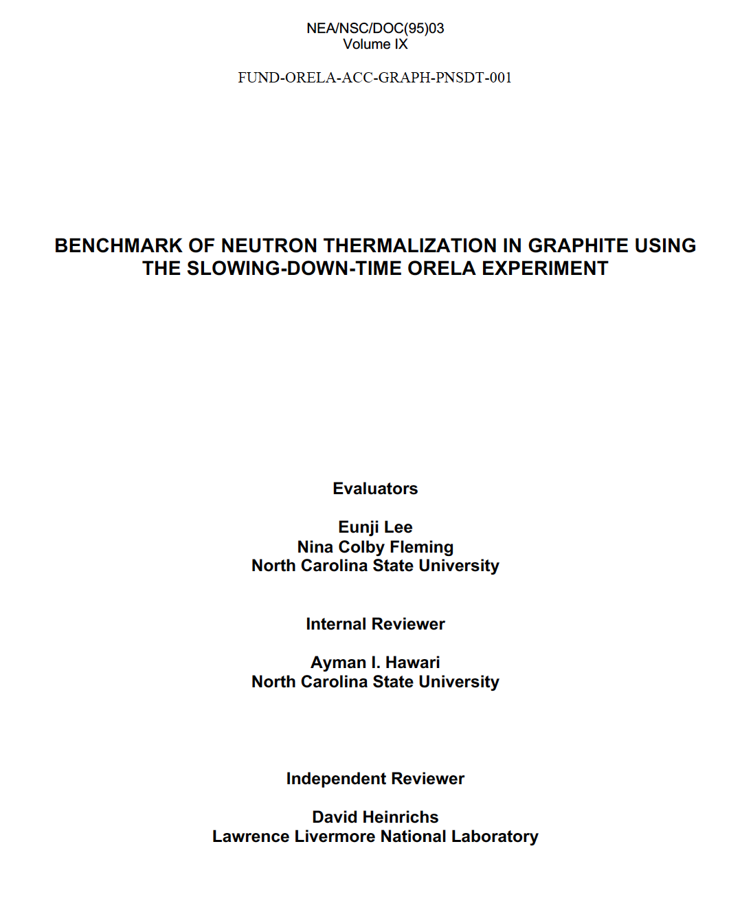
The benchmark
Confirmatory review calculations circa late 2021 were performed to low precision.
These calculations were recently re-run to the same precision as the benchmark (5E+9 neutrons).
LLNL (COG) results are shown to be consistent with NCSU (MCNP) results.

Slide 3
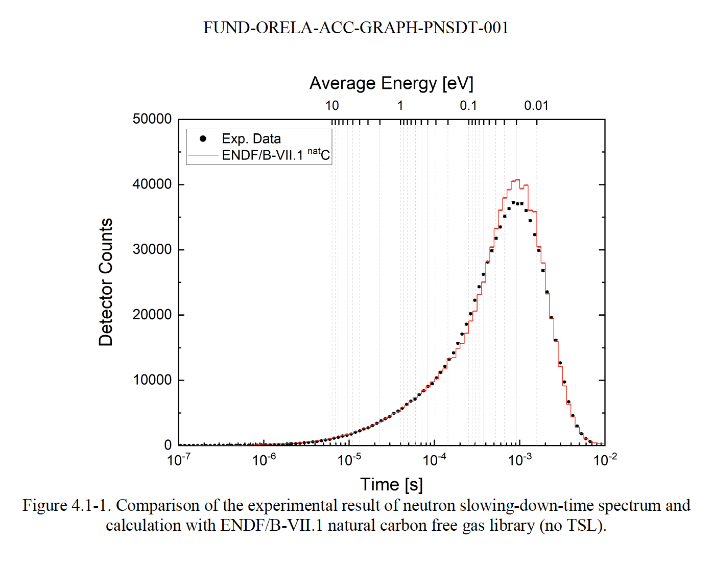
Free atom results

Slide 4

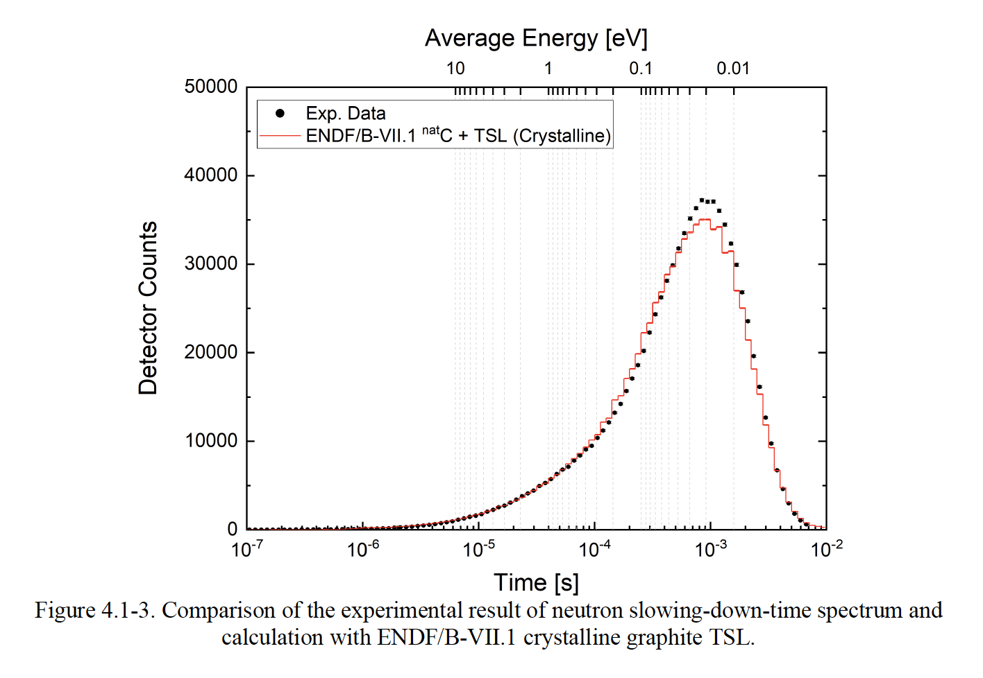
Single crystal results

Slide 5
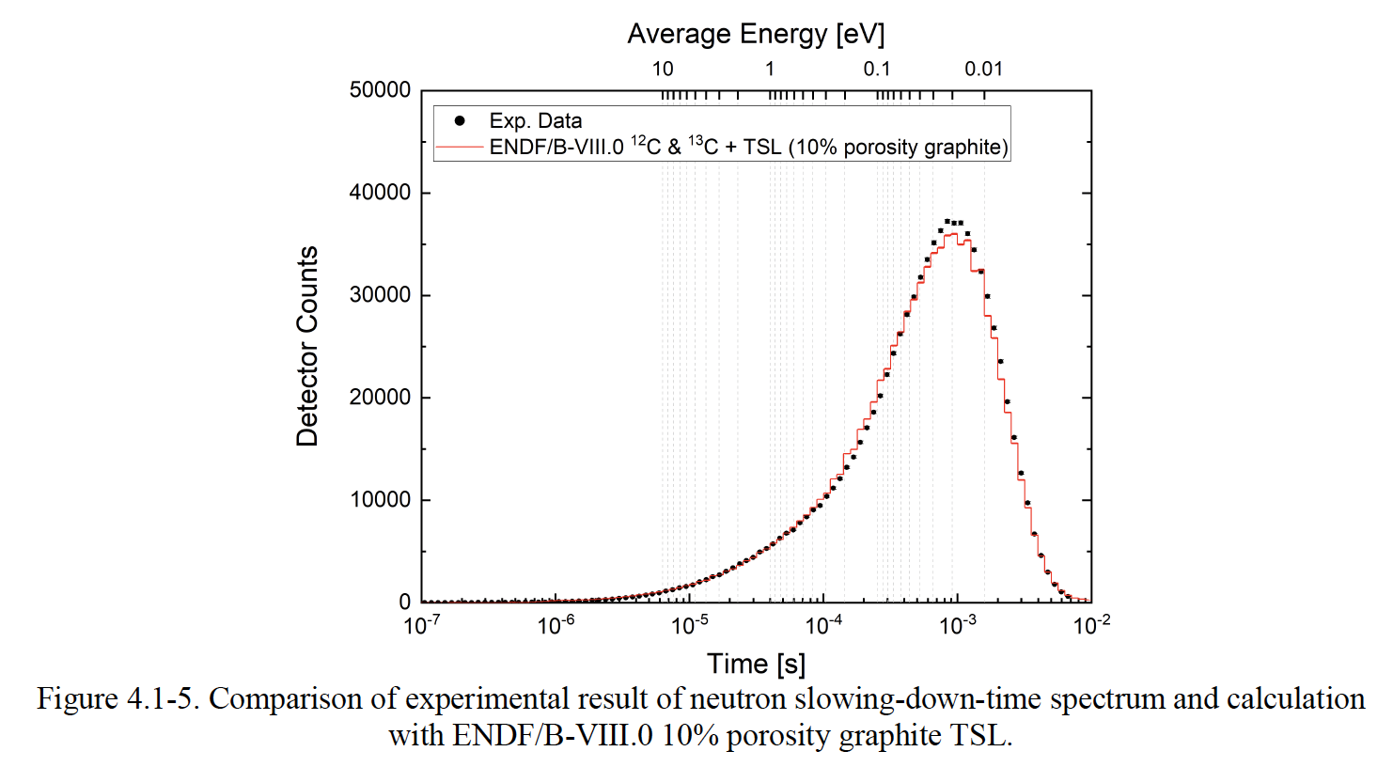
Results with 10% porosity

Slide 6
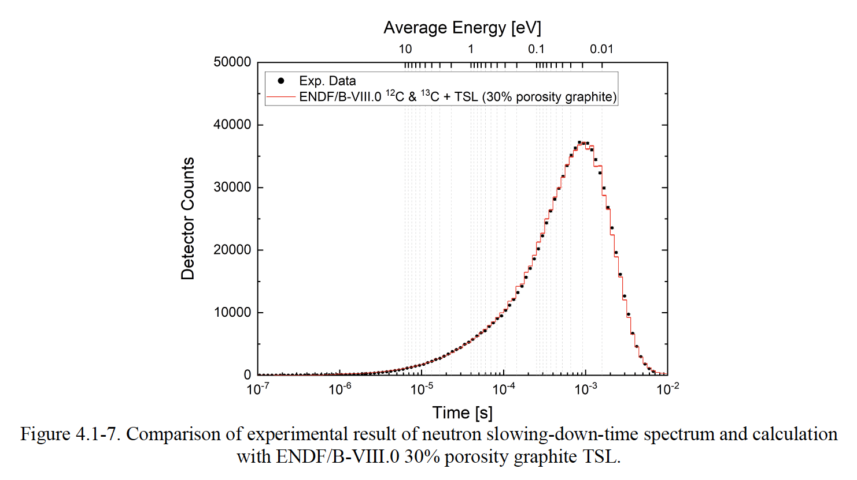
Results with 30% porosity

Slide 7
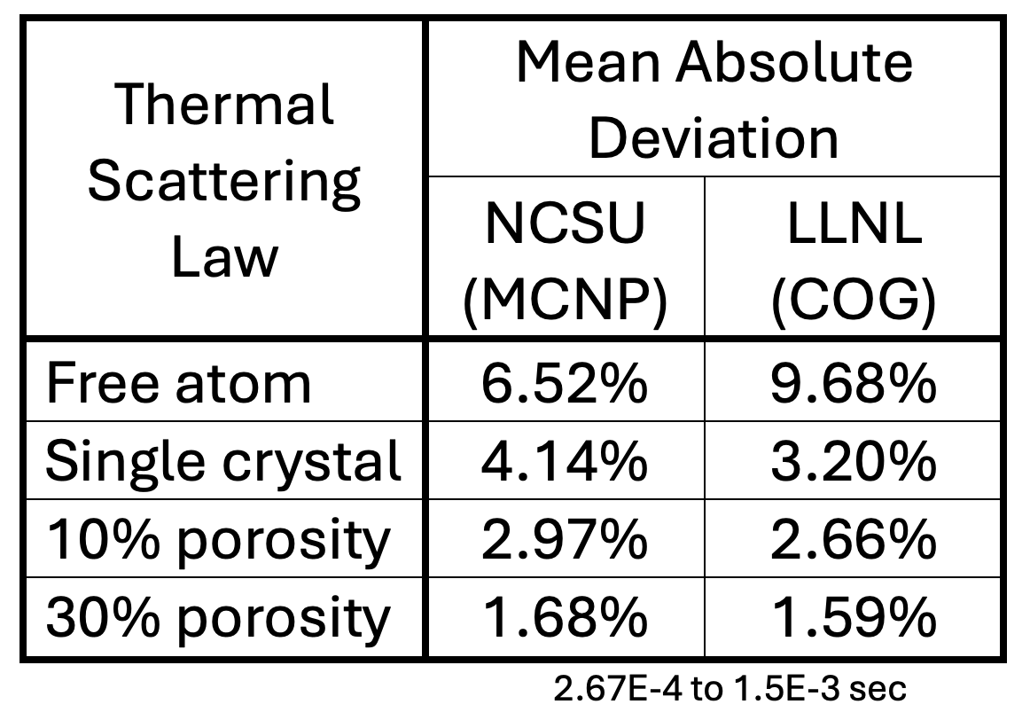
Summary of Results

Slide 9
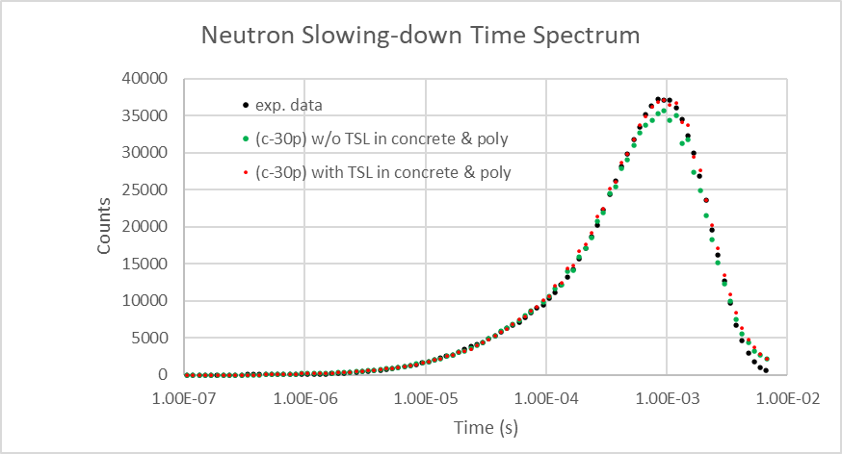
Backup slide

