Slide 1
Climate Apocalypse
The Gamble with All Life on Earth, and How to Avoid Taking It
Wolfgang Bauer
SEPTEMBER 2, 2025

Slide 2
Part 1: Why We Are In Trouble

Slide 3
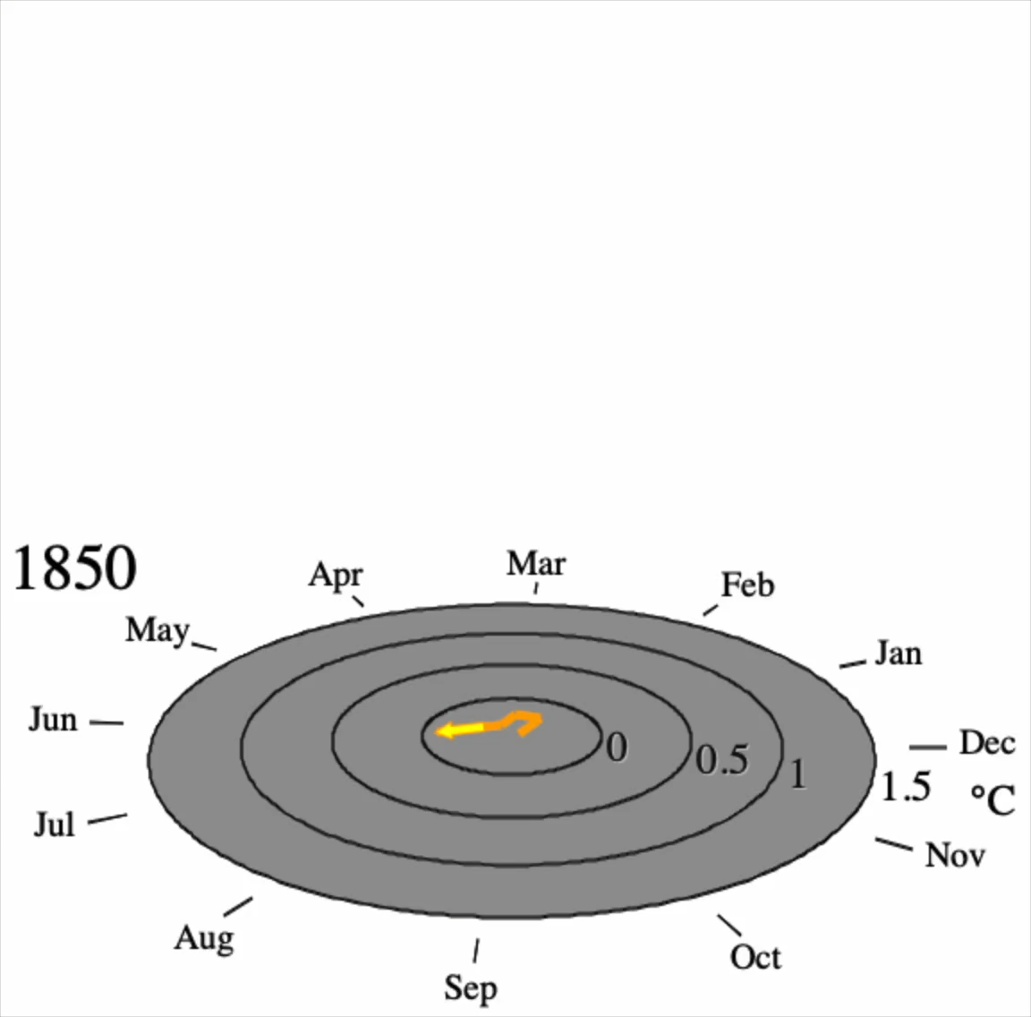
It’s getting hotter
Global average surface temperature anomaly relative to the average of the 20th century
Data range from January 1850 to December 2024.
Data source: https://www.ncei.noaa.gov/access/monitoring/climate-at-a-glance/global/time-series/globe/tavg/land_ocean/1/0/1850-2024
Animation website:
https://web.pa.msu.edu/people/bauer/TemperatureTornado25.html

Slide 4
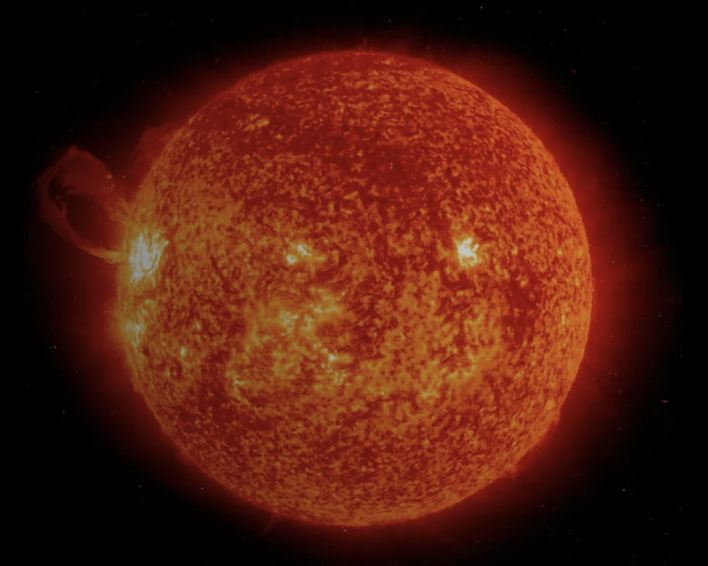
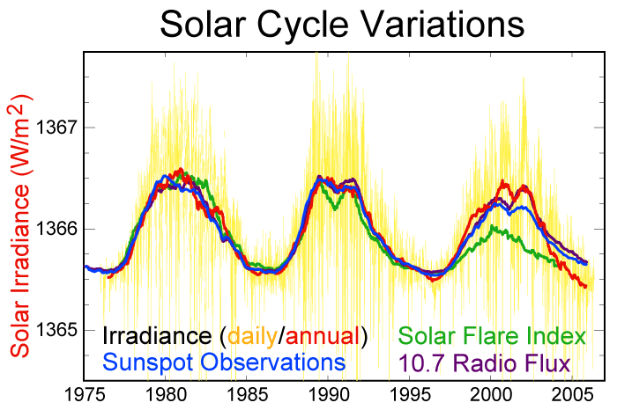

The Sun
Mass: $m=1.9885×{10}^{30} kg$
Temperature $T_{surface}=5,772 K$
Power: $P= 3.828×{10}^{26} W$
(increases by 1% per 100 My)
Solar 'constant’: $S=\frac{P}{4πR^{2}}=1,366 W/m^{2}$
with $R=1 AU=149.6 million km$
0.07%
https://science.nasa.gov/sun/
https://en.wikipedia.org/wiki/Sun#/media/File:Solar-cycle-data.png

Slide 5

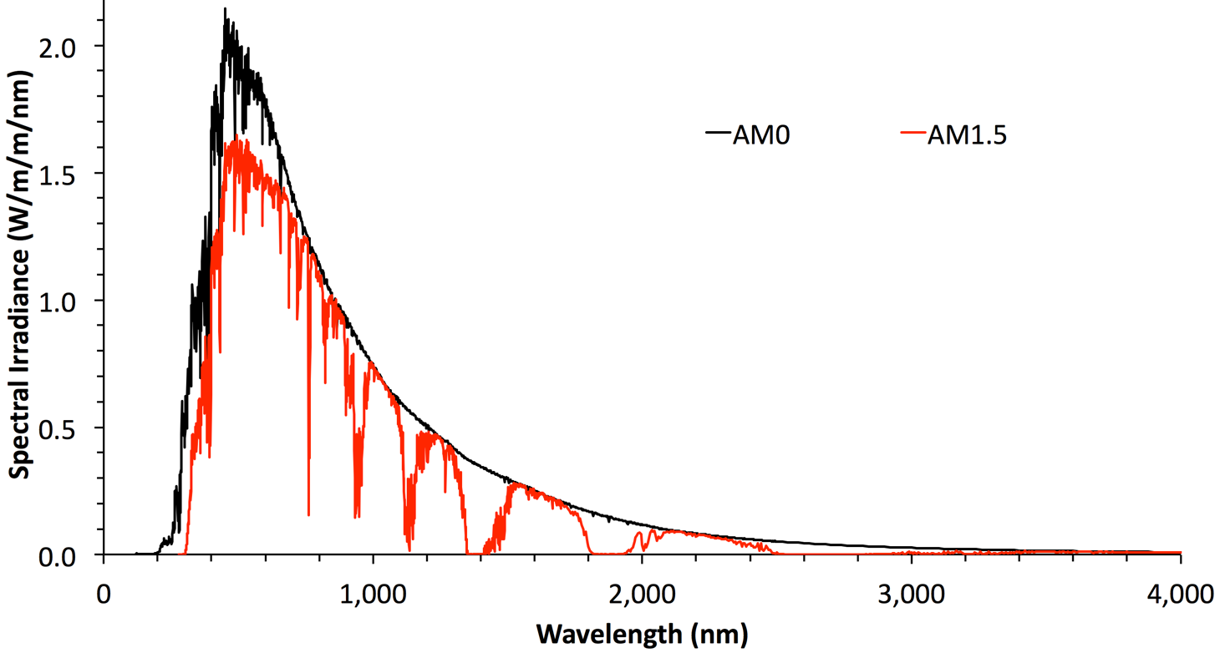
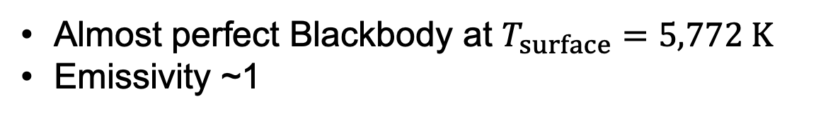
Solar Spectrum
Almost perfect Blackbody at $T_{surface}=5,772 K$
Emissivity ~1
Top of atmosphere
Sea level
Data: Gueymard, C. (2004). The sun’s total and spectral irradiance for solar energy applications and solar radiation models, Solar Energy 76 (4), pp. 423-453.

Slide 6

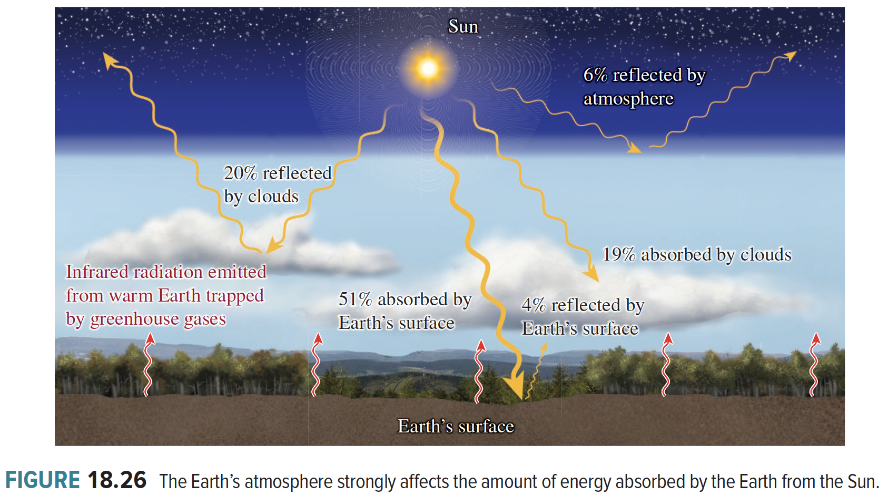
Reflected and Absorbed Solar Power
Bauer & Westfall University Physics
(3rd Ed., 2024)

Slide 7
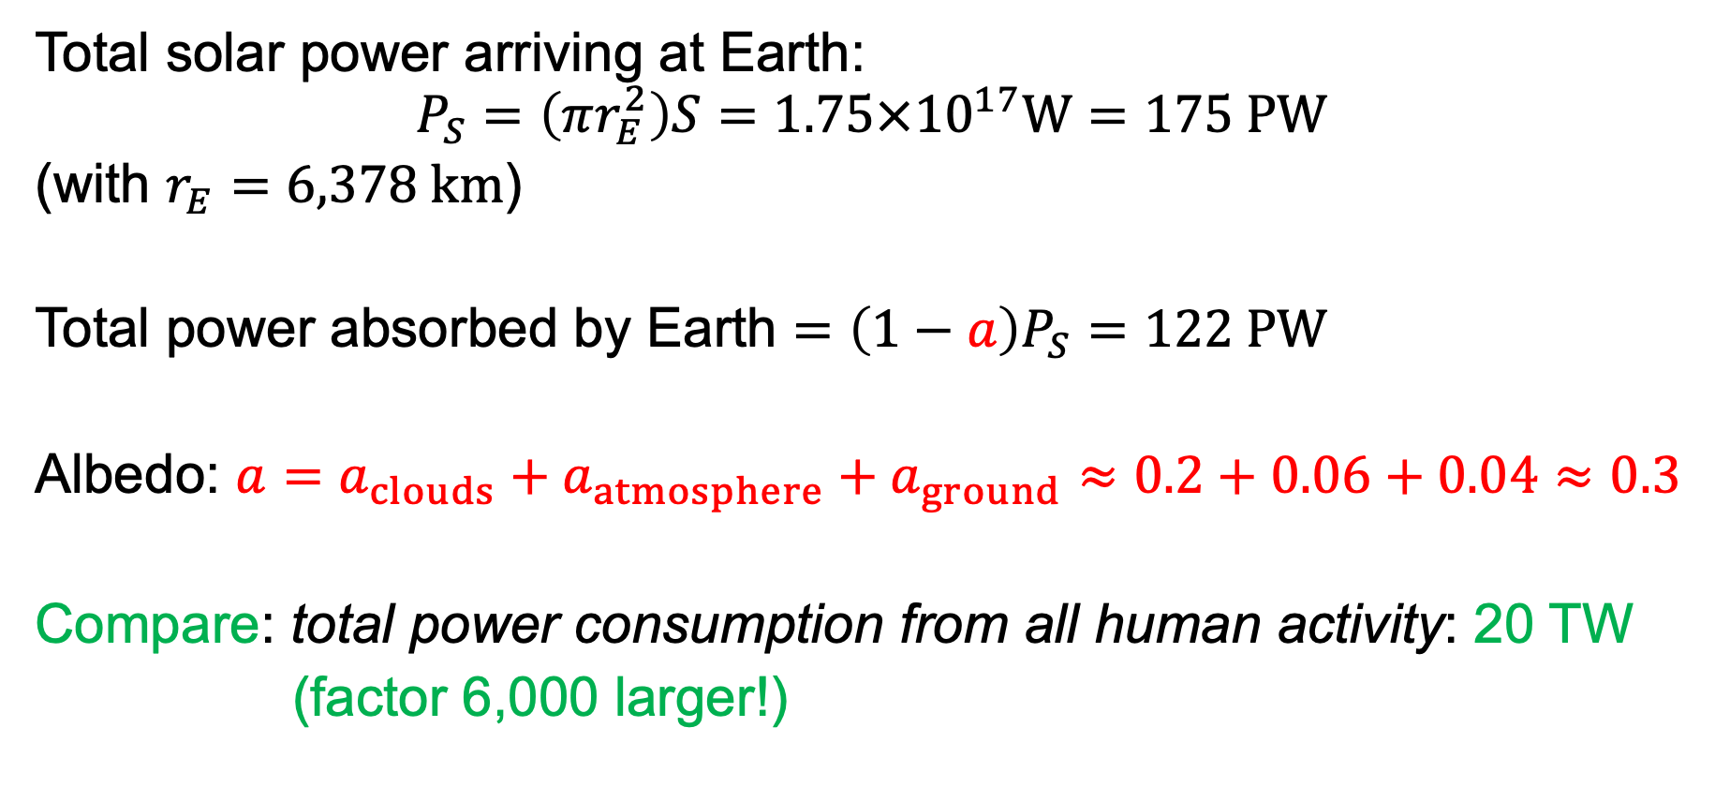
Reflected and Absorbed Solar Power
Total solar power arriving at Earth:
$$P_{S}=\left(πr_{E}^{2}\right)S=1.75×{10}^{17}W=175 PW$$
(with $r_{E}=6,378 km$)
Total power absorbed by Earth $=\left(1−a\right)P_{S}=122 PW$
Albedo: $a=a_{clouds}+a_{atmosphere}+a_{ground}≈0.2+0.06+0.04≈0.3$
Compare: total power consumption from all human activity: 20 TW
(factor 6,000 larger!)

Slide 8
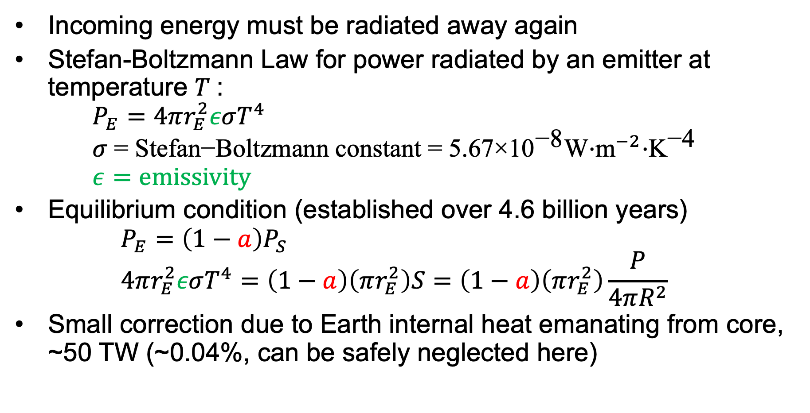
Equilibrium
Incoming energy must be radiated away again
Stefan-Boltzmann Law for power radiated by an emitter at temperature $T$: $P_{E}=4πr_{E}^{2}εσT^{4}$ $σ \text{=} \text{Stefan}\text{−}\text{Boltzmann} \text{constant}\text{ = 5.67}\text{×}{\text{10}}^{\text{−8}}\text{W}\text{⋅}{\text{m}}^{−2}\text{⋅}{\text{K}}^{\text{−4}}$ $ε=emissivity$
Equilibrium condition (established over 4.6 billion years) $P_{E}=\left(1−a\right)P_{S}$ $4πr_{E}^{2}εσT^{4}=\left(1−a\right)\left(πr_{E}^{2}\right)S=\left(1−a\right)\left(πr_{E}^{2}\right)\frac{P}{4πR^{2}}$
Small correction due to Earth internal heat emanating from core, ~50 TW (~0.04%, can be safely neglected here)

Slide 9
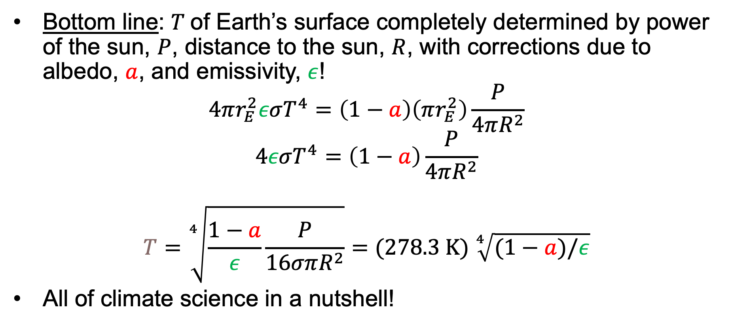
Equilibrium
Bottom line: $T$of Earth’s surface completely determined by power of the sun, $P$, distance to the sun, $R$, with corrections due to albedo, $a$, and emissivity, $ε$!
$$4πr_{E}^{2}εσT^{4}=\left(1−a\right)\left(πr_{E}^{2}\right)\frac{P}{4πR^{2}} \\ 4εσT^{4}=\left(1−a\right)\frac{P}{4πR^{2}}$$
$$T=\sqrt[4]{\frac{1−a}{ε}\frac{P}{16σπR^{2}}}=(278.3 K) \sqrt[4]{(1−a)/ε}$$
All of climate science in a nutshell!

Slide 10


… this works for all planets (except Venus!)
$$T∝R^{−1/2}$$
$ΔT$ = 398 K = 716 F
Mercury
Venus
Earth
Jupiter
Mars
Saturn
Uranus
Neptune

Slide 11

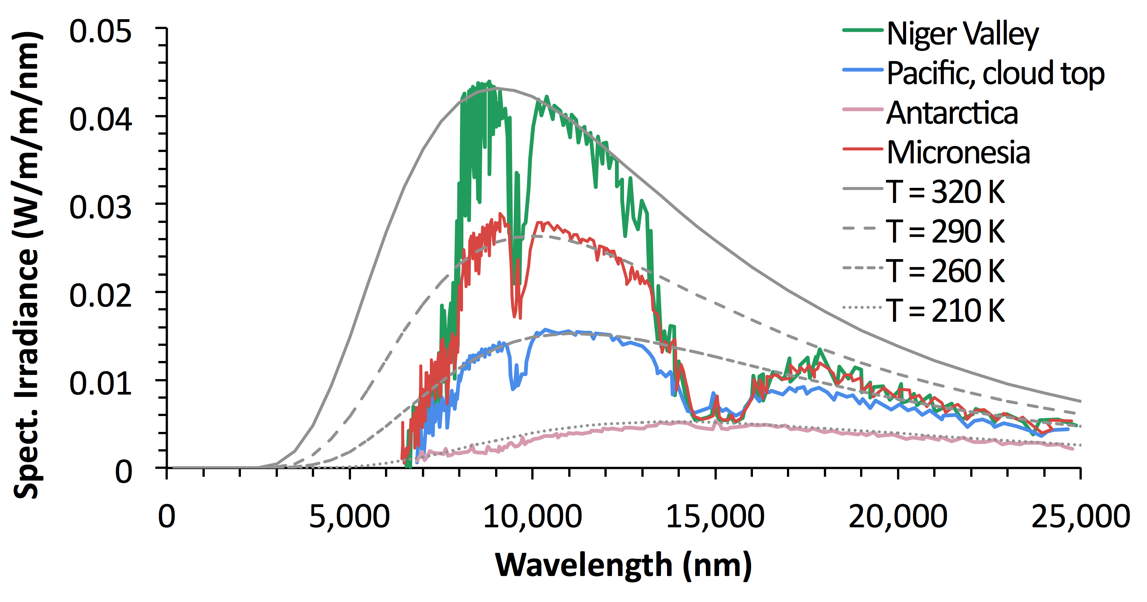
Earth’s Radiation
MIT Press
Fall 2025
Fig. 4-4
Data from: Hanel, R. A., Conrath, B. J., Kunde, V. G., Prabhakara, C., Revah, I., Solomonson, V. V., and Wolfrod, G. (1972). The Nimbus 4 Infrared Spectroscopy Experiment, 1. Calibrated Thermal Emission Spectra, Journal of Geophysical Research 77, pp. 2629-2641.

Slide 12

What Comes Down, Must Go Up!
Sun, incoming radiation
Earth, outgoing radiation
T = 5772 K
T = 288 K
Fraction of radiation absorbed by Earth’s atmosphere
CO₂
H₂O
CH₄
N₂O
O₂, O₃
Rayleigh
Absorption Fraction
$$λ (μm)$$

Slide 13
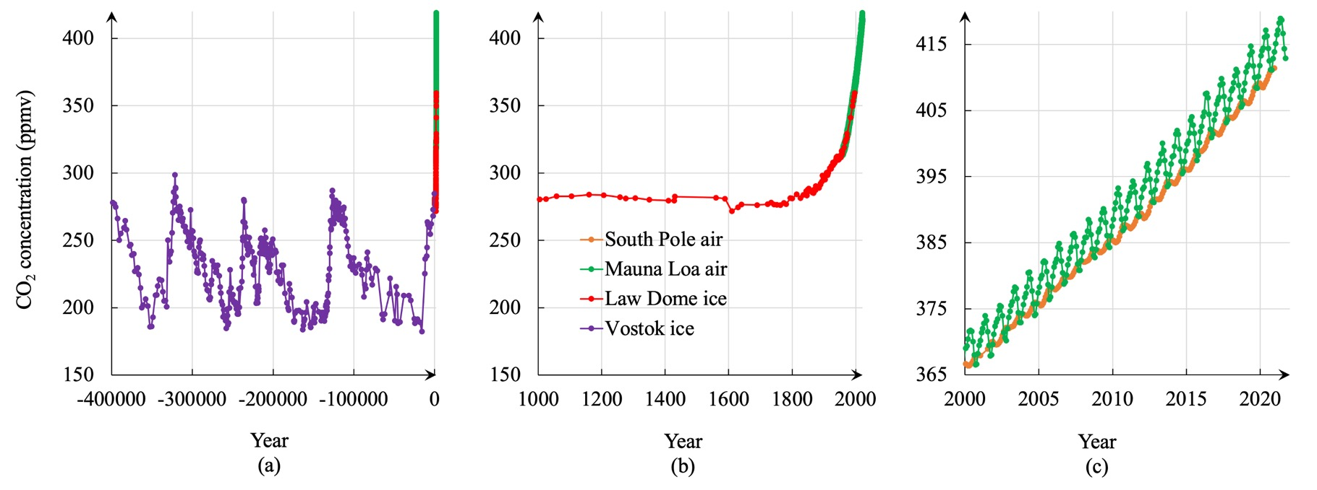
Emissivity Change With Time
Bauer & Westfall
University Physics
3rd ed., 2024
CO₂ concentration between 190 ppm and 290 ppm during the last million years (ice core samples)
Near exponential rise from burning fossil fuels since the beginning of the industrial revolution (hockey stick graph)
6-7 ppm seasonal oscillations from plant growth and decay (Keeling Curve) Net addition of ~2 ppm/year from human activity (35x weight of all humans)
· Today: 425 ppm

Slide 14
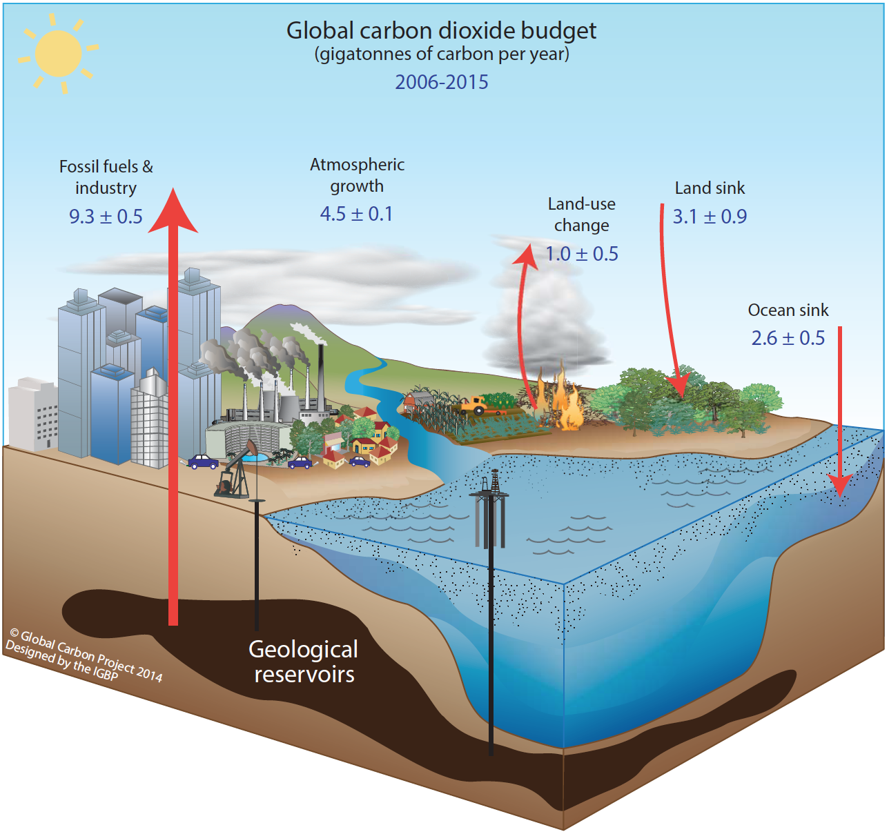
Removing CO₂ from the Atmosphere
Dissolving in water CO₂ + H₂O ➔ H₂CO₃ (carbonic acid)
Ocean acidification
Weathering of rocks, mainly limestone (Calcium-carbonate CaCO₃)
1 gigaton C ➔ 3.664 gigaton CO₂
C. Le Quéré et al.: Global Carbon Budget 2016
Earth Syst. Sci. Data, 8, 605–649, 2016 [Fig. 2]

Slide 15
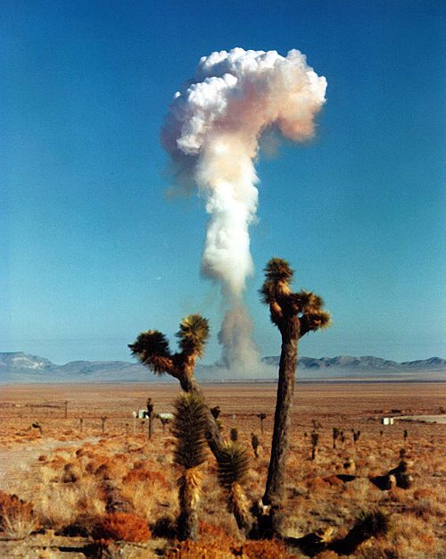

CO₂ Half-Life in the Atmosphere
Nuclear weapons tests in the 1950s almost doubled the ¹⁴C content of the entire atmosphere
(summer)
(summer)
(summer)
$$τ=16 years$$
Nuclear Test Ban
Treaty, Oct. ‘63
Note: ¹⁴C half life is 5,730 years!
US test detonation 1958
(Wikipedia)
Data from: Ingeborg Levin and Bernd Kromer. The tropospheric $Δ$¹⁴CO₂ level in mid-latitudes of the Northern Hemisphere (1959-2003). Radiocarbon 46 (3), 2004.

Slide 16
Albedo Change With Time
4% of solar radiation gets reflected off Earth’s surface
Obvious: Albedo changes with seasons
Oscillates between higher values in winter and lower in summer
Main effect comes from the Northern hemisphere

Slide 17
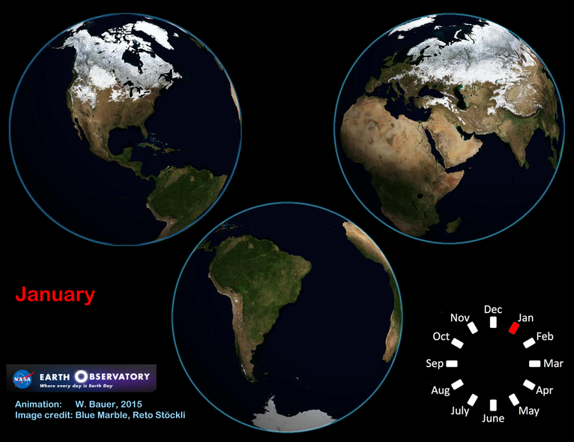

Slide 18
Albedo Change With Time
4% of solar radiation gets reflected off Earth’s surface
Obvious: Albedo changes with seasons
Oscillates between higher values in winter and lower in summer
Main effect comes from the Northern hemisphere
Built environment covers ever-larger fraction of Earth’s surface
Currently about 1%
Man-made structures tend to reflect less than vegetation or rocks (urban heat islands!)

Slide 19
Albedo Feedback
Higher surface temperature means less snow and ice in winters: exponential feedback loop
Arctic sea ice cover is decreasing rapidly
Glaciers melting (Alps, Himalayas)
Less snow cover than a few decades ago

Slide 20
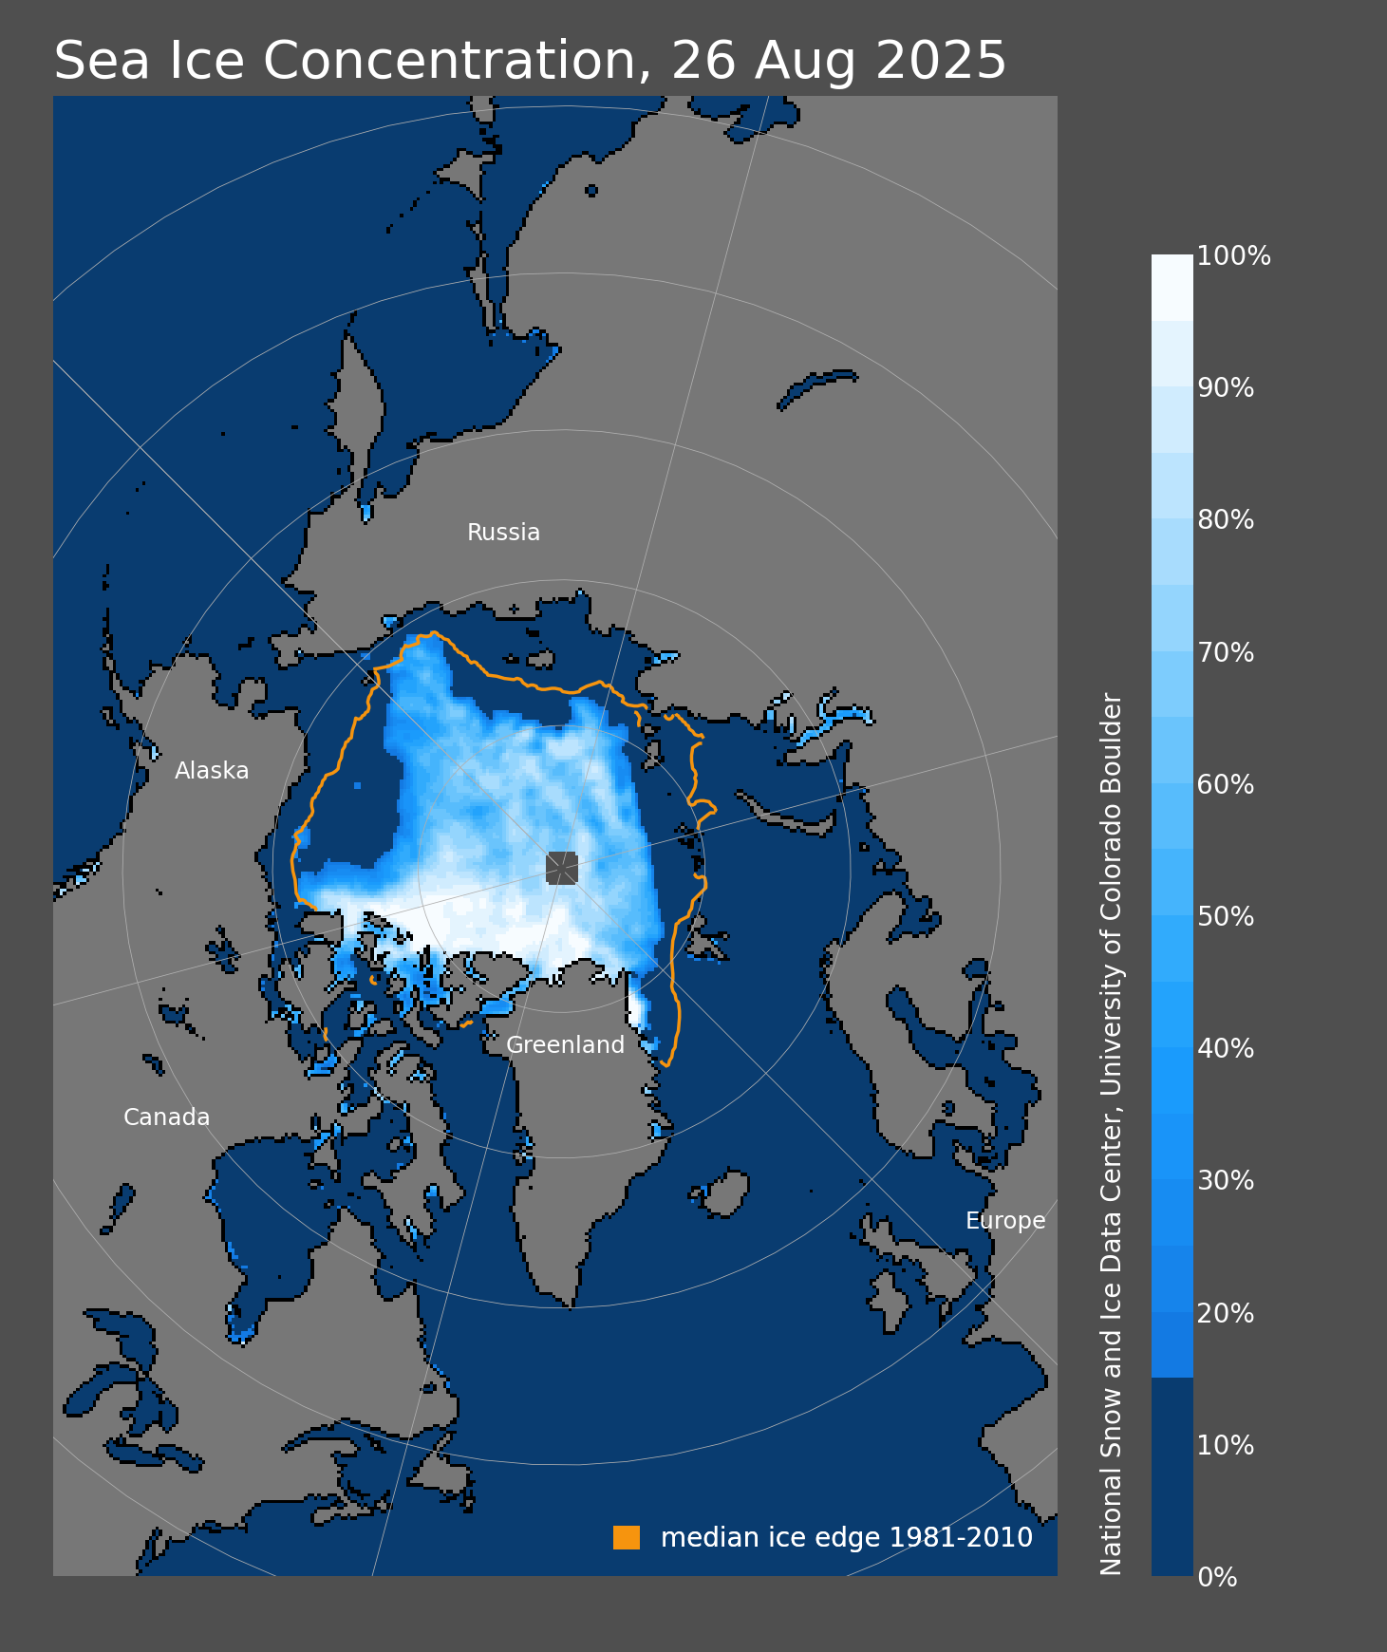
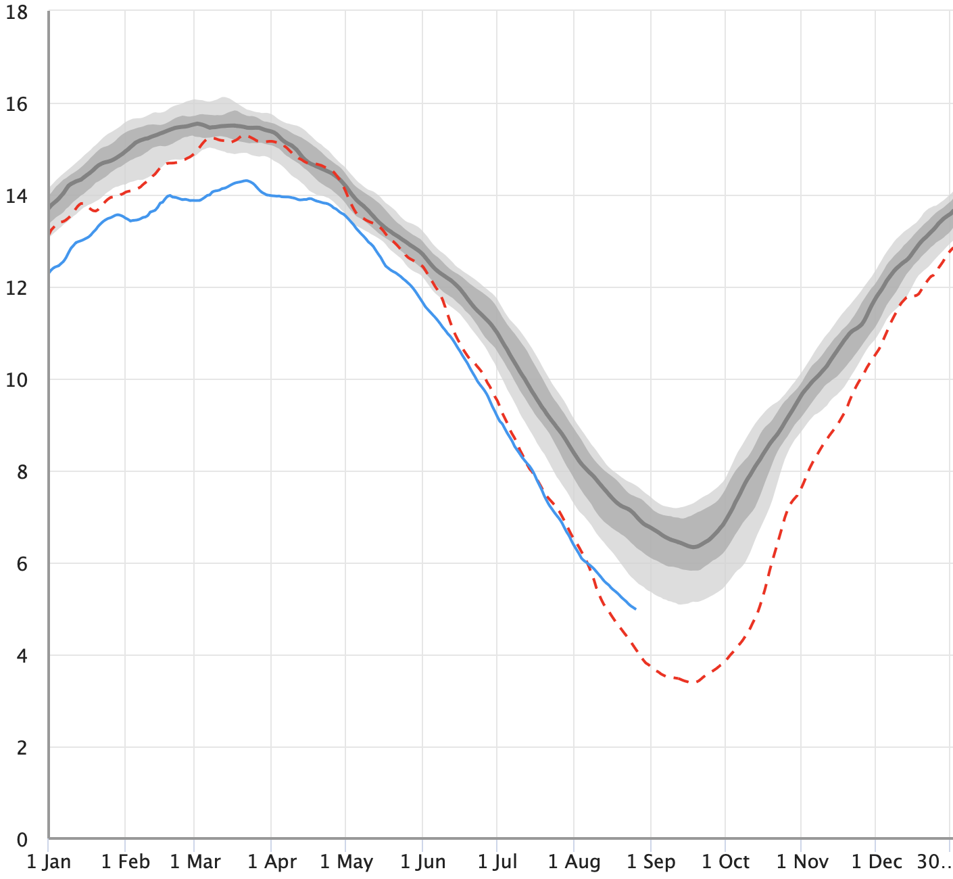

Arctic Sea Ice Cover
2025
2012, prior record low
Area with at least 15% sea ice cover (million km²)
Midnight
Sun
From: National Sea Ice Data Center, Boulder, CO

Slide 21
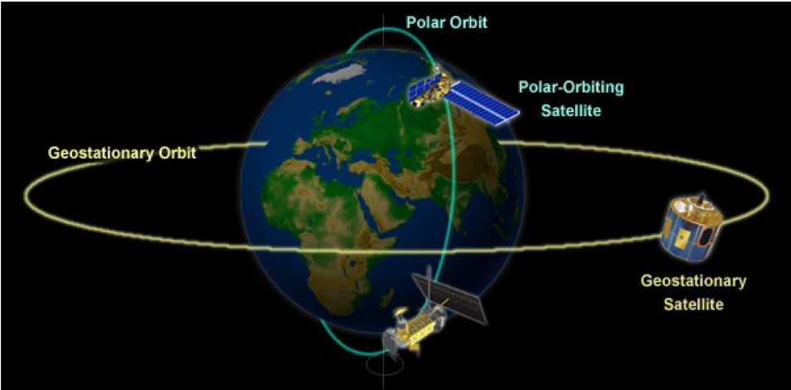
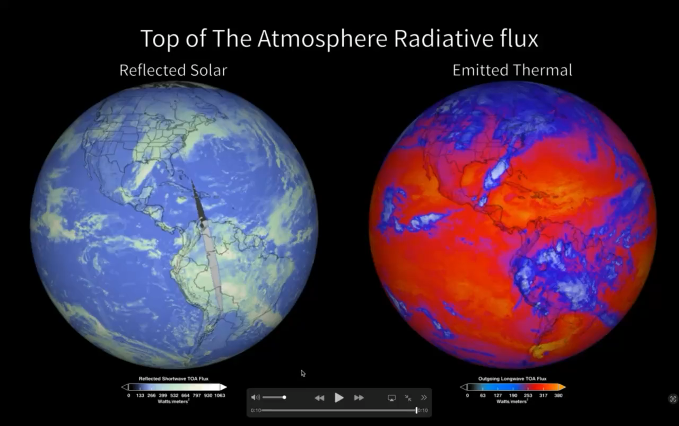
Measuring Albedo
Clouds and the Earth’s Radiant Energy System (CERES)
5 satellites with CERES instruments
10 – 24 km field of view => high spatial resolution
3 measurement bands each:
0.3-5 µm (reflected solar)
0.3-200 µm (total)
8-12 µm (Earth radiation)
https://ceres.larc.nasa.gov/science/

Slide 22
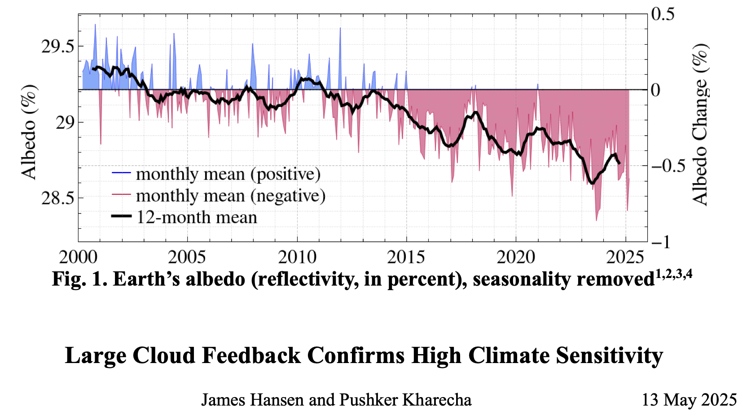
🔥Alarming🔥 CERES data
0.7% decrease during last quarter century
Additional 1.2 PW of solar radiation absorbed by Earth
Additional global warming of 0.7 °C expected, beyond what is currently observed
🧨
https://www.columbia.edu/~jeh1/mailings/2025/CloudFeedback.13May2025.pdf

Slide 23
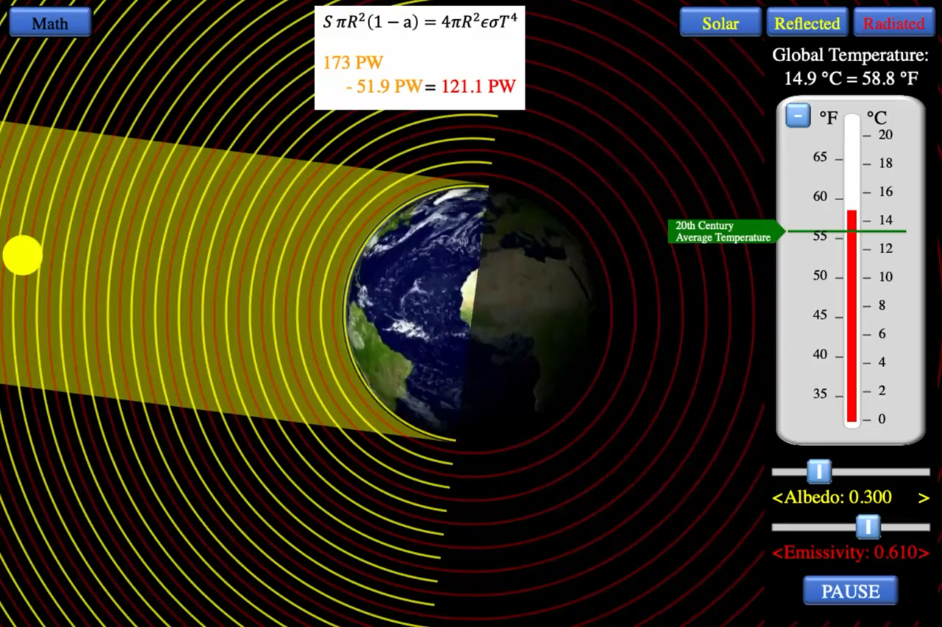
Visualization App
https://web.pa.msu.edu/people/bauer/AandE/

Slide 24
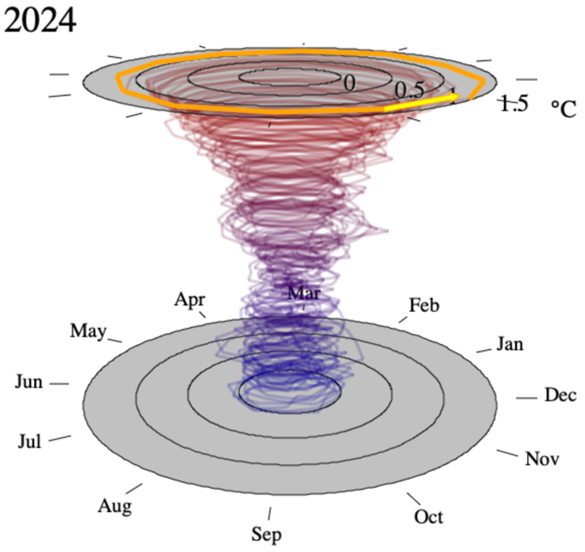
Back to the Global Temperature
Average global temperature during 20th century: 13.9 °C
https://dev-04-drupal-climate.woc.noaa.gov/news-features/understanding-climate/climate-change-global-temperature

Slide 25
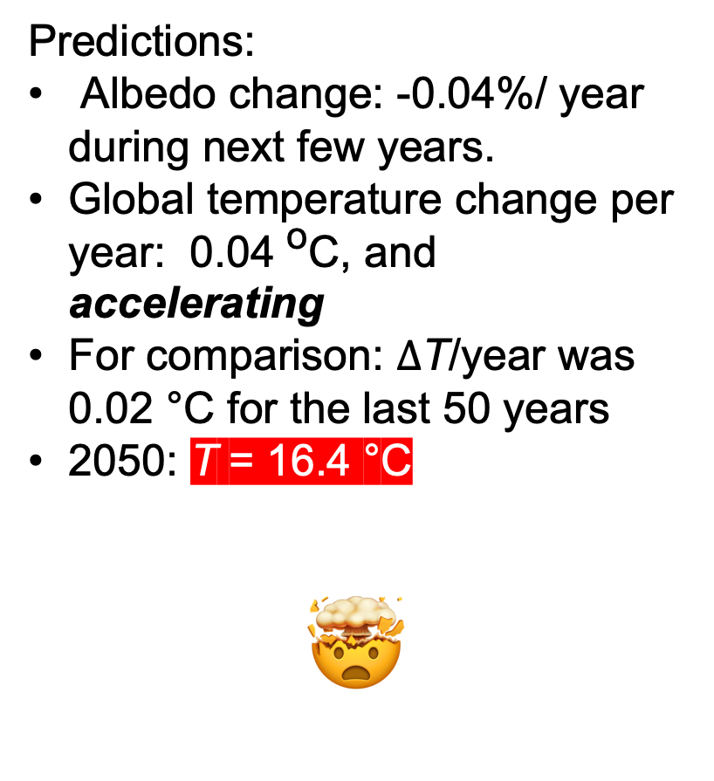
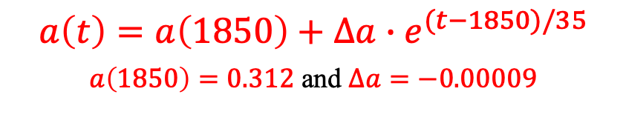
Model Fit
$$a\left(t\right)=a\left(1850\right)+∆a{∙e}^{(t−1850)/35}$$
$a\left(1850\right)=0.312$ and $∆a=−0.00009$
Predictions:
Albedo change: -0.04%/ year during next few years.
Global temperature change per year: 0.04 ºC, and accelerating
For comparison: $Δ$T/year was 0.02 °C for the last 50 years
2050: T = 16.4 °C
🤯

Slide 26

Runaway Feedback Loops
Fossil fuel burning
Greenhouse gas load (CO₂, CH₄, H₂O, N₂O, …) increases
Emissivity $ε$of atmosphere decreases
Global surface temperature rises
Atmospheric H₂O increases
More snow & ice melts
Ocean surface layer warms, releasing CO₂
Albedo $a$decreases
More energy from the Sun is absorbed by Earth
Potentially catastrophic exponential temperature runaway

Slide 27

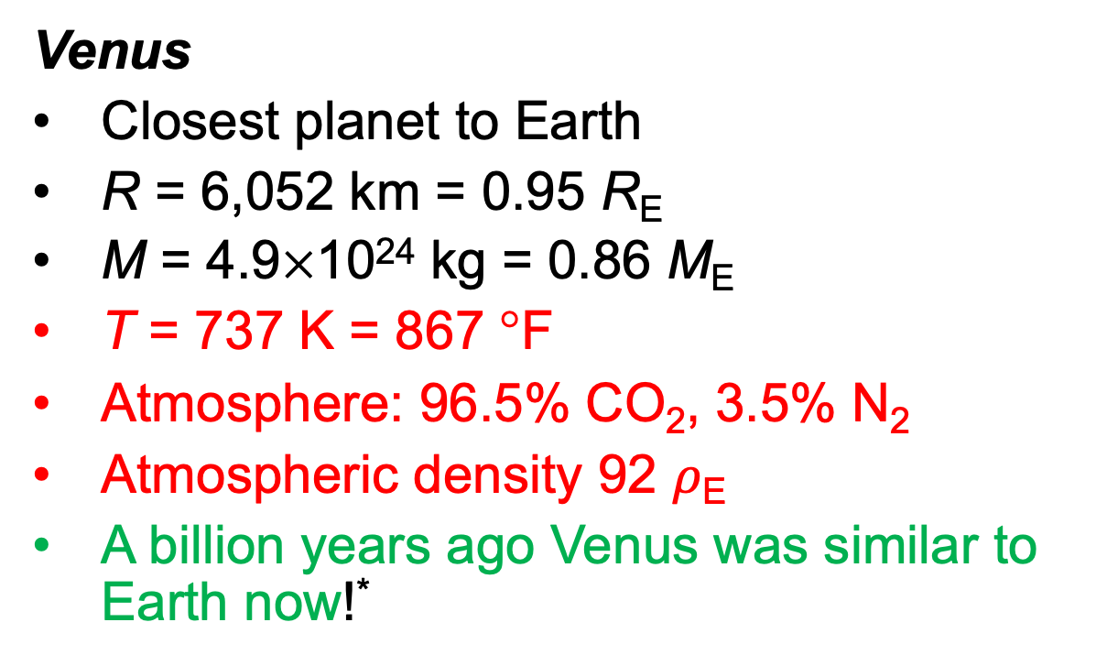
It Has Happened Before!!!
Venus
Closest planet to Earth
R = 6,052 km = 0.95 R_{E}
M = 4.9×10²⁴ kg = 0.86 M_{E}
T = 737 K = 867 °F
Atmosphere: 96.5% CO₂, 3.5% N₂
Atmospheric density 92 $ρ$_{E}
A billion years ago Venus was similar to Earth now!*
*Baines K. H., et al. (2013) The atmospheres of the terrestrial planets: Clues to the origins and early evolution of Venus, Earth, and Mars.
http://photojournal.jpl.nasa.gov/catalog/PIA10124

Slide 28
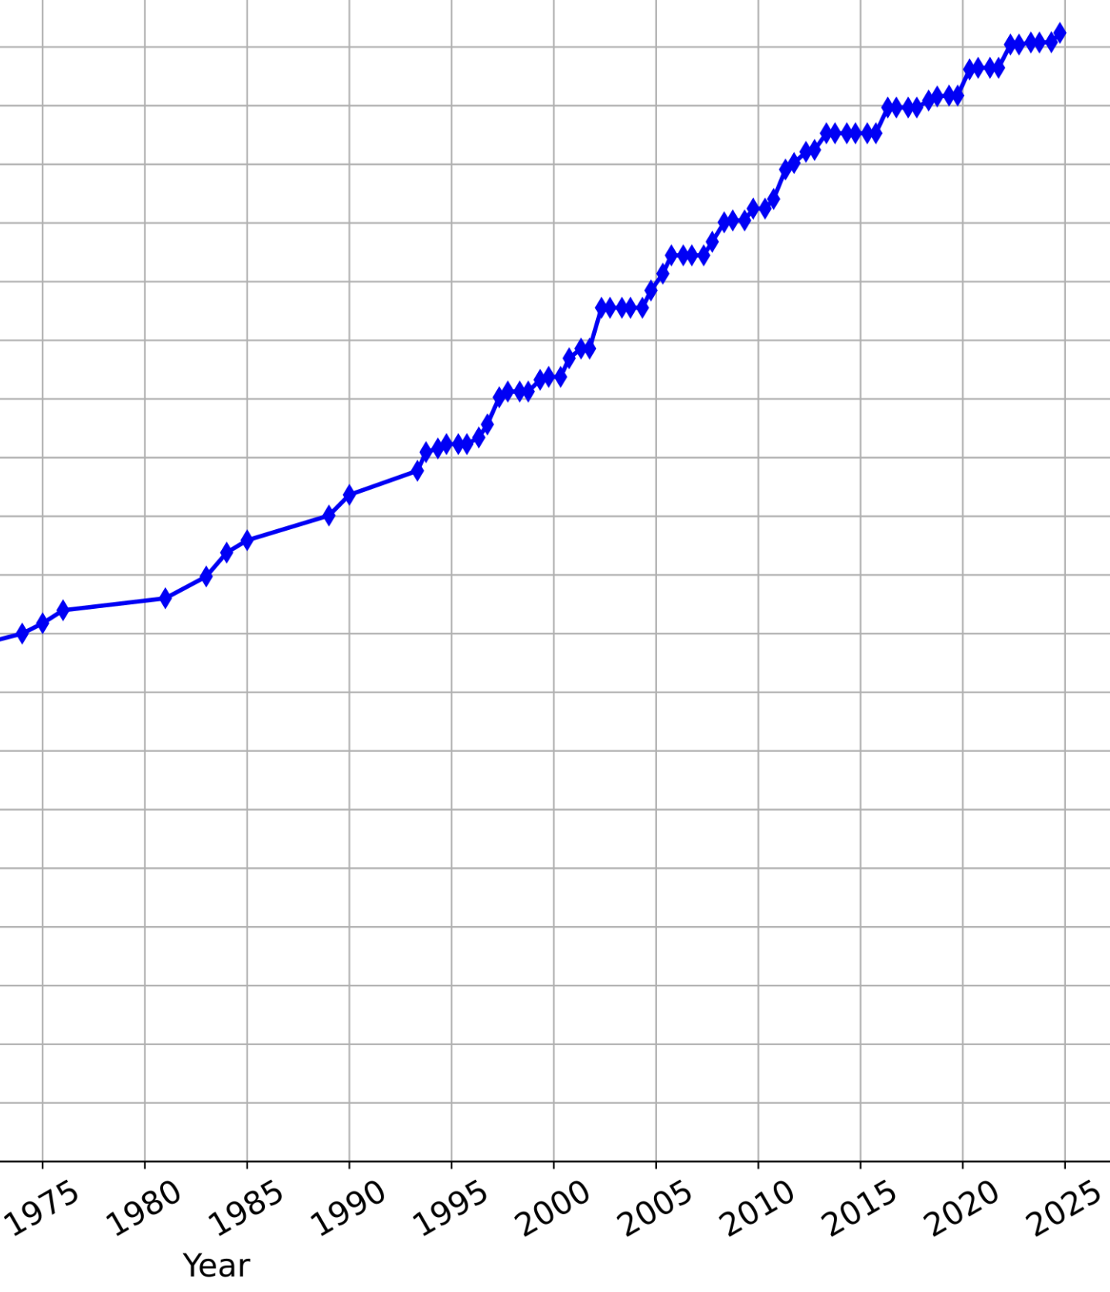
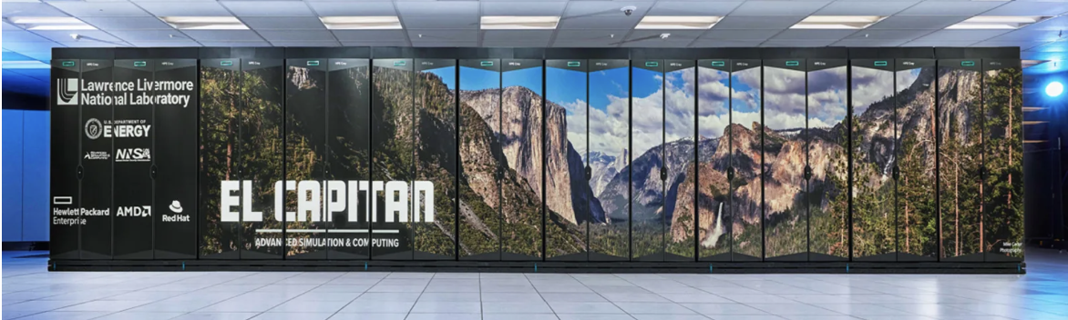

What Do Supercomputer Climate Models Say?
FLOPS
Supercomputer Climate Models provide limited guidance
‘tuning’
1979 Charney report: 2xCO₂ $⇒ΔT$ between 1.5 C and 4.5 C
2024 Coupled Model Intercomparison Project: $ΔT$ between 1.8 C and 5.5 C
Not much progress while computer power increased by a factor of 10 billion!!!
10¹⁸
10¹⁵
10¹²
10⁹
10⁶
10³
https://www.hpe.com/us/en/compute/hpc/lawrence-livermore-national-laboratory.html

Slide 29
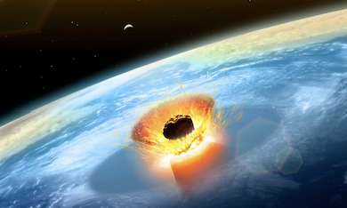
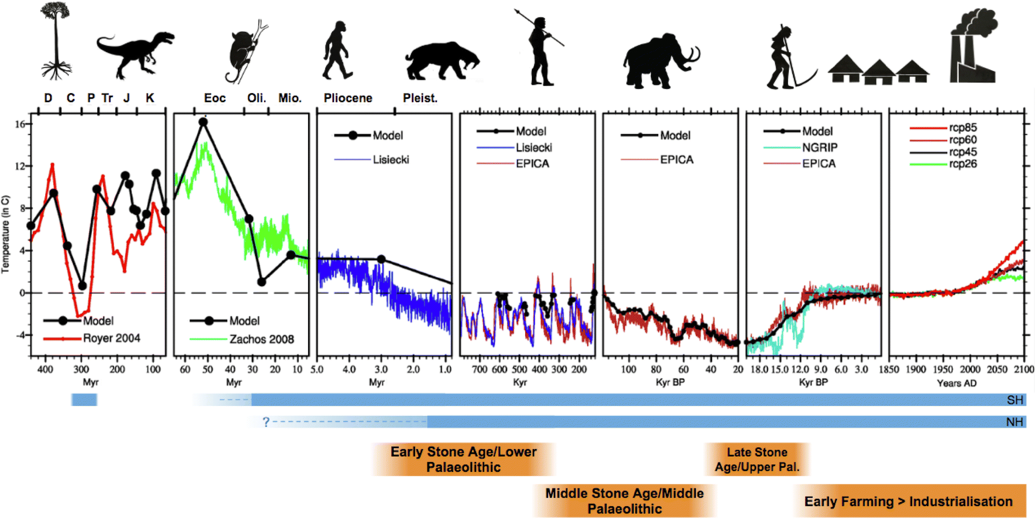
History Provides Limited Guidance
Yucatan meteor strike
History Provides Limited Guidance!
Industrial Revolution
Carboniferous period
“What can Palaeoclimate Modelling do for you?”
A.M. Haywood et al., Earth Systems and Environment 3, 1-18 (2019)
https://link.springer.com/article/10.1007/s41748-019-00093-1?shared-article-renderer

Slide 30
Part 2: What Can We Do?

Slide 31
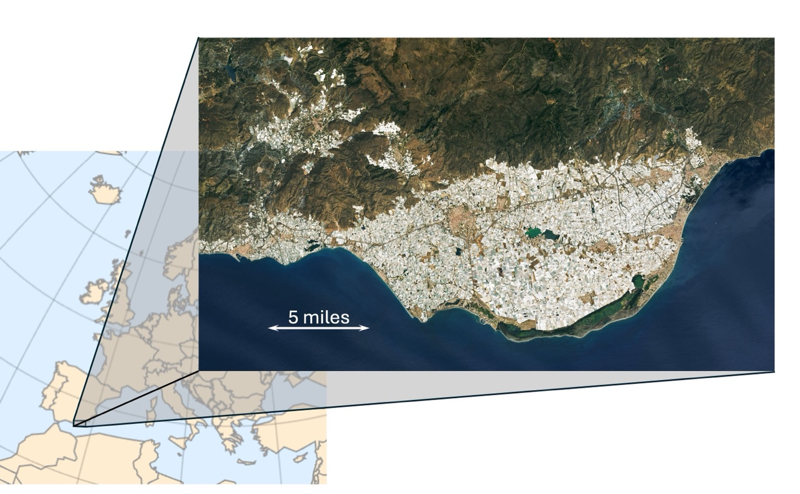
White Structures Help!
NASA satellite image of Almeria province in Southern Spain
Region provide much of vegetables for Northern Europe in winter
White color: greenhouses covered in white tarp
University of Almeira findings:
Albedo increase of 9%
Significant cooling of 0.3 °C of whole region
W. Bauer (2025), Climate Apocalypse (MIT Press). Figure 15-1

Slide 32
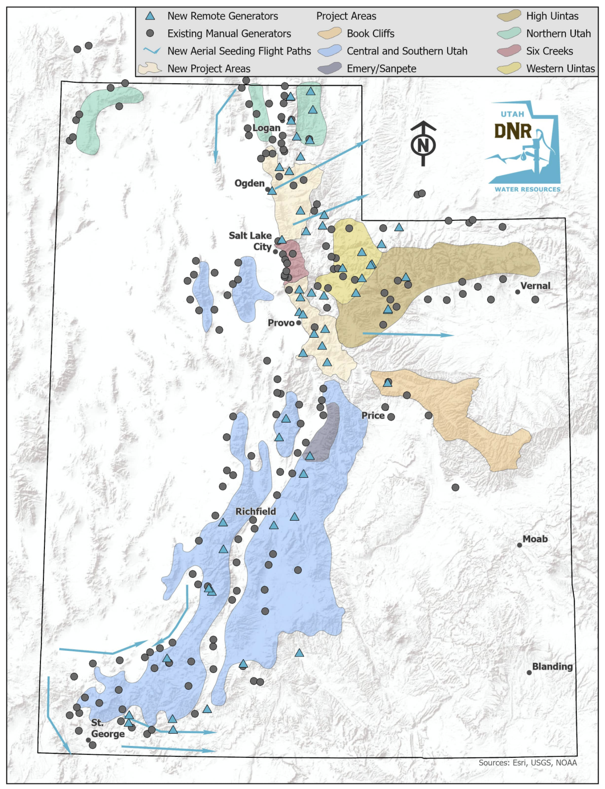
Cloud Seeding
https://water.utah.gov/cloudseeding/
Dispersion of silver-iodide in clouds to produce ice crystal
Produces additional snowfall (good for ski resorts, enhances water supply)
Utah Cloud Seeding Act legislated in 1973
Artificial surface albedo increase

Slide 33
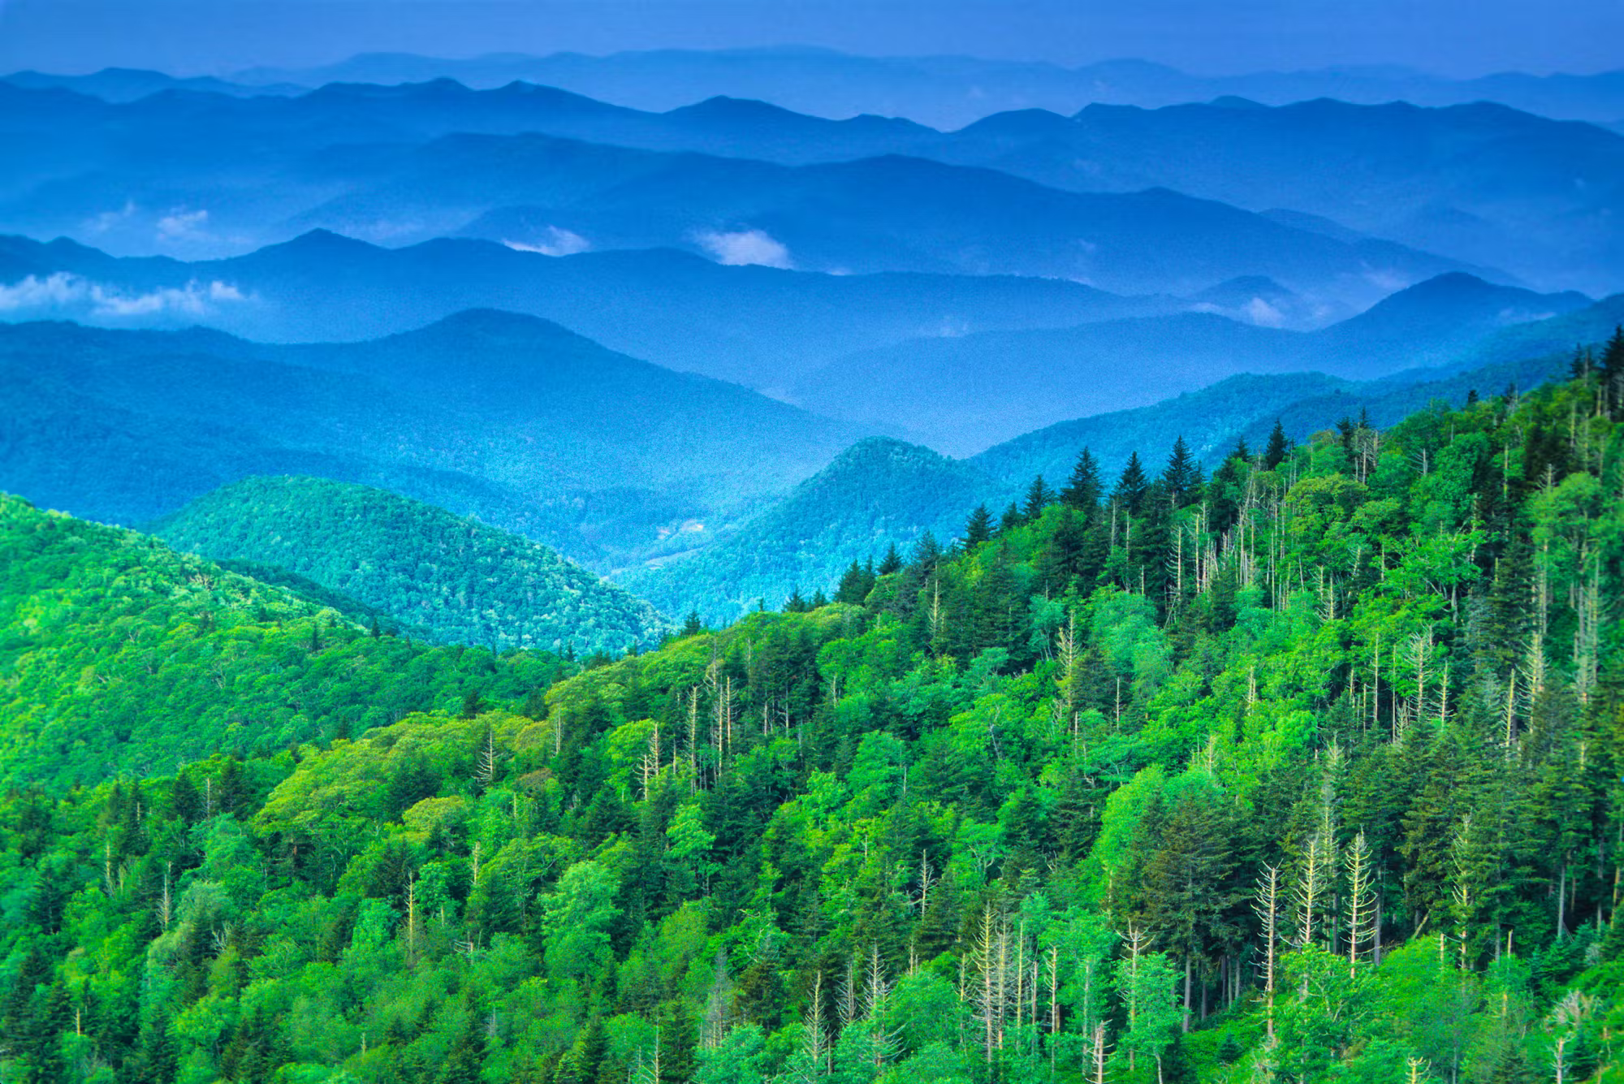
Planting Trees Helps … Some
Each tree captures 20-30 kg of CO₂ per year
Planting trees in cities reduces urban heat island effect
BUT: To absorb 20 gigatons of CO₂ per year we need to plant a trillion trees
Area needed is 5 times the entire area of the USA

Slide 34
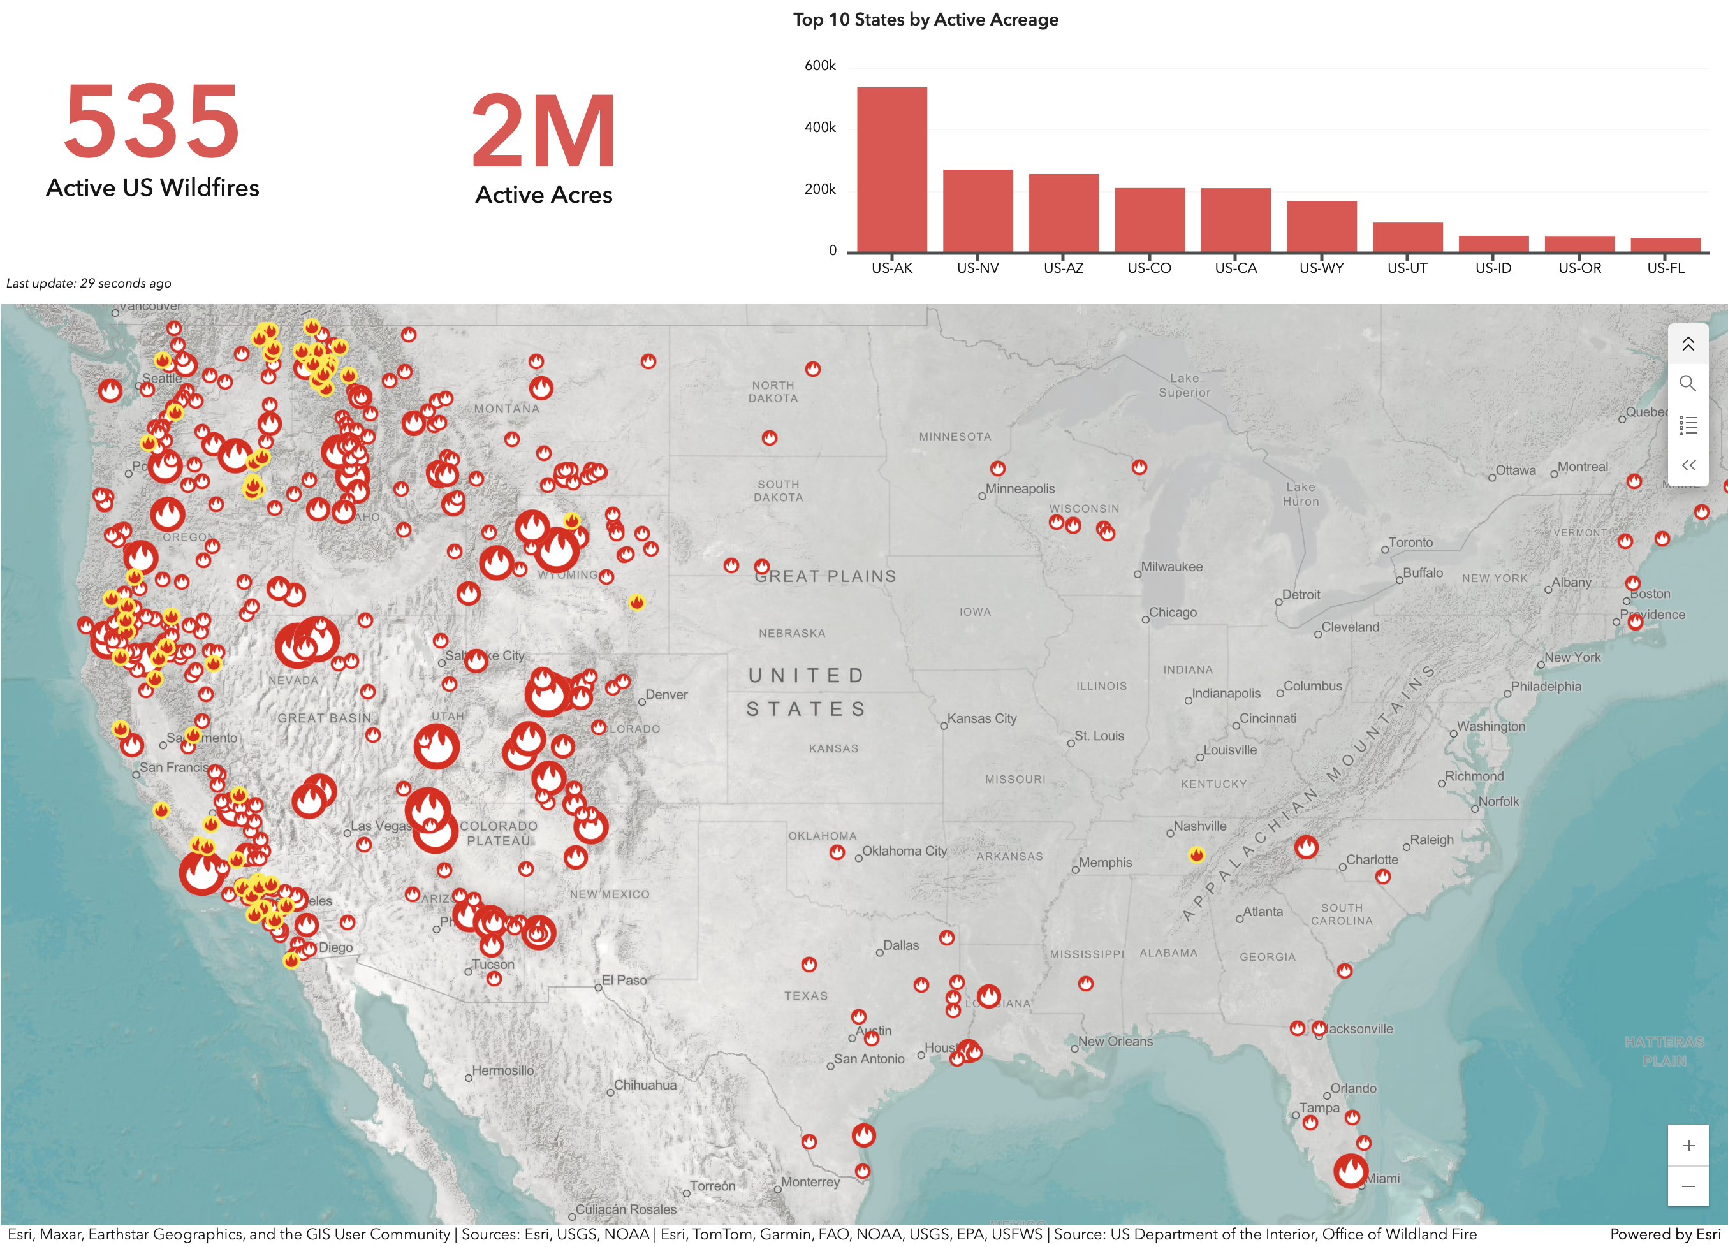
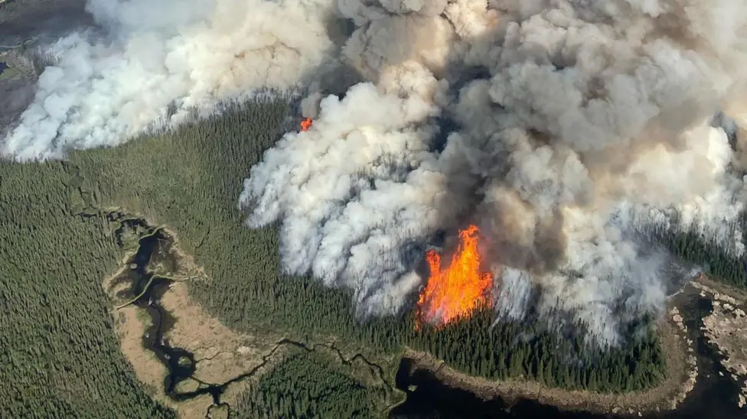
Forest Fires Increase in Frequency and Size
Each tree captures
Aug. 30, 2025, Snapshot
https://americanforests.maps.arcgis.com/
Sequestered carbon goes up in smoke, literally!
Reuters, 10 June 2025

Slide 35
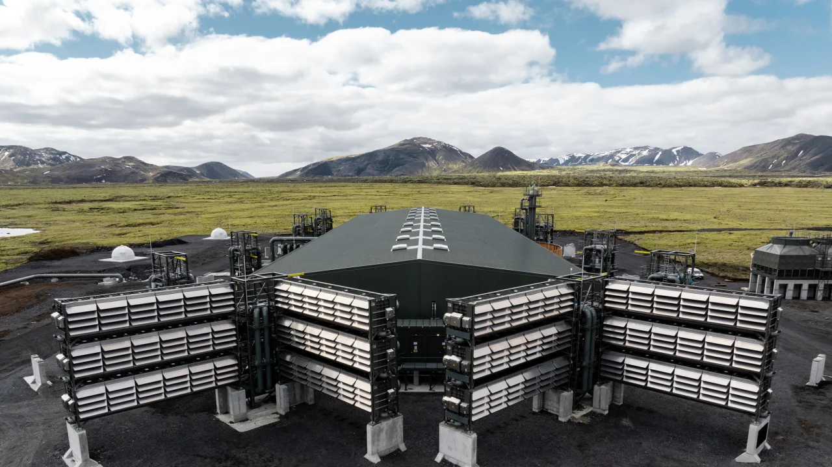
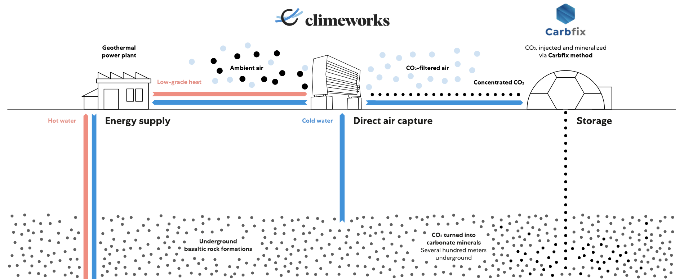
Carbon Capture
One Example: climeworks AG
https://climeworks.com/
Mammoth plant in Iceland:
36 kTons / year
Cost $500/ton
Comparison:
2 MWh of electricity generated with natural gas plant release 1 ton of CO₂
Generating 2 MWh with solar or wind costs $100

Slide 36
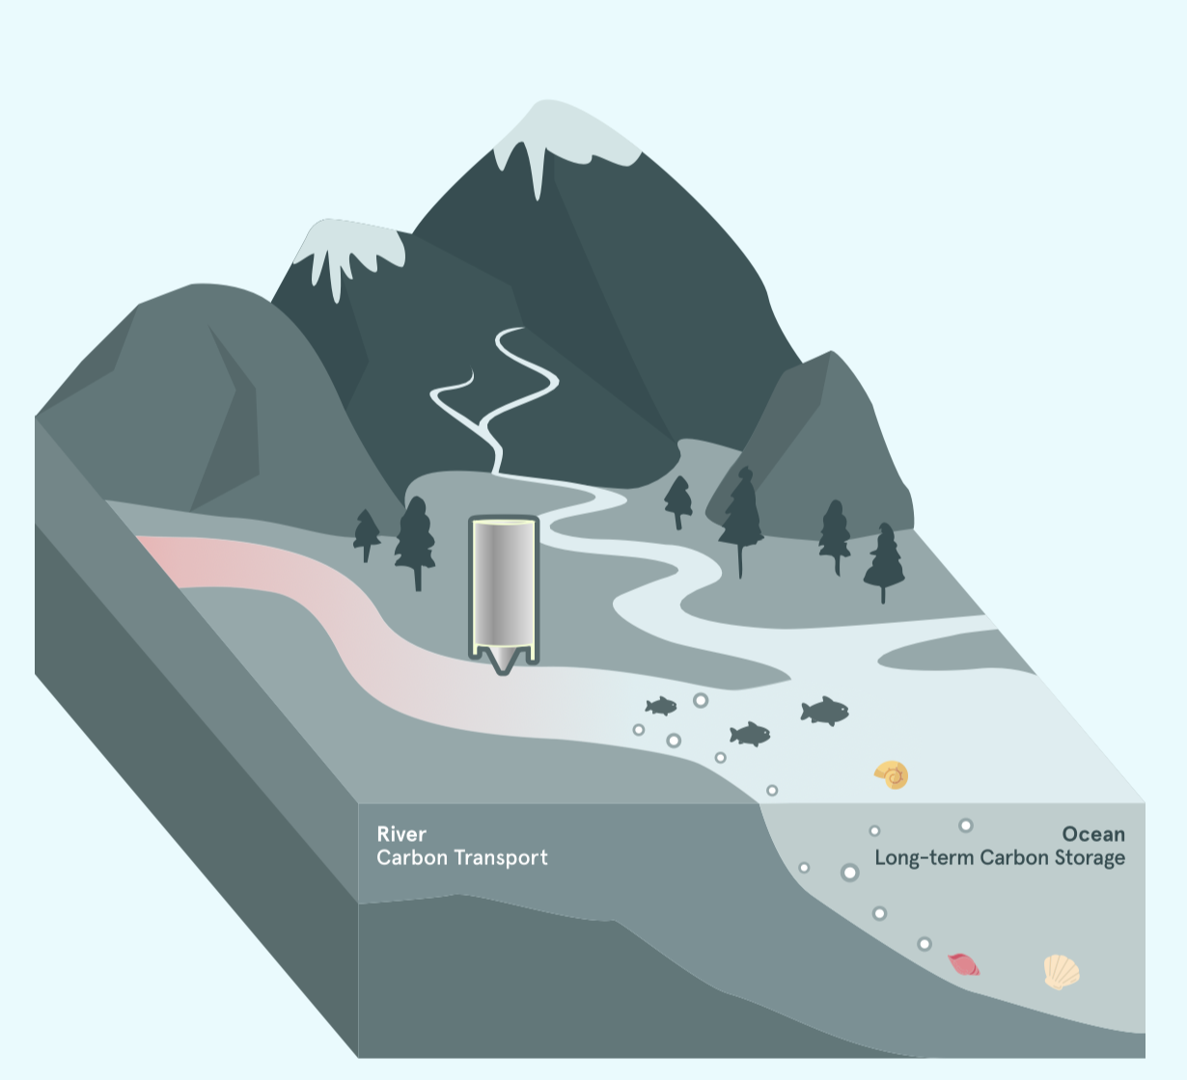
CarbonRun
Basic idea: add ground-up limestone to rivers, bind CO₂ in stable bicarbonates, which get washed into the ocean
Artificial rock weathering
2 tons of rock for every ton of carbon
Frontier climate fund will pay $25.4 million to sequester 55,442 tons of CO₂ from 2025 to 2029 (~$500/ton)
First operating plant in Nava Scotia
https://www.carbonrun.io/#science

Slide 37
More-than-questionable ideas
Adding aerosols to the stratosphere, mainly sulfur compounds, to recreate the effects of volcano eruptions on climate
Iron-fertilizing the oceans to create plankton forests
Re-freezing the West-Antarctic ice shield
Putting millions of spacecraft with solar shade sails at the L1 Lagrange point (cost: at least $10 trillion)

Slide 38
Part 3: Renewables

Slide 39
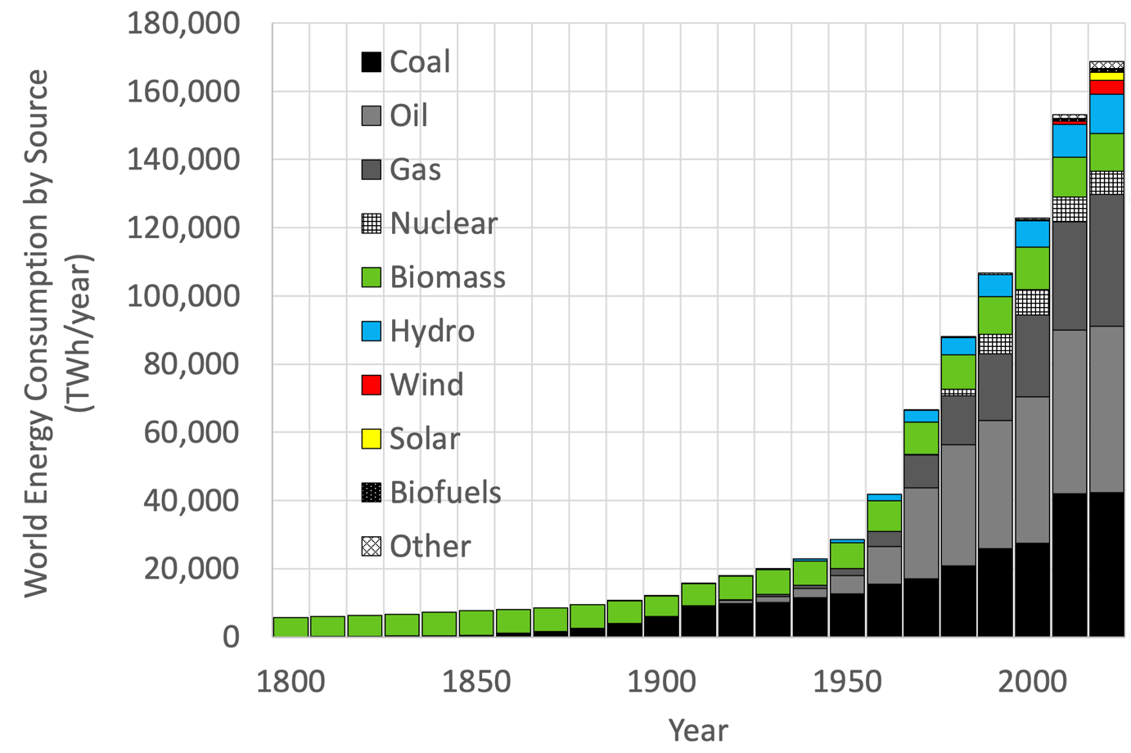
Fossil Fuel Combustion Needs to STOP
Data source:
https://ourworldindata.org/ energy-production-consumption
All of humanity:
140,000 TWh of fossil fuel energy in 2025
What does it take to replace all this with renewables?

Slide 40
140,000 TWh of Fossil Fuel Replacement
Typical conversion efficiency ~40%
40% of 140,000 TWh = 56,000 TWh
We need to generate and additional 56,000 TWh of renewables per year, at 3-5x increase over current install (including hydro and biomass)
56,000 TWh/year = 6.4 TW (of electricity)

Slide 41
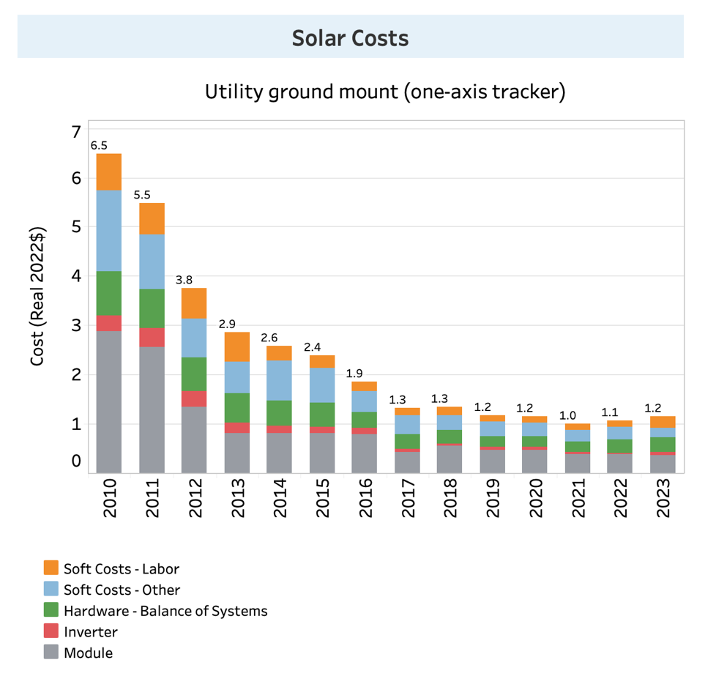
Price Tag for 6.4 TW of Renewables
Example: Solar
Last 7 years: costs have bottomed out around $1/W, all in
But solar is intermittent!
https://www.nrel.gov/solar/market-research-analysis/solar-installed-system-cost.html

Slide 42
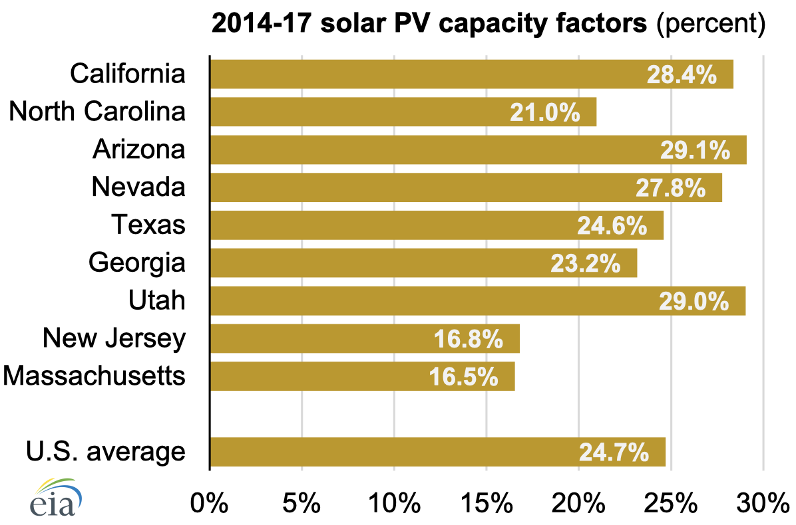
Solar Capacity Factor
Capacity Factor = average power / peak power
Time averaged solar power cost = $1/W / capacity factor
Assuming, conservatively, capacity factor 20% (USA)
Time averaged solar power cost = $5/W

Slide 43
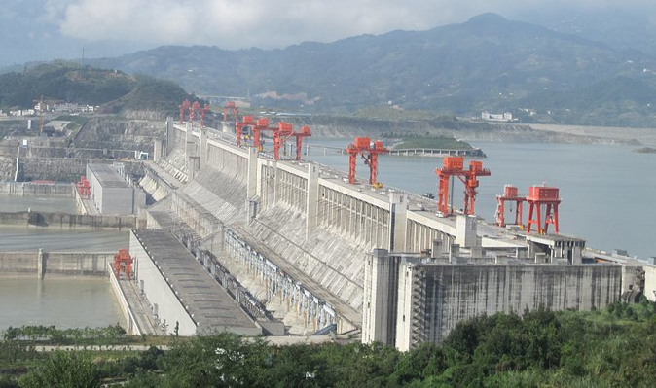
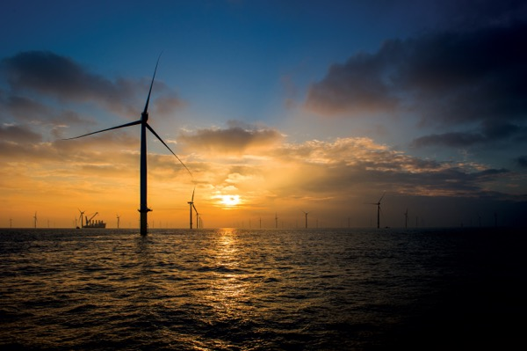
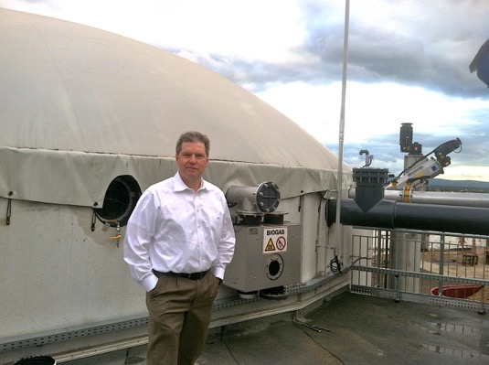
Wind / Hydro / Bio: $5/W
(or a bit higher …)
Three Gorges Dam ($5.1/W)
18.2 GW
Cost: $26B
CF = 0.48
London Array ($7.1/W)
630 MW
Cost: $2B
CF = 0.45
Biogas Plant ($5.2/W)
1 MW
Cost: $5M
CF = 0.98

Slide 44
Bottom Line
Replace 6.4 TW of fossil fuel power with renewables
Cost for time-averaged renewable power = $5/W
Total investment needed:
$32 trillion
For comparison: Fossil fuels cost $7 trillion/year!
ROI Time: 5 years 😎

Slide 45
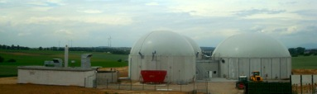
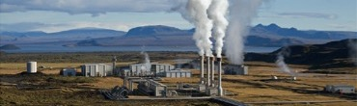
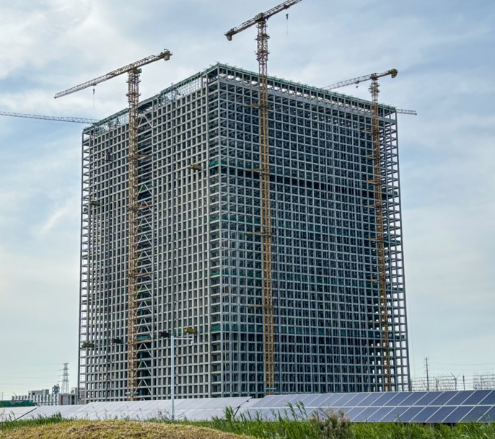
What About Intermittency?
Baseload providers 👍👍
Nuclear (SMRs, Natrium, Thorium, Fusion?)
Dispatchable renewables 👍👍👍
Biogas
Deep geothermal
Energy storage 👍
Batteries, BESS (Li-ion, salt, Pb-acid, …): currently up to 500 MW, up to 3,300 MWh
Pump-storage hydro (Mountains, wells, …) 👍👍
Energy vault
Gravity Energy Storage System (GESS), Rudong, China
25 MW, 100 MWh, 80% efficient

Slide 46
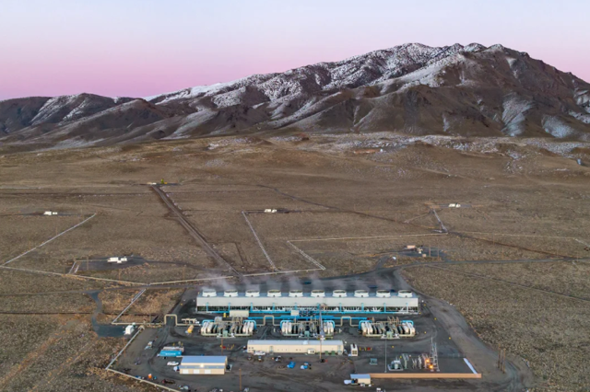
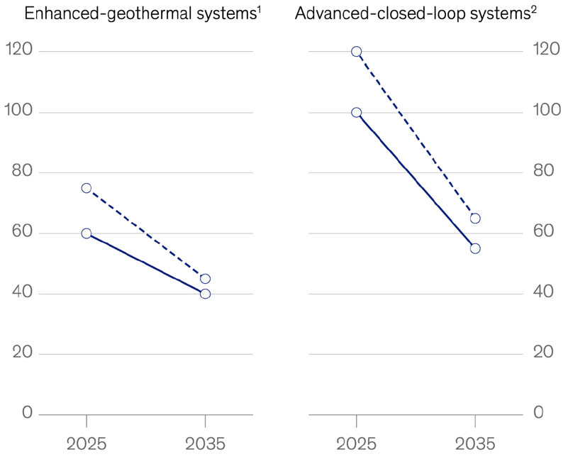

Geothermal
https://blog.google/outreach-initiatives/sustainability/ google-fervo-geothermal-energy-partnership/
Google & Fervo EGS, Nevada
US-DOE: 120 GW potential by 2050

Slide 47


Luddington Pump Storage (est. 1973)
27 billion gallons
19.5 million kWh
110 feet
363 feet
6 turbines
2.17 GW total
70% efficient
Stores as much energy as ¼ million EV batteries!
https://www.google.com/maps/

Slide 48
Instead of a Summary
E = $

