Slide 1
EIC Project News
E.C. Aschenauer (BNL), R. Ent (JLab)
Co-Associate Directors for the EIC Experimental Program
ePIC Bi-Weekly General Meeting
September 12th, 2025

Slide 2
Outline
Detector Reviews and Meetings 2025/2026
DOE and EIC Planning Dates
Baseline Readiness Assessment Reviews
ePIC Schedule
Detector Serviceability Work and Detector Envelope Update
Work on Quality Control Documents

Slide 3
Detector Reviews & Meetings planned for 2025/2026
Preliminary Design Reviews (60% design maturity equivalent, called PDR, PDR2 or PDR3, pending the subsystem)
  PDR: MPGD Tracking Detectors (6.10.03.02) – Summer/Fall 2025→ checking November-January period – Note: FDR only after completion of first engineering test articles
  PDR2: Silicon Tracking Detectors (6.10.03.01) – Fall 2025 – TBD → Tentative January 2026
  PDR2: Cherenkov-based Particle Identification Detectors (6.10.04; pfRICH, hpDIRC, dRICH) – April 1-2, 2025
  PDR2: AC-LGAD-based Particle Identification Detectors (6.10.04; BTOF, FTOF, common systems) – November 2025
  PDR3: Barrel EM Cal (6.10.05.02) – Confirmed for September 17-18
  PDR (60%) Barrel & Forward & Backward HCAL (6.10.05.01; 6.10.06.02; 6.10.06.03) and forward ECAL – week of October 6
  PDR: Magnet Cryogenics and infrastructure (6.10.07) – October 22 or 23, 2025 → Moved to 1st week of November to integrate with overarching Cryogenics review.
  PDR3: Electronics/DAQ-computing (6.10.08. 6.10.09.01) – September 3-4, 2025 (this did not include slow controls)
  PDR: DAQ-Slow Controls (6.10.09.02) → early 2026 – Later to ensure integration DAQ in the collider common platform
  PDR: Integration, Infrastructure and Installation (6.10.10) – October 30, 2025 – everything outside GST, includes cradle, HCAL, etc. → Week of Dec. 8 or Dec. 15
  PDR: Integration, Infrastructure and Installation (6.10.10) – December 15, 2025 – everything inside GST → Week of Dec. 8 or Dec. 15
  PDR3: IR Integration and Auxiliary Detectors (6.10.11) – November/December 2025 → March 2026 – includes 6.10.14 lumi detector
  PDR2: Polarimetry (6.10.14) – September/October 2025 → January 2026
Final Design Reviews (FDR):
  FDR: Final Design Review of the BABAR DIRC Bar Refurbishment for the High Performance DIRC Particle Identification Detector – April 1, 2025
  FDR: Backward EM Calorimetry → February 2026.
Project Reviews:
  DOE OPA CD-3B Review – January 7-9, 2025
  “Red Team” Review (acts as Director’s Review for DOE OPA Focused Status Review) – May 20-21, 2025
  DOE OPA Focused Status Review – August 5-7, 2025
  Baseline Readiness Assessment Review – November 12-14, 2025
  DOE OPA Independent Project Review – March 9-12, 2026
Other Meetings:
  EIC International Computing Organization (EICO) – April 2–4, 2025 @BNL
  Detector R&D Day hosted by ePIC and EIC Project – April 16-17, 2025
  Technical interchange meeting with EIC Computing and Software Advisory Committee (ECSAC) – May 12, 2025
  5th RRB Meeting: June 5-6, 2025 – Prague, Czech
  10th DAC Meeting – Comprehensive look to design status and readiness for CD-2. June 11-13, 2025.
  EIC Software & Computing annual review – October 6-7 @ JLab (and Echelon 0–1 mini-workshop on October 8)
  6th RRB Meeting: November 4-5, 2025 - BNL

Slide 4
DOE and EIC Planning Dates
Milestone |  | Milestone
DOE Independent Project Review (IPR) | Jan. 7-9, 2025 | DOE RHIC R&R/Injector Operations Review | Sept. 8-10, 2025
Start Developing Scope of Subprojects | January 10, 2025 | Machine Advisory Committee Meeting | Sept. 16-18, 2025
IR SC Magnet Steering Group Meetings - Monthly | January 17, 2025 | Infrastructure Construction Advisory Committee | October 2025
Project Advisory Committee Meeting | February 11, 2025 | Resource Review Board Meeting (BNL) | Nov. 4-5, 2025
EIC Advisory Board Meeting | February 25, 2025 | Assessments of Baseline Readiness for SPs Detector Interaction Region Accelerator Storage Rings Global and Energy and Luminosity Ramp-Up Electron Injector (follow-up to Apr ‘25 Review) | Nov. 12-14, 2025 Nov. 18-20, 2025 Jan. 14-16, 2025 February 2026 April 2026
Electron Injector Design and Cost Review | April 8-10, 2025
Infrastructure Construction Advisory Committee | April 16-17, 2025
Project Advisory Committee "Red Team" Review | May 20-21, 2025
Resource Review Board Meeting (Prague) | June 5-6, 2025
Detector Advisory Committee Meeting | June 11-13, 2025 | RHIC Operations Conclude | ~End 2025
EIC Advisory Board Meeting | June 17, 2025 | RHIC Removal and Repurposing (R&R) Starts | ~Early 2026
DOE CD-3B ESAAB Approval | Pending | DOE IPR Comprehensive Review | Mar 9-13, 2026
DOE IPR Focused Status Review | August 5-7, 2025 | DOE CD-2/3 Approval for Accelerator Rings | ~End 2026

Slide 5
Assessments of Baseline Readiness
Assessments of baseline readiness for each subproject will measure status and evaluate future work needed to be ready for a DOE CD-2 IPR. The charge for these reviews includes technical, cost, schedule, and management. The charge will also evaluate plans to design to cost.
The charge for the Detector and Accelerator Storage Rings will be consistent with a CD-2 baselining review mid-late 2026; the charge for the other subprojects will reflect their lower design maturity
Director’s Reviews will be completed by mid-2026:
Electron Injector Complex - Initial April 8-10, 2025
Co-Chairs: T. Raubenheimer, SLAC, MAC Chair & E. Peoples-Evans, ANL, APS-U PM.
Detector November 12-14, 2025
Co-Chairs: A. White, UTA, DAC Chair & S. Nahn, FNAL, USCMS PM.
Interaction Region November 18-20, 2025
Co-Chairs: O. Bruning, CERN, HL LHC PM, & R. Carcagno, FNAL retired, HL LHC AUP LHC Deputy PM.
Accelerator Storage Rings January 14-16, 2026
Co-Chairs: TBD
Global Project and Energy & Luminosity Ramp-up ~February, 2026
Electron Injector ~April, 2026

Slide 6
November 12-14 Detector Baseline Readiness Assessment
Co-Chairs: Steve Nahn (FNAL) and Andy White (UTA)
Committee near completed, ~18 people all confirmed
Readiness of documentation is done by prebrief posted ~2 weeks before review and asking committee to look at this in advance. Talks only include snapshots.
Pre-meeting with committee is done ~1 week in advance. This is organized by Jim Yeck. Plan a 1.5 hour meeting to include:
EIC Status and Plans (including accelerator status) – Jim Yeck
ePIC Collaboration Status and Plans – John Lajoie/Silvia Dalla Torre
Baseline Readiness Assessment Review Charge and Plan
Prebrief and Performance Baseline Documentation Overview
Structure of Parallel Session Talks: Introduce Technical Scope, Updates since DAC meeting, Plans for Construction, snapshot of readiness of documentation, BOE and >1/3 time for discussion. Project Control Analysts are in the sessions.
Three parallel sessions:
Technical I – Electronics and DAQ, Tracking, Particle Identification
Technical II – Integration, Infrastructure and Installation, Magnet, Calorimetry, Auxiliary Detectors, Polarimetry
Management, Cost and Schedule – Project Readiness, Assumptions and Dependencies, In-Kind, Procurement Planning, Baseline Management and Control, Drill Downs, Interviews

Slide 7
November 12-14 Detector Baseline Readiness Assessment
To be ready: Must have:
WBS dictionary updates with scope descriptions and deliverables
P6 updates done (as applicable)
Basis Of Estimates in good order such that they are traceable
Remaining review (PDR, FDR) dates finalized
Some Interface Control Documents
Most Subsystem Individual Quality Control Plans
Some Inspection and Test Plans (component and unit tests, transportation)
Multi-Party ICRADAs started and Draft (In-Kind) Project Planning Document
Should have:
All Inspection and Test Plans
(In-Kind) Project Planning Documents
Updated Budget Estimate Quotes (need them early 2026)

Slide 8
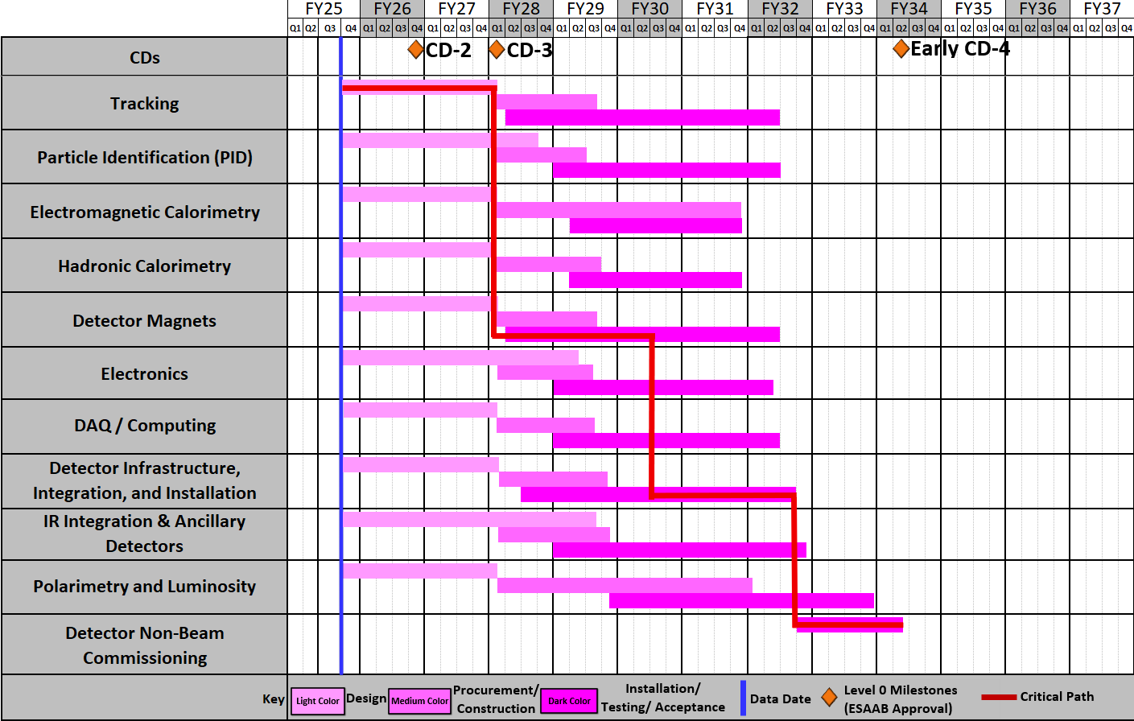
ePIC Schedule
Ready
for non-beam
commissioning
Ready
for
commissioning
with beam
Schedule Drivers:
  To hold the date for a CD-2 Independent Project
  Review (IPR) expected not before June 2026
  To keep the (inter)national user community engaged
  and limit the danger to lose groups
  all subdetectors need to be more or less ready at the same time to be assembled to ePIC
  Superconducting Solenoid → CD-3A item
  Silicon Sensors (MAPS, AC-LGAD & ASTROPIX)
  ASIC long time frames only one ASIC designed from scratch all others are modifications to existing ASICS
  Items with long production times, single vendor and complex assembly → CD-3A & CD-3B
  International agreements driving in-kind and MAPS design (agreement with CERN)

Slide 9
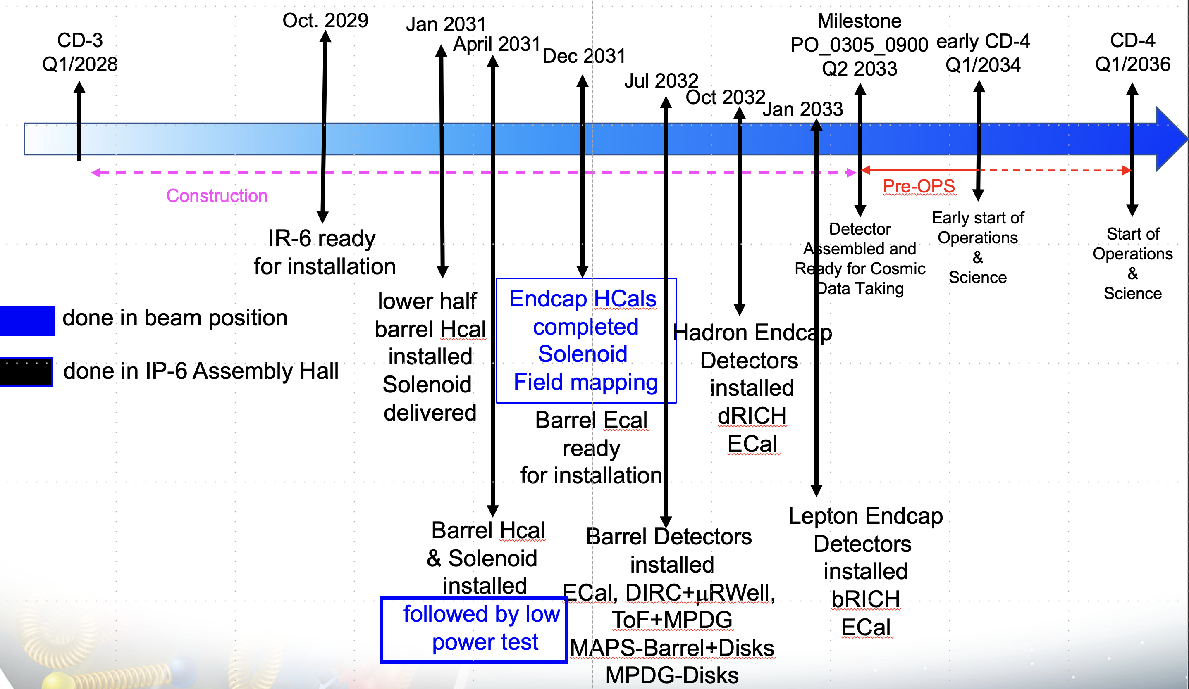
High Level Installation Schedule

Slide 10
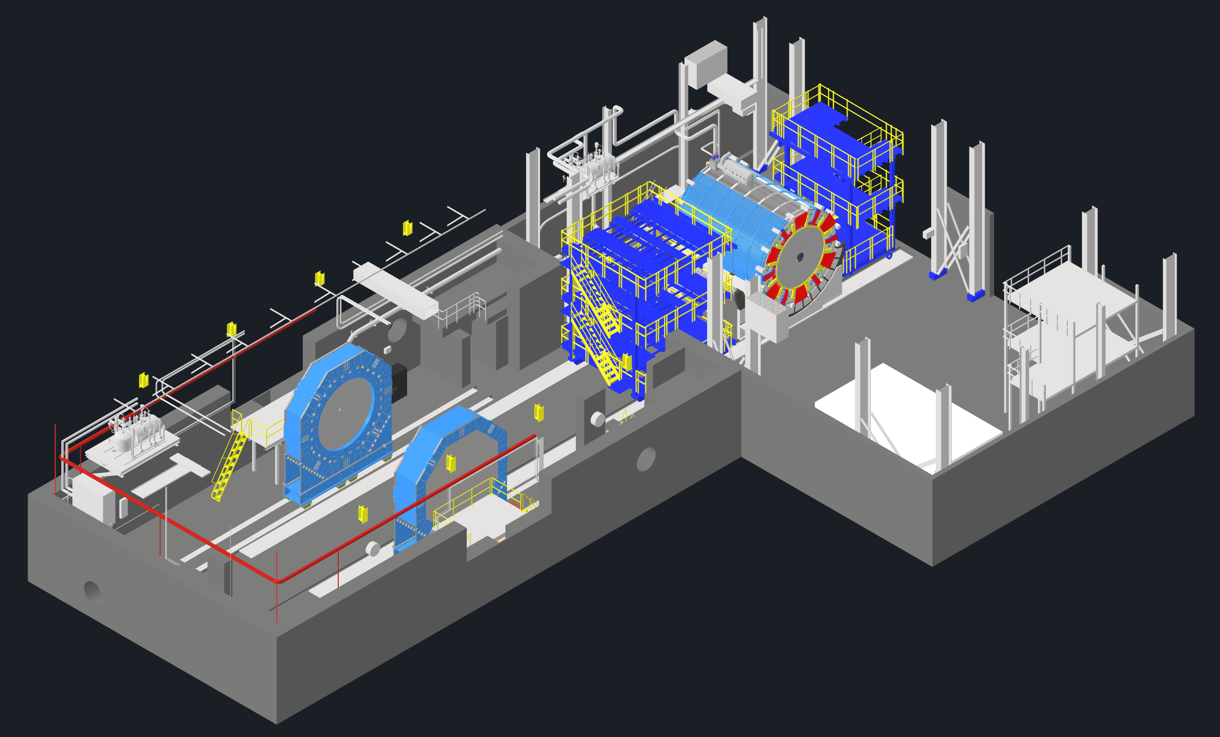
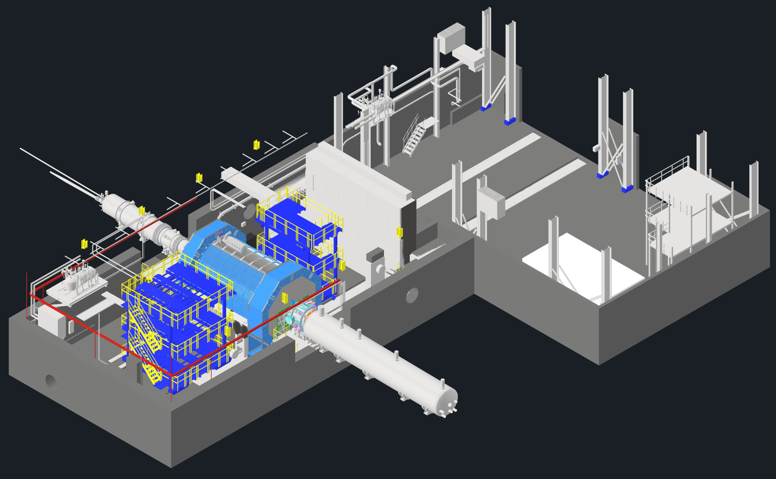
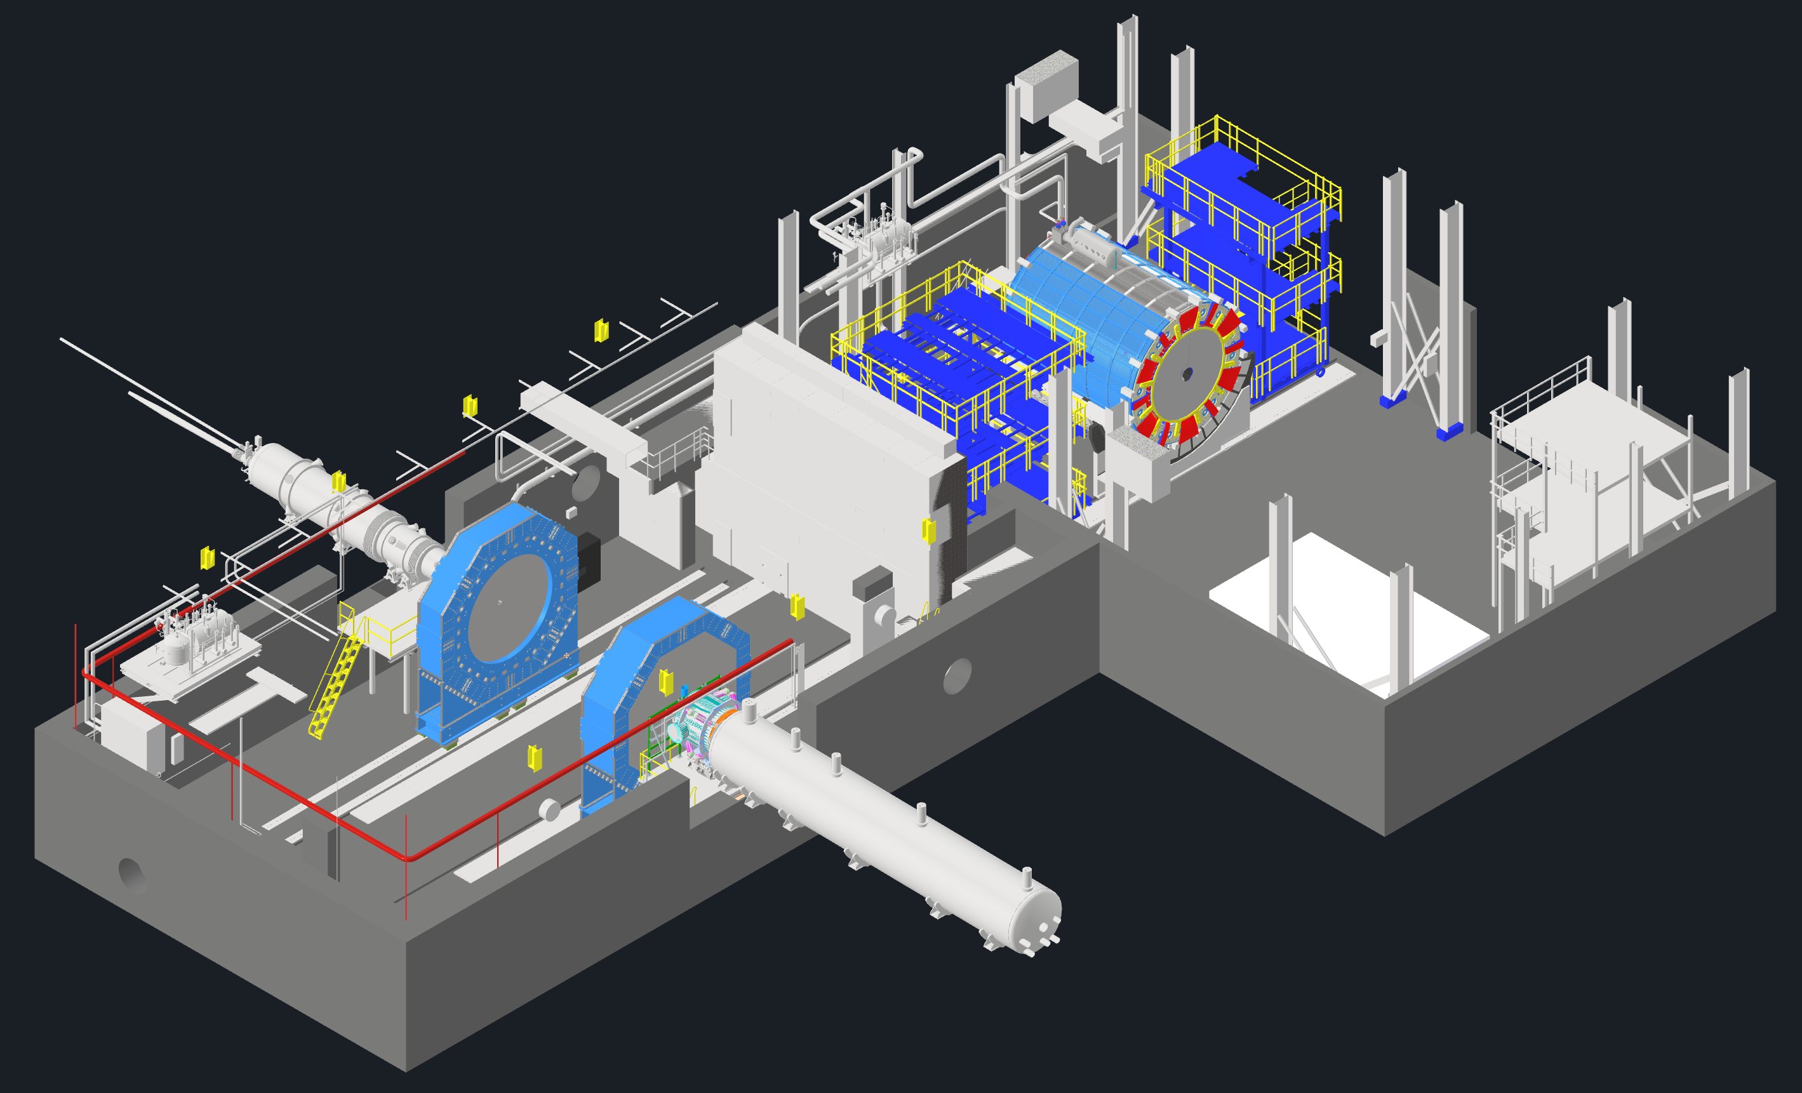
EIC - ePIC Commissioning
Q2/2033
~ CY 2034
exact dates under development
ePIC no-beam commissioning
ePIC commissioning with beam
ePIC fully assembled and Ready for Cosmic Data Taking
EIC first beam commissioning
central ePIC in assembly hall
endcap calorimeters
and beam pipe with instrumentation to have a first look on backgrounds
Luminosity detector and hadron & electron polarimeters fully installed
move central
ePIC into wide-angle hall
commission
ePIC with beam
All auxiliary detectors, but RPs and OMDs are installed
Start of Science
program
RPs and OMDs will be installed in year-2

Slide 11
CD-3A Status and CD-3B Scope
CD | Scope | Status
CD-3A | Lead Tungstate Crystals for the Detector Backward Electro-Magnetic (EM) Calorimeter (1500 of 3000 crystals) | Contract awarded 3/5/2025 (CRYTUR) – 600 crystals delivered – quality tests completed on 470 crystals, all passed specifications
 | Scintillating Fibers for the Detector Barrel (1125 km of 4900 km) and Forward EM Calorimeters (750 km of 3000 km) | Barrel SciFi: Contract with Kuraray close to be awarded → add DOE for final approval → award by the end of September 2025 Forward SciFi: Contract awarded 3/12/2025 (Luxium) -> 2nd batch fulfills requirements → 38 km received to date
 | Silicon Photomultipliers for the Detector Forward Hadronic Calorimeter (321k of 540k) | Contract awarded 11/25/2024 (Hamamatsu) → first delivery of 100K arrived at BNL →QA at Yale starting
 | Steel towers for the Detector Forward Hadronic Calorimeter (650 towers of 1500) | All engineering test articles are finalized; Contract moving to DOE for bidding approval
 | Detector Solenoid Magnet Design and Fabrication and Conductor | Solenoid: becomes in-kind. Tender process starting in August led by Italy Conductor: approved by DOE and only vendor signature missing 🥂 🍾
CD-3B | Lead Tungstate Crystals for the Detector Backward Electro-Magnetic (EM) Calorimeter (1000 pieces cont. CD-3A) | Waiting for CD-3B approval Implemented as options in CD-3A contracts
 | Scintillating Fibers for the Detector Barrel (1264 km cont. CD-3A ) and Forward EM Calorimeters (1065 km cont. CD-3A )
 | Steel towers for the Detector Forward Hadronic Calorimeter (200 towers cont. CD-3A )
 | Detector Solenoid Magnet Power Supply | SOW is signed and approved; the specification document is approved. TPRR completed in August 2025
 | Flux Return Steel for the Electron and Hadron Endcap Structures (50% of needed steel → first phase hadron endcap) | procurement package nearly finalized, PRR planed for September 2025
 | VTRx+: Versatile Link Plus Transceivers (5500 pieces ) and lpGBT: Low Power GigaBit Transceivers (1500 pieces) | Procurement of components proceeding following the ER_2 MAPS sensor example --> assembly will happen after HI-LHC components are done.

Slide 12
Detector Envelope
Work has been ongoing to update the detector envelope and freeze some of the envelopes of the inner detectors to proceed with their design work towards production drawing packages.
Thanks for updated input to the service needs!
We are nearly ready to release, but hit recently one snag that we first had to resolve (see next slides)

Slide 13
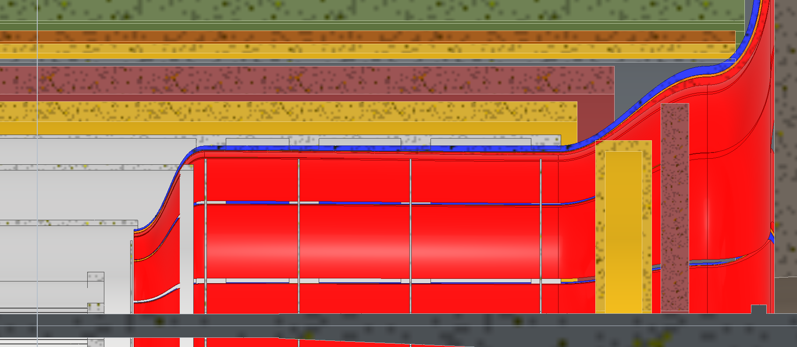
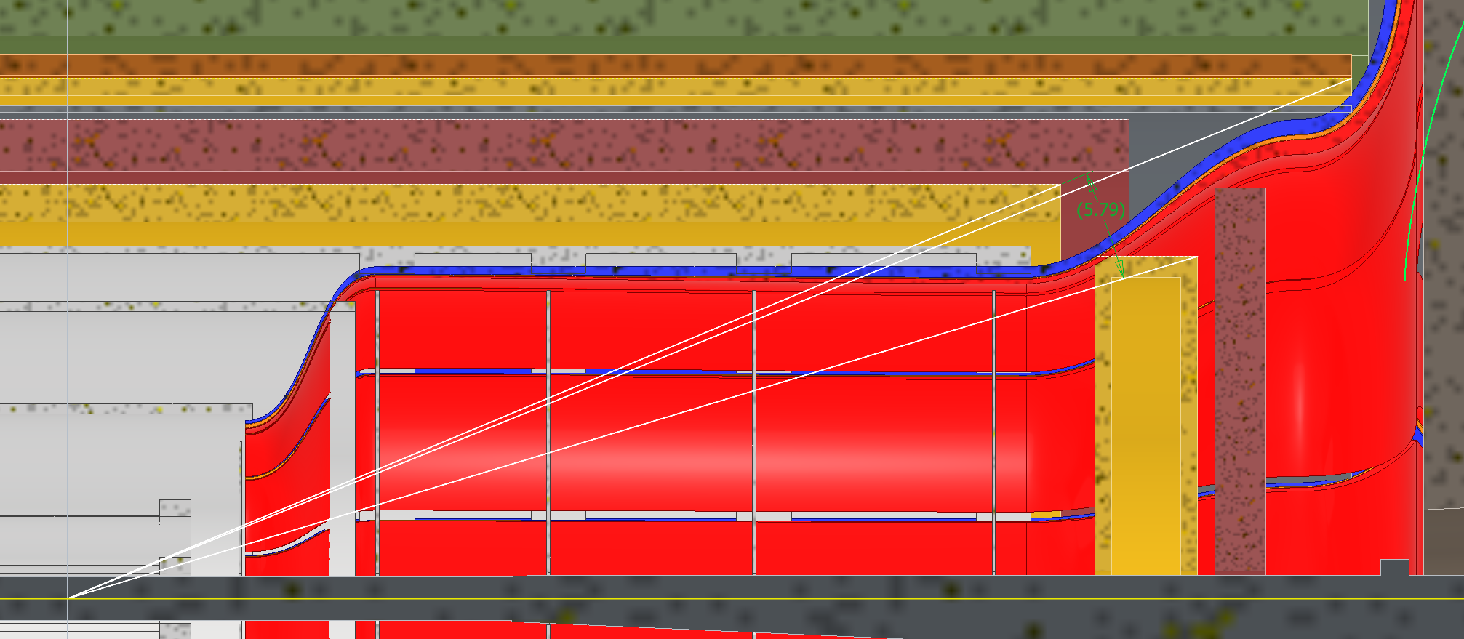
Current Layout
Does not work
5.8 deg MPGD coverage angle
ToF:
  Inner Face Z: 1675mm
  Thickness Z: 75mm
  Outer Radius: 600mm
MPGD:
  Inner Face Z: 1500mm
  Thickness Z: 150mm
  Outer Radius: 500mm
Slides Courtesy Roland Wimmer (also TIC meeting of last Monday)

Slide 14
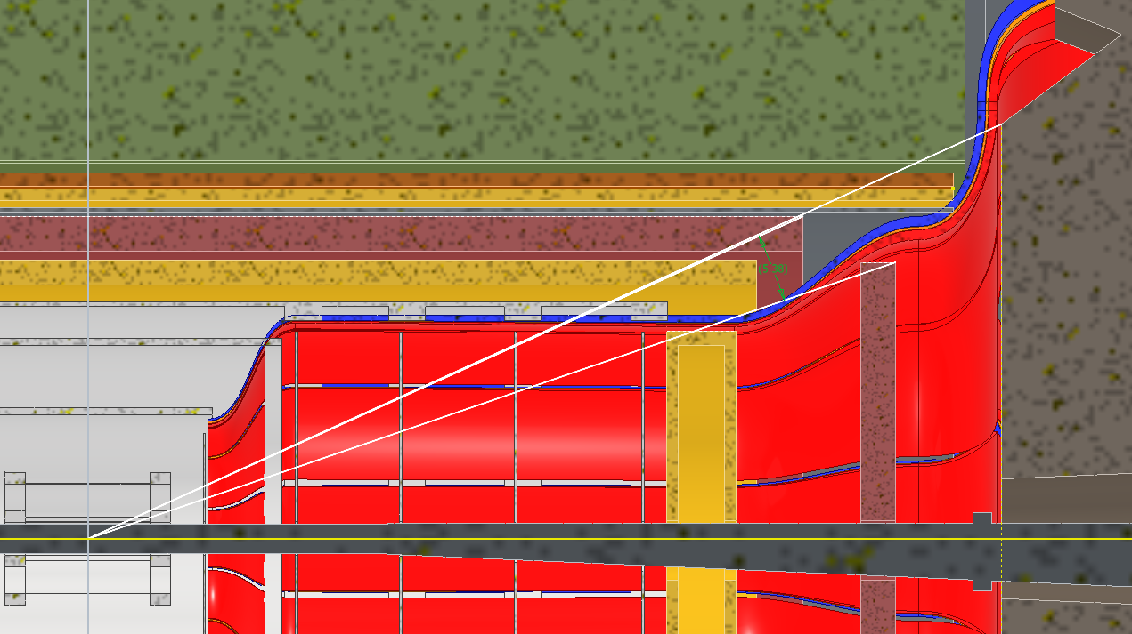
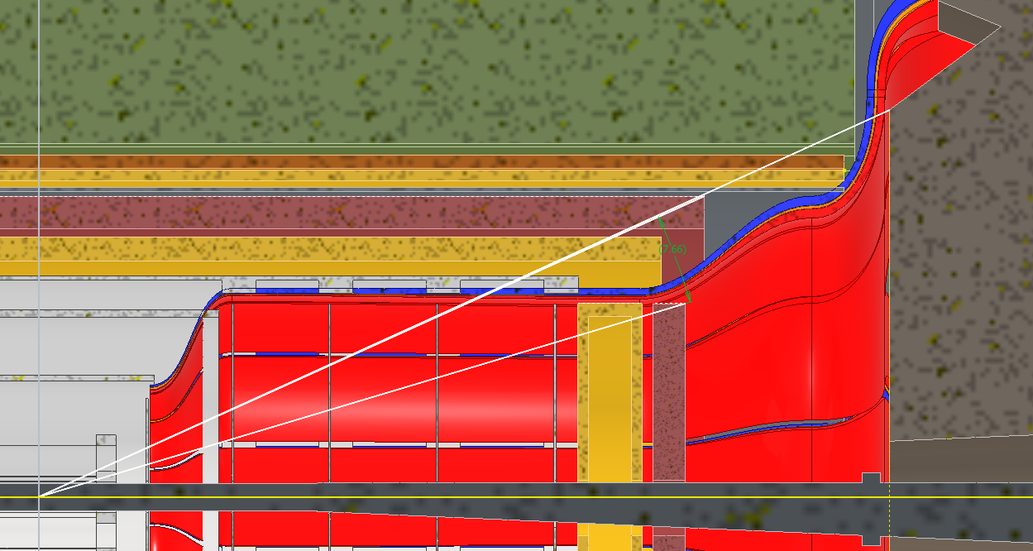
Forward MPGD goes Backwards
A
Requires moving the SVT disks towards IP. ToF will either be removable and supported by GST in option A or not removable and supported by the PST in option B.
MPGD:
  Inner Face Z: 1285mm
  Thickness Z: 150mm
  Outer Radius: 450mm
A: ToF stays at current location
  5.4 deg ToF coverage angle
  ToF Inner Face Z: 1675mm
  ToF Thickness Z: 75mm
  ToF Outer Radius: 600mm
B: ToF is moved next to MPGD disks
  7.7 deg ToF coverage angle
  ToF Inner Face Z: 1475mm
  ToF Thickness Z: 75mm
  ToF Outer Radius: 450mm
B
B IS PREFERRED SOLUTION AS IT EASES SERVICEABILITY FOR bTOF/CYMBAL

Slide 15
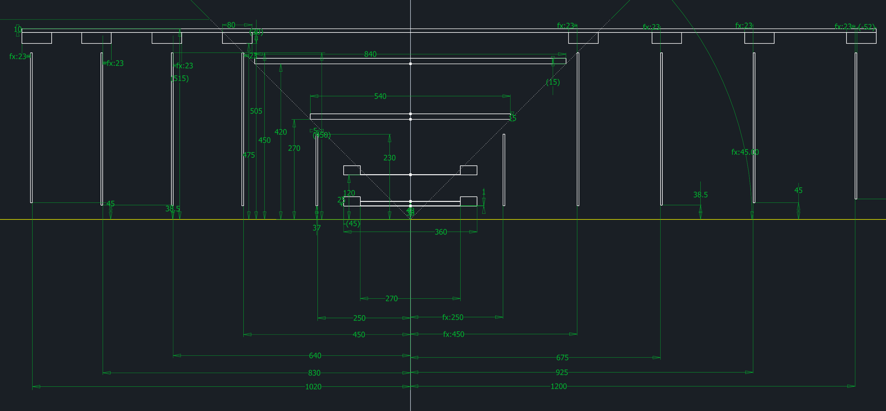
New SVT locations
Move from: Si-Disk-3: 700 mm → 675 mm
Si-Disk-4: 1000 mm → 925 mm
Si-Disk-5: 1350 mm → 1200 mm

Slide 16
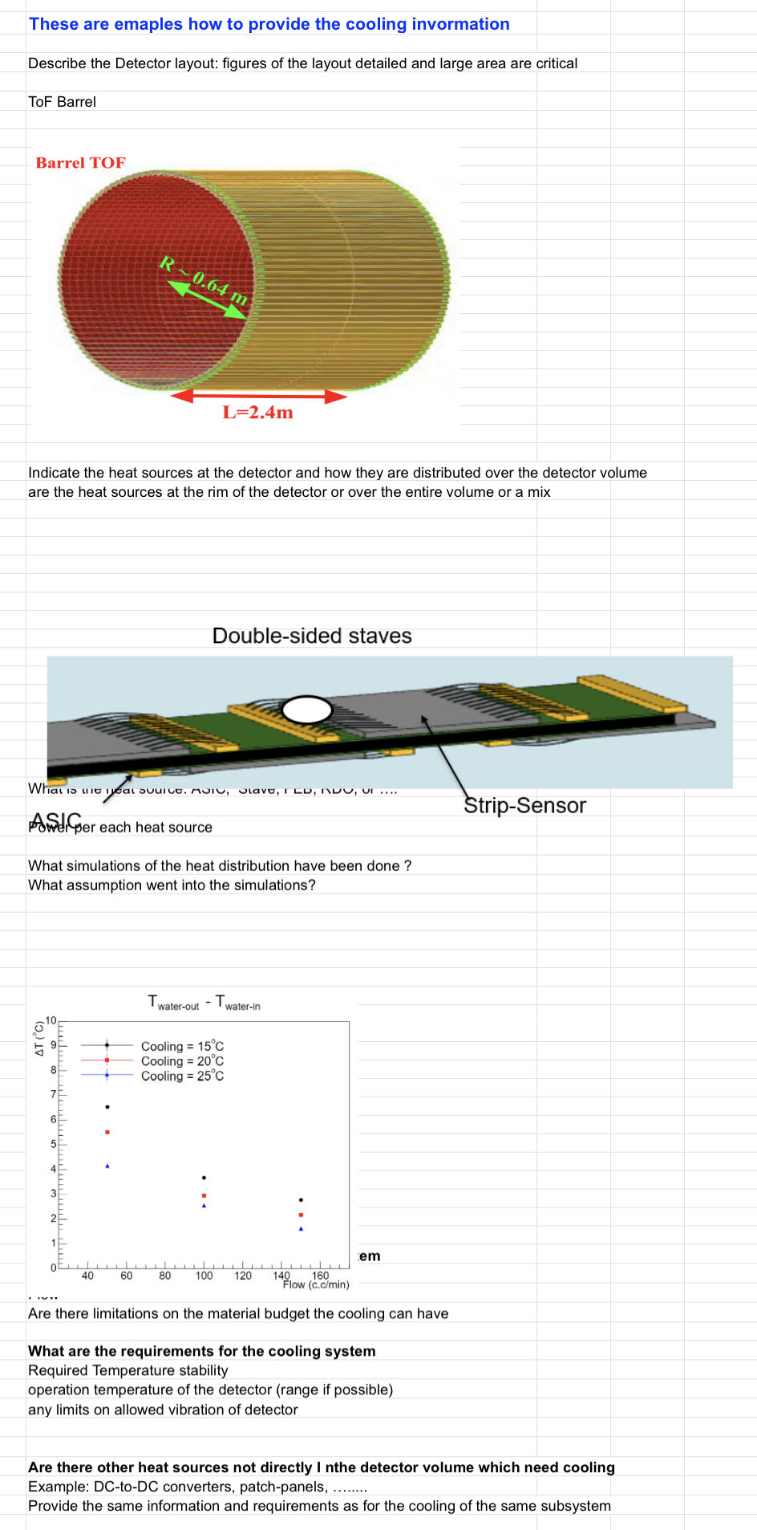
Cooling Requirements – Deadline 03/17/2025
The information about cooling per subsystems becomes now really critical,
as we get recommendations to develop a heat map of the detector frequently.
At Detector Parameters and Services per Subsystem.xlsx
still several detectors missing 🥲
hpDIRC, BarrelHCal, fHCal, Electronics,
Lumi, B0-detectors, OMDs
Slide from March 2025
Made an example of what we would like to see for the cooling from each subgroup.
Spreadsheet is here
Some examples of information we would like:
  Heat sources and where they are located on your detector
    How are the heat sources distributed over your detector?
    How many heat sources are there? Are they FEBs, ASICs, RDOs, etc.
  What simulations have you done for heat distribution?
    What assumptions did you make for these simulations?
  What assumptions have you made about your cooling system?
  What are your requirements for a cooling?
    What is the required temperature stability?
    What is the operating temperature?
    Any limits on allowed vibration for the detector?
  Are there any other heat sources not in the detector volume which need cooling?
  Is there any other pertinent information we should know?
We understand there remain unknowns but please fill in what you can such that we can iterate.

Slide 17
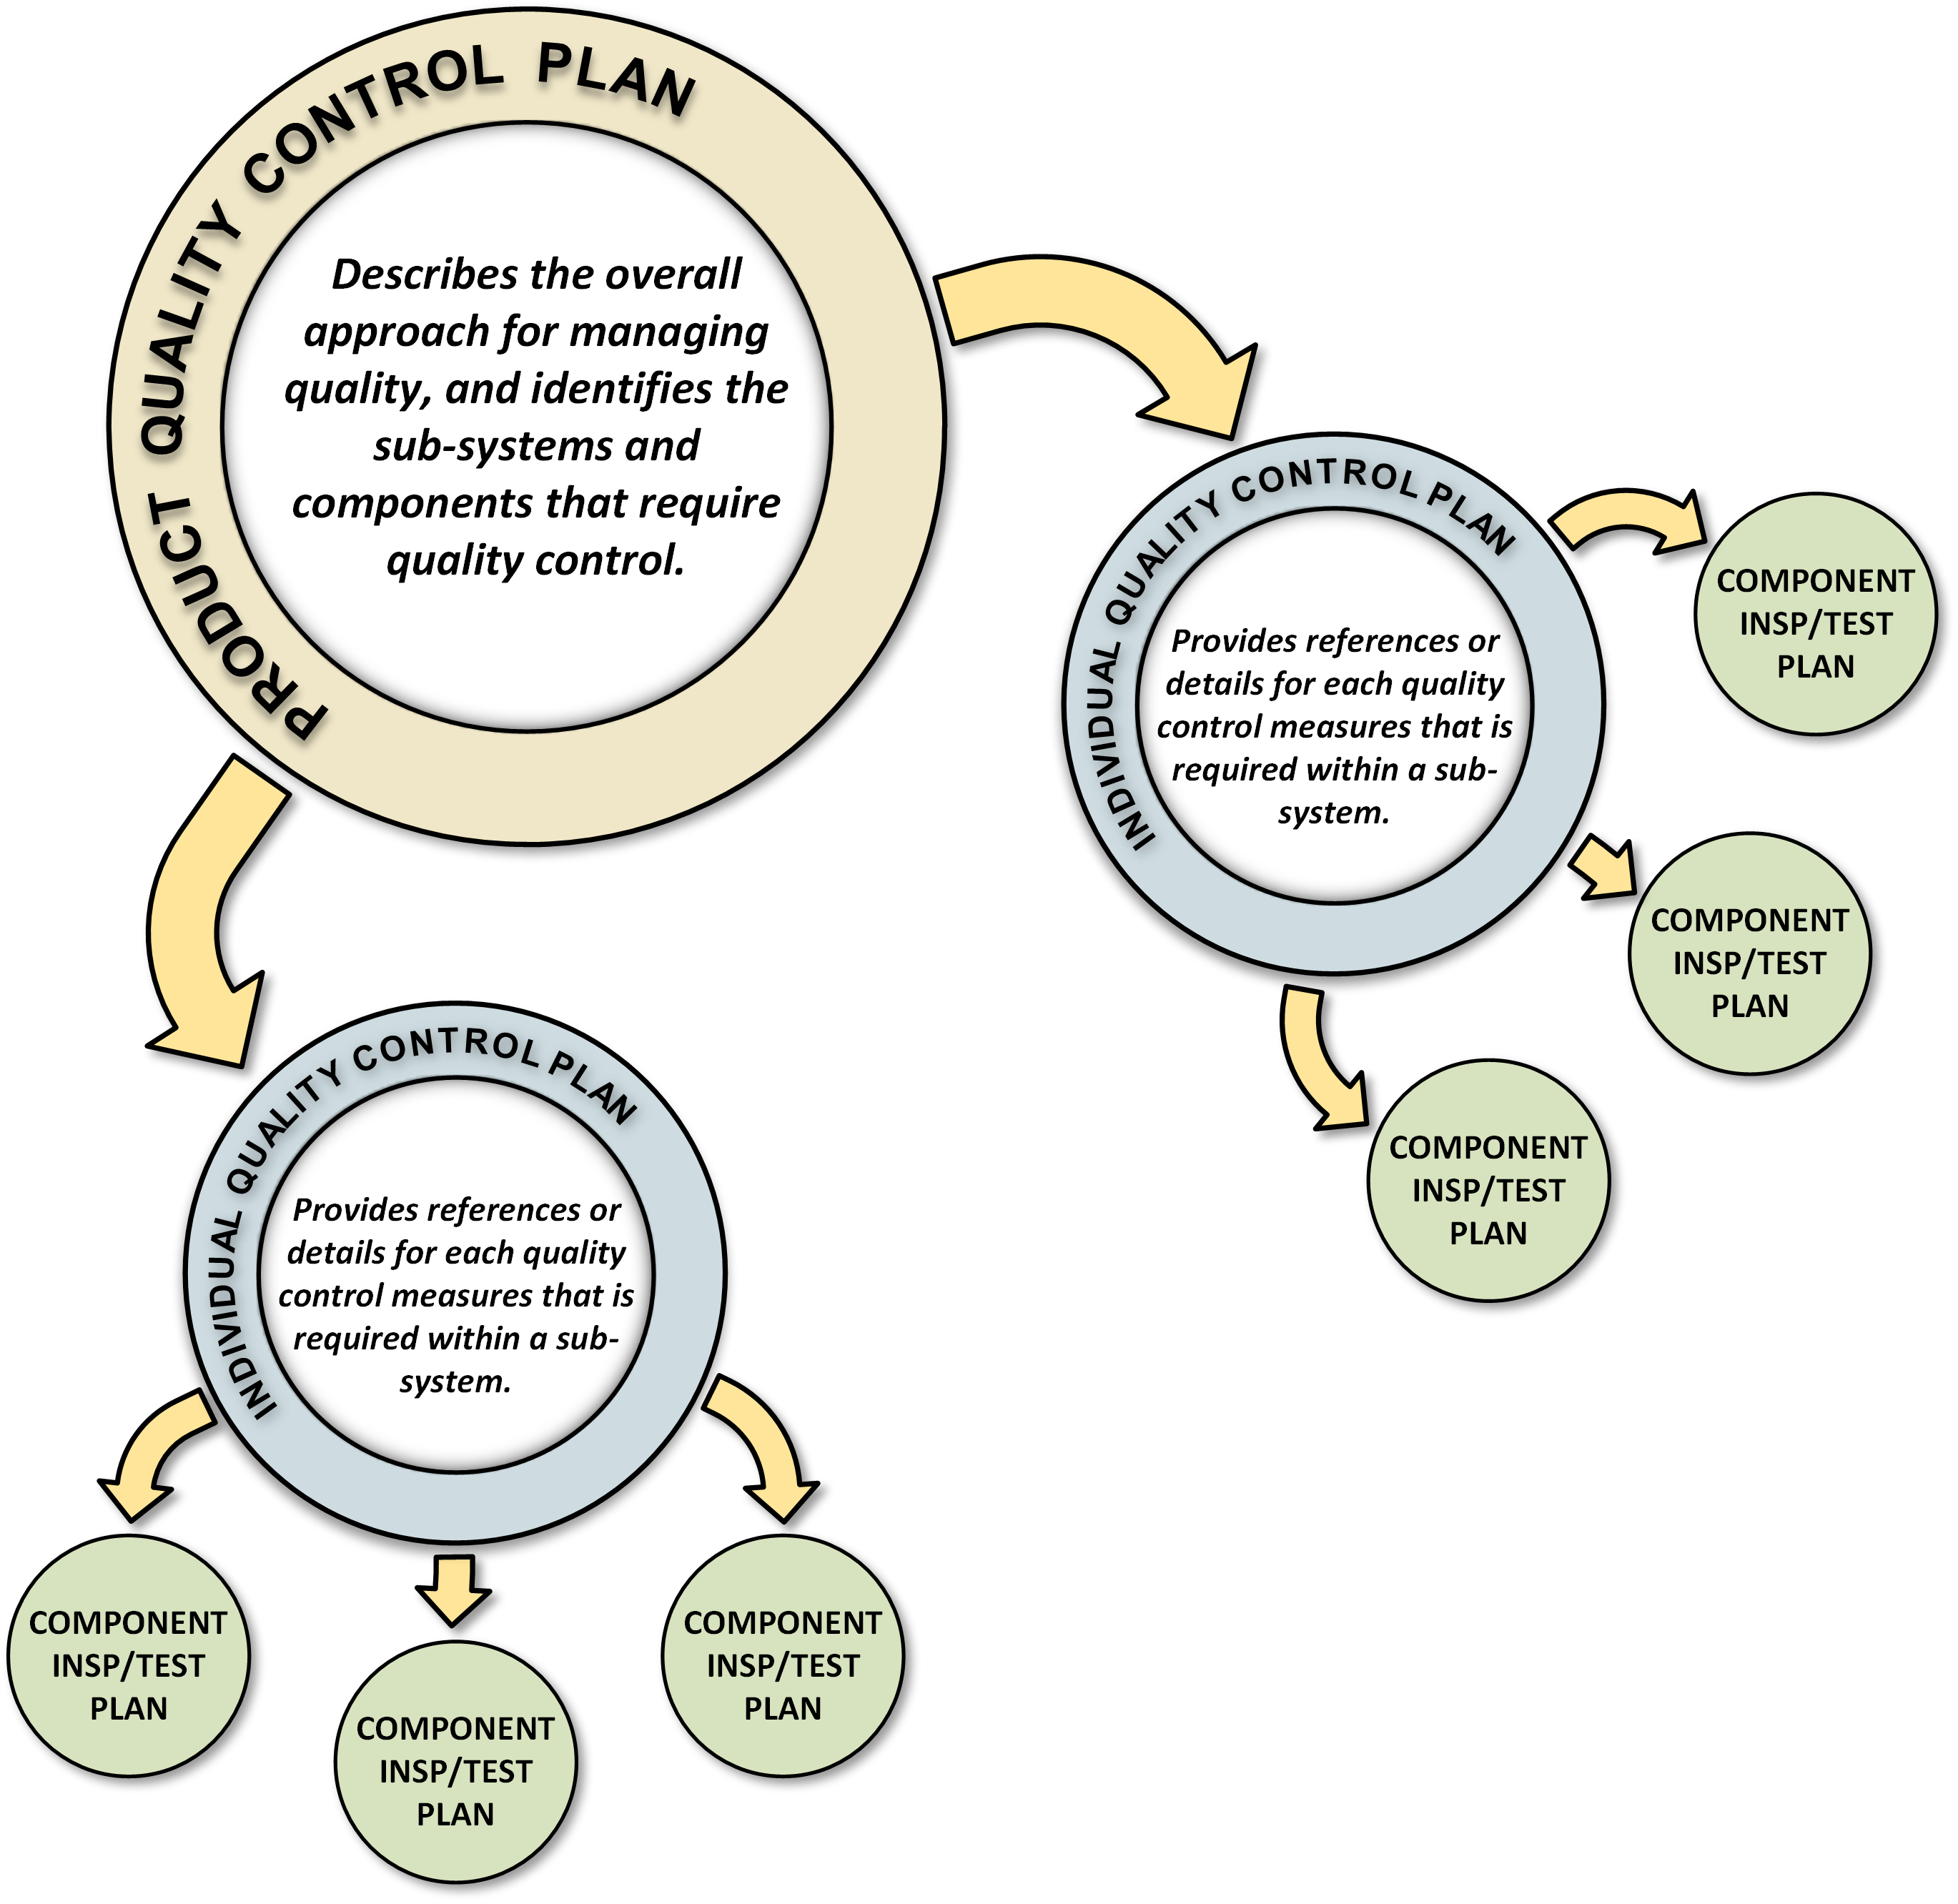
Quality Assurance Planning
Hierarchy of Quality Assurance Documentation
  Quality assurance planning documents exist in a hierarchy, where the highest level documents provide general guidance and lower level documents become increasingly specific.
  Product Quality Control Plan
    Describes the overall approach for managing quality assurance issues, and identifies the systems, sub-systems, and components that will require quality control measures.
  Individual Quality Control Plan
    Provides references (or details) for each quality control measure that is required by within a sub-system or collection of components.
  Component Inspection & Test Plans
    Provide detail methods, measures, and processes for assuring quality control for individual components throughout their development lifecycle.
Slide Courtesy Walt Akers (also TIC Meeting of late May)
See https://eic.jlab.org/Detector for examples of all documents
17

Slide 18
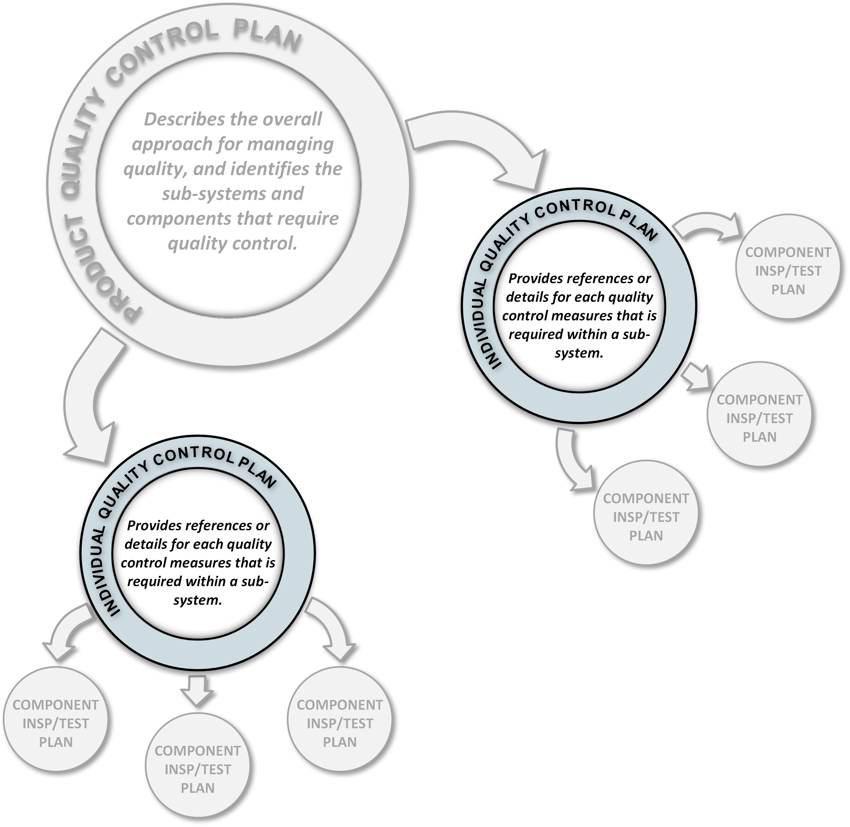
Quality Assurance Planning
The Individual Collective Quality Control Plan
  Individual Product Quality Control Plans (IQCP) typically refer to a single Level-3 or Level-4 WBS sub-system (as categorized in the L2 product quality control plan) and provide references or details for how the quality control requirements in the Product Quality Control Plan will be satisfied. These plans are:
  Auto-Generated Where Possible
    Whenever possible, the IQCP will be auto-generated using a spreadsheet that provides details about the components that are included in the plan, and references to external Inspection and Test Plans.
  Detailed Where Necessary
    For details that are not provided in an existing Inspection and Test Plan, it may be necessary to provide specific detailed information within the IQCP.
  A Roadmap for Reviewers
    The IQCP provides a standard format for reviewers to use to find documentation that may exist in numerous locations and various formats.
Reminder Slide (Courtesy Walt Akers)
18

Slide 19
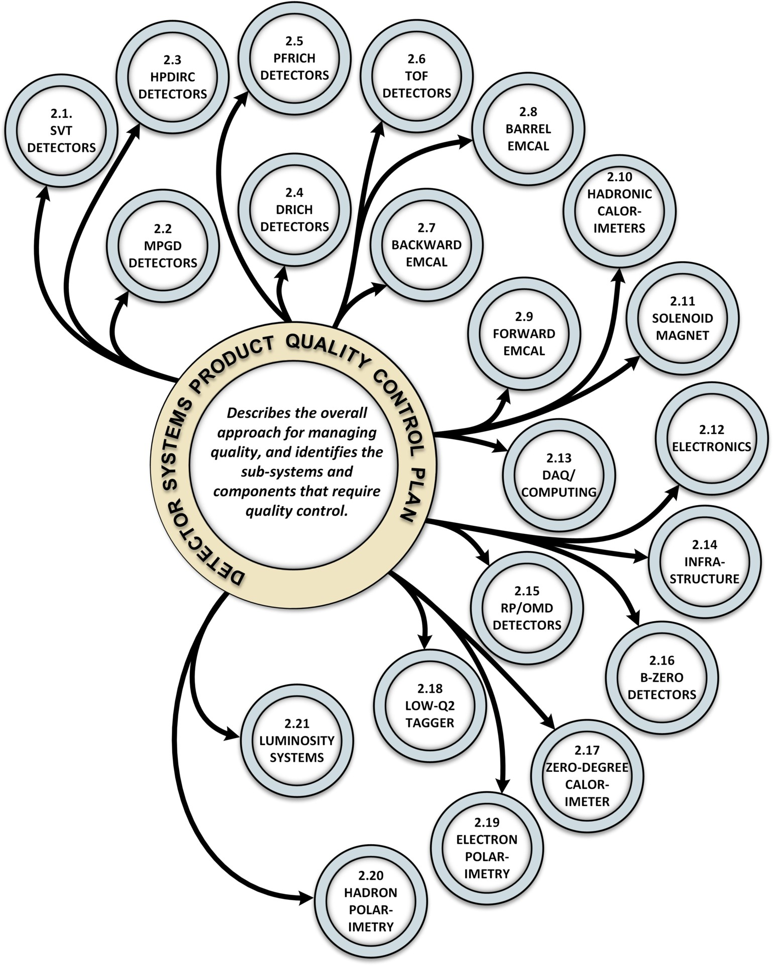
Quality Assurance Planning
The Individual Collective Quality Control Plan
  There are 21 Individual Product Quality Control Plans (IQCP) foreseen
  They follow the 21 sections of the umbrella detector product quality control plan https://eic.jlab.org/Documents/DET/Templates/Quality/Detector-6.10-QualityControlPlan.pdf
  A template is autogenerated from an excel spread sheet with info on the components (are they in-kind, are they from a vendor, etc).
  These are done by the project control account managers.
  We will post the IQCP for the magnet shortly, and are working on the backward EM calorimeter, and then more.
  The goal is to have a handful complete by the time of the prebrief posting for the Baseline Readiness Assessment review.
19

Slide 20
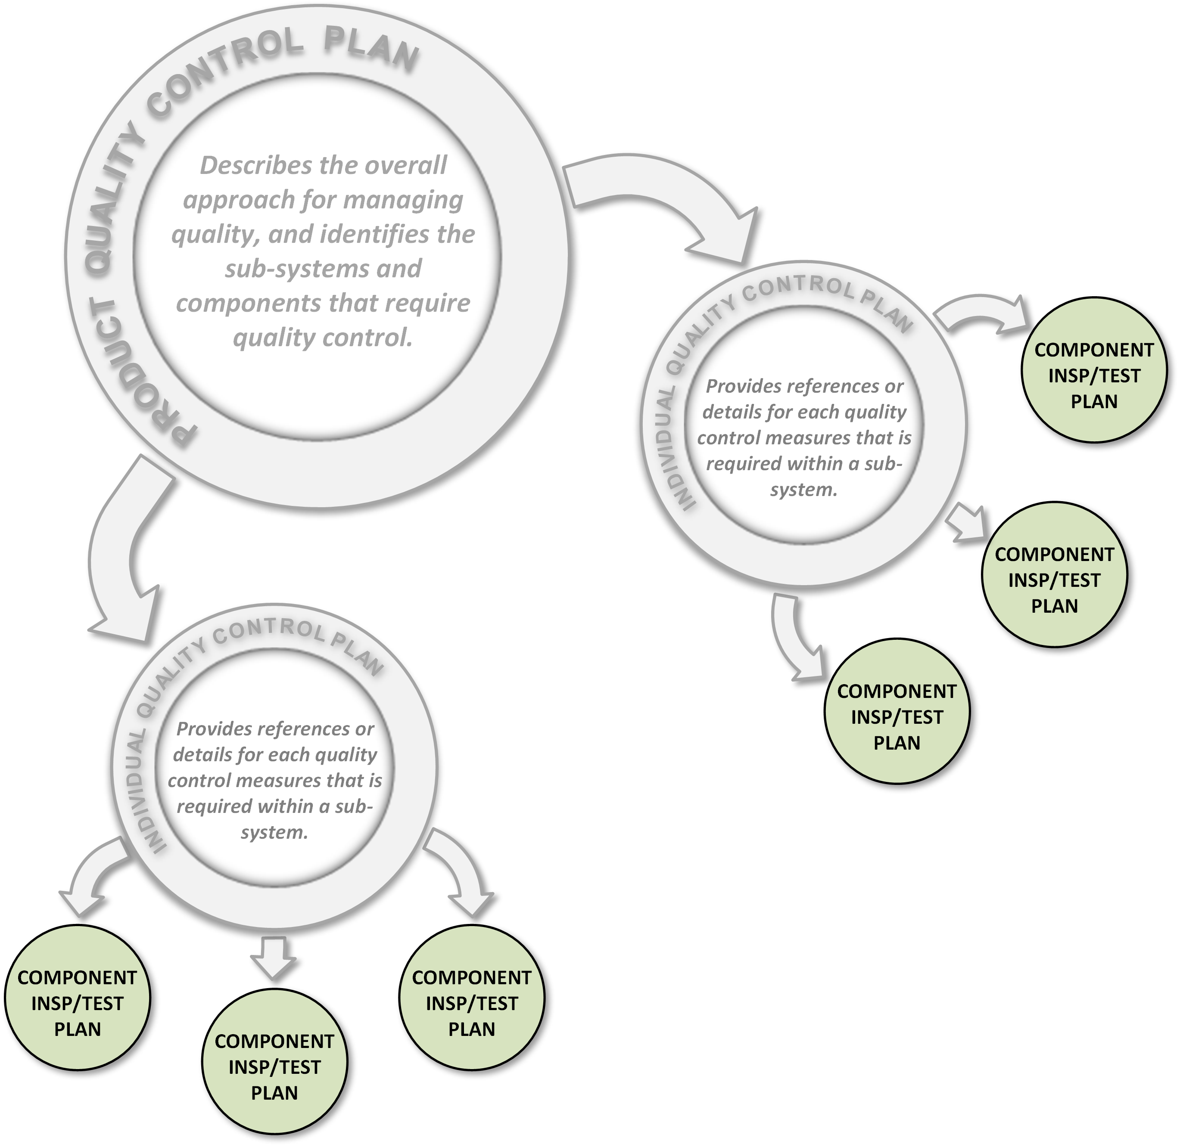
Quality Assurance Planning
The Inspection and Test Plan
  Inspection and Test Plans are stand-alone documents that provide quality assurance information for individual components and parts. They are highly specific, functionally formatted, and developed/maintained by systems experts.
  These documents are the heart of our quality control program and may include :
  Material Properties
  Test Setups and Plans
  Matrices of Component Quality Data
  Required Environmental Conditions
  Testing Resource Requirements
For a nice example see https://eic.jlab.org/Documents/DET/PID/pfRICH/Aerogel/Aerogel_Test_Stand_Q_A_Prodedures.pdf
Reminder Slide (Courtesy Walt Akers)
20

Slide 21
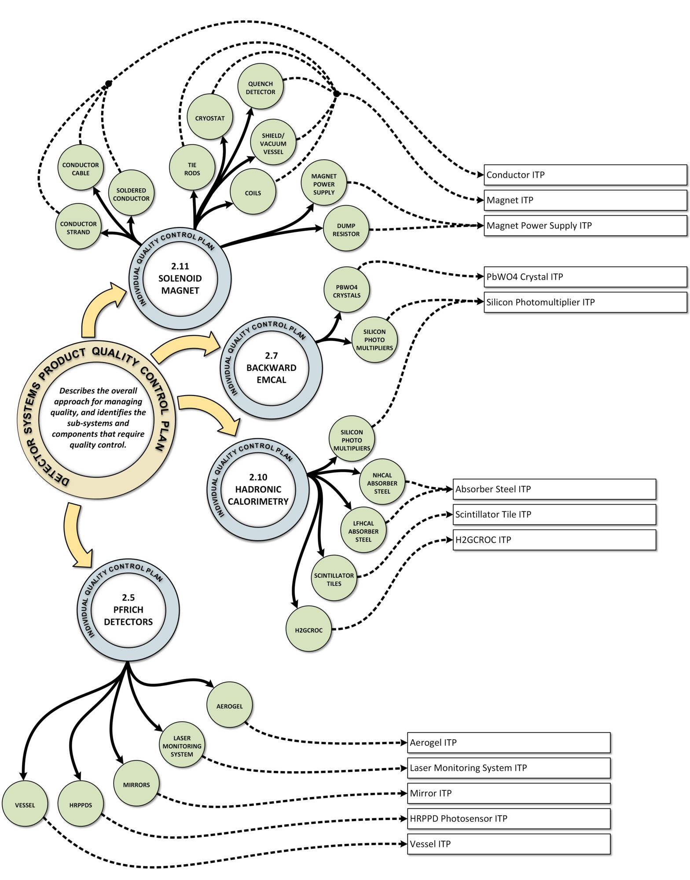
Quality Assurance Planning
Condensing and Collecting the Information
  For the magnet there are 12 components prone to quality control but they are condensed into three inspection and test plans: conductor, magnet and magnet power supply
  The backward EM calorimeter has 2 components prone to quality control
    The PbWO4 crystal ITP will be posted, and can also be used for the B0 detector, the ZDC
    The SiPM inspection and test plan is written as generic plan following the CD-3A procurements
  The vessel inspection and test plan for the pfRICH (& dRICH) will be written as a short and simple inspection and test plan, the aerogel ITP can be shared
  The hadron calorimeters have much in common so are written as one individual quality control plan
    Some common inspection and test plans, some are specific to an individual HCAL
    The SiPM inspection and test plan is the generic one
21

Slide 22


Slide 23
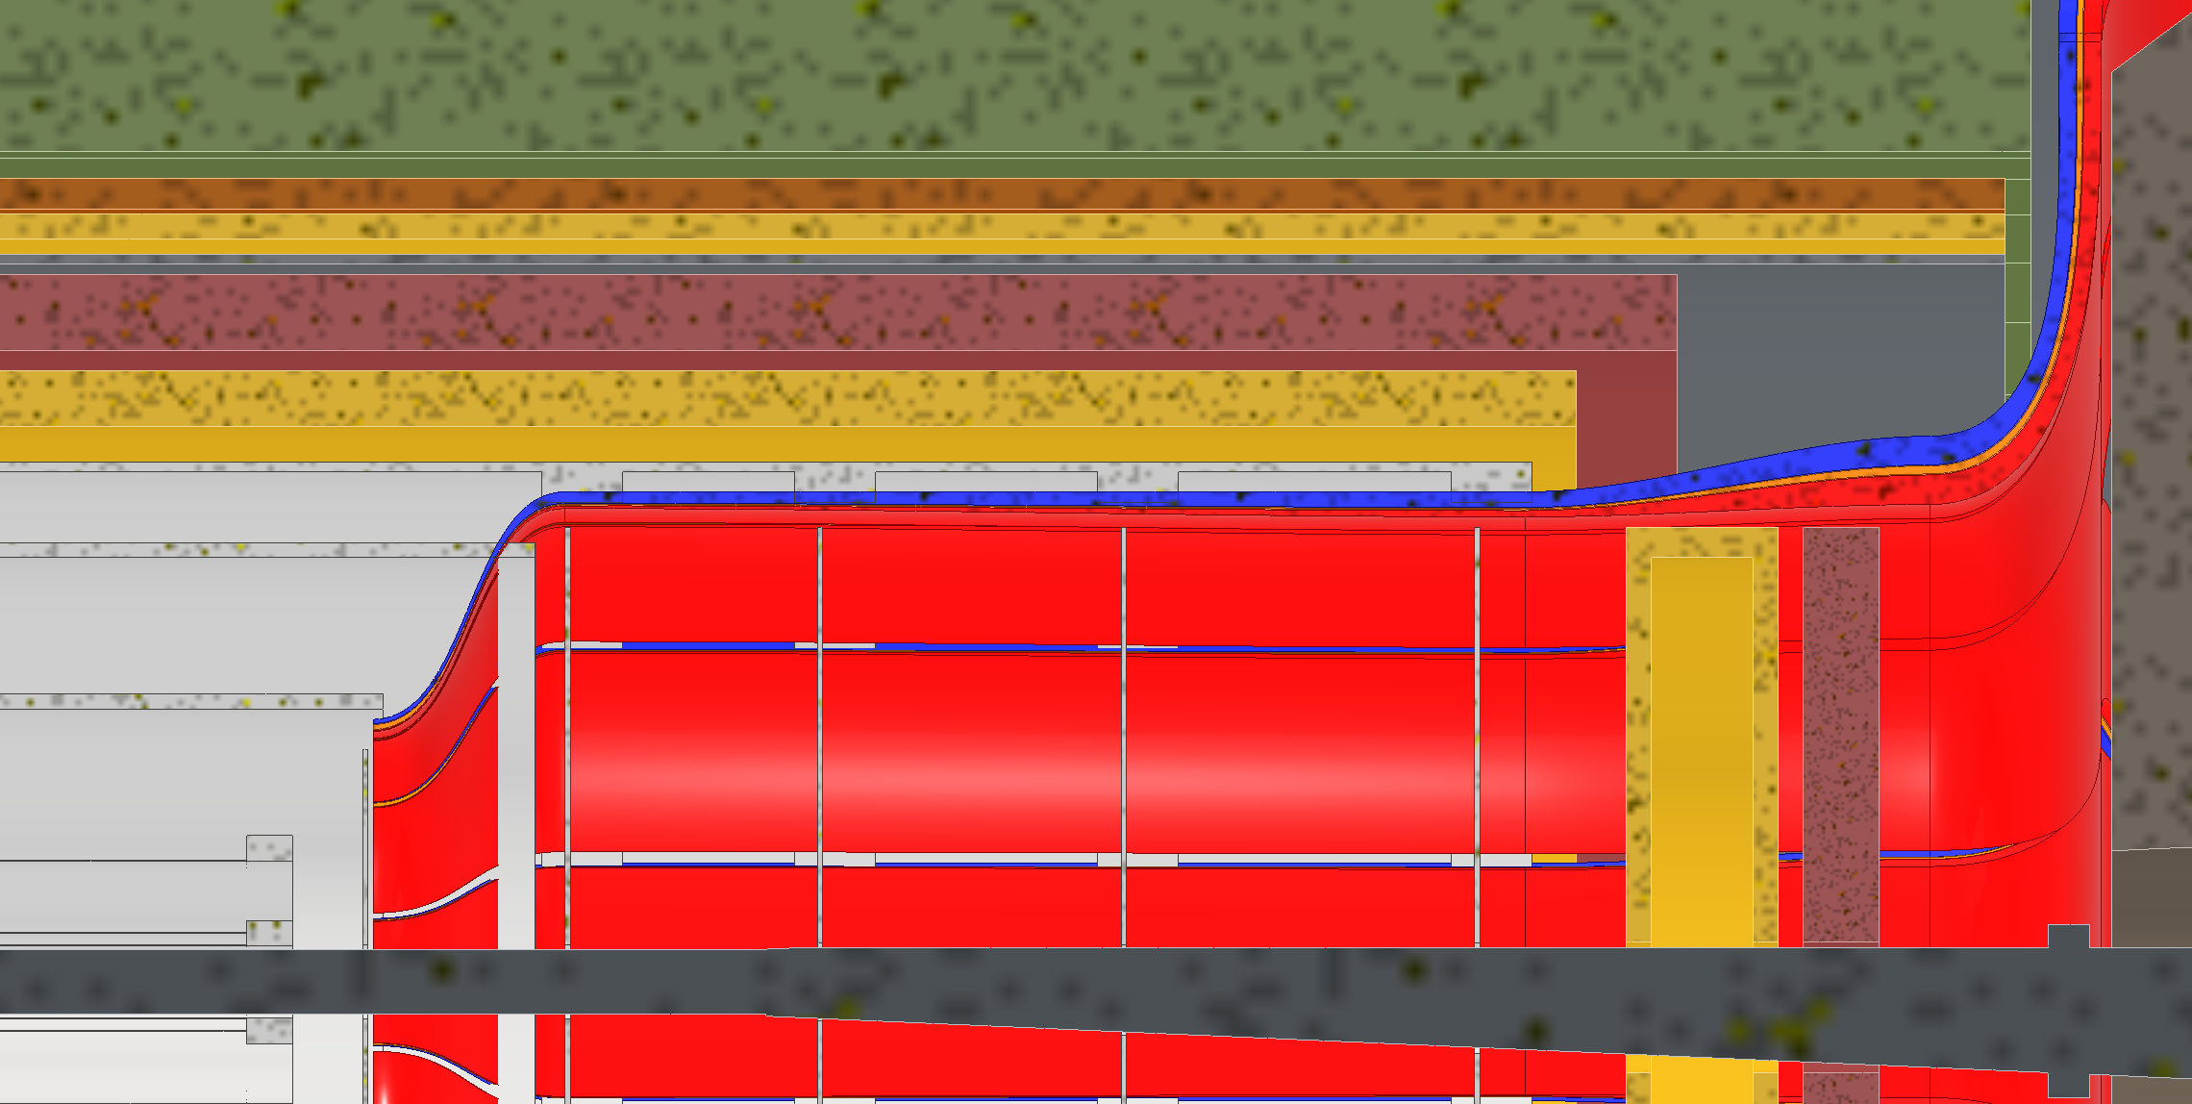
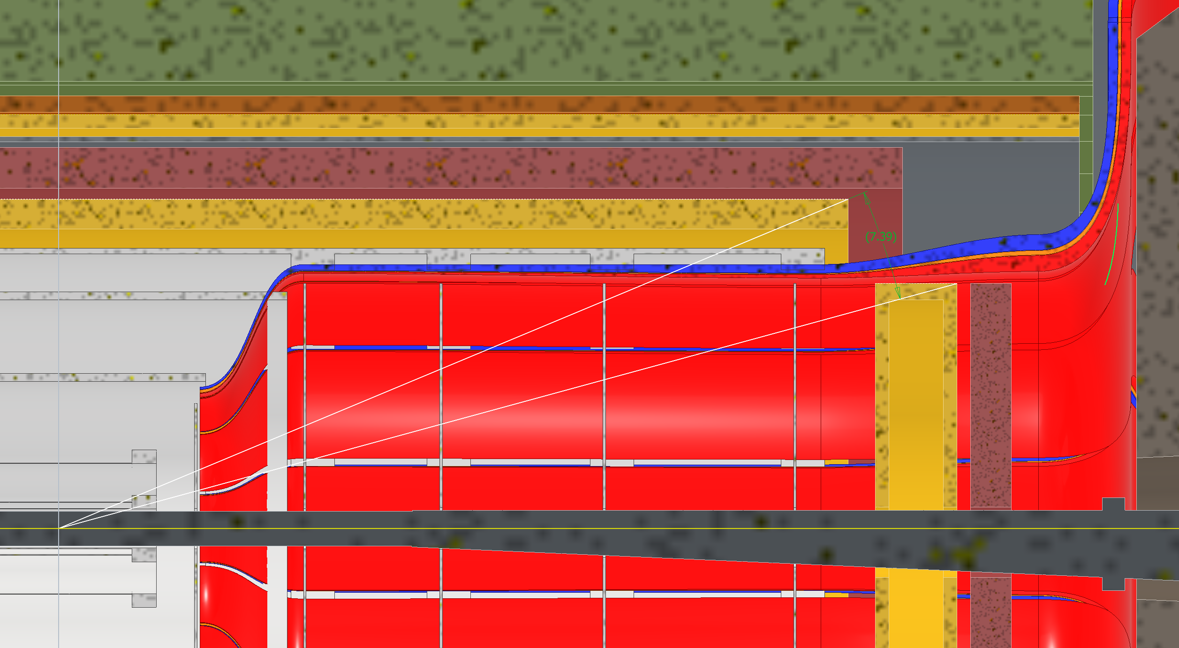
Option 1: Smaller Dia. Disks
Both disks shrink in diameter, MPGD disk would be attached to PST, unsure where ToF would be attached to.
7.4 deg MPGD coverage angle
ToF:
  Inner Face Z: 1675mm
  Thickness Z: 75mm
  Outer Radius: 450mm
MPGD:
  Inner Face Z: 1500mm
  Thickness Z: 150mm
  Outer Radius: 450mm

Slide 24
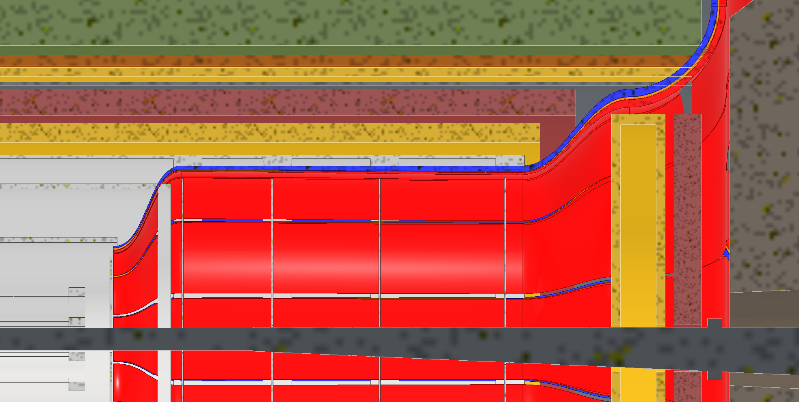
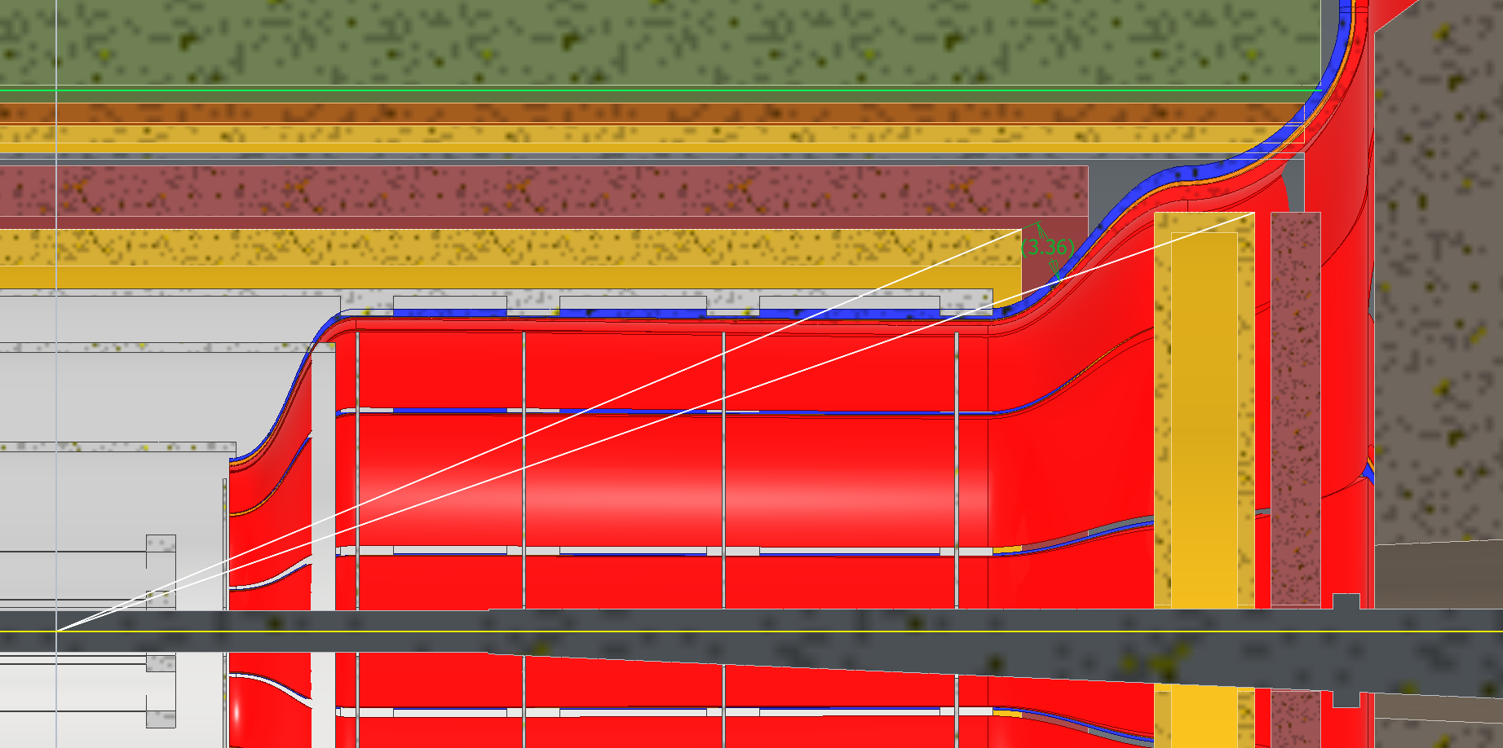
Option 2: Removable Disks
Both disks would be removable, would need to figure out where to support them from. Disks will need wither space in X to move out or larger inner diameters to fit around flange (Flange doesn’t exist yet)
3.4 deg MPGD coverage angle
ToF:
  Inner Face Z: 1825mm
  Thickness Z: 75mm
  Outer Radius: 630mm
MPGD:
  Inner Face Z: 1650mm
  Thickness Z: 150mm
  Outer Radius: 630mm

Slide 25
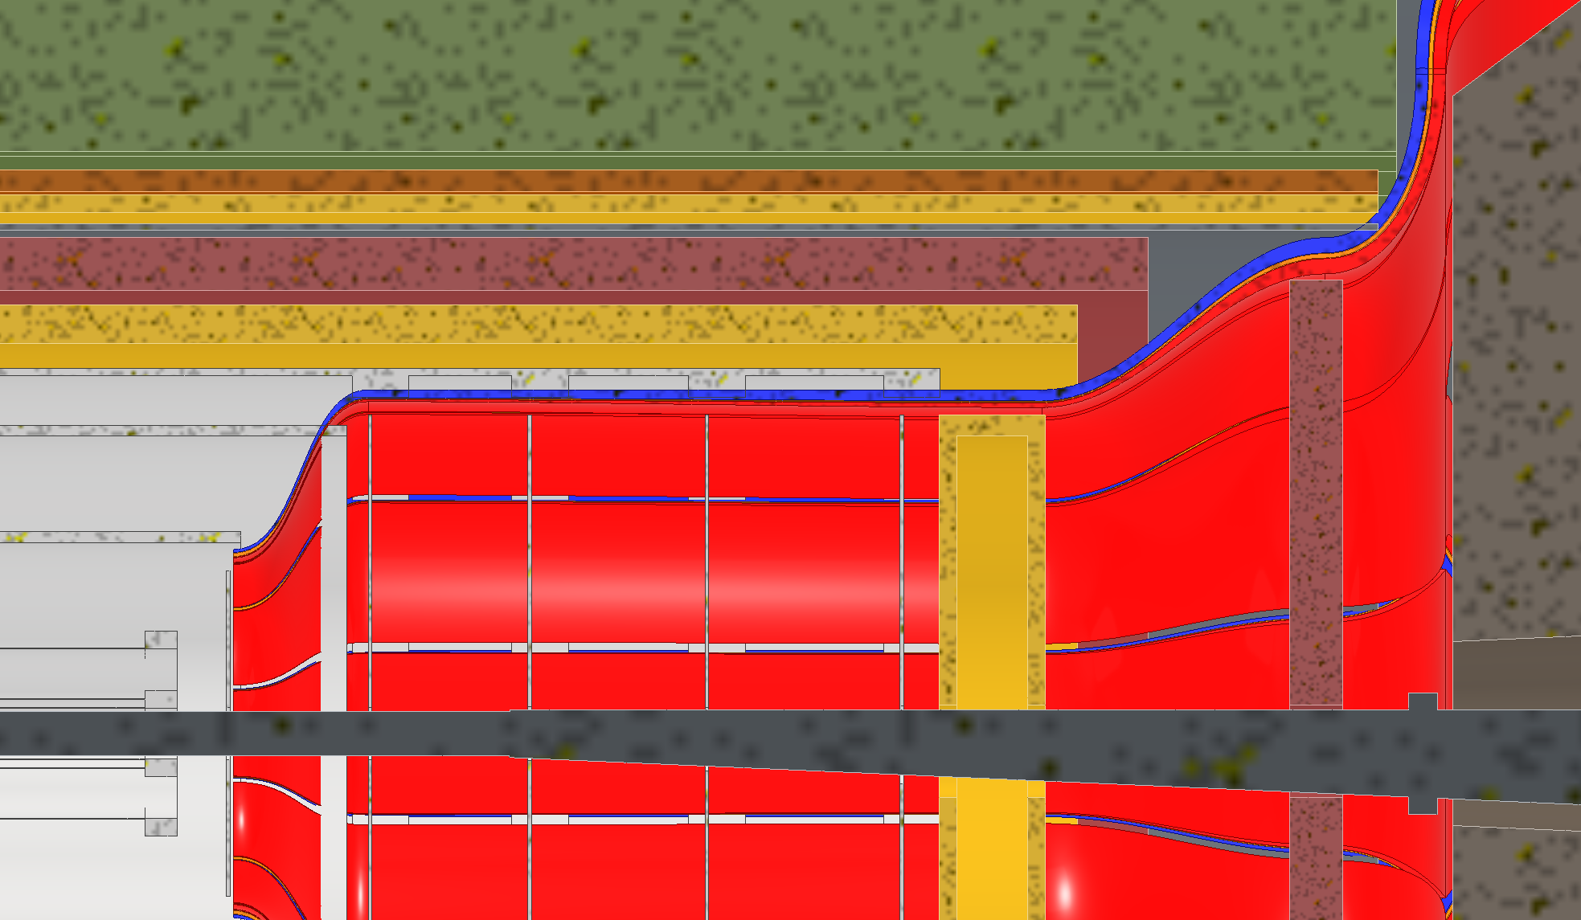
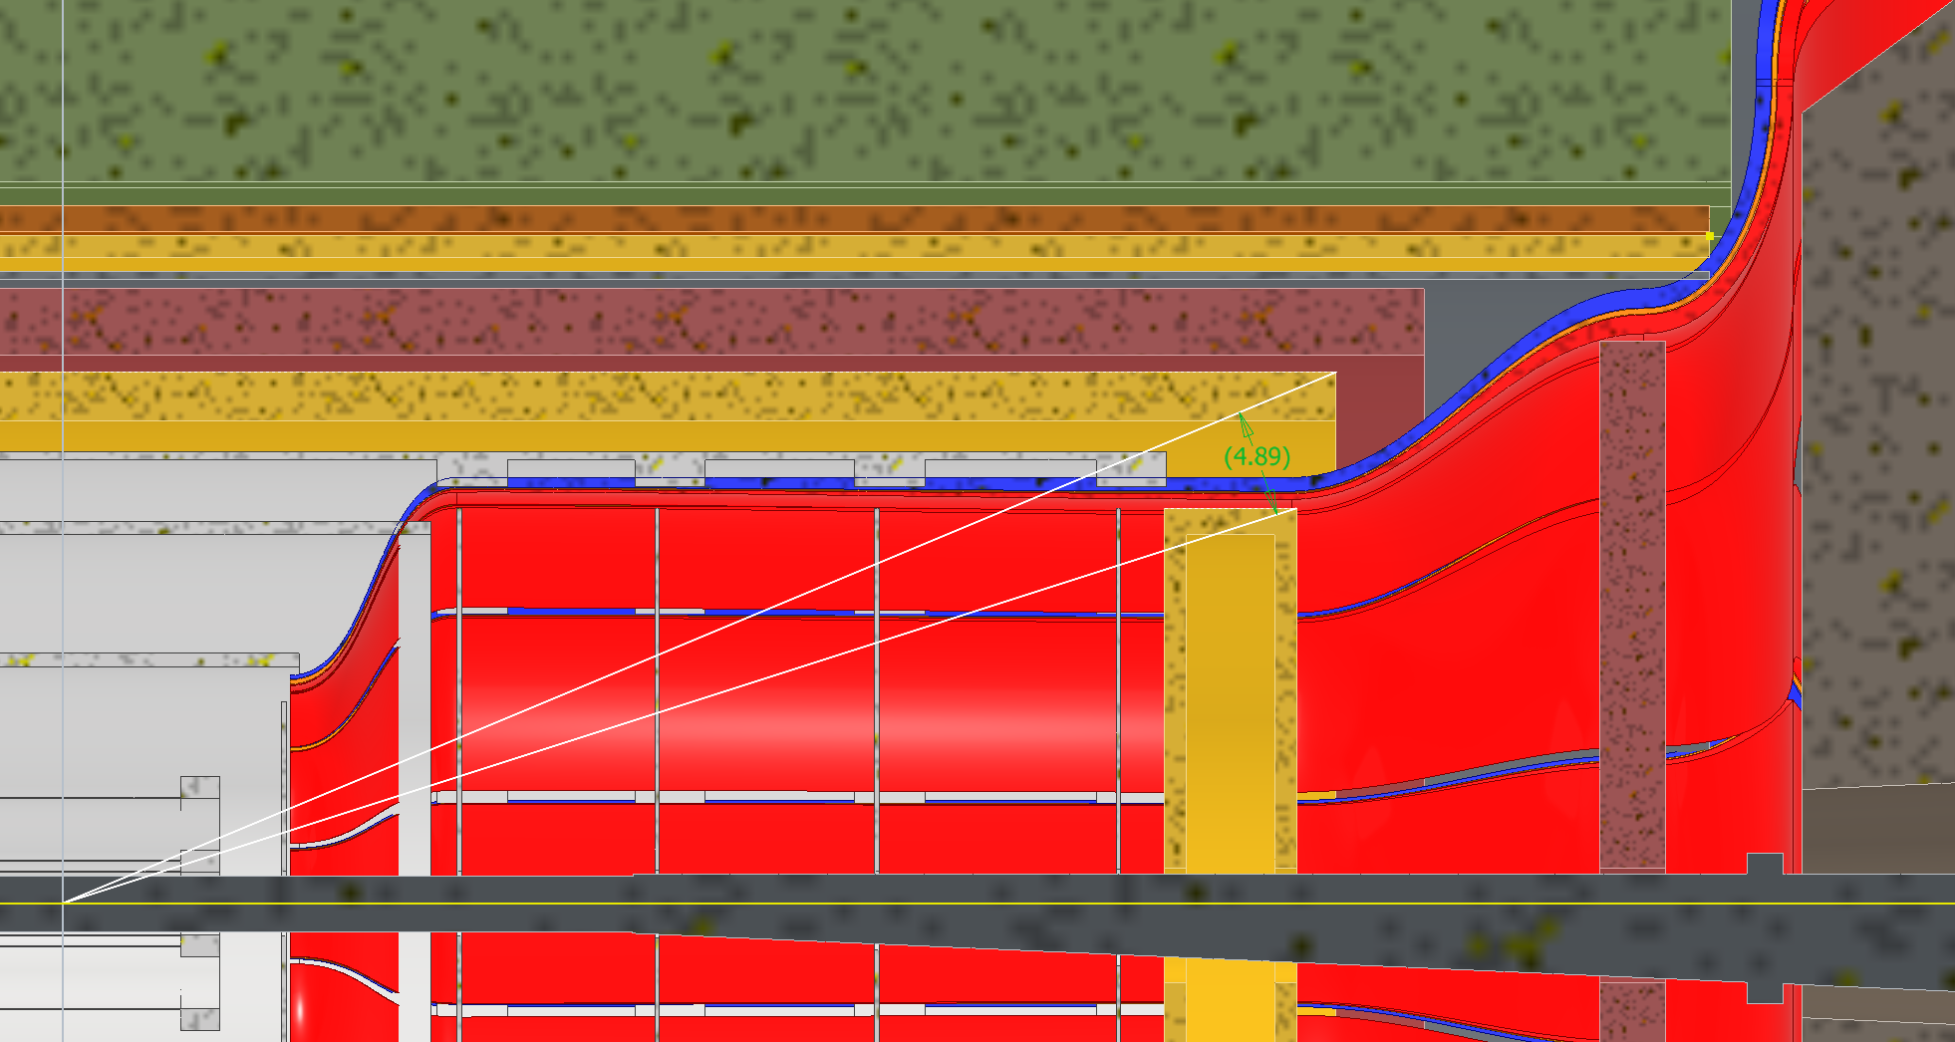
Option 3: MPGD goes Backwards
Requires moving the SVT disks around, need to figure out where we would support ToF from. ToF would still need to be removable.
4.9 deg MPGD coverage angle
ToF:
  Inner Face Z: 1750mm
  Thickness Z: 75mm
  Outer Radius: 630mm
MPGD:
  Inner Face Z: 1285mm
  Thickness Z: 150mm
  Outer Radius: 450mm

Slide 26
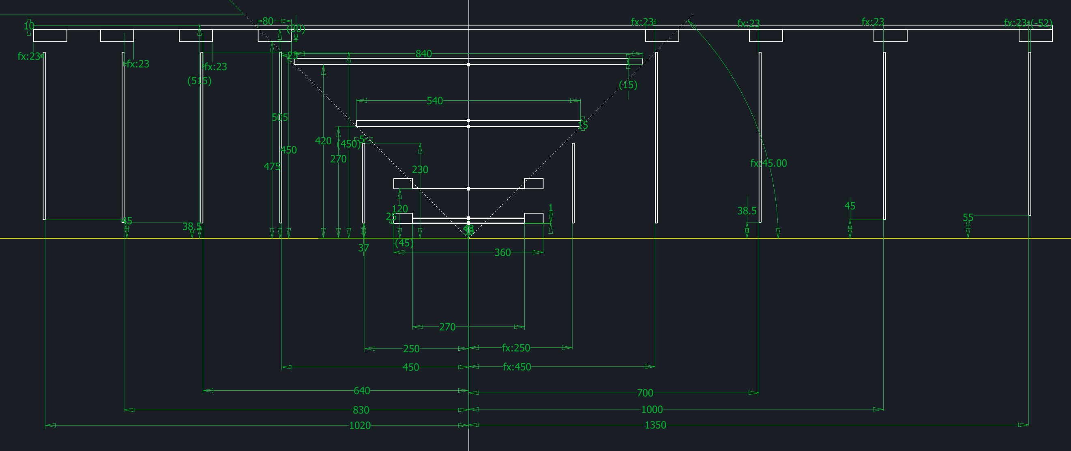
Old SVT Locations

